Slide 1
STK-4051/9051 Computational Statistics
Spring 2024
Compulsory Part 2
Instructor: Odd Kolbjørnsen, oddkol@math.uio.no

Slide 2
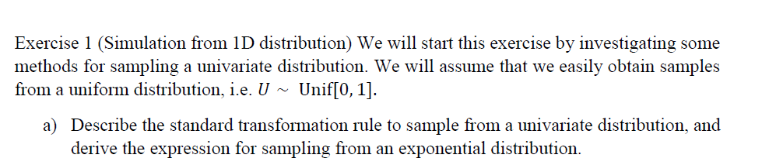
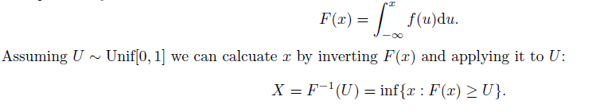
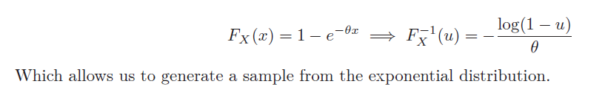
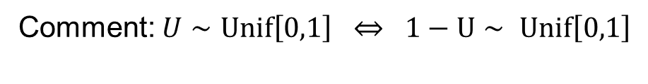
Comment: $U∼Unif\left[0,1\right] ⇔ 1−U∼ Unif\left[0,1\right]$

Slide 3
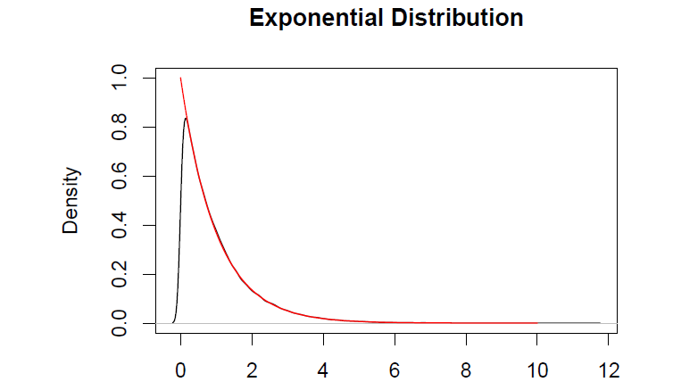
Deviation is due to «artefact» of density(.)
It smooths edges, Chapter 10 part IV in book

Slide 4
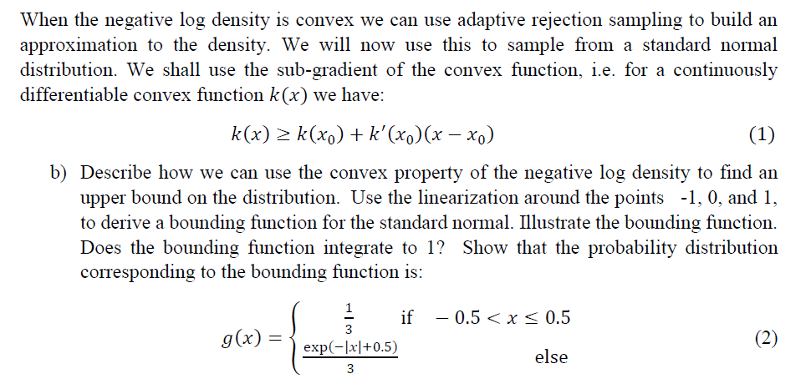
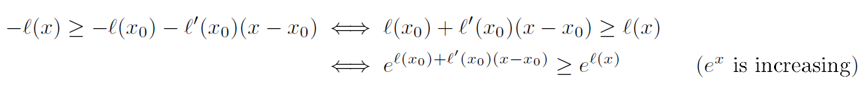
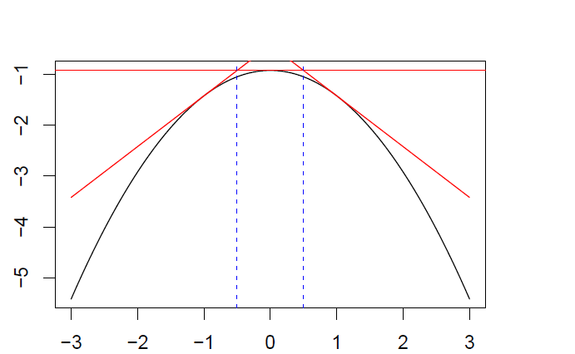
We can use this relation for many different locations and take the minimum of these
$$L\left(x\right)=\exp{l\left(x\right)}≤\min_{i}\left\{\exp\left\{l\left(x_{i}\right)+l′(x_{i})(x−x_{i})\right\} \right\}$$

Slide 5
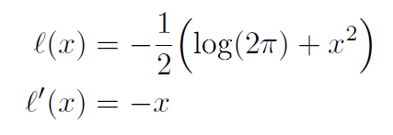
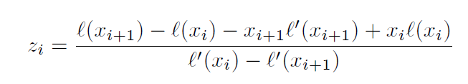
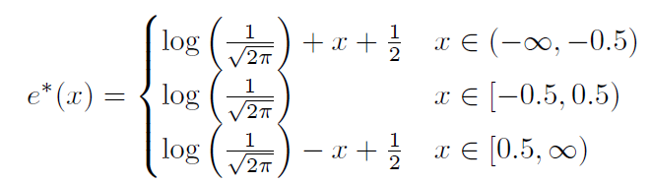

Slide 6
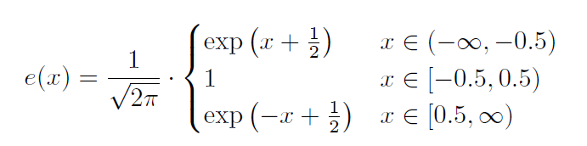
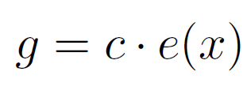
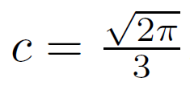
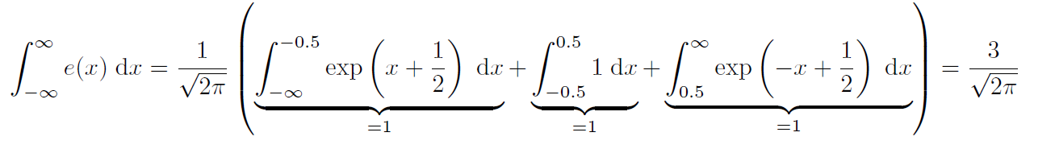
e(x), do not integrate to 1

Slide 7
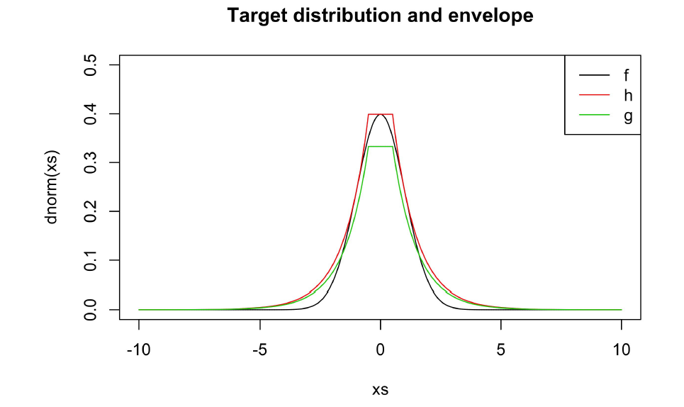
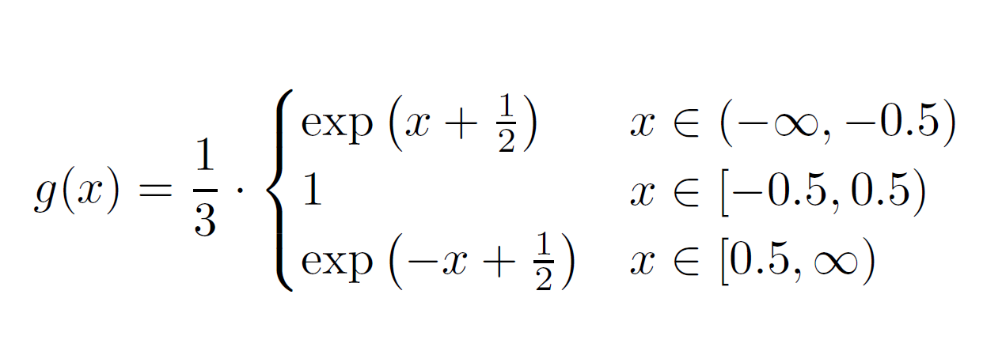
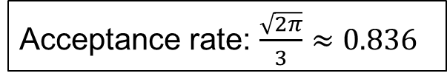
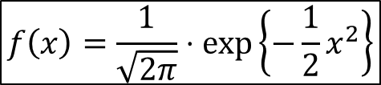
e
$$f\left(x\right)=\frac{1}{\sqrt{2π}}⋅\exp\left\{−\frac{1}{2}x^{2}\right\}$$
Acceptance rate: $\frac{\sqrt{2π}}{3}≈0.836$

Slide 8
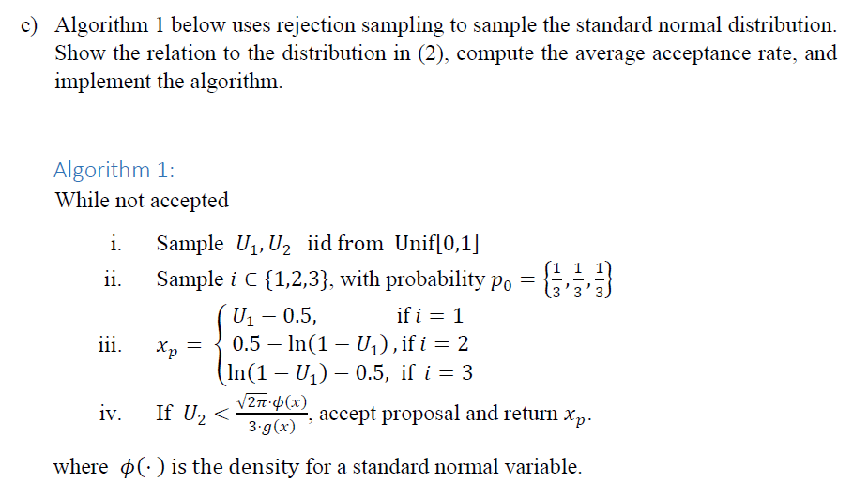


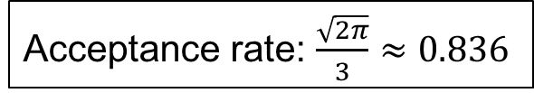
Sampling $g(x)$
Acceptance step: $U≤\frac{φ\left(x\right)}{e\left(x\right)}$
Acceptance rate: $\frac{\sqrt{2π}}{3}≈0.836$

Slide 9
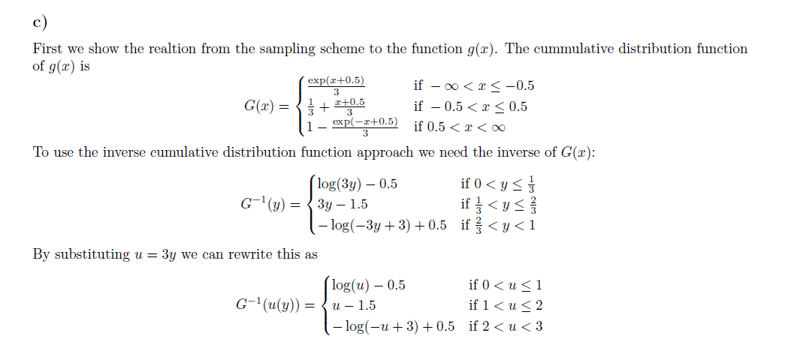

i) Sample 𝑈1 ~ Unif[0,1]
Sample 𝑖∈{1,2,3}, with probability 𝑝0={1/3,1/3,1/3}
$$U∼Unif[0, 3]$$

Slide 10
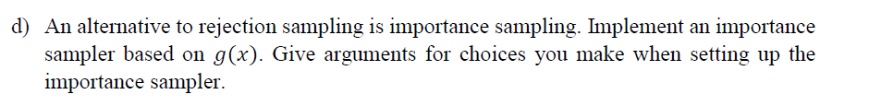
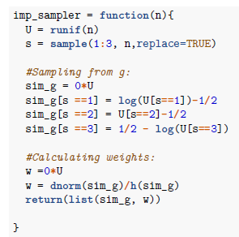
This weight can either be standardized or not.
A major advantage of using the standardized weights is that it does not require knowing possible proportionality constants of the target function.
As we don't have a problem with proportionality constants and further, is biased for standardized weights, I would suggest to use the non-standardized version for this example.
If a function h is given, we can do a further comparison of the performances of the two different weighting-types.

Slide 11

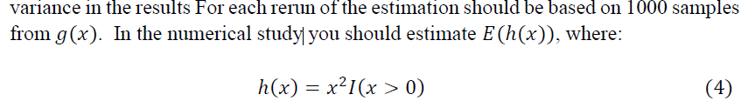

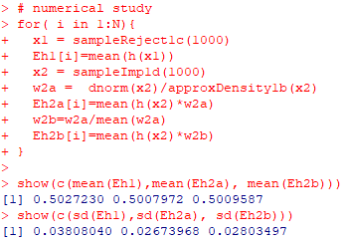
By repeating the experiment
N=1000 times we get:
Importance better than rejection
Normalized vs un-normalized
are almost identical
Computed by repeating integral
Computed by single sample

Slide 12
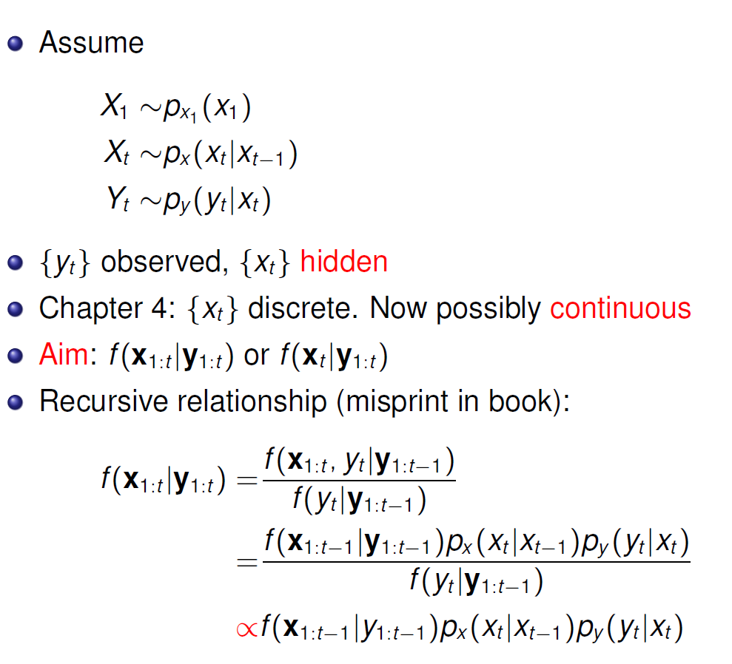












Hidden Markov models - state space models
$$y_{1}$$
$$y_{2}$$
$$y_{3}$$
$$y_{4}$$
$$⋯$$
$$y_{n}$$
$$x_{1}$$
$$x_{2}$$
$$x_{3}$$
$$x_{4}$$
$$⋯$$
$$x_{n}$$

Slide 13


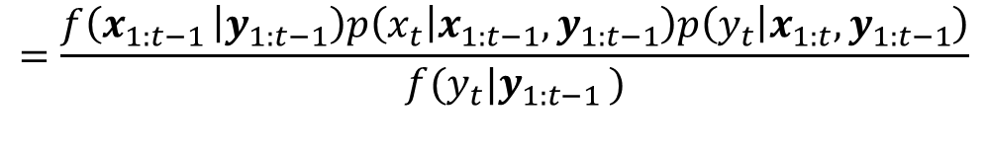


Bayes rule $P\left(A | B,C\right)=\frac{P(A,B|C)}{P(B|C)}$
$$=\frac{f\left(x_{1:t−1 } | y_{1:t−1}\right)p\left(x_{t} | x_{1:t−1},y_{1:t−1}\right)p\left(y_{t} | x_{1:t}, y_{1:t−1}\right)}{f(y_{t}|y_{1:t−1 })}$$
$$y_{1}$$
$$y_{2}$$
$$y_{3}$$
$$y_{4}$$
$$y_{n}$$
Markov property
$$⋯$$
$$p\left(x_{t} | x_{1:t−1},y_{1:t−1}\right)=p_{x}(x_{t}|x_{t−1})$$
Conditional independence
$$x_{1}$$
$$x_{2}$$
$$x_{3}$$
$$x_{4}$$
$$⋯$$
$$x_{n}$$
$$p\left(y_{t} | x_{1:t},y_{1:t−1}\right)=p(y_{t}|x_{t})$$
Does not depend on $x_{1:t }$

Slide 14
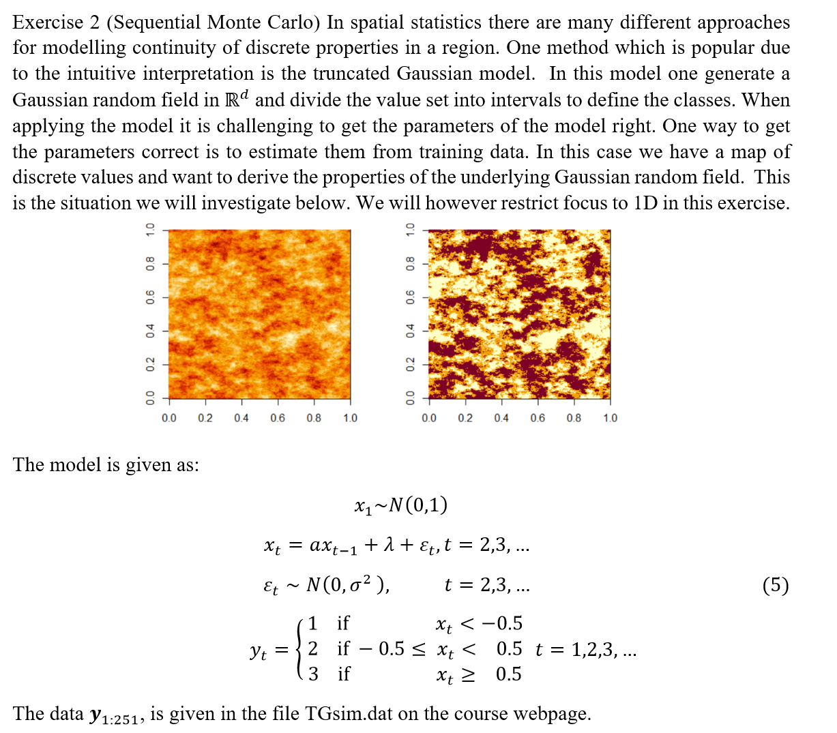
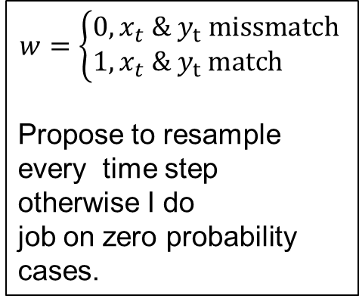
$$w=\left\{\begin{matrix}0, x_{t} \& y_{t} missmatch \\ 1, x_{t} \& y_{t} match \end{matrix}\right.$$
Propose to resample
every time step
otherwise I do
job on zero probability cases.

Slide 15
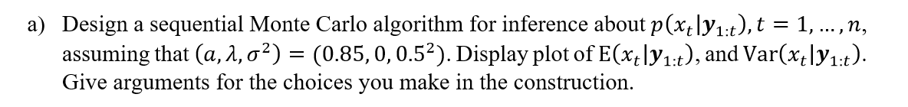
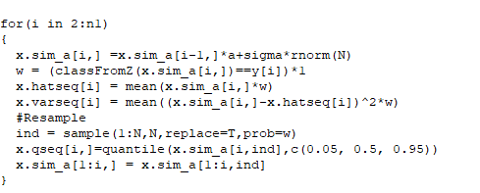
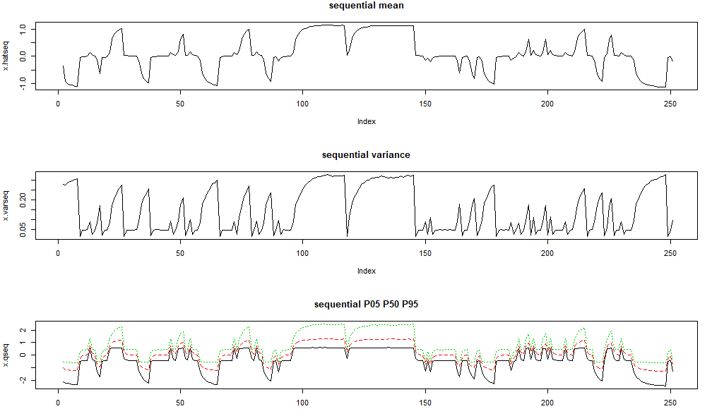
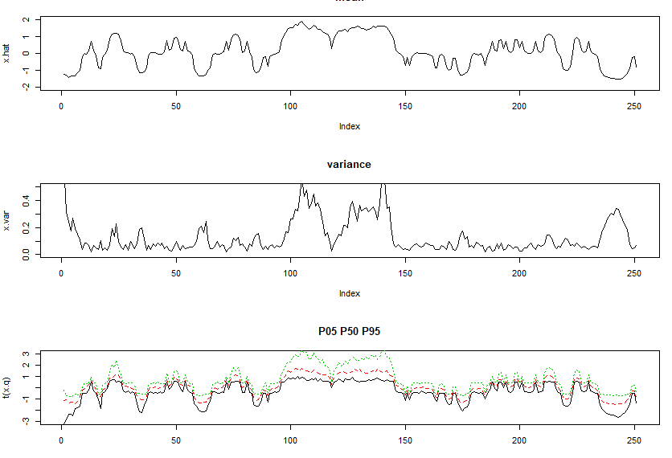



Stable, «time-skewed»
$$p(x_{t}|y_{1:t})$$
Since i resample the past as well
$$p(x_{t}|y_{1:T})$$
Unstable, «symmetric»
(Larger group = better estimate)

Slide 16
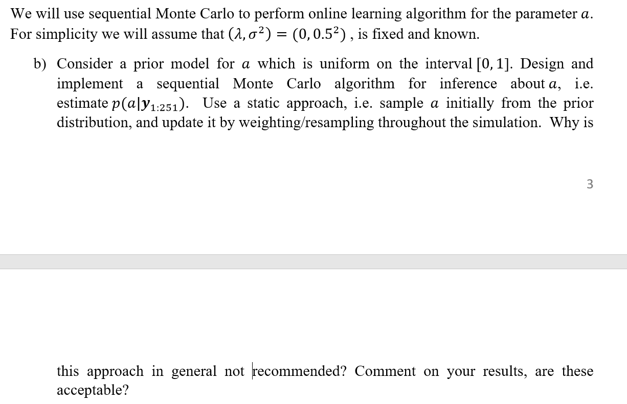
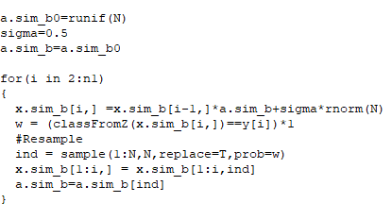
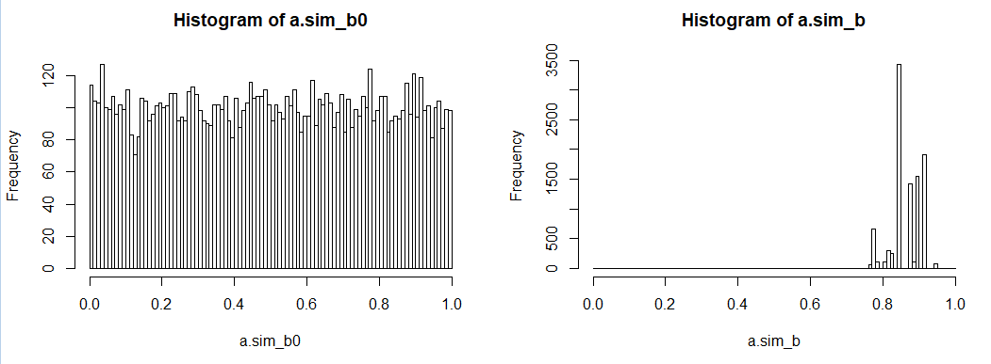
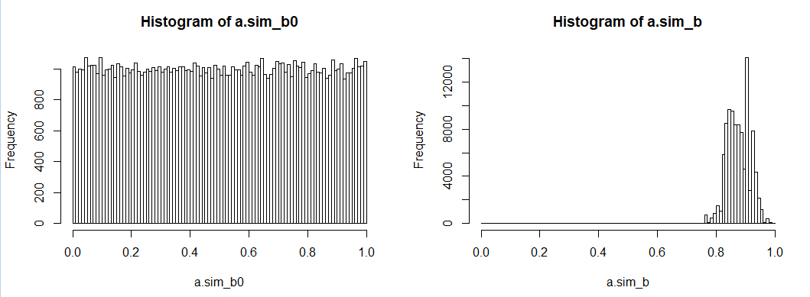


$N={10}^{4}$
Not so good
$N={10}^{5}$
The method tend to
give degenerated sample sets,
i.e just a few are retained
Acceptable
But not perfect

Slide 17
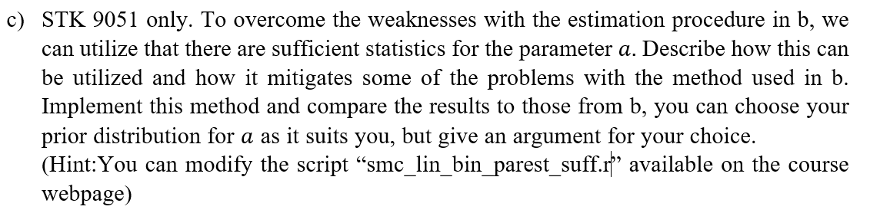
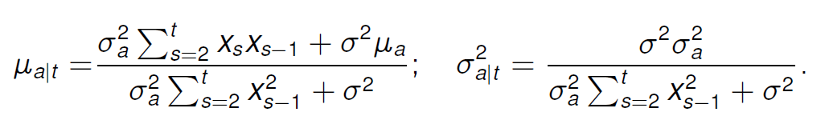
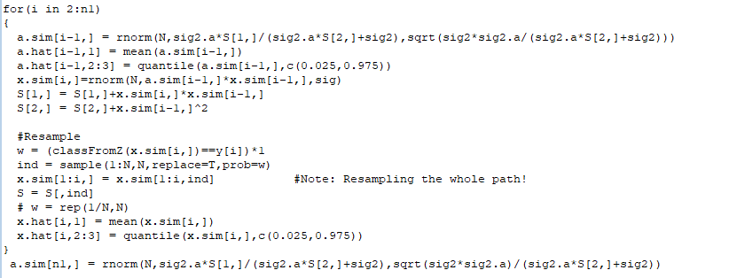


Slide 18
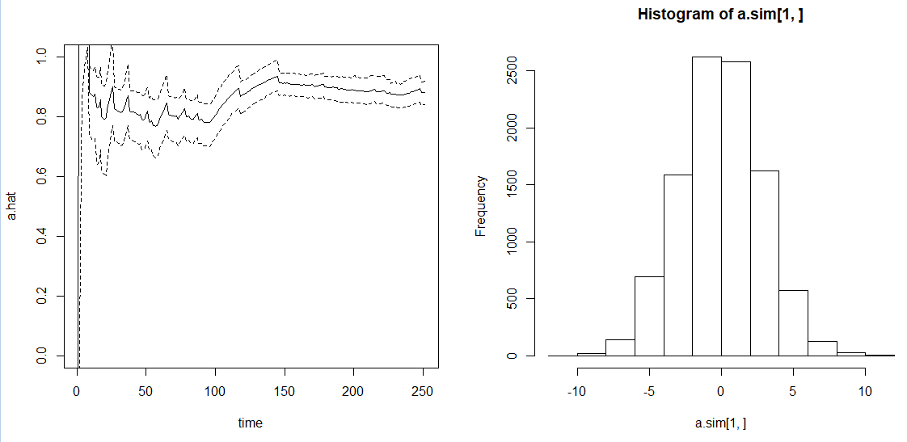
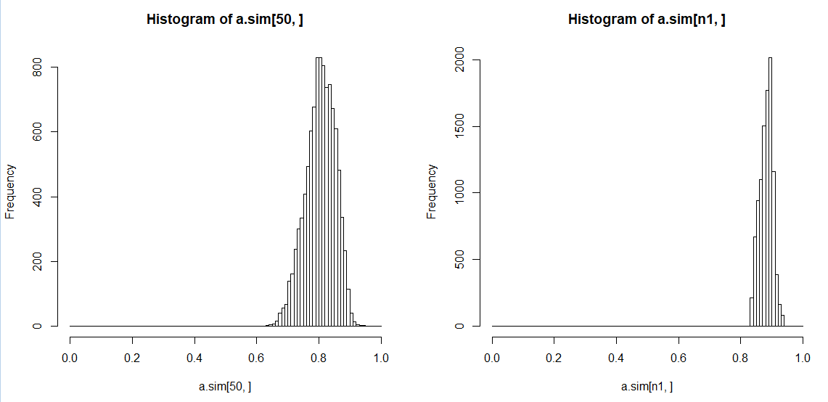

$N={10}^{4}$
Select a wide
Prior which is
Gaussian as this is
suited for the the
updating rules
Acceptable

Slide 19
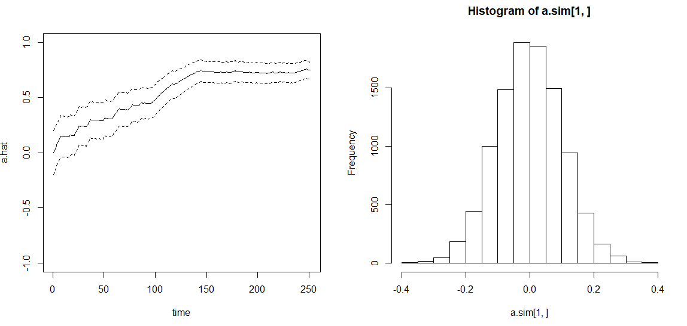
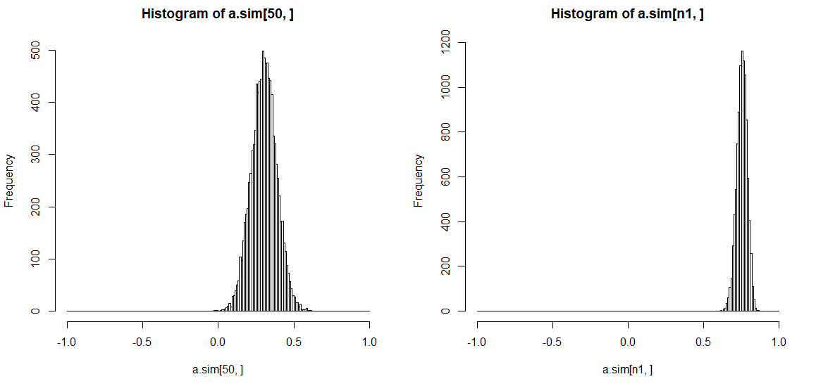
Covergence with «narrow prior» centerd in wrong place
The method still
converge to the
Correct location since
the prior is overpowered
by the likelihood
This would not have
worked with
Approach in 2.b !

Slide 20
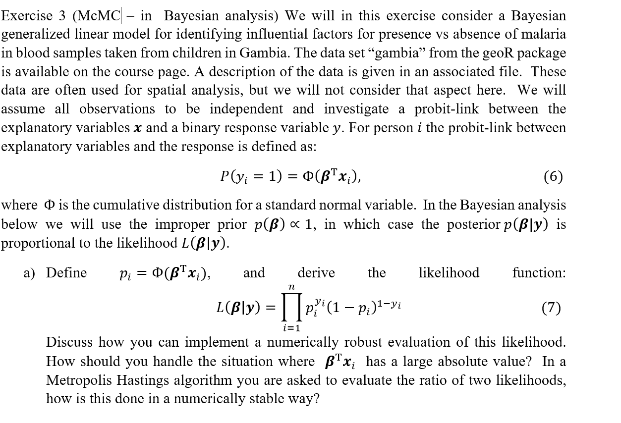

Slide 21
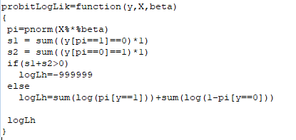
Important to separate
cases where
the probability becomes
zero and is consistent
with data and when it
becomes zero and is
Inconsistent !
Work on log likelihood
If inconsistent
Set LH low
Sum only terms
that are positive
Then you dont get conflict

Slide 22
Some «bad choices»
If log(0) set to likelihood contribution to 0
  You ignore data ☹
Never set likelihood probability less than tolerance.
  Having a small probability for everything gives problems ☹
  => Mc fail to be recurrent
If you get
out here and dimension
is larger than 2 chances
are that you will never
return to «central part»
Example to follow

Slide 23
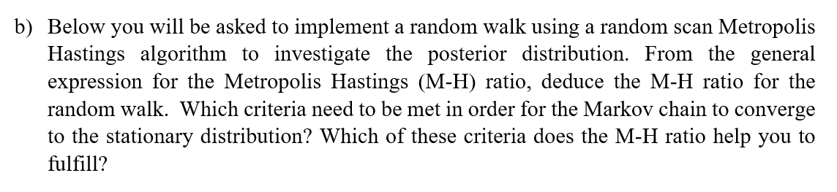
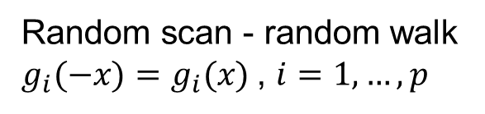

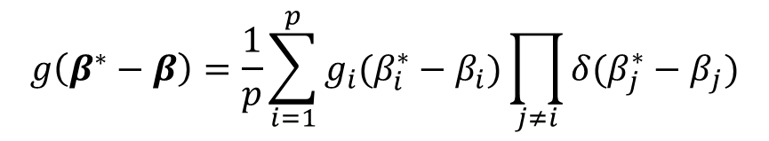
$$R\left(β^{∗} | β\right)=\frac{f\left(β^{∗}\right)g\left(β^{∗}−β\right)}{f\left(β\right)g\left(β−β^{∗}\right)}=\frac{f\left(β^{∗}\right)}{f\left(β\right)}$$
Random walk $g(−x)=g(x)$
Random scan - random walk
$$g\left(β^{∗}−β\right)=\frac{1}{p}\sum_{i=1}^{p}{g_{i}(β_{i}^{∗}−β_{i})}\prod_{j≠i}{δ(β_{j}^{∗}−β_{j})}$$
Random scan - random walk
$g_{i}(−x)=g_{i}(x)$, $i=1,…,p$

Slide 24


The that three grants us an ergodic chain
  irreducible (that we can move from any point to another),
  aperiodic (so that we do not get stuck in cycles),
  recurrent (so that we can visit any subset of points infinitely often).
The one to ensure the correct distribution
  Which is fulfilled by detailed balance
MH gives this

Slide 25





Slide 26


Trace plot
Multiple chains ☺

Slide 27

Auto correlation ☺

Slide 28

Auto correlation ☺
With more lags ☺

Slide 29

Gelman and Rubin statistis
Compute for all parameters
Can also do it for likelihood often among the worst parameters

Slide 30


☹
☹
Histograms with comparision to MLE
☺
☺

Slide 31


Slide 32

High correlation
High correlation

Slide 33

Problems: Reccurence issue?? ☹
Never to return
(At the same time)
Comment from student:
We can clearly see that the variance is too high
we get one traceplot that varies from 50 to -50. ☺
A good comment to a bad plot is easier to forgive...
(if your code otherwise is OK then this is almost no loss )

Slide 34





$$y_{i} =1$$
$$y_{i} =0$$

Slide 35


Joint:
$${I\left(y_{i}=1\right)p}_{i}+{I\left(y_{i}=0\right)(1−p}_{i}) ={ p}_{i}^{y_{i}}{\left(1−p_{i}\right)}^{1−y_{i}}$$
$$p\left(β | y\right)=\int{p\left(β,z | y\right)dz}$$

Slide 36



Slide 37

=1

Slide 38





Linear regression:
Here: $σ^{2}$=1 ☺
$$E\left(\hat{β} | y \right)={\left(X^{T}X\right)}^{−1}X^{T}z$$
$$Cov\left(\hat{β} | y \right)={σ^{2}\left(X^{T}X\right)}^{−1}$$

Slide 39






Slide 40


Compare result
(absolute result depend on normalization)

Slide 41

Compare mixing

Slide 42


Compute time
Good measure: Number of effective samples per time unit

Slide 43
Work ahead of implementation

Slide 44
Gelman and Rubin statistis

