Slide 1
STK-4051/9051 Computational Statistics
Spring 2024
Compulsory Part 1
Instructor: Odd Kolbjørnsen, oddkol@math.uio.no

Slide 2
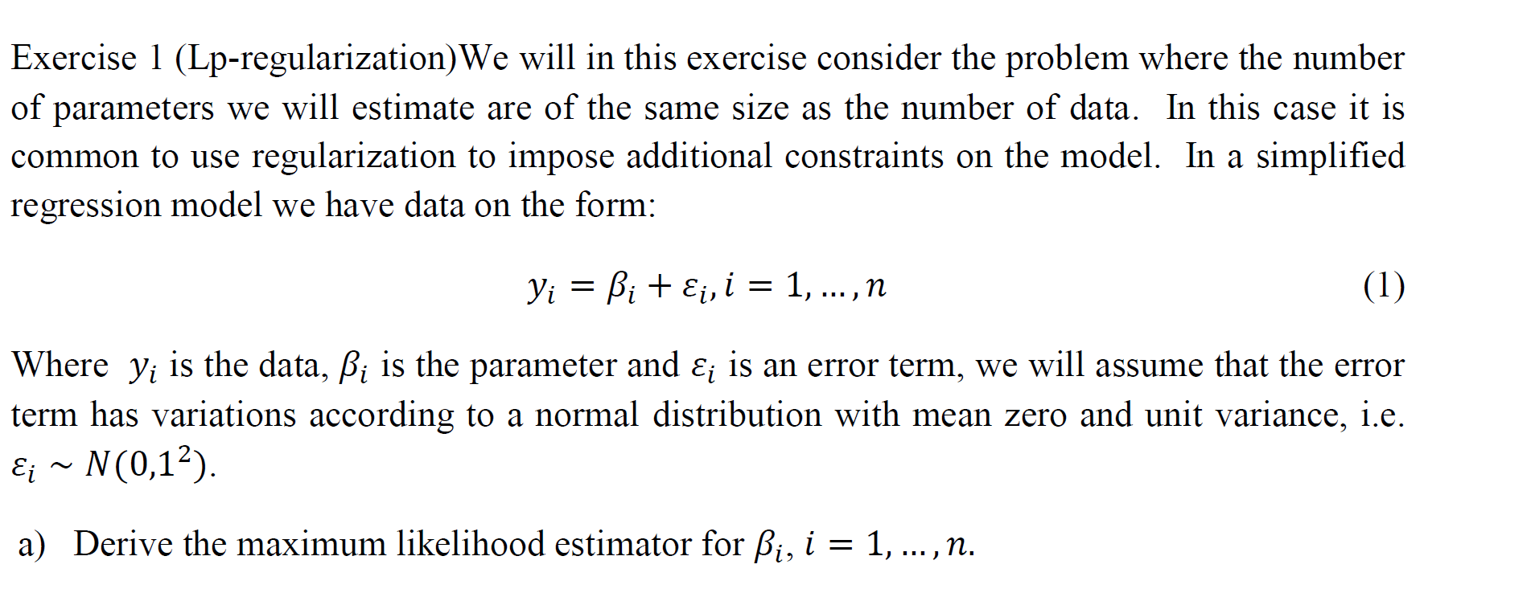
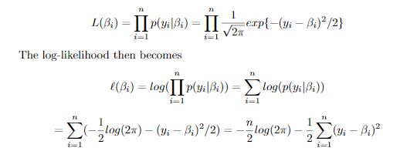
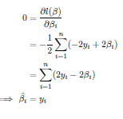
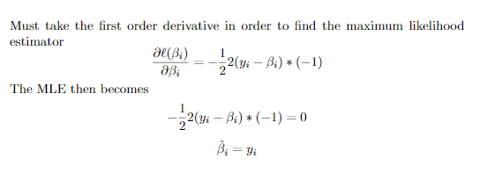

Slide 3
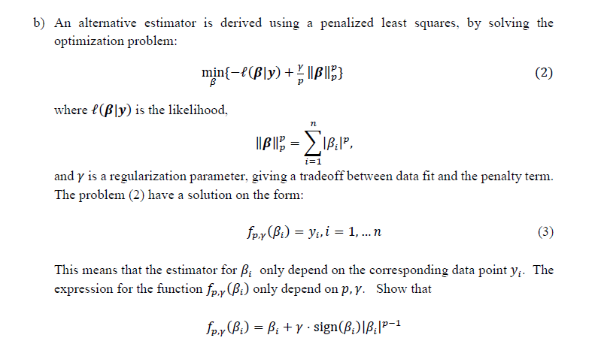
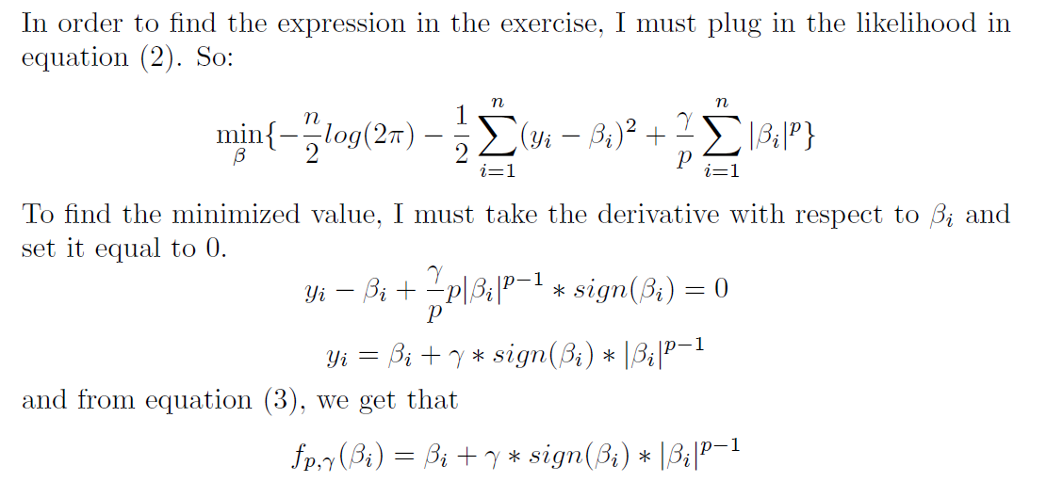

Slide 4
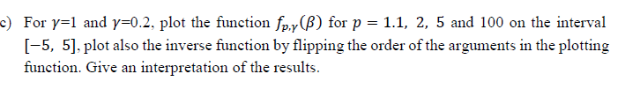
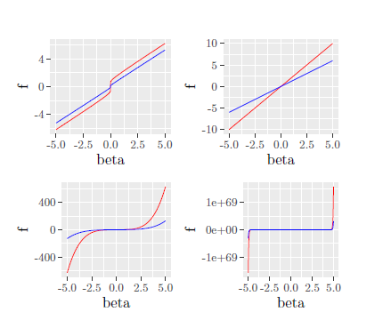
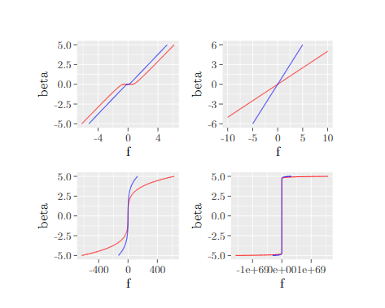

Slide 5
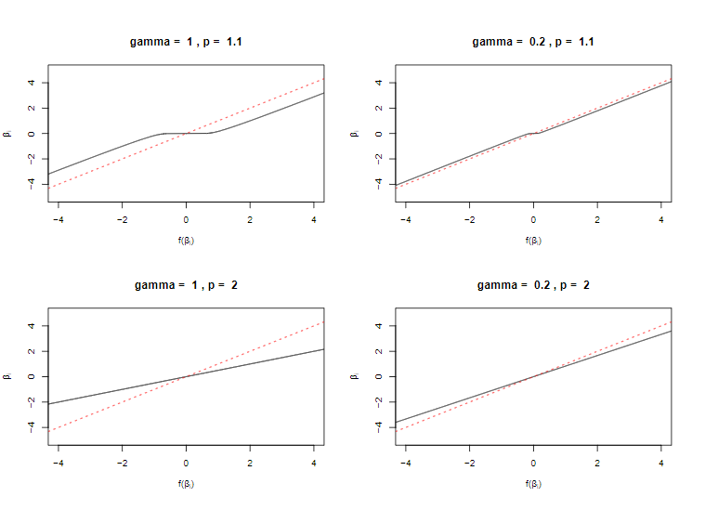
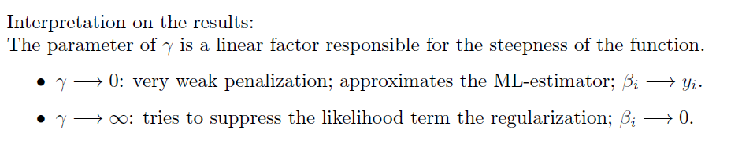
Inverse function Zoom (with x=y)
1.1:
  Close to zero we get
  «almost zero»
  «flat region» depend on gamma
  Away from zero we increase almost linearly
2.0:
  linear
  the slope depend on gamma

Slide 6
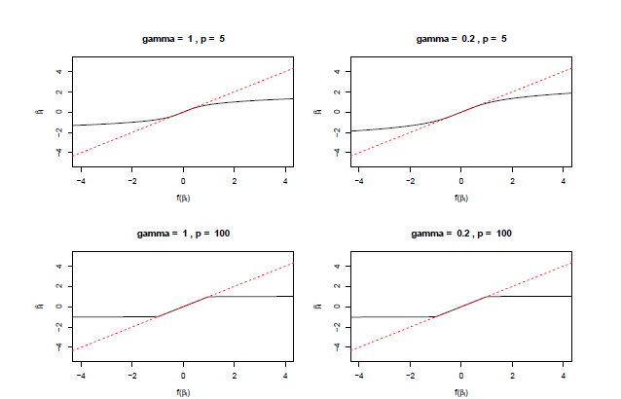
Inverse function Zoom (with x=y)
p>2
  Close to zero we get «the data back»
  Larger deviations for larger values of data
p=large:
  The maximum value is limited

Slide 7
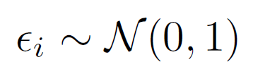
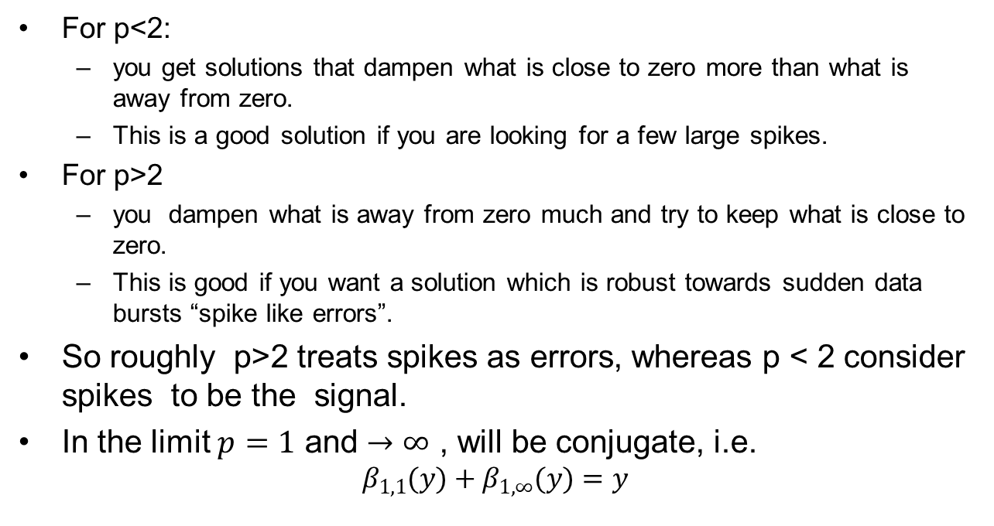
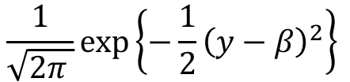
For p<2:
  you get solutions that dampen what is close to zero more than what is away from zero.
  This is a good solution if you are looking for a few large spikes.
For p>2
  you dampen what is away from zero much and try to keep what is close to zero.
  This is good if you want a solution which is robust towards sudden data bursts “spike like errors”.
So roughly p>2 treats spikes as errors, whereas p < 2 consider spikes to be the signal.
In the limit $p=1$ and $→∞$ , will be conjugate, i.e.
$$β_{1,1}(y)+β_{1,∞}(y)=y$$
$$\frac{1}{\sqrt{2π }}exp\left\{−\frac{1}{2}{\left(y−β\right)}^{2}\right\}$$
Why is p=2 special ?

Slide 8
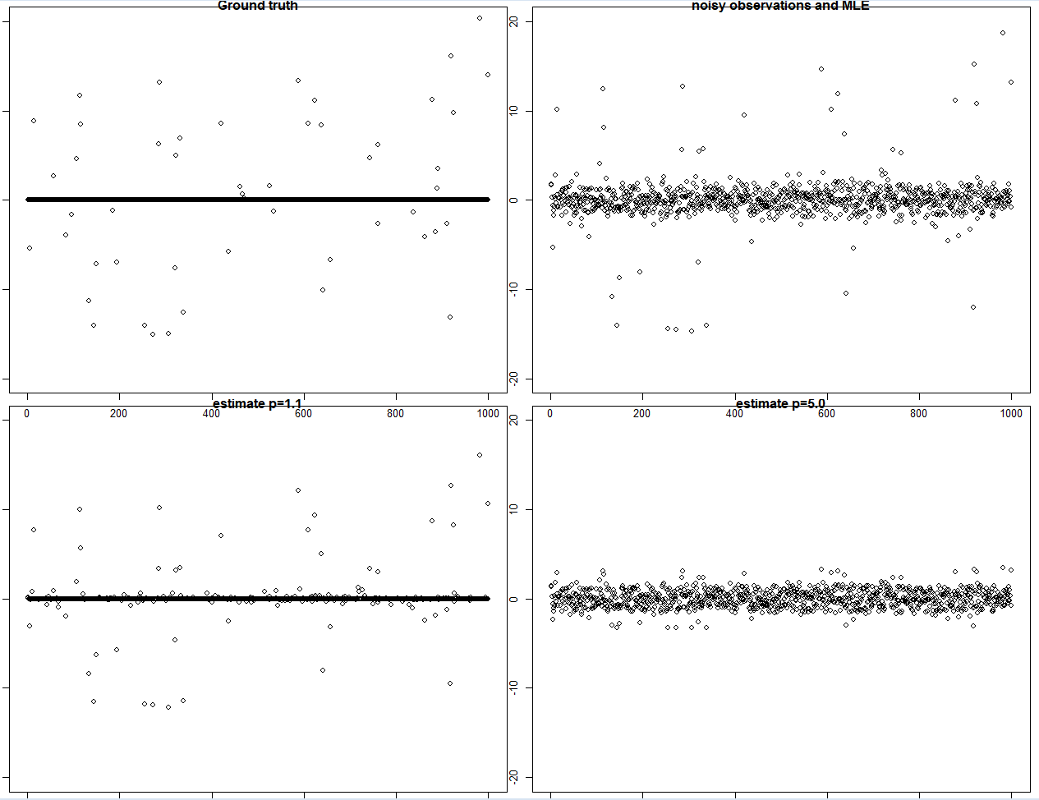


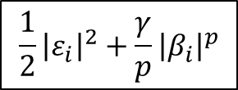
$$\frac{1}{2}{\left|ε_{i}\right|}^{2}+{\frac{γ}{p}\left|β_{i}\right|}^{p}$$
Ground truth
Data = MLE
The signal is sparse
$$γ=2, p=1.1$$
$$γ=0.1, p=5$$

Slide 9
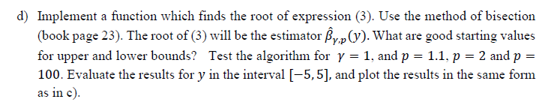
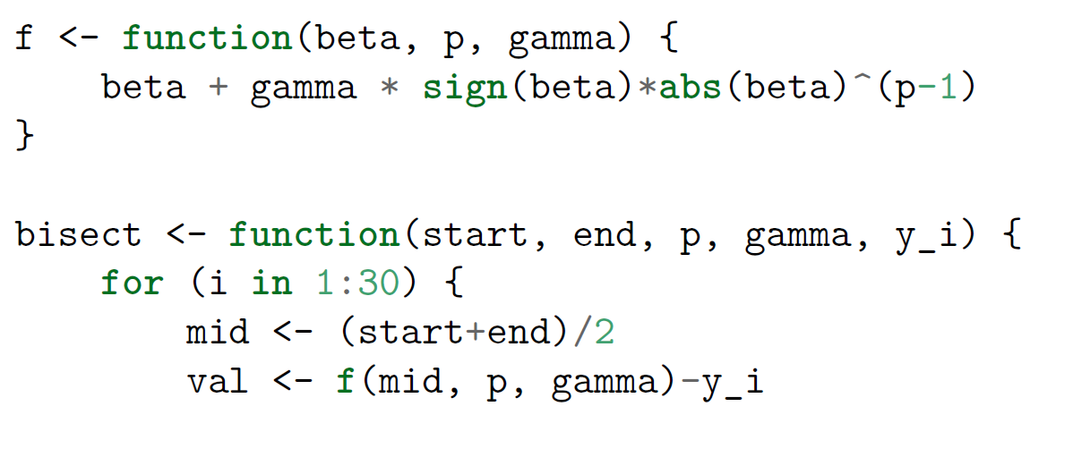
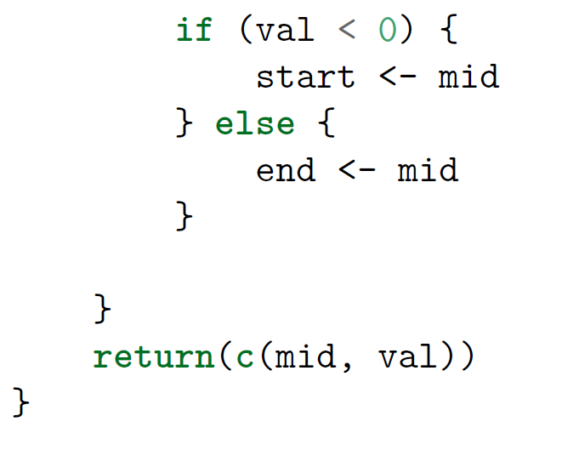
Starting values:
As all functions are closer
to zero than to x = y,
start with:
  upper = |y|
  lower= -|y|
MY ORIGINAL:
Separate in positive and
negative by symmetry
Make solution |y|
add sign after

Slide 10
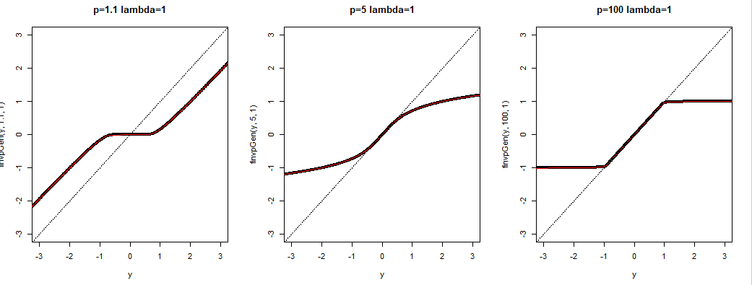
You get the same figure as before, thus you can check your implementation ☺

Slide 11
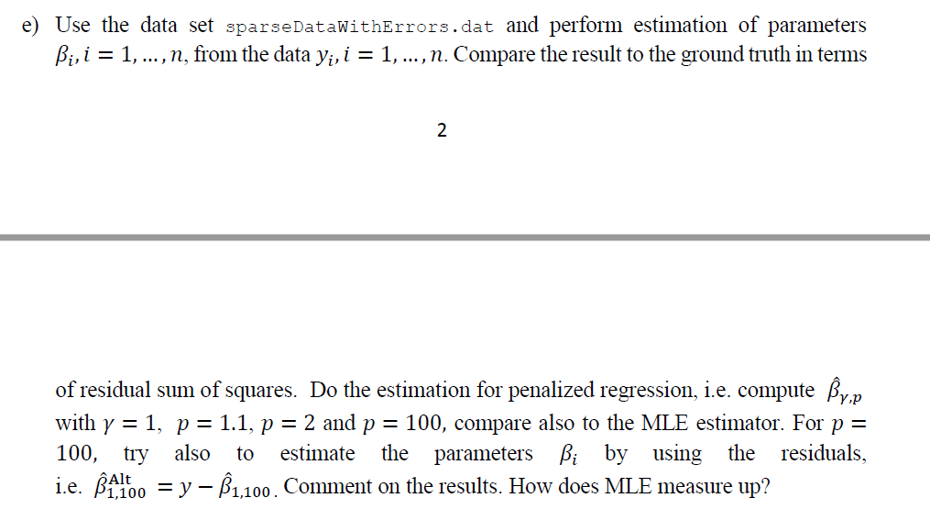
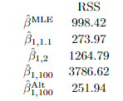
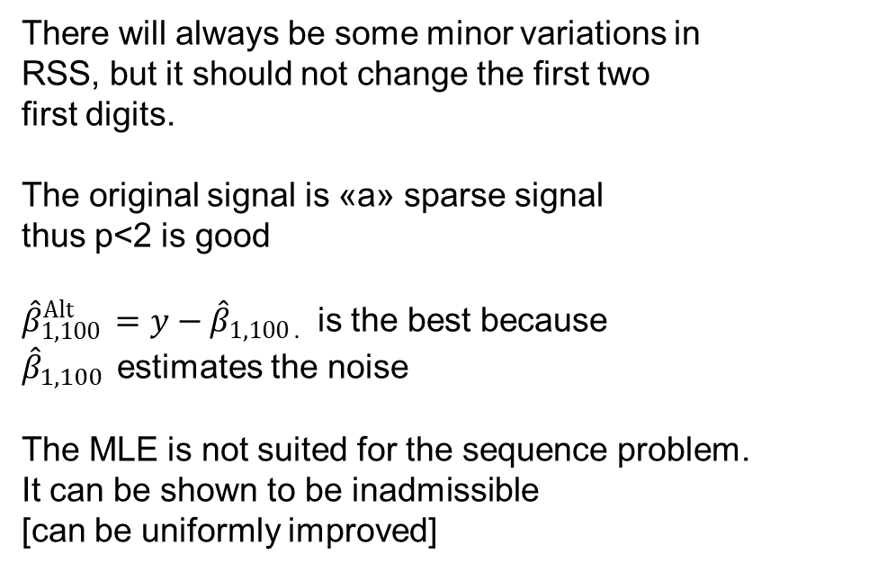
There will always be some minor variations in
RSS, but it should not change the first two
first digits.
The original signal is «a» sparse signal
thus p<2 is good
${\hat{β}}_{1,100 }^{Alt}=$ $y−{\hat{β}}_{1,100 .}$ is the best because
${\hat{β}}_{1,100 }$ estimates the noise
The MLE is not suited for the sequence problem.
It can be shown to be inadmissible
[can be uniformly improved]

Slide 12
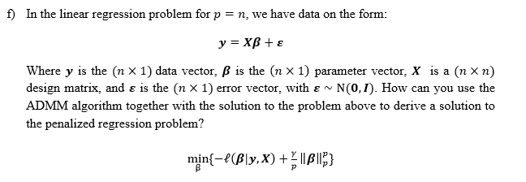
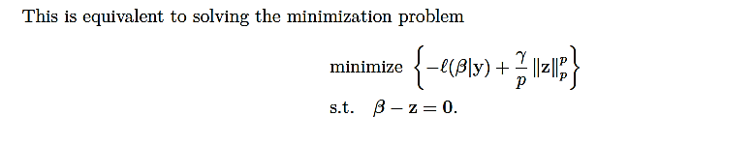
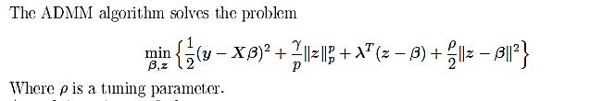

Slide 13
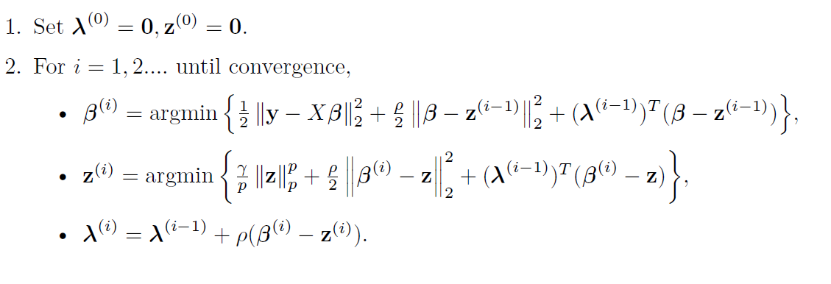

Slide 14
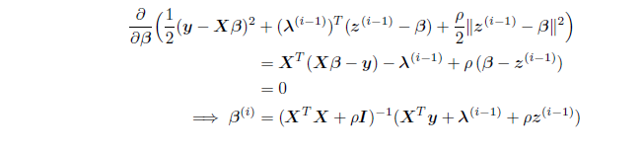
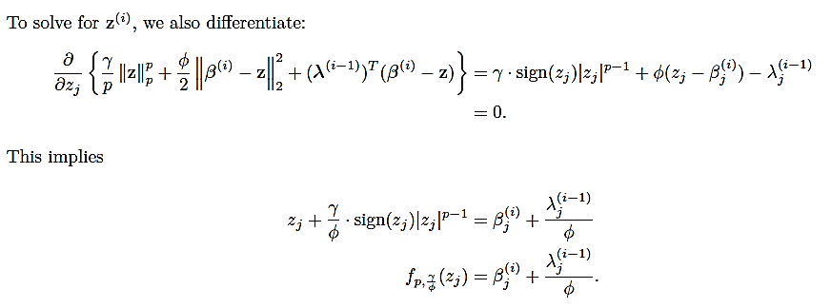
First problem:
Second problem:
Same «solver» as above

Slide 15
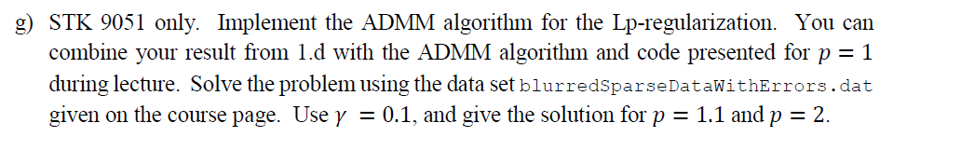
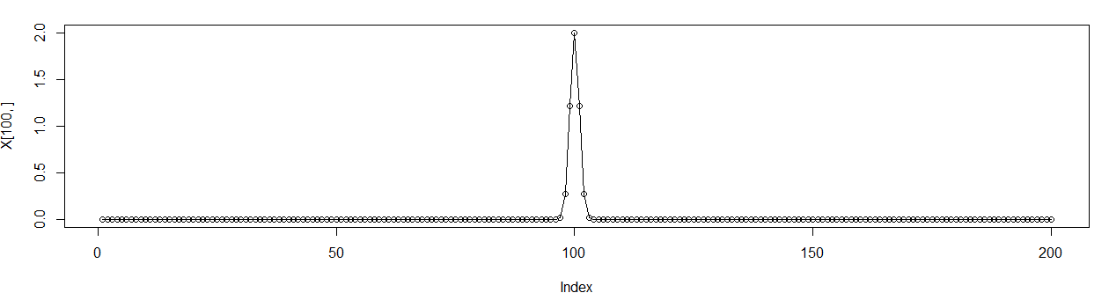
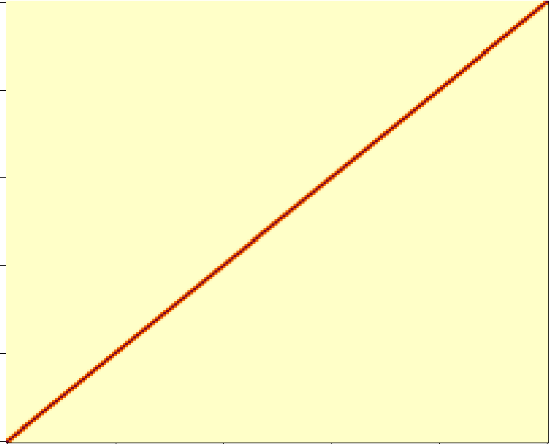
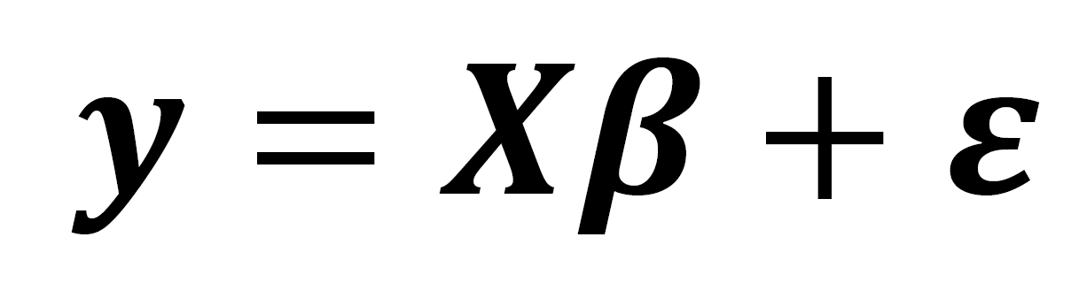
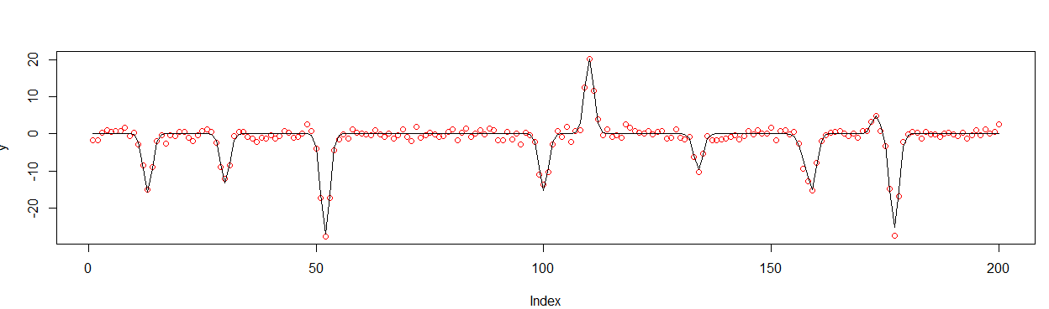
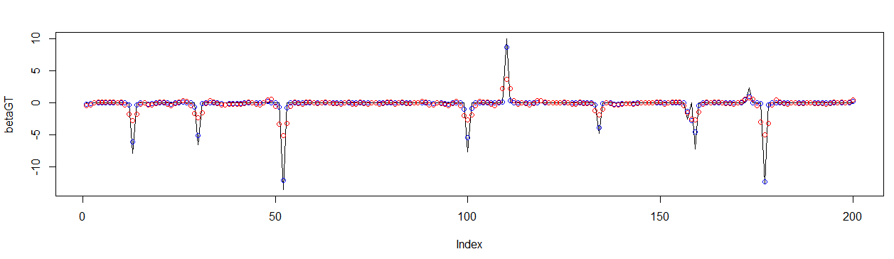
=X
X is a
Blurring kernel
solution p=1.1 gives
«super resolution»

Slide 16
Stop 1

Slide 17
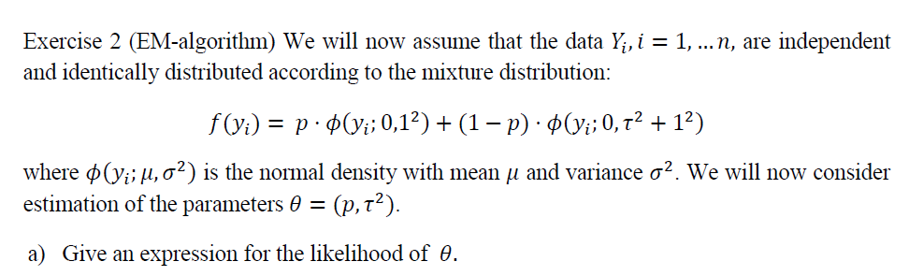
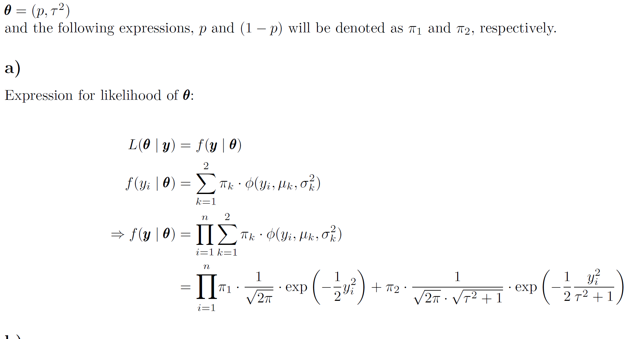

Slide 18
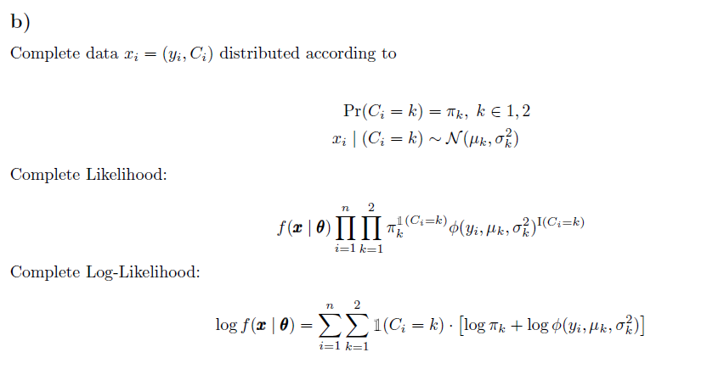
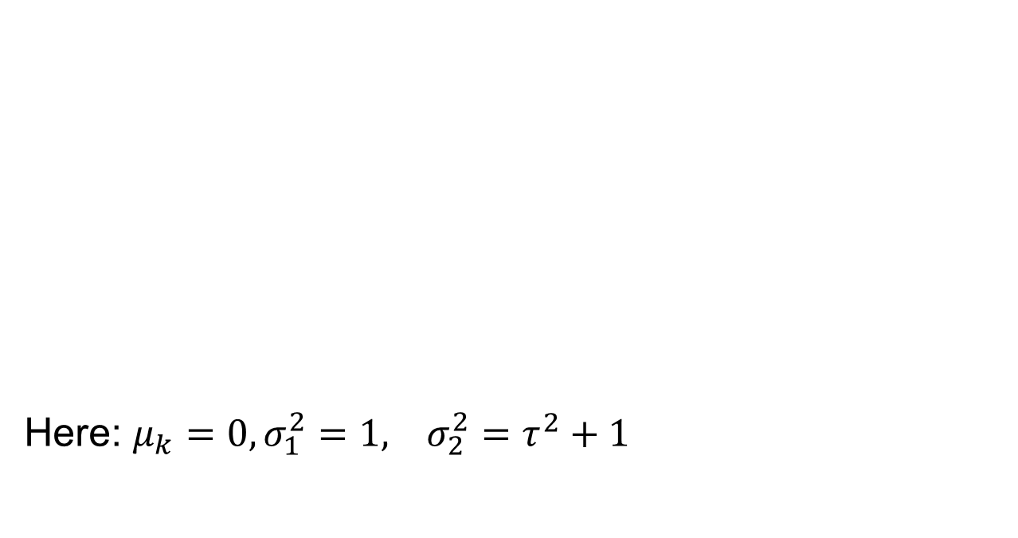
Here: $μ_{k}=0, σ_{1}^{2}=1, σ_{2}^{2}=τ^{2}+1$

Slide 19
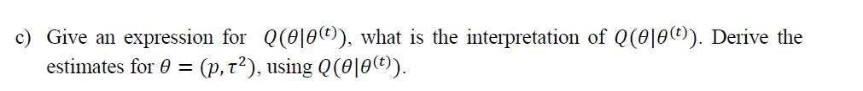
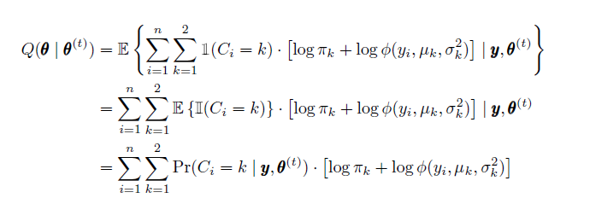
Is the expectation of the joint log likelihood for the complete data,
conditional on the observed data, and with the current estimate
of the parameter

Slide 20
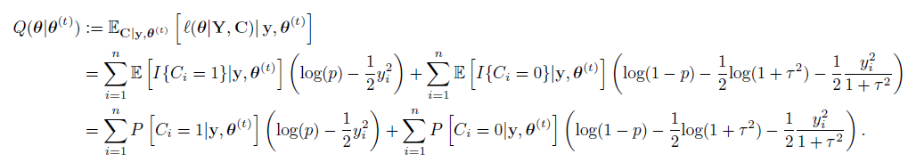
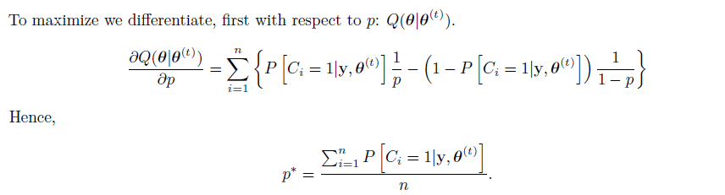
Expression which is «simpler» to optimize

Slide 21
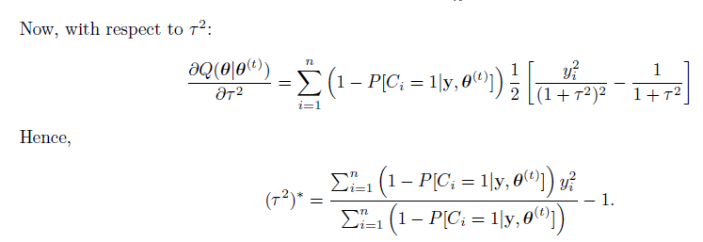
Expression which is «simpler» to optimize

Slide 22
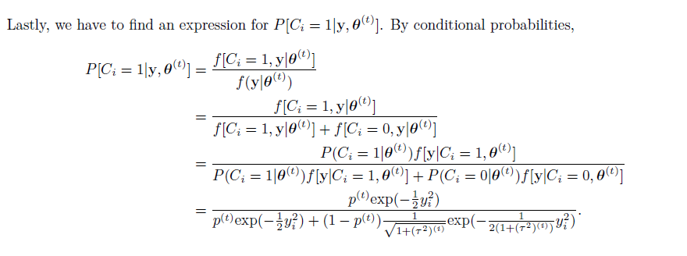

Slide 23
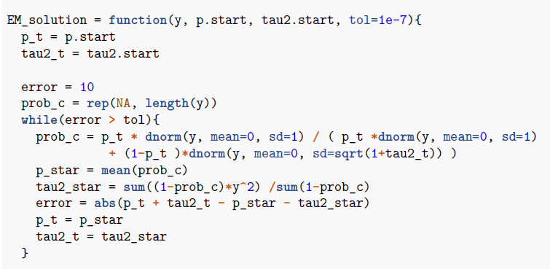
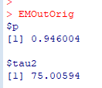
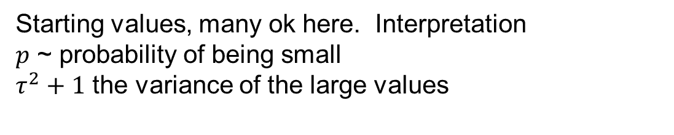
Starting values, many ok here. Interpretation
$p$ ~ probability of being small
$τ^{2}+1$ the variance of the large values

Slide 24
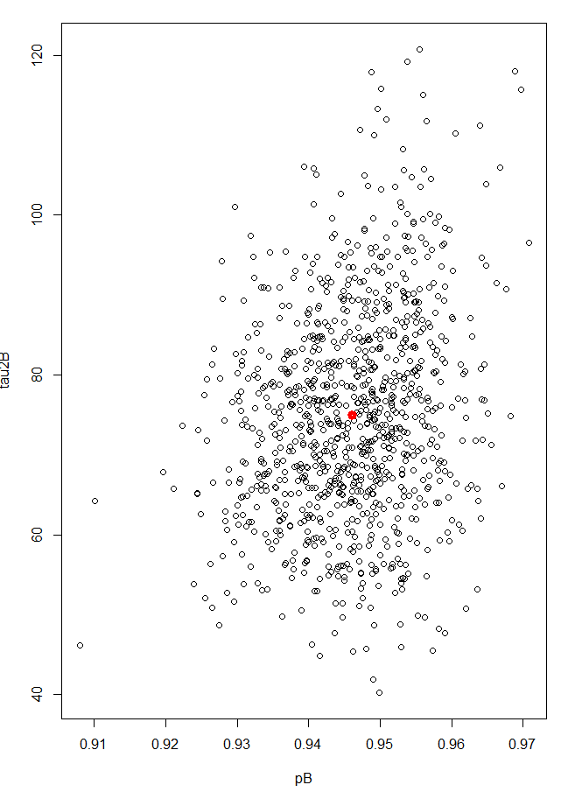


Slide 25




One option: Numerical differentiation

Slide 26





Extra points:
The Hessian of Q gives the complete information
Observed information:
Complete information:
Information loss
Diagonal

Slide 27



Minor differences

Slide 28
Stop 2

Slide 29


Slide 30


Slide 31


In addition since $β$and $ε$are independent
and $y$ is normally distributed $β$is also normal

Slide 32


State independence of $β$and $ε$.
Don’t start of like: β$=y−ε$ you will end up in problems with
dependency between $y and ε$

Slide 33



$P\left(β_{i}=0 | y_{i}=y\right)$
$=P\left(β_{i}=0 | {C_{i}=0,y}_{i}=y\right)P\left(C_{i} =0 | y_{i}=y\right)$
$+P\left(β_{i}=0 | C_{i}{=1,y}_{i}=y\right)P\left(C_{i}=1 | y_{i}=y\right)$
$=1⋅P\left(C_{i} =0 | y_{i}=y\right)$
$+0⋅P\left(C_{i}=1 | y_{i}=y\right)$
$=P\left(C_{i} =0 | y_{i}=y\right)$
$$P\left(β_{i} =0 | y_{i}=y\right)$$
$=$

Slide 34






Slide 35




Slide 36
Stop 3

Slide 37





Slide 38


Cooling schedule
$τ_{i}=K/i$
$τ_{i}=K⋅ρ^{i}$, $ρ<1$(but not much)
$τ_{i}=K/log⁡(i+1)$
Cap at start $\min\left(1,τ_{i}\right)$
Cap at end $max⁡(0.001,τ_{i})$
Assume that you want to go from one permutation to another, if you swap pairs such that you first get the first city to match then the next, ….
You will have a perfect match after after p-1 steps (p beeing the length )

Slide 39



Convergence plots
Too fast cooling
(relative to the number of iterations)
Looks good
Lucky

Slide 40


both positive and negative
by forcing a move even though it might to a worse possition, and
restricting the moves by making a list of illegal moves (taboo)

Slide 41




TABU convergence
Loop
Could be just really small movements
Make tabu list longer
No movement
= strange

Slide 42


“Best” solution last year surprisingly good
3.995
3.77
If your algorithm finds the «best» and
you currently are using the «surprisingly good» you will
* reduce your environmental footprint by more than 5%
* cut cost by more than 5%

Slide 43

The solution I give to you is a good one. I can’t give a guarantee that it is the optimal one. It is impossible to check all solutions as the problem is NP-Hard. No one can give guarantee.
Improve confidence
  Multiple start points / parameter settings
  Multiple algorithms
  Run for a really long time
  Check visually
  Compare to lower bound
    For each city compute the minimum distance to any city sum these (=>2.488)

Slide 44




Slide 45


To solve the same problem, but with to cycles, we can add an extra index of the home city to the permutation path. This will produce solutions with two loops. One on each side of the home city.
The objective function then has to evaluate each route and return the maximum distance of the two.
Max distance:
2.43

Slide 46


Slide 47
Stop 4

Slide 48




(From note)
$$g\left(t\right)=t$$
$$h\left(x\right)=σ\left(x\right)$$
$$x_{i1}=x$$
$$x_{i2}=1$$
$$p=2$$
$$M=50$$

Slide 49


$$λ_{1} =λ_{2}=0$$

Slide 50




Slide 51

The test-set an training-set having similar MSE
With 151 parameters and 10 000 data we are
not in the position of over parameterization

Slide 52


Initialization for example
Alphas random (order of 1)
* Betas do regression with
the alphas above
* Random these as well

Slide 53

Too «fast decay» of learning rate

Slide 54

Data fit predicted vs observed

Slide 55

Data fit predicted vs observed

Slide 56


Slide 57

Prediction outside data range

Slide 58
Stop 5

