Slide 1
STK-4051/9051 Computational Statistics Spring 2020
Variational Inference
Instructor: Odd Kolbjørnsen, oddkol@math.uio.no
Slides partly made by Geir Olve Storvik

Slide 2
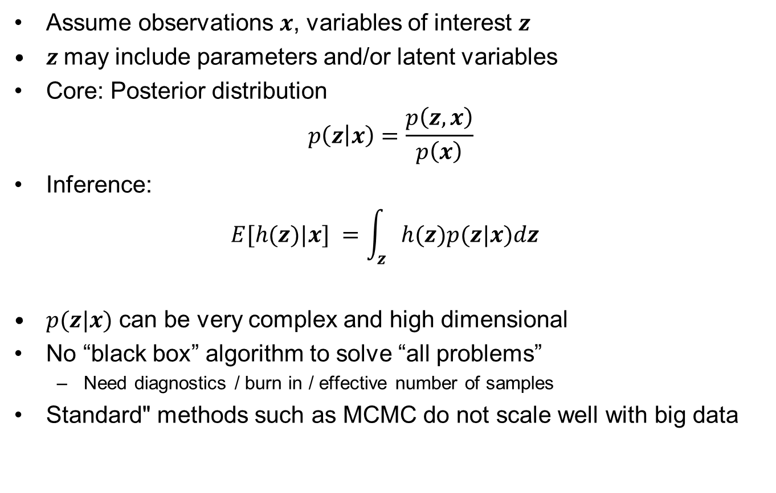
Bayesian inference
Assume observations $x$, variables of interest $z$
$z$may include parameters and/or latent variables
Core: Posterior distribution
$$p\left(z | x\right)=\frac{p\left(z,x\right)}{p\left(x\right)}$$
Inference:
$$E[h(z)|x] =\int_{z}{h(z)p(z|x)dz }$$
$p(z|x)$ can be very complex and high dimensional
No “black box” algorithm to solve “all problems”
  Need diagnostics / burn in / effective number of samples
Standard" methods such as MCMC do not scale well with big data

Slide 3
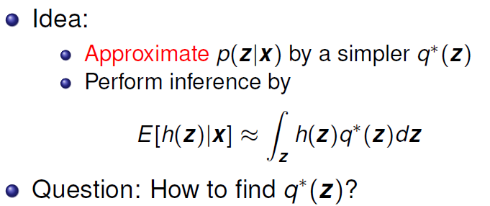
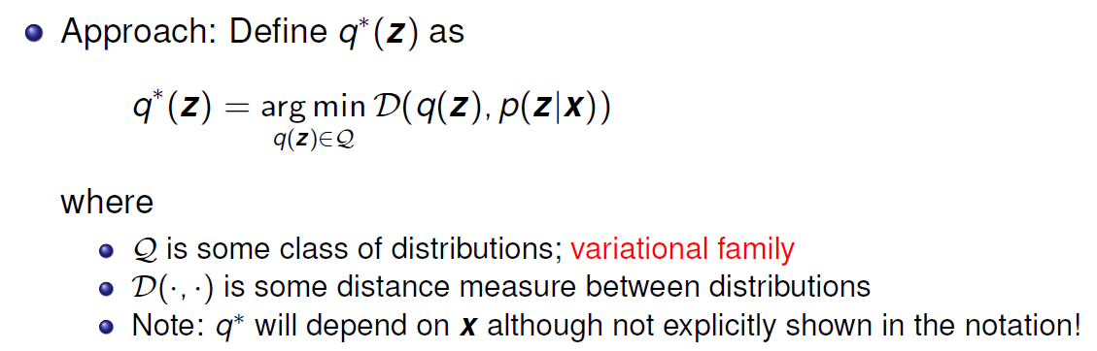
Variational Inference
Main source: Blei et al. (2017) Variational inference: A review for statisticians. JASA
This integral is «easy»
This optimization must be solved

Slide 4
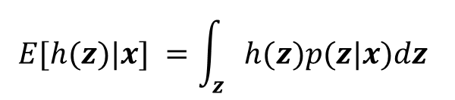
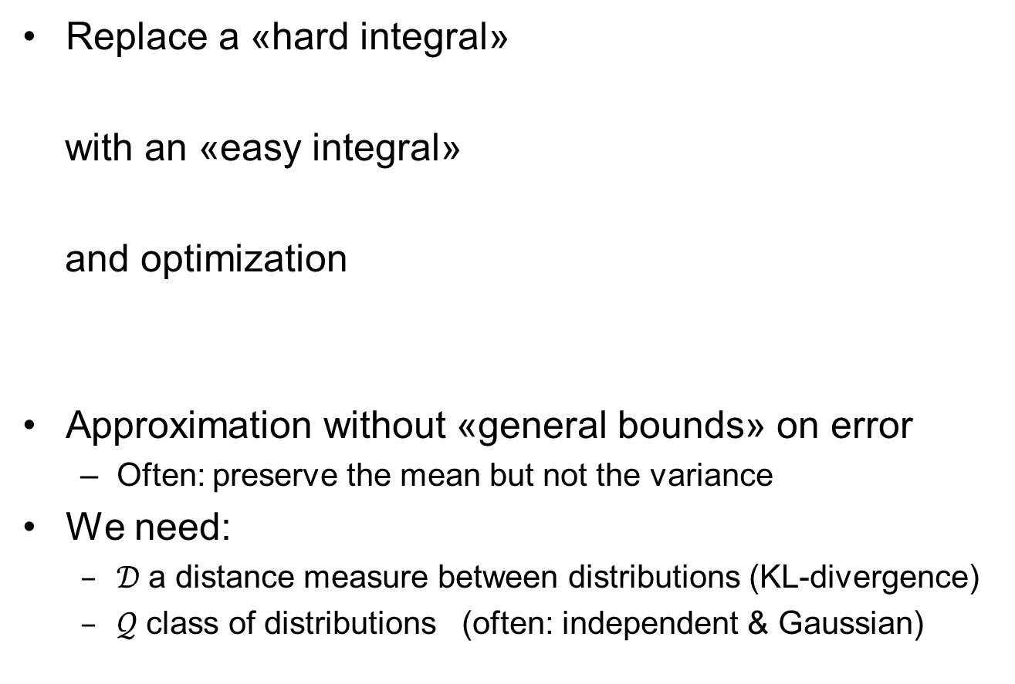
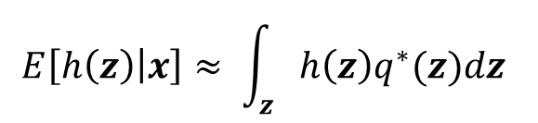
Variational inference
Replace a «hard integral»
with an «easy integral»
and optimization
Approximation without «general bounds» on error
  Often: preserve the mean but not the variance
We need:
  $𝒟$a distance measure between distributions (KL-divergence)
  $𝒬$class of distributions (often: independent & Gaussian)
$$E[h(z)|x] =\int_{z}{h(z)p(z|x)dz }$$
$$E\left[h\left(z\right) | x\right]≈ \int_{z}{h\left(z\right)q^{∗}(z)dz }$$

Slide 5
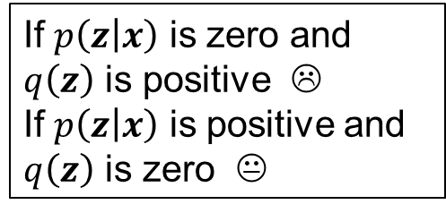
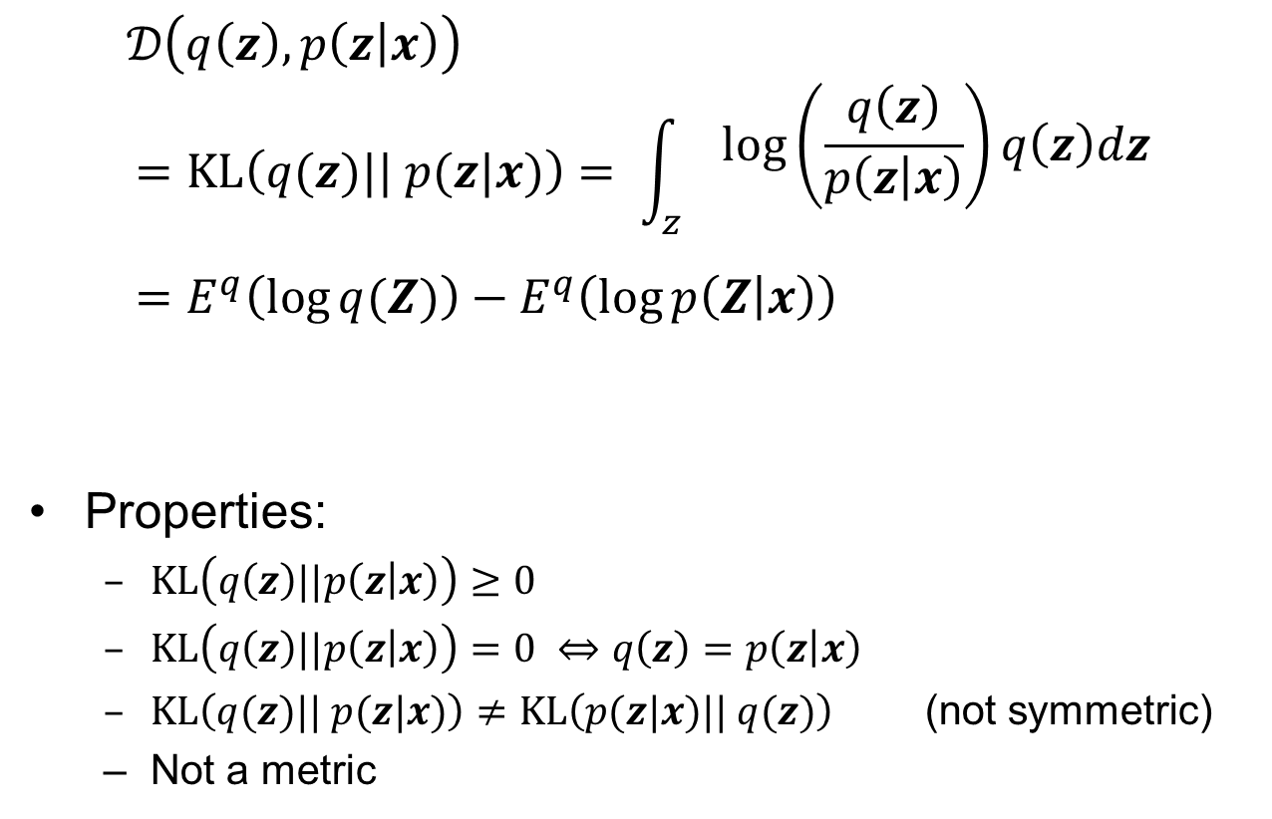
Kullback-Leibler divergence
$$𝒟\left(q\left(z\right), p\left(z | x\right)\right)$$
$$=KL\left(q(z)|| p(z|x)\right)= \int_{z}{\begin{aligned}log⁡\left(\frac{q\left(z\right)}{p\left(z | x\right)}\right)q\left(z\right)dz \\ \end{aligned}}=E^{q}\left(\log{q(Z)}\right)−E^{q}\left(\log{p\left(Z | x\right)}\right)$$
Properties:
  $KL\left(q\left(z\right)||p\left(z | x\right)\right)≥0$
  $KL\left(q\left(z\right)||p\left(z | x\right)\right)=0 ⇔q\left(z\right)=p\left(z | x\right)$
  $KL\left(q(z)|| p(z|x)\right)≠KL\left(p(z|x)|| q(z)\right)$ (not symmetric)
  Not a metric
If $p\left(z | x\right)$ is zero and
$q\left(z\right)$ is positive ☹
If $p\left(z | x\right)$ is positive and
$q\left(z\right)$ is zero 😐

Slide 6
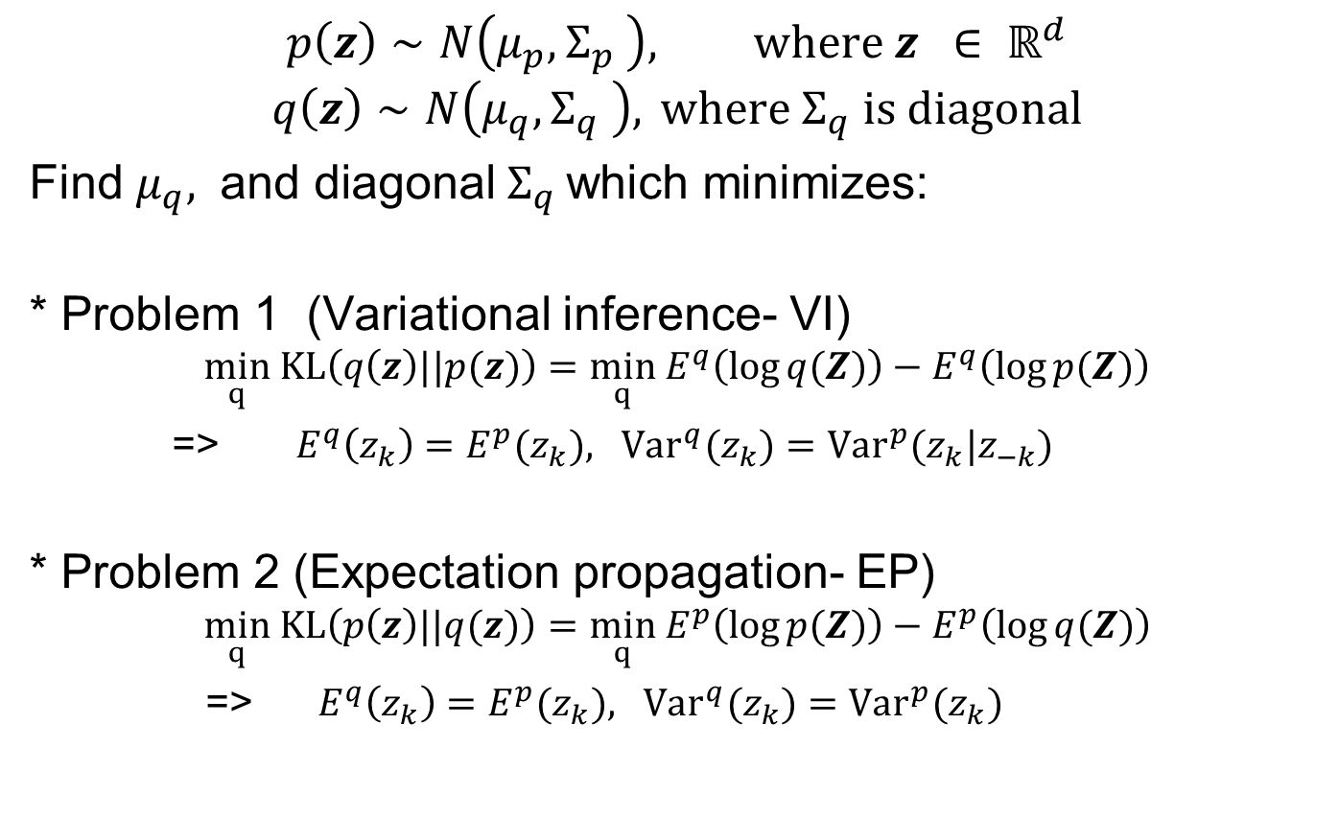
Asymmetry of Kullback Lieibler divergence
$$p\left(z\right)∼N\left(μ_{p},Σ_{p} \right), where z ∈ ℝ^{d}$$
$$q\left(z\right)∼N\left(μ_{q},Σ_{q} \right), { where Σ}_{q} is diagonal$$
Find ${μ_{q}, \text{and} \text{diagonal} Σ}_{q}$which minimizes:
* Problem 1 (Variational inference- VI)
$$\min_{q} KL\left(q\left(z\right)||p(z)\right)={\min_{q} E}^{q}\left(\log{q(Z)}\right)−E^{q}\left(\log{p(Z)}\right)$$
=> $E^{q}\left(z_{k}\right)=E^{p}{(z}_{k}), Var^{q}(z_{k})={Var}^{p}(z_{k}|z_{−k})$
* Problem 2 (Expectation propagation- EP)
$$\min_{q} KL\left(p\left(z\right)||q(z)\right)=\min_{q}{ E}^{p}\left(\log{p(Z)}\right)−E^{p}\left(\log{q(Z)}\right)$$
=> $E^{q}\left(z_{k}\right)=E^{p}{(z}_{k}), Var^{q}(z_{k})={Var}^{p}(z_{k})$

Slide 7
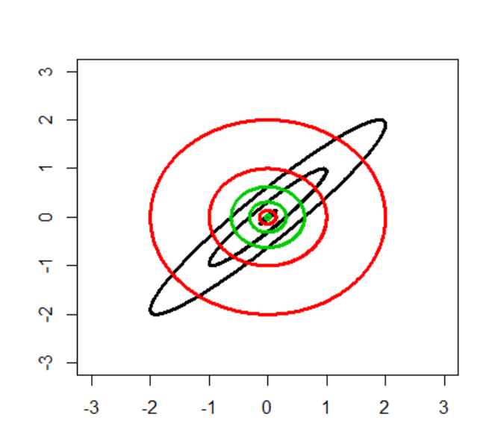
VI vs EP
GT
EP
VI
Ground truth:
Bi-normal
Correlation 0.95
Contours at 1 and 2 standard deviations

Slide 8

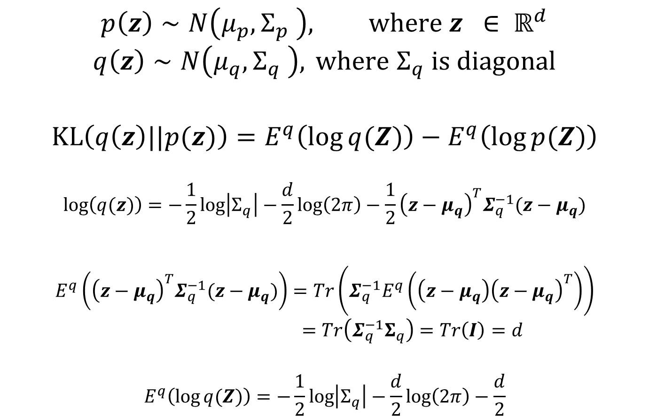
Computations: Variational inference
$$p\left(z\right)∼N\left(μ_{p},Σ_{p} \right), where z ∈ ℝ^{d}$$
$$q\left(z\right)∼N\left(μ_{q},Σ_{q} \right), { where Σ}_{q} is diagonal$$
$$KL\left(q\left(z\right)||p(z)\right)=E^{q}\left(\log{q(Z)}\right)−E^{q}\left(\log{p(Z)}\right)$$
$$\log\left(q(z)\right)=−\frac{1}{2}\log\left|Σ_{q}\right|−\frac{d}{2}\log\left(2π\right)−\frac{1}{2}{\left(z−μ_{q}\right)}^{T}Σ_{q}^{−1}(z−μ_{q})$$
$$E^{q}\left({\left(z−μ_{q}\right)}^{T}Σ_{q}^{−1}(z−μ_{q})\right)=Tr\left(Σ_{q}^{−1}E^{q}\left(\left(z−μ_{q}\right){\left(z−μ_{q}\right)}^{T}\right)\right)$$
$$=Tr\left(Σ_{q}^{−1}Σ_{q}\right)=Tr\left(I\right)=d$$
$$E^{q}\left(\log{q(Z)}\right)=−\frac{1}{2}\log\left|Σ_{q}\right|−\frac{d}{2}\log\left(2π\right)−\frac{d}{2}$$
$E^{q}\left(\log{q(Z)}\right)$:

Slide 9
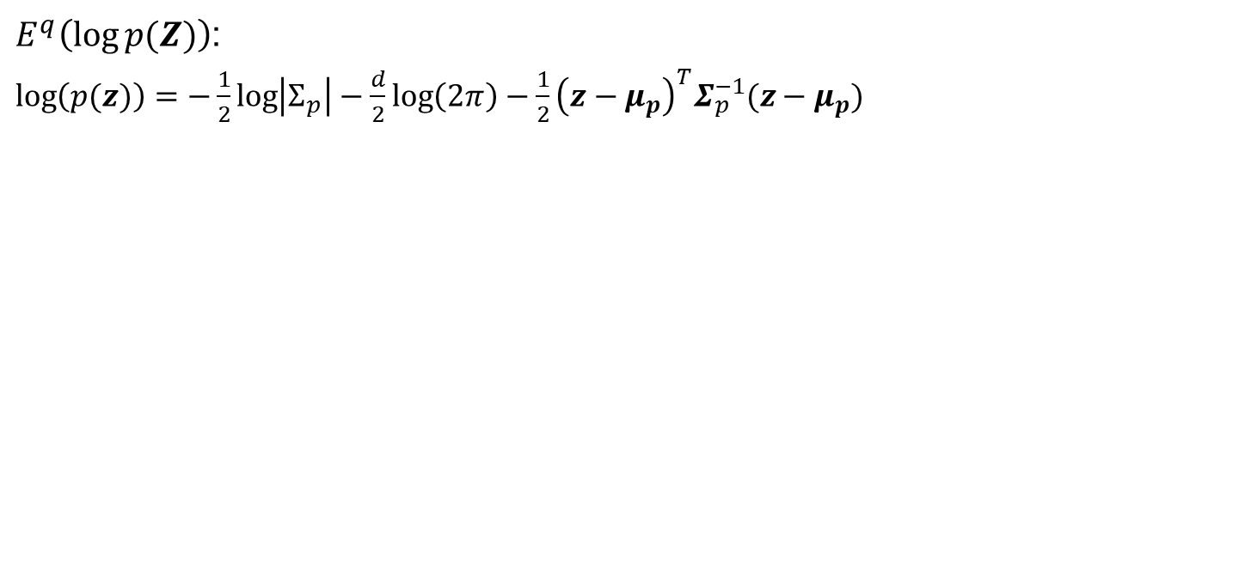

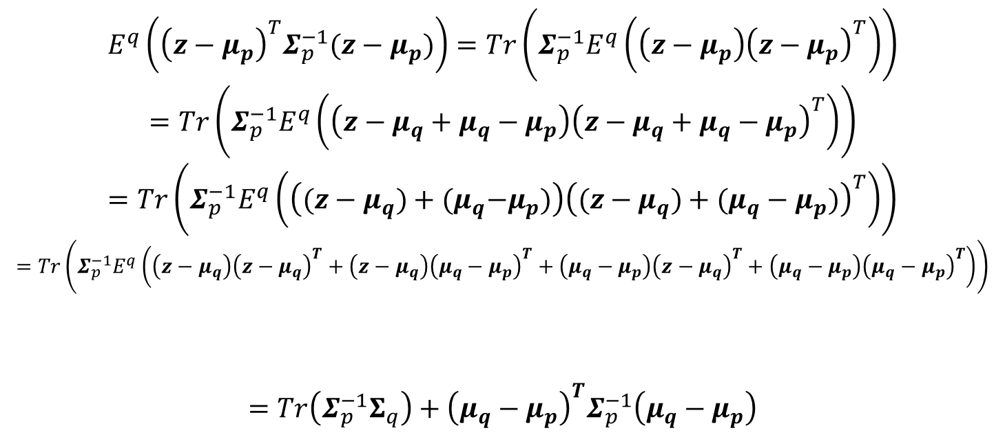
$E^{q}\left(\log{p(Z)}\right)$:
$\log\left(p(z)\right)=−\frac{1}{2}\log\left|Σ_{p}\right|−\frac{d}{2}\log\left(2π\right)−\frac{1}{2}{\left(z−μ_{p}\right)}^{T}Σ_{p}^{−1}(z−μ_{p})$
$$E^{q}\left({\left(z−μ_{p}\right)}^{T}Σ_{p}^{−1}(z−μ_{p})\right)=Tr\left(Σ_{p}^{−1}E^{q}\left(\left(z−μ_{p}\right){\left(z−μ_{p}\right)}^{T}\right)\right)$$
$$=Tr\left(Σ_{p}^{−1}E^{q}\left(\left(z−μ_{q}+μ_{q}−μ_{p}\right){\left(z−μ_{q}+μ_{q}−μ_{p}\right)}^{T}\right)\right)$$
$$=Tr\left(Σ_{p}^{−1}E^{q}\left(\left((z−μ_{q})+{(μ}_{q}−μ_{p})\right){\left((z−μ_{q})+(μ_{q}−μ_{p})\right)}^{T}\right)\right)$$
$$=Tr\left(Σ_{p}^{−1}E^{q}\left(\left(z−μ_{q}\right){\left(z−μ_{q}\right)}^{T}+\left(z−μ_{q}\right){\left(μ_{q}−μ_{p}\right)}^{T}+\left(μ_{q}−μ_{p}\right){\left(z−μ_{q}\right)}^{T}+\left(μ_{q}−μ_{p}\right){\left(μ_{q}−μ_{p}\right)}^{T}\right)\right)$$
$$=Tr\left(Σ_{p}^{−1}Σ_{q}\right)+{\left(μ_{q}−μ_{p}\right)}^{T}Σ_{p}^{−1}\left(μ_{q}−μ_{p}\right)$$
E()=$Σ_{q}$
E()=0
E()=0
$$E^{q}\left(\log{p(Z)}\right)=−\frac{1}{2}\log\left|Σ_{p}\right|−\frac{d}{2}\log\left(2π\right)−\frac{1}{2}Tr\left(Σ_{p}^{−1}Σ_{q}\right)−{\frac{1}{2}\left(μ_{q}−μ_{p}\right)}^{T}Σ_{p}^{−1}\left(μ_{q}−μ_{p}\right)$$

Slide 10
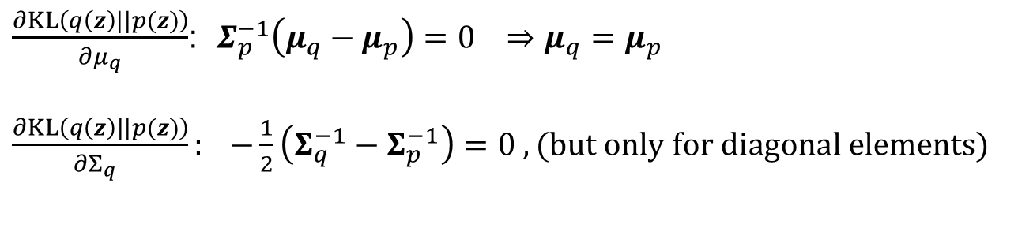
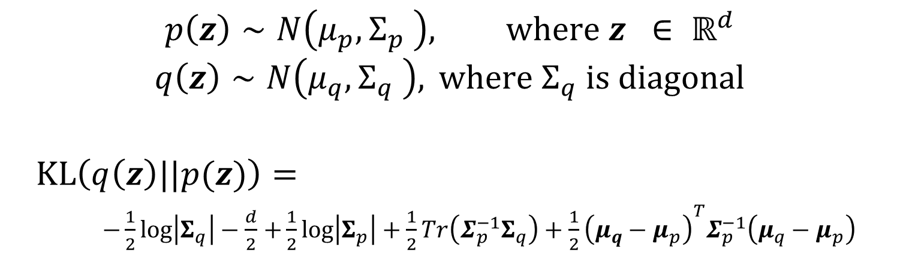


$$p\left(z\right)∼N\left(μ_{p},Σ_{p} \right), where z ∈ ℝ^{d}$$
$$q\left(z\right)∼N\left(μ_{q},Σ_{q} \right), { where Σ}_{q} is diagonal$$
$$KL\left(q\left(z\right)||p(z)\right)=$$
$−\frac{1}{2}\log\left|Σ_{q}\right|−\frac{d}{2}$ $+\frac{1}{2}\log\left|Σ_{p}\right|+\frac{1}{2}Tr\left(Σ_{p}^{−1}Σ_{q}\right)+{\frac{1}{2}\left(μ_{q}−μ_{p}\right)}^{T}Σ_{p}^{−1}\left(μ_{q}−μ_{p}\right)$
$\frac{∂KL\left(q\left(z\right)||p(z)\right)}{∂μ_{q}}$: $Σ_{p}^{−1}\left(μ_{q}−μ_{p}\right)=0 ⇒μ_{q}=μ_{p}$
$\frac{∂KL\left(q\left(z\right)||p(z)\right)}{∂Σ_{q} }: −\frac{1}{2}\left(Σ_{q}^{−1}−Σ_{p}^{−1}\right)=0 , (but only for diagonal elements)$
$${ since Σ}_{q} is diagonal$$
Solution:
$$E^{q}\left(z_{k}\right)=E^{p}{(z}_{k})$$
$$Var^{q}(z_{k})={Var}^{p}(z_{k}|z_{−k})$$

Slide 11
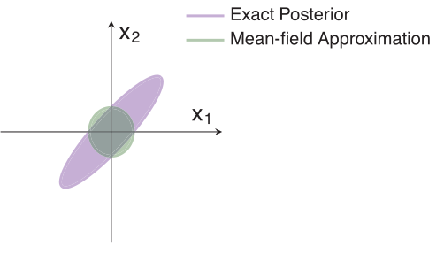
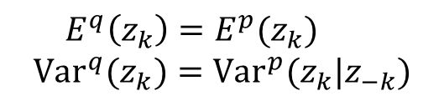
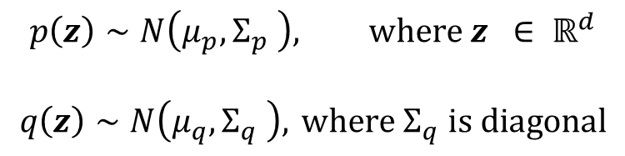
Independent Gaussian approximation to a general Gaussian
$$p\left(z\right)∼N\left(μ_{p},Σ_{p} \right), where z ∈ ℝ^{d}$$
$$q\left(z\right)∼N\left(μ_{q},Σ_{q} \right), { where Σ}_{q} is diagonal$$
Match the mean ☺
Underestimate the variance ☹
$$E^{q}\left(z_{k}\right)=E^{p}{(z}_{k})$$
$$Var^{q}(z_{k})={Var}^{p}(z_{k}|z_{−k})$$
This is due to the direction we define the KL divergence:
Avoid «low probability» regions
Little penalty for not including «high probability» regions
Is this what we want?

Slide 12
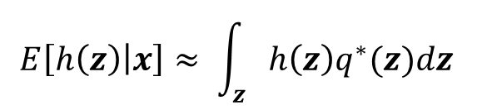
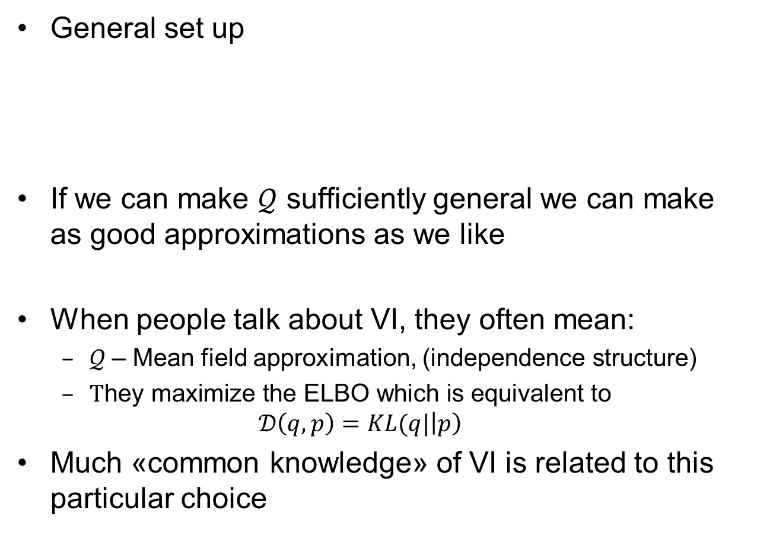
Variational inference
$$E\left[h\left(z\right) | x\right]≈ \int_{z}{h\left(z\right)q^{∗}(z)dz }$$
General set up
If we can make $𝒬$ sufficiently general we can make as good approximations as we like
When people talk about VI, they often mean:
  $𝒬$– Mean field approximation, (independence structure)
  $\text{T}\text{hey} \text{maximize} \text{the} \text{ELBO} \text{which} \text{is} \text{equivalent} \text{to}$
  $$𝒟\left(q,p\right)=KL(q|\left|p\right)$$
Much «common knowledge» of VI is related to this particular choice

Slide 13
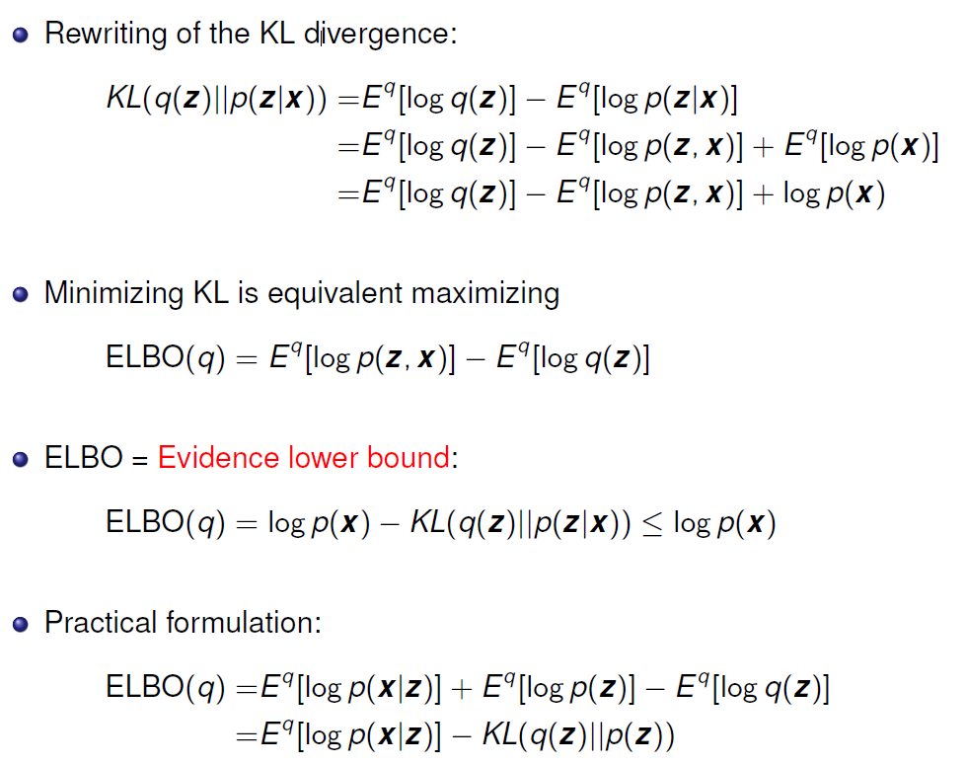
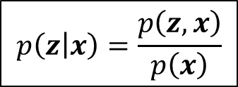


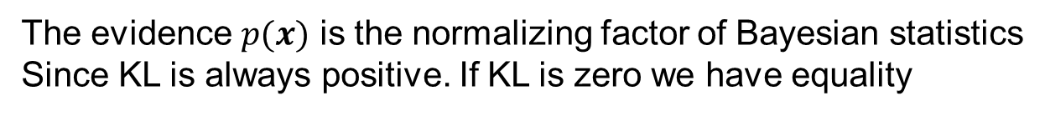
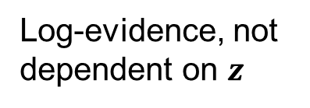
The evidence lower bound (ELBO)
$$p\left(z | x\right)=\frac{p\left(z,x\right)}{p\left(x\right)}$$
Log-evidence, not dependent on $z$
$p(z,x)$ implied
The evidence $p(x)$ is the normalizing factor of Bayesian statistics
Since KL is always positive. If KL is zero we have equality
$$ELBO(q)≤ log{p(x)}$$
(hence the name)

Slide 14

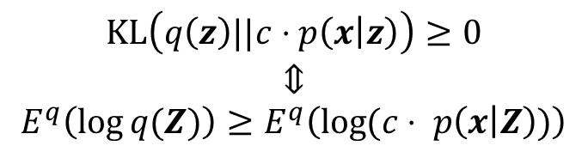
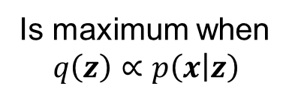
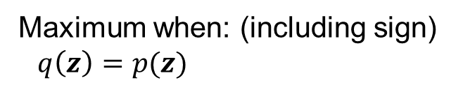
ELBO practical use
$$p\left(z,x\right)=p\left(x | z\right)⋅p\left(z\right)$$
Is maximum when
$$q\left(z\right)∝p\left(x | z\right)$$
Maximum when: (including sign)
$q\left(z\right)=p(z)$
$$KL\left(q\left(z\right)||c⋅p\left(x | z\right)\right)≥0$$
$$⇕$$
$$E^{q}\left(\log{q(Z)}\right)≥E^{q}\left(\log{(c⋅ p\left(x | Z\right)})\right)$$
Trade off between likelihood and prior
Common in Bayesian statistics

Slide 15
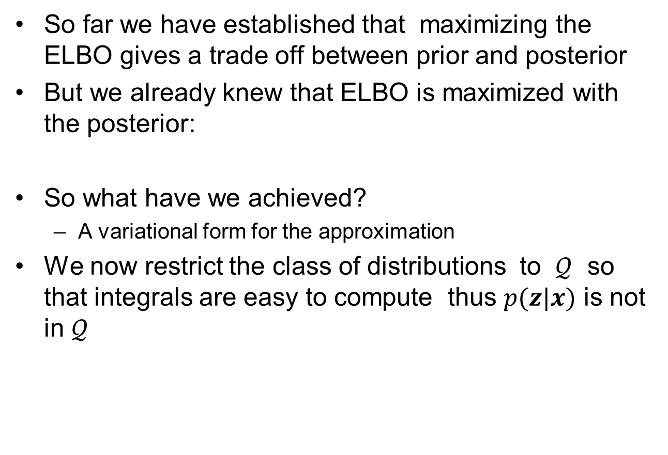
So what ?
So far we have established that maximizing the ELBO gives a trade off between prior and posterior
But we already knew that ELBO is maximized with the posterior:
So what have we achieved?
  A variational form for the approximation
We now restrict the class of distributions to $𝒬$ so that integrals are easy to compute thus $p(z|x)$ is not in $𝒬$

Slide 16
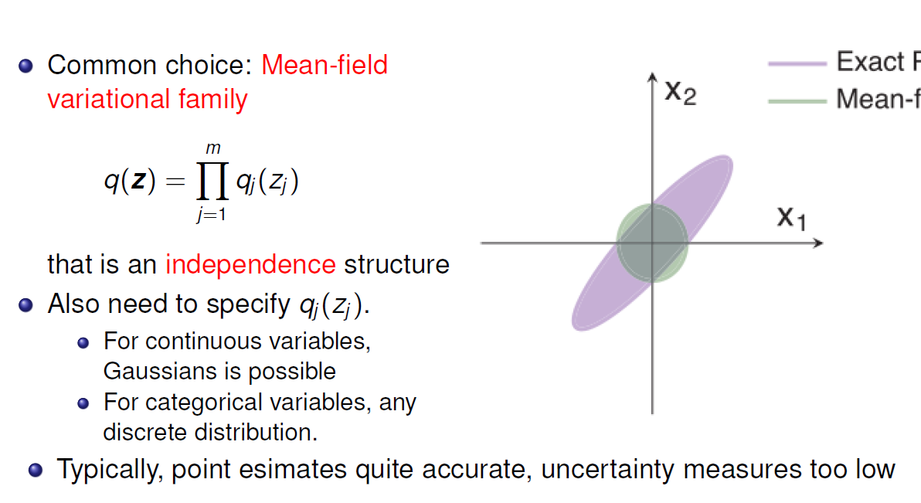
Mean field variational familiy

Slide 17
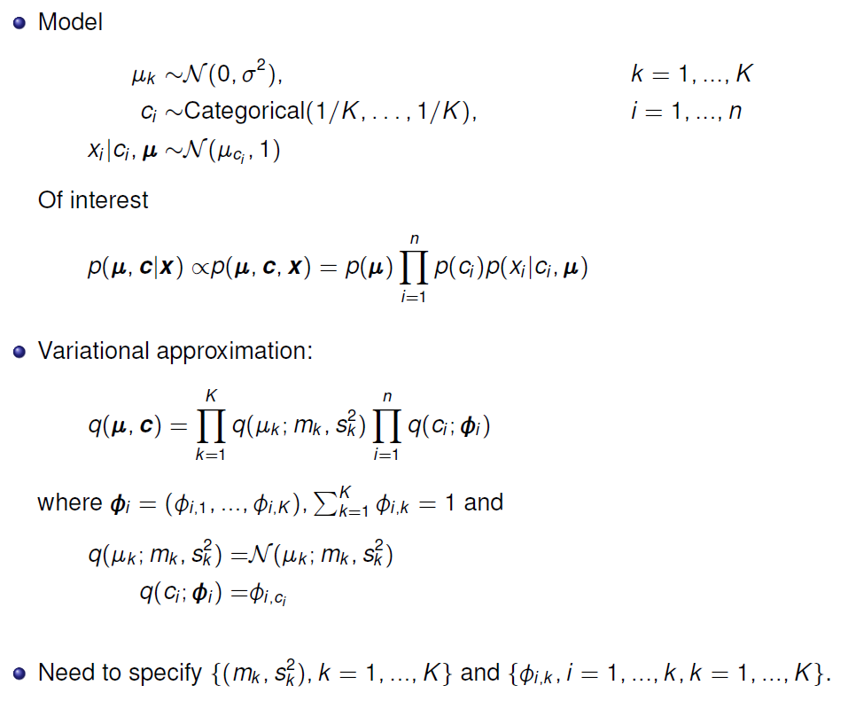
Example mixture Gaussian

Slide 18
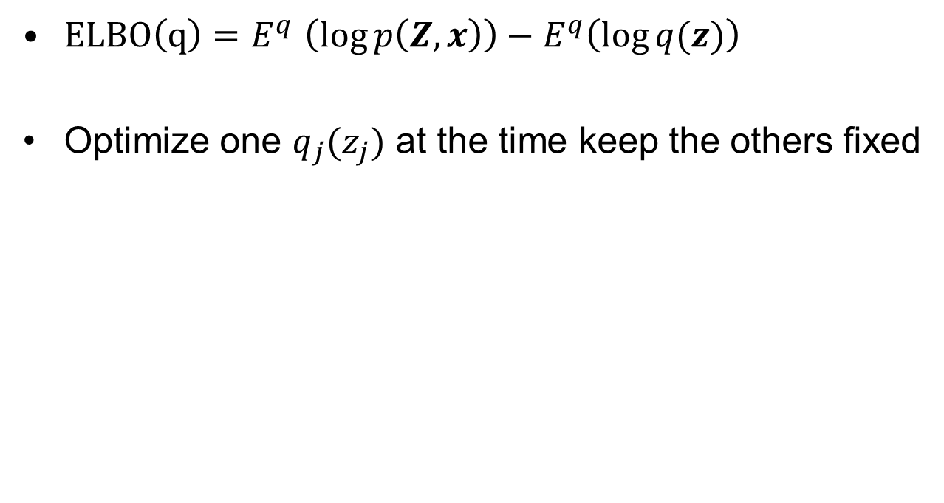


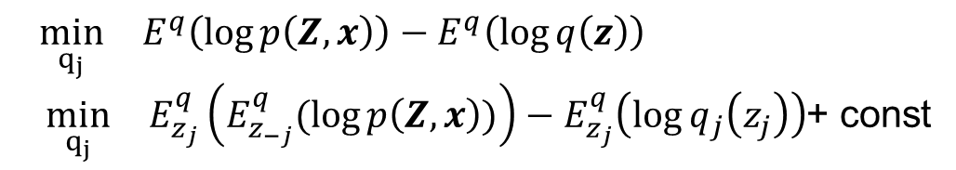
Optimization - CAVI
$ELBO\left(q\right){=E}^{q}\left(\log{p\left(Z,x\right)}\right)−E^{q}\left(\log{q(z)}\right)$
Optimize one $q_{j}(z_{j})$ at the time keep the others fixed
$$\min_{q_{j}}{ }E^{q}\left(\log{p\left(Z,x\right)}\right)−E^{q}\left(\log{q\left(z\right)}\right)$$
$\min_{q_{j}}{ }E_{z_{j}}^{q}\left(E_{z_{−j}}^{q}(\log{p\left(Z,x\right)})\right)−E_{z_{j}}^{q}\left(\log{q_{j}\left(z_{j}\right)}\right)$+ const
$$=log{q_{j}\left(z_{j}\right)+const}$$
$$q_{j}\left(z_{j}\right)∝exp\left\{E_{z_{−j}}^{q}(\log{p\left(Z,x\right)})\right\}$$

Slide 19
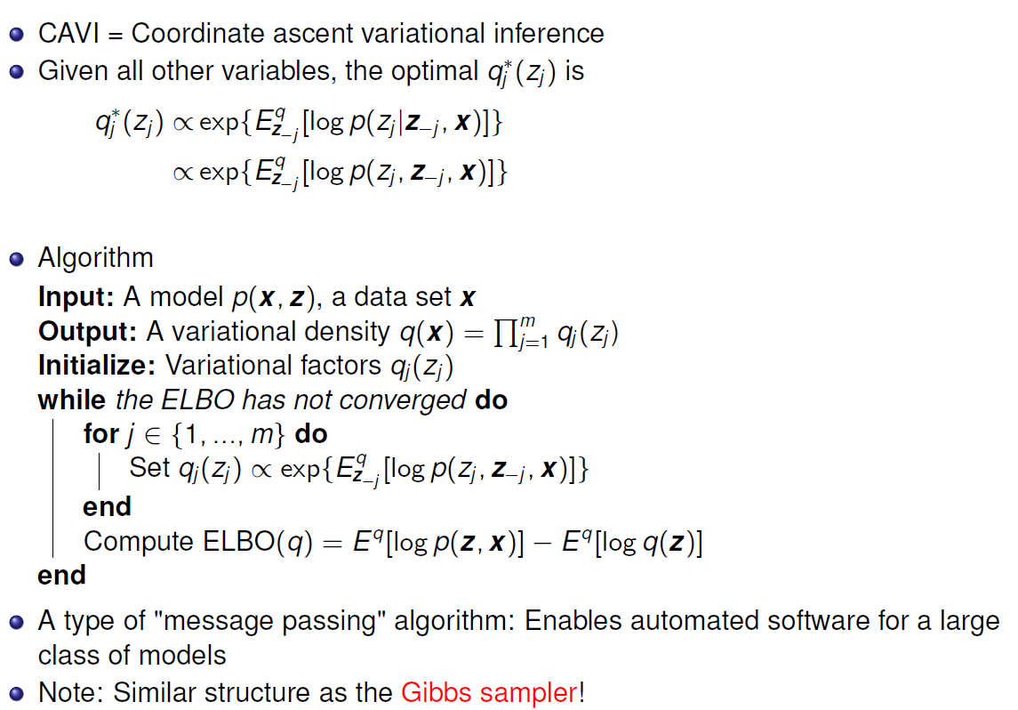
Optimization - CAVI

Slide 20
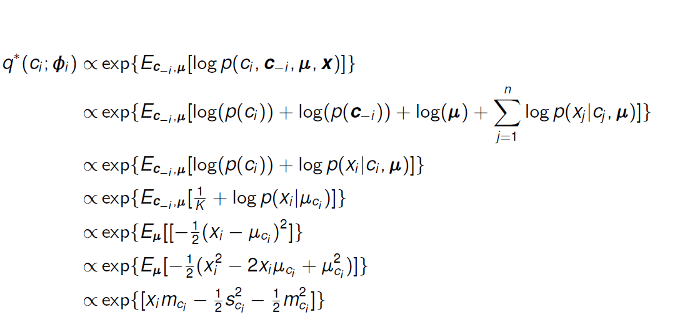


Example - updating for $c_{i}$:
$$\log{p(μ )}+$$

Slide 21
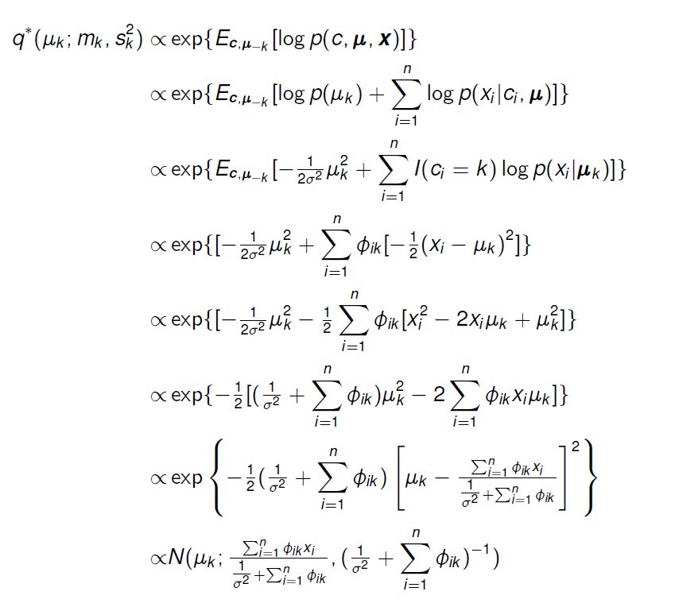

Example, updating for $μ_{k}$
Independence in q

Slide 22
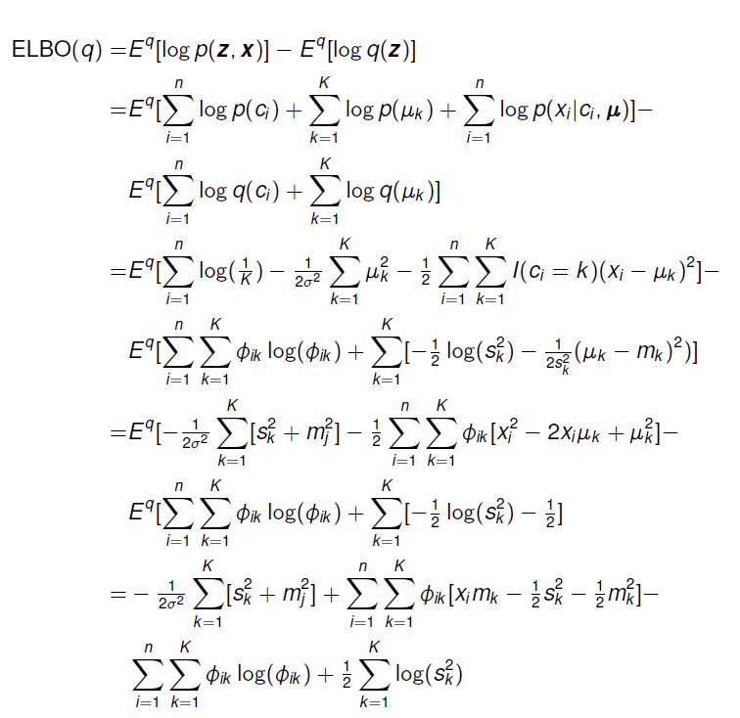
Example - calculating ELBO
+const
+const
+const

Slide 23
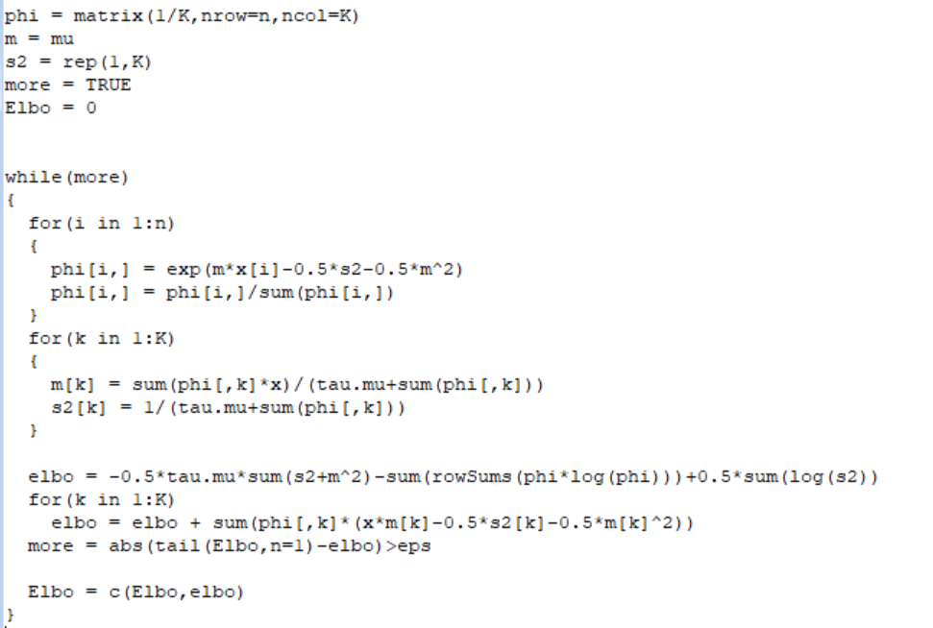
Implementation ELBO- CAVI
VI_mix_dim1.R

Slide 24
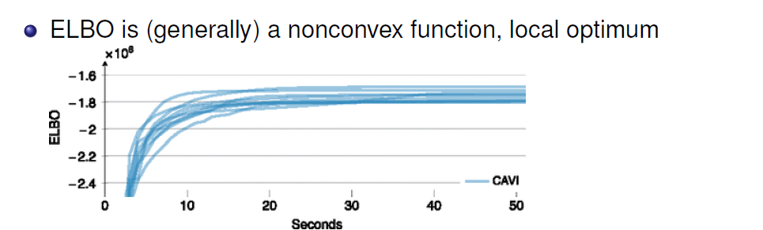
Different initializations may lead
CAVI to find different local optima of the ELBO

Slide 25
Theory Results on the following type:
Treat VI posterior means as point estimates
Bayesian linear models: VI posterior means are consistent
Poisson-mixed model with Gaussian VI
  Consistency and asymptotic normality
Network data with stochastic block models: Asymptotic normality (which might not be the case for ML estimates!)
Gaussian variational approximations: Asymptotic covariance matrix estimator
Mixture of Gaussians: CAVI converges to local optimum, VI estimator is consistent, VI posterior variance too small.

Slide 26
Extensions and open problems
Other distance measures than KL
Alternatives to mean-field
  Add dependencies between variables: structured variational inference
  Mixtures of variational densities
Interface between VI and MCMC
Statistical properties

Slide 27
VI compared to ML/MAP estimation
VI retain Bayesian inference ideas but neglect correlations between parameters
ML/MAP retain the model but neglect the uncertainty in the parameters,
MCMC retain both.
Expectation propagation is an other alternative
(Minka 2001 & Hernández-Lobato et al., 2015)

Slide 28
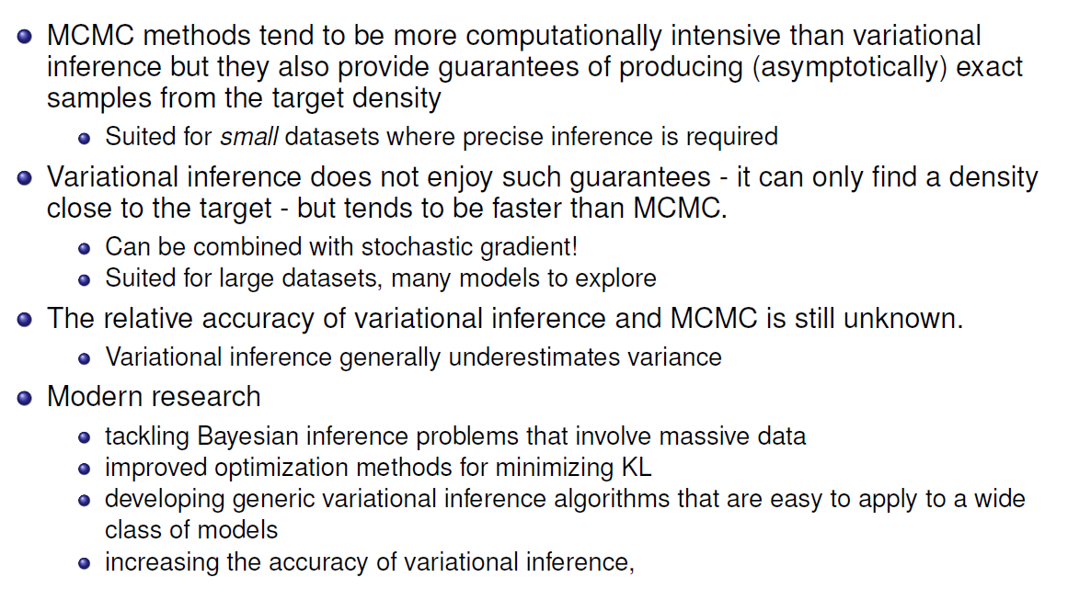
McMC vs variational inference

Slide 29
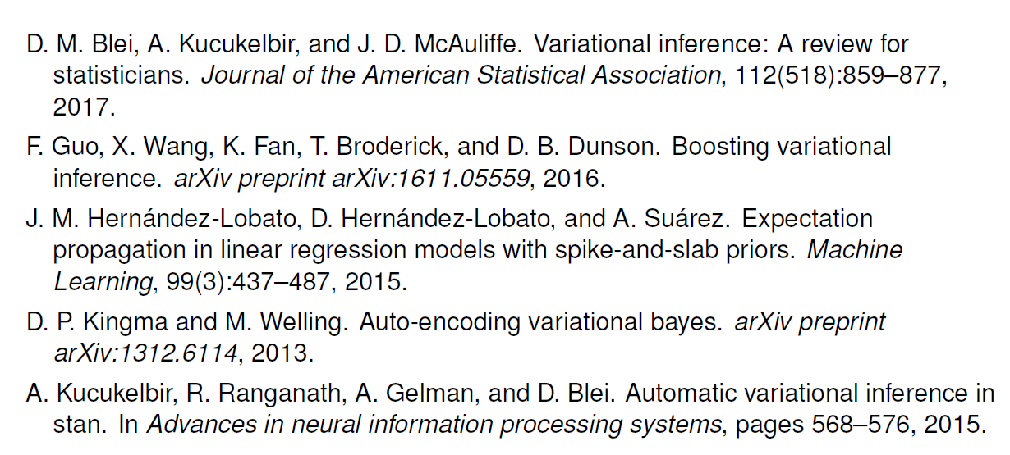
Reference
T.P Minka, “Expectation Propagation for Approximate Bayesian Inference,”
in Uncertainty in Artificial Intelligence, pp. 362–369. [860,873], 2001

