Slide 1
STK-4051/9051 Computational Statistics Spring 2023
Software for Bayesian Inference
Instructor: Odd Kolbjørnsen, oddkol@math.uio.no

Slide 2
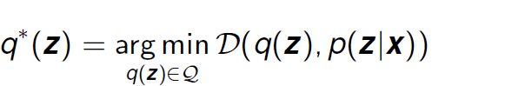
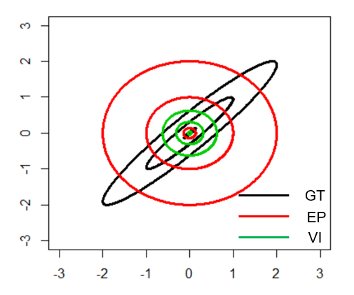
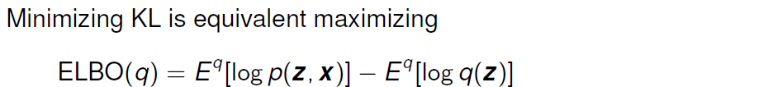
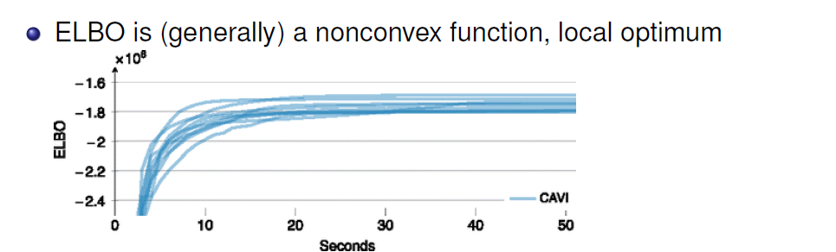
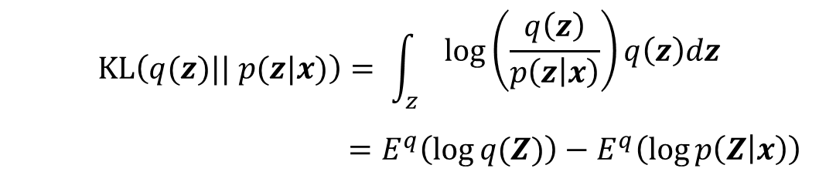
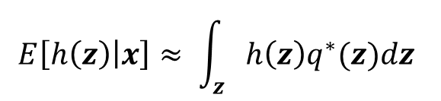
Variational inference
$$E\left[h\left(z\right) | x\right]≈ \int_{z}{h\left(z\right)q^{∗}(z)dz }$$
$$KL\left(q(z)|| p(z|x)\right)= \int_{z}{\begin{aligned}log⁡\left(\frac{q\left(z\right)}{p\left(z | x\right)}\right)q\left(z\right)dz \\ \end{aligned}}$$
$$=E^{q}\left(\log{q(Z)}\right)−E^{q}\left(\log{p\left(Z | x\right)}\right)$$
CAVI: Coordinate ascent variational inference

Slide 3
Software for Bayesian inference
MCMC (https://en.wikipedia.org/wiki/Probabilistic_programming)
  WinBUGS
  OpenBUGS
  JAGS ( Just Another Gibbs Sampler)
  TensorFlow Probability
  R-STAN (Hamiltonian MC)
Approximation
  R-STAN ( Variational Inference )
  TensorFlow Probability ( Variational Inference )
  R-INLA (Integrated Nested Laplace Approximations)
  BUGS = Bayesian inference Using Gibbs Sampler

Slide 4
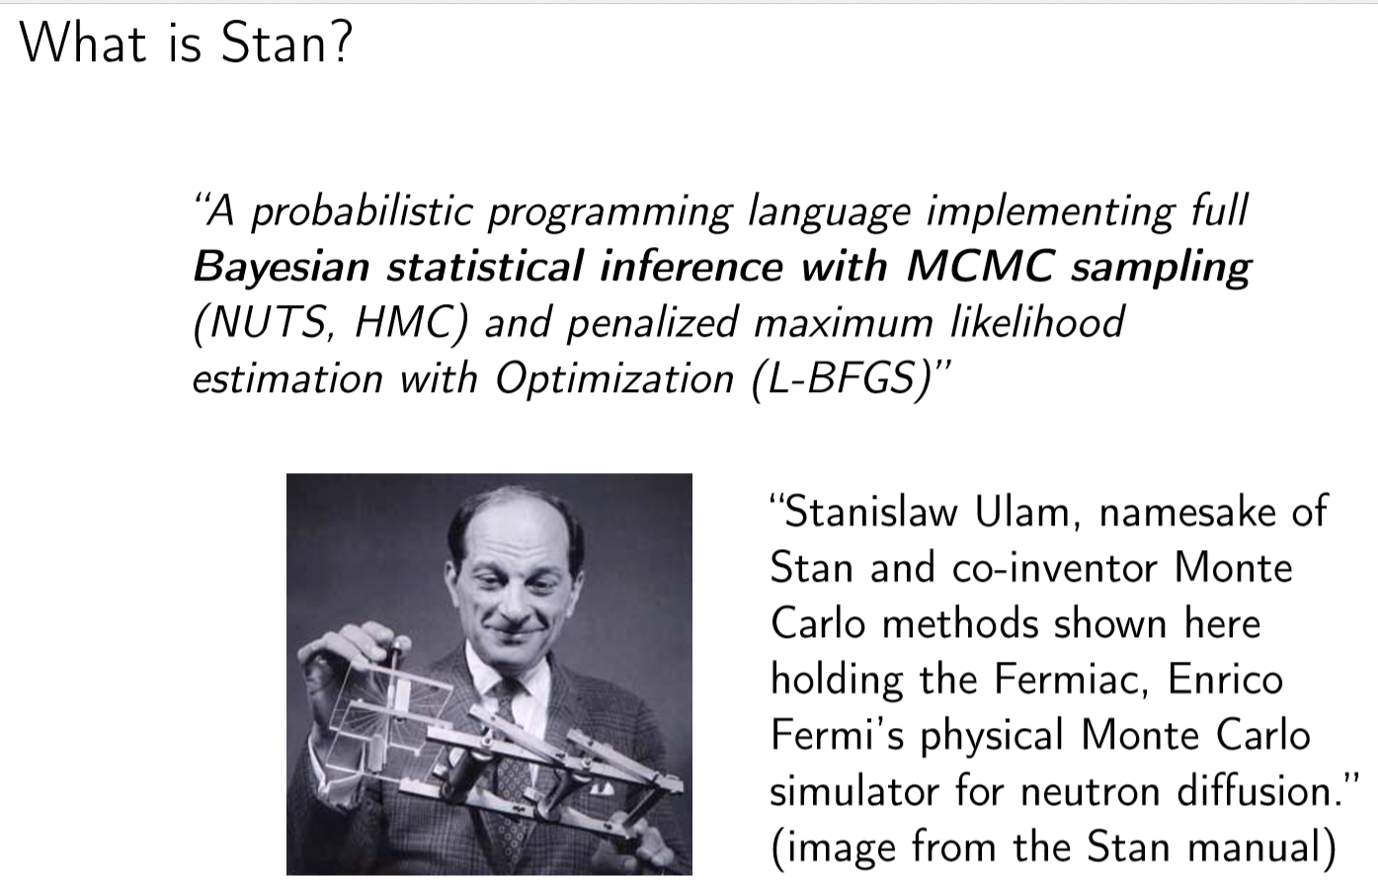

Slide 5
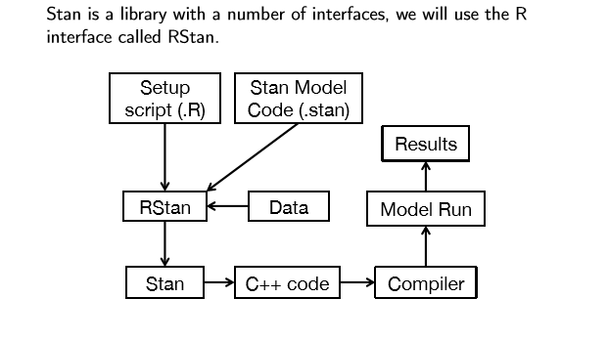
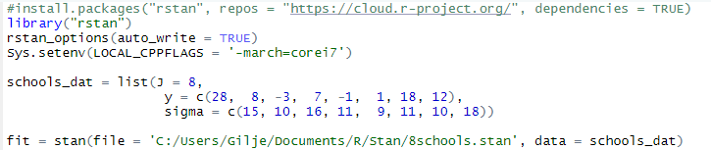
How things are built together

Slide 6
What does a stan call do in R?
The stan function does all of the work of fitting a Stan model and returning the results as an instance of stanfit.
The steps are roughly as follows:
  Translate the Stan model to C++ code. (stanc)
  Compile the C++ code into a binary shared object, which is loaded into the current R session (an object of S4 class stanmodel is created). (stan_model)
  Draw samples and wrap them in an object of S4 class stanfit. (sampling)
The returned object can be used with methods such as print, summary, and plot to inspect and retrieve the results of the fitted model.
stan can also be used to sample again from a fitted model under different settings (e.g., different iter, data, etc.) by using the fit argument to specify an existing stanfit object. In this case, the compiled C++ code for the model is reused.
Stan keeps track of what he has already compiled, if you change file you get:
(not an error)

Slide 7
What does a stan call do in R?
The stan function does all of the work of fitting a Stan model and returning the results as an instance of stanfit.
The steps are roughly as follows:
  Translate the Stan model to C++ code. (stanc)
  Compile the C++ code into a binary shared object, which is loaded into the current R session (an object of S4 class stanmodel is created). (stan_model)
  Draw samples and wrap them in an object of S4 class stanfit. (sampling)
The returned object can be used with methods such as print, summary, and plot to inspect and retrieve the results of the fitted model.
stan can also be used to sample again from a fitted model under different settings (e.g., different iter, data, etc.) by using the fit argument to specify an existing stanfit object. In this case, the compiled C++ code for the model is reused.
Stan keeps track of what he has already compiled, if you change file you get:
(not an error)

Slide 8
Meta analysis of treatment effect in 8 schools
Effect of coaching program for SAT-V
(Scholastic Aptitude Test - Verbal)
Data analyzed at each school separately to derive:
  Estimated treatment effect (Treatment=Special preparation)
  Standard error of the treatment effect
Analysis of data at each school adjust for PSAT (initial level of students)
By pooling data across experiments we can improve all estimates
Is the pooling justified or is there an effect of “better” teaching at schools that does the best job
  If so we should look to the best school to investigate what they
  did differently (~right)

Slide 9
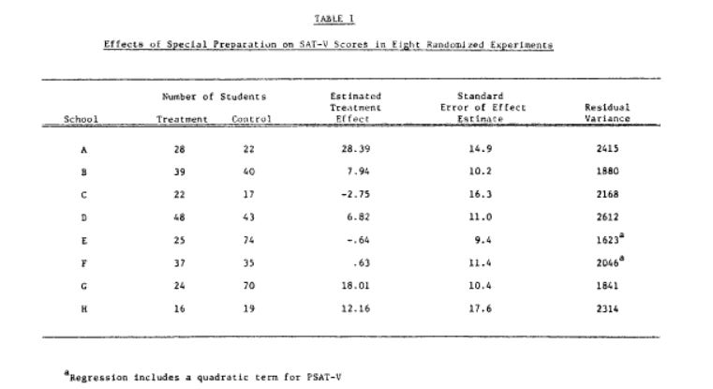

Data from Rubin (1981)
Code on webpage: 8schools.r,
8schools.stan, 8schoolsDirect.stan

Slide 10
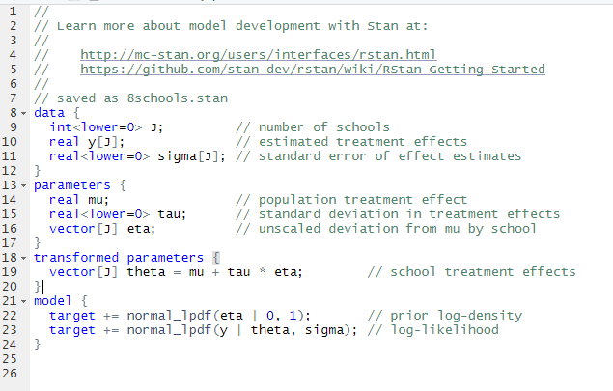
Running Stan in RStudio
rstan install
add to current session
Data (Rubin 1981)
Run
files
Stan program for the model
RStudio version 1.2.x or later
Has good support for R-STAN
File -> New File -> Stan File
Be sure that your Stan programs ends in a blank line without any characters including spaces and comments.

Slide 11
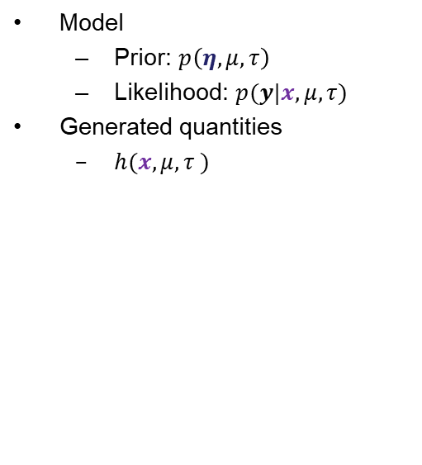
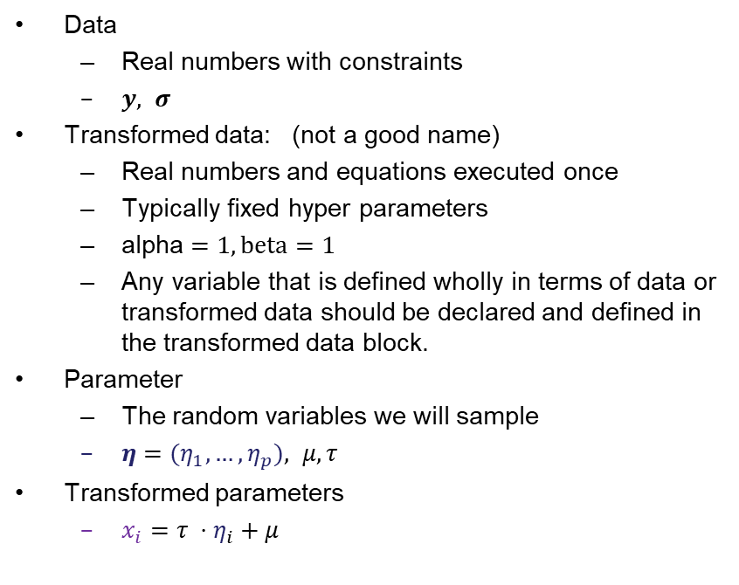
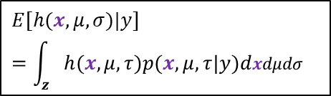
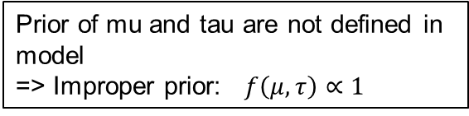
Content of .stan file
Data
  Real numbers with constraints
  $y, σ$
Transformed data: (not a good name)
  Real numbers and equations executed once
  Typically fixed hyper parameters
  alpha $=1, beta=1$
  Any variable that is defined wholly in terms of data or transformed data should be declared and defined in the transformed data block.
Parameter
  The random variables we will sample
  $η={(η}_{1},…,η_{p}), μ,τ$
Transformed parameters
  $x_{i}={τ ⋅η}_{i}+μ$
Model
  Prior: $p\left(η,μ,τ\right)$
  Likelihood: $p(y|x,μ,τ)$
Generated quantities
  $h(x,μ,τ )$
$$E[h(x,μ,σ)|y] =\int_{z}{h(x,μ,τ)p(x,μ,τ|y)dxdμdσ}$$
Prior of mu and tau are not defined in model
=> Improper prior: $f\left(μ, τ\right)∝1$

Slide 12
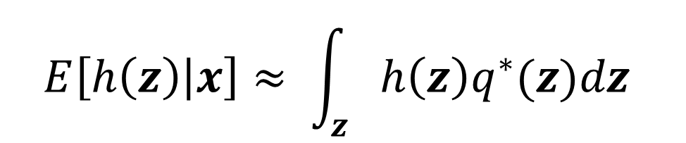
Variational Bayes in STAN
The same STAN program can be used to make inference by variational Bayes
vb() replace stan()
$$E\left[h\left(z\right) | x\right]≈ \int_{z}{h\left(z\right)q^{∗}(z)dz }$$

Slide 13
Variational Bayes in STAN
vb(object,
data = list(),
pars = NA,
include = TRUE,
init = 'random',
check_data = TRUE,
sample_file = tempfile(fileext = '.csv'),
algorithm = c("meanfield", "fullrank"),
importance_resampling = FALSE,
keep_every = 1,
...)
Making a stanmodel
stan_model(file,
model_name = "anon_model",
model_code = "",
…)
object An object of class stanmodel.
data A named list or environment providing
the data for the model
check_data If TRUE the data will be preprocessed
algorithm
  "meanfield" uses a fully factorized
  Gaussian for the approximation
  "fullrank", uses a Gaussian with a full-rank covariance matrix for the approximation.
importance_resampling: If TRUE we do importance resampling to adjust the draws at the optimum to be more like draws from the posterior distribution
StanModel
file: The path to the Stan program. Use a .stan extension on file
model_code: A character string either containing the model definition
model_name: A string to use as the name of the model; (affects the name used in printed messages)

Slide 14
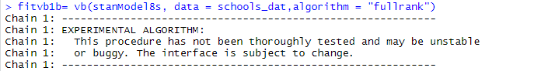
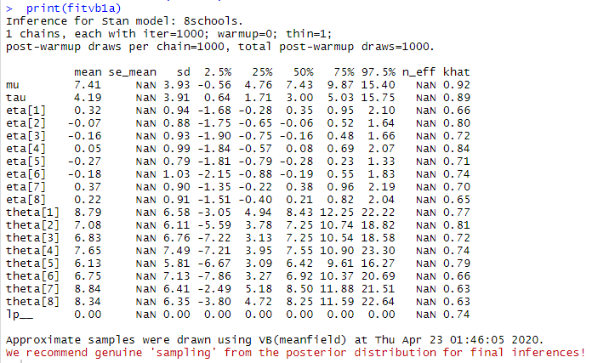
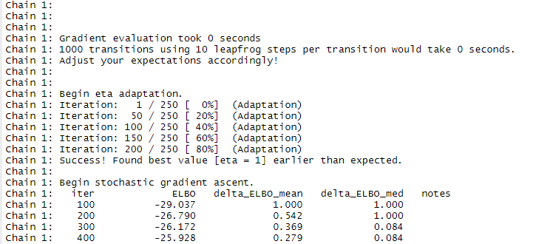
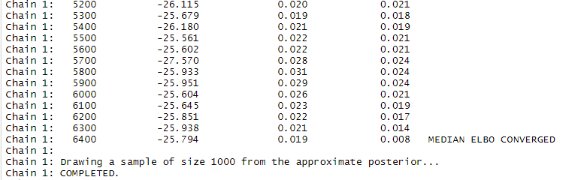
Running Variational Bayes
…
Results are not trusted by developer 😐 (they are statisticians)

Slide 15
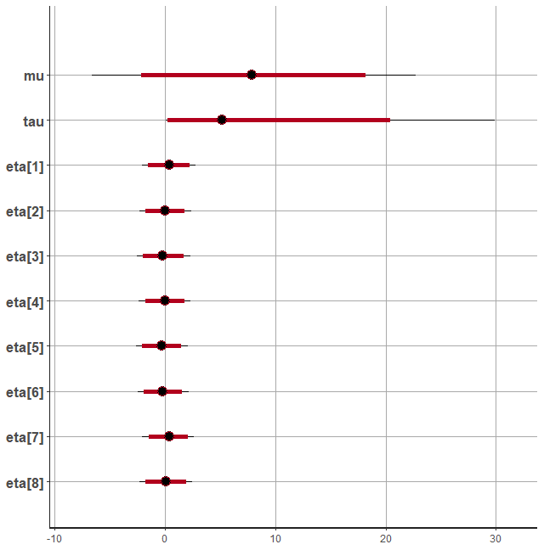
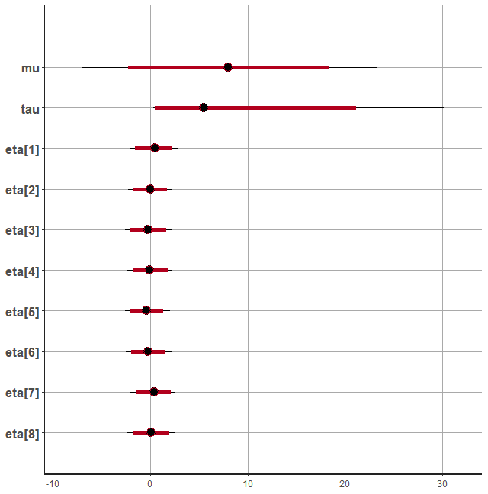
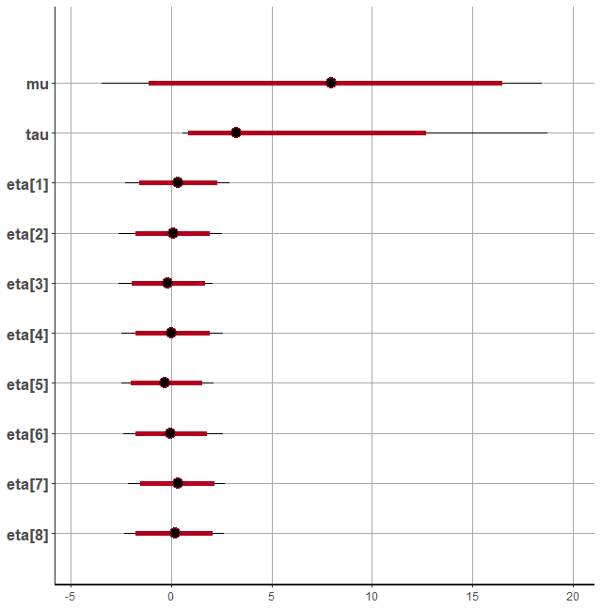
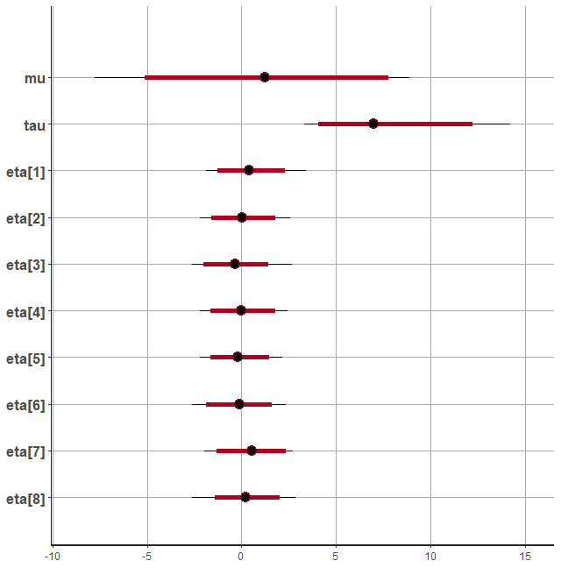
Full rank VB - compared to MCMC
Transformed
Direct
MCMC / VB full rank
MCMC / VB full rank

Slide 16
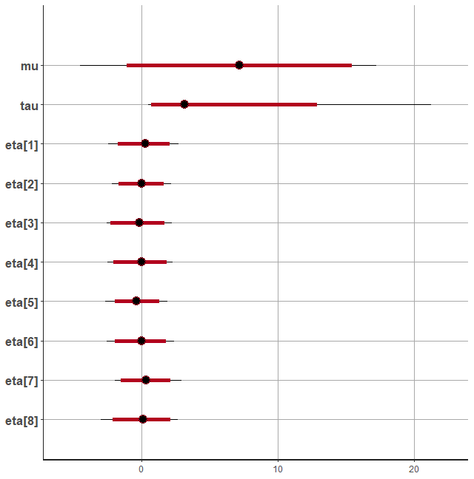
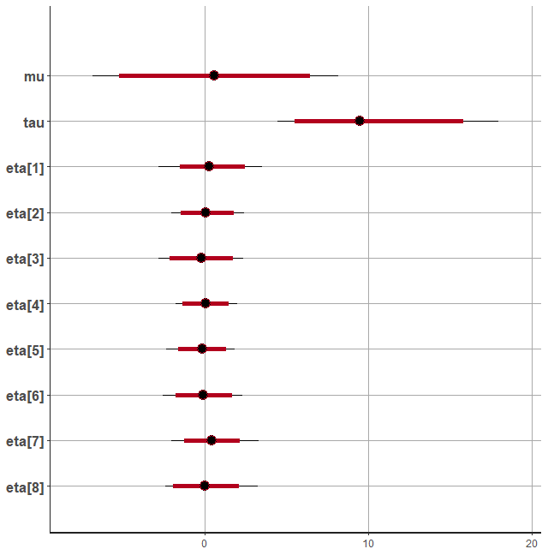
Mean field VB - compared to MCMC
Transformed
Direct
MCMC / VB mean field
MCMC / VB mean field

Slide 17
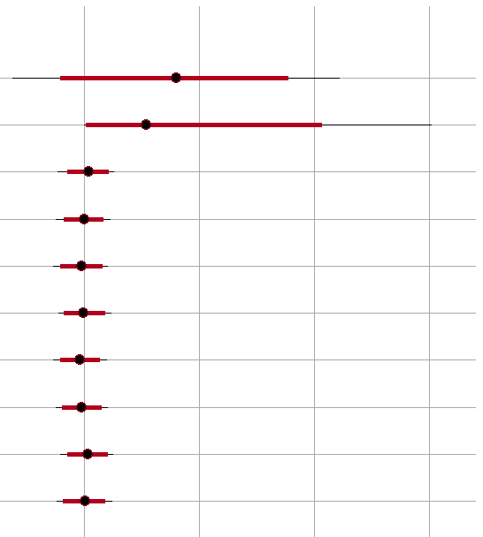
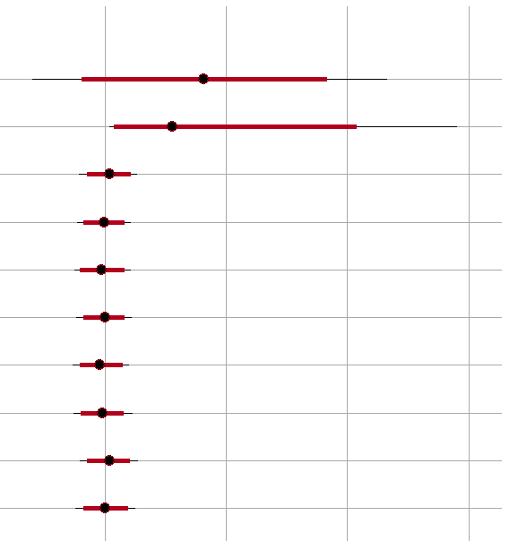
«Short» MCMC compared to MCMC
Transformed
Direct
MCMC long / MCMC short
MCMC long / MCMC short

Slide 18
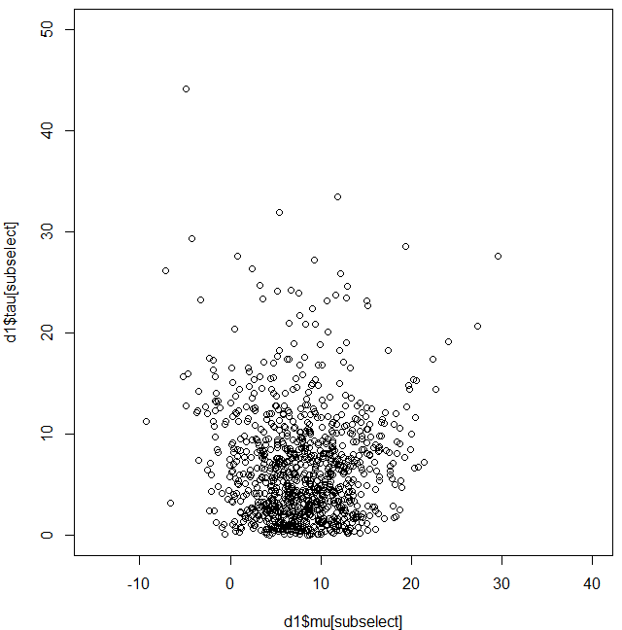
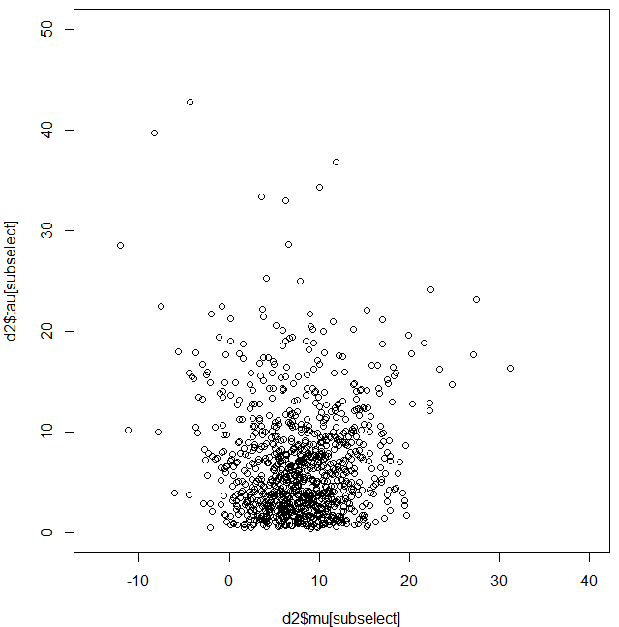
Joint distribution MCMC
Transformed
Direct

Slide 19
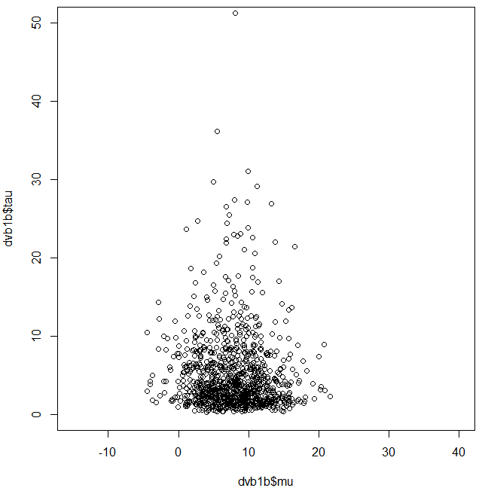
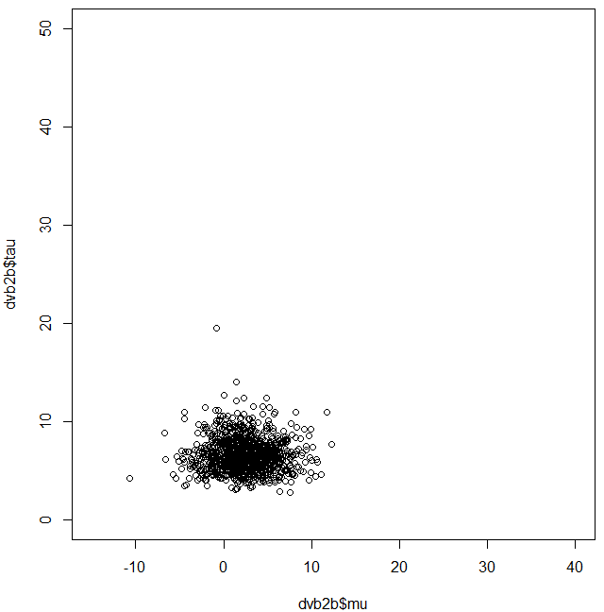
Joint distribution VB full rank
Transformed
Direct

Slide 20
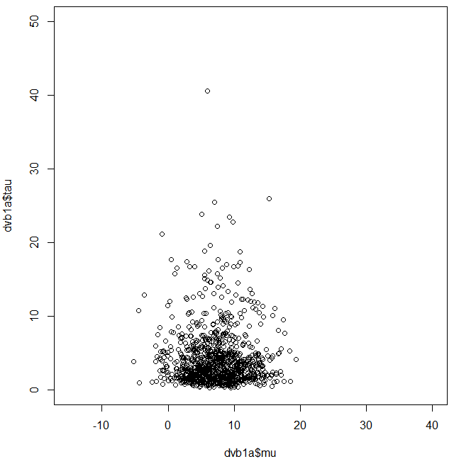
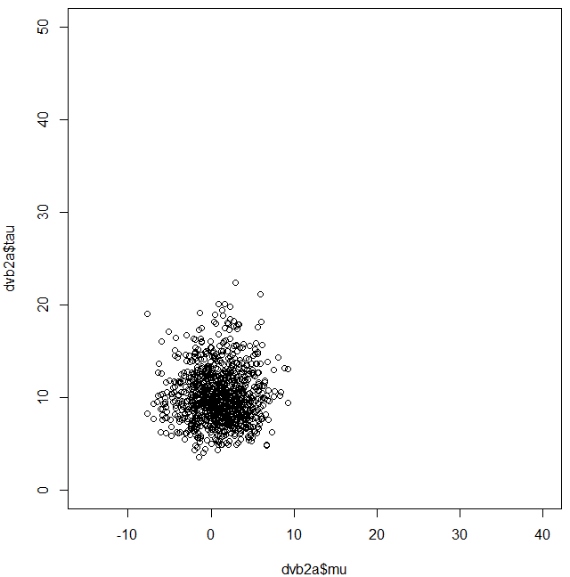
Joint distribution VB mean filed
Transformed
Direct

Slide 21
STAN summary (including HMC result from Lecture 12)
Possible to do inference with
  MCMC
  VB
Quite robust/adaptive MCMC sampler
Still work to be done for VB
  Methodologically weaknesses
  Implementational weaknesses
Test show
  VB underestimate uncertainty
  VB sensitive to parameterization
  VB can be “far off”
  NUTS is also sensitive to parameterization, but can compensate by longer chain
Same STAN program

Slide 22
References
Slides: Introduction to Stan by Cameron Bracken at University of Colorado Boulder February 2015
https://github.com/stan-dev/rstan/wiki/RStan-Getting-Started
https://mc-stan.org/docs/2_26/reference-manual
https://mc-stan.org/docs/2_26/functions-reference
https://mc-stan.org/rstan/reference/
https://faculty.ucr.edu/~jflegal/203/STAN_tutorial.pdf
https://mc-stan.org/users/documentation/case-studies/divergences_and_bias.html
Betancourt, Michael 2016a. “Diagnosing Suboptimal Cotangent Disintegrations in Hamiltonian Monte Carlo. ” arXiv 1604.00695. https://arxiv.org/abs/1604.00695.
Rubin DB (1981). “Estimation in Parallel Randomized Experiments.” Journal of Educational Statistics, 6, 377–400

