Slide 1
STK-4051/9051 Computational Statistics Spring 2023
Software for Bayesian Inference - STAN
Instructor: Odd Kolbjørnsen, oddkol@math.uio.no

Slide 2
Software
There is always an existing software that ”does your job”
Even if the software does not do exactly what you want maybe it is good enough (cost - benefit)
The challenge is to figure out how this works
(and how you can make it do what you want)
Reasons not to make your own computer code:
  existing code is tested (less bugs)
  existing code is optimized (speed)
  often related to publications easier to get others to ”accept it”
Reasons to make your own computer code:
  understand the methodology better
  improve/develop existing methodology
  combining with other techniques
  compete with existing computer code
  because you have too much spare time

Slide 3
Software for Bayesian inference
MCMC
  WinBUGS
  OpenBUGS
  JAGS ( Just Another Gibbs Sampler)
  TensorFlow Probability
  R-STAN (Hamiltonian MC)
Approximation
  R-STAN ( Variational Inference )
  TensorFlow Probability ( Variational Inference )
  R-INLA (Integrated Nested Laplace Approximations)
  BUGS = Bayesian inference Using Gibbs Sampler
https://en.wikipedia.org/wiki/Markov_chain_Monte_Carlo#Software
https://en.wikipedia.org/wiki/Probabilistic_programming

Slide 4
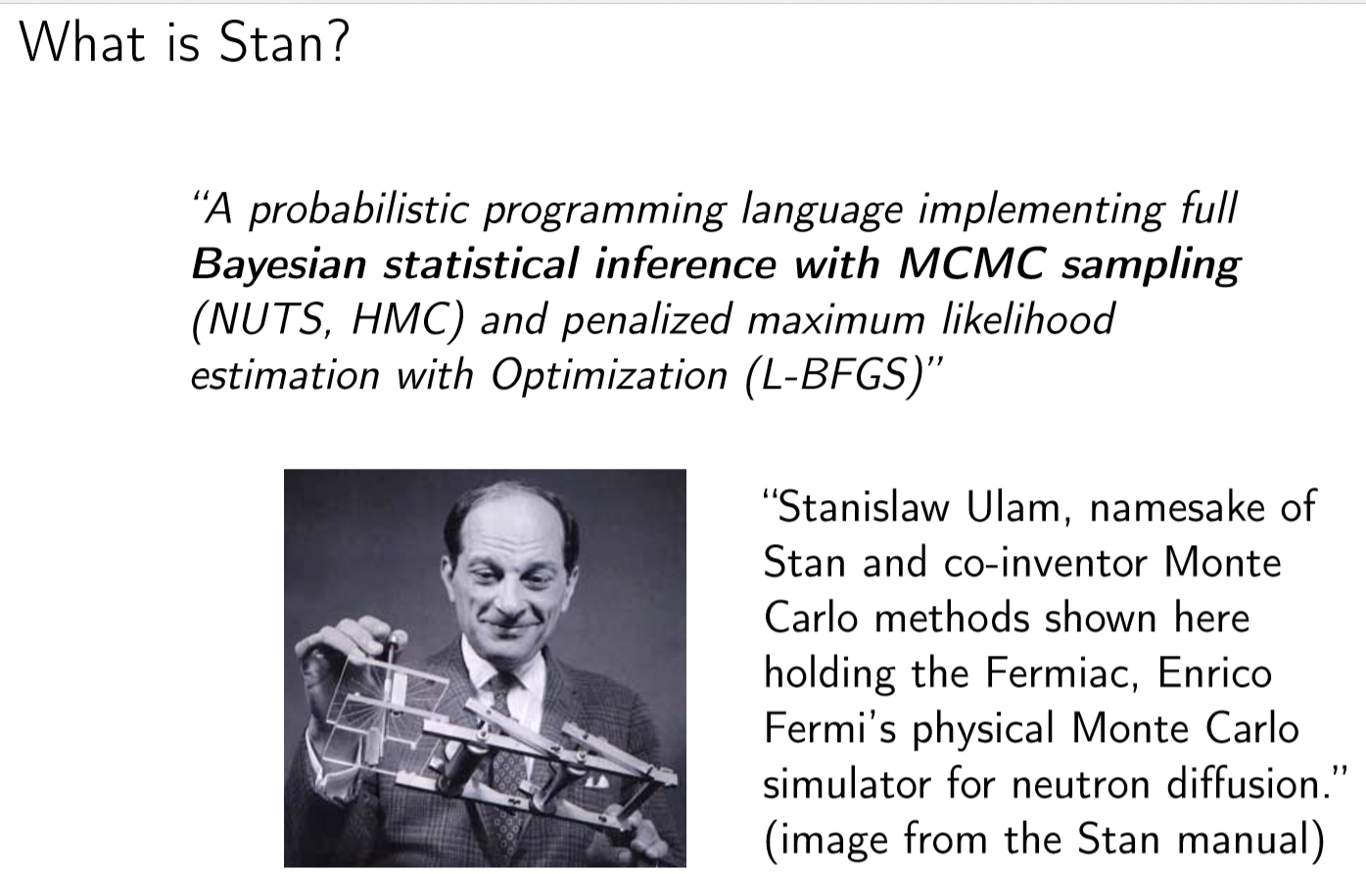

Slide 5
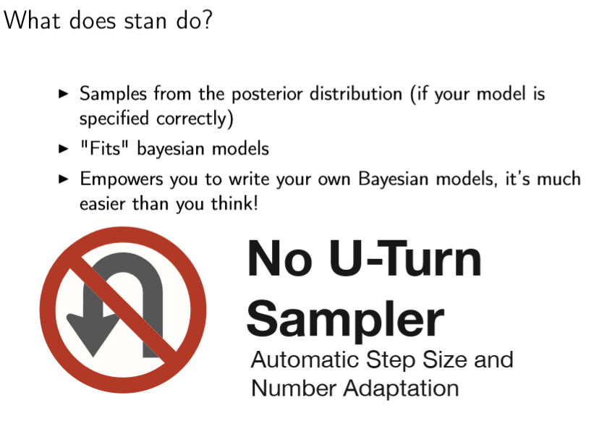
“Adaptive Hamiltonian MC”

Slide 6
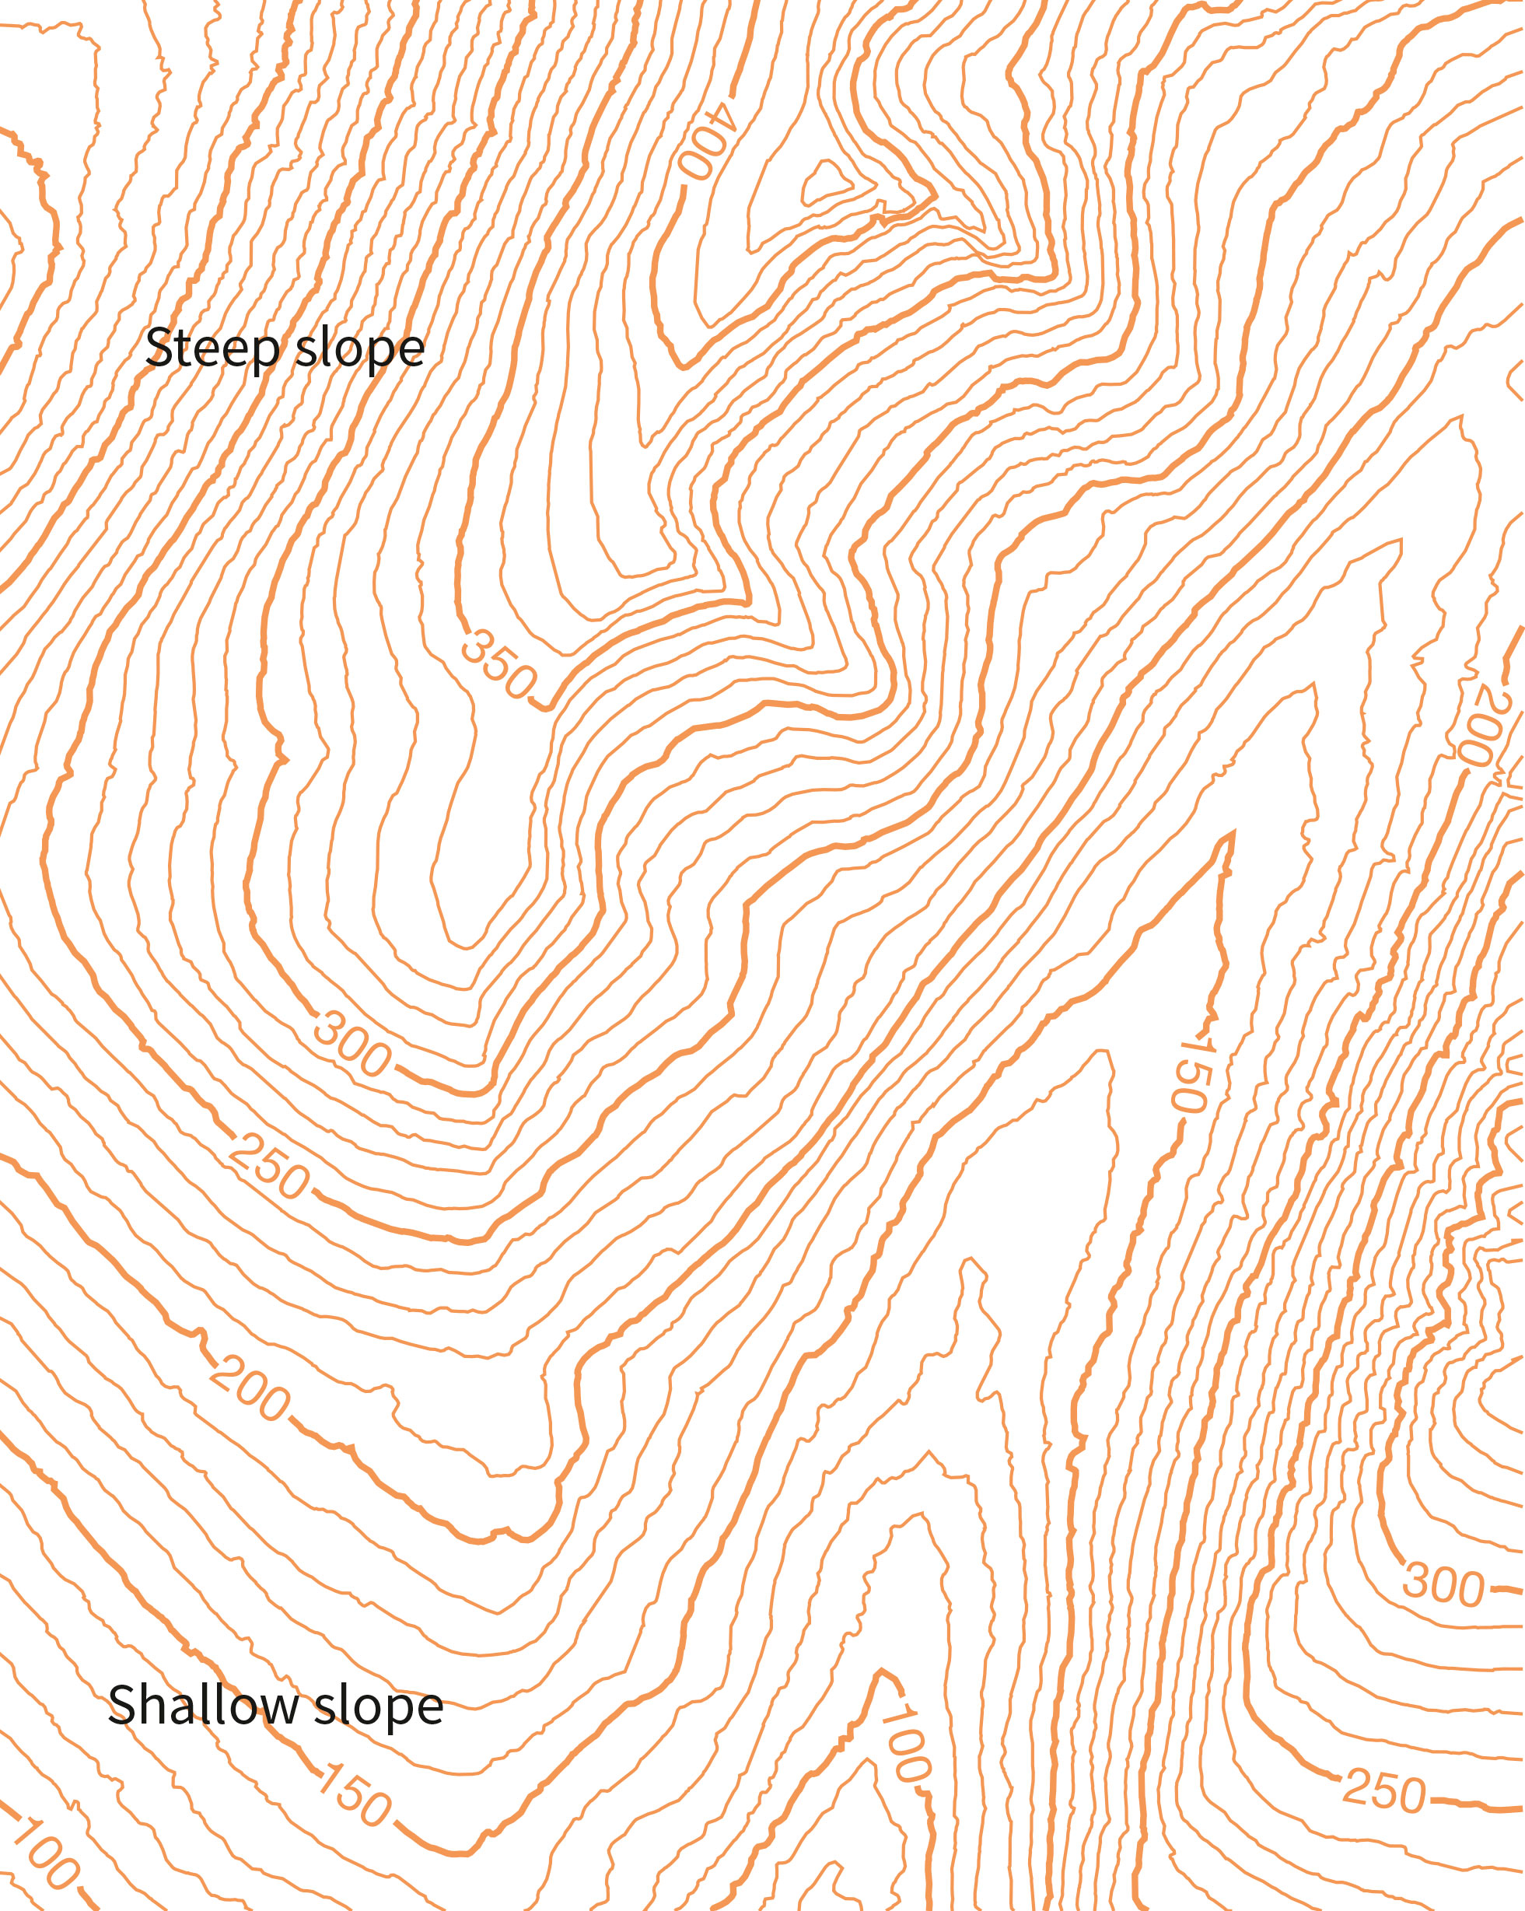
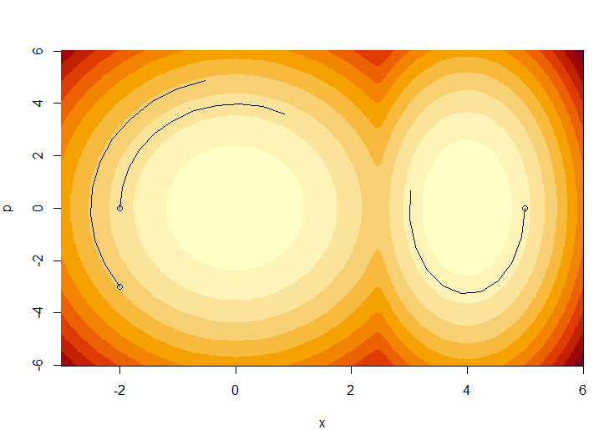
NUTS = No U-Turn Sampler

Slide 7
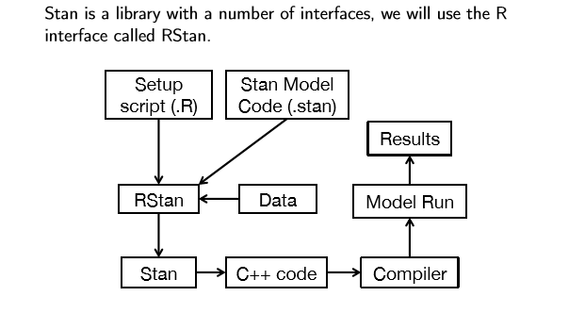
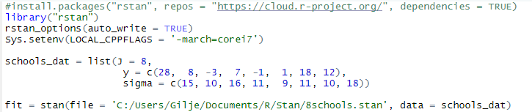
How things are built together

Slide 8
What does a stan call do in R?
The stan function does all of the work of fitting a Stan model and returning the results as an instance of stanfit.
The steps are roughly as follows:
  Translate the Stan model to C++ code. (stanc)
  Compile the C++ code into a binary shared object, which is loaded into the current R session (an object of S4 class stanmodel is created). (stan_model)
  Draw samples and wrap them in an object of S4 class stanfit. (sampling)
The returned object can be used with methods such as print, summary, and plot to inspect and retrieve the results of the fitted model.
stan can also be used to sample again from a fitted model under different settings (e.g., different iter, data, etc.) by using the fit argument to specify an existing stanfit object. In this case, the compiled C++ code for the model is reused.
Stan keeps track of what he has already compiled, if you change file you get:
(not an error)

Slide 9
What does a stan call do in R?
The stan function does all of the work of fitting a Stan model and returning the results as an instance of stanfit.
The steps are roughly as follows:
  Translate the Stan model to C++ code. (stanc)
  Compile the C++ code into a binary shared object, which is loaded into the current R session (an object of S4 class stanmodel is created). (stan_model)
  Draw samples and wrap them in an object of S4 class stanfit. (sampling)
The returned object can be used with methods such as print, summary, and plot to inspect and retrieve the results of the fitted model.
stan can also be used to sample again from a fitted model under different settings (e.g., different iter, data, etc.) by using the fit argument to specify an existing stanfit object. In this case, the compiled C++ code for the model is reused.
Stan keeps track of what he has already compiled, if you change file you get:
(not an error)

Slide 10
Meta analysis of treatment effect in 8 schools
Effect of coaching program for SAT-V
(Scholastic Aptitude Test - Verbal)
Data analyzed at each school separately to derive:
  Estimated treatment effect (Treatment=Special preparation)
  Standard error of the treatment effect
Analysis of data at each school adjust for PSAT (initial level of students)
By pooling data across experiments we can improve all estimates
Is the pooling justified or is there an effect of “better” teaching at schools that does the best job
  If so we should look to the best school to investigate what they
  did differently (~right)

Slide 11
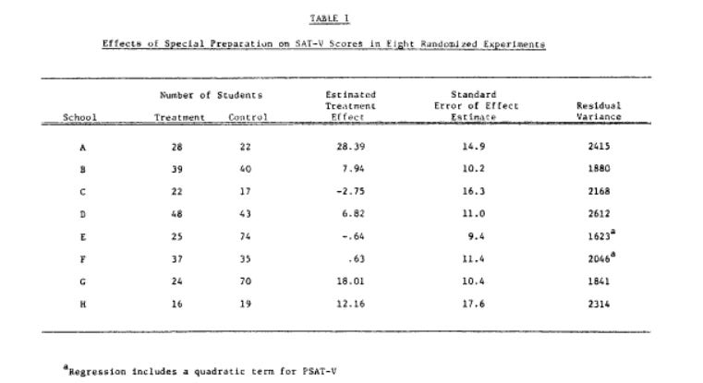

Data from Rubin (1981)
Code on webpage: 8schools.r,
8schools.stan, 8schoolsDirect.stan

Slide 12
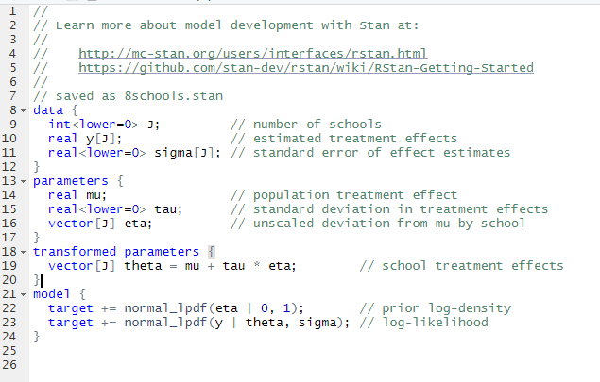
Running Stan in RStudio
rstan install
add to current session
Data (Rubin 1981)
Run
files
Stan program for the model
RStudio version 1.2.x or later
Has good support for R-STAN
File -> New File -> Stan File
Be sure that your Stan programs ends in a blank line without any characters including spaces and comments.

Slide 13
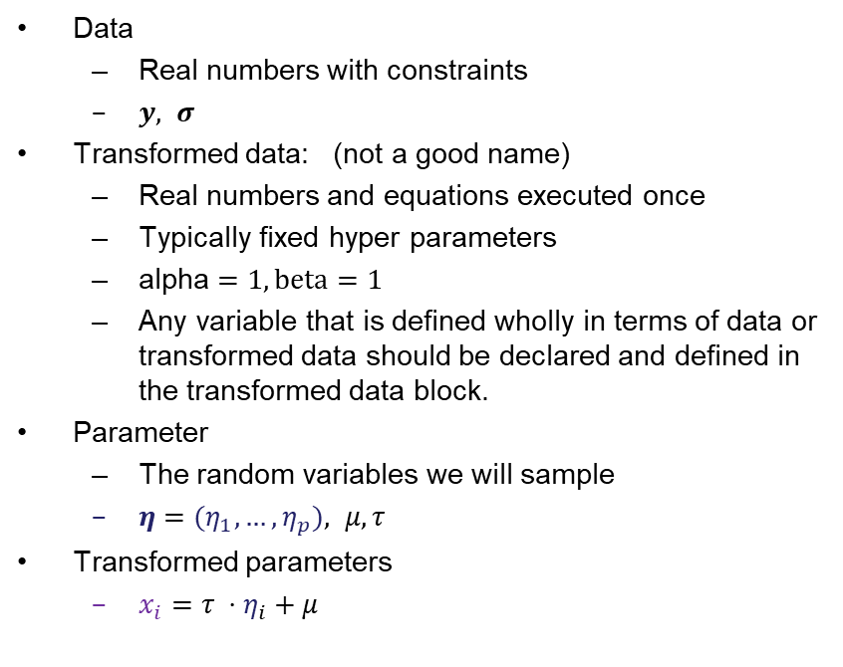
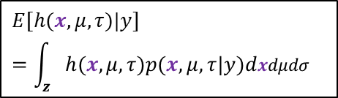
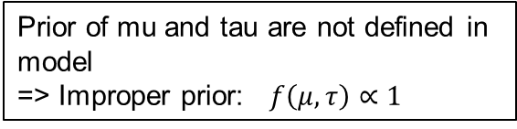
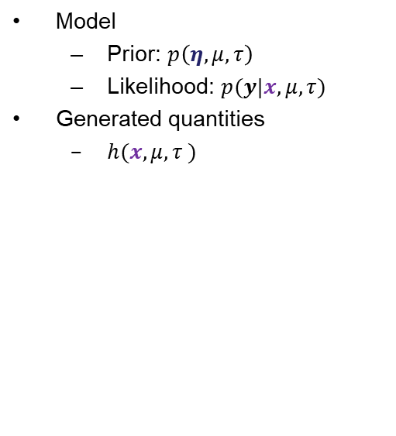
Content of .stan file
Data
  Real numbers with constraints
  $y, σ$
Transformed data: (not a good name)
  Real numbers and equations executed once
  Typically fixed hyper parameters
  alpha $=1, beta=1$
  Any variable that is defined wholly in terms of data or transformed data should be declared and defined in the transformed data block.
Parameter
  The random variables we will sample
  $η={(η}_{1},…,η_{p}), μ,τ$
Transformed parameters
  $x_{i}={τ ⋅η}_{i}+μ$
Model
  Prior: $p\left(η,μ,τ\right)$
  Likelihood: $p(y|x,μ,τ)$
Generated quantities
  $h(x,μ,τ )$
$$E[h(x,μ,τ)|y] =\int_{z}{h(x,μ,τ)p(x,μ,τ|y)dxdμdσ}$$
Prior of mu and tau are not defined in model
=> Improper prior: $f\left(μ, τ\right)∝1$

Slide 14
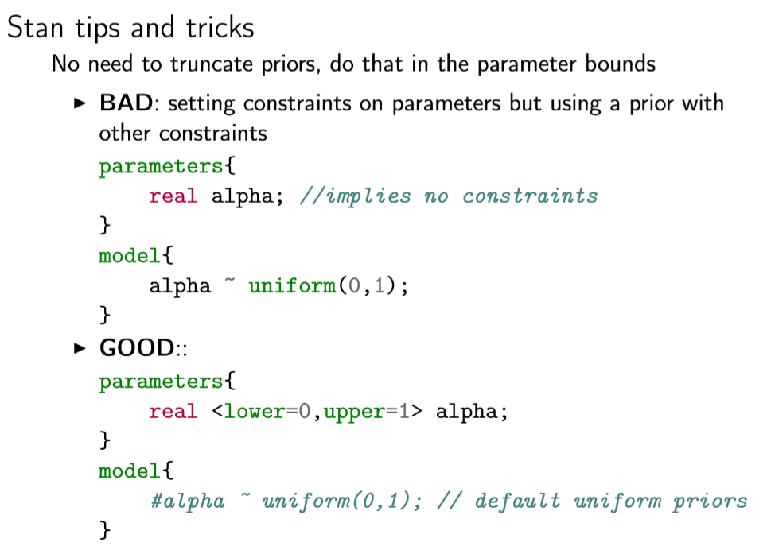

Slide 15
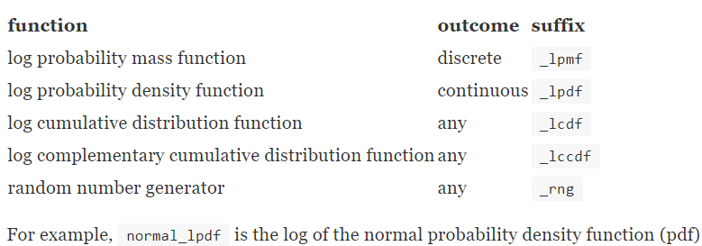
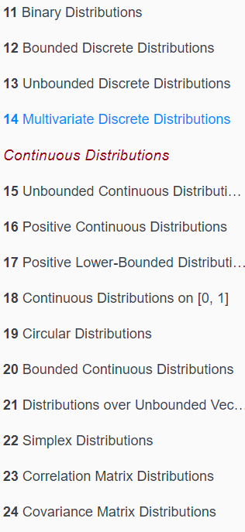
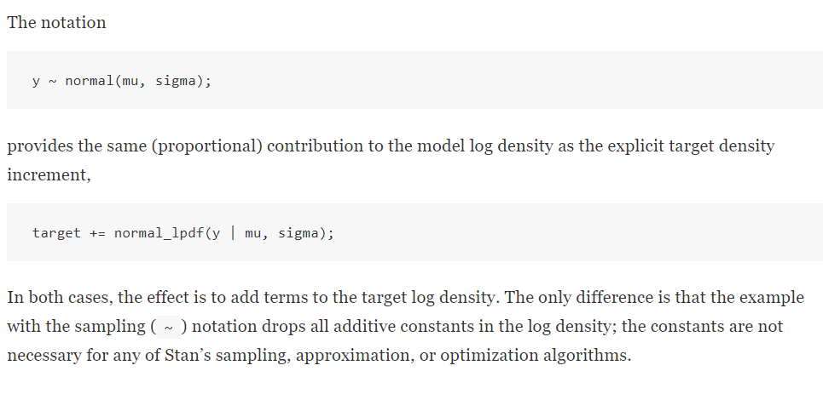
Model
https://mc-stan.org/docs/2_26/functions-reference/

Slide 16
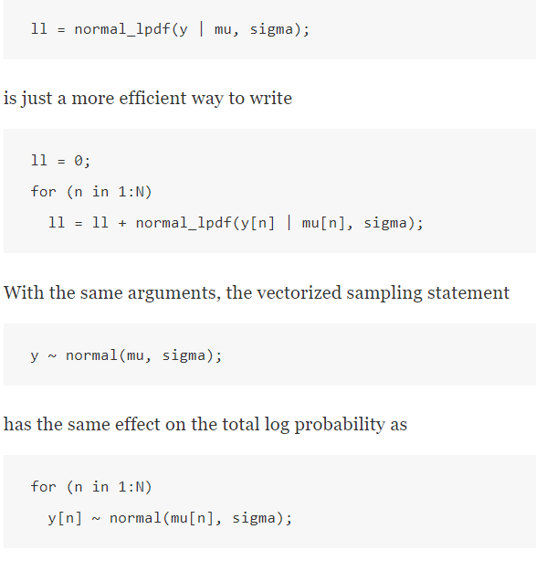




Vectorization of model conditional independence assumed
☺
Conditional independence
$$p\left(y_{n} | y_{−n},μ,σ\right)=p\left(y_{n} | μ_{n},σ\right)$$
$$σ$$
😐
$$y_{n}$$
$$μ_{n}$$
☺
Dependency structure:
  Built in:
    Multi Normal & Multi-Student-T
    Hidden Markov models
    Wishart/Inverse Wishart
  Program it
😐

Slide 17
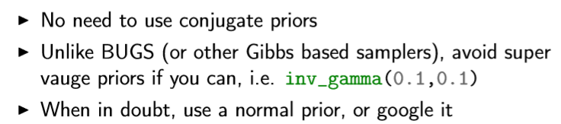
Tip about priors
> Stan Online
The Stan Forums (mc-stan.org)
Stan · GitHub
https://github.com/stan-dev

Slide 18
Stan MCMC parameters
file: The path to the Stan program. Use a .stan extension
model_code: A character string (or variable) containing the
model definition
fit: An instance of S4 class stanfit derived from a previous fit; Time for recompiling the C++ code for the model can be saved.
model_name: A string to use as the name of the model;
(affects the name used in printed messages),
data: A named list or environment providing the data for the
model, or a character vector for all the names of objects
to use as data.
pars: A character vector specifying parameters of interest to
be saved(or not). The default is to save all parameters
from the model.
include: include or exclude the parameters given by the pars
argument
Iter: total number of iterations (including warmup).
The default is 2000.
warmup: The number of samples in warmup (aka burnin)
(also controls the number of iterations for which
adaptation is run)
chains: The number of Markov chains.
thin: A positive integer specifying the period for saving samples.
algorithm
  “NUTS", which is the No-U-Turn sampler variant of Hamiltonian Monte Carlo
  (Hoffman and Gelman 2011, Betancourt 2017).
  "HMC" (Hamiltonian Monte Carlo),
  "Fixed_param” no sampling is performed (e.g., for simulating with in the generated quantities block).
Alternative
Model
definitions
stan(file,
model_name = "anon_model",
model_code = "",
fit = NA,
data = list(),
pars = NA,
chains = 4,
iter = 2000,
warmup = floor(iter/2),
thin = 1,
init = "random",
seed = sample.int(.Machine$integer.max, 1),
algorithm = c("NUTS", "HMC", "Fixed_param"),
....)
… =
Specification of initial values
File name for diagnostics
Print out in R console
Save warm up
Number of cores to use
Call to other than default libraries
Parameters to control the sampler's behavior.

Slide 19
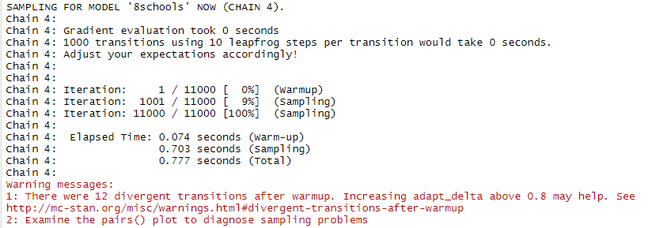
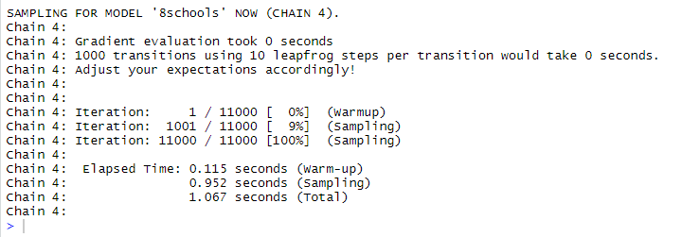
Running Stan
N=10000
fit1 = stan(file = '8schools.stan', data = schools_dat,
iter=1.1*N,
warmup=0.1*N,
thin=N/1000,
chains=4,
seed=231171,
refresh=10000,
control=list(adapt_delta=0.95))
fit1 = stan(file = '8schools.stan', data = schools_dat,
iter=1.1*N,
warmup=0.1*N,
thin=N/1000,
chains=4,
seed=231171,
refresh=10000)
😐
☺

Slide 20
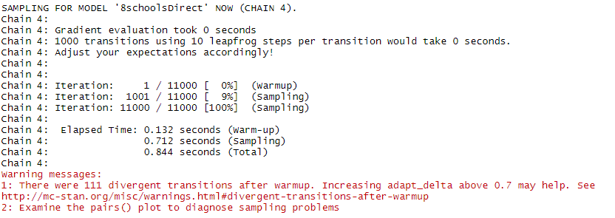
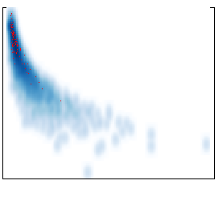
Runtime Reported divergence
Divergence: the simulated Hamiltonian trajectory does not conserve energy. (i.e. depart from the true trajectory)
Limits the ability to explore the posterior distribution.
(can cause irreducible issues)
When this
divergence is
too high, the
simulation has
gone off the
rails and
cannot be
trusted
log posterior
tau

Slide 21
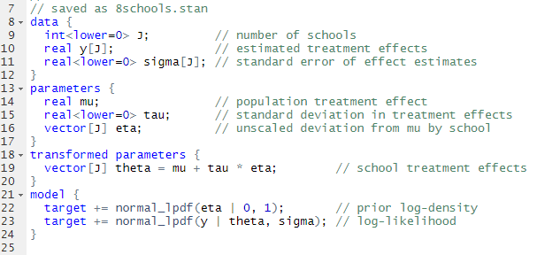
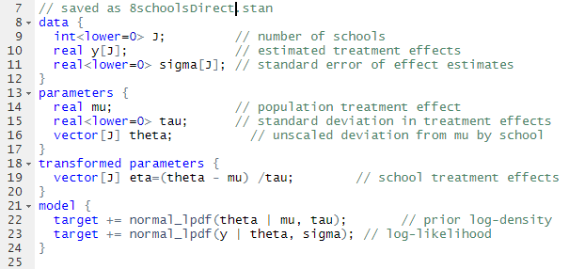



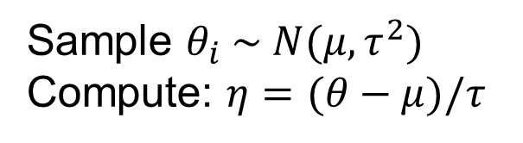
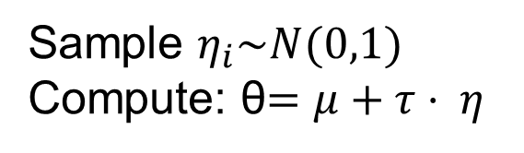

The effect of clever transformations
normalized
Sample $η_{i}\sim N(0,1)$
Compute: θ$=μ+τ⋅ η$
Sample $θ_{i} \sim N(μ,τ^{2})$
Compute: $η=(θ−μ)/τ$
$$η_{2}$$
Identical models. The difference is correlations vs not
recap Exercise 42 vs 39
$$θ_{2}$$
$$η_{1}$$
$$θ_{1}$$

Slide 22
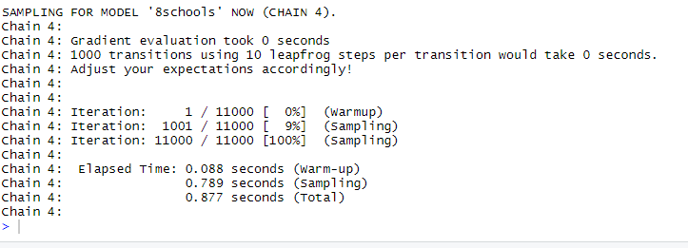
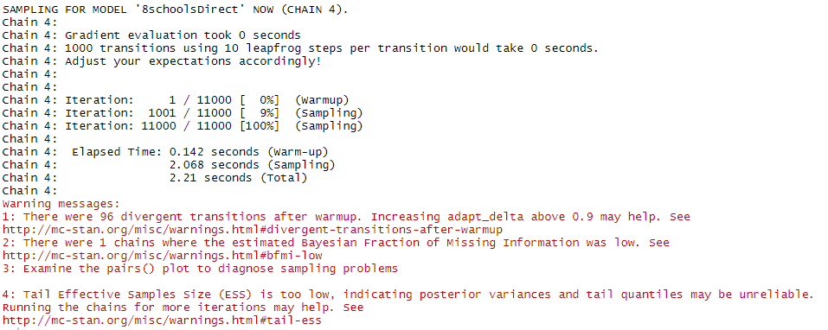

Running two models
No reported errors !
Problem with:
divergence,
Effective sample size
Bayesian Fraction of Missing Information (BFMI)
Related to
lag 1 correlation
of log posterior

Slide 23
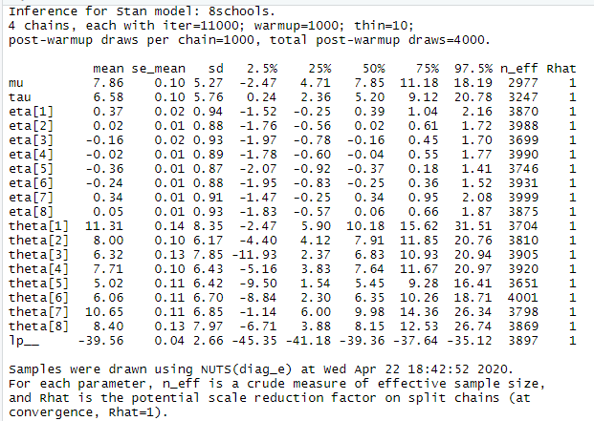
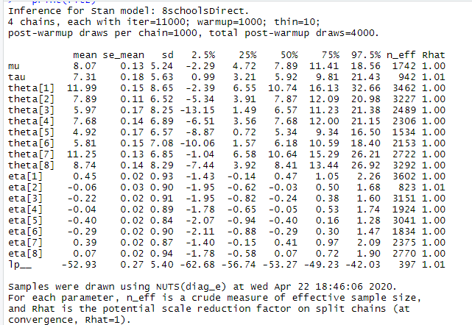
Result of chain:
Effective number of samples is
consistently high
Effective number of samples is variable
some low some high
Have not investigated full space

Slide 24
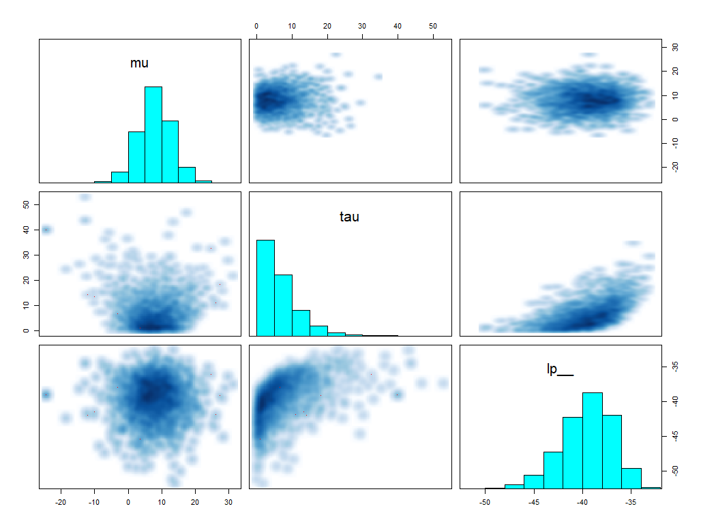
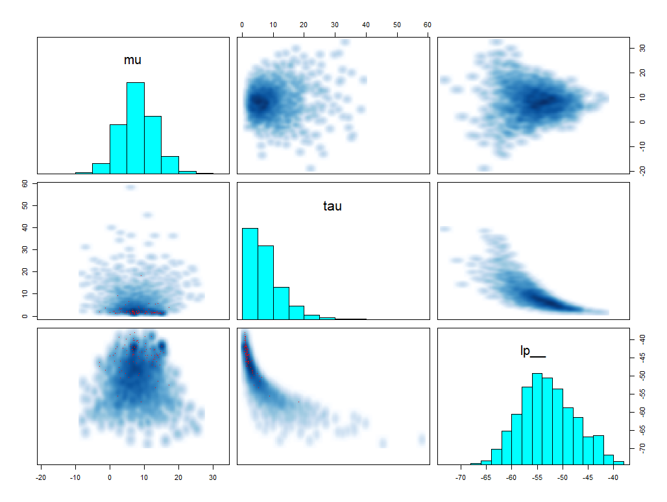
Pairs() is specialized in STAN
Log posterior
Log posterior
The models are the same but log posterior is different why?

Slide 25
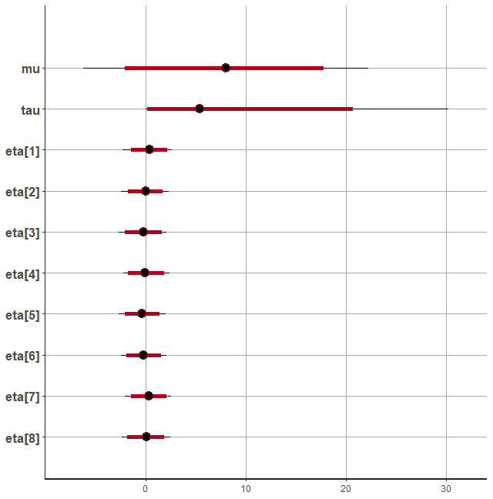
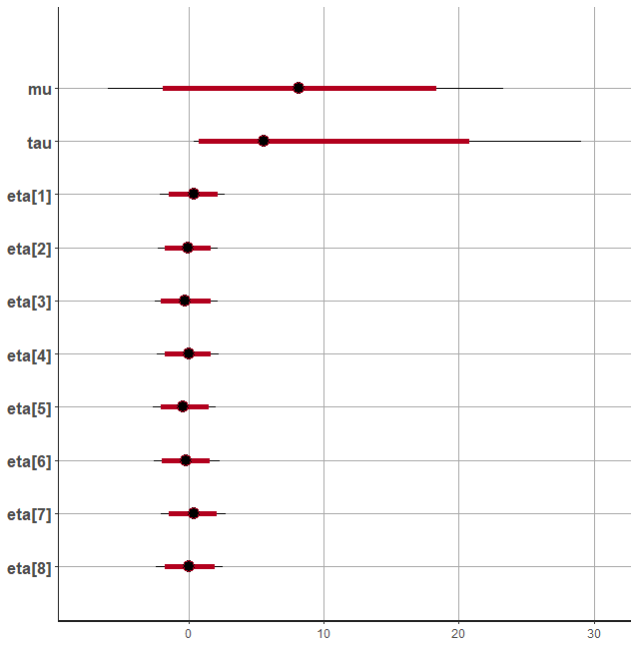
Credibility intervals
Transformed
Direct
plot(fit1,pars = c("mu", "tau", "eta"),ci_level = 0.95,outer_level = 0.99) plot(fit2,pars = c("mu", "tau", "eta"),ci_level = 0.95,outer_level = 0.99)

Slide 26
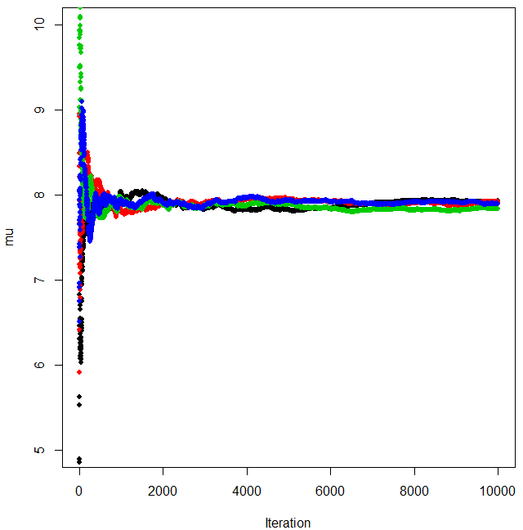
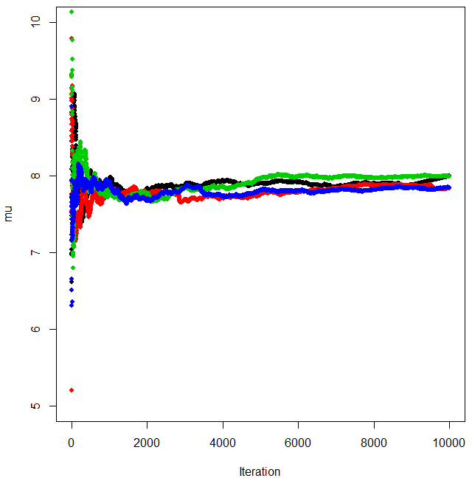
Convergence for MCMC, cumulative mean mu
Transformed
Direct

Slide 27
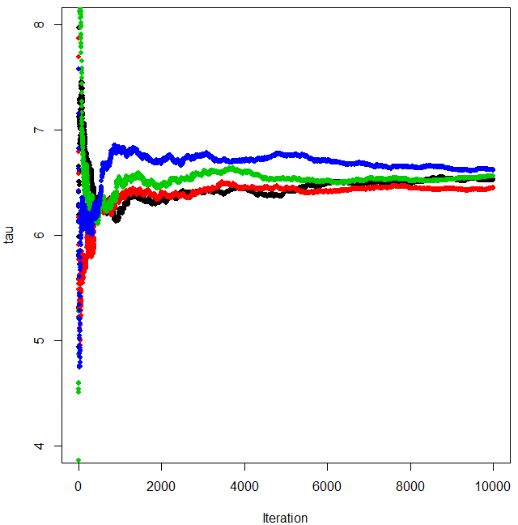
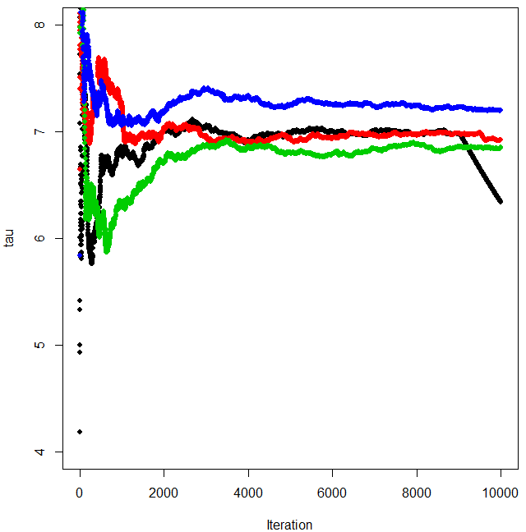
Convergence for MCMC, cumulative mean tau
Transformed
Direct

Slide 28
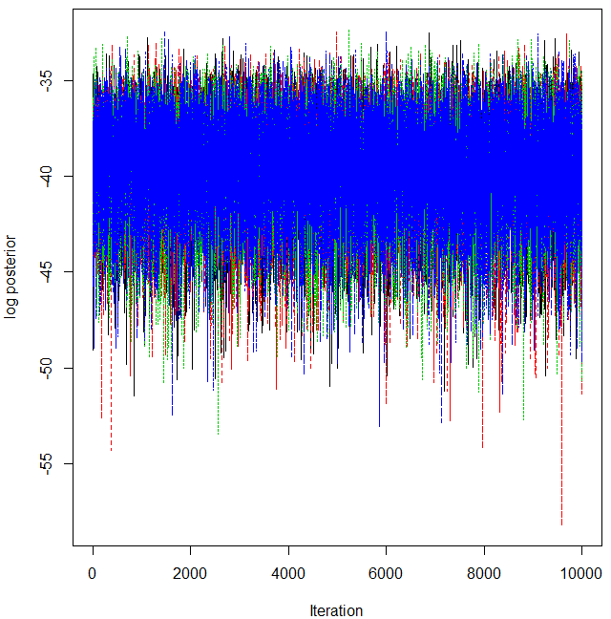
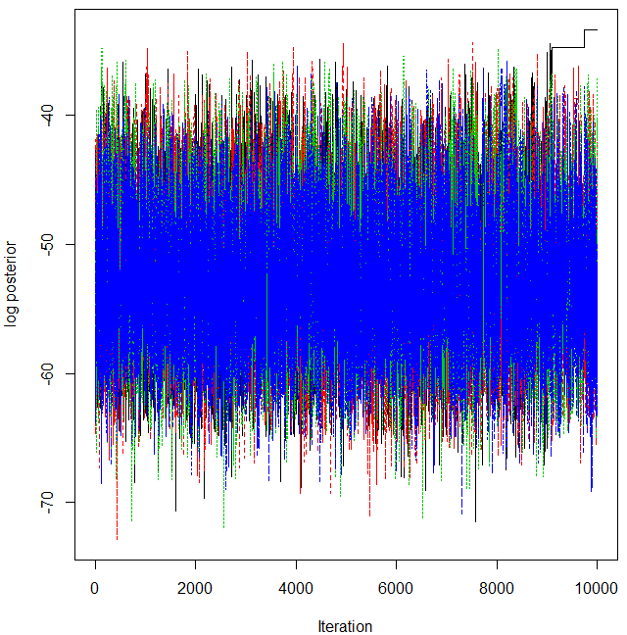
Likelihood
Transformed
Direct

Slide 29
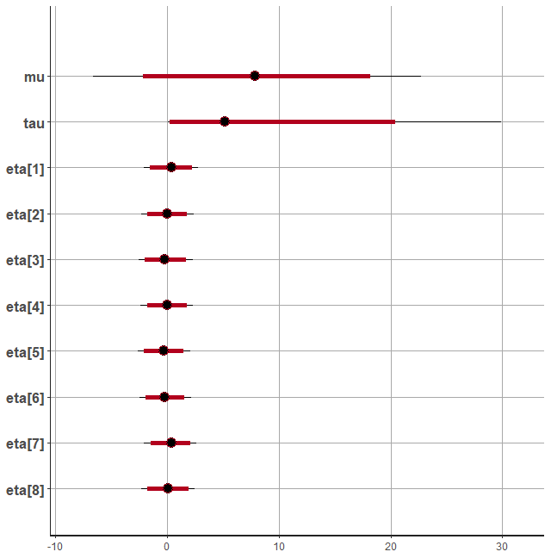
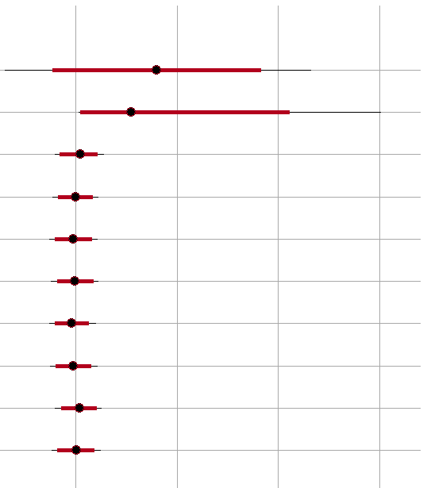
Result MCMC long
Transformed
Direct
The Transformed approach has better convergence properties
In a long run 100000 samples
The difference between the two chains is not large
Results
  The effect of coaching is not significant 5%-level, but has a strong indication
  The «good» school appears as a «lucky shot»

Slide 30
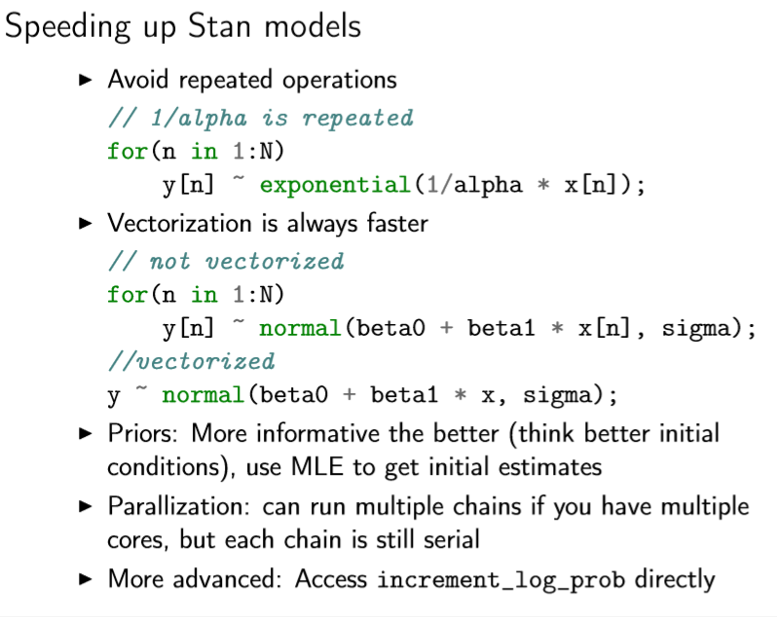

Slide 31
