Slide 1
STK-4051/9051 Computational Statistics Spring 2024
Markov Chain Monte Carlo part 3
Instructor: Odd Kolbjørnsen, oddkol@math.uio.no

Slide 2
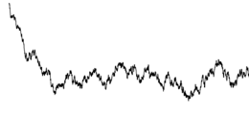
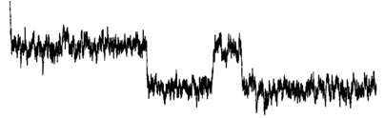
Last time: Convergence in practice
Burn in
  remove bias due to a bad start
Mixing
  Effective number of samples
Visual
  sample path
  cumsum diagnostics
  Be aware of apparent convergence
How many chains?
  at least two in «new territory»
Diagnostics
  Gelman-Rubin
Practical
  Monte Carlo variance less than 5%
Acceptance rate
  Independence sampler high
  Random walk not too high
Need a check of all model parameters!
(and important functions)

Slide 3
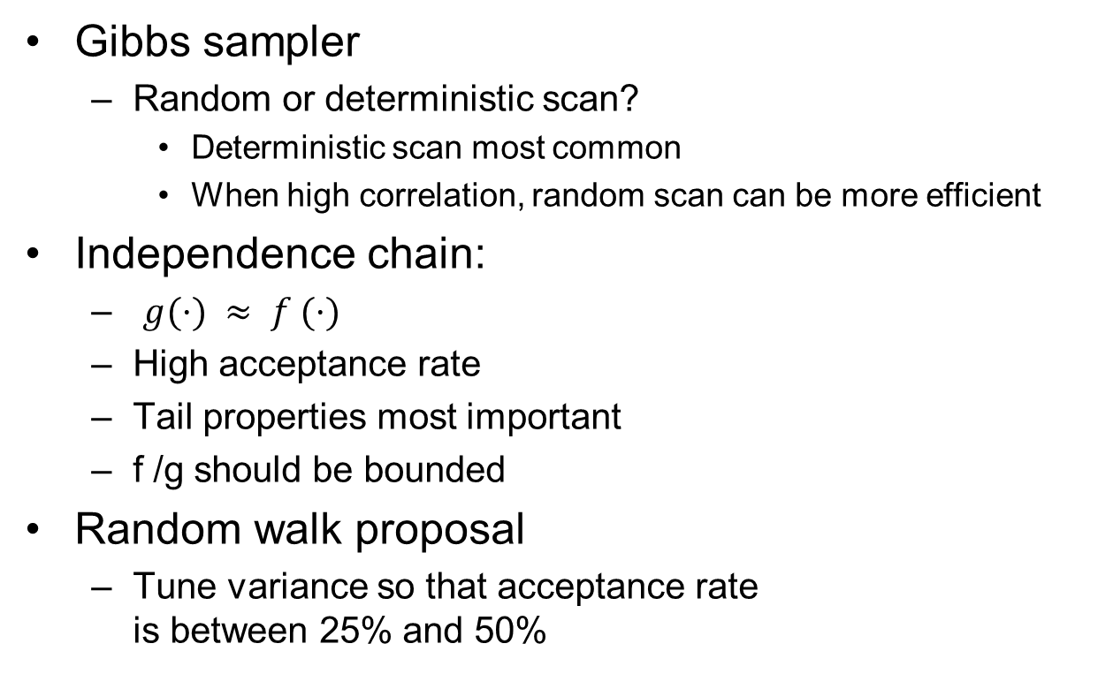
Choices
Gibbs sampler
  Random or deterministic scan?
    Deterministic scan most common
    When high correlation, random scan can be more efficient
Independence chain:
  $g(·) ≈ f (·)$
  High acceptance rate
  Tail properties most important
  f /g should be bounded
Random walk proposal
  Tune variance so that acceptance rate
  is between 25% and 50%

Slide 4
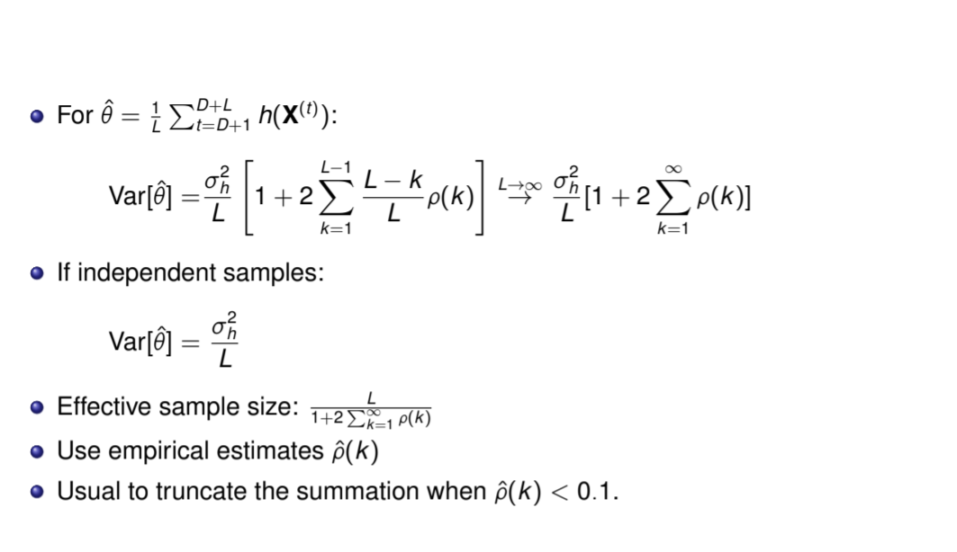
Effective sample size for MCMC
Monte Carlo variance (L samples)
Independence:
With correlation in samples:

Slide 5
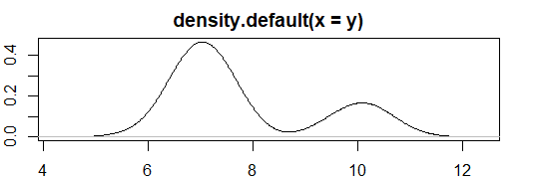
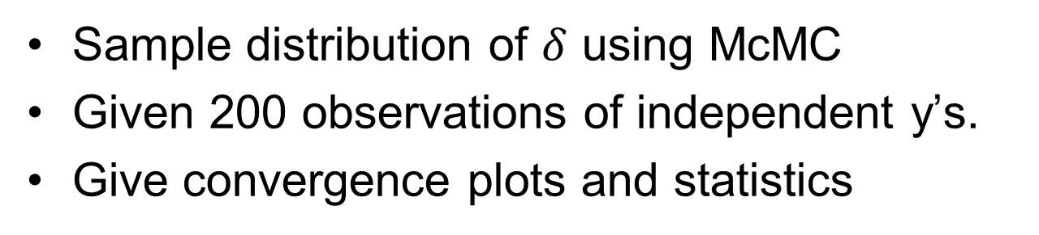

EX mixture estimation
y = rnorm(n,7,0.5) with probability $δ$
y = rnorm(n,10,0.5) with probability $1−δ$
Sample distribution of $δ$ using McMC
Given 200 observations of independent y’s.
Give convergence plots and statistics

Slide 6
Today
Tricks to customize sampling
  Reparametrize
  Augmentation
  Block update
  Hybrid
  Griddy-Gibbs
Advanced topics in MCMC
  Adaptive MCMC: Automatic tuning of proposal distributions (ex 36)
  Multiple-Try M-H (improve griddy Gibbs)
  Slice sampler
  Simulated tempering
  Reversible Jump MCMC (model selection)
  Langevin
  Hamiltonian [Central in STAN]

Slide 7
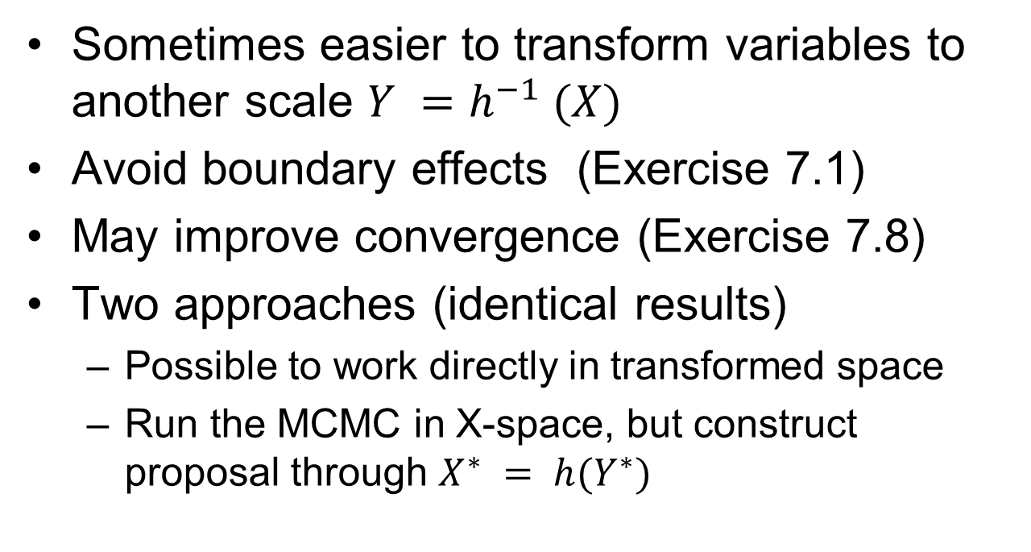
Reparameterization
Sometimes easier to transform variables to another scale $Y =h^{−1} (X)$
Avoid boundary effects (Exercise 7.1)
May improve convergence (Exercise 7.8)
Two approaches (identical results)
  Possible to work directly in transformed space
  Run the MCMC in X-space, but construct proposal through $X^{∗} = h(Y^{∗})$

Slide 8
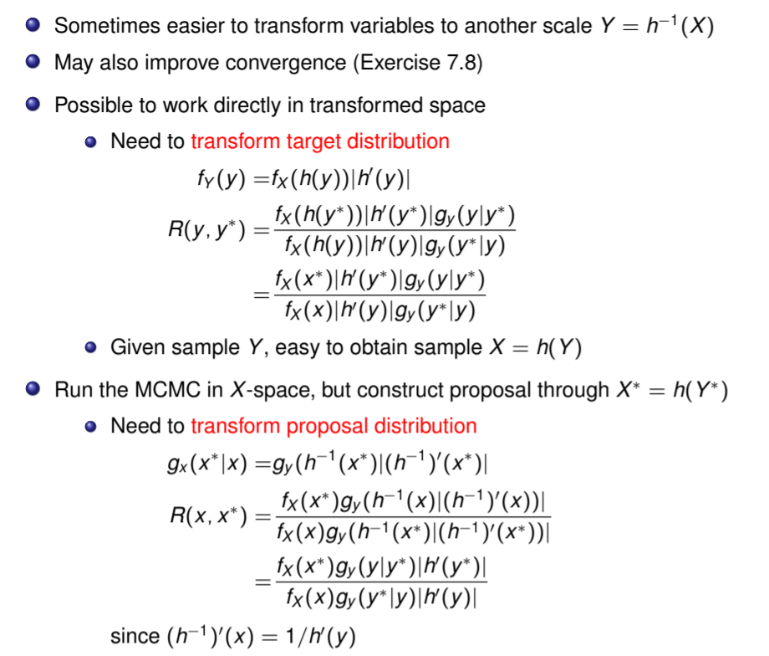


Reparameterization version 1
$$Y =h^{−1} (X)$$
$$X =h (Y)$$

Slide 9
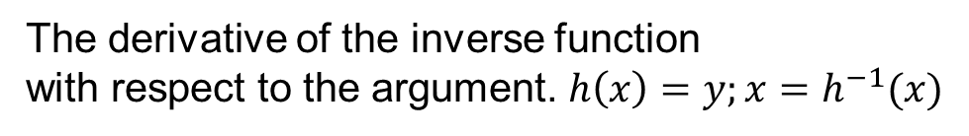
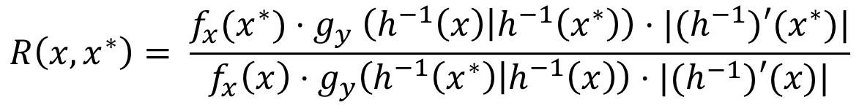
Reparameterization version 2, 1D
$$g_{x}\left(x^{∗} | x\right)=g_{y}\left(h^{−1}\left(x^{∗}\right)|h^{−1}\left(x\right)\right)⋅|{(h}^{−1})′(x^{∗})|$$
$$R\left(x,x^{∗}\right)= \frac{f_{x}(x^{∗}){⋅g}_{y}\left(h^{−1}\left(x\right) | h^{−1}\left(x^{∗}\right)\right)⋅|{(h}^{−1})′(x^{∗})|}{f_{x}\left(x\right)⋅g_{y}\left(h^{−1}\left(x^{∗}\right) | h^{−1}\left(x\right)\right)⋅|{(h}^{−1})′(x)|}$$
The derivative of the inverse function
with respect to the argument. $h\left(x\right)=y;x=h^{−1}(x)$

Slide 10

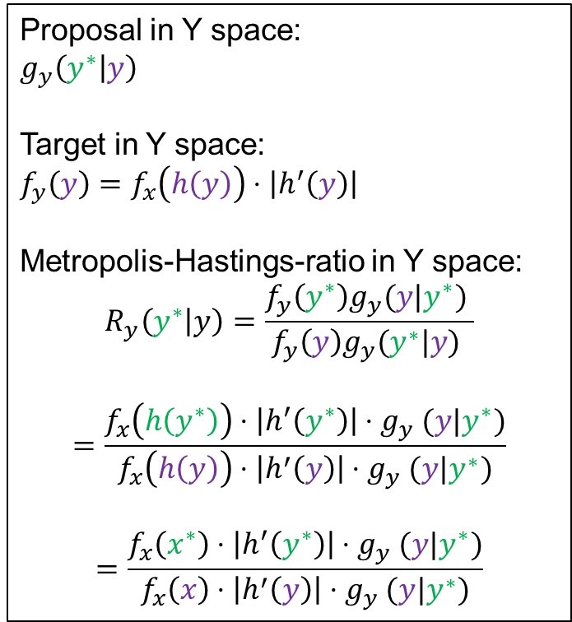

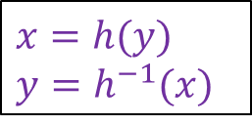

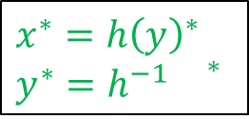
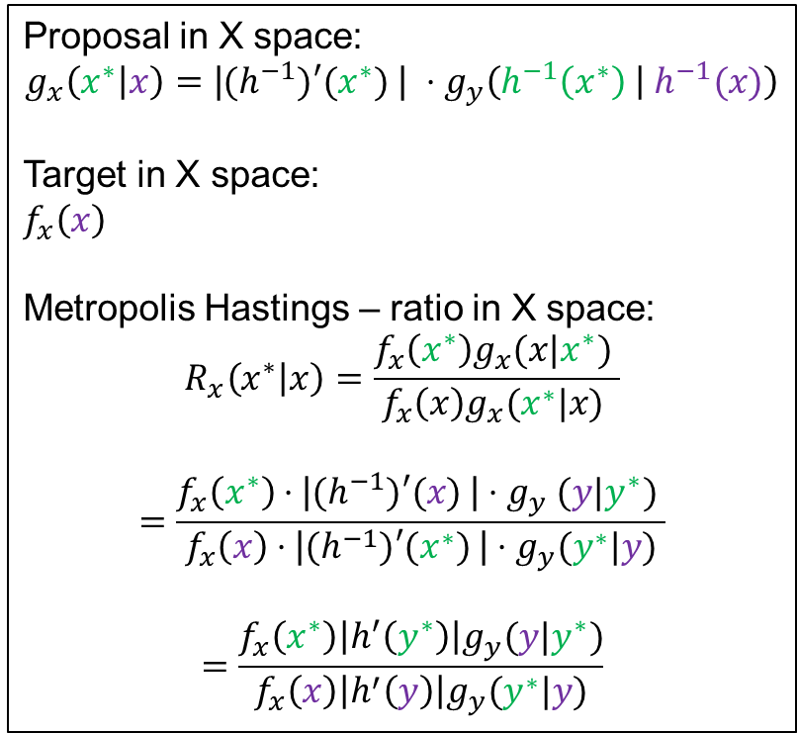
Reparameterization
$x=h(y)$
$y=h^{−1}(x)$
$x^{∗}=h{\left(y\right)}^{∗}$
$y^{∗}=h^{−1}{}^{∗}$
McMC in Y space
McMC in X space (original)
Proposal in Y space:
$g_{y}\left(y^{∗} | y\right)$
Target in Y space:
$f_{y}\left(y\right)=f_{x}\left(h\left(y\right)\right)⋅\left|h^{′}\left(y\right)\right|$
Metropolis-Hastings-ratio in Y space:
$$R_{y}\left(y^{∗} | y\right)=\frac{f_{y}\left(y^{∗}\right)g_{y}(y|y^{∗}) }{f_{y}\left(y\right)g_{y}(y^{∗}|y) }$$
$$=\frac{f_{x}\left(h\left(y^{∗}\right)\right)⋅\left|h^{′}\left(y^{∗}\right)\right|{⋅g}_{y}(y|y^{∗})}{f_{x}\left(h\left(y\right)\right)⋅\left|h^{′}\left(y\right)\right|{⋅g}_{y}(y|y^{∗})}$$
$$=\frac{f_{x}\left(x^{∗}\right)⋅\left|h^{′}\left(y^{∗}\right)\right|{⋅g}_{y}(y|y^{∗})}{f_{x}\left(x\right)⋅\left|h^{′}\left(y\right)\right|{⋅g}_{y}(y|y^{∗})}$$
Proposal in X space:
$${g_{x}\left(x^{∗} | x\right)=\text{|}{(h}^{−1})′(x^{∗}) \text{| }⋅g}_{y}\left(h^{−1}\left(x^{∗}\right) | { h}^{−1}(x)\right)$$
Target in X space:
$f_{x}\left(x\right)$
Metropolis Hastings – ratio in X space:
$$R_{x}\left(x^{∗} | x\right)=\frac{f_{x}\left(x^{∗}\right)g_{x}(x|x^{∗}) }{f_{x}\left(x\right)g_{x}(x^{∗}|x) }$$
$$=\frac{f_{x}\left(x^{∗}\right){⋅\text{|}{(h}^{−1})′(x) \text{|}⋅g}_{y}(y|y^{∗}) }{f_{x}\left(x\right)⋅\text{|}{(h}^{−1})′(x^{∗}) \text{|}⋅g_{y}(y^{∗}|y)}$$
$$=\frac{f_{x}\left(x^{∗}\right){\left|h^{′}\left(y^{∗}\right)\right|g}_{y}(y|y^{∗})}{f_{x}\left(x\right){\left|h^{′}\left(y\right)\right|g}_{y}(y^{∗}|y)}$$
$$y^{∗}$$
$$y$$
$$\text{|}{(h}^{−1})′(x) \text{|}\text{=}\frac{1}{\left|h^{′}\left(y\right)\right|}$$

Slide 11
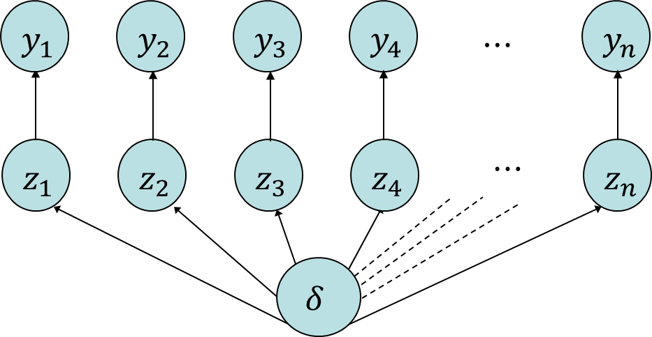
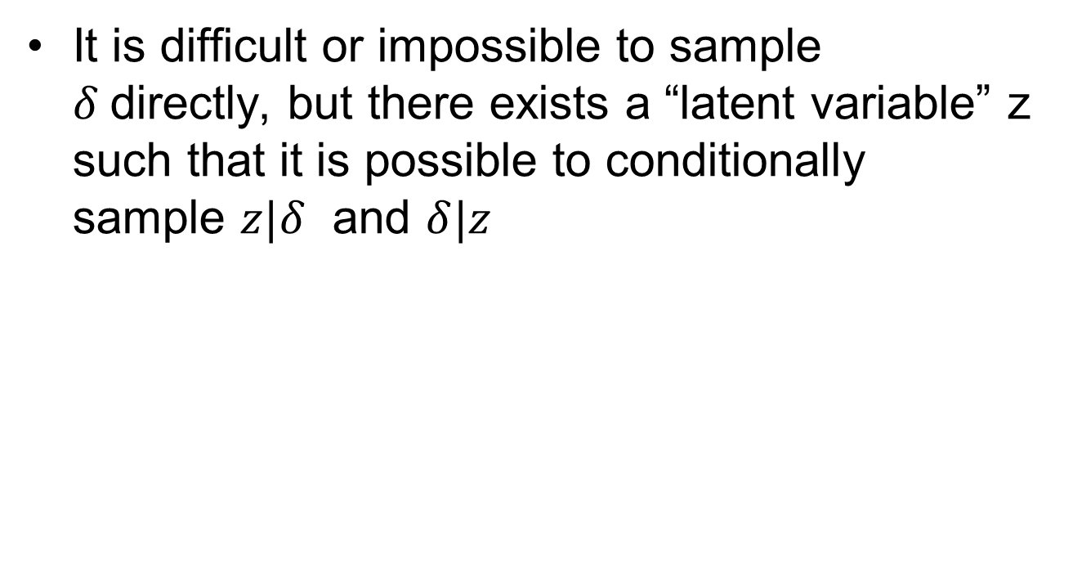
Variable augmentation
It is difficult or impossible to sample $δ$directly, but there exists a “latent variable” z such that it is possible to conditionally sample $z|δ$ and $δ|z$
Example:
data
latent variable
parameter

Slide 12
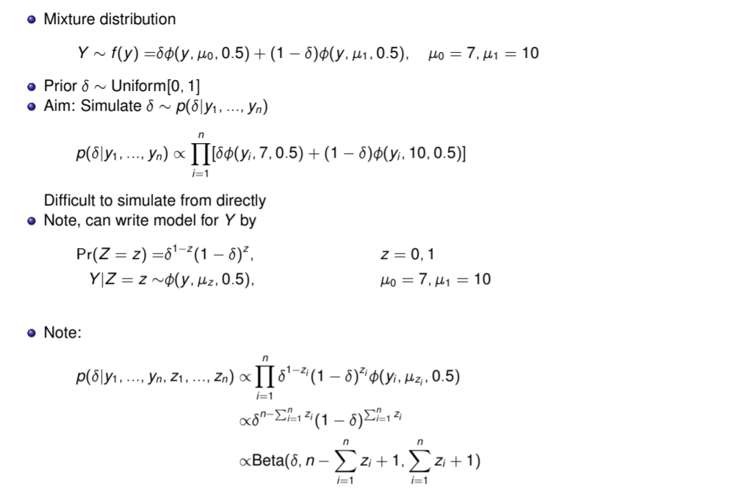
Example mixture distribution (augmenting)
Augmenting the
variable set with z
(similar to EM-algorithm)

Slide 13
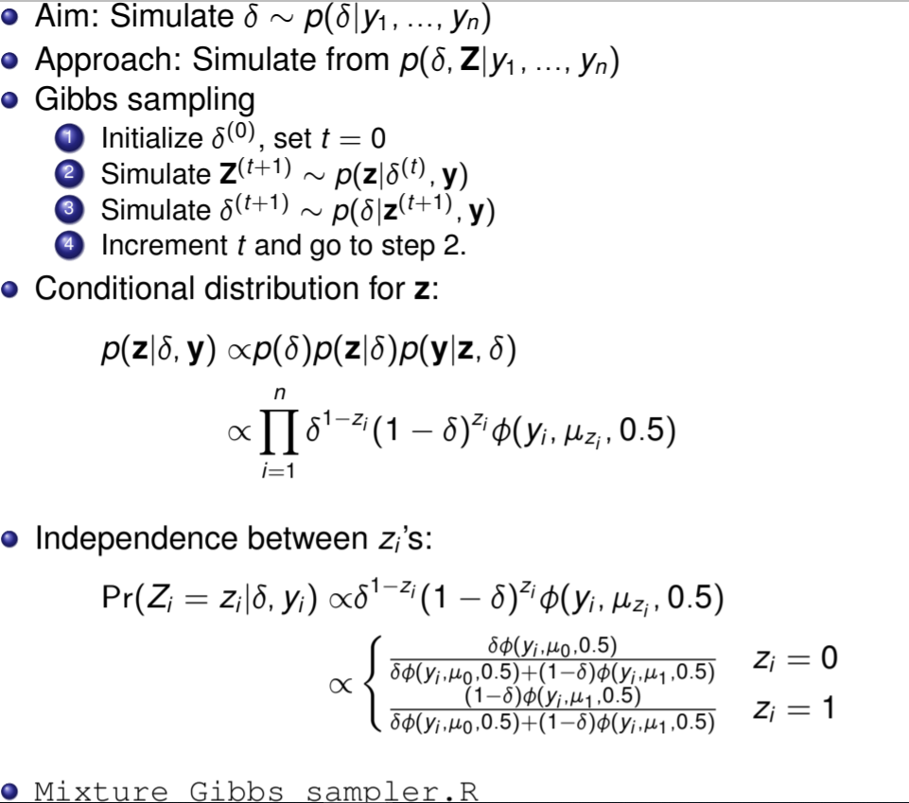
Example mixture distribution cont…

Slide 14
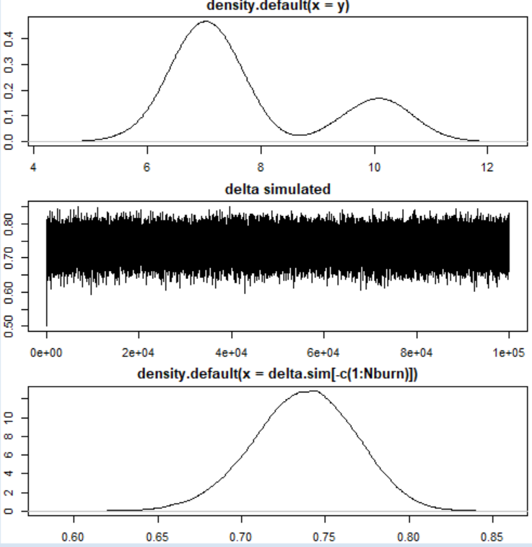


Slide 15
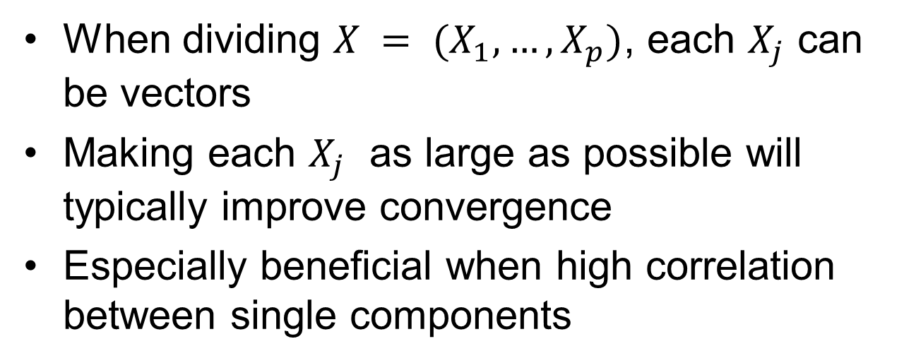
Blocking/ Block update
When dividing $X = (X_{1}, …, X_{p})$, each $X_{j}$ can be vectors
Making each $X_{j}$ as large as possible will typically improve convergence
Especially beneficial when high correlation between single components

Slide 16
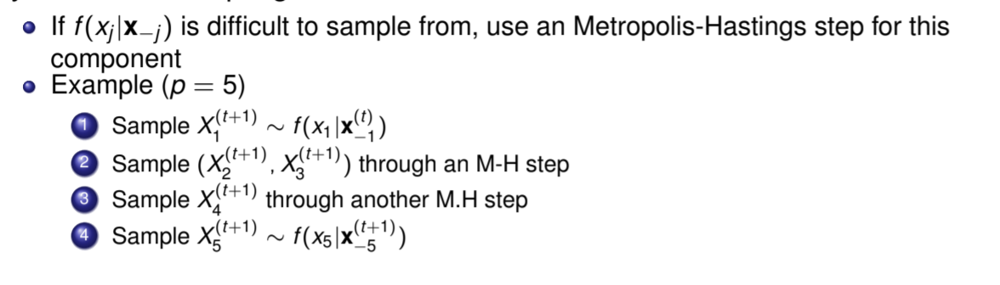
Hybrid Gibbs sampler

Slide 17
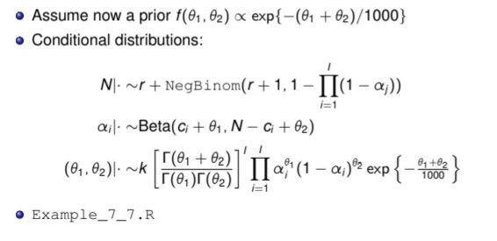
Capture-recapture - extended approach
Sample using M.H
= Hybrid Gibbs sampler

Slide 18
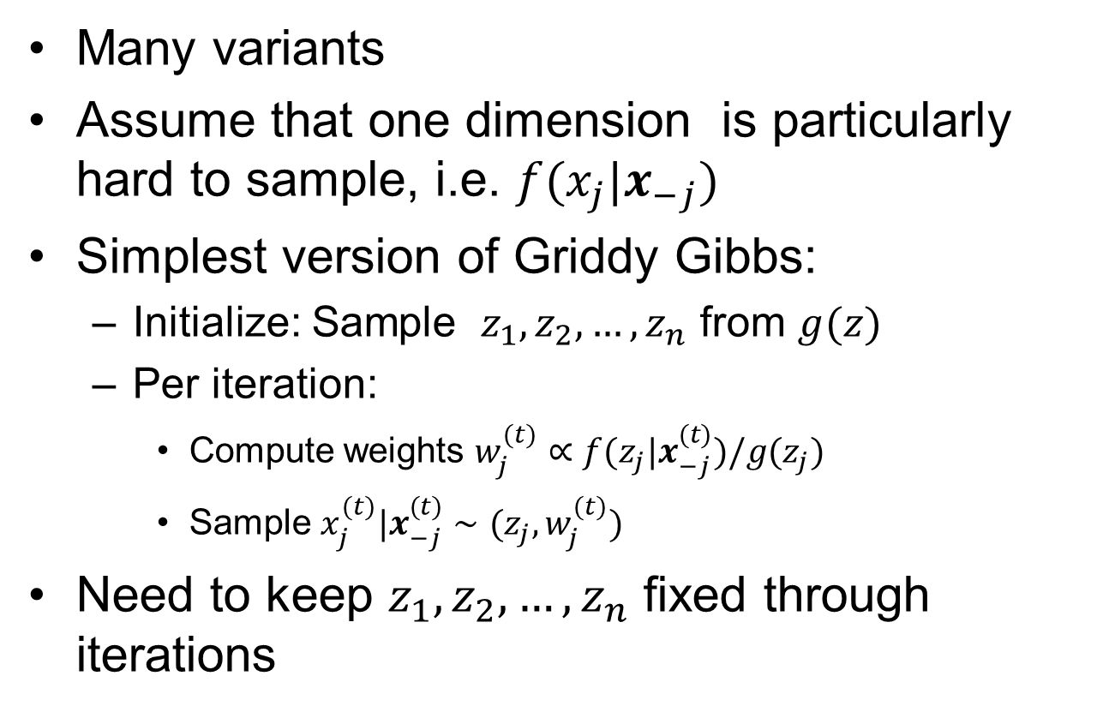
Griddy Gibbs sampler
Many variants
Assume that one dimension is particularly hard to sample, i.e. $f(x_{j}|x_{−j})$
Simplest version of Griddy Gibbs:
  Initialize: Sample $z_{1},z_{2},…,z_{n}$ from $g(z)$
  Per iteration:
    Compute weights $w_{j}^{(t)}∝f(z_{j}|x_{−j}^{(t)})/g(z_{j})$
    Sample $x_{j}^{(t)}|x_{−j}^{(t)}∼(z_{j},w_{j}^{(t)})$
Need to keep $z_{1},z_{2},…,z_{n}$ fixed through iterations

Slide 19
Now advanced topics in MCMC
Adaptive MCMC: Automatic tuning of proposal distributions (ex 36)
Multiple-Try M-H (improve griddy Gibbs)
Slice sampler
Simulated tempering
Reversible Jump MCMC (model selection)
Langevin
Hamiltonian [Central in STAN]

Slide 20
About Syllabus
Chapter 8 is not a part of syllabus, but
the general theory of McMC is a part of syllabus and all the topics today are examples where we use this theory.
STAN is a popular tool for McMC it is an implementation of Hamiltonian Monte Carlo

Slide 21
Adaptive MCMC
Want: Automatic tuning of proposal distributions
(To get a black box algorithm- universal inference)
Main challenge: Specifying proposal based on history of chain breaks down the Markov property
Solution: Reduce the amount of tuning as the number of iterations increase
Example: Tune the variance in proposal distribution per component in random walk to get 44% acceptance rate

Slide 22
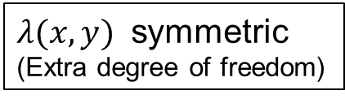
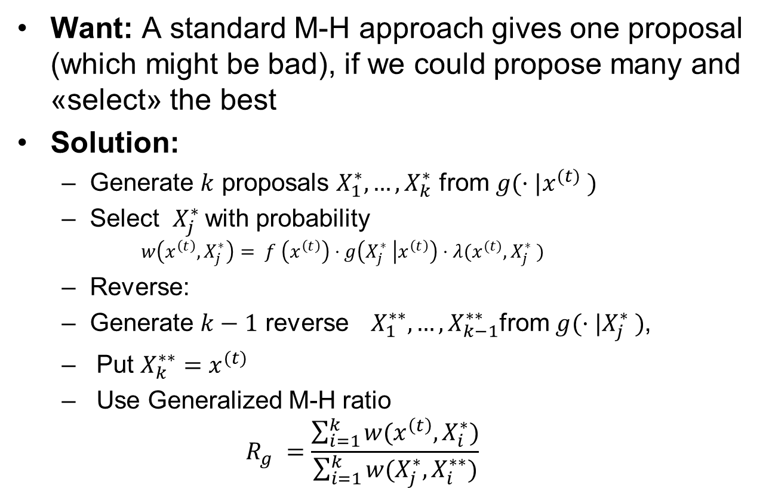
Multiple-Try M-H
Want: A standard M-H approach gives one proposal (which might be bad), if we could propose many and «select» the best
Solution:
  Generate $k$ proposals $X_{1}^{∗}, …,X_{k}^{∗}$ from $g(·|x^{(t)} )$
  Select $X_{j}^{∗}$with probability
    $$w\left(x^{\left(t\right)}, X_{j}^{∗}\right)= f \left(x^{\left(t\right)}\right)⋅g\left(X_{j}^{∗} | x^{\left(t\right)}\right)⋅λ(x^{(t)}, X_{j}^{∗} )$$
  Reverse:
  Generate $k−1$ reverse ${ X}_{1}^{∗∗}, …,X_{k−1}^{∗∗}$from $g(·|X_{j}^{∗} )$,
  Put $X_{k}^{∗∗}=x^{(t)}$
  Use Generalized M-H ratio
  $$R_{g} =\frac{\sum_{i=1}^{k}{w(x^{\left(t\right)}, X_{i}^{∗})}}{\sum_{i=1}^{k}{w(X_{j}^{∗}, X_{i}^{∗∗})}}$$
$λ(x,y)$ symmetric
(Extra degree of freedom)

Slide 23
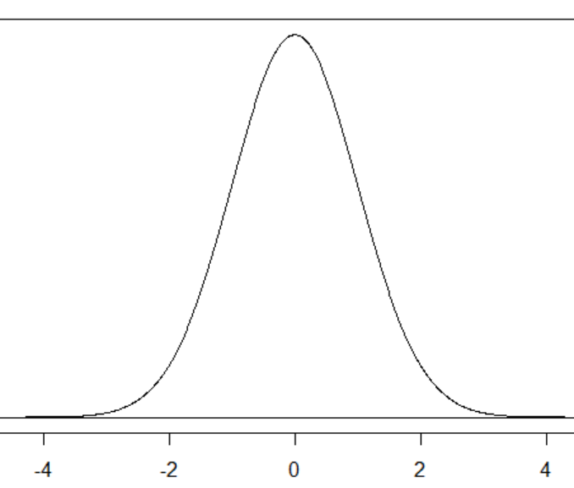
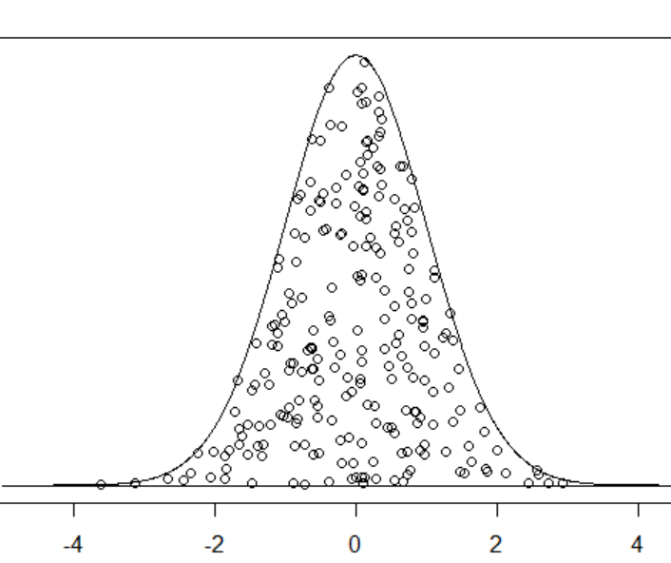
Slice sampler
Want: Show that sampling from any distribution can be reduced to sampling from a uniform distribution (on a restricted domain)
Solution: Sample the uniform distribution obtained by the image of the distribution.
  Alternate horizontal moves
  Vertical moves
Multivariate distributions using one-dimensional conditional
Do not require sampling of the conditional distributions
only need to evaluate them
Can cope with multiple modes if not too far apart

Slide 24
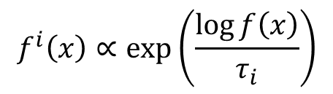
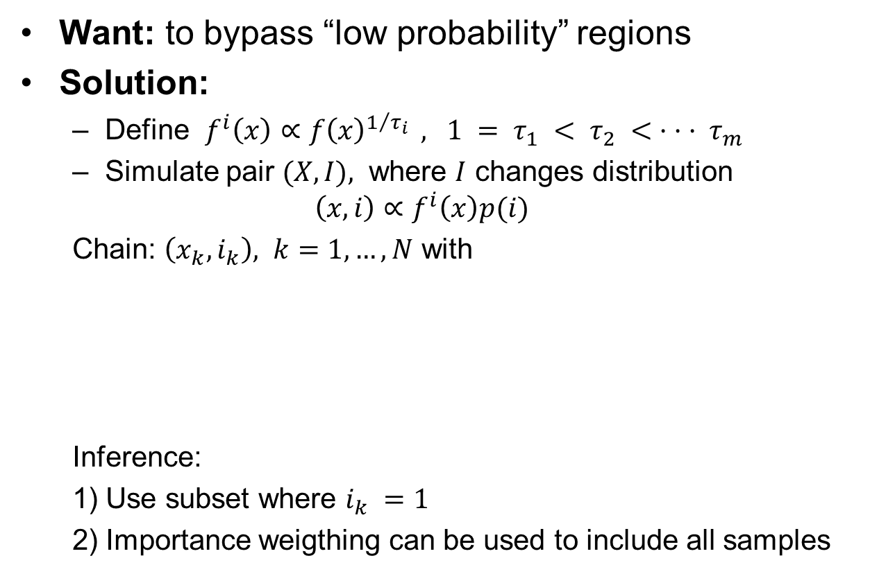
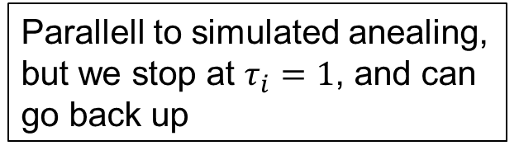
Simulated tempering
Want: to bypass “low probability” regions
Solution:
  Define $f^{i}\left(x\right)∝f{\left(x\right)}^{1/{τ_{i} }} , 1 = τ_{1} < τ_{2} < · · · τ_{m}$
  Simulate pair $(X,I),$ where $I$ changes distribution
  $$\left(x,i\right)∝f^{i}\left(x\right)p(i)$$
  Chain: $\left(x_{k},i_{k}\right), k=1,…,N$ with
  Inference:
  1) Use subset where $i_{k} =1$
  2) Importance weigthing can be used to include all samples
$$f^{i}\left(x\right)∝\exp\left(\frac{\log{f\left(x\right)}}{τ_{i}}\right)$$
Parallell to simulated anealing, but we stop at $τ_{i}=1$, and can go back up

Slide 25
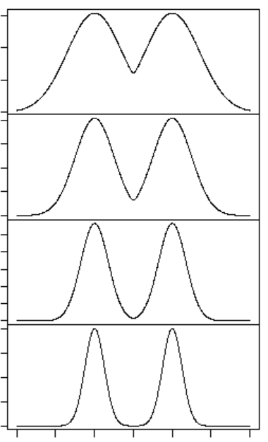







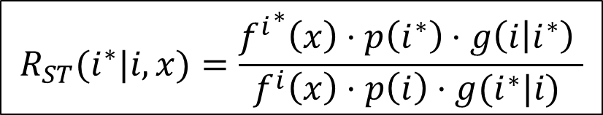

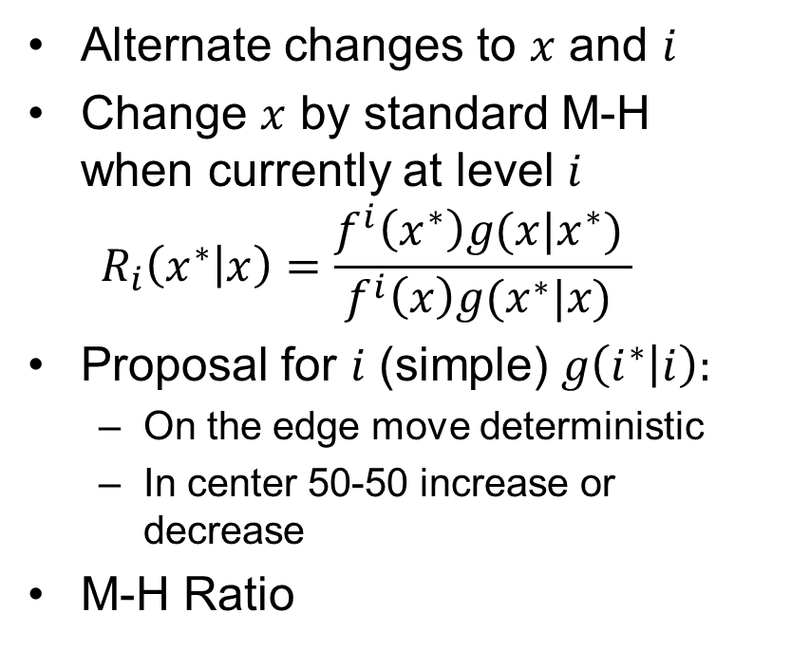


Simulated tempering
$$f^{4}\left(x\right)$$
Alternate changes to $x$ and $i$
Change $x$ by standard M-H when currently at level $i$
  $$R_{i}\left(x^{∗} | x\right)=\frac{f^{i}\left(x^{∗}\right)g(x|x^{∗}) }{f^{i}\left(x\right)g(x^{∗}|x) }$$
Proposal for $i$ (simple) $g\left(i^{∗} | i\right):$
  On the edge move deterministic
  In center 50-50 increase or decrease
M-H Ratio
$$f^{3}\left(x\right)$$
$$f^{2}\left(x\right)$$
$$f\left(x\right)$$
$$g\left(2 | 1 \right)=1$$
$$g\left(k≠2 | 1 \right)=0$$
$$g\left(M−1 | M\right)=1$$
$$R_{ST}(i^{∗}|i,x)=\frac{{f^{i}}^{∗}\left(x\right)⋅p\left(i^{∗}\right)⋅g\left(i | i^{∗}\right) }{f^{i}\left(x\right)⋅p\left(i\right)⋅g(i^{∗}|i) }$$
$$g\left(k≠M−1 | M\right)=0$$
$g\left(\left|k−j\right|=1 | j \right)=\frac{1}{2}$
$$g\left(\left|k−j\right|≠1 | j \right)=0$$

Slide 26
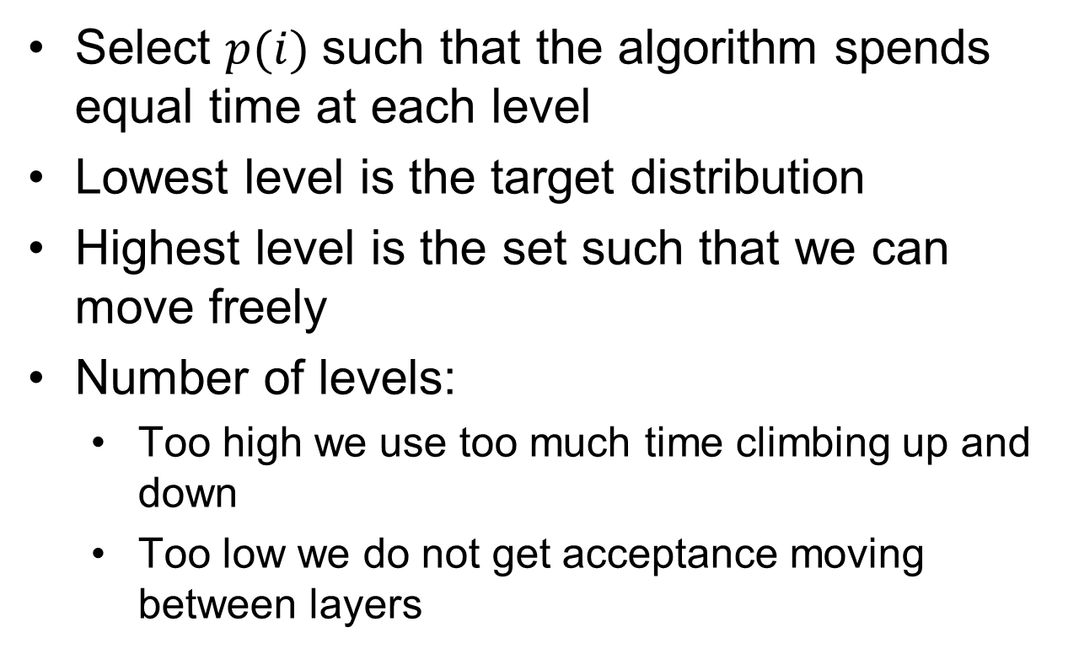
Simulated tempering
Select $p(i)$such that the algorithm spends equal time at each level
Lowest level is the target distribution
Highest level is the set such that we can move freely
Number of levels:
  Too high we use too much time climbing up and down
  Too low we do not get acceptance moving between layers

Slide 27
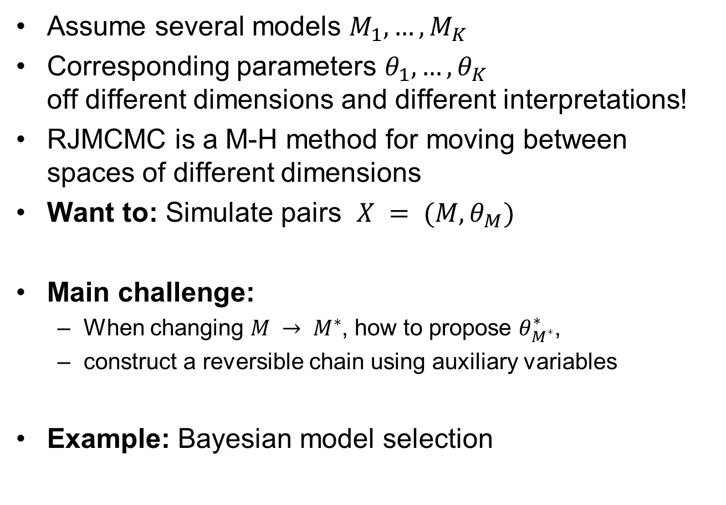
Reversible Jump MCMC
Assume several models $M_{1}, …,M_{K}$
Corresponding parameters $θ_{1}, …, θ_{K}$
off different dimensions and different interpretations!
RJMCMC is a M-H method for moving between spaces of different dimensions
Want to: Simulate pairs $X = (M, θ_{M})$
Main challenge:
  When changing $M → M^{∗}$, how to propose $θ_{M^{∗}}^{∗}$,
  construct a reversible chain using auxiliary variables
Example: Bayesian model selection

Slide 28
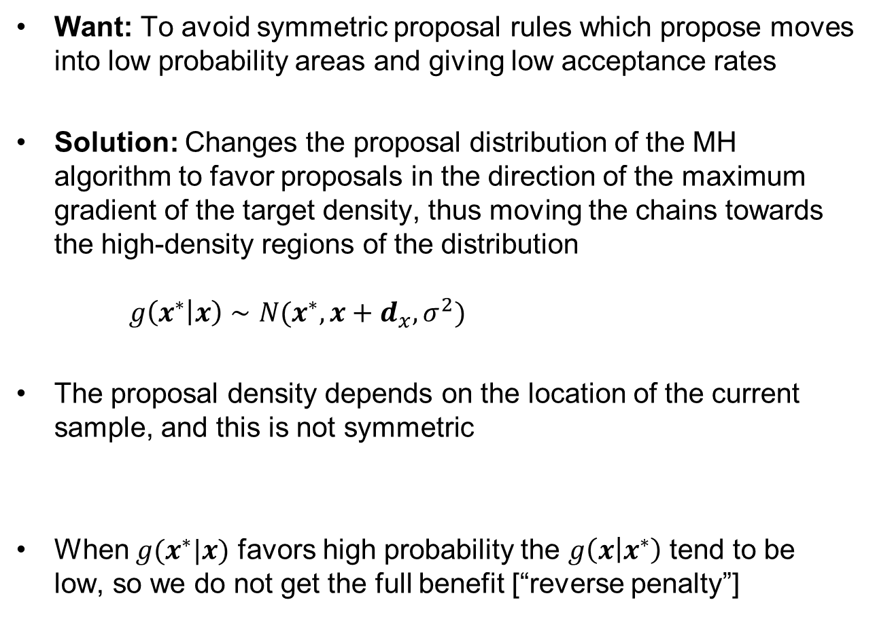
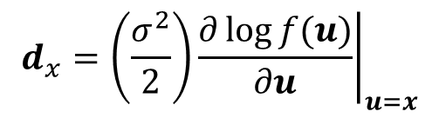
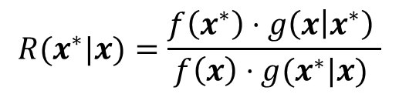
Langevin M-H
Want: To avoid symmetric proposal rules which propose moves into low probability areas and giving low acceptance rates
Solution: Changes the proposal distribution of the MH algorithm to favor proposals in the direction of the maximum gradient of the target density, thus moving the chains towards the high-density regions of the distribution
$g\left(x^{∗} | x\right)∼N(x^{∗},x+d_{x},σ^{2})$
The proposal density depends on the location of the current sample, and this is not symmetric
When $g(x^{∗}|x)$ favors high probability the $g\left(x | x^{∗}\right)$ tend to be low, so we do not get the full benefit [“reverse penalty”]
$$d_{x}=\left(\frac{σ^{2}}{2}\right){\left.\frac{∂\log{f(u)}}{∂u}\right|}_{u=x}$$
$$R(x^{∗}|x)=\frac{f\left(x^{∗}\right)⋅g\left(x | x^{∗}\right) }{f\left(x\right)⋅g(x^{∗}|x) }$$
Notes:
Boltzmann distribution

Slide 29
Hamiltonian MC
Want: To avoid symmetric proposal rules which propose moves into low probability areas and giving low acceptance rates, but want to avoid the “reverse penalty” from Langevin
Solution: Adding a momentum term p to each component of the target variable q (auxiliary variable = p) ,
  Helps the chain move more rapidly though the target distribution
  It favors successive proposals in the same direction, allowing the simulation to move rapidly through the space
  Update target q and and moment p simultaneously .
  We couple the proposal of the target variables q and the auxiliary variables p
  such that a low probability of the target variable is countered by a high probability of the auxiliary variables [avoid “reverse penalty”]
  Interpreted as a trade off between potential and kinetic energy
target variables
auxiliary variables

Slide 30
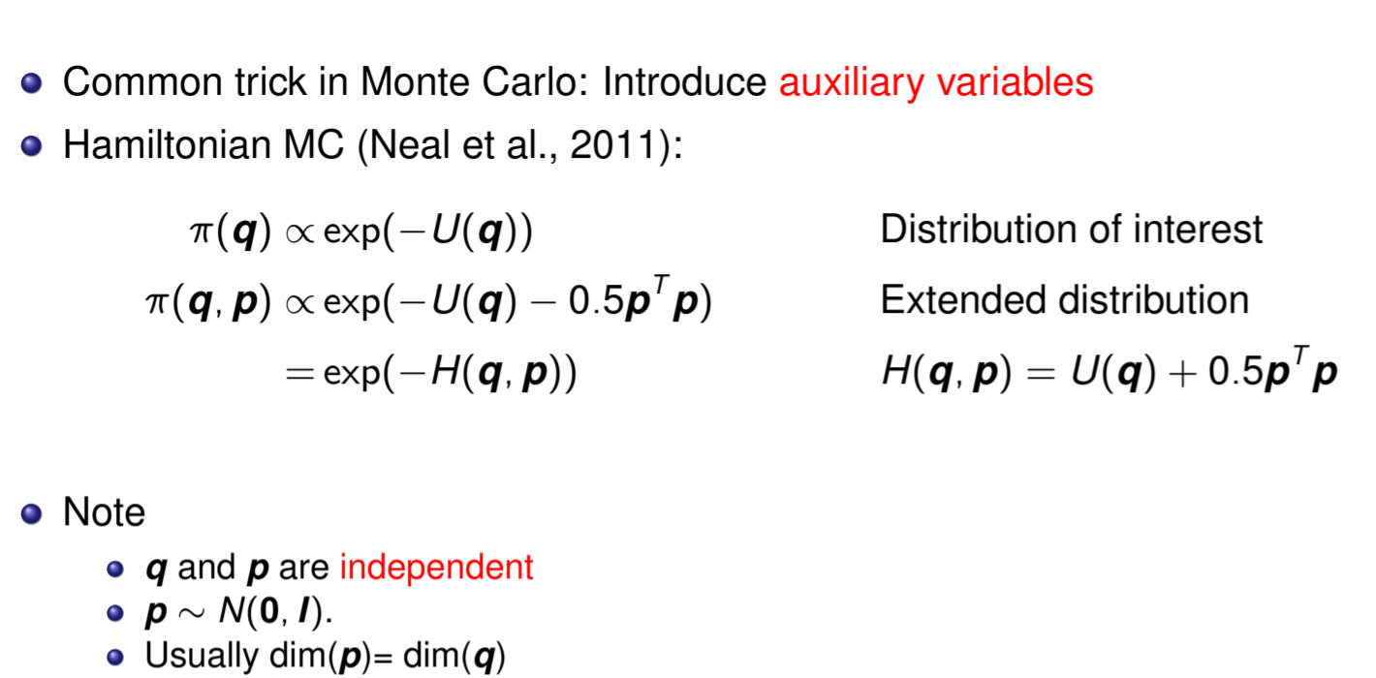
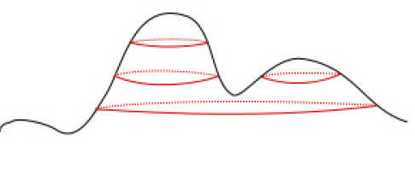
Hamiltonian MC
«potential energy»
Momentum
«kinetic energy»
Figure from: https://www.imperial.ac.uk/inference-group/projects/monte-carlo-methods/hamiltonian-monte-carlo/

Slide 31
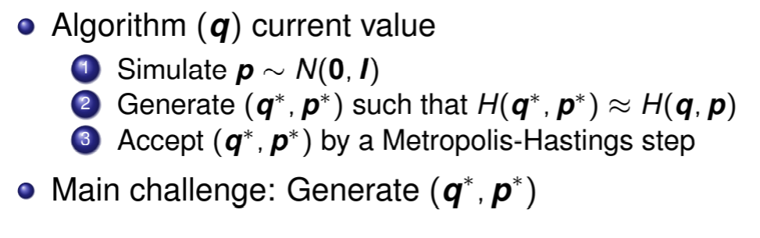
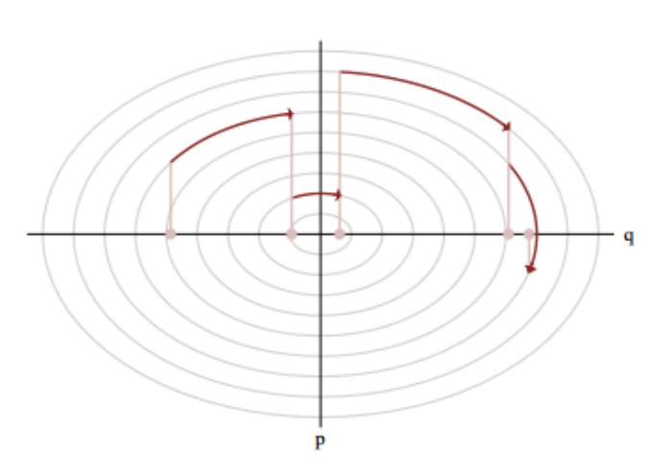
Hamiltonian MC Algorithm
Figure from: https://mucrn.missouri.edu/assets/docs/stanintro_0.pdf

Slide 32
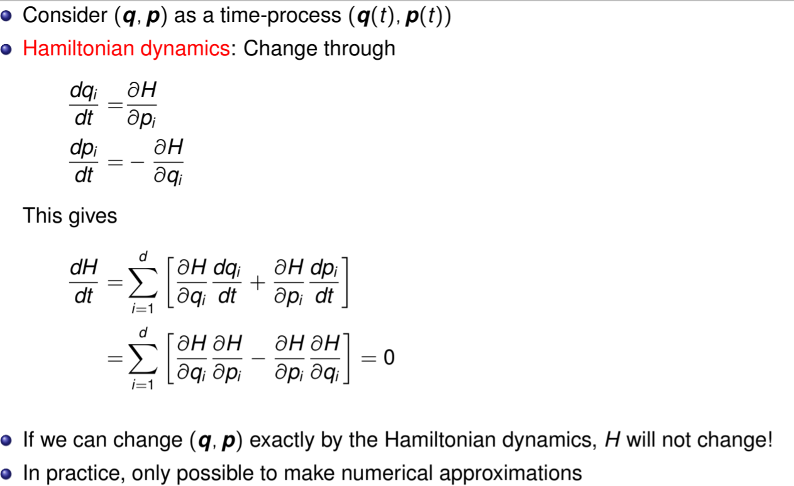
Hamiltonian dynamics preserve energy
«Conservation of energy»
Potential to kinetic
Need to solve equations
for the Hamiltonian Dynamics
by numerical scheeme

Slide 33
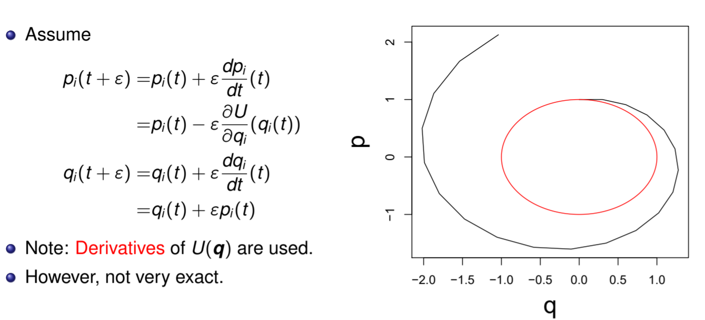
Hamiltonian dynamics - Eulers method
Negative log-density

Slide 34
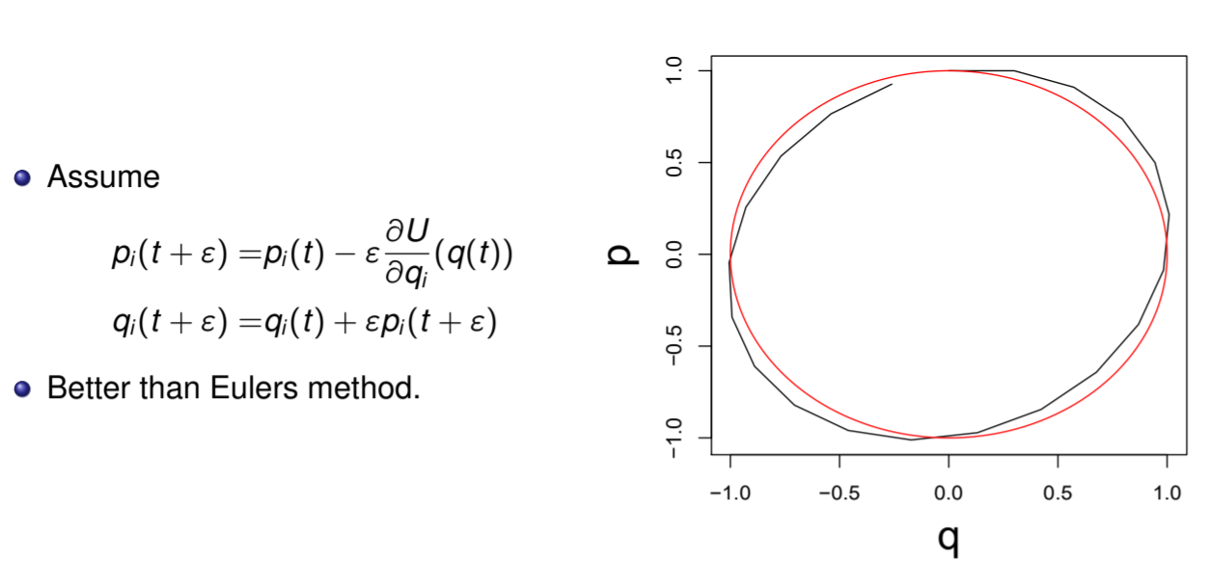
Hamiltonian dynamics - the modified
Eulers method

Slide 35
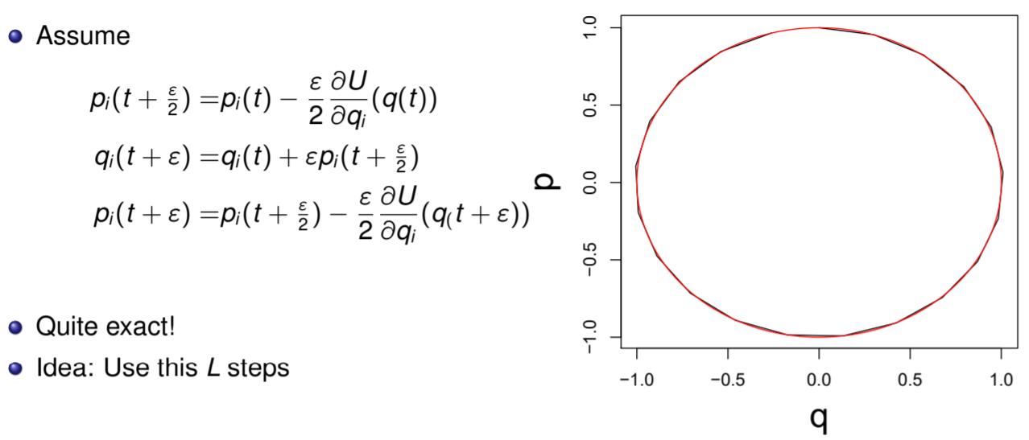
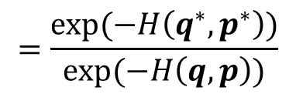
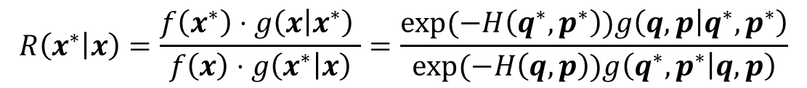
Hamiltonian dynamics – the Leapfrog method
By solving this excact we get the inverse
proposal to be identical and we keep the total energy
(in practice still need to correct for approaximation)
$$R\left(x^{∗} | x\right)=\frac{f\left(x^{∗}\right)⋅g\left(x | x^{∗}\right) }{f\left(x\right)⋅g\left(x^{∗} | x\right)}=\frac{exp⁡(−H\left(q^{∗},p^{∗}\right))g\left(q,p | q^{∗},p^{∗}\right)}{exp(−H\left(q,p\right))g\left(q^{∗},p^{∗} | q,p\right)}$$
$$=\frac{exp⁡(−H\left(q^{∗},p^{∗}\right))}{exp(−H\left(q,p\right))}$$
Notes:
Symplectic groups

Slide 36
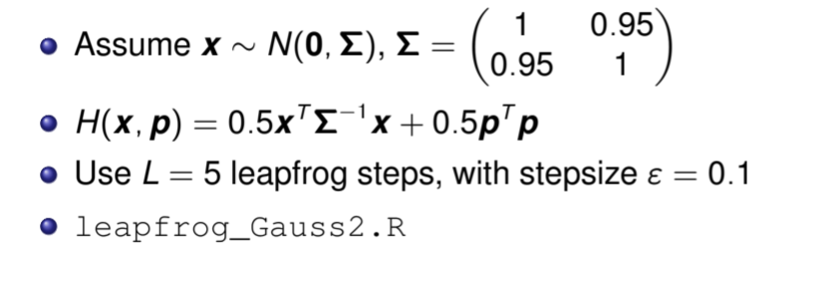
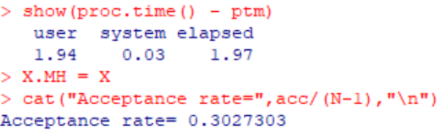


Example - 2-dimensional Gaussian
Standard
Leap - frog

Slide 37


Sets the kinetic energy
Conservation of energy
Metropolis Hastings
(To correct for not conserving the energy perfectly)

Slide 38




Example - mixture Gaussians
)

Slide 39



Slide 40



Random step length

