Slide 1
STK-4051/9051 Computational Statistics Spring 2024
Markov Chain Monte Carlo part 2
Instructor: Odd Kolbjørnsen, oddkol@math.uio.no

Slide 2
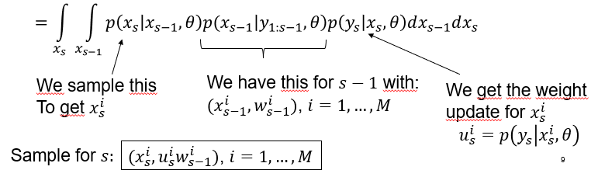
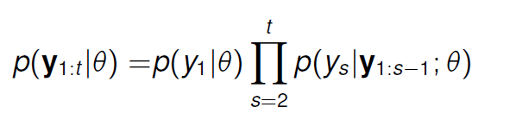
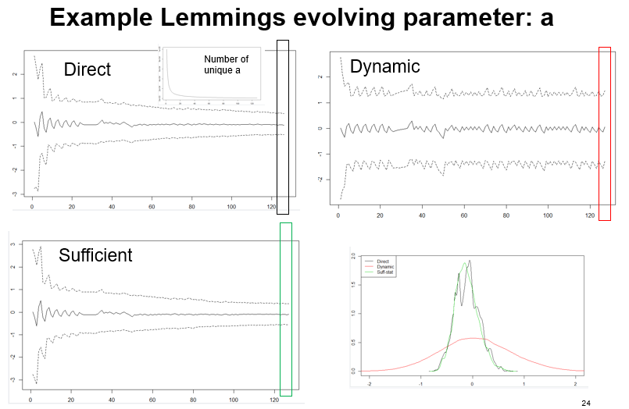
Last time SMC parameter estimation
Maximum likelihood in SMC
Bayesian inference:
  Direct (degenerate?)
  Dynamic
  (not the same model!)
  Sufficient
  (reduces the problem
  of degeneracy)

Slide 3
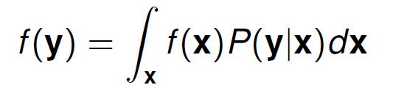


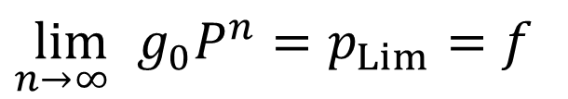
Last time McMC
Markov chain Monte Carlo
  Make a Markov chain P(y|x) with f(x) as
  limiting distribution / stationary distribution
  Markov chain discrete/continuous
  Irreducible, aperiodic, recurrent (always revisit)
${{\lim_{n→∞ }⁡g}_{0}P}^{n}=p_{Lim}=f$
Periodic examples, state transitions
1.0
0.5
A
B
A
1.0
B
$$P(y|x)=\left[\begin{matrix}0 & 1 & 0 \\ 0 & 0 & 1 \\ 1 & 0 & 0\end{matrix}\right]$$
1.0
1.0
$$P(y|x)=\left[\begin{matrix}0 & 0.5 & 0.5 \\ 1 & 0 & 0 \\ 1 & 0 & 0\end{matrix}\right]$$
1.0
C
C
0.5

Slide 4

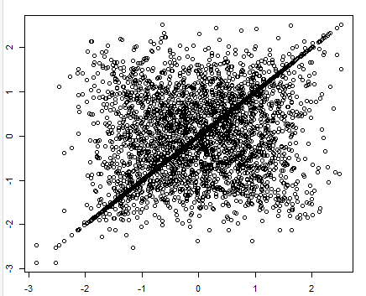
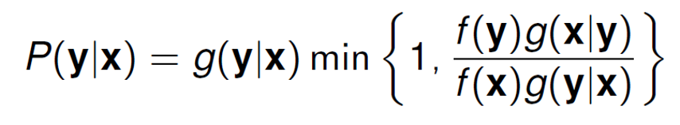
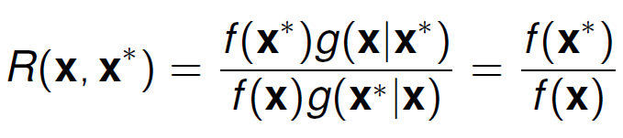
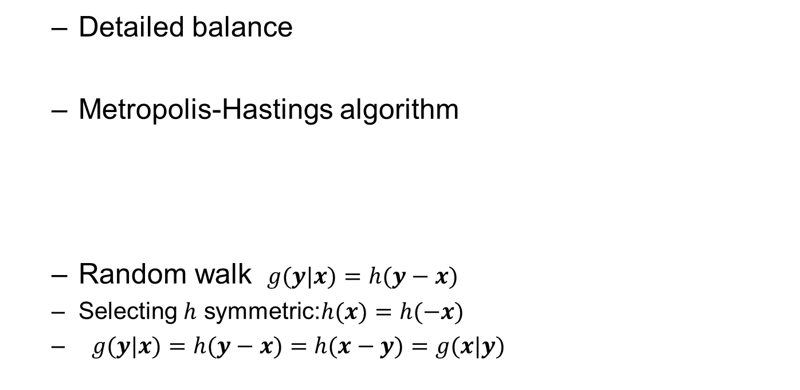

How to construct the chain?
  Detailed balance
  Metropolis-Hastings algorithm
  Random walk $g(y|x)=h(y−x)$
  Selecting $h$ symmetric:$h(x)=h(−x)$
  $g(y|x)=h(y−x)=h(x−y)=g(x|y)$
Lag 1 scatter
$$y≠x$$
Any proposal
MH-Ratio

Slide 5
Today
Multivariate chains
Gibbs sampler
Convergence
Burn in
  remove bias due to a bad start
Mixing
  Effective number of samples
Visual
  sample path
  cumsum diagnostics
  Be aware of apparent convergence
How many chains?
  at least two in «new territory»
Diagnostics
  Gelman-Rubin
Practical
  Monte Carlo variance less than 5%
Acceptance rate
  Independence sampler high
  Random walk not too high

Slide 6
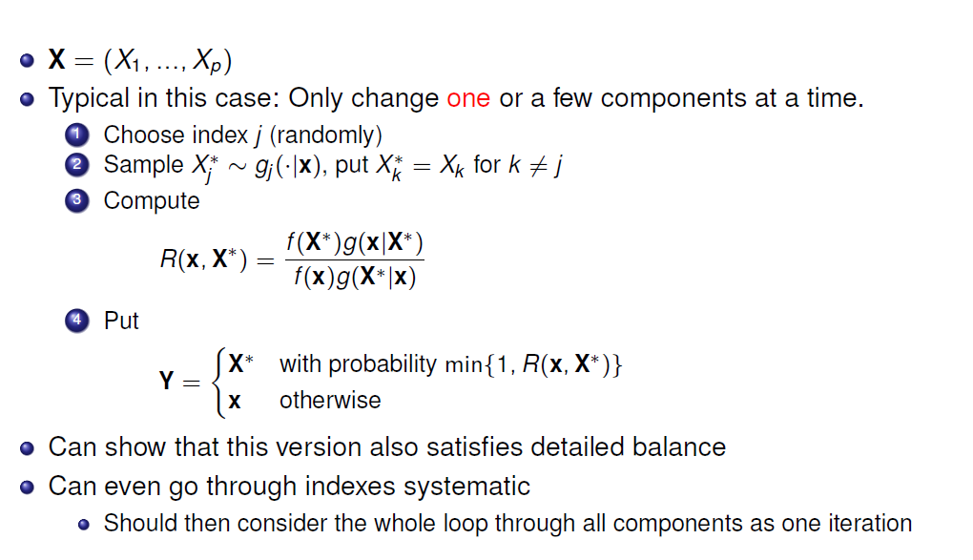
M-H and multivariate settings

Slide 7
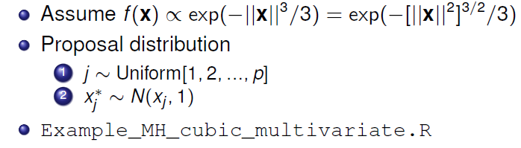
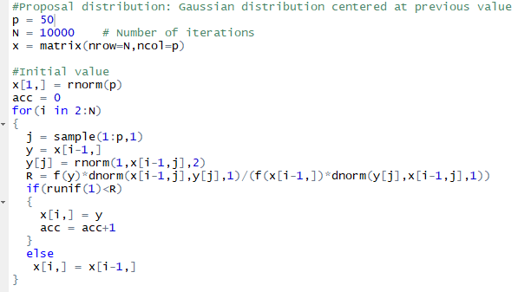
Example multivariate with single coordinate update
See also fixed scan in: Example_MH_cubic_multivariate_2.R

Slide 8
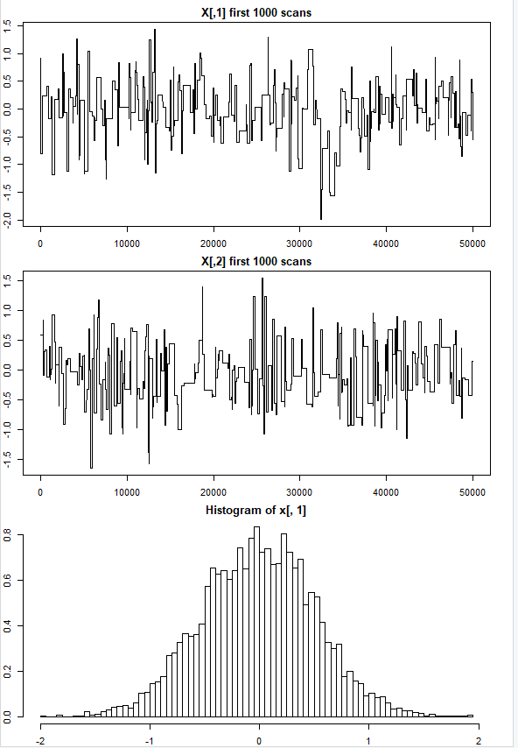
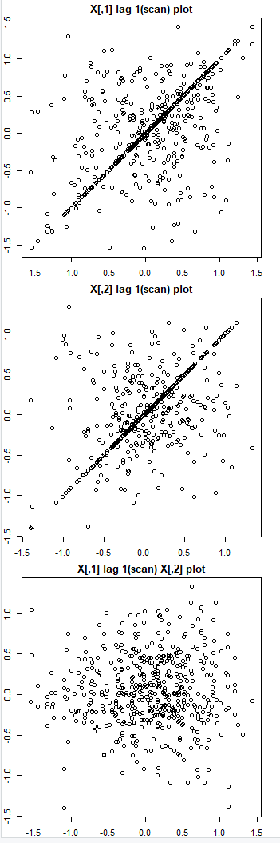
Results independent
Acceptance rate= 0.3053943

Slide 9
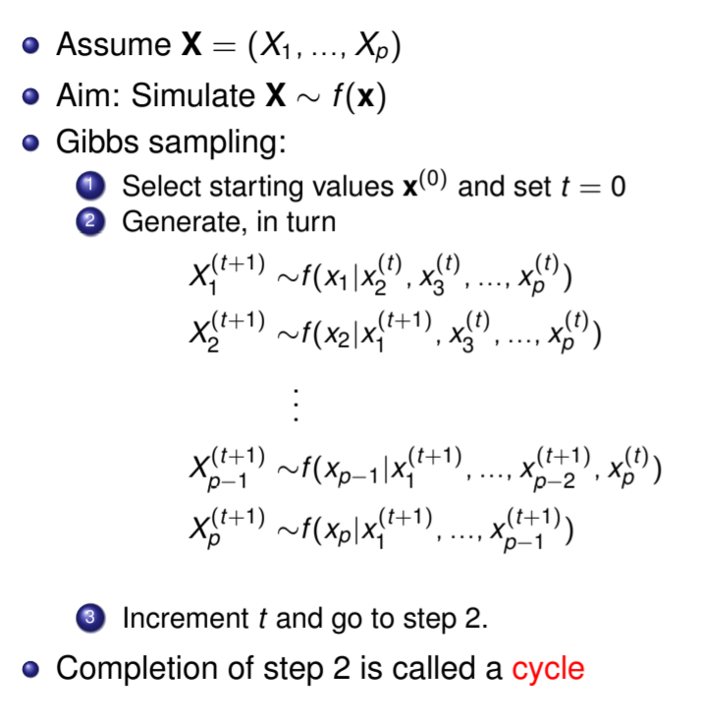





Gibbs sampler
The Metropolis Hastings
Ratio is 1
Notation:
$$=f(x_{1}|x_{−1}^{(t)})$$
$$=f(x_{2}|x_{−2}^{(t)})$$
$$=f(x_{p−1}|x_{−(p−1)}^{(t)})$$
$$=f(x_{p}|x_{−p}^{(t)})$$
All x’es except $x_{p}$

Slide 10

Gibbs sampler is popular in
Bayesian inference
Has acceptance rate (MH-Ratio) 1 [show this later]
Use analytical results to speed up computation
Often easy to evaluate the conditional distribution given everything else being fixed.
Gives «tailor made» algorithms
  Good and bad
Example Bayesian inference:
$$f\left(θ | x\right)∝f\left(θ\right)L(θ|x)$$
Posterior distribution is proportional to prior distribution times the likelihood

Slide 11
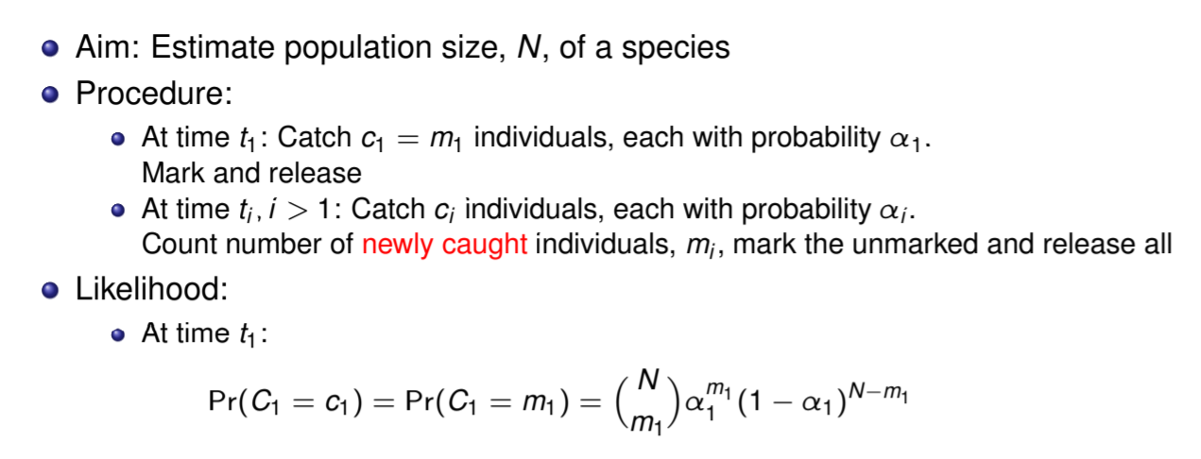
Example capture recapture
c = catch
m = mark (new)
Note: N is a parameter
no proportionality trick 😐

Slide 12
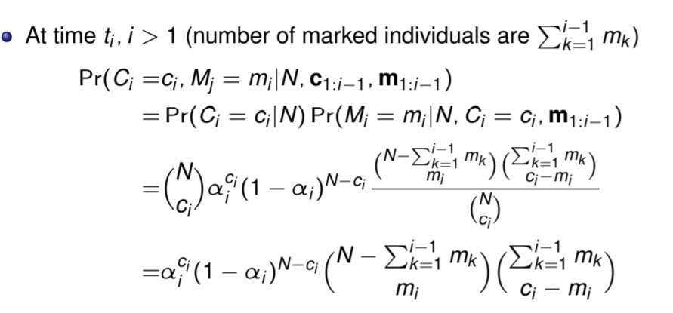
Capture recapture cont…

Slide 13
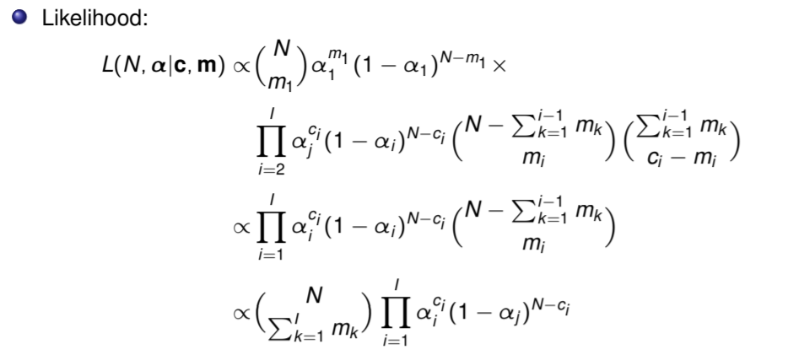
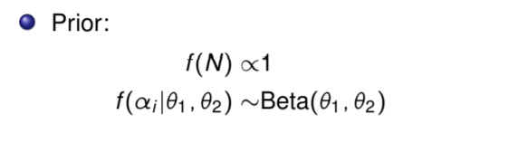
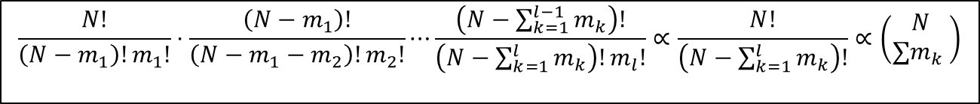
Capture recapture cont…
$$\frac{N!}{\left(N−m_{1}\right)!m_{1}!}⋅\frac{\left(N−m_{1}\right)!}{\left(N−m_{1}−m_{2}\right)!m_{2}!}⋯\frac{\left(N−\sum_{k=1}^{l−1}{m_{k}}\right)!}{\left(N−\sum_{k=1}^{l}{m_{k}}\right)!m_{l}!}∝\frac{N!}{\left(N−\sum_{k=1}^{l}{m_{k}}\right)!}∝\left(\begin{matrix}N \\ ∑m_{k} \end{matrix}\right)$$

Slide 14



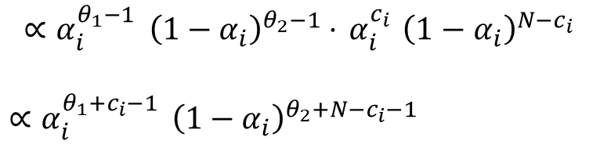
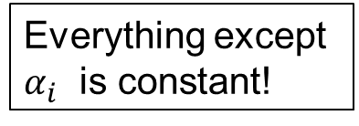
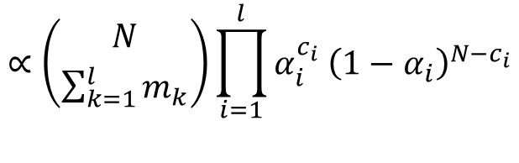
The conditional distribution of α$i$
$${{∝α}_{i}^{θ_{1}−1 } \left(1−α_{i}\right)}^{θ_{2}−1}$$
Likelihood:
$$∝\left({N \atop \sum_{k=1}^{l}{m_{k}}}\right)\prod_{i=1}^{l}{{α_{i}^{c_{i}} \left(1−α_{i}\right)}^{N−c_{i}}}$$
Everything except
$α_{i}$ is constant!
Posterior:
$$∝{{α_{i}^{θ_{1}−1 } \left(1−α_{i}\right)}^{θ_{2}−1}⋅{ α}_{i}^{c_{i}} \left(1−α_{i}\right)}^{N−c_{i}}$$
$∝{α_{i}^{θ_{1}+c_{i}−1 } \left(1−α_{i}\right)}^{θ_{2}+N−c_{i}−1}$
$$∝Beta(θ_{1}+c_{i},θ_{2}+N−c_{i})$$

Slide 15

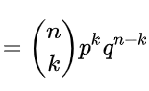
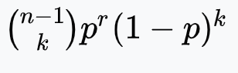
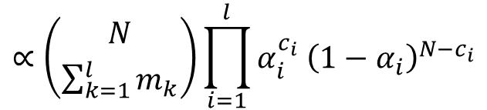

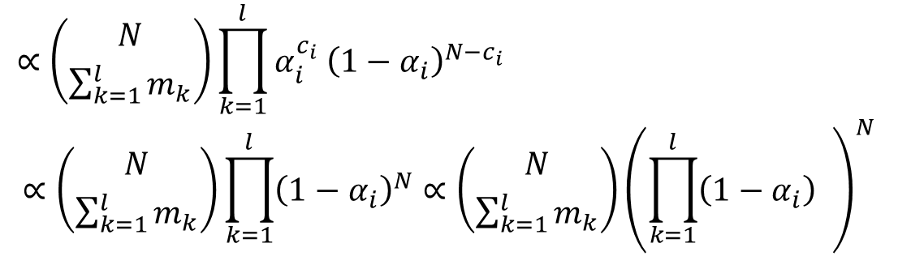

The conditional distribution of N
Likelihood:
Everything except
N is constant!
$$∝\left({N \atop \sum_{k=1}^{l}{m_{k}}}\right)\prod_{i=1}^{l}{{α_{i}^{c_{i}} \left(1−α_{i}\right)}^{N−c_{i}}}$$
Posterior:
$$∝\left({N \atop \sum_{k=1}^{l}{m_{k}}}\right)\prod_{k=1}^{l}{{α_{i}^{c_{i}} \left(1−α_{i}\right)}^{N−c_{i}}}$$
$$∝\left({N \atop \sum_{k=1}^{l}{m_{k}}}\right)\prod_{k=1}^{l}{{\left(1−α_{i}\right)}^{N}}∝\left({N \atop \sum_{k=1}^{l}{m_{k}}}\right){\left(\prod_{k=1}^{l}{\left(1−α_{i}\right)} \right)}^{N}$$
Binomial
Negative binomial $k=n−r≥0$
$$\operatorname{Pr}\left(X=n\right)=$$

Slide 16
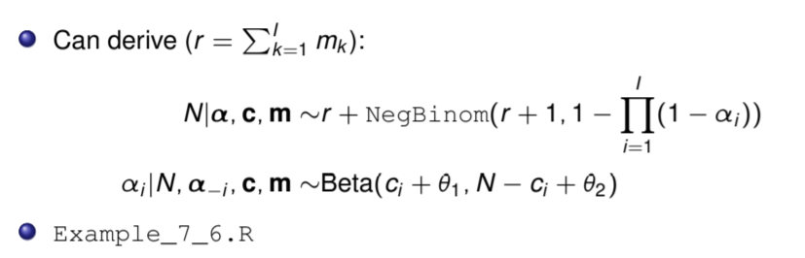
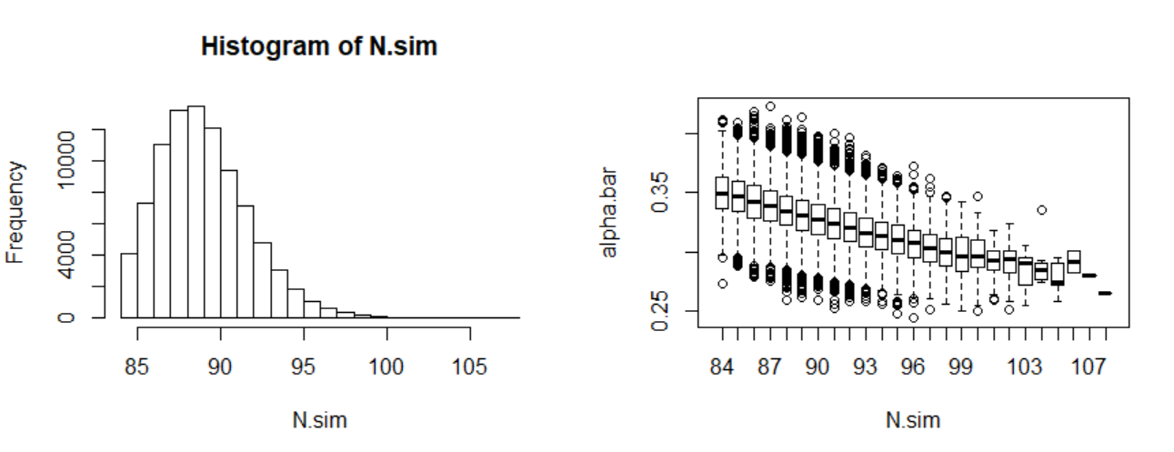
Capture recapture cont…

Slide 17
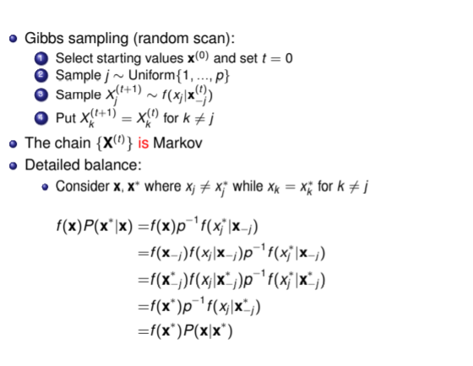

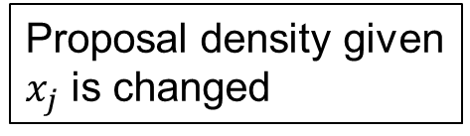

Properties of Gibbs sampler-random scan
Pr($x_{j}$ is changed)
Proposal density given
$x_{j}$ is changed
$$x_{−j}=x_{−j}^{∗}$$

Slide 18
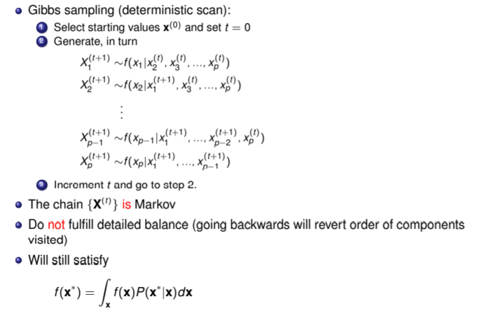
Gibbs sampler-deterministic scan

Slide 19
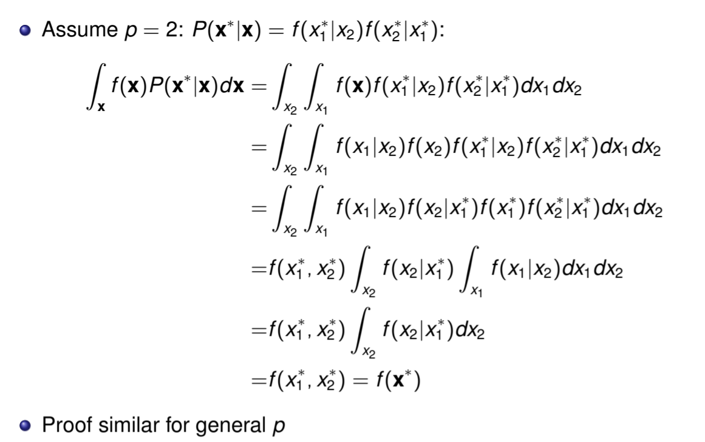
Proof d=2
=1
=1

Slide 20
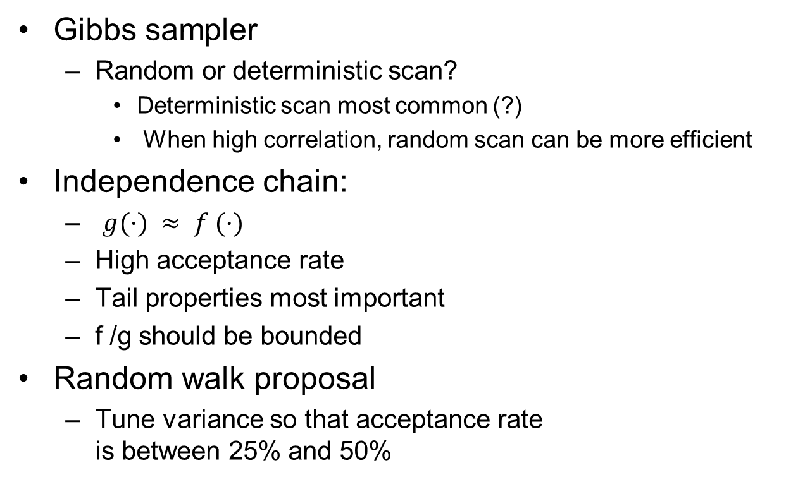
Choices
My experience:
Random is robust
You should rather spend time improving other parts of code
Gibbs sampler
  Random or deterministic scan?
    Deterministic scan most common (?)
    When high correlation, random scan can be more efficient
Independence chain:
  $g(·) ≈ f (·)$
  High acceptance rate
  Tail properties most important
  f /g should be bounded
Random walk proposal
  Tune variance so that acceptance rate
  is between 25% and 50%

Slide 21
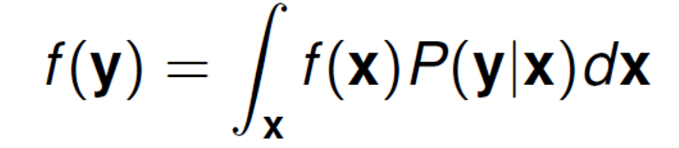

Requirement for convergence
Markov chain:
  is Irreducible: you can visit all of parameter space
  is Aperiodic : you do not go in loop
  Is Recurrent : you will always return to a set
  Has the correct stationary distribution
Detailed balance:
Sufficient for stationary distribution
$$f\left(y\right)P\left(x | y\right)=f\left(x\right)P(y|x)$$
No guarantee for the other three

Slide 22
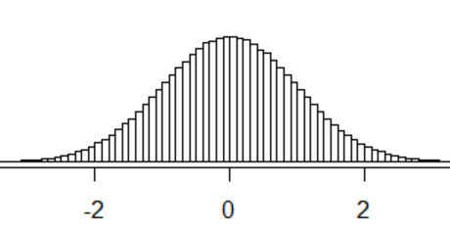
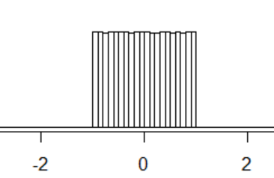
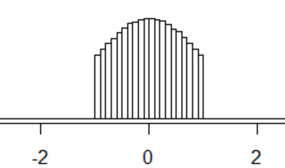
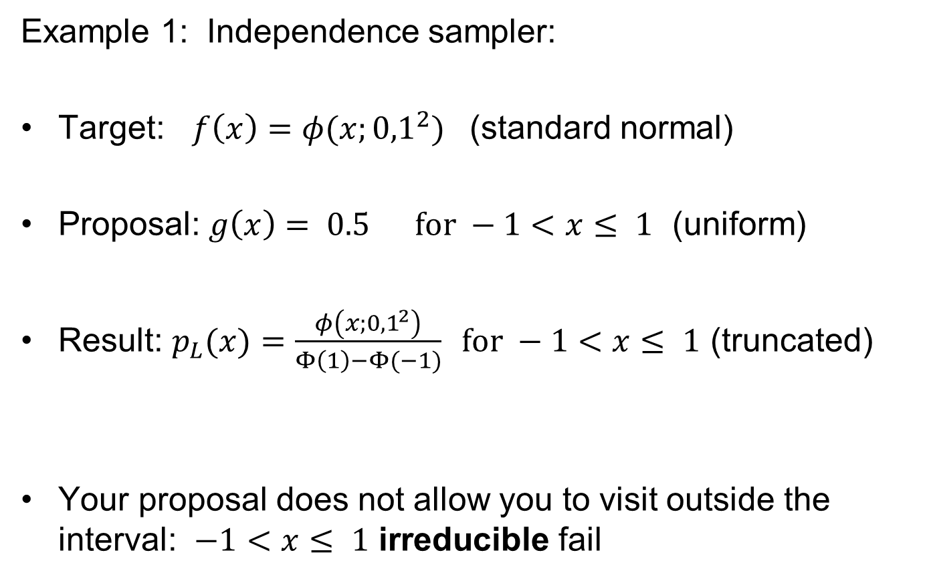
Error in independence sampler
Example 1: Independence sampler:
Target: $f\left(x\right)=φ(x;{0,1}^{2})$ (standard normal)
Proposal: $g\left(x\right)= 0.5 for −1<x≤ 1$ (uniform)
Result: $p_{L}(x)=\frac{φ\left(x;{0,1}^{2}\right)}{Φ\left(1\right)−Φ(−1)} for −1<x≤ 1$ (truncated)
Your proposal does not allow you to visit outside the interval: $−1<x≤ 1$ irreducible fail

Slide 23
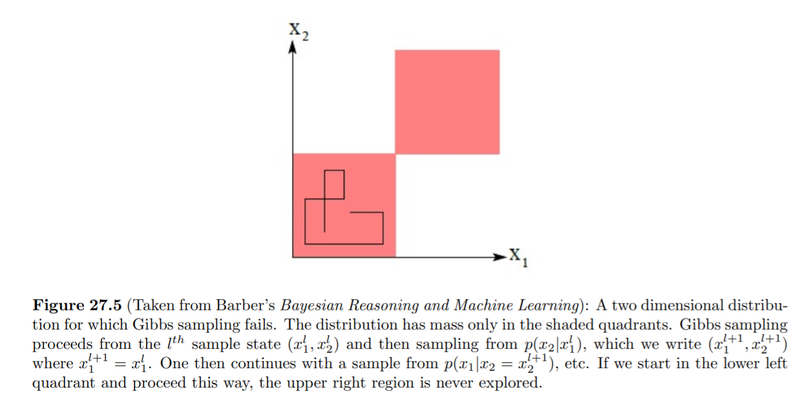
Gibbs sampler failure, not irreducible
MCMC and Bayesian Modeling(2017), Martin Haugh Columbia University
(under resources on course page)

Slide 24
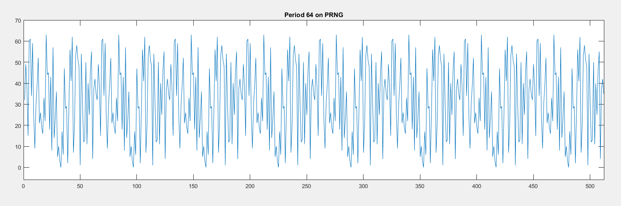
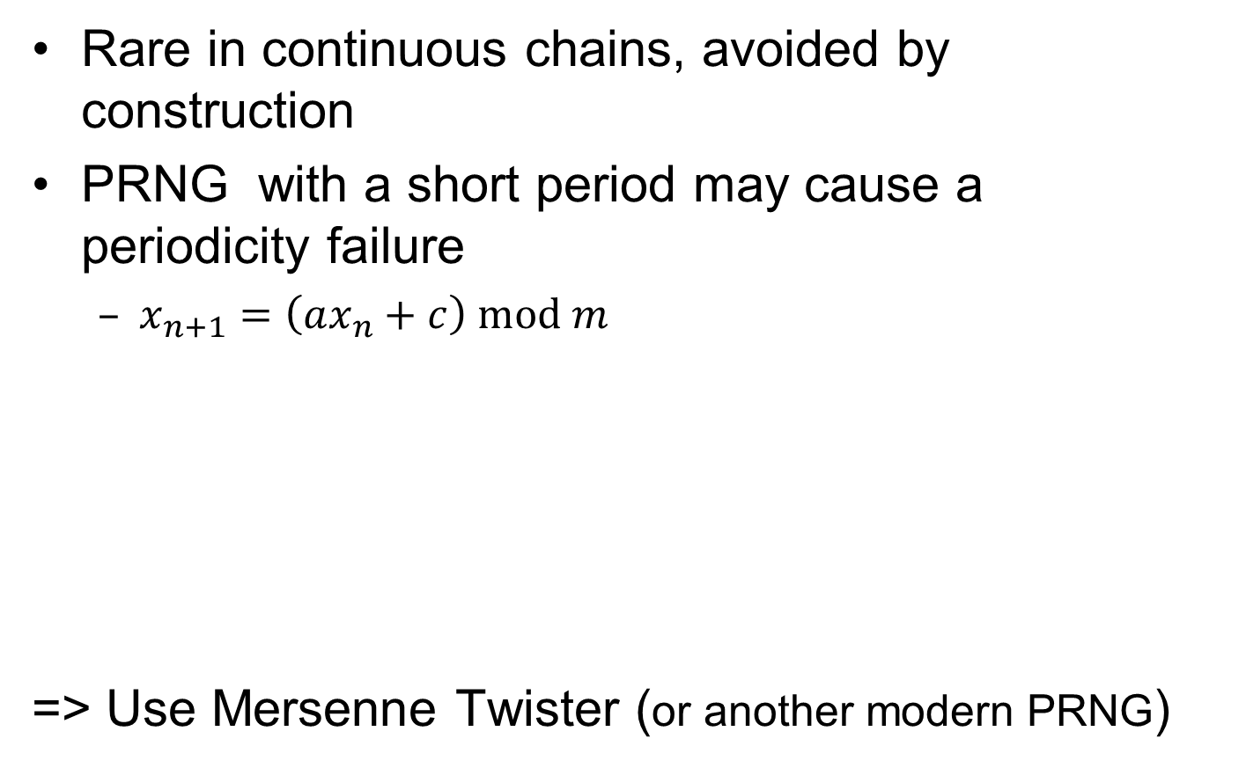
When does a MCMC fail periodicity?
Rare in continuous chains, avoided by construction
PRNG with a short period may cause a
periodicity failure
  $x_{n+1}=\left(ax_{n}+c\right) mod m$
=> Use Mersenne Twister (or another modern PRNG)

Slide 25
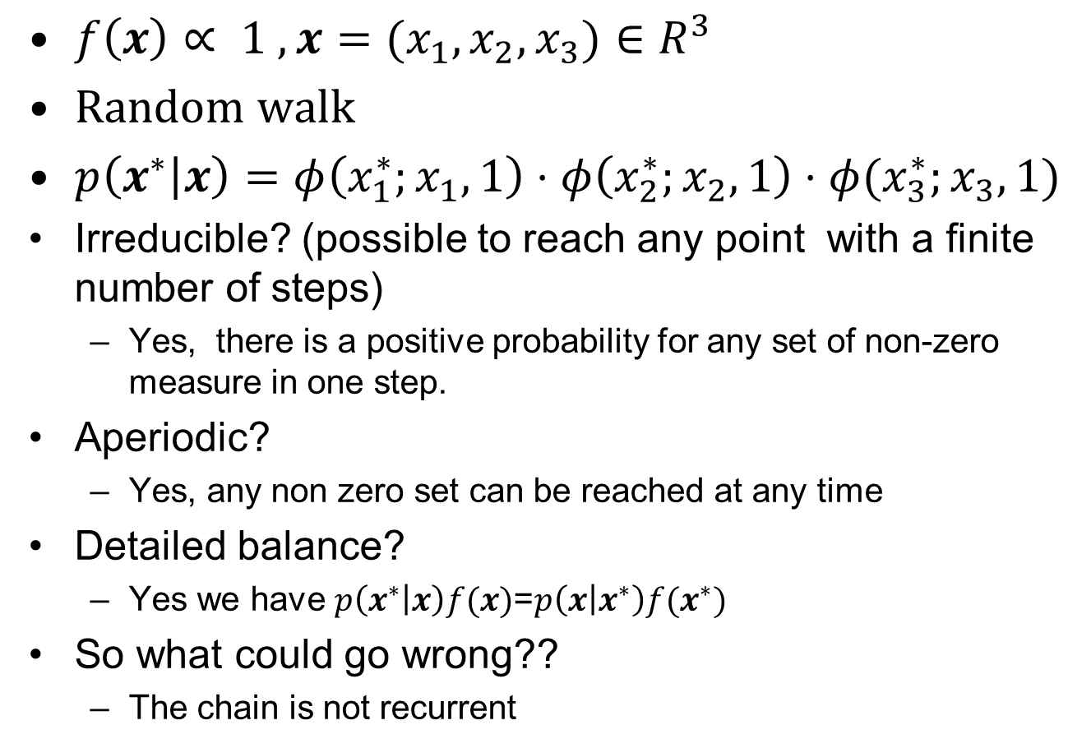
Example recurrent fail : improper prior
$f\left(x\right)∝ 1 , x=(x_{1},x_{2},x_{3})∈R^{3}$
Random walk
$p\left(x^{∗} | x\right)=φ\left(x_{1}^{∗};x_{1},1\right)⋅φ\left(x_{2}^{∗};x_{2},1\right)⋅φ(x_{3}^{∗};x_{3},1)$
Irreducible? (possible to reach any point with a finite number of steps)
  Yes, there is a positive probability for any set of non-zero measure in one step.
Aperiodic?
  Yes, any non zero set can be reached at any time
Detailed balance?
  Yes we have $p\left(x^{∗} | x\right)f(x)$=$p\left(x | x^{∗}\right)f(x^{∗})$
So what could go wrong??
  The chain is not recurrent

Slide 26
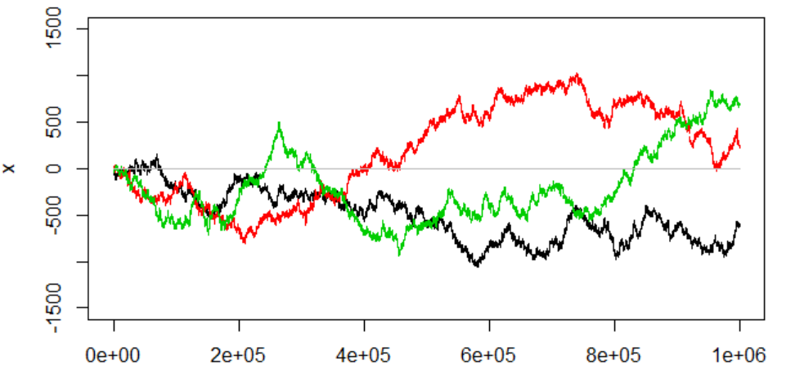
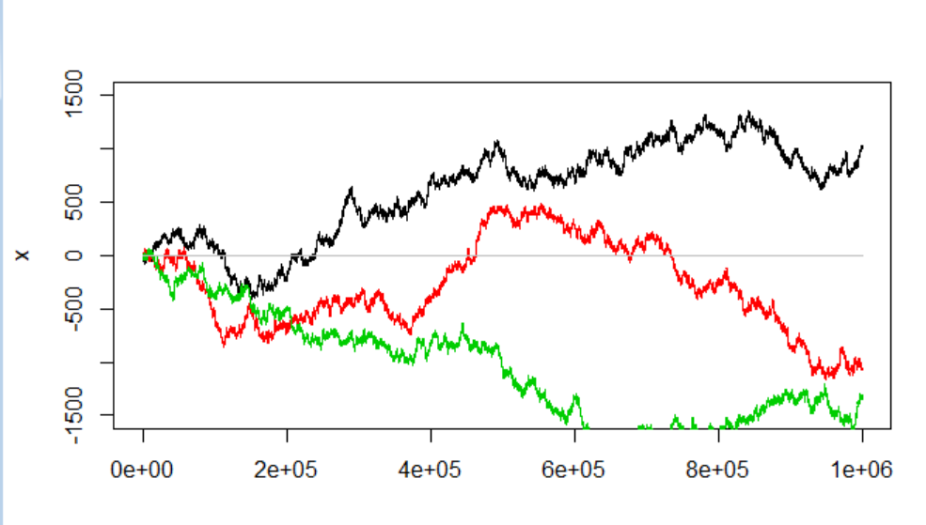

Example random walk in $R^{3}$
If you get sample paths like these, you might have a recurrence issue
Perhaps your target distribution is not a proper distribution
[not easy to tell upfront]
If you safeguard yourself against zero density regions by setting a minimum density value.
[you get into trouble]

Slide 27
Reccurent fail
Since we often work with log density a probability of zero causes problems. A quick fix could be to allow the probability to be slightly positive everywhere.
This is not a good solution
  Having a small probability for everything gives problems ☹
  => Mc fail to be recurrent
If you get
out here and dimension
is larger than 2 chances
are that you will never
return to «central part»

Slide 28
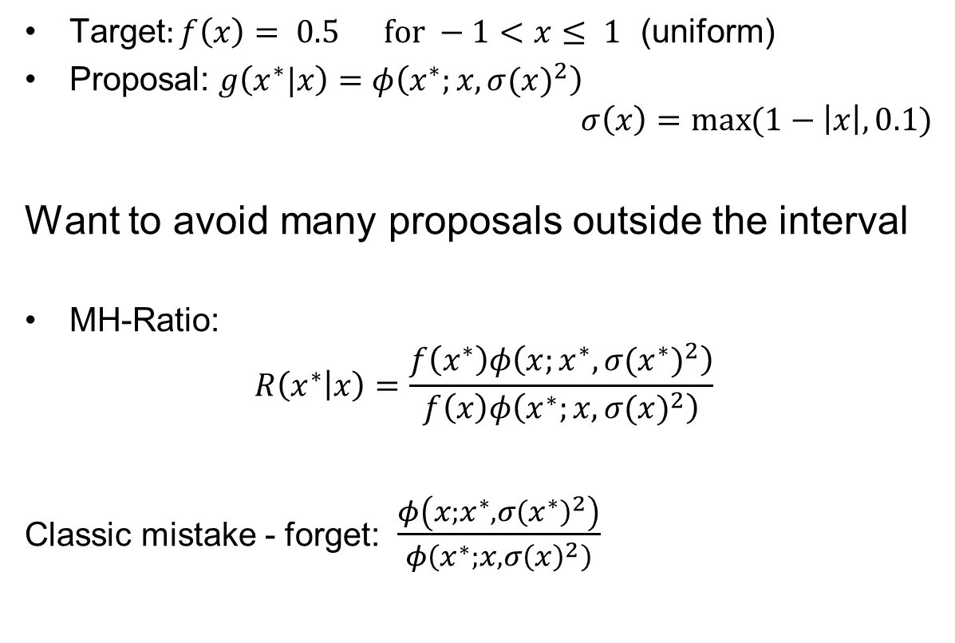
Example where we it is easy to overlook detailed balance (and it matters)
Target$:f\left(x\right)= 0.5 for −1<x≤ 1$ (uniform)
Proposal: $g\left(x^{∗}|x\right)=φ\left(x^{∗};x,{σ(x)}^{2}\right)$
$$σ\left(x\right)=\max{(1−\left|x\right|,0.1)}$$
Want to avoid many proposals outside the interval
MH-Ratio:
$$R\left(x^{∗} | x\right)=\frac{f\left(x^{∗}\right)φ\left(x;x^{∗},{σ(x^{∗})}^{2}\right)}{f\left(x\right)φ\left(x^{∗};x,{σ(x)}^{2}\right)}$$
Classic mistake - forget: $\frac{φ\left(x;x^{∗},{σ\left(x^{∗}\right)}^{2}\right)}{φ\left(x^{∗};x,{σ\left(x\right)}^{2}\right)}$

Slide 29
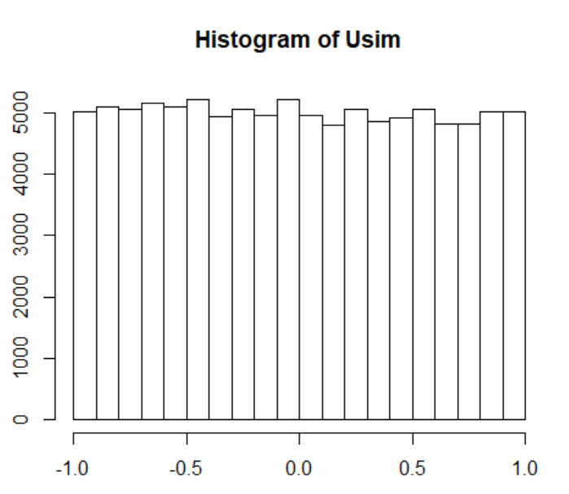
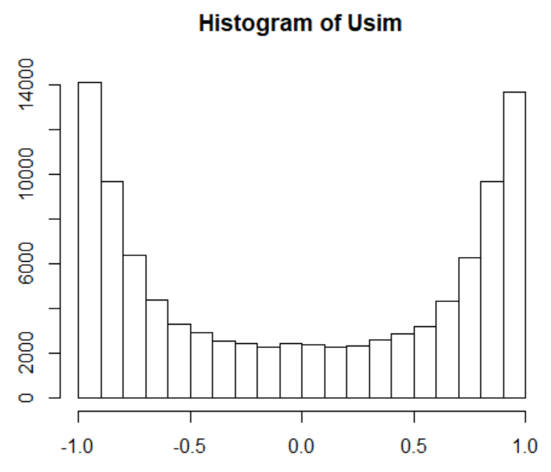
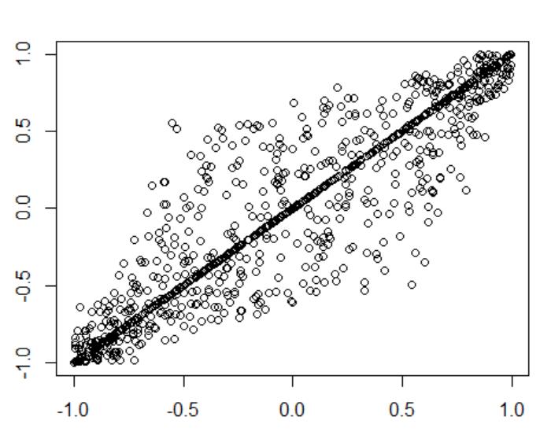
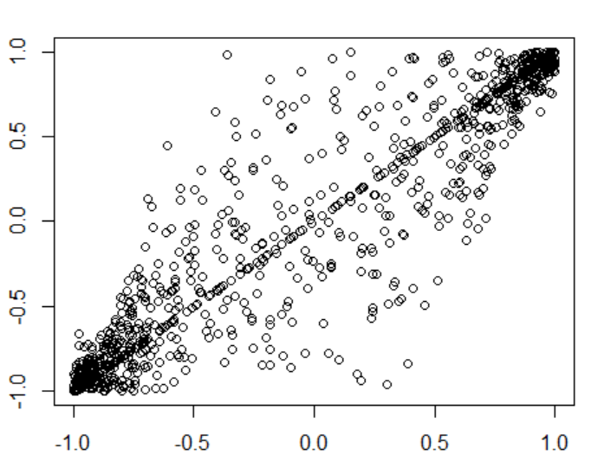

Results with and without error:
☺
Forget: ☹
$\frac{φ\left(x;x^{∗},{σ\left(x^{∗}\right)}^{2}\right)}{φ\left(x^{∗};x,{σ\left(x\right)}^{2}\right)}$
Too easy to move from center hard to return since variance on edge is smaller

Slide 30


Now: Convergence in practice
Burn in
  remove bias due to a bad start
Mixing
  Effective number of samples
Visual
  sample path
  cumsum diagnostics
  Be aware of apparent convergence
How many chains?
  at least two in «new territory»
Diagnostics
  Gelman-Rubin
Practical
  Monte Carlo variance less than 5%
Acceptance rate
  Independence sampler high
  Random walk not too high
Need a check of all model parameters!
(and important functions)

Slide 31


Convergence issues of MCMC
D is denoted «burn in»

Slide 32

Mixing

Slide 33



acf=autocorrelation function
Corresponding covariance matrix:$Σ$
$$Var\left(\frac{1}{L}\sum_{i=1}^{L}{x_{i}}\right)={\frac{1}{L^{2}}1}^{T}Σ1=\frac{1}{L^{2}}\sum_{i=1}^{L}{\sum_{j=1}^{L}{σ_{ij}}=\frac{σ^{2}}{L^{2}}\sum_{i=1}^{L}{\sum_{j=1}^{L}{ρ_{ij}}}}$$
$$\sum_{i=1}^{L}{\sum_{j=1}^{L}{ρ_{ij}}=L+2\sum_{h=1}^{L−1}{ (L−h) ρ(h)}≈}L+2L\sum_{h=1}^{R}{ ρ(h)}$$
$$Var\left(\frac{1}{L}\sum_{i=1}^{L}{x_{i}}\right)=\frac{σ^{2}}{L}\left(1+2\sum_{h=1}^{R}{ ρ\left(h\right)}\right)$$
$$1+2\sum_{h=1}^{R}{ ρ(h)}=2\left(\sum_{h=0}^{R}{ ρ\left(h\right)}\right) −1$$

Slide 34

Effective sample size for MCMC

Slide 35
Convergence for all
We can have the situation that: some variables mix well while other have bad mixing
Need to check
  Each model parameter
  Important functions of model parameters
Consider also
  Likelihood and/or posterior density (to proportionality)
Convergence check is essential, the McMC code is not complete without it.

Slide 36

Visual inspection of chain

Slide 37

Gibbs sampler for the Bivariate normal distribution
Will work well
Bad mixing

Slide 38

How to assess convergence
Bad
Better

Slide 39
Apparent convergence

Slide 40

Use multiple chains to visually check convergence

Slide 41

Number of chains

Slide 42

The Gelman-Rubin diagnostic

Slide 43

Example: Exercise 7.8

Slide 44

Data uncertainty and Monte Carlo uncertainty (a practical approach)
Practical argument: since the uncertainty in h(X) has a
fixed uncertainty (for a give dataset), it makes little sense
to estimate the mean with an accuracy several orders below.

Slide 45
McMC:
General Markov chain theory
Specific chains:
  Random walk chain
  Independent chain
  Gibbs sampler
Convergence
  Burnin
  Mixing
  Effective sample size
  Visual
  Multple chains
  Diagnostics: Gelman-Rubin
  Monte Carlo variance less than 5%
  Acceptance rate
    Independence sampler high
    Random walk not too high
Next time:
Tricks to customize sampling
  Augmentation
  Block update
  Reparametrize
  Hybrid
  Griddy-Gibbs

