Slide 1
STK-4051/9051 Computational Statistics Spring 2024
Sequential Monte Carlo
Instructor: Odd Kolbjørnsen, oddkol@math.uio.no

Slide 2
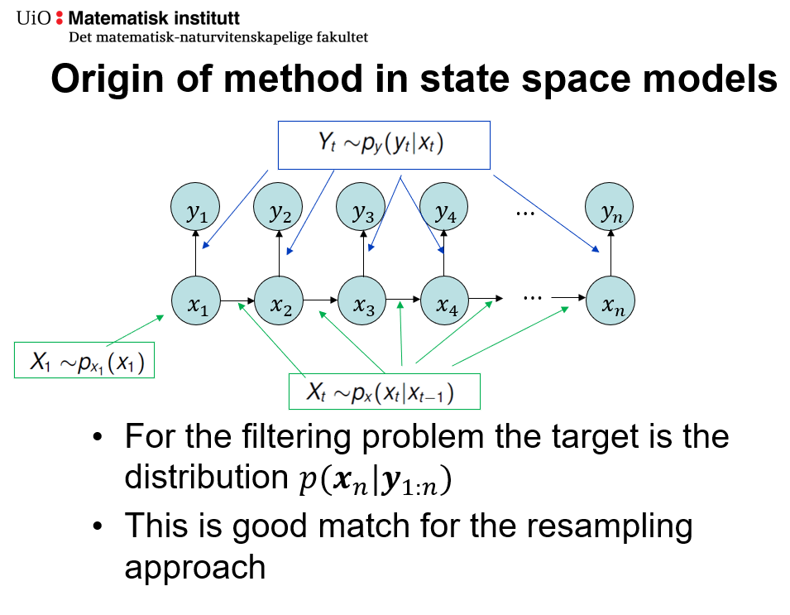
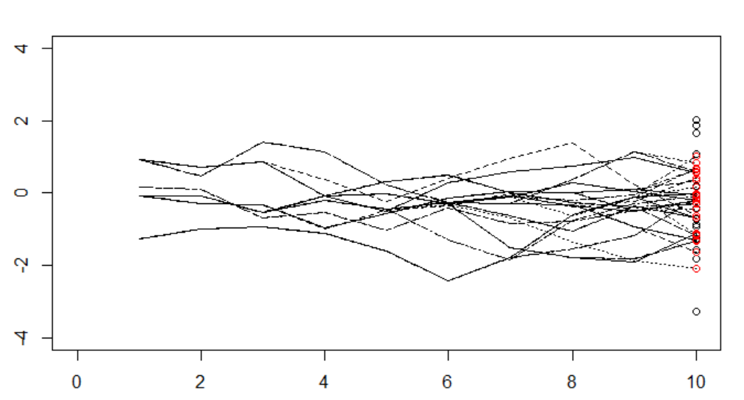
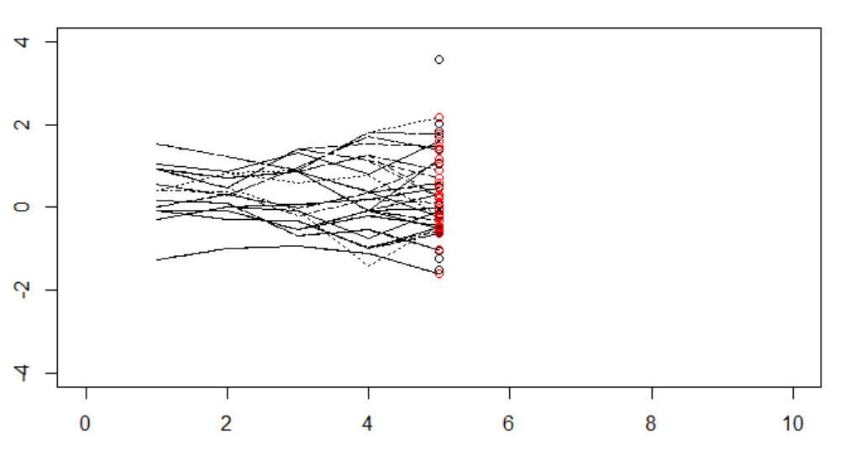




Last time
SMC
  Particle filter SMC with resampling
  Bootstrap filter proposal from prior
SMC use case:
  GPS
  Terrain navigation
  Robot location on a map
  COVID
$$f\left(x_{n}|y_{1:n}\right)$$
$$f\left(x_{1:n}|y_{1:n}\right)$$
$$f\left(x_{t}|y_{1:t}\right)$$
$$f\left(x_{t}|y_{1:n}\right)$$

Slide 3
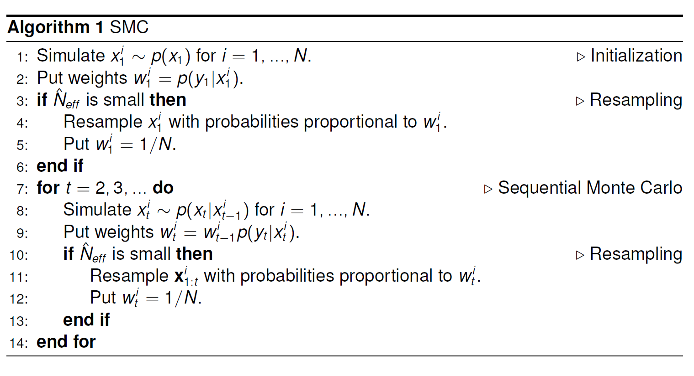
Bootstrap filter

Slide 4
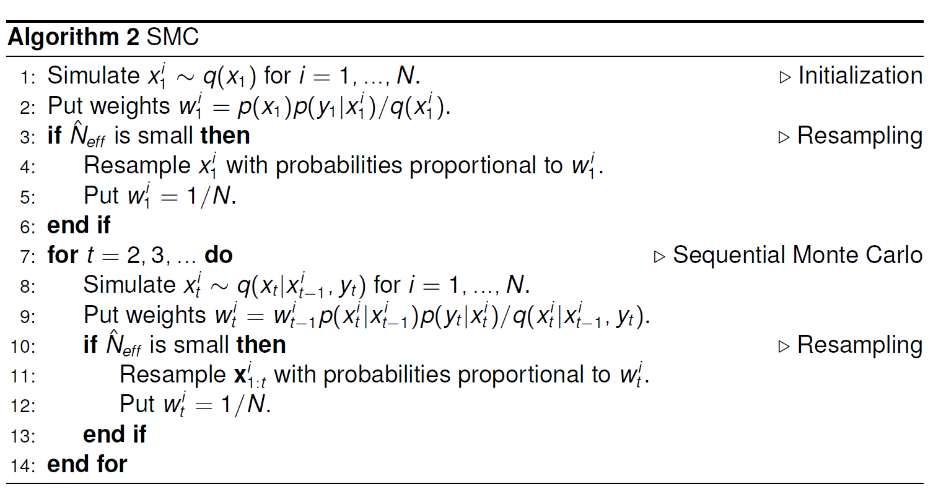

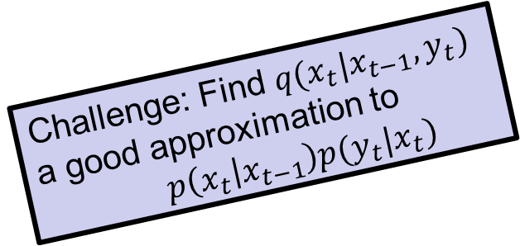
General algorithm particle filter
Challenge: Find $q(x_{t}|x_{t−1},y_{t})$
a good approximation to
$p\left(x_{t} | x_{t−1}\right)p(y_{t}|x_{t})$
Could also have: $q(x_{1}^{i}|y_{1})$

Slide 5
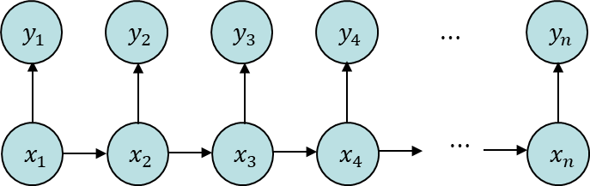
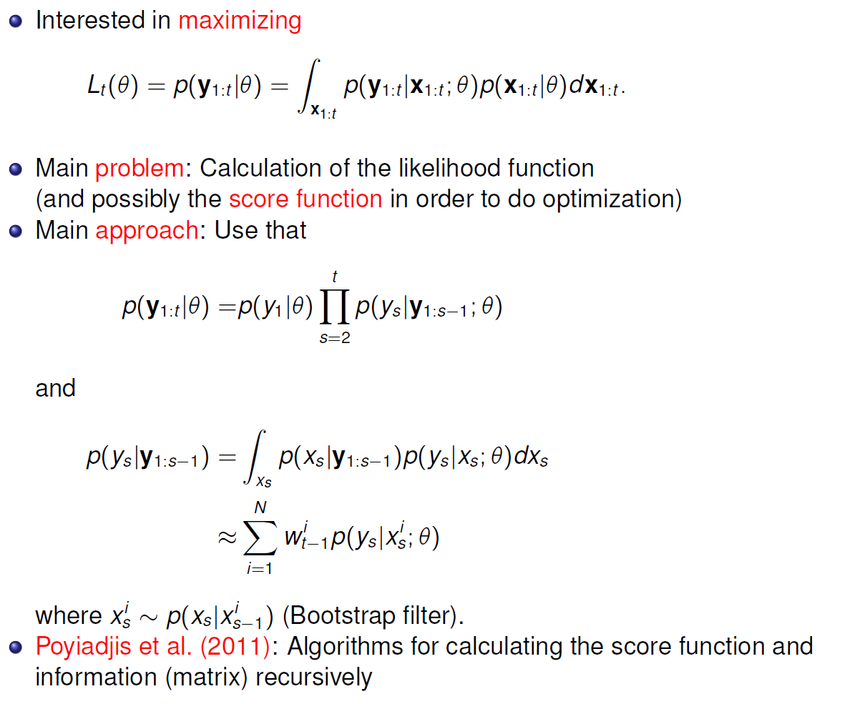
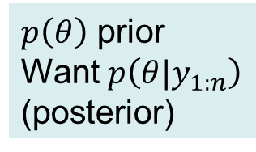

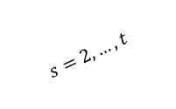

Today
Inference in Markov models
Maximum likelihood
  Likelihood by sampling (bootstrap filter)
Bayesian approach
  Direct approach
  Dynamic approach
  Sufficient statistics
$θ$
$$θ=?$$
$$s=2,…,t$$
$p\left(θ\right)$ prior
Want $p\left(θ|y_{1:n}\right)$
(posterior)

Slide 6
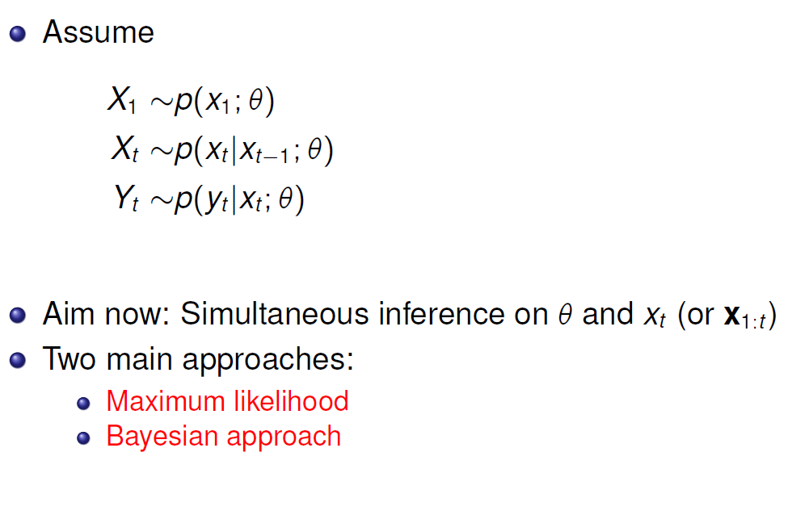
SMC and parameter estimation
Hidden Markov model
With unknown parameters
(we saw this type of model
in lecture 4, EM for HMM )

Slide 7
SMC and maximum likelihood

Slide 8

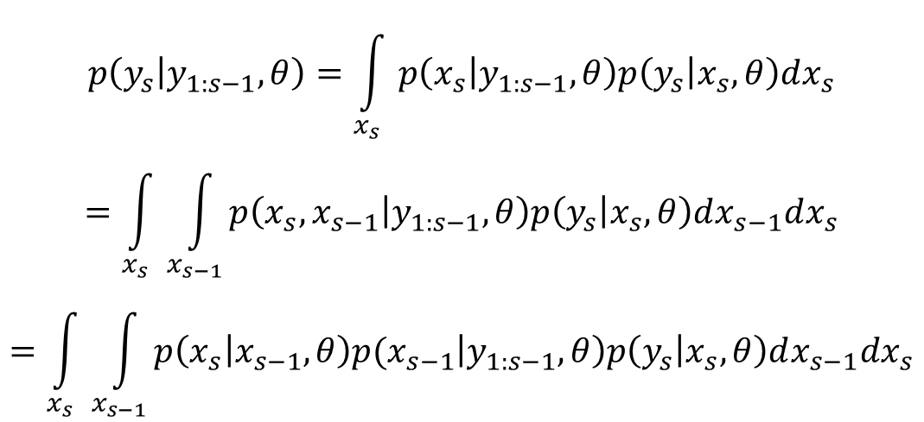

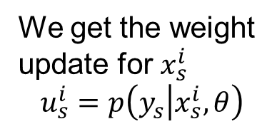

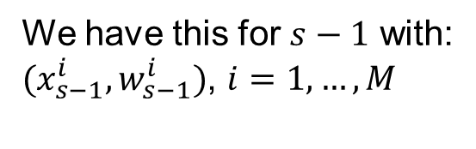
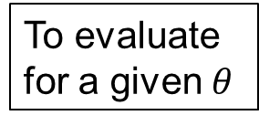
Maximum likelihood in SMC
To evaluate
for a given $θ$
$$p\left(y_{s} | y_{1:s−1},θ\right)=\int_{x_{s}}{p\left(x_{s} | y_{1:s−1},θ\right)p\left(y_{s} | x_{s},θ\right)dx_{s}}$$
$$=\int_{x_{s}}{\int_{x_{s−1}}{p\left(x_{s},x_{s−1} | y_{1:s−1},θ\right)p\left(y_{s} | x_{s},θ\right)dx_{s−1}dx_{s}}}$$
$$=\int_{x_{s}}{\int_{x_{s−1}}{p\left(x_{s}\left|x_{s−1},θ\right)p(x_{s−1} | y_{1:s−1},θ\right)p\left(y_{s} | x_{s},θ\right)dx_{s−1}dx_{s}}}$$
We sample this
To get $x_{s}^{i}$
We have this for $s−1$ with:
$(x_{s−1}^{i},w_{s−1}^{i})$, $i=1,…,M$
We get the weight
update for $x_{s}^{i}$
$$u_{s}^{i}=p\left(y_{s} | x_{s}^{i},θ\right)$$
Sample for $s:$
$(x_{s}^{i},{u_{s}^{i}w}_{s−1}^{i})$, $i=1,…,M$

Slide 9
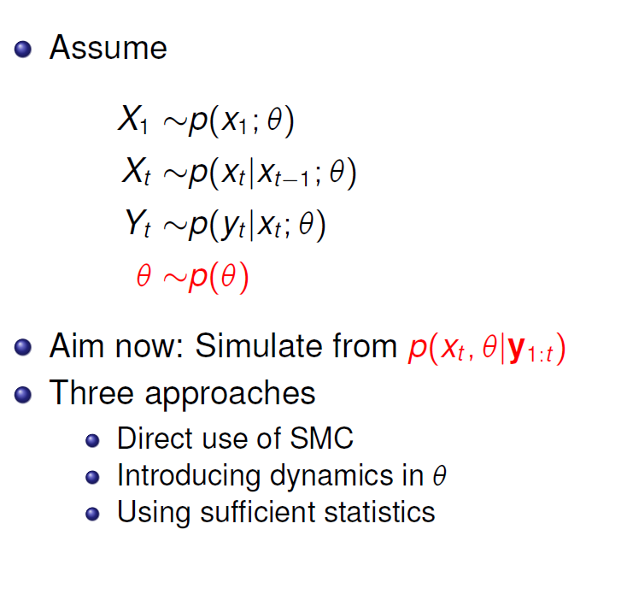
SMC and Bayesian parameter estimation

Slide 10
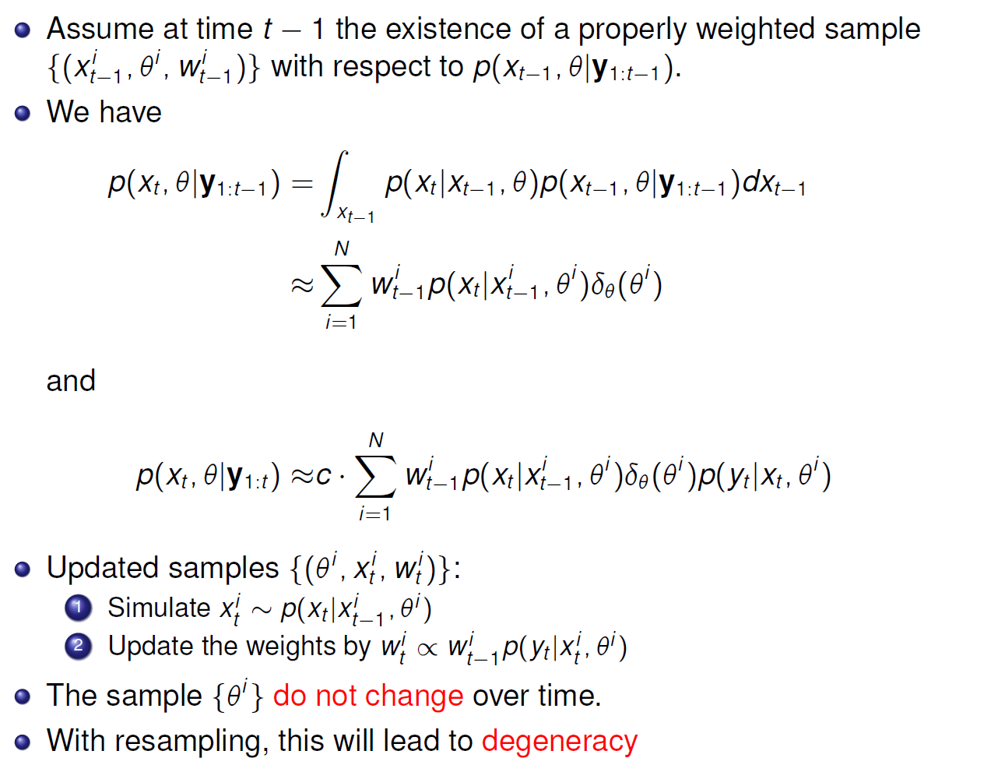
Direct use of SMC

Slide 11
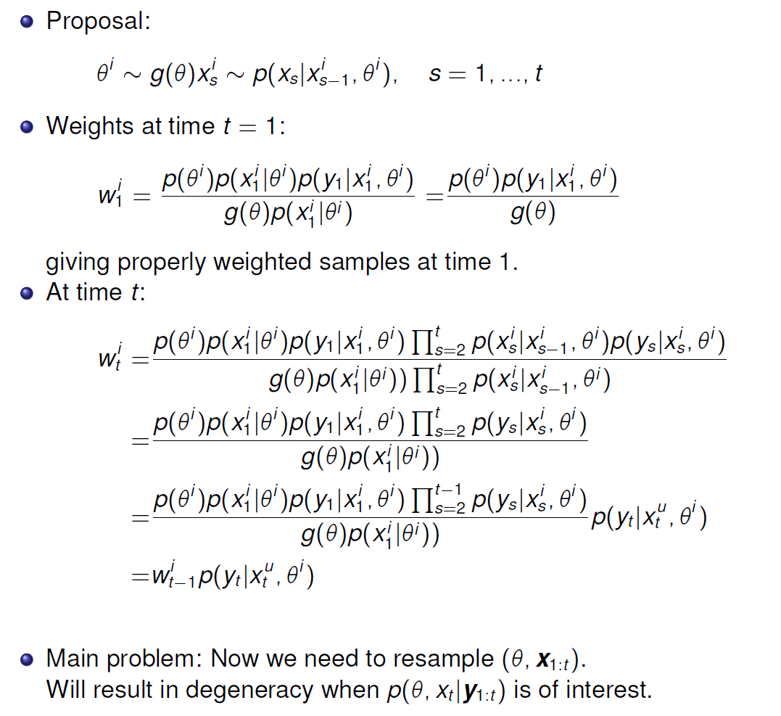
Is direct use of SMC properly weighted?
i
i
i
i
i
i
i

Slide 12
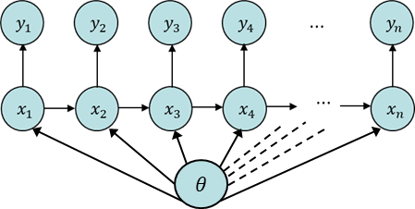
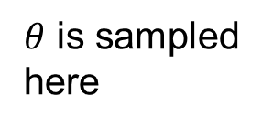
Issue: Direct approach
Direct approach samples theta initially and
is never able to resample it thus at each resampling
it is a thinning/depletion of unique elements
$θ$ is sampled
here
Prior
Sample from prior
Posterior

Slide 13
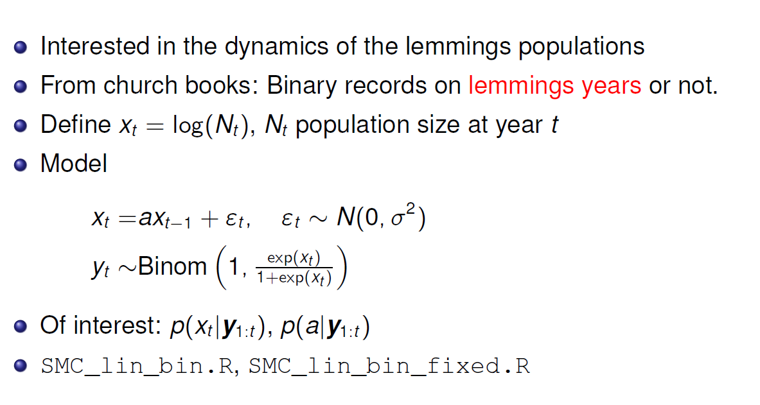
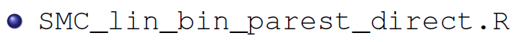
Lemmings data

Slide 14
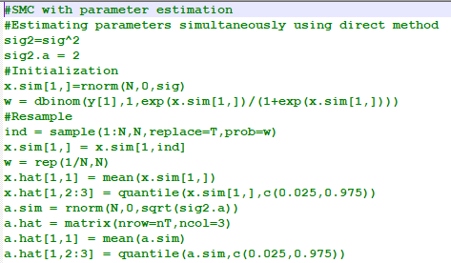
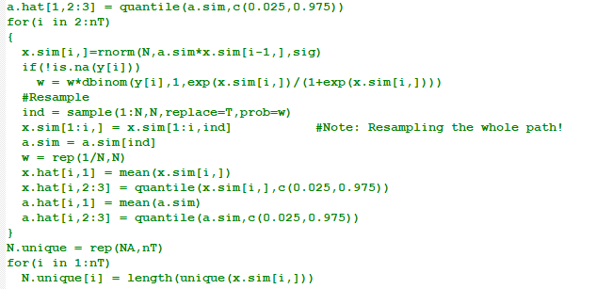

Slide 15
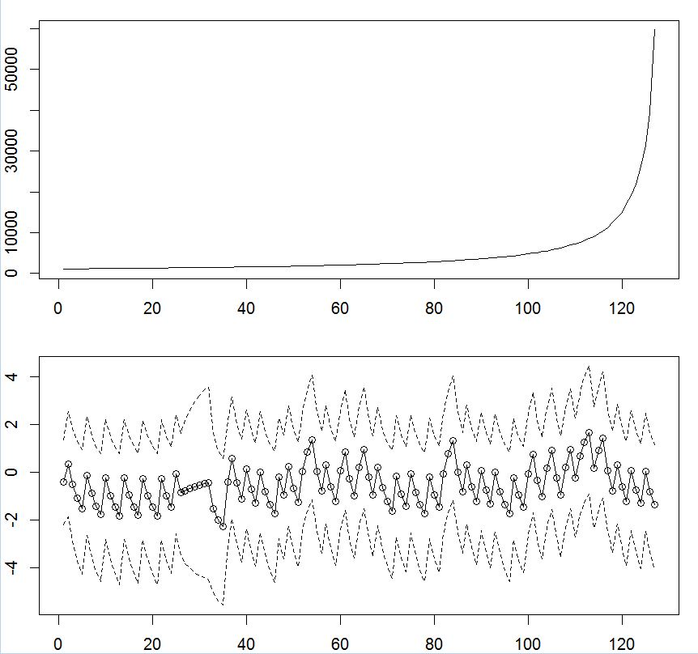
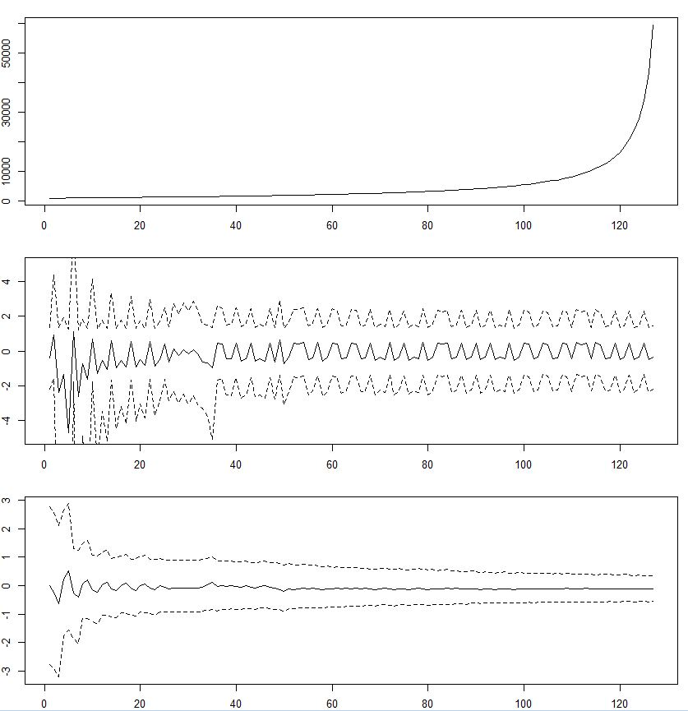



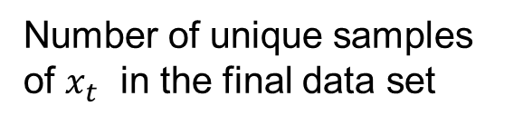


Number of unique samples of $x_{t}$ in the final data set
$$t$$
$$t$$
$$x_{t}$$
$$t$$
$$t$$
a=0.9

Slide 16
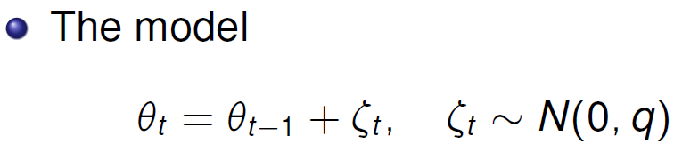
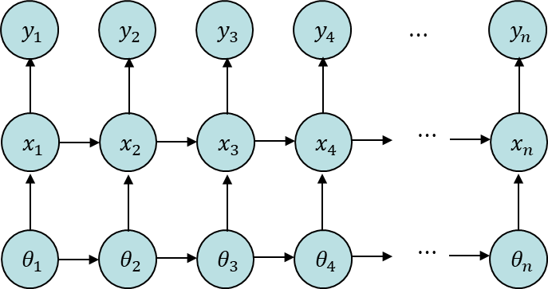


Introducing dynamics in $θ$
«$θ$is like $x$»
1
t
t

Slide 17
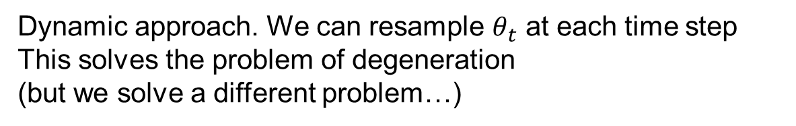
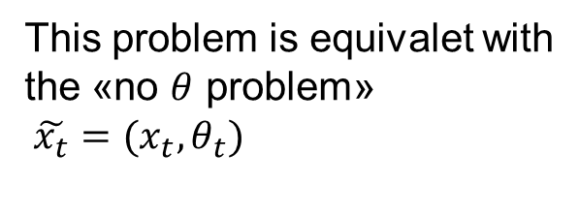
Issue: Dynamic approach
Dynamic approach. We can resample $θ_{t}$ at each time step
This solves the problem of degeneration
(but we solve a different problem…)
Original problem
New problem
This problem is equivalet with
the «no $θ$ problem»
$\tilde{x_{t}}=(x_{t},θ_{t})$
«Dynamic duo»

Slide 18
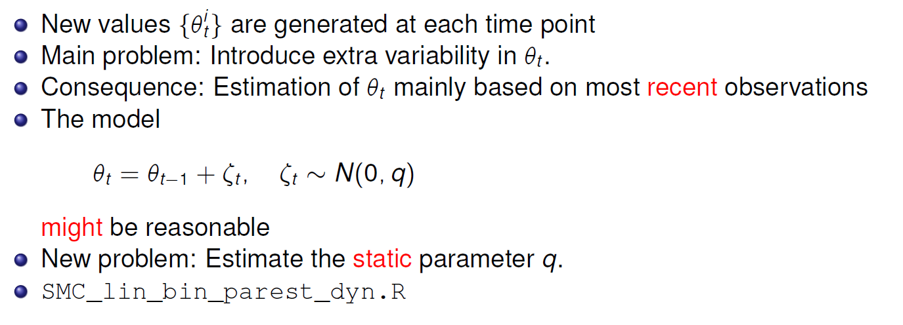

Dynamics in $θ$ continued

Slide 19
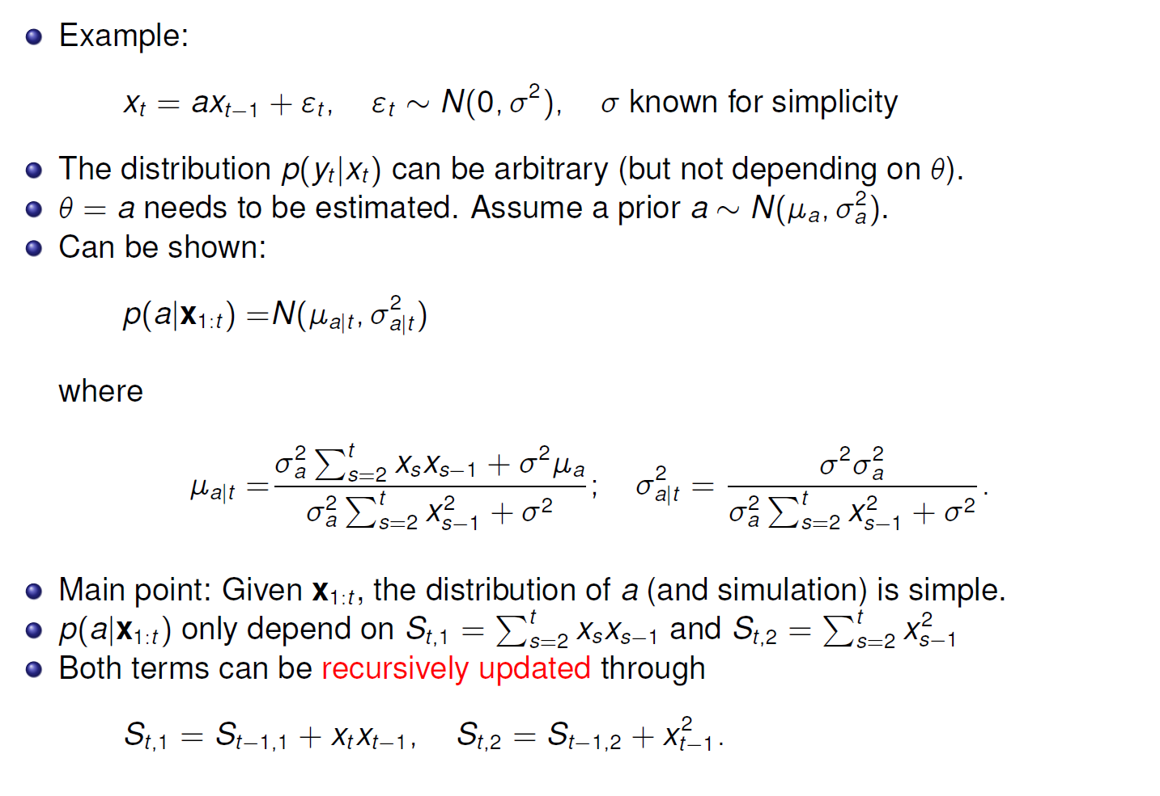
Sufficient statistics

Slide 20
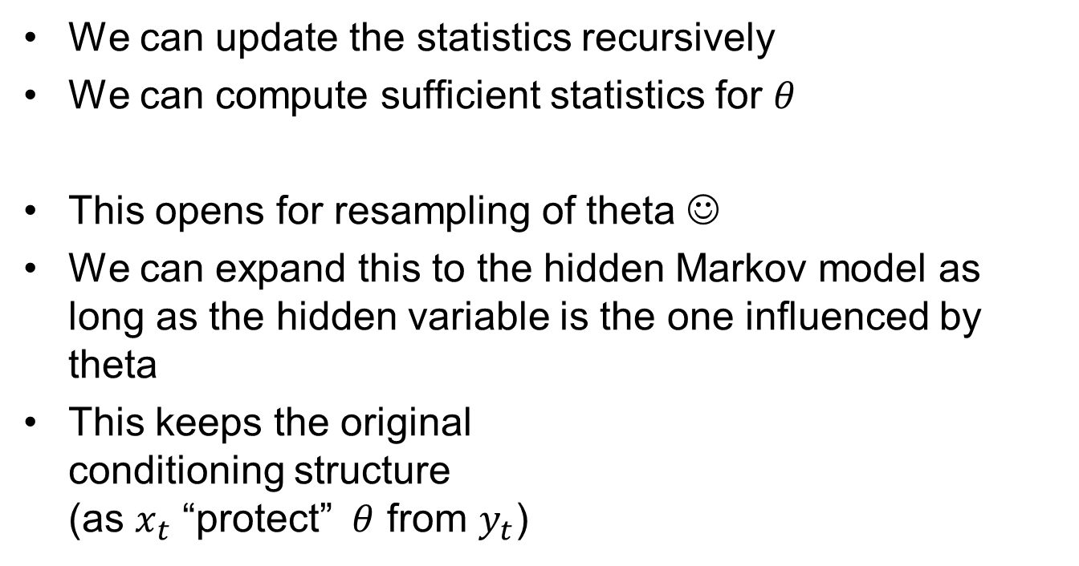
Approach using sufficient statistics
We can update the statistics recursively
We can compute sufficient statistics for $θ$
This opens for resampling of theta ☺
We can expand this to the hidden Markov model as long as the hidden variable is the one influenced by theta
This keeps the original
conditioning structure
(as $x_{t}$ “protect” $θ$ from $y_{t}$)

Slide 21
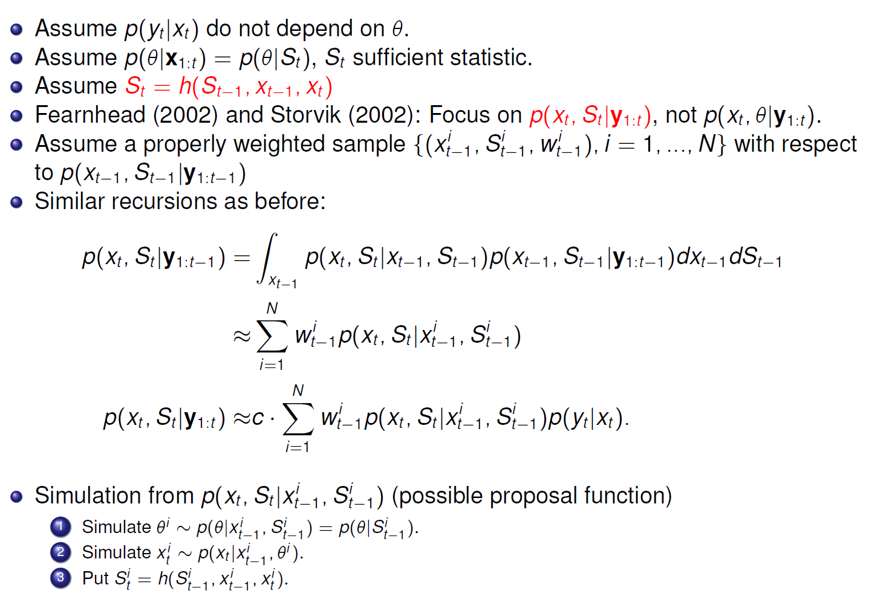
SMC and sufficient statistics general
«Dynamic duo»
Bootstrap filter
for the «dynamic duo»…

Slide 22
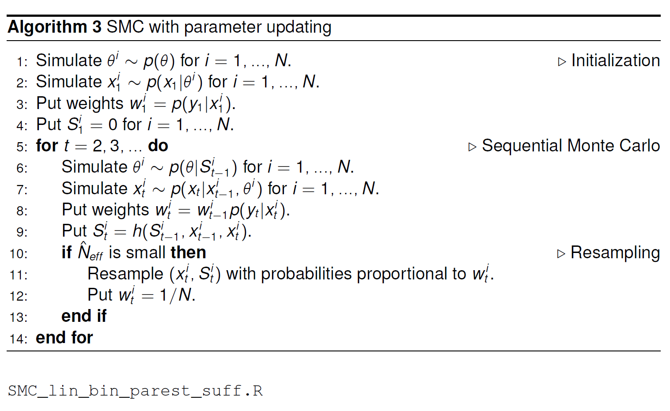
Algorithm Storvik filter

Slide 23
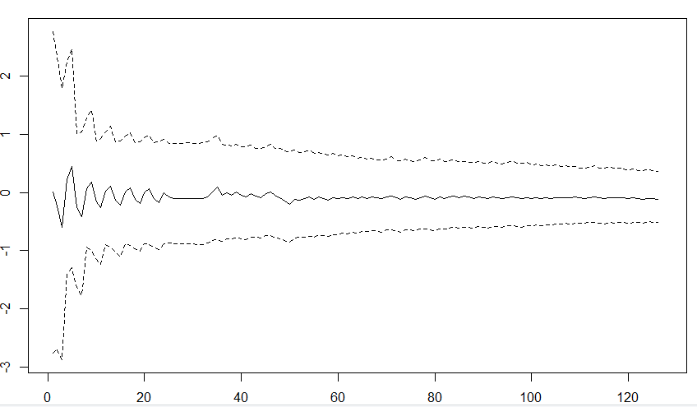
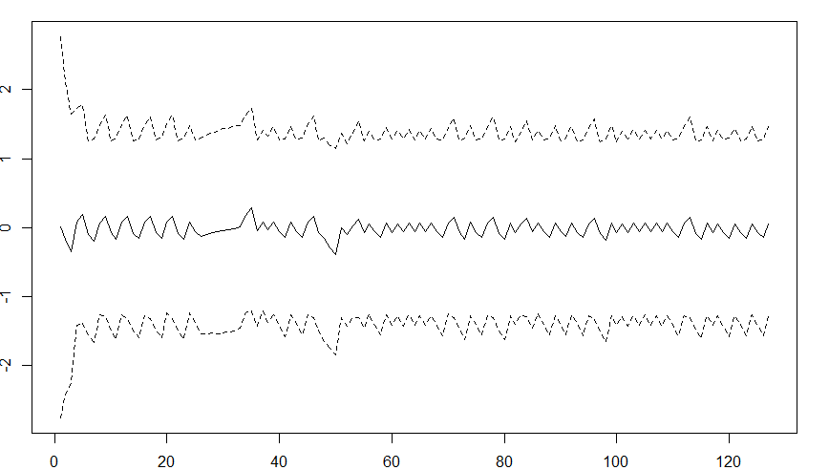
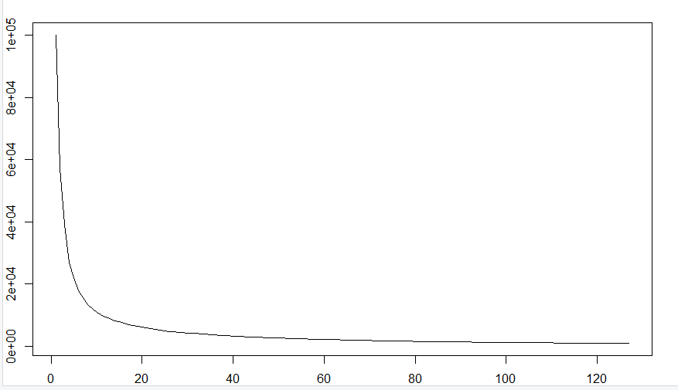
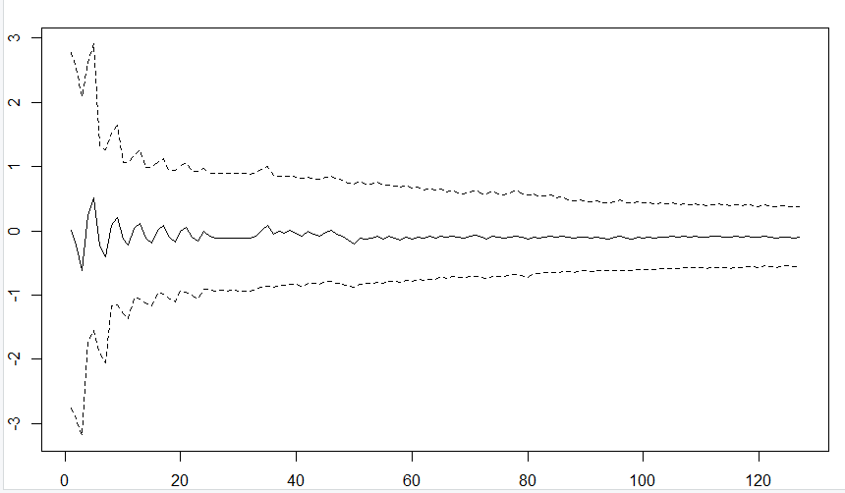
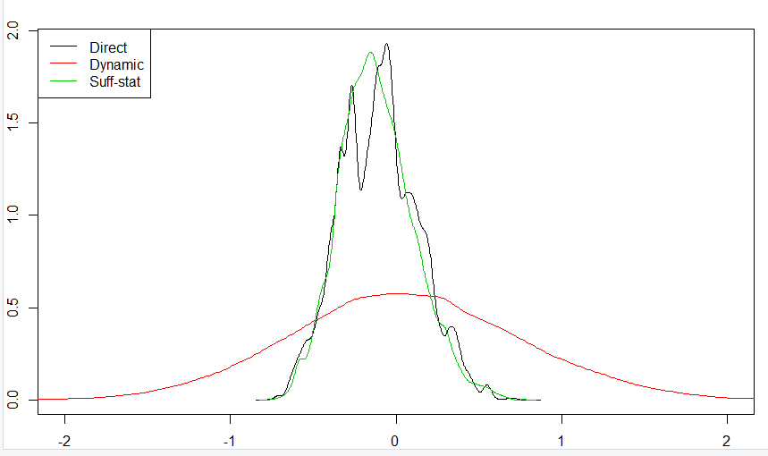
Example Lemmings evolving parameter: a
Direct
Number of
unique a
Dynamic
Sufficient

Slide 24
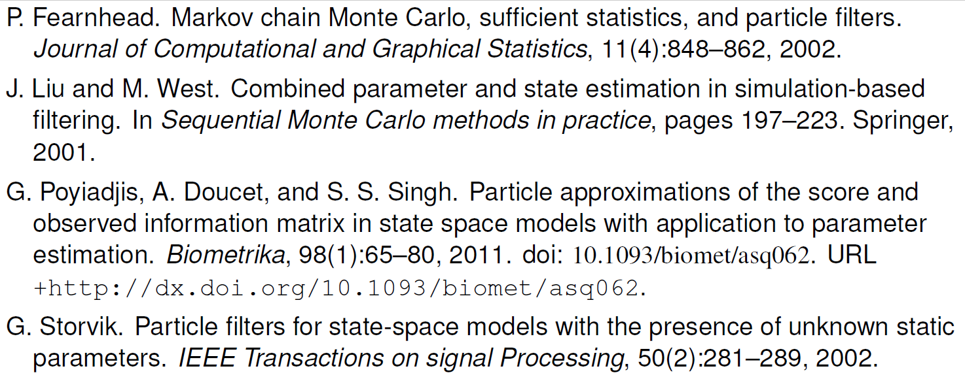
References

Slide 25




























$$y_{1}$$
$$y_{2}$$
$$y_{3}$$
$$y_{4}$$
$$⋯$$
$$y_{n}$$
$$x_{1}$$
$$x_{2}$$
$$x_{3}$$
$$x_{4}$$
$$⋯$$
$$x_{n}$$
$$x_{1}$$
$$x_{2}$$
$$x_{3}$$
$$x_{4}$$
$$⋯$$
$$x_{n}$$
$$y_{1}$$
$$y_{2}$$
$$y_{3}$$
$$y_{4}$$
$$⋯$$
$$y_{n}$$
$$x_{1}$$
$$x_{2}$$
$$x_{3}$$
$$x_{4}$$
$$⋯$$
$$x_{n}$$
$θ$
$$θ_{1}$$
$$θ_{2}$$
$$θ_{3}$$
$$θ_{4}$$
$$⋯$$
$$θ_{n}$$

Slide 26
SMC and sufficient statistics

Slide 27
Algorithm Storvik filter

