Slide 1
STK-4051/9051 Computational Statistics Spring 2024
Markov Chain Monte Carlo part 1 (chapter 7.1)
Instructor: Odd Kolbjørnsen, oddkol@math.uio.no

Slide 2
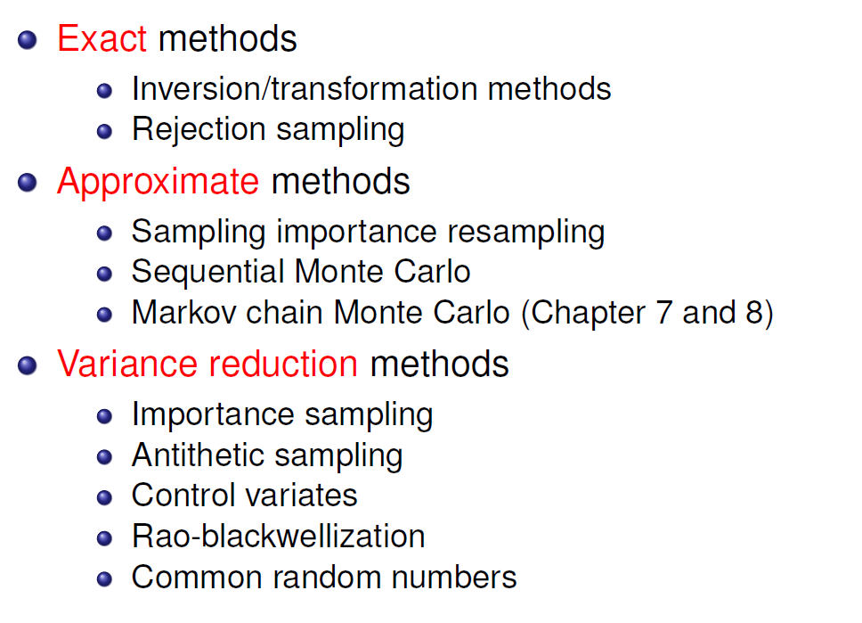
Where are we?
Now

Slide 3
Now
McMC the concept, discrete and continuous
Irreducible, aperiodic, recurrent
Fixpoint distribution of McMC
Constructing the Markov transition
  Detailed balance
  Metropolis Hastings
Examples:
  Random walk
  Independence sampler

Slide 4






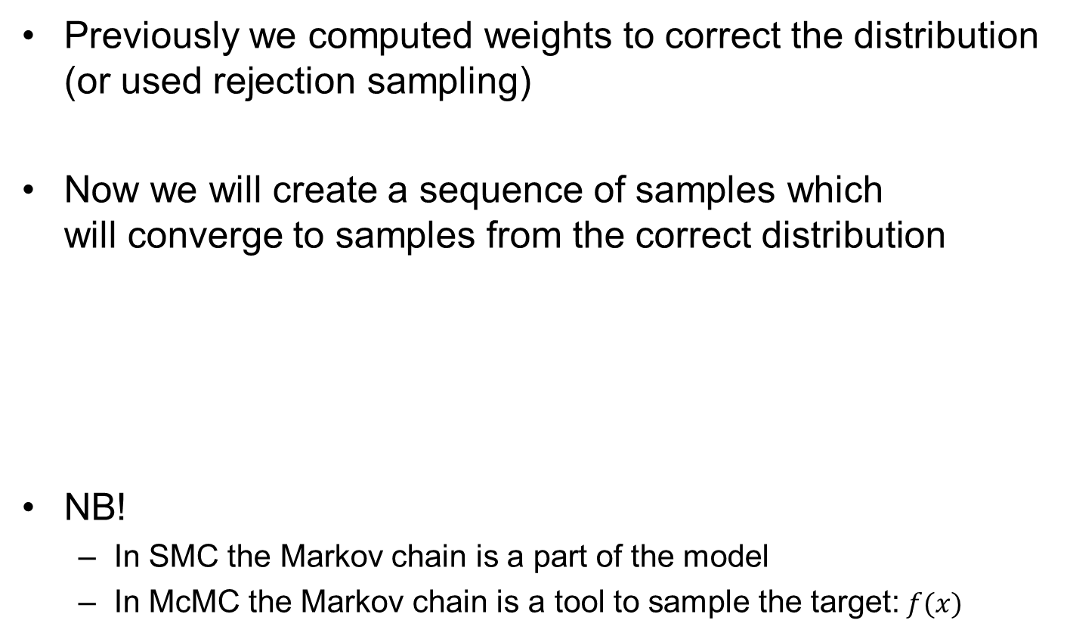









Markov chain Monte Carlo
Previously we computed weights to correct the distribution (or used rejection sampling)
Now we will create a sequence of samples which
will converge to samples from the correct distribution
NB!
  In SMC the Markov chain is a part of the model
  In McMC the Markov chain is a tool to sample the target:$f(x)$
$$p(x_{2}|x_{1})$$
$$⋯$$
$$p(x_{t+1}|x_{t})$$
$$x_{1}$$
$$x_{2}$$
$$x_{3}$$
$$x_{4}$$
$$⋯$$
$$x_{t}$$
$$x_{t+1}$$
$$⋯$$
$$p(x_{1})$$
$$p(x_{2})$$
$$⋯$$
$$p(x_{t})$$
$$p(x_{t+1})$$
$$p\left(x_{t}\right)→f(x)$$

Slide 5
MCMC why?
Our other methods to sample the target distribution do not work
  Direct not possible
  Importance sampling weight variance too big
  SIR degeneracy
  Sequential Monte Carlo
    Want joint distribution
    Want smoothing distribution
MCMC gives the opportunity to
«iterate towards a distribution»

Slide 6
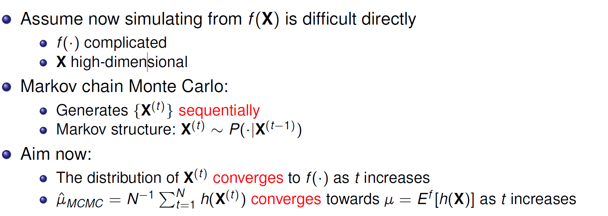
Markov chain Monte Carlo (McMC)
Note:
* Expression converge even if samples are dependent
(but we need more samples)
* Expression converge regardless of distribution of X⁽¹⁾
(but we might reduce bias by starting sum at t= L )

Slide 7
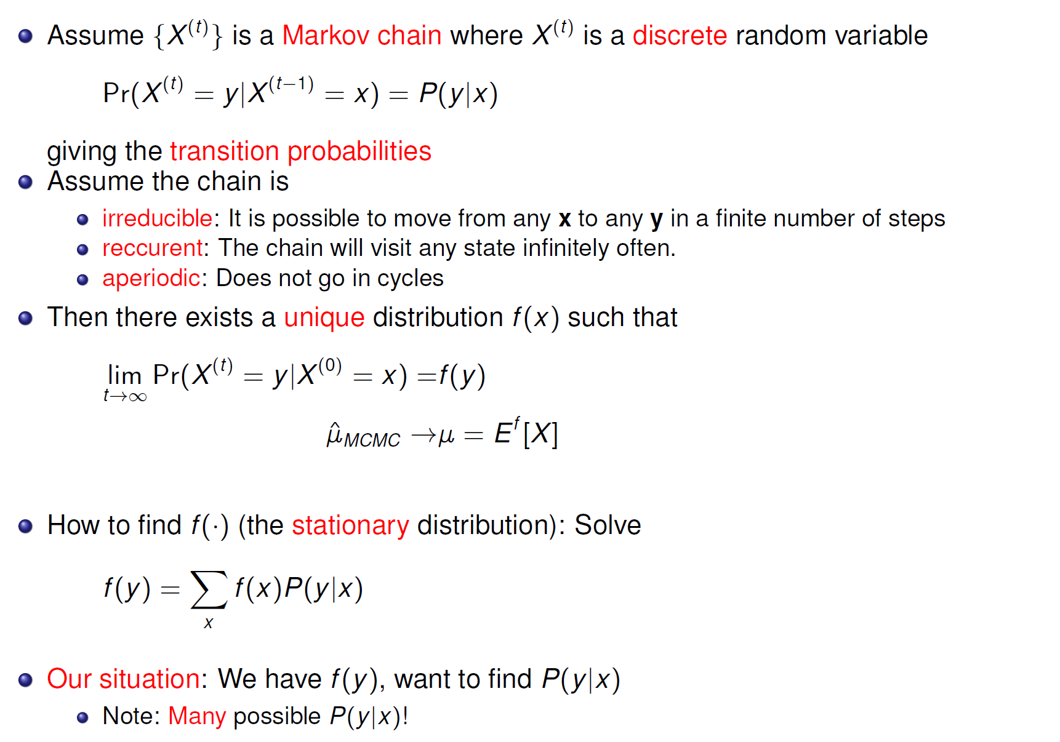
Markov chain theory – discrete case
Limit distribution
Stationary distribution
(fix point)

Slide 8


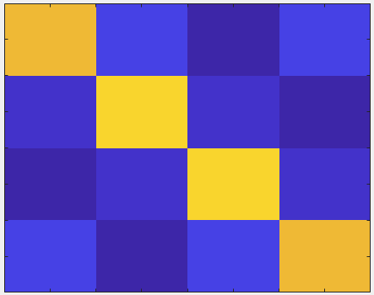



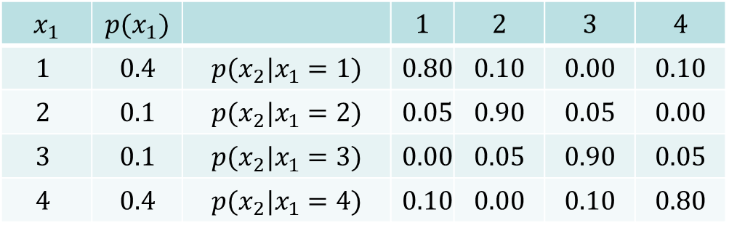
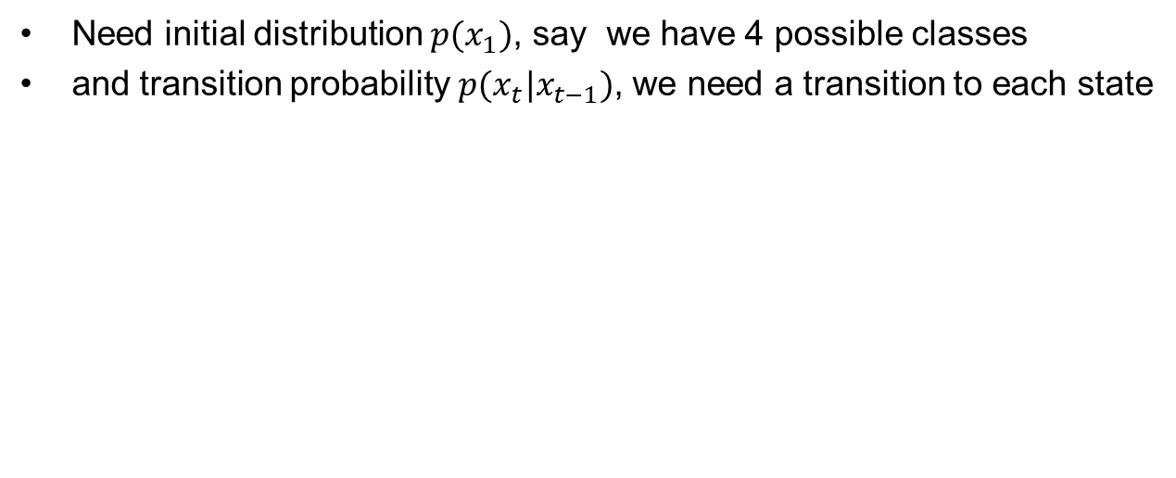







Discrete Transition probability
$$p(x_{2}|x_{1})$$
$$⋯$$
$$p(x_{t+1}|x_{t})$$
$$x_{1}$$
$$x_{2}$$
$$x_{3}$$
$$x_{4}$$
$$⋯$$
$$x_{t}$$
$$x_{t+1}$$
$$⋯$$
$$p(x_{1})$$
$$p(x_{2})$$
$$⋯$$
$$p(x_{t})$$
$$p(x_{t+1})$$
$$p\left(x_{t}\right)→f(x)$$
Need initial distribution $p(x_{1})$, say we have 4 possible classes
and transition probability $p(x_{t}|x_{t−1})$, we need a transition to each state
$$x_{2}$$
$$x_{1}$$ | $$p(x_{1})$$ |  | $$1$$ | $$2$$ | $$3$$ | $$4$$
$$1$$ | $$0.4$$ | $$p(x_{2}|x_{1}=1)$$ | $$0.80$$ | $$0.10$$ | $$0.00$$ | $$0.10$$
$$2$$ | $$0.1$$ | $$p(x_{2}|x_{1}=2)$$ | $$0.05$$ | $$0.90$$ | $$0.05$$ | $$0.00$$
$$3$$ | $$0.1$$ | $$p(x_{2}|x_{1}=3)$$ | $$0.00$$ | $$0.05$$ | $$0.90$$ | $$0.05$$
$$4$$ | $$0.4$$ | $$p(x_{2}|x_{1}=4)$$ | $$0.10$$ | $$0.00$$ | $$0.10$$ | $$0.80$$
$$p_{0}=$$
$$p\left(x_{i+1} | x_{i}\right)=$$

Slide 9
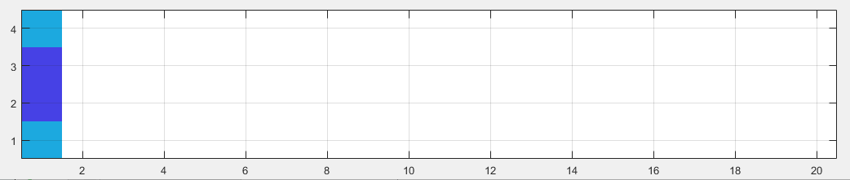
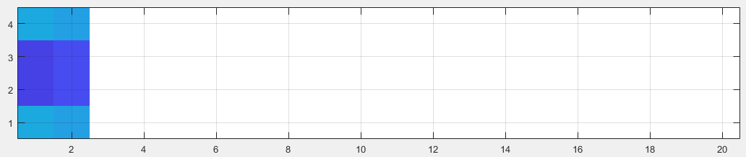
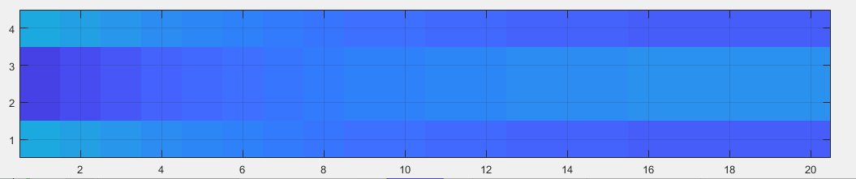




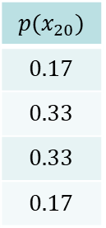





$$p_{0}$$
$$p_{0}$$
$$p_{0}P$$
$$p(x_{20})$$
$$0.17$$
$$0.33$$
$$0.33$$
$$0.17$$
$$p_{0}$$
$$p_{0}P$$
$$…$$
$$p_{0}P^{7}$$
$$…$$
$$p_{0}P^{19}$$

Slide 10
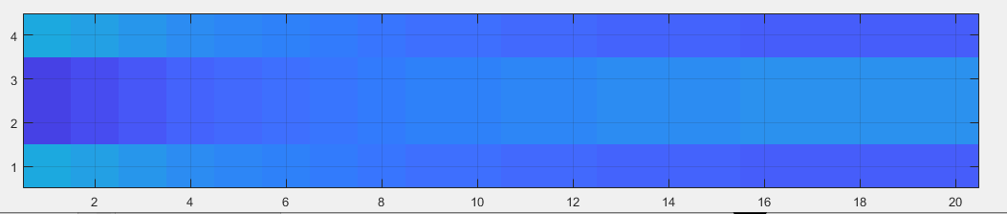
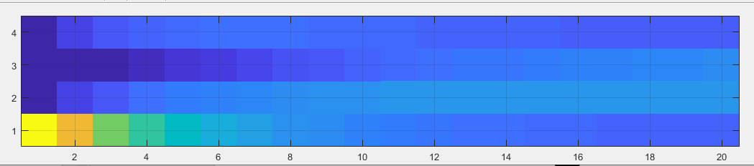
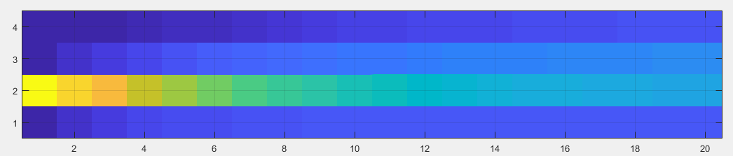
Limiting distribution

Slide 11
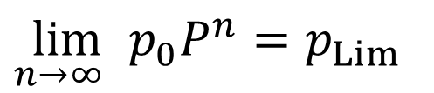
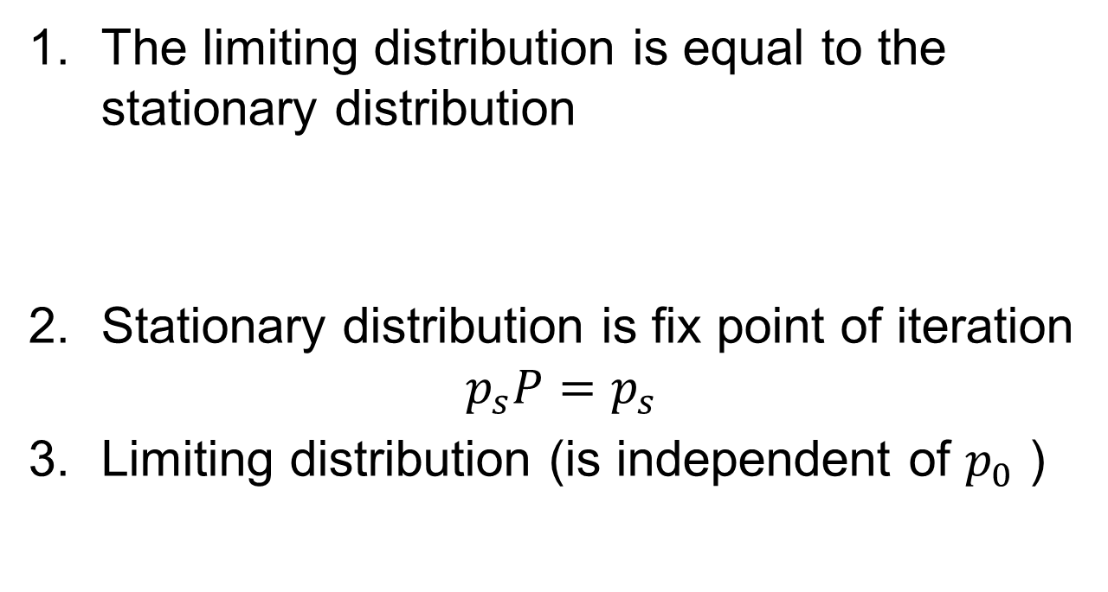

When the Markov chain is irreducible / aperiodic /recurrent
The limiting distribution is equal to the stationary distribution
Stationary distribution is fix point of iteration
$$p_{s}P=p_{s}$$
Limiting distribution (is independent of $p_{0}$ )
$$p_{s}=p_{Lim}$$
${{\lim_{n→∞ }⁡p}_{0}P}^{n}=p_{Lim}$

Slide 12
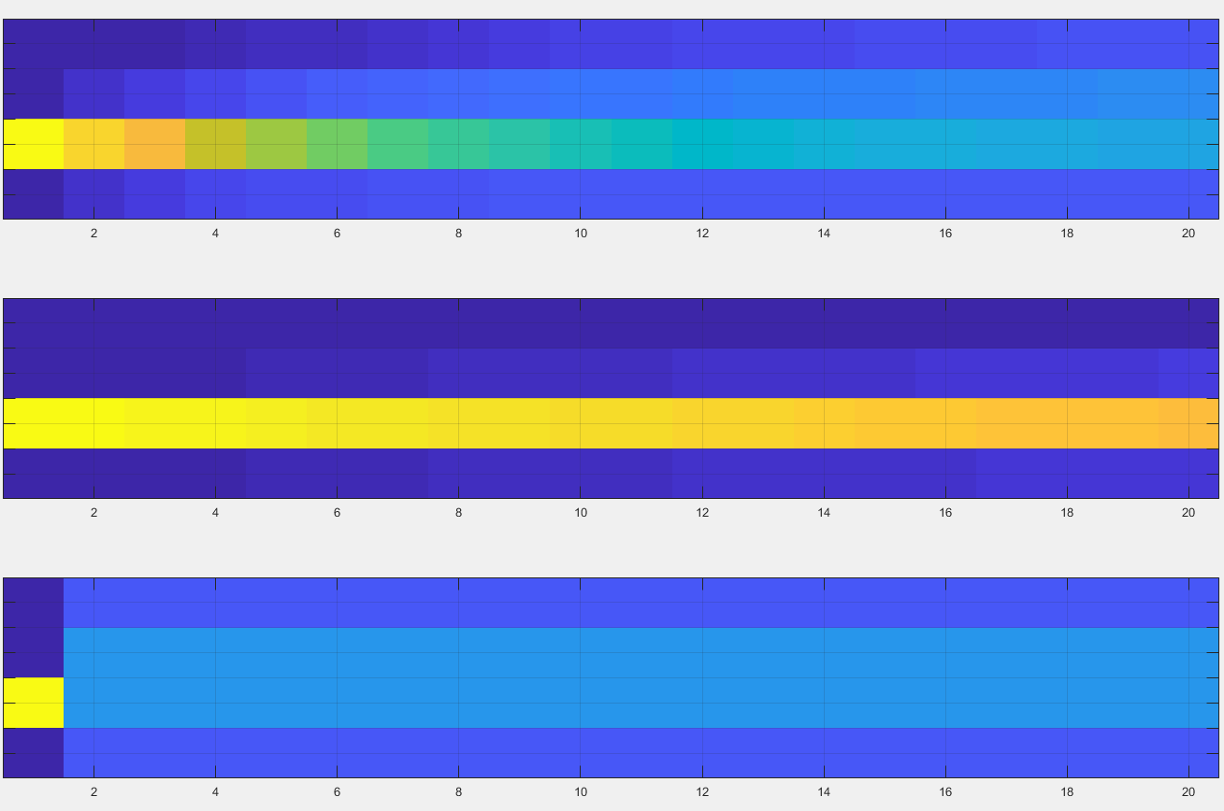

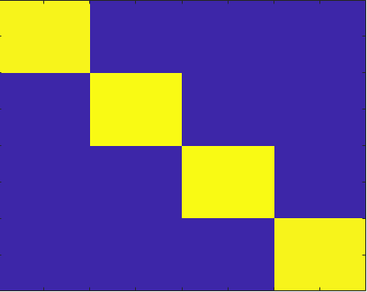

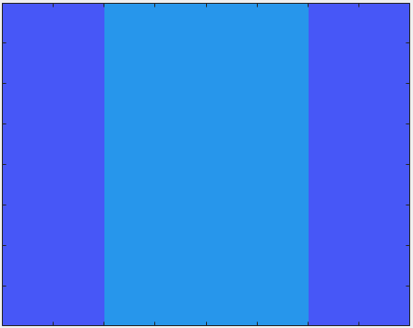

Time to reach limiting distribution n=20

Slide 13
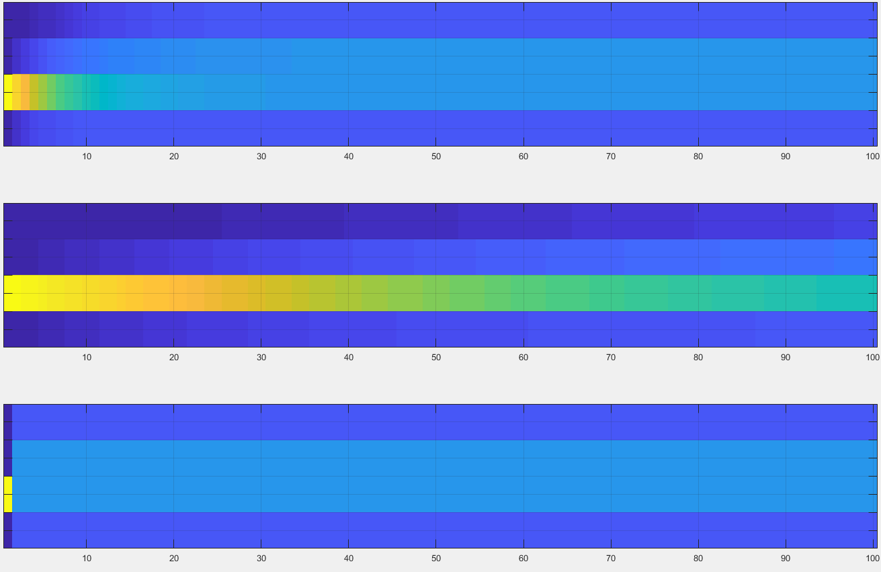
Time to reach limiting distribution n=100

Slide 14
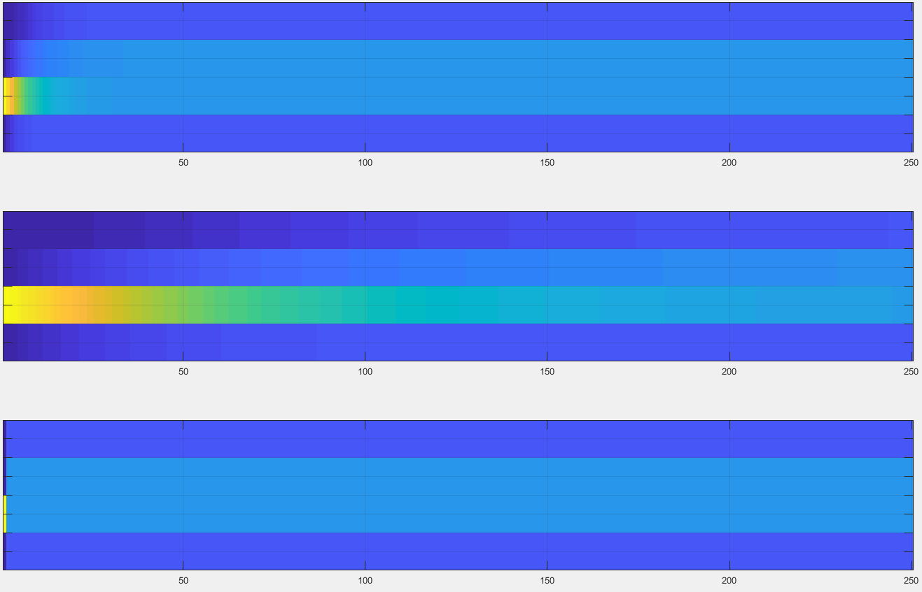
Time to reach limiting distribution n=250

Slide 15
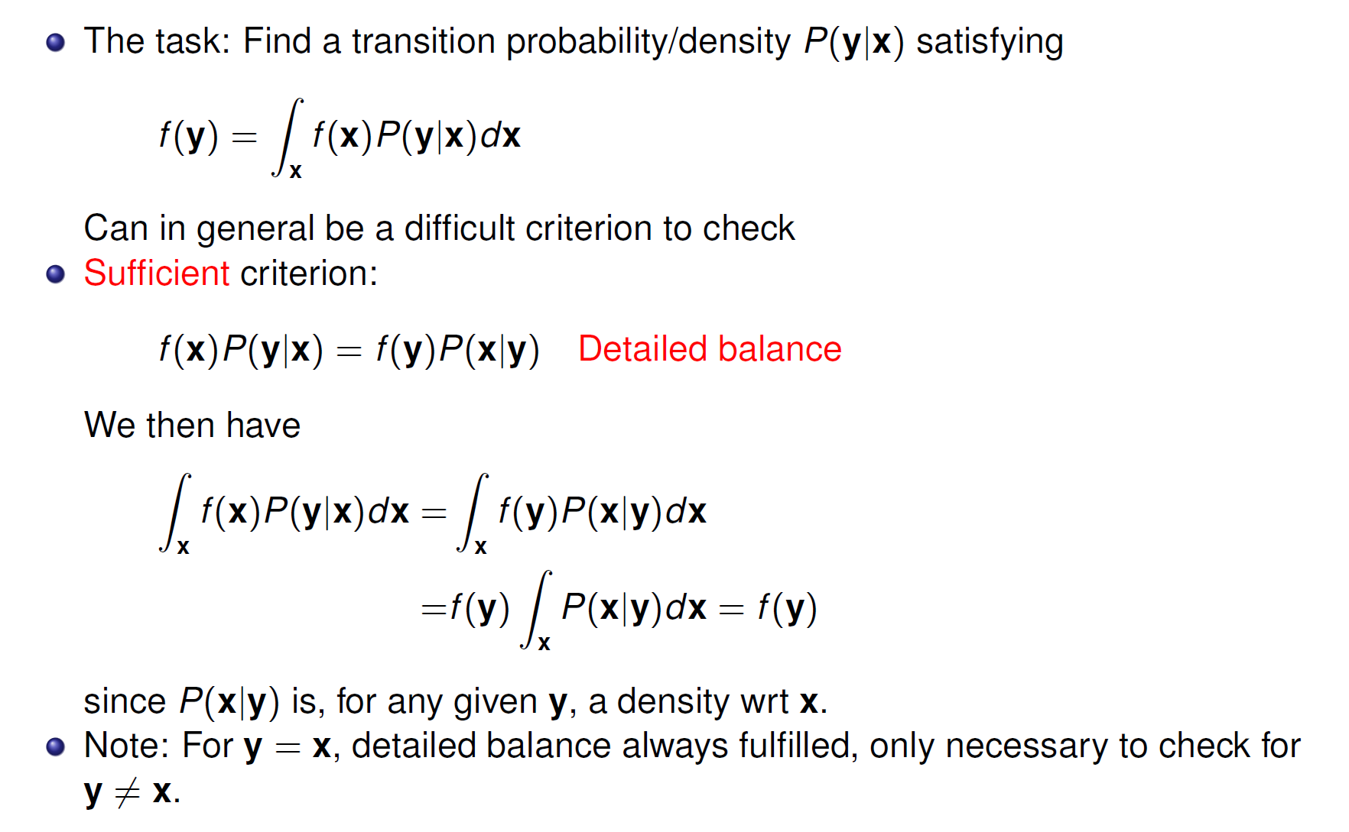


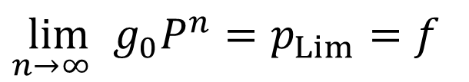
McMC requirements
Markov chain Monte Carlo
  Make a Markov chain P(y|x) with f(x) as
  limiting distribution / stationary distribution
  Markov chain discrete/continuous
  Irreducible, aperiodic, recurrent (always revisit)
${{\lim_{n→∞ }⁡g}_{0}P}^{n}=p_{Lim}=f$
Periodic examples, state transitions
1.0
0.5
A
B
A
1.0
B
$$P(y|x)=\left[\begin{matrix}0 & 1 & 0 \\ 0 & 0 & 1 \\ 1 & 0 & 0\end{matrix}\right]$$
1.0
1.0
$$P(y|x)=\left[\begin{matrix}0 & 0.5 & 0.5 \\ 1 & 0 & 0 \\ 1 & 0 & 0\end{matrix}\right]$$
1.0
C
C
0.5

Slide 16
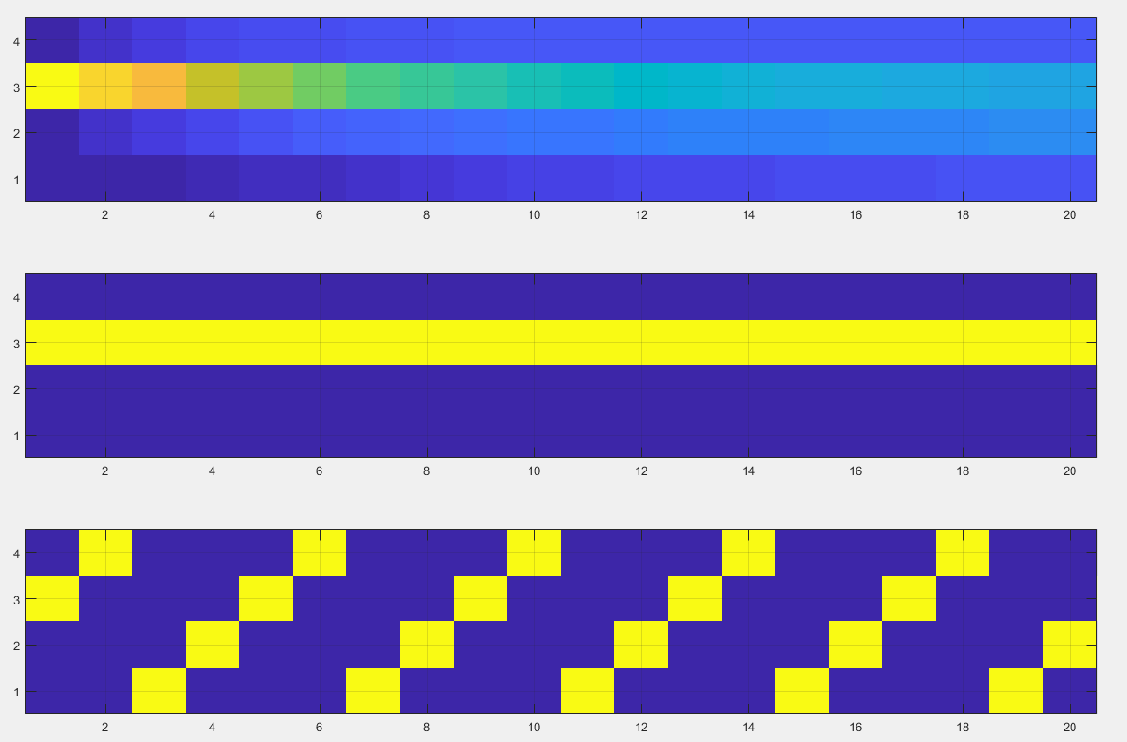
Irreducible/ aperiodic:
Irreducible
aperiodic
~Limiting
distribution
Absorbing state
reducible
Periodic

Slide 17
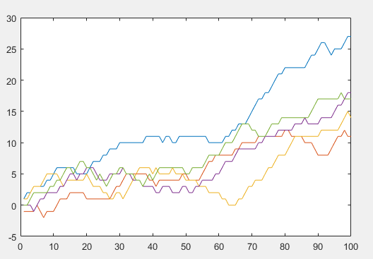
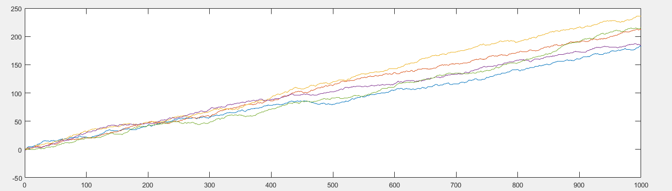
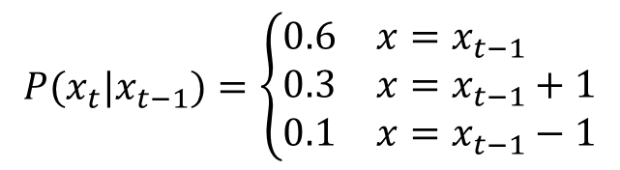
Recurrent (OK if finite and irreducible)
Problem if uncountable many discrete classes
$$P(x_{t}|x_{t−1})=\left\{\begin{matrix}0.6 & x=x_{t−1} \\ 0.3 & x=x_{t−1}+1 \\ 0.1 & x=x_{t−1}−1\end{matrix}\right.$$
No return

Slide 18
Markov chain theory – discrete case

Slide 19
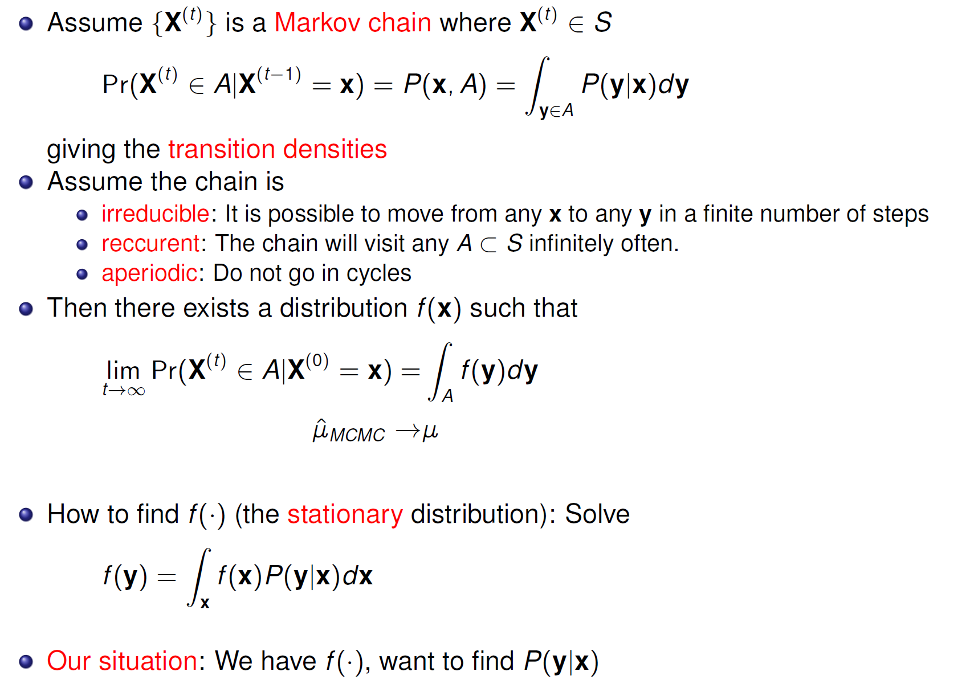
Markov chain theory - general setting

Slide 20
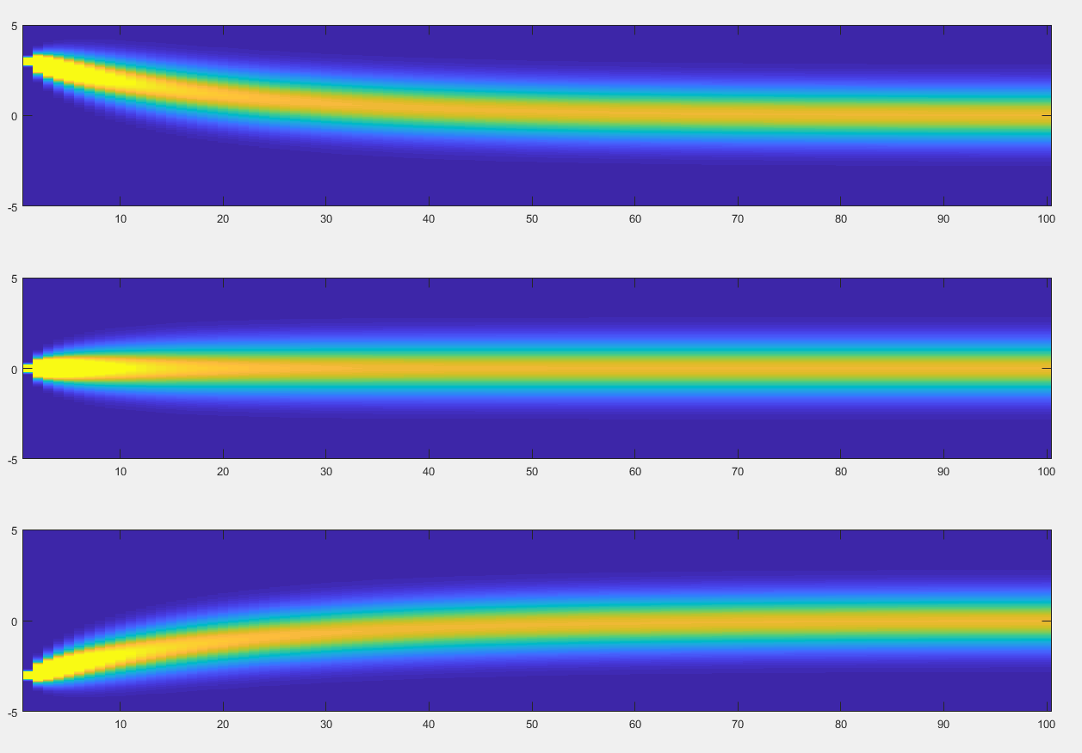








Example of a continuous transition density, AR1 model
$$p(x_{t}|x_{t−1})=φ\left(ax_{t−1},σ^{2}(1−a^{2})\right)$$
$$p\left(x_{1}\right)$$
$$p\left(x_{n}\right)$$
$$p(x_{1})$$
$$p(x_{n})$$
$$p(x_{n})$$
$$p(x_{1})$$
$$p(x_{t})$$

Slide 21
Markov chain theory - general setting

Slide 22
We want to construct P(x|y) to match our needs
Need to have good properties
  Stationary
  Irreducible
  Aperiodic
  Recurrent
Also need to get our target as a stationary distribution
  Simplify the hunt by introducing symmetry
  detailed balance

Slide 23
Detailed balance

Slide 24
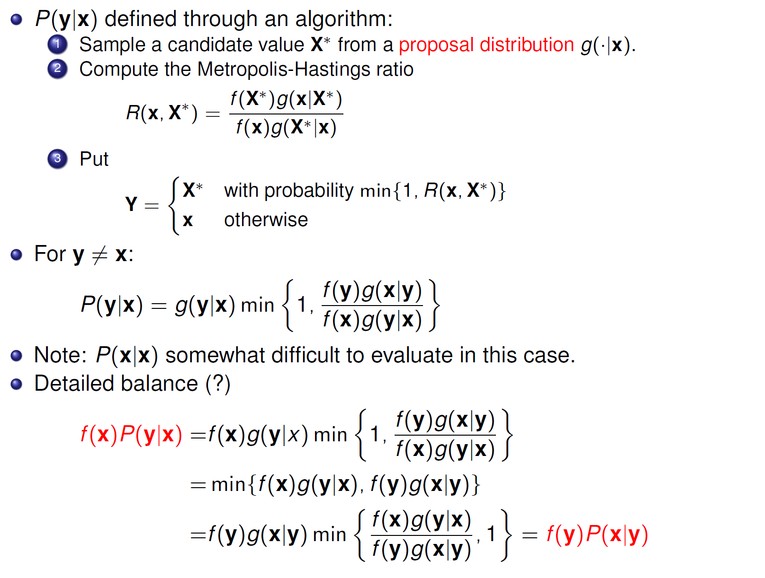
Metropolis-Hastings algorithm
Either we keep x with a certain probability
Or we change to X* which have a certain density

Slide 25
Metropolis-Hastings algorithm
Detailed balance

Slide 26
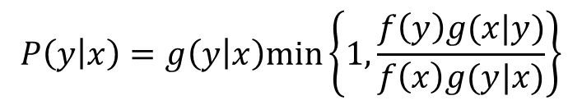
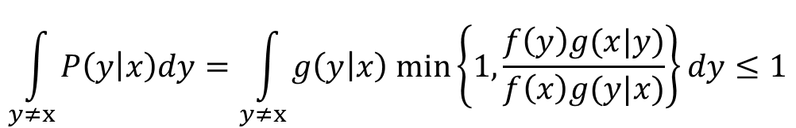
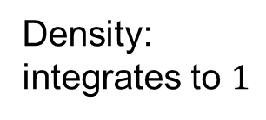

The probability of a value being repeated is positive
Pf:
$$P\left(y | x\right)=g\left(y | x\right)min\left\{1,\frac{f\left(y\right)g(x|y)}{f\left(x\right)g(y|x)}\right\}$$
$$\int_{y≠x}{P\left(y | x\right)dy=\int_{y≠x}{g\left(y | x\right) min\left\{1,\frac{f\left(y\right)g(x|y)}{f\left(x\right)g(y|x)}\right\}dy}}≤1$$
Density:
integrates to $1$
Positive number:
$$≤1$$

Slide 27
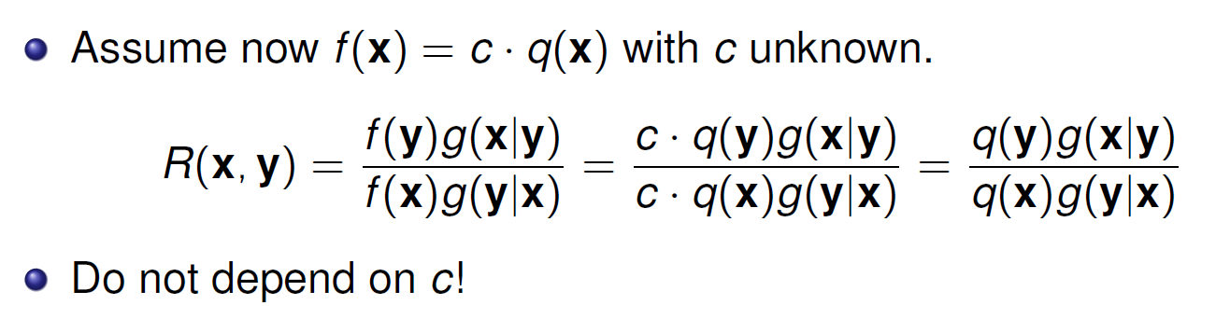
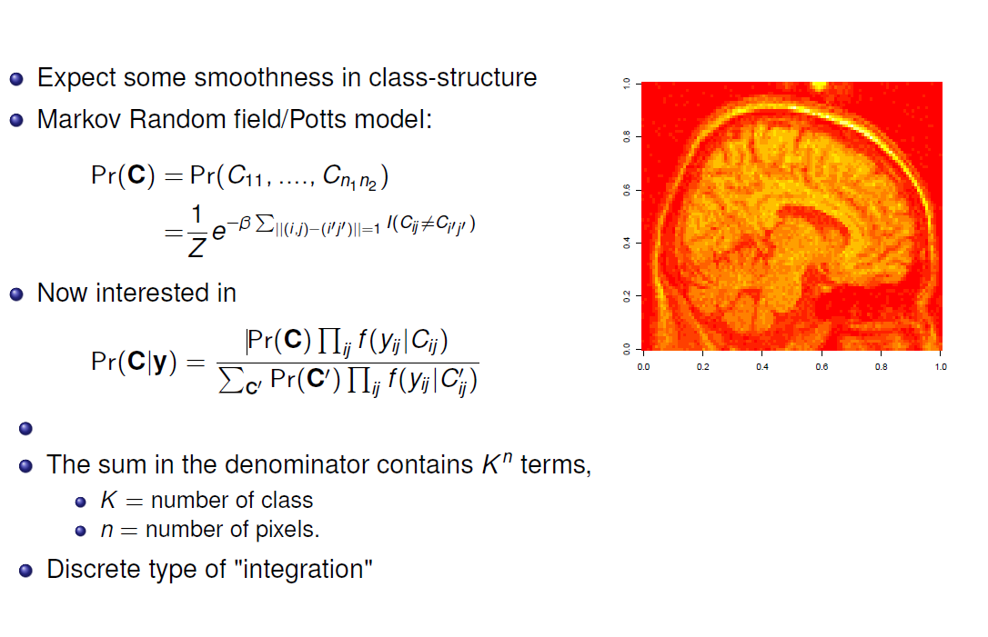

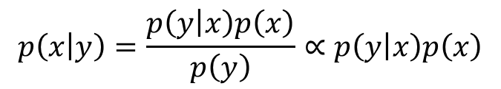
What about unknown scaling and MH
Important for Bayesian analysis
$$Posterior∝Likelihood× Prior$$
$$p\left(x | y\right)=\frac{p\left(y | x\right)p\left(x\right)}{p\left(y\right)}∝p\left(y | x\right)p\left(x\right)$$
Important for Gibbs type distributions

Slide 28
Metropolis Hastings is a general form:
Specific chains:
  Random walk chains
  Independent chains
  Gibbs sampler
Tricks to customize sampling
  Reparametrize
  Block update
  Hybrid
  Griddy Gibbs

Slide 29
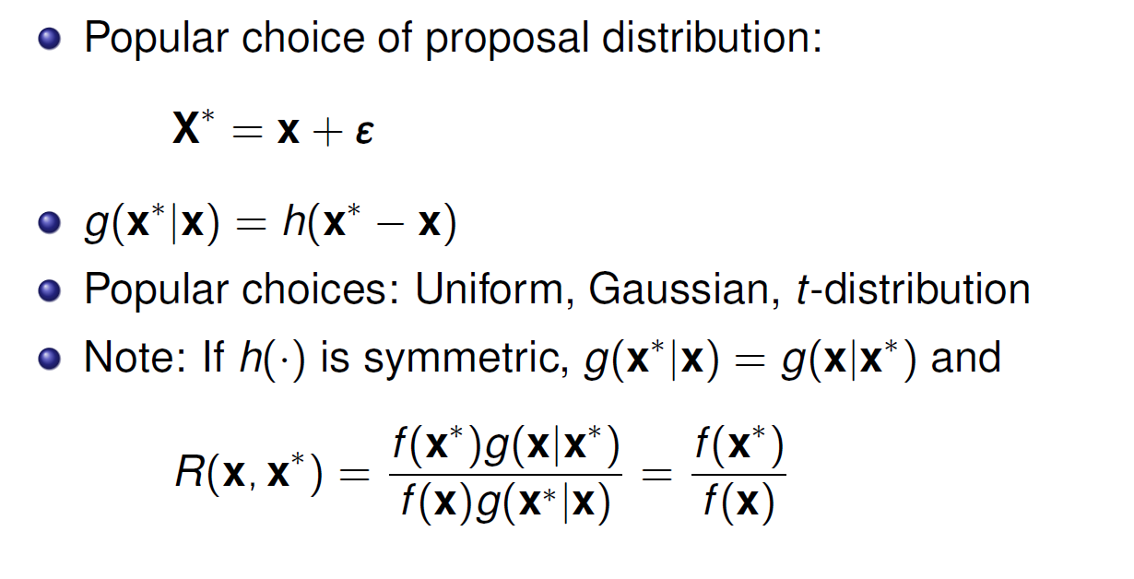
Random walk chains

Slide 30
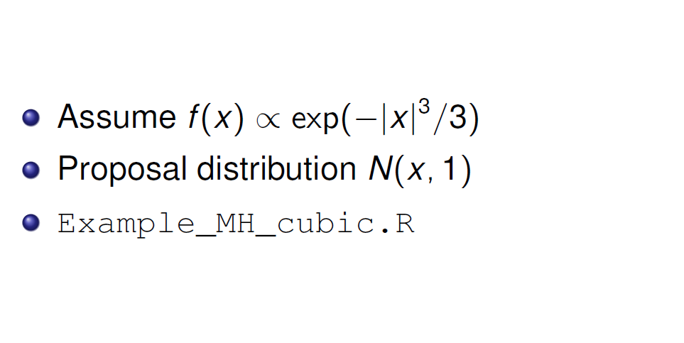
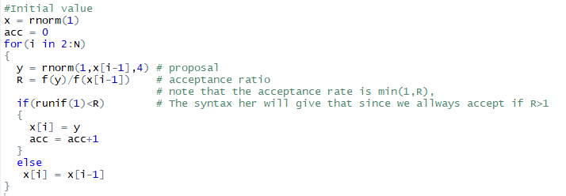

Example
$$4^{2})$$

Slide 31
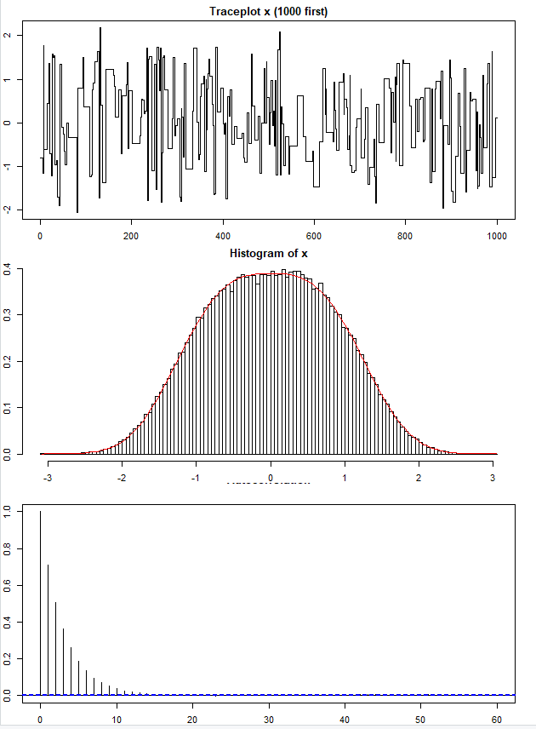
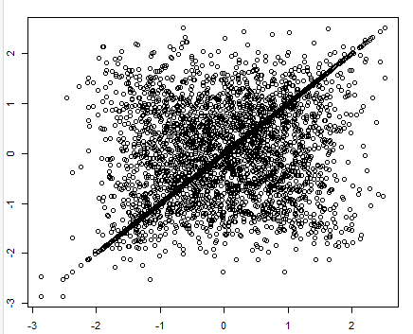


Results random walk
Acceptance rate
= 0.2755276
Lag one scatterplot
$$x_{t−1}$$
$$x_{t}$$
Auto correlation

Slide 32
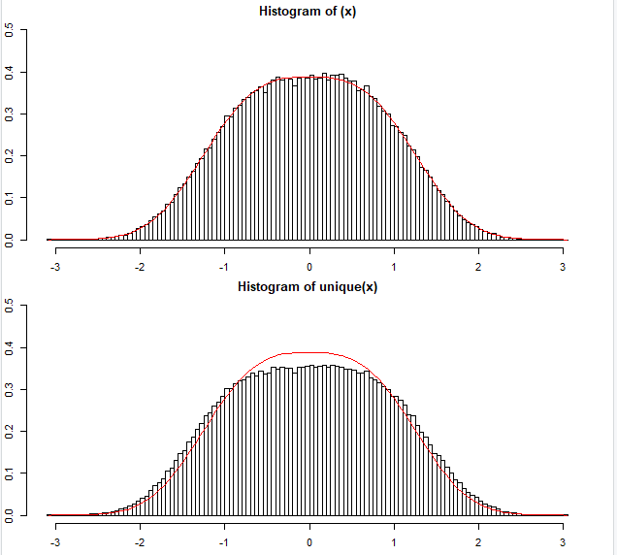
The repeats of a value is needed to get the correct distribution
Compare histograms
to true distribution
This is kind of similar to what we have for sampling importance resampling (SIR)
If a value is repeated it gets «more weight»

Slide 33
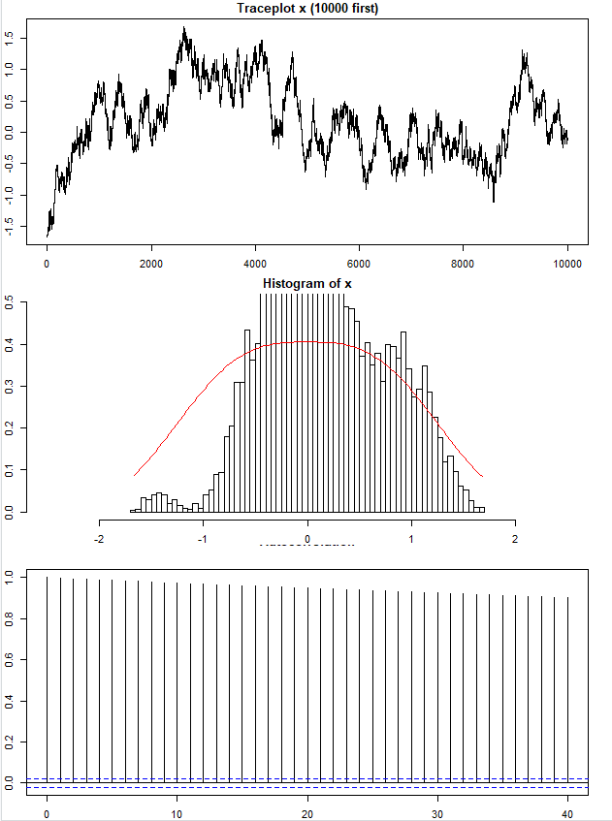
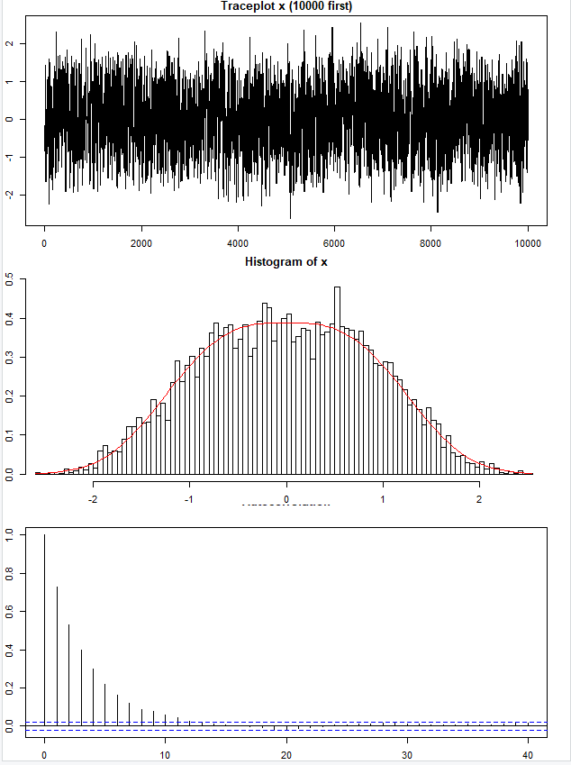
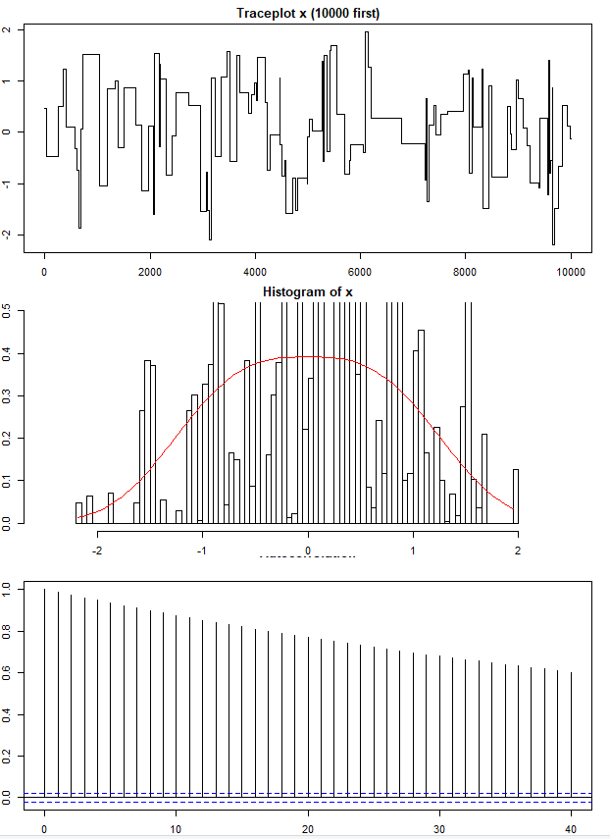



The effect variance in proposal distribution
N = 10 000
$$g\left(y | x\right)=φ(y;x,{0.04}^{2})$$
$$g\left(y | x\right)=φ(y;x,1^{2})$$
$$g\left(y | x\right)=φ(y;x,{100}^{2})$$
☹
☹
☹
☺
☹
Acc. rate =0.994
Acc. Rate = 0.700
Acc. Rate = 0.012
Too small steps,
high acceptance
high correlation ☹
Just about right,
good acceptance
low correlation ☺
Too large changes proposed,
low acceptance
high correlation ☹

Slide 34
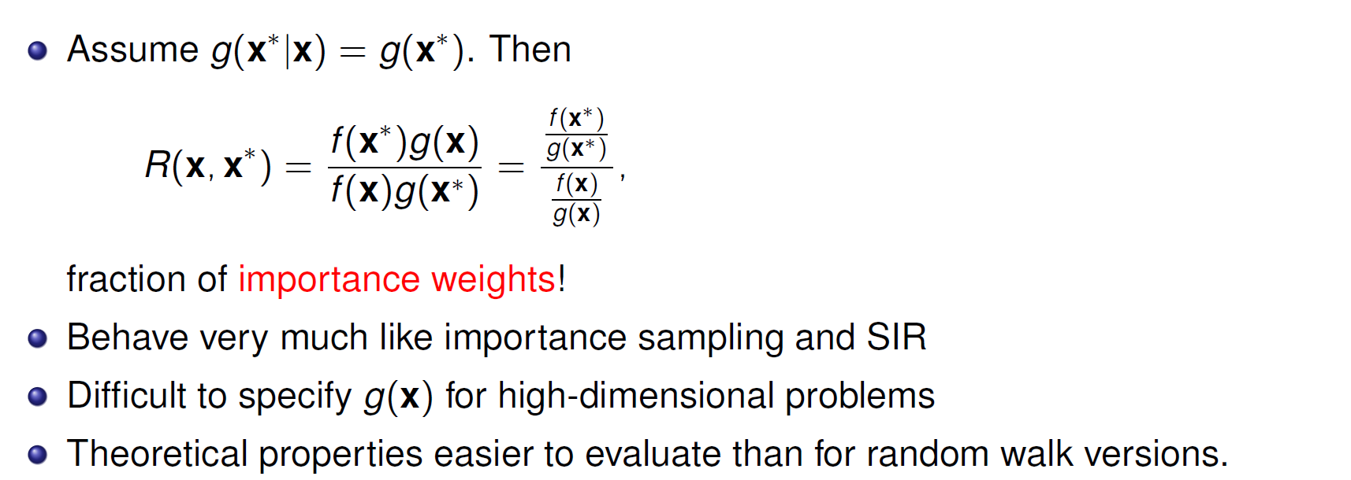
Independent chains
Challenges similar to what seen in:
rejection sampling
importance sampling
sampling importance resampling

Slide 35
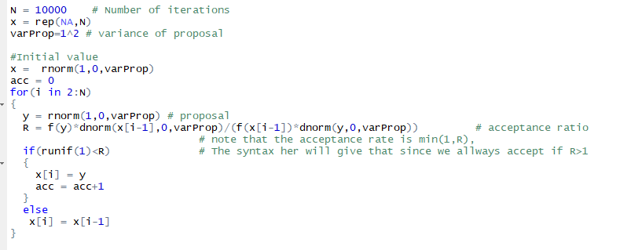

Example
$$g\left(y | x\right)=φ(y;0,1^{2})$$
Example_MH_cubic_independence.R

Slide 36
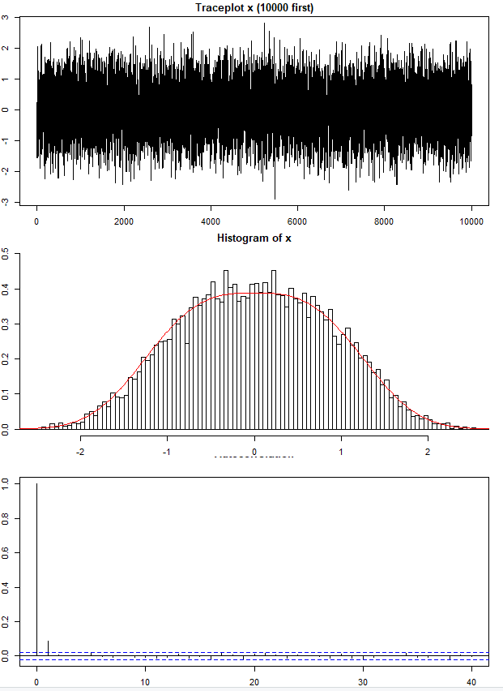
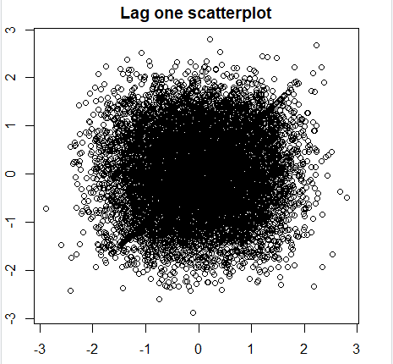
Results independent
Acceptance rate= 0.9149915

Slide 37
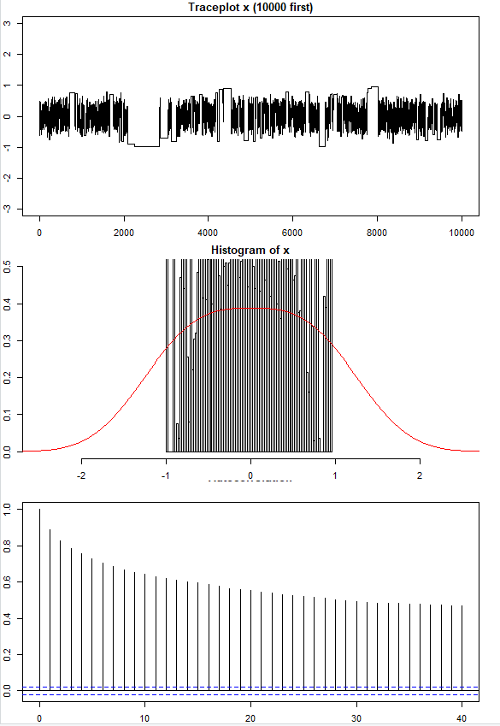





The effect variance in proposal distribution
N = 10 000
$$g\left(y | x\right)=φ(y;0,{0.25}^{2})$$
$$g\left(y | x\right)=φ(y;{0,4}^{2})$$
$$g\left(y | x\right)=φ(y;0,{100}^{2})$$
☹
Acc. rate =0.419
Acc. Rate = 0.288
Acc. Rate = 0.012
Too narrow proposal,
good acceptance
high correlation ☹
Just about right,
reasonable acceptance
low correlation ☺
Too large changes proposed,
low acceptance
high correlation ☹

Slide 38

M-H and multivariate settings

Slide 39


Example multivariate with single coordinate update
See also fixed scan in: Example_MH_cubic_multivariate_2.R

Slide 40


Results independent
Acceptance rate= 0.3053943

Slide 41

Choices
My experience:
Random is robust
You should rather spend time improving other parts of code
Gibbs sampler
  Random or deterministic scan?
    Deterministic scan most common (?)
    When high correlation, random scan can be more efficient
Independence chain:
  $g(·) ≈ f (·)$
  High acceptance rate
  Tail properties most important
  f /g should be bounded
Random walk proposal
  Tune variance so that acceptance rate
  is between 25% and 50%

