Slide 1
STK-4051/9051 Computational Statistics Spring 2024
Sequential Monte Carlo
Instructor: Odd Kolbjørnsen, oddkol@math.uio.no

Slide 2
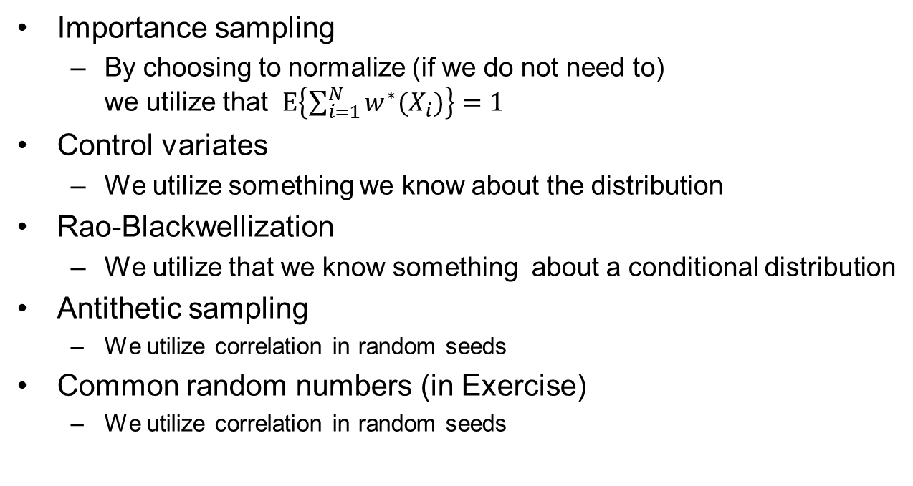
Last time:
Variance reduction methods
Importance sampling
  By choosing to normalize (if we do not need to)
  we utilize that $E\left\{\sum_{i=1}^{N}{w^{∗}(X_{i})}\right\}=1$
Control variates
  We utilize something we know about the distribution
Rao-Blackwellization
  We utilize that we know something about a conditional distribution
Antithetic sampling
  We utilize correlation in random seeds
Common random numbers (in Exercise)
  We utilize correlation in random seeds

Slide 3
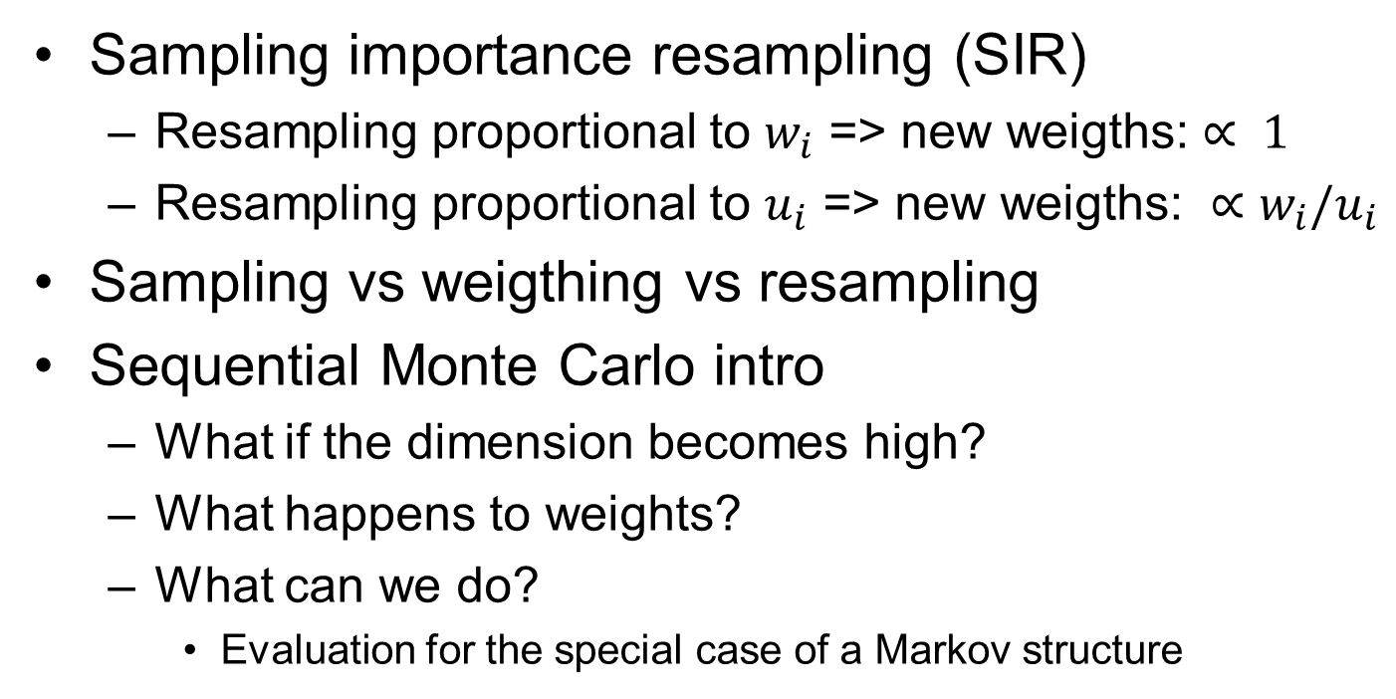
Last time
Sampling importance resampling (SIR)
  Resampling proportional to $w_{i}$ => new weigths: $∝ 1$
  Resampling proportional to $u_{i}$ => new weigths: ${∝w}_{i}/u_{i}$
Sampling vs weigthing vs resampling
Sequential Monte Carlo intro
  What if the dimension becomes high?
  What happens to weights?
  What can we do?
    Evaluation for the special case of a Markov structure

Slide 4



Illustration of optimal resampling ($resample weigth: 1/N$)
$$m⋅w_{i}$$
m=25
0
0
0
0
0
2
1
2
0
6
1
4
1
2
0
Total=19
$$v_{i}∝{m⋅w}_{i}^{}−\left\lfloor {m⋅w}_{i}^{}\right\rfloor$$
Resample=6

Slide 5


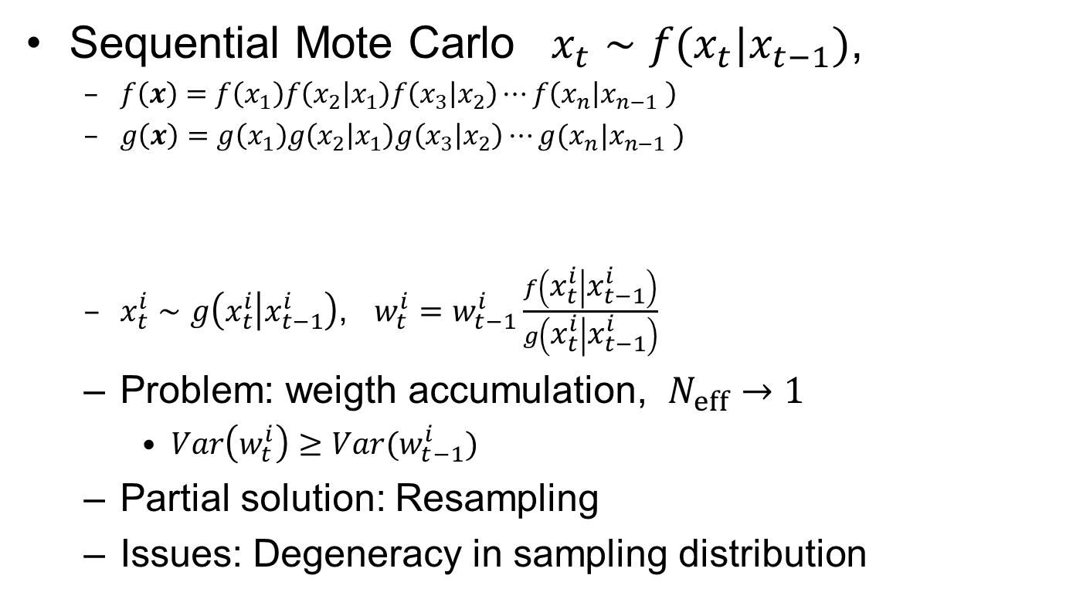




Recap
Sequential Mote Carlo $x_{t}∼f(x_{t}|x_{t−1})$,
  $f\left(x\right)=f\left(x_{1}\right)f\left(x_{2} | x_{1}\right)f\left(x_{3} | x_{2}\right)⋯f\left(x_{n} | x_{n−1} \right)$
  $g\left(x\right)=g\left(x_{1}\right)g\left(x_{2} | x_{1}\right)g\left(x_{3} | x_{2}\right)⋯g(x_{n}|x_{n−1} )$
  $x_{t}^{i}∼g\left(x_{t}^{i} | x_{t−1}^{i}\right)$, $w_{t}^{i}=w_{t−1}^{i}\frac{f\left(x_{t}^{i} | x_{t−1}^{i}\right)}{g\left(x_{t}^{i} | x_{t−1}^{i}\right)}$
  Problem: weigth accumulation, $N_{eff}→1$
    $Var\left(w_{t}^{i}\right)≥Var(w_{t−1}^{i})$
  Partial solution: Resampling
  Issues: Degeneracy in sampling distribution
$$x_{1}$$
$$x_{2}$$
$$x_{3}$$
$$x_{4}$$
$$⋯$$
$$x_{n}$$

Slide 6
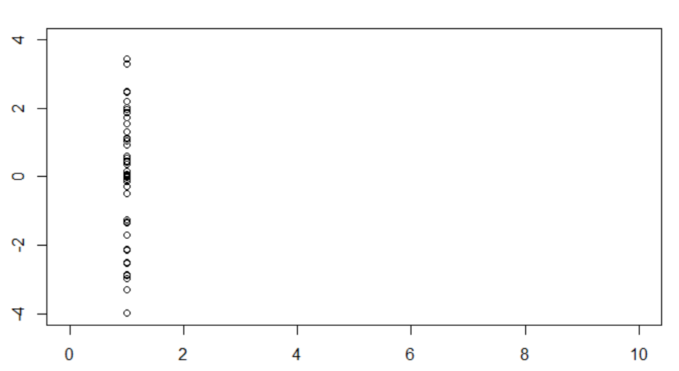

Proposal = sample from $g(x_{1})$

Slide 7
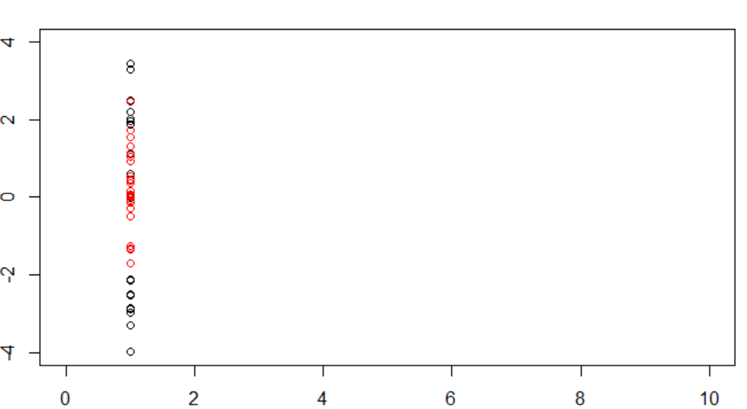

Compute weigths and resample =red
Red is a good approximation to ${f(x}_{1})$

Slide 8
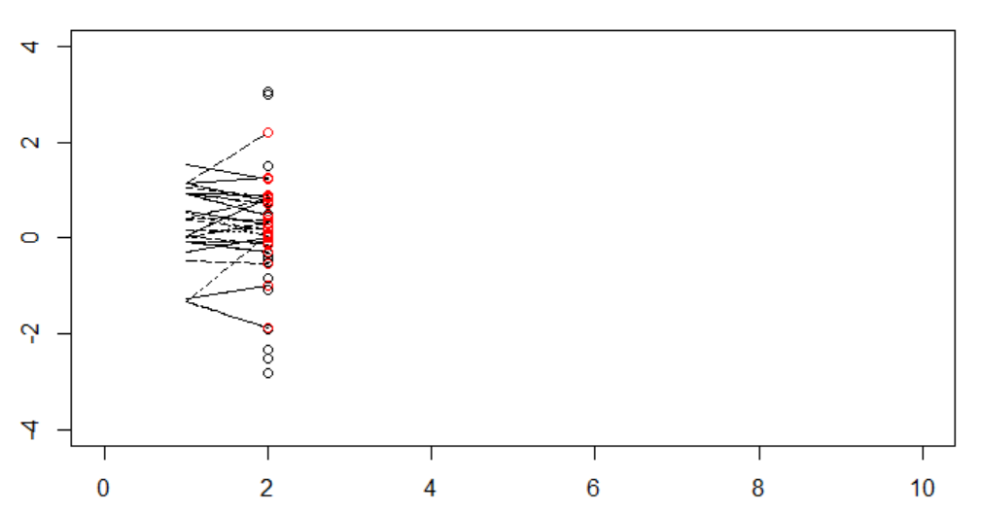

Step 2
Red is a good approximation to ${p(x}_{2})$

Slide 9
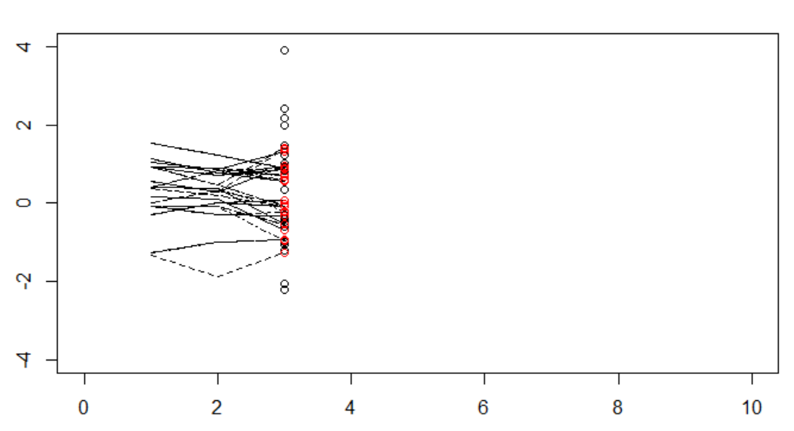

Step 3
Red is a good approximation to ${p(x}_{3})$

Slide 10
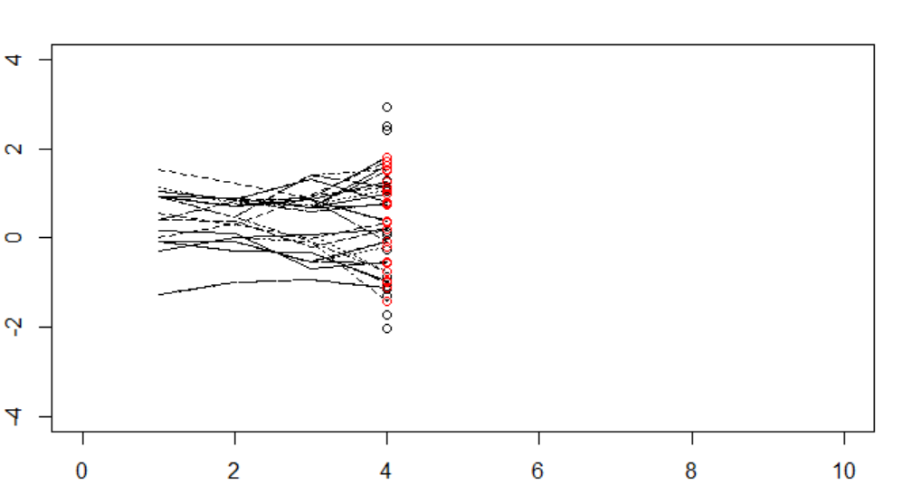

Step 4
Red is a good approximation to ${p(x}_{4})$
Not resampled
The full sample path «is out»

Slide 11
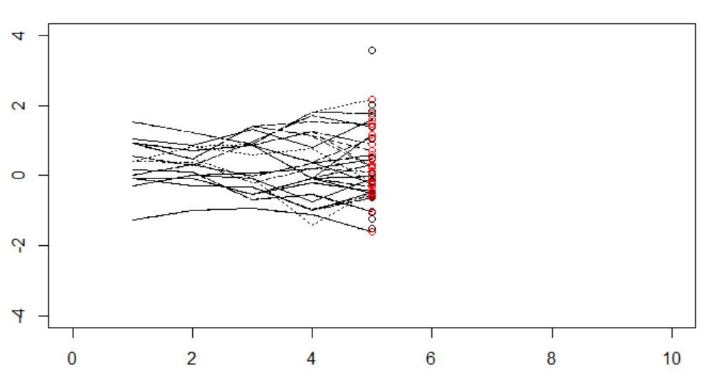

Step 5
Red is a good approximation to ${p(x}_{5})$

Slide 12
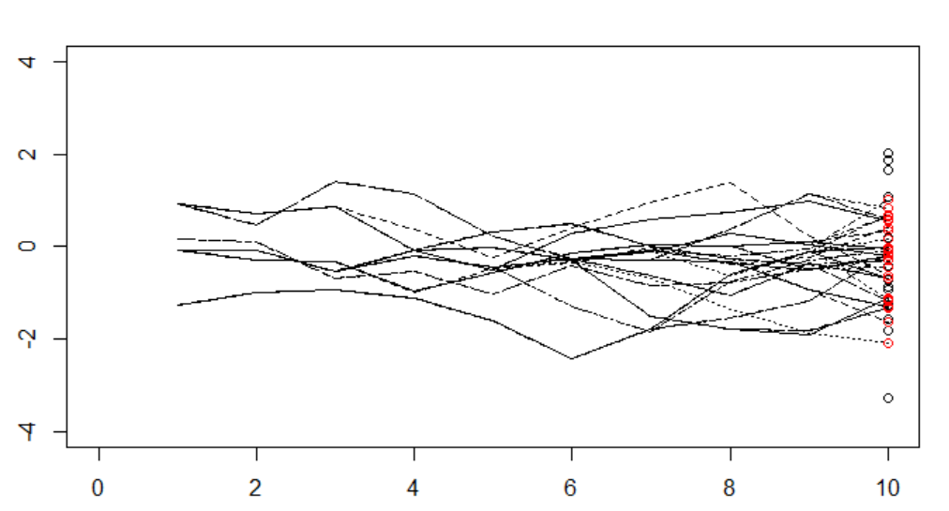

50 samples using resampling
Red is a good approximation to ${p(x}_{10})$

Slide 13
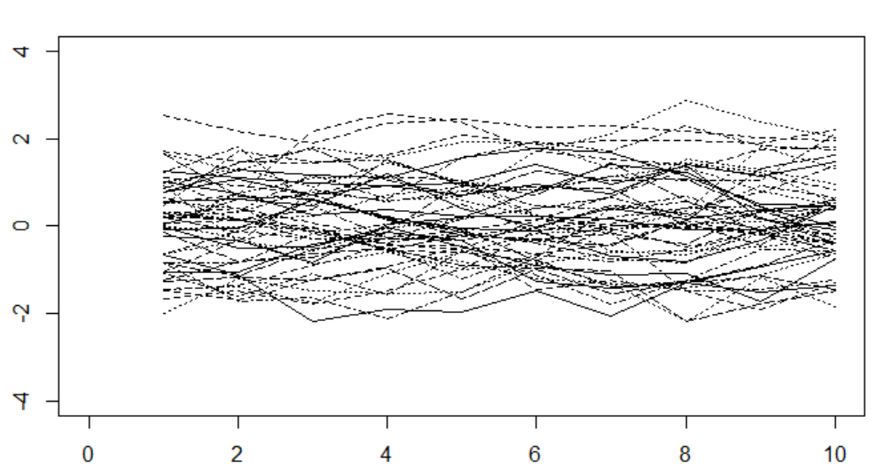
How 50 samples should look

Slide 14
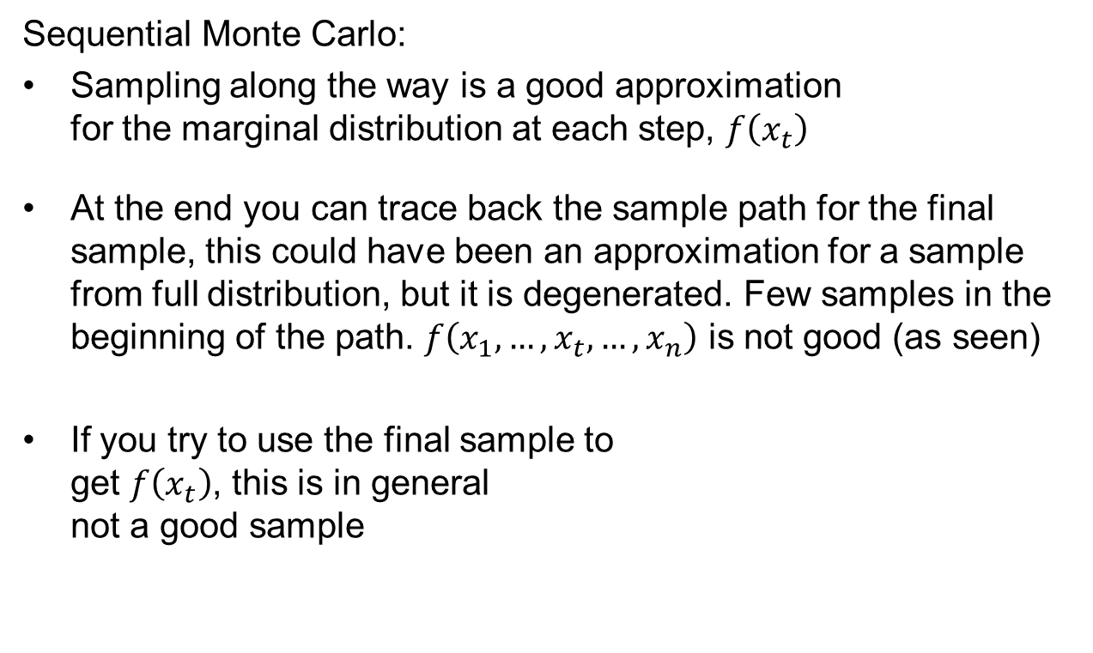
When is what a good approximation?
☺
Sequential Monte Carlo:
Sampling along the way is a good approximation
for the marginal distribution at each step, $f\left(x_{t}\right)$
At the end you can trace back the sample path for the final sample, this could have been an approximation for a sample from full distribution, but it is degenerated. Few samples in the beginning of the path. $f\left({x_{1},…,x}_{t},…,x_{n}\right)$ is not good (as seen)
If you try to use the final sample to
get $f\left(x_{t}\right)$, this is in general
not a good sample
☹
☺
☹

Slide 15
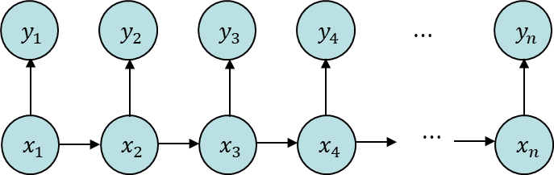

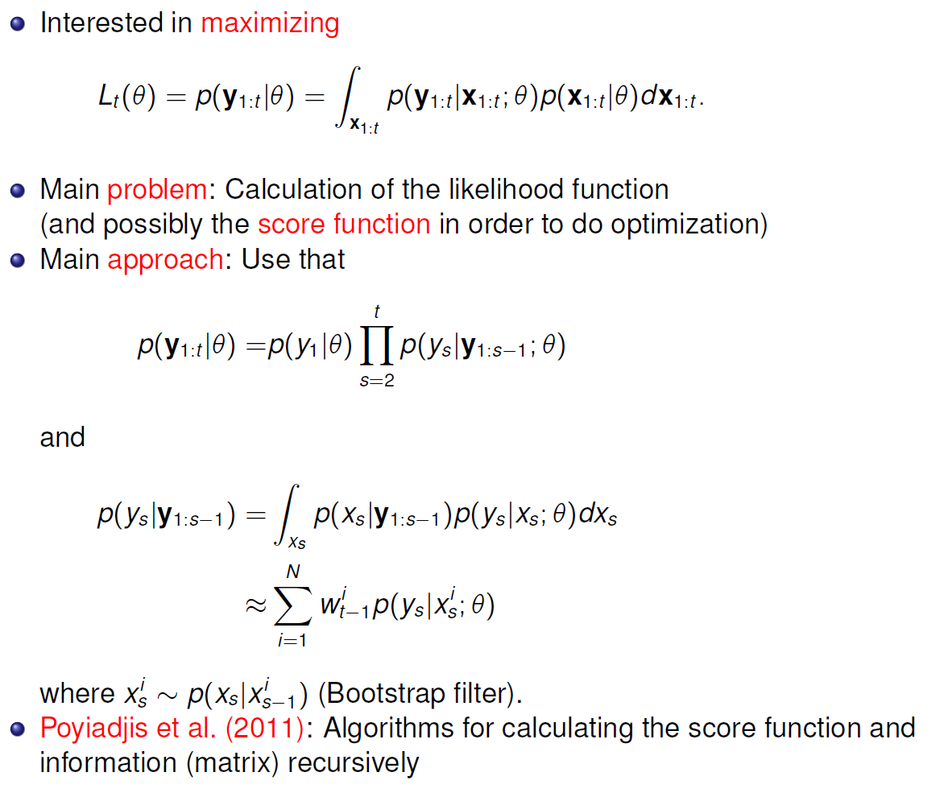
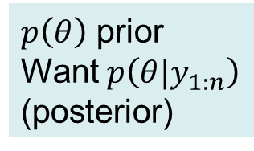

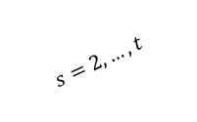

Today
State space models
Inference in Markov models
Maximum likelihood
  Likelihood by sampling (bootstrap filter)
Bayesian approach
  Direct approach
  Dynamic approach
  Sufficient statistics
$θ$
$$θ=?$$
$$s=2,…,t$$
$p\left(θ\right)$ prior
Want $p\left(θ|y_{1:n}\right)$
(posterior)

Slide 16



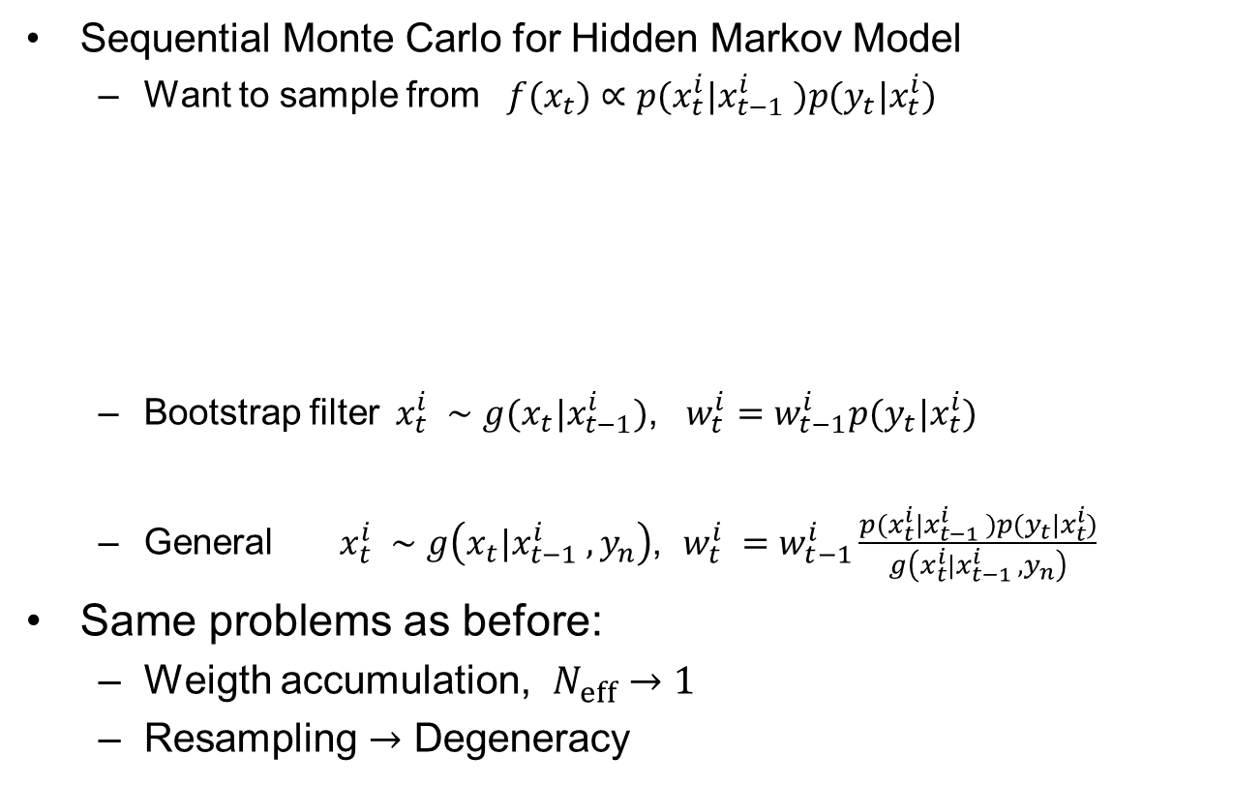



Sequential Monte Carlo for Hidden Markov Model
  Want to sample from $f(x_{t})∝p(x_{t}^{i}|x_{t−1}^{i} )p(y_{t}|x_{t}^{i})$
  Bootstrap filter$x_{t}^{i} ∼g(x_{t}|x_{t−1}^{i})$, $w_{t}^{i}=w_{t−1}^{i}p(y_{t}|x_{t}^{i})$
  General $x_{t}^{i} ∼g\left(x_{t}|x_{t−1}^{i} ,y_{n}\right)$, $w_{t}^{i} =w_{t−1}^{i}\frac{p(x_{t}^{i}|x_{t−1}^{i} )p(y_{t}|x_{t}^{i})}{g\left(x_{t}^{i}|x_{t−1}^{i} ,y_{n}\right)}$
Same problems as before:
  Weigth accumulation, $N_{eff}→1$
  Resampling $→$ Degeneracy
$$y_{1}$$
$$y_{2}$$
$$y_{3}$$
$$y_{4}$$
$$⋯$$
$$y_{n}$$
$$x_{1}$$
$$x_{2}$$
$$x_{3}$$
$$x_{4}$$
$$⋯$$
$$x_{n}$$

Slide 17
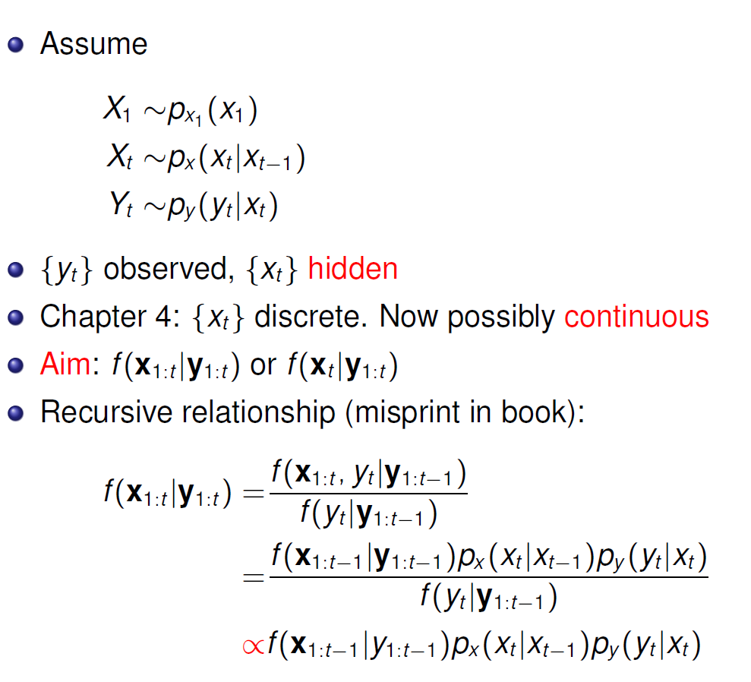





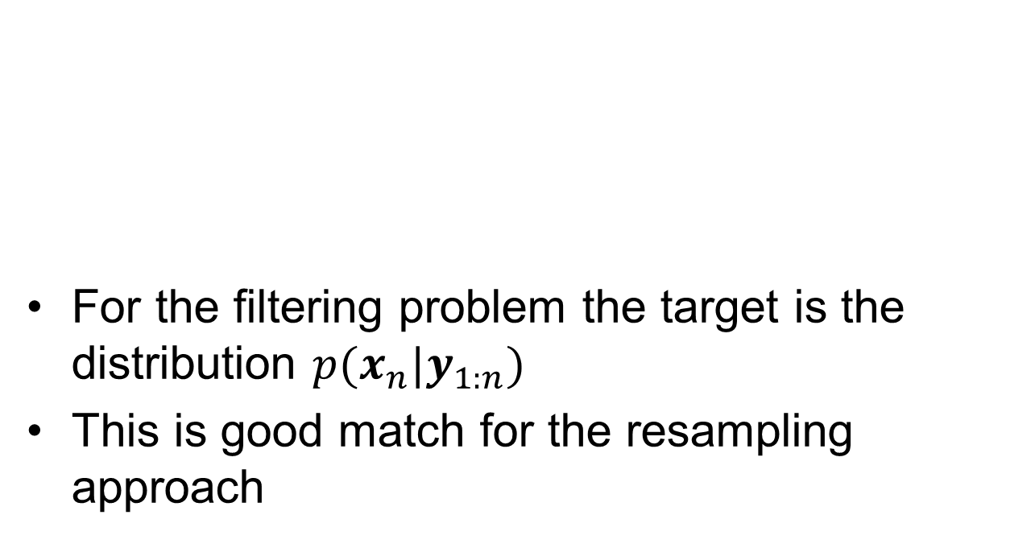







Origin of method in state space models
$$y_{1}$$
$$y_{2}$$
$$y_{3}$$
$$y_{4}$$
$$⋯$$
$$y_{n}$$
For the filtering problem the target is the distribution $p(x_{n}|y_{1:n})$
This is good match for the resampling approach
$$x_{1}$$
$$x_{2}$$
$$x_{3}$$
$$x_{4}$$
$$⋯$$
$$x_{n}$$

Slide 18
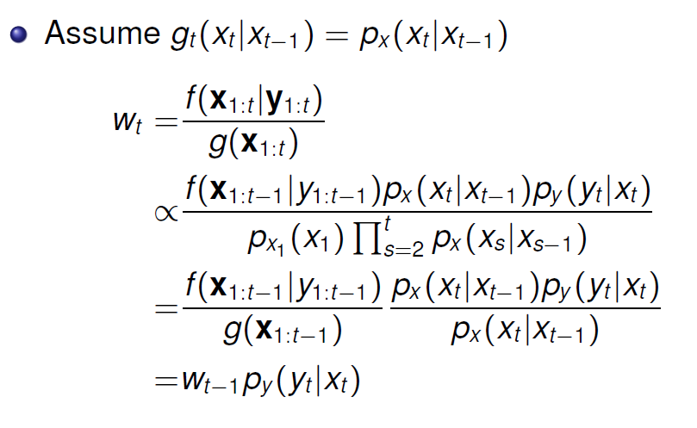
Hidden Markov model sequential Monte Carlo
Sample next time step
Current sample
Update according to Markov dynamics
Weight adjustment
Use :
Expand
«Summarize t-1»
«Recognize»

Slide 19
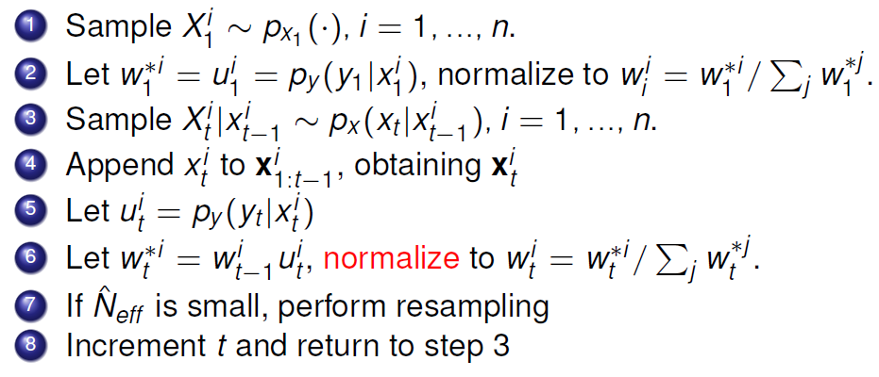
Algorithm SMC for HMM
First
Sequence

Slide 20
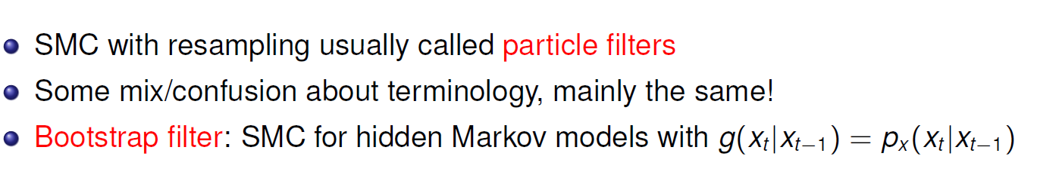
SMC/ Particle filter / Bootstrap filter

Slide 21
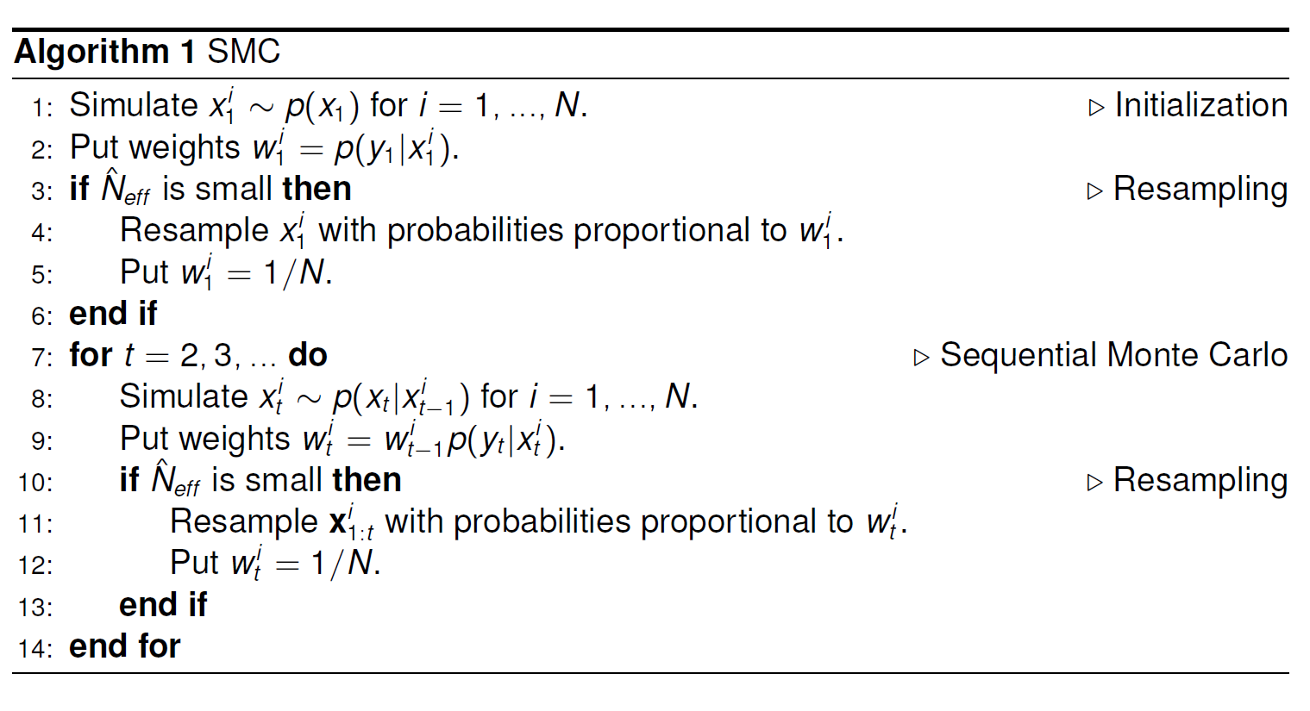
Bootstrap filter

Slide 22
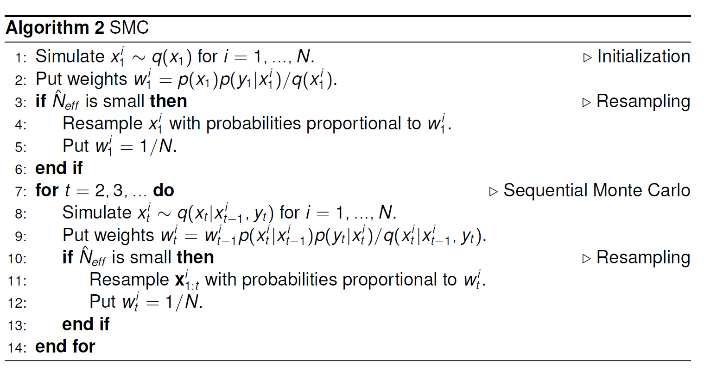

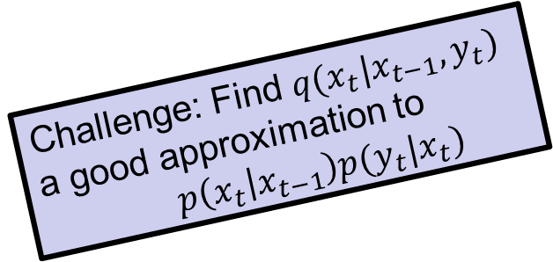
General algorithm particle filter
Challenge: Find $q(x_{t}|x_{t−1},y_{t})$
a good approximation to
$p\left(x_{t} | x_{t−1}\right)p(y_{t}|x_{t})$
Could also have: $q(x_{1}^{i}|y_{1})$

Slide 23
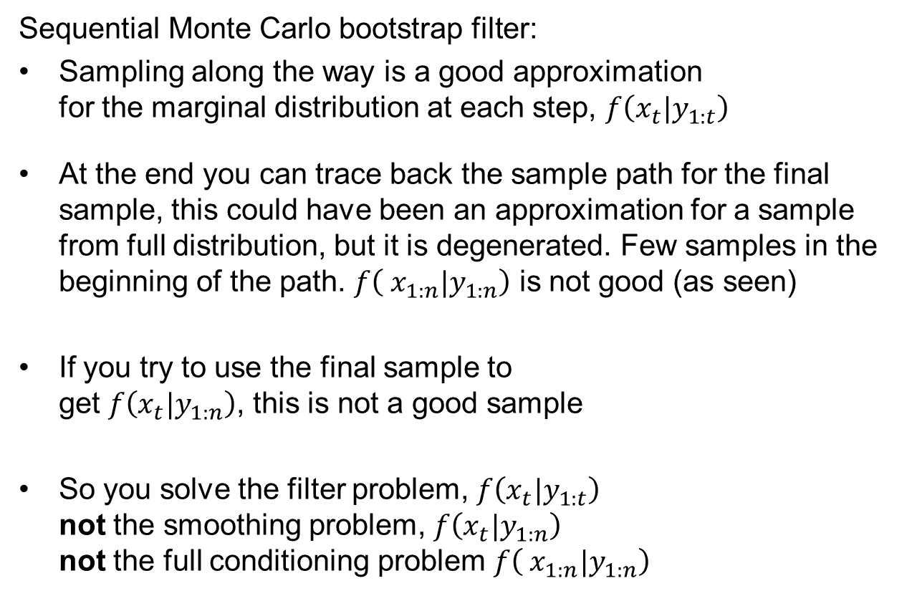
When is what a good approximation?
Sequential Monte Carlo bootstrap filter:
Sampling along the way is a good approximation
for the marginal distribution at each step, $f\left(x_{t}|y_{1:t}\right)$
At the end you can trace back the sample path for the final sample, this could have been an approximation for a sample from full distribution, but it is degenerated. Few samples in the beginning of the path. $f\left( x_{1:n}|y_{1:n}\right)$ is not good (as seen)
If you try to use the final sample to
get $f\left(x_{t}|y_{1:n}\right)$, this is not a good sample
So you solve the filter problem, $f\left(x_{t}|y_{1:t}\right)$
not the smoothing problem, $f\left(x_{t}|y_{1:n}\right)$
not the full conditioning problem $f\left( x_{1:n}|y_{1:n}\right)$
The difference is which
data you condition to

Slide 24


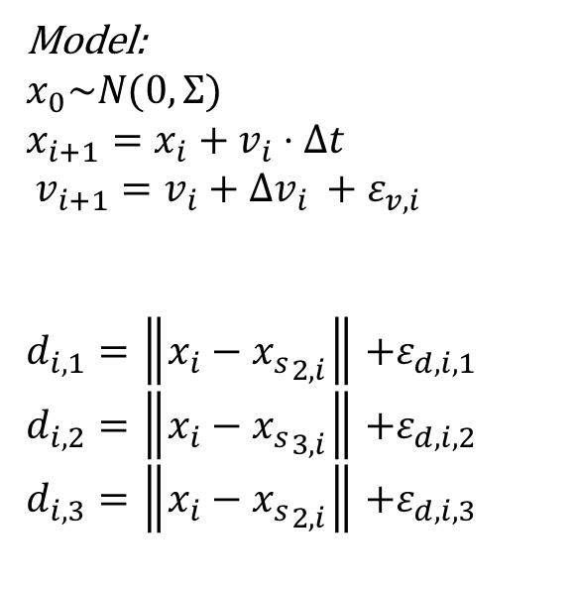



Model for GPS positioning
Model:
$x_{0}\sim N(0,Σ)$
$x_{i+1}=x_{i}+v_{i}⋅Δt$
$v_{i+1}=v_{i}+{Δv_{i} +ε}_{v,i}$
$d_{i,1}=\left\|x_{i}−{x_{s}}_{2,i}\right\|$ $+ε_{d,i,1}$
$d_{i,2}=\left\|x_{i}−{x_{s}}_{3,i}\right\|$ $+ε_{d,i,2}$
$d_{i,3}=\left\|x_{i}−{x_{s}}_{2,i}\right\|$ $+ε_{d,i,3}$
$${x_{s}}_{1}$$
$${x_{s}}_{2}$$
$$v_{i}$$
$$x_{i}$$
$${x_{s}}_{3}$$
How can this problem be solved using SMC?

Slide 25
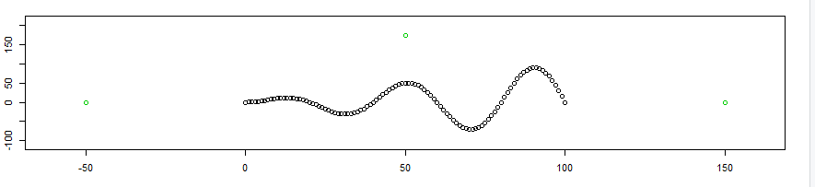
Solving two different ways
Solving for the filter distribution
Solving for the posterior [degeneracy issues]
Code GPS_EX.R

Slide 26
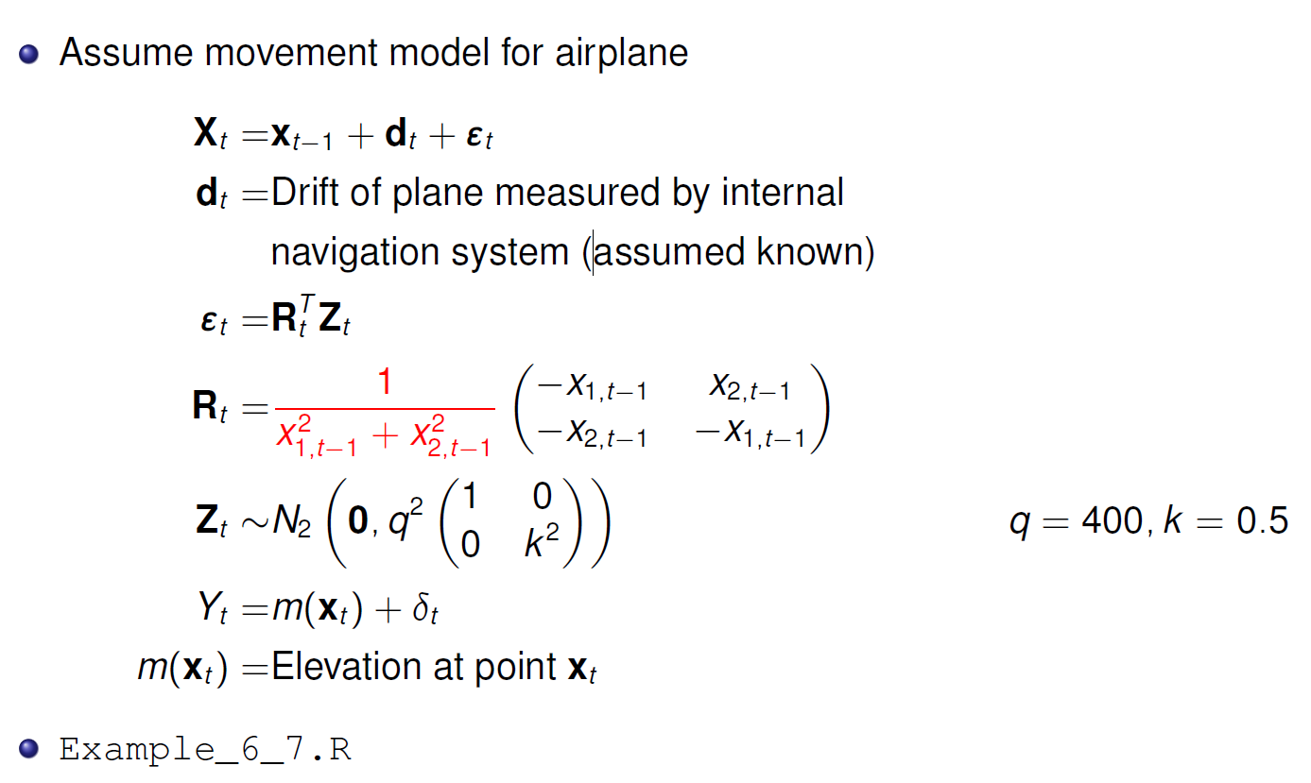
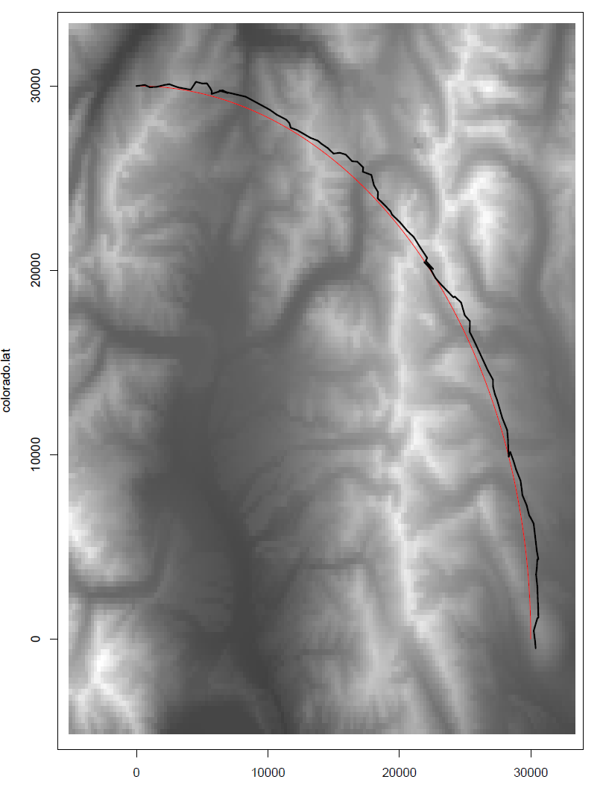


Terrain navigation
Uncertainty
normal to path
Uncertainty along path
Model
Rotation
$$√$$
Data
Map
Uncertainty $ε_{t}, δ_{t}$

Slide 27
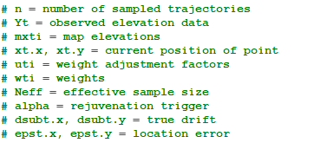
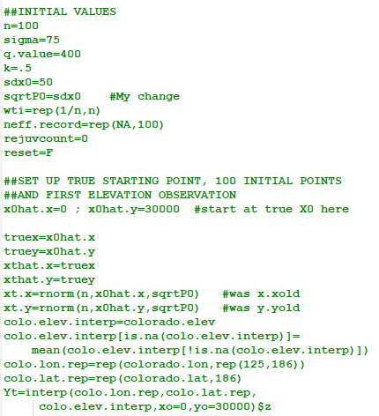
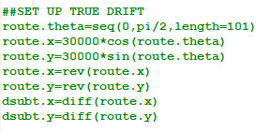

Terrain navigation
path (given)
Initialization
  Path is constructed
  Radius of curve 30 000
Initial ensemble members equal weight
Just one way to get it from the synthetic
Initial ensemble (n = 100 )

Slide 28

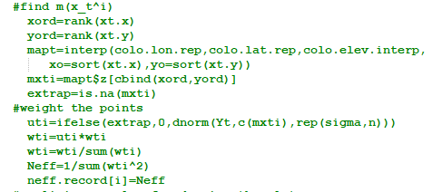




Terrain navigation
Mimic observation process
Update weights from data
Current estimate

Slide 29
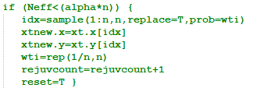
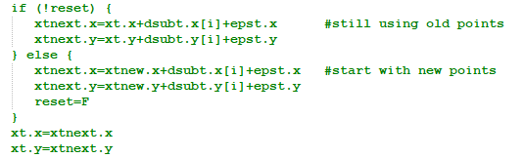
Terrain navigation
Resample?
Update according to dynamic model

Slide 30
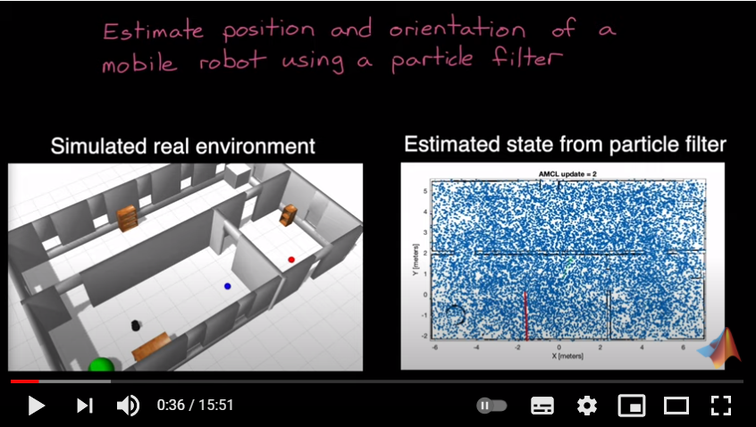
Autonomous Navigation, Part 2: Understanding the Particle Filter - YouTube

Slide 31
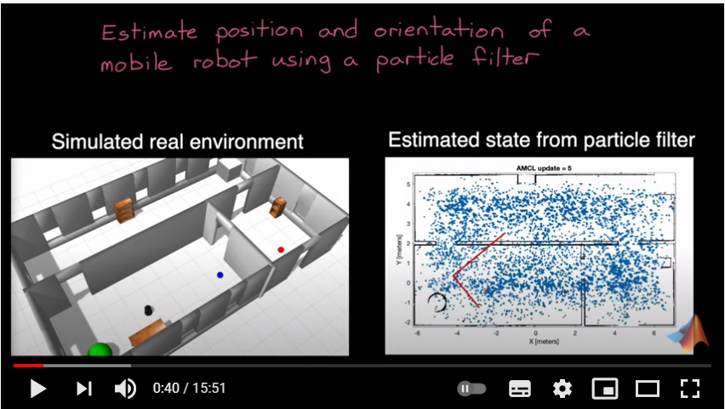
Autonomous Navigation, Part 2: Understanding the Particle Filter - YouTube

Slide 32
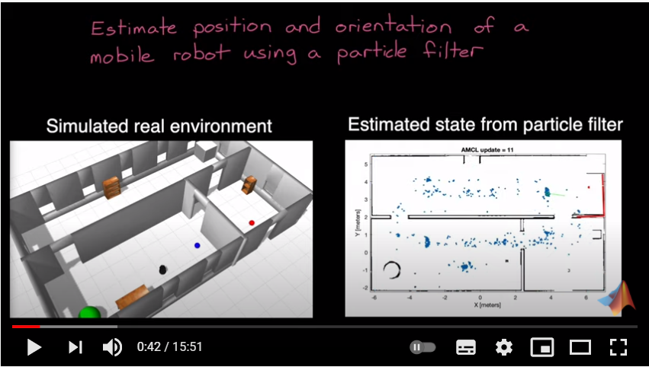
Autonomous Navigation, Part 2: Understanding the Particle Filter - YouTube

Slide 33
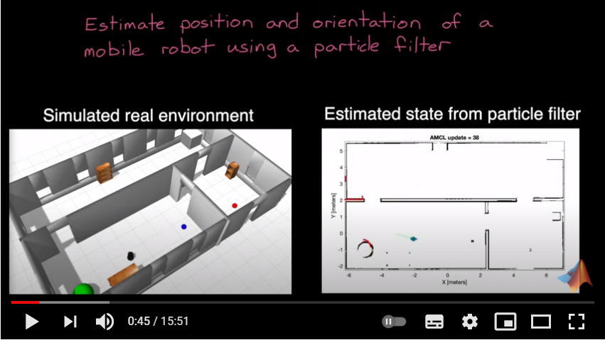
Autonomous Navigation, Part 2: Understanding the Particle Filter - YouTube

Slide 34

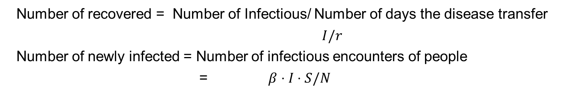


Kermack-McKendrick theory, population with N individuals (SIR)
(or deceased)
$$N=S+I+R$$
$$ΔI=β⋅ S⋅I/N − I/r$$
Change in number of infectious =
Number of newly infected-number recovered
Number of recovered = Number of Infectious/ Number of days the disease transfer
$I/r$
Number of newly infected = Number of infectious encounters of people
= $β⋅I⋅S/N$
Details of the model used in Norway:
https://www.fhi.no/sv/smittsomme-sykdommer/corona/koronavirus-modellering/

Slide 35

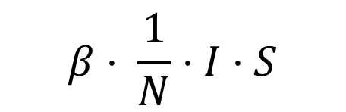
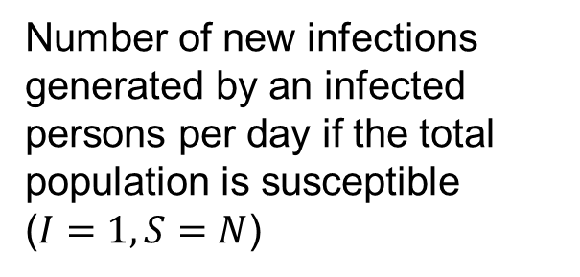
Number of infectious encounters?
S | I | R
 |  |  | S
 |  |  | I
 |  |  | R
S | I | R
 |  |  | S
 |  |  | I
 |  |  | R
Just a fraction of all possible meetings occur
Infectious
encounters
$$I⋅S$$
$$β⋅ \frac{1}{N}⋅I⋅S$$
Transfer rate:
Infectious encounters
Number of new infections generated by an infected persons per day if the total population is susceptible
($I=1,S=N$)

Slide 36

SIR in Kermack-McKendrick theory population of N
(or deceased)
Number of new infections per day = $β⋅I⋅S/N$
$$ΔI=β⋅ S⋅I/N − I/r$$
Change in count of infected
New infections
Recovered
From: Compartmental models in epidemiology - Wikipedia

Slide 37
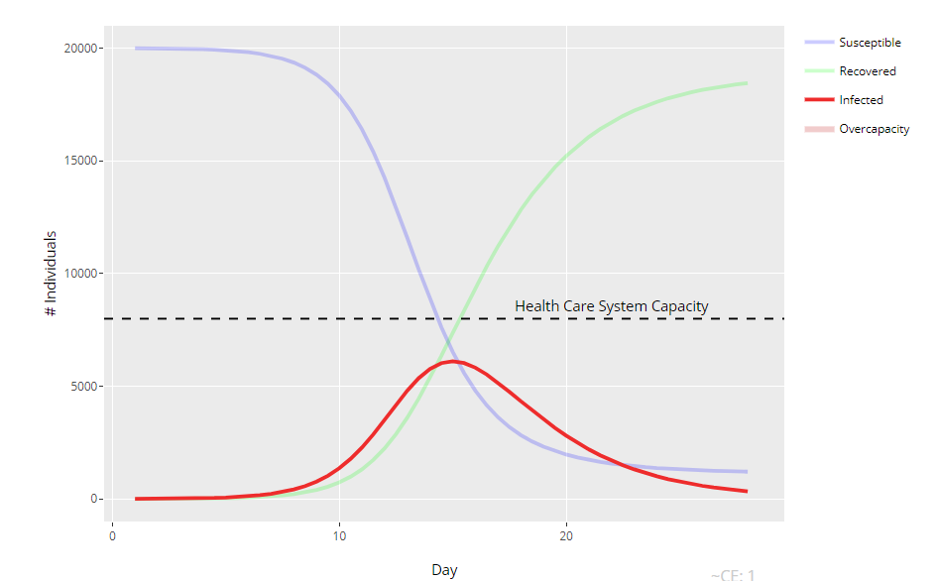
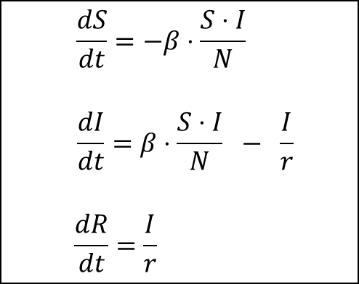
This gives a system of differential equations
$$\frac{dS}{dt}=−β⋅\frac{S⋅I}{N}$$
$$\frac{dI}{dt}=β⋅\frac{S⋅I}{N} − \frac{I}{r}$$
$$\frac{dR}{dt}=\frac{I}{r}$$
Største antall «syke» samtidig
(Not «covid numbers» i
The shape of the curve is given by: $R_{0}=β⋅ r$
Number of infections generated
by one infected
(if everybody else are susceptible)
Number of days the disease is infectious
Number of infections generated
by one infected per one day
(if everybody else are susceptible)

Slide 38
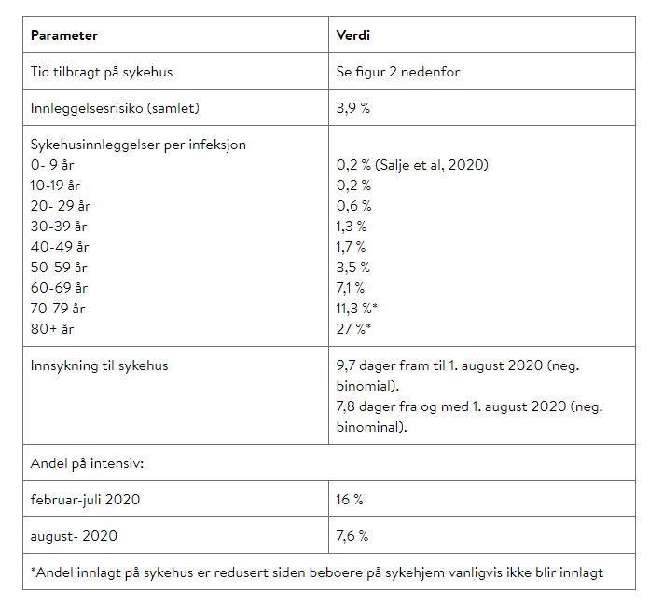
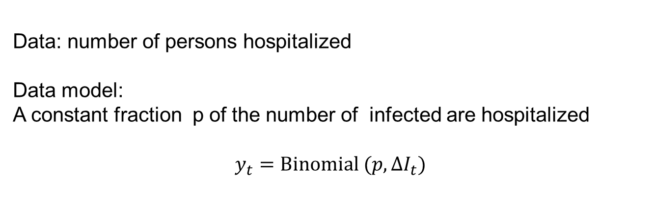
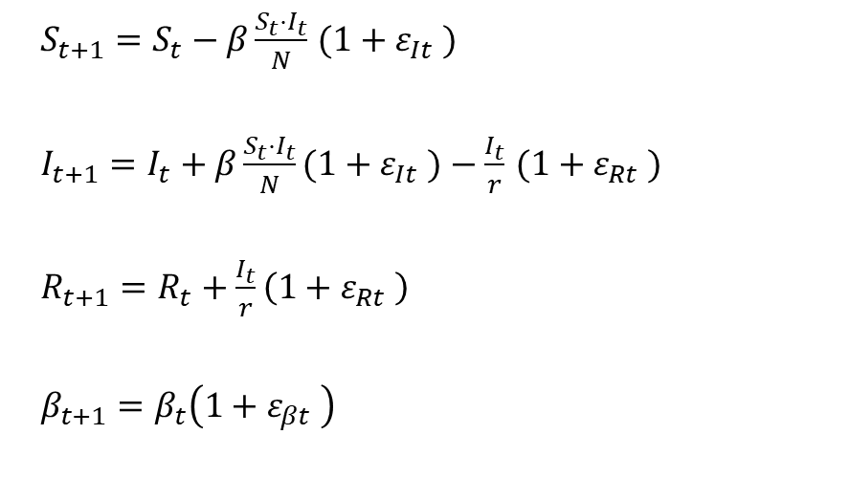
Discrete random SIR model
[for example purpose]
$S_{t+1}=S_{t}−β\frac{S_{t}⋅I_{t}}{N}$ $(1+ε_{It} )$
$I_{t+1}=I_{t}+β\frac{S_{t}⋅I_{t}}{N}(1+ε_{It} )−\frac{I_{t}}{r}$ $(1+ε_{Rt} )$
$R_{t+1}=R_{t}+\frac{I_{t}}{r}\left(1+ε_{Rt} \right)$
$β_{t+1}=β_{t}\left(1+ε_{βt} \right)$
Data: number of persons hospitalized
Data model:
A constant fraction p of the number of infected are hospitalized
$${y_{t}=Binomial (p,ΔI}_{t})$$

Slide 39
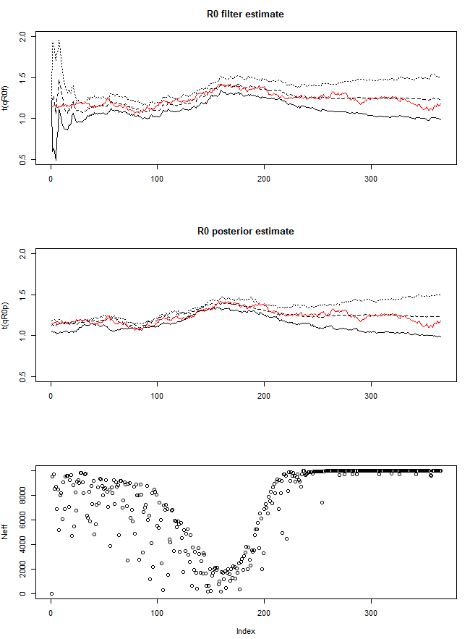
SIR model for COVID 19
Solving for the filter distribution
Solving for the posterior [degeneracy issues]
Code SIR_EX.R

Slide 40
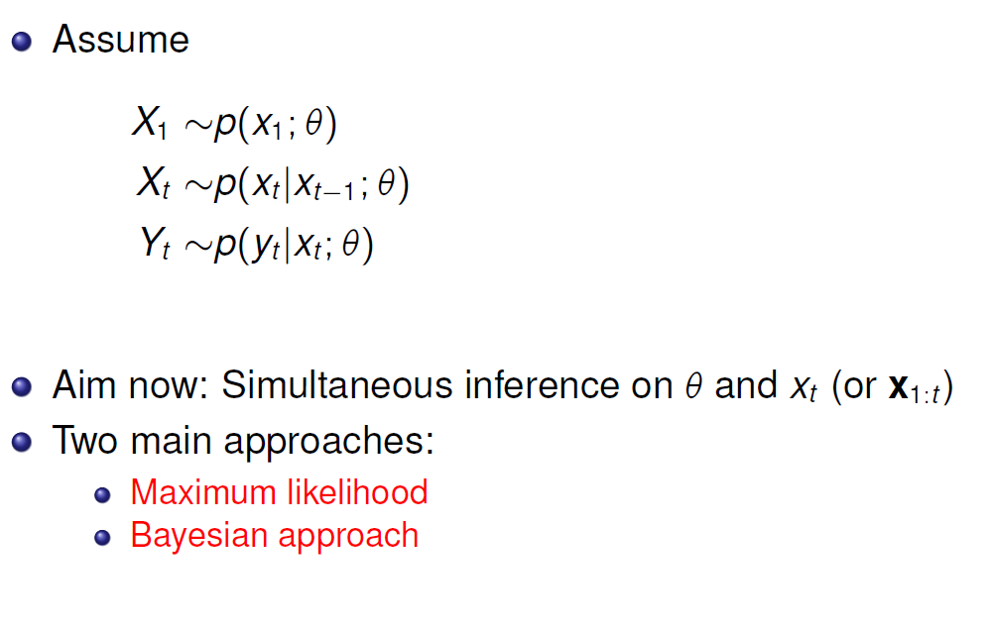
SMC and parameter estimation
Hidden Markov model
With unknown parameters
(we saw this type of model
in lecture 4, EM for HMM )

Slide 41
SMC and maximum likelihood

Slide 42







Maximum likelihood in SMC
To evaluate
for a given $θ$
$$p\left(y_{s} | y_{1:s−1},θ\right)=\int_{x_{s}}{p\left(x_{s} | y_{1:s−1},θ\right)p\left(y_{s} | x_{s},θ\right)dx_{s}}$$
$$=\int_{x_{s}}{\int_{x_{s−1}}{p\left(x_{s},x_{s−1} | y_{1:s−1},θ\right)p\left(y_{s} | x_{s},θ\right)dx_{s−1}dx_{s}}}$$
$$=\int_{x_{s}}{\int_{x_{s−1}}{p\left(x_{s}\left|x_{s−1},θ\right)p(x_{s−1} | y_{1:s−1},θ\right)p\left(y_{s} | x_{s},θ\right)dx_{s−1}dx_{s}}}$$
We sample this
To get $x_{s}^{i}$
We have this for $s−1$ with:
$(x_{s−1}^{i},w_{s−1}^{i})$, $i=1,…,M$
We get the weight
update for $x_{s}^{i}$
$$u_{s}^{i}=p\left(y_{s} | x_{s}^{i},θ\right)$$
Sample for $s:$
$(x_{s}^{i},{u_{s}^{i}w}_{s−1}^{i})$, $i=1,…,M$

Slide 43

SMC and Bayesian parameter estimation

Slide 44

Direct use of SMC

Slide 45

Is direct use of SMC properly weighted?
i
i
i
i
i
i
i

Slide 46


Issue: Direct approach
Direct approach samples theta initially and
is never able to resample it thus at each resampling
it is a thinning/depletion of unique elements
$θ$ is sampled
here
Prior
Sample from prior
Posterior

Slide 47


Lemmings data

Slide 48



Slide 49








Number of unique samples of $x_{t}$ in the final data set
$$t$$
$$t$$
$$x_{t}$$
$$t$$
$$t$$
a=0.9

Slide 50




Introducing dynamics in $θ$
«$θ$is like $x$»
1
t
t

Slide 51


Issue: Dynamic approach
Dynamic approach. We can resample $θ_{t}$ at each time step
This solves the problem of degeneration
(but we solve a different problem…)
Original problem
New problem
This problem is equivalet with
the «no $θ$ problem»
$\tilde{x_{t}}=(x_{t},θ_{t})$
«Dynamic duo»

Slide 52


Dynamics in $θ$ continued

Slide 53

Sufficient statistics

Slide 54

SMC and sufficient statistics

Slide 55

Algorithm Storvik filter

Slide 56

Approach using sufficient statistics
We can update the statistics recursively
We can compute sufficient statistics for $θ$
This opens for resampling of theta ☺
We can expand this to the hidden Markov model as long as the hidden variable is the one influenced by theta
This keeps the original
conditioning structure
(as $x_{t}$ “protect” $θ$ from $y_{t}$)

Slide 57
SMC and sufficient statistics general
«Dynamic duo»
Bootstrap filter
for the «dynamic duo»…

Slide 58
Algorithm Storvik filter

Slide 59





Example Lemmings evolving parameter: a
Direct
Number of
unique a
Dymamic
Sufficient

Slide 60

References

Slide 61
















$$y_{1}$$
$$y_{2}$$
$$y_{3}$$
$$y_{4}$$
$$⋯$$
$$y_{n}$$
$$x_{1}$$
$$x_{2}$$
$$x_{3}$$
$$x_{4}$$
$$⋯$$
$$x_{n}$$
$$x_{1}$$
$$x_{2}$$
$$x_{3}$$
$$x_{4}$$
$$⋯$$
$$x_{n}$$
$$y_{1}$$
$$y_{2}$$
$$y_{3}$$
$$y_{4}$$
$$⋯$$
$$y_{n}$$
$$x_{1}$$
$$x_{2}$$
$$x_{3}$$
$$x_{4}$$
$$⋯$$
$$x_{n}$$
$θ$
$$θ_{1}$$
$$θ_{2}$$
$$θ_{3}$$
$$θ_{4}$$
$$⋯$$
$$θ_{n}$$

