Slide 1
STK-4051/9051 Computational Statistics Spring 2024
SGD part 2
Instructor: Odd Kolbjørnsen, oddkol@math.uio.no

Slide 2
Last time
Bootstrap
EM algorithm
  Missing data
  Moths
  Proof of increasing log likelihood when using
  EM algorithm
  Mixture Gaussian clustering
  Exponential family
Variance estimate in EM
  Bootstrap
  Approximation using, information matrix’
EM for hidden Markov model
  Forward – backward for Mixture Gauss

Slide 3
Last time:
Stochastic Gradient Decent (SGD)
What it is and why we do it
Requirements for convergence
SGD for neural nets
Proof of convergence !
SGD for Spatial data

Slide 4
Today: :
Stochastic Gradient Decent (SGD)
What it is and why we do it
Requirements for convergence
SGD for neural nets
Proof of convergence !
SGD for Spatial data

Slide 5
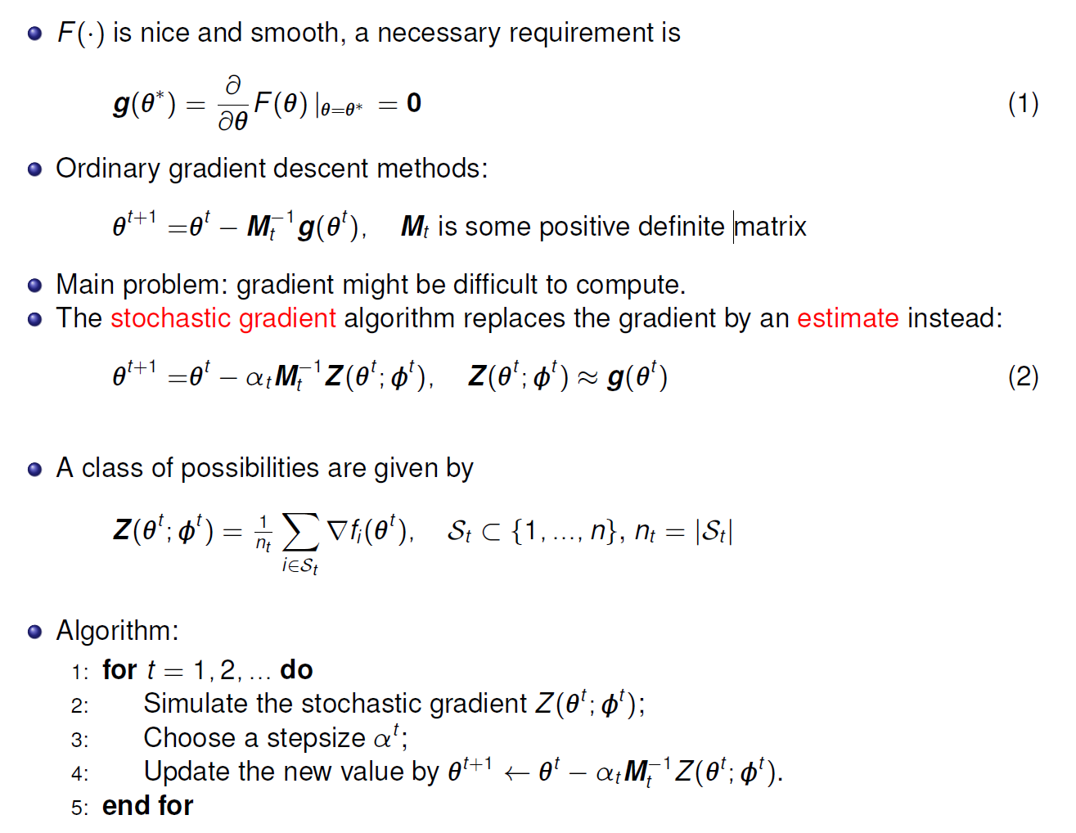

SGD: Main Idea
(Gradient)
«some stochastic element»
$$"φ^{t} =𝒮_{t}"$$

Slide 6
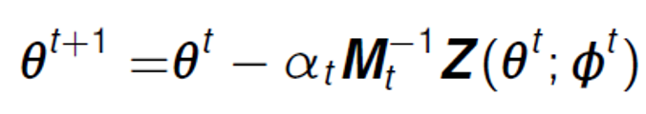
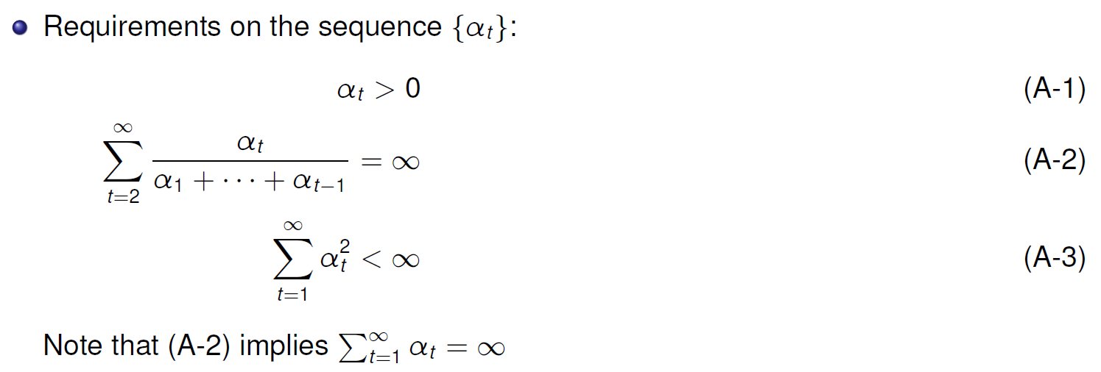
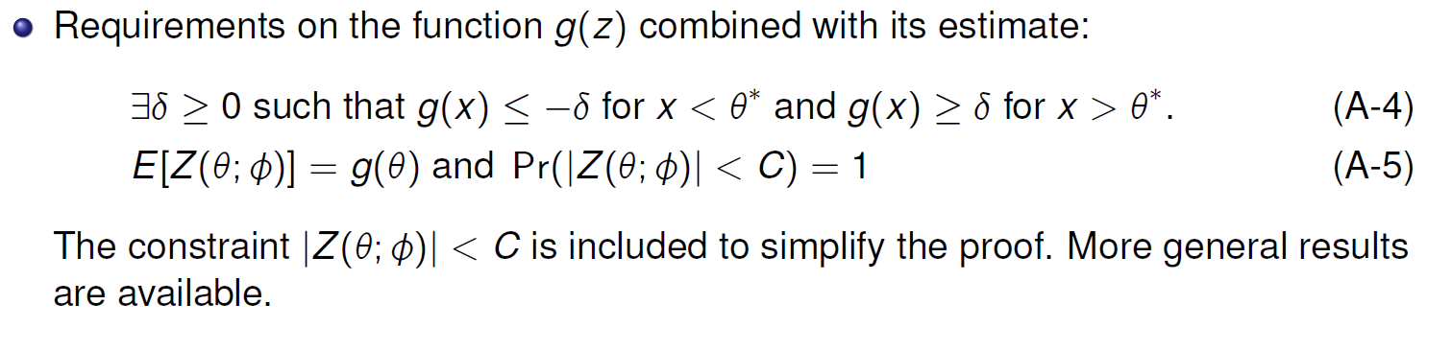






Assumptions for proof of convergence
x
$$f(x)$$
$$g(x)$$
$g(x)$ has same sign as${ (x −θ}^{∗})$
$${ x<θ}^{∗}$$
$${ x>θ}^{∗}$$
$${ θ}^{∗}$$

Slide 7
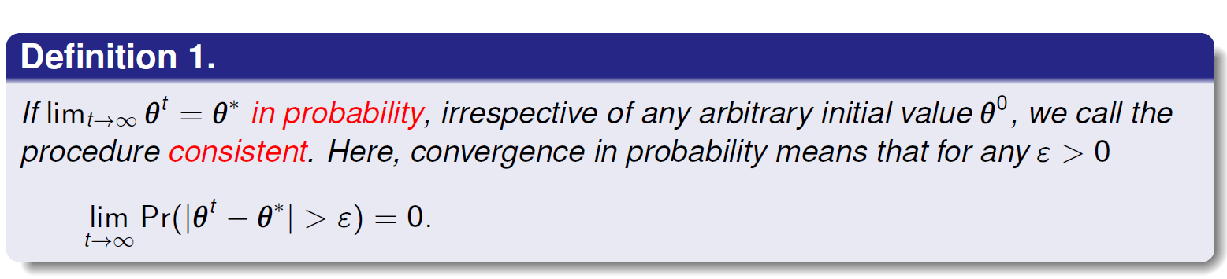






Convergence of SGD
Want to show that the SGD procedure is consistent
Do this in three steps (with some sub-steps on the way)
  Prove that L2 convergence gives consistency
  Prove that the sequence converge
  Prove that we converge to the true parameter
    Sharp transition at zero
    Smooth transition at zero
$$g(x)$$
$$f(x)$$
$${ x<θ}^{∗}$$
$${ x>θ}^{∗}$$
$$f(x)$$
$$g(x)$$
$${ x<θ}^{∗}$$
$${ x>θ}^{∗}$$

Slide 8
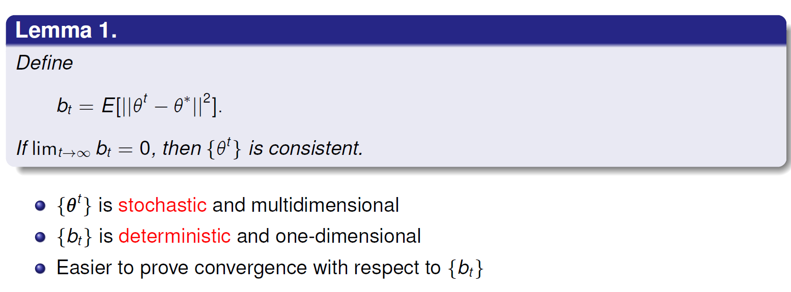
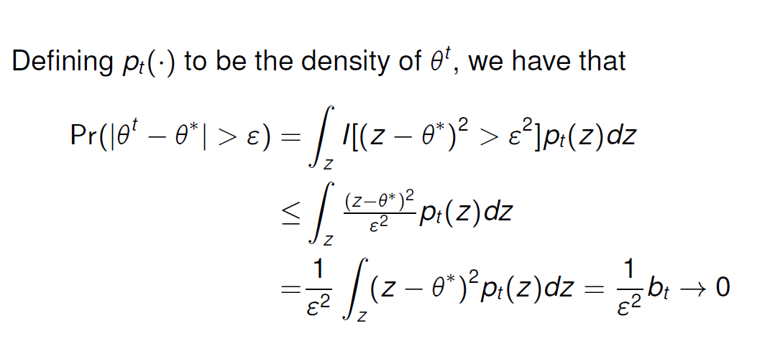


Step 1 L2 convergence gives consistency
$$−ε$$
$$ε$$

Slide 9
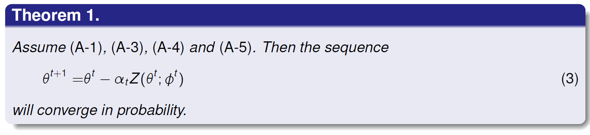
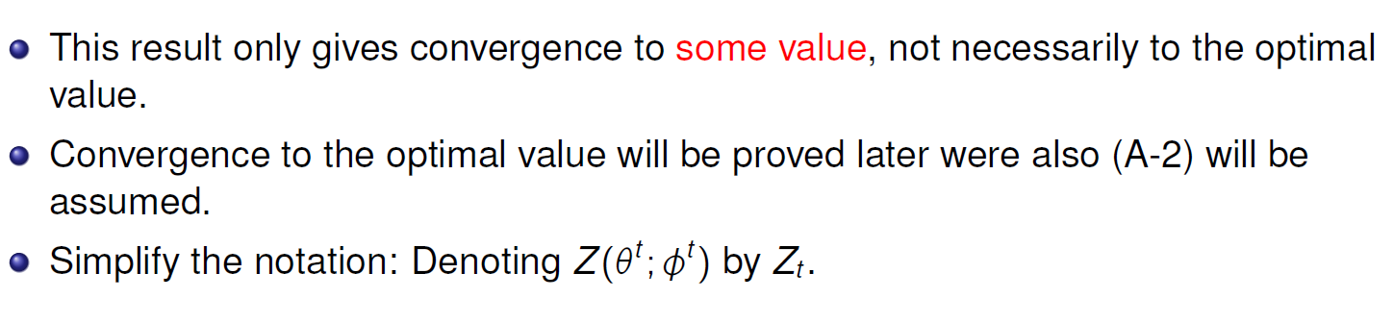

Step 2 Prove that the sequence converge
Recall: $Z$ is the stochastic version of the gradient

Slide 10
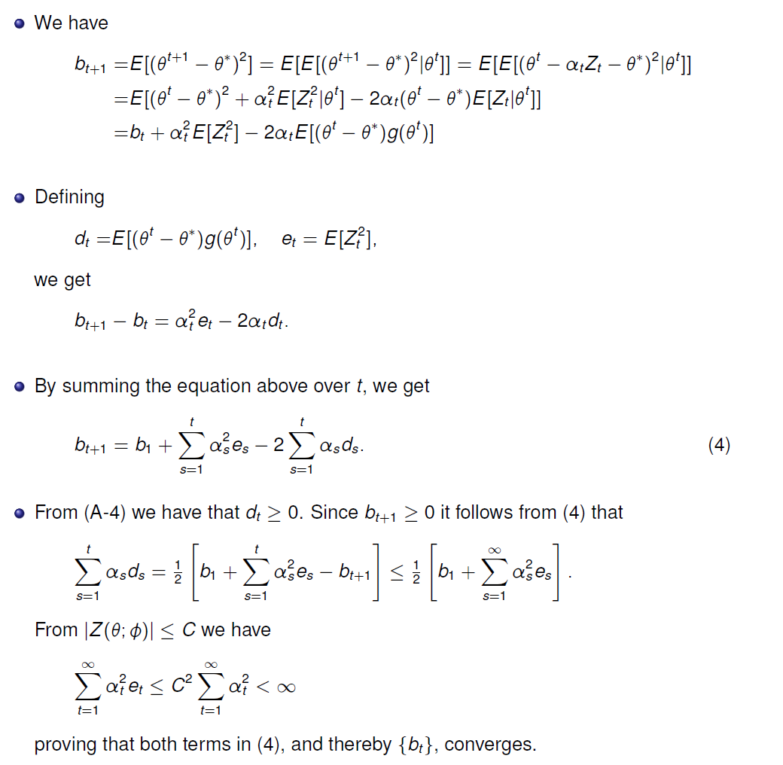
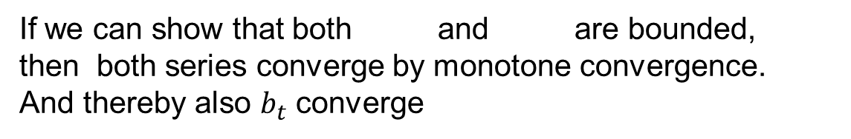
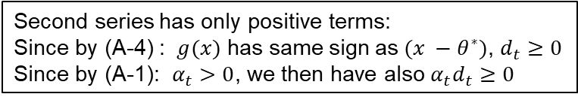

Proof of Theorem 1
(4)
Second series has only positive terms:
Since by (A-4) : $g(x)$ has same sign as${ (x −θ}^{∗})$, $d_{t}≥0$
Since by (A-1): $α_{t}>0$, we then have also ${α_{t}d}_{t}≥0$
First series has only positive terms:
Since $α>0,$
If we can show that both and are bounded,
then both series converge by monotone convergence.
And thereby also $b_{t}$ converge

Slide 11
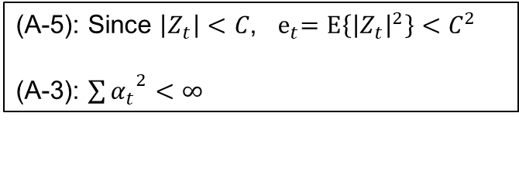


Bounding the two series
(A-5): Since $\left|Z_{t}\right|<C$, ${ e}_{t}=E\left\{{\left|Z_{t}\right|}^{2}\right\}<C^{2}$
(A-3): ${\sum{α_{t}}}^{2}<∞$
$$+\sum_{s=t+1 }^{∞}{α_{s}^{2}}e_{s}≥0$$
Add two
Non-negative finite numbers
$$≥0$$
Thus if we remove it we reduce the sum
Both series are bounded and therefore converge

Slide 12
Convergence of SGD (repeated)
Want to show that the SGD procedure is consistent
Do this in three steps (with some sub-steps on the way)
  Prove that L2 convergence gives consistency
  Prove that the sequence converge
  Prove that we converge to the true parameter
    Sharp transition at zero
    Smooth transition at zero
So far
$$f(x)$$
$${ x<θ}^{∗}$$
$${ x>θ}^{∗}$$
$$f(x)$$
$$g(x)$$
$${ x<θ}^{∗}$$
$${ x>θ}^{∗}$$

Slide 13
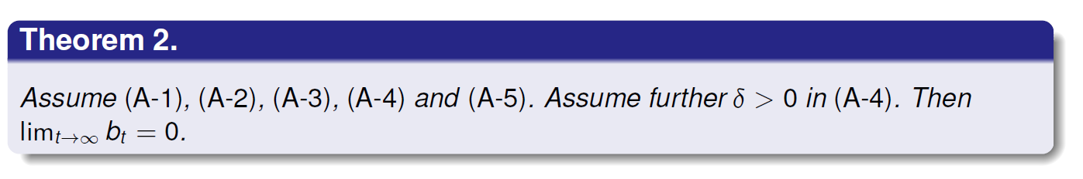
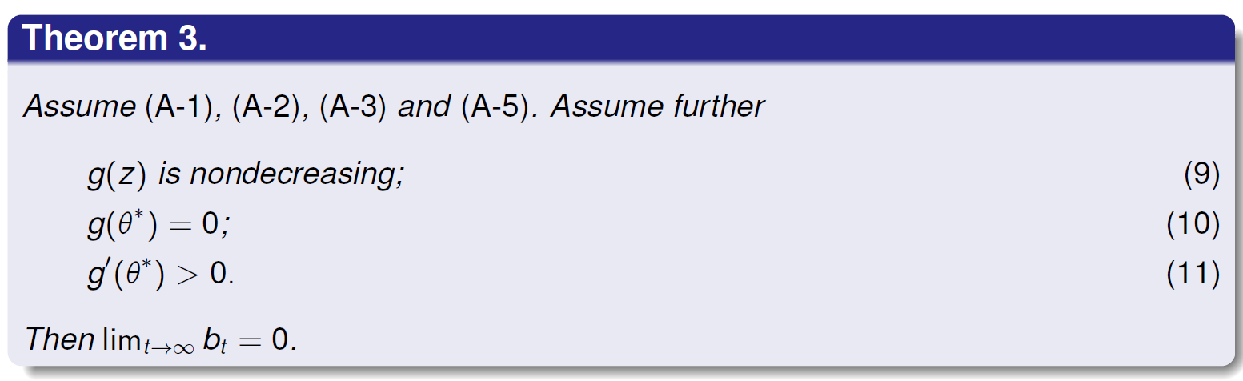






Two main results
$$f(x)$$
$$g(x)$$
$${ x<θ}^{∗}$$
$${ x>θ}^{∗}$$
(A-4)
$$f(x)$$
$$g(x)$$
$${ x<θ}^{∗}$$
$${ x>θ}^{∗}$$

Slide 14
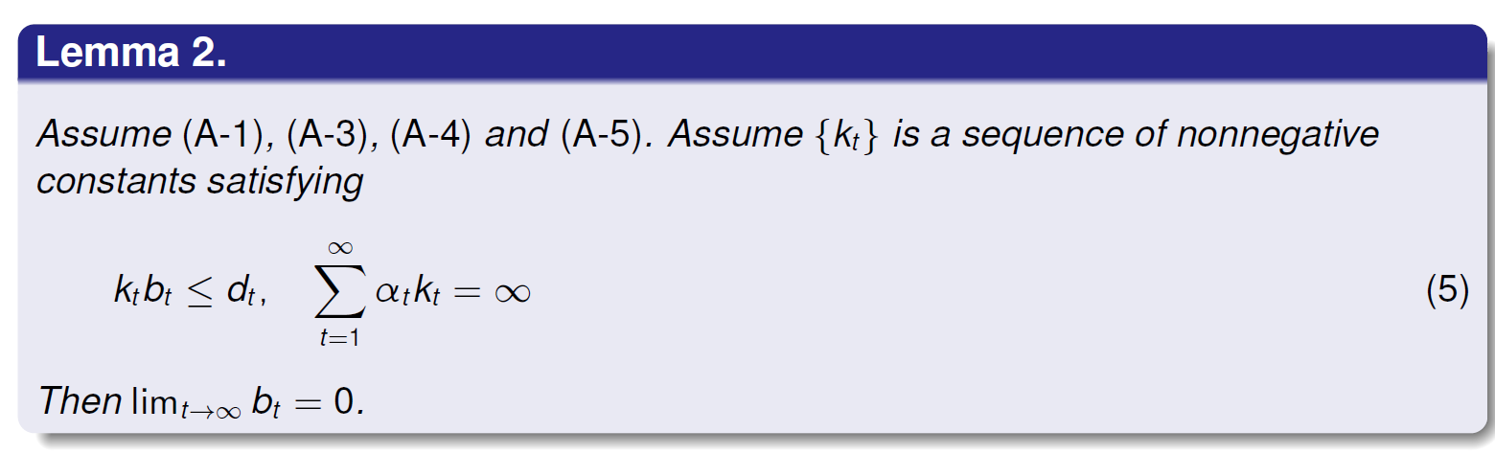
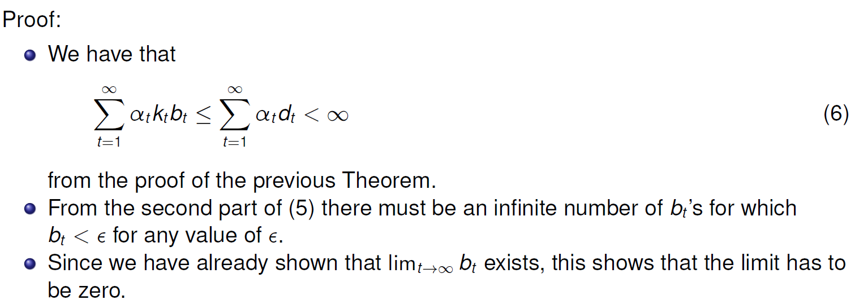
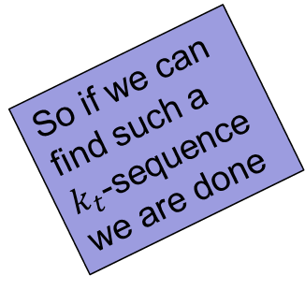
Warm up to Theorems
So if we can find such a $k_{t}$-sequence we are done

Slide 15
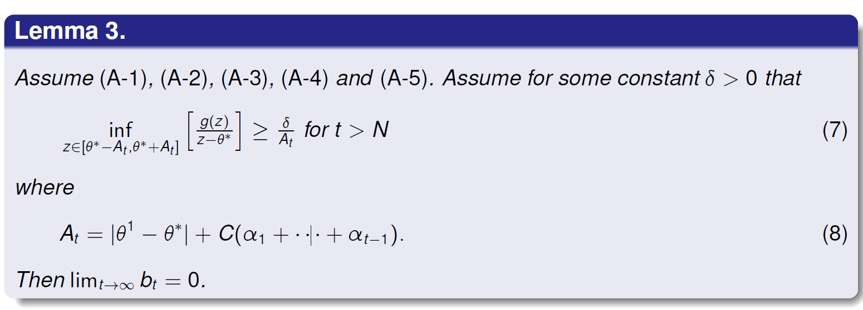
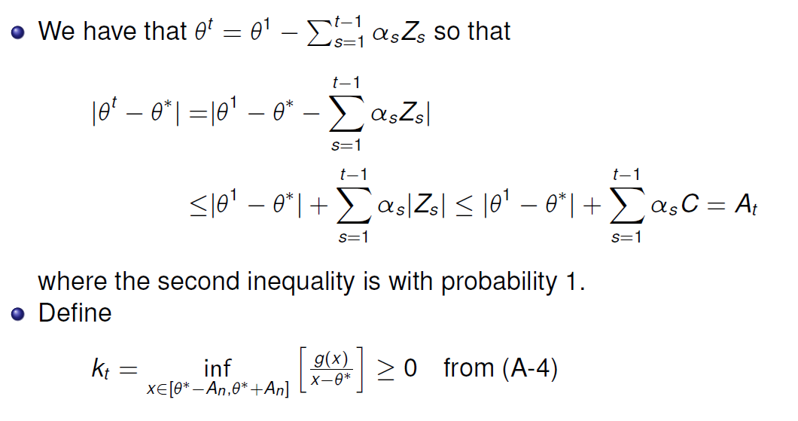

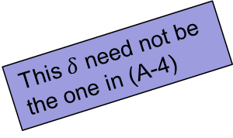
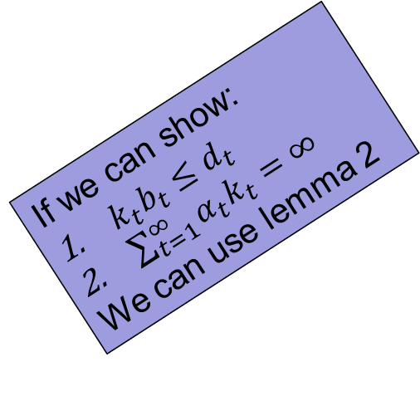
Warm up to Theorems cont…
This $δ$ need not be the one in (A-4)
($A_{t}$: max distance from $θ^{∗}$)
If we can show:
$k_{t}b_{t}≤d_{t}$
$\sum_{t=1}^{∞}{α_{t}k_{t}=∞}$
We can use lemma 2

Slide 16
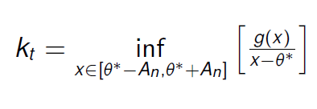

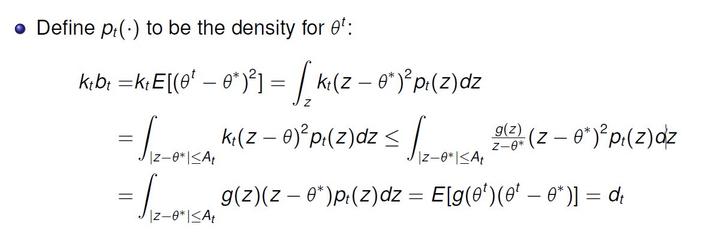

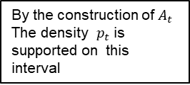
Proof $k_{t}b_{t}≤d_{t}$
By the construction of $A_{t}$
The density $p_{t}$ is supported on this interval

Slide 17
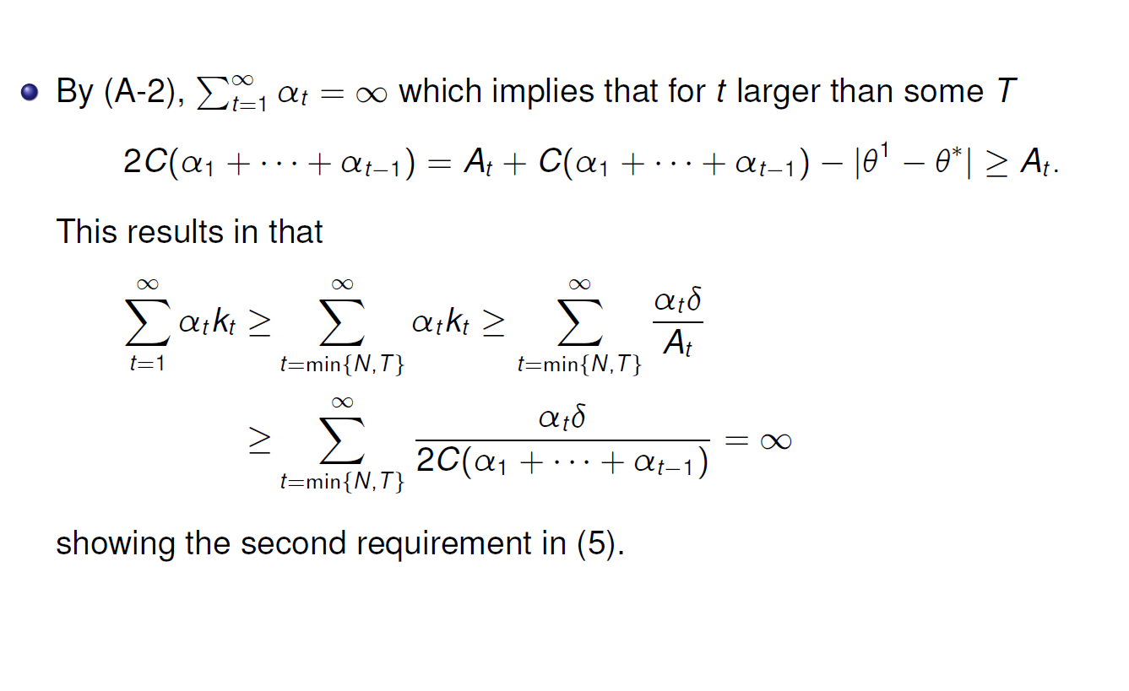

Proof $\sum_{t=1}^{∞}{α_{t}k_{t}=∞}$

Slide 18
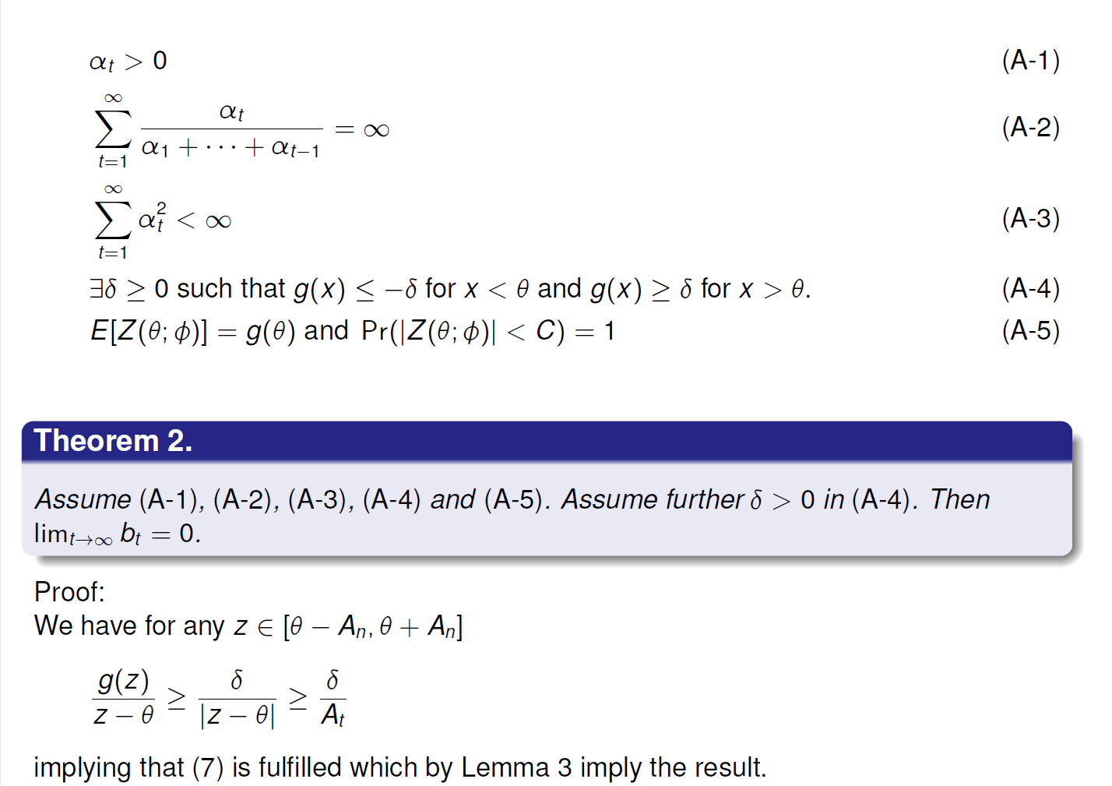
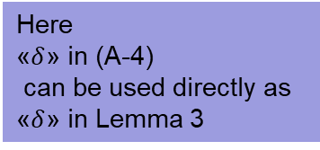
Theorem 2
Here
«$δ$» in (A-4)
can be used directly as
«$δ$» in Lemma 3
t
t

Slide 19
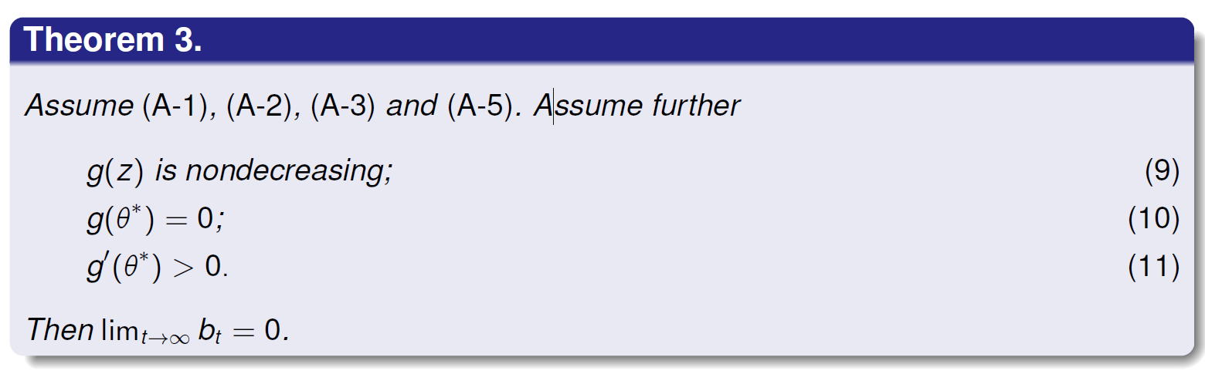
Theorem 3

Slide 20
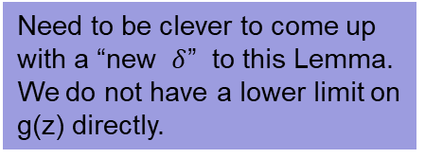




(A4) with a $δ=0$
$$f(x)$$
$$g(x)$$
$${ x<θ}^{∗}$$
$${ x>θ}^{∗}$$
Need to be clever to come up with a “new $δ$” to this Lemma. We do not have a lower limit on g(z) directly.

Slide 21
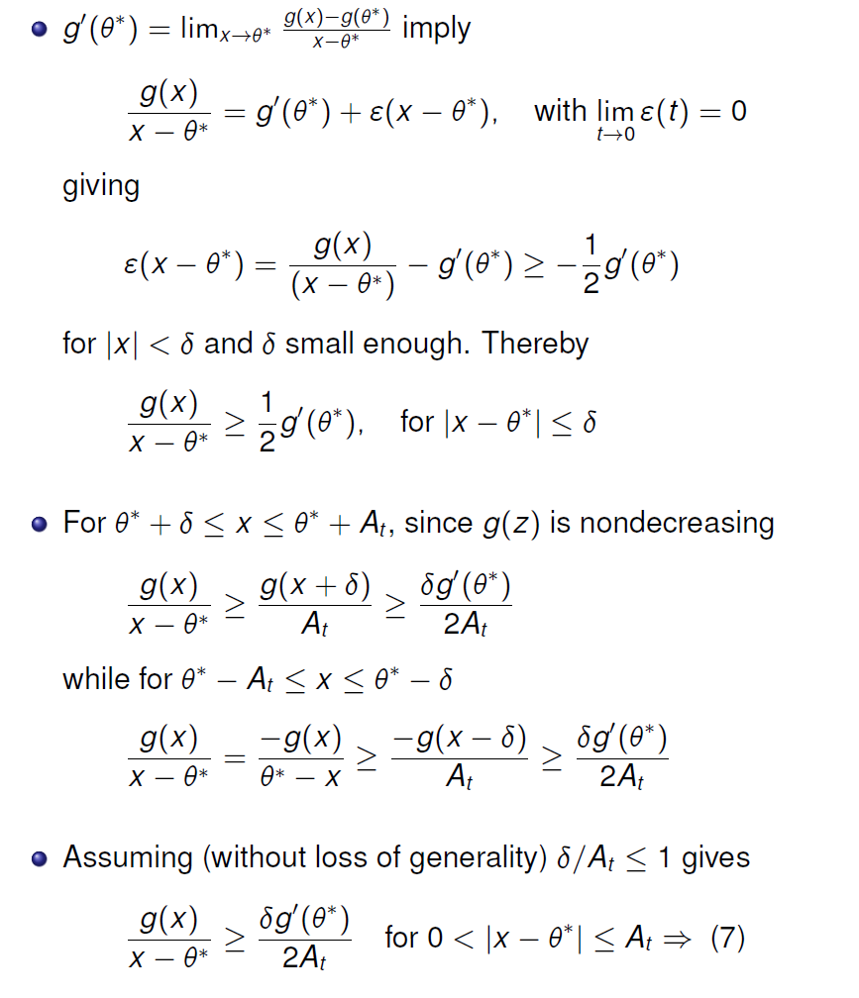


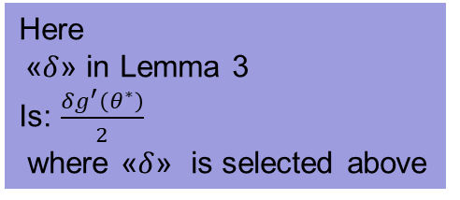
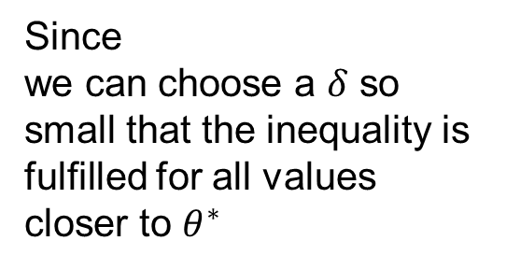
Proof of Theorem 3
Since
we can choose a $δ$ so small that the inequality is fulfilled for all values
closer to $θ^{∗}$
for $\left|x−θ^{∗}\right|<δ$
Here
«$δ$» in Lemma 3
Is: $\frac{δg^{′}\left(θ^{∗}\right)}{2}$
where «$δ$» is selected above

Slide 22
Assumptions for proof of convergence (repeat)
x
$$f(x)$$
$$g(x)$$
$g(x)$ has same sign as${ (x −θ}^{∗})$
$${ x<θ}^{∗}$$
$${ x>θ}^{∗}$$
$${ θ}^{∗}$$

Slide 23
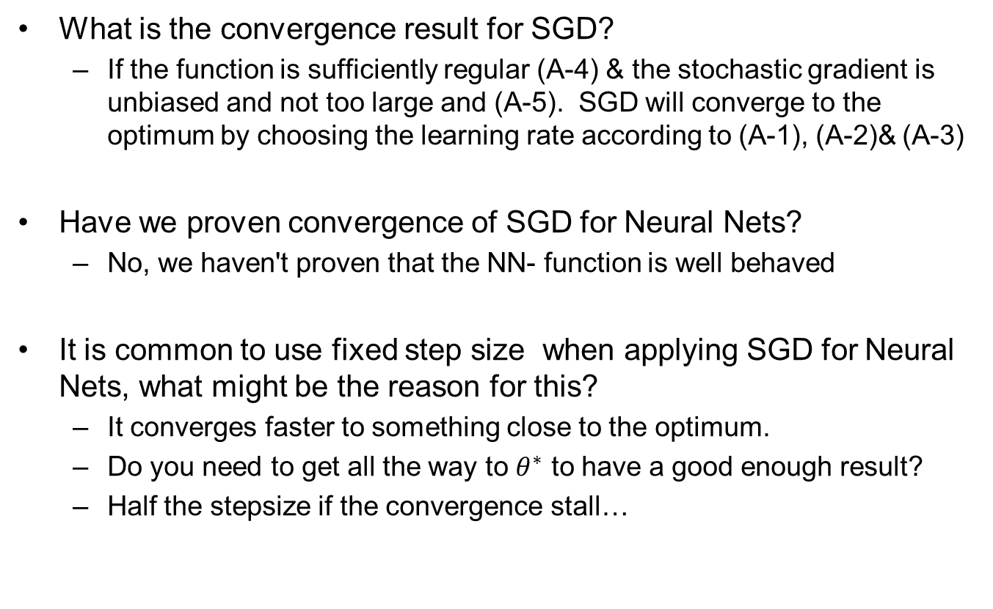
Questions?
What is the convergence result for SGD?
  If the function is sufficiently regular (A-4) & the stochastic gradient is unbiased and not too large and (A-5). SGD will converge to the optimum by choosing the learning rate according to (A-1), (A-2)& (A-3)
Have we proven convergence of SGD for Neural Nets?
  No, we haven't proven that the NN- function is well behaved
It is common to use fixed step size when applying SGD for Neural Nets, what might be the reason for this?
  It converges faster to something close to the optimum.
  Do you need to get all the way to $θ^{∗}$ to have a good enough result?
  Half the stepsize if the convergence stall…

Slide 24
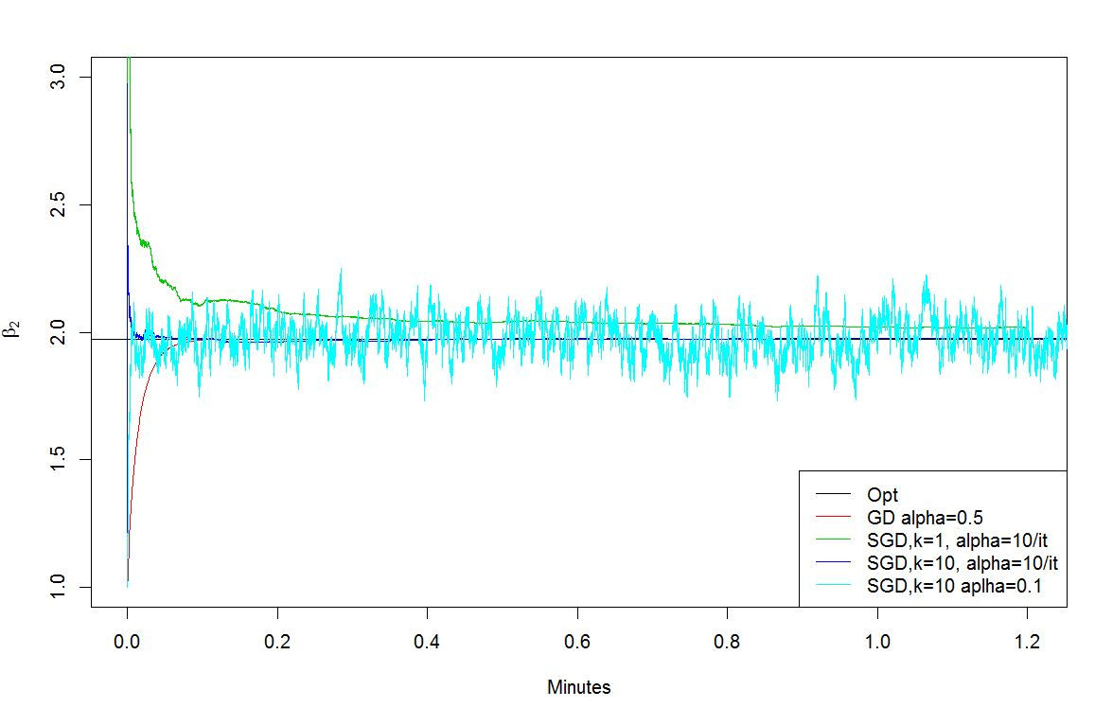
Constant learning rate
Gets you close faster, but «never settles»

Slide 25
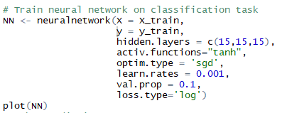
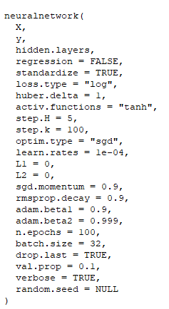
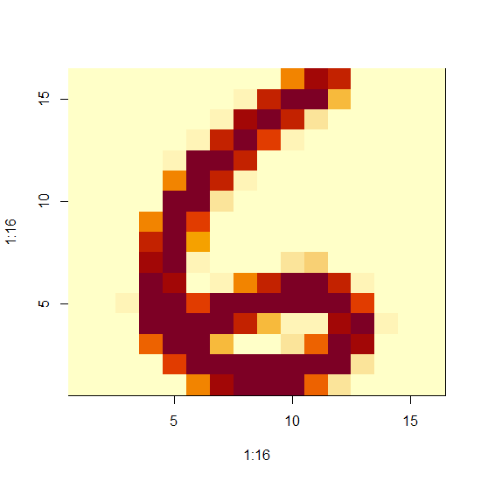
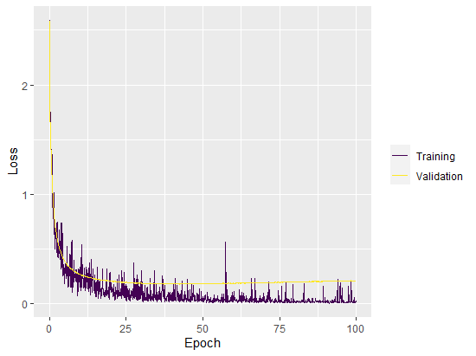
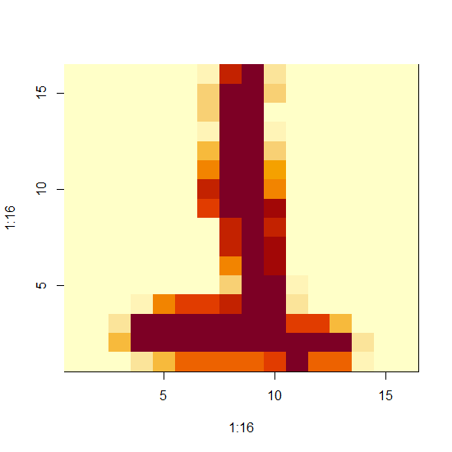
ANN2_zip.R
Data: https://www.uio.no/studier/emner/matnat/math/STK4051/data/
Code:

Slide 26
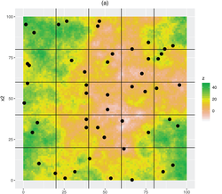
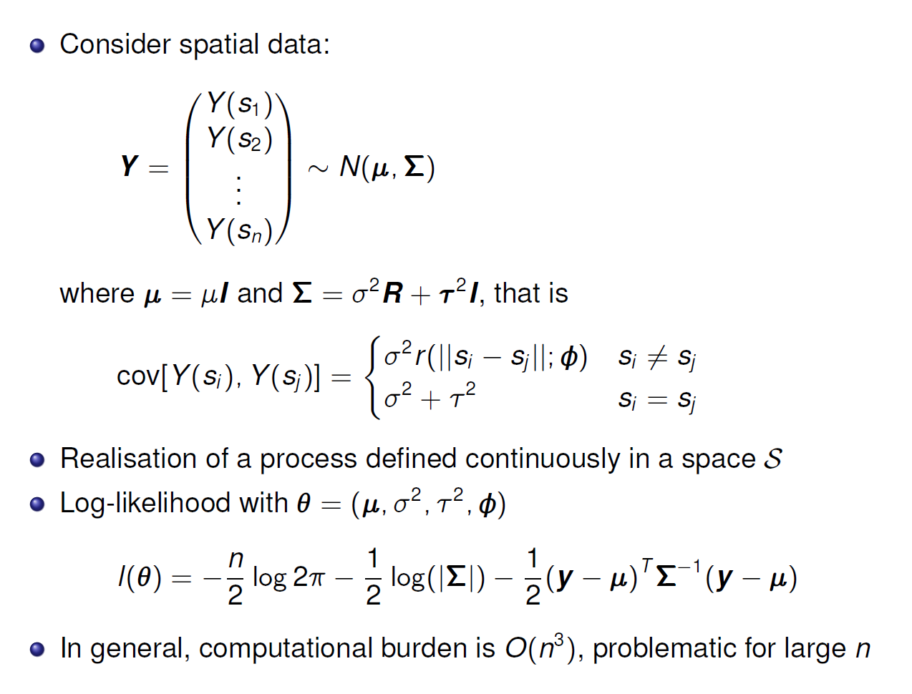
SGD for dependent data
Statistical approaches for spatial sample survey: Persistent misconceptions and new developments - Brus - 2024 - European Journal of Soil Science - Wiley Online Library

Slide 27
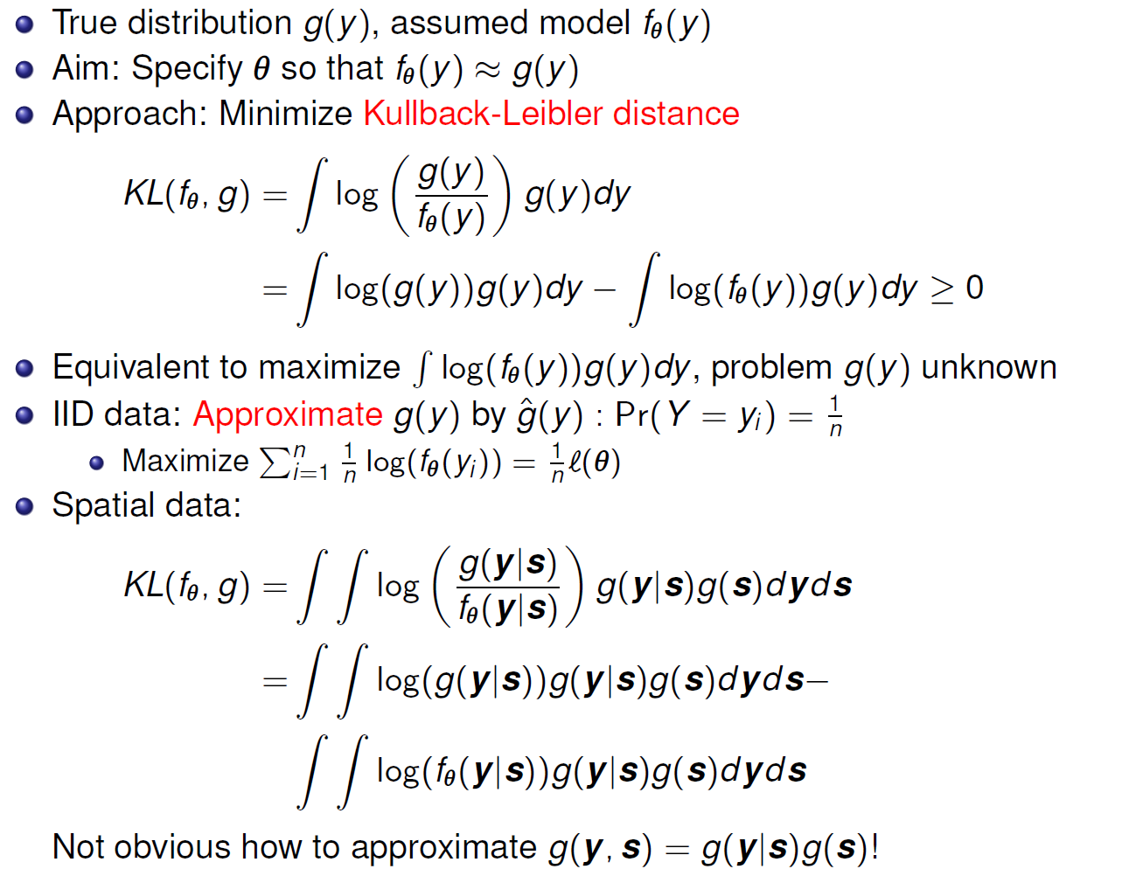
ML and Kullback-Leibler divergence

Slide 28
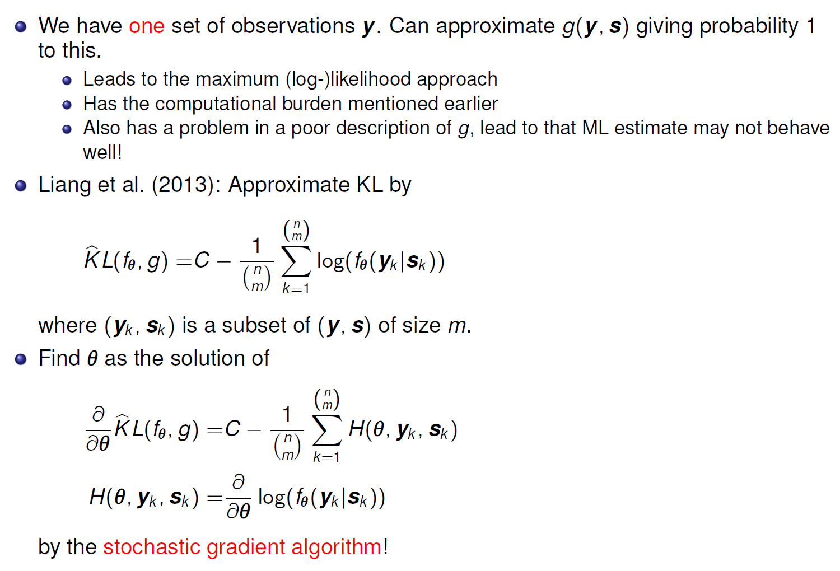
KL and Geostatistics

Slide 29
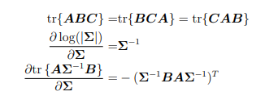
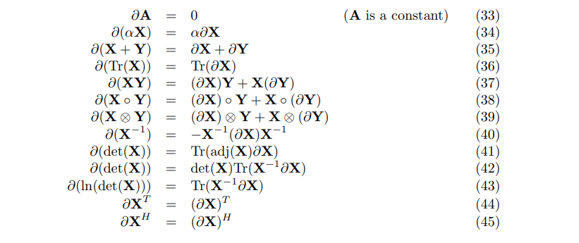

Slide 30
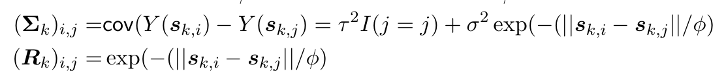
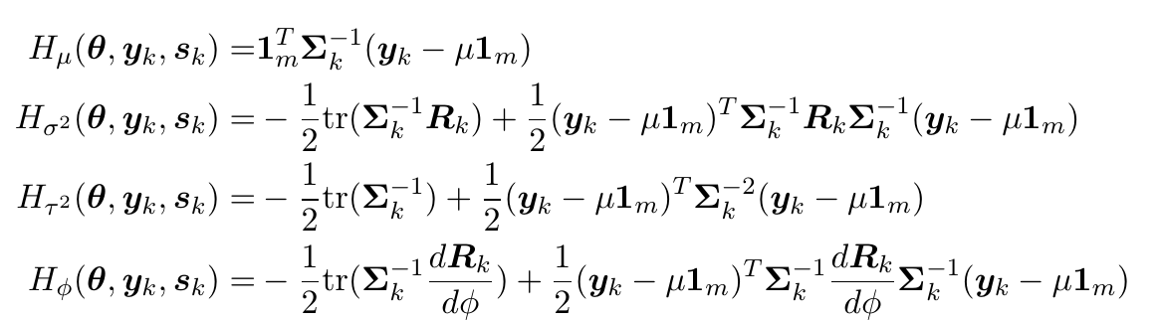
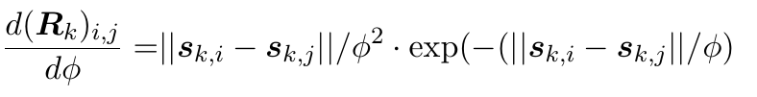
Example (using Matrix Cook Book)
$$\log{f\left(y_{k} | s_{k}\right)=−\frac{m}{2}\log{2π}−\frac{1}{2}\log\left|Σ_{k}\right|−\frac{1}{2}{\left(y_{k}−μ1_{m}\right)}^{T}Σ_{k}^{−1}\left(y_{k}−μ1_{m}\right)⁡}$$

