Slide 1
STK-4051/9051 Computational Statistics Spring 2024
SGD
Instructor: Odd Kolbjørnsen, oddkol@math.uio.no

Slide 2
Stochastic Gradient Decent (SGD)
What it is and why we do it
SGD for neural nets
Requirements for convergence
Proof of convergence !
SGD for Spatial data
Note: Decent is for minimization, we can also use it for maximization. The difference is just the sign in front of the gradient.

Slide 3
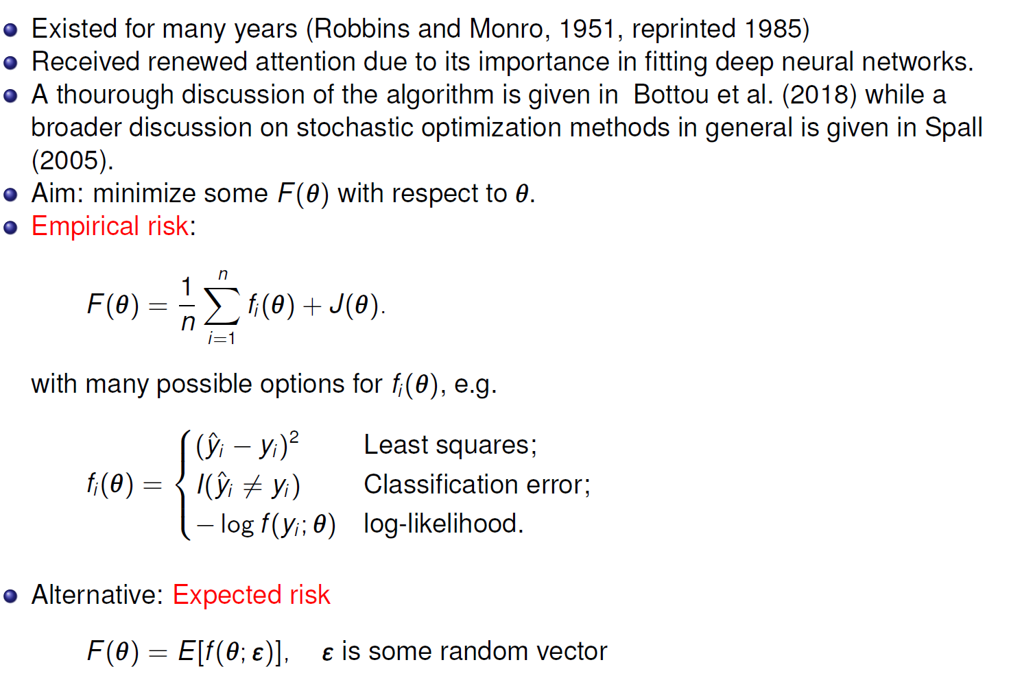
Stochastic gradient decent

Slide 4
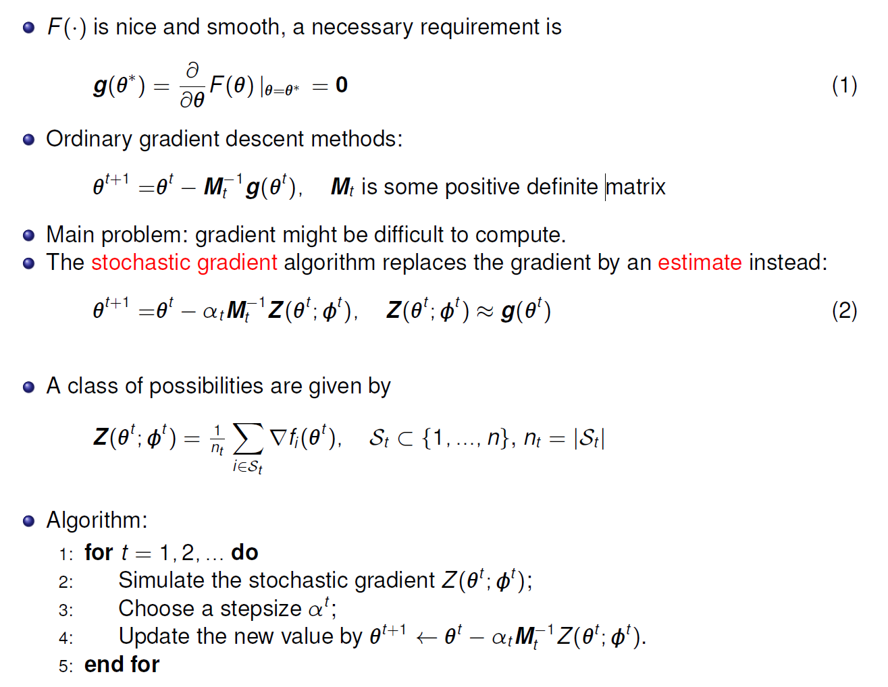

Main Idea
«some stochastic element»
$$"φ^{t} =𝒮_{t}"$$

Slide 5
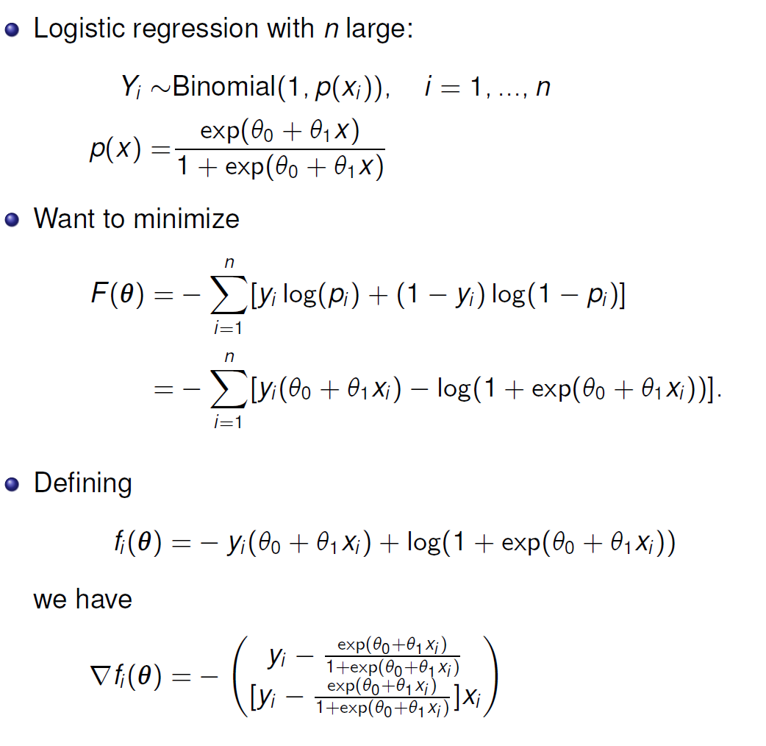
Example logistic regression

Slide 6
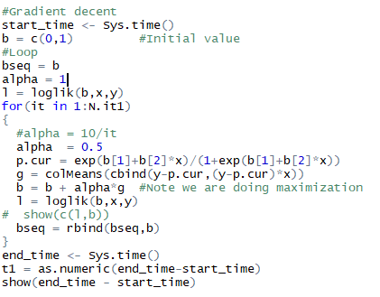

Gradient ascent learning rate =0.5
$$θ^{(t+1)}=θ^{(t)}+α⋅g(θ)$$

Slide 7
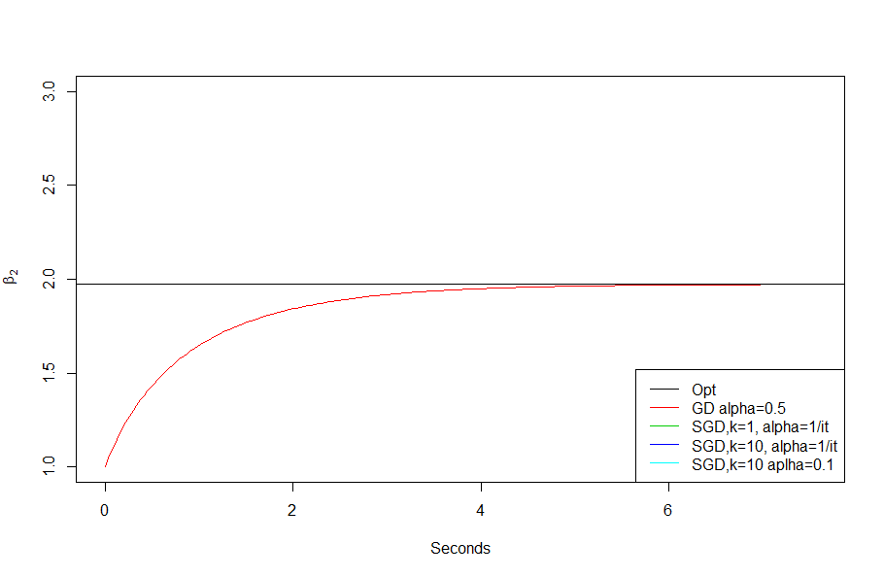
Convergence Gradient ascent

Slide 8
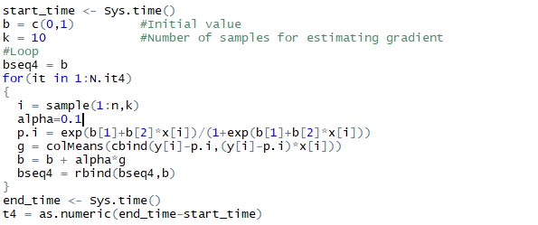

SGD (really SGA), batch size 10, learning rate =0.1
$$θ^{(t+1)}=θ^{(t)}+α⋅z(θ)$$

Slide 9
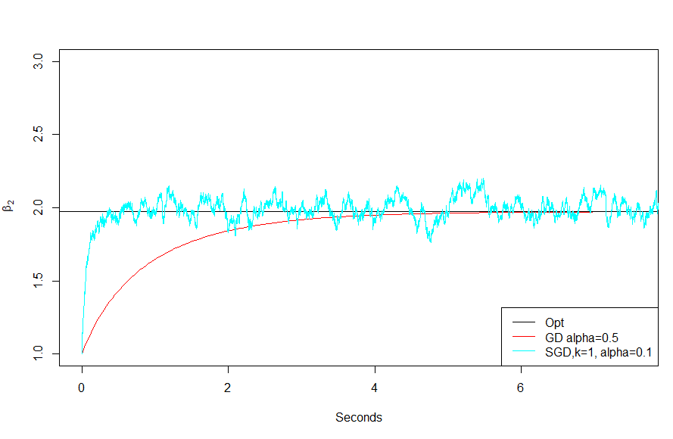
Convergence SGD constant learning rate
k=10

Slide 10
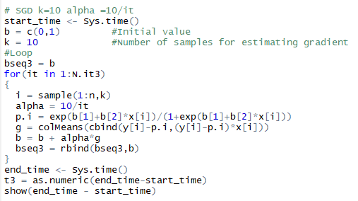
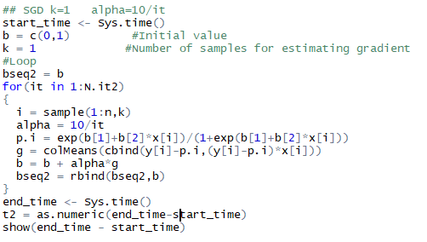

SGD (really SGA), batch size 10 or 1 learning rate =1/iteration or 10/iteration
$$θ^{(t+1)}=θ^{(t)}+α_{t}⋅z(θ)$$

Slide 11
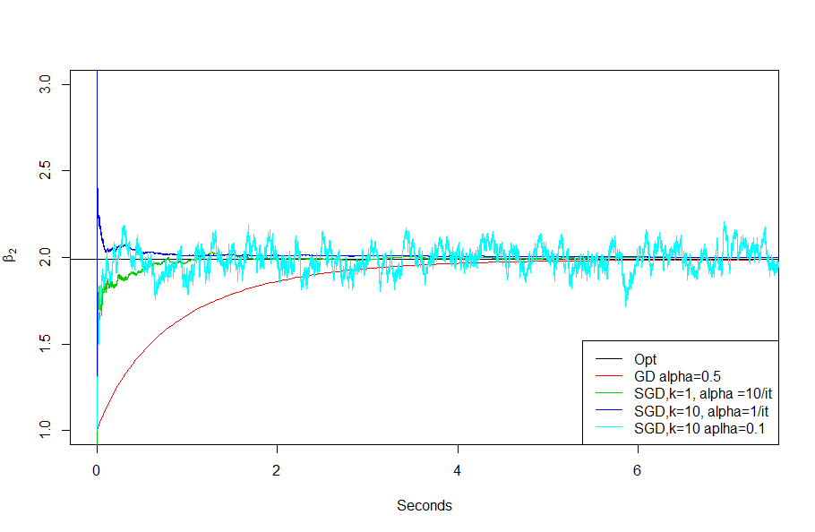
Convergence SGD

Slide 12
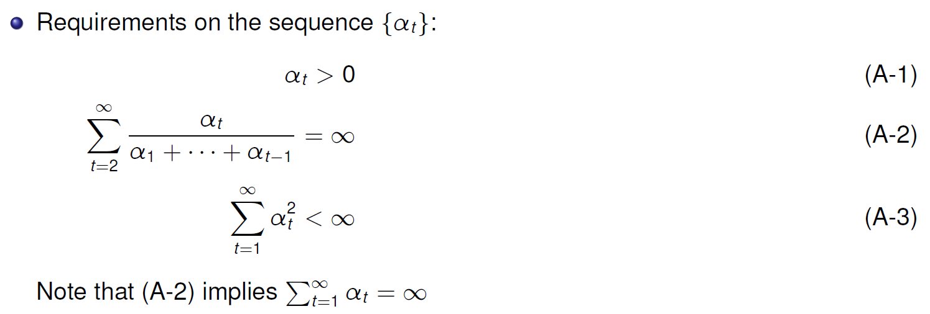
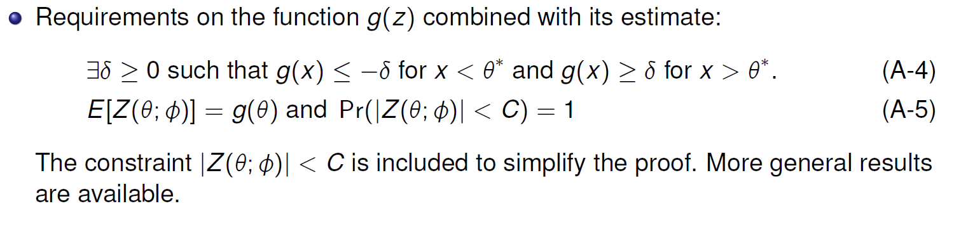






Assumptions for proof of convergence
x
$$f(x)$$
$$g(x)$$
$g(x)$ has same sign as${ (x −θ}^{∗})$
$${ x<θ}^{∗}$$
$${ x>θ}^{∗}$$
$${ θ}^{∗}$$

Slide 13
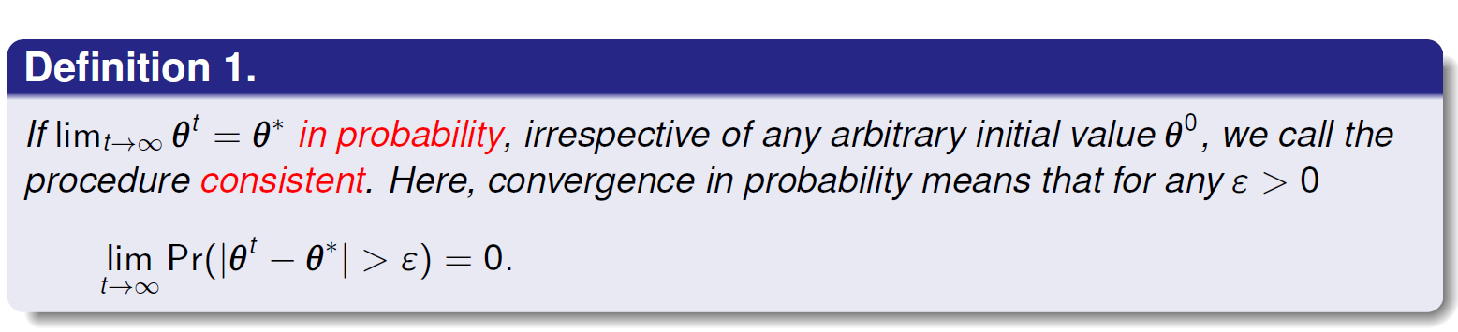
Convergence of SGD
Want to show that the SGD procedure is consistent
Do this in three steps (with some sub-steps on the way)
  Prove that L2 convergence gives consistency
  Prove that the sequence converge
  Prove that we converge to the true parameter
Next time ☺

Slide 14

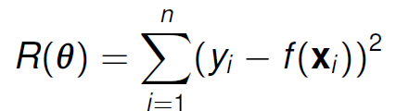
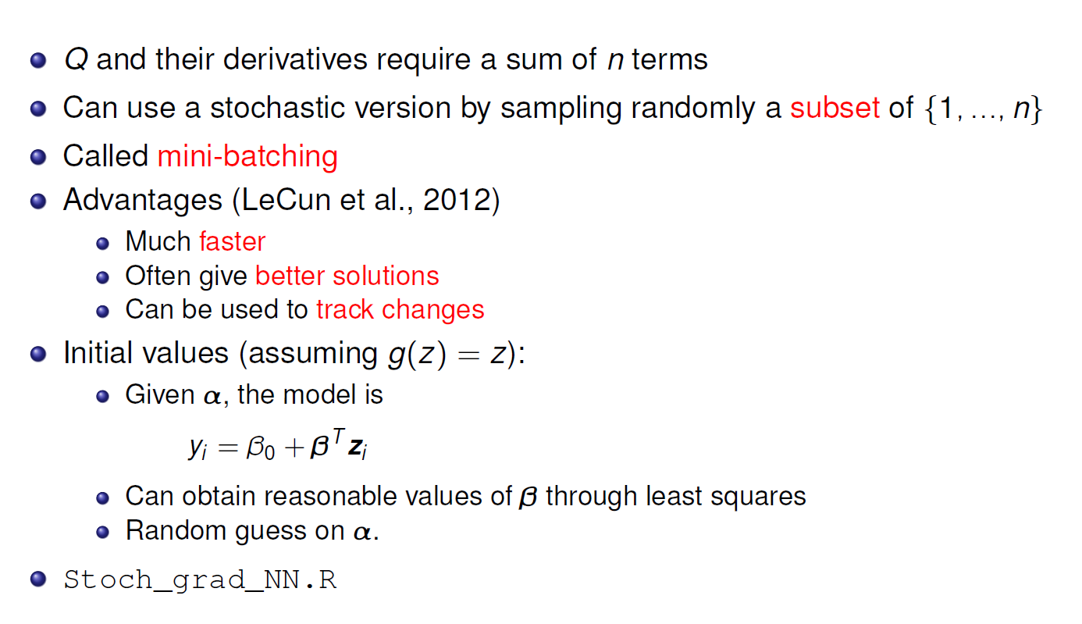
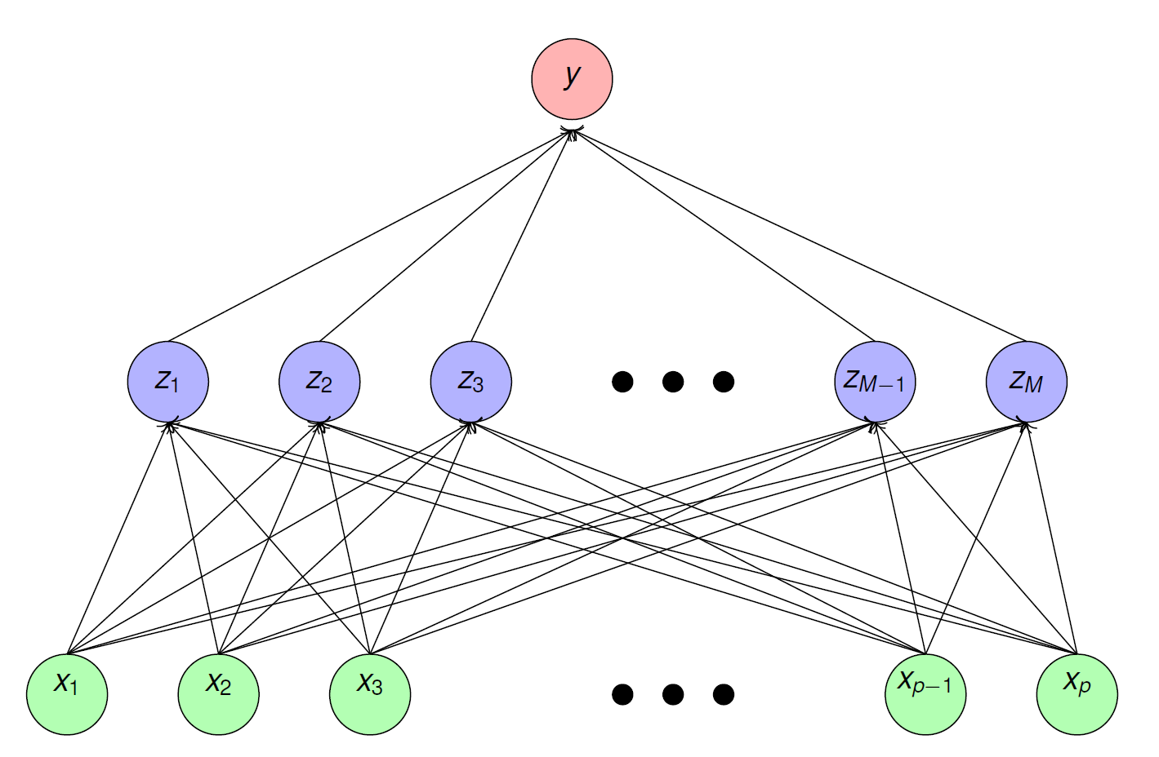


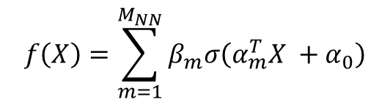
Stochastic gradients and neural nets
$$f\left(X\right)=\sum_{m=1}^{M_{NN}}{β_{m}σ\left(α_{m}^{T}X +α_{0}\right)}$$
$$β$$
$$α$$
One hidden layer

Slide 15


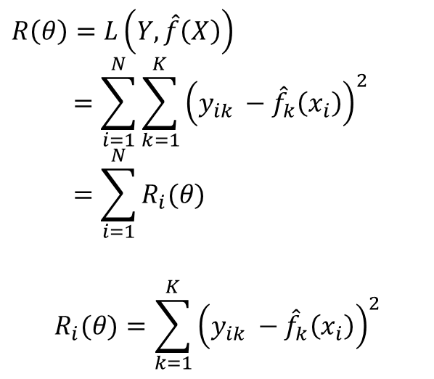
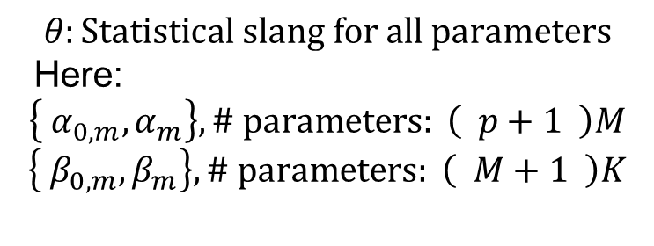








Fitting neural networks
$K(=1$)
$$β$$
$$M$$
$$θ:Statistical slang for all parameters$$
Here:
$$\left\{ α_{0,m},α_{m}\right\},\# parameters: \left( p+1 \right)M$$
$$\left\{ β_{0,m},β_{m}\right\},\# parameters: \left( M+1 \right)K$$
$$α$$
$$p$$
$$p+1$$
$$M$$
$$M+1$$
$$K$$
$$f\left(X\right)=\sum_{m=1}^{M_{NN}}{β_{m}σ\left(α_{m}^{T}X +α_{0}\right)}$$
$$R\left(θ\right)=L\left(Y,\hat{f}\left(X\right)\right)$$
$$=\sum_{i=1}^{N}{\sum_{k=1}^{K}{{\left(y_{ik} −{\hat{f}}_{k}\left(x_{i}\right)\right)}^{2}}} \\ =\sum_{i=1}^{N}{R_{i}(θ)}$$
$$R_{i}(θ)=\sum_{k=1}^{K}{{\left(y_{ik} −{\hat{f}}_{k}\left(x_{i}\right)\right)}^{2}}$$
The “standard” approach:
Minimize the loss
Use steepest decent to solve this minimization problem
The key to success is the efficient way of computing the gradient
Quadratic loss
K output variables
Contribution of
the i’th data record

Slide 16
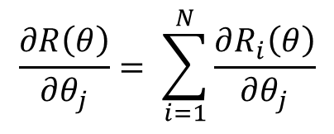
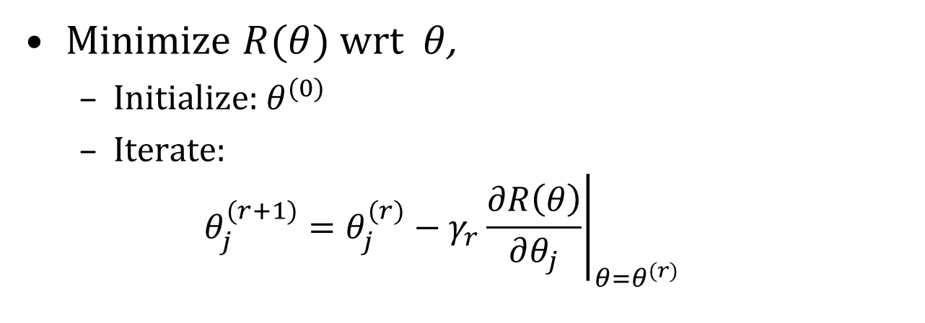
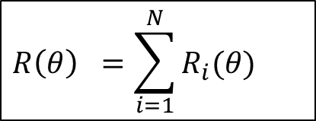
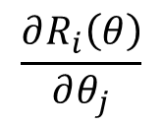
Steepest decent
$$R\left(θ\right) =\sum_{i=1}^{N}{R_{i}(θ)}$$
Minimize $R(θ)$wrt $θ$,
  Initialize: $θ^{(0)}$
  Iterate:
  $$θ_{j}^{(r+1)}=θ_{j}^{(r)}−γ_{r}{\left.\frac{∂R\left(θ\right)}{∂θ_{j}}\right|}_{θ=θ^{(r)}}$$
Learning rate
$$\frac{∂R\left(θ\right)}{∂θ_{j}}= \sum_{i=1}^{N}{\frac{∂R_{i}\left(θ\right)}{∂θ_{j}}}$$
$$\frac{∂R_{i}\left(θ\right)}{∂θ_{j}}$$
we compute term per data record
(easily aggregated from
parallel computation)

Slide 17

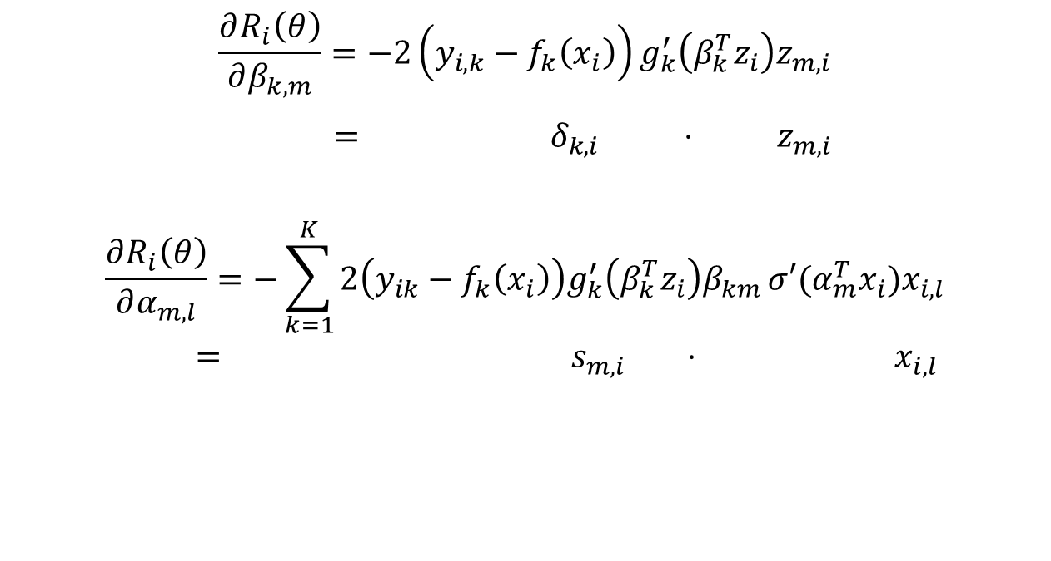
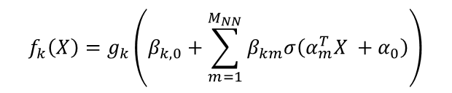
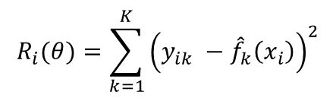
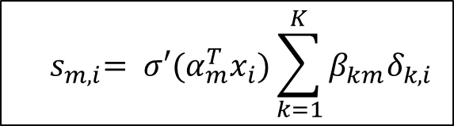
Squared error loss
$$R_{i}(θ)=\sum_{k=1}^{K}{{\left(y_{ik} −{\hat{f}}_{k}\left(x_{i}\right)\right)}^{2}}$$
$$f_{k}\left(X\right)=g_{k}\left(β_{k,0}+\sum_{m=1}^{M_{NN}}{β_{km}σ\left(α_{m}^{T}X +α_{0}\right)}\right)$$
$$Z_{m}$$
Output layer:
$$\frac{∂R_{i}\left(θ\right)}{∂β_{k,m}}=−2\left(y_{i,k}−f_{k}\left(x_{i}\right)\right)g_{k}^{′}\left(β_{k}^{T}z_{i}\right)z_{m,i}$$
$= { δ}_{k,i} ⋅ z_{m,i}$
$$\frac{∂R_{i}\left(θ\right)}{∂α_{m,l}}=−\sum_{k=1}^{K}{2\left(y_{ik}−f_{k}\left(x_{i}\right)\right)g_{k}^{′}\left(β_{k}^{T}z_{i}\right)β_{km}}{σ′(α}_{m}^{T}x_{i})x_{i,l}$$
$$= { s}_{m,i} ⋅ x_{i, l}$$
Hidden layer:
Back propagation equation
$${ s}_{m,i}= {σ′(α}_{m}^{T}x_{i})\sum_{k=1}^{K}{β_{km}δ_{k,i}}$$

Slide 18
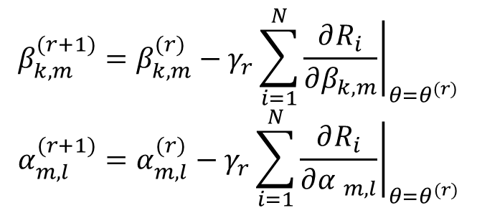
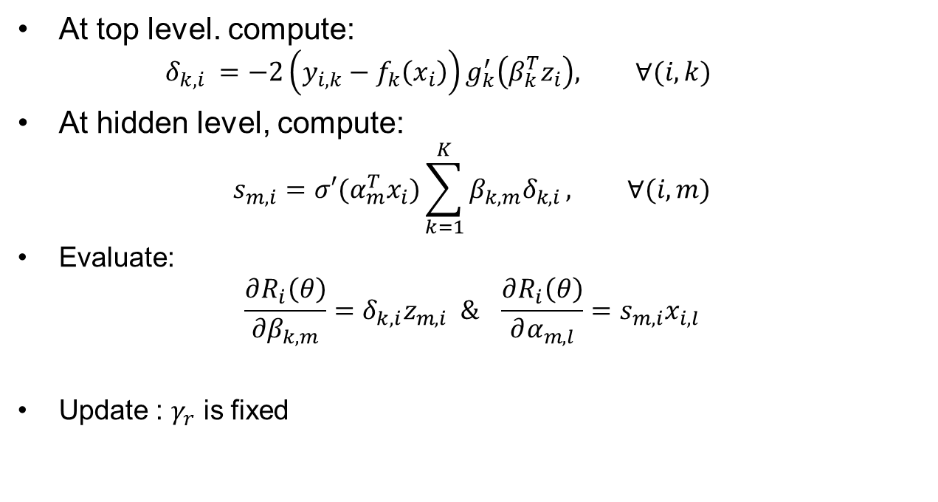
Back propagation (delta rule)
At top level. compute:
  $$δ_{k,i} =−2\left(y_{i,k}−f_{k}\left(x_{i}\right)\right)g_{k}^{′}\left(β_{k}^{T}z_{i}\right), ∀(i,k)$$
At hidden level, compute:
$$s_{m,i}={σ′(α}_{m}^{T}x_{i})\sum_{k=1}^{K}{β_{k,m}δ_{k,i}}, ∀(i,m)$$
Evaluate:
$$\frac{∂R_{i}\left(θ\right)}{∂β_{k,m}}=δ_{k,i}z_{m,i} \& \frac{∂R_{i}\left(θ\right)}{∂α_{m,l}}=s_{m,i}x_{i,l}$$
Update : $γ_{r}$ is fixed
$$β_{k,m}^{(r+1)}=β_{k,m}^{(r)}−γ_{r}\sum_{i=1}^{N}{{\left.\frac{∂R_{i}}{∂β_{k,m}}\right|}_{θ=θ^{(r)}}}$$
$$α_{m,l}^{(r+1)}=α_{m,l}^{(r)}−γ_{r}\sum_{i=1}^{N}{{\left.\frac{∂R_{i}}{∂{α }_{m,l}}\right|}_{θ=θ^{(r)}}}$$

Slide 19
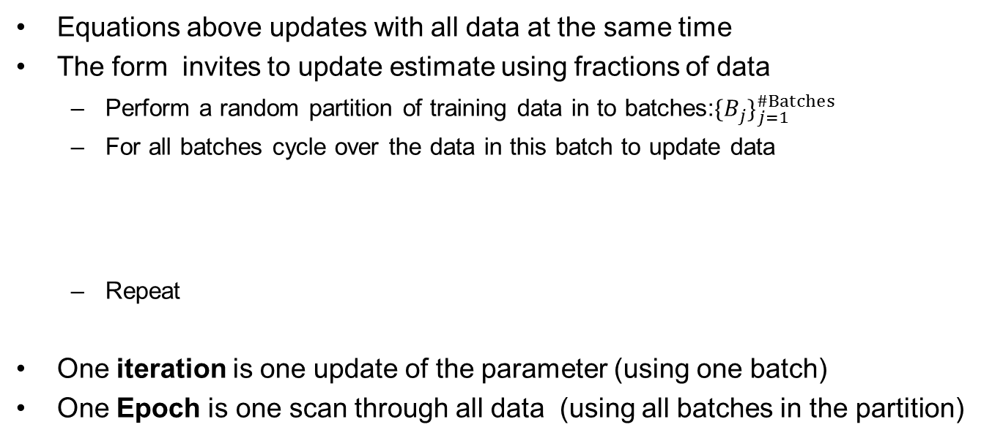
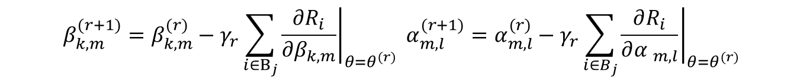
Stochastic gradient decent using minibatch
$$β_{k,m}^{(r+1)}=β_{k,m}^{(r)}−γ_{r}\sum_{i=1}^{N}{{\left.\frac{∂R_{i}}{∂β_{k,m}}\right|}_{θ=θ^{(r)}}}α_{m,l}^{(r+1)}=α_{m,l}^{(r)}−γ_{r}\sum_{i=1}^{N}{{\left.\frac{∂R_{i}}{∂{α }_{m,l}}\right|}_{θ=θ^{(r)}}}$$
Equations above updates with all data at the same time
The form invites to update estimate using fractions of data
  Perform a random partition of training data in to batches:${{\{B}_{j}\}}_{j=1}^{\#Batches}$
  For all batches cycle over the data in this batch to update data
  Repeat
One iteration is one update of the parameter (using one batch)
One Epoch is one scan through all data (using all batches in the partition)
$$β_{k,m}^{(r+1)}=β_{k,m}^{(r)}−γ_{r}\sum_{i∈B_{j}}{{\left.\frac{∂R_{i}}{∂β_{k,m}}\right|}_{θ=θ^{(r)}}} α_{m,l}^{(r+1)}=α_{m,l}^{(r)}−γ_{r}\sum_{i∈B_{j}}{{\left.\frac{∂R_{i}}{∂{α }_{m,l}}\right|}_{θ=θ^{(r)}}}$$

Slide 20
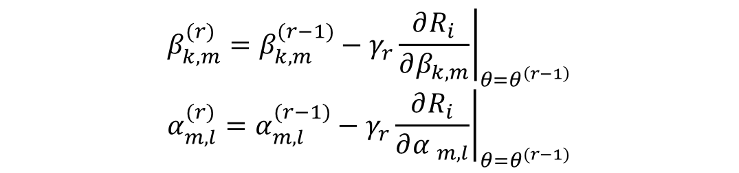
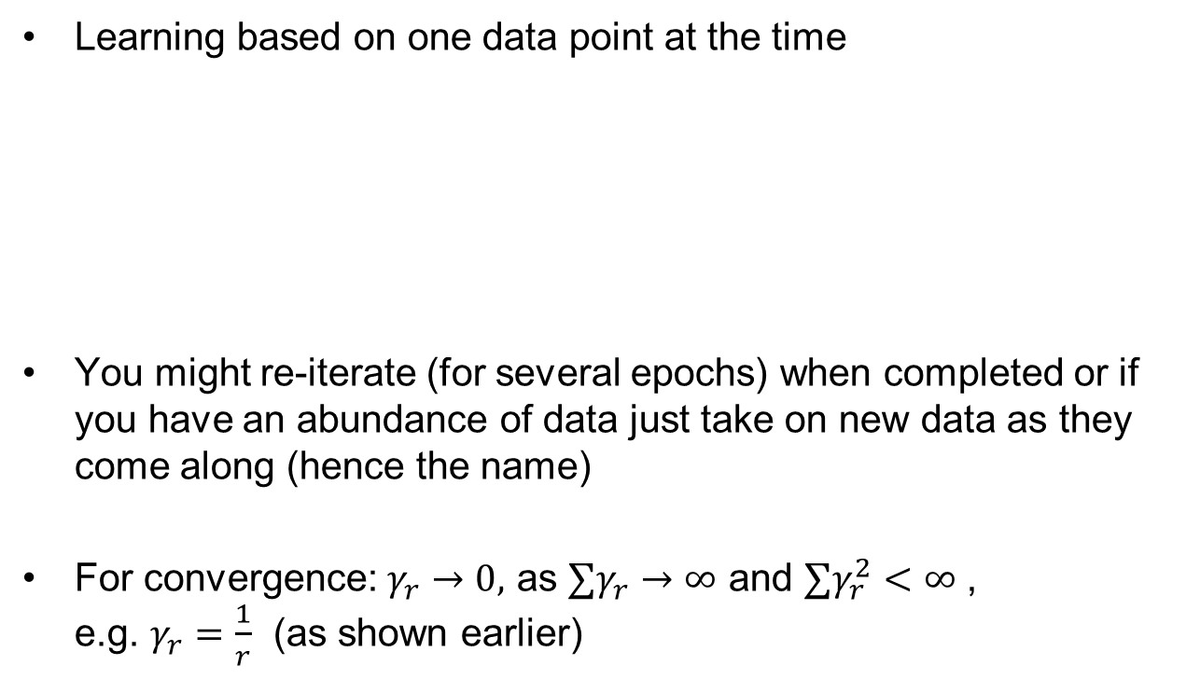
Online learning (Batch size =1)
Learning based on one data point at the time
You might re-iterate (for several epochs) when completed or if you have an abundance of data just take on new data as they come along (hence the name)
For convergence: $γ_{r}→0,$ as $∑γ_{r}→∞$ and $∑γ_{r}^{2}<∞$ ,
e.g. $γ_{r}=\frac{1}{r}$ (as shown earlier)
$$β_{k,m}^{(r)}=β_{k,m}^{(r−1)}−γ_{r}{\left.\frac{∂R_{i}}{∂β_{k,m}}\right|}_{θ=θ^{\left(r−1\right)}}$$
$$α_{m,l}^{(r)}=α_{m,l}^{(r−1)}−γ_{r}{\left.\frac{∂R_{i}}{∂{α }_{m,l}}\right|}_{θ=θ^{(r−1)}}$$

Slide 21
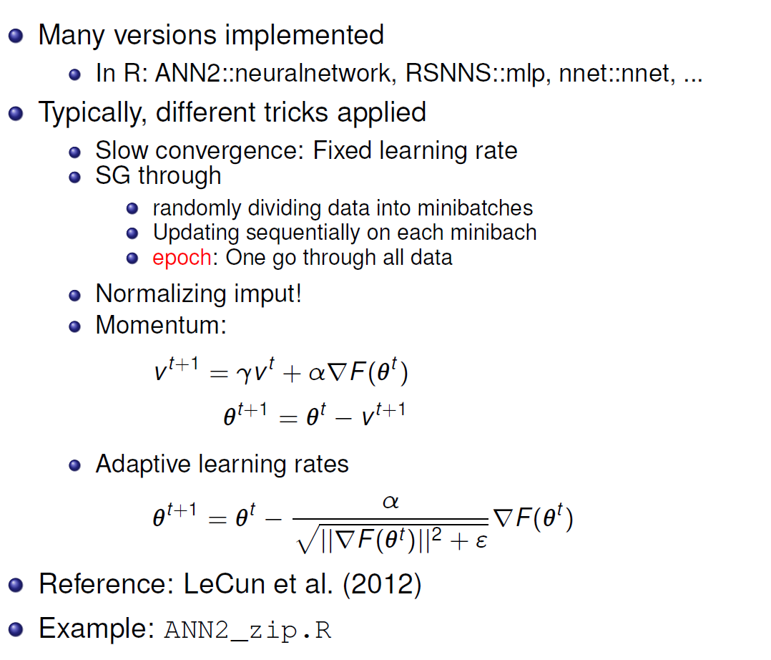
Stochastic gradients and neural nets

Slide 22
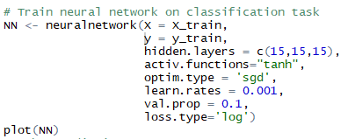
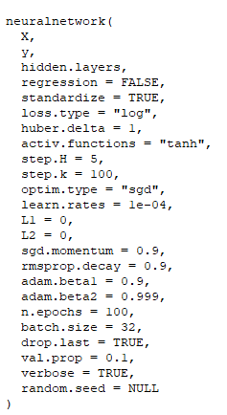
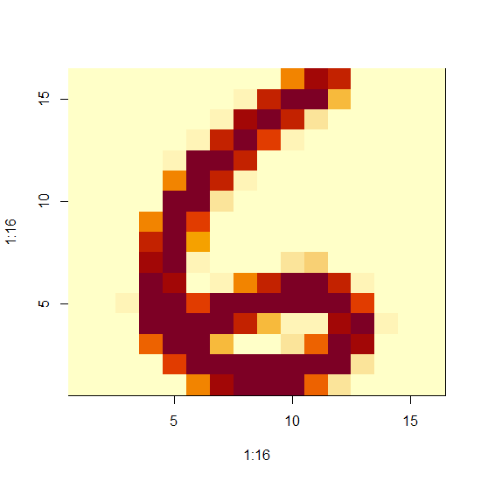
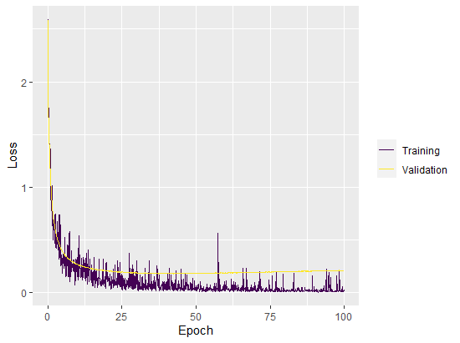
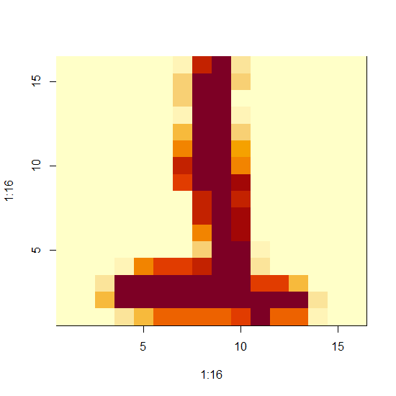
ANN2_zip.R
Data: https://www.uio.no/studier/emner/matnat/math/STK4051/data/
Code:

