Slide 1
STK-4051/9051 Computational Statistics Spring 2024
Chapter 4 part 2
Instructor: Odd Kolbjørnsen, oddkol@math.uio.no

Slide 2
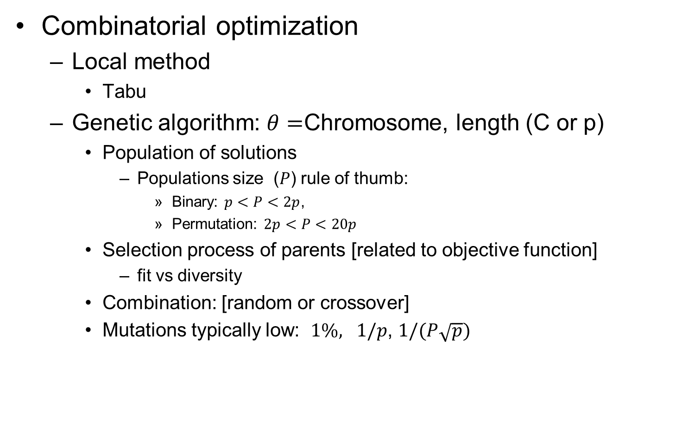
Last time
Combinatorial optimization
  Local method
    Tabu
  Genetic algorithm: $θ=$Chromosome, length (C or p)
    Population of solutions
      Populations size ($P$) rule of thumb:
        Binary: $p<P<2p$,
        Permutation: $2p<P<20p$
    Selection process of parents [related to objective function]
      fit vs diversity
    Combination: [random or crossover]
    Mutations typically low: $1\%, 1/p$, $1/(P\sqrt{p})$

Slide 3
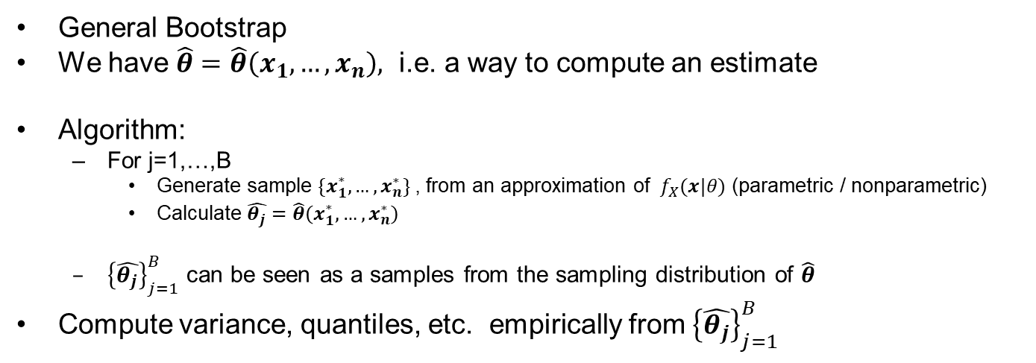
Bootstrapping
General Bootstrap
We have $\hat{θ}=\hat{θ}\left(x_{1},…,x_{n}\right),$ i.e. a way to compute an estimate
Algorithm:
  For j=1,…,B
    Generate sample $\{x_{1}^{∗},…,x_{n}^{∗}\}$, from an approximation of ${ f}_{X}(x|θ)$ (parametric / nonparametric)
    Calculate $\hat{θ_{j}}=\hat{θ}\left(x_{1}^{∗},…,x_{n}^{∗}\right)$
  ${\left\{\hat{θ_{j}}\right\}}_{j=1}^{B}$ can be seen as a samples from the sampling distribution of $\hat{θ}$
Compute variance, quantiles, etc. empirically from ${\left\{\hat{θ_{j}}\right\}}_{j=1}^{B}$

Slide 4
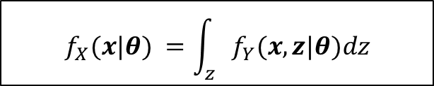
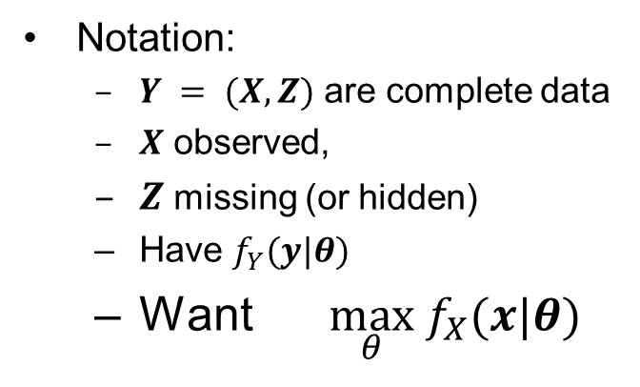
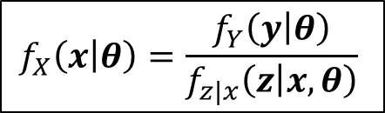
EM algorithm
  $$f_{X}(x|θ) =\int_{z}{f_{Y}(x,z|θ)dz}$$
Notation:
  $Y = (X,Z)$ are complete data
  $X$ observed,
  $Z$ missing (or hidden)
  Have $f_{Y}(y|θ)$
  Want $\max_{θ} f_{X}(x|θ)$
Marginal likelihood
$$f_{X}\left(x | θ\right)=\frac{f_{Y}\left(y | θ\right)}{f_{z|x}\left(z | x,θ\right)}$$
We maximize:
$$Q\left(θ | θ^{\left(t\right)}\right)=E[\log{f_{Y}\left(y | θ\right)\left|{x,θ}^{\left(t\right)}\right]}$$
Expected value of the complete log-likelihood
given the observed data, using the
current estimate of the parameter

Slide 5
Last time about EM
EM algorithm
  Missing data
  Moths example
  Proof of increasing log likelihood when using
  EM algorithm
  Mixture Gaussian clustering
  Exponential family
Variance estimate in EM
  Bootstrap
  Approximation using, information matrix’
EM for hidden Markov model
  Forward – backward for Mixture Gauss

Slide 6
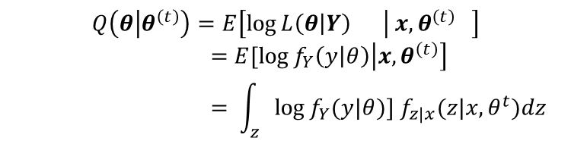
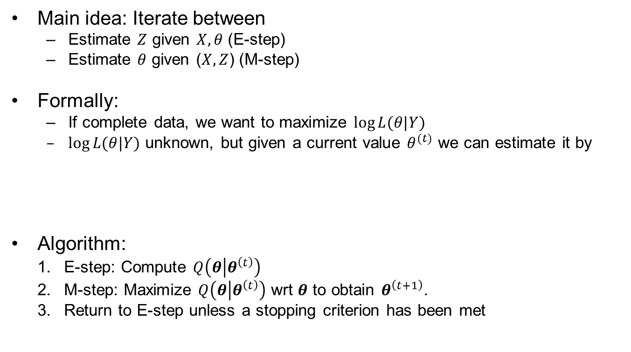
EM algorithm
Main idea: Iterate between
  Estimate $Z$ given $X,θ$ (E-step)
  Estimate $θ$ given ($X,Z$) (M-step)
Formally:
  If complete data, we want to maximize $\log{L(θ|Y)}$
  $\log{L(θ|Y)}$ unknown, but given a current value $θ^{(t)}$ we can estimate it by
Algorithm:
  E-step: Compute $Q\left(θ | θ^{\left(t\right)}\right)$
  M-step: Maximize $Q\left(θ | θ^{\left(t\right)}\right)$ wrt $θ$ to obtain $θ^{\left(t+1\right)}$.
  Return to E-step unless a stopping criterion has been met
$$Q\left(θ | θ^{\left(t\right)}\right)=E\left[\log{L\left(θ | Y\right)} | x,θ^{\left(t\right)} \right]$$
$$=E[\log{f_{Y}\left(y | θ\right)\left|{x,θ}^{\left(t\right)}\right]} \\ = \int_{z}{\log{f_{Y}(y|θ)}] f_{z|x}(z|x,θ^{t})dz}$$

Slide 7
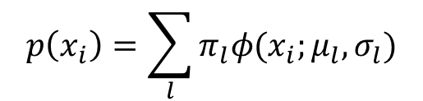
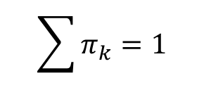
Mixture gaussian distribution
$$p\left(x_{i}\right)=\sum_{l}{π_{l}φ(x_{i};μ_{l},σ_{l})}$$
$p\left(x_{i},C_{i}=k\right)=$ $π_{k}⋅φ(x_{i};μ_{k},σ_{k})$
$$\sum{π_{k}}=1$$

Slide 8

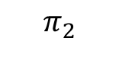

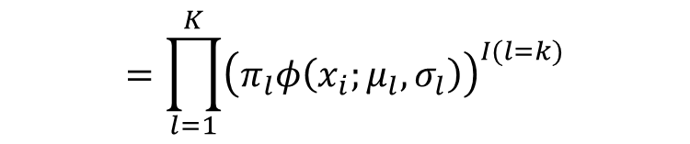

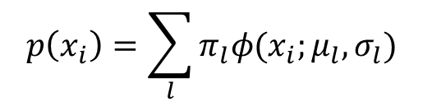


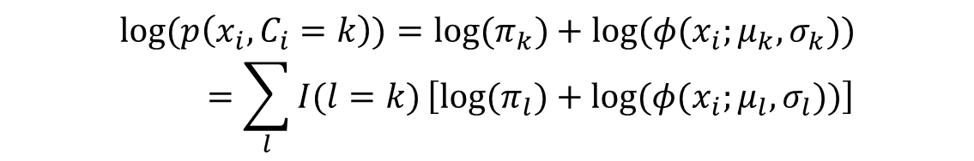
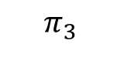
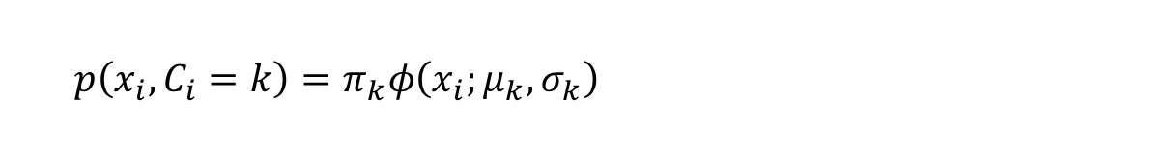
Example: Mixture Gaussian clustering
Class probability
$$P\left(C_{i}=k\right)=π_{k}$$
$$p(x_{i}|C_{i})$$
Conditional probability given class
$$π_{3}$$
$$p\left(x_{i} | C_{i}=k\right)=φ(x_{i};μ_{k},σ_{k})$$
$$π_{1}$$
$$π_{2}$$
Joint distribution
$$=\prod_{l=1}^{K}{{\left(π_{l}φ\left(x_{i};μ_{l},σ_{l}\right)\right)}^{I(l=k)}}$$
$$p\left(x_{i},C_{i}=k\right)=π_{k}φ\left(x_{i};μ_{k},σ_{k}\right)=\prod_{l=1}^{K}{{\left(π_{k}φ\left(x_{i};μ_{k},σ_{k}\right)\right)}^{I(l=k)}}$$
Marginal distribution of $x_{i}$
$$p\left(x_{i}\right)=\sum_{l}{π_{l}φ(x_{i};μ_{l},σ_{l})}$$
Complete log likelihood for one individual
$$log⁡(p\left(x_{i},C_{i}=k\right))={log⁡(π}_{k})+log⁡(φ(x_{i};μ_{k},σ_{k}))$$
$$=\sum_{l}{I(l=k)}\left[{log⁡(π}_{l})+log⁡(φ(x_{i};μ_{l},σ_{l}))\right]$$

Slide 9
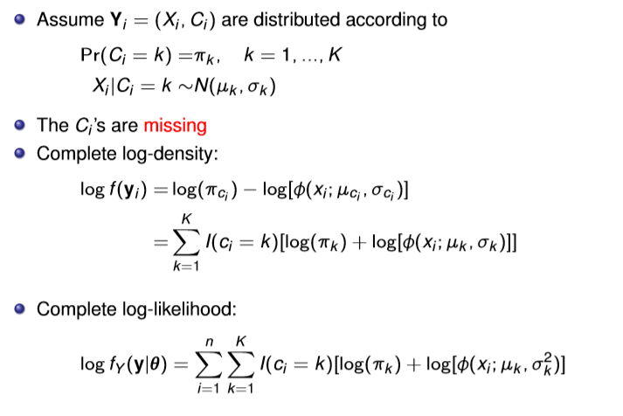
Example: Mixture Gaussian clustering
$$p(x_{i}|C_{i})$$
$$π_{3}$$
$$π_{1}$$
$$π_{2}$$
$$p(x_{i})$$
+

Slide 10
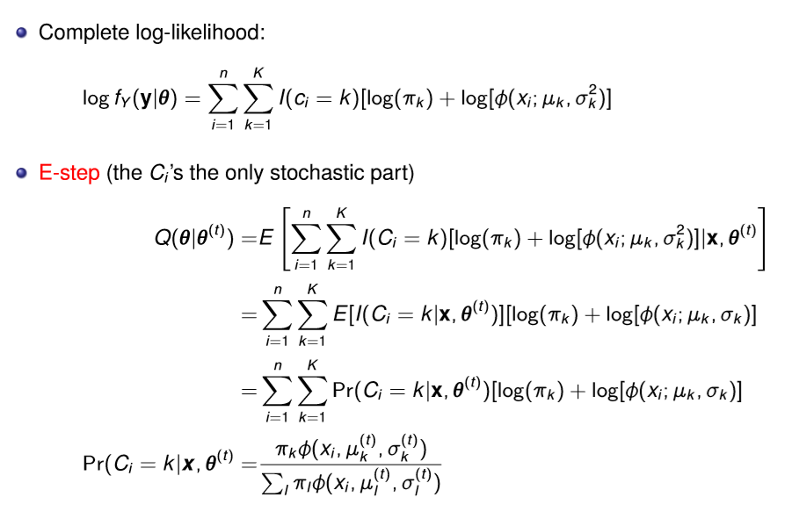
E-step- Mixture Gaussian
(t)
)
(t)

Slide 11

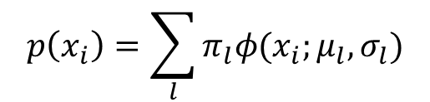

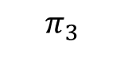

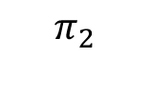

(t)
)
(t)
$$P\left(C_{i}=k | {X_{i}=x}_{i}\right)=\frac{p(C_{i}=k \&{{ X}_{i}=x}_{i})}{p(X_{i}=x_{i})}=\frac{P(C_{i}=k) p(x_{i}|C_{i}=k)}{p(x_{i})}$$
$$p(x_{i}|C_{i})$$
$$P\left(C_{i}=k\right)=π_{k}$$
$$π_{3}$$
$$p\left(x_{i} | C_{i}=k\right)=φ(x_{i};μ_{k},σ_{k})$$
$$π_{1}$$
$$π_{2}$$
$$p\left(x_{i}\right)=\sum_{l}{π_{l}φ(x_{i};μ_{l},σ_{l})}$$

Slide 12
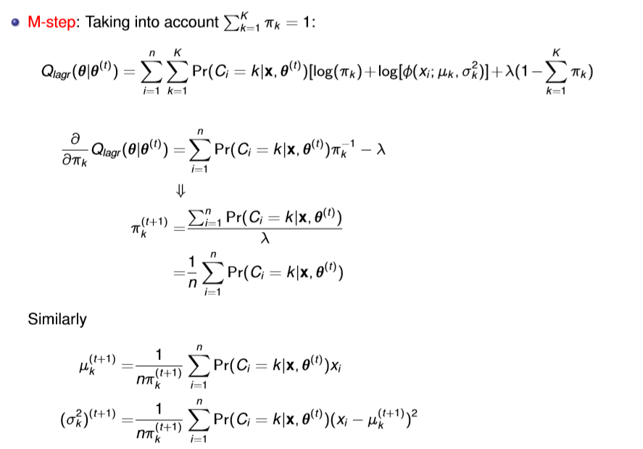
M-step- Mixture Gaussian
$$\sum_{k=1}^{K}{\sum_{i=1}^{n}{\frac{Pr⁡(C_{i}=k|x,θ^{(t)})}{λ}}=1}$$
$$\frac{1}{λ}\sum_{i=1}^{n}{\sum_{k=1}^{K}{Pr⁡(C_{i}=k|x,θ^{(t)})}=1}$$
$$=1$$

Slide 13
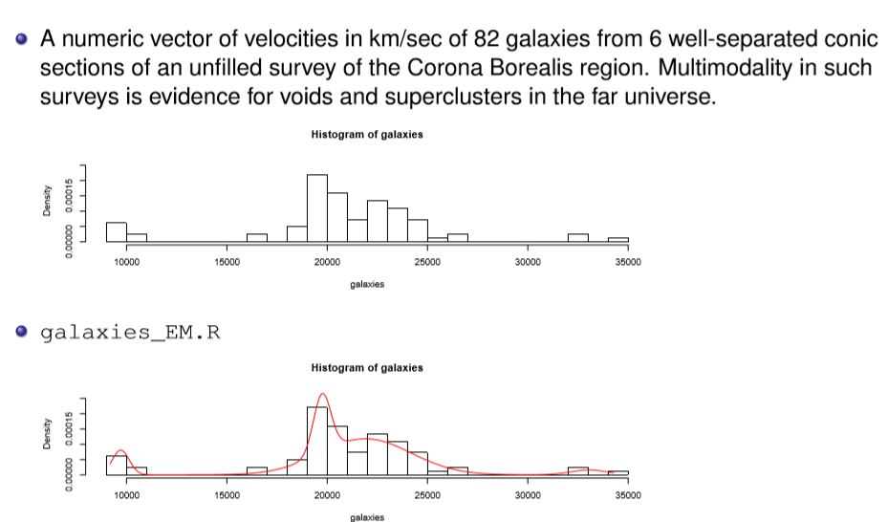
Examples galaxy

Slide 14
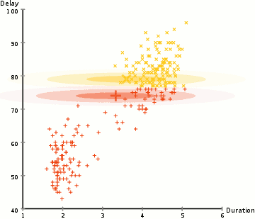
EM clustering of Old Faithful eruption data.
By Chire - Own work, CC BY-SA 3.0, https://commons.wikimedia.org/w/index.php?curid=20494862

Slide 15
Info
Many videos on course topics online
  Some gives an overview
  Some gives details
  Be critical, is what you get what you need?
Explanation and example of the EM algorithm for the for the mixture gaussian case:
  https://www.youtube.com/watch?v=REypj2sy_5U
  https://www.youtube.com/watch?v=iQoXFmbXRJA

Slide 16
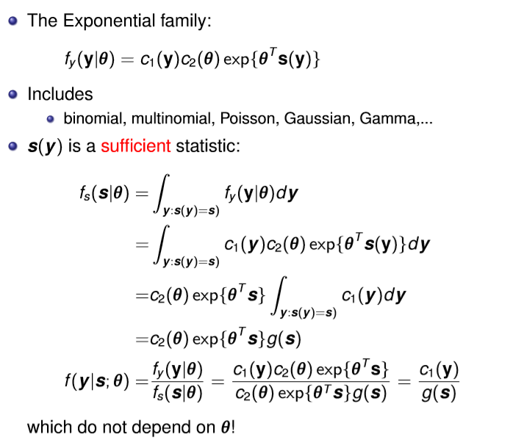
EM in exponential family
Why? We can do computations in advance and just identify terms afterwards
Simplifies a lot of standard problems

Slide 17
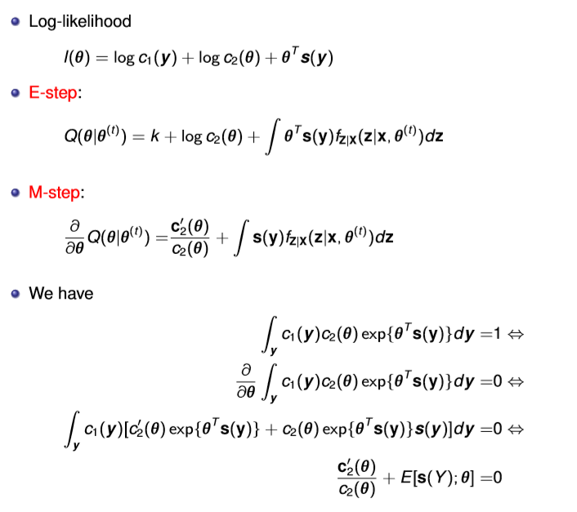
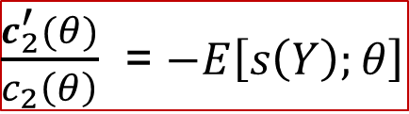
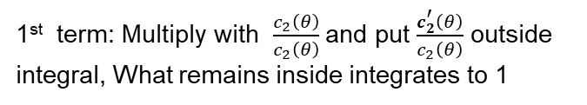


The EM algorithms in exponential families E & M
What is this?
$$\frac{∂}{∂θ}Q\left(θ | θ^{\left(t\right)}\right)=0$$
$$∫s\left(y\right)f_{z|x}\left(z|x,θ^{(t)}\right)dz=E\left[s\left(Y\right);θ\right]$$
$\frac{c_{2}^{′}(θ)}{c_{2}\left(θ\right)}$ = $−E\left[s\left(Y\right);θ\right]$
1st term: Multiply with $\frac{c_{2}\left(θ\right)}{c_{2}\left(θ\right)}$and put $\frac{c_{2}^{′}\left(θ\right)}{c_{2}\left(θ\right)}$ outside integral, What remains inside integrates to 1

Slide 18
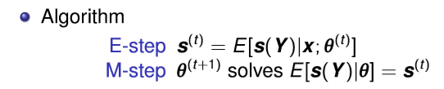
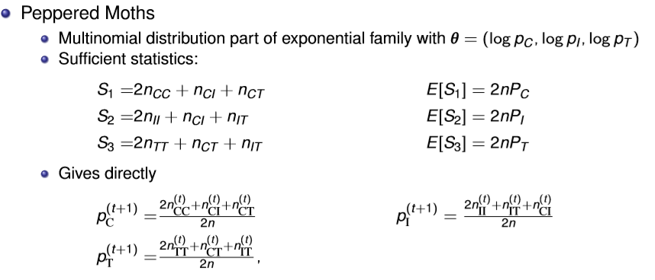
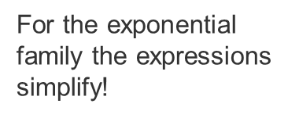
Results
For the exponential family the expressions simplify!
$E[s\left(Y\right)|x,θ]$is the conditional expectation of the sufficient statistics given the observed data.
$E[s\left(Y\right)|θ]$is the unconditional expectation of the sufficient statistic

Slide 19
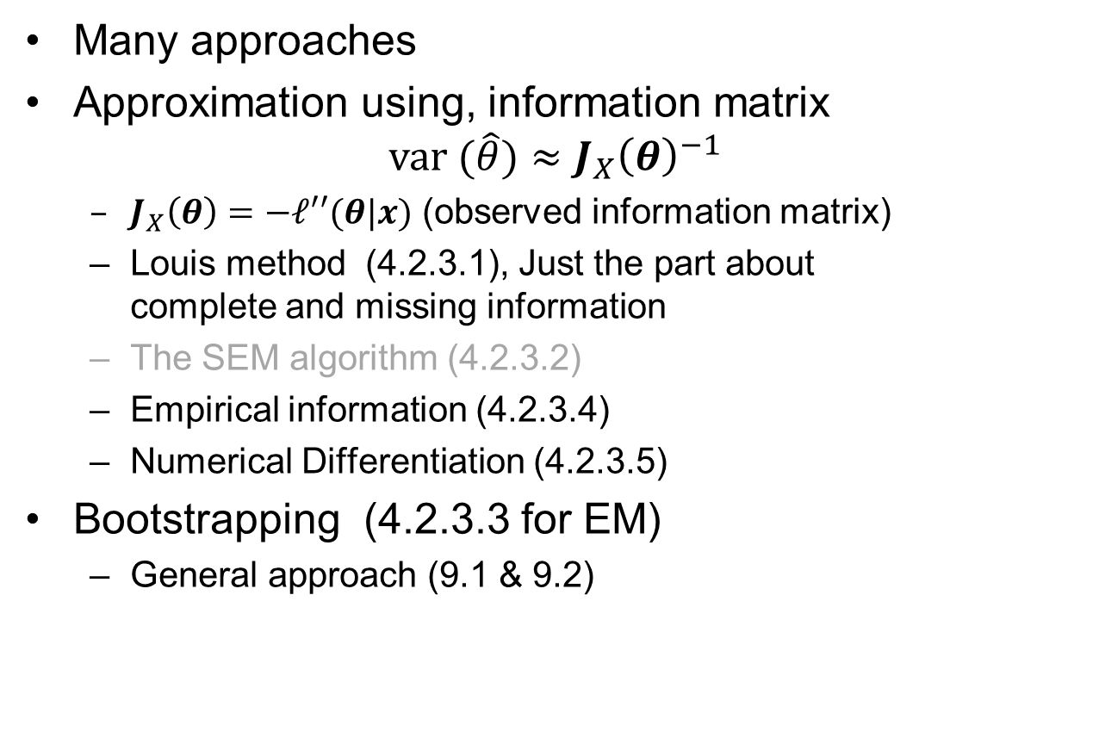
Variance estimate in EM (4.2.3.4)
Many approaches
Approximation using, information matrix
$var (\hat{θ})≈J_{X}{\left(θ\right)}^{−1}$
  $J_{X}\left(θ\right)=−ℓ′′(θ|x)$ (observed information matrix)
  Louis method (4.2.3.1), Just the part about
  complete and missing information
  The SEM algorithm (4.2.3.2)
  Empirical information (4.2.3.4)
  Numerical Differentiation (4.2.3.5)
Bootstrapping (4.2.3.3 for EM)
  General approach (9.1 & 9.2)

Slide 20
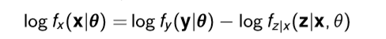
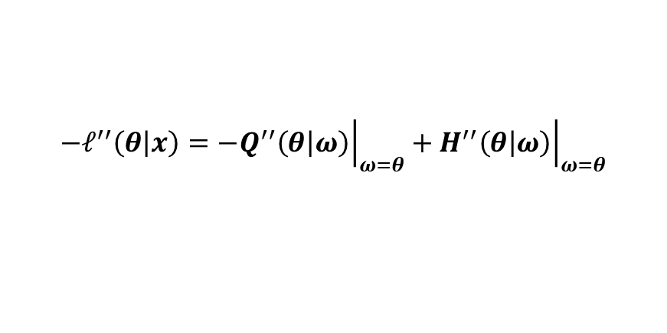
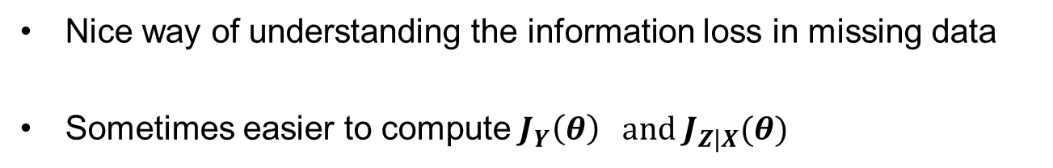

Missing information (4.2.3.1)
$ℓ\left(θ | x\right)=Q\left(θ | θ^{(t)}\right)−$ $H\left(θ | θ^{(t)}\right)$
So you do not differentiate with respect to second argument
$${\left.{{−ℓ}^{′′}\left(θ | x\right)=−Q}^{′′}\left(θ | ω\right)\right|}_{ω=θ}+{\left.H^{′′}\left(θ | ω\right)\right|}_{ω=θ}$$
$$J_{X}\left(θ\right)= J_{Y}\left(θ\right) − J_{Z|X}(θ)$$
Observed information
Complete information
Missing information
Nice way of understanding the information loss in missing data
Sometimes easier to compute $J_{Y}\left(θ\right) and J_{Z|X}(θ)$

Slide 21
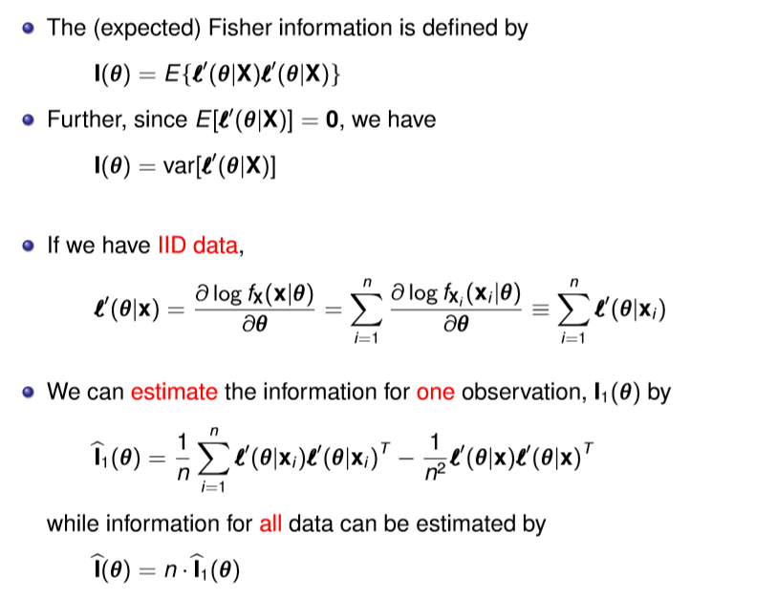
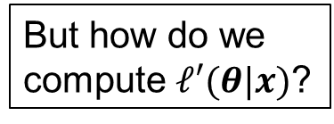
Empirical information
But how do we compute $ℓ′(θ|x)$?

Slide 22
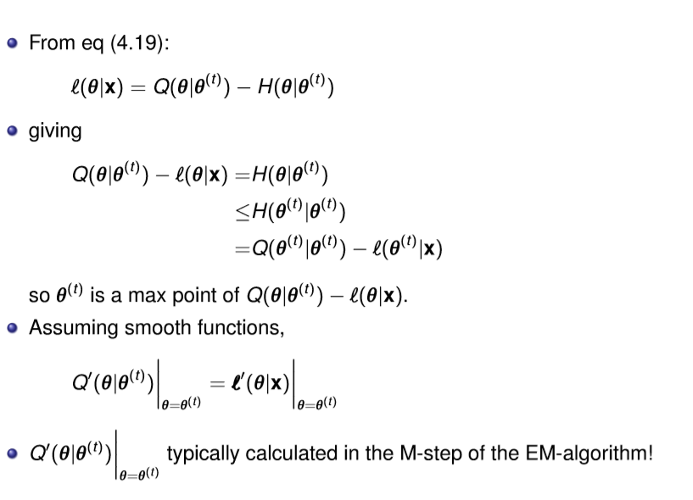


Computing the score function in EM
$ℓ\left(θ | x\right)=Q\left(θ | θ^{(t)}\right)−$ $H\left(θ | θ^{(t)}\right)$
$\frac{∂}{∂θ}(Q\left(θ | θ^{(t)}\right)$- $ℓ\left(θ | x\right))=0$

Slide 23
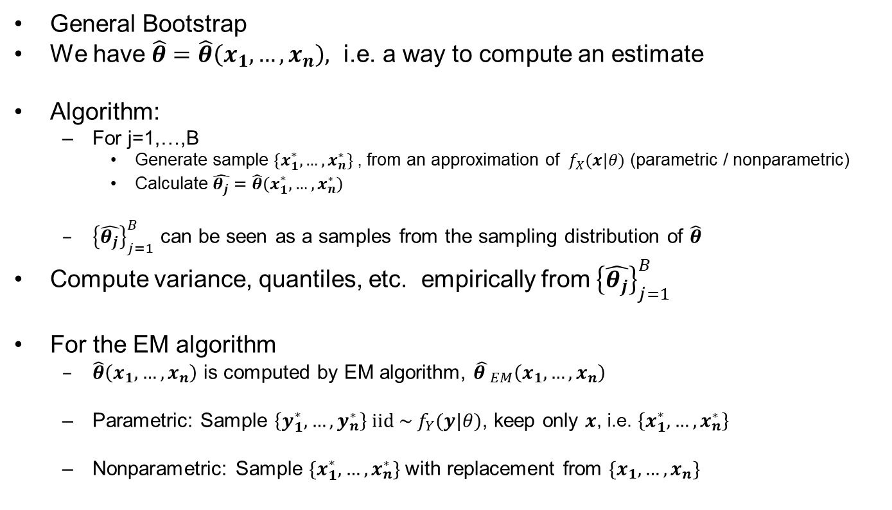
Bootstrapping EM algorithm
General Bootstrap
We have $\hat{θ}=\hat{θ}\left(x_{1},…,x_{n}\right),$ i.e. a way to compute an estimate
Algorithm:
  For j=1,…,B
    Generate sample $\{x_{1}^{∗},…,x_{n}^{∗}\}$, from an approximation of ${ f}_{X}(x|θ)$ (parametric / nonparametric)
    Calculate $\hat{θ_{j}}=\hat{θ}\left(x_{1}^{∗},…,x_{n}^{∗}\right)$
  ${\left\{\hat{θ_{j}}\right\}}_{j=1}^{B}$ can be seen as a samples from the sampling distribution of $\hat{θ}$
Compute variance, quantiles, etc. empirically from ${\left\{\hat{θ_{j}}\right\}}_{j=1}^{B}$
For the EM algorithm
  $\hat{θ}\left(x_{1},…,x_{n}\right)$ is computed by EM algorithm, ${\hat{θ }}_{EM}\left(x_{1},…,x_{n}\right)$
  Parametric: Sample $\left\{y_{1}^{∗},…,y_{n}^{∗}\right\} iid{ \sim f}_{Y}(y|θ)$, keep only $x$, i.e. $\left\{x_{1}^{∗},…,x_{n}^{∗}\right\}$
  Nonparametric: Sample $\{x_{1}^{∗},…,x_{n}^{∗}\}$with replacement from $\{x_{1},…,x_{n}\}$

Slide 25
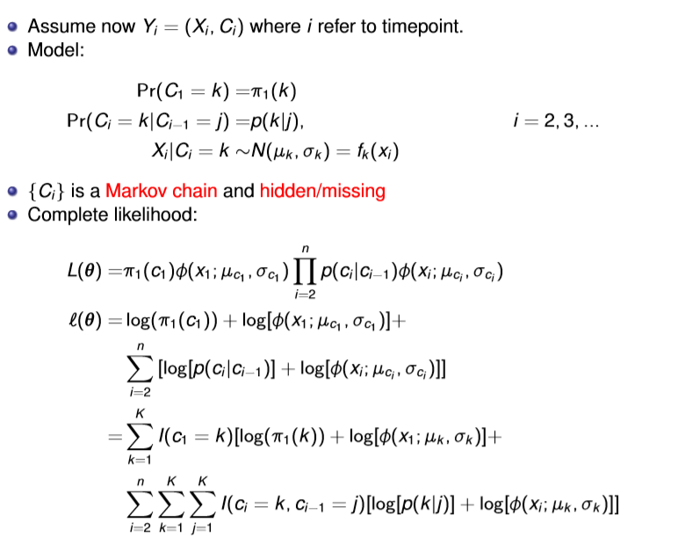
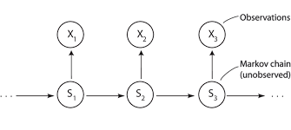



EM-Hidden Markov model
$$C_{1}$$
$$C_{2}$$
$$C_{3}$$

Slide 26
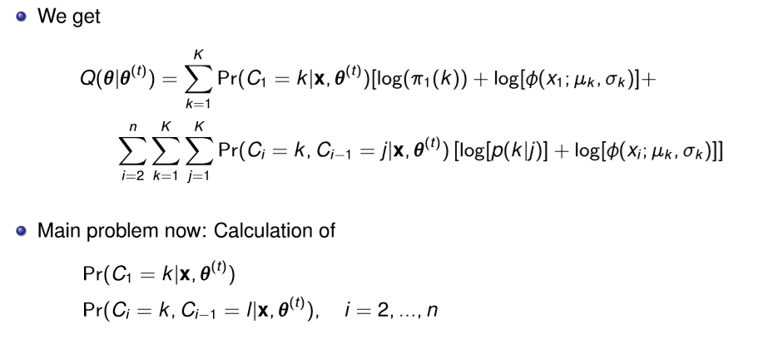
EM - Hidden Markov model

Slide 27




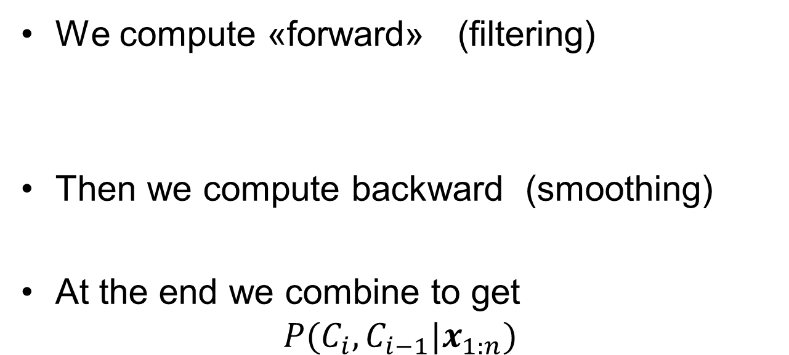






General idea in hidden Markov Model
Any time
All data
$$P(C_{i}|x_{1:n})$$
We compute «forward» (filtering)
Then we compute backward (smoothing)
At the end we combine to get
$$P(C_{i},C_{i−1}|x_{1:n})$$
$$P(C_{i−1}|x_{1:(i−1)})$$
$$P(C_{i}|x_{1:(i−1)})$$
$$P(C_{i}|x_{1:i})$$
$$P(C_{i+1}|x_{1:i})$$
…
$$P(C_{n}|x_{1:n})$$
Update
Predict
Update
Predict
Update
$$P(C_{i+1}|x_{1:n})$$
$$P(C_{i}|x_{1:n})$$
$$P(C_{i−1}|x_{1:n})$$
…
$$P(C_{1}|x_{1:n})$$

Slide 28
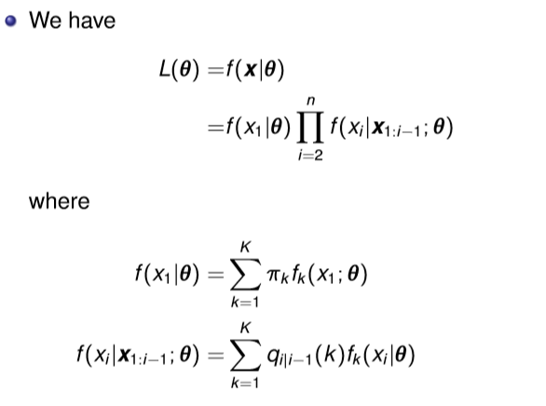
Hidden Markov model
$$C_{1}$$
$$C_{2}$$
$$C_{3}$$

Slide 29
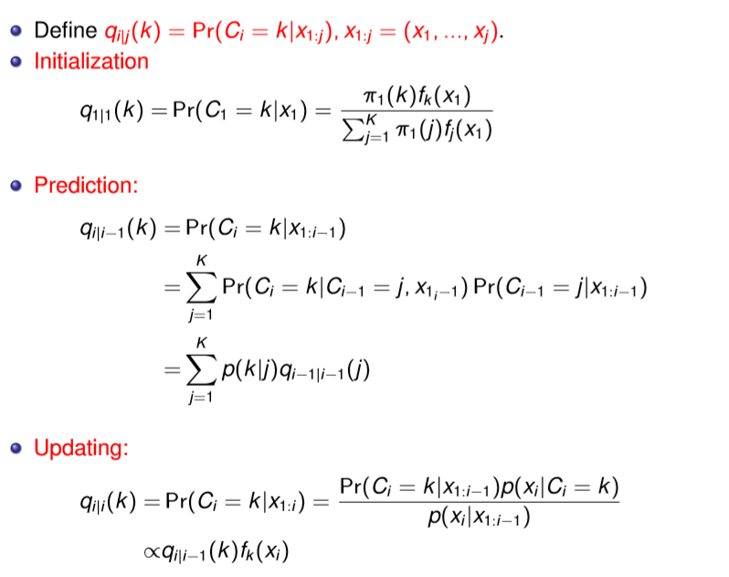
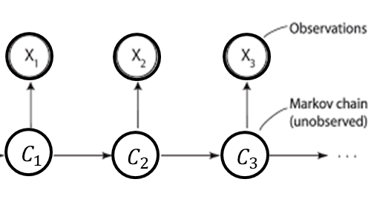
HMM forward equations

Slide 30
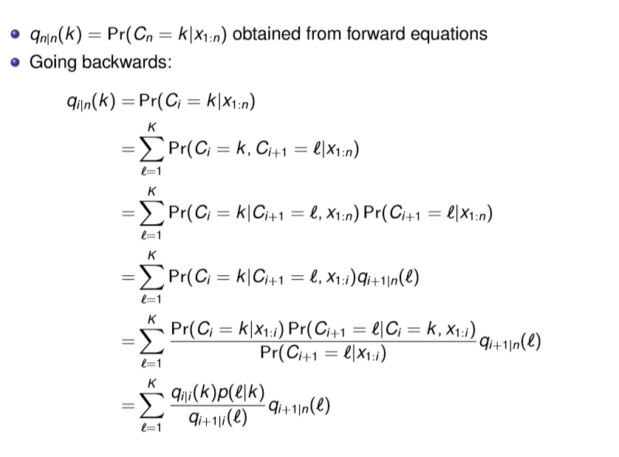

Backward equations
Expand
Because of the Markov structure
Recognize
$$=P(C_{i+1}=l|C_{i}=k)$$
Bayes formula
Recognize

Slide 31
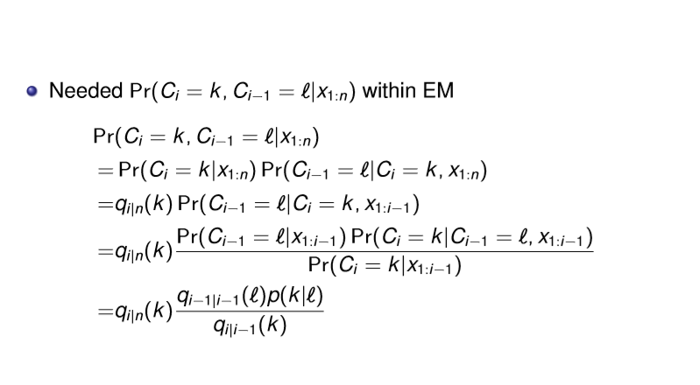
Sequence probability
Recognize
C_{i} shadow for x_{i:n}
Bayes formula
Recognize

Slide 32
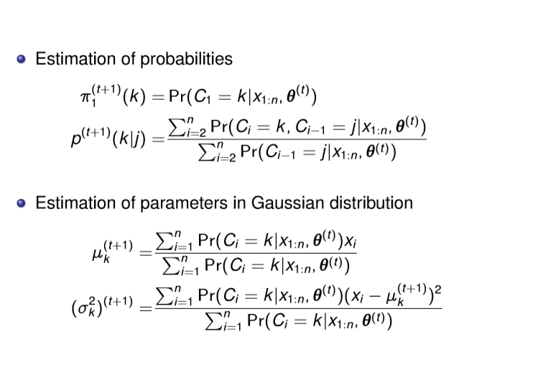
HMM - M-step

