Slide 1
STK-4051/9051 Computational Statistics Spring 2024
Chapter 9 + Chaper 4 part 1
Instructor: Odd Kolbjørnsen, oddkol@math.uio.no

Slide 2
Now
Bootstrap
EM algorithm
  Missing data
  Moths
  Proof of increasing log likelihood when using
  EM algorithm
  Mixture Gaussian clustering
  Exponential family
Variance estimate in EM
  Bootstrap
  Approximation using, information matrix’
EM for hidden Markov model
  Forward – backward for Mixture Gauss

Slide 3
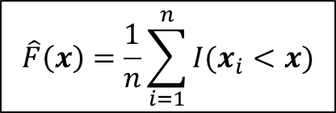
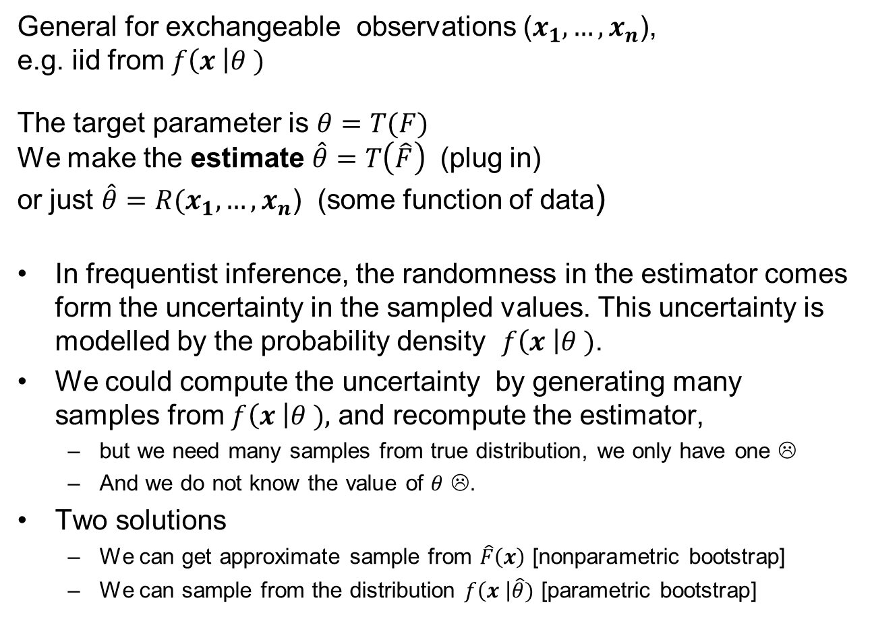
Bootstrapping (9.1-9.2.2)
General for exchangeable observations ($x_{1},…,x_{n}$),
e.g. iid from $f\left(x \right|θ )$
The target parameter is $θ=T(F)$
We make the estimate $\hat{θ}=T\left(\hat{F}\right)$ (plug in)
or just $\hat{θ}=R{(x}_{1},…,x_{n}$) (some function of data)
In frequentist inference, the randomness in the estimator comes form the uncertainty in the sampled values. This uncertainty is modelled by the probability density $f\left(x \right|θ )$.
We could compute the uncertainty by generating many samples from $f\left(x \right|θ ),$ and recompute the estimator,
  but we need many samples from true distribution, we only have one ☹
  And we do not know the value of $θ$ ☹.
Two solutions
  We can get approximate sample from $\hat{F}\left(x\right)$ [nonparametric bootstrap]
  We can sample from the distribution $f\left(x \right|\hat{θ})$ [parametric bootstrap]
$$\hat{F}\left(x\right)=\frac{1}{n}\sum_{i=1}^{n}{I(x_{i}<x)}$$

Slide 4
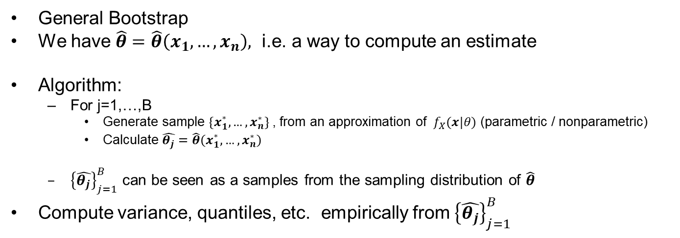
Bootstrapping
General Bootstrap
We have $\hat{θ}=\hat{θ}\left(x_{1},…,x_{n}\right),$ i.e. a way to compute an estimate
Algorithm:
  For j=1,…,B
    Generate sample $\{x_{1}^{∗},…,x_{n}^{∗}\}$, from an approximation of ${ f}_{X}(x|θ)$ (parametric / nonparametric)
    Calculate $\hat{θ_{j}}=\hat{θ}\left(x_{1}^{∗},…,x_{n}^{∗}\right)$
  ${\left\{\hat{θ_{j}}\right\}}_{j=1}^{B}$ can be seen as a samples from the sampling distribution of $\hat{θ}$
Compute variance, quantiles, etc. empirically from ${\left\{\hat{θ_{j}}\right\}}_{j=1}^{B}$

Slide 5
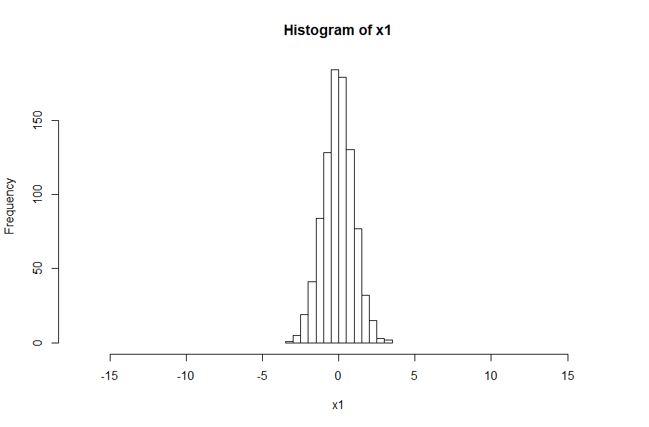
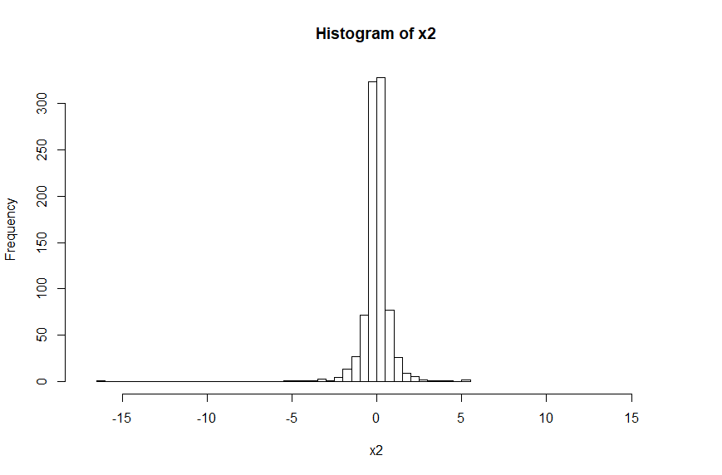
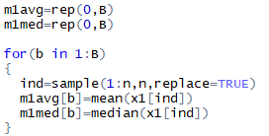
Example: In a symmetric distribution should you estimate the center using the mean or the median?
If data have a normal distribution the theory says mean.
But what if the distribution is not known to be normal?
Case 1: normal
Bootstrap code:
Case 2 Student-t
One very low value

Slide 6
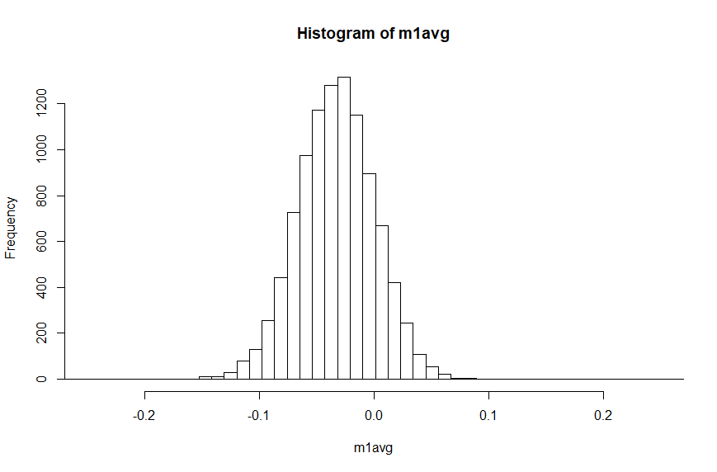
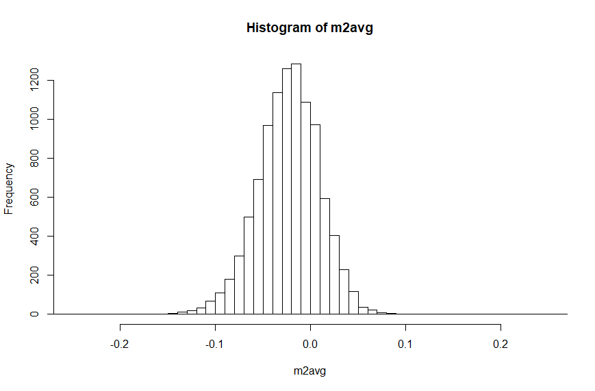
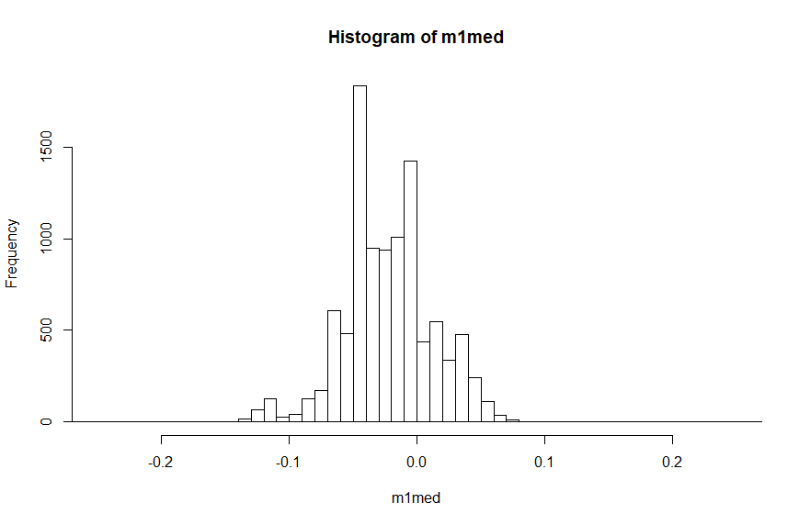
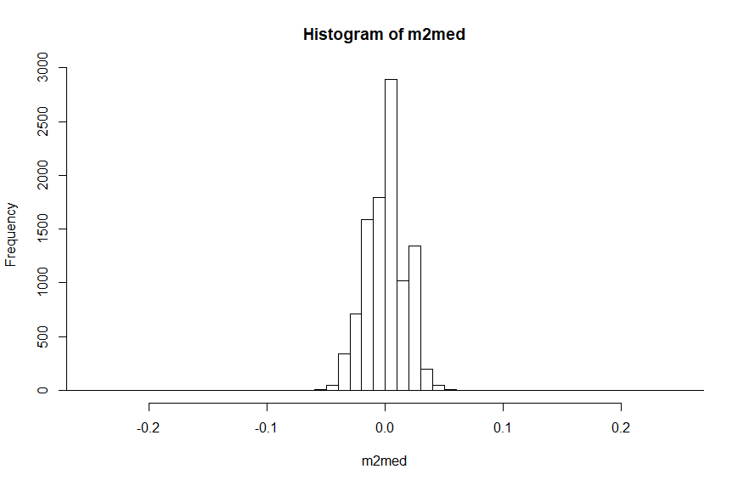


Case 1: normal
Case 2 Student-t
Estimator:
mean
Estimator:
mean
Estimator:
median
Estimator:
median

Slide 7
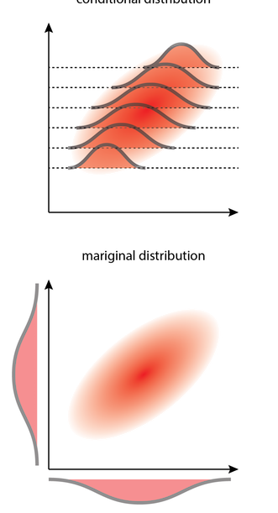

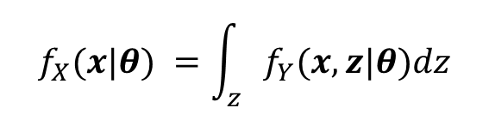




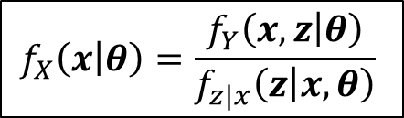

Recap:
Joint, marginal and conditional distribution
$$f_{X}(x|θ)$$
$${f_{Y}(y|θ)=f}_{Y}(x,z|θ)$$
$$f_{z|x}\left(z | x=a,θ\right)$$
$$f_{z|x}\left(z | x=b,θ\right)$$
$$f_{X}(x|θ) =\int_{z}{f_{Y}(x,z|θ)dz}$$
$$f_{z|x}\left(z | x,θ\right)=\frac{f_{Y}\left(x,z | θ\right)}{f_{X}\left(x | θ\right)}$$
$$f_{X}\left(x | θ\right)=\frac{f_{Y}\left(x,z | θ\right)}{f_{z|x}\left(z | x,θ\right)}$$
$$f_{Y}\left(x,z | θ\right)=f_{z|x}\left(z | x,θ\right)f_{X}\left(x | θ\right)$$

Slide 8
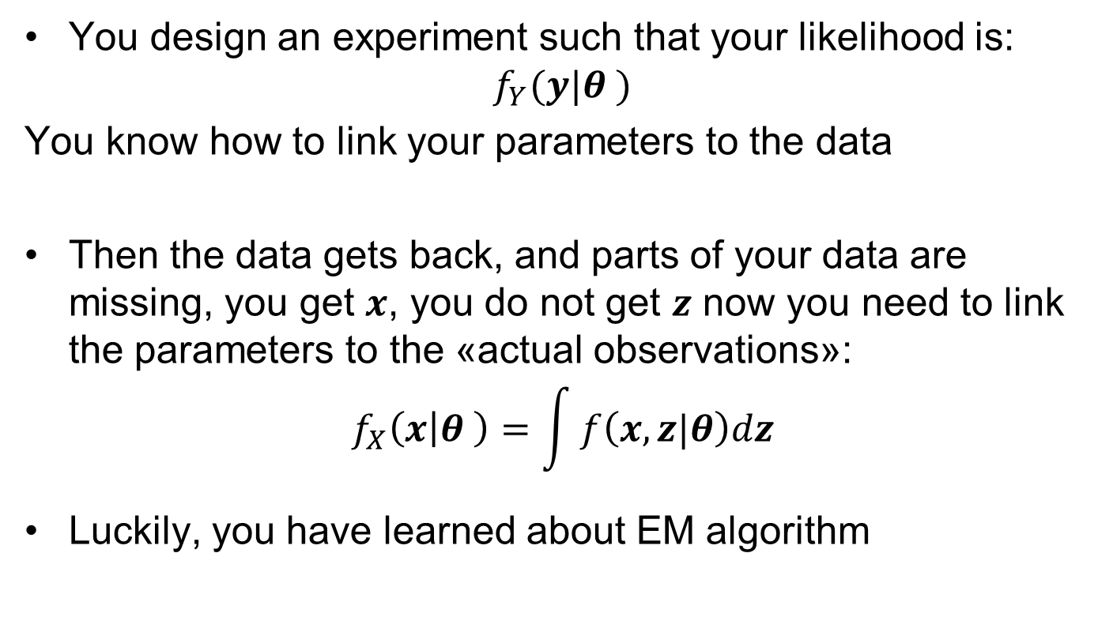
The problem of missing data
You design an experiment such that your likelihood is:
$$f_{Y}(y|θ )$$
You know how to link your parameters to the data
Then the data gets back, and parts of your data are missing, you get $x$, you do not get $z$ now you need to link the parameters to the «actual observations»:
$$f_{X}\left(x | θ \right)=\int{f\left(x,z|θ\right)dz}$$
Luckily, you have learned about EM algorithm

Slide 9
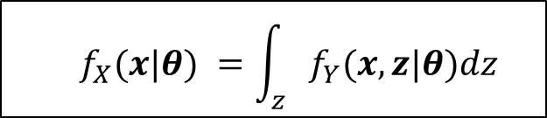
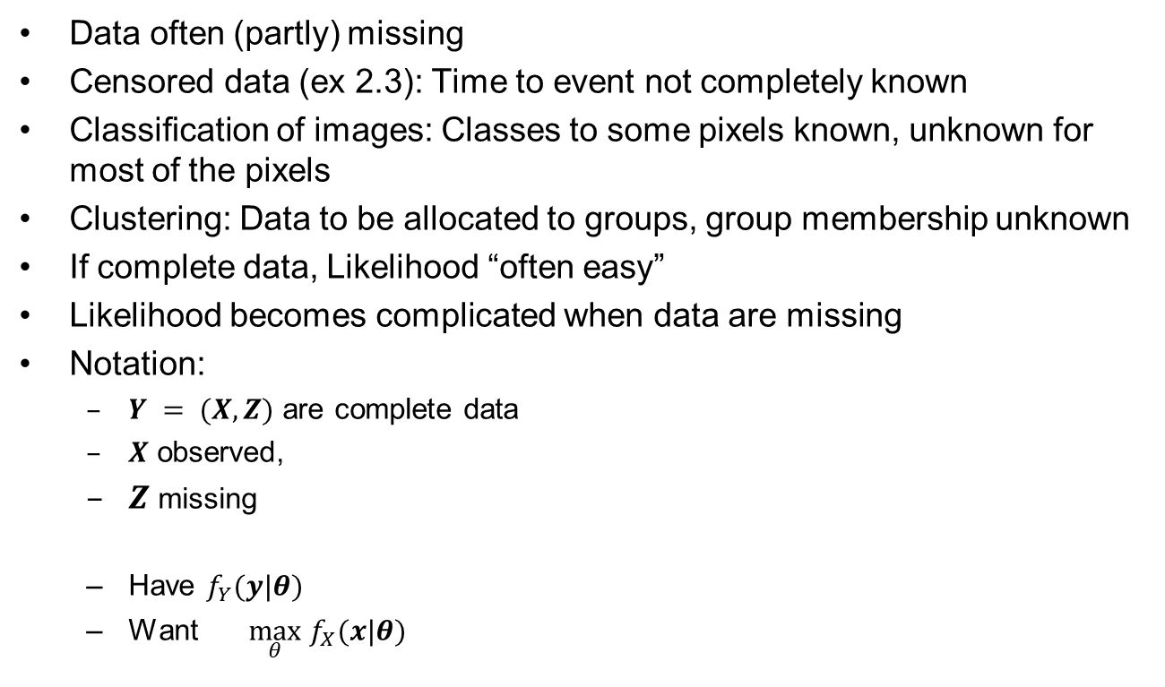
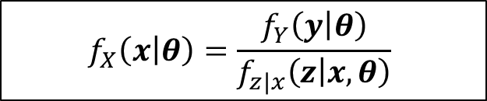
Missing data
Data often (partly) missing
Censored data (ex 2.3): Time to event not completely known
Classiﬁcation of images: Classes to some pixels known, unknown for most of the pixels
Clustering: Data to be allocated to groups, group membership unknown
If complete data, Likelihood “often easy”
Likelihood becomes complicated when data are missing
Notation:
  $Y = (X,Z)$ are complete data
  $X$ observed,
  $Z$ missing
  Have $f_{Y}(y|θ)$
  Want $\max_{θ} f_{X}(x|θ)$
  $$f_{X}(x|θ) =\int_{z}{f_{Y}(x,z|θ)dz}$$
$$f_{X}\left(x | θ\right)=\frac{f_{Y}\left(y | θ\right)}{f_{z|x}\left(z | x,θ\right)}$$

Slide 10
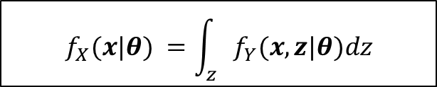
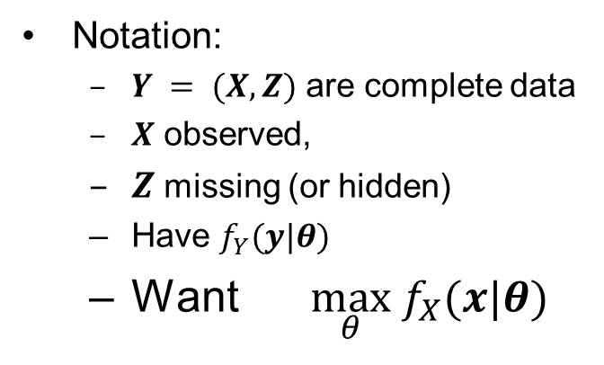
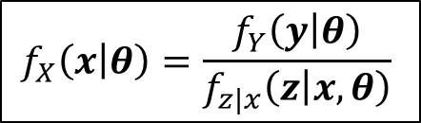
EM algorithm
  $$f_{X}(x|θ) =\int_{z}{f_{Y}(x,z|θ)dz}$$
Notation:
  $Y = (X,Z)$ are complete data
  $X$ observed,
  $Z$ missing (or hidden)
  Have $f_{Y}(y|θ)$
  Want $\max_{θ} f_{X}(x|θ)$
Marginal likelihood
$$f_{X}\left(x | θ\right)=\frac{f_{Y}\left(y | θ\right)}{f_{z|x}\left(z | x,θ\right)}$$
Complete likelihood
We maximize:
$$Q\left(θ | θ^{\left(t\right)}\right)=E[\log{f_{Y}\left(y | θ\right)\left|{x,θ}^{\left(t\right)}\right]}$$
Expected value of the complete log likelihood
given the observed data
using the current estimate of the parameter

Slide 11
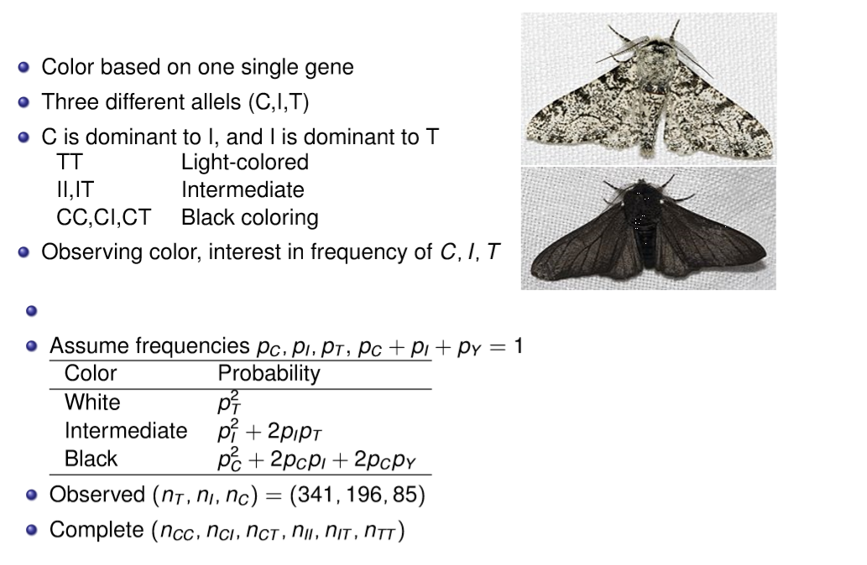
Peppered Moths - Example
T
Options | Count
CC | 1
CI (IC) | 2
CT (TC) | 2
II | 1
IT (TI) | 2
TT | 1
T

Slide 12
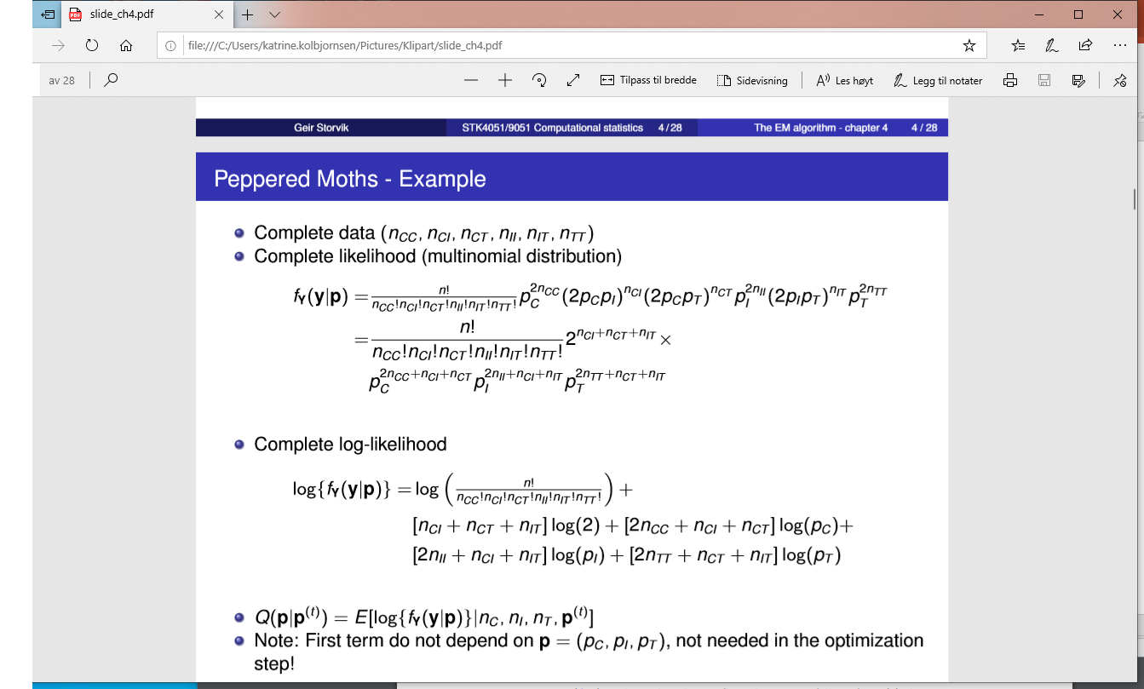
Peppered Moths - Likelihood

Slide 13
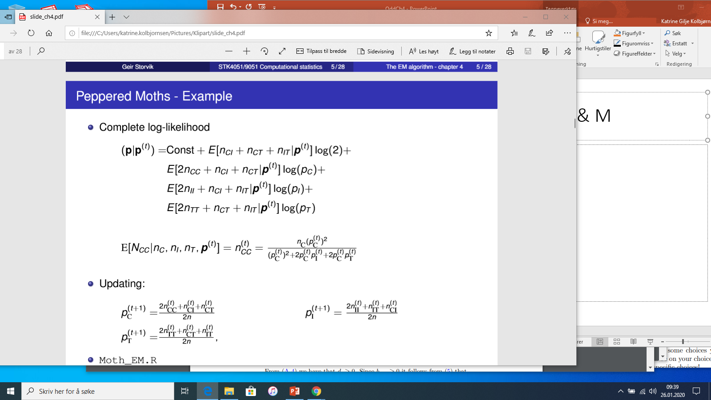


Peppered Moths – updating E & M
$$Q$$
Expectation
Maximization

Slide 14
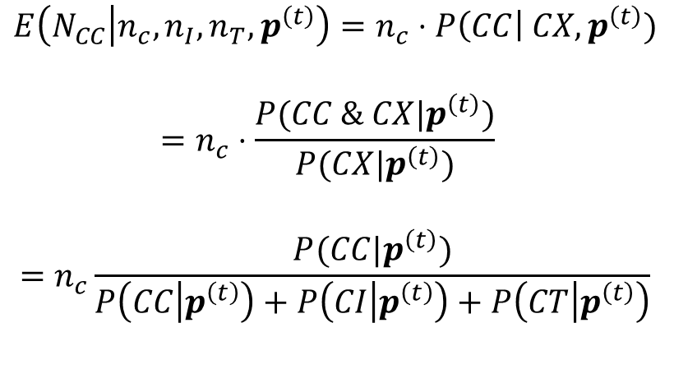



Expectation
X could be either C,T, or I
$$E\left(N_{CC} | n_{c},n_{I},n_{T}, p^{\left(t\right)}\right)=n_{c}⋅P\left(CC\right| CX,p^{\left(t\right)})$$
$$=n_{c}⋅\frac{P(CC \& CX|p^{\left(t\right)})}{P(CX|p^{\left(t\right)})}$$
$$=n_{c}\frac{P(CC|p^{\left(t\right)})}{P\left(CC | p^{\left(t\right)}\right)+P\left(CI | p^{\left(t\right)}\right)+P\left(CT | p^{\left(t\right)}\right)}$$
$$P\left(CC \right)=p_{c}^{2}$$
$$P\left(CI \right)=2p_{c}p_{I}$$
$$P\left(CI \right)=2p_{c}p_{T}$$
Insert to get result

Slide 15



Maximization
$$Q$$
$$−λ(p_{c}+p_{I}+p_{T}−1)$$
Lagrange multiplier
$$\frac{∂Q}{∂p_{C}}=\frac{E(2n_{CC}+n_{CI}+n_{CT}|p^{t})}{p_{C}}−λ=0⇒p_{C}=\frac{E(2n_{CC}+n_{CI}+n_{CT}|p^{t})}{λ}$$
${1=p}_{c}+p_{I}+p_{T}=\frac{E\left(2n_{CC}+n_{CI}+n_{CT} | p^{(t)}\right)+E\left(2n_{II}+n_{CI}+n_{IT} | p^{(t)}\right)+E\left(2n_{CC}+n_{CI}+n_{CT} | p^{(t)}\right)}{λ}=\frac{2n}{λ}$
$$λ=2n$$

Slide 16
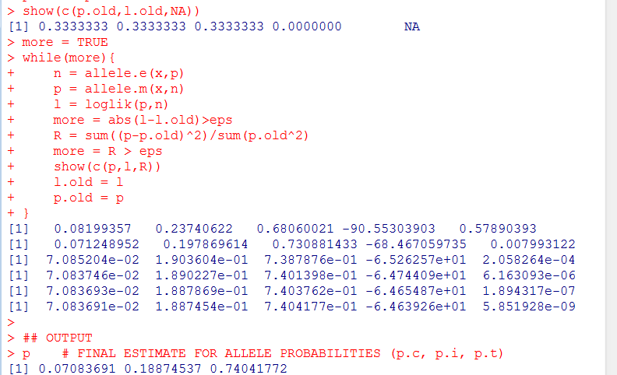
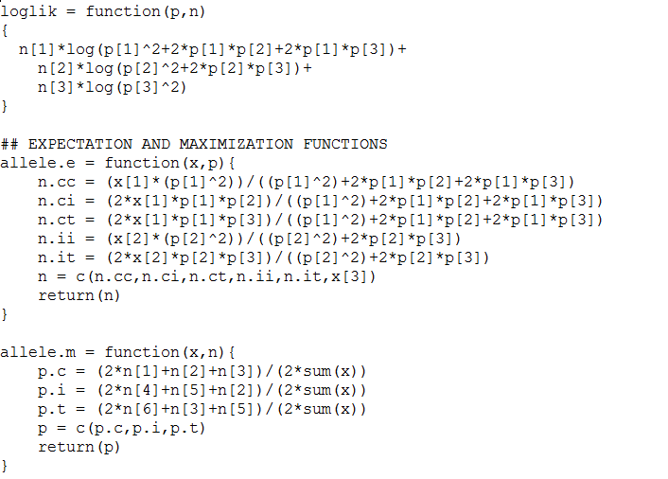
Moths in R
Data = (85, 196, 341)

Slide 17


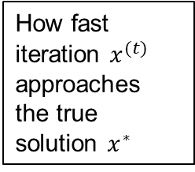
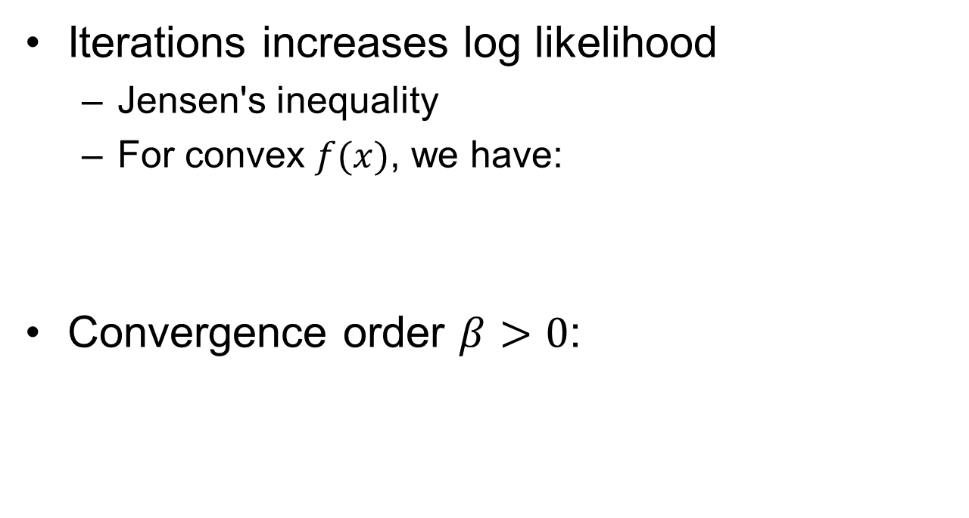


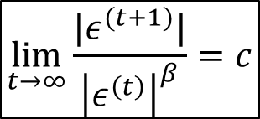
Convergence EM
Iterations increases log likelihood
  Jensen's inequality
  For convex $f(x)$, we have:
Convergence order $β>0$:
$$ℓ\left(θ | x\right)=\log{f_{X}(x|θ)}$$
$$f\left(E\left(X\right)\right) ≤ E(f(X))$$
How fast iteration $x^{(t)}$ approaches the true solution $x^{∗}$
$$ε^{\left(t\right)}=x^{(t)}−x^{∗}$$
$$\lim_{t→∞}\frac{|ε^{(t+1)}|}{{\left|ε^{\left(t\right)}\right|}^{β}}=c$$
$$\lim_{t→∞}|ε^{(t)}|→0$$

Slide 18
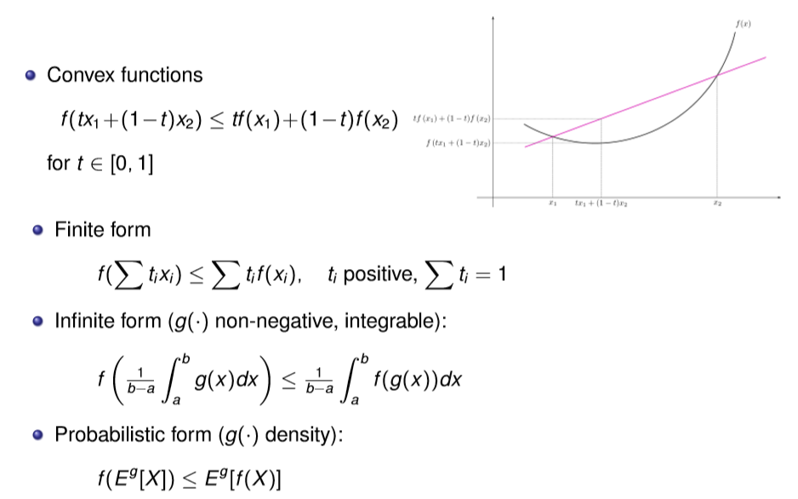
Jensen’s inequality
Ill prove this next week in exercise

Slide 19

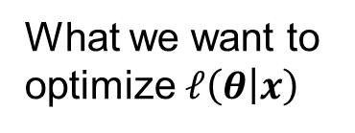
The Q function vs marginal log likelihood
$$Q\left(θ | θ^{\left(t\right)}\right)=E[\log{f_{Y}\left(y | θ\right)\left|{x,θ}^{\left(t\right)}\right]}$$
The expected value of the complete log likelihood
given the observed data and the current estimate of parameter
$${log⁡( f}_{X}(x|θ))=Q\left(θ | θ^{\left(t\right)}\right)−H\left(θ | θ^{\left(t\right)}\right)$$
What we want to
optimize $ℓ\left(θ | x\right)$
What EM tells
us to optimize
$$=E\left[\log{f_{z|x}\left(z | x,θ\right)|}x,θ^{(t)} \right]$$
Theorem : by optimizing $Q\left(θ | θ^{\left(t\right)}\right)$ we optimize ${log⁡( f}_{X}(x|θ))$

Slide 20
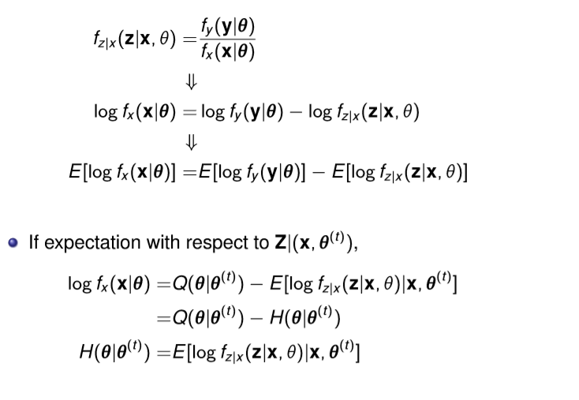
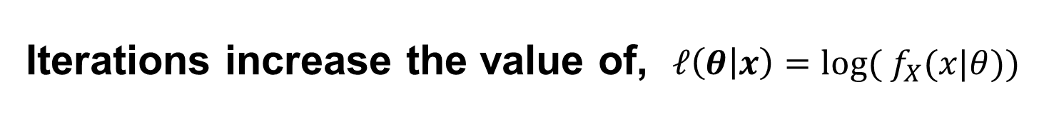
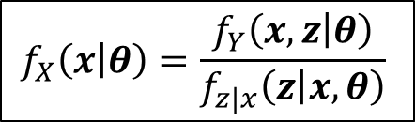
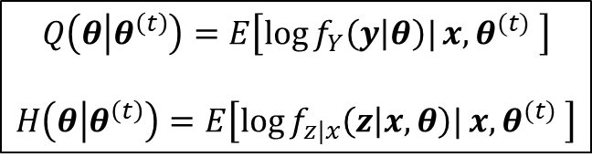
Iterations increase the value of, $ℓ\left(θ | x\right)={log⁡( f}_{X}(x|θ))$
$$f_{X}\left(x | θ\right)=\frac{f_{Y}\left(x,z | θ\right)}{f_{z|x}\left(z | x,θ\right)}$$
Any expectation
Select :
Expectation with respect to the distribution the missing data have
under the current estimate of the parameter
$$Q\left(θ | θ^{\left(t\right)}\right)=E\left[\log{f_{Y}\left(y | θ\right)|}x,θ^{(t)} \right]$$
$$H\left(θ | θ^{\left(t\right)}\right)=E\left[\log{f_{z|x}\left(z | x,θ\right)|}x,θ^{(t)} \right]$$

Slide 21
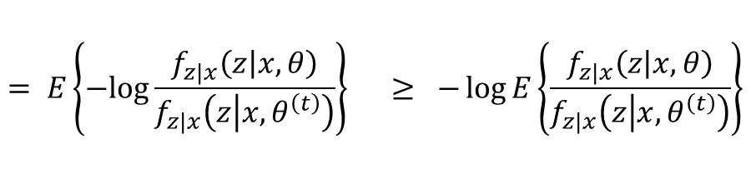


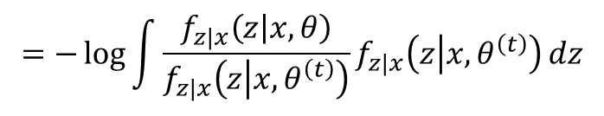
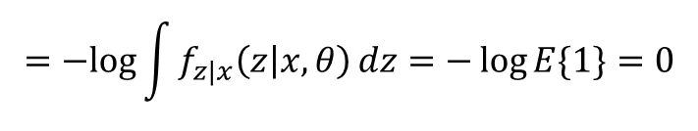
Proof: $H\left(θ^{\left(t\right)} | θ^{\left(t\right)}\right)≥ H\left(θ | θ^{\left(t\right)}\right)$ for any $θ$
$$H\left(θ | θ^{\left(t\right)}\right)=E\left[\log{f_{z|x}\left(z | x,θ\right)|}x,θ^{(t)} \right]$$
$$H\left(θ^{(t)} | θ^{(t)}\right)−H\left(θ | θ^{\left(t\right)}\right)= E\left\{\log{f_{z|x}\left(z | x,θ^{\left(t\right)}\right)}−\log{f_{z|x}\left(z | x,θ\right)}\right\}$$
$$= E\left\{−log\frac{f_{z|x}\left(z | x,θ\right)}{f_{z|x}\left(z | x,θ^{\left(t\right)}\right)}\right\} ≥ −\log{E\left\{\frac{f_{z|x}\left(z | x,θ\right)}{f_{z|x}\left(z | x,θ^{\left(t\right)}\right)}\right\}}$$
Jensen’s
$$=−\log{\int{\frac{f_{z|x}\left(z | x,θ\right)}{f_{z|x}\left(z | x,θ^{\left(t\right)}\right)}f_{z|x}\left(z | x,θ^{\left(t\right)}\right)}}dz$$
$$=−log{\int{f_{z|x}\left(z | x,θ\right)}}dz=−\log{E\{1\}=0}$$

Slide 22
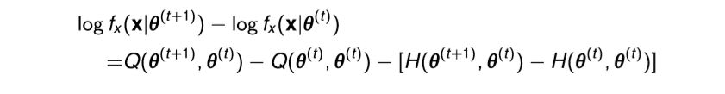
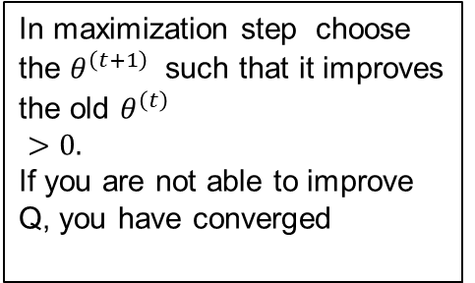
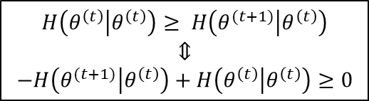
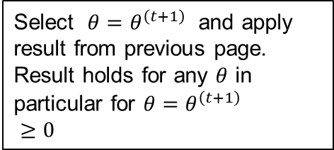

Proof of increasing likelihood
In maximization step choose the $θ^{\left(t+1\right)}$ such that it improves the old $θ^{\left(t\right)}$
$>0.$
If you are not able to improve
Q, you have converged
Select $θ=θ^{\left(t+1\right)}$ and apply result from previous page. Result holds for any $θ$ in particular for $θ=θ^{\left(t+1\right)}$
$≥0$
$$H\left(θ^{\left(t\right)} | θ^{\left(t\right)}\right)≥ H\left(θ^{(t+1)} | θ^{\left(t\right)}\right)$$
$$⇕$$
$$−H\left(θ^{(t+1)} | θ^{\left(t\right)}\right)+H\left(θ^{\left(t\right)} | θ^{\left(t\right)}\right)≥0$$
$$\log{f_{x}(x|θ^{\left(t+1\right)})}>\log{f_{x}(x|θ^{\left(t\right)})}$$

Slide 23
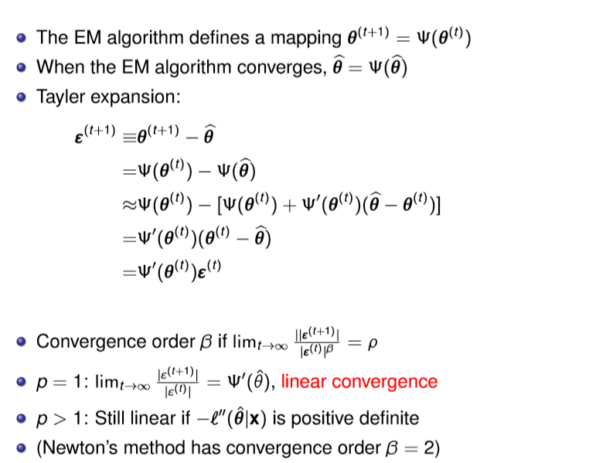
Convergence order (good to know, but need not derive)
(Fix point)
Taylor expansion:

Slide 25
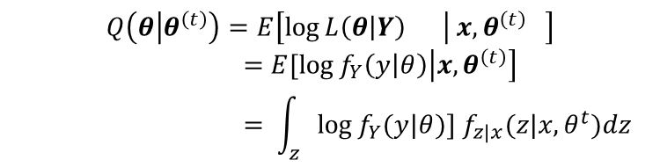
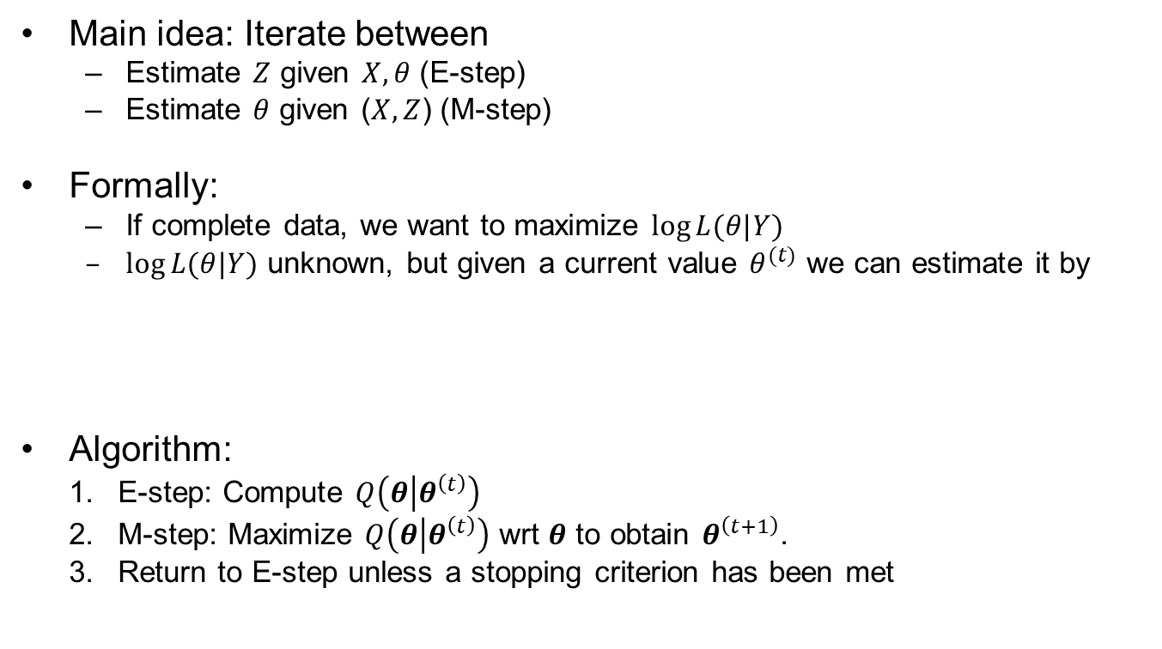
EM algorithm
Main idea: Iterate between
  Estimate $Z$ given $X,θ$ (E-step)
  Estimate $θ$ given ($X,Z$) (M-step)
Formally:
  If complete data, we want to maximize $\log{L(θ|Y)}$
  $\log{L(θ|Y)}$ unknown, but given a current value $θ^{(t)}$ we can estimate it by
Algorithm:
  E-step: Compute $Q\left(θ | θ^{\left(t\right)}\right)$
  M-step: Maximize $Q\left(θ | θ^{\left(t\right)}\right)$ wrt $θ$ to obtain $θ^{\left(t+1\right)}$.
  Return to E-step unless a stopping criterion has been met
$$Q\left(θ | θ^{\left(t\right)}\right)=E\left[\log{L\left(θ | Y\right)} | x,θ^{\left(t\right)} \right]$$
$$=E[\log{f_{Y}\left(y | θ\right)\left|{x,θ}^{\left(t\right)}\right]} \\ = \int_{z}{\log{f_{Y}(y|θ)}] f_{z|x}(z|x,θ^{t})dz}$$

Slide 26

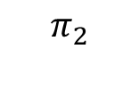


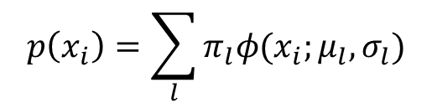


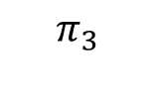
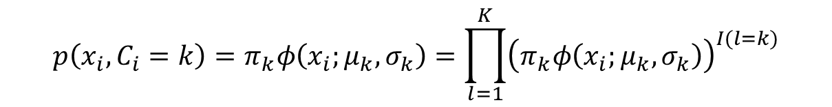
Example: Mixture Gaussian clustering
Class probability
$$P\left(C_{i}=k\right)=π_{k}$$
$$p(x_{i}|C_{i})$$
Conditional probability given class
$$π_{3}$$
$$p\left(x_{i} | C_{i}=k\right)=φ(x_{i};μ_{k},σ_{k})$$
$$π_{1}$$
$$π_{2}$$
Joint distribution
$$p\left(x_{i},C_{i}=k\right)=π_{k}φ\left(x_{i};μ_{k},σ_{k}\right)=\prod_{l=1}^{K}{{\left(π_{k}φ\left(x_{i};μ_{k},σ_{k}\right)\right)}^{I(l=k)}}$$
Marginal distribution of $x_{i}$
$$p\left(x_{i}\right)=\sum_{l}{π_{l}φ(x_{i};μ_{l},σ_{l})}$$
Complete log likelihood for one individual
$$log⁡(p\left(x_{i},C_{i}=k\right))={log⁡(π}_{k})+log⁡(φ(x_{i};μ_{k},σ_{k}))$$

Slide 27
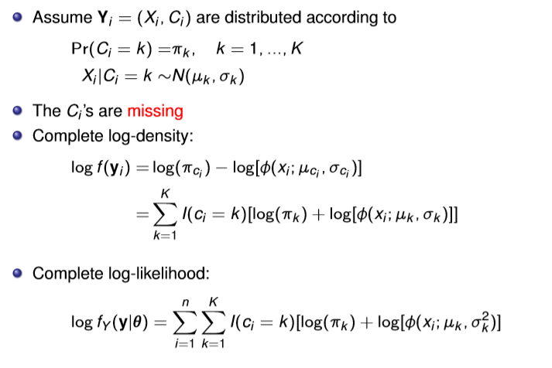
Example: Mixture Gaussian clustering
$$p(x_{i}|C_{i})$$
$$π_{3}$$
$$π_{1}$$
$$π_{2}$$
$$p(x_{i})$$
+

Slide 28

E-step- Mixture Gaussian
(t)
)
(t)

Slide 29
(t)
)
(t)
$$p(x_{i}|C_{i})$$
$$P\left(C_{i}=k\right)=π_{k}$$
$$π_{3}$$
$$p\left(x_{i} | C_{i}=k\right)=φ(x_{i};μ_{k},σ_{k})$$
$$π_{1}$$
$$π_{2}$$
$$p\left(x_{i}\right)=\sum_{l}{π_{l}φ(x_{i};μ_{l},σ_{l})}$$
$$P\left(C_{i}=k | {X_{i}=x}_{i}\right)=\frac{p(C_{i}=k \&{{ X}_{i}=x}_{i})}{p(X_{i}=x_{i})}=\frac{P(C_{i}=k) p(x_{i}|C_{i}=k)}{p(x_{i})}$$

Slide 30

M-step- Mixture Gaussian
$$\sum_{k=1}^{K}{\sum_{i=1}^{n}{\frac{Pr⁡(C_{i}=k|x,θ^{(t)})}{λ}}=1}$$
$$\frac{1}{λ}\sum_{i=1}^{n}{\sum_{k=1}^{K}{Pr⁡(C_{i}=k|x,θ^{(t)})}=1}$$
$$=1$$

Slide 31

Examples galaxy

Slide 32

EM clustering of Old Faithful eruption data.
By Chire - Own work, CC BY-SA 3.0, https://commons.wikimedia.org/w/index.php?curid=20494862

Slide 33

EM in exponential family
Why? We can do computations in advance and just identify terms afterwards
Simplifies a lot of standard problems

Slide 34





The EM algorithms in exponential families E & M
What is this?
$$\frac{∂}{∂θ}Q\left(θ | θ^{\left(t\right)}\right)=0$$
$$∫s\left(y\right)f_{z|x}\left(z|x,θ^{(t)}\right)dz=E\left[s\left(Y\right);θ\right]$$
$\frac{c_{2}^{′}(θ)}{c_{2}\left(θ\right)}$ = $−E\left[s\left(Y\right);θ\right]$
1st term: Multiply with $\frac{c_{2}\left(θ\right)}{c_{2}\left(θ\right)}$and put $\frac{c_{2}^{′}\left(θ\right)}{c_{2}\left(θ\right)}$ outside integral, What remains inside integrates to 1

Slide 35




Results
Compute this integral with your old theta
A bit sloppy to say that this is the E-step the real E-step is to compute the maximizing function:
In the exponential family it turns out that what you need for computations is the expectation of the sufficient statistics
$$Q\left(θ | θ^{\left(t\right)}\right)=E\left[\log{f_{Y}\left(y | θ\right)|}x,θ^{(t)} \right]$$
$E[s\left(Y\right)|x,θ]$is the conditional expectation of the complete data given the observed data.
$E[s\left(Y\right)|θ]$is the unconditional expectation of the complete data

Slide 36

Variance estimate in EM (4.2.3.4)
Many approaches
Approximation using, information matrix
$var (\hat{θ})≈J_{X}{\left(θ\right)}^{−1}$
  $J_{X}\left(θ\right)=−ℓ′′(θ|x)$ (observed information matrix)
  Louis method (4.2.3.1), Just the part about
  complete and missing information
  The SEM algorithm (4.2.3.2)
  Empirical information (4.2.3.4)
  Numerical Differentiation (4.2.3.5)
Bootstrapping (4.2.3.3 for EM)
  General approach (9.1 & 9.2)

Slide 37



Missing information (4.2.3.1)
$ℓ\left(θ | x\right)=Q\left(θ | θ^{(t)}\right)−$ $H\left(θ | θ^{(t)}\right)$
So you do not differentiate with respect to second argument
$${\left.{{−ℓ}^{′′}\left(θ | x\right)=−Q}^{′′}\left(θ | ω\right)\right|}_{ω=θ}+{\left.H^{′′}\left(θ | ω\right)\right|}_{ω=θ}$$
$$J_{X}\left(θ\right)= J_{Y}\left(θ\right) − J_{Z|X}(θ)$$
Observed information
Complete information
Missing information
Nice way of understanding the information loss in missing data
Sometimes easier to compute $J_{Y}\left(θ\right) and J_{Z|X}(θ)$

Slide 38


Empirical information
But how do we compute $ℓ′(θ|x)$?

Slide 39



Computing the score function in EM
$ℓ\left(θ | x\right)=Q\left(θ | θ^{(t)}\right)−$ $H\left(θ | θ^{(t)}\right)$
$\frac{∂}{∂θ}(Q\left(θ | θ^{(t)}\right)$- $ℓ\left(θ | x\right))=0$

Slide 40

Bootstrapping EM algorithm
General Bootstrap
We have $\hat{θ}=\hat{θ}\left(x_{1},…,x_{n}\right),$ i.e. a way to compute an estimate
Algorithm:
  For j=1,…,B
    Generate sample $\{x_{1}^{∗},…,x_{n}^{∗}\}$, from an approximation of ${ f}_{X}(x|θ)$ (parametric / nonparametric)
    Calculate $\hat{θ_{j}}=\hat{θ}\left(x_{1}^{∗},…,x_{n}^{∗}\right)$
  ${\left\{\hat{θ_{j}}\right\}}_{j=1}^{B}$ can be seen as a samples from the sampling distribution of $\hat{θ}$
Compute variance, quantiles, etc. empirically from ${\left\{\hat{θ_{j}}\right\}}_{j=1}^{B}$
For the EM algorithm
  $\hat{θ}\left(x_{1},…,x_{n}\right)$ is computed by EM algorithm, ${\hat{θ }}_{EM}\left(x_{1},…,x_{n}\right)$
  Parametric: Sample $\left\{y_{1}^{∗},…,y_{n}^{∗}\right\} iid{ \sim f}_{Y}(y|θ)$, keep only $x$, i.e. $\left\{x_{1}^{∗},…,x_{n}^{∗}\right\}$
  Nonparametric: Sample $\{x_{1}^{∗},…,x_{n}^{∗}\}$with replacement from $\{x_{1},…,x_{n}\}$

Slide 42





EM-Hidden Markov model
$$C_{1}$$
$$C_{2}$$
$$C_{3}$$

Slide 43

EM - Hidden Markov model

Slide 44











General idea in hidden Markov Model
Any time
All data
$$P(C_{i}|x_{1:n})$$
We compute «forward» (filtering)
Then we compute backward (smoothing)
At the end we combine to get
$$P(C_{i},C_{i−1}|x_{1:n})$$
$$P(C_{i−1}|x_{1:(i−1)})$$
$$P(C_{i}|x_{1:(i−1)})$$
$$P(C_{i}|x_{1:i})$$
$$P(C_{i+1}|x_{1:i})$$
…
$$P(C_{n}|x_{1:n})$$
Update
Predict
Update
Predict
Update
$$P(C_{i+1}|x_{1:n})$$
$$P(C_{i}|x_{1:n})$$
$$P(C_{i−1}|x_{1:n})$$
…
$$P(C_{1}|x_{1:n})$$

Slide 45

Hidden Markov model
$$C_{1}$$
$$C_{2}$$
$$C_{3}$$

Slide 46


HMM forward equations

Slide 47


Backward equations
Expand
Because of the Markov structure
Recognize
$$=P(C_{i+1}=l|C_{i}=k)$$
Bayes formula
Recognize

Slide 48

Sequence probability
Recognize
Bayes formula
Recognize

Slide 49

HMM - M-step

