Slide 1
STK-4051/9051 Computational Statistics Spring 2024
Combinatorial Optimization
Instructor: Odd Kolbjørnsen, oddkol@math.uio.no

Slide 2
Today :Combinatorial optimization
P, NP, NP-hard, NP-Complete
Heuristics
Neighborhood
Local search
Simulated annealing
Tabu algorithms
Genetic algorithms

Slide 3
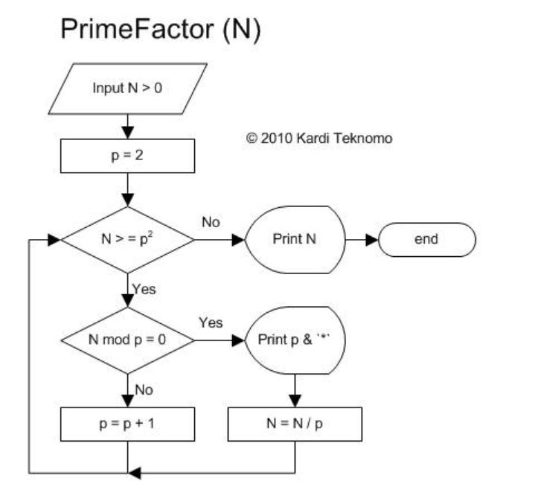
Decision problem, and algorithms
Decision problem is a computational problem that can be posed as a yes–no question of the input values.
Example 1:
  Question: Does M evenly divide N?
  Algorithm: Long division
Example 2:
  Question: Is M a prime?
  Algorithm PrimeFactor
A central question is the complexity
of the algorithm to solve the decision
problem
How hard is the problem?
Prime Factor:
Algorithm (revoledu.com)

Slide 4
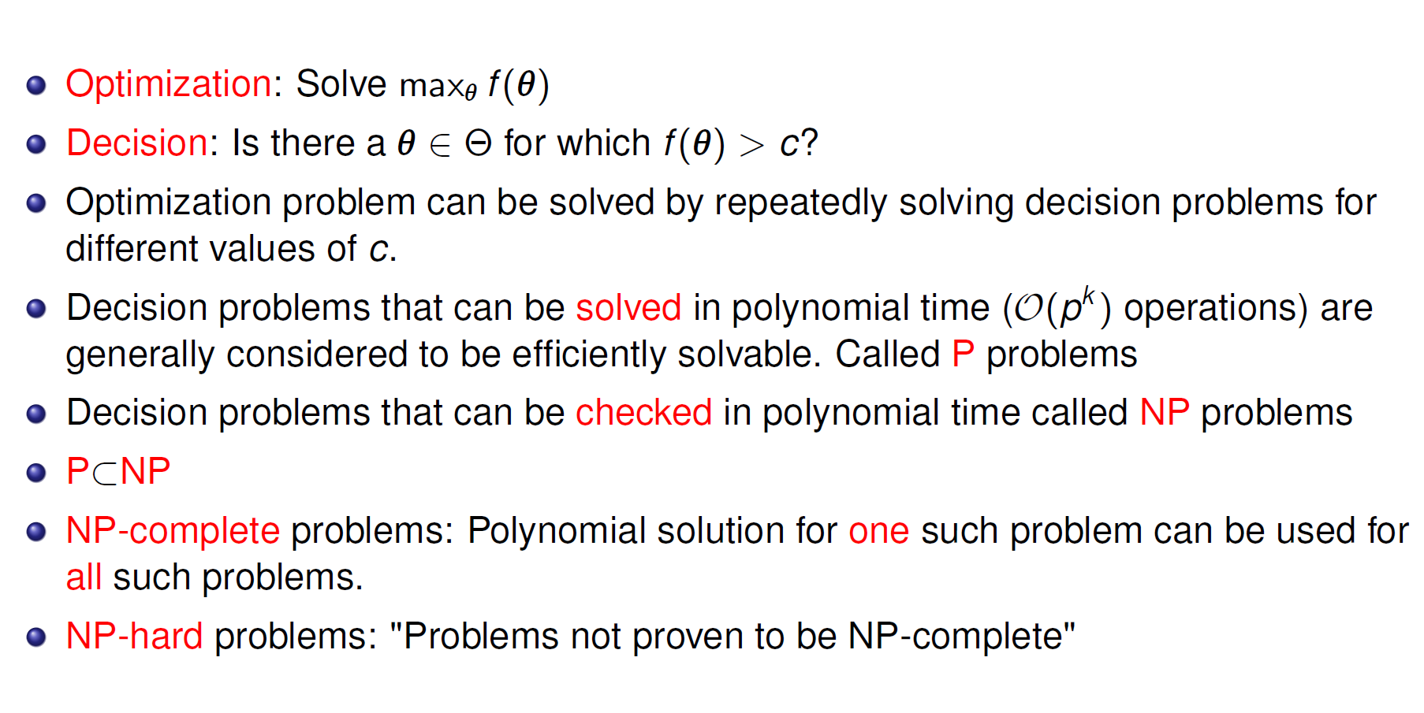
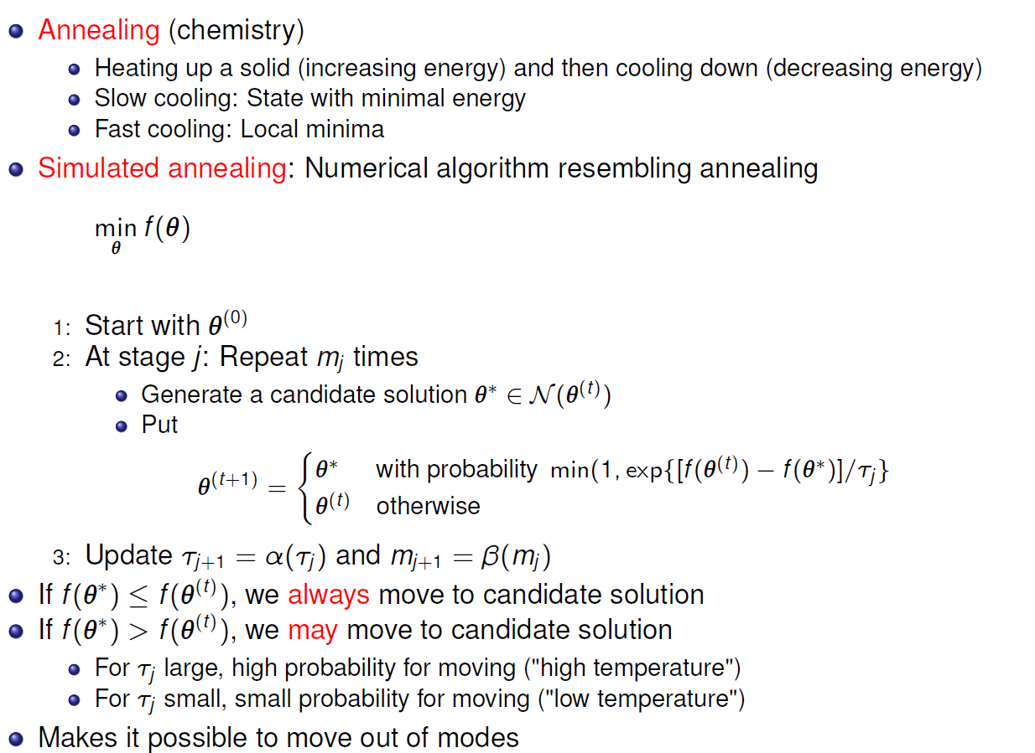
Decision problems and Optimization
NP hard: solution to one such problem can be used to solve any NP problem
NP complete: problem is both NP and NP hard
Complexity theory is developed for decision problems
Optimization problems are classified the same way as decision problems

Slide 5
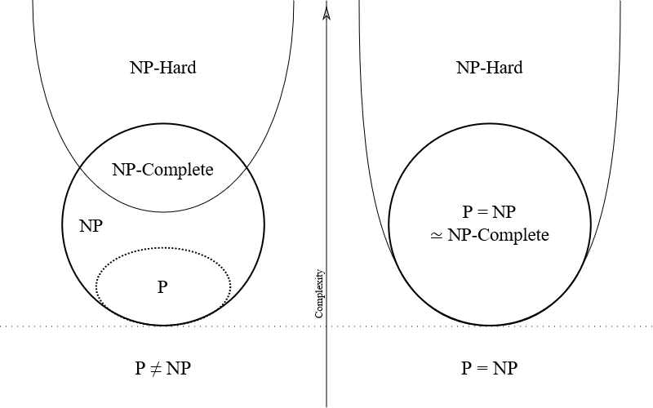
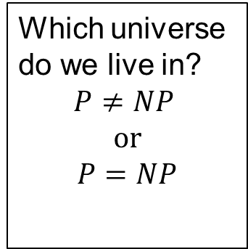
NP - hard
P (Polynomial-time): decision problems that can be solved in polynomial time
NP (Non-deterministic Polynomial-time): decision problems
that can be checked in polynomial time
We do not know if NP problem can be solved in polynomial time
NP-hard: (Non-deterministic Polynomial-time hard) problems that are
"at least as hard as the hardest problems in NP“ Solution to a NP-hard problem can be used to solve any NP problem
NP-complete: subclass which are both NP and NP-hard.
The hardest problems among NP.
Which universe do we live in?
$$P≠NP$$
$$or$$
$$P=NP$$
Most people think this
FigBy Behnam Esfahbod, CC BY-SA 3.0,
https://commons.wikimedia.org/w/index.php?curid=3532181

Slide 6
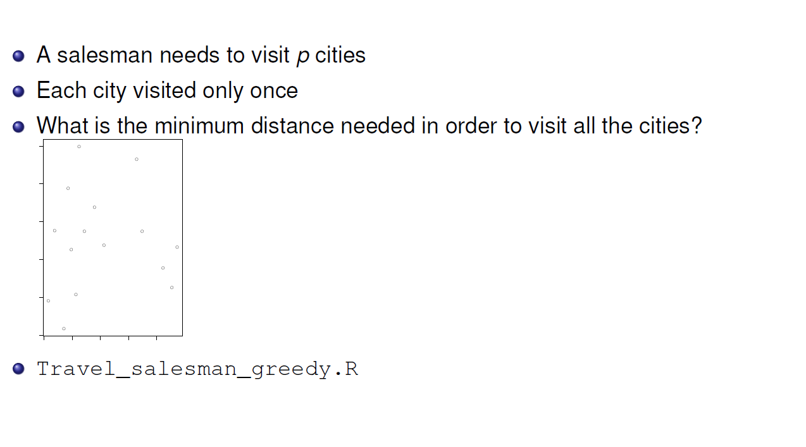
Example – Traveling salesperson problem

Slide 7
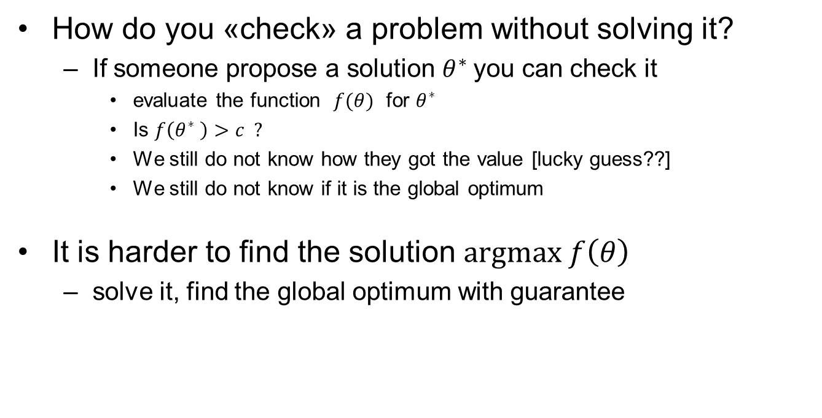
Check versus solve
How do you «check» a problem without solving it?
  If someone propose a solution $θ^{∗}$you can check it
    evaluate the function $f(θ)$ for $θ^{∗}$
    Is $f\left(θ^{∗} \right)>c ?$
    We still do not know how they got the value [lucky guess??]
    We still do not know if it is the global optimum
It is harder to find the solution $argmax f\left(θ\right)$
  solve it, find the global optimum with guarantee

Slide 8
Example – Traveling salesperson problem
Problem is NP-hard
  Check:
  Compute the travel time along one specific path
  N – operations (N = number of cities)
  Solve:
  Find the optimal route for the traveling salesman
  N! possibilities (number of orderings)

Slide 9
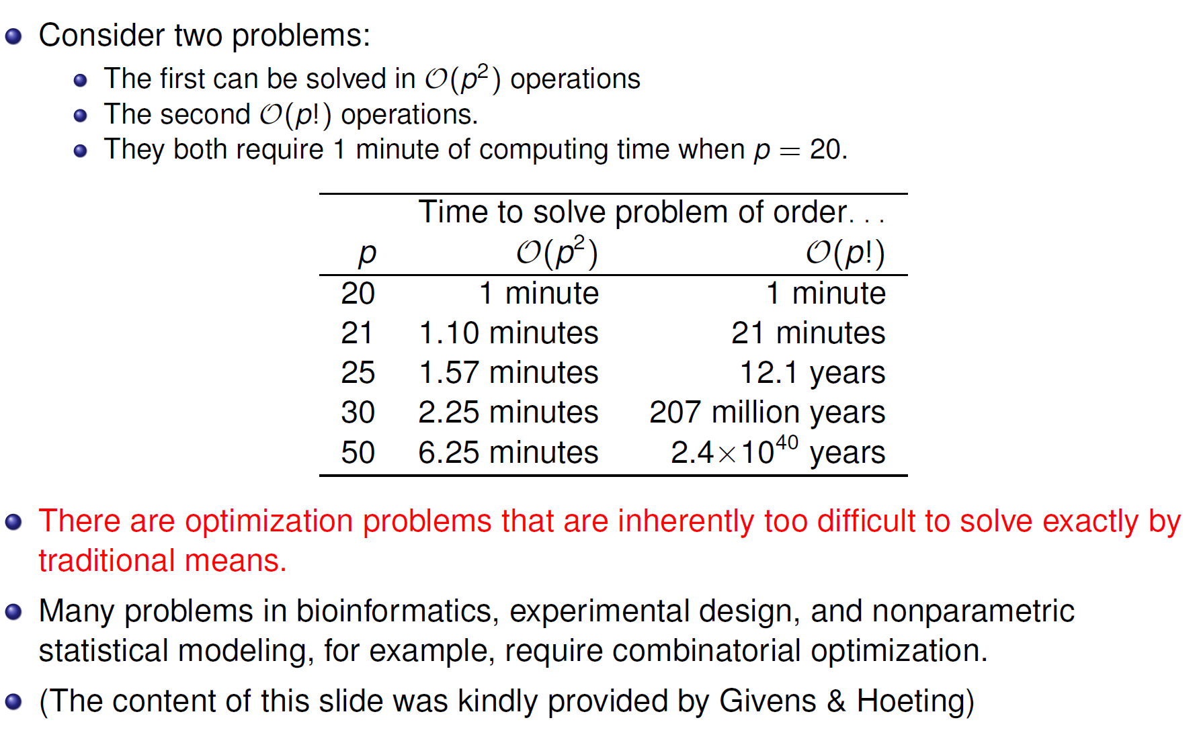
NP-complete problems (how hard can it be?)

Slide 10
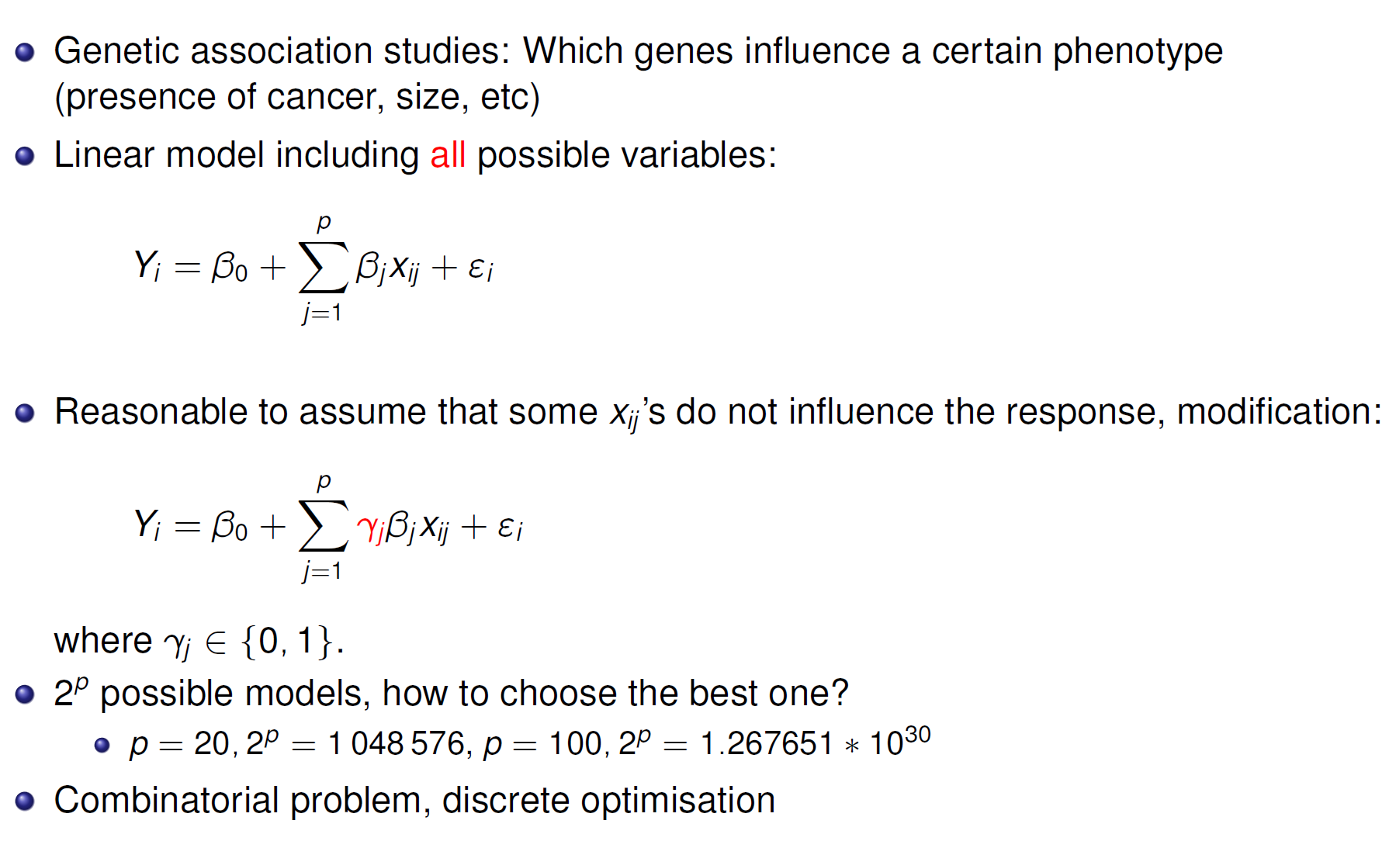
Model selection

Slide 11
Need for heuristics
When no algorithm guaranties a global maximum (within a time frame)
Heuristics: Algorithms that find a good local optima within tolerable time
  Local search
  Simulated annealing
  Tabu algorithm
  Genetic algorithm
Neighborhood-algorithms

Slide 12
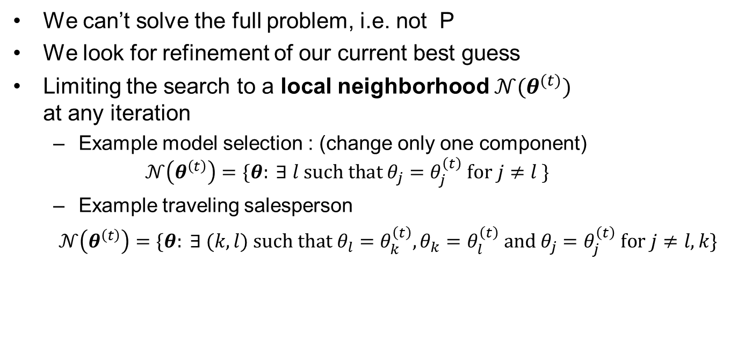


Neighborhood
We can’t solve the full problem, i.e. not P
We look for refinement of our current best guess
Limiting the search to a local neighborhood $𝒩(θ^{(t)})$
at any iteration
  Example model selection : (change only one component)
  $𝒩\left(θ^{\left(t\right)}\right)=\{θ: ∃ l such that θ_{j}=θ_{j}^{\left(t\right)} for j≠l \}$
  Example traveling salesperson
  $𝒩\left(θ^{\left(t\right)}\right)=\{θ: ∃ (k,l) such that{ θ}_{l}=θ_{k}^{\left(t\right)},θ_{k}=θ_{l}^{\left(t\right)} and θ_{j}=θ_{j}^{\left(t\right)} for j≠l,k\}$
$$"θ=γ"$$
$$"θ=ordering"$$

Slide 13

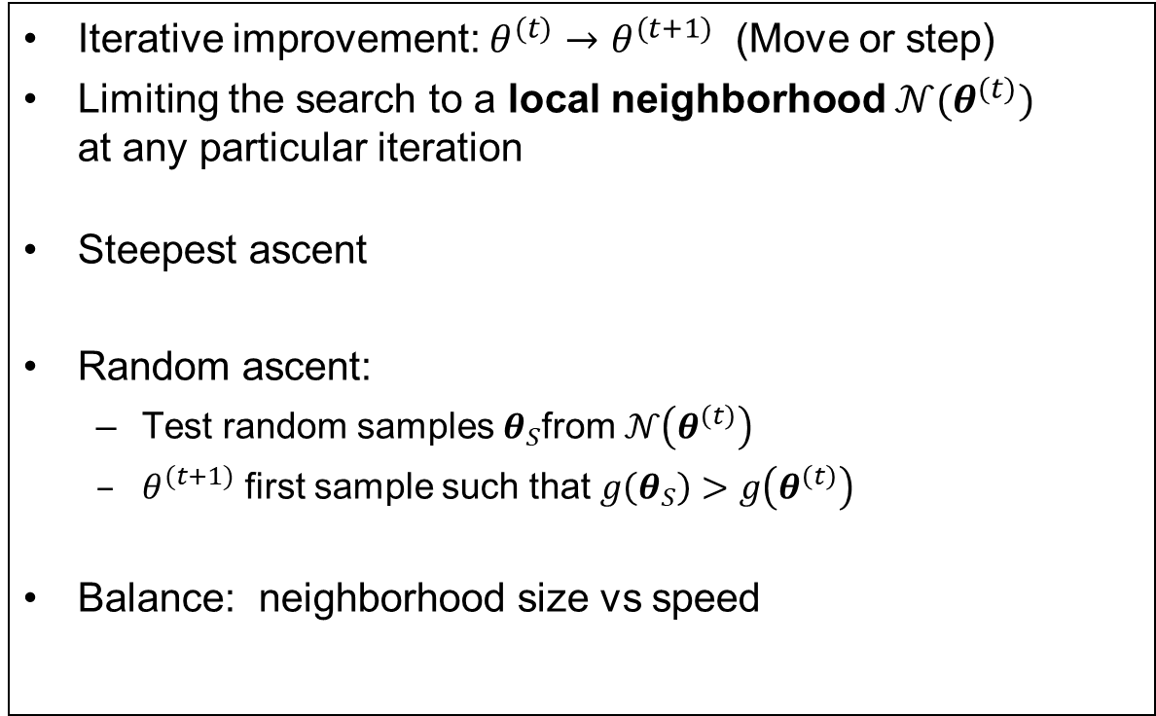
Local search
Iterative improvement: $θ^{(t)}→θ^{(t+1)}$ (Move or step)
Limiting the search to a local neighborhood $𝒩(θ^{(t)})$
at any particular iteration
Steepest ascent
Random ascent:
  Test random samples $θ_{S}$from $𝒩\left(θ^{\left(t\right)}\right)$
  $θ^{(t+1)}$ first sample such that $g\left(θ_{S}\right)>g\left(θ^{\left(t\right)}\right)$
Balance: neighborhood size vs speed
$$θ^{(t+1)}={{argmax}_{ }}_{θ∈𝒩\left(θ^{\left(t\right)}\right)}{g(θ)}$$

Slide 14
Random starting points combined with local search
Select many starting points
  Stratified or random sampling
Run local search from each staring point
  Random or steepest ascent
Select best final answer
Works very well in many cases
Random starting point can be used for any optimization method. (Build confidence in optimum)

Slide 15
Example – Traveling salesperson problem

Slide 16
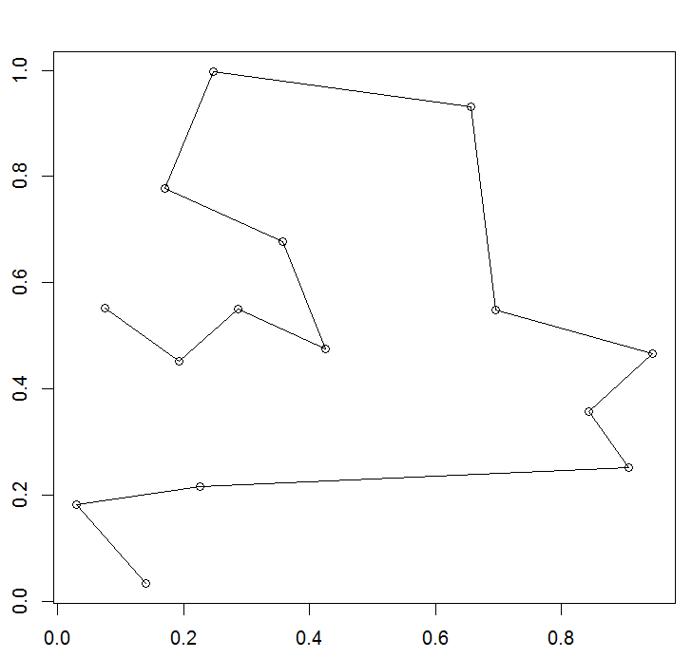
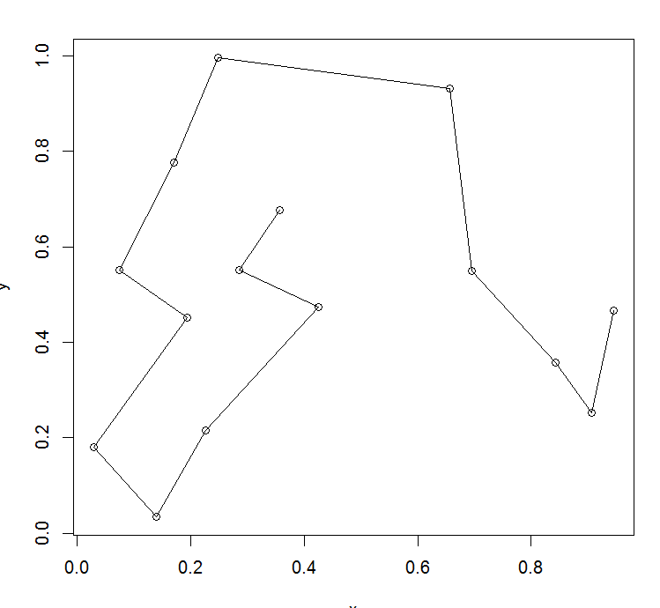
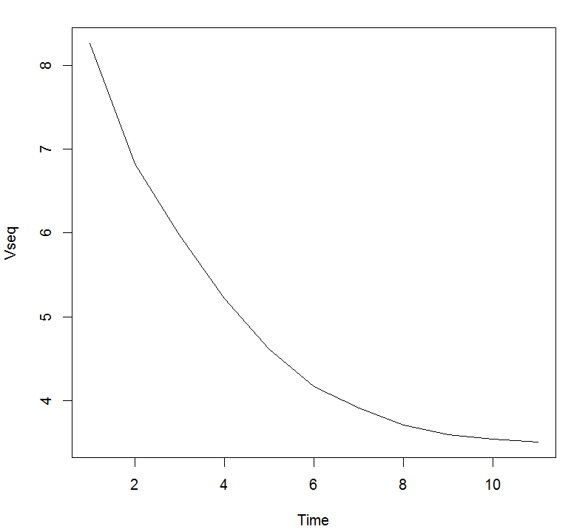
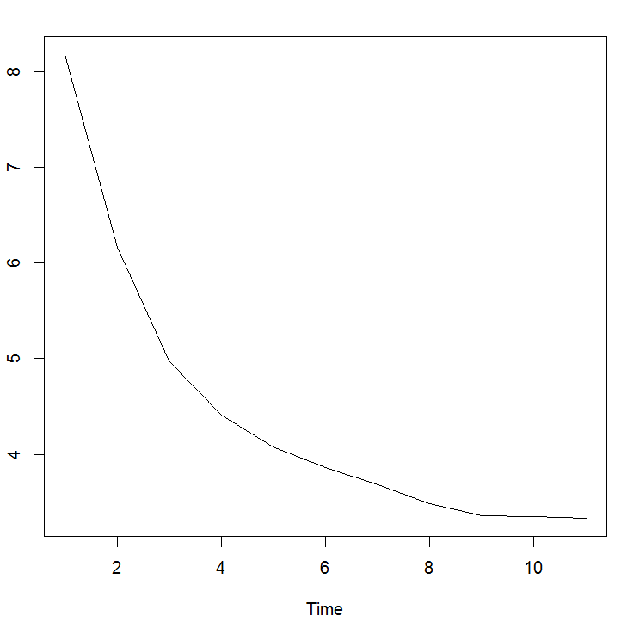
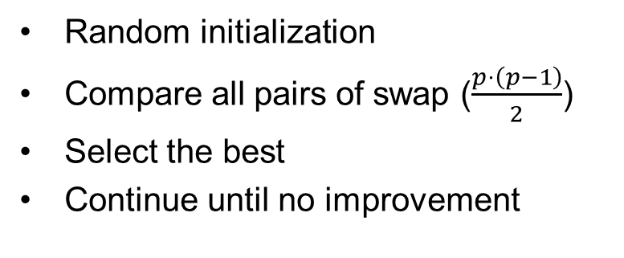
Greedy TS
Seed=2323
Random initialization
Compare all pairs of swap ($\frac{p⋅\left(p−1\right)}{2}$)
Select the best
Continue until no improvement
Seed= 232323
(NB keep same points )
Endpoint
= 3.346855
Endpoint
= 3.50689
× 105
× 105

Slide 17
Simulated annealing
= Cooling schedule
Store «best so far» in addition to iterations (for the end game)

Slide 18
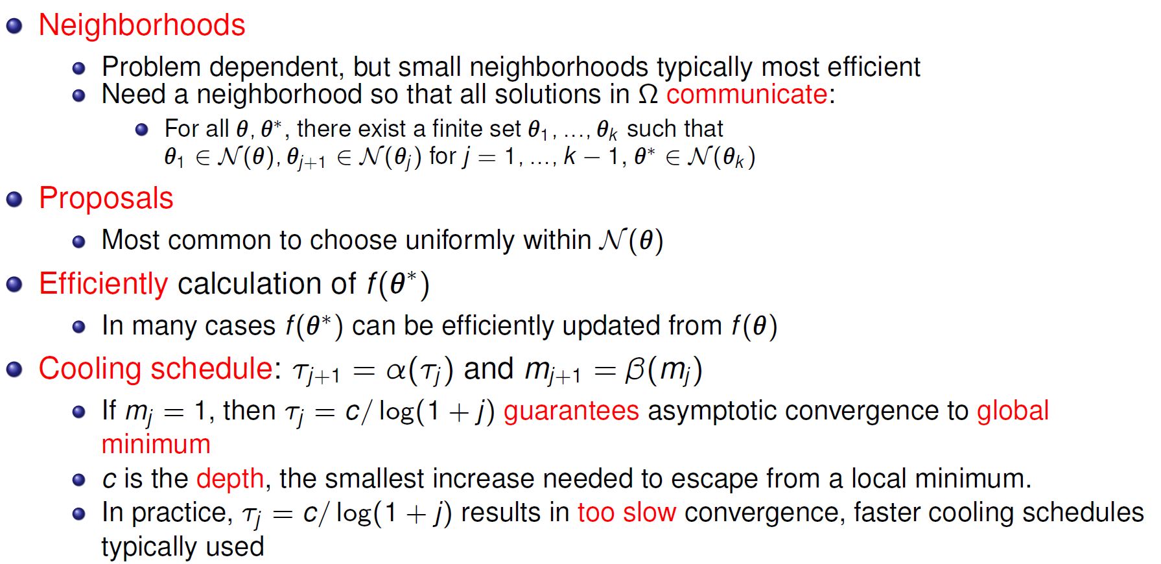
Practical issues – Simulated annealing
the deepest local minima.

Slide 19
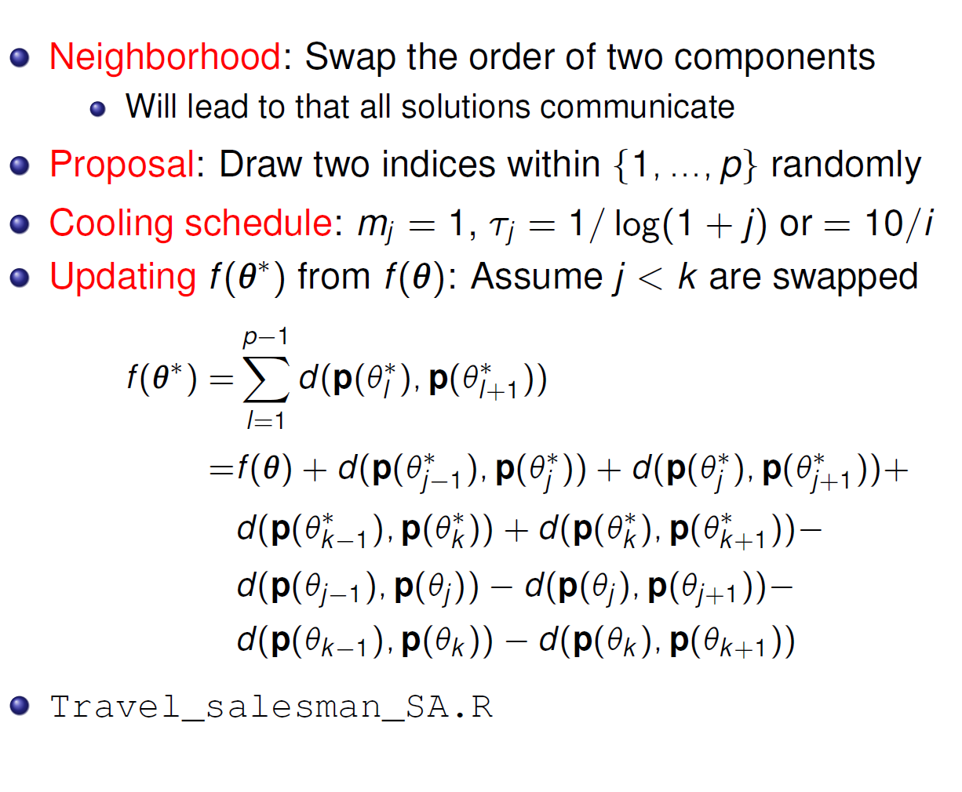
Traveling salesperson Simulated annealing

Slide 20
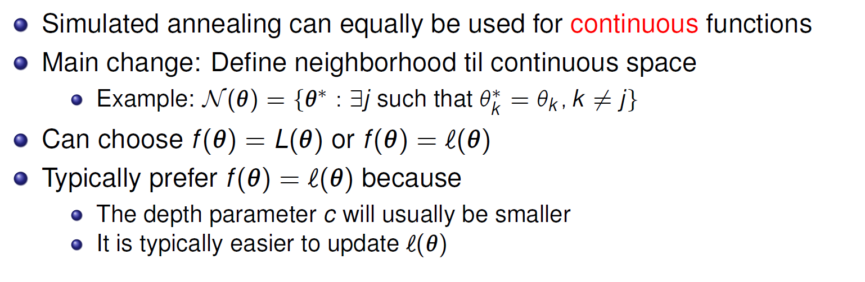
Simulated annealing for continuous function
in

Slide 21
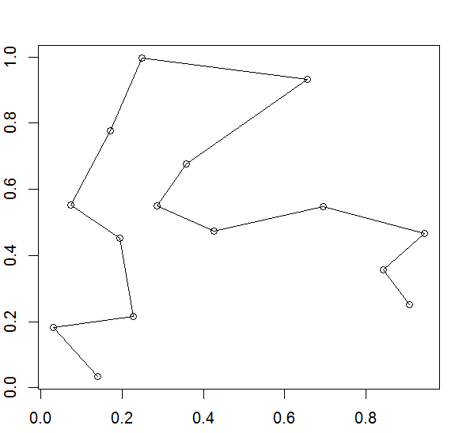
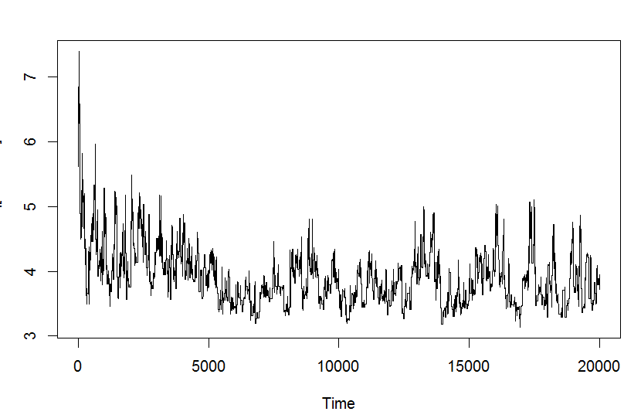
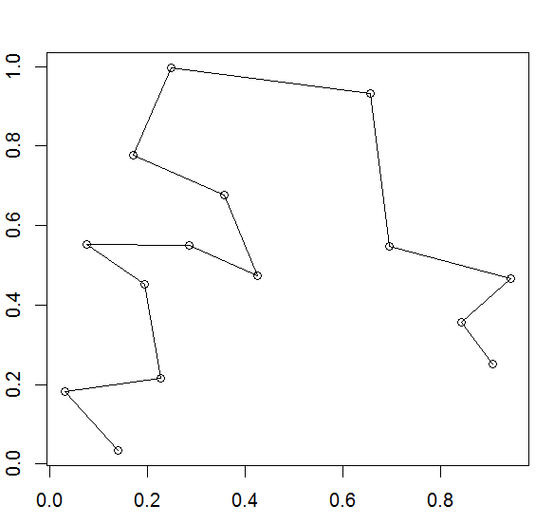
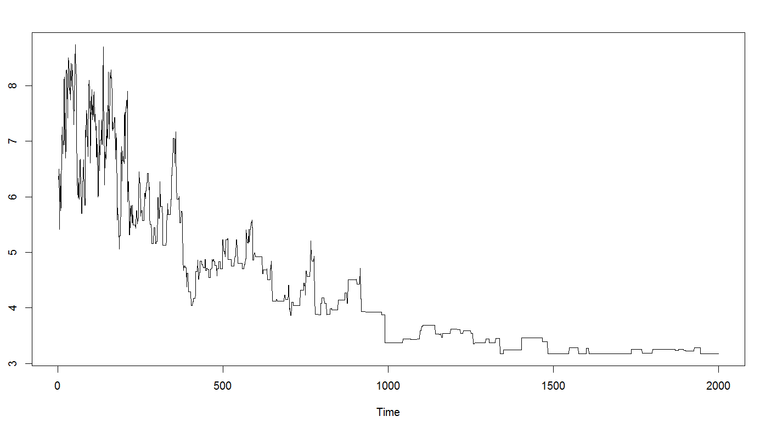
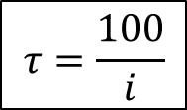
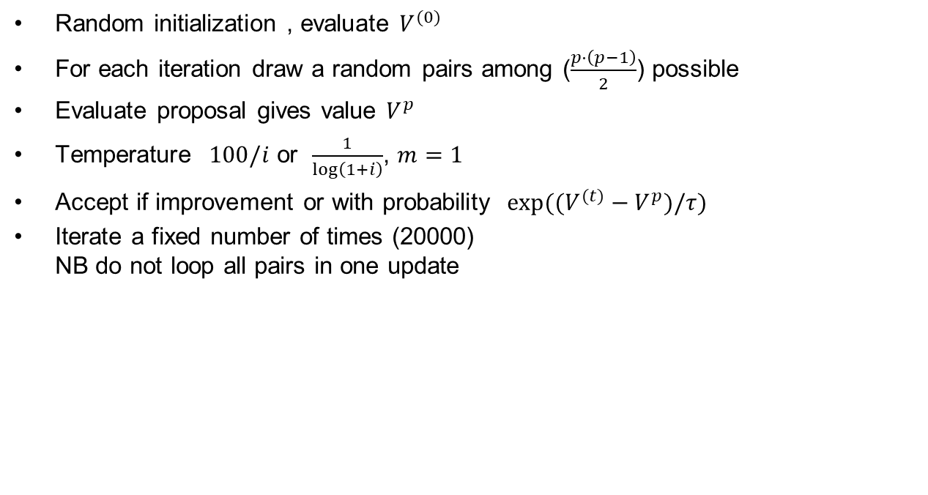
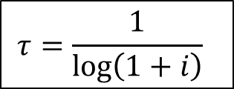
Simulated annealing TS
Random initialization , evaluate $V^{(0)}$
For each iteration draw a random pairs among ($\frac{p⋅\left(p−1\right)}{2}$) possible
Evaluate proposal gives value $V^{p}$
Temperature $100/i$ or $\frac{1}{\log\left(1+i\right)}$, $m=1$
Accept if improvement or with probability $exp⁡((V^{(t)}−V^{p})/τ)$
Iterate a fixed number of times (20000)
NB do not loop all pairs in one update
$$τ=\frac{100}{i}$$
Endpoint
= 3.13913
$$τ=\frac{1}{\log\left(1+i\right)}$$
Endpoint
= 3.1798

Slide 22
Tabu algorithms
Local (random) search weakness
  Next move will in many cases reverse previous move
Tabu idea:
  Allow downhill move when no uphill move is possible
  Make some moves temporarily forbidden or tabu
  Early form: steepest ascent /mildest decent
    Move to least unfavorable when there is no uphill move

Slide 23
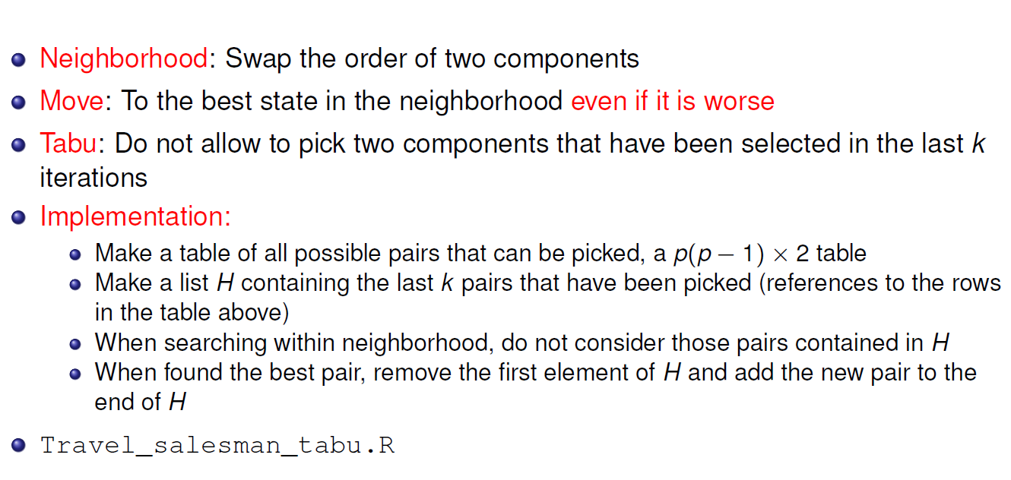
Traveling salesperson Tabu

Slide 24
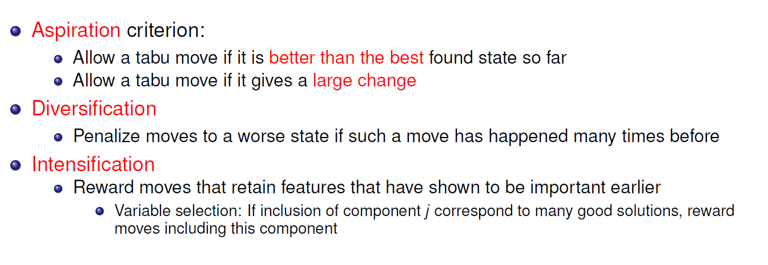
Tabu additional rules

Slide 25
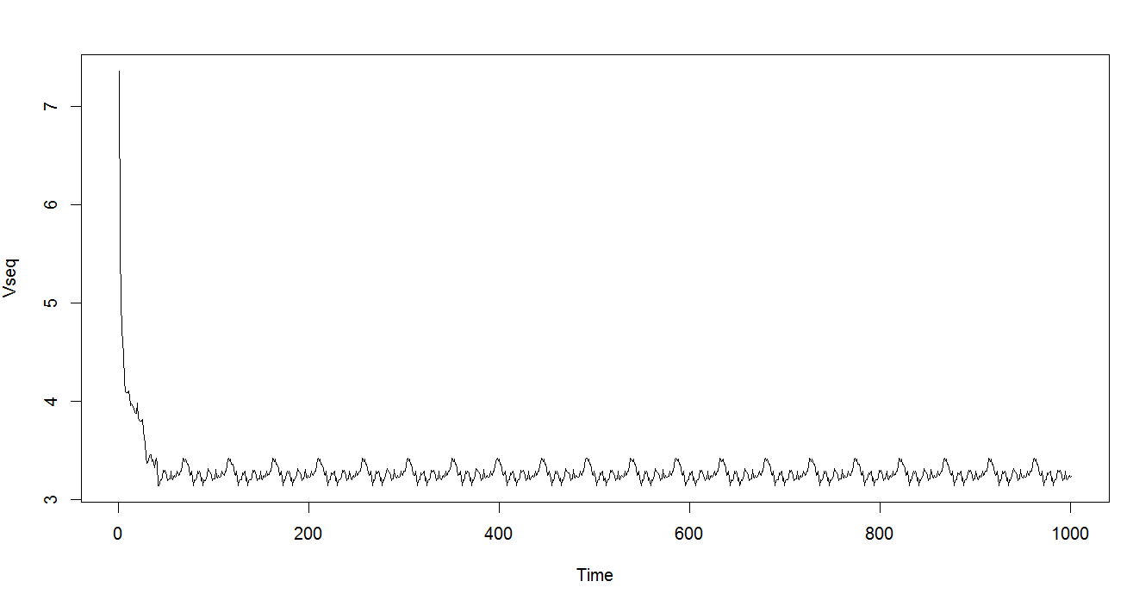
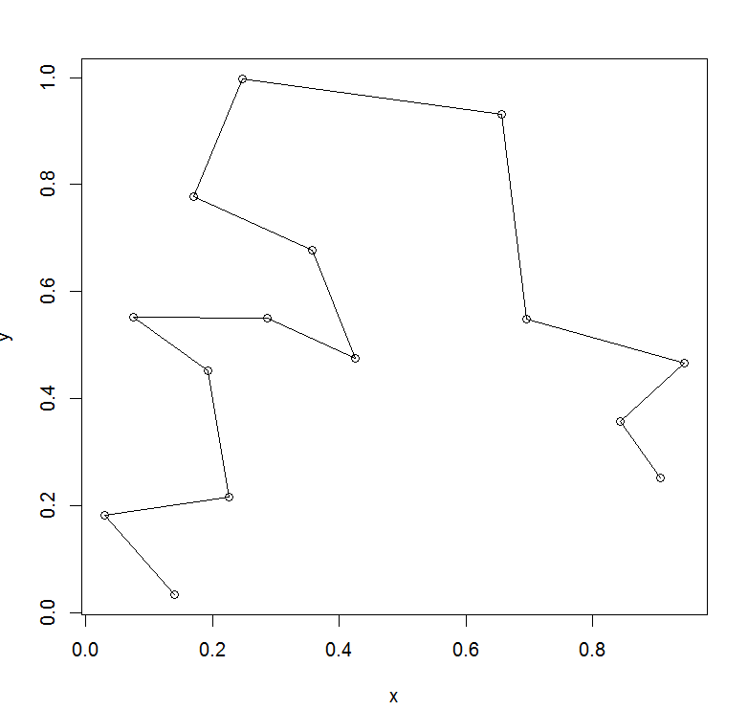
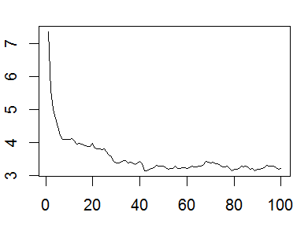
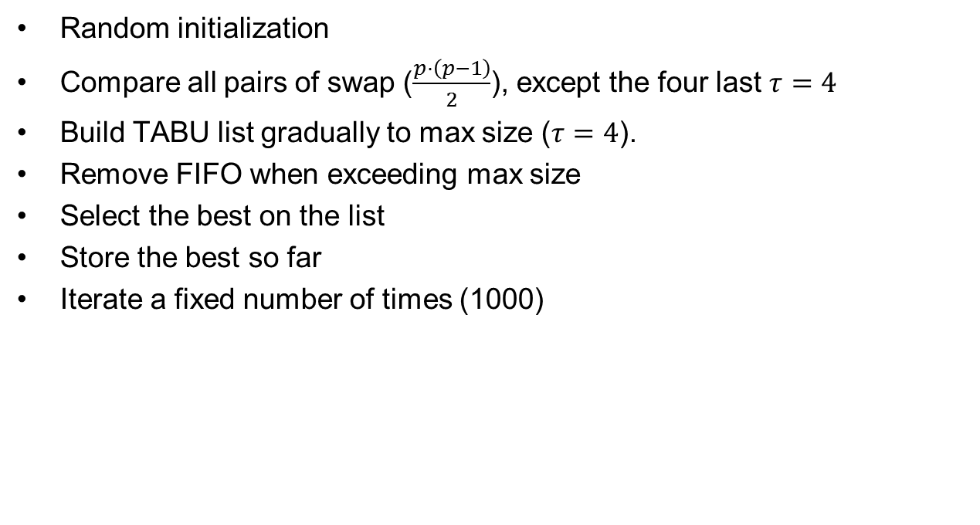
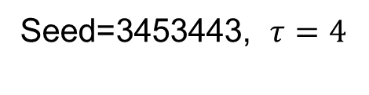
TABU TS
Random initialization
Compare all pairs of swap ($\frac{p⋅\left(p−1\right)}{2}$), except the four last $τ=4$
Build TABU list gradually to max size ($τ=4$).
Remove FIFO when exceeding max size
Select the best on the list
Store the best so far
Iterate a fixed number of times (1000)
Seed | tau | Value | First occur.
2323 | 4 | 3.5068 | 11
2323 | 10 | 3.1391 | 359
232323 | 4 | 3.2979 | 10
232323 | 10 | 3.1391 | 915
3453443 | 4 | 3.1391 | 42
3453443 | 10 | 3.1391 | 22
Seed=3453443, $τ=4$
End point
= 3.13913
× 105

Slide 26
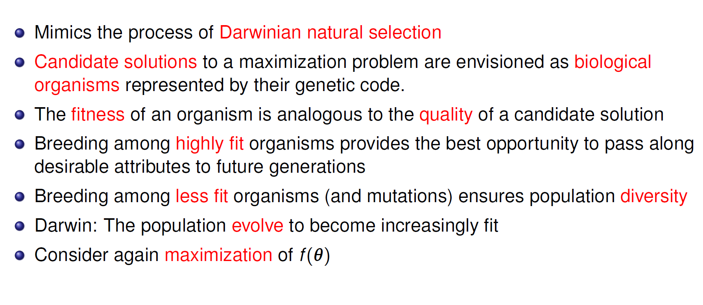
Genetic algorithm background

Slide 27
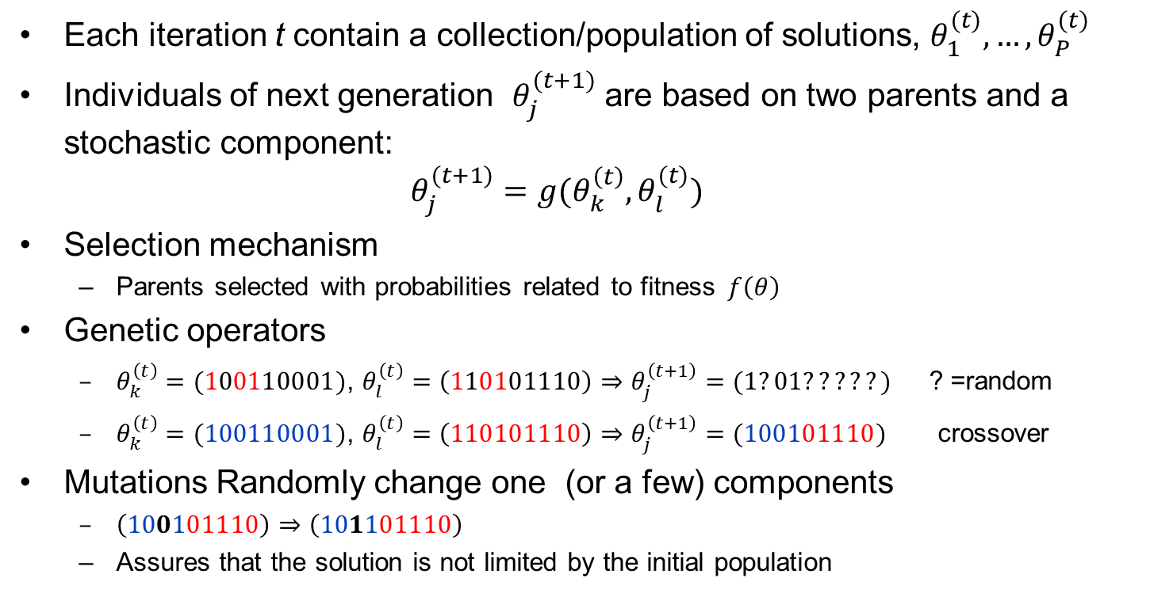
Genetic algorithm (iterations)
Each iteration t contain a collection/population of solutions, $θ_{1}^{(t)},…,θ_{P}^{(t)}$
Individuals of next generation $θ_{j}^{(t+1)}$ are based on two parents and a stochastic component:
$θ_{j}^{(t+1)}=g(θ_{k}^{\left(t\right)},θ_{l}^{(t)})$
Selection mechanism
  Parents selected with probabilities related to fitness$f\left(θ\right)$
Genetic operators
  $θ_{k}^{\left(t\right)}=(100110001)$, $θ_{l}^{\left(t\right)}=\left(110101110\right)⇒θ_{j}^{\left(t+1\right)}=(1?01?????)$ ? =random
  $θ_{k}^{\left(t\right)}=(100110001)$, $θ_{l}^{\left(t\right)}=\left(110101110\right)⇒θ_{j}^{\left(t+1\right)}=(100101110)$ crossover
Mutations Randomly change one (or a few) components
  $\left(100101110\right)$ $⇒\left(101101110\right)$
  Assures that the solution is not limited by the initial population

Slide 28
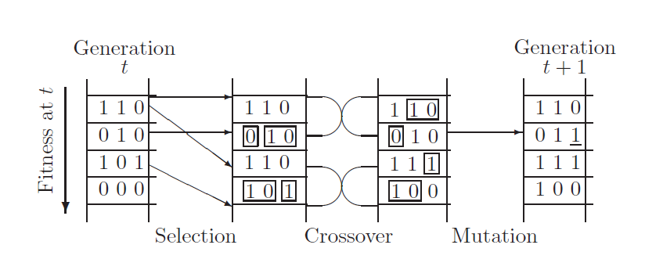
Schematic example (fig 3.5)
Population size: P = 4
Chromosome length: C=3 (= # of parameters, i.e. p=3)

Slide 29
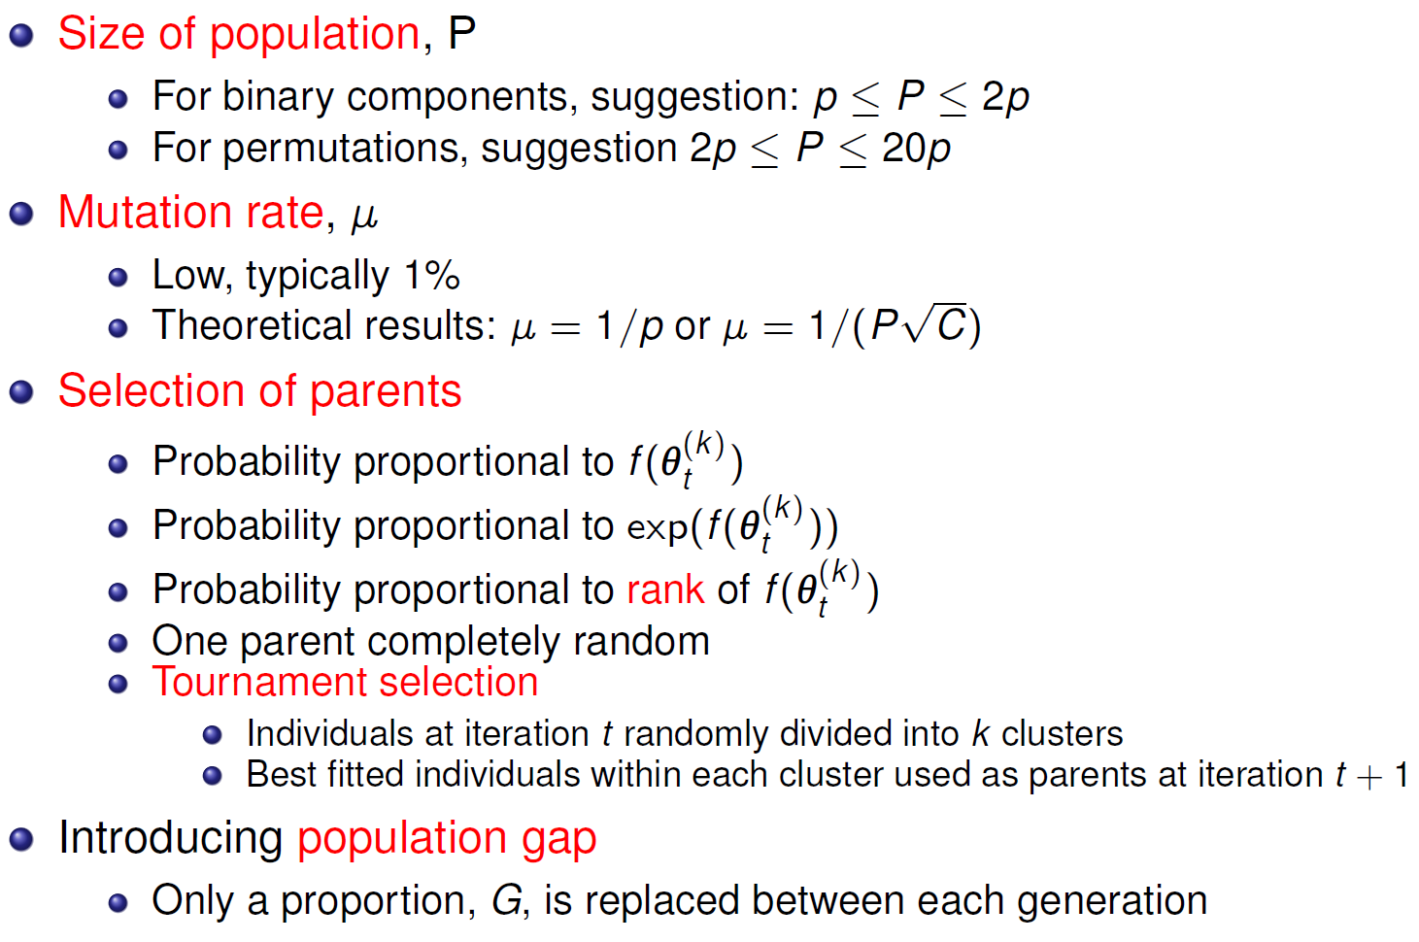
Genetic algorithm – Practical issues

Slide 30
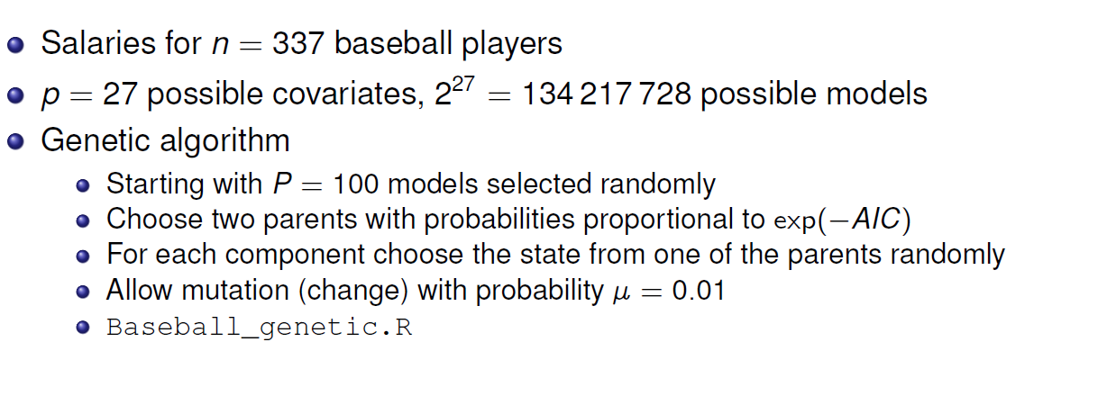
Genetic algorithm baseball salaries
Covariates are statistics collected during a season
  # runs scored
  batting average
  on pace percentage
  …
(for model selection)

Slide 31
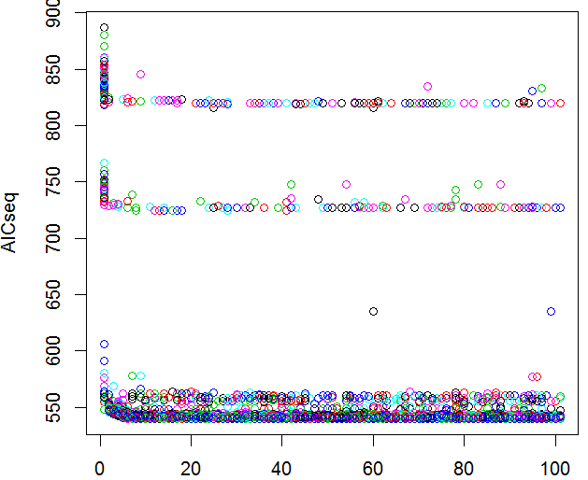
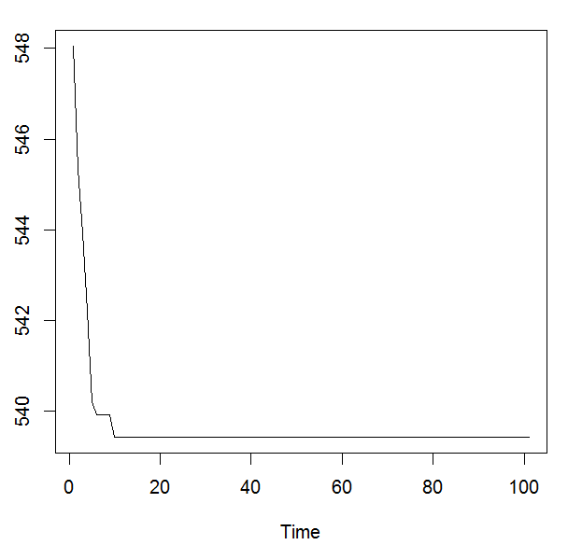
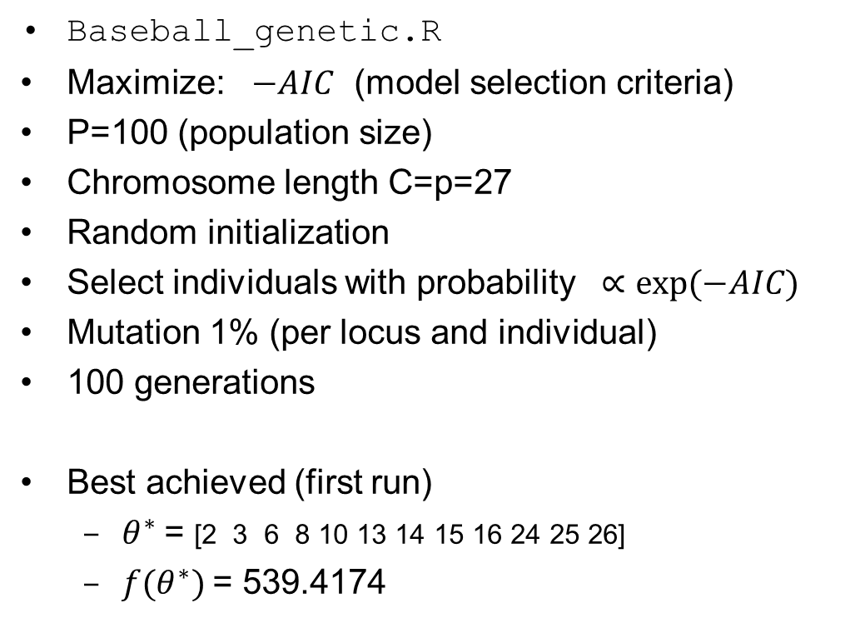
Genetic algorithm, Baseball $
Population fit
Baseball_genetic.R
Maximize: $−AIC$ (model selection criteria)
P=100 (population size)
Chromosome length C=p=27
Random initialization
Select individuals with probability $∝exp⁡(−AIC)$
Mutation 1% (per locus and individual)
100 generations
Best achieved (first run)
  $θ^{∗}$= [2 3 6 8 10 13 14 15 16 24 25 26]
  $f(θ^{∗})$= 539.4174
Best in generation
Other seeds 539.4174, 541.7527

