Slide 1
STK-4051/9051 Computational Statistics Spring 2024
Background
Instructor: Odd Kolbjørnsen, oddkol@math.uio.no
Course originally made by
Geir Storvik

Slide 2
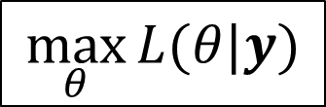
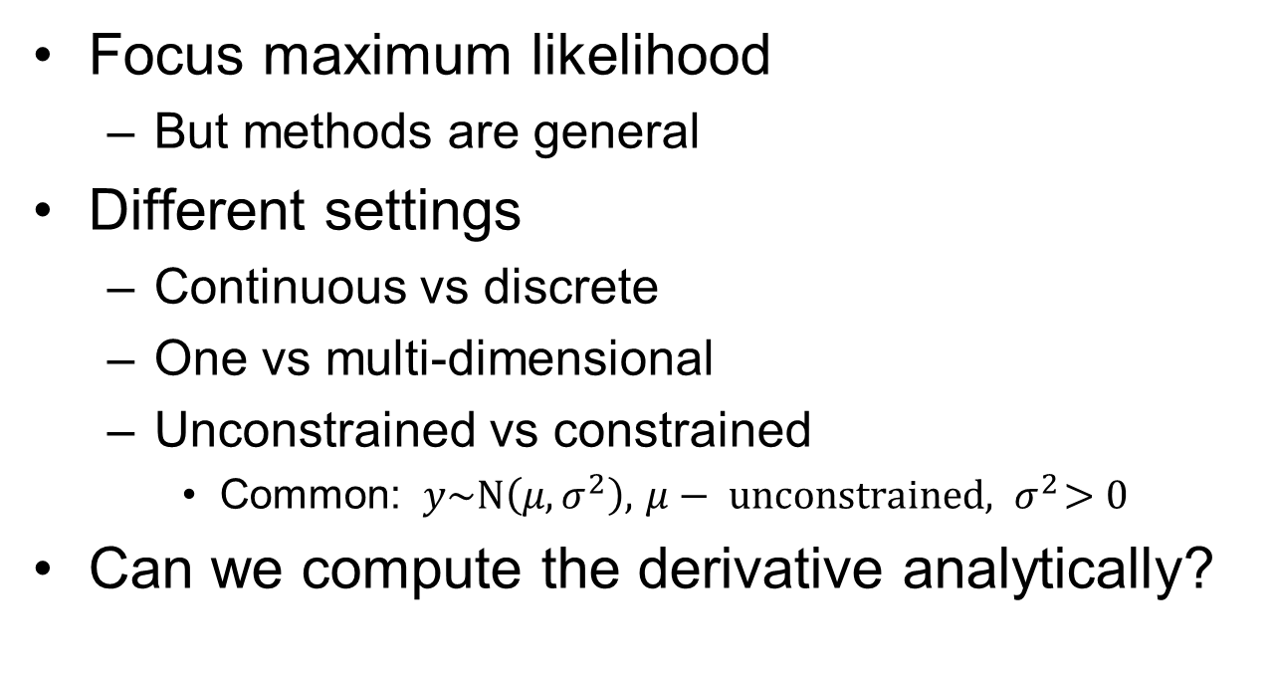
Optimization
Focus maximum likelihood
  But methods are general
Different settings
  Continuous vs discrete
  One vs multi-dimensional
  Unconstrained vs constrained
    Common: $y\sim N\left(μ,σ^{2}\right), { μ− unconstrained, σ}^{2}>0$
Can we compute the derivative analytically?
$$\max_{θ}{L(θ|y)}$$

Slide 3
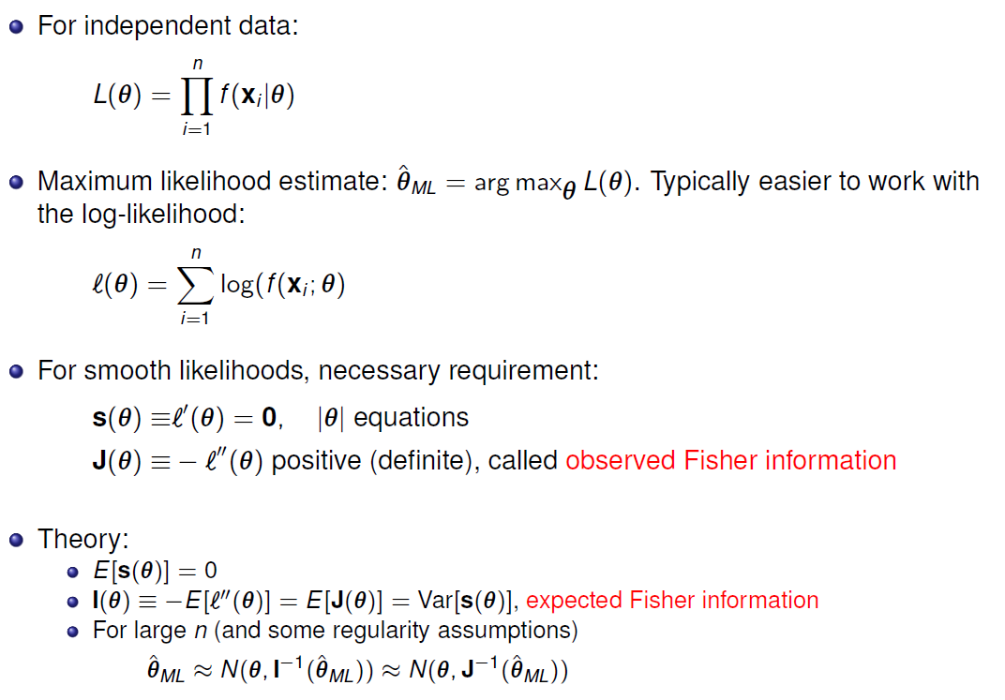
Maximum likelihood Theory
Likelihood function
Log-Likelihood function
, called score (a vector)

Slide 4

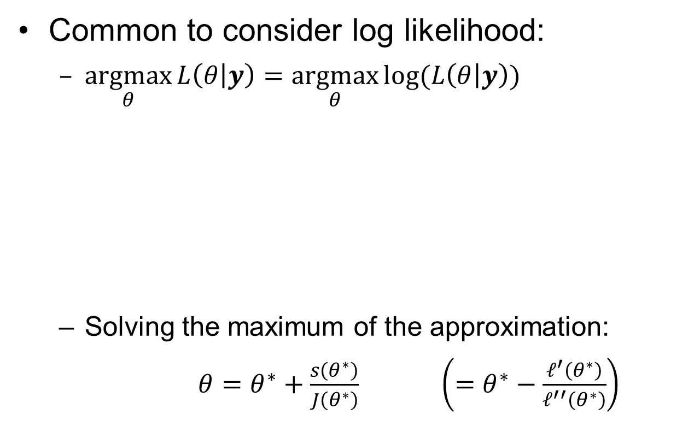

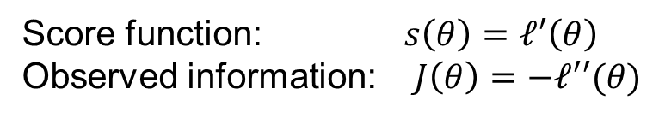
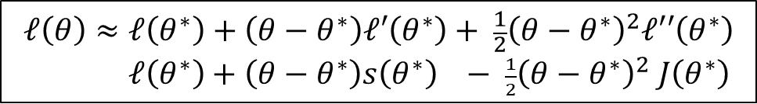
One dimensional ML, Newton’s method
Common to consider log likelihood:
  $\underset{θ}{argmax}{L\left(θ | y\right)=\underset{θ}{argmax}{log⁡(L\left(θ | y\right))}}$
  Solving the maximum of the approximation:
  $θ=θ^{∗}+\frac{s\left(θ^{∗}\right)}{J\left(θ^{∗}\right)} \left(=θ^{∗}−\frac{ℓ^{′}\left(θ^{∗}\right)}{ℓ^{′′}\left(θ^{∗}\right)}\right)$
So common that people usually do not mention that this is what they use
$ℓ\left(θ | y\right)$ or just $ℓ(θ)$
$$ℓ\left(θ\right)≈ℓ\left(θ^{∗}\right)+\left(θ−θ^{∗}\right)ℓ′\left(θ^{∗}\right)+ \frac{1}{2}{\left(θ−θ^{∗}\right)}^{2}ℓ′′\left(θ^{∗}\right)$$
$ℓ\left(θ^{∗}\right)+\left(θ−θ^{∗}\right)s\left(θ^{∗}\right) − \frac{1}{2}{\left(θ−θ^{∗}\right)}^{2} J\left(θ^{∗}\right)$
Taylor expansion
around $θ^{∗}$
Score function: $s\left(θ\right)=ℓ′\left(θ\right)$
Observed information: $J\left(θ\right)=−ℓ′′(θ)$

Slide 5
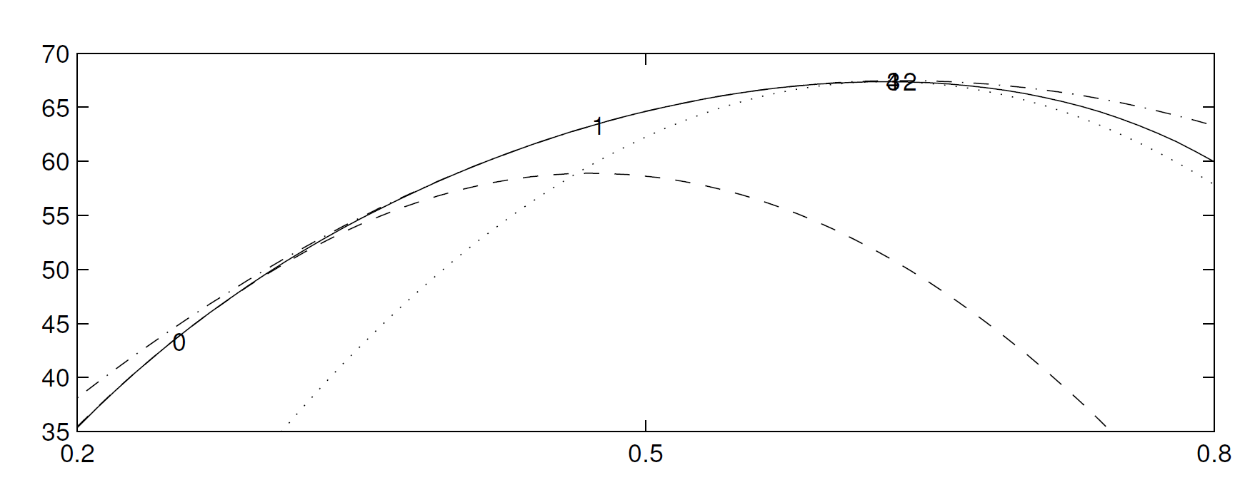
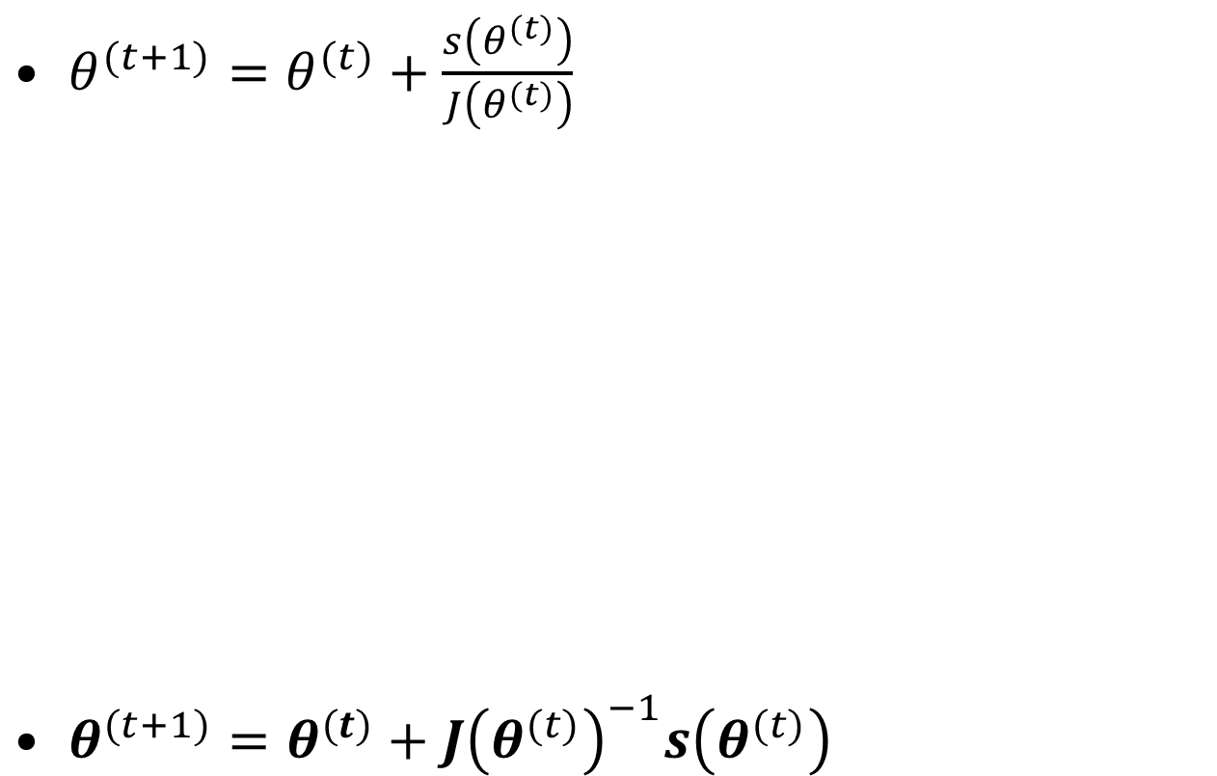


Iterations in Newton’s method
$θ^{(t+1)}=θ^{(t)}+\frac{s\left(θ^{(t)}\right)}{J\left(θ^{(t)}\right)}$
$θ^{(t+1)}=θ^{(t)}+{J\left(θ^{(t)}\right)}^{−1}s\left(θ^{(t)}\right)$
$$ℓ\left(θ^{1}\right)+\left(θ−θ^{1}\right)s\left(θ^{1}\right) −…$$
$$ℓ\left(θ\right)$$
$$ℓ\left(θ^{0}\right)+\left(θ−θ^{0}\right)s\left(θ^{0}\right) − \frac{1}{2}{\left(θ−θ^{0}\right)}^{2} J\left(θ^{0}\right)$$

Slide 6
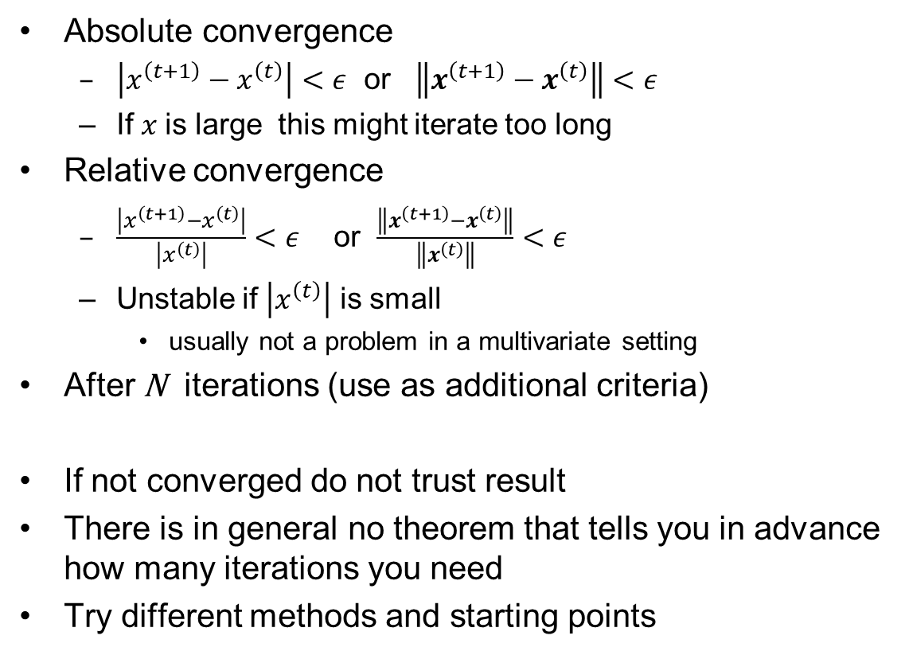
Stopping criteria
Absolute convergence
  $\left|x^{\left(t+1\right)}−x^{\left(t\right)}\right|<ε$ or $\left\|x^{\left(t+1\right)}−x^{\left(t\right)}\right\|<ε$
  If $x$is large this might iterate too long
Relative convergence
  $\frac{\left|x^{\left(t+1\right)}−x^{\left(t\right)}\right|}{\left|x^{\left(t\right)}\right|}<ε$ or $\frac{\left\|x^{\left(t+1\right)}−x^{\left(t\right)}\right\|}{\left\|x^{\left(t\right)}\right\|}<ε$
  Unstable if $\left|x^{\left(t\right)}\right|$ is small
    usually not a problem in a multivariate setting
After N iterations (use as additional criteria)
If not converged do not trust result
There is in general no theorem that tells you in advance
how many iterations you need
Try different methods and starting points

Slide 7
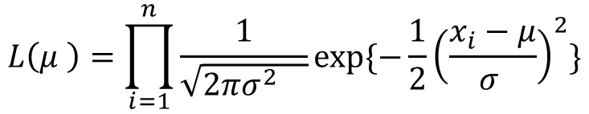



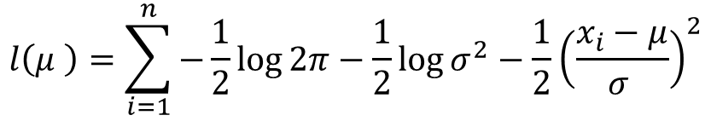

Example $ℝ$, log likelihood score & observed information
$$L\left(μ \right)=\prod_{i=1}^{n}{\frac{1}{\sqrt{2πσ^{2} }}\exp{\{−\frac{1}{2}{\left(\frac{x_{i}−μ}{σ }\right)}^{2}\}}}$$
$σ$ known
$$l\left(μ \right)=\sum_{i=1}^{n}{−\frac{1}{2}\log{2π−\frac{1}{2}\log{σ^{2}}}}−\frac{1}{2}{\left(\frac{x_{i}−μ}{σ }\right)}^{2}$$
$$s\left(μ\right)=l^{′}(μ)=\sum_{i=1}^{n}{−0−0}−\frac{x_{i}−μ}{σ^{2} }=\frac{1}{σ^{2}}\sum_{i=1}^{n}{(x_{i}−μ)}$$
$$J\left(μ\right)=−l^{′′}\left(μ\right)=−s′(μ)=\frac{−1}{σ^{2}}\sum_{i=1}^{n}{−1} = \frac{n}{σ^{2}}$$

Slide 8
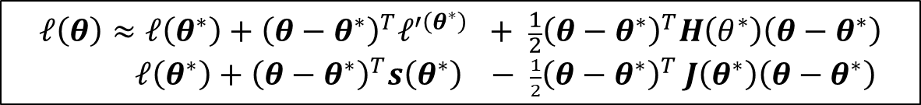
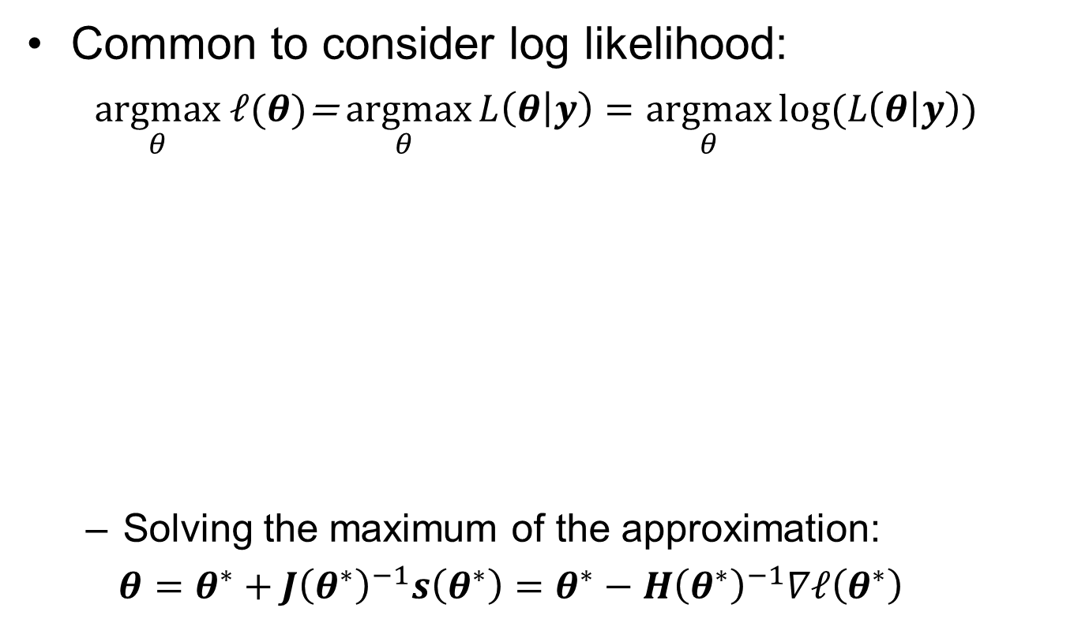
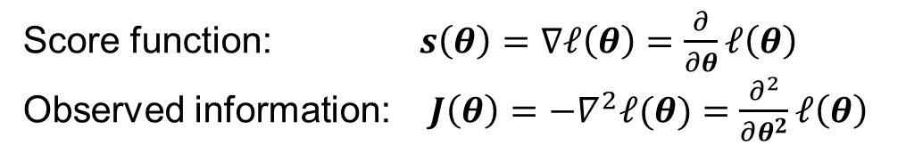
Multidimensional extension
Common to consider log likelihood:
  $\underset{θ}{argmax} ℓ(θ)$=$\underset{θ}{argmax}{L\left(θ | y\right)=\underset{θ}{argmax}{log⁡(L\left(θ | y\right))}}$
  Solving the maximum of the approximation:
  $θ=θ^{∗}+{J\left(θ^{∗}\right)}^{−1}s\left(θ^{∗}\right)=θ^{∗}−H{\left(θ^{∗}\right)}^{−1}∇ℓ\left(θ^{∗}\right)$
$$ℓ\left(θ\right)≈ℓ\left(θ^{∗}\right)+{\left(θ−θ^{∗}\right)}^{T}ℓ^{′\left(θ^{∗}\right)} + \frac{1}{2}{\left(θ−θ^{∗}\right)}^{T}H\left(θ^{∗}\right)\left(θ−θ^{∗}\right)$$
$ℓ\left(θ^{∗}\right)+{\left(θ−θ^{∗}\right)}^{T}s\left(θ^{∗}\right) − \frac{1}{2}{\left(θ−θ^{∗}\right)}^{T} J\left(θ^{∗}\right)\left(θ−θ^{∗}\right)$
Score function: $s\left(θ\right)=∇ℓ\left(θ\right)=\frac{∂}{∂θ}ℓ\left(θ\right)$
Observed information: $J\left(θ\right)=−∇^{2}ℓ(θ)=\frac{∂^{2}}{∂θ^{2}}ℓ\left(θ\right)$
p - vector
p ×p - matrix

Slide 9
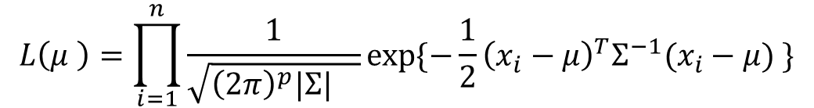



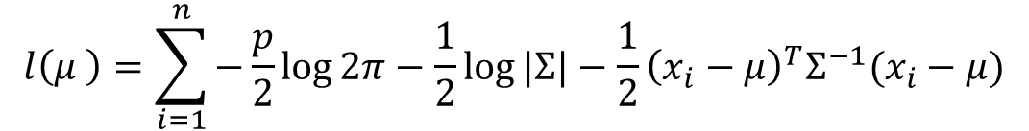

Example $ℝ^{p}$, log likelihood score & observed information
$$L\left(μ \right)=\prod_{i=1}^{n}{\frac{1}{\sqrt{{\left(2π\right)}^{p}|Σ| }}\exp{\{−\frac{1}{2}{\left(x_{i}−μ\right)}^{T}{Σ^{−1}(x}_{i}−μ) \}}}$$
$Σ$ known
$$l\left(μ \right)=\sum_{i=1}^{n}{−\frac{p}{2}\log{2π−\frac{1}{2}\log{|Σ|}}}−\frac{1}{2}{\left(x_{i}−μ\right)}^{T}{Σ^{−1}(x}_{i}−μ)$$
$$s\left(μ\right)=∇ l\left(μ\right)=\sum_{i=1}^{n}{{Σ^{−1}(x}_{i}−μ)}=Σ^{−1}\sum_{i=1}^{n}{(x_{i}−μ)}$$
$$J\left(μ\right)=−∇^{2}l\left(μ\right)=−\sum_{i=1}^{n}{{−Σ}^{−1}} = nΣ^{−1}={\left(\frac{1}{n}Σ\right)}^{−1}$$

Slide 10
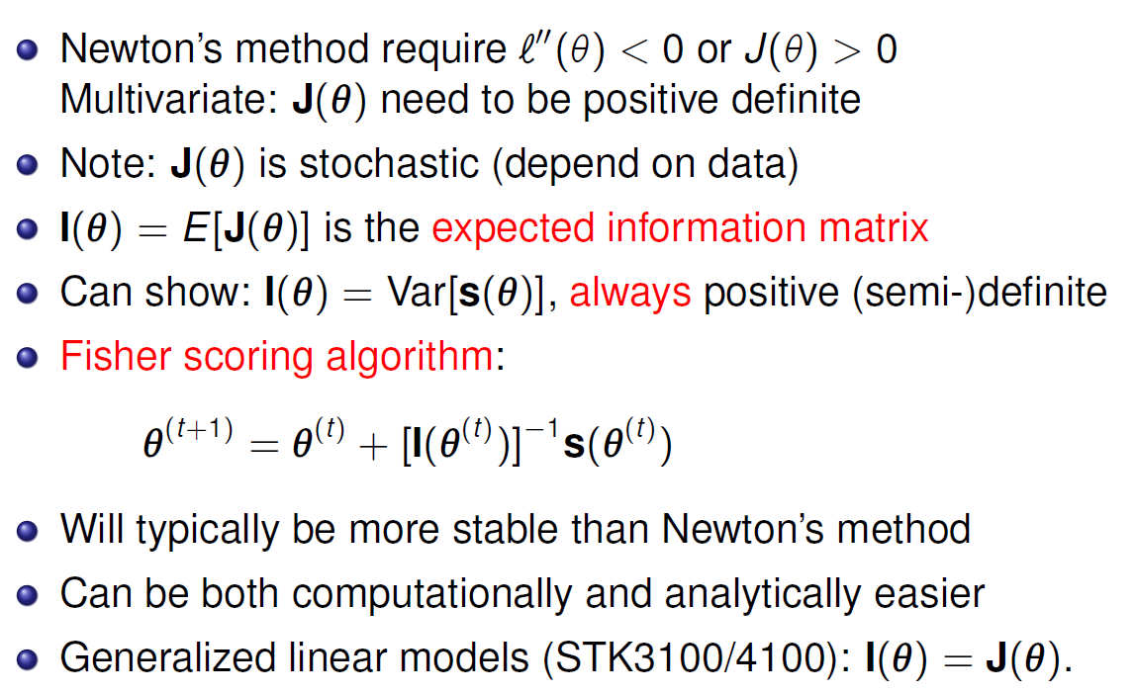
Fisher scoring

Slide 11
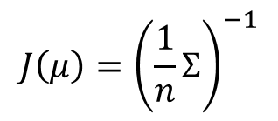
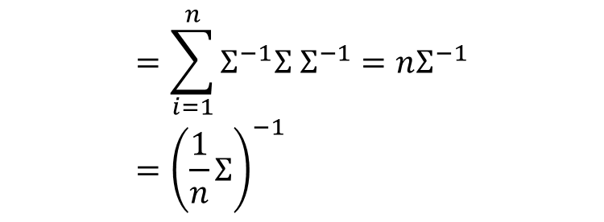

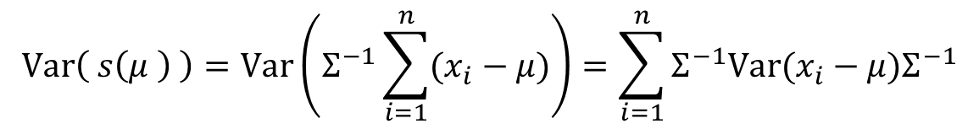
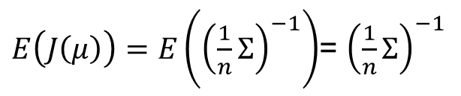
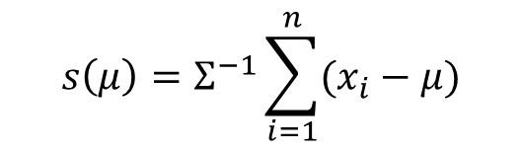
Example $ℝ^{p}$: $I\left(μ\right)=E\left(J\left(μ\right)\right)=Var( s\left(μ \right) )$
$$s\left(μ\right)=Σ^{−1}\sum_{i=1}^{n}{(x_{i}−μ)}$$
$$J\left(μ\right)={\left(\frac{1}{n}Σ\right)}^{−1}$$
$E\left(J\left(μ\right)\right)=E\left({\left(\frac{1}{n}Σ\right)}^{−1}\right)$= ${\left(\frac{1}{n}Σ\right)}^{−1}$
1
Independent observations
$$Var\left( s\left(μ \right) \right)=Var\left(Σ^{−1}\sum_{i=1}^{n}{(x_{i}−μ)}\right)=\sum_{i=1}^{n}{Σ^{−1}Var(x_{i}−μ)Σ^{−1}}$$
2
$$=\sum_{i=1}^{n}{Σ^{−1}Σ Σ^{−1}}=nΣ^{−1} \\ ={\left(\frac{1}{n}Σ\right)}^{−1}$$

Slide 13
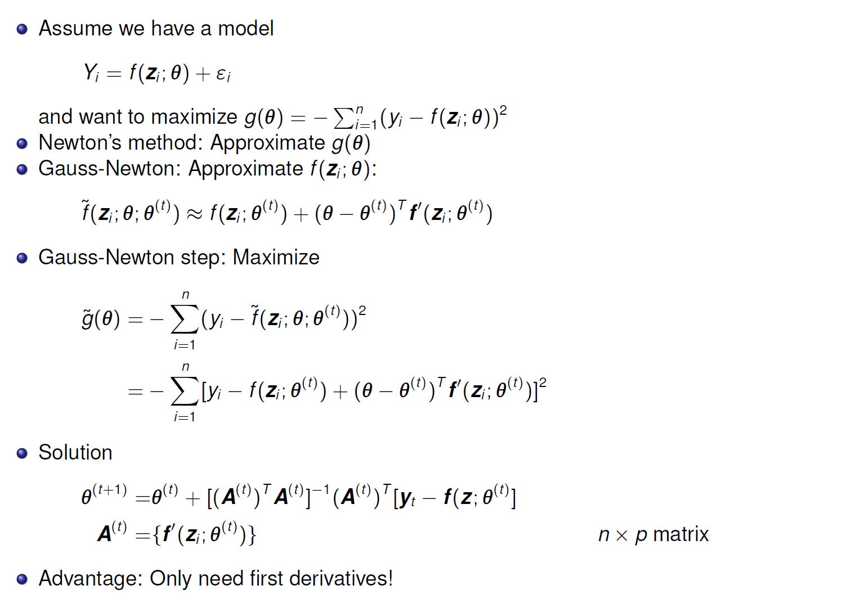
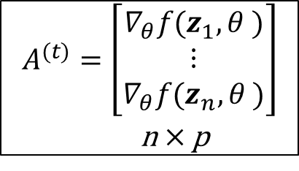

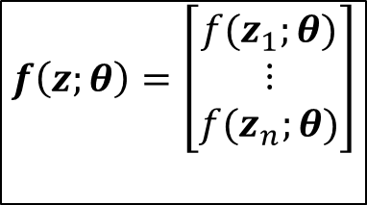

Gauss-Newton method
$$∇_{θ}f(z_{i}, θ^{(t)})$$
$$f\left(z;θ\right)=\left[\begin{matrix}f(z_{1};θ) \\ ⋮ \\ f(z_{n};θ)\end{matrix}\right]$$
$$∇_{θ}f\left(z_{i}, θ^{\left(t\right)}\right)]^{2}$$
$$A^{(t)}=\left[\begin{matrix}∇_{θ}f(z_{1}, θ ) \\ ⋮ \\ ∇_{θ}f(z_{n}, θ )\end{matrix}\right]$$
n × p
)]

Slide 14
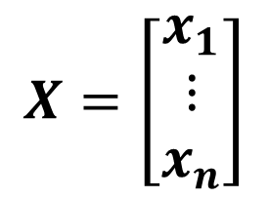
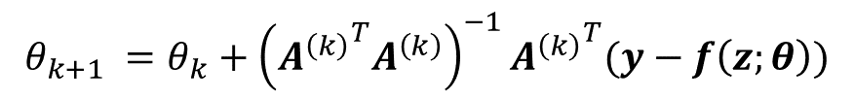
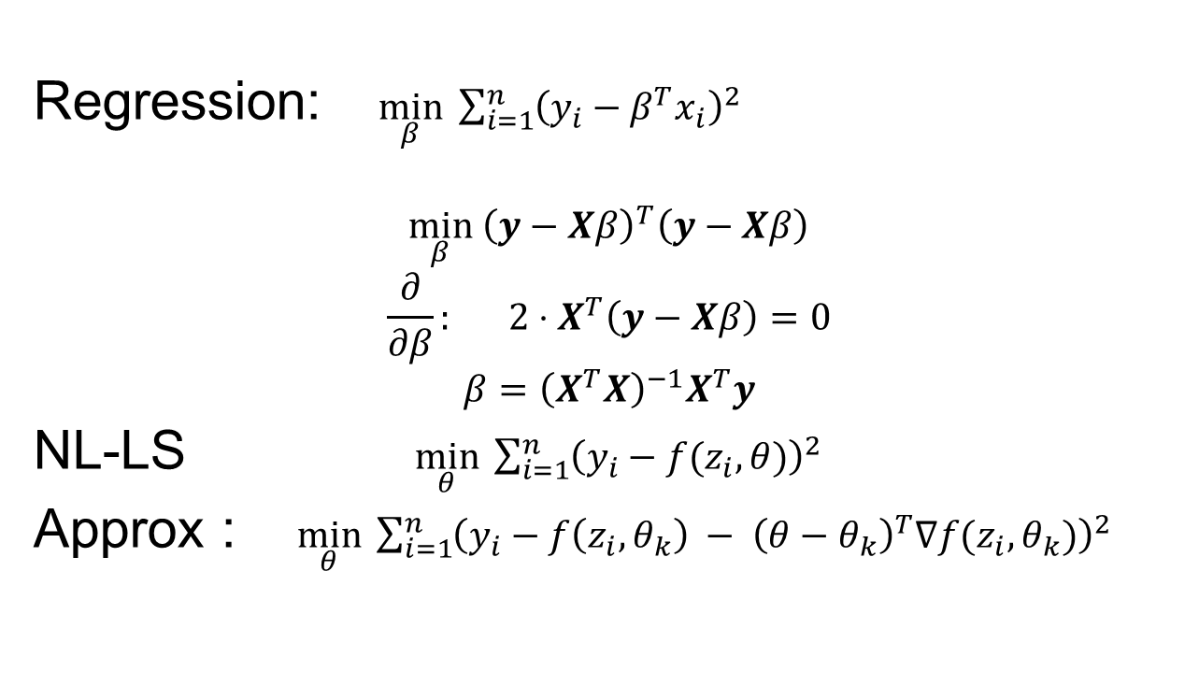
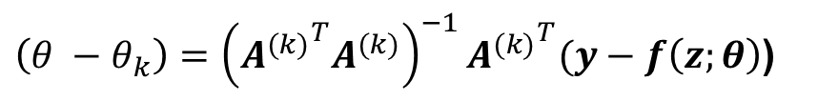
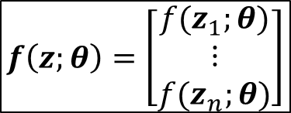
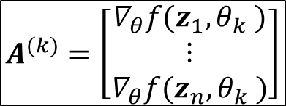
GAUSS-NEWTON
$$X=\left[\begin{aligned}x_{1} \\ ⋮ \\ x_{n}\end{aligned}\right]$$
Regression: $\min_{β} \sum_{i=1}^{n}{{\left(y_{i}−β^{T}x_{i}\right)}^{2}}$
$$\min_{β} {\left(y−Xβ\right)}^{T}\left(y−Xβ\right)$$
$$\frac{∂}{∂β}: 2⋅X^{T}\left(y−Xβ\right)=0$$
$$β={\left(X^{T}X\right)}^{−1}X^{T}y$$
NL-LS $\min_{θ} \sum_{i=1}^{n}{{\left(y_{i}−f(z_{i},θ)\right)}^{2}}$
Approx : $\min_{θ} \sum_{i=1}^{n}{{\left(y_{i}−f\left({z_{i}, θ}_{k}\right) − {\left(θ−θ_{k}\right)}^{T}∇f(z_{i},θ_{k})\right)}^{2}}$
$$f\left(z;θ\right)=\left[\begin{matrix}f(z_{1};θ) \\ ⋮ \\ f(z_{n};θ)\end{matrix}\right]$$
$$A^{(k)}=\left[\begin{matrix}∇_{θ}f(z_{1}, θ_{k} ) \\ ⋮ \\ ∇_{θ}f(z_{n}, θ_{k} )\end{matrix}\right]$$
$$θ_{k+1} =θ_{k}+{\left({A^{\left(k\right)}}^{T}A^{\left(k\right)}\right)}^{−1}{A^{\left(k\right)}}^{T}(y−f\left(z;θ\right))$$
$\left(θ −θ_{k}\right)={\left({A^{(k)}}^{T}A^{(k)}\right)}^{−1}{A^{(k)}}^{T}(y−f\left(z;θ\right)$)

Slide 15
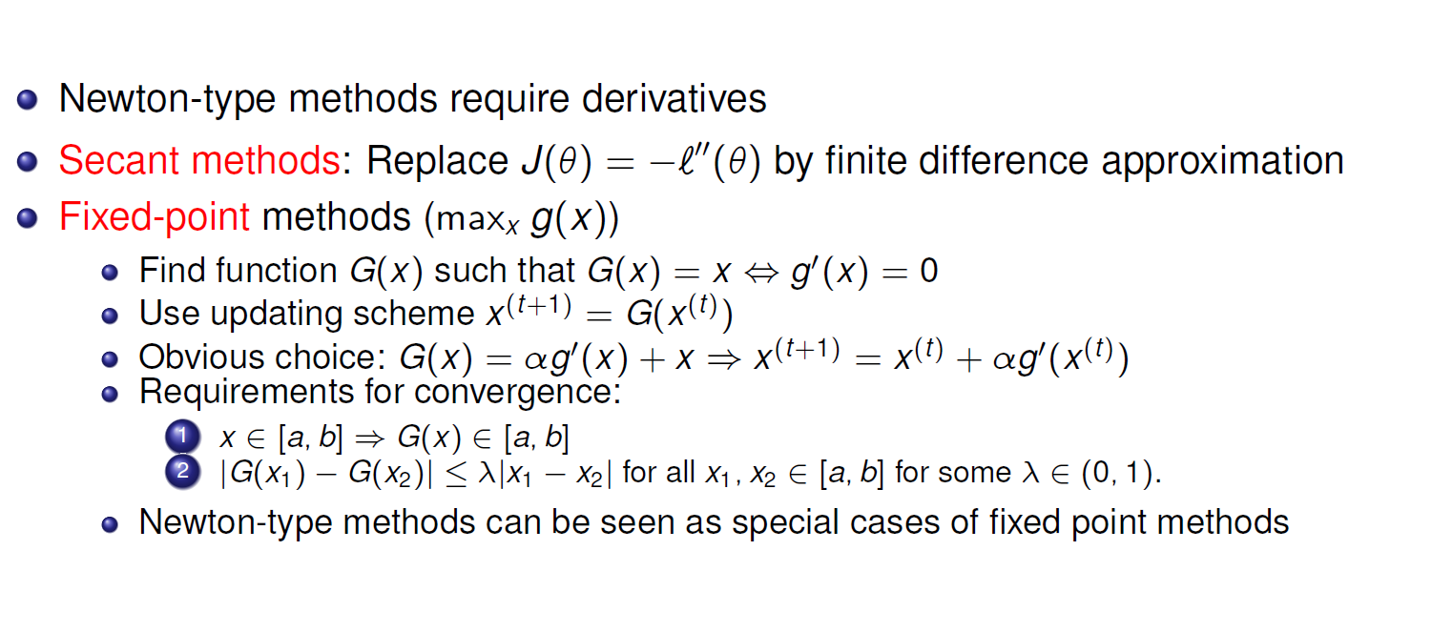
Other optimization methods

Slide 16
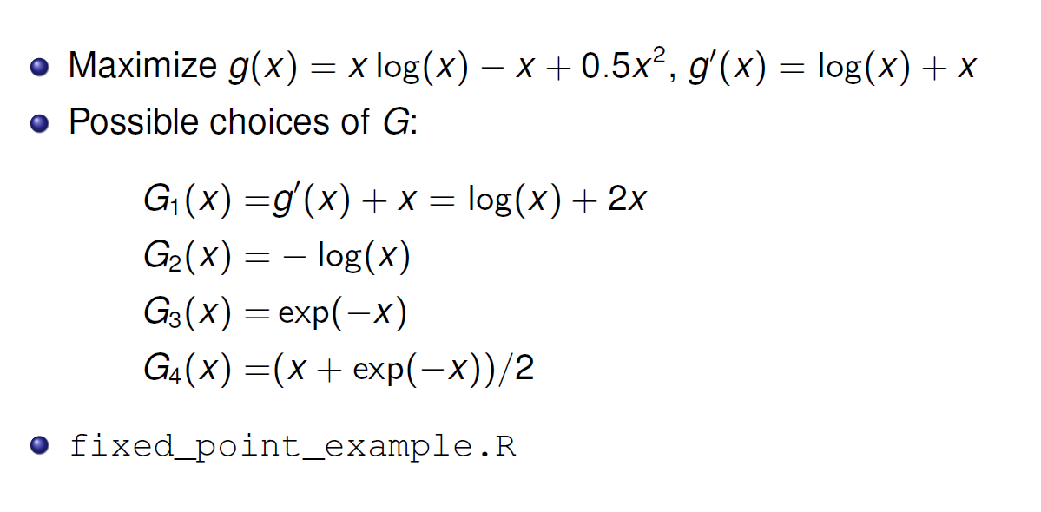
Example fixed point

Slide 17
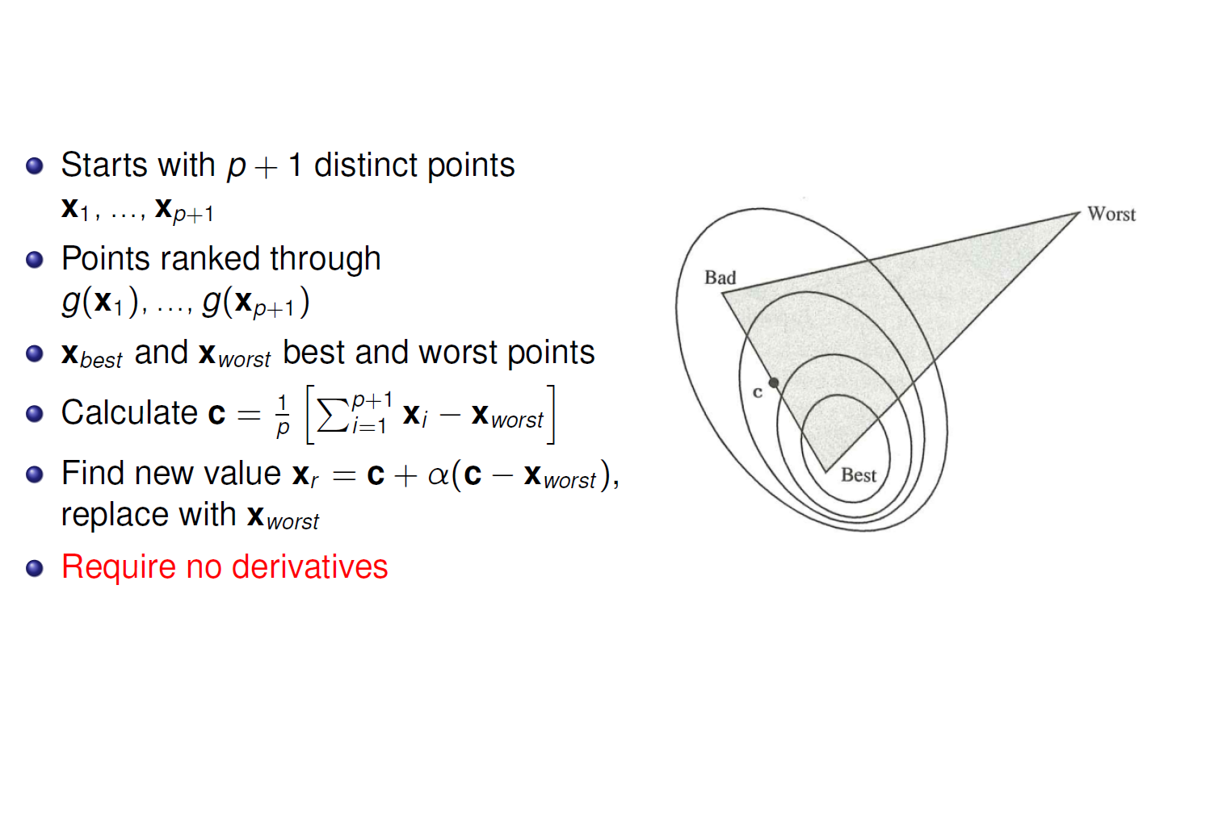
Nelder - Mead
x_{r} somewhere along this line
If you do not find improvement shrink all points towards best

Slide 18


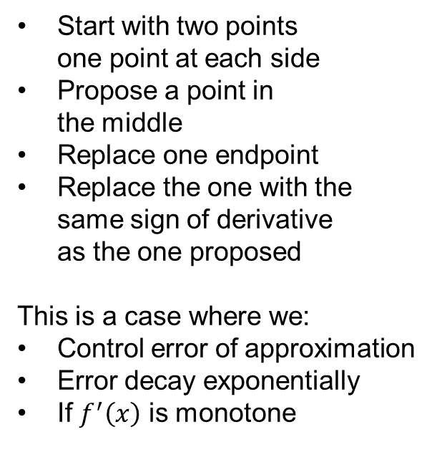
Bisection
Minimum of $f(x)$
Start with two points
one point at each side
Propose a point in
the middle
Replace one endpoint
Replace the one with the
same sign of derivative
as the one proposed
This is a case where we:
Control error of approximation
Error decay exponentially
If $f^{′}\left(x\right)$ is monotone
Root of $f^{′}\left(x\right)=0$

Slide 19
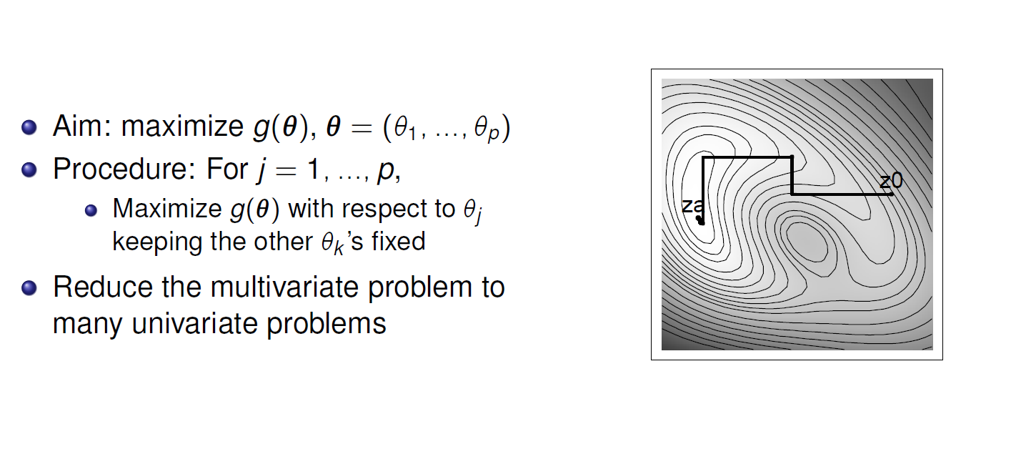
Gauss- Seidel
Pick your favorite 1D optimization

Slide 20

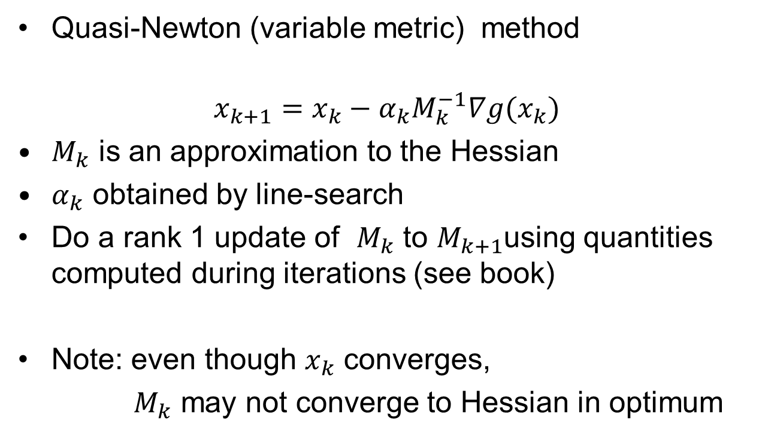
BFGS-algorithm
Broyden–Fletcher–Goldfarb–Shanno
Quasi-Newton (variable metric) method
$$x_{k+1}=x_{k}−{α_{k}M}_{k}^{−1}∇g(x_{k})$$
$M_{k}$ is an approximation to the Hessian
$α_{k}$ obtained by line-search
Do a rank 1 update of $M_{k}$ to $M_{k+1}$using quantities computed during iterations (see book)
Note: even though $x_{k}$ converges,
$M_{k}$ may not converge to Hessian in optimum
(argmax $g(x))$

Slide 21
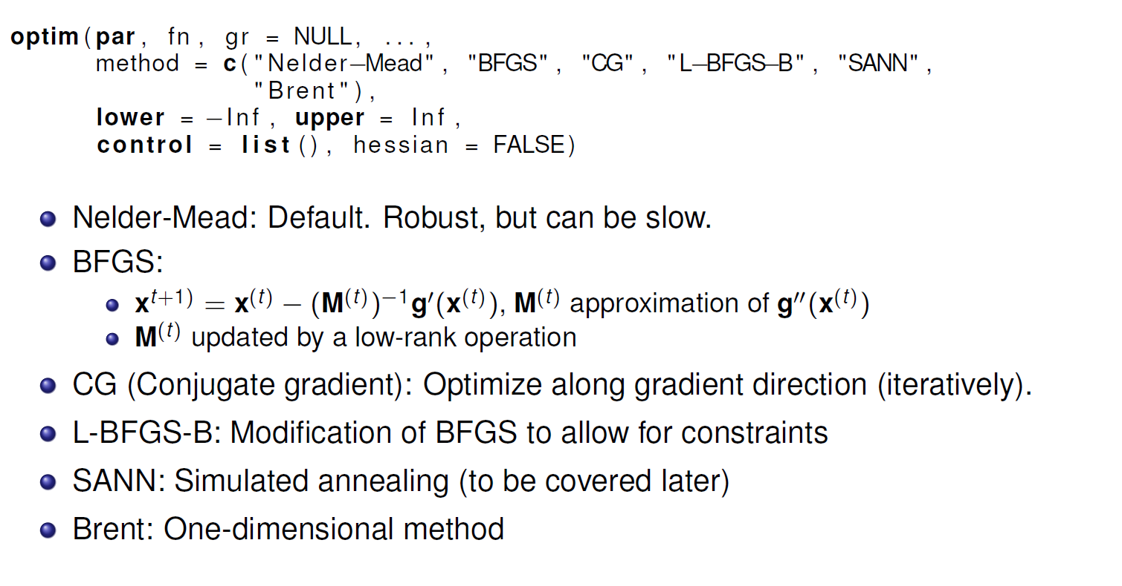
optim in R

Slide 22
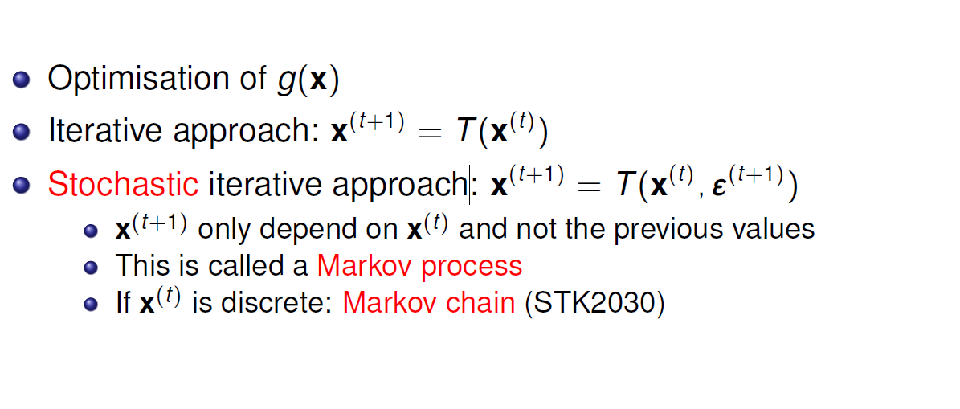
Recursive approaches

Slide 23
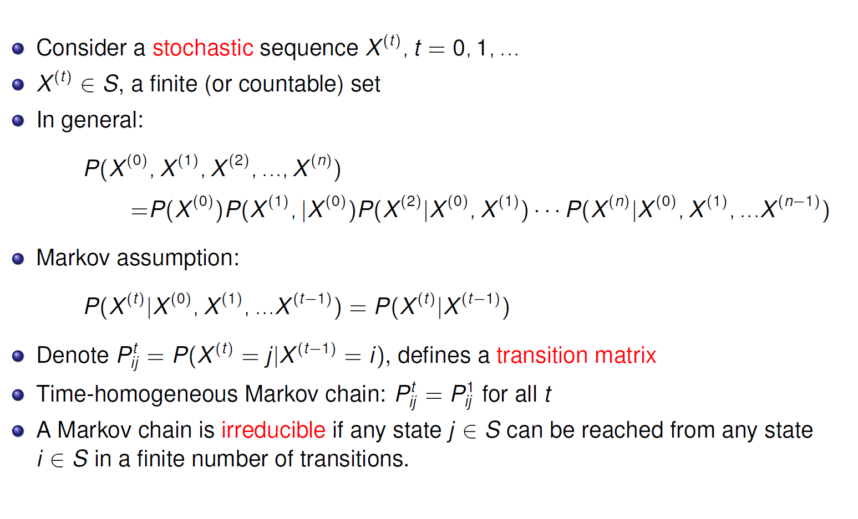
Brief review of Markov chains

Slide 24
Next time:
Iterative re-weighted least square
ADMM
  Lasso example
Combinatorial optimization (chapter 3)
Exercise

