Slide 1
STK-4051/9051 Computational Statistics Spring 2020
Exercise 14
Instructor: Odd Kolbjørnsen, oddkol@math.uio.no

Slide 2
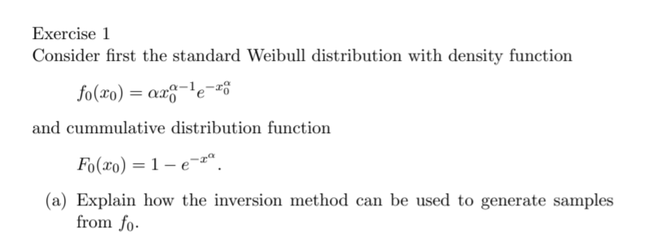
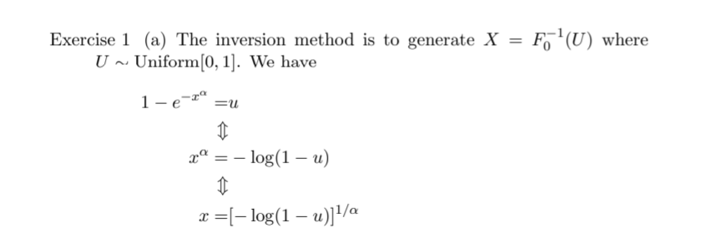

Slide 3

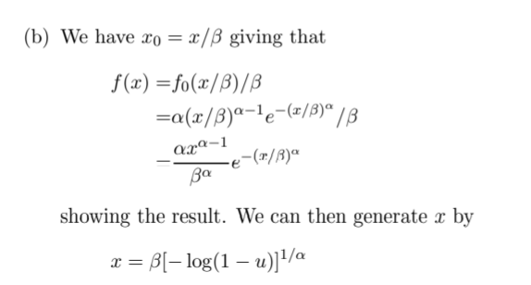

Slide 4
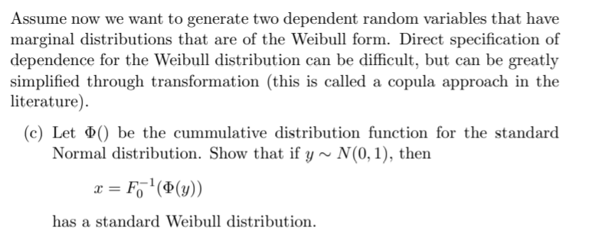
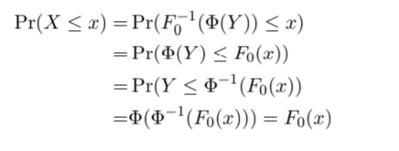

Slide 5


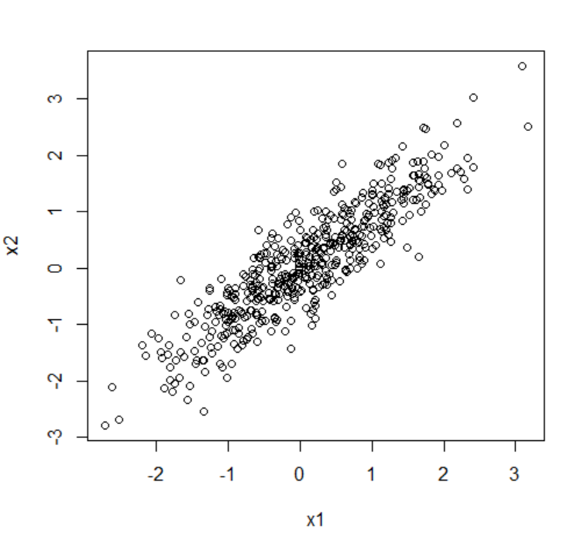
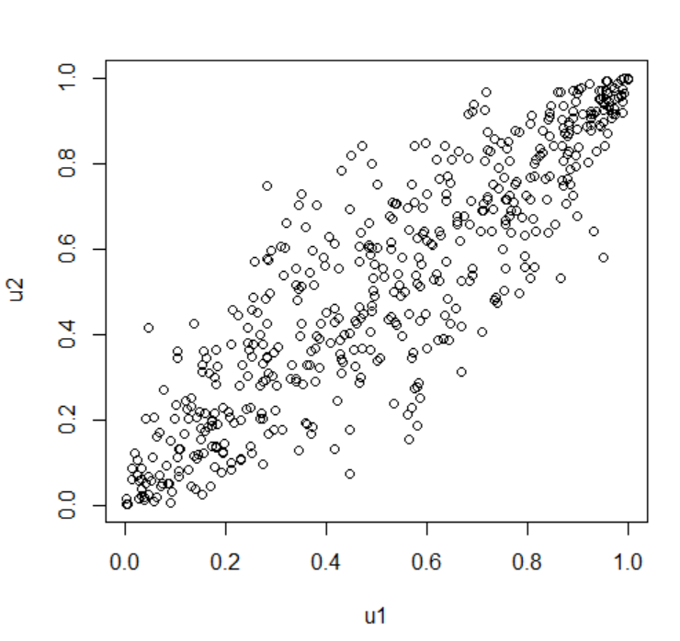
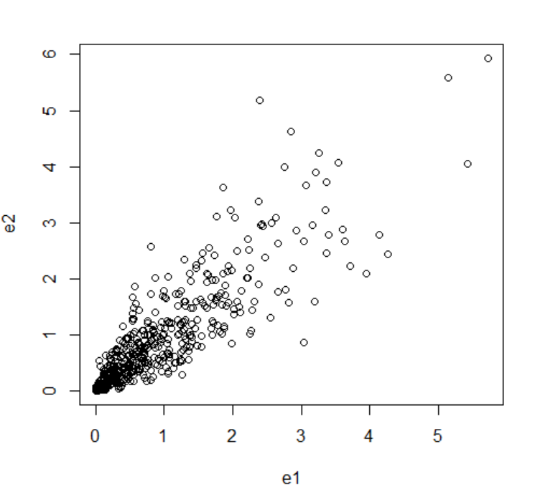
As transformations are monotone, the rank correlation will be preserved
Normal
Uniform
Weibull(1,1)
=exponential

Slide 6
N=500
n1=rnorm(N,0,1)
n2=rnorm(N,0,1)
rho=0.9
x1=n1
x2=x1*rho+sqrt(1-rho^2)*n2
u1=pnorm(x1)
u2=pnorm(x2)
e1 =-log(u1)
e2 =-log(u2)
hist(e1)
plot(x1,x2)
plot(u1,u2)
plot(e1,e2)

Slide 7

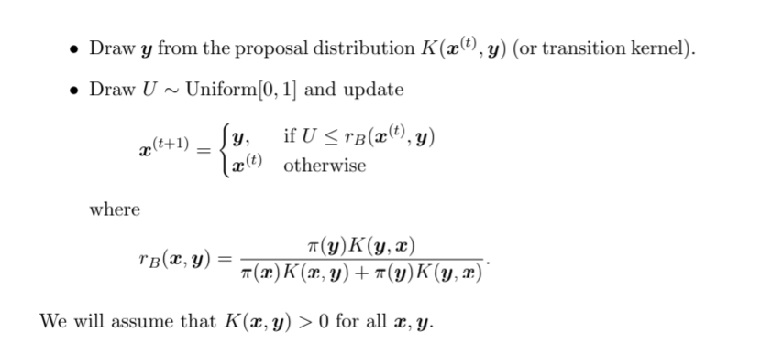

Slide 8
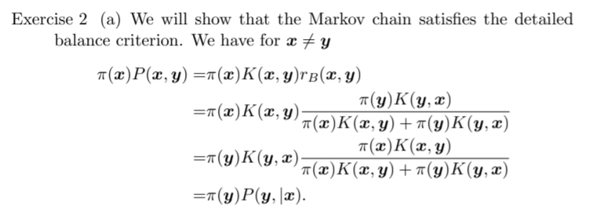

Slide 9

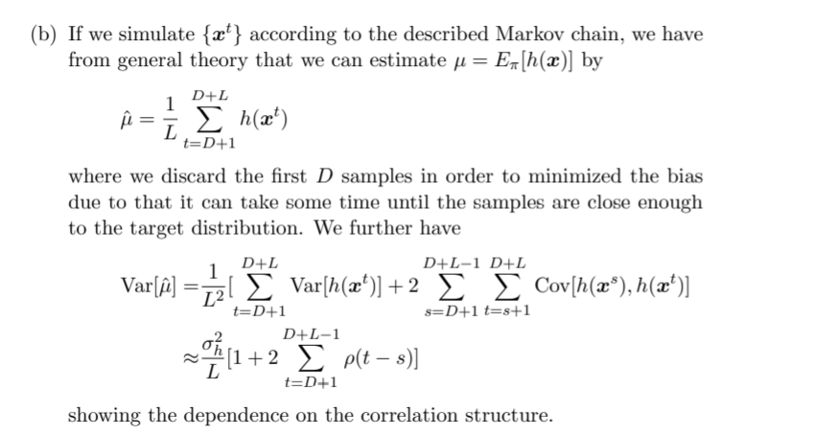

Slide 10
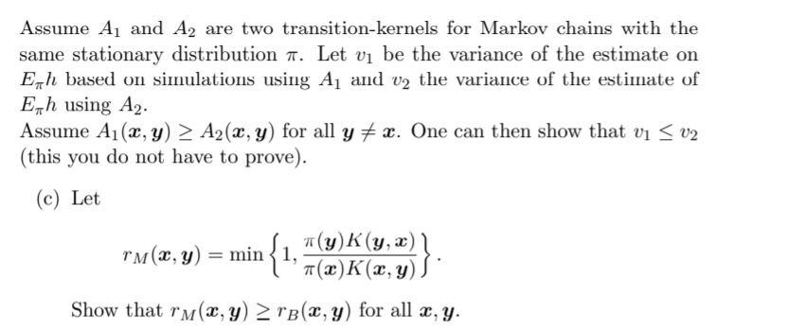


Slide 11




Since we have proven that:
We have proven:
The result then apply:
=
=

Slide 12

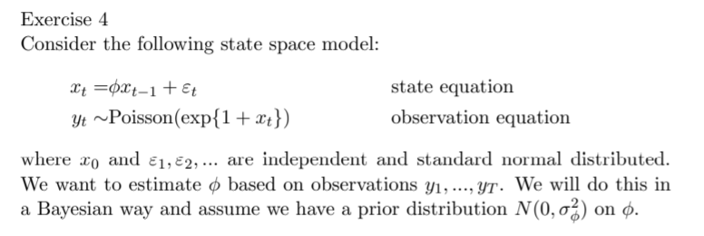
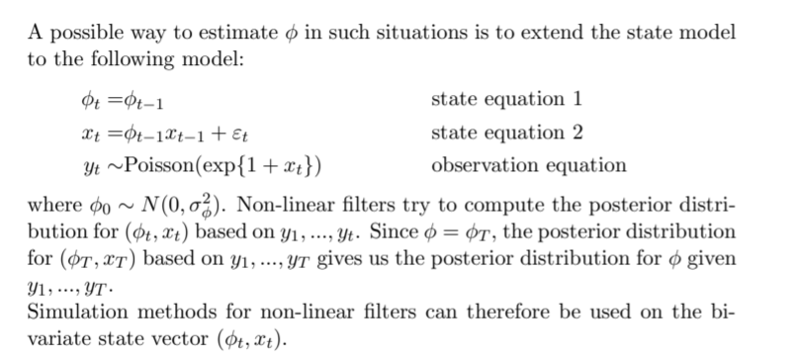

$θ$

Slide 13

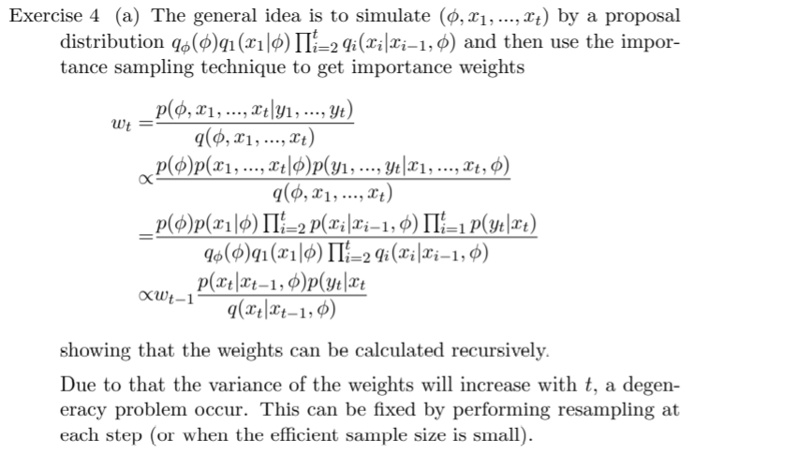

$$p(y_{i}|x_{i})$$
)

Slide 14
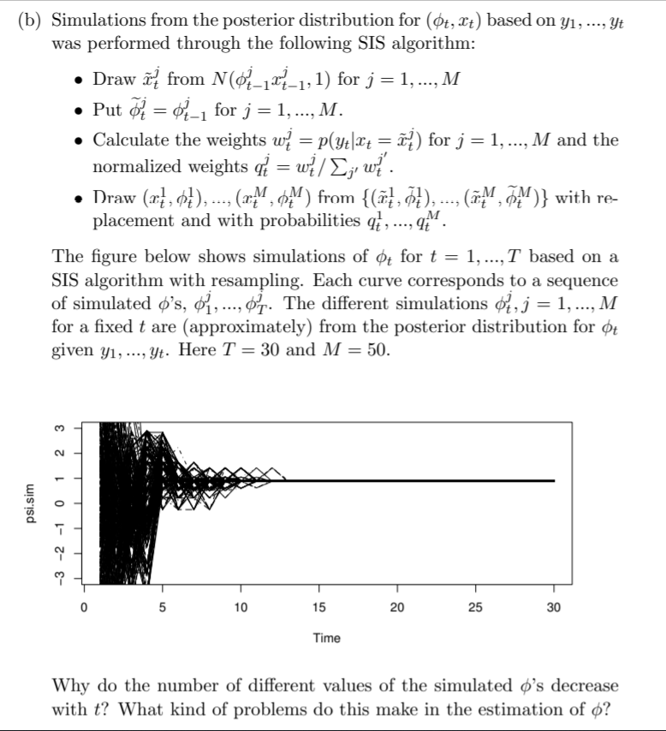


Slide 15
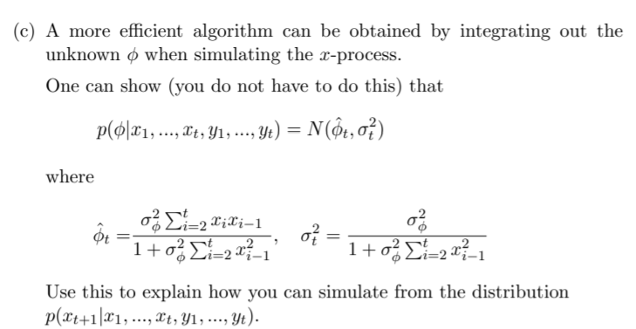




Slide 16
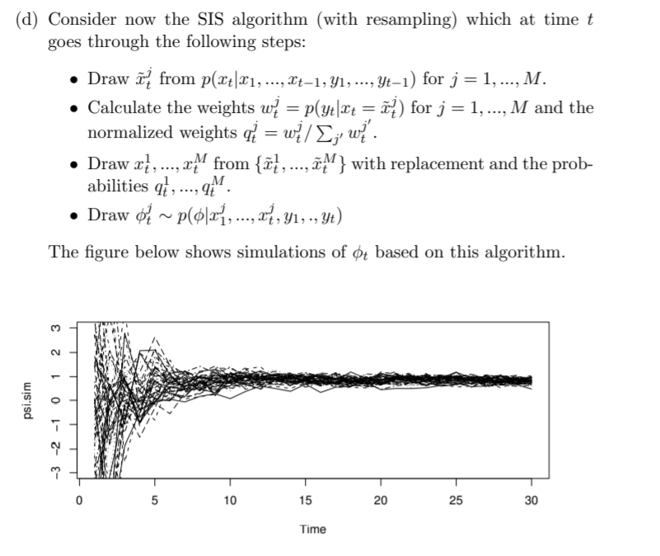


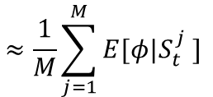
$$≈\frac{1}{M}\sum_{j=1}^{M}{E[φ|S_{t}^{j} ]}$$

