Slide 1
STK-4051/9051 Computational Statistics Spring 2024
Slides Exercise 11
Instructor: Odd Kolbjørnsen, oddkol@math.uio.no

Slide 2
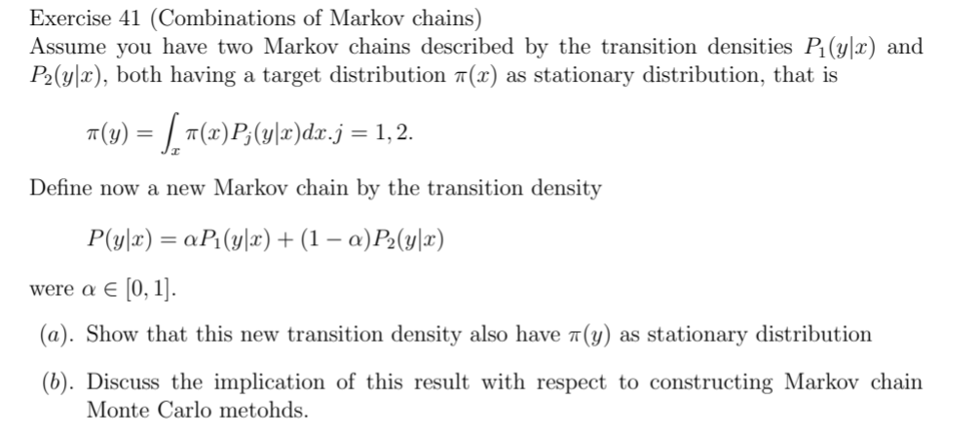
Exercise 41 (Combinations of Markov chains)

Slide 3
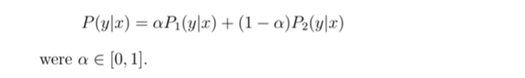
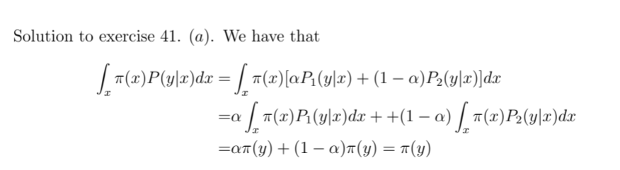
Exercise 41

Slide 4
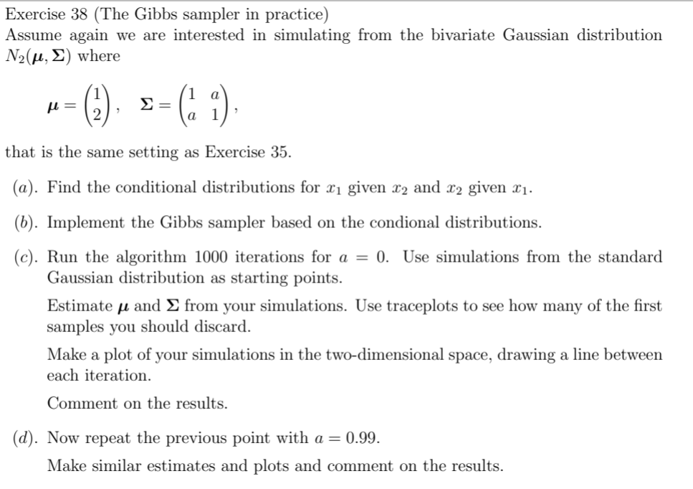
Exersice 38

Slide 5
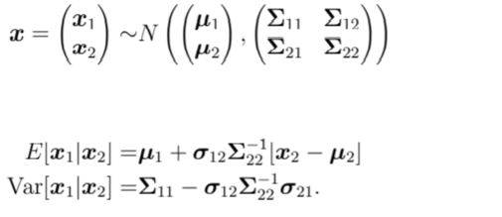

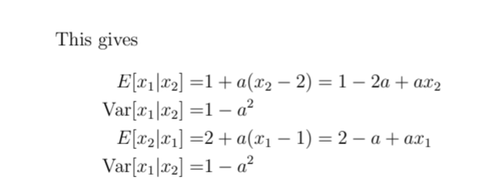
Conditional distributions Ex 38

Slide 6
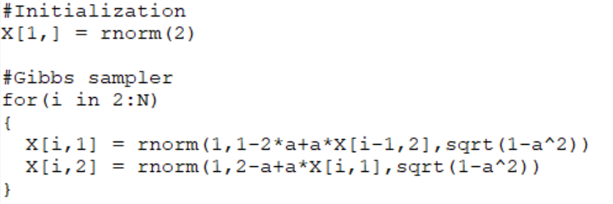
Gibbs sampler

Slide 7
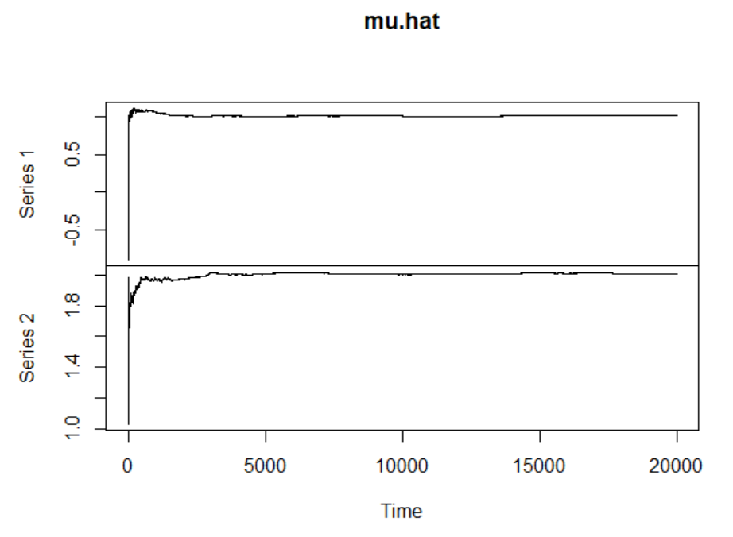
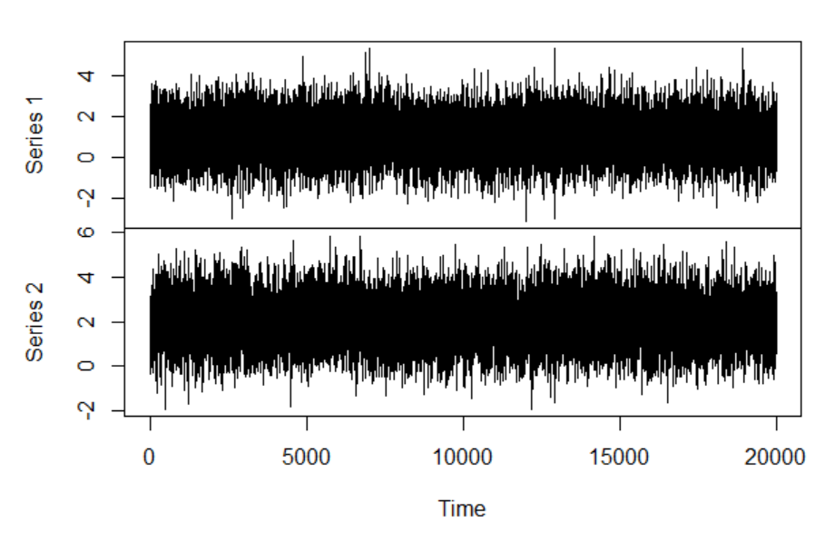
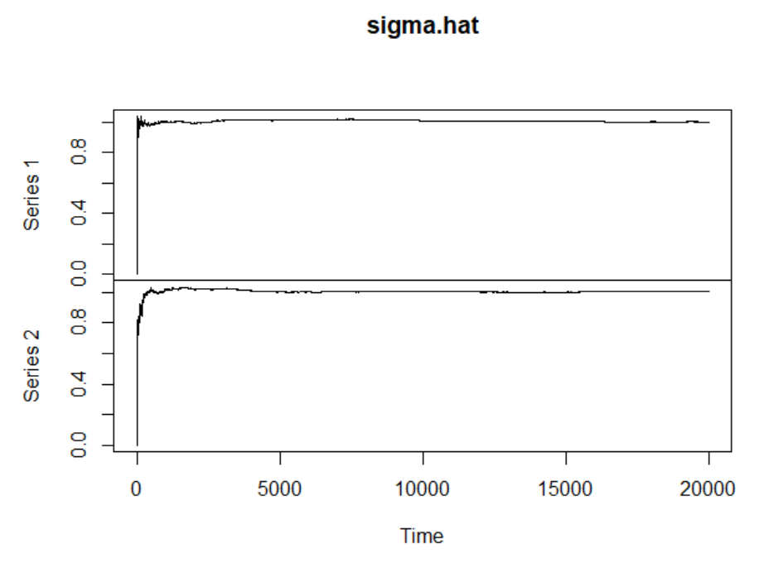
Results a=0
Instant convergence!

Slide 8
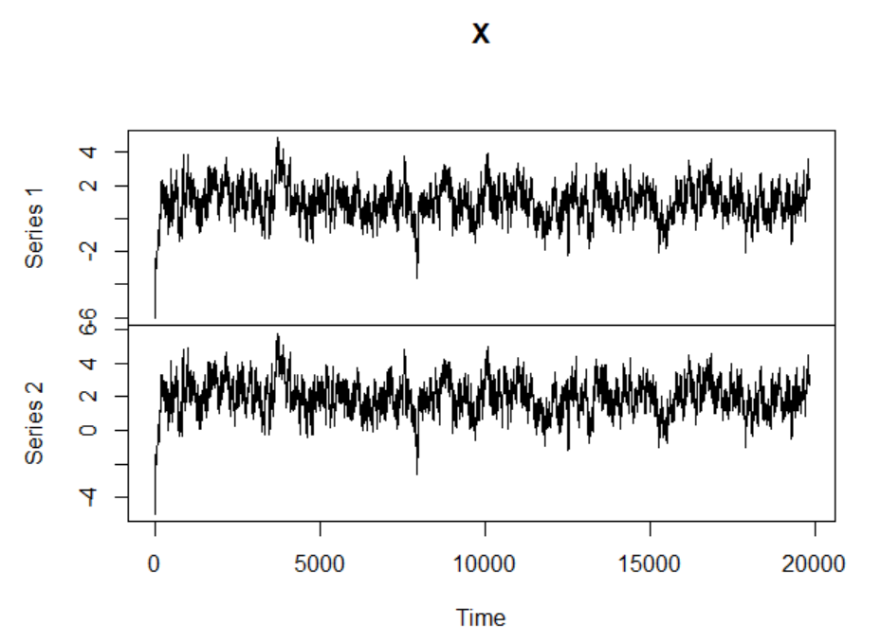
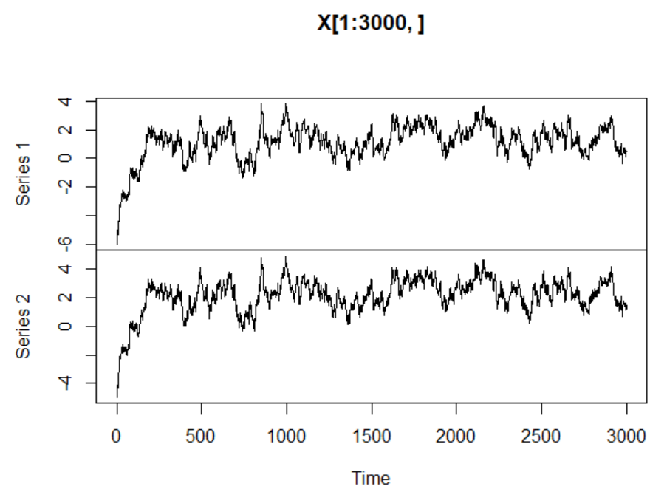
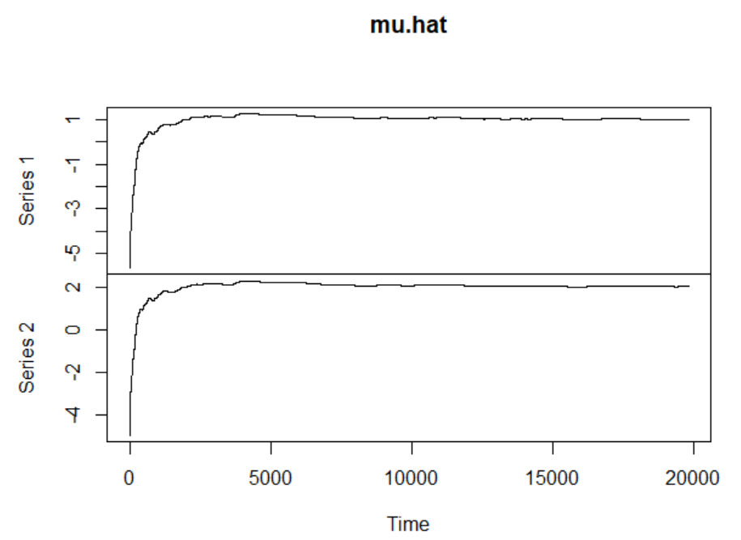
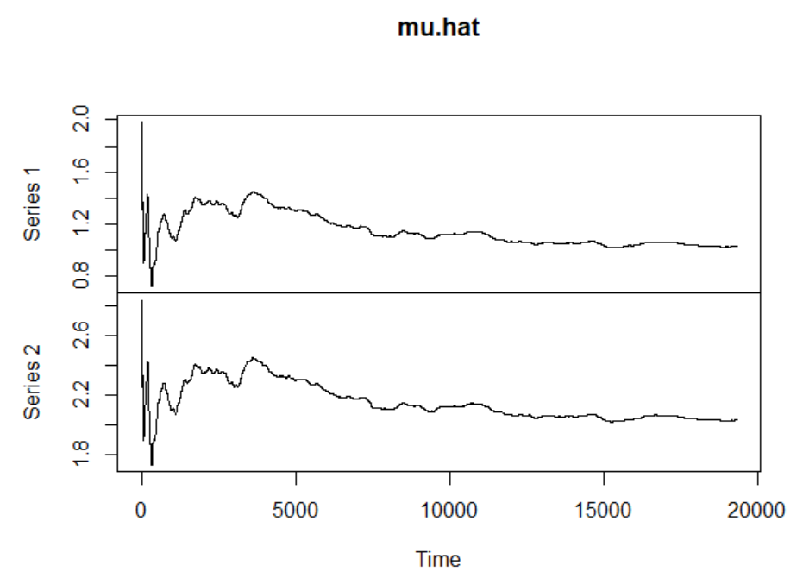
Results a=0.99
Discard 500 first

Slide 9
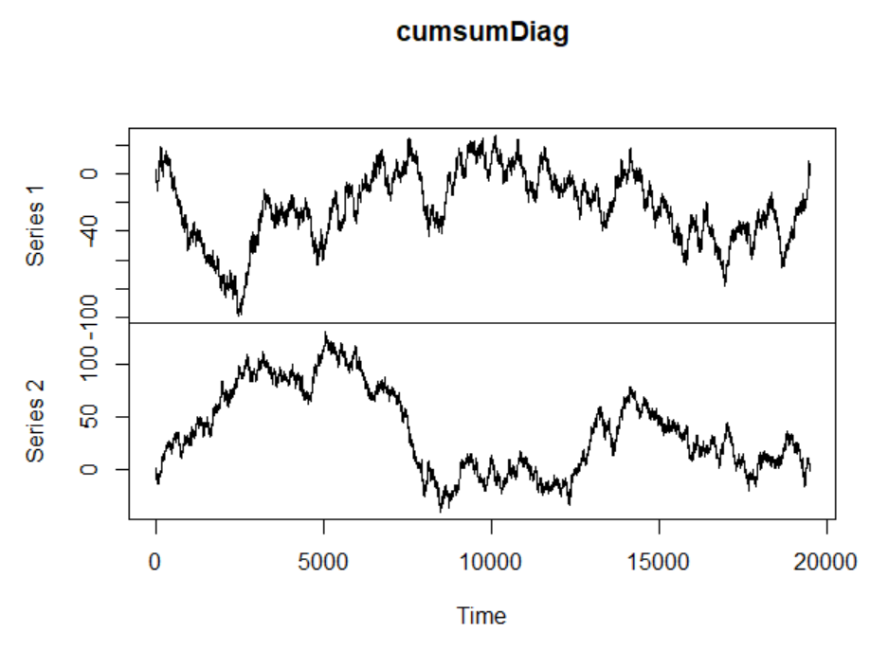
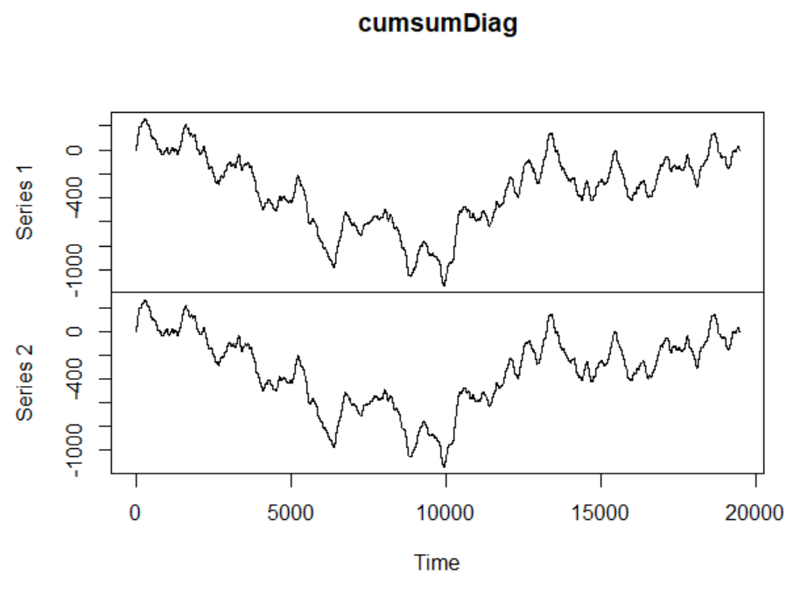
a=0.00
a=0.99

Slide 10
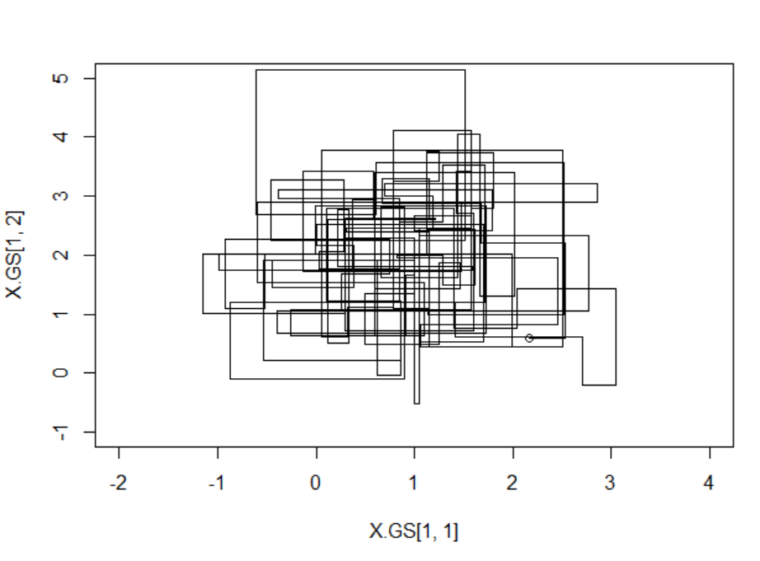
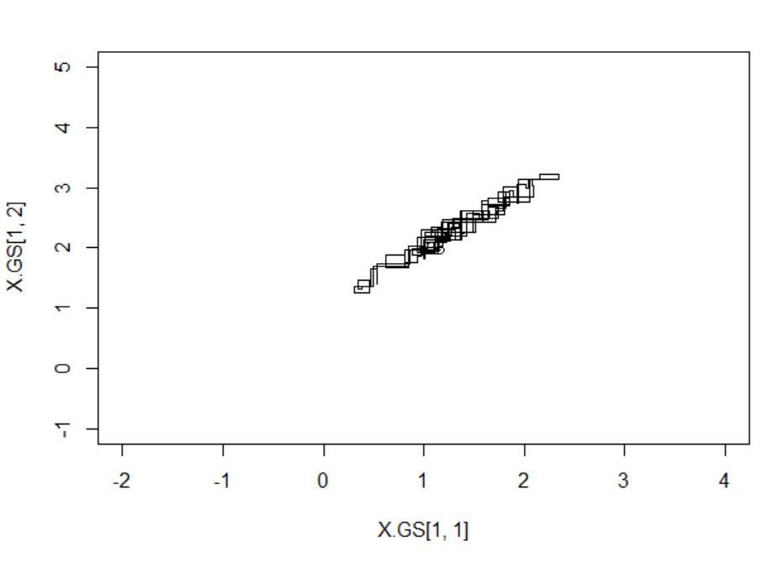
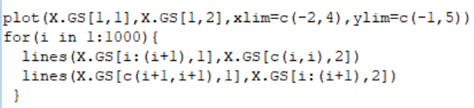
100 Samples in a row
Fore update of individual coordinates

Slide 11
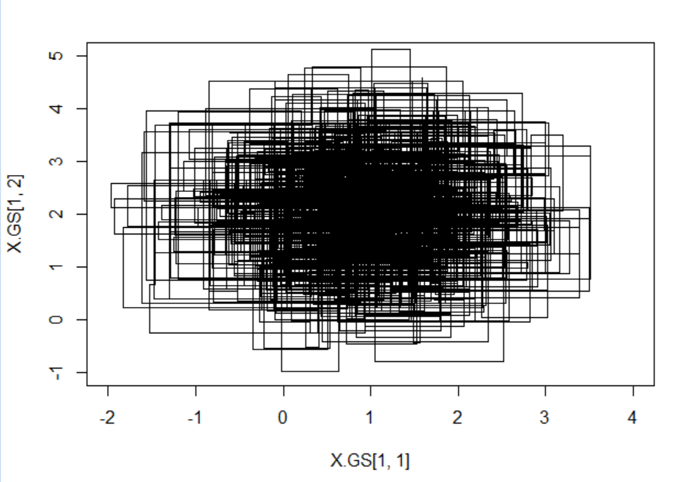
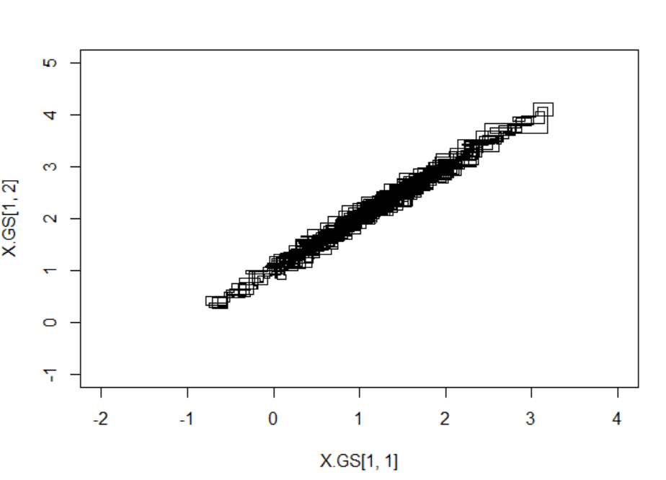
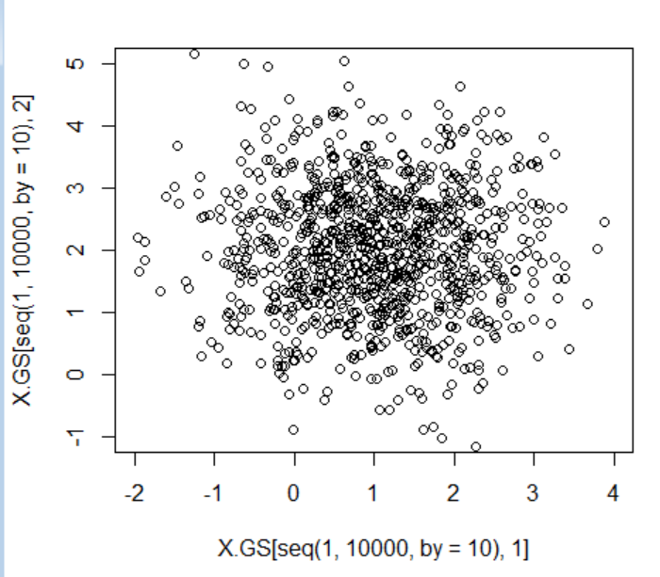
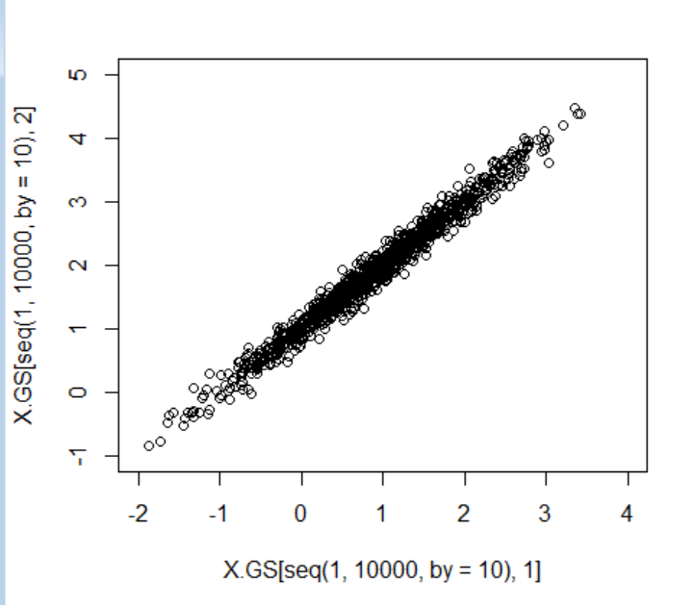
1000 Samples in a row

Slide 12
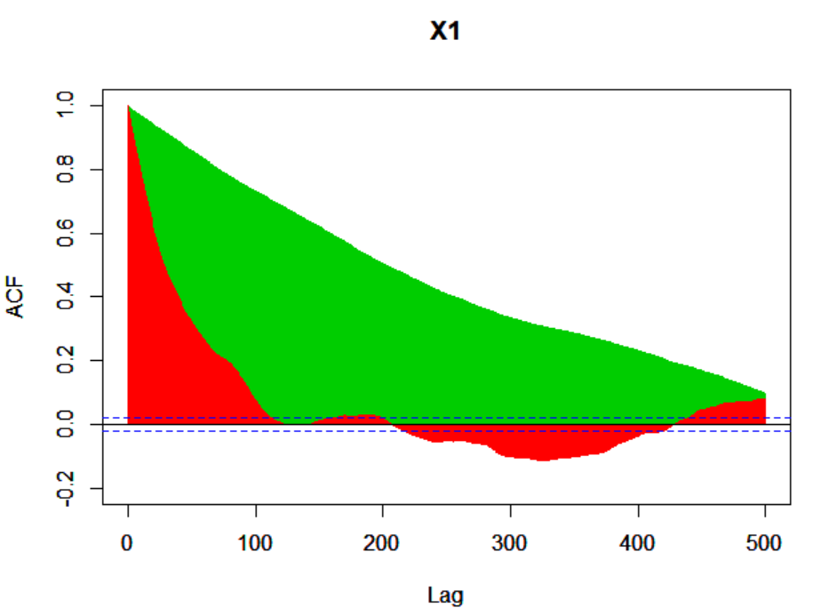
Compare ex 35, M-H vs Gibbs
In general Compare also
* runtime per iteration
* Complexity of code (=probability of error)

Slide 13
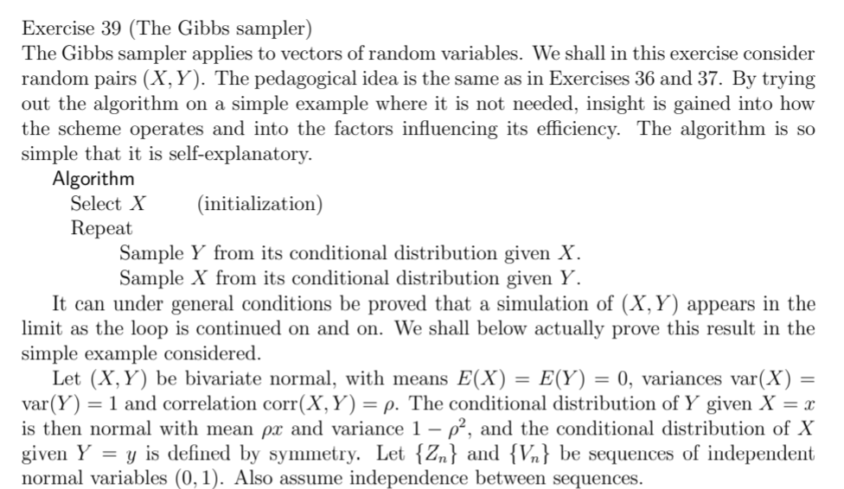
Ex 39

Slide 14
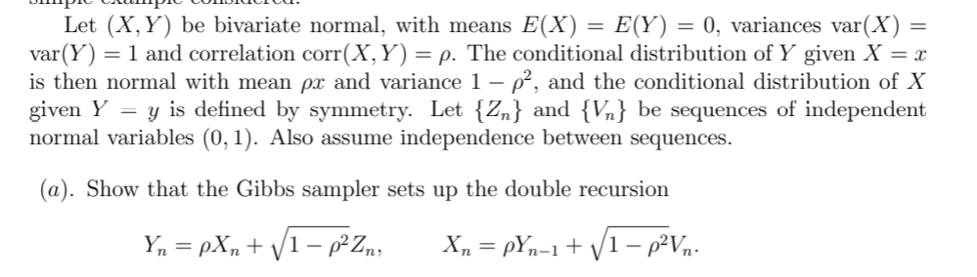
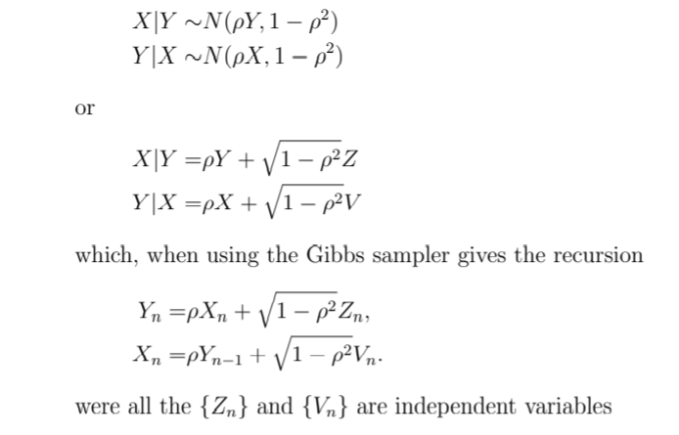
39 a

Slide 15
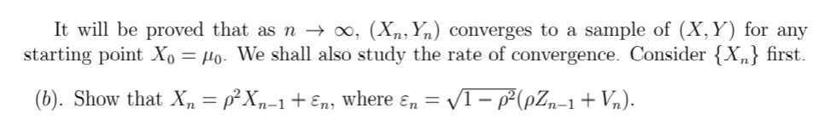
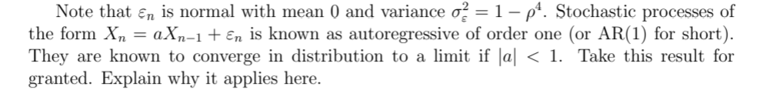
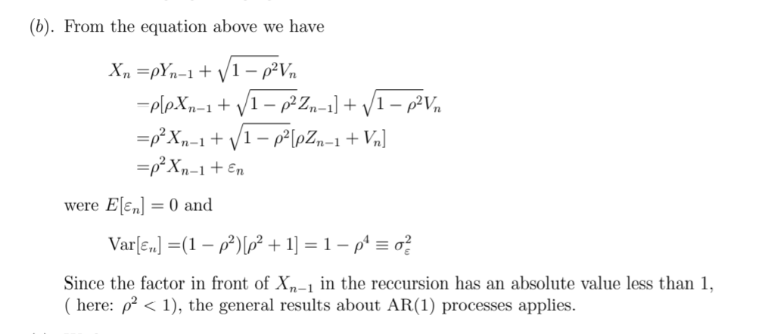
39b

Slide 16
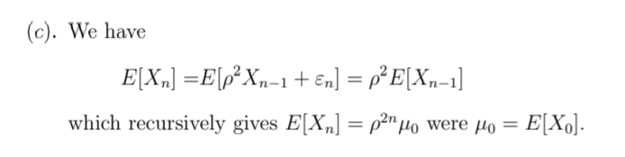
39c

Slide 17
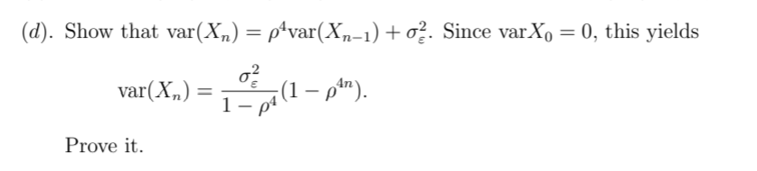
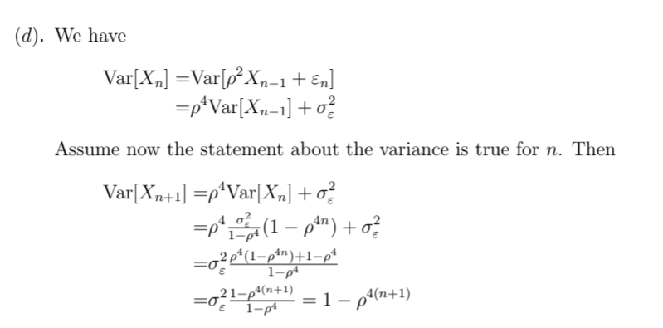
39d

Slide 18
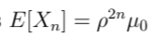
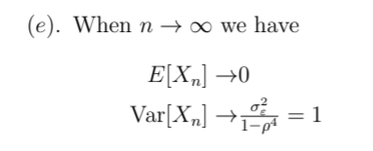
39e

Slide 19
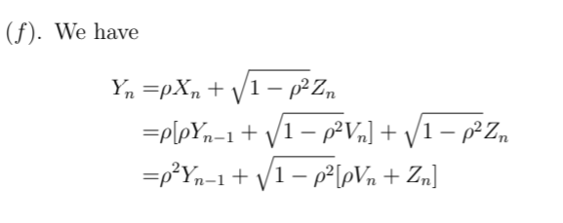
39f

Slide 20
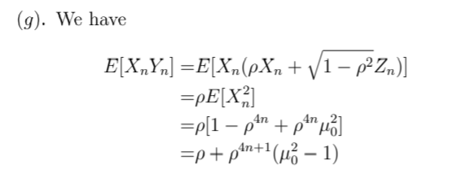

39g & h

Slide 21
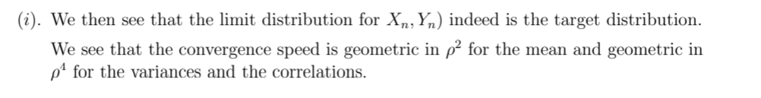
39i

Slide 22
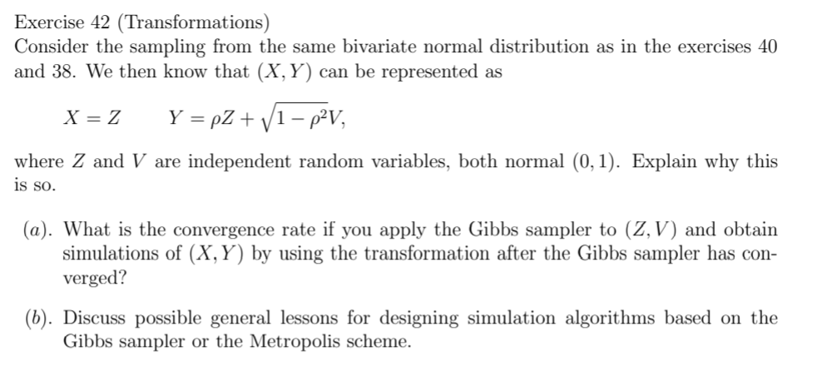
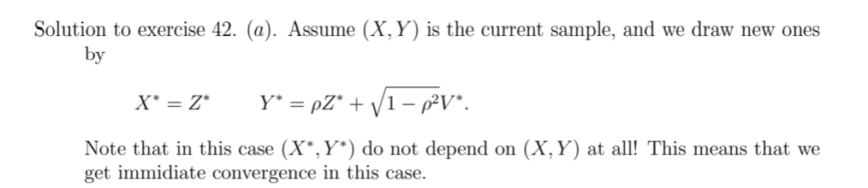
Ex 42

Slide 23
Ex 42 b

Slide 24
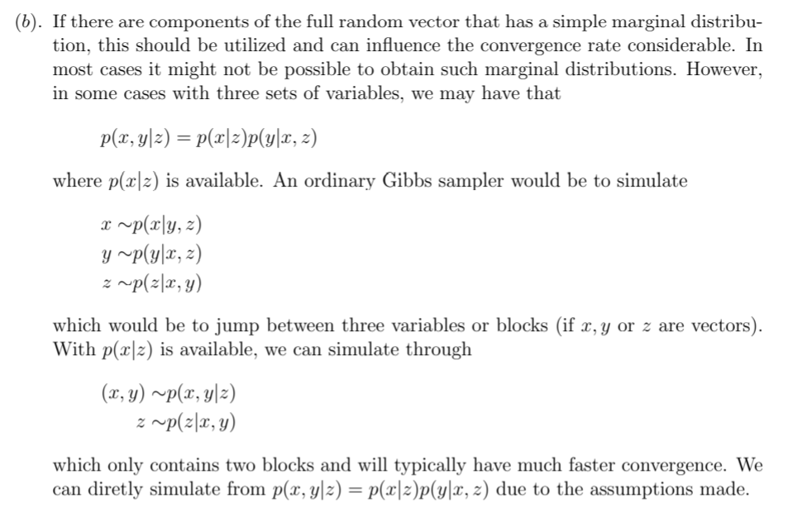
Discussion 42 b

Slide 25
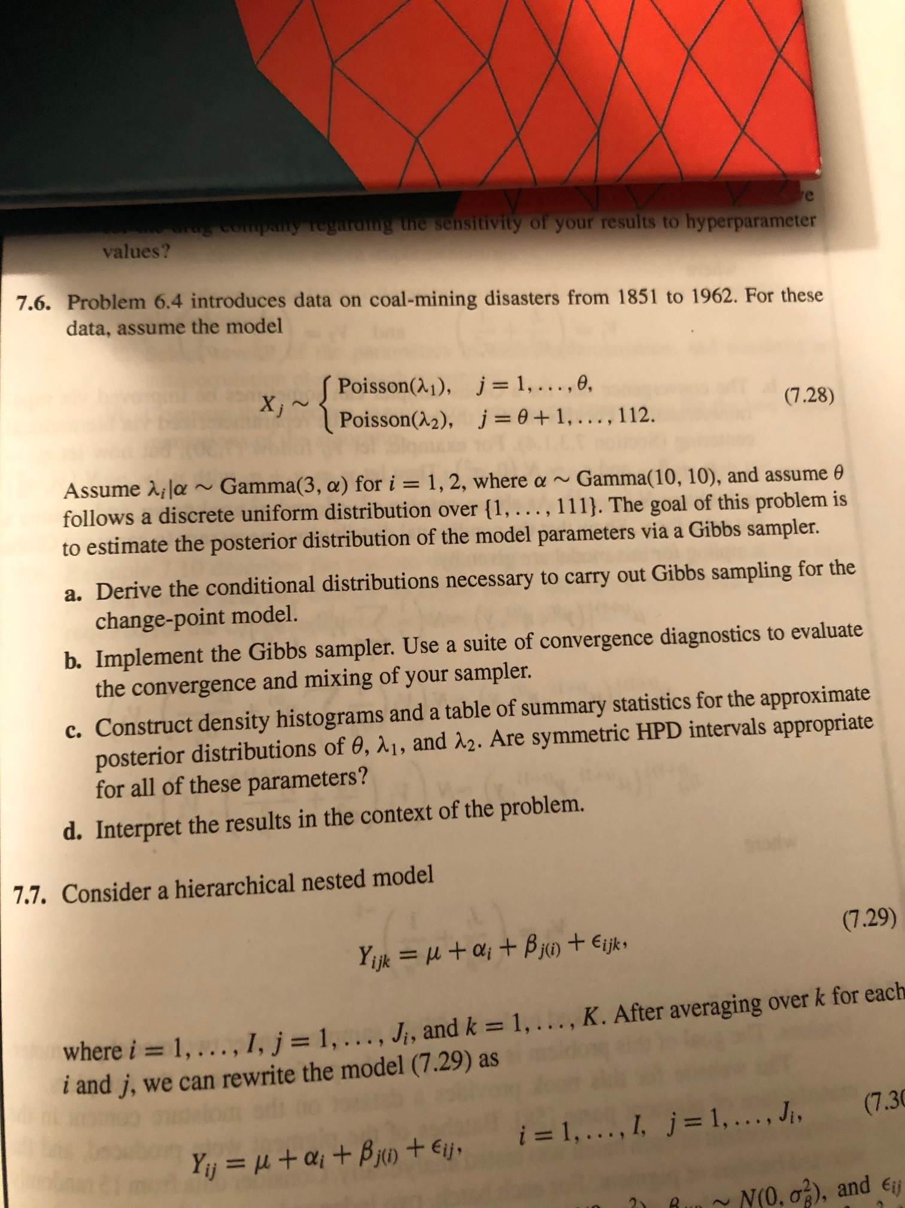
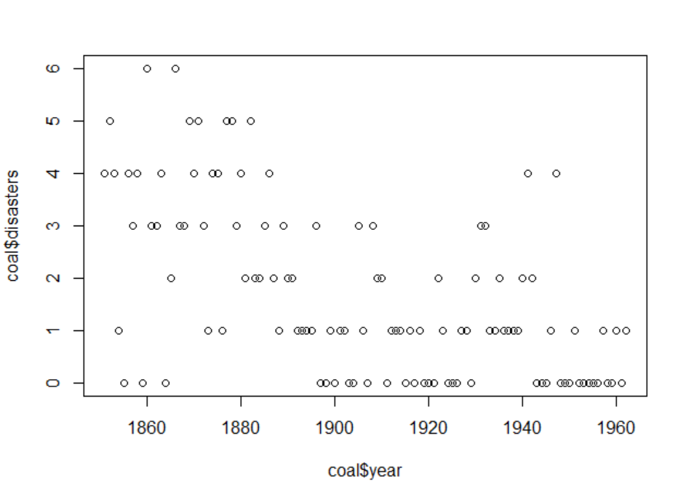

Higest
Posterior
Density
Parameters $θ, λ_{1}, λ_{2}, α$

Slide 26
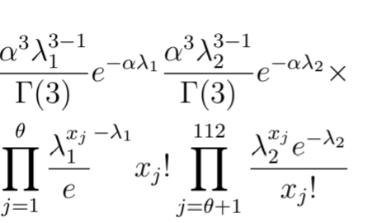
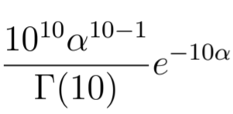
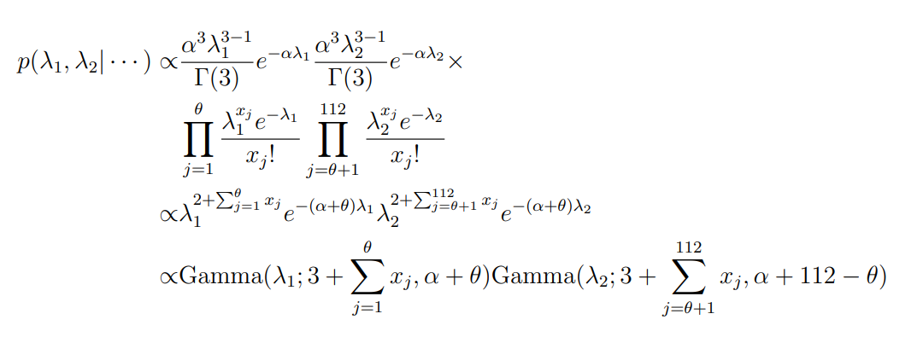


Exersice 7.6
$$p\left(θ,λ_{1},λ_{2} \right)∝p(α)p\left(θ\right)⋅p\left(λ_{1}|α \right)⋅p\left(λ_{2}|α\right)×L({θ,λ}_{1},λ_{2})$$
$$\frac{1}{111}$$
$$−\left(α+112−θ\right)λ_{2}$$

Slide 27
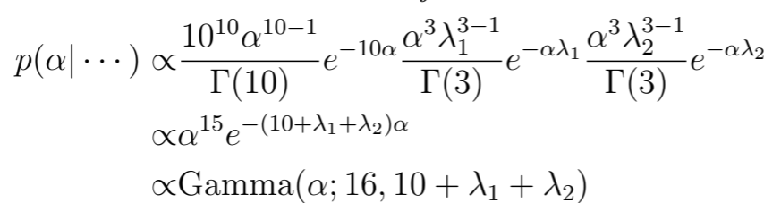
Exersice 7.6
$$p\left(θ,λ_{1},λ_{2} \right)∝p(α)p\left(θ\right)⋅p\left(λ_{1}|α \right)⋅p\left(λ_{2}|α\right)×L({θ,λ}_{1},λ_{2})$$
$$\frac{1}{111}$$

Slide 28
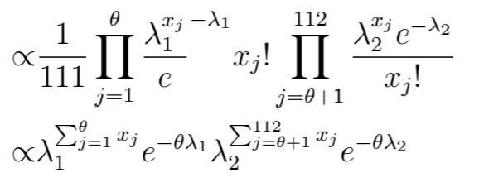
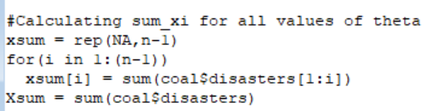
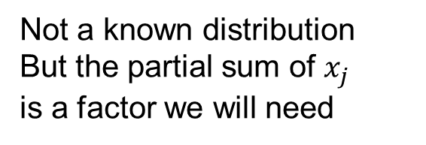

Exersice 7.6
$$p\left(θ,λ_{1},λ_{2} \right)∝p(α)p\left(θ\right)⋅p\left(λ_{1}|α \right)⋅p\left(λ_{2}|α\right)×L({θ,λ}_{1},λ_{2})$$
$$\frac{1}{111}$$
$$p\left(θ|…\right)$$
Not a known distribution
But the partial sum of $x_{j}$
is a factor we will need

Slide 29



7.6 b

Slide 30


Diagnostics
Have removed the 1000 first
Trace plot
Cumsum

Slide 31



Results

Slide 32


