Slide 1
STK-4051/9051 Computational Statistics Spring 2024
Comments to exercise 8
Instructor: Odd Kolbjørnsen, oddkol@math.uio.no

Slide 2
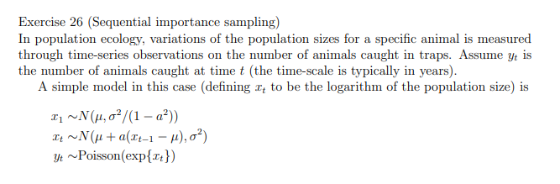
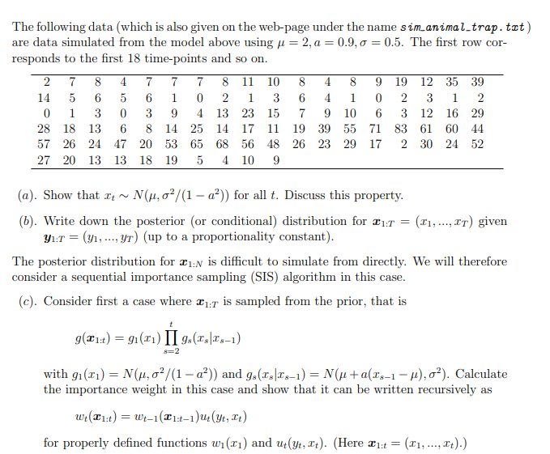
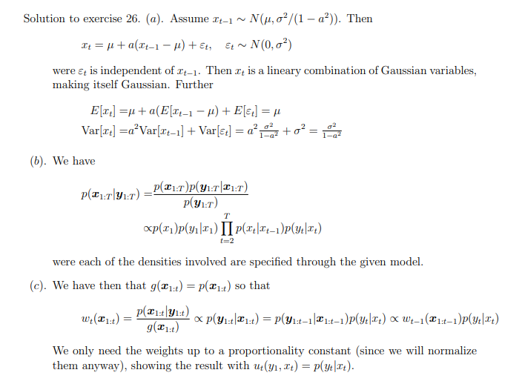
#26

Slide 3












$$y_{1}$$
$$y_{2}$$
$$y_{3}$$
$$y_{4}$$
$$⋯$$
$$y_{n}$$
$$x_{1}$$
$$x_{2}$$
$$x_{3}$$
$$x_{4}$$
$$⋯$$
$$x_{n}$$

Slide 5
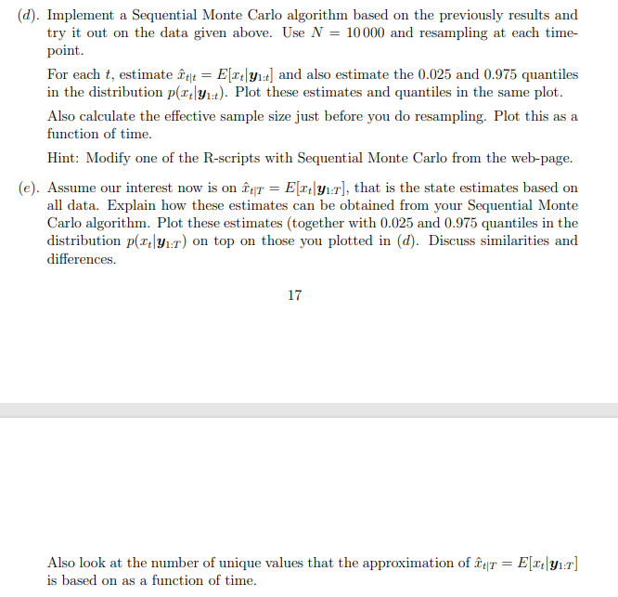
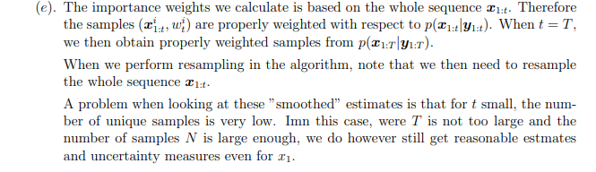
Filtering
Smoothing

Slide 6
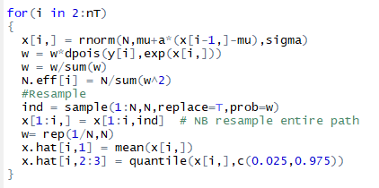
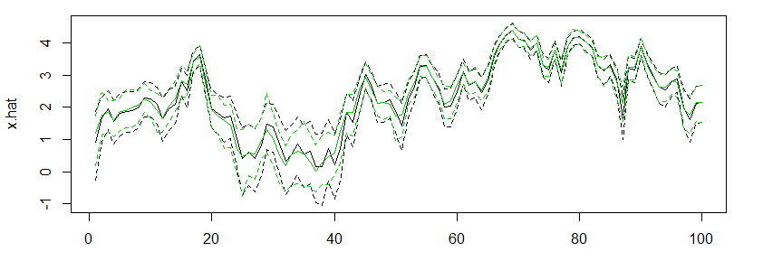
Filtering:
Computed
on the fly

Slide 7
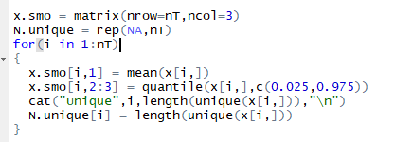
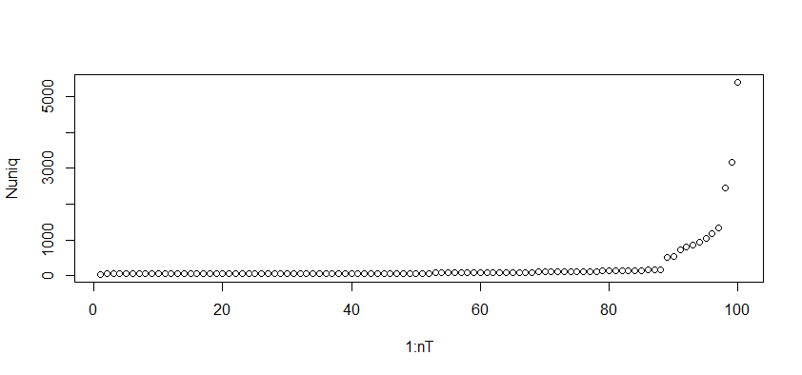
Smoothing
Computed
after loop
Is finished
49

Slide 8
Ex 26
See solution, it is nice to know that the distribution is stationary.
Solution is a bit brief, but see also 27a) to get the expression for the likelihood
Too ease the understanding of the derivation, think of this as a proof by induction, the lines here is the general step from t-1 to t. Use also the expression in 26b to derive the result
See code,
The comment in the solution, is good.

Slide 9
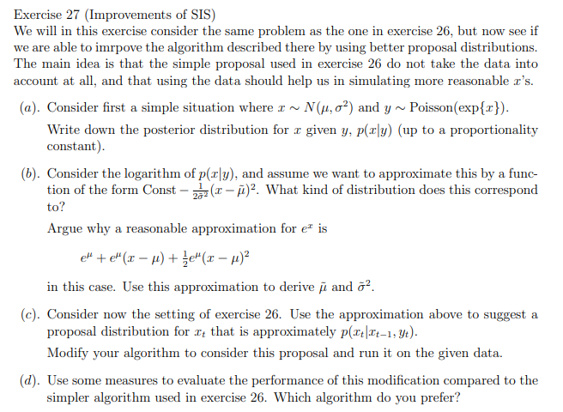
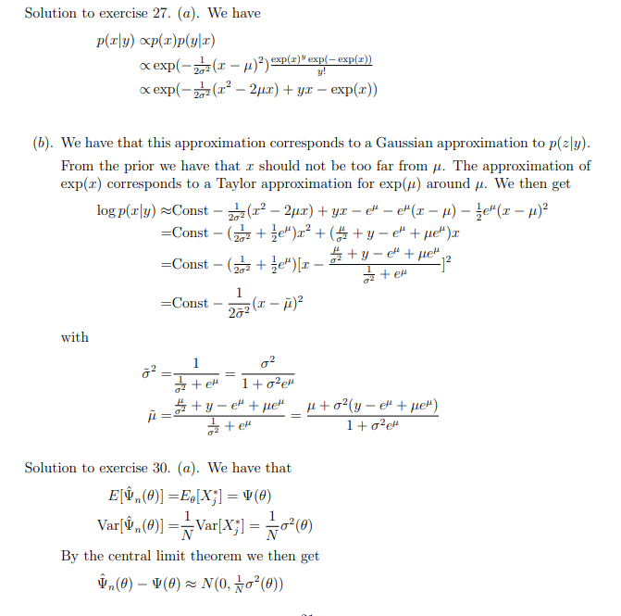

Slide 11
Make a proposal from a normal distribution using the approximation

Slide 12
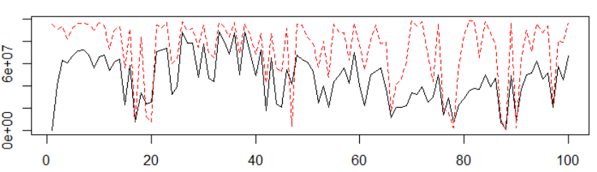
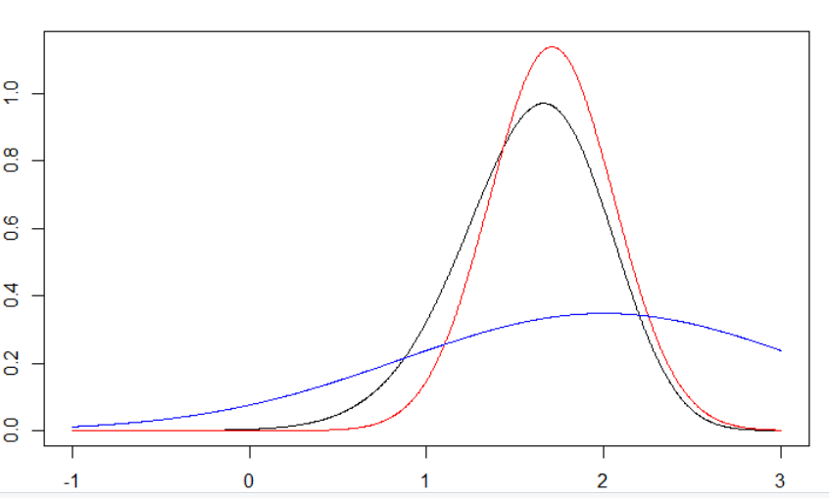
Ex 26 & 27 compare
N.eff ex27
N.eff ex26
Example of approximation
The approximation
(ex 27) is not
allways better
The main problem is the
approximation in the left tail.
In this region Gauss approx. is
too low which gives large weights
True distribution
Gaussian approx
Prior

Slide 13
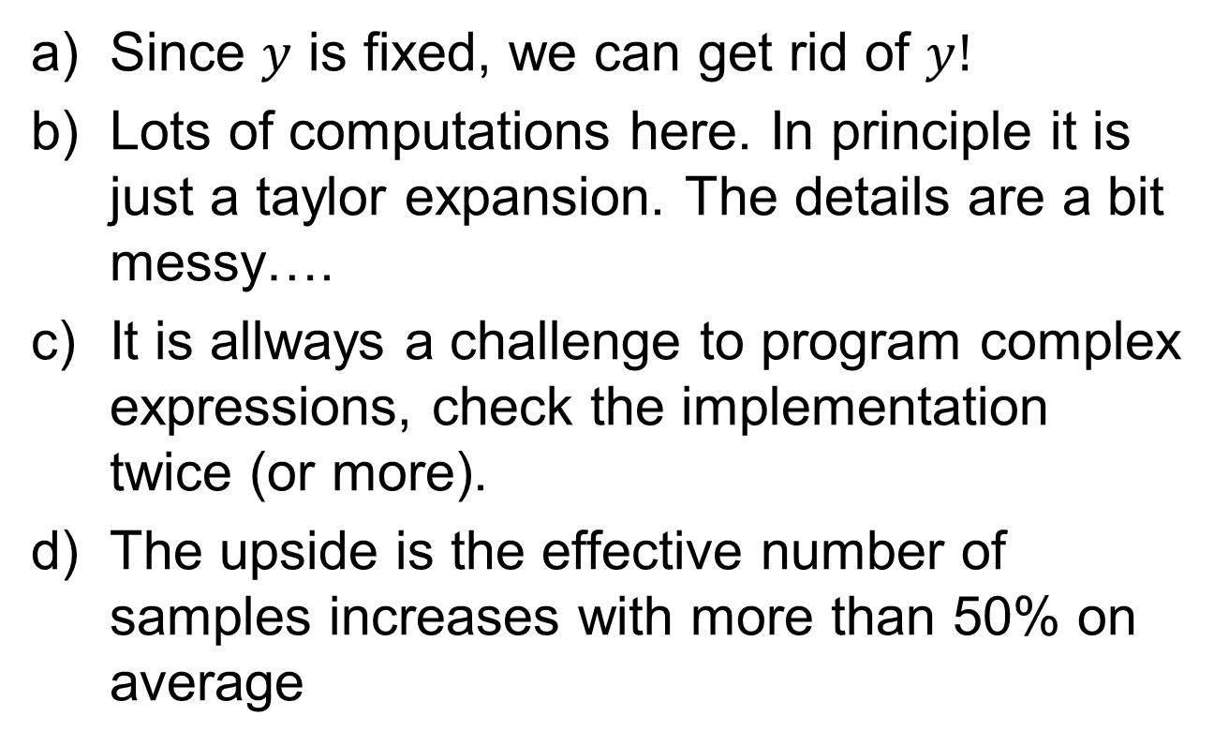
Ex 27 comments
Since $y$ is fixed, we can get rid of $y!$
Lots of computations here. In principle it is just a taylor expansion. The details are a bit messy….
It is allways a challenge to program complex expressions, check the implementation twice (or more).
The upside is the effective number of samples increases with more than 50% on average

Slide 14
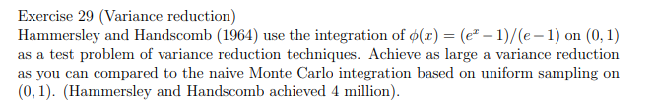

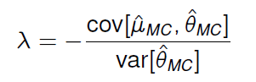
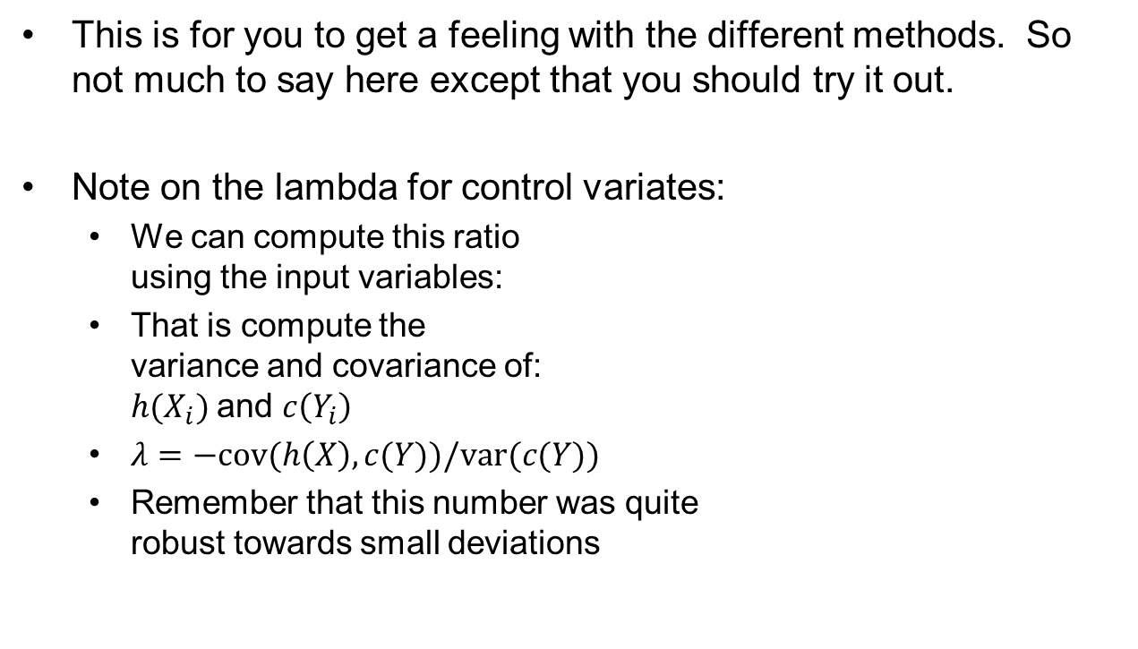
Ex 29
This is for you to get a feeling with the different methods. So not much to say here except that you should try it out.
Note on the lambda for control variates:
  We can compute this ratio
  using the input variables:
  That is compute the
  variance and covariance of:
  $h(X_{i})$and $c\left(Y_{i}\right)$
  $λ=−cov(h\left(X\right),c(Y))/var(c(Y))$
  Remember that this number was quite
  robust towards small deviations

Slide 15
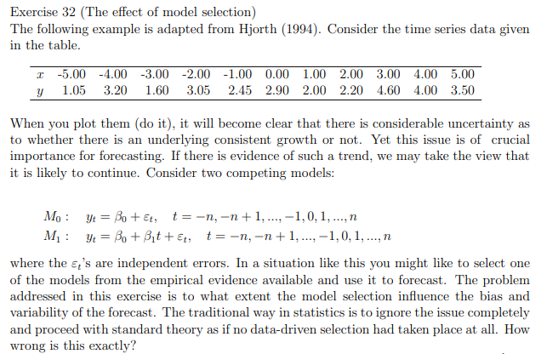
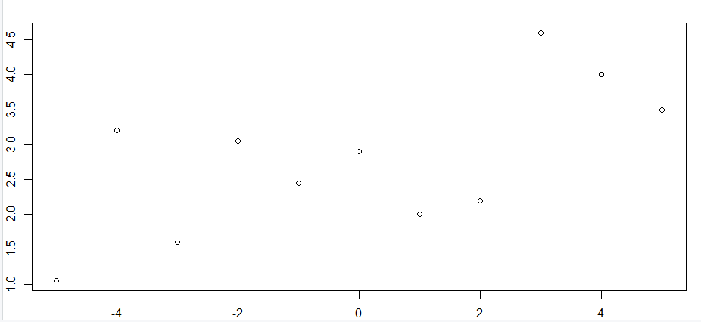

Slide 16
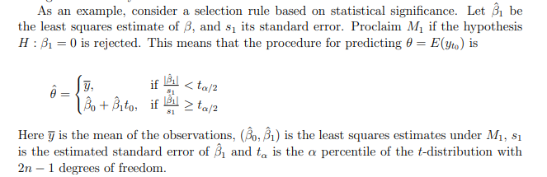
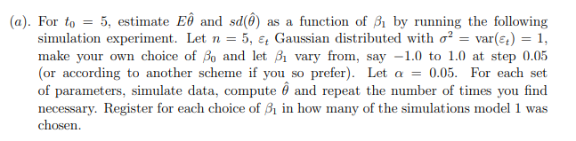
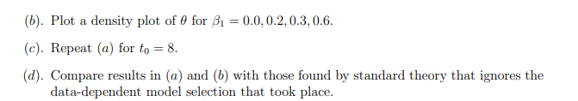

Slide 17
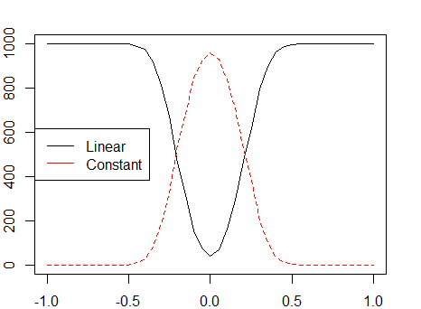
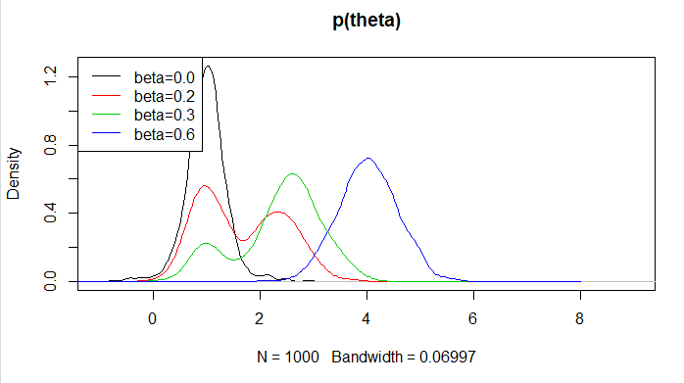
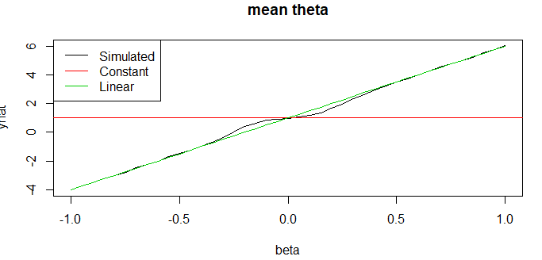
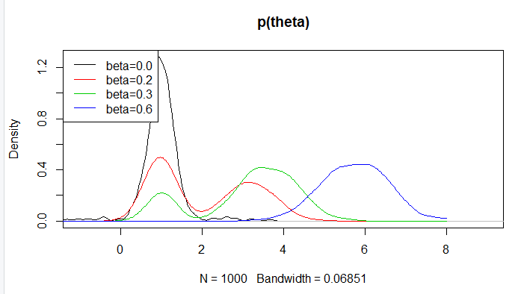
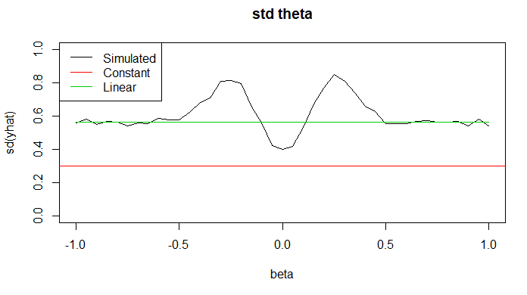




Ex 32
This task is just an example of how you can use simulations to check the method you are using. In this case for model selection. See code in R-file for implementation
$$t_{0}=5$$
$$t_{0}=5$$
$$t_{0}=8$$
$$t_{0}=5$$

Slide 18

Comments
The standard approach does not properly take the uncertainty into account when it is used for model selection.
The true model is actually bi-modal.
$$t_{0}=8$$

Slide 19
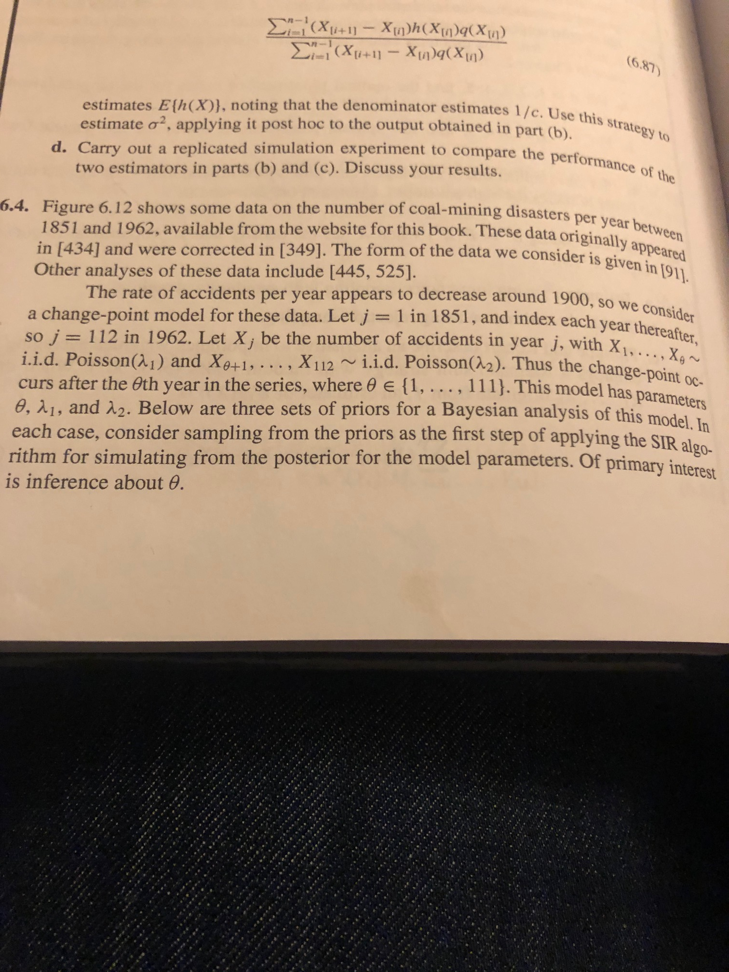



$θ$= change point
$$λ_{1}$$
$$λ_{2}$$

Slide 20
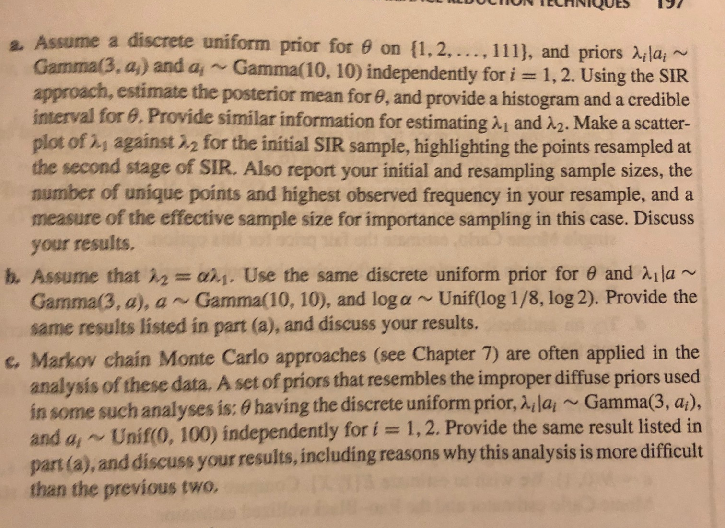

Slide 21
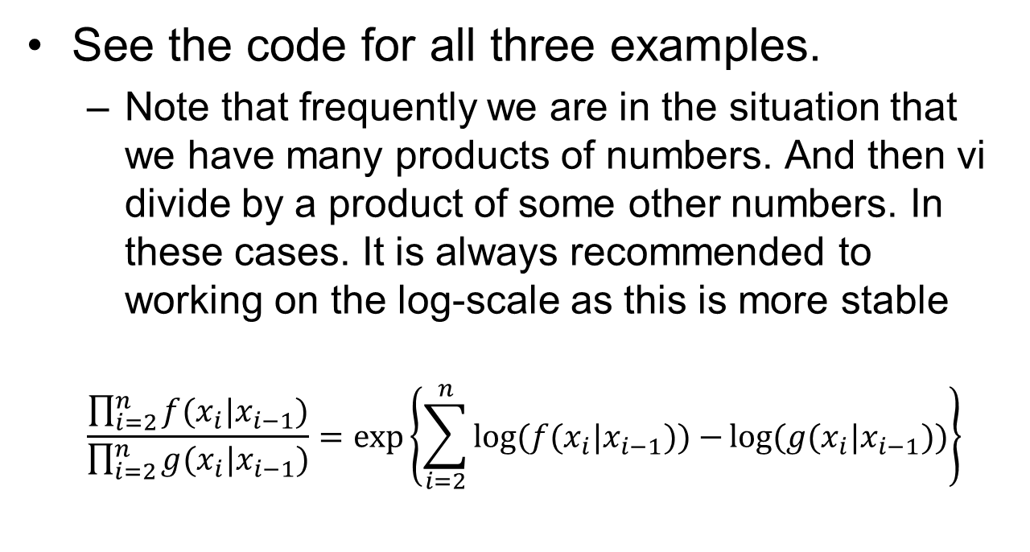
Ex 6.4
See the code for all three examples.
  Note that frequently we are in the situation that we have many products of numbers. And then vi divide by a product of some other numbers. In these cases. It is always recommended to working on the log-scale as this is more stable
  $$\frac{\prod_{i=2}^{n}{f(x_{i}|x_{i−1})}}{\prod_{i=2}^{n}{g(x_{i}|x_{i−1})}}=exp⁡\left\{\sum_{i=2}^{n}{\log{(f(x_{i}|x_{i−1}))}−}\log{(g(x_{i}|x_{i−1}))}\right\}$$
Often give
numerical problems
e.g. (0/0) or Nan/Nan
Better

Slide 22
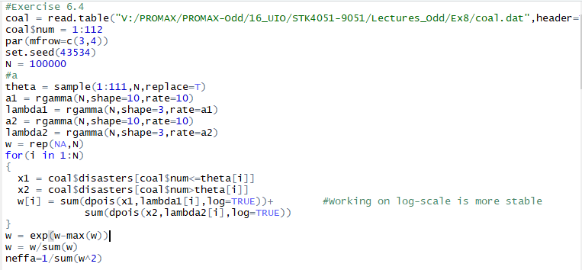
Given theta
all variables are independent
This sets the level of the weights
such that the largest value before
normalization is 1

Slide 23
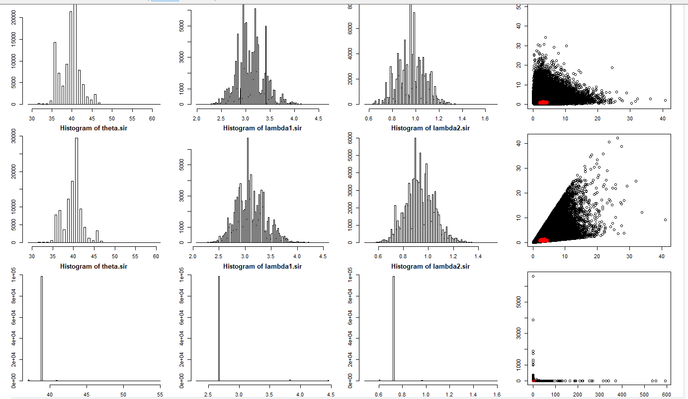
Ex 6.4

Slide 24
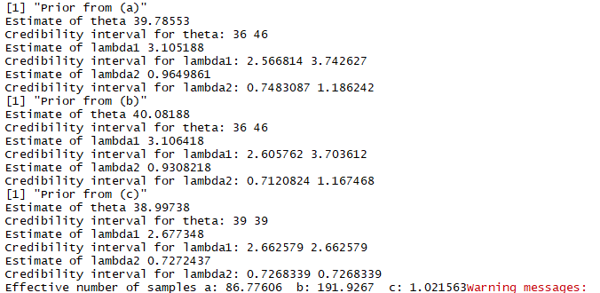
Ex 6.4
In the posterior of a and b
  The marginal distributions are similar
  Joint distribution of lambda 1 and 2 are different
The estimates are robust towards the formulation of prior distribution
In c. The method is a failure, we need many more samples to get this right
A too wide prior is sometimes not helpful
Important to know when the method has failed!

