Slide 1
STK-4051/9051 Computational Statistics Spring 2024
Ex5
Instructor: Odd Kolbjørnsen, oddkol@math.uio.no

Slide 2
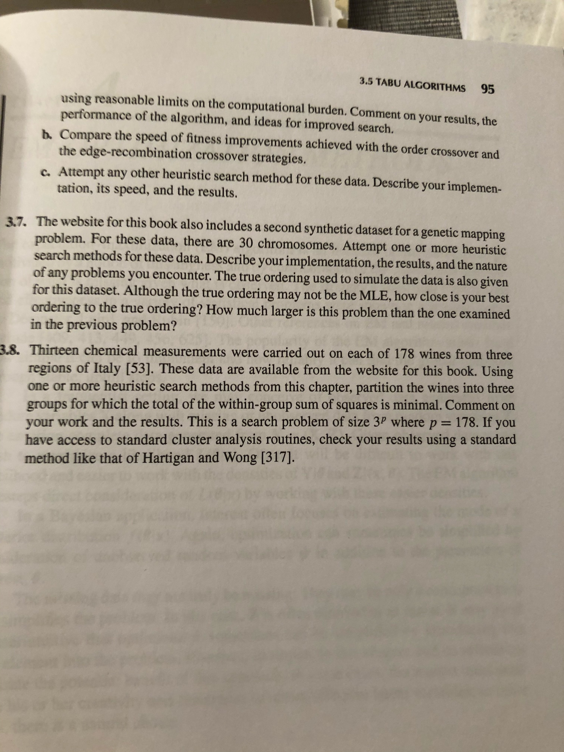
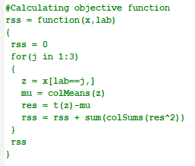
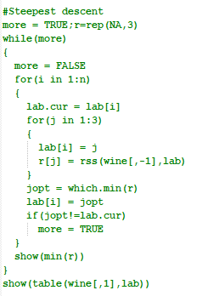
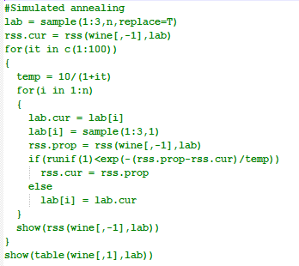

Slide 3
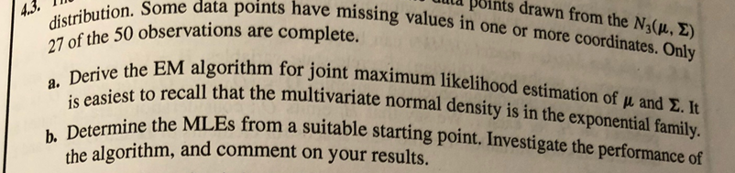
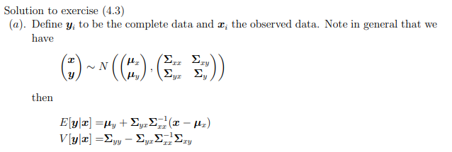
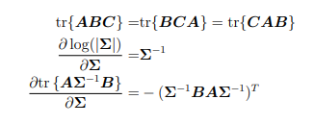

Slide 4
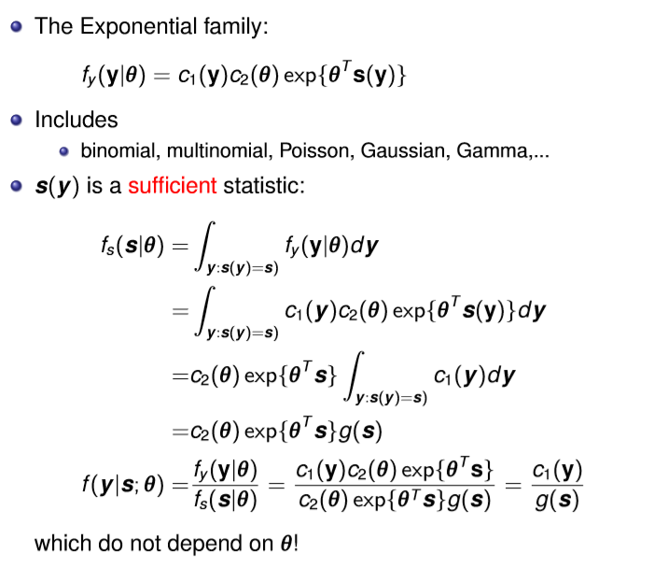
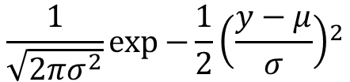
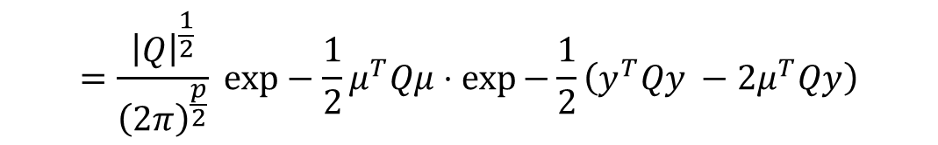
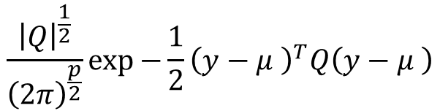
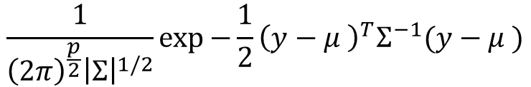
Normal distribution is in the exponential family
$$\frac{1}{\sqrt{2πσ^{2}}}{\exp{−\frac{1}{2}\left(\frac{y−μ}{σ}\right)}}^{2}$$
$$\frac{1}{{\left(2π\right)}^{\frac{p}{2}}{\left|Σ\right|}^{1/2}}\exp{−\frac{1}{2}{\left(y−μ \right)}^{T}Σ^{−1}(y−μ )}$$
$$\frac{{\left|Q\right|}^{\frac{1}{2}}}{{\left(2π\right)}^{\frac{p}{2}}}\exp{−\frac{1}{2}{\left(y−μ \right)}^{T}Q\left(y−μ \right)}$$
$$=\frac{{\left|Q\right|}^{\frac{1}{2}}}{{\left(2π\right)}^{\frac{p}{2}}} exp−\frac{1}{2}μ^{T}Qμ⋅\exp{−\frac{1}{2}\left(y^{T}Qy −2μ^{T}Qy\right)}$$

Slide 5
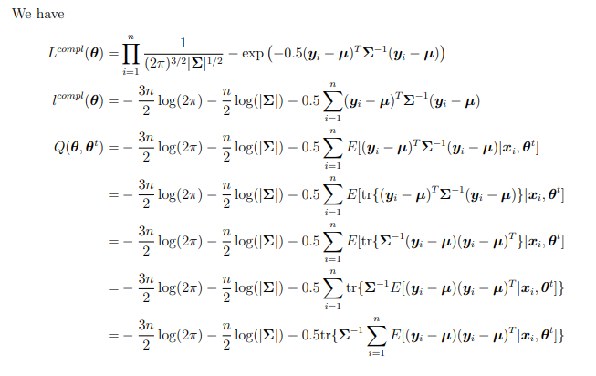
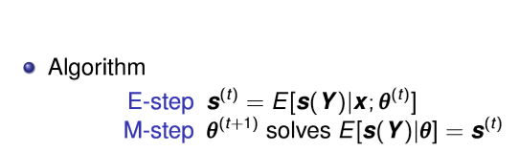
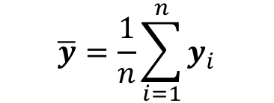
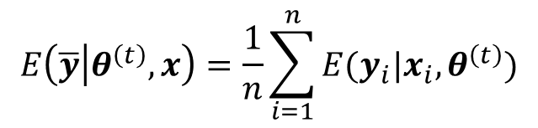

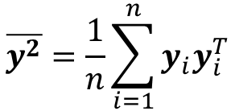
Alternative:
Sufficient statistics for normal distribution:
$$\overline{y}=\frac{1}{n}\sum_{i=1}^{n}{y_{i}}$$
$$\overline{y^{2}}=\frac{1}{n}\sum_{i=1}^{n}{{y_{i}y}_{i}^{T}}$$
$$E\left(\overline{y} | θ^{\left(t\right)},x\right)=\frac{1}{n}\sum_{i=1}^{n}{{E(y}_{i}|x_{i},θ^{\left(t\right)})}$$
$$E\left(\overline{y} | θ\right)=μ$$

Slide 6

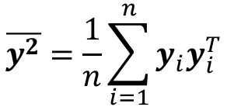
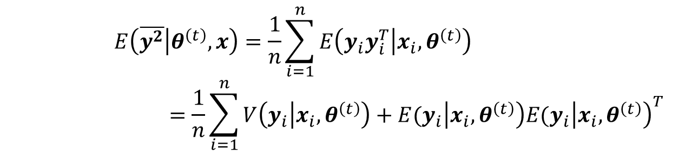
$$\overline{y^{2}}=\frac{1}{n}\sum_{i=1}^{n}{{y_{i}y}_{i}^{T}}$$
$$E\left(\overline{y^{2}} | θ\right)=Σ+μμ^{T}$$
$$E\left(\overline{y^{2}} | θ^{\left(t\right)},x\right)=\frac{1}{n}\sum_{i=1}^{n}{E\left({y_{i}y}_{i}^{T} | x_{i},θ^{\left(t\right)}\right) }$$
$$=\frac{1}{n}\sum_{i=1}^{n}{V\left(y_{i} | x_{i},θ^{\left(t\right)}\right)+{E(y}_{i}\left|x_{i},θ^{\left(t\right)}\right){E(y}_{i}{\left|x_{i},θ^{\left(t\right)}\right)}^{T}}$$

Slide 7
From scratch…

Slide 8
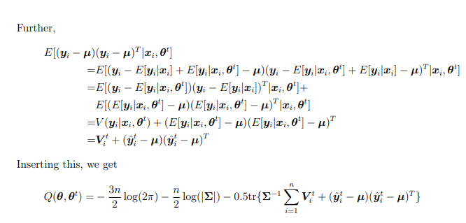
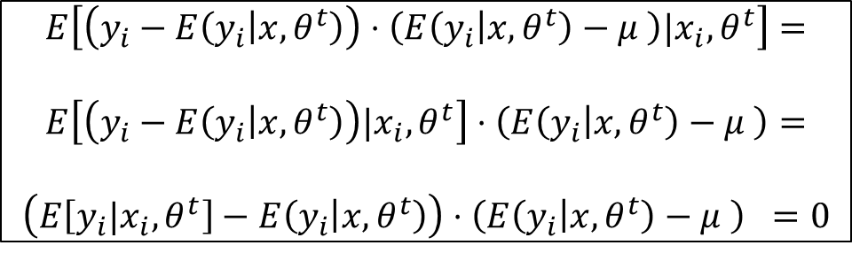
$$E\left[\left(y_{i}−E\left(y_{i} | x,θ^{t}\right)\right)⋅\left(E\left(y_{i} | x,θ^{t}\right)−μ \right)|x_{i},θ^{t}\right]=$$
$$E\left[\left(y_{i}−E\left(y_{i} | x,θ^{t}\right)\right)|x_{i},θ^{t}\right]⋅\left(E\left(y_{i} | x,θ^{t}\right)−μ \right)=$$
$$\left(E\left[y_{i}|x_{i},θ^{t}\right]−E\left(y_{i} | x,θ^{t}\right)\right)⋅\left(E\left(y_{i} | x,θ^{t}\right)−μ \right) =0$$

Slide 9
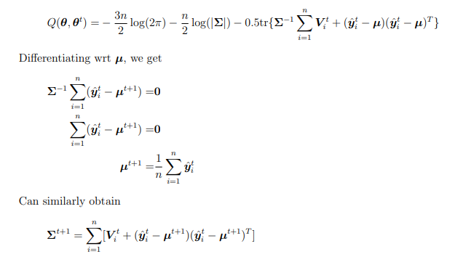

Slide 10
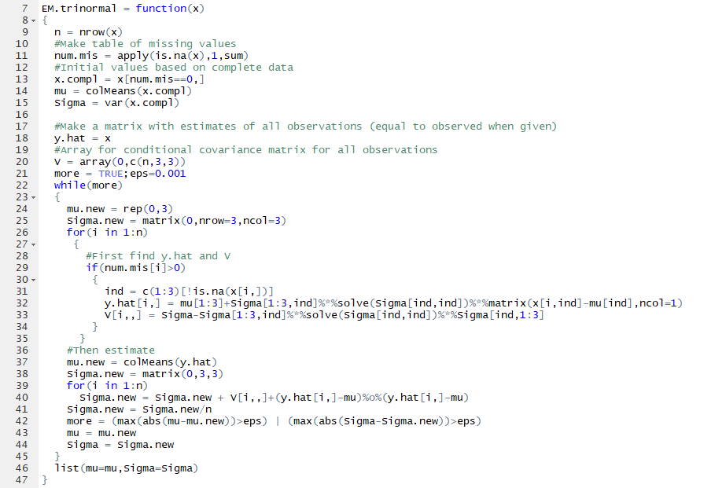
Initialize mu and sigma
Set data for all
Only update data which have missing

Slide 12



Slide 13
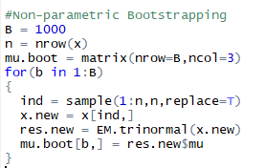
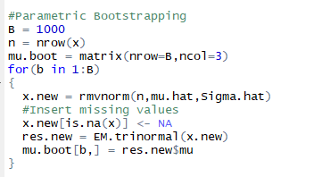
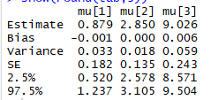
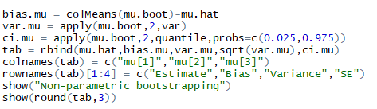
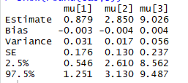
Bootstrap

Slide 14

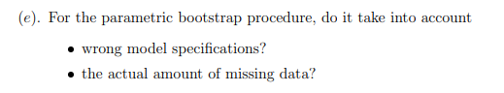

Slide 15
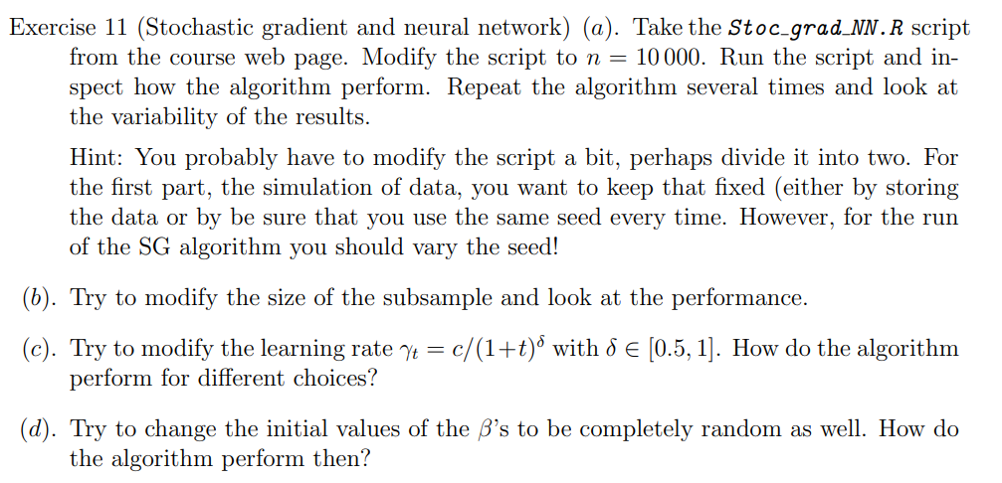
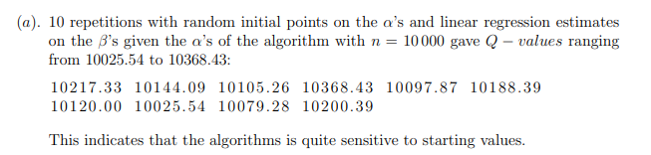

Slide 16
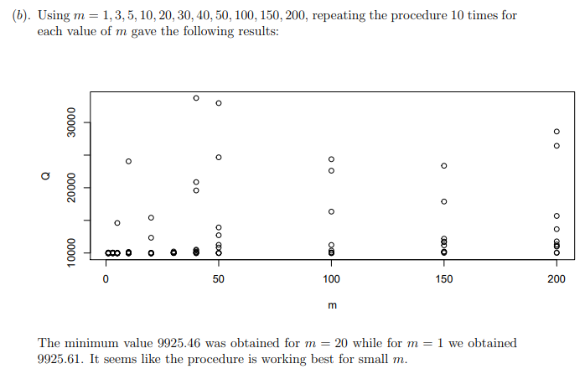

Slide 17
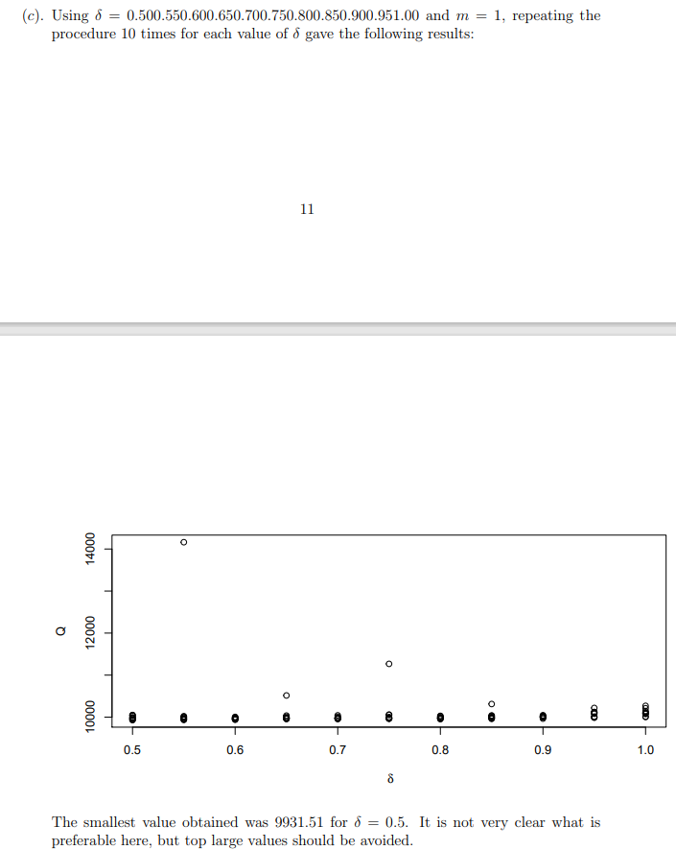

Slide 18
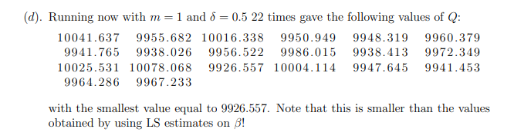

Slide 19
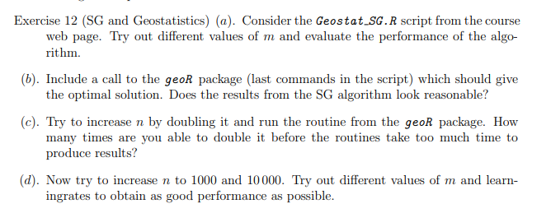

Slide 20
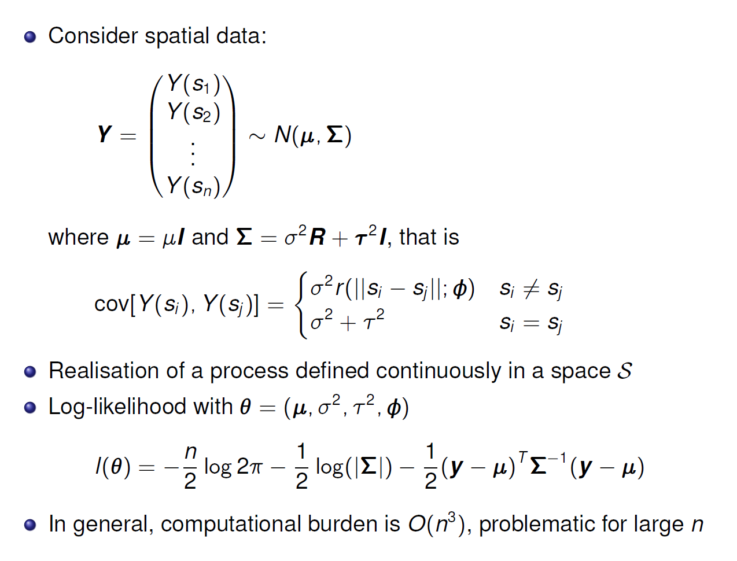
SGD for dependent data

Slide 21
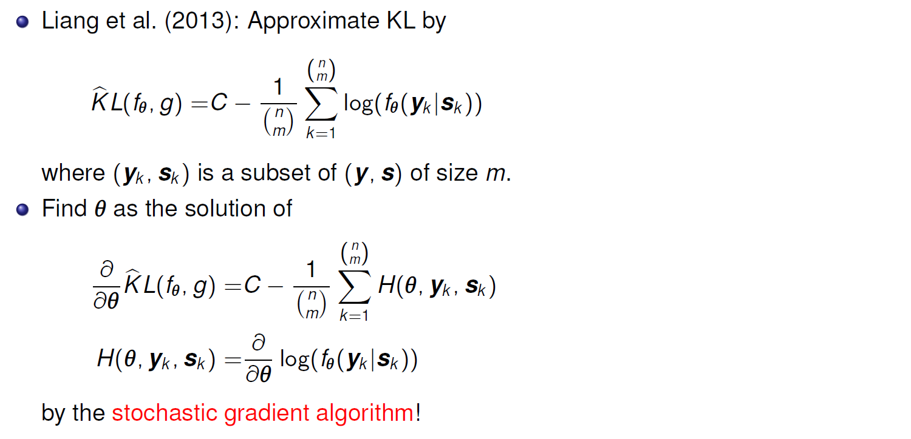
KL and Geostatistics

Slide 22
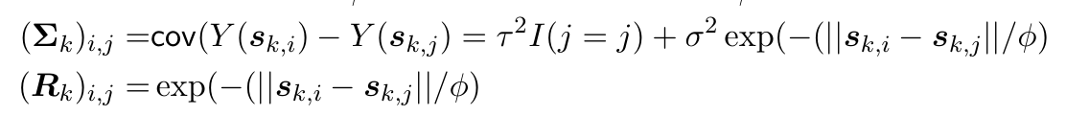
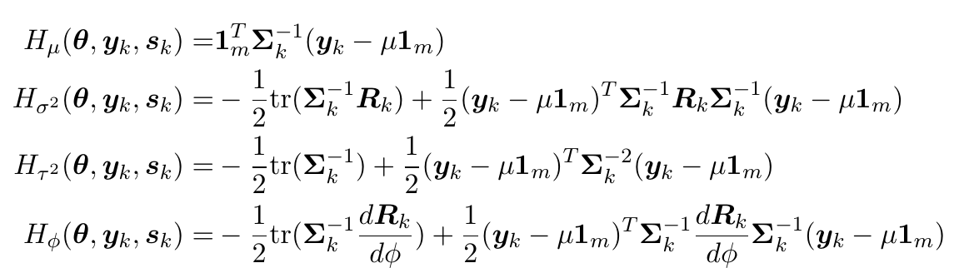
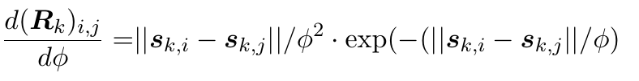


Example
$$\log{f\left(y_{k} | s_{k}\right)=−\frac{m}{2}\log{2π}−\frac{1}{2}\log\left|Σ_{k}\right|−\frac{1}{2}{\left(y_{k}−μ1_{m}\right)}^{T}Σ_{k}^{−1}\left(y_{k}−μ1_{m}\right)⁡}$$
$$σ^{2}$$
$$σ^{2}$$

Slide 23
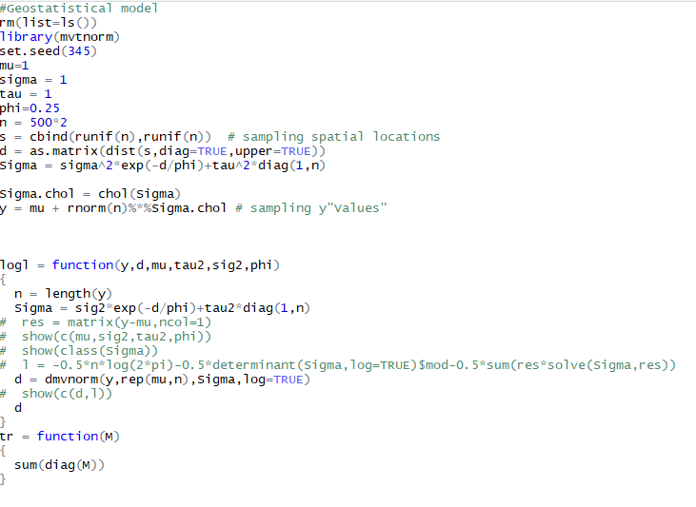

Slide 24
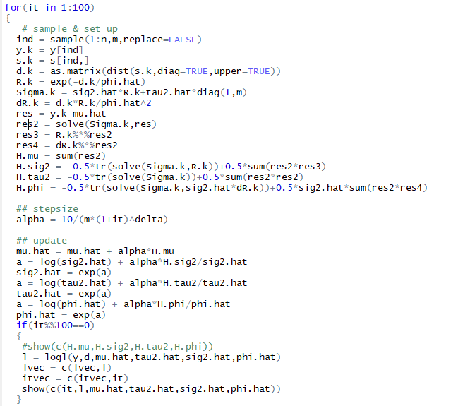

Slide 25
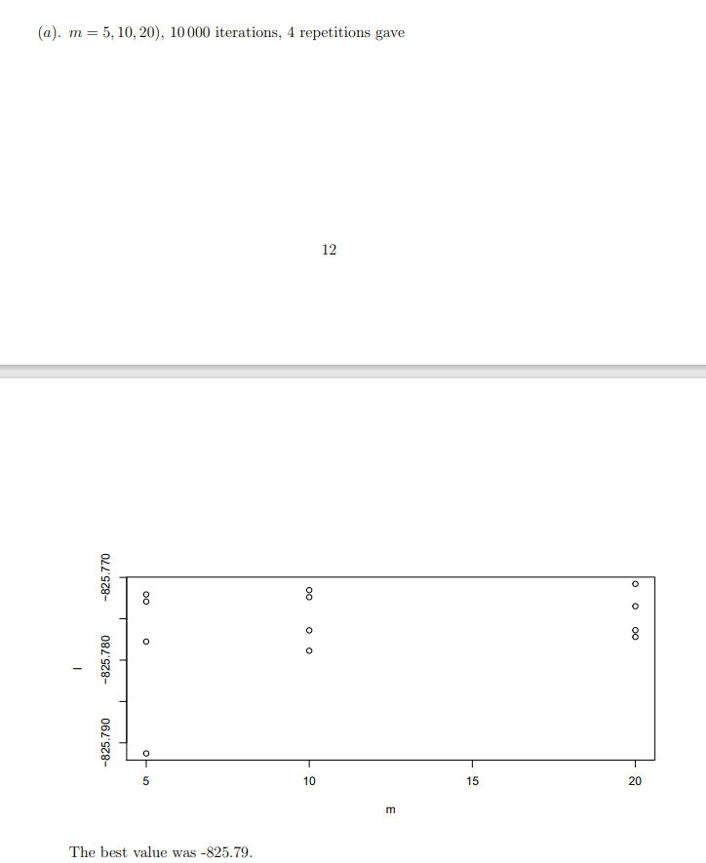

Slide 26


