Slide 1
STK-4051/9051 Computational Statistics Spring 2024
Ex4
Instructor: Odd Kolbjørnsen, oddkol@math.uio.no

Slide 2
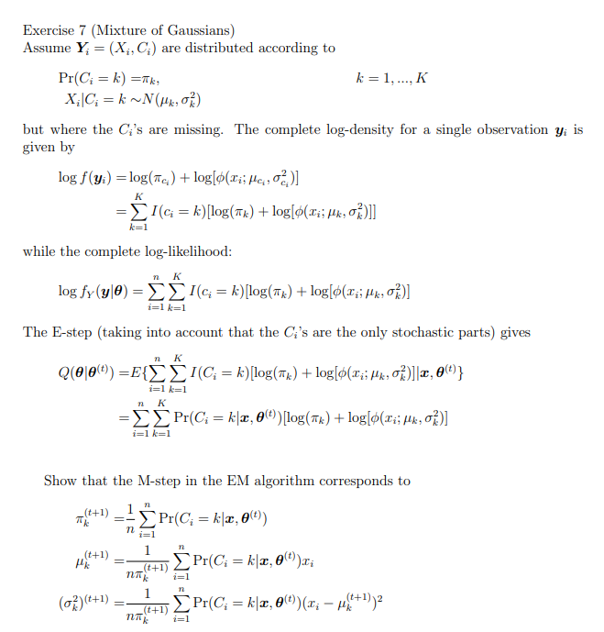

Slide 3
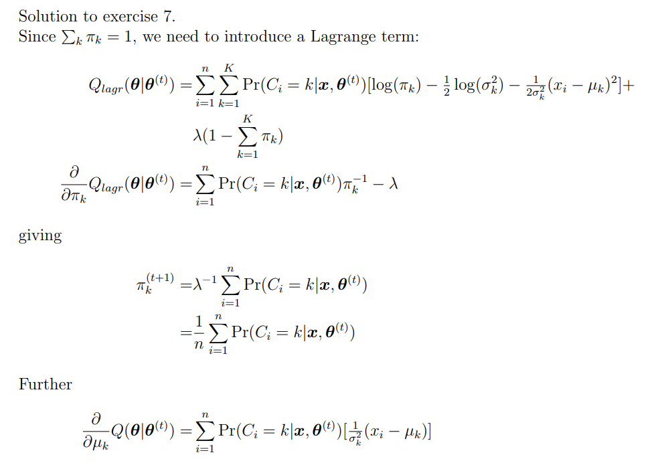
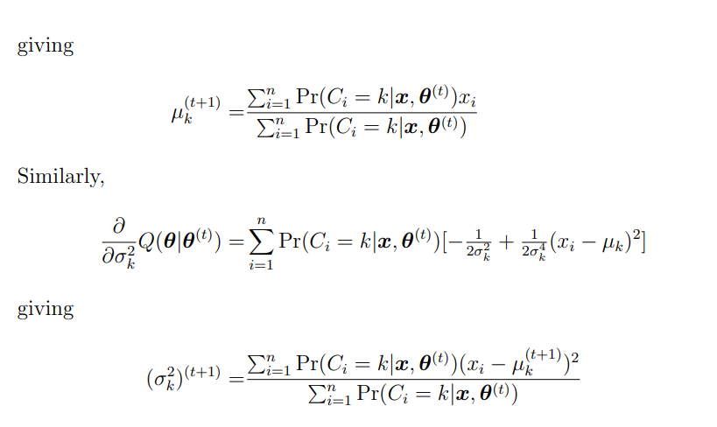

Slide 4

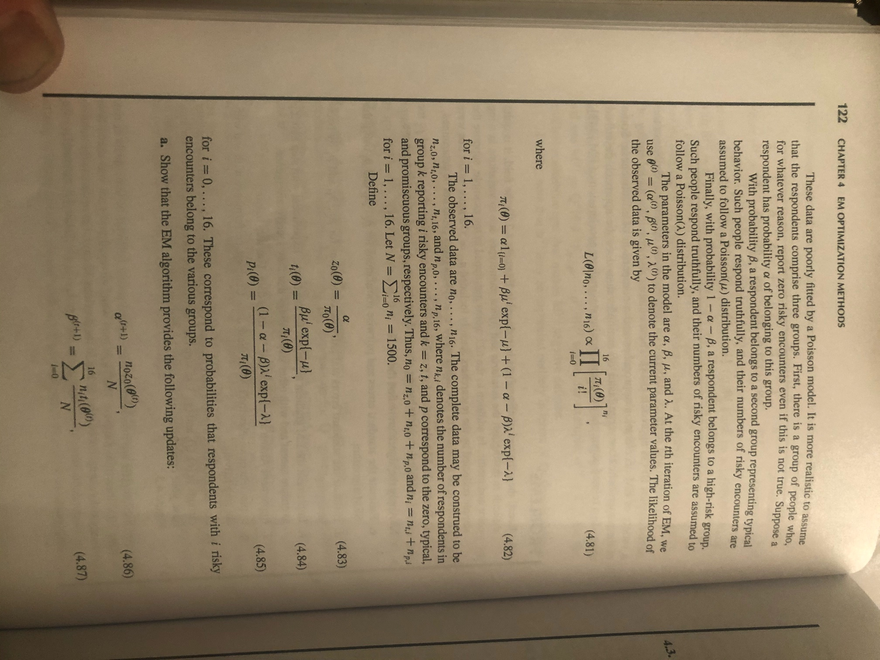

$$i=0,1,…,16$$

Slide 5


Slide 6
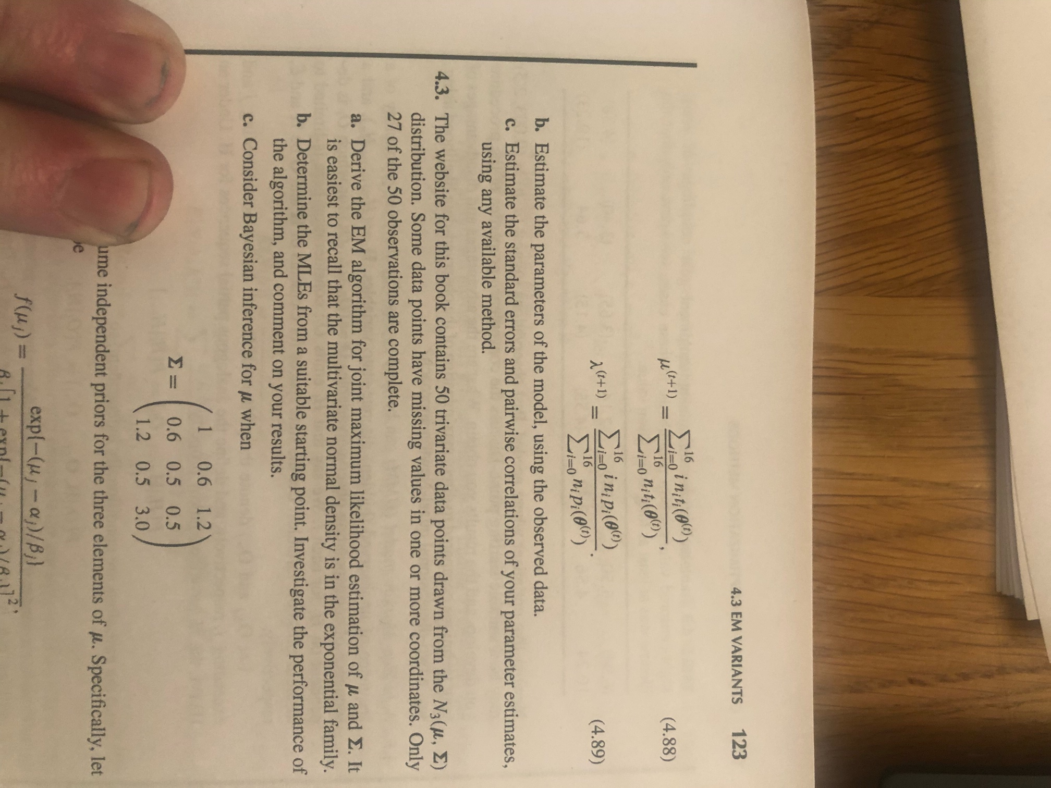

Slide 7

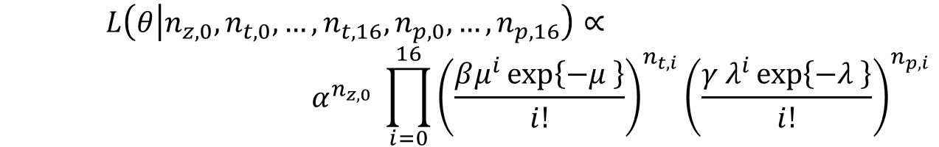
The complete and marginal likelihood
Marginal likelihood
The complete likelihood, we know also how many there are
in each group (i.e. for each person we know group membership and count)
$$L\left(θ | n_{z,0}, n_{t,0},…,n_{t,16},n_{p,0},…,n_{p,16}\right)∝$$
$$α^{n_{z,0}} \prod_{i=0}^{16}{{\left(\frac{βμ^{i}\exp\left\{−μ \right\}}{i!}\right)}^{n_{t,i}}}{\left(\frac{γ λ^{i}\exp\left\{−λ \right\}}{i!}\right)}^{n_{p,i}}$$

Slide 8
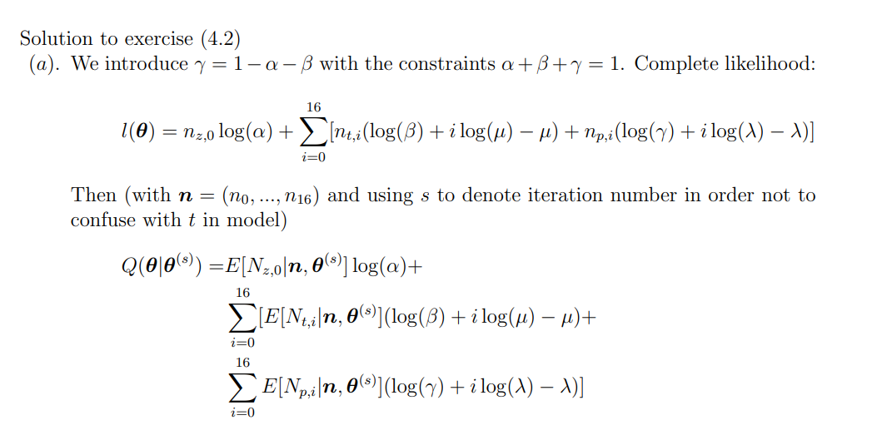
So we need the expectations

Slide 9
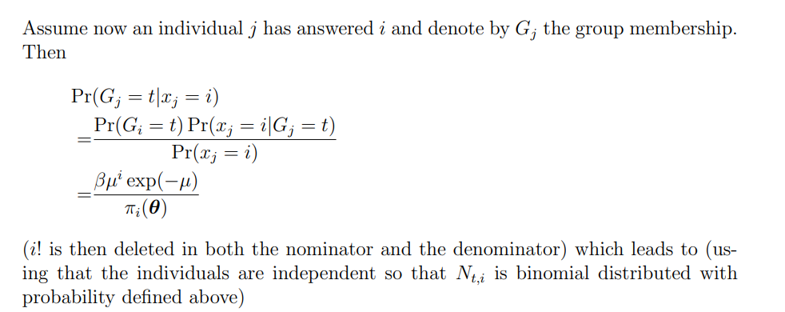
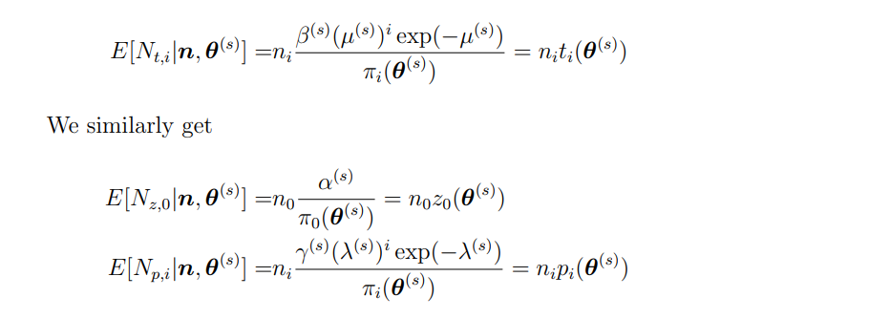


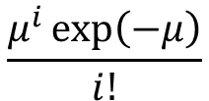

$$\frac{μ^{i}\exp\left(−μ\right)}{i!}$$
$$G_{j}∈\{z,t,p\}$$
$$β$$
$$\frac{π_{i}(θ)}{i!}$$

Slide 10
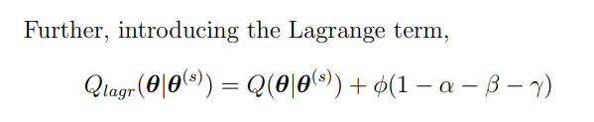
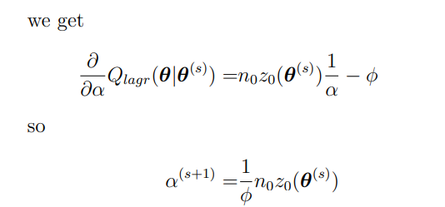
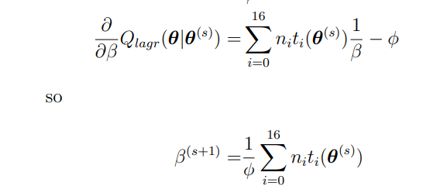
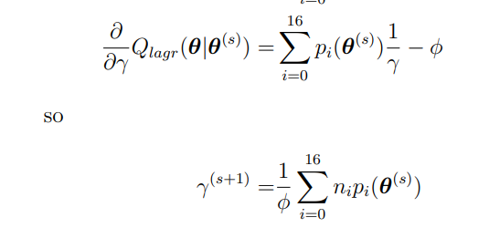
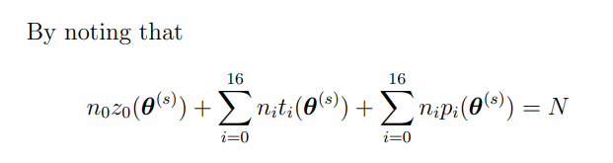

Lagrange multiplier
$$we get: φ=N$$

Slide 11
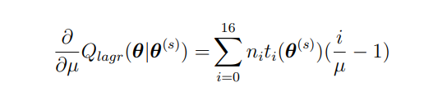
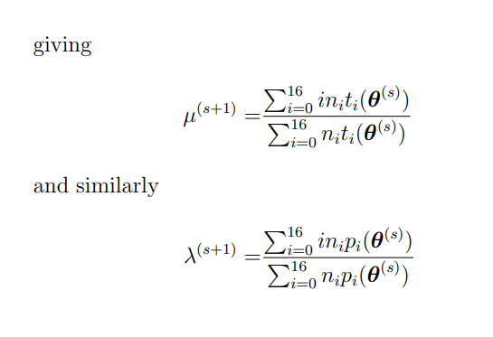

Slide 12
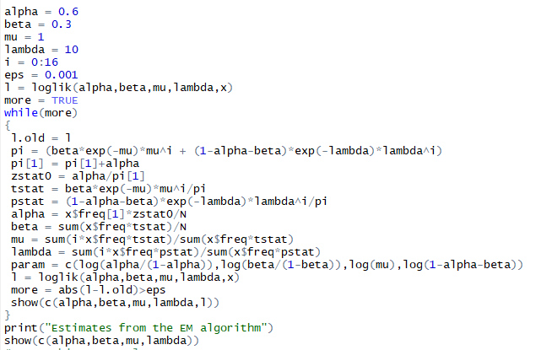
What happends if you start off:
mu=5
lambda=5

Slide 13
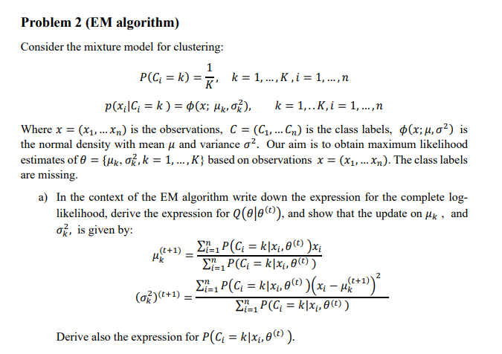

Slide 14
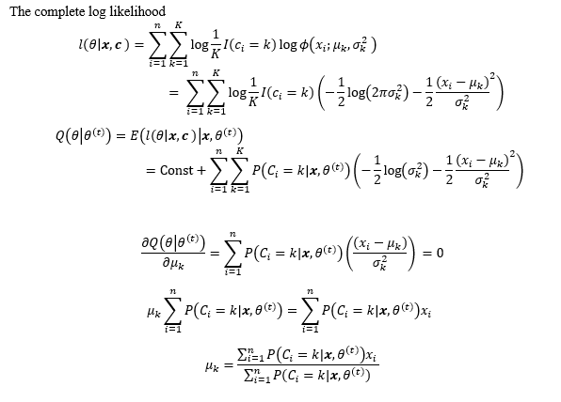

Slide 15
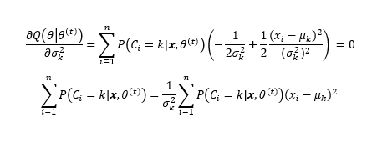
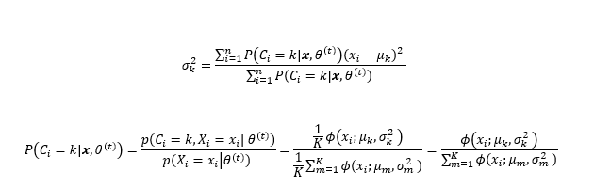

Slide 16
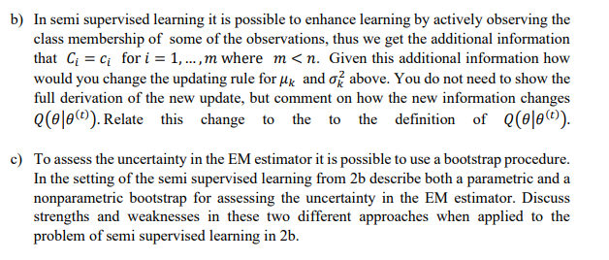
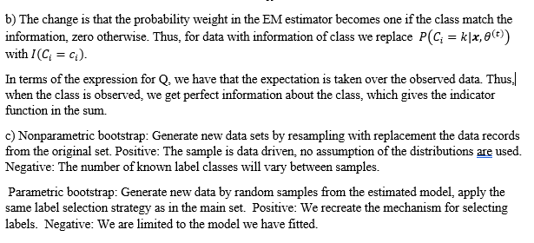

Slide 18
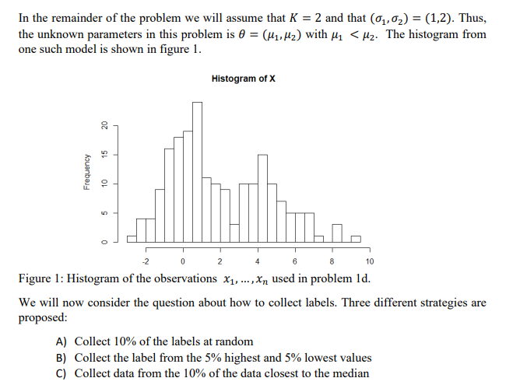

Slide 19

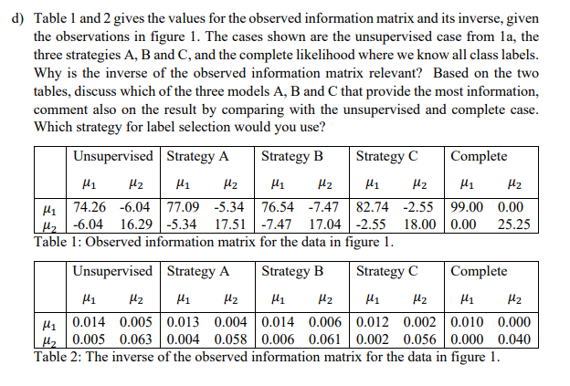

Slide 20
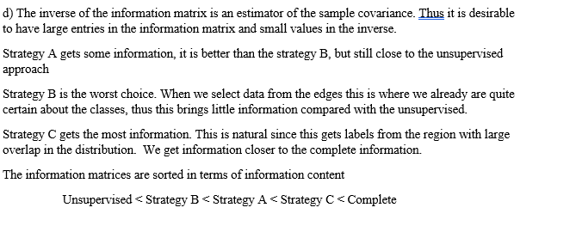

Slide 21
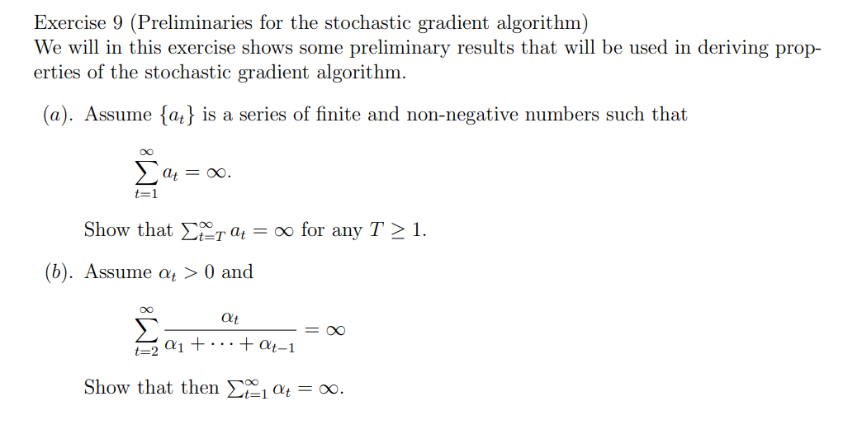
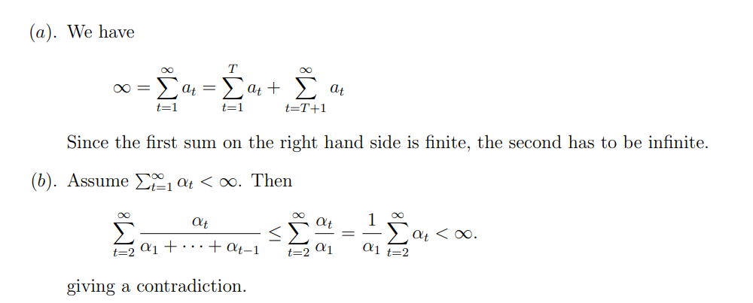

Slide 23
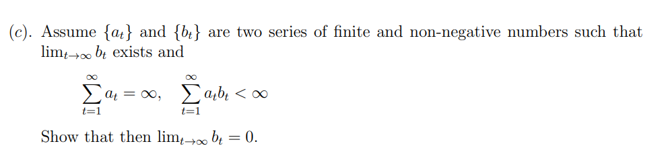
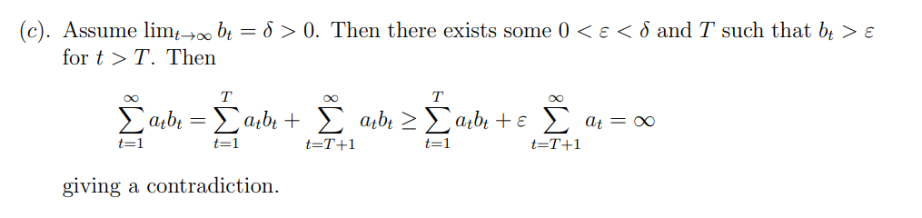

Slide 24
