Slide 1
STK-4051/9051 Computational Statistics Spring 2024
Ex2
Instructor: Odd Kolbjørnsen, oddkol@math.uio.no

Slide 2
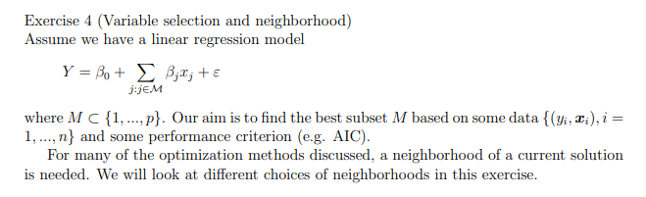

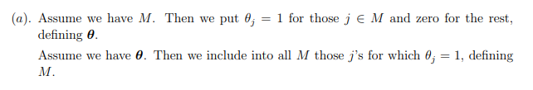

Slide 3
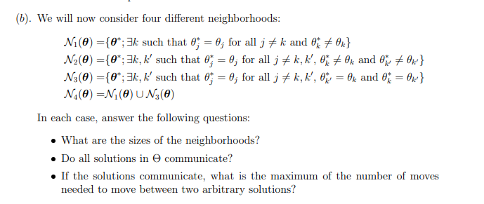
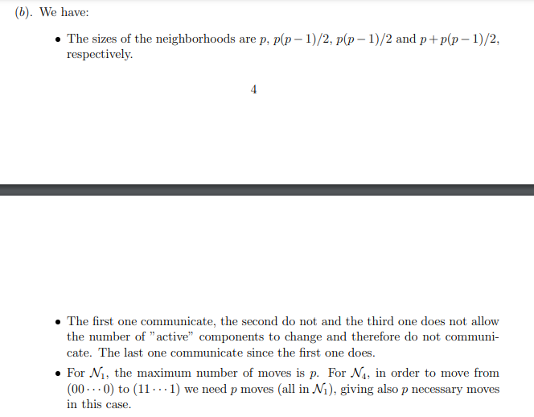

Slide 4
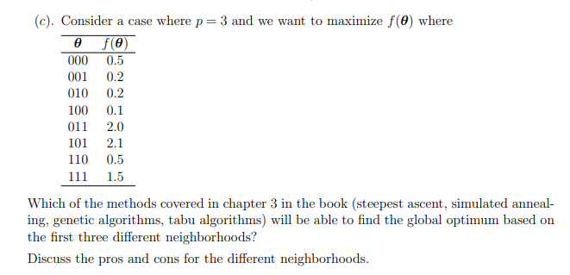
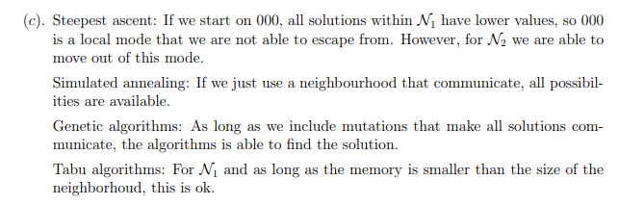

Slide 5
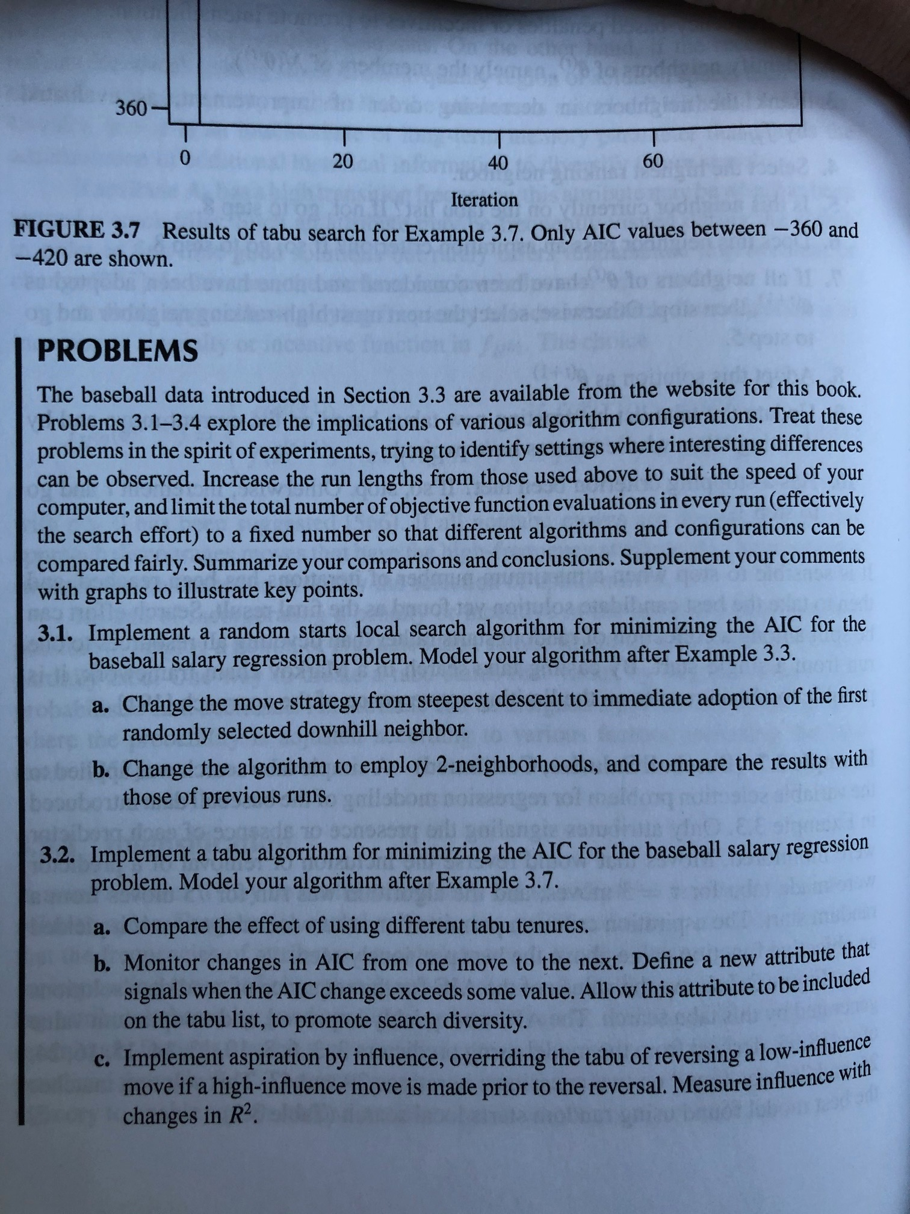
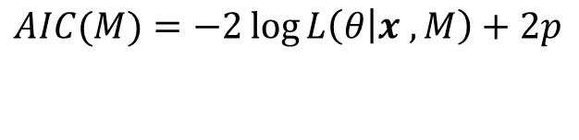
AIC is used for model selection where we also account for
different numbers of parameters, want AIC to be small
$$AIC(M)=−2\log{L\left(θ | x ,M\right)+2p}$$
Term giving penalty for «bad match» to data
Term giving penalty for number of parameters in M
Intuition: if you have a model with many parameters,
you will fit data better, but you are in danger of overfitting
Thus we need to penalize model complexity

Slide 6
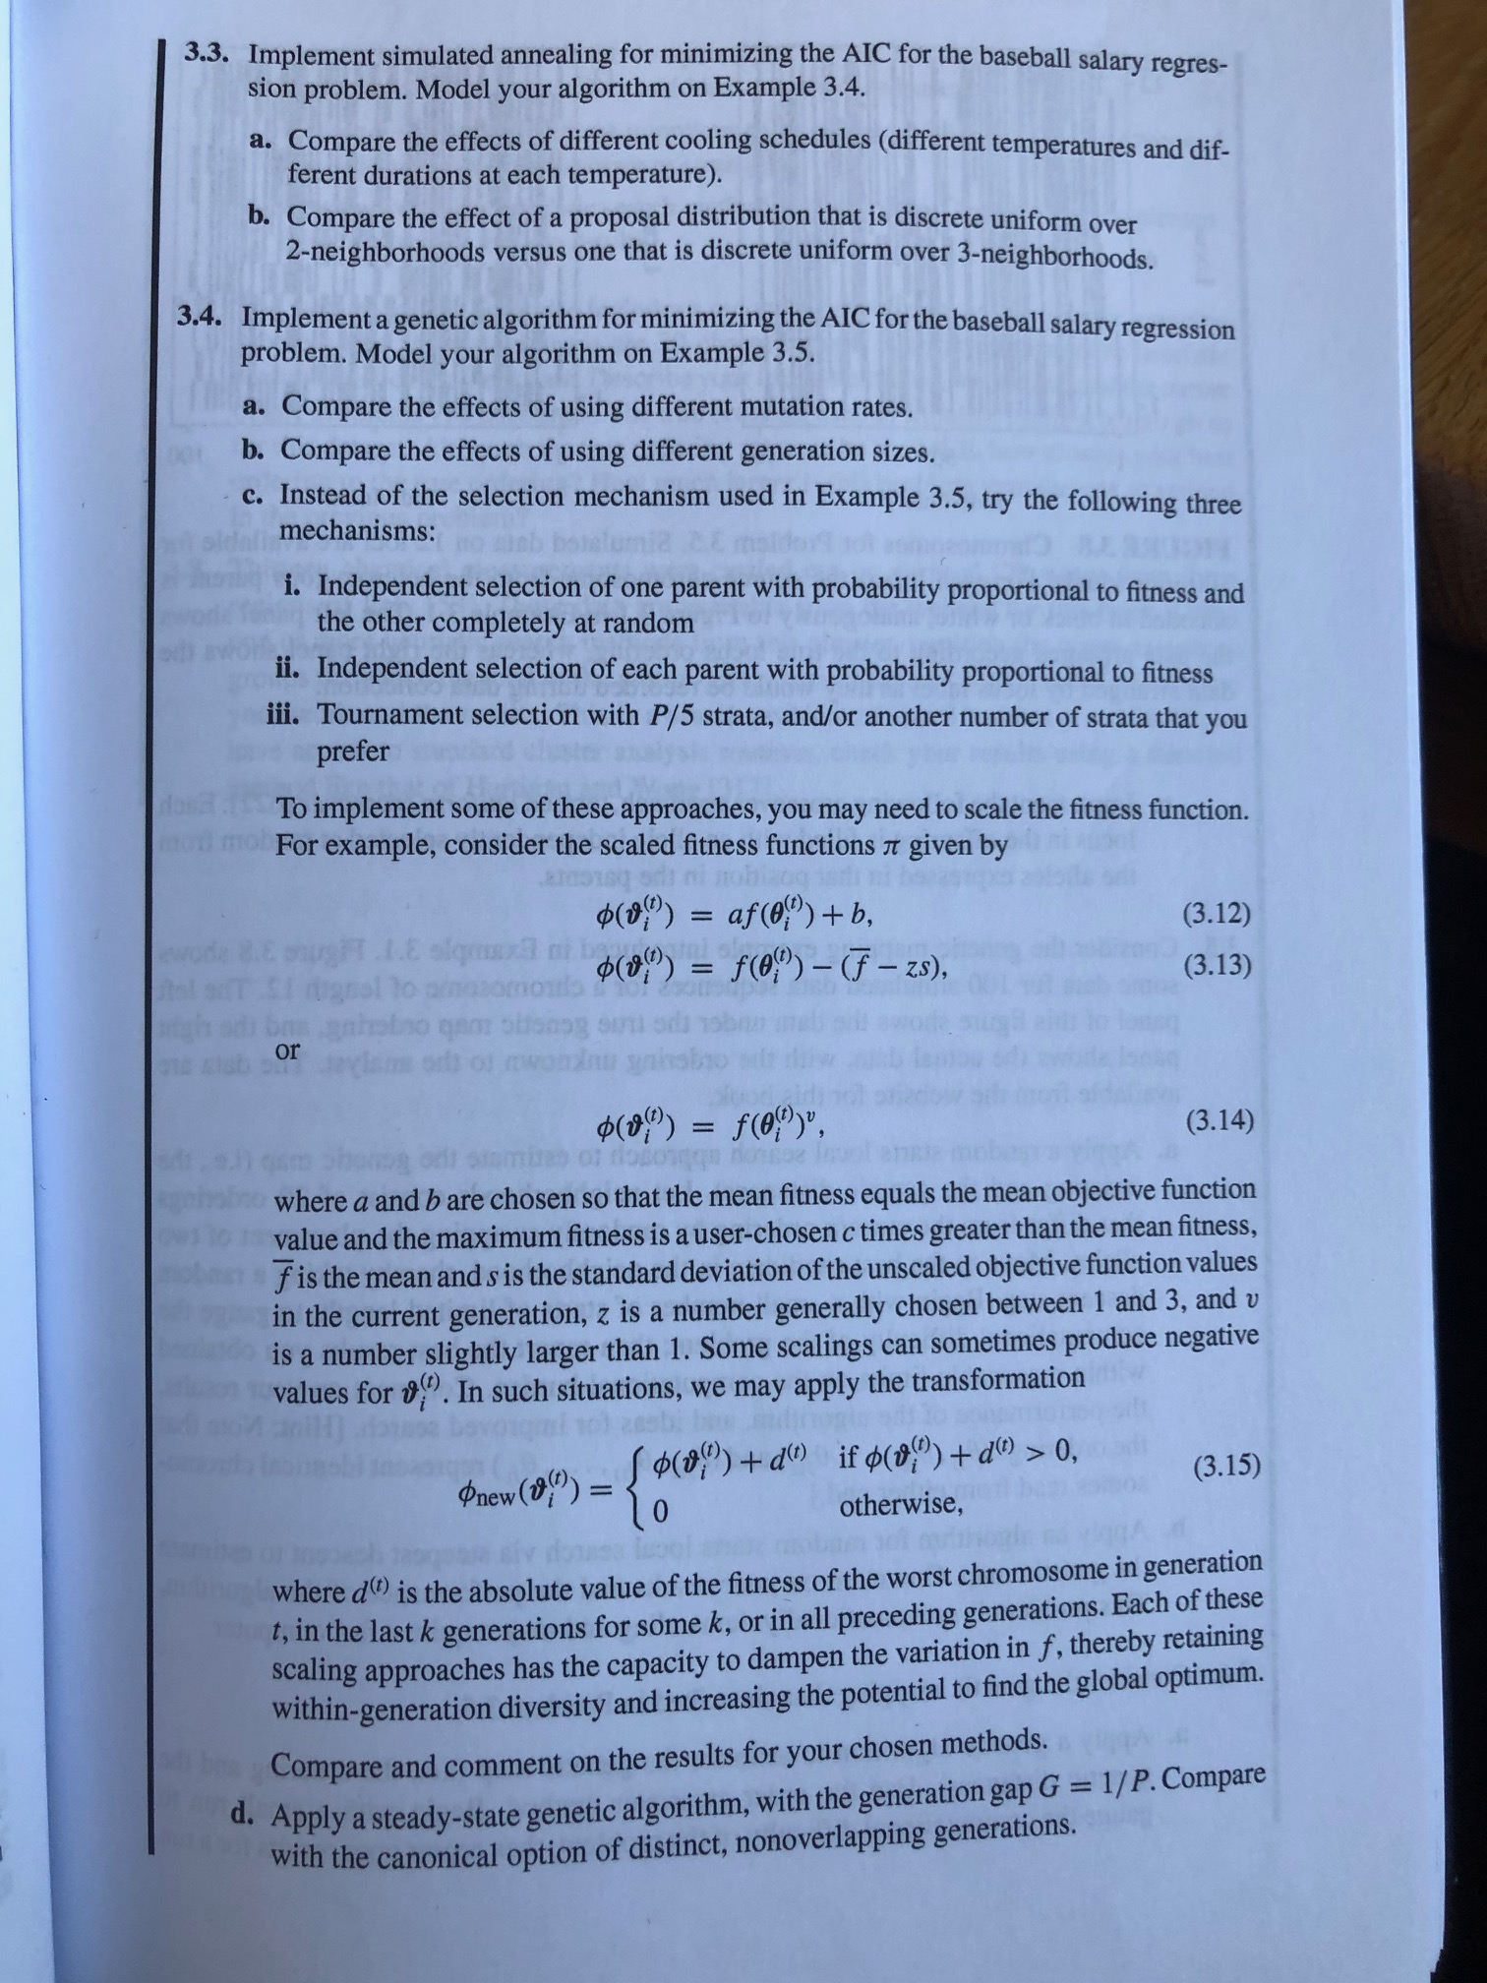

Slide 7
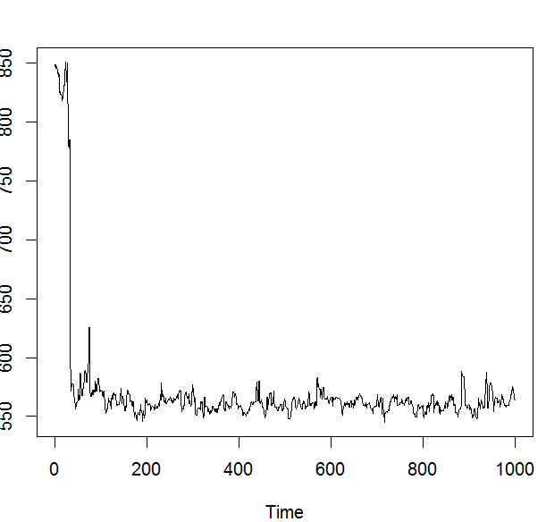
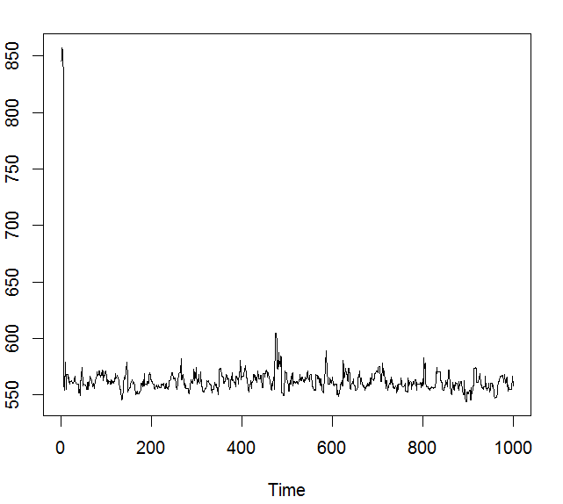
Ex 3.3 100/log(i+1) mi=1
2-nbh
3-nbh

Slide 8
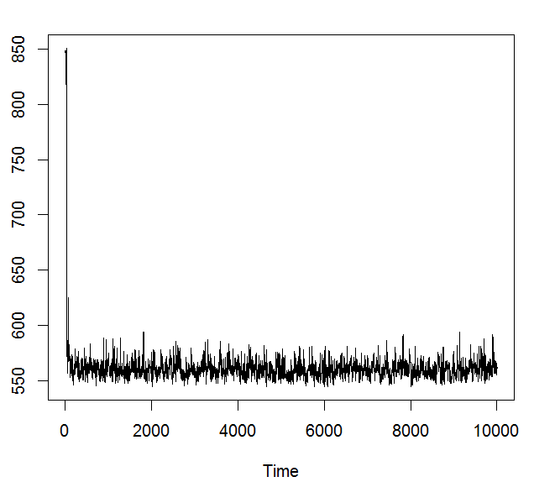
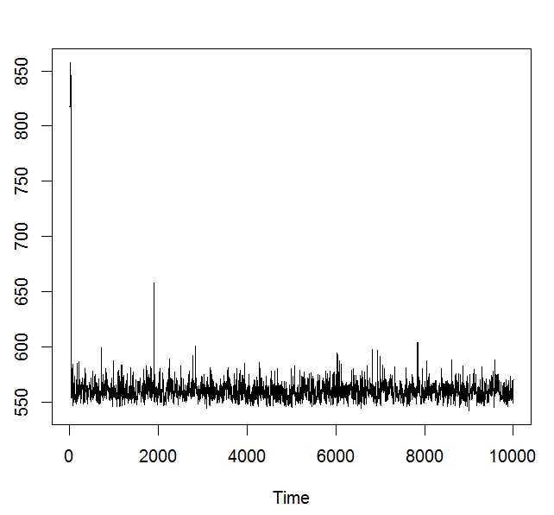
Ex 3.3 100/log(i+1) mi=1
2-nbh
3-nbh

Slide 9
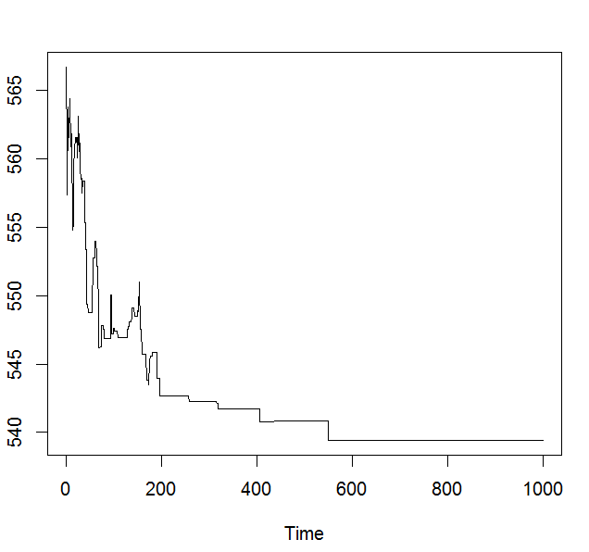
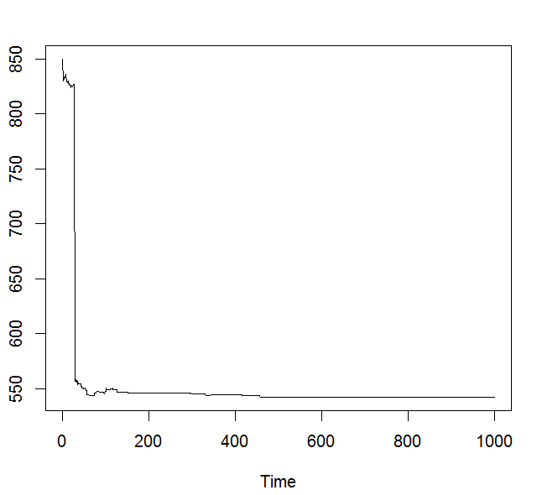
Ex 3.3 100/(i+1) mi=1
2-nbh
3-nbh

Slide 10
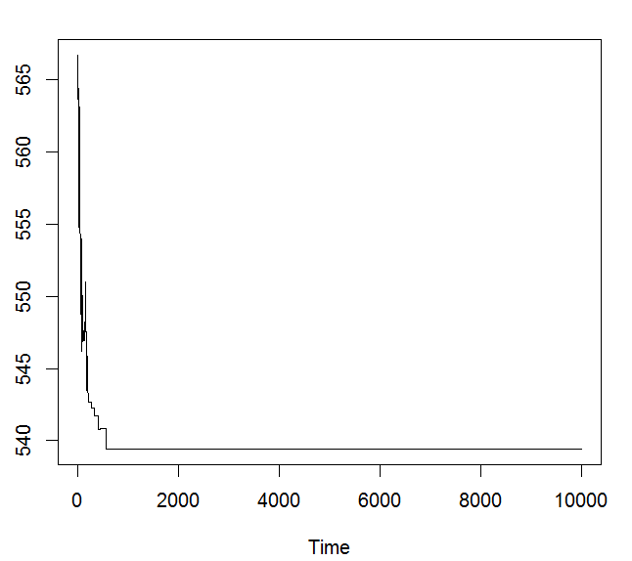
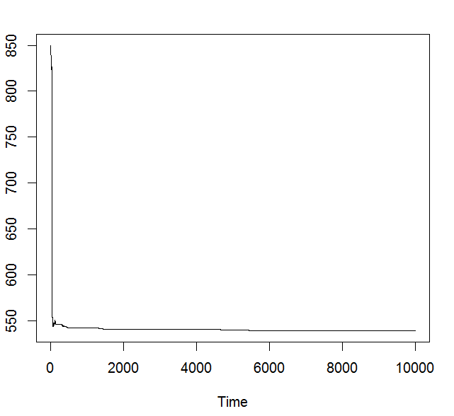
Ex 3.3 100/(i+1); mi=1
2-nbh
3-nbh

Slide 11
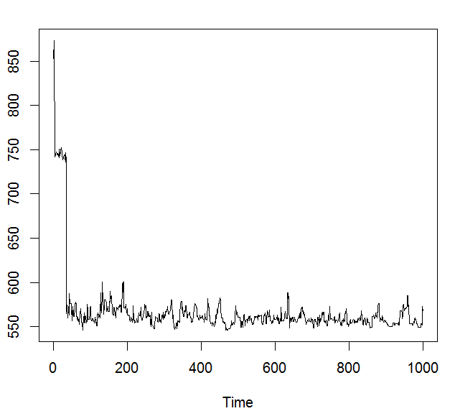
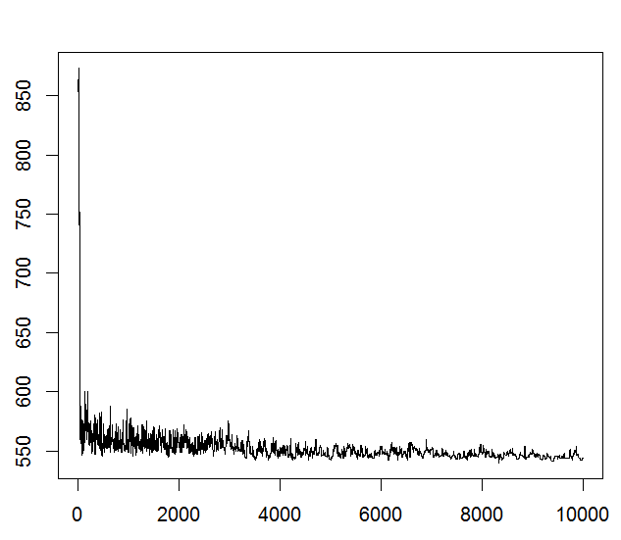
Ex 3.3 100/(i+1); mi=100
3-nbh

