Slide 1



KJM3110 Electrochemistry
Expansion of Ch 5 on Batteries
Truls Norby
(thanks to prof. Ola Nilsen for many inputs and figures)
Some slides are integrated from those in Ch 5 so as to contain all on batteries here

Slide 2
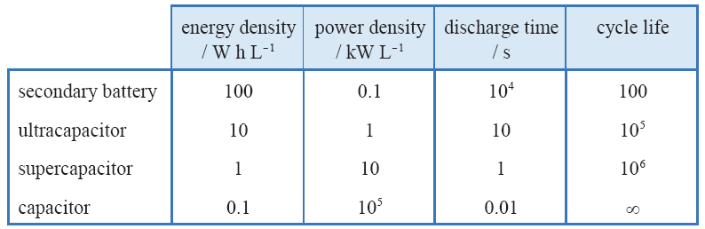
Storage
Battery: Chemistry
Ultracapacitor: Chemistry + electrode interface
Supercapacitor: Electrode interface
Capacitor: Dielectric

Slide 3
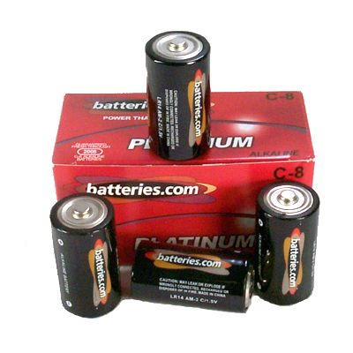
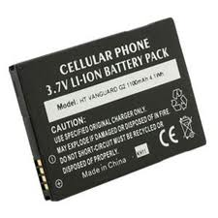
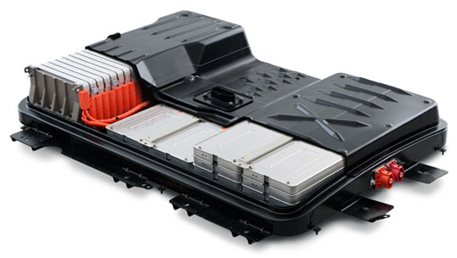
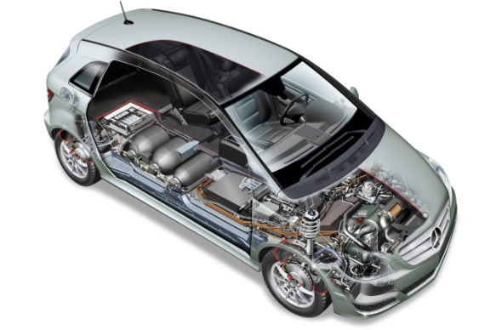
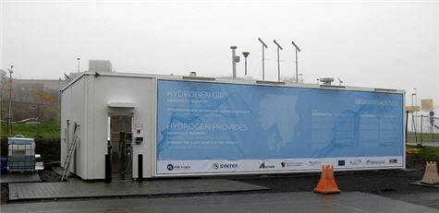
Overview: Batteries, fuel cells, and electrolysers
Primary batteries
  Factory charged
  Single discharge
Secondary batteries - accumulators
  Rechargeable
  Multiple discharges and recharges
  All chemical energy stored
“Ternary batteries” – fuel cells
  Fuel continuously supplied from external source
Electrolysers
  Reversed fuel cells
  Fuel generated continuously and stored externally

Slide 4
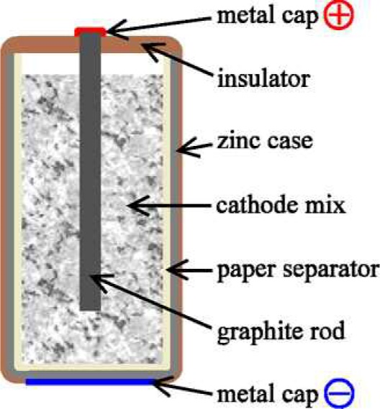
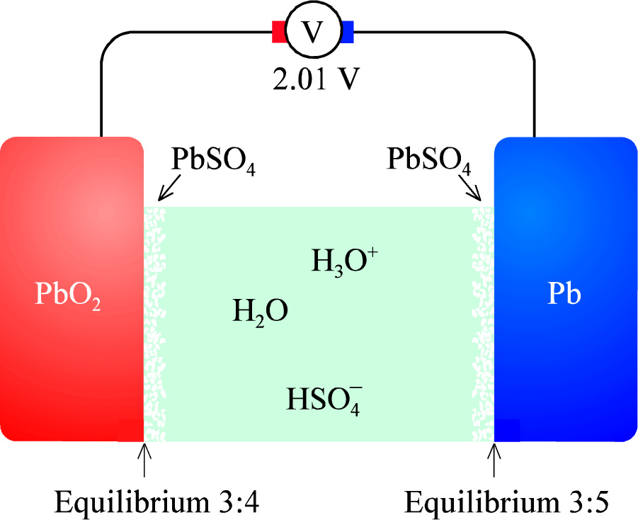
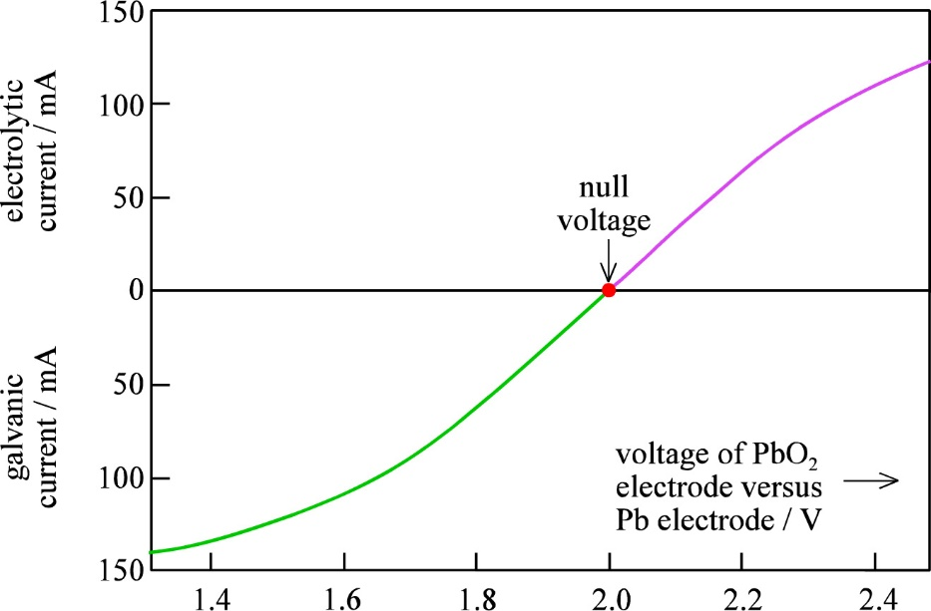
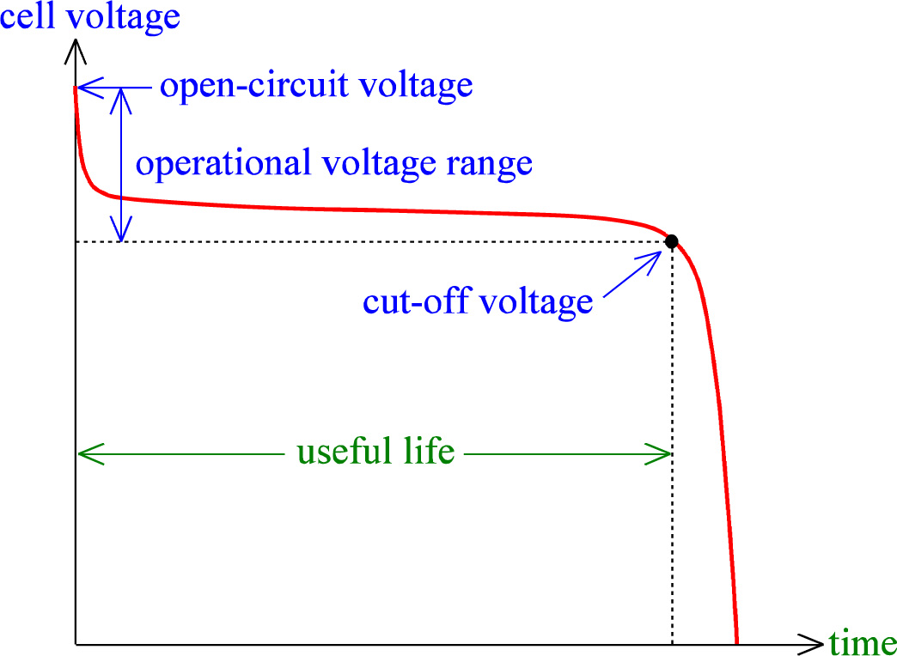
Battery key features
Positive and negative electrodes
Positrode and negatrode
Cathode and anode
Cell voltage terms
  Nominal voltage = OCV fully charged
  Cut-off voltage
  Operational voltage range
  Null voltage?
Capacity (amount of charge)
  Coulomb, C = A s
  1 A h = 3600 A s = 3600 C
Energy
  J = W s = A s V
  U = 4 V
  Typical car battery stacks: 20-80 kWh
  Energy density (volumetric or gravimetric)
Power
  W or kW
  W = A V
  Typical cars: 100-400 kW
  U_{stack} = 400 V → I_{stack} = 25–100 A

Slide 5
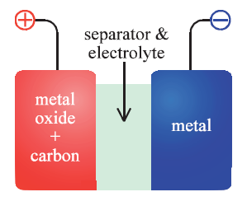


Primary batteries
Volta pile
Daniell cell
Leclanché wet cell with NH₄Cl(aq)
Dry cell
  NH₄Cl + ZnCl₂ paste
  C powder composite cathode
Zn + 2MnO₂ → 2ZnO*Mn₂O₃ 1.5 V

Slide 6
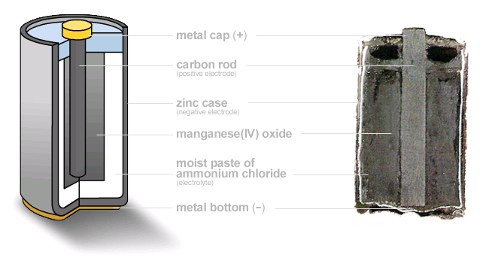
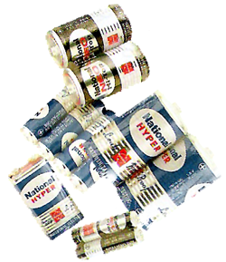
The zinc-carbon battery (dry cell)

Slide 7


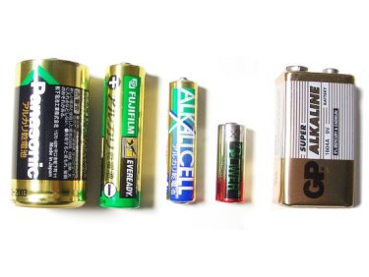
Alkaline battery – in principle…
Cathode(+)
2MnO₂ + H₂O + 2e – → Mn₂O₃ + 2OH⁻
→ Mn₃O₄
Electrolyte
KOH
Anode (-)
Zn + 2OH⁻ → ZnO + H₂O + 2e–
Zn + 2MnO₂ → ZnO*Mn₂O₃ 1.5 V

Slide 8
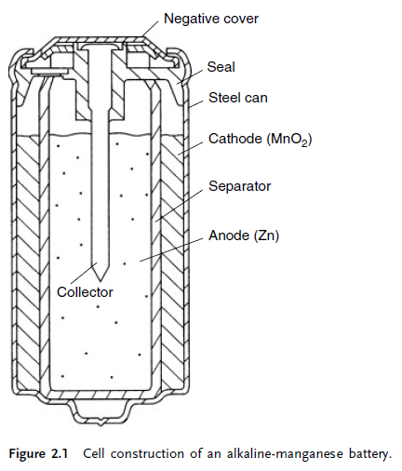
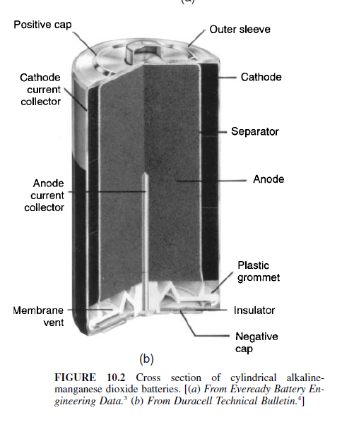
Alkaline battery – in reality

Slide 9
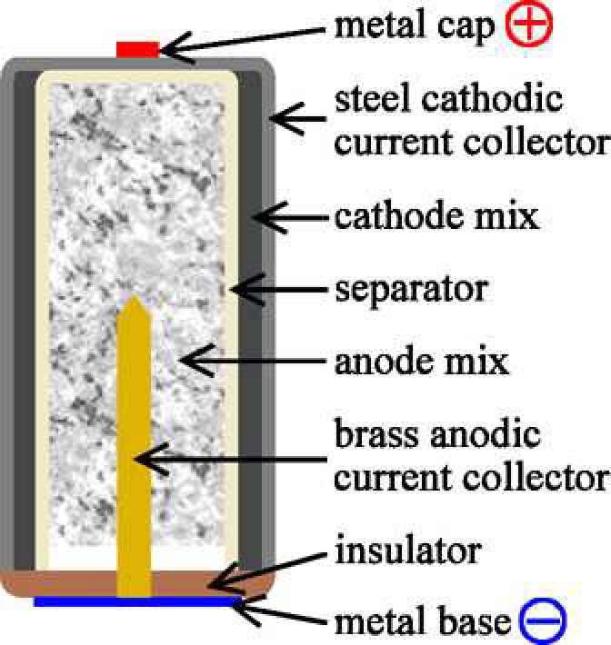
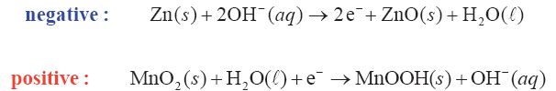
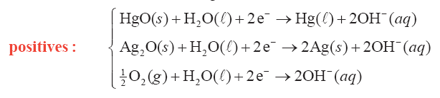
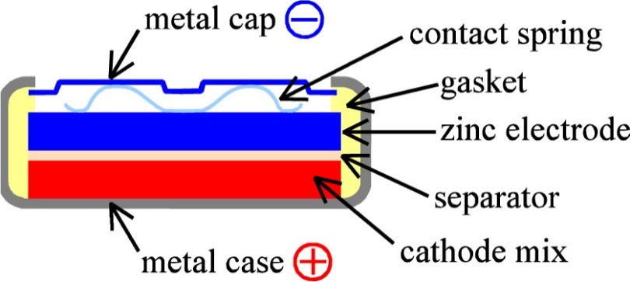
Alkaline batteries
Inversed design…
Other alkaline positrodes
Air battery

Slide 10
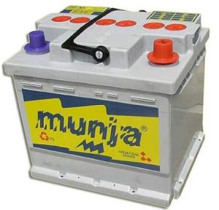
Pb battery
Cathode(+)
PbO₂ + 3H⁺ + HSO₄ – + 2e – → PbSO₄ + 2H₂O
Electrolyte
H₂SO₄
Anode (-)
Pb + HSO₄ – → PbSO₄ + H⁺ + 2e–
Pb + PbO₂ + 2H₂SO₄ → 2PbSO₄ + 2H₂O 2.0 V

Slide 11
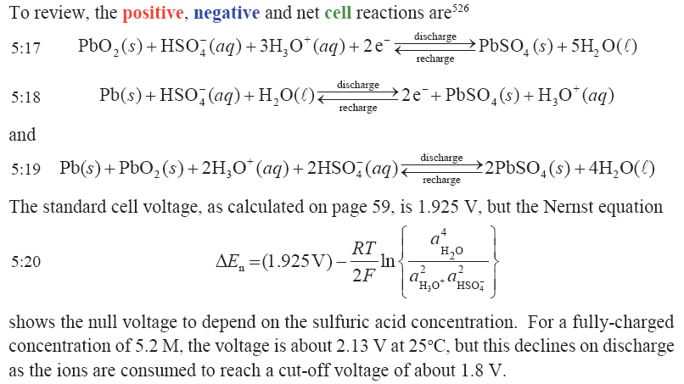
Secondary (rechargeable) batteries (accumulators)
Most widespread: Lead-acid battery.
Repeat from Ch. 3:

Slide 12
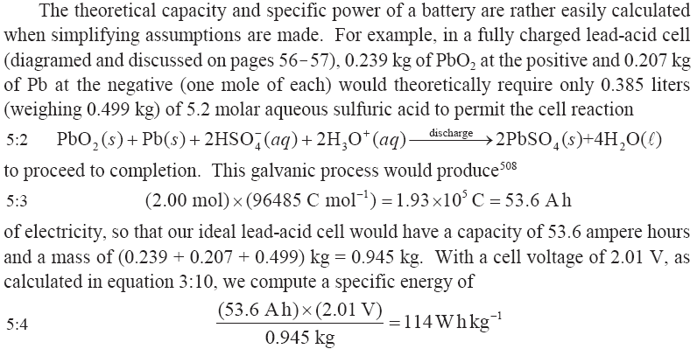
Lead acid battery

Slide 13
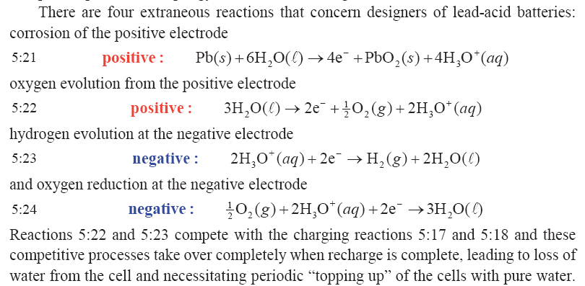
Lead acid batteries: Extraneous reactions
In modern, sealed batteries, diffusion of O₂ + reaction 5.24 replenishes the water.

Slide 14
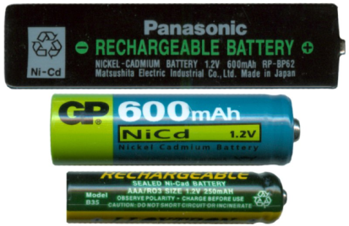
NiCd battery
Cathode(+)
2NiO(OH) + 2H₂O + 2e – → 2Ni(OH)₂ + OH⁻
Electrolyte
KOH
Anode (-)
Cd + 2OH– → Cd(OH)₂ + 2e–
Cd + 2NiO(OH) + 2H₂O → 2Ni(OH)₂ + Cd(OH)₂ 1.2 V

Slide 15
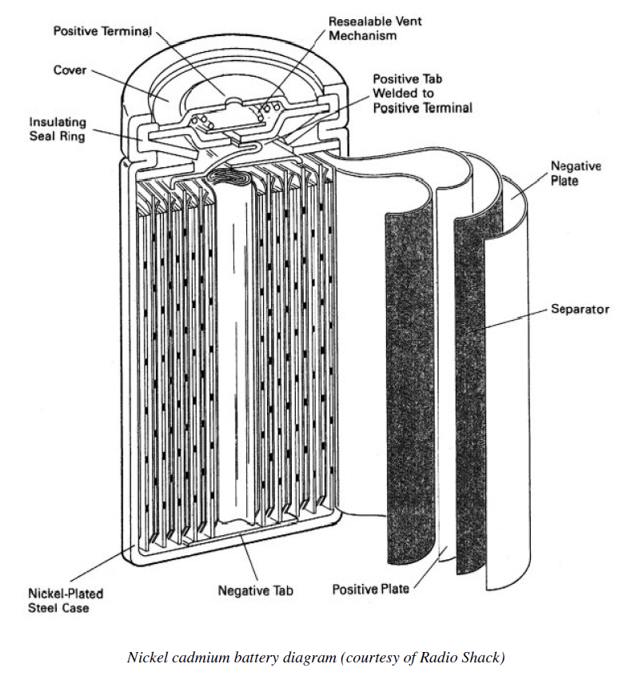
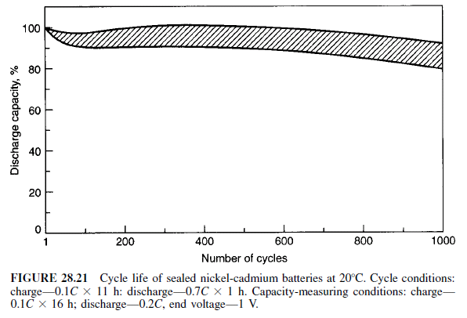
NiCd battery

Slide 16
NiMH battery
Cathode(+)
NiO(OH) + H₂O + e– → Ni(OH)₂ + OH⁻
Electrolyte
M = AB₅, AB₂
A= Ce, Nd, Pr, Gd, Y, La
B= Ni, Co, Al, Ti, Zr, Si
KOH
Anode (-)
OH⁻ + MH → M + H₂O + e –
NiO(OH) + MH → Ni(OH)₂ + M 1.3 V

Slide 17
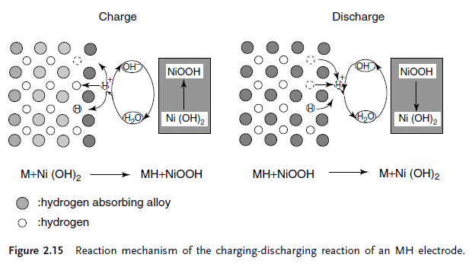
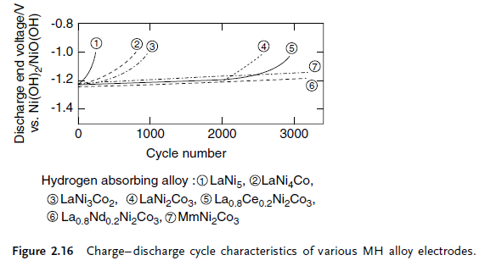
NiMH battery

Slide 18
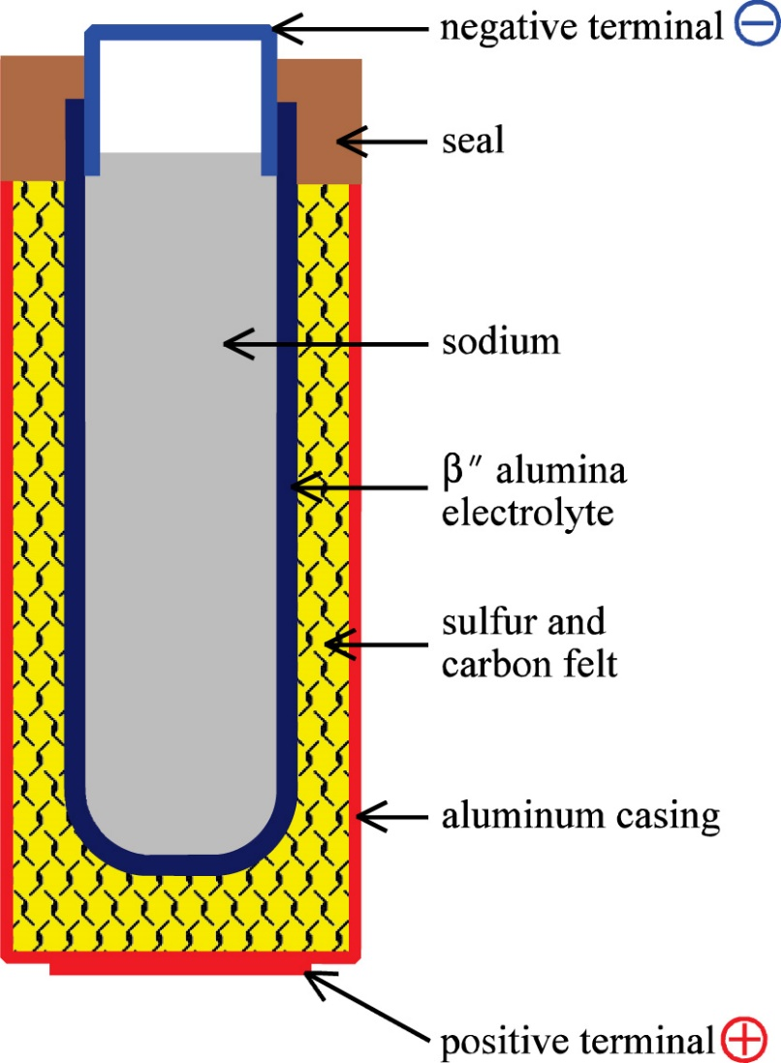
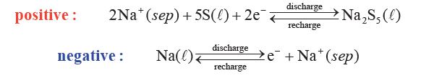
Na-S battery
Exercise: What is the total reaction and Gibbs expression?

Slide 19
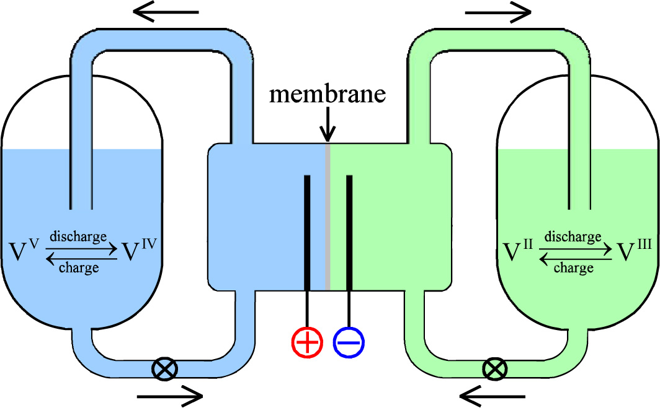
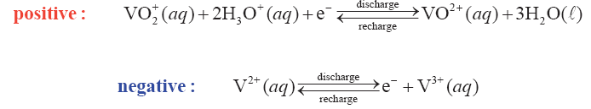
Redox flow battery
What are the electrodes?
What goes on in the membrane?

Slide 20
Role of electrolyte
Both NiCd and NiMH batteries require some volume for the electrolyte, as material is moved from the electrodes into the electrolyte, and vice versa.
Would it not be better if the ionic charge could merely travel from within the anode, through the electrolyte, into the cathode?
And back. The rocking chair battery.
The electrolyte could then be reduced to a simple ionic conductor.
This is exactly the idea behind the Li⁺ ion battery

Slide 21
Li ion batteries

Slide 22
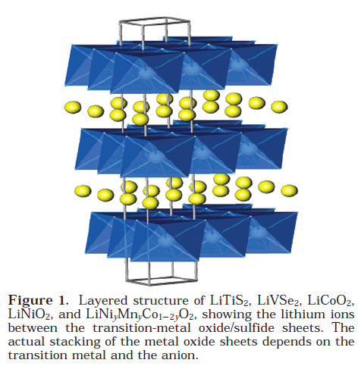
Li-battery – The beginning
The concept of rechargeable lithium batteries was first demonstrated with a transition metal sulfide TiS₂ as the cathode, metallic lithium as the anode, and a nonaqueous electrolyte.
2 V
Li
Ti⁴⁺ -> Ti³⁺

Slide 23

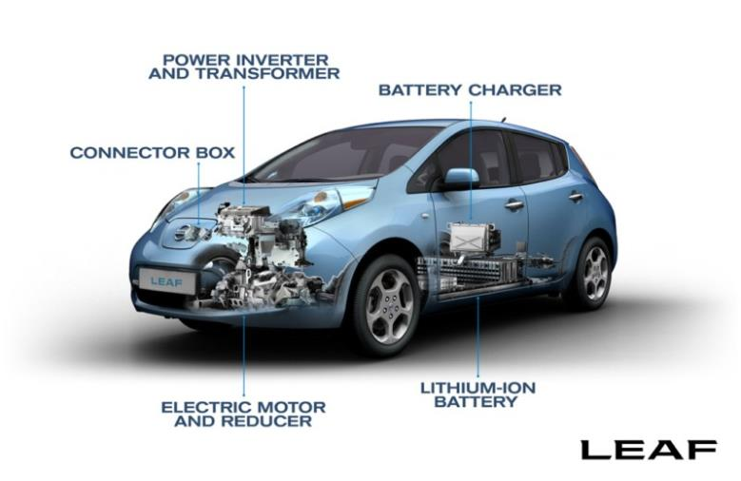
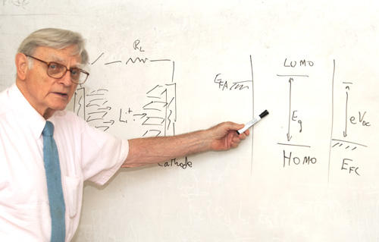
Modern Li-ion batteries
M. Stanley Whittingham (1941-) proposed the first Li ion battery in the 1970s.
John B. Goodenough (1922-) proposed today’s cathode materials.

Slide 24



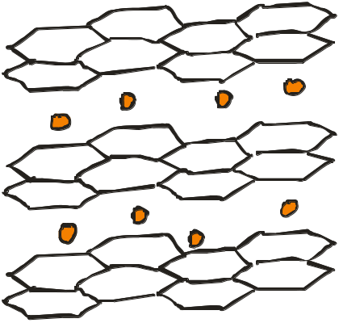

Li battery
4 V
Discharge
Charge
Graphite
LiCoO₂
LiMn₂O₄
LiFePO₄

Slide 25
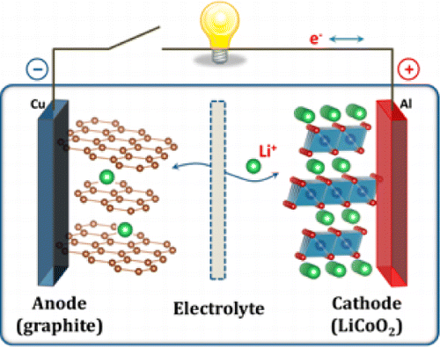
Li-ion batteries
The electrolyte used in most lithium-ion cells is a solution of LiClO₄ or LiAsF₆ in organic carbonates, absorbed in microporous polyolefin separator.
Positrode: Simple
or more realistic
Negatrode:
Copyright 2013, ACS

Slide 26
Li ion battery electrolytes

Slide 27
Requirements of the electrolyte
Conduct Li⁺ ions
Not react with electrodes
Not oxidised or reduced (electrolysed) at the electrodes
  Must tolerate > 4 V
  Chemical redox stability
  Band gap
Harder during charge than discharge

Slide 28
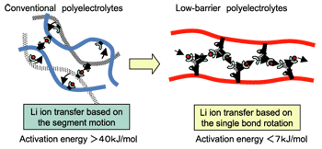
Liquid Li ion conducting electrolytes
Aqueous solutions cannot withstand 4 V
  Water would be electrolysed (gas evolution during charge)
  Li metal at the anode reacts with water
Li⁺ ion electrolytes must be non-aqueous
  Li salts
    E.g. LiPF₆, LiBH₄, LiClO₄
  dissolved in liquid organic solvents
    e.g. ethylene carbonate
    possibly embedded in solid composites with
    Polyethylene oxide (PEO) or other polymers of high molecular weight
    Porous ceramics
Conductivity typically 0.01 S/cm, increasing with temperature
http://www.sci.osaka-u.ac.jp

Slide 29
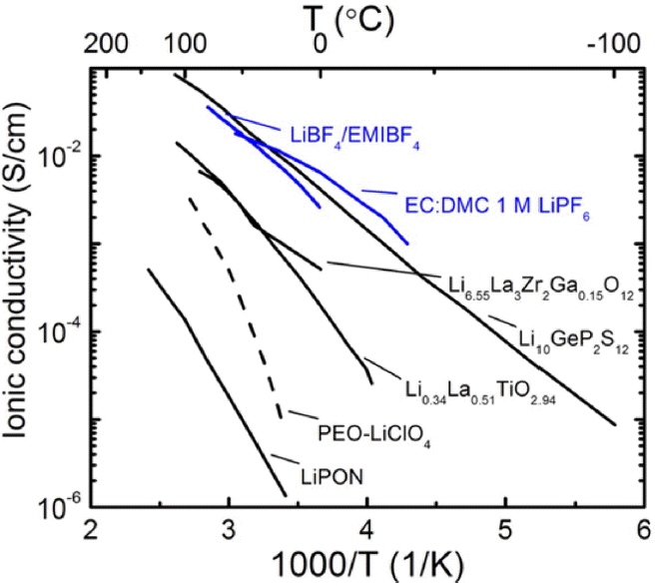
Solid Li⁺ ion electrolytes
Incombustible in air in case of leakage
Can be thinner than liquids and polymers
Reduced chance of whisker short-circuits
Challenges of band gap and Li⁺ diffusion
Li_{3x}La_{3/2-x}TiO₃ perovskites
Li₇La₃Zr₂O₁₂ garnets
Li₂S

Slide 30
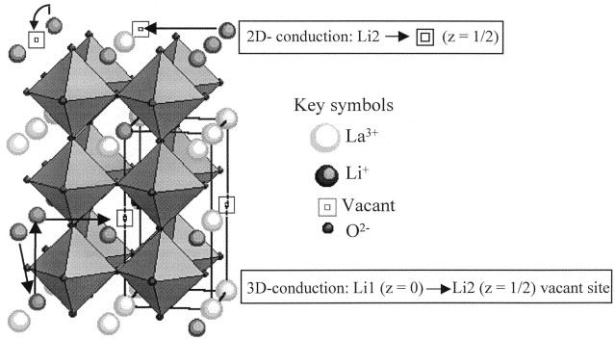
Li_{3x}La_{2/3-x}TiO₃ perovskite
A.I. Ruiz et al., Solid State Ionics, 112 (1998) 291–297

Slide 31
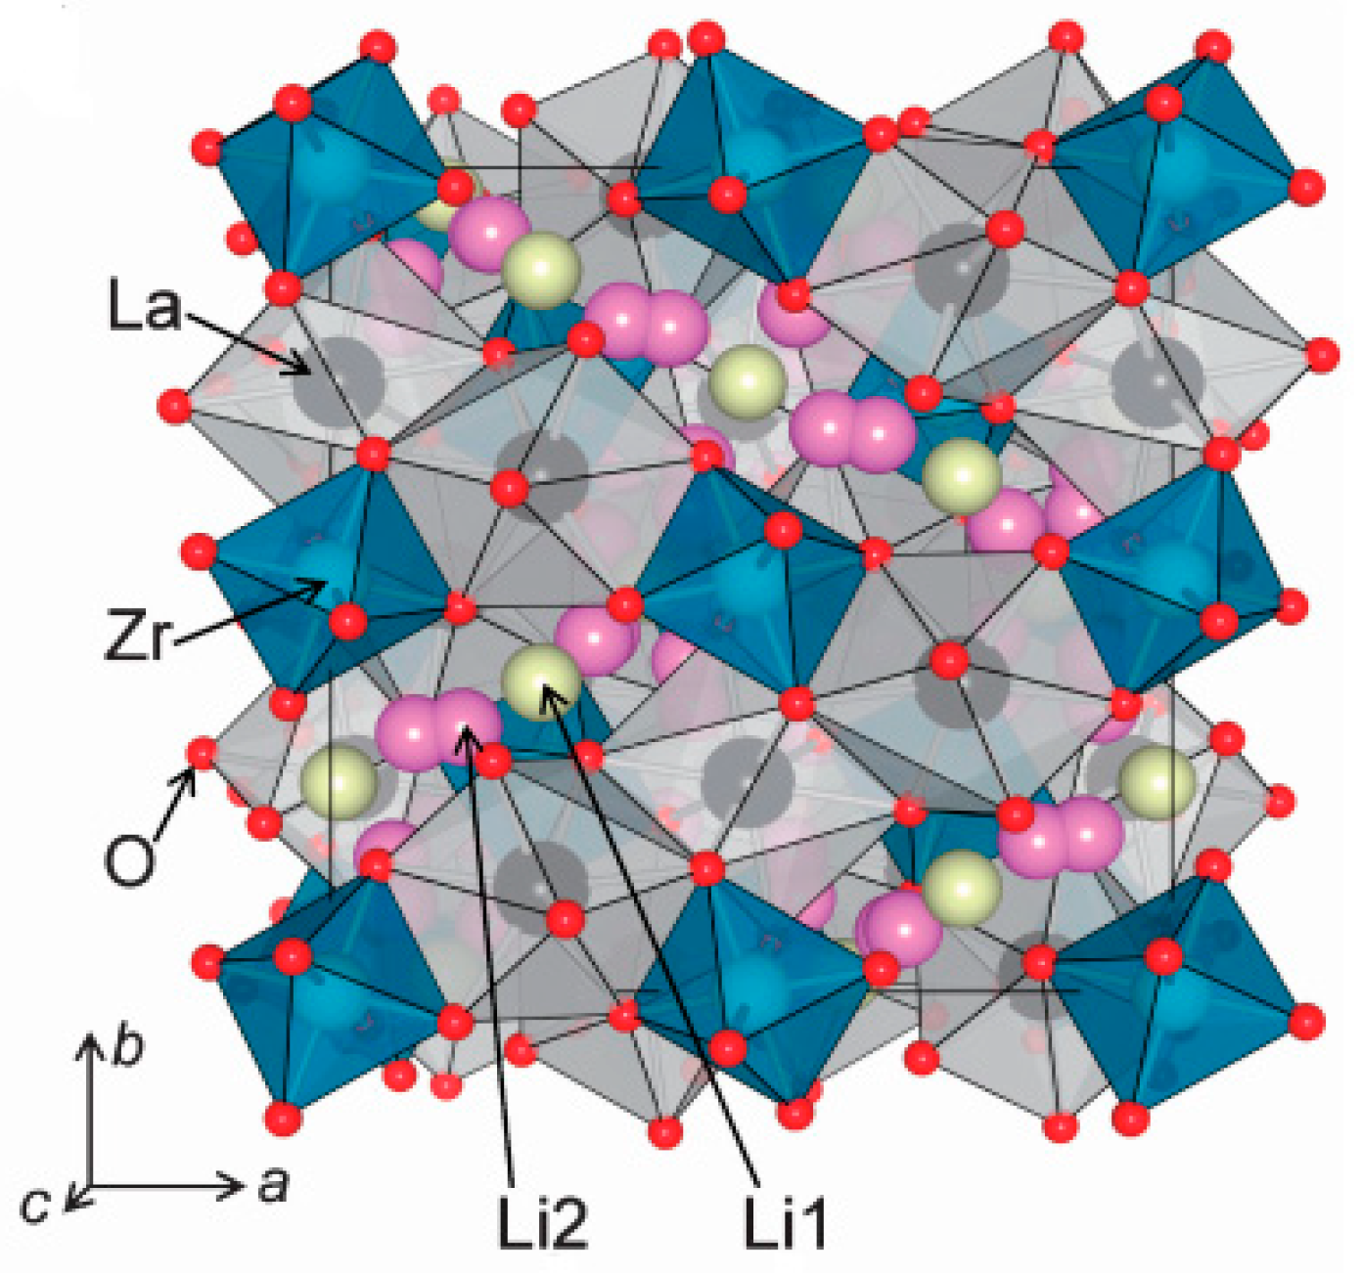
Li₇La₃Zr₂O₁₂ (LLZO) garnet
Stabilised in the cubic form by high temperature or doping, e.g. with Al³⁺ substituting Li⁺ or Nb⁵⁺ substituting Zr⁴⁺
8-coordinated La³⁺
6-coordinated Zr⁴⁺
Li1 and Li2 sites
Partial occupancy 7/9 of Li sites facilitates self-diffusion

Slide 32
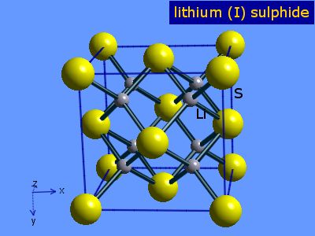
Li₂S
Antifluorite structure
Diffusion by jumps between regular tetrahedral and interstitial octahedral sites
Doping with higher-valent cations: P⁵⁺, Ge⁴⁺
  Increases concentration of Li vacancies
May use S/Li₂S as cathode
  Composite with e.g. graphite or graphene

Slide 33
Li ion battery anodes

Slide 34
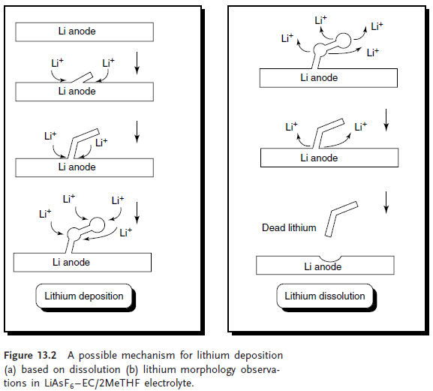
Metallic Li anodes
Metallic Li anode is a practically good anode to work with under production, but what can happen during:
Rapid charging?
Rupture?

Slide 35
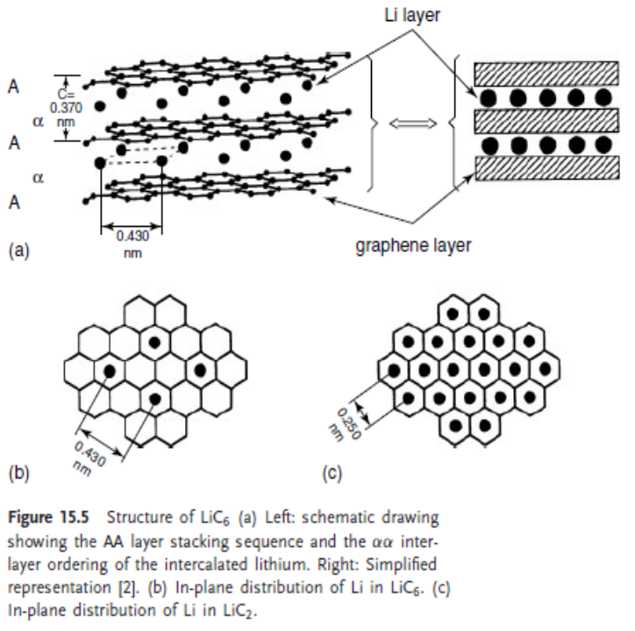
LiC₆
Direct reaction of well crystalline graphite and metallic Li will result in LiC₆, passing through (LiC₁₂, LiC₁₈ …).
Can intercalate Li up to LiC₂, however, this is unstable:
3 LiC₂ -> LiC₆ + 2Li.
E⁰ for the anode is raised 0.1-0.2 V to the LiC₆/Li⁺ as compared to Li/Li⁺.
Question: What implications does this give?
What is lost in electrochemical capacity is gained in safety.
Why is electroplating during charging avoided?
Exercise: Why does the overall capacity vary with potential? How do you calculate the energy capacity from potential and… something more…?

Slide 36
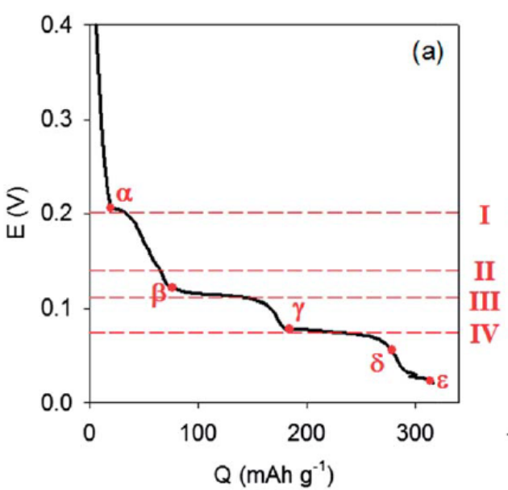
LiC₆
Direct reaction of well crystalline graphite and metallic Li will result in LiC₆, passing through (LiC₁₂, LiC₁₈ …).
Exercise C: Regard the different stages of intercalation in graphite and consider these as individual phases. Use the Gibbs phase rule to argue that you would expect to observe steps in the potentiometric diagram rather than a slope.
Exercise D: How would the potentiometric graph appear if the material shows complete solid solubility with respect to Li⁺ content?

Slide 37
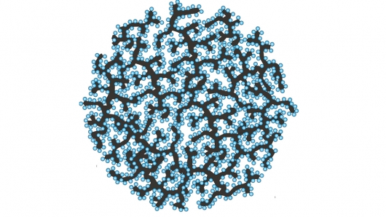
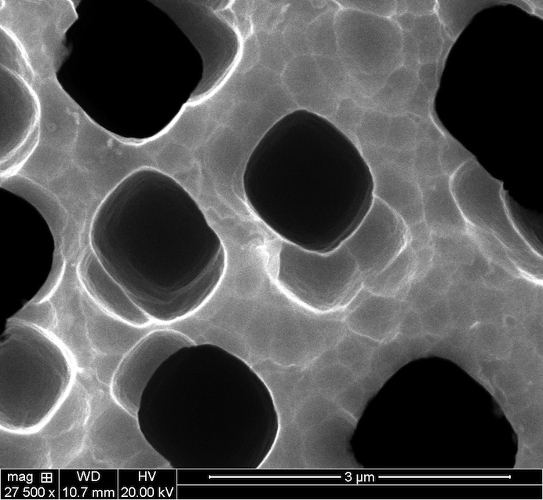

Si anodes
Using micro- and nanoscopic Si keeps structure porous and allows Li to intercalate without changing macroscopic dimensions
Si on C backbone
Porous Si
Norwegian Cenate AS (centrifugal nanotechnology) produces nano Si for battery anodes

Slide 38
Li ion battery cathodes
(Brief introduction – much more materials chemistry in other courses (KJM-MENA 3120, MENA 3201)

Slide 39
Two classes of Li cathode materials
Mainly two classes of Li cathode materials:
(1) Layered compounds with an anion close-packed or almost close-packed lattice in which alternate layers between the anion sheets are occupied by a redox-active transition metal and lithium then inserts itself into the essentially empty remaining layers.
Exemplified by first LiTiS₂, followed by LiCoO₂, LiNi_{1-y}Co_{y}O₂, and today LiNi_{y}Mn_{y}Co_{1-2y}O₂. The spinels may be considered as a special case
where the transition-metal cations are ordered in all the layers.
This group has rather compact lattices, which is an inherent advantage in energy stored per unit of volume.

Slide 40
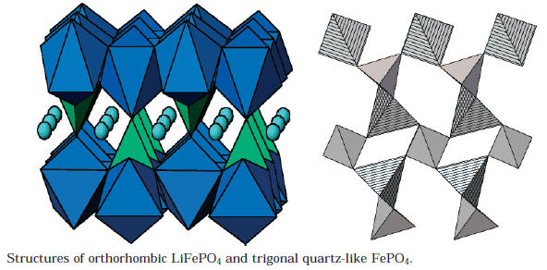
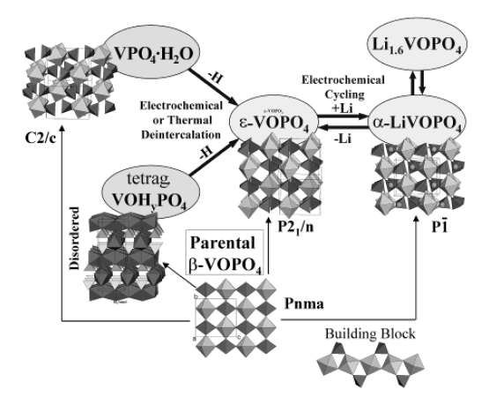
Two classes of Li cathode materials
Mainly two classes of Li cathode materials:
(2) More open structures, like many of the vanadium oxides, the tunnel compounds of manganese dioxide, and most recently the transition-metal phosphates, such as the olivine LiFePO₄.
This group has potentially lower cost .

Slide 41

SEI and SPI
Solid electrolyte interphase (SEI)
  Forms by reduction of electrolyte at the negatrode
  Supports migration and diffusion of Li+ ions
Solid permeable interface (SPI)
  At the positrode

Slide 42


EIS on Li ion batteries
R_{electrolyte}, R_{gb}, R_{ct}, R_{SEI}, Q_{warburg, chemical}

Slide 43



Charge-discharge curves
The cell voltage can be recorded as a function of many parameters that measure the discharge of the battery
Time
Capacity or specific capacity
  Steady state
  Charge or charge/g
Composition
  Li content
  Finite rate
  Monitored with in-situ

Slide 44


Coin cells for application and research
Commercial
Laboratory
  Made in inert atmosphere (glove-box)
  Prevents air-intrusion
  Allows electrochemical and performance characterisation + in-situ measurements
® Jan Petter Mæhlen

Slide 45



Battery stacks
Typically 100 cells stacked in series to a module of 400 V
Several modules in parallel
Control electronics for e.g. 12 cell subunits

Slide 46
Safety aspects of high-power Li-ion batteries
High voltage
  Series connected, e,g, 100 x 4 V = 400 V → lethal
  Rigid insulation and warning/shut-off systems
High currents
  Resistance may give overheating → fire
    Monitor overpotentials
Internal short-circuit
  Whiskers
  Runaway reactions between cathode and anode components → fire
  Individual cell(s) control
Leakage
  High redox stability (4 V) of materials, but not towards O₂ or H₂O
  Anode (e.g. C + Li) combust with O₂ and Li reacts with H₂O
    Intercalation in e.g. C or Si prevents explosive speeds
  Liquid electrolyte solvents (e.g. PEO) combust with O₂
  Mechanical integrity during charge/discharge, vibrations, shock, collision

