Slide 1
KJM 3110 Electrochemistry
Chapter 14
Other interfaces
Most figures from the textbook we use for the course, via its web resources:

Slide 2
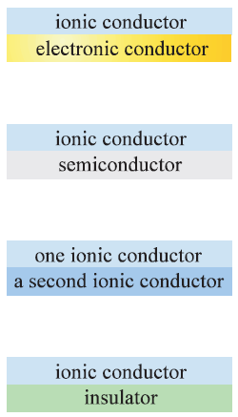
Summary Ch. 13 The electrode interface
Interface
  Large capacitance
  Compact and diffuse adsorption layers
  Non-faradaic currents
  Adsorption
  Next chapter: Other interfaces
ionic conductor
metal

Slide 3




Metallic and semiconducting electrodes
Metallic electrode:
  Working electrode is a metal (=is metallic (?))
  Always abundance of electrons
  Or rather: … Always abundance of electrons and states the electrons can be in.
Semiconducting electrode:
  Working electrode is a semiconductor (full valence band, empty conduction band)
  Not necessarily an abundance of electrons or states.

Slide 4
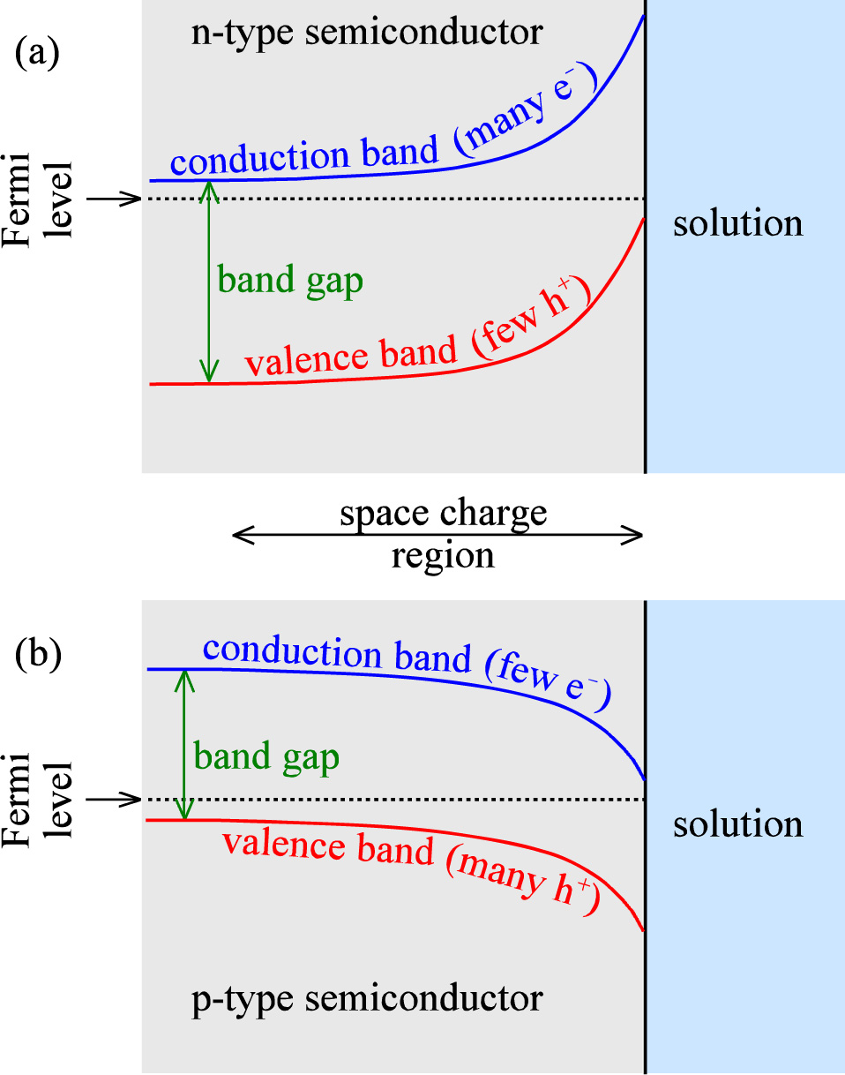
Semiconductor electrodes - overview
Semiconductor
  Molecule → Lattice
  HOMO → Valence band
  LUMO → Conduction band
  Band gap
  Fermio level: (electro)chemical potential of electrons
  Work function: Energy to bring electrons to vacuum
n-type semiconductor
  Donor-doped n = [e⁻] = [D⁺]
  Electrons e⁻ in the conduction band
p-type semiconductor
  Acceptor-doped p = [h⁺] = [A⁻]
  Electron holes h⁺ in the valence band

Slide 5
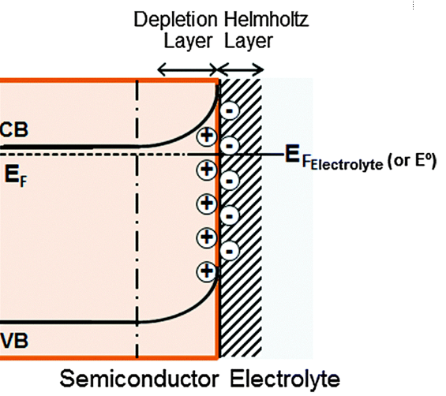
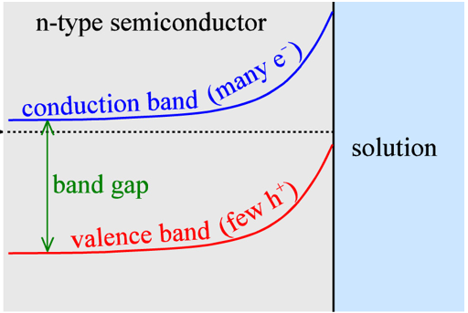
n-type electrode – a closer look
Bulk of n-type semiconductor:
n ≈ [D⁺]
Fermi (energy) level near conduction band
Interface:
Adsorption of anions in Helmholtz layer
compensated by
positive space charge in the semiconductor
by
depletion of electrons
excess of holes
Band bending:
Cause: Adsorption of one of the ions
Shape: Boltzmann distribution, Poisson
-
-
-
-
-
-
-
-

Slide 6
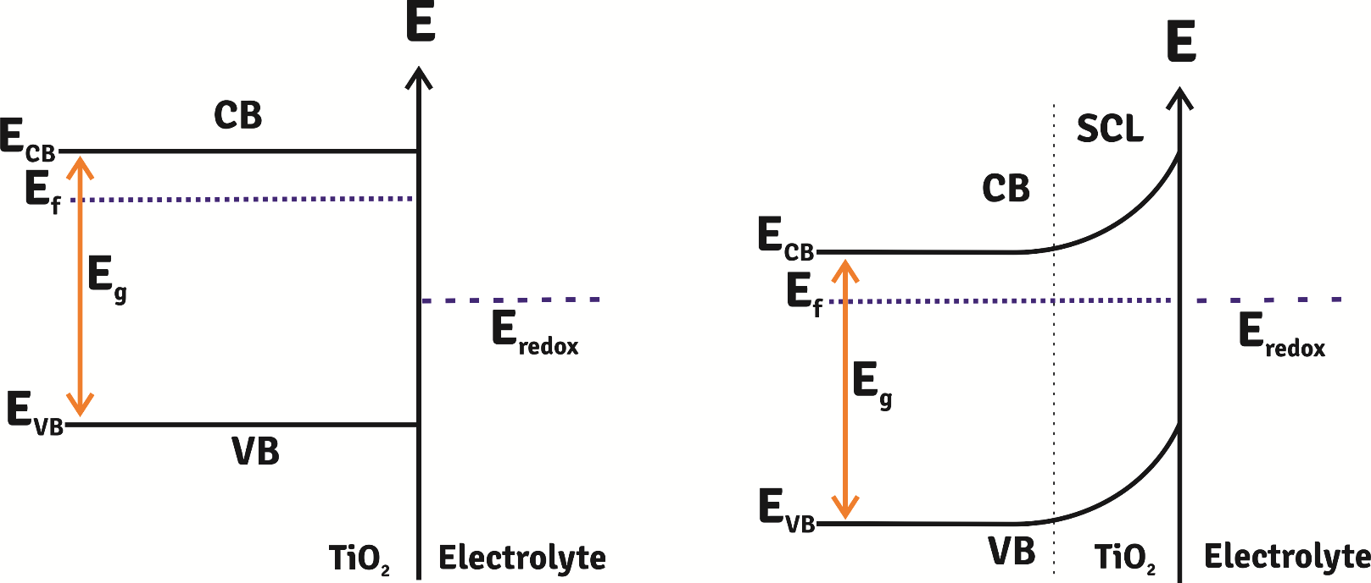
Adsorption vs redox
In the previous slide, and in the textbook in general, the semiconductor charge and energy levels are affected by selective adsorption of ions.
Another possibility is that the electrolyte-electrode interface has a potential (Fermi level) determined by a redox reaction.
Charge flows into the electrode to align its Fermi level with the redox reaction.
But the level at the interface remains pinned. Band bending.

Slide 7
Exercise
How do the bands look before contact with the electrolyte?
Based on your memory and understanding, populate the top figure with ions, electrons, and holes
Populate the bottom figure with ions, electrons, and holes
How could we force the bands flat?
What is the flat-band potential?
Try to populate the valence bands with electrons instead of holes

Slide 8
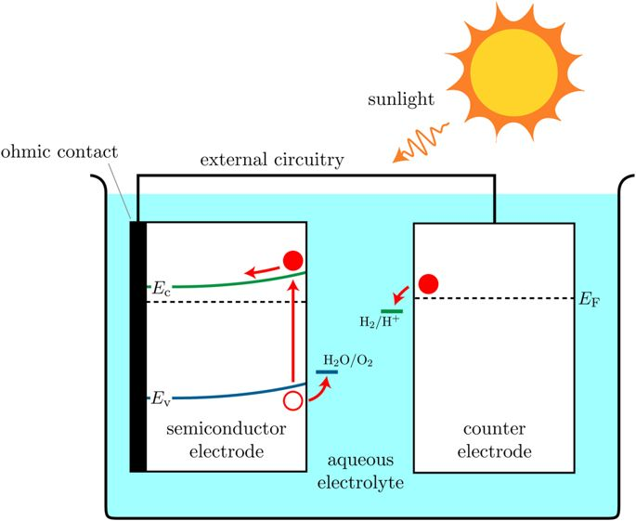
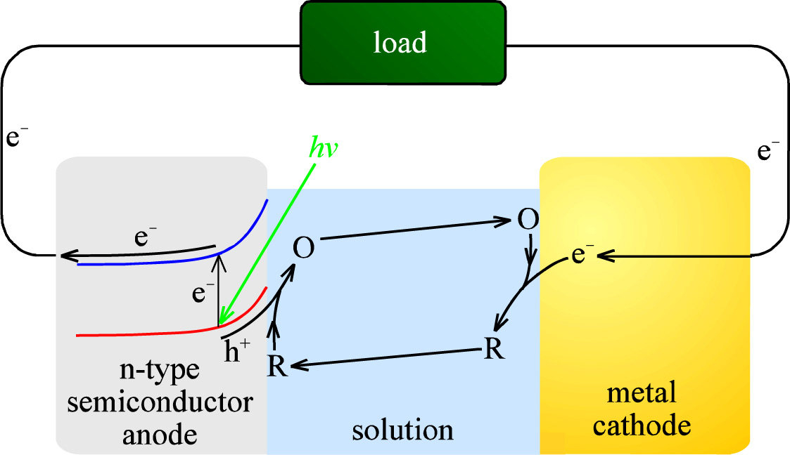
Photoelectrochemical (PEC) cell
n-type photoanode or p-type photocathode
Suitable bandgap
Charge separation
Photoanode

Slide 9
PEC water splitting, artificial photosynthesis
Low efficiencies
Photocorrosion of electrodes
Cathode traditionally a noble (platinum group) metal
  Research: Non-noble metals, oxides. Enzymes
Sunlight cannot drive the reaction alone, just assist it
  Research: Combine photoanode and photocathode. Combine PV and PEC.
Reduce CO₂ instead of H₂O
Solid-state electrolyte instead of aqueous

Slide 10
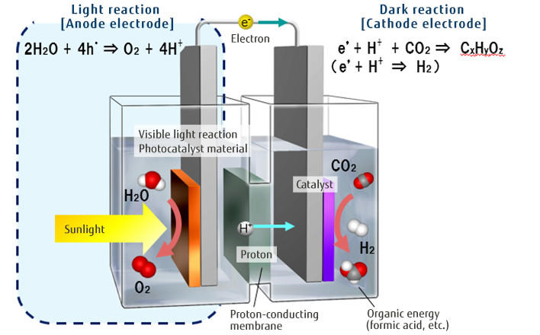
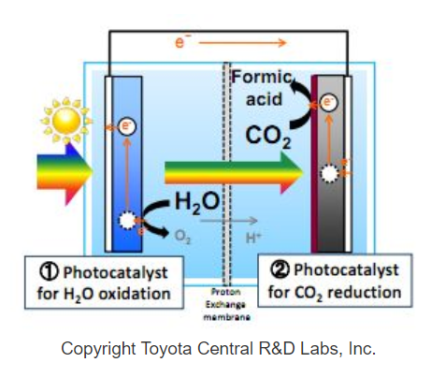
Artificial photosynthesis
Fujitsu Journal

Slide 11

The following slides about “ITIES” are not curriculum…

Slide 12
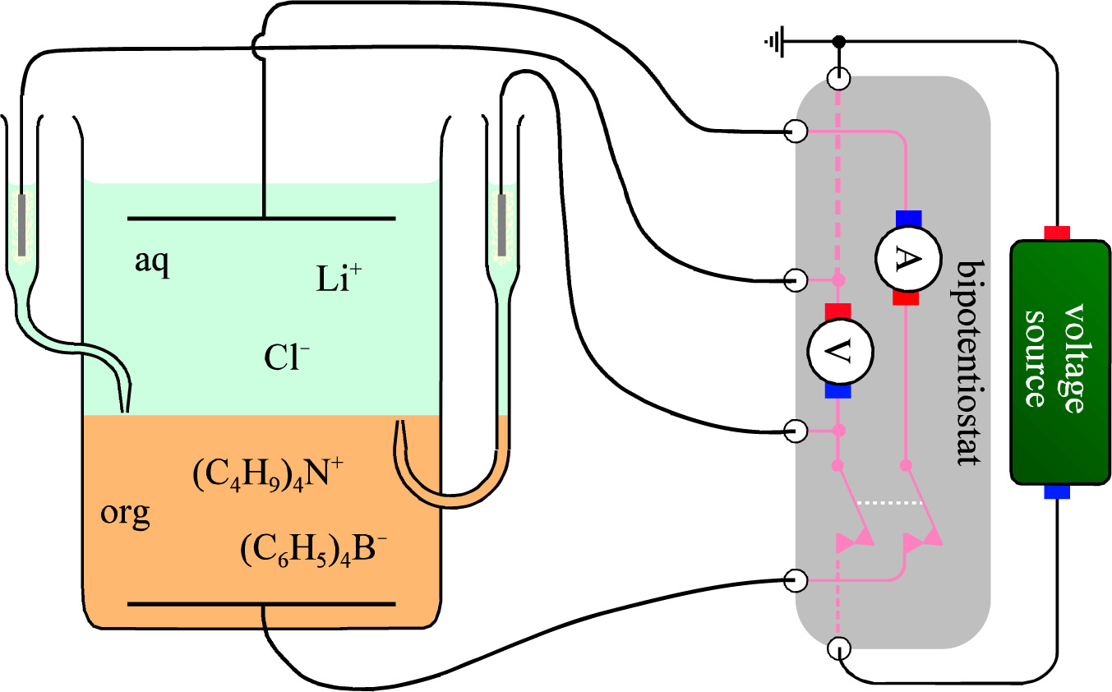
Interface between two immiscible electrolyte solutions (ITIES)
Aqueous vs organic liquids
Use of bipotentiostat

Slide 13
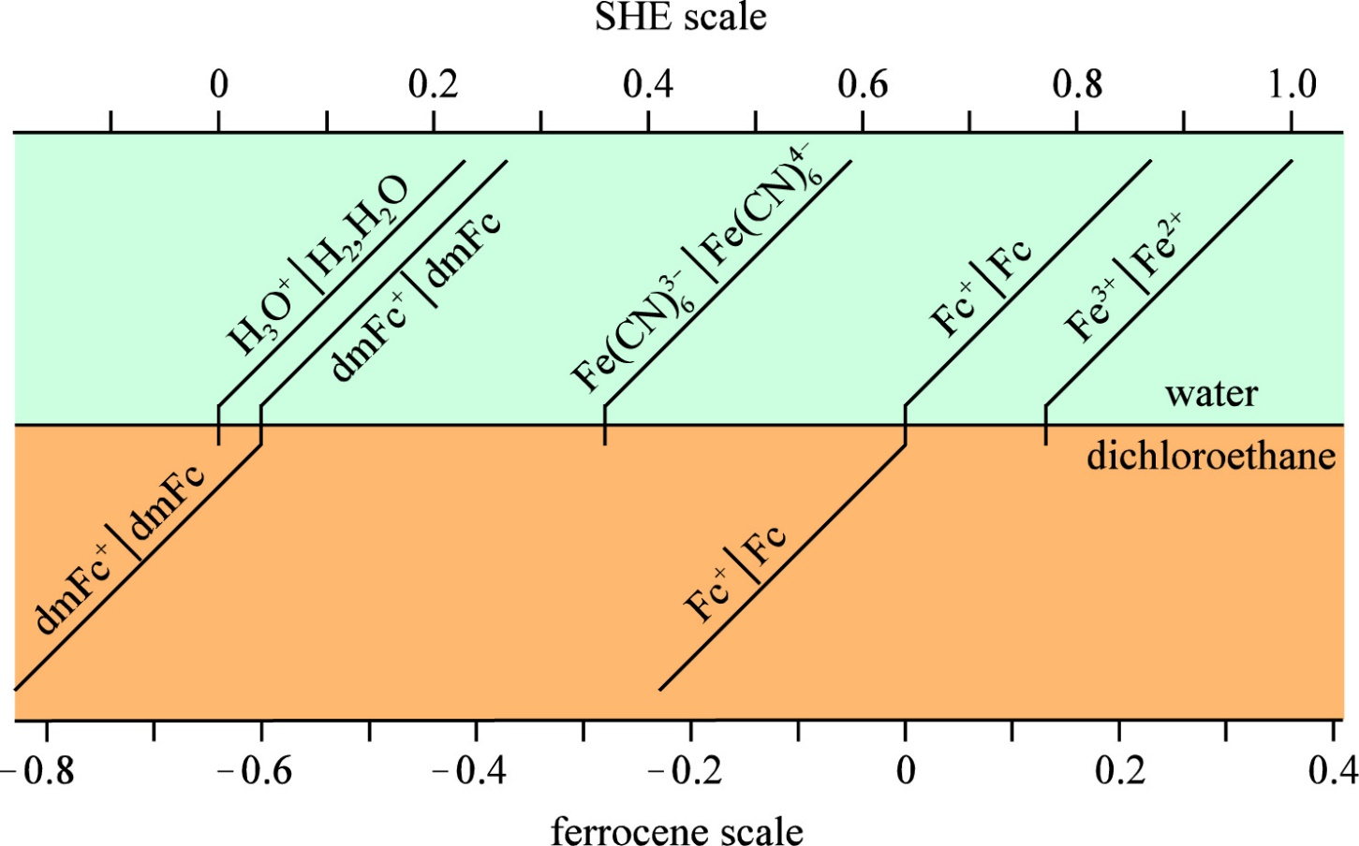
Redox scales – SHE and ferrocene (C₅H₅)₂Fe – for ITIES

Slide 14
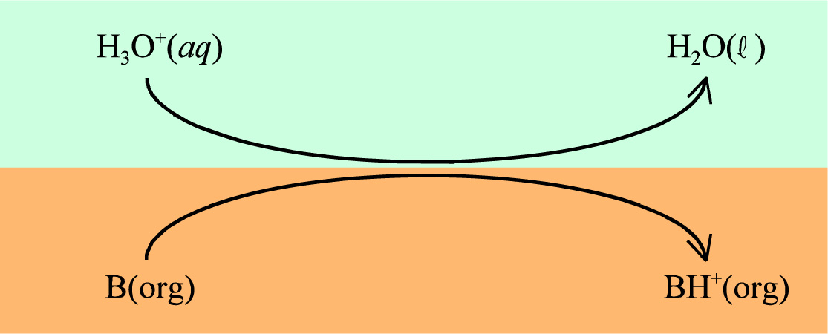
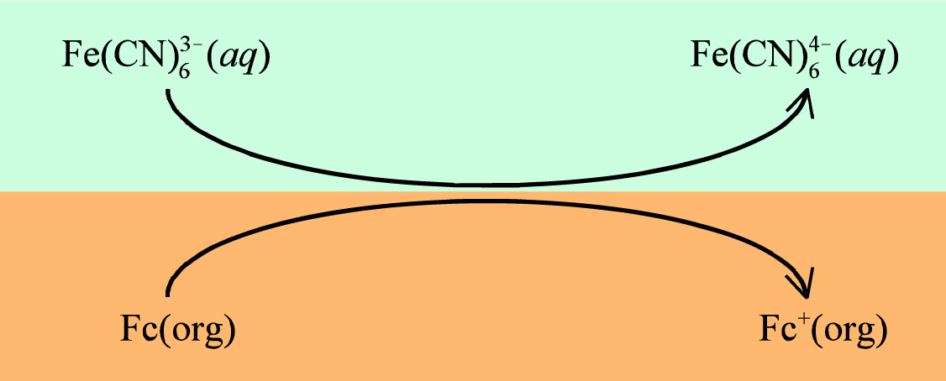
ITIES ion and electron transfers
Proton
Electron

Slide 15
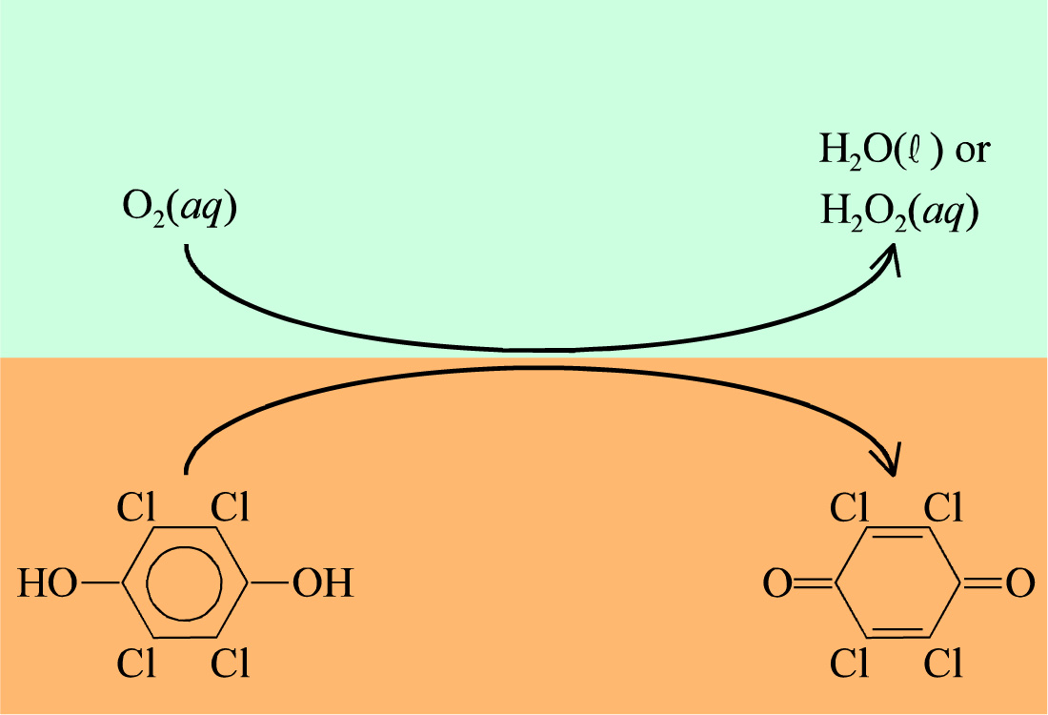
ITIES combined proton and electron transfers

Slide 16
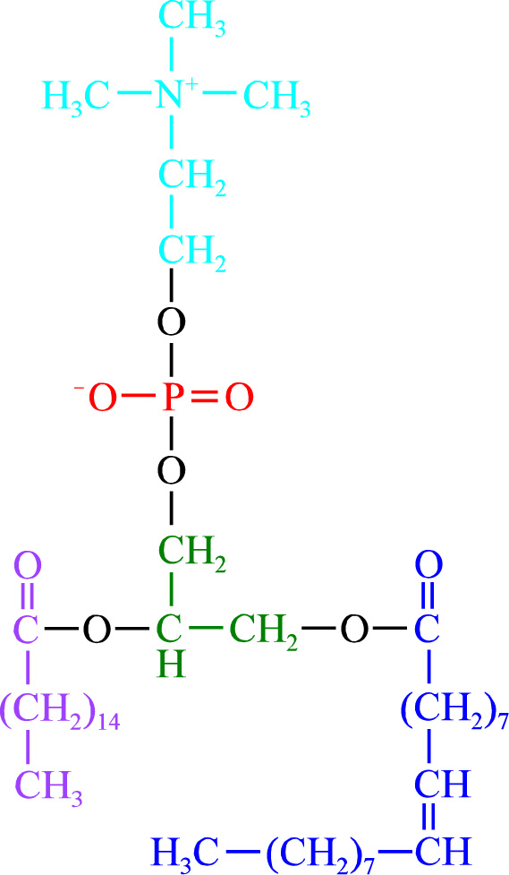
Phospholipid….
Zwitterion
Not curriculum

Slide 17

From here we are back at curriculum again:
Electrolyte – insulator interfaces

Slide 18
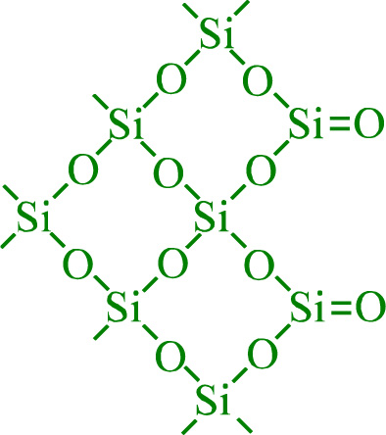
Electrokinetic phenomena
Electrical double layers can initiate movement and this is the source of the adjective electrokinetic [“electrically generated motion”] used to describe these phenomena.
No direct relationship to “electrode kinetics”, despite similar name
Electrolyte – insulator interface
No electrical current across
But double layers form
Scales with interface area: Porous materials, suspensions, etc.
Silica:
  Terminating covalent O, denoted as >Si=O
  H₂O adsorb
  Protolyses weakly (Silica is weakly acidic)
Glass
  Ionic alkali cations compensated by ionic terminating oxygen
  Reduces acidity
Adsorption of cations like Al³⁺ may reverse the charge

Slide 19
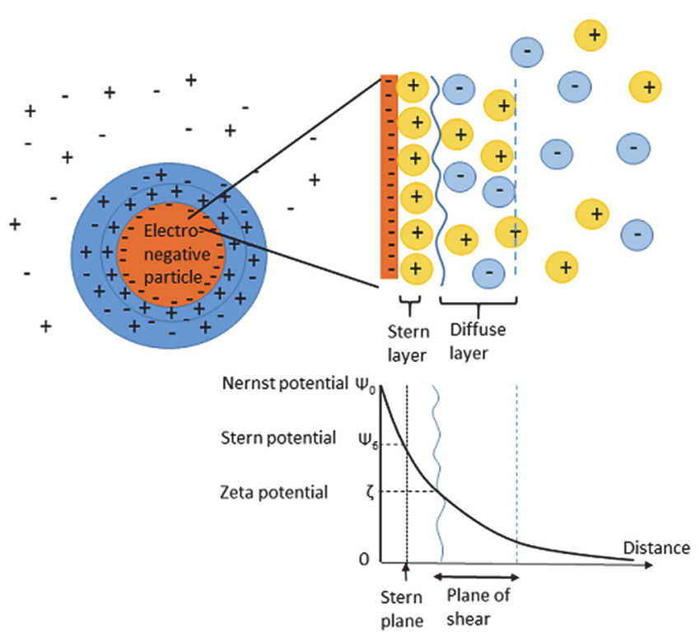
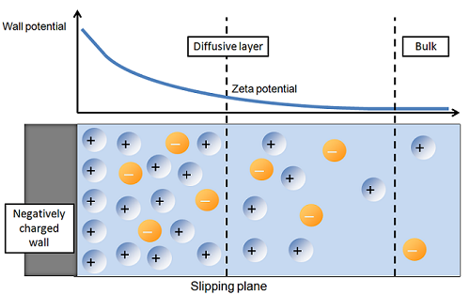
Charged particles and walls
Silica and other materials with double layers can be mobile particles or stationary walls
Nernst, Stern, and zeta potentials
Shearing planes = slipping planes
Electrical field moves net charge and drags water

Slide 20
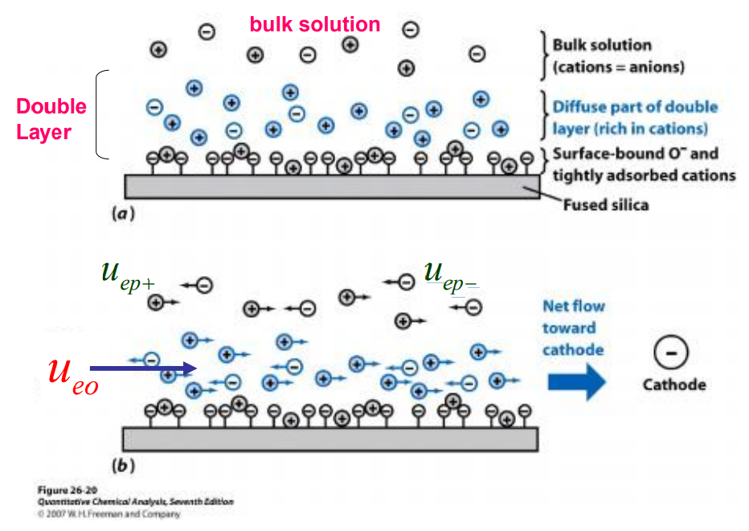
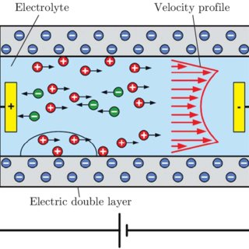
Electroosmotic drag
Diffuse layer is net charged and mobile outside of the slip plane
Electrical field yields velocity profile of the liquid phase

Slide 21
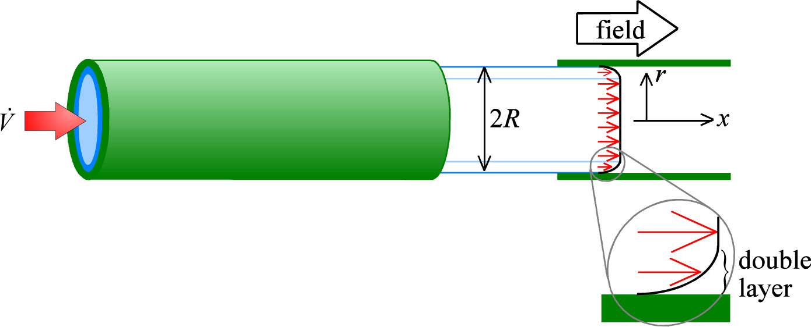

Electroosmotic drag
Friction between the positive double layer and the solution volume
Volume rate v (m³/s)
Field X, radius R, viscosity η
Zeta potential ζ at the slip plane
  (zeta is ζ in the font set, not like in the formula in the textbook)
  Similar to Helmholtz potential φ_{H}
  Around -150 mV for glass, higher for silica
Electroosmotic flow is laminar, but it does not have the quadratic dependence of
velocity on radius, as described on pages 161-162, that is seen in Poiseuille (laminar) flow. This is because electro-osmotic flow is not pressure-driven; instead, it is induced by friction from the motion of the field-driven sleeve. Thus the velocity profile is as shown in the Figure: it is uniform apart from within the narrow double-layer region.

Slide 22
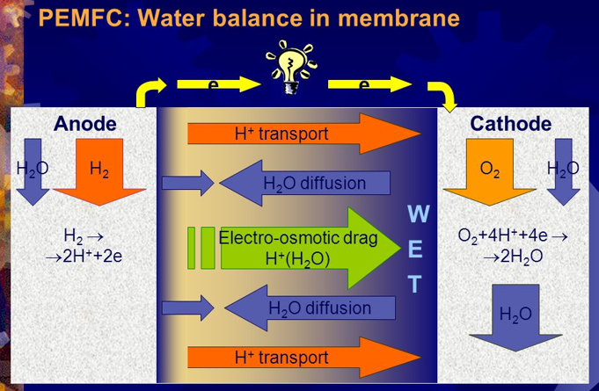
Water drag in PEMs is called electroosmotic, but is a bit special…
Polymer is net negative by sulfonate –R-SO₃⁻ terminating groups
Water phase is net positive by H₃O⁺ ions
Electroosmotic drag on water phase in electrical field
H₃O⁺ may be seen as positive particle dragging 5-6 coordinated water molecules

Slide 23
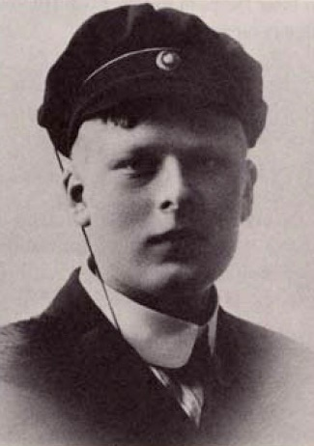

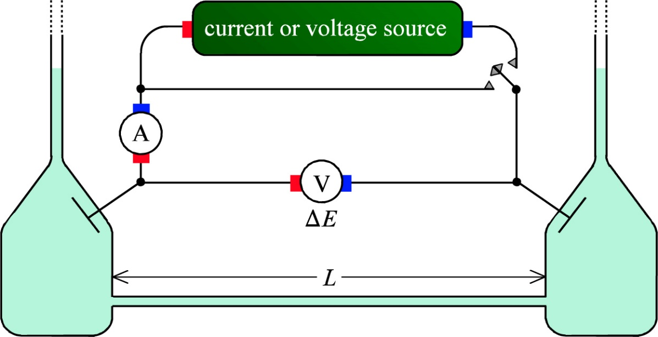
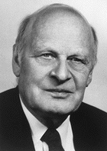
Electroosmotic drag
Electroosmotic flow by voltage or current
Electroosmotic pressure by voltage or current
Streaming potential or current by flow or pressure
Universality, e.g.
Lars Onsager reciprocal relations
Irreversible thermodynamics
Nobel prize 1968
Lars Onsager
Lars Onsager

Slide 24
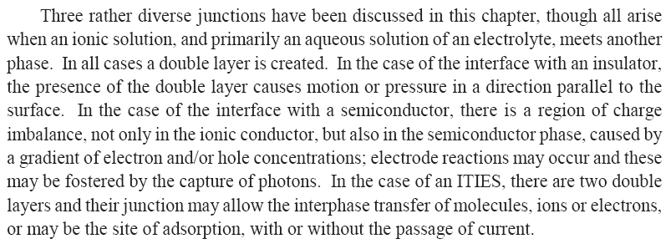
Ch. 14 Other interfaces - Summary

