Slide 1
Lecture 6 – Hash functions
TEK4500
04.10.2023
Håkon Jacobsen
hakon.jacobsen@its.uio.no

Slide 2
Basic goals of cryptography
AEAD: AES-GCM
Block cipher: AES
Encryption: AES-CTR, AES-CBC
 | Message privacy | Message integrity / authentication
Symmetric keys | Symmetric encryption | Message authentication codes (MAC)
Asymmetric keys | Asymmetric encryption (a.k.a. public-key encryption) | Digital signatures
AES-CMAC
Unkeyed
Hash functions

Slide 3
Hash function applications
File storage verification
Data authentication (MACs and digital signatures)
Certificates
Randomness extraction and key derivation (PRFs)
Password hashing
Quantum-resistant signatures
Hash chains (Bitcoin)

Slide 4

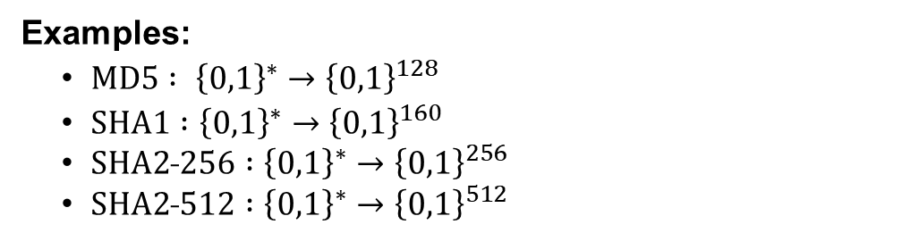







Hash functions
$$H :ℳ→𝒴$$
$$\left|ℳ\right|$$
$$>$$
$$\left|𝒴\right|$$
$$ℳ$$
$$≫$$
$$H$$
$$𝒴$$
Pre-image
Keyless function
Compressing
Collision!
Examples:
  $MD5 : {\left\{0,1\right\}}^{∗}→{\left\{0,1\right\}}^{128}$
  $SHA1 :{\left\{0,1\right\}}^{∗}→{\left\{0,1\right\}}^{160}$
  $SHA2˗256 :{\left\{0,1\right\}}^{∗}→{\left\{0,1\right\}}^{256}$
  $SHA2˗512 :{\left\{0,1\right\}}^{∗}→{\left\{0,1\right\}}^{512}$
Possible security goals:
  Hard to find pre-images
  Hard to find collisions

Slide 5
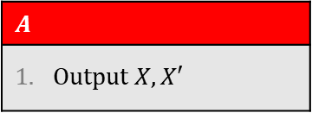
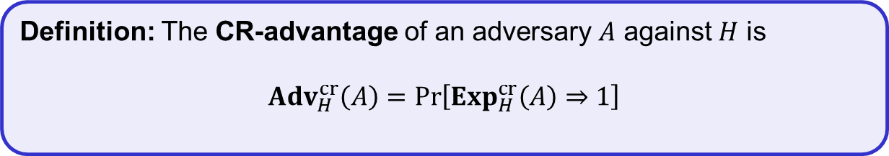
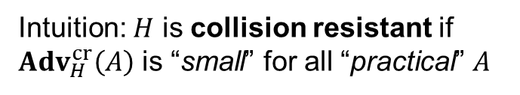
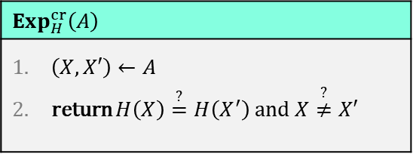

Collision resistance
$$Exp_{H}^{cr}\left(A\right)$$
$\left(X,X′\right)←A$ return $H\left(X\right)\overset{?}{=}H\left(X^{′}\right)$ and $X\overset{?}{≠}X′$
Since $\left|ℳ\right|≫\left|𝒴\right|$, there exists $X≠X′$ s.t. $H\left(X\right)=H\left(X′\right)$
$$A$$
Output $X,X′$
$${Adv}_{H}^{cr}\left(A\right)=1$$
…but how do we actually find $X,X′$?
Intuition: $H$ is collision resistant if
${Adv}_{H}^{cr}\left(A\right)$ is “small” for all “practical” $A$
Doesn't work!
There always exists a very efficient $A$ with ${Adv}_{H}^{cr}\left(A\right)=1$!
Definition: The CR-advantage of an adversary $A$ against $H$ is
$${Adv}_{H}^{cr}\left(A\right)=\operatorname{Pr}\left[Exp_{H}^{cr}\left(A\right)⇒1\right]$$

Slide 6

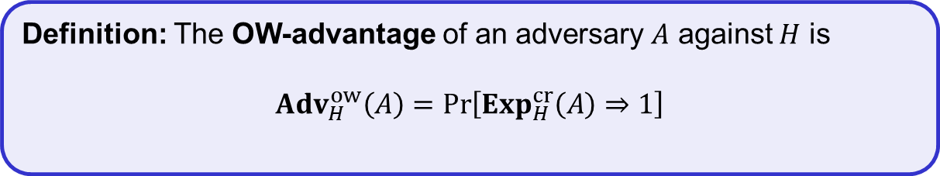

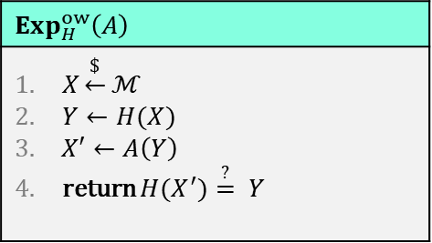




One-way / pre-image security
$$ℳ$$
$$Exp_{H}^{ow}\left(A\right)$$
$X\underset{←}{\$}ℳ$ $Y←H(X)$ $X′←A\left(Y\right)$ return ${H(X}^{′})\overset{?}{=} Y$
$$𝒴$$
$$H$$
$$X$$
$$Y$$
$$X′$$
Definition: The OW-advantage of an adversary $A$ against $H$ is
$${Adv}_{H}^{ow}\left(A\right)=\operatorname{Pr}\left[Exp_{H}^{cr}\left(A\right)⇒1\right]$$

Slide 7
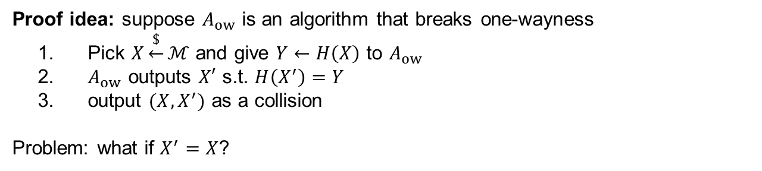
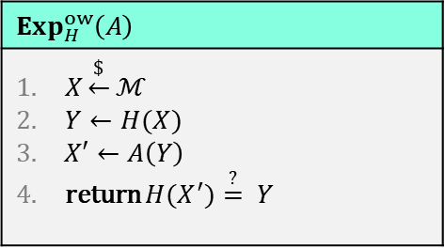
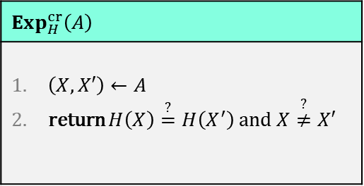

Collision resistance vs. one-wayness
$$Exp_{H}^{cr}\left(A\right)$$
$\left(X,X′\right)←A$ return $H\left(X\right)\overset{?}{=}H\left(X^{′}\right)$ and $X\overset{?}{≠}X′$
$$Exp_{H}^{ow}\left(A\right)$$
$X\underset{←}{\$}ℳ$ $Y←H(X)$ $X′←A\left(Y\right)$ return ${H(X}^{′})\overset{?}{=} Y$
Theorem: Collision-resistance $⟹$ One-wayness
Proof idea: suppose $A_{ow}$ is an algorithm that breaks one-wayness
Pick $X\underset{←}{\$}ℳ$ and give $Y←H\left(X\right)$ to $A_{ow}$
$A_{ow}$ outputs $X′$ s.t. $H\left(X^{′}\right)=Y$
output $(X,X^{′})$ as a collision
Problem: what if $X^{′}=X$?
Very unlikely assuming $\left|ℳ\right|≫\left|𝒴\right|$

Slide 8


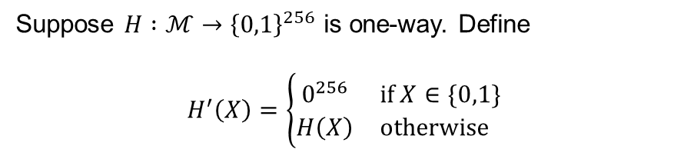
Collision resistance vs. one-wayness
$$Exp_{H}^{cr}\left(A\right)$$
$\left(X,X′\right)←A$ return $H\left(X\right)\overset{?}{=}H\left(X^{′}\right)$ and $X\overset{?}{≠}X′$
$$Exp_{H}^{ow}\left(A\right)$$
$X\underset{←}{\$}ℳ$ $Y←H(X)$ $X′←A\left(Y\right)$ return ${H(X}^{′})\overset{?}{=} Y$
Theorem: Collision-resistance $⟹$ One-wayness
Theorem: Collision-resistance $⟸$ One-wayness
Suppose $H :ℳ→{\left\{0,1\right\}}^{256}$ is one-way. Define
$$H^{′}\left(X\right)=\left\{\begin{matrix}0^{256} & if X∈\{0,1\} \\ H\left(X\right) & otherwise \end{matrix}\right.$$
$H′$ is one-way (if $\left|ℳ\right|$ is large)
$H′$ is not collision-resistant

Slide 9
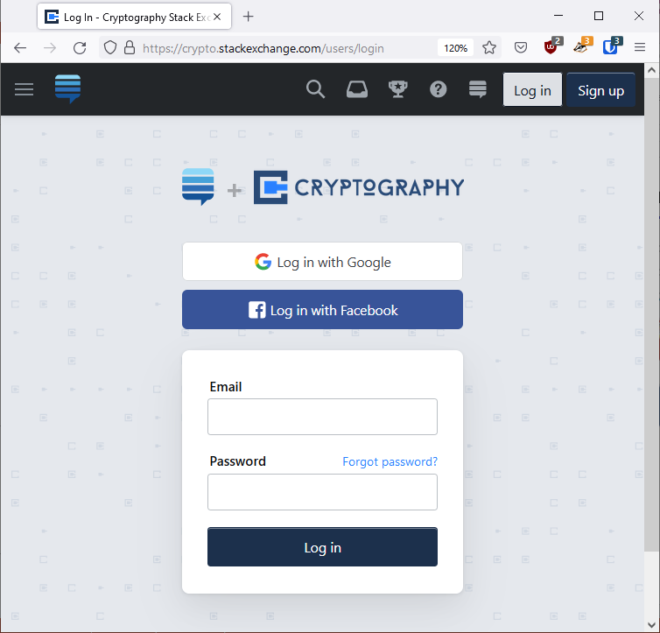
Hash function applications – password storage
Username | Password
Alice | cat1234
Bob | dog
Charlie | password1234
Dave | batman
… | …
DB

Slide 10
Hash function applications – password storage
Username | Password
Alice | H(cat1234)
Bob | H(dog)
Charlie | H(password1234)
Dave | H(batman)
… | …
DB

Slide 11
Hash function applications – password storage
Username | Password
Alice | 0x1b383a798bc2c5
Bob | 0x512df2a1e63860
Charlie | 0x26c540082d18cd
Dave | 0xe33805da40919f
… | …
DB

Slide 12
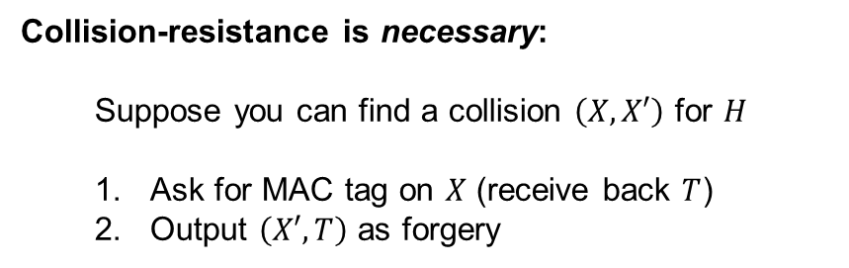

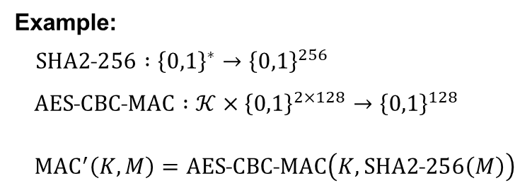



Hash function applications – MAC domain extension
$$MAC :𝒦×{\left\{0,1\right\}}^{n}→𝒯$$
$$H :{\left\{0,1\right\}}^{∗}→{\left\{0,1\right\}}^{n}$$
$$MAC′ :𝒦×{\left\{0,1\right\}}^{∗}→𝒯$$
$${MAC}^{′}\left(K, M\right)=MAC\left(K, H\left(M\right)\right)$$
Hash-then-MAC paradigm
Theorem: If $H$ is collision-resistant and $MAC$ is UF-CMA secure, then $MAC′$ is UF-CMA secure
Example:
$SHA2˗256 :{\left\{0,1\right\}}^{∗}→{\left\{0,1\right\}}^{256}$
$AES˗CBC˗MAC :𝒦×{\left\{0,1\right\}}^{2×128}→{\left\{0,1\right\}}^{128}$
${MAC}^{′}\left(K,M\right)=AES˗CBC˗MAC\left(K,SHA2˗256\left(M\right)\right)$
Collision-resistance is necessary:
  Suppose you can find a collision $\left(X, X′\right)$ for $H$
  Ask for MAC tag on $X$ (receive back $T$)
  Output $\left(X′,T\right)$ as forgery

Slide 13


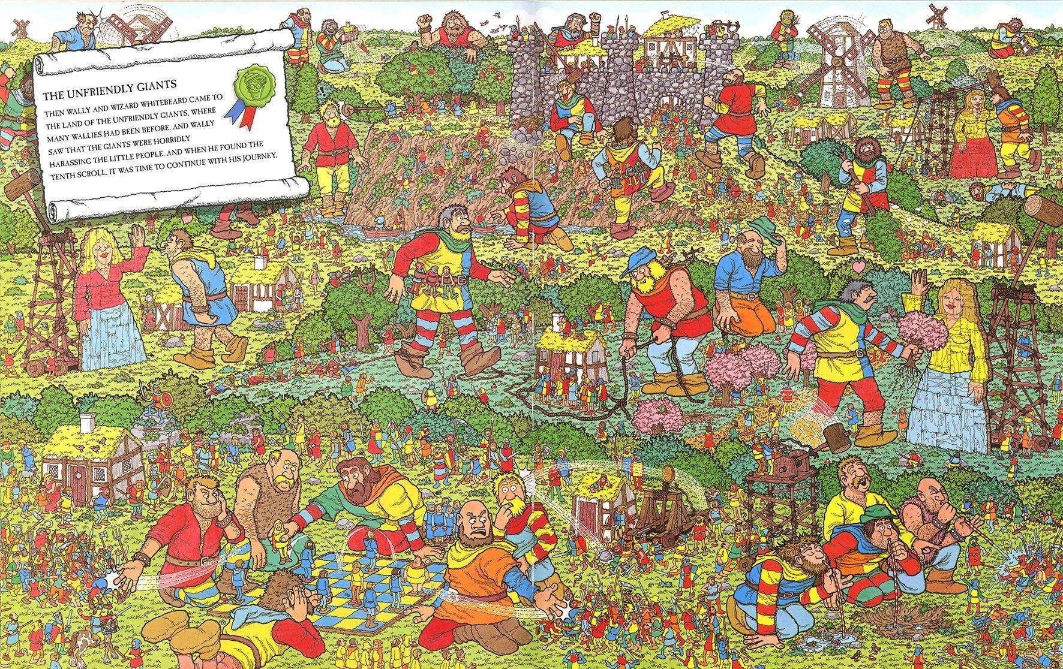


Hash function applications – commitment schemes

Slide 14



Hash function applications – commitment schemes
"Bob: Waldo is at pos. …"
$$H$$
0x59d67
"Alice: Waldo is at pos. …"
"Charlie: Waldo is at pos. …"
$$H$$
$$H$$
0x4fb04
0xf2200

Slide 15

The birthday paradox

Slide 16
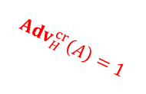
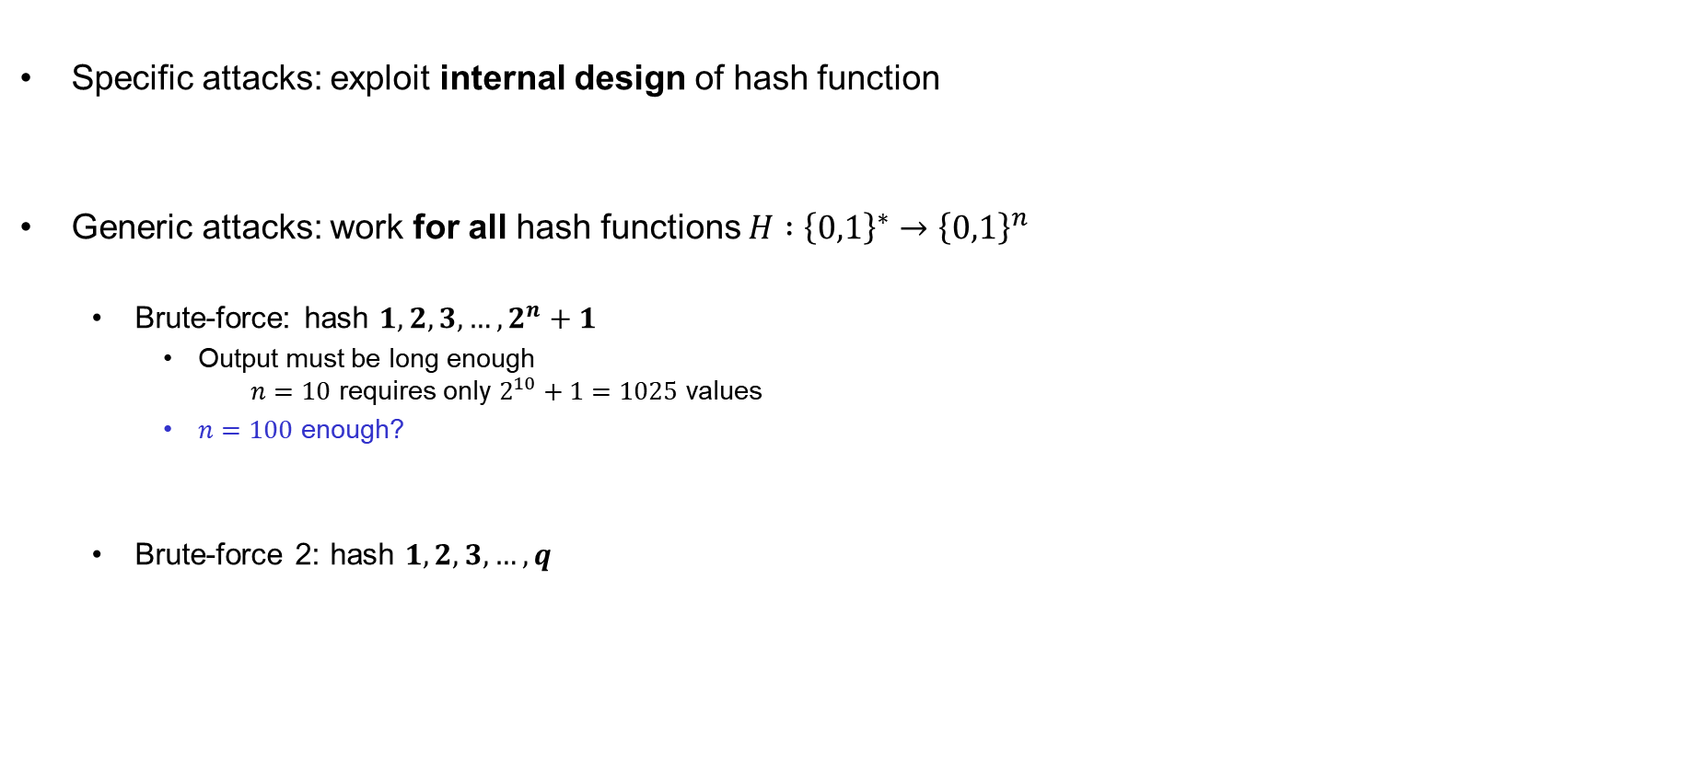
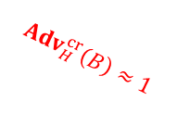

Attacks on hash functions
Specific attacks: exploit internal design of hash function
Generic attacks: work for all hash functions $H :{\left\{0,1\right\}}^{∗}→{\left\{0,1\right\}}^{n}$
  Brute-force: hash $1, 2, 3,…, 2^{n}+1$
    Output must be long enough
    $n=10$ requires only $2^{10}+1=1025$ values
    $n=100$ enough?
  Brute-force 2: hash $1, 2, 3,…, q$
$${Adv}_{H}^{cr}\left(A\right)=1$$
$${Adv}_{H}^{cr}\left(B\right)≈1$$
$$q≈2^{50}≪2^{100}$$

Slide 17




















Birthday attack
$0$ $1$ $⋯$
$$N$$
$${ Y}_{3}$$
$${ Y}_{1}$$
$${ Y}_{6}$$
$${ Y}_{2}$$
$${ Y}_{q}$$
$${ Y}_{5}$$
$${ Y}_{4}$$
$${ Y}_{i}$$
$Y_{1}←H(X_{1})$
$Y_{2}←H(X_{2})$
$$=Pr\left[∃i≠j :H\left(X_{i}\right)=H(X_{j})\right]$$
$${Adv}_{H}^{cr}\left(B\right)=Pr\left[coll\right]$$
$Y_{3}←H(X_{3})$
$Y_{4}←H(X_{4})$
$Y_{5}←H(X_{5})$
$Y_{6}←H(X_{6})$
$Y_{i}←H(X_{i})$
$Y_{q}←H(X_{q})$

Slide 18










Birthday attack
$0$ $1$ $⋯$
$$N$$
$${ Y}_{3}$$
$${ Y}_{1}$$
$${ Y}_{6}$$
$${ Y}_{2}$$
$${ Y}_{q}$$
$${ Y}_{5}$$
$${ Y}_{4}$$
$${ Y}_{i}$$
$Y_{1}←ρ(X_{1})$
$Y_{2}←ρ(X_{2})$
$$=Pr\left[∃i≠j :ρ\left(X_{i}\right)=ρ(X_{j})\right]$$
$${Adv}_{H}^{cr}\left(B\right)=Pr\left[coll\right]$$
$$=Pr\left[∃i≠j :H\left(X_{i}\right)=H(X_{j})\right]$$
$Y_{3}←ρ(X_{3})$
$Y_{4}←ρ(X_{4})$
$Y_{5}←ρ(X_{5})$
$Y_{6}←ρ(X_{6})$
$X_{1}, X_{2}, …, X_{q}$ are distinct
$Y_{i}←ρ(X_{i})$
$Y_{q}←ρ(X_{q})$

Slide 19












Birthday attack
$0$ $1$ $⋯$
$$N$$
$${ Y}_{3}$$
$${ Y}_{1}$$
$${ Y}_{6}$$
$${ Y}_{2}$$
$${ Y}_{q}$$
$${ Y}_{5}$$
$${ Y}_{4}$$
$${ Y}_{i}$$
$$Y_{1}←𝒴$$
$$\$$$
$$Y_{2}←𝒴$$
$$\$$$
$$=Pr\left[∃i≠j :ρ\left(X_{i}\right)=ρ(X_{j})\right]$$
$${Adv}_{H}^{cr}\left(B\right)=Pr\left[coll\right]$$
$$=\operatorname{Pr}\left[{∃i≠j :Y}_{i} =Y_{j}\right]$$
$$Y_{3}←𝒴$$
$$\$$$
$$Y_{4}←𝒴$$
$$\$$$
$Y_{5}←𝒴$
$$\$$$
$$Y_{6}←𝒴$$
$$\$$$
$X_{1}, X_{2}, …, X_{q}$ are distinct
$$Y_{i}←𝒴$$
$$\$$$
$$Y_{q}←𝒴$$
$$\$$$

Slide 20













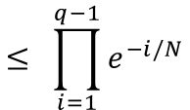


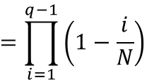

Birthday attack
$0$ $1$ $⋯$
$$N$$
$${ Y}_{3}$$
$${ Y}_{1}$$
$${ Y}_{6}$$
$${ Y}_{2}$$
$${ Y}_{q}$$
$${ Y}_{5}$$
$${ Y}_{4}$$
$${ Y}_{i}$$
$$\operatorname{Pr}\left[coll\right]=$$
$$1−Pr\left[no˗coll\right]$$
$$≥ 1−{ e}^{−q(q−1)/2N}$$
$$1$$
$$×\frac{N−1}{N}$$
$$×\frac{N−2}{N}$$
$$×\frac{N−3}{N}$$
$$⋯$$
$$×\frac{N−\left(q−1\right)}{N}$$
$$e^{−x}≥\left(1−x\right)$$
$$x≥0$$
$$\operatorname{Pr}\left[no˗coll\right]=$$
$$=1×\left(1−\frac{1}{N}\right)×\left(1−\frac{2}{N}\right)×\left(1−\frac{3}{N}\right) ⋯ ×\left(1−\frac{q−1}{N}\right)$$
$$e^{−x}=1−\frac{x}{1!}+\frac{x^{2}}{2!}−\frac{x^{3}}{3!}+\frac{x^{4}}{4!}+⋯$$
$$=\prod_{i=1}^{q−1}{\left(1−\frac{i}{N}\right)}$$
$$≤ \prod_{i=1}^{q−1}{e^{−i/N}}$$
$$={ e}^{−\left(1+2+⋯+q−1\right)/N}$$
$$={ e}^{−q(q−1)/2N}$$

Slide 21
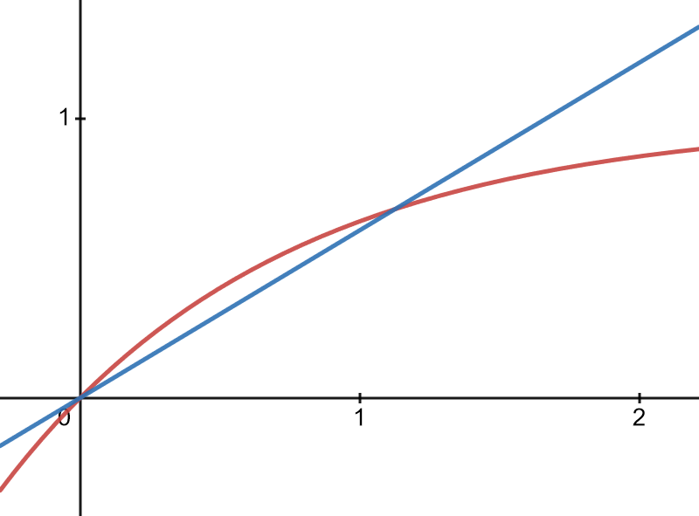





Birthday attack
$0$ $1$ $⋯$
$$N$$
$${ Y}_{3}$$
$${ Y}_{1}$$
$${ Y}_{6}$$
$${ Y}_{2}$$
$${ Y}_{q}$$
$${ Y}_{5}$$
$${ Y}_{4}$$
$${ Y}_{i}$$
$$\operatorname{Pr}\left[coll\right]=$$
$$1−Pr\left[no˗coll\right]$$
$$≥ 1−{ e}^{−q(q−1)/2N}$$
$$≥0.6×\frac{q(q−1)}{2N}$$
$$0.6x$$
$$x$$
$$1−e^{−x}$$
$$q<\sqrt{2N}$$

Slide 22





Birthday attack
$0$ $1$ $⋯$
$$N$$
$${ Y}_{3}$$
$${ Y}_{1}$$
$${ Y}_{6}$$
$${ Y}_{2}$$
$${ Y}_{q}$$
$${ Y}_{5}$$
$${ Y}_{4}$$
$${ Y}_{i}$$
$$0.6×\frac{q\left(q−1\right)}{2N} ≤\operatorname{Pr}\left[coll\right]$$
$$=\operatorname{Pr}{[Y_{1}∨Y_{2}∨⋯∨Y_{q}]}$$
$$≤\operatorname{Pr}\left[Y_{1}\right]+\operatorname{Pr}\left[Y_{2}\right]+⋯+\operatorname{Pr}\left[Y_{q}\right]$$
$$≤\frac{0}{N}+\frac{1}{N}+⋯+\frac{q−1}{N}$$
$$=\frac{q\left(q−1\right)}{2N}$$

Slide 23
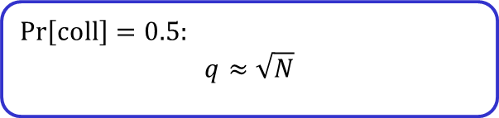
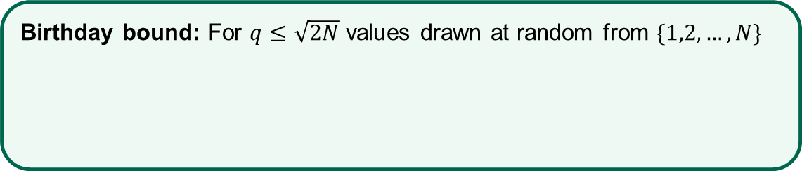

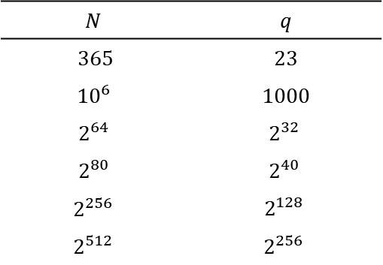

Birthday attack
$0$ $1$ $⋯$
$$N$$
$${ Y}_{3}$$
$${ Y}_{1}$$
$${ Y}_{6}$$
$${ Y}_{2}$$
$${ Y}_{q}$$
$${ Y}_{5}$$
$${ Y}_{4}$$
$${ Y}_{i}$$
$$\operatorname{Pr}\left[coll\right]=0.5:$$
$$q≈\sqrt{N}$$
$$0.6×\frac{q\left(q−1\right)}{2N} ≤\operatorname{Pr}\left[coll\right]$$
$$≤ \frac{q\left(q−1\right)}{2N}$$
$$N$$ | $$q$$
365 | 23
$${10}^{6}$$ | 1000
$$2^{64}$$ | $$2^{32}$$
$$2^{80}$$ | $$2^{40}$$
$$2^{256}$$ | $$2^{128}$$
$$2^{512}$$ | $$2^{256}$$
Birthday bound: For $q≤\sqrt{2N}$ values drawn at random from $\{1,2,…,N\}$
$$\operatorname{Pr}\left[coll\right]≈ \frac{q^{2}}{2N}$$

Slide 24
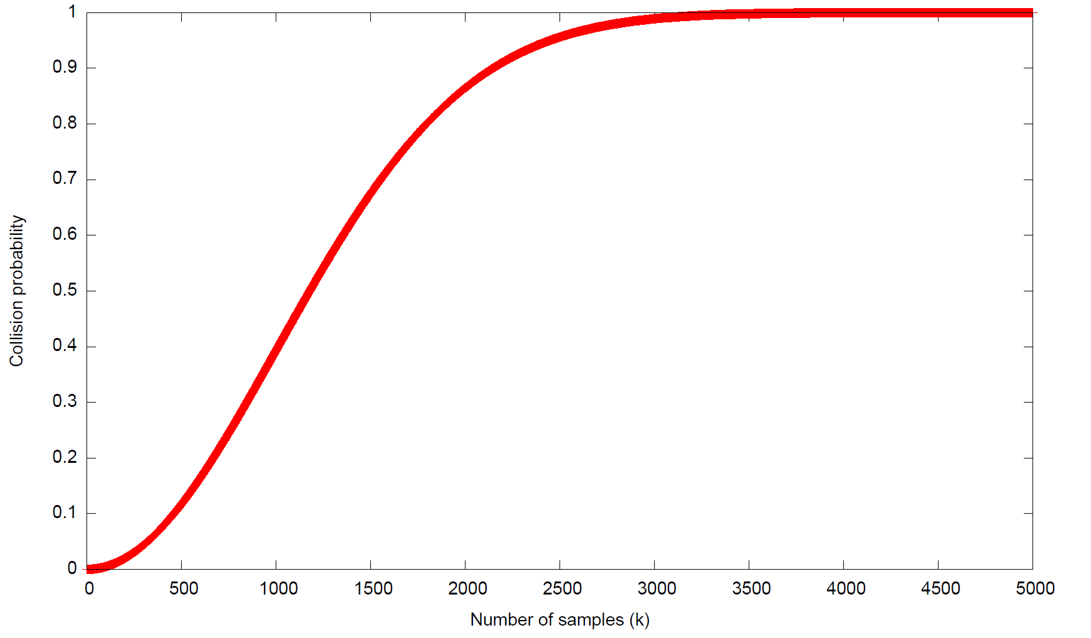


$$N={10}^{6}$$
$$\left(q\right)$$

Slide 25
Attacks on hash functions
Specific attacks: exploit internal design of hash function
Generic attacks: work for all hash functions $H :{\left\{0,1\right\}}^{∗}→{\left\{0,1\right\}}^{n}$
  Brute-force: hash $1, 2, 3,…, 2^{n}+1$
    Output must be long enough
    $n=10$ requires only $2^{10}+1=1025$ values
    $n=100$ enough?
  Brute-force 2: hash $1, 2, 3,…, q$
$${Adv}_{H}^{cr}\left(A\right)=1$$
No! $n/2$ must be large enough $⟹ n≥200$
$${Adv}_{H}^{cr}\left(B\right)≈1$$
$$q≈2^{50}≪2^{100}$$

Slide 26


Designing hash functions

Slide 27
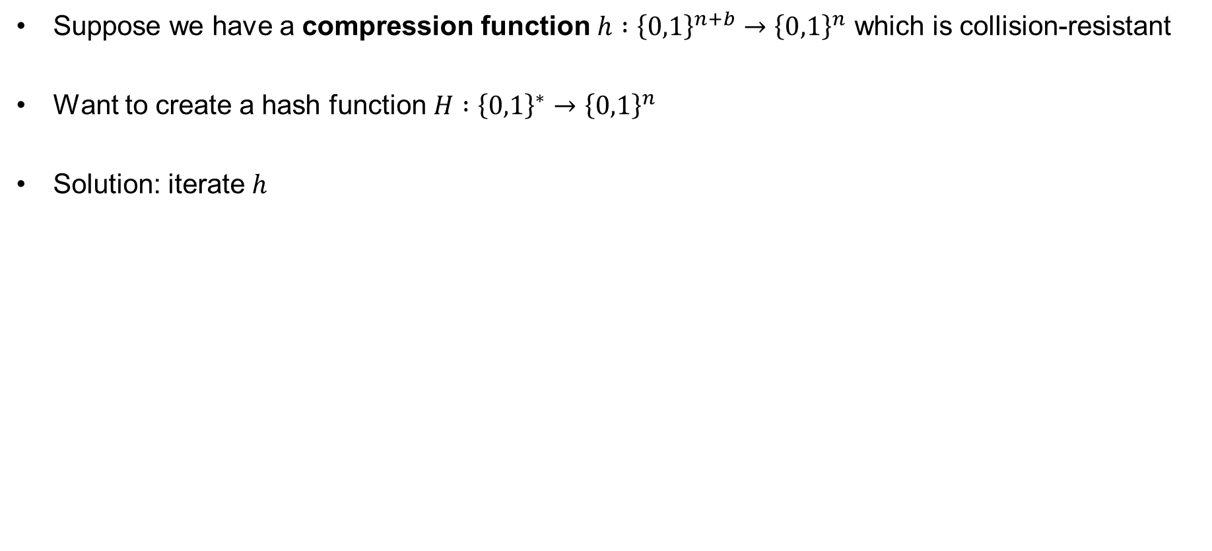
Merkle-Damgård
Suppose we have a compression function $h :{\left\{0,1\right\}}^{n+b}→{\left\{0,1\right\}}^{n}$ which is collision-resistant
Want to create a hash function $H :{\left\{0,1\right\}}^{∗}→{\left\{0,1\right\}}^{n}$
Solution: iterate $h$

Slide 28




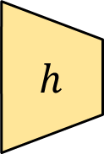
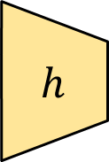

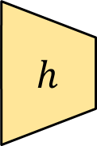

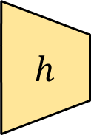

Merkle-Damgård
$$H :{\left\{0,1\right\}}^{∗}→{\left\{0,1\right\}}^{n}$$
$$H\left(M\right)=h\left(h\left( ⋯h\left(h\left(IV||M_{1}\right) || M_{2}\right) ⋯ || M_{n−1}\right) || M_{n}\right)$$
$${ M}_{1}$$
$${ M}_{2}$$
$${ M}_{3}$$
$${ M}_{4}$$
$$h$$
$$h$$
$$h$$
$$h$$
$$IV$$
$$h :{\left\{0,1\right\}}^{n+b}→{\left\{0,1\right\}}^{n}$$

Slide 29

Merkle-Damgård
$$H :{\left\{0,1\right\}}^{∗}→{\left\{0,1\right\}}^{n}$$
$$H\left(M\right)=h\left(h\left( ⋯h\left(h\left(IV||M_{1}\right) || M_{2}\right) ⋯ || M_{n−1}\right) || M_{n}\right)$$
$${ M}_{1}$$
$${ M}_{2}$$
$${ M}_{3}$$
$${ M}_{4}|| pad\left(M\right)$$
$$h$$
$$h$$
$$h$$
$$h$$
$$IV$$
$$h :{\left\{0,1\right\}}^{n+b}→{\left\{0,1\right\}}^{n}$$

Slide 30

Merkle-Damgård
$$H :{\left\{0,1\right\}}^{∗}→{\left\{0,1\right\}}^{n}$$
$$H\left(M\right)=h\left(h\left( ⋯h\left(h\left(IV||M_{1}\right) || M_{2}\right) ⋯ || M_{n−1}\right) || M_{n}\right)$$
$${ M}_{1}$$
$${ M}_{2}$$
$${ M}_{3}$$
$${ M}_{4}|| \left|M\right|$$
$$h$$
$$h$$
$$h$$
$$h$$
$$IV$$
$$h :{\left\{0,1\right\}}^{n+b}→{\left\{0,1\right\}}^{n}$$

Slide 31
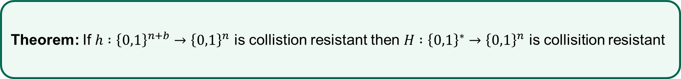
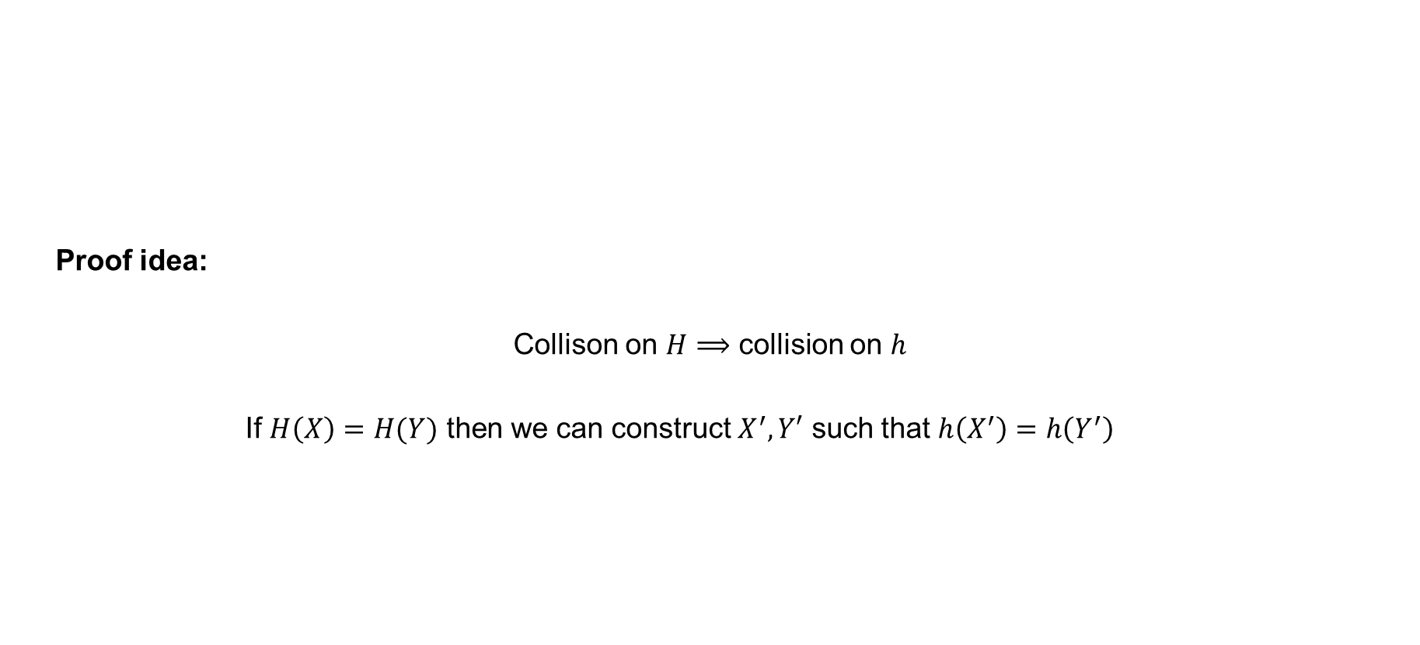
Merkle-Damgård – security
Proof idea:
Collison on $H⟹$ collision on $h$
If $H\left(X\right)=H(Y)$ then we can construct $X^{′}, Y′$ such that $h\left(X^{′}\right)=h\left(Y^{′}\right)$
Theorem: If $h :{\left\{0,1\right\}}^{n+b}→{\left\{0,1\right\}}^{n}$ is collistion resistant then $H :{\left\{0,1\right\}}^{∗}→{\left\{0,1\right\}}^{n}$ is collisition resistant

Slide 32


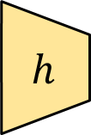














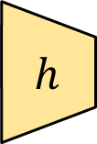




Merkle-Damgård – security
Assumption: $X≠Y$and $H\left(X\right)=H\left(Y\right)=Z$
$${ X}_{1}$$
$${ X}_{2}$$
$${ X}_{18}$$
$${ X}_{19}$$
$${ X}_{20}$$
$$h$$
$$h$$
$$h$$
$$h$$
$$h$$
$$⋯$$
$$Z$$
$$IV$$
$${ Y}_{1}$$
$$Y_{2}$$
$${ Y}_{3}$$
$$h$$
$$h$$
$$h$$
$$IV$$
$$Z$$

Slide 33


Merkle-Damgård – security
Assumption: $X≠Y$and $H\left(X\right)=H\left(Y\right)=Z$
$${ X}_{1}$$
$${ X}_{2}$$
$${ X}_{18}$$
$${ X}_{19}$$
$$… || \left|X\right|$$
$$h$$
$$h$$
$$h$$
$$h$$
$$h$$
$$⋯$$
$$Z$$
$$IV$$
$${ Y}_{1}$$
$$Y_{2}$$
$$… || \left|Y\right|$$
$$h$$
$$h$$
$$h$$
$$IV$$
$$Z$$

Slide 34



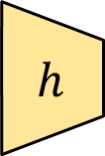



Merkle-Damgård – security
Assumption: $X≠Y$and $H\left(X\right)=H\left(Y\right)=Z$
$${ X}_{1}$$
$${ X}_{2}$$
$${ X}_{18}$$
$${ X}_{19}$$
$${ X}_{20}$$
$$h$$
$$h$$
$$h$$
$$h$$
$$h$$
$$⋯$$
$$Z$$
$$IV$$
$${ Y}_{1}$$
$${ Y}_{2}$$
$${ Y}_{18}$$
$${ Y}_{19}$$
$${ Y}_{20}$$
$$h$$
$$h$$
$$h$$
$$h$$
$$h$$
$$IV$$
$$⋯$$
$$Z$$

Slide 35





















Merkle-Damgård – security
Assumption: $X≠Y$and $H\left(X\right)=H\left(Y\right)=Z$
$${ X}_{1}$$
$${ X}_{2}$$
$${ X}_{18}$$
$${ X}_{19}$$
$${ X}_{20}$$
$$h$$
$$h$$
$$h$$
$$h$$
$$h$$
$$⋯$$
$$Z$$
$$IV$$
$$V_{20}$$
$${ Y}_{1}$$
$${ Y}_{2}$$
$${ Y}_{18}$$
$${ Y}_{19}$$
$${ Y}_{20}$$
$$h$$
$$h$$
$$h$$
$$h$$
$$h$$
$$⋯$$
$$Z$$
$$IV$$
$$V_{20}^{′}$$

Slide 36

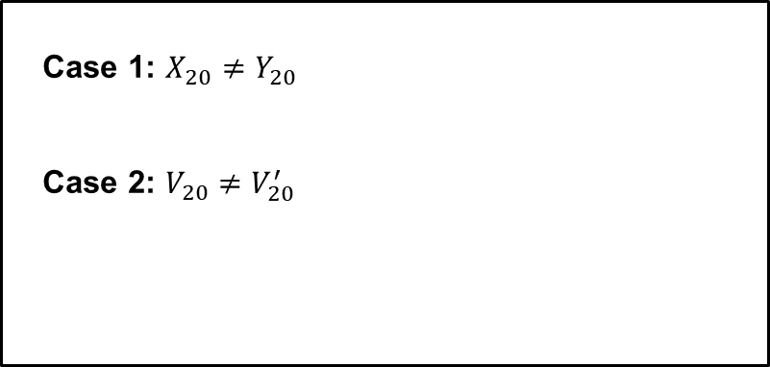

Merkle-Damgård – security
Assumption: $X≠Y$and $H\left(X\right)=H\left(Y\right)=Z$
$${ X}_{1}$$
$${ X}_{2}$$
$${ X}_{18}$$
$${ X}_{19}$$
$${ X}_{20}$$
Case 1: $X_{20}≠Y_{20}$
Case 2: $V_{20}≠V_{20}^{′}$
$$h$$
$$h$$
$$h$$
$$h$$
$$h$$
$$⋯$$
$$Z$$
$$IV$$
$$V_{20}$$
$${ Y}_{1}$$
$${ Y}_{2}$$
$${ Y}_{18}$$
$${ Y}_{19}$$
$${ Y}_{20}$$
$$h$$
$$h$$
$$h$$
$$h$$
$$h$$
$$⋯$$
$$Z$$
$$IV$$
$$V_{20}^{′}$$

Slide 37
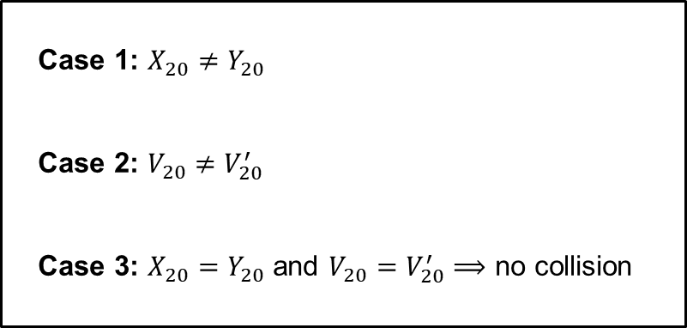

Merkle-Damgård – security
Assumption: $X≠Y$and $H\left(X\right)=H\left(Y\right)=Z$
$${ X}_{1}$$
$${ X}_{2}$$
$${ X}_{18}$$
$${ X}_{19}$$
Case 1: $X_{20}≠Y_{20}$
Case 2: $V_{20}≠V_{20}^{′}$
Case 3: $X_{20}=Y_{20}$ and $V_{20}=V_{20}^{′}⟹$ no collision
$$h$$
$$h$$
$$h$$
$$h$$
$$h$$
$$⋯$$
$$Z$$
$$IV$$
$$V_{20}$$
$${ Y}_{1}$$
$${ Y}_{2}$$
$${ Y}_{18}$$
$${ Y}_{19}$$
$$h$$
$$h$$
$$h$$
$$h$$
$$h$$
$$⋯$$
$$Z$$
$$IV$$
$$V_{20}$$

Slide 38













Merkle-Damgård – security
Assumption: $X≠Y$and $H\left(X\right)=H\left(Y\right)=Z$
$${ X}_{1}$$
$${ X}_{2}$$
$${ X}_{18}$$
$${ X}_{19}$$
Case 1: $X_{19}≠Y_{19}$
Case 2: $V_{19}≠V_{19}^{′}$
Case 3: $X_{19}=Y_{19}$ and $V_{19}=V_{19}^{′}⟹$ no collision
$$h$$
$$h$$
$$h$$
$$h$$
$$h$$
$$⋯$$
$$Z$$
$$IV$$
$$V_{19}$$
$$V_{20}$$
$${ Y}_{1}$$
$${ Y}_{2}$$
$${ Y}_{18}$$
$${ Y}_{19}$$
$$h$$
$$h$$
$$h$$
$$h$$
$$h$$
$$⋯$$
$$Z$$
$$IV$$
$$V_{19}^{′}$$
$$V_{20}$$

Slide 39


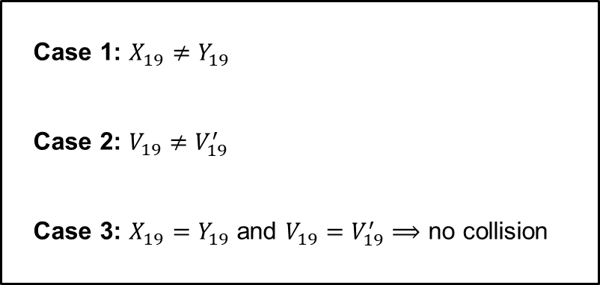

Merkle-Damgård – security
Assumption: $X≠Y$and $H\left(X\right)=H\left(Y\right)=Z$
$${ X}_{1}$$
$${ X}_{2}$$
$${ X}_{18}$$
Case 1: $X_{19}≠Y_{19}$
Case 2: $V_{19}≠V_{19}^{′}$
Case 3: $X_{19}=Y_{19}$ and $V_{19}=V_{19}^{′}⟹$ no collision
$$h$$
$$h$$
$$h$$
$$h$$
$$h$$
$$⋯$$
$$Z$$
$$IV$$
$$V_{19}$$
$$V_{20}$$
$${ Y}_{1}$$
$${ Y}_{2}$$
$${ Y}_{18}$$
$$h$$
$$h$$
$$h$$
$$h$$
$$h$$
$$⋯$$
$$Z$$
$$IV$$
$$V_{19}$$
$$V_{20}$$

Slide 40
Merkle-Damgård – security
Assumption: $X≠Y$and $H\left(X\right)=H\left(Y\right)=Z$
$${ X}_{1}$$
$${ X}_{2}$$
$${ X}_{18}$$
$$h$$
$$h$$
$$h$$
$$h$$
$$h$$
$$⋯$$
$$Z$$
$$IV$$
$$V_{19}$$
$${ Y}_{1}$$
$${ Y}_{2}$$
$${ Y}_{18}$$
$$h$$
$$h$$
$$h$$
$$h$$
$$h$$
$$⋯$$
$$Z$$
$$IV$$
$$V_{19}$$

Slide 41
Merkle-Damgård – security
Assumption: $X≠Y$and $H\left(X\right)=H\left(Y\right)=Z$
$${ X}_{1}$$
$${ X}_{2}$$
$${ X}_{18}$$
$$h$$
$$h$$
$$h$$
$$h$$
$$h$$
$$⋯$$
$$Z$$
$$IV$$
$${ Y}_{1}$$
$${ Y}_{2}$$
$${ Y}_{18}$$
$$h$$
$$h$$
$$h$$
$$h$$
$$h$$
$$⋯$$
$$Z$$
$$IV$$

Slide 42

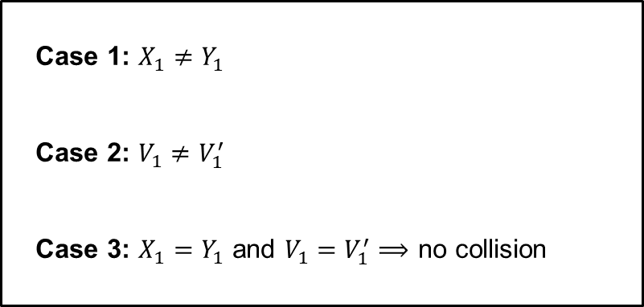
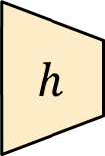



Merkle-Damgård – security
Assumption: $X≠Y$and $H\left(X\right)=H\left(Y\right)=Z$
$${ X}_{1}$$
$$h$$
$$h$$
$$h$$
$$h$$
$$h$$
Case 1: $X_{1}≠Y_{1}$
Case 2: $V_{1}≠V_{1}^{′}$
Case 3: $X_{1}=Y_{1}$ and $V_{1}=V_{1}^{′}⟹$ no collision
$$⋯$$
$$Z$$
$$IV$$
$$V_{1}$$
$$V_{2}$$
$${ Y}_{1}$$
$$h$$
$$h$$
$$h$$
$$h$$
$$h$$
$$⋯$$
$$Z$$
$$IV$$
$$V_{1}$$
$$V_{2}$$

Slide 43



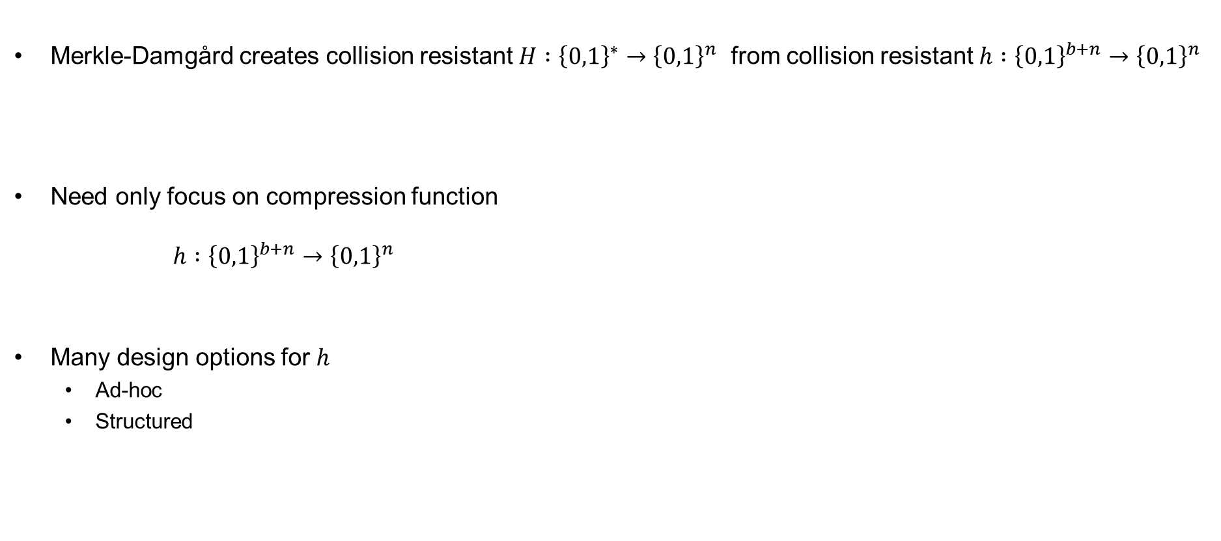



Compression function designs
Merkle-Damgård creates collision resistant $H :{\left\{0,1\right\}}^{∗}→{\left\{0,1\right\}}^{n}$ from collision resistant $h :{\left\{0,1\right\}}^{b+n}→{\left\{0,1\right\}}^{n}$
Need only focus on compression function
$h :{\left\{0,1\right\}}^{b+n}→{\left\{0,1\right\}}^{n}$
Many design options for $h$
  Ad-hoc
  Structured
$$H :{\left\{0,1\right\}}^{∗}→{\left\{0,1\right\}}^{n}$$
$${ M}_{1}$$
$${ M}_{2}$$
$${ M}_{3}$$
$${ M}_{4}|| \left|M\right|$$
$$h$$
$$h$$
$$h$$
$$h$$
$$IV$$

Slide 44



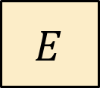



Compression functions from block ciphers – Davies-Meyer
$k+n$ bits
$M$
$$= M_{1} || M_{2}$$
$M_{1}$
$$E$$
$$M_{2}$$
$$Z$$

Slide 45
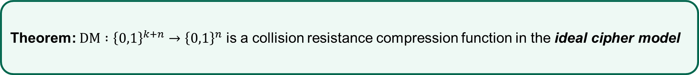
Compression functions from block ciphers – Davies-Meyer
$k+n$ bits
$M$
$$= M_{1} || M_{2}$$
$M_{1}$
$$E$$
$$M_{2}$$
$$Z$$
Theorem: $DM :{\left\{0,1\right\}}^{k+n}→{\left\{0,1\right\}}^{n}$ is a collision resistance compression function in the ideal cipher model

Slide 46
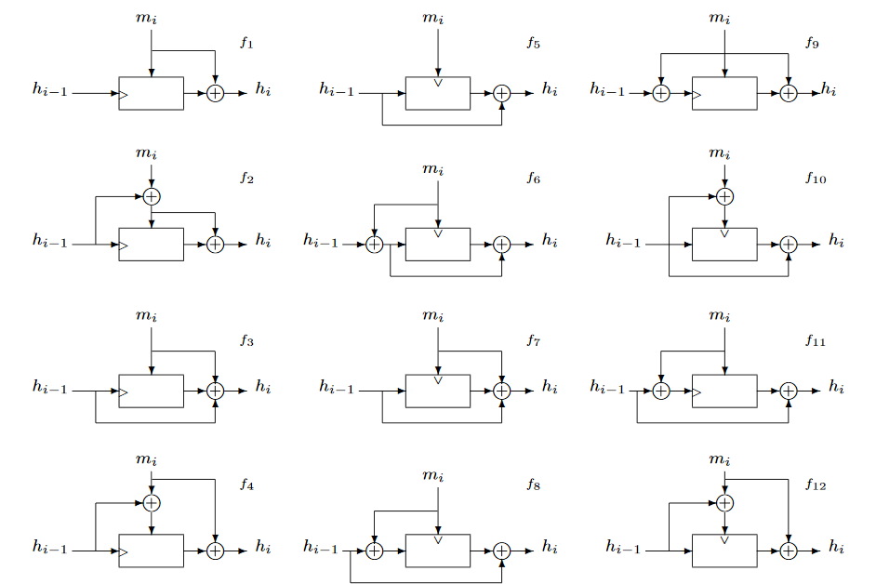
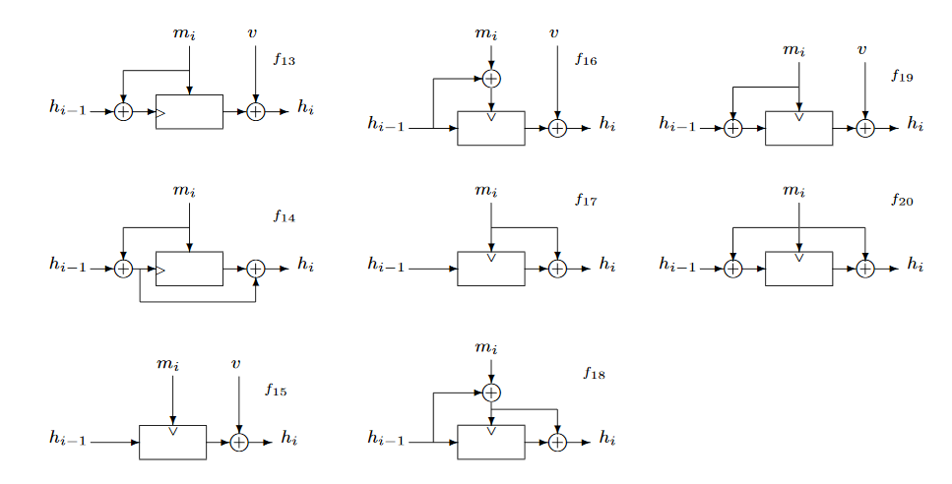
Alternatives…
Davies-Mayer
Black, Rogaway & Shrimpton: Black-Box Analysis of the Block-Cipher-Based Hash-Function Constructions from PGV; CRYPTO'02

Slide 47
SHA – Secure Hash Algorithm
Family of hash functions published by NIST
  SHA1 in 1995
  SHA2-256 and SHA2-512 in 2001
    Also truncated versions: SHA2-224, SHA2-384
  SHA3-256 and SHA3-512 in 2015
SHA1 and SHA2 designed by NSA
  Merkle-Damgård + Davies-Meyer designs
SHA3 designed by Belgian cryptographers
  Sponge design

Slide 48
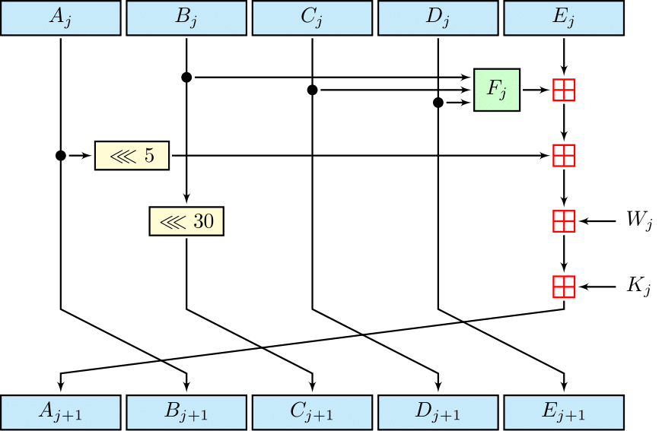





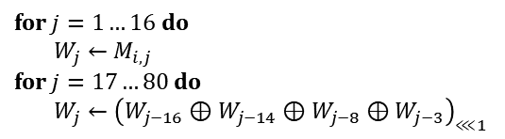


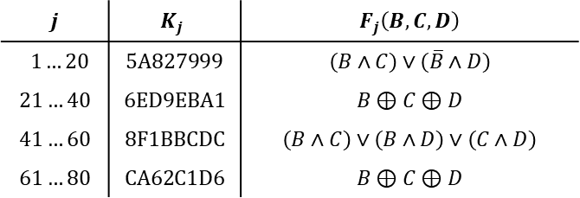


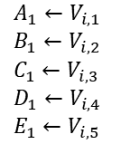






SHA1
$$E(M_{i}, V_{i})$$
Merkle-Damgård
$$A_{1}←V_{i,1}$$
$$B_{1}←V_{i,2}$$
$$C_{1}←V_{i,3}$$
$$D_{1}←V_{i,4}$$
$$E_{1}←V_{i,5}$$
for $j=1…16$ do
$W_{j}←M_{i,j}$
for $j=17…80$ do
$W_{j}←{\left(W_{j−16}⊕W_{j−14}⊕W_{j−8}⊕W_{j−3}\right)}_{⋘1}$
$${ M}_{1}$$
$${ M}_{2}$$
$${ M}_{n}||pad$$
$$IV$$
$$E$$
$$E$$
$$⋯$$
$$E$$
$$T$$
$$j$$
Davies-Mayer
Repeat
80 times
$${frac}_{32}\left(\sqrt{2}\right)$$
$$E :{\left\{0,1\right\}}^{512}×{\left\{0,1\right\}}^{160}→{\left\{0,1\right\}}^{160}$$
$${frac}_{32}\left(\sqrt{3}\right)$$
$$j$$ | $$K_{j}$$ | $$F_{j}\left(B, C,D\right)$$
$$1…20$$ | $$\text{5}\text{A}\text{827999}$$ | $$\left(B∧C\right)∨\left(\overline{B}∧D\right)$$
$$21…40$$ | $$\text{6}\text{ED}\text{9}\text{EBA}\text{1}$$ | $$B⊕C⊕D$$
$$41…60$$ | $$\text{8}\text{F}\text{1}\text{BBCDC}$$ | $$\left(B∧C\right)∨\left(B∧D\right)∨\left(C∧D\right)$$
$$61…80$$ | $$\text{CA}\text{62}\text{C}\text{1}\text{D}\text{6}$$ | $$B⊕C⊕D$$
$${frac}_{32}\left(\sqrt{5}\right)$$
$$\text{IV}\text{ = }\text{67452301}\text{ || }\text{EFCDAB}\text{89}\text{ ||}\text{98}\text{BADCFE}\text{ || }\text{10325476}\text{ ||}\text{C}\text{3}\text{D}\text{2}\text{E}\text{1}\text{F}\text{0}$$
$${frac}_{32}\left(\sqrt{10}\right)$$

Slide 49
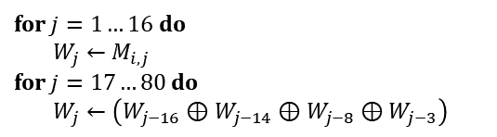

SHA0
$$E(M_{i}, V_{i})$$
$$A_{1}←V_{i,1}$$
$$B_{1}←V_{i,2}$$
$$C_{1}←V_{i,3}$$
$$D_{1}←V_{i,4}$$
$$E_{1}←V_{i,5}$$
for $j=1…16$ do
$W_{j}←M_{i,j}$
for $j=17…80$ do
$W_{j}←\left(W_{j−16}⊕W_{j−14}⊕W_{j−8}⊕W_{j−3}\right)$
$${}_{⋘1}$$
$${ M}_{1}$$
$${ M}_{2}$$
$${ M}_{n}||pad$$
$$IV$$
$$E$$
$$E$$
$$⋯$$
$$E$$
$$T$$
SHA1
$$j$$
Repeat
80 times
$$E :{\left\{0,1\right\}}^{512}×{\left\{0,1\right\}}^{160}→{\left\{0,1\right\}}^{160}$$
$$j$$ | $$K_{j}$$ | $$F_{j}\left(B, C,D\right)$$
$$1…20$$ | $$\text{5}\text{A}\text{827999}$$ | $$\left(B∧C\right)∨\left(\overline{B}∧D\right)$$
$$21…40$$ | $$\text{6}\text{ED}\text{9}\text{EBA}\text{1}$$ | $$B⊕C⊕D$$
$$41…60$$ | $$\text{8}\text{F}\text{1}\text{BBCDC}$$ | $$\left(B∧C\right)∨\left(B∧D\right)∨\left(C∧D\right)$$
$$61…80$$ | $$\text{CA}\text{62}\text{C}\text{1}\text{D}\text{6}$$ | $$B⊕C⊕D$$
$$\text{IV}\text{ = }\text{67452301}\text{ || }\text{EFCDAB}\text{89}\text{ ||}\text{98}\text{BADCFE}\text{ || }\text{10325476}\text{ ||}\text{C}\text{3}\text{D}\text{2}\text{E}\text{1}\text{F}\text{0}$$

Slide 50



Attacks against SHA1
2004: First SHA0 collision found (Wang et al.)
2005: Theoretical attack on SHA1 ($2^{69}$ ops.)
2017: First SHA1 collision found ($2^{63.1}$ ops.)
(Stevens & Karpman + Google 2017)

Slide 51





SHA2
$$E(M_{i}, V_{i})$$
$$A_{1}←V_{i,1}$$
$$B_{1}←V_{i,2}$$
$$C_{1}←V_{i,3}$$
$$D_{1}←V_{i,4}$$
for $j=1…16$ do
$W_{j}←M_{i,j}$
for $j=17…64$ do
$σ_{0}←{ROTR^{7}(W}_{j−15})⊕{ROTR^{18}(W}_{j−15})⊕{{SHR}^{3}(W}_{j−15})$
$σ_{1}←{ROTR^{17}(W}_{j−2})⊕{ROTR^{19}(W}_{j−2})⊕{{SHR}^{10}(W}_{j−2})$
$W_{j}←W_{j−16}+σ_{0}+W_{i−7}+σ_{1}$
$$E_{1}←V_{i,5}$$
$$F_{1}←V_{i,6}$$
$$G_{1}←V_{i,7}$$
$$H_{1}←V_{i,8}$$
$${ M}_{1}$$
$${ M}_{2}$$
$${ M}_{n}||pad$$
$$IV$$
$$E$$
$$E$$
$$⋯$$
$$E$$
$$T$$
$$j$$
SHA2-256
$$E :{\left\{0,1\right\}}^{512}×{\left\{0,1\right\}}^{256}→{\left\{0,1\right\}}^{256}$$
Repeat 64 times
$$E :{\left\{0,1\right\}}^{1024}×{\left\{0,1\right\}}^{512}→{\left\{0,1\right\}}^{512}$$
SHA2-512

Slide 52









MACs from hash functions – $H(K || M)$
Doesn't work in general
Length-extension attacks on Merkle-Damgård hash functions
$$H\left(K||M\right)$$
$$K$$
$$M$$
$$pad\left(K|M\right)$$
$$h$$
$$h$$
$$h$$
$$IV$$
$$T$$

Slide 53






MACs from hash functions – $H(K || M)$
Doesn't work in general
Length-extension attacks on Merkle-Damgård hash functions
$$H\left(K||M\right)$$
$$H\left(K||M||pad\left(K|M\right)\right)$$
$$K$$
$$M$$
$$pad\left(K|M\right)$$
$$pad\left(K|M|pad\left(K|M\right)\right)$$
$$h$$
$$h$$
$$h$$
$$h$$
$$IV$$
$$T$$
$$T′$$

Slide 54










MACs from hash functions – $H(K || M)$
Doesn't work in general
Length-extension attacks on Merkle-Damgård hash functions
$$H\left(K||M\right)$$
$$H\left(K||M||pad\left(K|M\right)||X_{1}||X_{2}||⋯||X_{t}\right)$$
$$K$$
$$M$$
$$pad\left(K|M\right)$$
$$X_{1}$$
$$X_{2}$$
$$X_{t}$$
$$pad\left(…\right)$$
$$h$$
$$h$$
$$h$$
$$h$$
$$h$$
$$⋯$$
$$h$$
$$h$$
$$IV$$
$$T$$
$$T′$$

Slide 55













NMAC
$$M_{1}$$
$$M_{2}$$
$$M_{t}||pad$$
$$h$$
$$h$$
$$⋯$$
$$h$$
$$K_{1}^{′}$$
$$T^{′}||pad$$
$$h$$
$$K_{2}^{′}$$
$$T$$
Theorem (Gaži, Pietrzak, Rybár ‘2014):
If $h :{\left\{0,1\right\}}^{n}×{\left\{0,1\right\}}^{b}→{\left\{0,1\right\}}^{n}$ is a secure PRF then $NMAC :{\left\{0,1\right\}}^{n}×{\left\{0,1\right\}}^{∗}→{\left\{0,1\right\}}^{n}$ is a secure PRF.

Slide 56












HMAC
$$H\left(K⊕ipad || M\right)$$
$$K_{1}$$
$$M_{1}$$
$$M_{2}$$
$$M_{t}||pad$$
$$h$$
$$h$$
$$h$$
$$⋯$$
$$h$$
$$IV$$
$$K_{1}^{′}$$
$$H\left(K⊕opad || …\right)$$
$$K_{2}$$
$$T^{′}||pad$$
$$K_{1}=K⊕ipad$$
$$h$$
$$h$$
$$IV$$
$$T$$
$$K_{2}=K⊕opad$$
$$K_{2}^{′}$$
$$HMAC\left(K,M\right)=H\left( K⊕opad || H\left(K⊕ipad || M\right)\right)$$

Slide 57



HMAC
Very widely used
  TLS
  IPsec
  SSH
  LTE
  …
Standardized by NIST and IETF (RFC 2104)
Security proof for NMAC can be lifted to HMAC:
  + assume $h$ is a secure dual PRF ($h$ keyed through the message is also a secure PRF)
  + assume $h$ is secure against related-key attacks (since $K_{1}, K_{2}$ are derived from $K$)
  very tricky proof; controversies
$$K⊕ipad$$
$$K_{1}$$
$$M_{1}$$
$$M_{2}$$
$$M_{t}||pad$$
$$h$$
$$h$$
$$h$$
$$⋯$$
$$h$$
$$IV$$
$$K⊕opad$$
$$K_{2}$$
$$T^{′}||pad$$
$$h$$
$$h$$
$$T$$
$$IV$$
$$HMAC\left(K,M\right)=H\left( K⊕opad || H\left(K⊕ipad || M\right)\right)$$

Slide 58


SHA3
$f :{\left\{0,1\right\}}^{1600}→{\left\{0,1\right\}}^{1600}$
Absorption phase
Squeezing phase

Slide 59
Midterm exam
Available next week (Wednesday 11. October)
Due: two weeks later (Thursday 26. October, 23:59)
Take-home exam
Individual: collaboration is not allowed
Mandatory: need to pass in order to be eligible for the exam
All sources allowed (save for explicitly searching for the solution)
Submission: Canvas (file type = PDF; strongly prefer if you use provided LaTex template)
Start early! The assignment may be more challenging than you expect

