Slide 1
Lecture 5 – Authenticated encryption
TEK4500
27.09.2023
Håkon Jacobsen
hakon.jacobsen@its.uio.no

Slide 2
Basic goals of cryptography
 | Message privacy | Message integrity / authentication
Symmetric keys | Symmetric encryption | Message authentication codes (MAC)
Asymmetric keys | Asymmetric encryption (a.k.a. public-key encryption) | Digital signatures

Slide 3

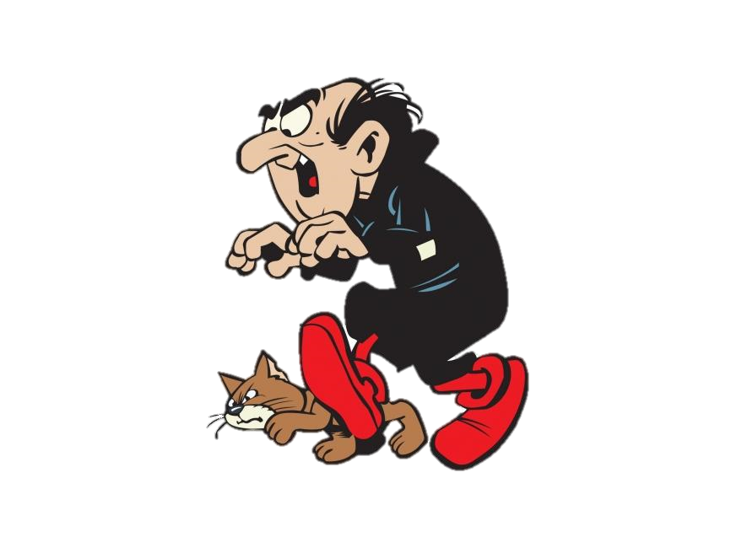
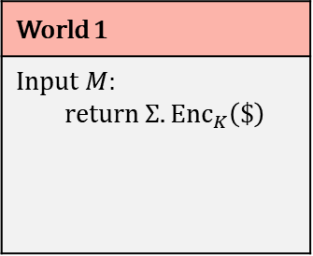
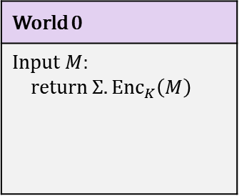

IND-CPA – Indistinguishability against chosen-plaintext attacks
World 0
Input $M$: return $Σ.{Enc}_{K}\left(M\right)$
World 1
Input $M$: return $Σ.{Enc}_{K}\left(\$\right)$
I’m in World $b′$

Slide 4





Chosen-plaintext attacks
Public Internet
Google Search (internal)
C
M

Slide 5
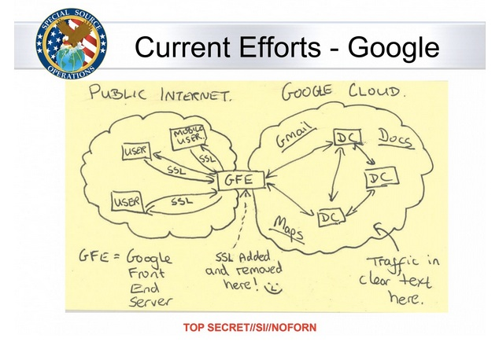
Chosen-plaintext attacks

Slide 6
IND-CPA – Indistinguishability against chosen-plaintext attacks
World 0
Input $M$: return $Σ.{Enc}_{K}\left(M\right)$
World 1
Input $M$: return $Σ.{Enc}_{K}\left(\$\right)$
I’m in World $b′$

Slide 7
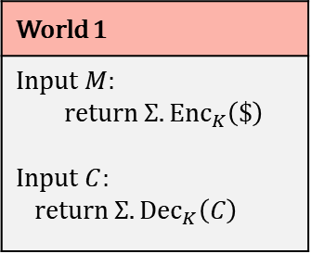
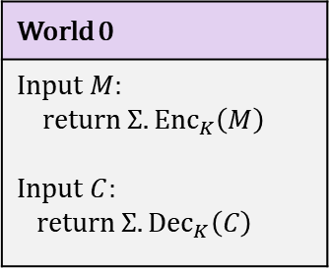
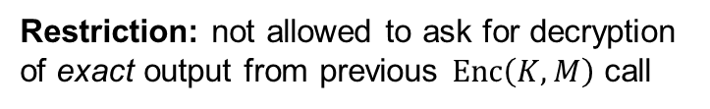
IND-CCA – Indistinguishability against chosen-ciphertext attacks
World 0
Input $M$: return $Σ.{Enc}_{K}\left(M\right)$ Input $C$: return $Σ.{Dec}_{K}\left(C\right)$
World 1
Input $M$: return $Σ.{Enc}_{K}\left(\$\right)$ Input $C$: return $Σ.{Dec}_{K}\left(C\right)$
I’m in World $b′$
Restriction: not allowed to ask for decryption of exact output from previous $Enc\left(K,M\right)$ call

Slide 8
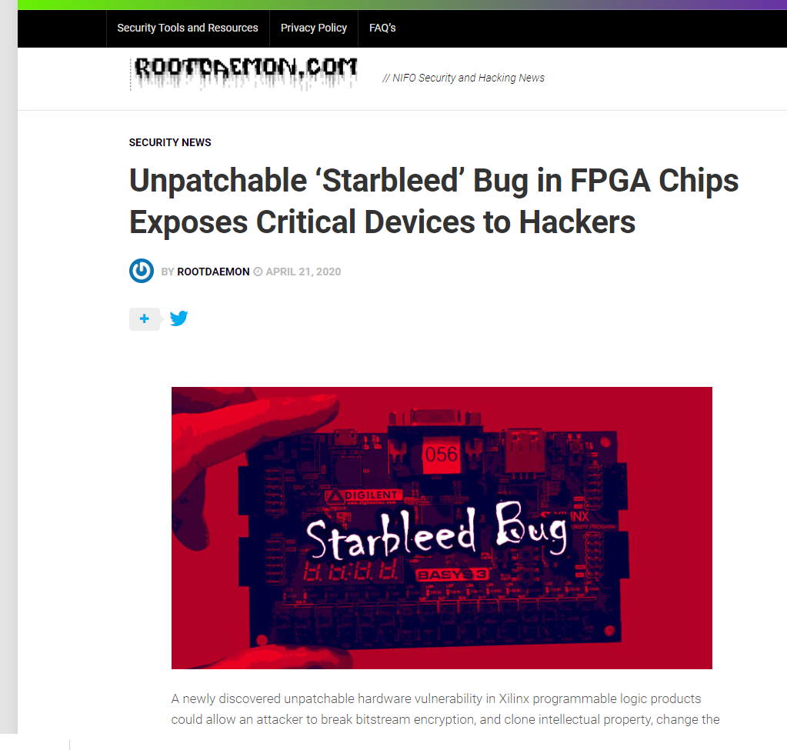
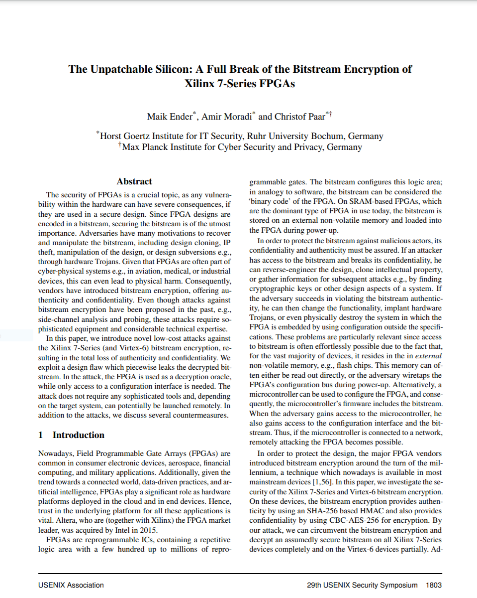
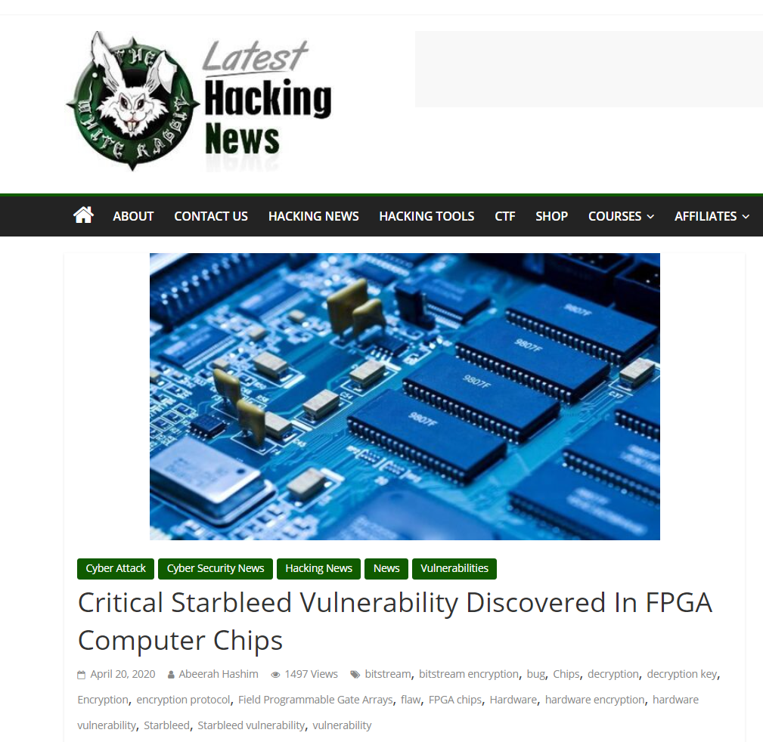
Xilinx FPGA – Starbleed attack

Slide 9


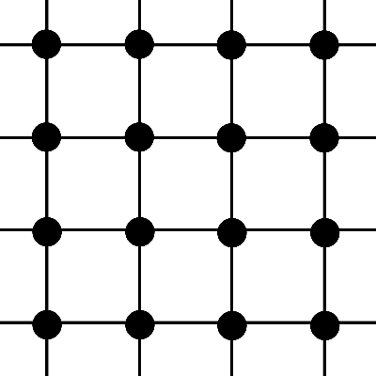
FPGA – Field Programmable Gate Array
Bitstream
Configure

Slide 10
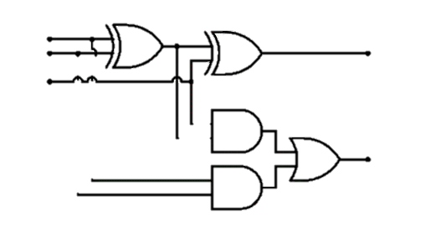
FPGA – Field Programmable Gate Array
Bitstream

Slide 11
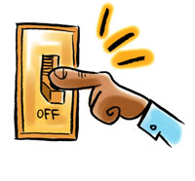
FPGA – Field Programmable Gate Array
Bitstream design typically a business secret
(or even a national/military secret)
Bitstream
FPGA applications:
  Aerospace and avionics
  Digital signal processors
  Defense and military
  Medical devices
  General hardware accelerators
  (e.g. cryptography)

Slide 12

FPGA – Field Programmable Gate Array
Bitstream
Decrypt bitstream with K
Configure
K

Slide 13
FPGA – Field Programmable Gate Array
Bitstream
Decrypt bitstream with K
K

Slide 14
Xilinx Starbleed attack
Bitstream
Decrypt bitstream with K
⋯ | ⋯ | ⋯
K_{MAC} | ⋯ | ⋯
⋯ | WRITE WBSTAR | 0x00000000
 |  | MAC TAG
Header
K
WBSTAR: 0x000000
AES-CBC encrypted
WBSTAR = Warm-Boot Start-address

Slide 15



Xilinx Starbleed attack
Bitstream
Decrypt bitstream with K
⋯ | ⋯ | ⋯
K_{MAC} | ⋯ | ⋯
⋯ | WRITE WBSTAR
 |  | BAD TAG
Reboot
K
Configure
WBSTAR: 0x23d001
Decrypted

Slide 16
Xilinx Starbleed attack
Bitstream
“Read out WBSTAR”
Decrypt bitstream with K
Configure
K
WBSTAR: 0x23d001
0x23d001

Slide 17
Xilinx Starbleed attack
Bitstream
“Read out WBSTAR”
Decrypt bitstream with K
⋯ | ⋯ | ⋯
K_{MAC} | ⋯ | ⋯
⋯ | WRITE WBSTAR
 |  | BAD TAG
K
WBSTAR: 0x23d001

Slide 18
Xilinx Starbleed attack
Bitstream
“Read out WBSTAR”
Decrypt bitstream with K
Configure
⋯ | ⋯ | ⋯
K_{MAC} | ⋯ | ⋯
⋯ | WRITE WBSTAR
 |  | BAD TAG
Reboot
K
Configure
WBSTAR: 0xff0015
0xff0015

Slide 19
Xilinx Starbleed attack
Bitstream
“Read out WBSTAR”
Decrypt bitstream with K
⋯ | ⋯ | ⋯
K_{MAC} | ⋯ | ⋯
⋯ | WRITE WBSTAR
 |  | BAD TAG
Reboot
K
Configure
WBSTAR: 0x6391dd
0x6391dd

Slide 20
Xilinx Starbleed attack
Bitstream
“Read out WBSTAR”
Decrypt bitstream with K
⋯ | ⋯ | ⋯
K_{MAC} | ⋯ | ⋯
⋯ | WRITE WBSTAR
 |  | BAD TAG
Reboot
K
Configure
WBSTAR: 0xba11c0
0xba11c0

Slide 21
Xilinx Starbleed attack
Bitstream
“Read out WBSTAR”
Decrypt bitstream with K
⋯ | ⋯ | ⋯
K_{MAC} | ⋯ | ⋯
⋯ | WRITE WBSTAR
 |  | BAD TAG
Reboot
K
Configure
WBSTAR: 0x833ad7
0x833ad7

Slide 22
Xilinx Starbleed attack
Bitstream
“Read out WBSTAR”
Decrypt bitstream with K
⋯ | ⋯ | ⋯
K_{MAC} | ⋯ | ⋯
⋯ | WRITE WBSTAR
 |  | BAD TAG
Reboot
K
Configure
WBSTAR: 0xfe4115
0xfe4115
Time to fully decrypt bitstream: 26 hours

Slide 23
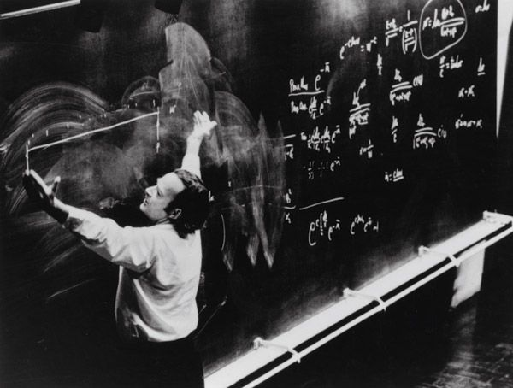
Authenticated encryption

Slide 24
Authenticated encryption
Authenticated encryption: privacy and integrity from a single primitive:
Syntactically (almost) the same as a normal encryption scheme

Slide 25






Authenticated encryption – syntax
$$Enc :𝒦×ℳ→𝒞$$
$$Enc(K,M)={Enc}_{K}\left(M\right)=C$$
$$Dec :𝒦×𝒞→ℳ$$
$$∪\left\{⊥\right\}$$
$$Dec\left(K, C\right)=Dec_{K}\left(C\right)=M$$
$$/ ⊥$$

Slide 26

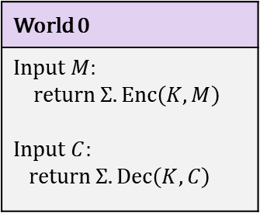
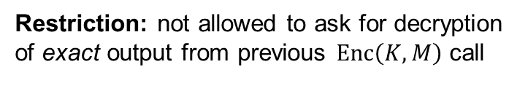
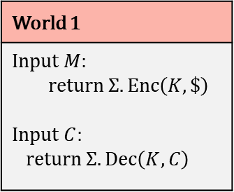
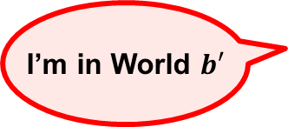
Authenticated encryption – security
World 0
Input $M$: return $Σ.Enc\left(K, M\right)$ Input $C$: return $Σ.Dec\left(K,C\right)$
World 1
Input $M$: return $Σ.Enc\left(K, \$\right)$ Input $C$: return $Σ.Dec\left(K,C\right)$
I’m in World $b′$
Restriction: not allowed to ask for decryption of exact output from previous $Enc\left(K,M\right)$ call

Slide 27
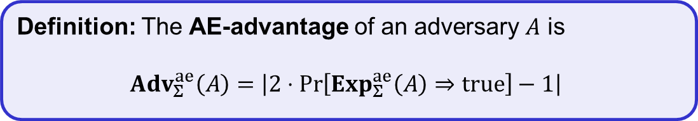
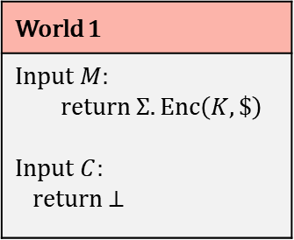
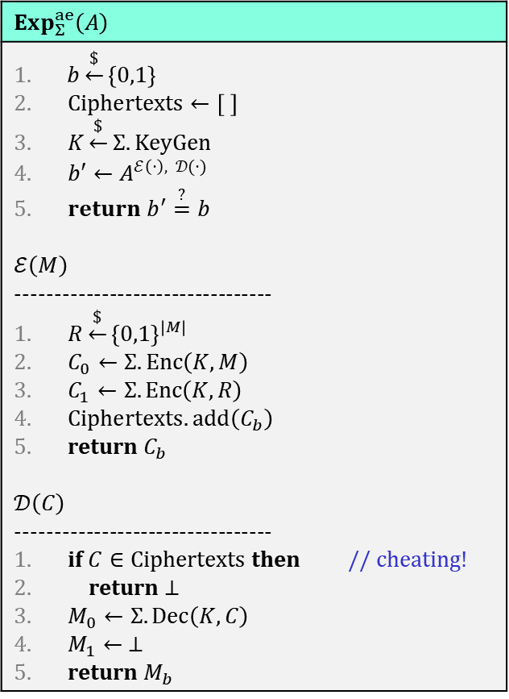
Authenticated encryption – security
$$Exp_{Σ}^{ae}\left(A\right)$$
$b\underset{←}{\$}\left\{0,1\right\}$ $Ciphertexts←\left[ \right]$ $K\underset{←}{\$}Σ.KeyGen$ $b′←A^{ℰ\left(⋅\right), 𝒟(⋅)}$ $return b^{′}\overset{?}{=}b$ $$ℰ\left(M\right)$$ --------------------------------- $R\underset{←}{\$}{\left\{0,1\right\}}^{\left|M\right| }$ $C_{0}←Σ.Enc\left(K, M\right)$ $C_{1}←Σ.Enc\left(K, R\right)$ $Ciphertexts.add\left(C_{b}\right)$ return $C_{b}$ $$𝒟\left(C\right)$$ --------------------------------- if $C∈Ciphertexts$ then // cheating! return $⊥$ $M_{0}←Σ.Dec\left(K, C\right)$ $M_{1}← ⊥$ return $M_{b}$
World 0
Input $M$: return $Σ.Enc\left(K, M\right)$ Input $C$: return $Σ.Dec\left(K,C\right)$
World 1
Input $M$: return $Σ.Enc\left(K, \$\right)$ Input $C$: return $⊥$
I’m in World $b′$
Restriction: not allowed to ask for decryption of exact output from previous $Enc\left(K,M\right)$ call
Definition: The AE-advantage of an adversary $A$ is
$${Adv}_{Σ}^{ae}\left(A\right)=\left|2⋅\operatorname{Pr}\left[Exp_{Σ}^{ae}\left(A\right)⇒true\right]−1\right|$$

Slide 28
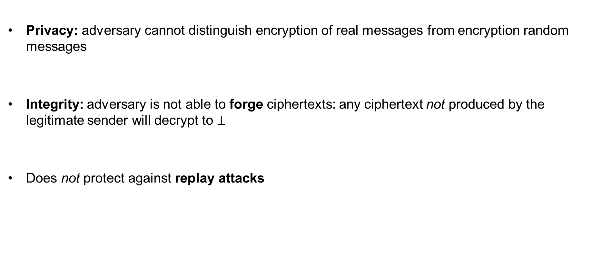
AE security definition – implications
Privacy: adversary cannot distinguish encryption of real messages from encryption random messages
Integrity: adversary is not able to forge ciphertexts: any ciphertext not produced by the legitimate sender will decrypt to $⊥$
Does not protect against replay attacks

Slide 29



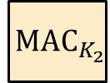
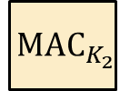

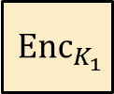
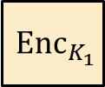






Generic composition: AE from Encryption + MAC
MAC-then-Encrypt (MtE)
Encrypt-and-MAC (E&M)
Encrypt-then-MAC (EtM)
$$M$$
$$M$$
$$M$$
$${ Enc}_{K_{1}}$$
$${ MAC}_{K_{2}}$$
$${ Enc}_{K_{1}}$$
$${ MAC}_{K_{2}}$$
$${ Enc}_{K_{1}}$$
$${ MAC}_{K_{2}}$$
$$C$$
$$C$$
$$T$$
$$C$$
$$T$$
Used in TLS 1.2
Used in SSH
Used in IPsec

Slide 30

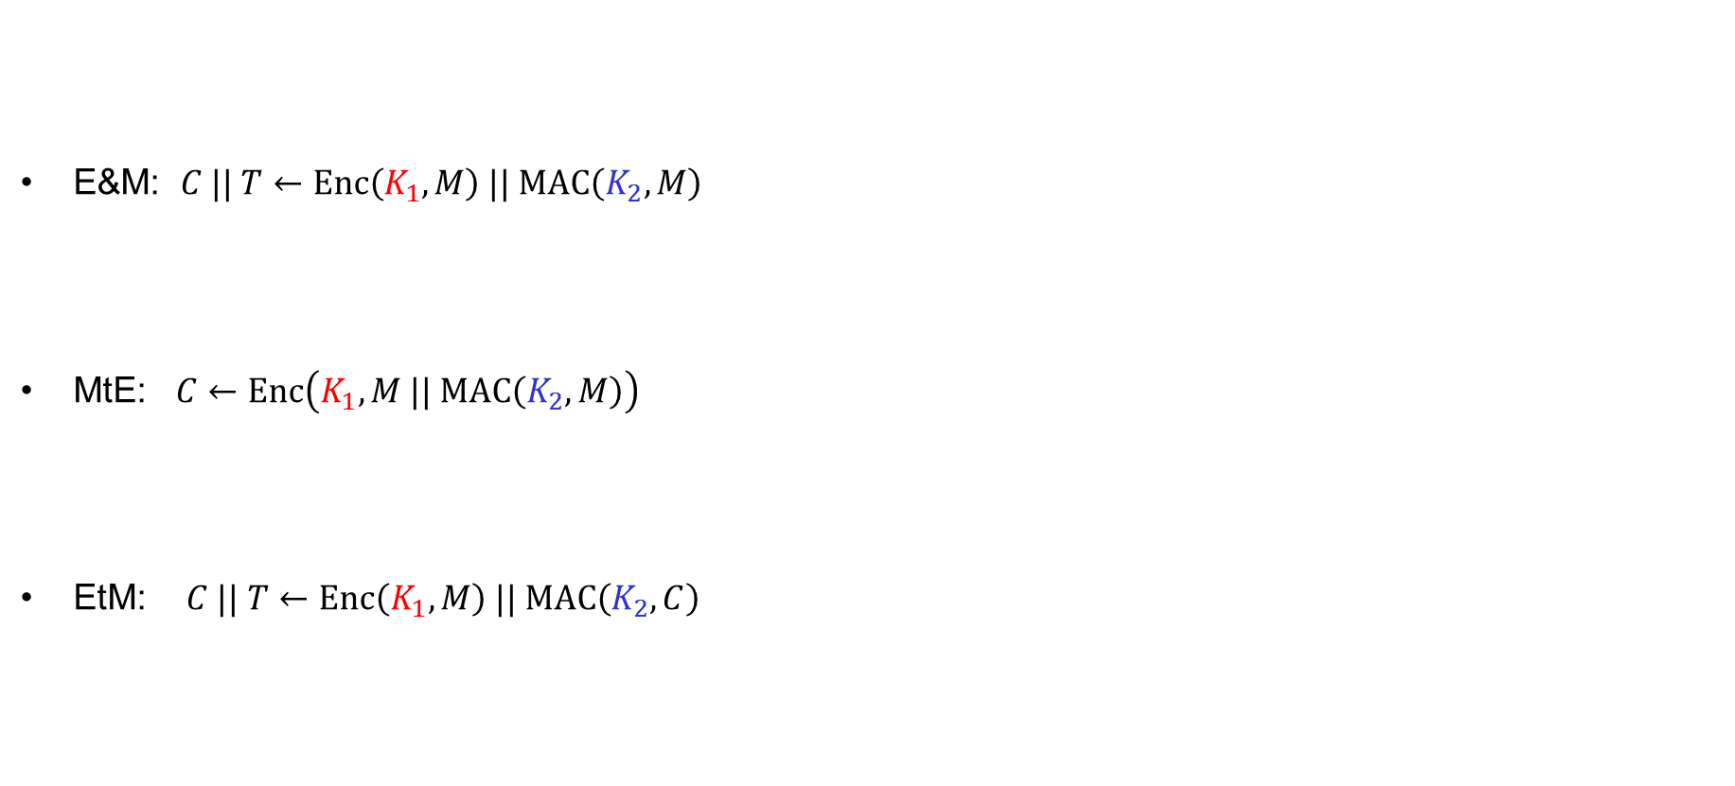


Generic composition: AE secure?
E&M: $C || T←Enc\left(K_{1}, M\right) || MAC\left(K_{2}, M\right)$
MtE: $C←Enc\left(K_{1}, M || MAC\left(K_{2}, M\right)\right)$
EtM: $C || T←Enc\left(K_{1}, M\right) || MAC\left(K_{2}, C\right)$
IND-CPA secure
UF-CMA secure
$$MAC\left(K_{2}, M\right)$$
✗
$$Enc\left(K_{1}, M\right) || M || T$$
AE secure?
✗
$$0000 || C$$
✓

Slide 31


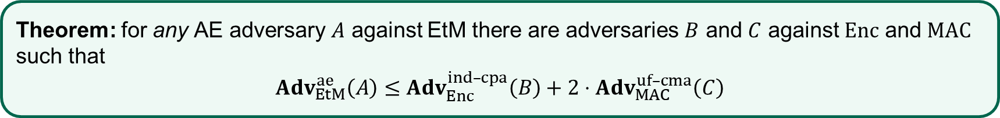
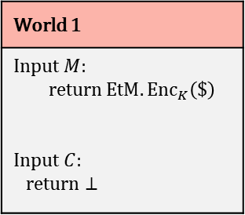
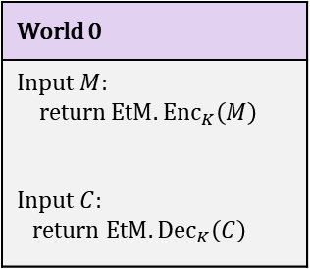
EtM – security
Theorem: for any AE adversary $A$ against EtM there are adversaries $B$ and $C$ against $Enc$ and $MAC$ such that
$Adv_{EtM}^{ae}\left(A\right)≤$ $Adv_{Enc}^{ind–cpa}\left(B\right)+2⋅Adv_{MAC}^{uf–cma}\left(C\right)$
Proof sketch:
World 0
Input $M$: return $EtM.{Enc}_{K}\left(M\right)$ Input $C$: return $EtM.{Dec}_{K}\left(C\right)$
World 1
Input $M$: return $EtM.{Enc}_{K}\left(\$\right)$ Input $C$: return $⊥$
IND-CPA
$$≈$$
$$≈$$
UF-CMA

Slide 32
CCA-attacks – revisited
MtE used in Starbleed attack
Gave rise to (partial) decryption oracle
Attack would not have been possible
with an AE secure scheme
Bitstream
“Read out WBSTAR”
Decrypt bitstream with K
⋯ | ⋯ | ⋯
K_{MAC} | ⋯ | ⋯
⋯ | WRITE WBSTAR
 |  | BAD TAG
K
Configure
WBSTAR: 0x833ad7
AES-CBC
0x833ad7

Slide 33


AEAD – Authenticated Encryption with Associated Data

Slide 34


AEAD – AE with associated data (AD)
AD – data that can't be encrypted but still need integrity protection
  Headers in protocols
  Configuration data
  Metadata
Integrity protected
Dst address
Src address
Payload
Tag
$$AD$$
$$M$$
Authenticated
Encrypted
Privacy protected
Notes:
Example: Filenames of (encrypted) files on disk

Slide 35








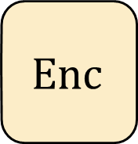
Authenticated encryption w/associated data (AEAD) – syntax
$$Enc :𝒦×ℳ→𝒞$$
$$Enc\left(K, M\right)=Enc_{K}\left(M\right)=C$$
$$Enc$$
$$\$$$
$$A$$
$$M$$
$$C$$
$$Dec :𝒦×𝒞→ℳ∪\left\{⊥\right\}$$
$$K$$
$$Dec\left(K, C\right)={Dec}_{K}\left(C\right)=M/⊥$$

Slide 36



Authenticated encryption w/associated data (AEAD) – syntax
$$Enc :𝒦×𝒜×ℳ→𝒞$$
$$Enc\left(K, A,M\right)=Enc_{K}\left(A,M\right)={Enc}_{K}^{A}\left(M\right)=C$$
$$N$$
$$Enc$$
$$\$$$
$$A$$
$$M$$
$$C$$
$$Dec :𝒦×𝒜×𝒞→ℳ∪\left\{⊥\right\}$$
$$K$$
$$Dec\left(K, A, C\right)={Dec}_{K}\left(A, C\right)={Dec}_{K}^{A}\left(C\right)=M/⊥$$

Slide 37
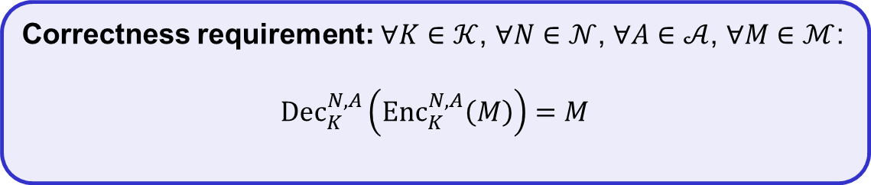

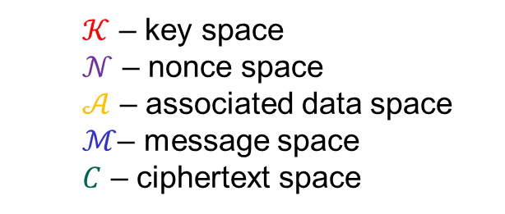
Authenticated encryption w/associated data (AEAD) – syntax
$$Enc :𝒦×𝒩×𝒜×ℳ→𝒞$$
$$Enc\left(K, N, A,M\right)={Enc}_{K}^{N}\left(A,M\right)={Enc}_{K}^{N,A}\left(M\right)=C$$
$$N$$
$$Enc$$
$$A$$
$$M$$
$$C$$
$$Dec :𝒦×𝒩×𝒜×𝒞→ℳ∪\left\{⊥\right\}$$
$$K$$
$$Dec\left(K, N, A,C\right)={Dec}_{K}^{N}\left(A, C\right)={Dec}_{K}^{N,A}\left(C\right)=M/⊥$$
  $𝒦$ – key space
  $𝒩$ – nonce space
  $𝒜$ – associated data space
  $ℳ$– message space
  $C$ – ciphertext space
Correctness requirement: $∀K∈𝒦$, $∀N∈𝒩$, $∀A∈𝒜$, $∀M∈ℳ$:
$${Dec}_{K}^{N,A}\left({Enc}_{K}^{N,A}\left(M\right)\right)=M$$

Slide 38
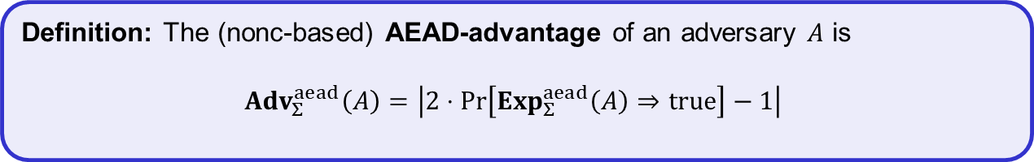
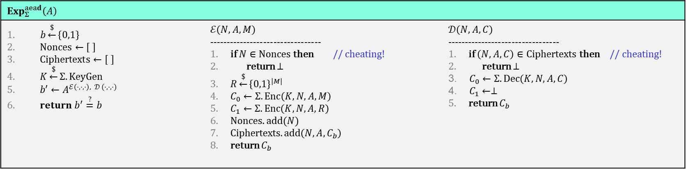
AEAD security (nonce-based)
$$Exp_{Σ}^{aead}\left(A\right)$$
$b\underset{←}{\$}\left\{0,1\right\}$ $Nonces←\left[ \right]$ $Ciphertexts←\left[ \right]$ $K\underset{←}{\$}Σ.KeyGen$ $b′←A^{ℰ\left(⋅,⋅,⋅\right), 𝒟 (⋅,⋅,⋅)}$ $return b^{′}\overset{?}{=}b$ | $$ℰ\left(N, A,M\right)$$ --------------------------------- if $N∈Nonces$ then // cheating! return $⊥$ $R\underset{←}{\$}{\left\{0,1\right\}}^{|M|}$ $C_{0}←Σ.Enc\left(K, N, A,M\right)$ $C_{1}←Σ.Enc\left(K, N, A,R\right)$ $Nonces.add(N)$ Ciphertexts$.add\left({N,A,C}_{b}\right)$ return $C_{b}$ | $$𝒟\left(N, A, C\right)$$ --------------------------------- if $\left(N,A,C\right)∈Ciphertexts$ then // cheating! return $⊥$ $C_{0}←Σ.Dec\left(K, N, A,C\right)$ $C_{1}←⊥$ return $C_{b}$
Definition: The (nonc-based) AEAD-advantage of an adversary $A$ is
$${Adv}_{Σ}^{aead}\left(A\right)=\left|2⋅\operatorname{Pr}\left[Exp_{Σ}^{aead}\left(A\right)⇒true\right]−1\right|$$

Slide 39
Constructing AEAD schemes

Slide 40


























GCM – Galois/Counter Mode
ctr+1
ctr+2
ctr+3
$${ E}_{K}$$
$${ E}_{K}$$
$${ E}_{K}$$
$${ M}_{1}$$
$${ M}_{2}$$
$${ M}_{3}$$
$${ A}_{1}$$
$${ A}_{2}$$
$${ C}_{1}$$
$${ C}_{2}$$
$${ C}_{3}$$
$$\left|A\right|+\left|C\right|$$
$$⋇$$
$$⋇$$
$$⋇$$
$$⋇$$
$$⋇$$
$$⋇$$
$$H$$
$$H$$
$$H$$
$$H$$
$$H$$
$$H$$
$$S$$
$$T$$

Slide 41







GCM – Galois/Counter Mode
CTR-mode
ctr+1
ctr+2
ctr+3
$$ctr←N||0^{31}1$$
$${ E}_{K}$$
$${ E}_{K}$$
$${ E}_{K}$$
$${ M}_{1}$$
$${ M}_{2}$$
$${ M}_{3}$$
$${ A}_{1}$$
$${ A}_{2}$$
$${ C}_{1}$$
$${ C}_{2}$$
$${ C}_{3}$$
$$\left|A\right|+\left|C\right|$$
$$⋇$$
$$⋇$$
$$⋇$$
$$⋇$$
$$⋇$$
$$⋇$$
$$H$$
$$H$$
$$H$$
$$H$$
$$H$$
$$H$$
$$S$$
$$T$$

Slide 42













GCM – Galois/Counter Mode
ctr+1
ctr+2
ctr+3
$H←E_{K}\left(0^{128}\right)$
$${ E}_{K}$$
$${ E}_{K}$$
$${ E}_{K}$$
$$S←E_{K}(N||0^{31}1)$$
$${ M}_{1}$$
$${ M}_{2}$$
$${ M}_{3}$$
GMAC
$${ A}_{1}$$
$${ A}_{2}$$
$${ C}_{1}$$
$${ C}_{2}$$
$${ C}_{3}$$
$$\left|A\right|+\left|C\right|$$
$$⋇$$
$$⋇$$
$$⋇$$
$$⋇$$
$$⋇$$
$$⋇$$
$$H$$
$$H$$
$$H$$
$$H$$
$$H$$
$$H$$
$$A_{1}H$$
$$A_{1}H^{2}+A_{2}H$$
$$A_{1}H^{3}+A_{2}H^{2}+C_{1}H$$
$$S$$
$$A_{1}H^{4}+A_{2}H^{3}+C_{1}H^{2}+C_{2}H$$
$$A_{1}H^{6}+A_{2}H^{5}+C_{1}H^{4}+C_{2}H^{3}+C_{3}H^{2}+LH+S=$$
$$T$$
$$A_{1}H^{5}+A_{2}H^{4}+C_{1}H^{3}+C_{2}H^{2}+C_{3}H$$

Slide 43

GCM – Galois/Counter Mode
ctr+1
ctr+2
ctr+3
$$ctr←N||0^{31}1$$
$H←E_{K}\left(0^{128}\right)$
$${ E}_{K}$$
$${ E}_{K}$$
$${ E}_{K}$$
$$S←E_{K}(N||0^{31}1)$$
$${ M}_{1}$$
$${ M}_{2}$$
$${ M}_{3}$$
$${ A}_{1}$$
$${ A}_{2}$$
$${ C}_{1}$$
$${ C}_{2}$$
$${ C}_{3}$$
$$\left|A\right|+\left|C\right|$$
$$⋇$$
$$⋇$$
$$⋇$$
$$⋇$$
$$⋇$$
$$⋇$$
$$H$$
$$H$$
$$H$$
$$H$$
$$H$$
$$H$$
$$S$$
$$T$$

Slide 44



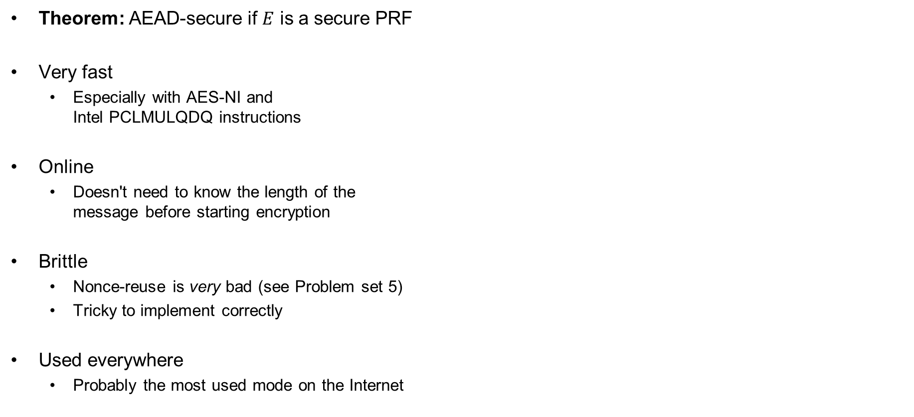


GCM – properties
Theorem: AEAD-secure if $E$ is a secure PRF
Very fast
  Especially with AES-NI and
  Intel PCLMULQDQ instructions
Online
  Doesn't need to know the length of the
  message before starting encryption
Brittle
  Nonce-reuse is very bad (see Problem set 5)
  Tricky to implement correctly
Used everywhere
  Probably the most used mode on the Internet
$ctr←N||0^{31}1$
$H←E_{K}\left(0^{128}\right)$
$$S←E_{K}(N||0^{31}1)$$
ctr+1
ctr+2
ctr+3
$${ E}_{K}$$
$${ E}_{K}$$
$${ E}_{K}$$
$${ M}_{1}$$
$${ M}_{2}$$
$${ M}_{3}$$
$${ A}_{1}$$
$${ A}_{2}$$
$${ C}_{1}$$
$${ C}_{2}$$
$${ C}_{3}$$
$$\left|A\right|+\left|C\right|$$
$$⋇$$
$$⋇$$
$$⋇$$
$$⋇$$
$$⋇$$
$$⋇$$
$$H$$
$$H$$
$$H$$
$$H$$
$$H$$
$$H$$
$$S$$
$$T$$

Slide 45

Ideal solution: secure channels
Internet
How to build?
Alice
Bob
M
Adversary
Security goals:
Data privacy: adversary should not be able to read message M ✓
Data integrity: adversary should not be able to modify message M ✓
Data authenticity: message M really originated from Alice ✓

Slide 46
Ideal solution: secure channels
AES-GCM?
Internet
Alice
Bob
M
Adversary
Security goals:
Data privacy: adversary should not be able to read message M ✓
Data integrity: adversary should not be able to modify message M ✓
Data authenticity: message M really originated from Alice ✓

Slide 47



AES-GCM = secure channel?
"Send Bob $10"
AES-GCM
AES-GCM
+10
AES-GCM
+10
AES-GCM
+10

Slide 48



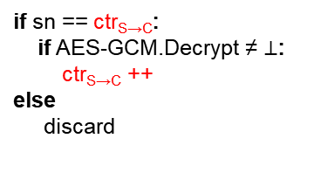
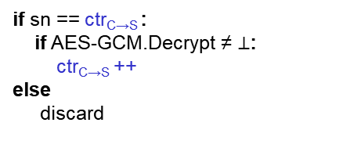
Secure channels – TLS / IPsec
ctr_{C→S} = 103
ctr_{S→C} = 395
AD
ctr_{C→S} = 103
ctr_{S→C} = 395
104
105
104
AES-GCM
105
396
398
397
398
396
397
398
sn = 103
data
if sn == ctr_{S→C}:
if AES-GCM.Decrypt ≠ $⊥$:
ctr_{S→C} ++
else
discard
sn = 395
data
if sn == ctr_{C→S} :
if AES-GCM.Decrypt ≠ $⊥$:
ctr_{C→S} ++
else
discard
sn = 396
data
sn =397
data
sn = 104
data
sn = 103
data
103 < ctr_{C→S}
Notes:
Why can't the attacker just change sn to 105? Because of AES-GCM!

Slide 49


























OCBv3 – Offset Codebook Mode
$${ A}_{1}$$
$${ A}_{2}$$
$${ M}_{1}$$
$${ M}_{2}$$
$${ M}_{3}$$
$$M_{1}⊕M_{2}⊕M_{3}$$
$$Δ_{1}$$
$$Δ_{2}$$
$$Δ_{3}$$
$$Δ_{4}$$
$$Δ_{5}$$
$$Δ_{6}$$
$${ E}_{K}$$
$${ E}_{K}$$
$${ E}_{K}$$
$${ E}_{K}$$
$${ E}_{K}$$
$${ E}_{K}$$
$$Δ_{3}$$
$$Δ_{4}$$
$$Δ_{5}$$
Auth
Auth
$${ C}_{1}$$
$${ C}_{2}$$
$${ C}_{3}$$
$$T$$
$Δ_{i}$ - derived from 96-bit nonce $N$

Slide 50
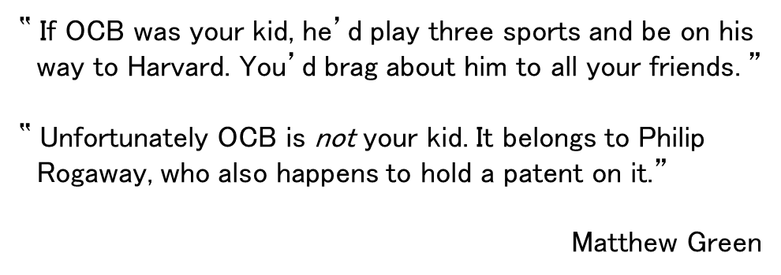
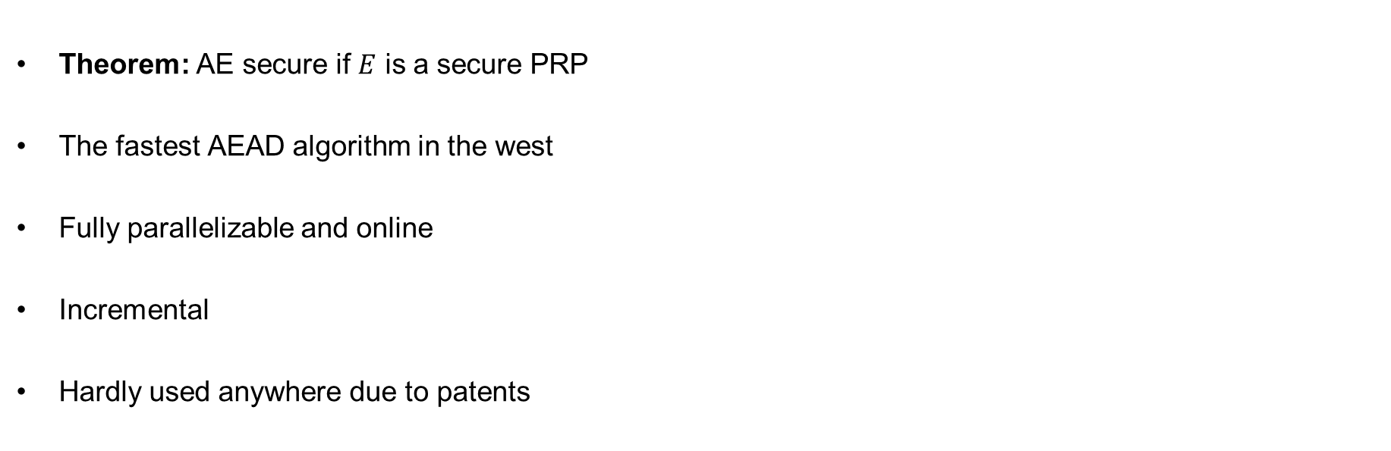


OCBv3 – properties
Theorem: AE secure if $E$ is a secure PRP
The fastest AEAD algorithm in the west
Fully parallelizable and online
Incremental
Hardly used anywhere due to patents
‟ If OCB was your kid, he’d play three sports and be on his
way to Harvard. You’d brag about him to all your friends. ”
‟ Unfortunately OCB is not your kid. It belongs to Philip
Rogaway, who also happens to hold a patent on it.”
Matthew Green
$${ A}_{1}$$
$${ A}_{2}$$
$${ M}_{1}$$
$${ M}_{2}$$
$${ M}_{3}$$
$$M_{1}⊕M_{2}⊕M_{3}$$
$$Δ_{1}$$
$$Δ_{2}$$
$$Δ_{3}$$
$$Δ_{4}$$
$$Δ_{5}$$
$$Δ_{6}$$
$${ E}_{K}$$
$${ E}_{K}$$
$${ E}_{K}$$
$${ E}_{K}$$
$${ E}_{K}$$
$${ E}_{K}$$
$$Δ_{3}$$
$$Δ_{4}$$
$$Δ_{5}$$
Auth
Auth
$${ C}_{1}$$
$${ C}_{2}$$
$${ C}_{3}$$
$$T$$

Slide 51














CCM – Counter Mode with CBC-MAC
$${ E}_{K}$$
$${ E}_{K}$$
$${ E}_{K}$$
$${ E}_{K}$$
$${ E}_{K}$$
$$T$$
$$IV$$
$${ A}_{1}$$
$${ M}_{1}$$
$${ M}_{2}$$
$${ M}_{3}$$
ctr+1
$${ E}_{K}$$
ctr+2
$${ E}_{K}$$
ctr+3
$${ E}_{K}$$
ctr
$${ E}_{K}$$
$${ C}_{1}$$
$${ C}_{2}$$
$${ C}_{3}$$
$${ C}_{T}$$

Slide 52








CCM – Counter Mode with CBC-MAC
$${ E}_{K}$$
$${ E}_{K}$$
$${ E}_{K}$$
$${ E}_{K}$$
$${ E}_{K}$$
$$T$$
CTR-mode
$$IV$$
$${ A}_{1}$$
$${ M}_{1}$$
$${ M}_{2}$$
$${ M}_{3}$$
ctr+1
$${ E}_{K}$$
ctr+2
$${ E}_{K}$$
ctr+3
$${ E}_{K}$$
ctr
$${ E}_{K}$$
$${ C}_{1}$$
$${ C}_{2}$$
$${ C}_{3}$$
$${ C}_{T}$$
ctr $←F_{1}||N|| 0^{16}$

Slide 53




CCM – Counter Mode with CBC-MAC
CBC-MAC
$${ E}_{K}$$
$${ E}_{K}$$
$${ E}_{K}$$
$${ E}_{K}$$
$${ E}_{K}$$
$$T$$
$$IV$$
$${ A}_{1}$$
$${ M}_{1}$$
$${ M}_{2}$$
$${ M}_{3}$$
ctr+1
$${ E}_{K}$$
ctr+2
$${ E}_{K}$$
ctr+3
$${ E}_{K}$$
ctr
$${ E}_{K}$$
$${ C}_{1}$$
$${ C}_{2}$$
$${ C}_{3}$$
$${ C}_{T}$$

Slide 54


CCM – Counter Mode with CBC-MAC
CBC-MAC
$\left|A+M\right|$-
$${ E}_{K}$$
$${ E}_{K}$$
$${ E}_{K}$$
$${ E}_{K}$$
$${ E}_{K}$$
$$T$$
$$IV$$
$${ A}_{1}$$
$${ M}_{1}$$
$${ M}_{2}$$
$${ M}_{3}$$
ctr+1
$${ E}_{K}$$
ctr+2
$${ E}_{K}$$
ctr+3
$${ E}_{K}$$
ctr
$${ E}_{K}$$
$${ C}_{1}$$
$${ C}_{2}$$
$${ C}_{3}$$
$${ C}_{T}$$
$$IV←F_{2}||N|| {len}_{16}\left(AD+M\right)$$

Slide 55

CCM – Counter Mode with CBC-MAC
≈ ECBC-MAC
$${ E}_{K}$$
$${ E}_{K}$$
$${ E}_{K}$$
$${ E}_{K}$$
$${ E}_{K}$$
$$T$$
$$IV$$
$${ A}_{1}$$
$${ M}_{1}$$
$${ M}_{2}$$
$${ M}_{3}$$
ctr+1
$${ E}_{K}$$
ctr+2
$${ E}_{K}$$
ctr+3
$${ E}_{K}$$
ctr
$${ E}_{K}$$
$${ C}_{1}$$
$${ C}_{2}$$
$${ C}_{3}$$
$${ C}_{T}$$
$$IV←F_{2}||N|| {len}_{16}\left(AD+M\right)$$

Slide 56
CCM – Counter Mode with CBC-MAC
$${ E}_{K}$$
$${ E}_{K}$$
$${ E}_{K}$$
$${ E}_{K}$$
$${ E}_{K}$$
$$T$$
$$IV$$
$${ A}_{1}$$
$${ M}_{1}$$
$${ M}_{2}$$
$${ M}_{3}$$
ctr+1
$${ E}_{K}$$
ctr+2
$${ E}_{K}$$
ctr+3
$${ E}_{K}$$
ctr
$${ E}_{K}$$
$${ C}_{1}$$
$${ C}_{2}$$
$${ C}_{3}$$
$${ C}_{T}$$
ctr $←F_{1}||N|| 0^{16}$
$$IV←F_{2}||N|| {len}_{16}\left(AD+M\right)$$

Slide 57

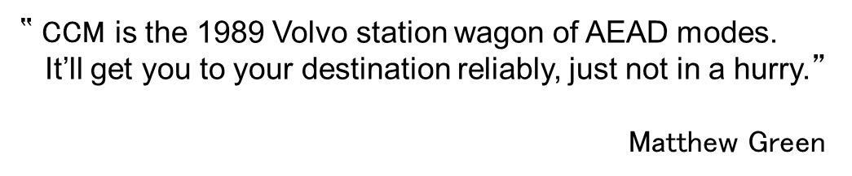
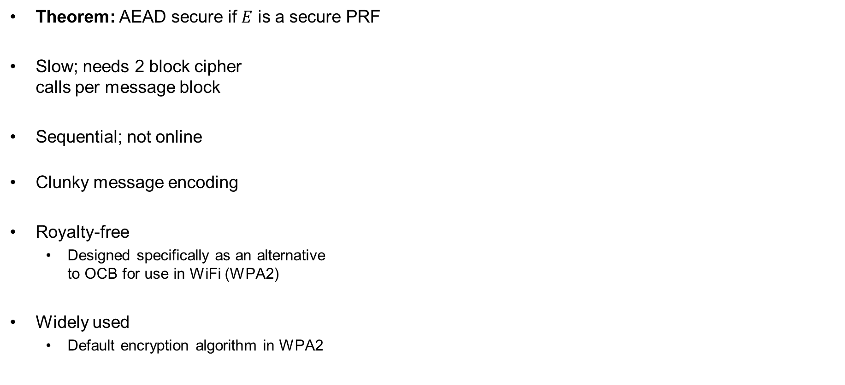





CCM – properties
Theorem: AEAD secure if $E$ is a secure PRF
Slow; needs 2 block cipher
calls per message block
Sequential; not online
Clunky message encoding
Royalty-free
  Designed specifically as an alternative
  to OCB for use in WiFi (WPA2)
Widely used
  Default encryption algorithm in WPA2
‟ CCM is the 1989 Volvo station wagon of AEAD modes.
It’ll get you to your destination reliably, just not in a hurry.”
Matthew Green
$${ E}_{K}$$
$${ E}_{K}$$
$${ E}_{K}$$
$${ E}_{K}$$
$${ E}_{K}$$
$$T$$
$$IV$$
$${ A}_{1}$$
$${ M}_{1}$$
$${ M}_{2}$$
$${ M}_{3}$$
ctr+1
$${ E}_{K}$$
ctr+2
$${ E}_{K}$$
ctr+3
$${ E}_{K}$$
ctr
$${ E}_{K}$$
$$ctr←F_{1}||N|| 0^{16}$$
$${ C}_{1}$$
$${ C}_{2}$$
$${ C}_{3}$$
$${ C}_{T}$$
$$IV←F_{2}||N|| {len}_{16}\left(AD+M\right)$$

Slide 58
Summary
Authenticated encryption: privacy + intergrity in one primitive
AEAD: AE + associated data: data that gets integrity protection, but not privacy protection
(e.g. protocol headers)
AEAD examples:
  GCM
  CCM
  OCB
AEAD is not a secure channel!
  Does not provide replay protection
  Secure channels from AEAD: add counters/nonces/timers
Next week: hash functions

