Slide 1
Lecture 11 – Public-key encryption, IND-CPA/CCA,
ElGamal, RSA
TEK4500
08.11.2023
Håkon Jacobsen
hakon.jacobsen@its.uio.no

Slide 2
Basic goals of cryptography
 | Message privacy | Message integrity / authentication
Symmetric keys | Symmetric encryption | Message authentication codes (MAC)
Asymmetric keys | Asymmetric encryption (a.k.a. public-key encryption) | Digital signatures
(Key exchange)

Slide 3








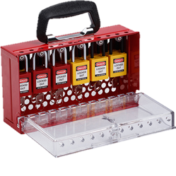



Public-key encryption

Slide 4
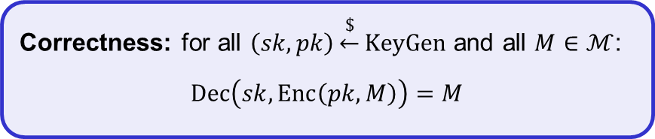


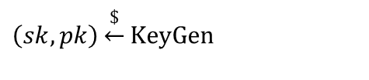







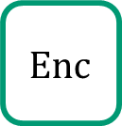
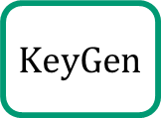

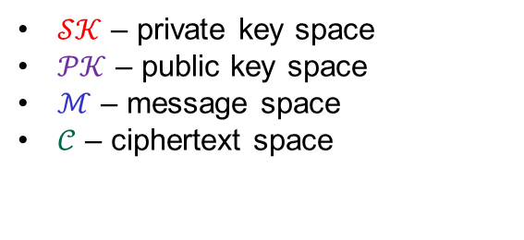

Public-key encryption – syntax
A public-key encryption scheme is a tuple $Σ=\left(KeyGen, Enc, Dec\right)$ of algorithms
$$KeyGen :\left\{ \right\}→𝒮𝒦×𝒫𝒦$$
$$Enc :𝒫𝒦×ℳ→𝒞$$
$$Dec :𝒮𝒦×𝒞→ℳ∪\left\{⊥\right\}$$
$$\left(sk, pk\right)\underset{←}{\$}KeyGen$$
$$Enc\left(pk, M\right)={Enc}_{pk}\left(M\right)=C$$
$$Dec\left(sk, C\right)={Dec}_{sk}\left(C\right)=M/⊥$$
Correctness: for all $\left(sk,pk\right)\underset{←}{\$}KeyGen$ and all $M∈ℳ$:
$$Dec\left(sk, Enc\left(pk, M\right)\right)=M$$
$$\$$$
$$KeyGen$$
$𝒮𝒦$ – private key space
$𝒫𝒦$ – public key space
$ℳ$ – message space
$𝒞$ – ciphertext space
$pk$
$sk$
$\left(sk,pk\right)$
$$Enc$$
$$C$$
$$Dec$$
$$\$$$
$$M$$
$$M / \left\{⊥\right\}$$
Adversary

Slide 5


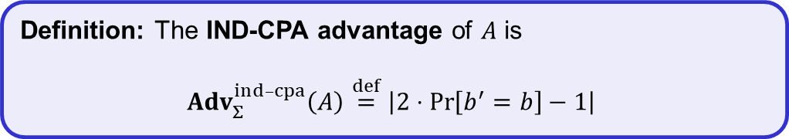


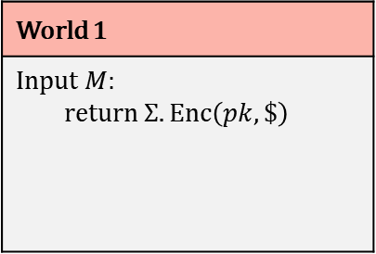
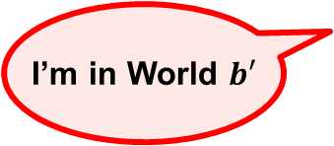
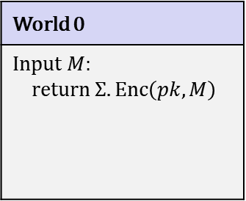
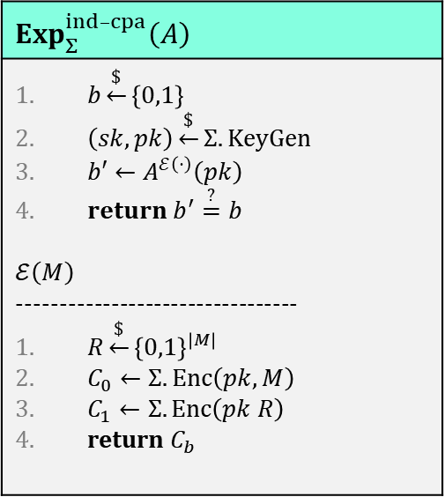
Public-key encryption – security: IND-CPA
$$Exp_{Σ}^{ind­­–cpa}\left(A\right)$$
$b\underset{←}{\$}\left\{0,1\right\}$ $\left(sk,pk\right)\underset{←}{\$}Σ.KeyGen$ $b′←A^{ℰ\left(⋅\right)}\left(pk\right)$ $return b^{′}\overset{?}{=}b$ $$ℰ\left(M\right)$$ --------------------------------- $R\underset{←}{\$}{\left\{0,1\right\}}^{\left|M\right|}$ $C_{0}←Σ.Enc\left(pk, M\right)$ $C_{1}←Σ.Enc\left(pk R\right)$ return $C_{b}$
World 0
Input $M$: return $Σ.Enc\left(pk, M\right)$
World 1
Input $M$: return $Σ.Enc\left(pk, \$\right)$
$b$
I’m in World $b′$
$$pk$$
Definition: The IND-CPA advantage of $A$ is
$${Adv}_{Σ}^{ind­–cpa}\left(A\right)\overset{def}{=}\left|2⋅Pr\left[b^{′}=b\right]−1\right|$$

Slide 6
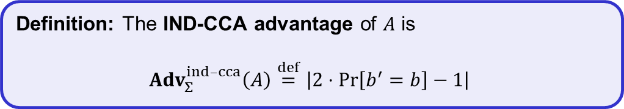

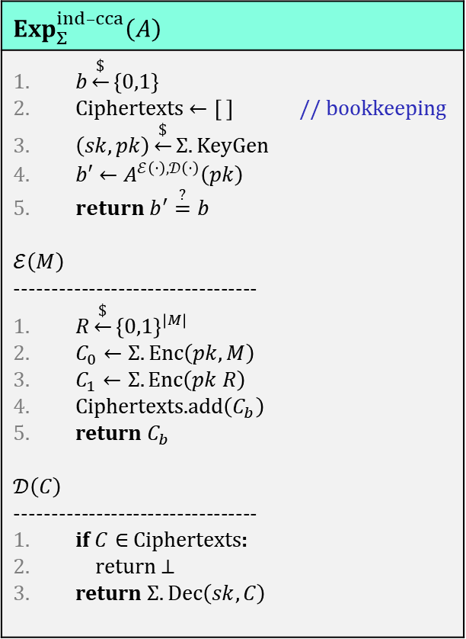
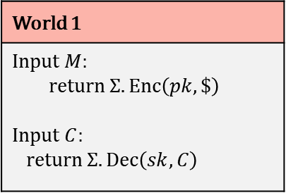
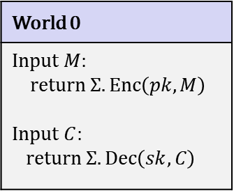
Public-key encryption – security: IND-CCA
$$Exp_{Σ}^{ind­­–cca}\left(A\right)$$
$b\underset{←}{\$}\left\{0,1\right\}$ Ciphertexts $←\left[ \right]$ // bookkeeping $\left(sk,pk\right)\underset{←}{\$}Σ.KeyGen$ $b′←A^{ℰ\left(⋅\right),𝒟\left(⋅\right)}\left(pk\right)$ $return b^{′}\overset{?}{=}b$ $$ℰ\left(M\right)$$ --------------------------------- $R\underset{←}{\$}{\left\{0,1\right\}}^{\left|M\right|}$ $C_{0}←Σ.Enc\left(pk, M\right)$ $C_{1}←Σ.Enc\left(pk R\right)$ Ciphertexts.add$\left(C_{b}\right)$ return $C_{b}$ $$𝒟\left(C\right)$$ --------------------------------- if $C∈$ Ciphertexts: return $⊥$ return $Σ.Dec\left(sk,C\right)$
World 0
Input $M$: return $Σ.Enc\left(pk, M\right)$ Input $C$: return $Σ.Dec\left(sk,C\right)$
World 1
Input $M$: return $Σ.Enc\left(pk, \$\right)$ Input $C$: return $Σ.Dec\left(sk,C\right)$
$b$
I’m in World $b′$
Restriction: not allowed to forward output from $Enc$ query directly to $Dec$ query
$$pk$$
Definition: The IND-CCA advantage of $A$ is
$${Adv}_{Σ}^{ind­–cca}\left(A\right)\overset{def}{=}\left|2⋅Pr\left[b^{′}=b\right]−1\right|$$

Slide 7
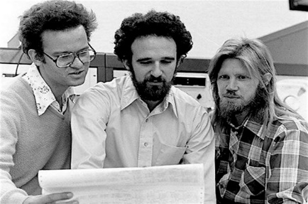
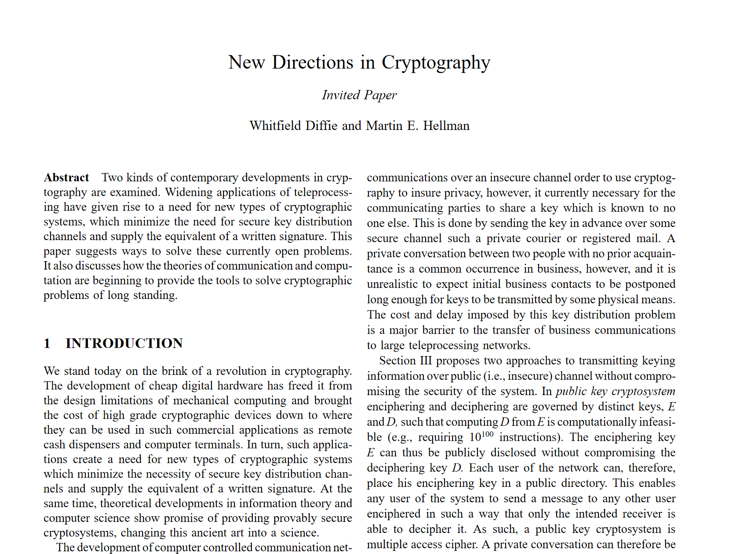
Diffie-Hellman key exchange
Discovered in the 1970's
Diffie & Hellman paper also introduced the idea of:
  Public-key encryption
    1984: ElGamal encryption scheme
  Digital signatures
Ralph Merkle
Whitfield Diffie
Martin Hellman

Slide 8















Public-key encryption: ElGamal
$$G=〈g〉$$
$$M$$
$$A$$
$$B$$
$$a\underset{←}{\$}\left\{1, …, \left|G\right|\right\}$$
$$b\underset{←}{\$}\left\{1, …, \left|G\right|\right\}$$
$$A←g^{a}$$
$$C$$
$$B←g^{b}$$
$$Z←B^{a}=H\left(g^{ab}\right)$$
$$Z←A^{b}=H\left(g^{ab}\right)$$
$$C←Σ.Enc\left(Z, M\right)$$
$$M←Σ. Dec\left(Z, C\right)$$
Symmetric encryption scheme

Slide 9


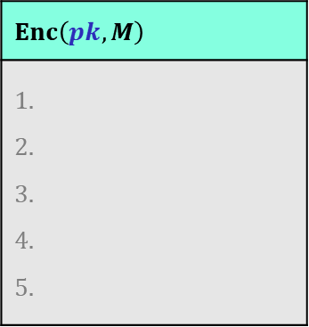


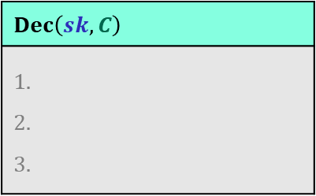







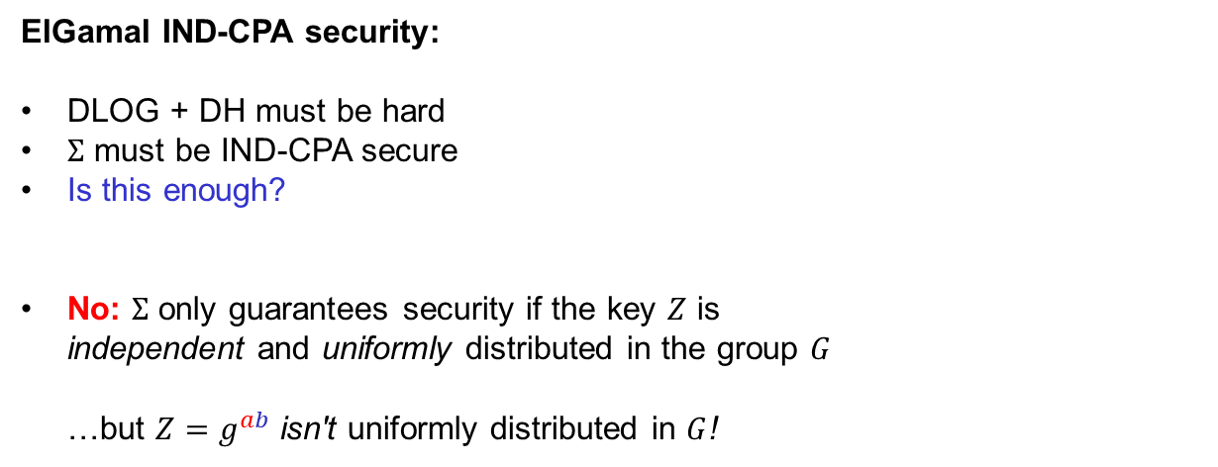
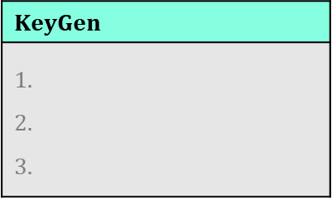



Public-key encryption: ElGamal
$$KeyGen$$
$$H :G→{\left\{0,1\right\}}^{k}$$
$$G=〈g〉$$
, $B$
$$sk=$$
$$b\underset{←}{\$}\left\{1, …, \left|G\right|\right\}$$
$$M$$
$$B$$
$$pk=$$
$$B←g^{b}$$
return $\left(sk,pk\right)$
$$,C$$
$$A$$
$$Enc\left(pk, M\right)$$
$$a\underset{←}{\$}\left\{1, …, \left|G\right|\right\}$$
ElGamal IND-CPA security:
DLOG + DH must be hard
$Σ$ must be IND-CPA secure
Is this enough?
No: $Σ$ only guarantees security if the key $Z$ is
independent and uniformly distributed in the group $G$
…but ${Z=g}^{ab}$ isn't uniformly distributed in $G$!
$$C$$
$$Dec\left(sk, C\right)$$
$$A←g^{a}$$
$$Z←B^{a}=H\left(g^{ab}\right)$$
$$Z←A^{b}=H\left(g^{ab}\right)$$
$$C←Σ.Enc\left(Z, M\right)$$
$$M←Σ. Dec\left(Z, C\right)$$
return $\left(A,C\right)$
return $M$
$$Σ. Enc :G×ℳ→𝒞$$
Actually want $Σ. Enc :{\left\{0,1\right\}}^{k}×ℳ→𝒞$

Slide 10


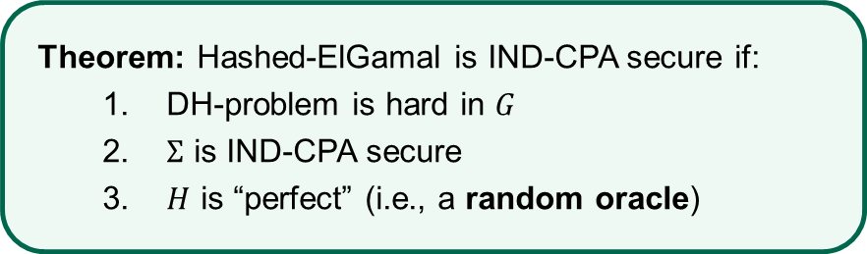

Public-key encryption: Hashed-ElGamal
$$KeyGen$$
$$H :G→{\left\{0,1\right\}}^{k}$$
$$G=〈g〉$$
, $B$
$$sk=$$
$$b\underset{←}{\$}\left\{1, …, \left|G\right|\right\}$$
$$M$$
$$pk=$$
$$B←g^{b}$$
return $\left(sk,pk\right)$
$$,C$$
$$A$$
$$Enc\left(pk, M\right)$$
Theorem: Hashed-ElGamal is IND-CPA secure if:
  DH-problem is hard in $G$
  $Σ$ is IND-CPA secure
  $H$ is “perfect” (i.e., a random oracle)
$$a\underset{←}{\$}\left\{1, …, \left|G\right|\right\}$$
$$Dec\left(sk, C\right)$$
$$A←g^{a}$$
$$Z←H\left(B^{a}\right)=H\left(g^{ab}\right)$$
$$Z←H\left(A^{b}\right)=H\left(g^{ab}\right)$$
$$C←Σ.Enc\left(Z, M\right)$$
$$M←Σ. Dec\left(Z, C\right)$$
return $\left(A,C\right)$
return $M$

Slide 11
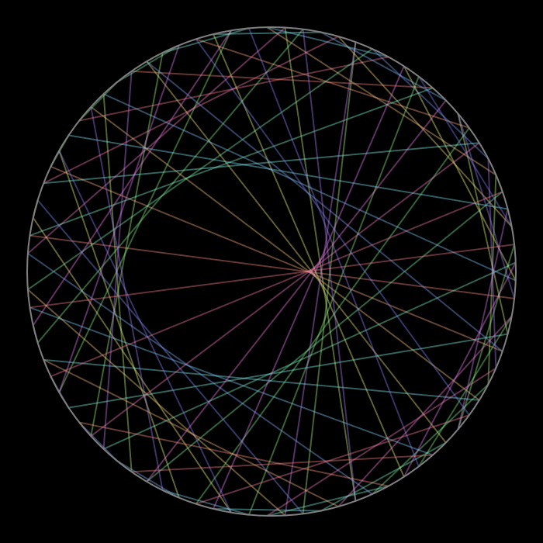

$$C=M^{e} \left(\operatorname{mod}{n}\right)$$
RSA encryption
Notes:
https://www.redblobgames.com/x/1847-mathologer-modulo-circle/#N=85&M=22&color=angle

Slide 12
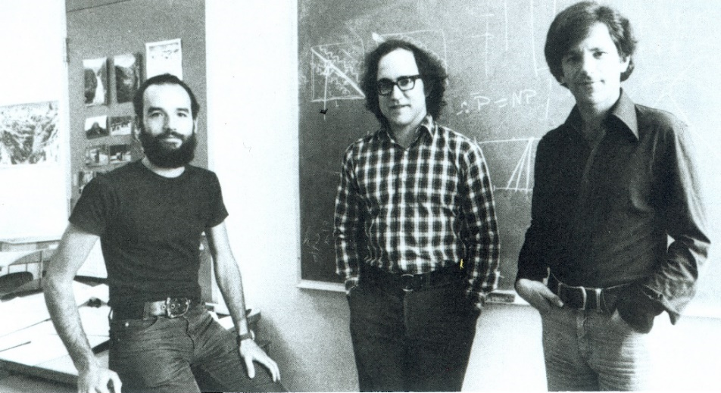
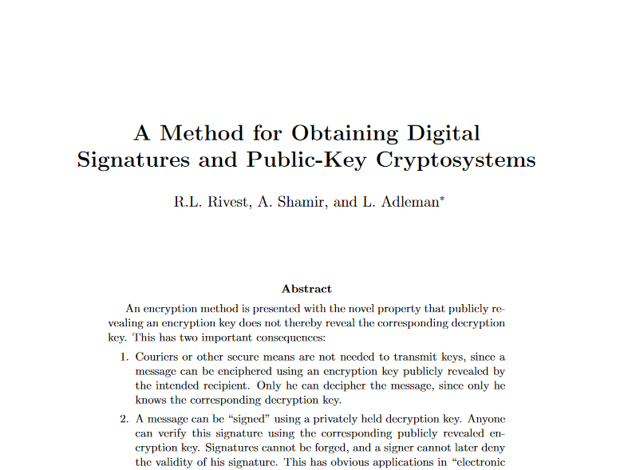
RSA
Designed by Rivest, Shamir and Adleman in 1977
Used both for public-key encryption and
digital signatures
Adi Shamir
Ron Rivest
Leonard Adleman

Slide 13





















































RSA encryption
$$32$$
$$0$$
$$1$$
$$31$$
$$2$$
$$30$$
$$3$$
$$29$$
$$C^{3}$$
$$C^{4}$$
$$4$$
$$e=3$$
$$28$$
$$5$$
$$d=7$$
$$27$$
$$C^{2}$$
$$6$$
$$26$$
$$7$$
$$M^{1}$$
$$C^{5}$$
$$25$$
$$C^{6}$$
$$8$$
$$M^{2}$$
$$M^{e}\operatorname{mod}{33}$$
$$={13}^{3}\operatorname{mod}{33}$$
$$=19$$
$$24$$
$$C^{1}$$
$$M^{3}$$
$$9$$
$$23$$
$$10$$
$$C^{d}\operatorname{mod}{33}$$
$$={19}^{7}\operatorname{mod}{33}$$
$$=13$$
$$C^{7}$$
$$22$$
$$11$$
$$21$$
$$12$$
$$20$$
$$13$$
$$M$$
$$19$$
$$14$$
$$C$$
$$18$$
$$17$$
$$16$$
$$15$$

Slide 14




























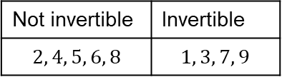




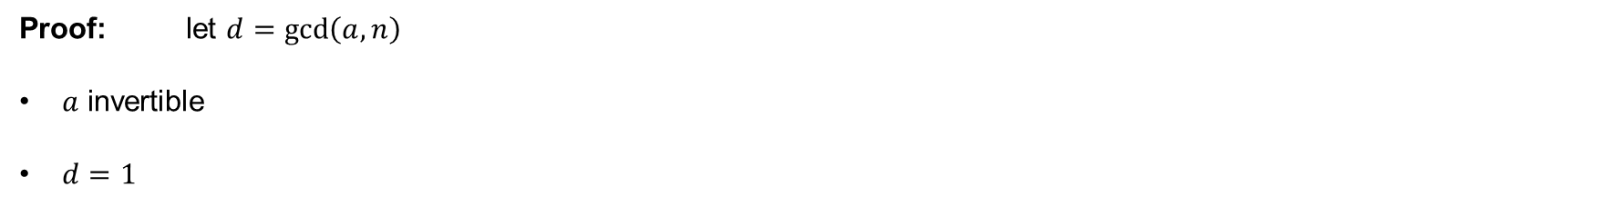








The group $\left(Z_{n}^{∗},⋅\right)$
$$Z_{p}=\left\{0, 1, …, p−1\right\}$$
$\left(Z_{p}, ⋅\right)$ is not a group!
Not invertible | Invertible
$$2, 4, 5, 6, 8$$ | $$1, 3, 7, 9$$
$$Z_{p}^{∗}=\left\{1, …, p−1\right\}$$
$\left(Z_{p}^{∗}, ⋅\right)$ is a group!
$$Z_{10}^{+}=\left\{1, 2, 3, 4, 5, 6, 7, 8, 9\right\}$$
$$2⋅1=2 \operatorname{mod}{10}$$
$$Z_{n}=\left\{0, 1, …, n−1\right\}$$
$\left(Z_{n}, ⋅\right)$ is not a group!
$$2⋅2=4 \operatorname{mod}{10}$$
$$2⋅3=6 \operatorname{mod}{10}$$
$$1⋅1=1 \operatorname{mod}{10}$$
$$Z_{n}^{∗}≠$$
$$\left\{1, …, n−1\right\}$$
$\left(Z_{n}^{+}, ⋅\right)$ is also not a group!
$$2⋅4=8 \operatorname{mod}{10}$$
$$3⋅7=21=1 \operatorname{mod}{10}$$
$$2⋅5=0 \operatorname{mod}{10}$$
$$Z_{n}^{+}$$
$$2⋅6=2 \operatorname{mod}{10}$$
$$9⋅9=81=1 \operatorname{mod}{10}$$
$$\overset{theorem}{=} \left\{a∈Z_{n} ∣ \gcd\left(a,n\right)=1\right\}$$
$$2⋅7=4 \operatorname{mod}{10}$$
$$Z_{n}^{∗}=invertible elements in Z_{n}$$
$$2⋅8=6 \operatorname{mod}{10}$$
$$2=2$$
$$2⋅9=8 \operatorname{mod}{10}$$
$$4=2⋅2$$
$\left(Z_{n}^{∗}, ⋅\right)$ is a group!
$$5=5$$
$$10=2⋅5$$
$$6=2⋅3$$
Proof: let $d=\gcd\left(a,n\right)$
$a$ invertible
$d=1$
$$8=2⋅2⋅2$$
$⟹$ $∃b∈Z_{n}$ such that $ab=1\operatorname{mod}{n}$
$⟹$ $∃k:$ $ab=1+kn$
$⟹$ $ab−kn=1$
$⟹$ $d\left(a^{′}b−kn′\right)=1$
$⟹$ $d=1$
$⟹$ Claim: $∃s,t∈Z$ such that $sa+tn=d=1$
$⟹$ $sa=1−tn$
$⟹$ $sa=1\operatorname{mod}{n}$
$⟹$ $a$ is invertible

Slide 15



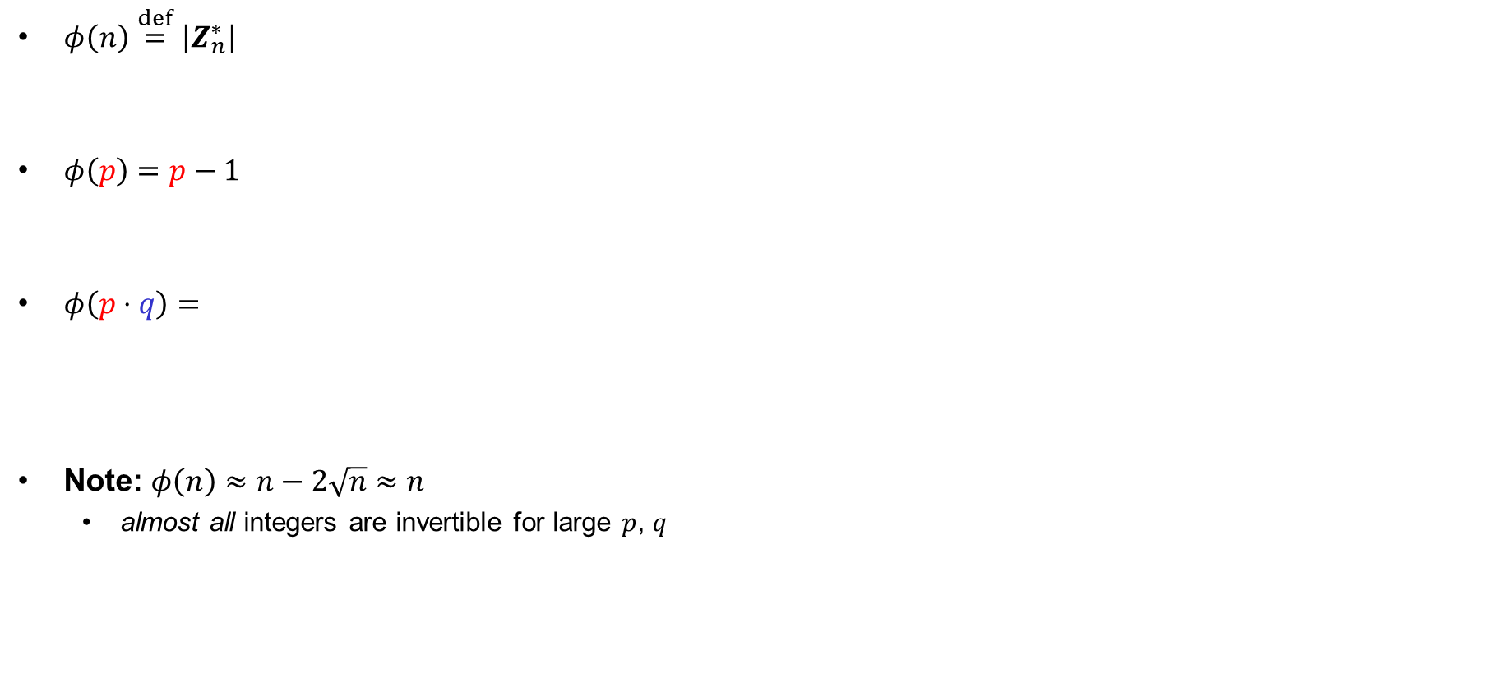


















Euler's $φ\left(n\right)$ function
$$q$$
$φ\left(n\right)\overset{def}{=}\left|Z_{n}^{∗}\right|$
$φ\left(p\right)=p−1$
$φ\left(p⋅q\right)=$
Note: $φ\left(n\right)≈n−2\sqrt{n}≈n$
  almost all integers are invertible for large $p$, $q$
$$= \left|\left\{a∈Z_{n} ∣ \gcd\left(a,n\right)=1\right\}\right|$$
$$1⋅p$$
$$2⋅p$$
$$3⋅p$$
$$⋯ q⋅p$$
$$1⋅q$$
$$2⋅q$$
$$3⋅q$$
$$⋯ p⋅q$$
$$p$$
$$\left(p−1\right)⋅\left(q−1\right)$$
$$φ\left(pq\right)=$$
$$pq$$
$$− \#numbers with gcd\left(a,pq\right)≠1$$
$$q$$
$$− p$$
$$= pq −$$
$$+ 1$$
$$p⋅q$$
$$=\left(p−1\right)⋅\left(q−1\right)$$
$$n$$ | 2 | 3 | 4 | 5 | 6 | 7 | 8 | 9 | 10 | 11 | 12 | 13 | 14 | 15 | 16 | 17 | 18 | 19 | 20 | 21 | 22 | 23
$$φ\left(n\right)$$ | 1 | 2 | 2 | 4 | 2 | 6 | 4 | 6 | 4 | 10 | 4 | 12 | 6 | 8 | 8 | 16 | 6 | 18 | 8 | 12 | 10 | 22

Slide 16


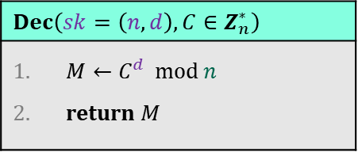



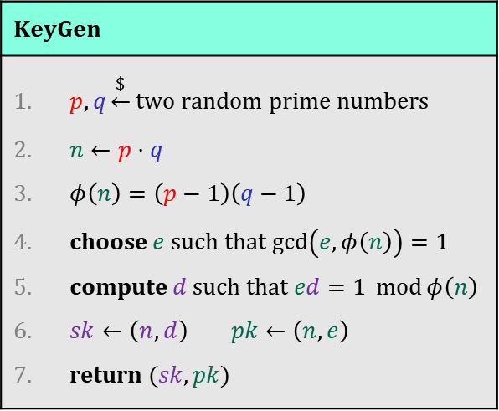







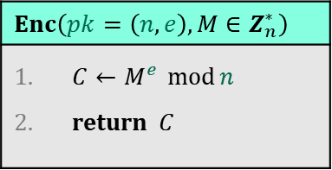

Textbook RSA
$$𝒫𝒦$$
$$ℳ$$
$$𝒞$$
$$KeyGen$$
$p,q\underset{←}{\$}$ two random prime numbers $n←p⋅q$ $φ\left(n\right)=\left(p−1\right)\left(q−1\right)$ choose $e$ such that $\gcd\left(e, φ\left(n\right)\right)=1$ compute $d$ such that $ed=1 \operatorname{mod}{φ\left(n\right)}$ $sk←\left(n,d\right)$ $pk←\left(n,e\right)$ return $(sk, pk)$
$$RSA.Enc :$$
$$Z^{+}×Z_{φ\left(n\right)}^{∗}×Z_{n}^{∗}→Z_{n}^{∗}$$
$$RSA.Dec:$$
$${Z^{+}×Z}_{φ\left(n\right)}^{∗}×Z_{n}^{∗}→Z_{n}^{∗}$$
$$𝒞$$
$$ℳ$$
$$𝒮𝒦$$
$$pk$$
$$Enc\left(pk=\left(n,e\right), M∈Z_{n}^{∗}\right)$$
$C←M^{e} \operatorname{mod}{n}$ return $C$
$$C$$
$$Dec\left(sk=\left(n,d\right), C∈Z_{n}^{∗}\right)$$
$M←C^{d} \operatorname{mod}{n}$ return $M$
Common choices of $e$: $3$ $17$ $65 537$
${11}_{2}$ ${10001}_{2}$ $1 0000 0000 0000 {0001}_{2}$

Slide 17
















RSA example
$$Z_{33}^{∗ }$$
$$31$$
$$32$$
$$0$$
$$1$$
$$2$$
$$30$$
$$3$$
$$n=33=3⋅11$$
$$29$$
$$4$$
$$φ\left(n\right)=\left(3−1\right)\left(11−1\right)=20$$
$$28$$
$$5$$
$$e=3$$
// need to find $d=e^{−1}\operatorname{mod}{φ\left(n\right)}$
$$27$$
$$6$$
$$7$$
$$26$$
$$7$$
$$3⋅7=21=1\operatorname{mod}{20}$$
$$d=7$$
$$25$$
$$8$$
$$24$$
$$9$$
$$M=13$$
$$23$$
$$10$$
$$C←{13}^{3}=2197=19\operatorname{mod}{33}$$
$$22$$
$$11$$
$$21$$
$$12$$
$$C^{7}={19}^{7}=893871739=13\operatorname{mod}{33}$$
$$20$$
$$13$$
$$19$$
$$14$$
$$M$$
$$C$$
$$18$$
$$17$$
$$16$$
$$15$$

Slide 18
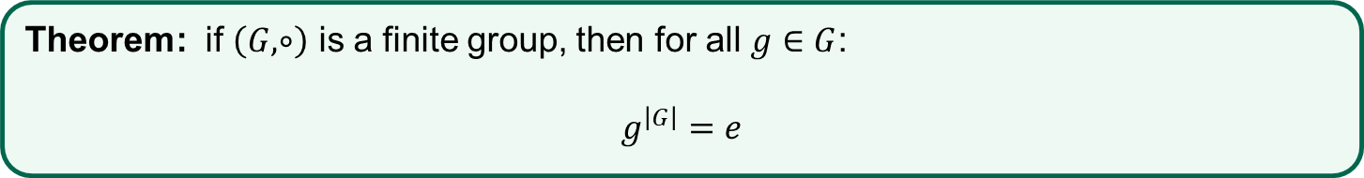
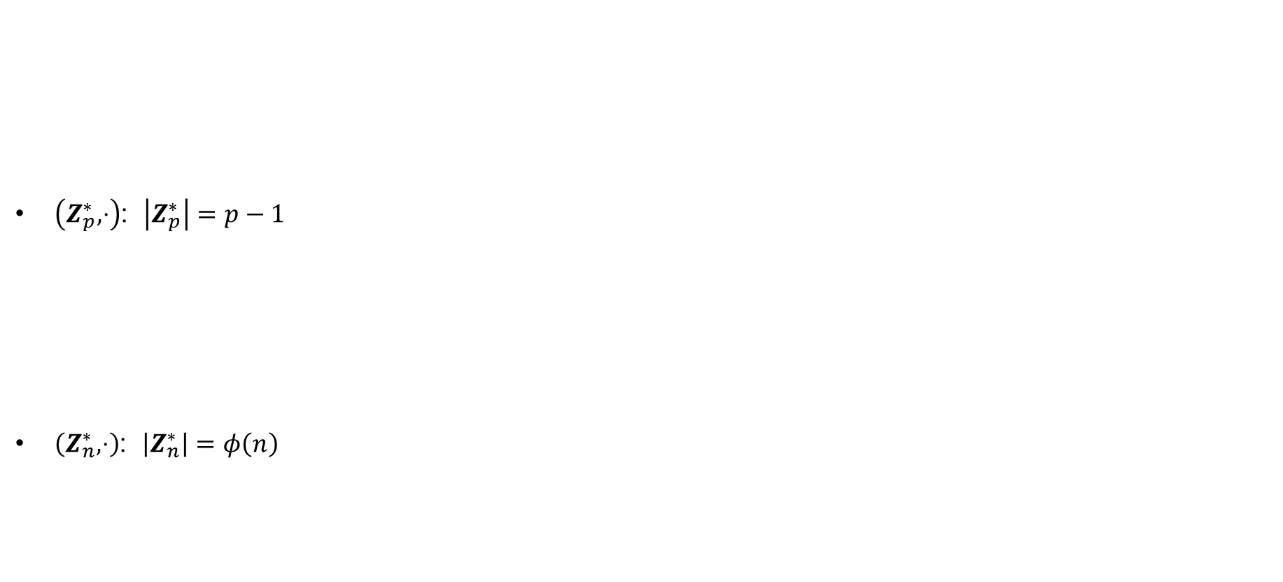
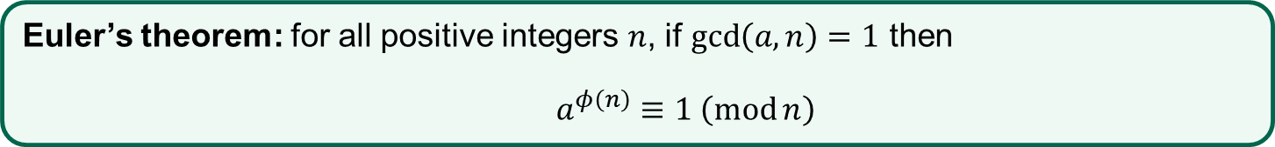
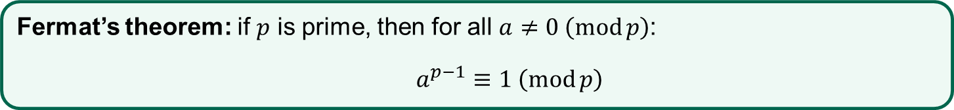
Euler’s Theorem
$\left(Z_{p}^{∗},⋅\right)$: $\left|Z_{p}^{∗}\right|=p−1$
$\left(Z_{n}^{∗},⋅\right)$: $\left|Z_{n}^{∗}\right|=φ\left(n\right)$
Theorem: if $\left(G,∘\right)$ is a finite group, then for all $g∈G$:
$$g^{\left|G\right|}=e$$
Fermat’s theorem: if $p$ is prime, then for all $a≠0 \left(\operatorname{mod}{p}\right)$:
$a^{p−1}≡1 \left(\operatorname{mod}{p}\right)$
Euler’s theorem: for all positive integers $n$, if $\gcd\left(a,n\right)=1$ then
$a^{φ\left(n\right)}≡1 \left(\operatorname{mod}{n}\right)$

Slide 19
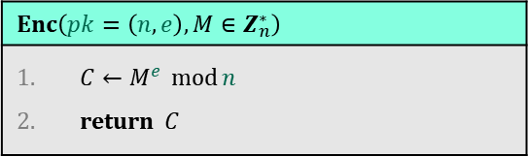

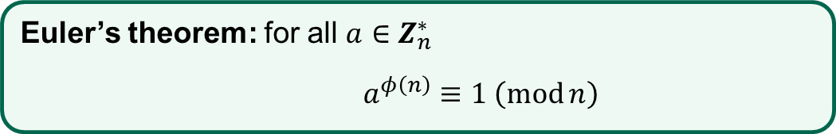
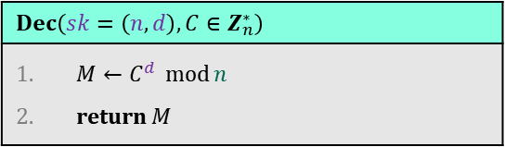

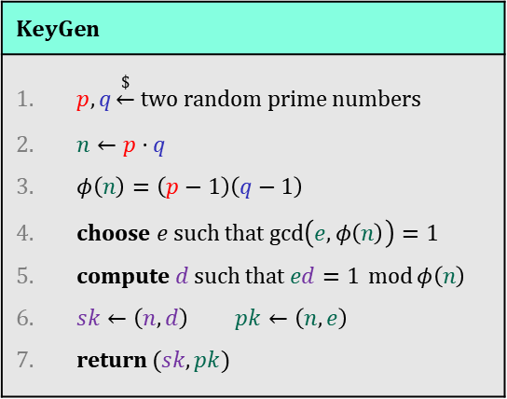





Textbook RSA – correctness
$$RSA.Dec\left(sk, RSA.Enc\left(pk, M\right)\right)=M$$
$$KeyGen$$
$p,q\underset{←}{\$}$ two random prime numbers $n←p⋅q$ $φ\left(n\right)=\left(p−1\right)\left(q−1\right)$ choose $e$ such that $\gcd\left(e, φ\left(n\right)\right)=1$ compute $d$ such that $ed=1 \operatorname{mod}{φ\left(n\right)}$ $sk←\left(n,d\right)$ $pk←\left(n,e\right)$ return $(sk, pk)$
Euler’s theorem: for all $a∈Z_{n}^{∗}$
$a^{φ\left(n\right)}≡1 \left(\operatorname{mod}{n}\right)$
$$=M^{1\operatorname{mod}{φ\left(n\right)}}$$
$$=M^{1+φ\left(n\right)⋅ℓ}$$
$$=M^{1}⋅M^{φ\left(n\right)⋅ℓ}$$
$$C^{d}=M^{ed}$$
$$=M⋅1\operatorname{mod}{n}$$
$$Enc\left(pk=\left(n,e\right), M∈Z_{n}^{∗}\right)$$
$C←M^{e} \operatorname{mod}{n}$ return $C$
Fact: RSA also works for $M∈Z_{n}$
$$Dec\left(sk=\left(n,d\right), C∈Z_{n}^{∗}\right)$$
$M←C^{d} \operatorname{mod}{n}$ return $M$
Notes:
p = 11
q = 17
n = p * q
Zn = Integers(n)
phi = euler_phi(n)
Zphi = Integers(phi)
e = Zphi(3)
d = e^-1
mod(e * d, phi)
M = Zn(123)
C = M^e
C^d

Slide 20




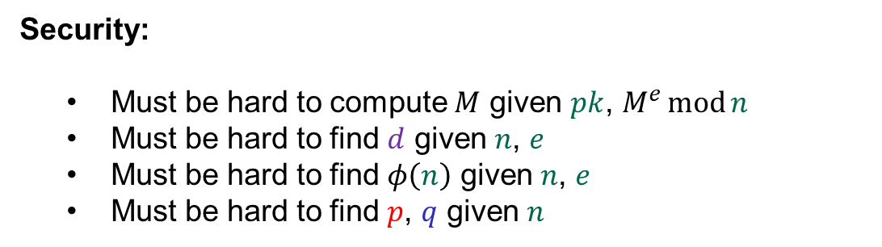






Textbook RSA – security
$$pq$$
$$pk$$
$$pk=(n,e)$$
$$C$$
$${=M}^{e}\operatorname{mod}{n}$$
$$sk=d$$
$$=e^{−1} \operatorname{mod}{φ\left(n\right)}$$
$$\left(p−1\right)\left(q−1\right)$$
$$pk$$
Security:
  Must be hard to compute $M$ given $pk$, $M^{e}\operatorname{mod}{n}$
  Must be hard to find $d$ given $n$, $e$
  Must be hard to find $φ\left(n\right)$ given $n$, $e$
  Must be hard to find $p$, $q$ given $n$
(RSA assumption)
equivalent!
(Factoring assumption)

Slide 21
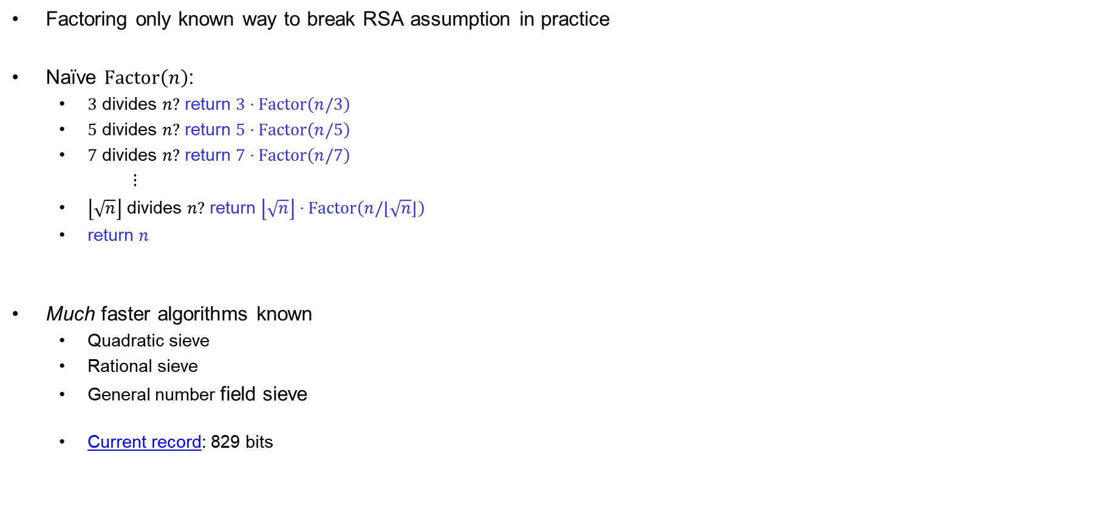

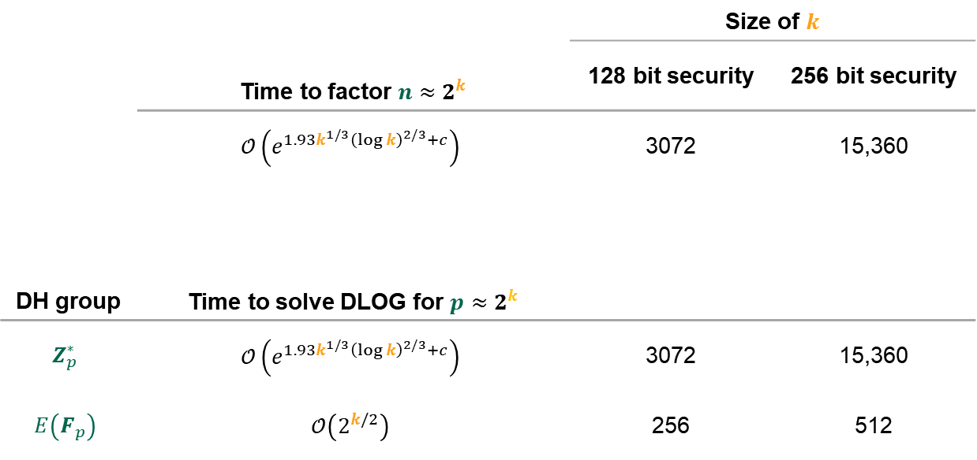
How hard is factoring?
Factoring only known way to break RSA assumption in practice
Naïve $Factor\left(n\right)$:
  $3$ divides $n?$ return $3⋅Factor\left(n/3\right)$
  $5$ divides $n?$ return $5⋅Factor\left(n/5\right)$
  $7$ divides $n?$ return $7⋅Factor\left(n/7\right)$
  $⋮$
  $\left\lfloor \sqrt{n}\right\rfloor$ divides $n?$ return $\left\lfloor \sqrt{n}\right\rfloor ⋅Factor\left(n/⌊\sqrt{n}⌋\right)$
  return $n$
Much faster algorithms known
  Quadratic sieve
  Rational sieve
  General number field sieve
  Current record: 829 bits
Very inefficient: $n≈2^{k} ⟹ π\left(n\right)≈\frac{2^{k}}{\ln{2^{k}}}≈\frac{2^{k}}{k}$
 | Time to factor $n≈2^{k}$ | Size of $k$
 |  | 128 bit security | 256 bit security
 | $$𝒪\left(e^{1.93k^{1/3}{\left(\log{k}\right)}^{2/3}+c}\right)$$ | 3072 | 15,360
DH group | Time to solve DLOG for $p≈2^{k}$
$$Z_{p}^{∗}$$ | $$𝒪\left(e^{1.93k^{1/3}{\left(\log{k}\right)}^{2/3}+c}\right)$$ | 3072 | 15,360
$$E\left(F_{p}\right)$$ | $$𝒪\left(2^{k/2}\right)$$ | 256 | 512

Slide 22



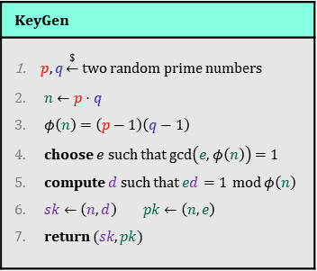

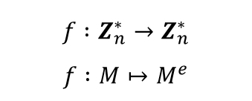
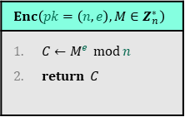
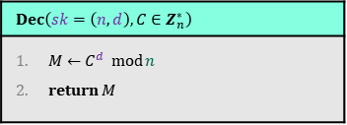
Textbook RSA – security
Textbook RSA is not IND-CPA secure!
  Deterministic
  Malleable
  Many other attacks as well*
Textbook RSA is not an encryption scheme!
So what is it?
  Answer: a one-way trapdoor permutation
* https://crypto.stackexchange.com/questions/20085/which-attacks-are-possible-against-raw-textbook-rsa
$$KeyGen$$
$p,q\underset{←}{\$}$ two random prime numbers $n←p⋅q$ $φ\left(n\right)=\left(p−1\right)\left(q−1\right)$ choose $e$ such that $\gcd\left(e, φ\left(n\right)\right)=1$ compute $d$ such that $ed=1 \operatorname{mod}{φ\left(n\right)}$ $sk←\left(n,d\right)$ $pk←\left(n,e\right)$ return $(sk, pk)$
$$Enc\left(pk=\left(n,e\right), M∈Z_{n}^{∗}\right)$$
$C←M^{e} \operatorname{mod}{n}$ return $C$
$$pk$$
$$C$$
$$Dec\left(sk=\left(n,d\right), C∈Z_{n}^{∗}\right)$$
$M←C^{d} \operatorname{mod}{n}$ return $M$
$$f :Z_{n}^{∗}→Z_{n}^{∗}$$
$$f :M↦M^{e}$$

Slide 23
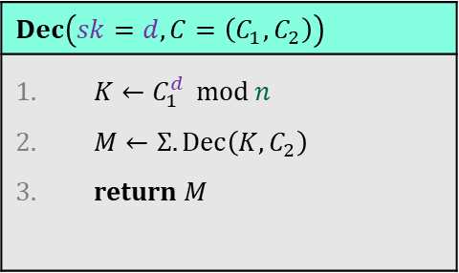
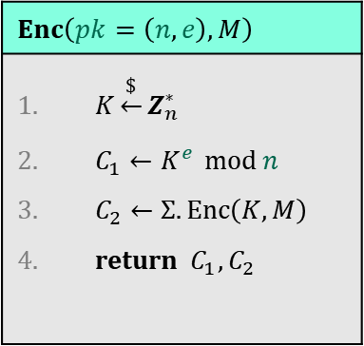


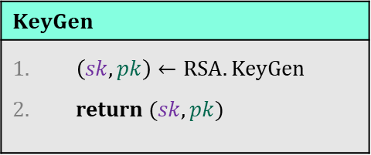



Shoup's RSA variant
Different each time
$$KeyGen$$
$\left(sk, pk\right)←RSA.KeyGen$ return $(sk, pk)$
$$Enc\left(pk=\left(n,e\right), M\right)$$
$K\underset{←}{\$}Z_{n}^{∗}$ $C_{1}←K^{e} \operatorname{mod}{n}$ $C_{2}←Σ.Enc\left(K,M\right)$ return $C_{1},C_{2}$
$$pk$$
$$C_{1},C_{2}$$
$$Dec\left(sk=d, C=\left(C_{1}, C_{2}\right)\right)$$
$K←C_{1}^{d} \operatorname{mod}{n}$ $M←Σ.Dec\left(K,C_{2}\right)$ return $M$
$$H :Z_{n}^{∗}→{\left\{0,1\right\}}^{k}$$
Symmetric encryption scheme
$$Σ. Enc :Z_{n}^{∗}×ℳ→𝒞$$
Actually want: $Σ. Enc :{\left\{0,1\right\}}^{k}×ℳ→𝒞$

Slide 24
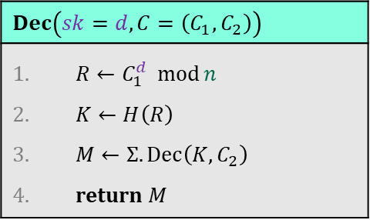


Shoup's RSA variant
$$KeyGen$$
$\left(sk, pk\right)←RSA.KeyGen$ return $(sk, pk)$
$$Enc\left(pk=\left(n,e\right), M\right)$$
$R\underset{←}{\$}Z_{n}^{∗}$ $C_{1}←R^{e} \operatorname{mod}{n}$ $K←H(R)$ $C_{2}←Σ.Enc\left(K,M\right)$ return $C_{1},C_{2}$
$$pk$$
$$C_{1},C_{2}$$
$$Dec\left(sk=d, C=\left(C_{1}, C_{2}\right)\right)$$
$R←C_{1}^{d} \operatorname{mod}{n}$ $K←H\left(R\right)$ $M←Σ.Dec\left(K,C_{2}\right)$ return $M$
$$H :Z_{n}^{∗}→{\left\{0,1\right\}}^{k}$$
Theorem: Shoup-RSA is IND-CPA (IND-CCA) secure if:
  RSA-problem is hard in $Z_{n}^{∗}$
  $Σ$ is IND-CPA (IND-CCA) secure
  $H$ is “perfect” (i.e., a random oracle)

Slide 25






RSA in practice I
Textbook RSA is deterministic $⟹$ cannot be IND-CPA/IND-CCA secure
How to achieve IND-CPA/IND-CCA?
  Pad message with random data before applying RSA function
  PKCS#1v1.5 (no existing security proof; many impl. attacks)
  RSA-OAEP (complicated security proof; first proof buggy)
RSA encryption not used much in practice anymore
  Mostly key transport of (short) symmetric key
  Lacks forward secrecy!
RSA digital signatures still very common
  Covered next week
256 bits
$$M$$
$$pad$$
$$r || M$$
$${\left(⋅\right)}^{e}\operatorname{mod}{n}$$
$$C$$
2048 bits

Slide 26



RSA in practice II
Multiple RSA modulus $n$ sharing a common prime
https://factorable.net/weakkeys12.extended.pdf
https://eprint.iacr.org/2012/064

Slide 27

Summary
Public-key encryption security goals: IND-CPA and IND-CCA
ElGamal
  Public-key encryption from Diffie-Hellman key exchange + symmetric encryption scheme
  Hashed-ElGamal: hash DH key to obtain a symmetric key $K$
RSA
  Textbook-RSA: not a public-key encryption scheme directly (not IND-CPA secure!)
  Shoup's RSA: encrypt random number with Textbook-RSA and derive symmetric key from hash function
    IND-CPA / IND-CCA secure (depending on symmetric scheme)
    Not much used in practice
    In practice: pad message before encrypting with Textbook-RSA (PKCS#1v1.5, RSA-OAEP)
  Must be hard: RSA-problem and factoring problem

