Slide 1
Lecture 1 – Introduction to cryptography
TEK4500
30.08.2023
Håkon Jacobsen
hakon.jacobsen@its.uio.no

Slide 2

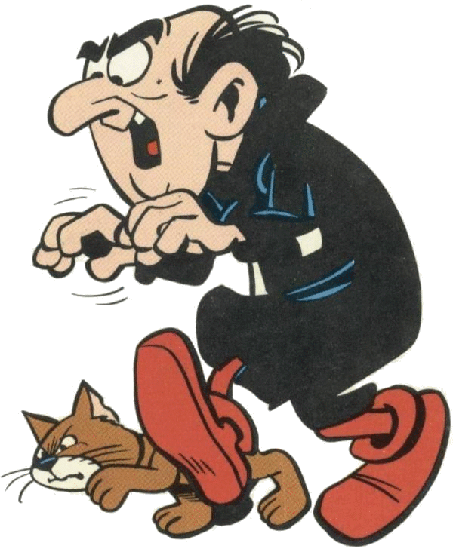

What is cryptography?
Internet
Alice
Bob
M
Adversary

Slide 3






What is cryptography?
Alice
Bob
M
Adversary

Slide 4
What is cryptography?
Alice
Bob
M
Adversary
Security goals:
Data privacy: adversary should not be able to read message M

Slide 5
What is cryptography?
Alice
Bob
M
M'
Adversary
Security goals:
Data privacy: adversary should not be able to read message M
Data integrity: adversary should not be able to modify message M
Data authenticity: message M really originated from Alice

Slide 6
Ideal solution: secure channels
But how to build?
Alice
Bob
M
Course done!
Adversary
Security goals:
Data privacy: adversary should not be able to read message M ✓
Data integrity: adversary should not be able to modify message M ✓
Data authenticity: message M really originated from Alice ✓

Slide 7


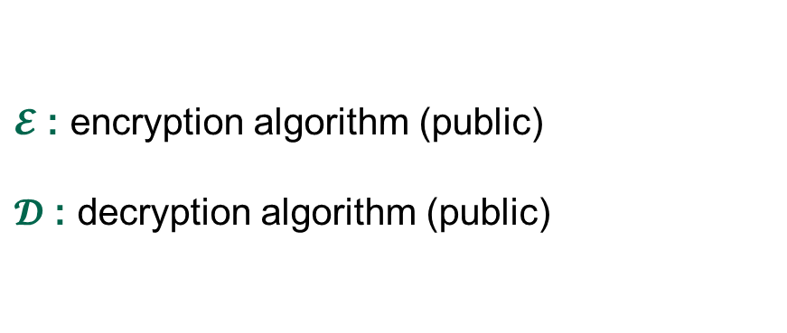
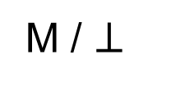
Creating secure channels: encryption schemes
Alice
Bob
K
K
$$ℰ$$
C
$$𝒟$$
M
M / $⊥$
Adversary
$𝓔$ : encryption algorithm (public)
$𝓓$ : decryption algorithm (public)
K : encryption / decryption key (secret)

Slide 8
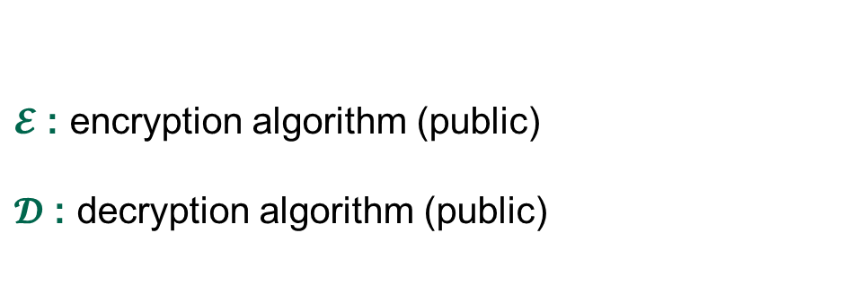
Creating secure channels: encryption schemes
Alice
Bob
K_{e}
K_{d}
$$ℰ$$
C
$$𝒟$$
M
M / $⊥$
Adversary
$𝓔$ : encryption algorithm (public)
$𝓓$ : decryption algorithm (public)
K_{e} : encryption key (public)
K_{d} : decryption key (secret)

Slide 9
Basic goals of cryptography
 | Message privacy | Message integrity / authentication
Symmetric keys | Symmetric encryption | Message authentication codes (MAC)
Asymmetric keys | Asymmetric encryption (public-key encryption) | Digital signatures

Slide 10
Basic goals of cryptography
 | Message privacy | Message integrity / authentication
Symmetric keys | Symmetric encryption | Message authentication codes (MAC)
Asymmetric keys | Asymmetric encryption (public-key encryption) | Digital signatures

Slide 11
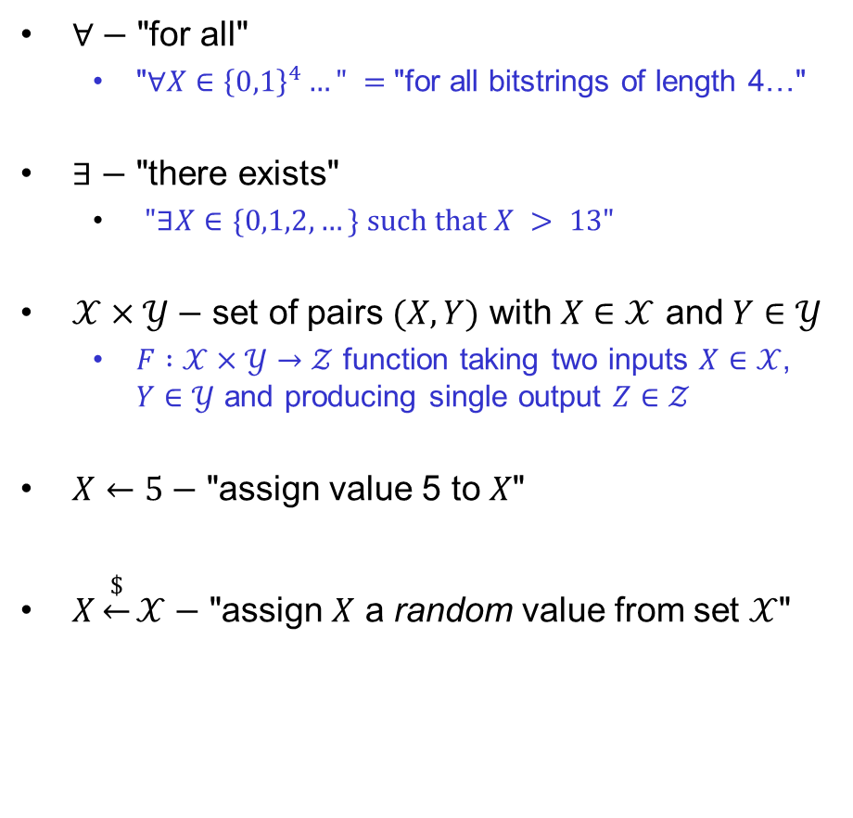
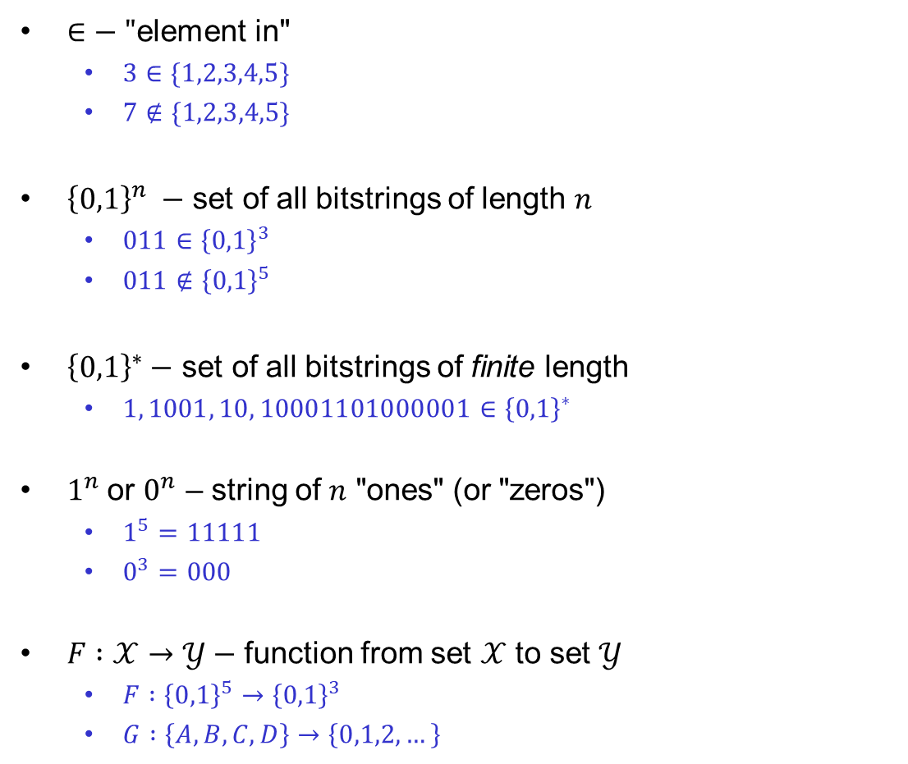
Some notation
$∈−$ "element in"
  $3∈\{1,2,3,4,5\}$
  $7∉\{1,2,3,4,5\}$
${\left\{0,1\right\}}^{n} −$ set of all bitstrings of length $n$
  $011∈{\left\{0,1\right\}}^{3}$
  $011∉{\left\{0,1\right\}}^{5}$
${\left\{0,1\right\}}^{∗}−$ set of all bitstrings of finite length
  $1, 1001, 10, 10001101000001∈{\left\{0,1\right\}}^{∗}$
$1^{n}$ or $0^{n}$ – string of $n$ "ones" (or "zeros")
  $1^{5}=11111$
  $0^{3}=000$
$F :𝒳→𝒴−$ function from set $𝒳$ to set $𝒴$
  $F :{\left\{0,1\right\}}^{5}→{\left\{0,1\right\}}^{3}$
  $G :\left\{A,B,C,D\right\}→\left\{0,1,2,…\right\}$
$∀−$ "for all"
  "$∀X∈{\left\{0,1\right\}}^{4}…" =$"for all bitstrings of length 4…"
$∃−$ "there exists"
  $"∃X∈\{0,1,2, …\} such that X > 13"$
$𝒳×𝒴−$ set of pairs $(X,Y)$ with $X∈𝒳$ and $Y∈𝒴$
  $F :𝒳×𝒴→𝒵$ function taking two inputs $X∈𝒳$, $Y∈𝒴$ and producing single output $Z∈𝒵$
$X←5−$ "assign value 5 to $X$"
$X\underset{←}{\$}𝒳−$ "assign $X$ a random value from set $𝒳$"
…independent, and uniformly distributed…

Slide 12

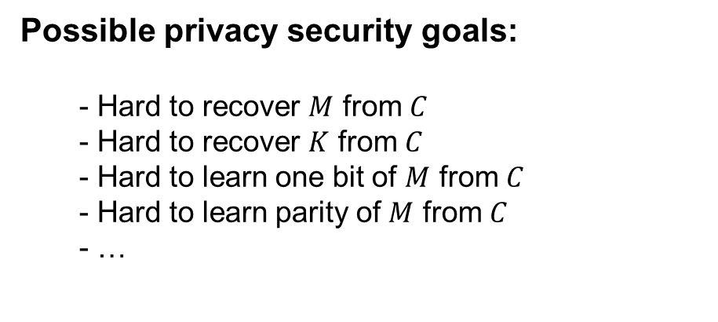
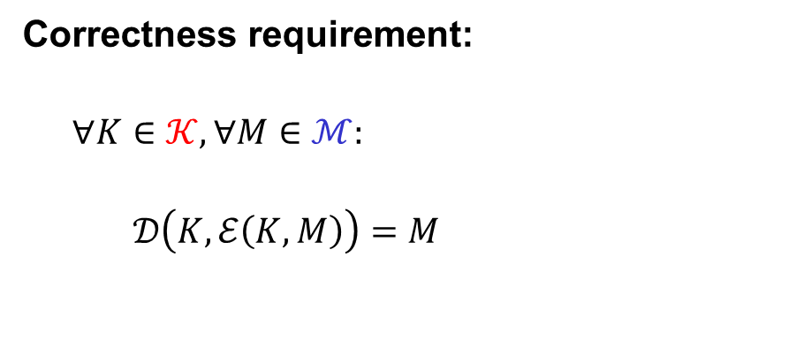




Symmetric encryption – syntax
$$Π=\left(ℰ, 𝒟\right)$$
Examples:
$$ℰ :𝒦×ℳ→𝒞$$
$$𝒦={\left\{0,1\right\}}^{128} ℳ={\left\{0,1\right\}}^{∗} 𝒞={\left\{0,1\right\}}^{∗}$$
$$ℰ\left(K, M\right)=ℰ_{K}\left(M\right)=C$$
$$𝒦={\left\{0,1\right\}}^{128} ℳ=\left\{A,B,…, Z\right\} 𝒞=\left\{A,B,…, Z\right\}$$
$$𝒟:𝒦×𝒞→ℳ$$
$$𝒦={\left\{0,1\right\}}^{128} ℳ=\left\{YES, NO\right\} 𝒞= {\left\{0,1\right\}}^{∗}$$
$$𝒟\left(K, C\right)=𝒟_{K}\left(C\right)=M$$
$$𝒦=\left\{1,…,p\right\} ℳ=\left\{A,B,…,Z\right\} 𝒞={\left\{0,1\right\}}^{∗}$$
Correctness requirement:
$$∀K∈𝒦, ∀M∈ℳ:$$
  $$𝒟\left(K, ℰ\left(K, M\right)\right)=M$$
Possible privacy security goals:
  Hard to recover $M$ from $C$
  Hard to recover $K$ from $C$
  Hard to learn one bit of $M$ from $C$
  Hard to learn parity of $M$ from $C$
  …

Slide 13
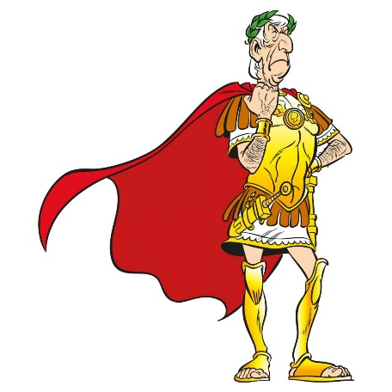
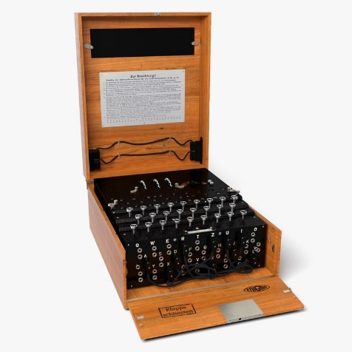
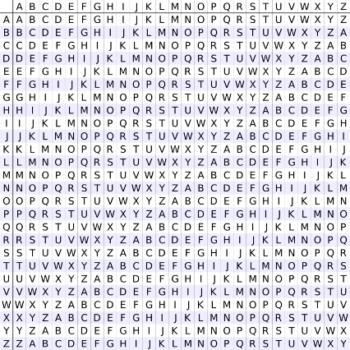
Historical encryption algorithms

Slide 14
Ceasar cipher
a b c d e f g h i j k l m n o p q r s t u v w x y z
a b c d e f g h i j k l m n o p q r s t u v w x y z
…
a
in the far distance a helicopter skimmed down between the roofs, hovered for an instant like a bluebottle, and darted away again with a curving flight. It was the police patrol, snooping into people's windows
lq wkh idu glvwdqfh d kholfrswhu vnlpphg grzq ehwzhhq wkh urriv, kryhuhg iru dq lqvwdqw olnh d eoxherwwoh, dqg gduwhg dzdb djdlq zlwk d fxuylqj ioljkw. Lw zdv wkh srolfh sdwuro, vqrrslqj lqwr shrsoh'v zlqgrzv

Slide 15
Ceasar cipher (ROT-13)
a b c d e f g h i j k l m n o p q r s t u v w x y z
a b c d e f g h i j k l m n o p q r s t u v w x y z
in the far distance a helicopter skimmed down between the roofs, hovered for an instant like a bluebottle, and darted away again with a curving flight. It was the police patrol, snooping into people's windows
va gur sne qvfgnapr n uryvpbcgre fxvzzrq qbja orgjrra gur ebbsf, ubirerq sbe na vafgnag yvxr n oyhrobggyr,
naq qnegrq njnl ntnva jvgu n pheivat syvtug. Vg jnf
gur cbyvpr cngeby, fabbcvat vagb crbcyr'f jvaqbjf

Slide 16

Ceasar cipher
a ↔ 0
b ↔ 1
c ↔ 2
d ↔ 3
e ↔ 4
⁞
z ↔ 25
$$C←M+3 (\operatorname{mod}{26})$$

Slide 17
















Modular arithmetic
$$−4$$
$$−3$$
$$−2$$
$$−1$$
$$0$$
$$1$$
$$2$$
$$3$$
$$4$$
$$5$$
$$6$$
$$7$$
$$8$$
$$9$$
$$10$$
$$11$$

Slide 18




















Modular arithmetic
$$14$$
$$13$$
$$5$$
$$4$$
$$12$$
$$15$$
$$3$$
$$6$$
$$16$$
$$7$$
$$2$$
$$11$$
$$20$$
$$8$$
$$17$$
$$1$$
$$10$$
$$19$$
$$−4$$
$$−3$$
$$−2$$
$$−1$$
$$0$$
$$9$$
$$18$$

Slide 19





Modular arithmetic
$$14$$
$$13$$
$$5$$
$$4$$
$$−4$$
$$12$$
$$15$$
$$3$$
$$6$$
$$−3$$
$$7$$
$$−2$$
$$2$$
$$16$$
$$11$$
$$20$$
$$−1$$
$$8$$
$$17$$
$$1$$
$$10$$
$$19$$
$$0$$
$$9$$
$$18$$

Slide 20












Modular arithmetic
$$14$$
$$13$$
$$5$$
$$4$$
$$1+3=4$$
$$−4$$
$$12$$
$$15$$
$$3$$
$$5+8=13$$
$$≡4 mod⁡9$$
$$6$$
$$−3$$
$$5⋅4=20≡2 mod⁡9$$
$$\operatorname{mod}{9}$$
$$7$$
$$−2$$
$$2$$
$$2−5=−3≡6 mod⁡9$$
$$16$$
$$11$$
$$20$$
$$−1$$
$$2^{10}=1024≡7 mod⁡9$$
$$8$$
$$17$$
$$1$$
$$10$$
$$158 mod⁡9$$
$$=153+r$$
$$≡r\operatorname{mod}{9}$$
$$19$$
$$0$$
$$9$$
$$r<9$$
$$18$$
$$9→18→27→36→…→153→162$$

Slide 21
Ceasar cipher
a ↔ 0
b ↔ 1
c ↔ 2
d ↔ 3
e ↔ 4
⁞
z ↔ 25
$$C←M+3 (\operatorname{mod}{26})$$

Slide 22







ROT-13
a ↔ 0
b ↔ 1
c ↔ 2
d ↔ 3
e ↔ 4
⁞
z ↔ 25
$$C←M+13 (\operatorname{mod}{26})$$
$$M←C−13 (\operatorname{mod}{26})$$
$$𝒦=\{13\}$$
$$ℰ :𝒦×ℳ→𝒞$$
$$ℳ=\{0,1,2,…, 25\}$$
$$𝒟 :𝒦×𝒞→ℳ$$
$$𝒞=\{0,1,2,…, 25\}$$

Slide 23



ROT-K
a ↔ 0
b ↔ 1
c ↔ 2
d ↔ 3
e ↔ 4
⁞
z ↔ 25
$$C←M+K (\operatorname{mod}{26})$$
$$M←C−K (\operatorname{mod}{26})$$
$$𝒦=\{0,1,2, …,25\}$$
$$ℰ :𝒦×ℳ→𝒞$$
$$ℳ=\{0,1,2,…, 25\}$$
$$𝒟 :𝒦×𝒞→ℳ$$
$$𝒞=\{0,1,2,…, 25\}$$

Slide 24
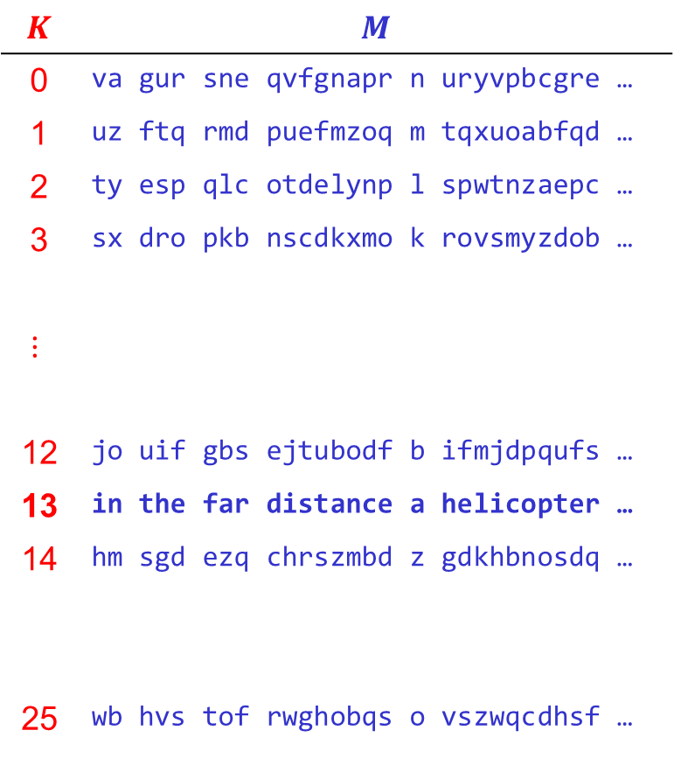

Attacking ROT-K
$$K$$ | $$M$$
0 | va gur sne qvfgnapr n uryvpbcgre …
1 | uz ftq rmd puefmzoq m tqxuoabfqd …
2 | ty esp qlc otdelynp l spwtnzaepc …
3 | sx dro pkb nscdkxmo k rovsmyzdob …
$$⋮$$
12 | jo uif gbs ejtubodf b ifmjdpqufs …
13 | in the far distance a helicopter …
14 | hm sgd ezq chrszmbd z gdkhbnosdq …
25 | wb hvs tof rwghobqs o vszwqcdhsf …
$$\left|𝒦\right|=26$$
$C$ = va gur sne qvfgnapr n uryvpbcgre …
Conclusion: key space must be large enough!

Slide 25
Substitution cipher
a b c d e f g h i j k l m n o p q r s t u v w x y z
…
a b c d e f g h i j k l m n o p q r s t u v w x y z

Slide 26
Substitution cipher
a b c d e f g h i j k l m n o p q r s t u v w x y z
…
a b c d e f g h i j k l m n o p q r s t u v w x y z

Slide 27



Substitution cipher
$$26!$$
$$≈{10}^{26}≈2^{88}$$
$$\left|𝒦\right|=$$
a b c d e f g h i j k l m n o p q r s t u v w x y z
↕ ↕ ↕ ↕ … ↕
s x d y w q f m j k o i l g z b e n t u c p a r v h
in the far distance a helicopter skimmed down between the roofs, hovered for an instant like a bluebottle, and darted away again with a curving flight. It was the police patrol, snooping into people's windows
jg umw qsn yjtusgdw s mwijdzbuwn tojllwy yzag xwuawwg umw nzzqt, mzpwnwy qzn sg jgtusgu ijow s xicwxzuuiw, sgy ysnuwy sasv sfsjg
ajum s dcnpjgf qijfmu. ju ast umw bzijdw bsunzi, tgzzbjgf jguz bwzbiw't ajgyzat

Slide 28
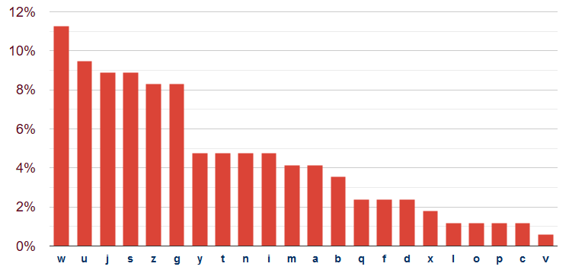
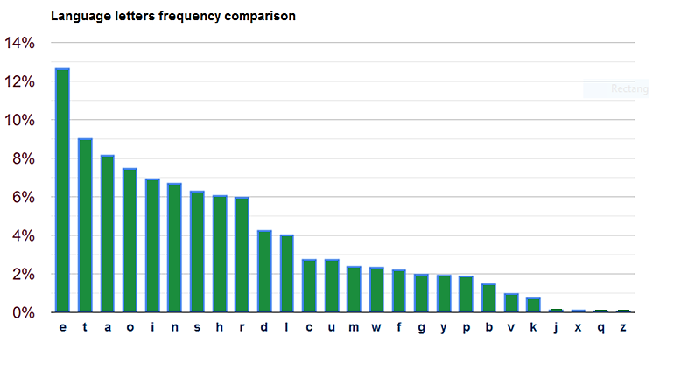
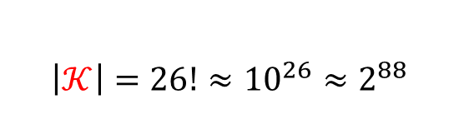
Attacking the substitution cipher
$\left|𝒦\right|=26!≈{10}^{26}≈2^{88}$
jg umw qsn yjtusgdw s mwijdzbuwn tojllwy yzag xwuawwg umw nzzqt, mzpwnwy qzn sg jgtusgu ijow s xicwxzuuiw, sgy ysnuwy sasv sfsjg ajum s dcnpjgf qijfmu. ju ast umw bzijdw bsunzi, tgzzbjgf jguz bwzbiw't ajgyzat
English letter frequency

Slide 29
Attacking the substitution cipher
$\left|𝒦\right|=26!≈{10}^{26}≈2^{88}$
jg ume qsn yjtusgde s meijdzbuen tojlley yzag xeuaeeg ume nzzqt, mzpeney qzn sg jgtusgu ijoe s xicexzuuie, sgy ysnuey sasv sfsjg ajum s dcnpjgf qijfmu. ju ast ume bzijde bsunzi, tgzzbjgf jguz bezbie't ajgyzat
English letter frequency
✓
✓

Slide 30
Attacking the substitution cipher
$\left|𝒦\right|=26!≈{10}^{26}≈2^{88}$
jg tme qsn yjttsgde s meijdzbten tojlley yzag xetaeeg tme nzzqt, mzpeney qzn sg jgttsgt ijoe s xicexzttie, sgy ysntey sasv sfsjg ajtm s dcnpjgf qijfmt. jt ast tme bzijde bstnzi, tgzzbjgf jgtz bezbie't ajgyzat
English letter frequency
✓
✓
✓
✓
Notes:
j or s? notice single s

Slide 31
Attacking the substitution cipher
$\left|𝒦\right|=26!≈{10}^{26}≈2^{88}$
jg tme qan yjttagde a meijdzbten tojlley yzag xetaeeg tme nzzqt, mzpeney qzn ag jgttagt ijoe a xicexzttie, agy yantey aaav afajg ajtm a dcnpjgf qijfmt. jt aat tme bzijde batnzi, tgzzbjgf jgtz bezbie't ajgyzat
English letter frequency
✓
✓
✓
✓
✓
✓
Notes:
J = o vs. i? notice "jt" -> "it"

Slide 32
Attacking the substitution cipher
$\left|𝒦\right|=26!≈{10}^{26}≈2^{88}$
ig tme qan yittagde a meiidzbten toilley yzag xetaeeg tme nzzqt, mzpeney qzn ag igttagt iioe a xicexzttie, agy yantey aaav afaig aitm a dcnpigf qiifmt. it aat tme bziide batnzi, tgzzbigf igtz bezbie't aigyzat
English letter frequency
✓
✓
✓
✓
✓
✓
✓
✓

Slide 33
Attacking the substitution cipher
$\left|𝒦\right|=26!≈{10}^{26}≈2^{88}$
ig tme qan yittagde a meiidobten toilley yoag xetaeeg tme nooqt, mopeney qon ag igttagt iioe a xicexottie, agy yantey aaav afaig aitm a dcnpigf qiifmt. it aat tme boiide batnoi, tgoobigf igto beobie't aigyoat
English letter frequency
✓
✓
✓
✓
✓
✓
✓
✓
✓
✓

Slide 34
Attacking the substitution cipher
$\left|𝒦\right|=26!≈{10}^{26}≈2^{88}$
in tme qan yittande a meiidobten toilley yoan xetaeen tme nooqt, mopeney qon an inttant iioe a xicexottie, any yantey aaav afain aitm a dcnpinf qiifmt. it aat tme boiide batnoi, tnoobinf into beobie't ainyoat
English letter frequency
✓
✓
✓
✓
✓
✓
✓
✓
✓
✓
✓
✓

Slide 35
Attacking the substitution cipher
$\left|𝒦\right|=26!≈{10}^{26}≈2^{88}$
in tme qan yistande a meiidobten soilley yoan xetaeen tme nooqs, mopeney qon an instant iioe a xicexottie, any yantey aaav afain aitm a dcnpinf qiifmt. it aas tme boiide batnoi, tnoobinf into beobie's ainyoas
English letter frequency
✓
✓
✓
✓
✓
✓
✓
✓
✓
✓
✓
✓
✓
✓

Slide 36
Attacking the substitution cipher
$\left|𝒦\right|=26!≈{10}^{26}≈2^{88}$
in the qan distande a heiidobter soilled down xetween the rooqs, hopered qor an instant iioe a xicexottie, and danted awav afain with a dcrpinf qiifht. it was tme boiide batroi, tnoobinf into beobie's windows
English letter frequency
✓
✓
✓
✓
✓
✓
✓
✓
✓
✓
✓
✓
✓
✓
✓
✓
✓
✓
✓
✓
✓
✓
Notes:
https://planetcalc.com/8047/

Slide 37
Conclusions
Key space must be large enough
Ciphertext should not reveal letter frequency of the message
Is this enough?

Slide 38
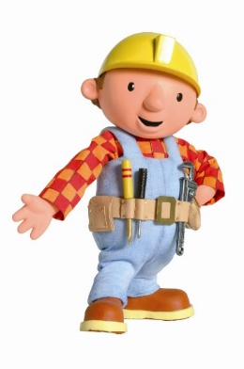


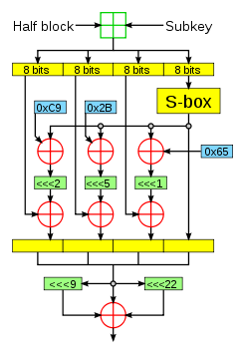

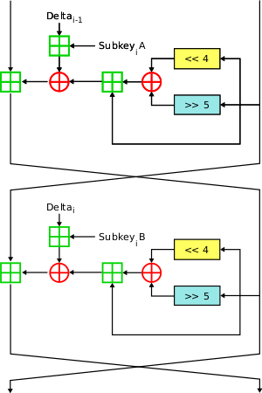
Historical approach to crypto development
build → break → fix → break → fix → break → fix ...
secure?

Slide 39
Modern approach
Trying to make cryptography more a science than an art
Focus on formal definitions of security (and insecurity)
Clearly stated assumptions
Analysis supported by mathematical proofs
... but old fashioned cryptanalysis continues to be very important!

Slide 40
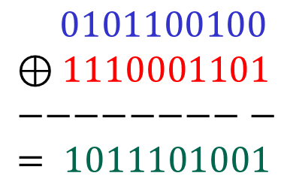







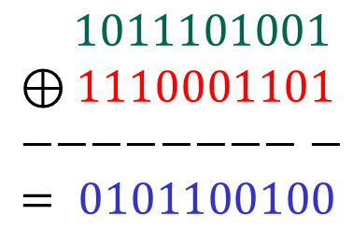




The one-time-pad (OTP)
$𝒦 ={\left\{0,1\right\}}^{n}$
$ℳ={\left\{0,1\right\}}^{n}$
$𝒞 ={\left\{0,1\right\}}^{n}$
$$ℰ\left(K, M\right)=K⊕M$$
$$𝒟\left(K, C\right)=K⊕C$$
$$0101100100$$
$$⊕1110001101 \\ −−−−−−−−− \\ = 1011101001$$
$$M$$
$$1011101001$$
$$⊕1110001101 \\ −−−−−−−−− \\ = 0101100100$$
$$C$$
$$K$$
$$K$$
$$C$$
$$M$$
Is the one-time pad secure?

Slide 41

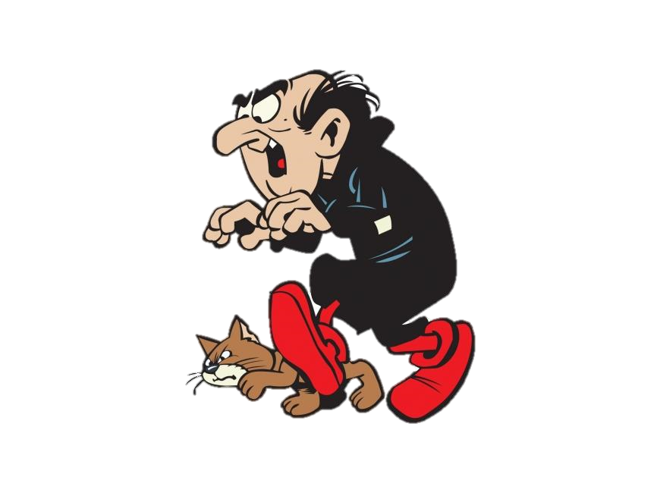



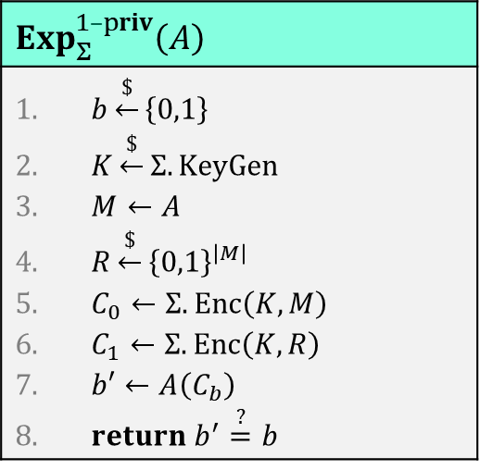
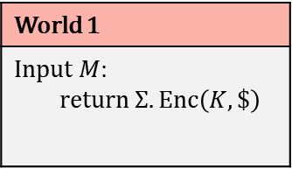
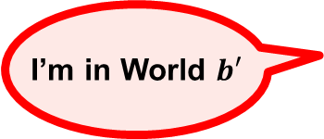
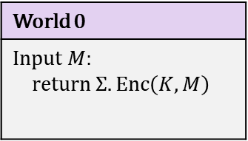


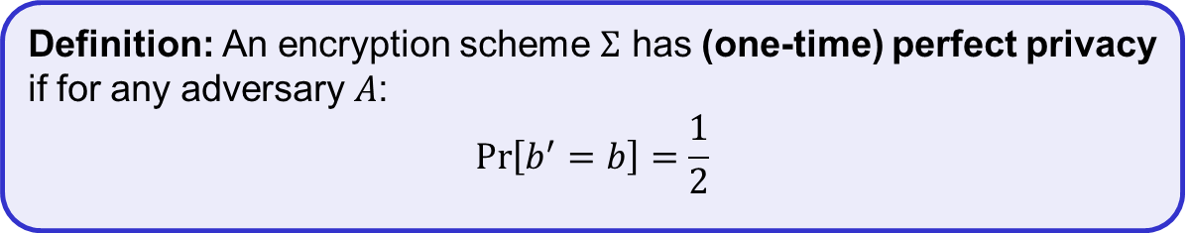
(One-time) perfect privacy
$$Exp_{Σ}^{1–priv}\left(A\right)$$
$b\underset{←}{\$}\left\{0,1\right\}$ $K\underset{←}{\$}Σ.KeyGen$ $M←A$ $R\underset{←}{\$}{\left\{0,1\right\}}^{\left|M\right|}$ $C_{0}←Σ.Enc\left(K, M\right)$ $C_{1}←Σ.Enc\left(K, R\right)$ $b′←A\left(C_{b}\right)$ $return b^{′}\overset{?}{=}b$
World 0
Input $M$: return $Σ.Enc\left(K, M\right)$
World 1
Input $M$: return $Σ.Enc\left(K, \$\right)$
$$b$$
$$M$$
$$M$$
$$C$$
$$C$$
I’m in World $b′$
Definition: An encryption scheme $Σ$ has (one-time) perfect privacy if for any adversary $A$:
$$\operatorname{Pr}\left[b^{′}=b\right]=\frac{1}{2}$$

Slide 42

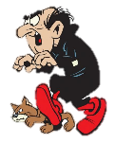







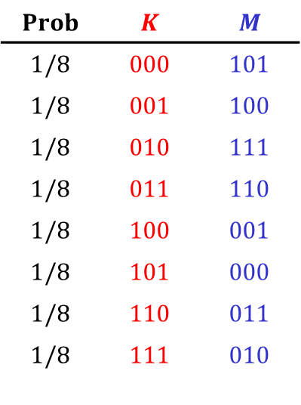


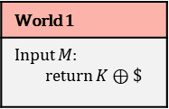


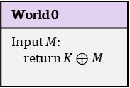


The one-time-pad (OTP) – security
Theorem (Shannon 1949): The one-time pad encryption scheme has one-time perfect privacy
$$Prob$$ | $$K$$ | $$M$$
$$1/8$$ | $$000$$ | $$101$$
$$1/8$$ | $$001$$ | $$100$$
$$1/8$$ | $$010$$ | $$111$$
$$1/8$$ | $$011$$ | $$110$$
$$1/8$$ | $$100$$ | $$001$$
$$1/8$$ | $$101$$ | $$000$$
$$1/8$$ | $$110$$ | $$011$$
$$1/8$$ | $$111$$ | $$010$$
World 0
Input $M$: return $K⊕M$
World 1
Input $M$: return $K⊕\$$
Proof:
Need to show: $\operatorname{Pr}\left[b^{′}=b\right]=1/2$
$$b$$
Suppose $A$ submits $M=110$ and receives $C=101$
$$M$$
$$M$$
$$C$$
$$C$$
I’m in World $b′$
$$\operatorname{Pr}\left[C=101 ∣ b=0\right]=$$
$$\operatorname{Pr}\left[K=011\right]$$
$$=1/8$$
$$\operatorname{Pr}\left[C=101 ∣ b=1\right]=$$
$$1/8$$
$$\operatorname{Pr}\left[C=101\right]=1/8$$
Probability that $A$ sees $C=101$ is independent of which world it's in!
$⟹$ $C$ contains no information about $b$
$⟹$ $\operatorname{Pr}\left[b^{′}=b\right]=1/2$
Notes:
Argument used for C = 101 applies to all C's, hence the theorem follows (of course generalized to the case {0,1}^n).

Slide 43
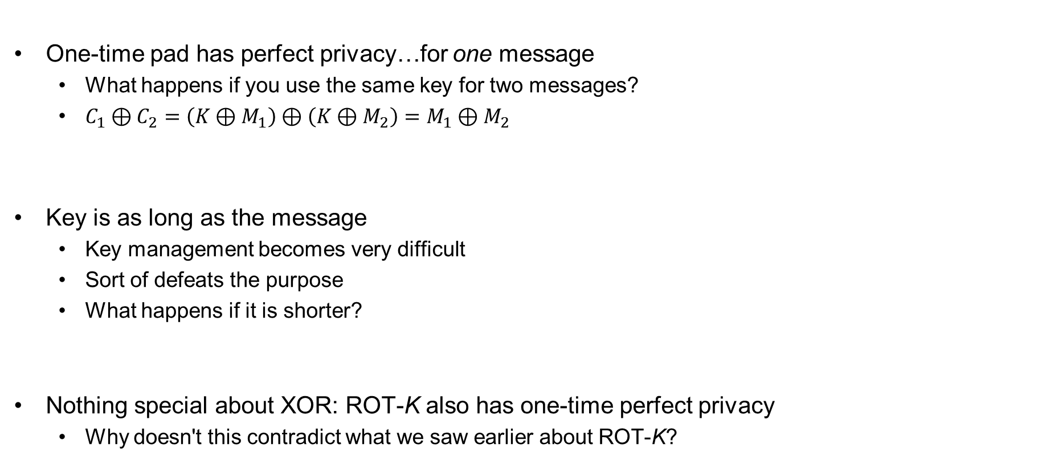
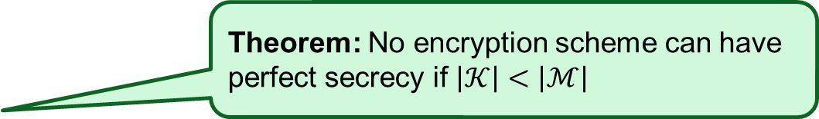
One-time pad – perfect?
One-time pad has perfect privacy…for one message
  What happens if you use the same key for two messages?
  $C_{1}⊕C_{2}=\left(K⊕M_{1}\right)⊕\left(K⊕M_{2}\right)=M_{1}⊕M_{2}$
Key is as long as the message
  Key management becomes very difficult
  Sort of defeats the purpose
  What happens if it is shorter?
Nothing special about XOR: ROT-K also has one-time perfect privacy
  Why doesn't this contradict what we saw earlier about ROT-K?
Theorem: No encryption scheme can have perfect secrecy if $\left|𝒦\right|<\left|ℳ\right|$

Slide 44
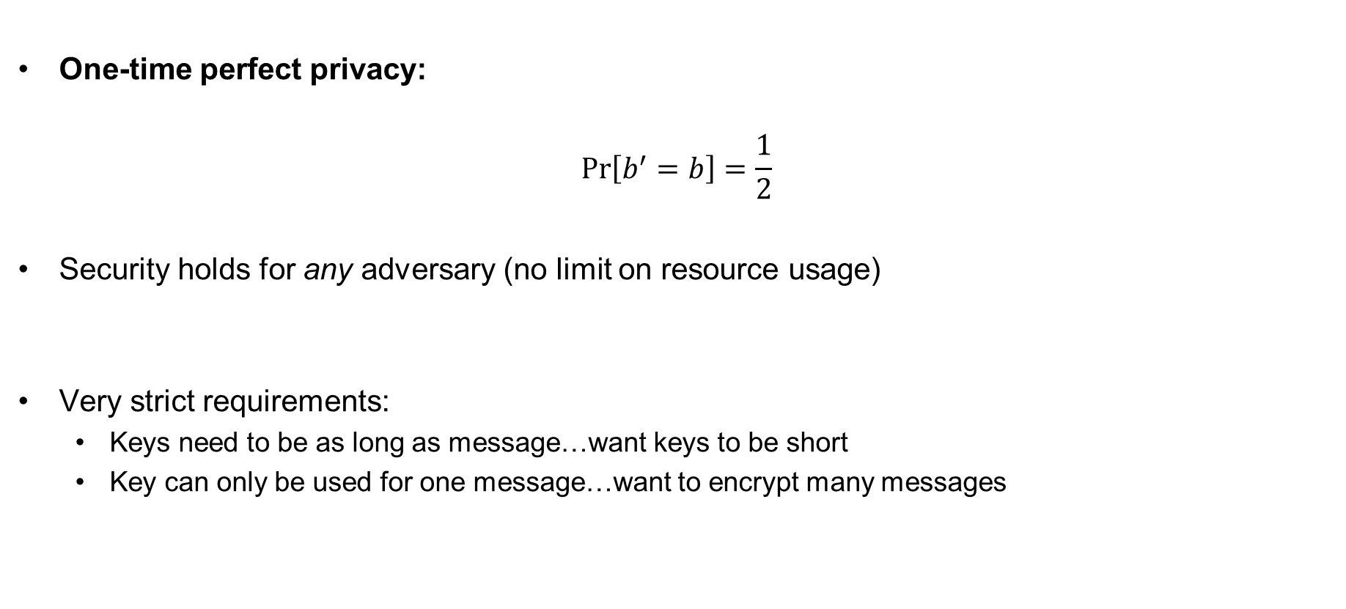
Wanted: security definition for symmetric encryption
One-time perfect privacy:
$$Pr\left[b^{′}=b\right]=\frac{1}{2}$$
Security holds for any adversary (no limit on resource usage)
Very strict requirements:
  Keys need to be as long as message…want keys to be short
  Key can only be used for one message…want to encrypt many messages

Slide 45

Modern cryptography – idea
One-time perfect privacy:
$$Pr\left[b^{′}=b\right]=\frac{1}{2}$$
Security holds for any adversary (no limit on resource usage)
Very strict requirements:
  Keys need to be as long as message…want keys to be short
  Key can only be used for one message…want to encrypt many messages
computational
$$± ε$$
resource bounded
✓
✓

Slide 46
Outline of course
 | Message privacy | Message integrity / authentication
Symmetric keys | Symmetric encryption | Message authentication codes (MAC)
Asymmetric keys | Asymmetric encryption (a.k.a. public-key encryption) | Digital signatures

Slide 47
Outline of course
 | Message privacy | Message integrity / authentication
Symmetric keys | Symmetric encryption | Message authentication codes (MAC)
Asymmetric keys | Asymmetric encryption (a.k.a. public-key encryption) | Digital signatures
Part I

Slide 48
Outline of course
 | Message privacy | Message integrity / authentication
Symmetric keys | Symmetric encryption | Message authentication codes (MAC)
Asymmetric keys | Asymmetric encryption (a.k.a. public-key encryption) | Digital signatures
Part II

Slide 49

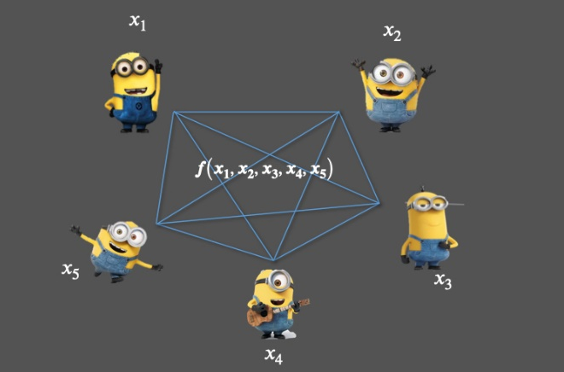
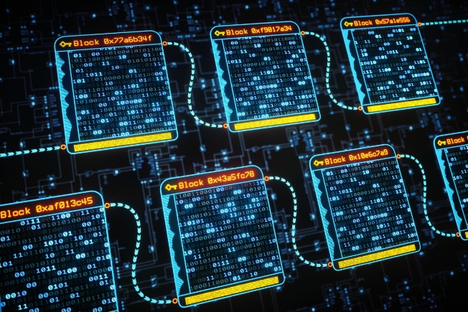
Much more to cryptography
Zero-knowledge proofs
Fully-homomorphic encryption
Multi-party computation
Blockchain
Password?
I know it
Welcome!
$$Enc\left(K, M_{1}+M_{2}\right)=Enc\left(K,M_{1}\right)+Enc\left(K, M_{2}\right)$$

Slide 50
The security pyramid
IN 5280 – Security by design
IN 5540 – Privacy by design
IN 5290 – Ethical hacking
User
Secure
systems
TEK 5510 – Security in operating systems and software
Communication
protocols
TEK 5520 – Cyber security of industrial systems
TEK 4500 – Introduction to cryptography
TEK 5550 – Advanced topics in cryptograpy
Cryptographic mechanisms
Notes:
Cryptography is harder
Cryptography is easier

Slide 51
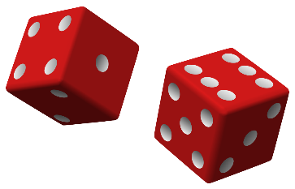
Discrete probability
the bare minimum
More details: https://en.wikibooks.org/wiki/High_School_Mathematics_Extensions/Discrete_Probability

Slide 52
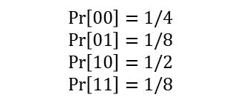
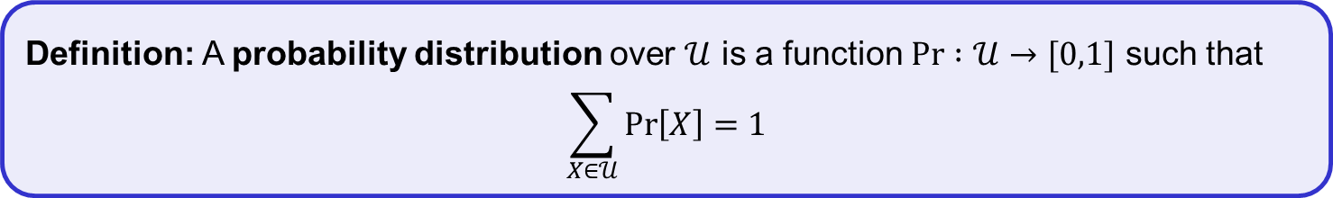
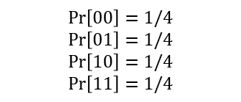
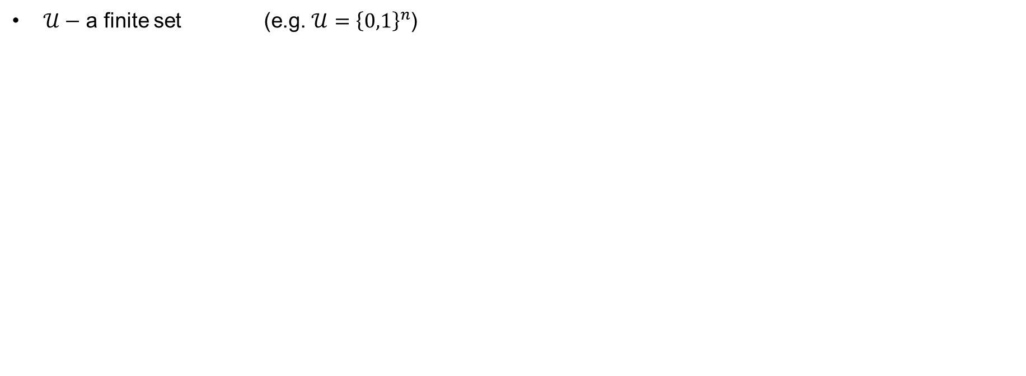


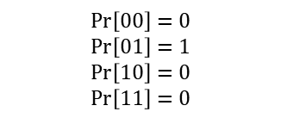
Discrete probability
$𝒰−$ a finite set (e.g. $𝒰={\left\{0,1\right\}}^{n}$)
Definition: A probability distribution over $𝒰$ is a function $\operatorname{Pr}{ :𝒰→[0,1]}$ such that
$$\sum_{X∈𝒰}{\operatorname{Pr}\left[X\right]=1}$$
$$𝒰={\left\{0,1\right\}}^{2}= \left\{00, 01, 10, 11\right\}$$
$$\operatorname{Pr}\left[X\right]$$
$$\operatorname{Pr}\left[00\right]=1/4$$
$$\operatorname{Pr}\left[01\right]=1/4$$
$$\operatorname{Pr}\left[10\right]=1/4$$
$$\operatorname{Pr}\left[11\right]=1/4$$
$$\operatorname{Pr}\left[00\right]=1/4$$
$$\operatorname{Pr}\left[01\right]=1/8$$
$$\operatorname{Pr}\left[10\right]=1/2$$
$$\operatorname{Pr}\left[11\right]=1/8$$
$$\operatorname{Pr}\left[00\right]=0$$
$$\operatorname{Pr}\left[01\right]=1$$
$$\operatorname{Pr}\left[10\right]=0$$
$$\operatorname{Pr}\left[11\right]=0$$
Uniform distribution
Point distribution

Slide 53
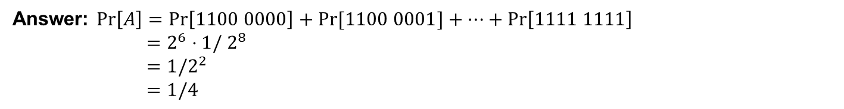
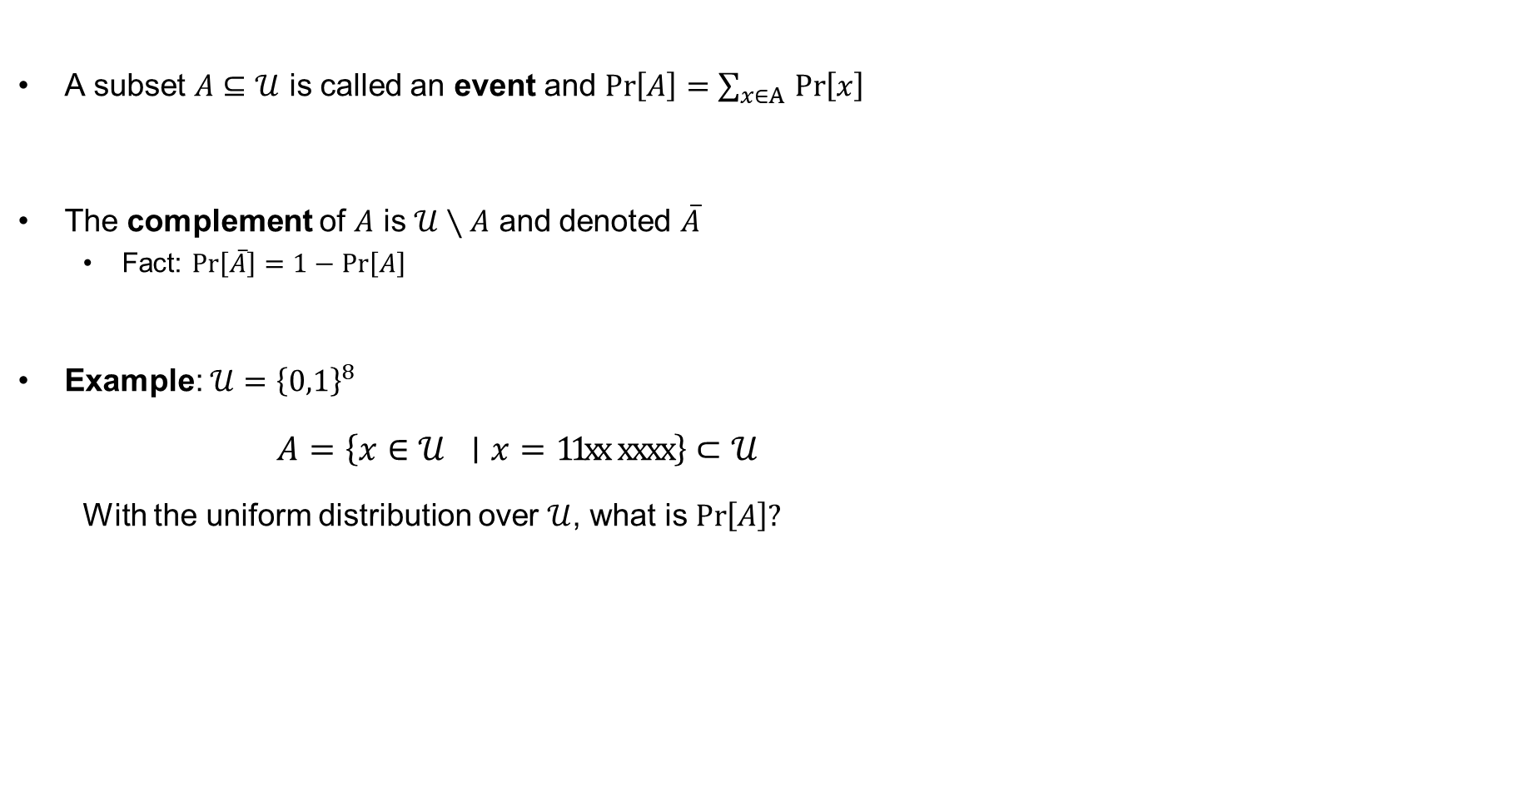
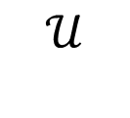
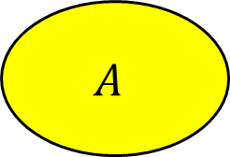
Discrete probability
A subset $A⊆𝒰$ is called an event and $\operatorname{Pr}\left[A\right]=\sum_{x∈A }{\operatorname{Pr}\left[x\right] }$
The complement of $A$ is $𝒰∖A$ and denoted $\overline{A}$
  Fact: $\operatorname{Pr}\left[\overline{A}\right]=1−\operatorname{Pr}\left[A\right]$
Example: $𝒰={\left\{0,1\right\}}^{8}$
  $A=\left\{x∈𝒰 ∣x=11xx xxxx\right\}⊂𝒰$
  With the uniform distribution over $𝒰$, what is $\operatorname{Pr}\left[A\right]?$
$$𝒰$$
$$A$$
Answer: $\operatorname{Pr}\left[A\right]=\operatorname{Pr}\left[1100 0000\right]+Pr⁡[1100 0001]+…+\operatorname{Pr}\left[1111 1111\right]$
$=2^{6}⋅1/ 2^{8}$
$=1/2^{2}$
$=1/4$

Slide 54
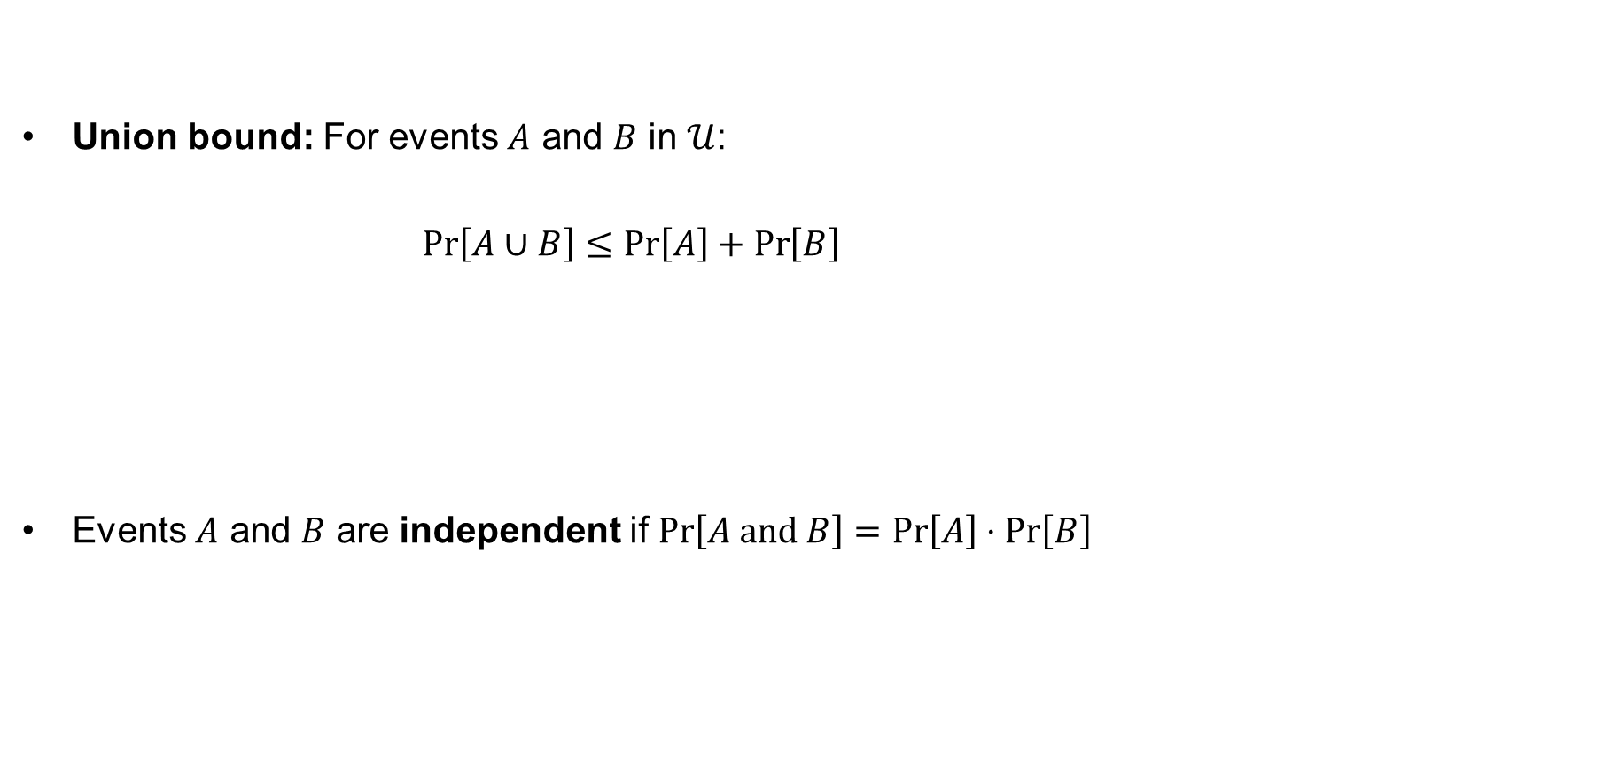
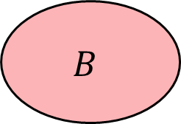
Union bound and independence
Union bound: For events $A$ and $B$ in $𝒰$:
$\operatorname{Pr}\left[A∪B\right]≤\operatorname{Pr}\left[A\right]+\operatorname{Pr}\left[B\right]$
Events $A$ and $B$ are independent if $\operatorname{Pr}\left[A and B\right]=\operatorname{Pr}\left[A\right]⋅\operatorname{Pr}\left[B\right]$
$$𝒰$$
$$A$$
$$B$$

Slide 55

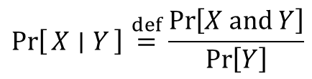
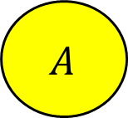

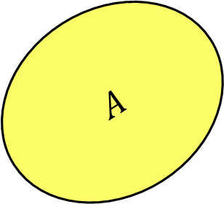










Law of total probability
Conditional probability
Law of total probability
$$B$$
$$\operatorname{Pr}\left[A∣B\right]$$
$$\operatorname{Pr}\left[A\right]$$
$$C$$
$$>$$
$$\operatorname{Pr}\left[X ∣ Y\right]\overset{def}{=}\frac{\operatorname{Pr}\left[X and Y\right]}{\operatorname{Pr}\left[Y\right]}$$
$$\operatorname{Pr}\left[A∣C\right]=0$$
$$A$$
$$E_{1}$$
$$\operatorname{Pr}\left[A∣E_{1}\right]⋅\operatorname{Pr}\left[E_{1}\right]$$
$+\operatorname{Pr}\left[A∣E_{2}\right]⋅\operatorname{Pr}\left[E_{2}\right]$
$⋮$
$+Pr\left[A∣E_{n}\right]⋅\operatorname{Pr}\left[E_{n}\right]$
$$E_{3}$$
$$A$$
$$\operatorname{Pr}\left[A\right]=$$
$$E_{2}$$
$$E_{n}$$

Slide 56













Random variables
A random variable $X$ is a function $X :𝒰→𝒱$
Example:
$$𝒰$$
$$𝒱$$
$$𝒰$$
$$𝒱$$
00000
00
$$X :{\left\{0,1\right\}}^{5}→{\left\{0,1\right\}}^{2}$$
00001
00010
$$X$$
01
$$X\left(s\right)\overset{def}{=}{msb}_{2}\left(s\right)$$
$$⋮$$
10
11111
11
$$\operatorname{Pr}{[X=11]}$$
$$\overset{def}{=}\underset{s∈𝒰}{Pr}\left[s=11xxx\right]$$
$$=\frac{2^{3}}{2^{5}}=1/4$$
Depends on the probability
distribution on $𝒰$
Uniform distribution on $𝒰$

Slide 57















Random variables
A random variable $X$ is a function $X :𝒰→𝒱$
Example:
$$𝒰$$
$$𝒱$$
$$𝒰$$
$$𝒱$$
00000
0
$$X :{\left\{0,1\right\}}^{5}→[0,1, 2, …, 10]$$
00001
1
$$X$$
2
00010
3
$$X\left(s\right)\overset{def}{=}s_{1}+s_{2}+s_{3}+s_{4}+s_{5}$$
4
$$⋮$$
$$⋮$$
11111
10
$$\operatorname{Pr}\left[X=0\right]=$$
$$1/32$$
$$\operatorname{Pr}\left[X=1\right]=$$
$$5/32$$
$$\operatorname{Pr}\left[X=2\right]=$$
$$\left({5 \atop 2}\right)$$
$$/ 32$$
$$=10/32$$
Uniform distribution on $𝒰$
but not on $𝒱$!
$$\operatorname{Pr}\left[X=10\right]=$$
$$0$$

Slide 58













Random variables
A random variable $X$ is a function $X :𝒰→𝒱$
Example:
$$𝒱$$
$$𝒰$$
$$𝒱$$
$$𝒰$$
$$𝒱$$
0
$$1/32$$
$$1/32$$
1
$$5/32$$
$$1/32$$
$$X :{\left\{0,1\right\}}^{5}→[0,1, 2, …, 10]$$
$$U :{\left\{0,1\right\}}^{5}→[0,1, 2, …, 10]$$
2
$$10/32$$
$$1/32$$
$$U$$
3
$$10/32$$
$$1/32$$
$$X\left(s\right)\overset{def}{=}s_{1}+s_{2}+s_{3}+s_{4}+s_{5}$$
$$X$$
4
$$5/32$$
$$1/32$$
$$⋮$$
10
$$0$$
$$1/32$$
$$\operatorname{Pr}\left[X=0\right]=$$
$$1/32$$
$$\operatorname{Pr}\left[X=1\right]=$$
$$5/32$$
$$\operatorname{Pr}\left[X=2\right]=$$
$$\left({5 \atop 2}\right)$$
$$/ 32$$
$$=10/32$$
Uniform distribution on $𝒰$
but not on $𝒱$!
Uniform distribution on $𝒱$
i.e. $U$ is a uniform random variable (on $𝒱$)
$$\operatorname{Pr}\left[X=10\right]=$$
$$0$$

Slide 59








Randomized algorithms
Deterministic algorithm:
$y←A(x)$
Randomized algorithm:
$y←A(x;r)$ where $r\underset{←}{\$}{\left\{0,1\right\}}^{n}$
$y\underset{←}{\$}A(x)$
Example:
$A\left(X;K\right)=Enc\left(K,X\right)$ $Y\underset{←}{\$}A(X)$
Inputs
Outputs
$$x$$
$$A(x)$$
$$A(x)$$
$A(x)$ is a random variable!
$$x$$
$$A(x′)$$
$$x′$$

Slide 60
Next week
Block ciphers
Pseudorandom functions and pseuorandom permutations
AES
NOTE: different room!

