Slide 1
Lecture 2 – Block ciphers,
PRFs/PRPs, AES
TEK4500
31.08.2022
Håkon Jacobsen
hakon.jacobsen@its.uio.no

Slide 2

Ideal solution: secure channels
Internet
But how to build?
Alice
Bob
M
Adversary
Security goals:
Data privacy: adversary should not be able to read message M ✓
Data integrity: adversary should not be able to modify message M ✓
Data authenticity: message M really originated from Alice ✓

Slide 3
Basic goals of cryptography
 | Message privacy | Message integrity / authentication
Symmetric keys | Symmetric encryption | Message authentication codes (MAC)
Asymmetric keys | Asymmetric encryption (a.k.a. public-key encryption) | Digital signatures

Slide 4

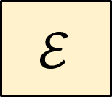



Encryption schemes
Plaintext
$$ℳ$$
$$\$$$
$$ℰ$$
$$𝒦$$
Key
Ciphertext
$$𝒞$$

Slide 5



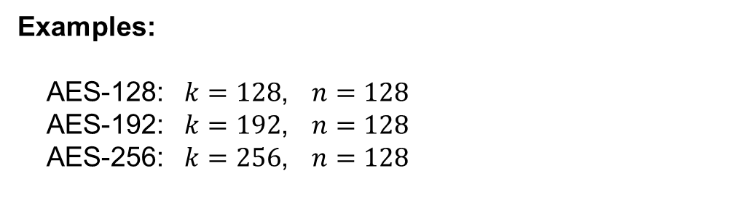


Block ciphers
Plaintext
$${\left\{0,1\right\}}^{n}$$
$$128$$
$$ℰ$$
$${\left\{0,1\right\}}^{k}$$
Key
AES
$$128$$
Ciphertext
$${\left\{0,1\right\}}^{n}$$
Examples:
AES-128: $k=128$, $n=128$
AES-192: $k=192$, $n=128$
AES-256: $k=256$, $n=128$

Slide 6







Block cipher applications (1)
Encryption of messages of 128 bits (block length)
However: actually want to encrypt messages of arbitrary length!
  Splitting the message into multiple 128 bit blocks (like above) is not secure!
  A mode-of-operation is needed (covered later in the course)
Correct viewpoint: block ciphers are not encryption schemes!
  Block ciphers are primitives used to construct other things
$$K$$
$$K$$
$$Y_{1}, { Y}_{2},…, { Y}_{t}$$
$$Y_{i}←E_{K}(X_{i})$$
$$X_{i}←E_{K}^{−1}(Y_{i})$$

Slide 7
Block cipher applications (2)
The “work horse” of crypto
Can be used to build:
  Encryption of arbitrary length messages (including stream ciphers)
  Message authentication codes
  Authenticated encryption
  Hash functions
  (Cryptographically secure) pseudorandom generators
  Key derivation functions

Slide 8
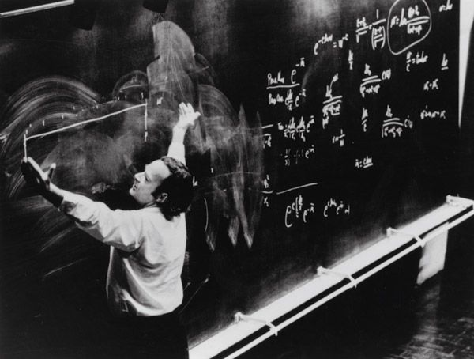
Defining block ciphers

Slide 9
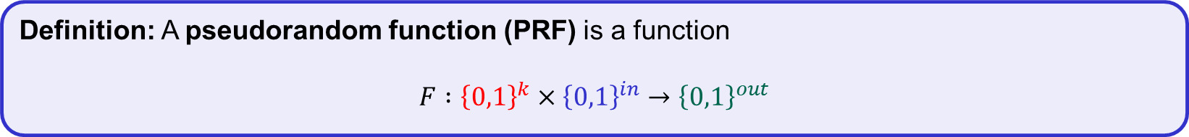
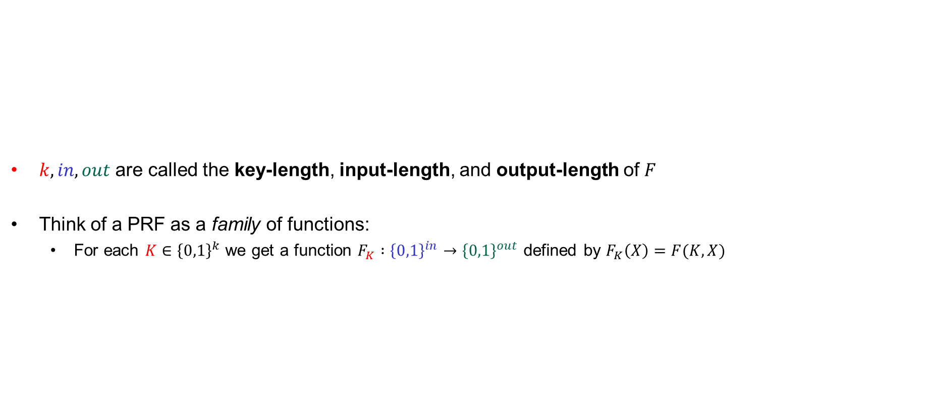
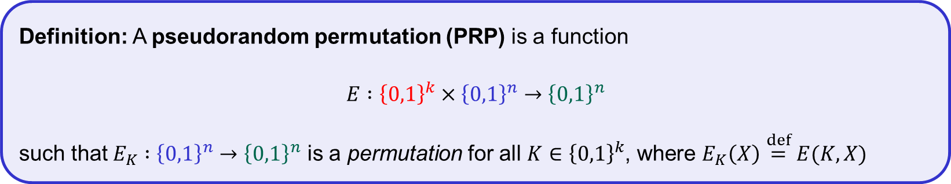
Pseudorandom functions (PRFs) and permutations (PRP)
$k, in, out$ are called the key-length, input-length, and output-length of $F$
Think of a PRF as a family of functions:
  For each $K∈{\left\{0,1\right\}}^{k}$ we get a function $F_{K} :{\left\{0,1\right\}}^{in}→{\left\{0,1\right\}}^{out}$ defined by $F_{K}\left(X\right)=F(K, X)$
Definition: A pseudorandom function (PRF) is a function
$$F :{\left\{0,1\right\}}^{k}×{\left\{0,1\right\}}^{in}→{\left\{0,1\right\}}^{out}$$
PRP = block cipher
note: all PRPs are PRFs
(but not all PRFs are PRPs!)
Definition: A pseudorandom permutation (PRP) is a function
$$E :{\left\{0,1\right\}}^{k}×{\left\{0,1\right\}}^{n}→{\left\{0,1\right\}}^{n}$$
such that $E_{K} :{\left\{0,1\right\}}^{n}→{\left\{0,1\right\}}^{n}$ is a permutation for all $K∈{\left\{0,1\right\}}^{k}$, where $E_{K}\left(X\right)\overset{def}{=}E(K, X)$

Slide 10
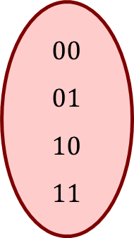
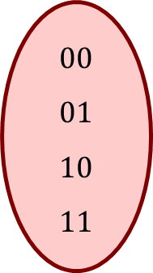


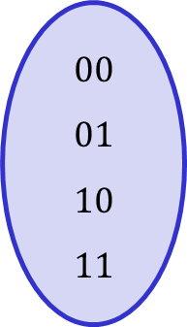
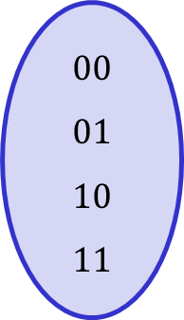
Permutations vs. functions
$$E_{K}$$
$$F_{K}$$
$$00 \\ 01 \\ 10 \\ 11$$
$$00 \\ 01 \\ 10 \\ 11$$
$$00 \\ 01 \\ 10 \\ 11$$
$$00 \\ 01 \\ 10 \\ 11$$
Permutation
Not a permutation

Slide 11
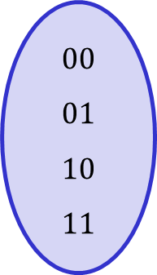
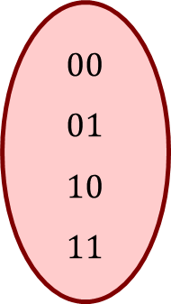
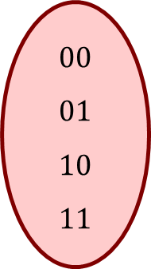

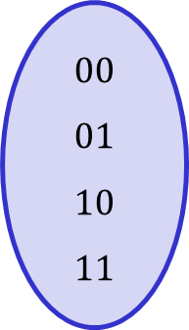
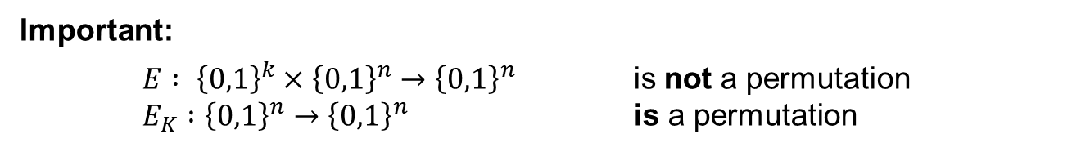
Permutations vs. functions
$$E_{K}^{−1}$$
$$F_{K}$$
$$00 \\ 01 \\ 10 \\ 11$$
$$00 \\ 01 \\ 10 \\ 11$$
$$00 \\ 01 \\ 10 \\ 11$$
$$00 \\ 01 \\ 10 \\ 11$$
Permutation
Not a permutation
Important:
${E : \left\{0,1\right\}}^{k}×{\left\{0,1\right\}}^{n}→{\left\{0,1\right\}}^{n}$ is not a permutation
$E_{K} :{\left\{0,1\right\}}^{n}→{\left\{0,1\right\}}^{n}$ is a permutation

Slide 12
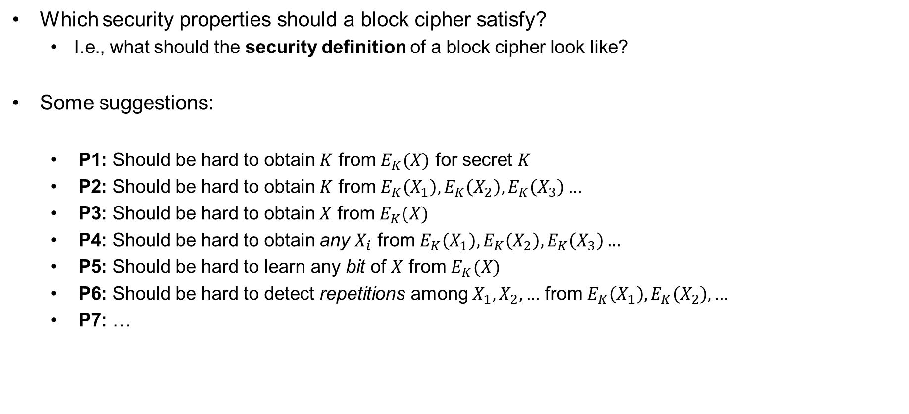
Block cipher security
Which security properties should a block cipher satisfy?
  I.e., what should the security definition of a block cipher look like?
Some suggestions:
  P1: Should be hard to obtain $K$ from $E_{K}(X)$ for secret $K$
  P2: Should be hard to obtain $K$ from $E_{K}\left(X_{1}\right),E_{K}\left(X_{2}\right),E_{K}\left(X_{3}\right)…$
  P3: Should be hard to obtain $X$ from $E_{K}(X)$
  P4: Should be hard to obtain any $X_{i}$ from $E_{K}\left(X_{1}\right),E_{K}\left(X_{2}\right),E_{K}\left(X_{3}\right)…$
  P5: Should be hard to learn any bit of $X$ from $E_{K}(X)$
  P6: Should be hard to detect repetitions among $X_{1},X_{2},…$ from $E_{K}\left(X_{1}\right),E_{K}\left(X_{2}\right), …$
  P7: …
Not good enough!
  Impossible!

Slide 13

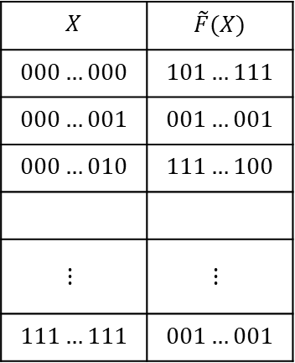


Random functions
$$\tilde{F }:{\left\{0,1\right\}}^{in}→{\left\{0,1\right\}}^{out}$$
$$X$$ | $$\tilde{F}(X)$$
$$000…000$$ | $$101…111$$
$$000…001$$ | $$001…001$$
$$000…010$$ | $$111…100$$
$$⋮$$ | $$⋮$$
$$111…111$$ | $$001…001$$
$$2^{in}$$
$$out$$

Slide 14

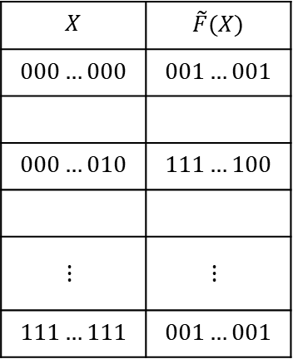
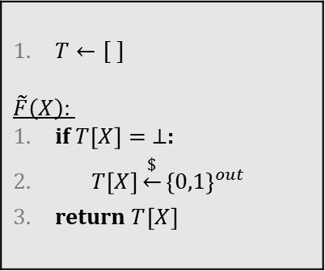
Random functions
$$\tilde{F }:{\left\{0,1\right\}}^{in}→{\left\{0,1\right\}}^{out}$$
$$X$$ | $$\tilde{F}(X)$$
$$000…000$$ | $$001…001$$
$$000…010$$ | $$111…100$$
$$⋮$$ | $$⋮$$
$$111…111$$ | $$001…001$$
$T←[ ]$ $$\tilde{F}\left(X\right):$$ if $T\left[X\right]= ⊥$: $T\left[X\right]\underset{←}{\$}{\left\{0,1\right\}}^{out}$ return $T{\left[X\right]}^{}$

Slide 15


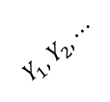
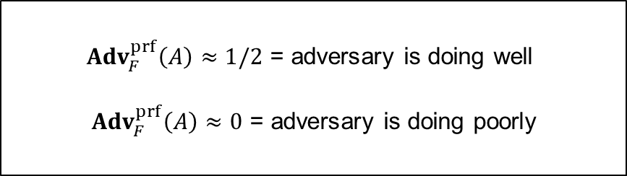
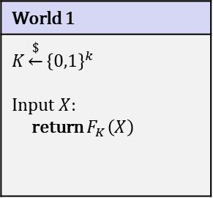
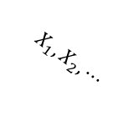

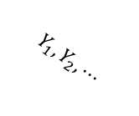

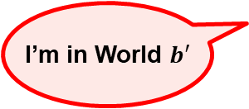
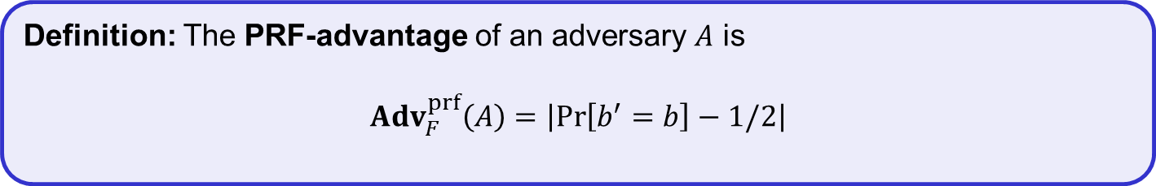

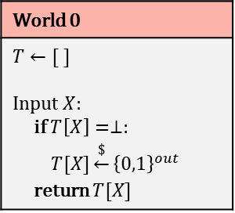
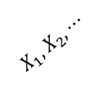
PRF – security; formal definition
World 1
$$K\underset{←}{\$}{\left\{0,1\right\}}^{k}$$ Input $X$: return $F_{K}\left(X\right)$
$b$
World 0
$$T←[ ]$$ Input $X$: if $T\left[X\right]=⊥:$ $T[X]\underset{←}{\$}{\left\{0,1\right\}}^{out}$ return $T[X]$
$$b=1$$
$$b=0$$
$$X_{1}, X_{2}, ⋯$$
$$X_{1}, X_{2}, ⋯$$
$$Y_{1}, Y_{2}, ⋯$$
${Adv}_{F}^{prf}\left(A\right)≈1/2$ = adversary is doing well
${Adv}_{F}^{prf}\left(A\right)≈0$ = adversary is doing poorly
$$Y_{1}, Y_{2}, ⋯$$
I’m in World $b′$
Definition: The PRF-advantage of an adversary $A$ is
$${Adv}_{F}^{prf}\left(A\right)=\left|\operatorname{Pr}\left[b^{′}=b\right]−1/2\right|$$

Slide 16
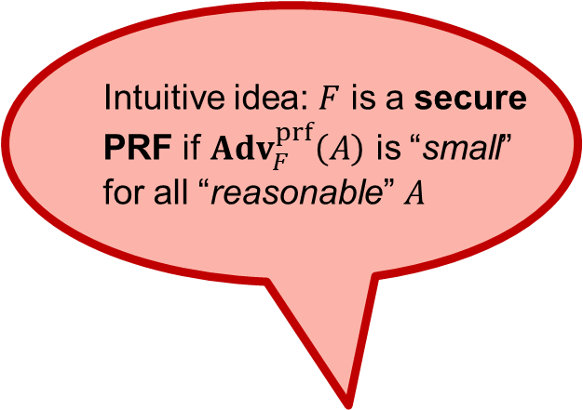
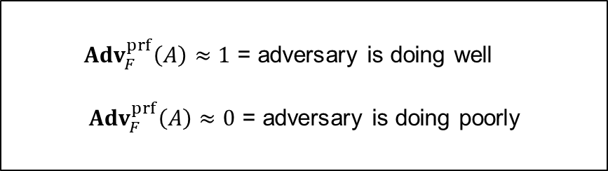
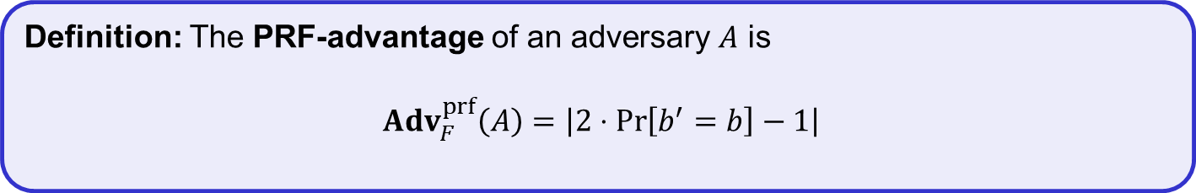
PRF – security; formal definition
World 1
$$K\underset{←}{\$}{\left\{0,1\right\}}^{k}$$ Input $X$: return $F_{K}\left(X\right)$
$b$
World 0
$$T←[ ]$$ Input $X$: if $T\left[X\right]=⊥:$ $T[X]\underset{←}{\$}{\left\{0,1\right\}}^{out}$ return $T[X]$
Intuitive idea: $F$ is a secure
PRF if ${Adv}_{F}^{prf}\left(A\right)$ is “small”
for all “reasonable” $A$
${Adv}_{F}^{prf}\left(A\right)≈1$ = adversary is doing well
${Adv}_{F}^{prf}\left(A\right)≈0$ = adversary is doing poorly
I’m in World $b′$
Definition: The PRF-advantage of an adversary $A$ is
$${Adv}_{F}^{prf}\left(A\right)=\left|2⋅Pr\left[b^{′}=b\right]−1\right|$$

Slide 17

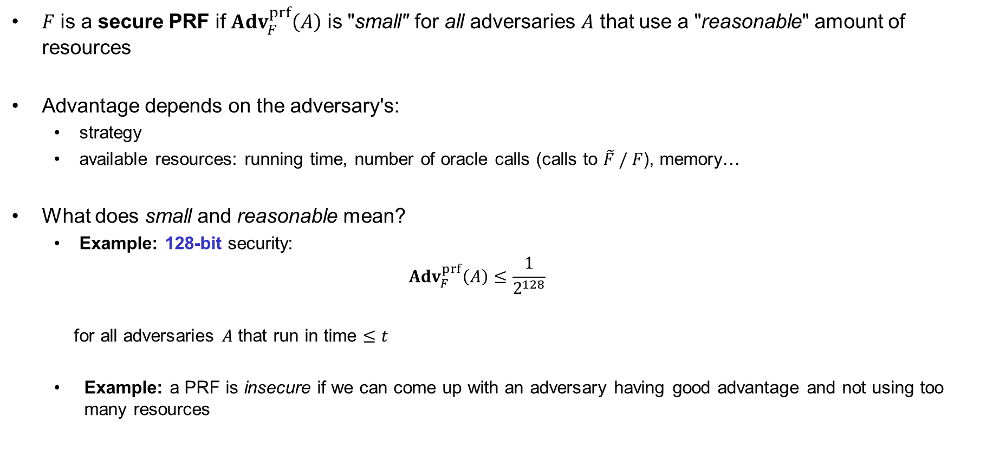
Understanding "advantage"
$F$ is a secure PRF if ${Adv}_{F}^{prf}\left(A\right)$ is "small" for all adversaries $A$ that use a "reasonable" amount of resources
Advantage depends on the adversary's:
  strategy
  available resources: running time, number of oracle calls (calls to $\tilde{F} / F$), memory…
What does small and reasonable mean?
  Example: 128-bit security:
  ${Adv}_{F}^{prf}\left(A\right)≤\frac{1}{2^{128}}$
  for all adversaries $A$ that run in time $≤t$
  Example: a PRF is insecure if we can come up with an adversary having good advantage and not using too many resources
$$t$$

Slide 18



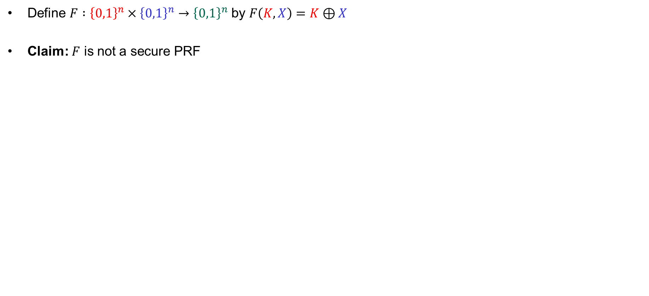
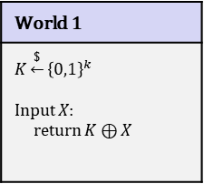
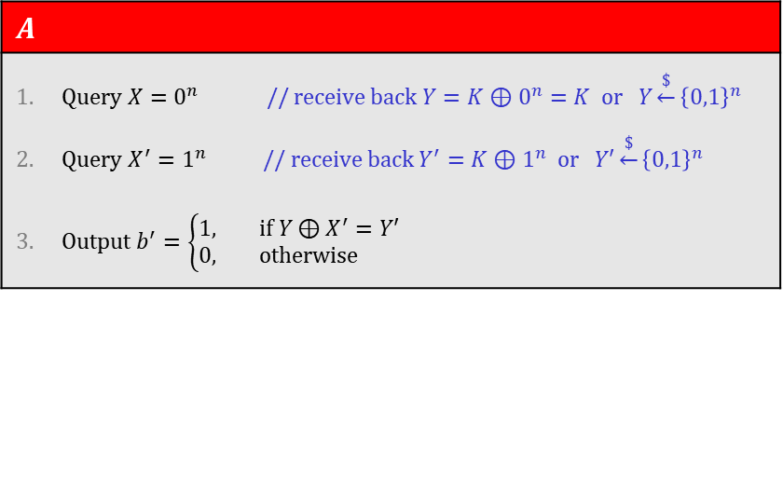

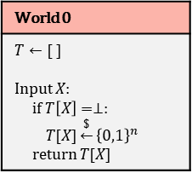

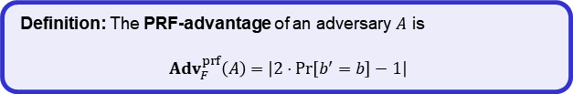
Example
Define $F :{\left\{0,1\right\}}^{n}×{\left\{0,1\right\}}^{n}→{\left\{0,1\right\}}^{n}$ by $F\left(K, X\right)=K⊕X$
Claim: $F$ is not a secure PRF
World 1
$$K\underset{←}{\$}{\left\{0,1\right\}}^{k}$$ Input $X$: return $K⊕X$
World 0
$$T←[ ]$$ Input $X$: if $T\left[X\right]=⊥:$ $T[X]\underset{←}{\$}{\left\{0,1\right\}}^{n}$ return $T[X]$
$b$
$$A$$
Query $X=0^{n}$ // receive back $Y=K⊕0^{n}=K$ or $Y\underset{←}{\$}{\left\{0,1\right\}}^{n}$ Query $X^{′}=1^{n}$ // receive back $Y^{′}=K⊕1^{n}$ or $Y′\underset{←}{\$}{\left\{0,1\right\}}^{n}$ Output $b^{′}=\left\{\begin{aligned}1, if Y⊕X^{′}=Y′ \\ &0, otherwise \end{aligned}\right.$
I’m in World $b′$
Definition: The PRF-advantage of an adversary $A$ is
$${Adv}_{F}^{prf}\left(A\right)=\left|2⋅Pr\left[b^{′}=b\right]−1\right|$$
$$\operatorname{Pr}\left[b^{′}=b\right] =$$
$$= \operatorname{Pr}\left[b^{′}=1 ∣ b=1\right]⋅\operatorname{Pr}\left[ b=1\right]+\operatorname{Pr}\left[b^{′}=0 ∣ b=0\right]⋅\operatorname{Pr}\left[ b=0\right]$$
$$= \operatorname{Pr}\left[b^{′}=1 ∣ b=1\right]⋅1/2 +\operatorname{Pr}\left[b^{′}=0 ∣ b=0\right]⋅1/ 2$$
$$= Pr\left[Y⊕X′=Y′∣b=1\right]{⋅1/2} + ⋯$$
$$= 1⋅1/2 + ⋯$$
Notes:
0^n = 0000…0 (n bits)
1^n = 1111…1 (n bits)

Slide 19
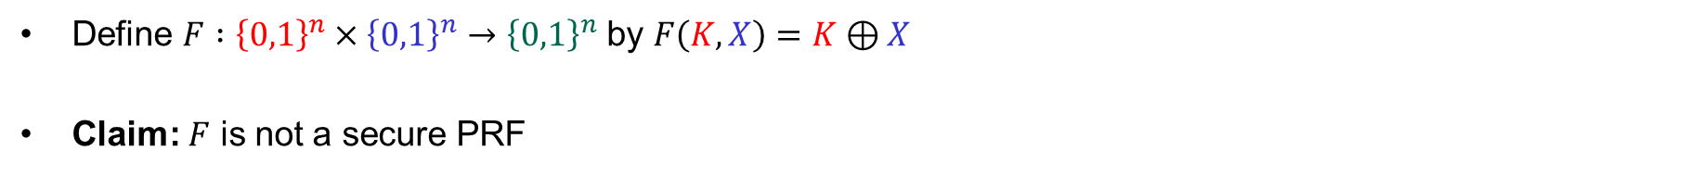

Example
Define $F :{\left\{0,1\right\}}^{n}×{\left\{0,1\right\}}^{n}→{\left\{0,1\right\}}^{n}$ by $F\left(K, X\right)=K⊕X$
Claim: $F$ is not a secure PRF
World 1
$$K\underset{←}{\$}{\left\{0,1\right\}}^{k}$$ Input $X$: return $K⊕X$
World 0
$$T←[ ]$$ Input $X$: if $T\left[X\right]=⊥:$ $T[X]\underset{←}{\$}{\left\{0,1\right\}}^{n}$ return $T[X]$
$b$
$$A$$
Query $X=0^{n}$ // receive back $Y=K⊕0^{n}=K$ or $Y\underset{←}{\$}{\left\{0,1\right\}}^{n}$ Query $X^{′}=1^{n}$ // receive back $Y^{′}=K⊕1^{n}$ or $Y′\underset{←}{\$}{\left\{0,1\right\}}^{n}$ Output $b^{′}=\left\{\begin{aligned}1, if Y⊕X^{′}=Y′ \\ &0, otherwise \end{aligned}\right.$
I’m in World $b′$
Definition: The PRF-advantage of an adversary $A$ is
$${Adv}_{F}^{prf}\left(A\right)=\left|2⋅Pr\left[b^{′}=b\right]−1\right|$$
$$\operatorname{Pr}\left[b^{′}=b\right] =$$
$$= \operatorname{Pr}\left[b^{′}=1 ∣ b=1\right]⋅\operatorname{Pr}\left[ b=1\right]+\operatorname{Pr}\left[b^{′}=0 ∣ b=0\right]⋅\operatorname{Pr}\left[ b=0\right]$$
$$= \operatorname{Pr}\left[b^{′}=1 ∣ b=1\right]⋅1/2 +\operatorname{Pr}\left[b^{′}=0 ∣ b=0\right]⋅1/ 2$$
$$= Pr\left[Y⊕X′=Y′∣b=1\right]{⋅1/2} +\left(1−Pr\left[b^{′}=1 ∣ b=0\right]\right)⋅1/2$$
$$= 1⋅1/2 + ⋯$$
$$\left(1−Pr\left[Y⊕X′=Y^{′} ∣ b=0\right]\right)⋅1/2$$

Slide 20

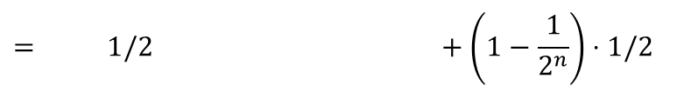




Example
Define $F :{\left\{0,1\right\}}^{n}×{\left\{0,1\right\}}^{n}→{\left\{0,1\right\}}^{n}$ by $F\left(K, X\right)=K⊕X$
Claim: $F$ is not a secure PRF
World 1
$$K\underset{←}{\$}{\left\{0,1\right\}}^{k}$$ Input $X$: return $K⊕X$
World 0
$$T←[ ]$$ Input $X$: if $T\left[X\right]=⊥:$ $T[X]\underset{←}{\$}{\left\{0,1\right\}}^{n}$ return $T[X]$
$b$
$$A$$
Query $X=0^{n}$ // receive back $Y=K⊕0^{n}=K$ or $Y\underset{←}{\$}{\left\{0,1\right\}}^{n}$ Query $X^{′}=1^{n}$ // receive back $Y^{′}=K⊕1^{n}$ or $Y′\underset{←}{\$}{\left\{0,1\right\}}^{n}$ Output $b^{′}=\left\{\begin{aligned}1, if Y⊕X^{′}=Y′ \\ &0, otherwise \end{aligned}\right.$
I’m in World $b′$
Definition: The PRF-advantage of an adversary $A$ is
$${Adv}_{F}^{prf}\left(A\right)=\left|2⋅Pr\left[b^{′}=b\right]−1\right|$$
$$\operatorname{Pr}\left[b^{′}=b\right] =$$
$$= \operatorname{Pr}\left[b^{′}=1 ∣ b=1\right]⋅\operatorname{Pr}\left[ b=1\right]+\operatorname{Pr}\left[b^{′}=0 ∣ b=0\right]⋅\operatorname{Pr}\left[ b=0\right]$$
$$= \operatorname{Pr}\left[b^{′}=1 ∣ b=1\right]⋅1/2 +\operatorname{Pr}\left[b^{′}=0 ∣ b=0\right]⋅1/ 2$$
$$= Pr\left[Y⊕X′=Y′∣b=1\right]{⋅1/2} +\left(1−Pr\left[b^{′}=1 ∣ b=0\right]\right)⋅1/2$$
$$= 1⋅1/2 + ⋯$$
$$\left(1−Pr\left[Z=Y^{′} ∣ b=0\right]\right)⋅1/2$$
$$= 1/2 +\left(1−\frac{1}{2^{n}}\right)⋅1/2$$
$$= 1−\frac{1}{{2⋅2}^{n}}$$

Slide 21




Example
Define $F :{\left\{0,1\right\}}^{n}×{\left\{0,1\right\}}^{n}→{\left\{0,1\right\}}^{n}$ by $F\left(K, X\right)=K⊕X$
Claim: $F$ is not a secure PRF
World 1
$$K\underset{←}{\$}{\left\{0,1\right\}}^{k}$$ Input $X$: return $K⊕X$
World 0
$$T←[ ]$$ Input $X$: if $T\left[X\right]=⊥:$ $T[X]\underset{←}{\$}{\left\{0,1\right\}}^{n}$ return $T[X]$
$b$
$$A$$
Query $X=0^{n}$ // receive back $Y=K⊕0^{n}=K$ or $Y\underset{←}{\$}{\left\{0,1\right\}}^{n}$ Query $X^{′}=1^{n}$ // receive back $Y^{′}=K⊕1^{n}$ or $Y′\underset{←}{\$}{\left\{0,1\right\}}^{n}$ Output $b^{′}=\left\{\begin{aligned}1, if Y⊕X^{′}=Y′ \\ &0, otherwise \end{aligned}\right.$
I’m in World $b′$
Definition: The PRF-advantage of an adversary $A$ is
$${Adv}_{F}^{prf}\left(A\right)=\left|2⋅Pr\left[b^{′}=b\right]−1\right|$$
$$\operatorname{Pr}\left[b^{′}=b\right] =$$
$$1−\frac{1}{{2⋅2}^{n}}$$
$${Adv}_{F}^{prf}\left(A\right)=\left|2⋅Pr\left[b^{′}=b\right]−1\right|$$
$$= \left|2⋅(1−\frac{1}{2{⋅2}^{n}})−1\right|$$
$$=1−2^{−n}$$

Slide 22

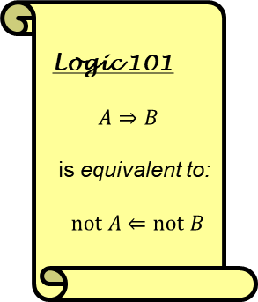

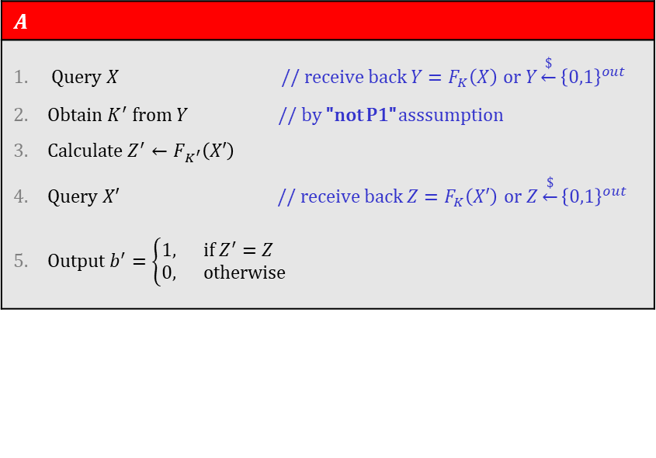
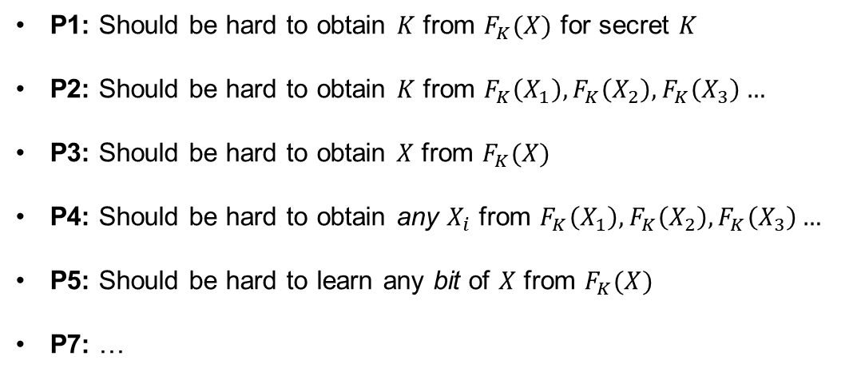
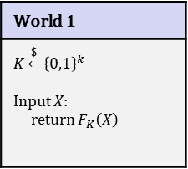


Why is the PRF definition good?
Logic 101
$$A⇒B$$
is equivalent to:
$not A⇐not B$
World 1
$$K\underset{←}{\$}{\left\{0,1\right\}}^{k}$$ Input $X$: return $F_{K}\left(X\right)$
World 0
$$T←[ ]$$ Input $X$: if $T\left[X\right]=⊥:$ $T[X]\underset{←}{\$}{\left\{0,1\right\}}^{n}$ return $T[X]$
$b$
  P1: Should be hard to obtain $K$ from $F_{K}(X)$ for secret $K$
  P2: Should be hard to obtain $K$ from $F_{K}\left(X_{1}\right),F_{K}\left(X_{2}\right),F_{K}\left(X_{3}\right)…$
  P3: Should be hard to obtain $X$ from $F_{K}(X)$
  P4: Should be hard to obtain any $X_{i}$ from $F_{K}\left(X_{1}\right),F_{K}\left(X_{2}\right),F_{K}\left(X_{3}\right)…$
  P5: Should be hard to learn any bit of $X$ from $F_{K}(X)$
  P7: …
$$A$$
Query $X$ // receive back $Y=F_{K}\left(X\right)$ or $Y\underset{←}{\$}{\left\{0,1\right\}}^{out}$ Obtain $K^{′}$ from $Y$ // by "not P1" asssumption Calculate $Z^{′}←F_{K^{′}}\left(X′\right)$ Query $X′$ // receive back $Z=F_{K}\left(X′\right)$ or $Z\underset{←}{\$}{\left\{0,1\right\}}^{out}$ Output $b^{′}=\left\{\begin{aligned}1, if Z^{′}=Z \\ &0, otherwise \end{aligned}\right.$
I’m in World $b′$
Definition: The PRF-advantage of an adversary $A$ is
$${Adv}_{F}^{prf}\left(A\right)=\left|2⋅Pr\left[b^{′}=b\right]−1\right|$$
$F$ is PRF secure $⟹$ $F$ has properties P1 – P5, P7, …
$$\operatorname{Pr}\left[b^{′}=1 ∣ b=1\right]=$$
$$1$$
$F$ is not PRF secure $⟸$ $F$ does not have properties P1 – P5, P7, …
$$1−\frac{1}{2^{out}}$$
$$\operatorname{Pr}\left[b^{′}=0 ∣ b=0\right]=$$

Slide 23
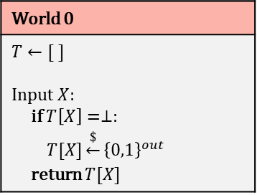

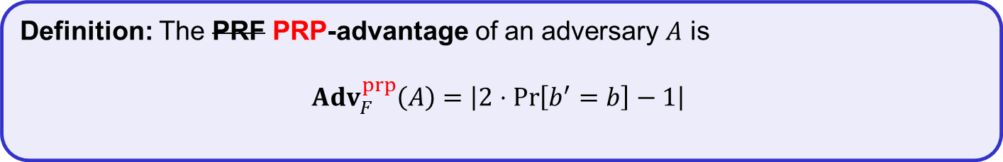
PRF PRP – security
World 1
$$K\underset{←}{\$}{\left\{0,1\right\}}^{k}$$ Input $X$: return $F_{K}\left(X\right)$
$b$
World 0
$$T←[ ]$$ Input $X$: if $T\left[X\right]=⊥:$ $T[X]\underset{←}{\$}{\left\{0,1\right\}}^{out}$ return $T[X]$
$$\backslash T.values$$
I’m in World $b′$
Definition: The PRF PRP-advantage of an adversary $A$ is
$${Adv}_{F}^{prp}\left(A\right)=\left|2⋅Pr\left[b^{′}=b\right]−1\right|$$

Slide 24




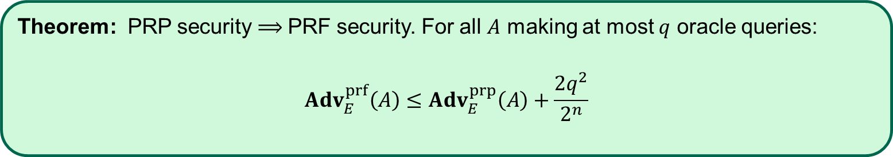




















PRP security $⟹$ PRF security
Theorem: PRP security $⟹$PRF security. For all $A$ making at most $q$ oracle queries:
$${Adv}_{E}^{prf}\left(A\right)≤{Adv}_{E}^{prp}\left(A\right)+\frac{{2q}^{2}}{2^{n}}$$
Proof sketch:
$${Adv}_{E}^{prf}\left(A\right)$$
$$($$
$$)$$
$$=$$
$$2⋅$$
$$\operatorname{Pr}\left[b^{′}=b∧\overline{coll}\right]+\operatorname{Pr}\left[b^{′}=b∧coll\right]$$
$$\operatorname{Pr}\left[b^{′}=b\right]$$
$$− 1$$
$$=$$
$$2⋅$$
$$− 1$$
$$($$
$$)$$
$$≤$$
$$2⋅$$
$$\operatorname{Pr}\left[b^{′}=b∧\overline{coll}\right]+\operatorname{Pr}\left[coll\right]$$
$$− 1$$
$$\operatorname{Pr}\left[b^{′}=b∧\overline{coll}\right] + \frac{q^{2}}{2^{n}}$$
$$≤$$
$$2⋅$$
$$2⋅$$
$$− 1$$
$${Adv}_{E}^{prp}\left(A\right) + \frac{{2q}^{2}}{2^{n}}$$
$$=$$

Slide 25


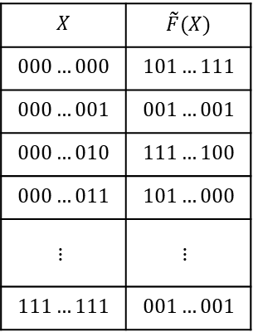
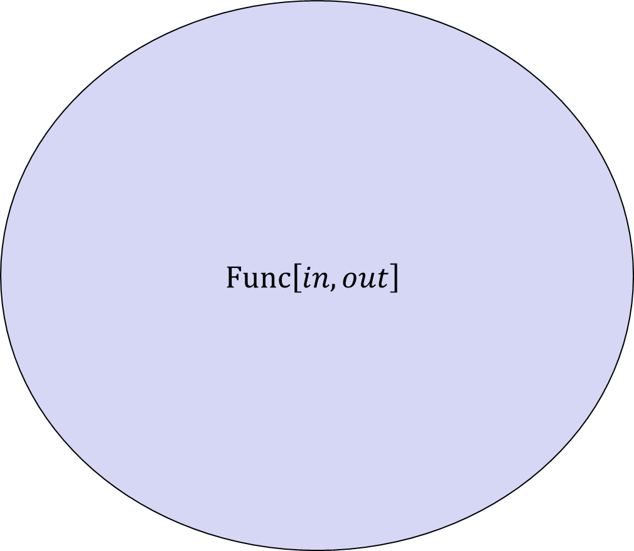




PRF – security; equivalent view
$$\left|Func\left[in,out\right]\right|=$$
$$Func\left[in, out\right]$$
$$X$$ | $$\tilde{F}(X)$$
$$000…000$$ | $$101…111$$
$$000…001$$ | $$001…001$$
$$000…010$$ | $$111…100$$
$$000…011$$ | $$101…000$$
$$⋮$$ | $$⋮$$
$$111…111$$ | $$001…001$$
$$G\left(X\right)=\overline{X}$$
$$F\left(X\right)=X$$
$$2^{in}$$
$$V\left(X\right)=X⊕17$$
$$\tilde{F}$$
$$H\left(X\right)=00…0$$
$$out$$

Slide 26







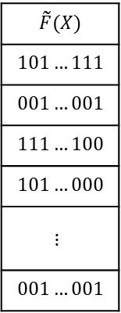


PRF – security; equivalent view
$$Func\left[in, out\right]$$
$$\left|Func\left[in,out\right]\right|=$$
# bitstrings of length $2^{in}⋅out$
$$=2^{\left(2^{in}⋅out\right)}$$
$$\tilde{F}(X)$$
$$101…111$$
$$001…001$$
$$111…100$$
$$101…000$$
$$⋮$$
$$001…001$$
$$G\left(X\right)=\overline{X}$$
Example:
$$\left|Func\left[3,2\right]\right|=$$
$$2^{2^{3}⋅2}$$
$$F\left(X\right)=X$$
$$2^{in}$$
$$V\left(X\right)=X⊕17$$
$$=2^{16}$$
$$=65536$$
$$\tilde{F}$$
$$H\left(X\right)=00…0$$
$$out$$
- Bits needed to specify one
function: $2^{in}⋅out$
- Each unique bitstring of length $2^{in}⋅out$
represents a unique function

Slide 27





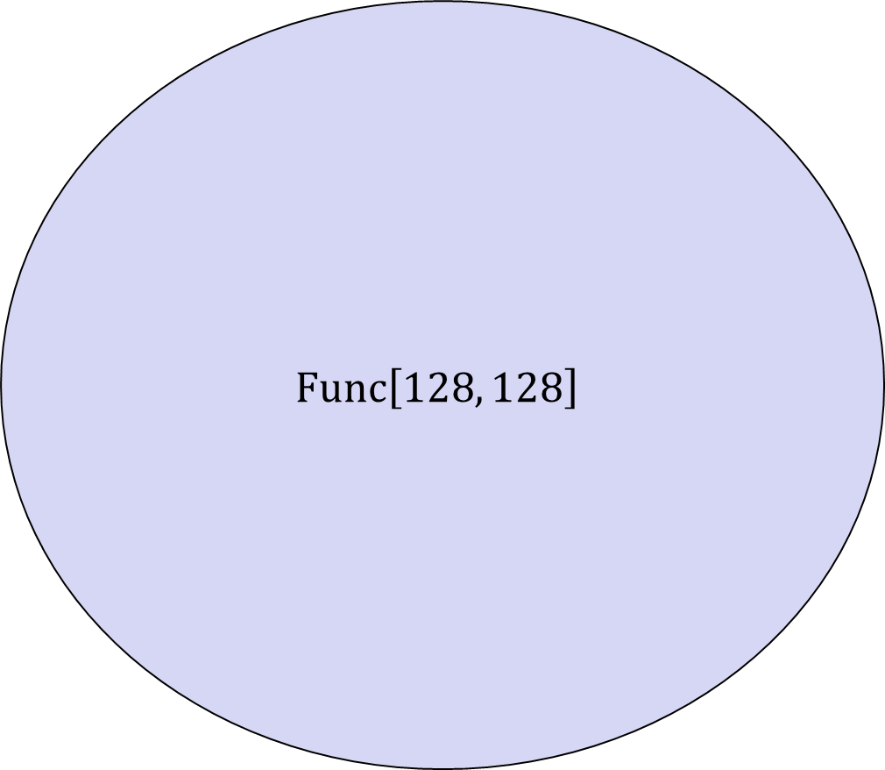




PRF – security; equivalent view
$$Func\left[128, 128\right]$$
$$\left|Func\left[in,out\right]\right|=$$
# bitstrings of length $2^{in}⋅out$
$$=2^{\left(2^{in}⋅out\right)}$$
$$\tilde{F}(X)$$
$$101…111$$
$$001…001$$
$$111…100$$
$$101…000$$
$$⋮$$
$$001…001$$
$$G\left(X\right)=\overline{X}$$
Example:
$$\left|Func\left[3,2\right]\right|=$$
$$2^{2^{3}⋅2}$$
$$F\left(X\right)=X$$
$$2^{in}$$
$$V\left(X\right)=X⊕17$$
$$=2^{16}$$
$$=65536$$
$$\tilde{F}$$
$$H\left(X\right)=00…0$$
$$out$$
$$AES$$
$$\left|Func\left[128,128\right]\right|=$$
$$2^{2^{128}⋅128}$$
$${AES}_{00…}\left(X\right)$$
- Bits needed to specify one
function: $2^{in}⋅out$
$${AES}_{101…}\left(X\right)$$
$$\left|AES\right|=$$
$$2^{128}$$
$${AES}_{11…}\left(X\right)$$
- Each unique bitstring of length $2^{in}⋅out$
represents a unique function

Slide 28

PRF – security; equivalent view
$$Func\left[128, 128\right]$$
$$\left|Func\left[in,out\right]\right|=$$
# bitstrings of length $2^{in}⋅out$
$$=2^{\left(2^{in}⋅out\right)}$$
$$\tilde{F}(X)$$
$$101…111$$
$$001…001$$
$$111…100$$
$$101…000$$
$$⋮$$
$$001…001$$
$$G\left(X\right)=\overline{X}$$
Example:
$$\left|Func\left[3,2\right]\right|=$$
$$2^{2^{3}⋅2}$$
$$F\left(X\right)=X$$
$$2^{in}$$
$$V\left(X\right)=X⊕17$$
$$=2^{16}$$
$$=65536$$
$$\tilde{F}$$
$$H\left(X\right)=00…0$$
$$out$$
$$\left|Func\left[128,128\right]\right|=$$
$$2^{2^{128}⋅128}$$
- Bits needed to specify one
function: $2^{in}⋅out$
$$\left|AES\right|=$$
$$2^{128}$$
$$AES$$
- Each unique bitstring of length $2^{in}⋅out$
represents a unique function

Slide 29


Block ciphers – security
$$\left|Func\left[128,128\right]\right|=$$
$$2^{2^{128}⋅128}$$
$$Func\left[128, 128\right]$$
$$G\left(X\right)=\overline{X}$$
$$F\left(X\right)=X$$
$$V\left(X\right)=X⊕17$$
$$H\left(X\right)=00…0$$
$$\left|AES\right|=$$
$$2^{128}$$
$$AES$$

Slide 30



Block ciphers – security
$$\left|Func\left[128,128\right]\right|=$$
$$2^{2^{128}⋅128}$$
$$Func\left[128, 128\right]$$
$$\left|Perm\left[128\right]\right|=$$
$$2^{128}!$$
$$Perm\left[128\right]$$
$$G\left(X\right)=\overline{X}$$
$$F\left(X\right)=X$$
$$V\left(X\right)=X⊕17$$
$$H\left(X\right)=00…0$$
$$\left|AES\right|=$$
$$2^{128}$$
$$AES$$

Slide 31




PRF – security
World 1
$$K\underset{←}{\$}{\left\{0,1\right\}}^{k}$$ Input $X$: return $F_{K}\left(X\right)$
$b$
World 0
$$T←[ ]$$ Input $X$: if $T\left[X\right]=⊥:$ $T[X]\underset{←}{\$}{\left\{0,1\right\}}^{out}$ return $T[X]$
I’m in World $b′$

Slide 32






PRF – security; equivalent view
$$Exp_{F}^{prf}\left(A\right)$$
$b\underset{←}{\$}\left\{0,1\right\}$ $F_{0}\underset{←}{\$}Func\left[in, out\right]$ // random $\tilde{F}$ $K\underset{←}{\$}{\left\{0,1\right\}}^{k}$ $F_{1}\underset{←}{}F_{K}$ // real $F$ $b^{′}\underset{←}{}A^{F_{b}(⋅)}$ $return b^{′}\overset{?}{=}b$
$$A=$$
World 1
$$K\underset{←}{\$}{\left\{0,1\right\}}^{k}$$ Input $X$: return $F_{K}\left(X\right)$
$b$
World 0
$$\tilde{F}\underset{←}{\$}Func\left[in, out\right]$$ Input $X$: return $\tilde{F}\left(X\right)$
I’m in World $b′$
Definition: The PRF-advantage of an adversary $A$ is
$${Adv}_{F}^{prf}\left(A\right)=\left|2⋅Pr\left[b^{′}=b\right]−1\right|$$
Definition: The PRF-advantage of an adversary $A$ is
$${Adv}_{F}^{prf}\left(A\right)=\left|2⋅Pr\left[Exp_{F}^{prf}\left(A\right)⇒true\right]−1\right|$$

Slide 33




PRF PRP – security; equivalent view
$$Exp_{F}^{prpprp}\left(A\right)$$
$b\underset{←}{\$}\left\{0,1\right\}$ $F_{0}\underset{←}{\$}Func\left[in, out\right]$ $K\underset{←}{\$}{\left\{0,1\right\}}^{k}$ $F_{1}\underset{←}{}F_{K}$ $b^{′}\underset{←}{}A^{F_{b}(⋅)}$ $return b^{′}\overset{?}{=}b$
World 1
$$K\underset{←}{\$}{\left\{0,1\right\}}^{k}$$ Input $X$: return $F_{K}\left(X\right)$
World 0
$$\tilde{F}\underset{←}{\$}Func\left[in, out\right]$$ Input $X$: return $\tilde{F}\left(X\right)$
$b$
$$Perm\left[n\right]$$
$$Perm\left[n\right]$$
I’m in World $b′$
Definition: The PRP-advantage of an adversary $A$ is
$${Adv}_{F}^{prp}\left(A\right)=\left|2⋅Pr\left[Exp_{F}^{prp}\left(A\right)⇒true\right]−1\right|$$

Slide 34


Constructing block ciphers

Slide 35
Principles for designing block ciphers
Claude Shannon, “Communication Theory of Secrecy Systems”(1949):
  Diffusion: plaintext spread over large parts of the ciphertext
  Confusion: a complex relation between plaintext, key and ciphertext

Slide 36
















Block ciphers
$K$
$$ℰ$$
$$M$$
Key expansion
$$C$$
$n$ bits
$$K_{1}$$
$$K_{2}$$
$$K_{3}$$
$$K_{R}$$
$n$ bits
$$Rnd$$
$$Rnd$$
$$Rnd$$
$$Rnd$$
$$⋯$$
$Rnd(K_{i}, M)$ is called a round function
AES-128/192/256 $R=10/12/14$

Slide 37

Advanced Encryption Standard

Slide 38


AES
History
  Date Encryption Standard (DES) used since the 70's
  Key length too short (56 bits)
  Block length too short (64 bits)
  Too slow in software
  1997: NIST hosts a competition to find a new block cipher
  2001: Rijndael is announced the winner → renamed AES
If you remember nothing else:
  $AES˗128 :{\left\{0,1\right\}}^{128}×{\left\{0,1\right\}}^{128}→{\left\{0,1\right\}}^{128}$
  $AES˗192 :{\left\{0,1\right\}}^{192}×{\left\{0,1\right\}}^{128}→{\left\{0,1\right\}}^{128}$
  $AES˗256 :{\left\{0,1\right\}}^{256}×{\left\{0,1\right\}}^{128}→{\left\{0,1\right\}}^{128}$

Slide 39










AES-128
128
$$K$$
128
128
128
128
128
$$K_{0}$$
$$K_{1}$$
$$K_{2}$$
$$K_{9}$$
$$K_{10}$$
input
SubBytes
ShiftRow
MixColumn
SubBytes
ShiftRow
MixColumn
SubBytes
ShiftRow
output
$$⊕$$
$$⊕$$
$$⊕$$
$$⋯$$
$$⊕$$
$$⊕$$
10 rounds

Slide 40



AES round function
SubBytes
ShiftRow
MixColumn

Slide 41



AES round function - SubBytes
SubBytes
ShiftRow
MixColumn
$a_{2,2}=$ 8A
$b_{2,2}=$ 7E

Slide 42
AES round function - ShiftRows
SubBytes
ShiftRow
MixColumn

Slide 43




AES round function - MixColumns
$$a_{1}$$
$$b_{1}$$
$$Ma_{1}=b_{1}$$
$$\left(\begin{matrix}\begin{matrix}02 & 03 \\ 01 & 02\end{matrix} & \begin{matrix}01 & 01 \\ 03 & 01\end{matrix} \\ \begin{matrix}01 & 01 \\ 03 & 01\end{matrix} & \begin{matrix}02 & 03 \\ 01 & 02\end{matrix}\end{matrix}\right)\left(\begin{matrix}a_{0,1} \\ a_{1,1} \\ \begin{matrix}a_{2,1} \\ a_{3,1}\end{matrix}\end{matrix}\right)=\left(\begin{matrix}b_{0,1} \\ b_{1,1} \\ \begin{matrix}b_{2,1} \\ b_{3,1}\end{matrix}\end{matrix}\right)$$
SubBytes
ShiftRow
MixColumn
$$1⋅a_{0,1}+2⋅a_{1,1}+3⋅a_{2,1}+1⋅a_{3,1}=b_{1,1}$$
$$a_{0,1}⊕2⋇a_{1,1}⊕3⋇a_{2,1}⊕a_{3,1}=b_{1,1}$$

Slide 44
AES-128
128
$$K$$
128
128
128
128
128
$$K_{0}$$
$$K_{1}$$
$$K_{2}$$
$$K_{9}$$
$$K_{10}$$
input
SubBytes
ShiftRow
MixColumn
SubBytes
ShiftRow
MixColumn
SubBytes
ShiftRow
output
$$⊕$$
$$⊕$$
$$⊕$$
$$⋯$$
$$⊕$$
$$⊕$$
10 rounds

Slide 45





AES round
$$a_{0,0}$$ | $$a_{0,1}$$ | $$a_{0,2}$$ | $$a_{0,3}$$
$$a_{1,0}$$ | $$a_{1,1}$$ | $$a_{1,2}$$ | $$a_{1,3}$$
$$a_{2,0}$$ | $$a_{2,1}$$ | $$a_{2,2}$$ | $$a_{2,3}$$
$$a_{3,0}$$ | $$a_{3,1}$$ | $$a_{3,2}$$ | $$a_{3,3}$$
SubBytes | $$b_{i,j}=S[a_{i,j}]$$
ShiftRows | $$\left[\begin{matrix}c_{0,j} \\ c_{1,j} \\ \begin{matrix}c_{2,j} \\ c_{3,j}\end{matrix}\end{matrix}\right]=\left[\begin{matrix}b_{0,j} \\ b_{1,j−1} \\ \begin{matrix}b_{2,j−2} \\ b_{3,j−3}\end{matrix}\end{matrix}\right]$$
MixColumns | $$\left[\begin{matrix}d_{0,j} \\ d_{1,j} \\ \begin{matrix}d_{2,j} \\ d_{3,j}\end{matrix}\end{matrix}\right]=\left[\begin{matrix}\begin{matrix}02 & 03 \\ 01 & 02\end{matrix} & \begin{matrix}01 & 01 \\ 03 & 01\end{matrix} \\ \begin{matrix}01 & 01 \\ 03 & 01\end{matrix} & \begin{matrix}02 & 03 \\ 01 & 02\end{matrix}\end{matrix}\right]\left[\begin{matrix}c_{0,j} \\ c_{1,j} \\ \begin{matrix}c_{2,j} \\ c_{3,j}\end{matrix}\end{matrix}\right]$$
AddRoundKey | $$\left[\begin{matrix}e_{0,j} \\ e_{1,j} \\ \begin{matrix}e_{2,j} \\ e_{3,j}\end{matrix}\end{matrix}\right]=\left[\begin{matrix}d_{0,j} \\ d_{1,j} \\ \begin{matrix}d_{2,j} \\ d_{3,j}\end{matrix}\end{matrix}\right]⊕\left[\begin{matrix}k_{0,j} \\ k_{1,j} \\ \begin{matrix}k_{2,j} \\ k_{3,j}\end{matrix}\end{matrix}\right]$$
$$\left[\begin{matrix}e_{0,j} \\ e_{1,j} \\ \begin{matrix}e_{2,j} \\ e_{3,j}\end{matrix}\end{matrix}\right]=\left[\begin{matrix}\begin{matrix}02 & 03 \\ 01 & 02\end{matrix} & \begin{matrix}01 & 01 \\ 03 & 01\end{matrix} \\ \begin{matrix}01 & 01 \\ 03 & 01\end{matrix} & \begin{matrix}02 & 03 \\ 01 & 02\end{matrix}\end{matrix}\right]\left[\begin{aligned}S[a_{0,j}] \\ S[a_{1,j−1}] \\ S[a_{2,j−2}] \\ S[a_{3,j−3}]\end{aligned}\right]⊕\left[\begin{matrix}k_{0,j} \\ k_{1,j} \\ \begin{matrix}k_{2,j} \\ k_{3,j}\end{matrix}\end{matrix}\right]$$
$$=\left(\left[\begin{aligned}02 \\ 01 \\ 01 \\ 03\end{aligned}\right]∙S[a_{0,j}]\right)⊕\left(\left[\begin{aligned}03 \\ 02 \\ 01 \\ 01\end{aligned}\right]∙S\left[a_{1,j−1}\right]\right)$$
$$⊕\left(\left[\begin{aligned}01 \\ 03 \\ 02 \\ 01\end{aligned}\right]∙S[a_{2,j−2}]\right)⊕\left(\left[\begin{aligned}01 \\ 01 \\ 03 \\ 02\end{aligned}\right]∙S[a_{3,j−3}]\right)⊕\left[\begin{matrix}k_{0,j} \\ k_{1,j} \\ \begin{matrix}k_{2,j} \\ k_{3,j}\end{matrix}\end{matrix}\right]$$
$$T_{0}\left[x\right]=\left(\left[\begin{aligned}02 \\ 01 \\ 01 \\ 03\end{aligned}\right]∙S\left[x\right]\right)$$ | $$T_{1}\left[x\right]=\left(\left[\begin{aligned}03 \\ 02 \\ 01 \\ 01\end{aligned}\right]∙S\left[x\right]\right)$$ | $$T_{2}\left[x\right]=\left(\left[\begin{aligned}01 \\ 03 \\ 02 \\ 01\end{aligned}\right]∙S\left[x\right]\right)$$ | $$T_{3}\left[x\right]=\left(\left[\begin{aligned}01 \\ 01 \\ 03 \\ 02\end{aligned}\right]∙S\left[x\right]\right)$$

Slide 46

AES round
$$a_{0,0}$$ | $$a_{0,1}$$ | $$a_{0,2}$$ | $$a_{0,3}$$
$$a_{1,0}$$ | $$a_{1,1}$$ | $$a_{1,2}$$ | $$a_{1,3}$$
$$a_{2,0}$$ | $$a_{2,1}$$ | $$a_{2,2}$$ | $$a_{2,3}$$
$$a_{3,0}$$ | $$a_{3,1}$$ | $$a_{3,2}$$ | $$a_{3,3}$$
SubBytes | $$b_{i,j}=S[a_{i,j}]$$
ShiftRows | $$\left[\begin{matrix}c_{0,j} \\ c_{1,j} \\ \begin{matrix}c_{2,j} \\ c_{3,j}\end{matrix}\end{matrix}\right]=\left[\begin{matrix}b_{0,j} \\ b_{1,j−1} \\ \begin{matrix}b_{2,j−2} \\ b_{3,j−3}\end{matrix}\end{matrix}\right]$$
MixColumns | $$\left[\begin{matrix}d_{0,j} \\ d_{1,j} \\ \begin{matrix}d_{2,j} \\ d_{3,j}\end{matrix}\end{matrix}\right]=\left[\begin{matrix}\begin{matrix}02 & 03 \\ 01 & 02\end{matrix} & \begin{matrix}01 & 01 \\ 03 & 01\end{matrix} \\ \begin{matrix}01 & 01 \\ 03 & 01\end{matrix} & \begin{matrix}02 & 03 \\ 01 & 02\end{matrix}\end{matrix}\right]\left[\begin{matrix}c_{0,j} \\ c_{1,j} \\ \begin{matrix}c_{2,j} \\ c_{3,j}\end{matrix}\end{matrix}\right]$$
AddRoundKey | $$\left[\begin{matrix}e_{0,j} \\ e_{1,j} \\ \begin{matrix}e_{2,j} \\ e_{3,j}\end{matrix}\end{matrix}\right]=\left[\begin{matrix}d_{0,j} \\ d_{1,j} \\ \begin{matrix}d_{2,j} \\ d_{3,j}\end{matrix}\end{matrix}\right]⊕\left[\begin{matrix}k_{0,j} \\ k_{1,j} \\ \begin{matrix}k_{2,j} \\ k_{3,j}\end{matrix}\end{matrix}\right]$$
$$\left[\begin{matrix}e_{0,j} \\ e_{1,j} \\ \begin{matrix}e_{2,j} \\ e_{3,j}\end{matrix}\end{matrix}\right]=T_{0}\left[a_{0,j}\right]⊕T_{1}\left[a_{1,j−1}\right]⊕T_{2}\left[a_{2,j−2}\right]⊕T_{3}\left[a_{3,j−3}\right]⊕\left[\begin{matrix}k_{0,j} \\ k_{1,j} \\ \begin{matrix}k_{2,j} \\ k_{3,j}\end{matrix}\end{matrix}\right]$$
$$T_{0}\left[x\right]=\left(\left[\begin{aligned}02 \\ 01 \\ 01 \\ 03\end{aligned}\right]∙S\left[x\right]\right)$$ | $$T_{1}\left[x\right]=\left(\left[\begin{aligned}03 \\ 02 \\ 01 \\ 01\end{aligned}\right]∙S\left[x\right]\right)$$ | $$T_{2}\left[x\right]=\left(\left[\begin{aligned}01 \\ 03 \\ 02 \\ 01\end{aligned}\right]∙S\left[x\right]\right)$$ | $$T_{3}\left[x\right]=\left(\left[\begin{aligned}01 \\ 01 \\ 03 \\ 02\end{aligned}\right]∙S\left[x\right]\right)$$

Slide 47
AES performance
AES is reasonably efficient in software
  T-table implementation very fast
  (but not secure!)
  Hard to implement fast and constant-time
Intel introduced dedicated AES instructions into their CPUs (AES-NI):
  aesenc, aesenclast: do one round of AES in one cycle
  aeskeygenassist: do AES key expansion
  aesdec, aesdeclast: do one round of AES decryption in one cycle
  aesimc: do AES inverser MixColumns
  Now standard in all modern CPUs
 | Throughput (my laptop)
AES-128 (in software) | 0.27 GB/s
AES-128 (w/AES-NI) | 3.45 GB/s

Slide 48


Attacking block ciphers

Slide 49
Attacks on block ciphers
Brute force attacks: search through every possible key in key space
  Generic: works for all block ciphers
  Not practical for large key spaces
Advanced attacks: try to exploit the concrete details of the block cipher
  Differential cryptanalysis ('90, but known by the designers of DES + NSA since mid '70 )
  Linear cryptanalysis ('92)
  AES designed to resist both
Implementation attacks: vulnerabilities due to implementation characteristics
  Power draw
  Timing
  Cache misses

Slide 50
Summary
Block ciphers are very important primitives (building blocks) – not encryption schemes!
Correct abstraction: block ciphers = PRPs
Right security notion for PRFs/PRPs:
indistinguishability from random function/permutation
Concrete block cipher design: DES, AES, …

