Slide 1
Lecture 12 – Digital signatures, UF-CMA,
RSA, PKI
TEK4500
09.11.2022
Håkon Jacobsen
hakon.jacobsen@its.uio.no

Slide 2
Basic goals of cryptography
 | Message privacy | Message integrity / authentication
Symmetric keys | Symmetric encryption | Message authentication codes (MAC)
Asymmetric keys | Asymmetric encryption (a.k.a. public-key encryption) | Digital signatures
(Key exchange)

Slide 3

What is cryptography?
Internet
Alice
Bob
M
M'
Adversary
Security goals:
Data privacy: adversary should not be able to read message M
Data integrity: adversary should not be able to modify message M
Data authenticity: message M really originated from Alice

Slide 4
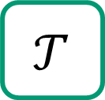
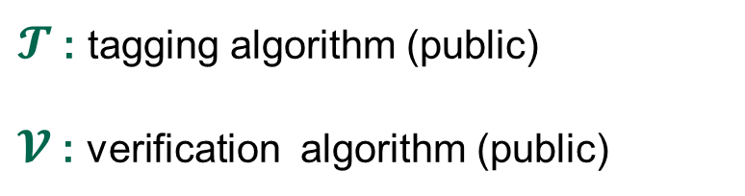

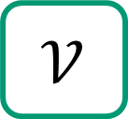
MACs
Internet
Alice
Bob
K
K
$$𝒯$$
M, T
$$𝒱$$
M
M / $⊥$
$𝓣$ : tagging algorithm (public)
$𝓥$ : verification algorithm (public)
K : tagging / verification key (secret)

Slide 5

Digital signatures
Internet
Alice
Bob
sk
vk
$$𝒮$$
M, σ
$$𝒱$$
M
M / $⊥$
$𝓣$ : tagging algorithm (public)
$𝓥$ : verification algorithm (public)
sk : signing key (secret)
vk : verification key (public)

Slide 6
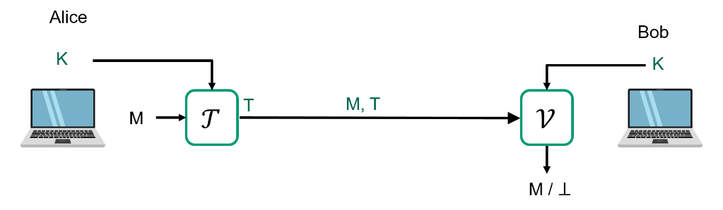
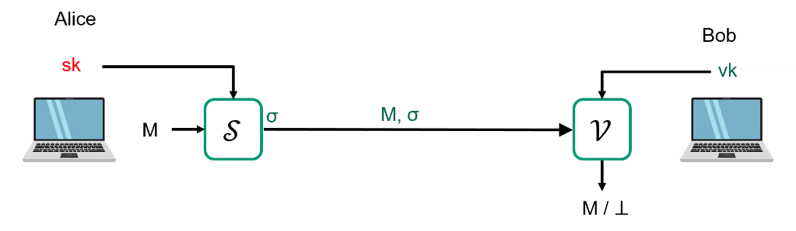
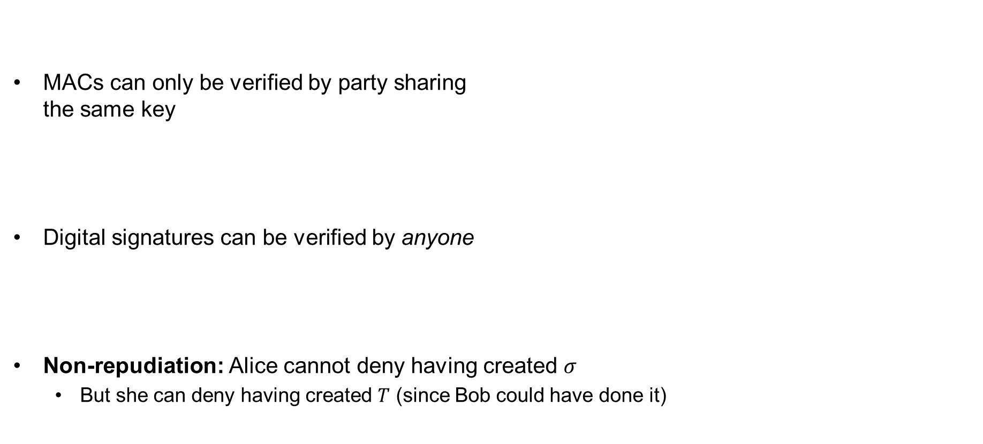
MACs vs. digital signatures
MACs can only be verified by party sharing
the same key
Digital signatures can be verified by anyone
Non-repudiation: Alice cannot deny having created $σ$
  But she can deny having created $T$ (since Bob could have done it)
MAC
Digital signature

Slide 7
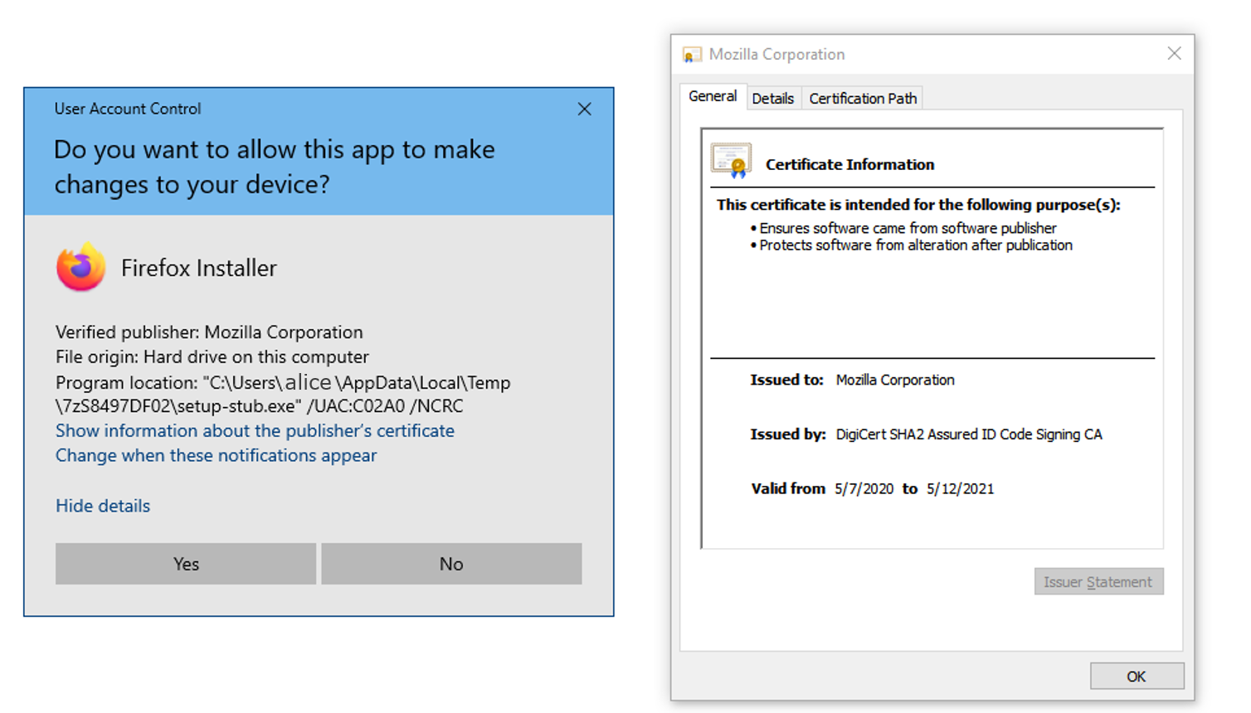
Applications of digital signatures
Electronic document signing
HTTPS / TLS certificates
Software installation
Email sender authentication
Bitcoin

Slide 8
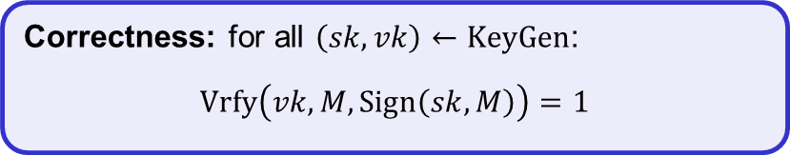
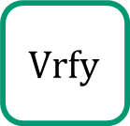







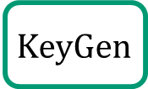








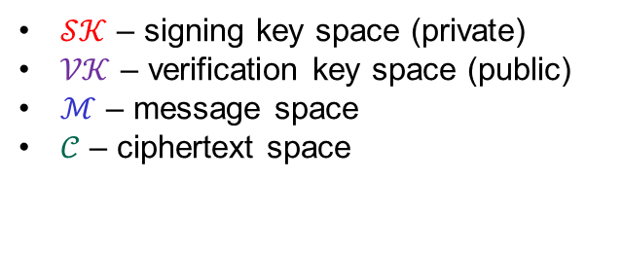
Digital signatures – syntax
A digital signature scheme is a tuple of algorithms $Σ=(KeyGen, Sign, Vrfy)$
$$KeyGen :( )→𝒮𝒦×𝒱𝒦$$
$$Sign :𝒮𝒦×ℳ→𝒮$$
$$Vrfy :𝒱𝒦×ℳ×𝒮→\{0,1\}$$
$$\left(sk, vk\right)\underset{←}{\$}KeyGen$$
$$Sign\left(sk, M\right)={Sign}_{sk}\left(M\right)=σ$$
$$Vrfy\left(vk, M,σ\right)={Vrfy}_{vk}\left(M,σ\right)=1/0$$
$𝒮𝒦$ – signing key space (private)
$𝒱𝒦$ – verification key space (public)
$ℳ$ – message space
$𝒞$ – ciphertext space
Correctness: for all $\left(sk,vk\right)←KeyGen$:
$$Vrfy\left(vk, M, Sign\left(sk, M\right)\right)=1$$
$$KeyGen$$
$$\$$$
$sk$
$vk$
$\left(sk,vk\right)$
$$Sign$$
$$σ$$
$$M, σ$$
$$Vrfy$$
$$M$$
$$1/0$$
Adversary
8

Slide 9
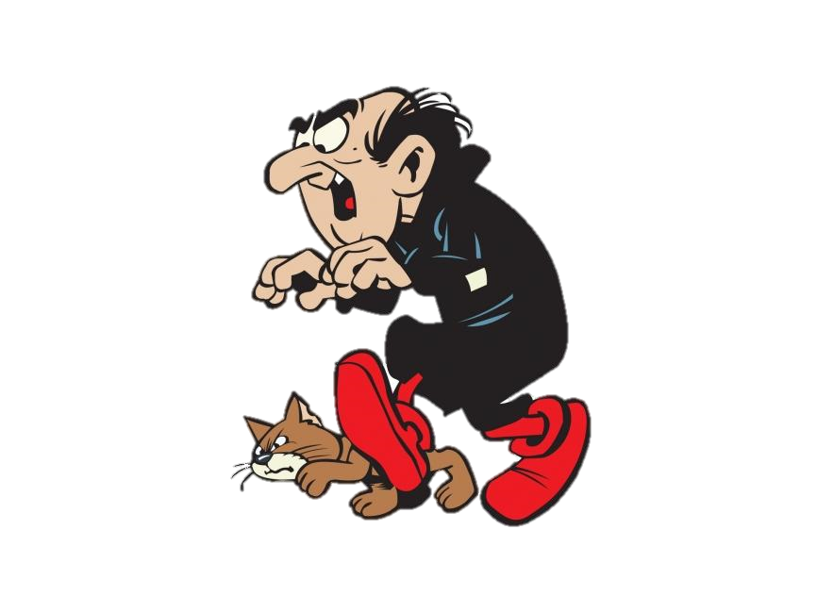
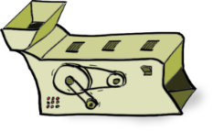
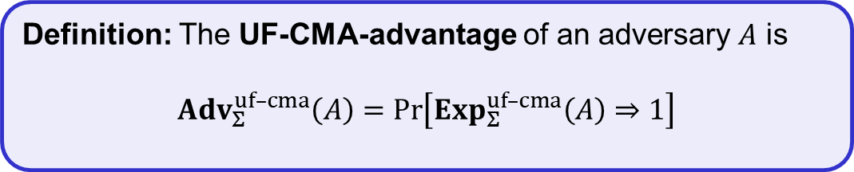

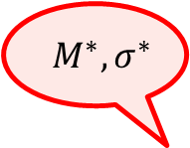
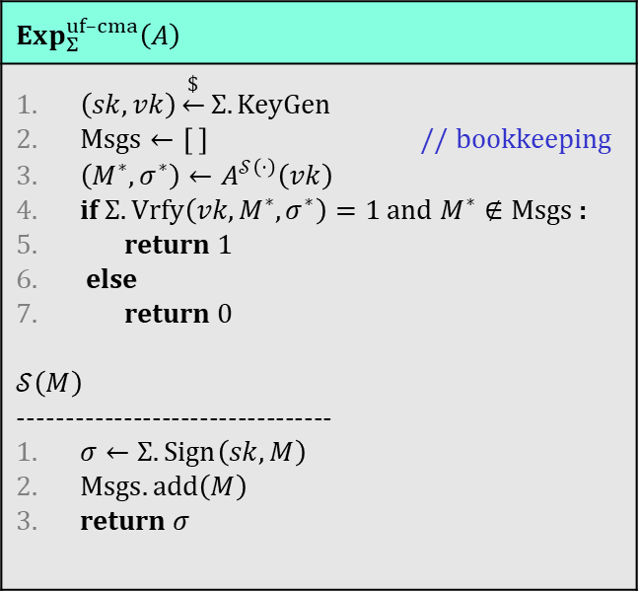


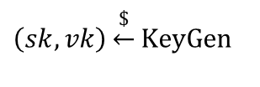

Digital signatures – security: UF-CMA
$$Exp_{Σ}^{uf–cma}\left(A\right)$$
$\left(sk,vk\right)\underset{←}{\$}Σ.KeyGen$ $Msgs←\left[ \right]$ // bookkeeping $\left(M^{∗}, σ^{∗}\right)←A^{𝒮\left(⋅\right)}\left(vk\right)$ if $Σ.Vrfy\left(vk, M^{∗}, σ^{∗}\right)=1$ and $M^{∗}∉Msgs$ : return 1 else return 0 $$𝒮\left(M\right)$$ --------------------------------- $σ←Σ.Sign\left(sk, M\right)$ $Msgs.add\left(M\right)$ return $σ$
Challenger
$${ M}^{∗}, σ^{∗}$$
$$vk$$
$$\left(sk,vk\right)\underset{←}{\$}KeyGen$$
$$M_{1},M_{2}, …$$
$$Sign(sk, ⋅)$$
$$σ_{1},σ_{2}, …$$
$A$ has forged a signature if $σ^{∗}$ is valid for $M^{∗}$
Definition: The UF-CMA-advantage of an adversary $A$ is
$${Adv}_{Σ}^{uf–cma}\left(A\right)=\operatorname{Pr}\left[Exp_{Σ}^{uf–cma}\left(A\right)⇒1\right]$$

Slide 10
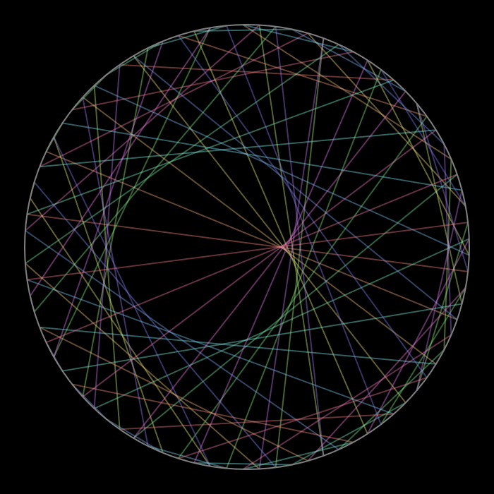
RSA signatures

Slide 11


Textbook RSA signatures
$$C$$
$$e$$
$$=M^{e} mod⁡n$$

Slide 12


Textbook RSA signatures
$$e$$
$$d$$
$$e$$
$$C$$
$$=M^{e} mod⁡n$$
$$=M$$

Slide 13



Textbook RSA signatures
$$e$$
$$d$$
$$σ$$
$$=M mod⁡n$$

Slide 14


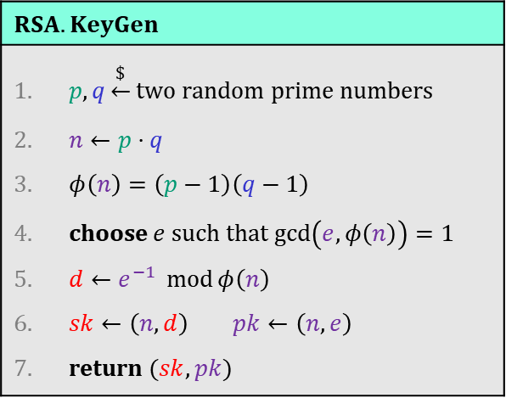

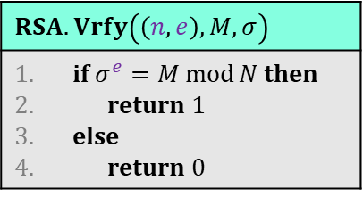
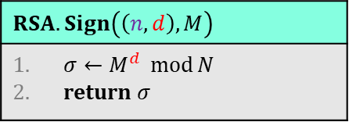
Textbook RSA signatures
$$RSA.KeyGen$$
$p,q\underset{←}{\$}$ two random prime numbers $n←p⋅q$ $φ\left(n\right)=\left(p−1\right)\left(q−1\right)$ choose $e$ such that $\gcd\left(e, φ\left(n\right)\right)=1$ $d←e^{−1} \operatorname{mod}{φ\left(n\right)}$ $sk←\left(n,d\right)$ $pk←\left(n,e\right)$ return $(sk, pk)$
$$RSA.Vrfy\left(\left(n,e\right), M,σ\right)$$
if $σ^{e}=M\operatorname{mod}{N}$ then return $1$ else return 0
$$d$$
$$M,$$
$$σ$$
$$=M mod⁡n$$
$$RSA.Sign\left(\left(n,d\right), M\right)$$
$σ←M^{d} \operatorname{mod}{N}$ return $σ$

Slide 15




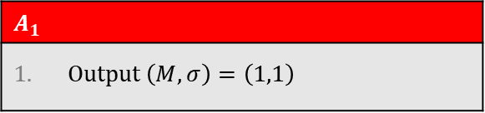








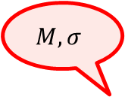


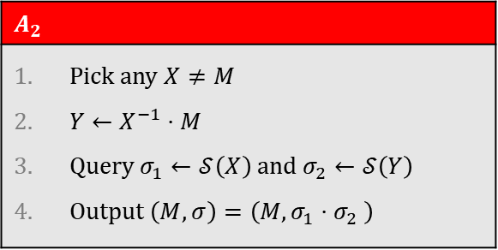



Textbook RSA signatures – (in)security
$$A_{1}$$
Output $\left(M, σ\right)=\left(1,1\right)$
UF-CMA Challenger
$${Adv}_{RSA}^{uf–cma}\left(A_{1}\right)=1$$
$$(n,e)$$
$$M, σ$$
$$\left(d,(e,n)\right)\underset{←}{\$}RSA.KeyGen$$
$$σ^{e}= M\operatorname{mod}{n}$$
$$M_{1},M_{2}, …$$
$Z_{n}^{∗}$ is group!
$$RSA.Sign$$
$$A_{2}$$
Pick any $X≠M$ $Y←X^{−1}⋅M$ Query $σ_{1}←𝒮\left(X\right)$ and $σ_{2}←𝒮\left(Y\right)$ Output $\left(M,σ\right)=\left(M, σ_{1}⋅σ_{2} \right)$
$$σ_{1}=M_{1}^{d},σ_{2}=M_{2}^{d}, …$$
$${Adv}_{RSA}^{uf–cma}\left(A_{2}\right)=1$$
$${\left(σ_{1}⋅σ_{2}\right)}^{e}\overset{?}{=} M\operatorname{mod}{n}$$
$${\left(X^{d}⋅Y^{d}\right)}^{e}$$
$$=X^{ed}⋅Y^{ed}$$
$$=X⋅Y$$
$$=X⋅X^{−1}⋅M$$
$$= M\operatorname{mod}{n}$$
Notes:
Additional problem: want to sign elements in {0,1}*

Slide 16

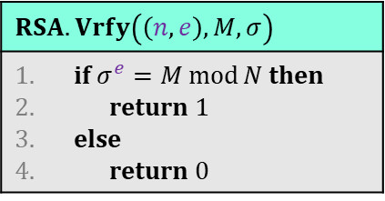


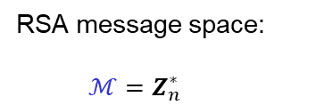


Textbook RSA signatures
$$RSA.KeyGen$$
$p,q\underset{←}{\$}$ two random prime numbers $n←p⋅q$ $φ\left(n\right)=\left(p−1\right)\left(q−1\right)$ choose $e$ such that $\gcd\left(e, φ\left(n\right)\right)=1$ $d←e^{−1} \operatorname{mod}{φ\left(n\right)}$ $sk←\left(n,d\right)$ $pk←\left(n,e\right)$ return $(sk, pk)$
$$H :{\left\{0,1\right\}}^{∗}→Z_{n}^{∗}$$
$$RSA.Vrfy\left(\left(n,e\right), M,σ\right)$$
if $σ^{e}=M\operatorname{mod}{N}$ then return $1$ else return 0
$$M,$$
$$σ$$
$$=M^{d} mod⁡n$$
$$RSA.Sign\left(\left(n,d\right), M\right)$$
$σ←M^{d} \operatorname{mod}{N}$ return $σ$
RSA message space:
$ℳ=Z_{n}^{∗}$
$$ℳ={\left\{0,1\right\}}^{∗}$$
Actually want

Slide 17
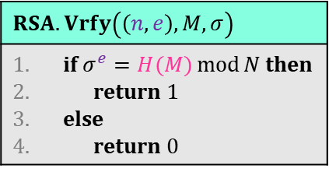
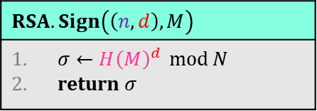

Hashed-RSA
$$RSA.KeyGen$$
$p,q\underset{←}{\$}$ two random prime numbers $n←p⋅q$ $φ\left(n\right)=\left(p−1\right)\left(q−1\right)$ choose $e$ such that $\gcd\left(e, φ\left(n\right)\right)=1$ $d←e^{−1} \operatorname{mod}{φ\left(n\right)}$ $sk←\left(n,d\right)$ $pk←\left(n,e\right)$ return $(sk, pk)$
$$H :{\left\{0,1\right\}}^{∗}→Z_{n}^{∗}$$
$$RSA.Vrfy\left(\left(n,e\right), M,σ\right)$$
if $σ^{e}=H(M)\operatorname{mod}{N}$ then return $1$ else return 0
$$M,$$
$$σ$$
$$=H{\left(M\right)}^{d} mod⁡n$$
$$RSA.Sign\left(\left(n,d\right), M\right)$$
$σ←{H\left(M\right)}^{d} \operatorname{mod}{N}$ return $σ$

Slide 18

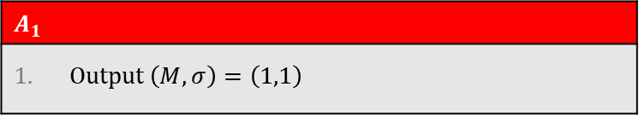





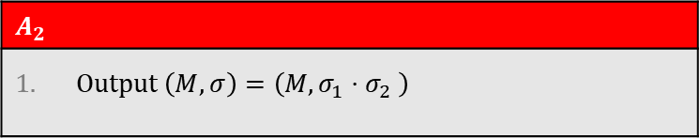

Hashed-RSA – security
$$A_{1}$$
Output $\left(M, σ\right)=\left(1,1\right)$
UF-CMA Challenger
Output $\left(X, 1\right)$ // $H\left(X\right)=1$
$$M, σ$$
$$(n,e)$$
$$\left(d,(e,n)\right)\underset{←}{\$}RSA.KeyGen$$
Hard to find!
$$σ^{e}=H(M)\operatorname{mod}{n}$$
$$M_{1},M_{2}, …$$
$$RSA.Sign$$
$$σ_{1}=H{\left(M_{1}\right)}^{d}, …$$
$$A_{2}$$
Output $\left(M,σ\right)=\left(M, σ_{1}⋅σ_{2} \right)$
$${\left(σ_{1}⋅σ_{2}\right)}^{e}\overset{?}{=} H(M)\operatorname{mod}{n}$$
$${\left(H{\left(X\right)}^{d}⋅H{\left(Y\right)}^{d}\right)}^{e}$$
$=H\left(X\right)⋅H\left(Y\right)$
$$= H\left(M\right)\operatorname{mod}{n}$$
Hard to find!
Notes:
Additional problem: want to sign elements in {0,1}*

Slide 19
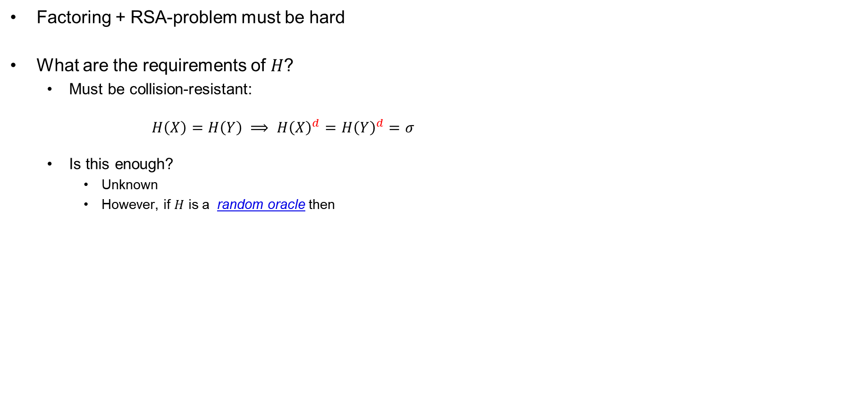
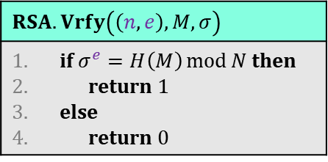
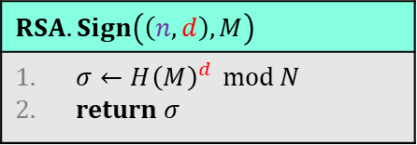
Hashed-RSA – security
Factoring + RSA-problem must be hard
What are the requirements of $H$?
  Must be collision-resistant:
  $H\left(X\right)=H\left(Y\right) ⟹ H{\left(X\right)}^{d}=H{\left(Y\right)}^{d}=σ$
  Is this enough?
    Unknown
    However, if $H$ is a random oracle then
$$RSA.KeyGen$$
$p,q\underset{←}{\$}$ two random prime numbers $n←p⋅q$ $φ\left(n\right)=\left(p−1\right)\left(q−1\right)$ choose $e$ such that $\gcd\left(e, φ\left(n\right)\right)=1$ $d←e^{−1} \operatorname{mod}{φ\left(n\right)}$ $sk←\left(n,d\right)$ $pk←\left(n,e\right)$ return $(sk, pk)$
Theorem: if the RSA problem is hard and $H$ is a random oracle, then Hashed-RSA is UF-CMA secure
$$RSA.Sign\left(\left(n,d\right), M\right)$$
$σ←{H\left(M\right)}^{d} \operatorname{mod}{N}$ return $σ$
$$RSA.Vrfy\left(\left(n,e\right), M,σ\right)$$
if $σ^{e}=H\left(M\right)\operatorname{mod}{N}$ then return $1$ else return 0

Slide 20
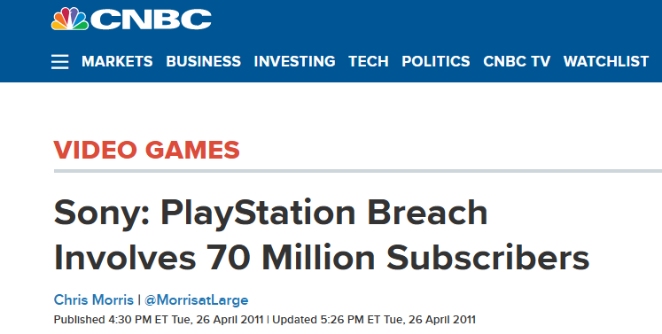
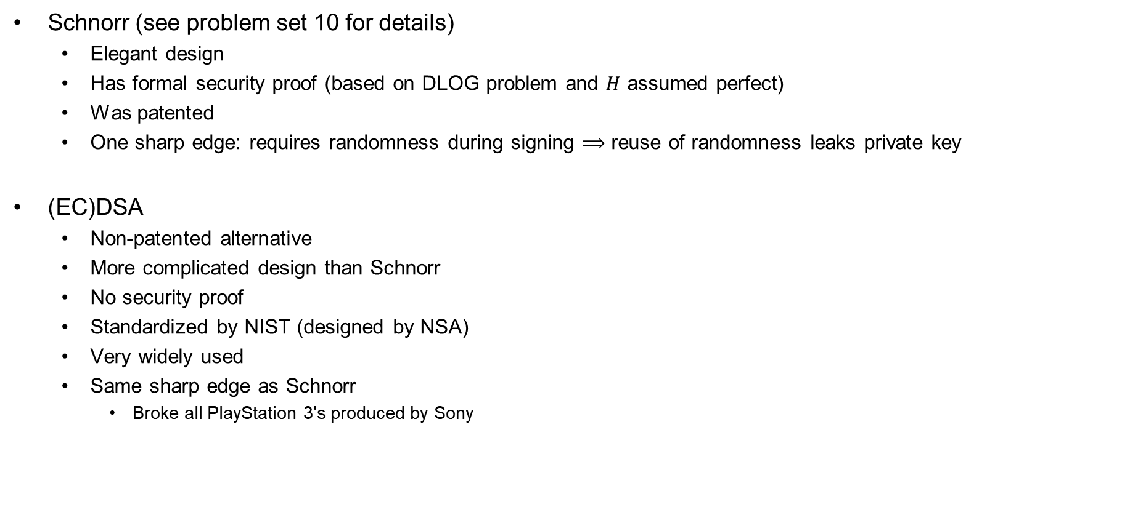
Discrete log based signatures
Schnorr (see problem set 10 for details)
  Elegant design
  Has formal security proof (based on DLOG problem and $H$ assumed perfect)
  Was patented
  One sharp edge: requires randomness during signing $⟹$ reuse of randomness leaks private key
(EC)DSA
  Non-patented alternative
  More complicated design than Schnorr
  No security proof
  Standardized by NIST (designed by NSA)
  Very widely used
  Same sharp edge as Schnorr
    Broke all PlayStation 3's produced by Sony

Slide 21
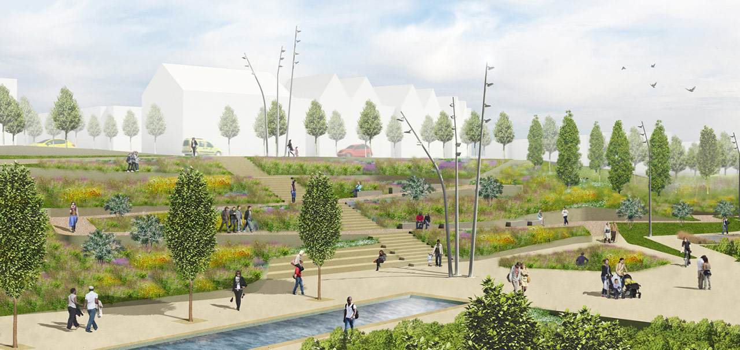
Public-key infrastructure (PKI)

Slide 22




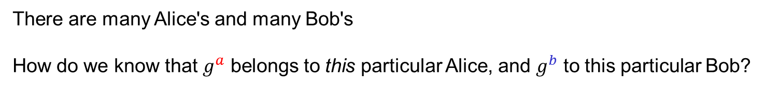
What are identities?
"Alice",
$$g^{a}$$
"Bob",
$$g^{b}$$
$${K←g}^{ab}$$
$${K←g}^{ab}$$
There are many Alice's and many Bob's
How do we know that $g^{a}$ belongs to this particular Alice, and $g^{b}$ to this particular Bob?
Need to bind public keys to entities

Slide 23



Identities on the internet
www.bob.com
"Alice",
$$g^{a}$$
"Bob",
$$g^{b}$$
www.bob.com,
$${K←g}^{ab}$$
$${K←g}^{ab}$$
There are many Alice's and many Bob's
How do we know that $g^{a}$ belongs to this particular Alice, and $g^{b}$ to this particular Bob?
Need to bind public keys to entities
– internet: bind public keys to domain names

Slide 24


Identities on the internet
www.evil.com
$$g^{a}$$
www.bob.com,
$$g^{b}$$
need proof these belong together
$$b\underset{←}{\$}\left\{1, …, \left|G\right|\right\}$$
$${K←g}^{ab}$$
$${K←g}^{ab}$$
There are many Alice's and many Bob's
How do we know that $g^{a}$ belongs to this particular Alice, and $g^{b}$ to this particular Bob?
Need to bind public keys to entities
– internet: bind public keys to domain names

Slide 25







Authenticated key exchange
$$\left(sk_{B},vk_{B}\right)$$
www.bob.com
$$g^{a}$$
$$g^{b}$$
www.bob.com,
$$,vk_{B}$$
if $Vrfy\left(vk_{B},…,σ\right)=1$
$$σ$$
$${K←g}^{ab}$$
$${K←g}^{ab}$$
else
abort
But why should we trust this $vk_{B}$?
Could have been created by the adversary itself

Slide 26
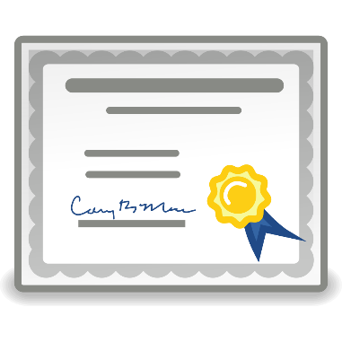
Digital certificates
Digital certificate: a way of binding a public key to an entity
A certificate consists of:
  The public key of the entity
  A bunch of information identifying the entity
    Name
    Address
    Occupation
    URL
    Email-address
    Phone number
    …
  A digital signature on all the above by a certificate authority (CA)

Slide 27
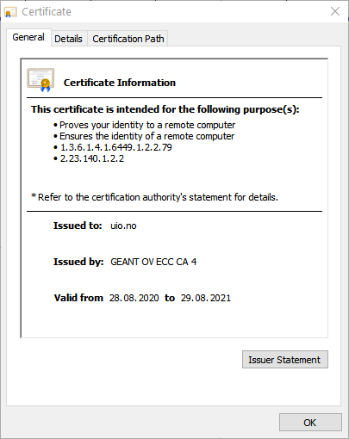
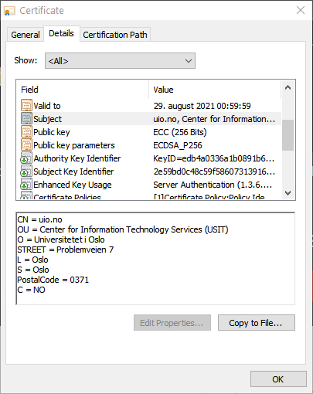
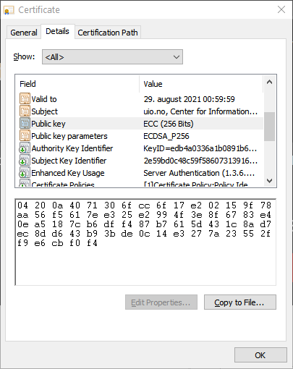
Digital certificates

Slide 28

Certificate authorities (CA)
CA: an issuer of digital certificates
Acts as a trusted third-party, certifying (i.e., signing)
the public keys of other entities
  Verifies the identity of a claimed public-key owner
The basis of a public-key infrastructure (PKI)
Certificate
Authority

Slide 29


















Authenticated key exchange + PKI
$$\left(sk_{B},vk_{B}\right)$$
www.bob.com
$$vk_{CA}$$
$$g^{a}$$
$${ g}^{b},$$
if $Vrfy\left(vk_{B},…,σ\right)=1$
www.bob.com,
$$vk_{B}$$
and $Vrfy\left(vk_{CA},…,σ\right)=1$
$$σ$$
$$σ$$
$${K←g}^{ab}$$
$${K←g}^{ab}$$
$$vk_{CA}$$
else
abort

Slide 30
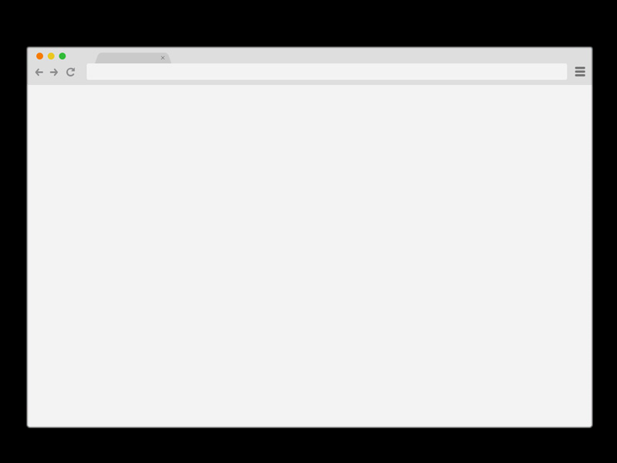




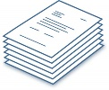



How to get a signed certificate?
4
www.bob.com
www.bob.com
2
$$vk_{B}$$
0x349a5
3
“Put 0x349a5 on your page”
1
Check
5
$$\left(sk_{B},vk_{B}\right)←KeyGen$$
Other validation methods also possible:
Confirmation emails
DNS entries
Physical verification
Passport or driver's license
6
$$←Sign\left(sk_{dc}, vk_{B}, \right)$$
7

Slide 31
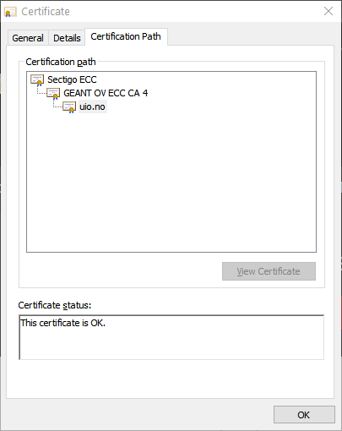
Certificate chains

Slide 32



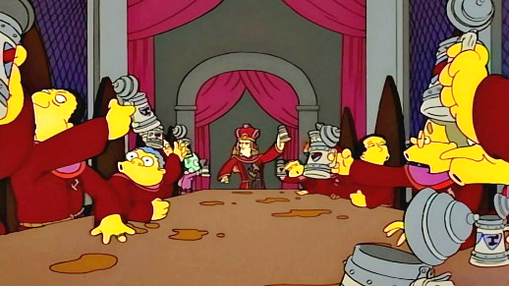

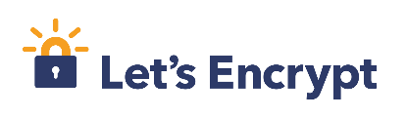
Root CAs
Root CAs: CAs that sign other CAs' public keys
  + only a few root CAs need to be trusted by end-users
  + root CAs can distribute the signing + verification load to smaller CAs
  - single point of failure
  Root CAs for the internet: a few large multinational corporations
  ; private key must be very heavily guarded
Root CA signing key

Slide 33










HTTPS / TLS + PKI
$$\left(sk_{B},vk_{B}\right)$$
www.bob.com
$$vk_{{CA}_{2}}$$
$$vk_{{CA}_{1}}$$
$$g^{a}$$
if $Vrfy\left(vk_{B},…,σ\right)=1$
www.bob.com,
$$g^{b}$$
and $Vrfy\left(vk_{{CA}_{1}},…,σ\right)=1$
$$σ$$
$$vk_{B}$$
and $Vrfy\left(vk_{{CA}_{2}},…,σ\right)=1$
$${K←g}^{ab}$$
$${K←g}^{ab}$$
$$σ$$
$$vk_{{CA}_{1}}$$
else
abort
$$σ$$

Slide 34




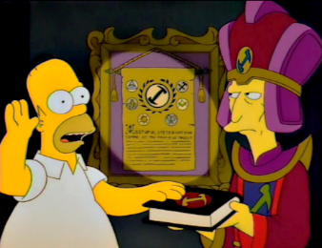
How to become an internet root CA?
Need to prove yourself (trust)worthy to browser and OS vendors
  Microsoft Root Certificate Program
  Mozilla CA Certificate Program
  Apple Root Certificate Program
  Chrome Root CA Program
Lot's of auditing and paperwork
Many formal technical and non-technical security requirements
  CA/Browser forum
  Baseline Requirements v1.7.3

Slide 35
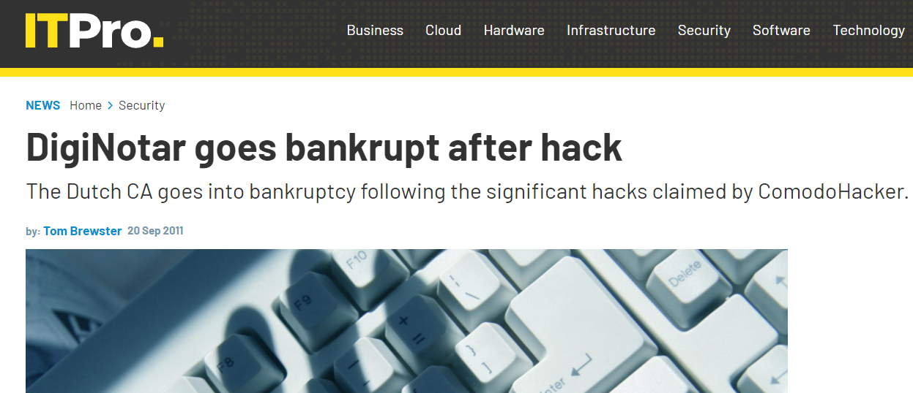
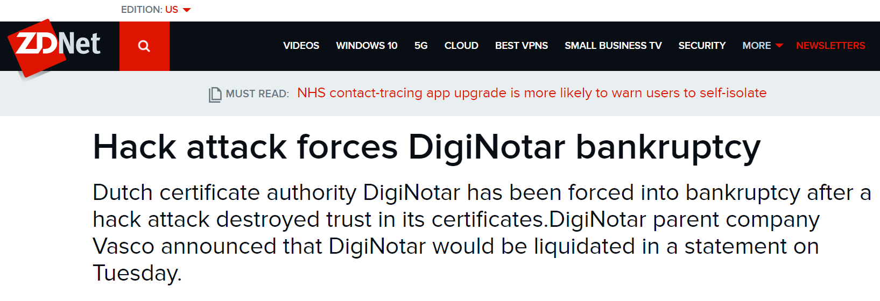
DigiNotar
Dutch root CA
Lost control of their private signing key in 2011
Fraudulent certificates issued for Gmail, Yahoo!, Mozilla, WordPress, …
30 000 Iranian Gmail users targeted

Slide 36



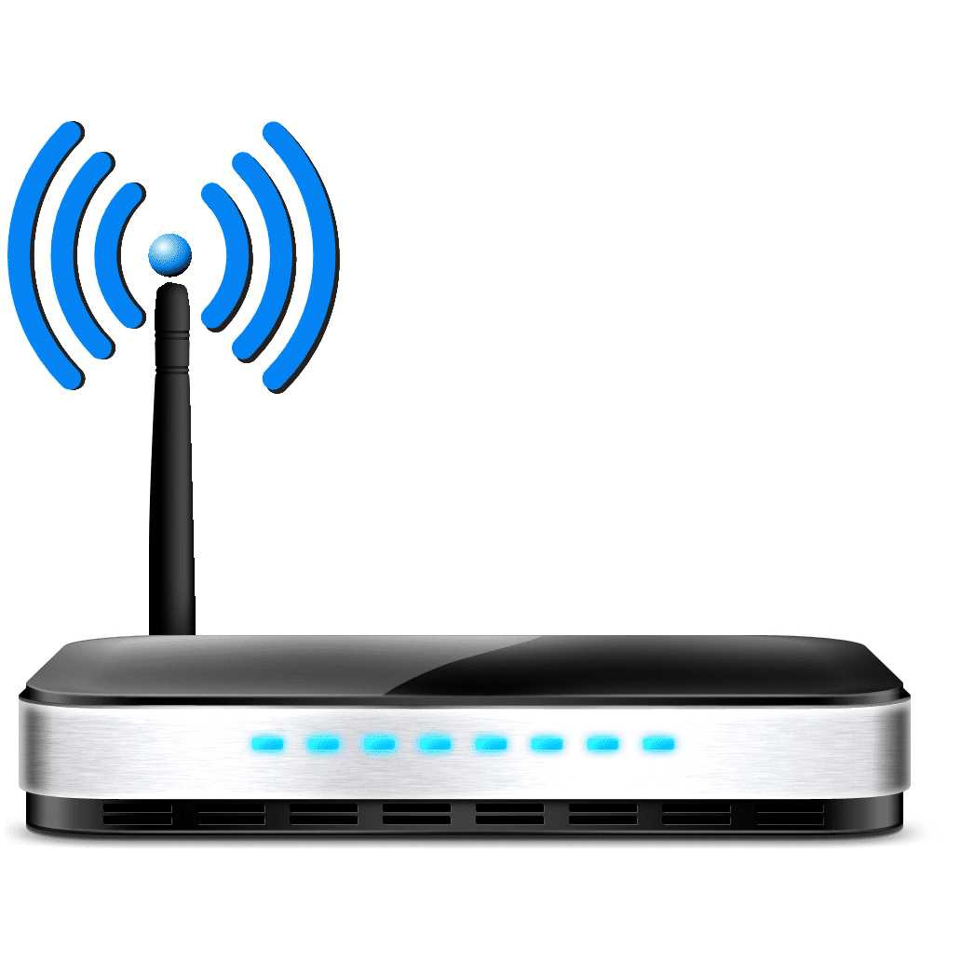

Other PKIs exist
Organization PKIs
  eduroam
TLS +

Slide 37






$$P$$
$$y^{2}=x^{3}+ax+b$$
$$a,b,x,y∈R$$
$$Q$$
$$P+Q$$
End of Part II
(Asymmetric crypto)

Slide 38


Summary of asymmetric cryptography
Primitive | Functionality + syntax | Hardness assumption / security goal | Acronym | Examples
Diffie-Hellman | Derive shared value (key) in a cyclic group $${A^{b}= g}^{ab}=B^{a}$$ | Discrete logarithm (DLOG) Diffie-Hellman (DH) | DH | $\left(Z_{p}^{∗},⋅\right)−$DH $\left(E\left(F_{p}\right),+\right)−$DH
RSA function | One-way trapdoor permutation | Factoring problem RSA-problem |  | Textbook RSA
Public-key encryption | Encrypt variable-length input $$Enc :𝒫𝒦×ℳ→𝒞$$ | Confidentiality: attacker should learn nothing about plaintext (except length) from ciphertexts | IND-CPA IND-CCA | ElGamal Hashed/Padded RSA Fujisaki-Okomoto-transform
Digital signatures | Create signature on variable length input $$Sign :𝒮𝒦×ℳ→𝒮$$ $$Vrfy :𝒱𝒦×ℳ×𝒮→\left\{1,0\right\}$$ | Integrity: attacker shouldn't be able to forge messages, i.e., create new messages with valid signatures | UF-CMA | Schnorr Hashed-RSA ECDSA
Cryptographic groups | Comment | Computational problem | Best-known attack | Common sizes
$$\left(Z_{p}^{∗},⋅\right)$$ | $p$ prime $$\left|Z_{p}^{∗}\right|=p−1$$ | Discrete logarithm | General number field sieve (GNFS) | $|p|≈2000–3000$ bits
Subgroups $H<\left(Z_{p}^{∗},⋅\right)$ | $\left|H\right|=q$ (typically prime) | Discrete logarithm | GNFS | $\left|q\right|≈256$ bits
$$\left(E\left(F_{p}\right),+\right)$$ | $p$ prime $\left|E\left(F_{p}\right)\right|=q$ (typically) prime $p≠q$ | Discrete logarithm | Generic attacks: Baby-step giant-step, Pollard-rho, Pohlig-Hellman | $\left|E\left(F_{p}\right)\right|≈256$ bits $\left|p\right|≈256$ bits
$$\left(Z_{n}^{∗},⋅\right)$$ | $n$ not prime $$\left|Z_{n}^{∗}\right|=φ\left(n\right)$$ | Factoring | GNFS | $\left|n\right|≈2000–4000$ bits

Slide 39

Next week
Quantum computers

