Slide 1
Lecture 3 – Symmetric encryption, IND-CPA,
CTR, CBC
TEK4500
08.09.2021
Håkon Jacobsen
hakon.jacobsen@its.uio.no

Slide 2
Basic goals of cryptography
 | Message privacy | Message integrity / authentication
Symmetric keys | Symmetric encryption | Message authentication codes (MAC)
Asymmetric keys | Asymmetric encryption (a.k.a. public-key encryption) | Digital signatures

Slide 3

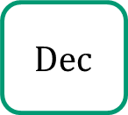
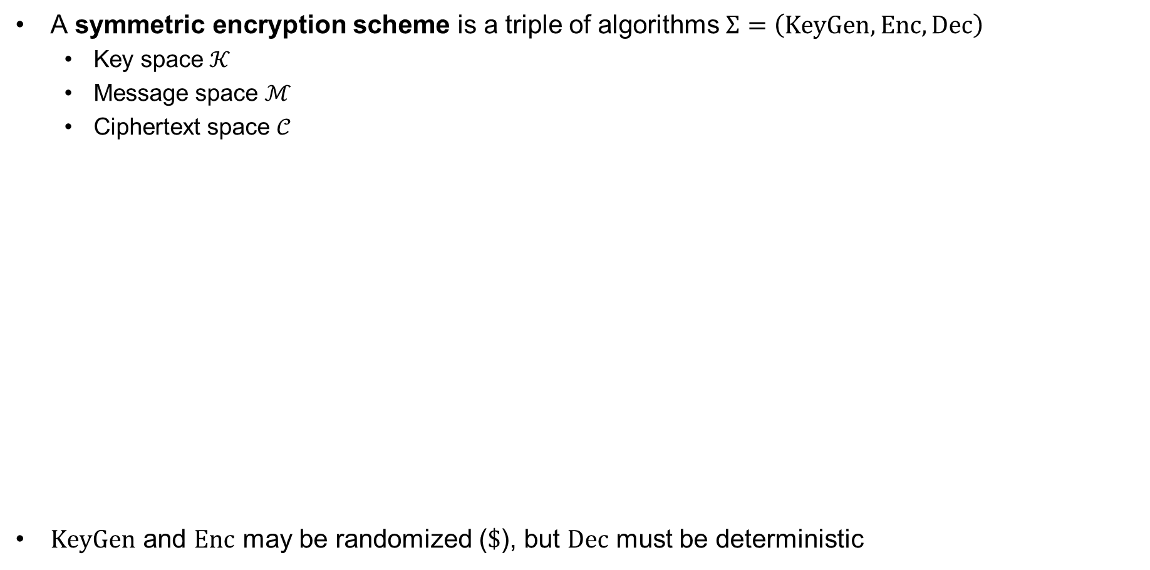
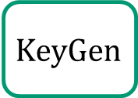
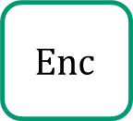


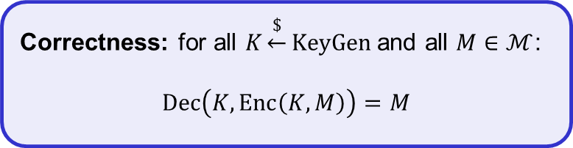


Encryption schemes – syntax
A symmetric encryption scheme is a triple of algorithms $Σ=\left(KeyGen, Enc, Dec\right)$
  Key space $𝒦$
  Message space $ℳ$
  Ciphertext space $𝒞$
$KeyGen$ and $Enc$ may be randomized ($\$$), but $Dec$ must be deterministic
Correctness: for all $K\underset{←}{\$}KeyGen$ and all $M∈ℳ$:
$$Dec\left(K, Enc\left(K, M\right)\right)=M$$
$$KeyGen$$
$$\$$$
$K$
$$\$$$
$$C$$
$$Dec$$
$$Enc$$
$$M$$
$M$
Adversary
Notes:
Delivery of K outside the "responsibility" of encryption scheme

Slide 4
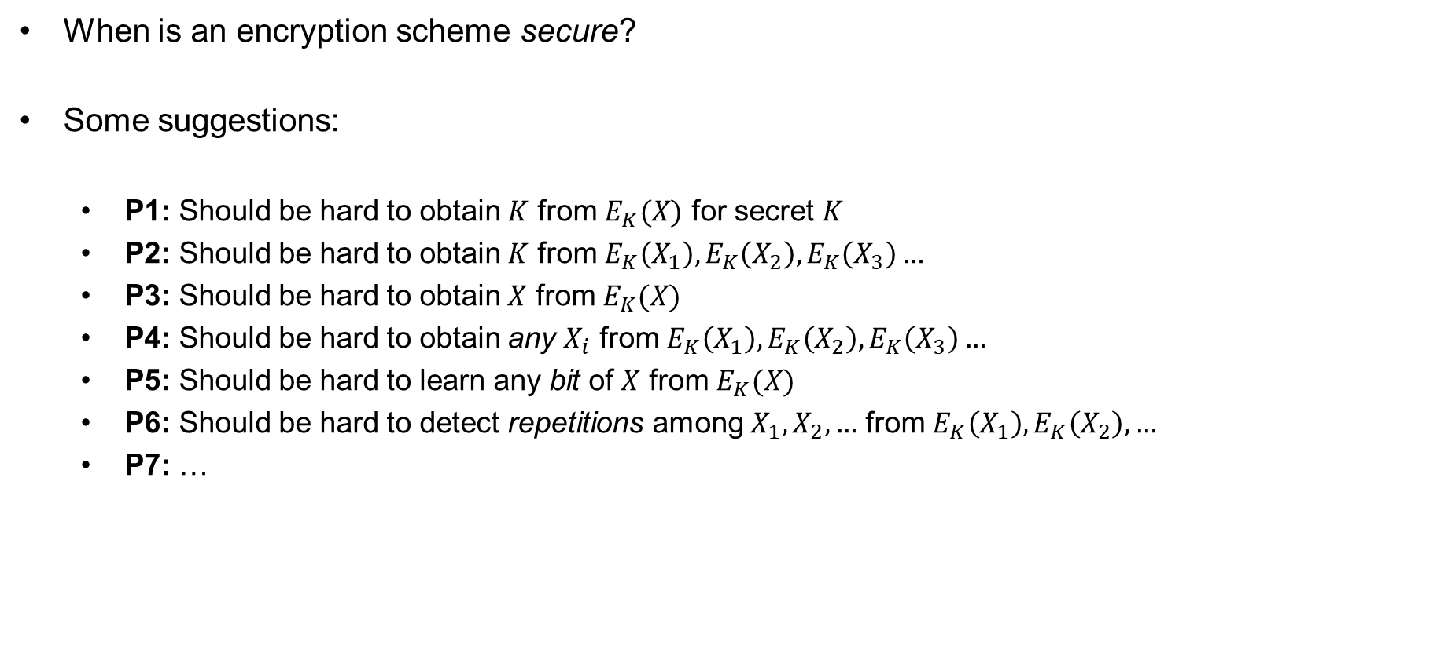
Symmetric encryption – security definition
When is an encryption scheme secure?
Some suggestions:
  P1: Should be hard to obtain $K$ from $E_{K}(X)$ for secret $K$
  P2: Should be hard to obtain $K$ from $E_{K}\left(X_{1}\right),E_{K}\left(X_{2}\right),E_{K}\left(X_{3}\right)…$
  P3: Should be hard to obtain $X$ from $E_{K}(X)$
  P4: Should be hard to obtain any $X_{i}$ from $E_{K}\left(X_{1}\right),E_{K}\left(X_{2}\right),E_{K}\left(X_{3}\right)…$
  P5: Should be hard to learn any bit of $X$ from $E_{K}(X)$
  P6: Should be hard to detect repetitions among $X_{1},X_{2},…$ from $E_{K}\left(X_{1}\right),E_{K}\left(X_{2}\right), …$
  P7: …

Slide 5













Electronic Code Book (ECB) mode
Block cipher: $ℰ :𝒦×{\left\{0,1\right\}}^{n}→{\left\{0,1\right\}}^{n}$
$$M$$
$$M_{1}$$
$$M_{2}$$
$$M_{3}$$
$$M_{4}$$
$${ ℰ}_{K}$$
$${ ℰ}_{K}$$
$${ ℰ}_{K}$$
$${ ℰ}_{K}$$
$$C_{1}$$
$$C_{2}$$
$$C_{3}$$
$$C_{4}$$

Slide 6

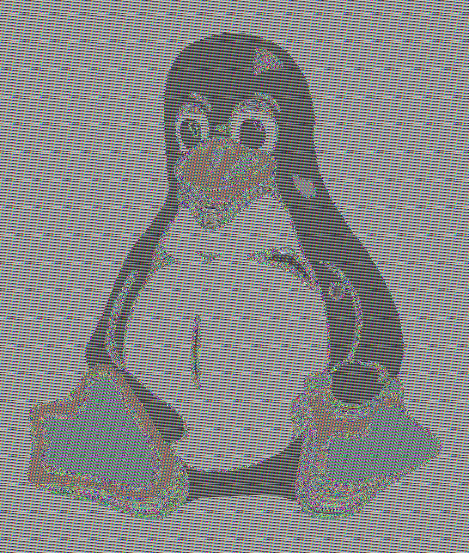

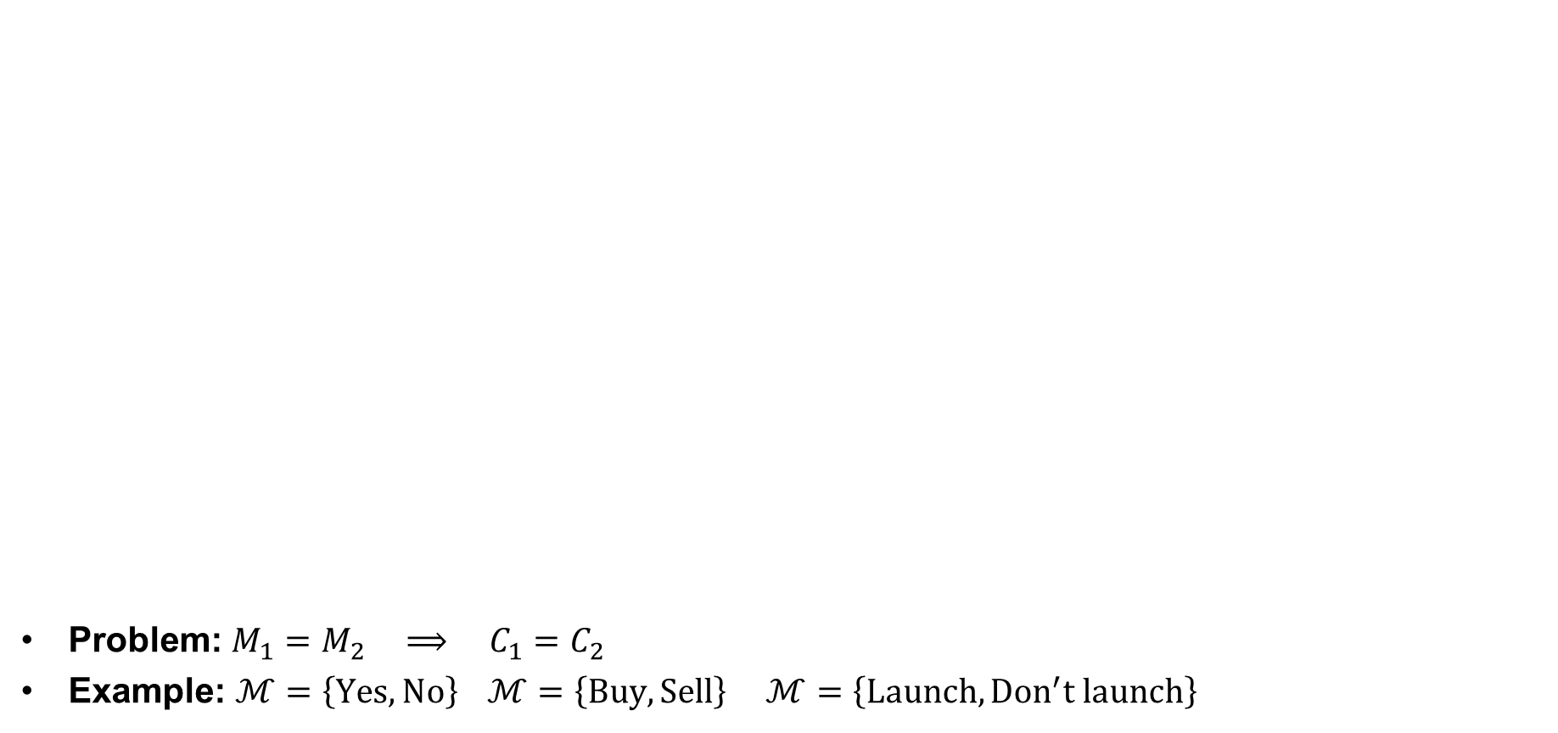
ECB problem
Problem: $M_{1}=M_{2} ⟹ C_{1}=C_{2}$
Example: $ℳ=\left\{Yes, No\right\}$ $ℳ=\left\{Buy, Sell\right\}$ $ℳ=\left\{Launch, {Don}^{′}t launch\right\}$
Plaintext
ECB encrypted
Properly encrypted

Slide 7

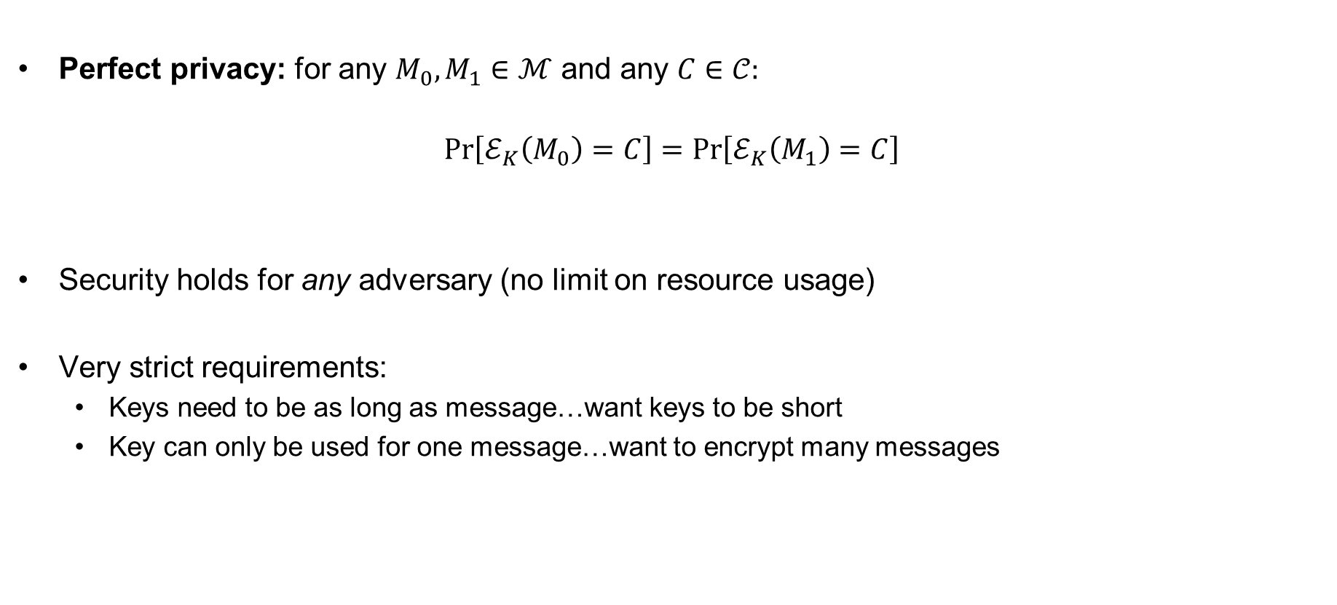
Modern cryptography – idea
Perfect privacy: for any $M_{0},M_{1}∈ℳ$ and any $C∈𝒞:$
$$Pr\left[ℰ_{K}\left(M_{0}\right)=C\right]=Pr\left[ℰ_{K}\left(M_{1}\right)=C\right]$$
Security holds for any adversary (no limit on resource usage)
Very strict requirements:
  Keys need to be as long as message…want keys to be short
  Key can only be used for one message…want to encrypt many messages
Computational
$$≈$$
resource bounded
✓
✓

Slide 8


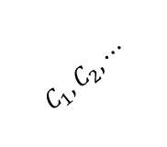
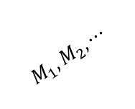
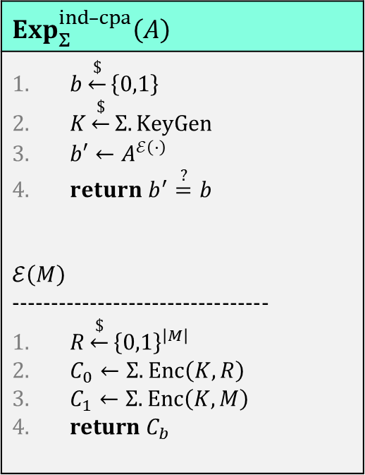
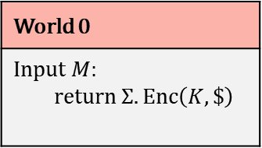
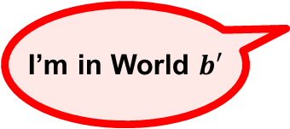
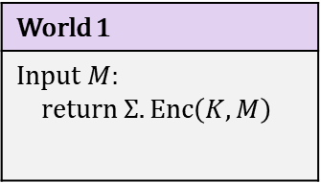
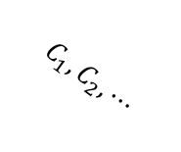
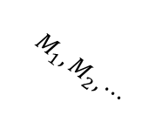
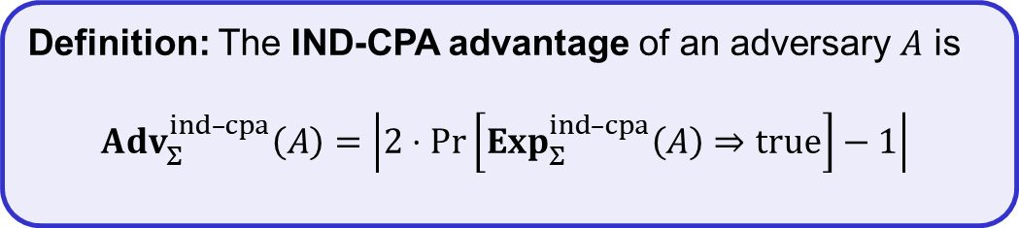
IND-CPA – indistinguishability against chosen-plaintext attacks
$$Exp_{Σ}^{ind­­–cpa}\left(A\right)$$
$b\underset{←}{\$}\left\{0,1\right\}$ $K\underset{←}{\$}Σ.KeyGen$ $b′←A^{ℰ\left(⋅\right)}$ $return b^{′}\overset{?}{=}b$ $$ℰ\left(M\right)$$ --------------------------------- $R\underset{←}{\$}{\left\{0,1\right\}}^{\left|M\right|}$ $C_{0}←Σ.Enc\left(K, R\right)$ $C_{1}←Σ.Enc\left(K, M\right)$ return $C_{b}$
World 1
Input $M$: return $Σ.Enc\left(K, M\right)$
World 0
Input $M$: return $Σ.Enc\left(K, \$\right)$
$$M_{1}, M_{2}, ⋯$$
$$M_{1}, M_{2}, ⋯$$
$$C_{1}, C_{2}, ⋯$$
$$C_{1}, C_{2}, ⋯$$
I’m in World $b′$
Definition: The IND-CPA advantage of an adversary $A$ is
$${Adv}_{Σ}^{ind­–cpa}\left(A\right)=\left|2⋅\operatorname{Pr}\left[Exp_{Σ}^{ind–cpa}\left(A\right)⇒true\right]−1\right|$$

Slide 9
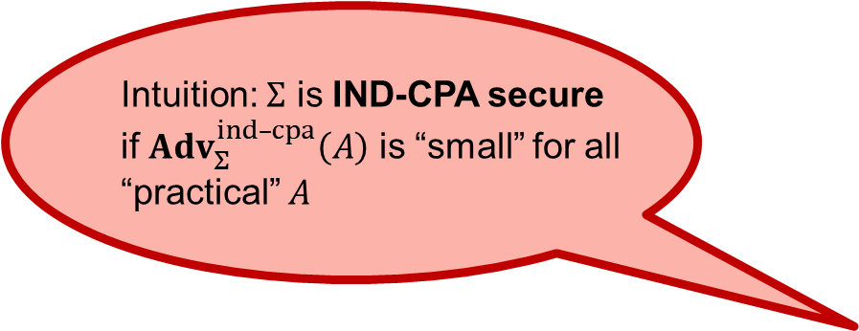
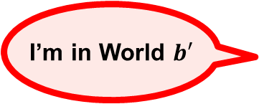
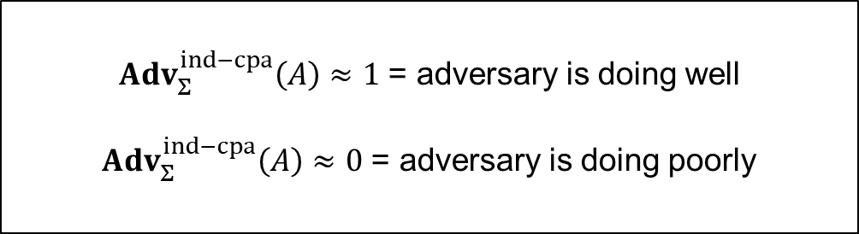
IND-CPA – indistinguishability against chosen-plaintext attacks
$$Exp_{Σ}^{ind­­–cpa}\left(A\right)$$
$b\underset{←}{\$}\left\{0,1\right\}$ $K\underset{←}{\$}Σ.KeyGen$ $b′←A^{ℰ\left(⋅\right)}$ $return b^{′}\overset{?}{=}b$ $$ℰ\left(M\right)$$ --------------------------------- $R\underset{←}{\$}{\left\{0,1\right\}}^{\left|M\right|}$ $C_{0}←Σ.Enc\left(K, R\right)$ $C_{1}←Σ.Enc\left(K, M\right)$ return $C_{b}$
World 1
Input $M$: return $Σ.Enc\left(K, M\right)$
World 0
Input $M$: return $Σ.Enc\left(K, \$\right)$
${Adv}_{Σ}^{ind−cpa}\left(A\right)≈1$ = adversary is doing well
${Adv}_{Σ}^{ind−cpa}\left(A\right)≈0$ = adversary is doing poorly
$$M_{1}, M_{2}, ⋯$$
$$M_{1}, M_{2}, ⋯$$
$$C_{1}, C_{2}, ⋯$$
$$C_{1}, C_{2}, ⋯$$
Intuition: $Σ$ is IND-CPA secure
if ${Adv}_{Σ}^{ind­–cpa}\left(A\right)$ is “small” for all
“practical” $A$
I’m in World $b′$
Definition: The IND-CPA advantage of an adversary $A$ is
$${Adv}_{Σ}^{ind­–cpa}\left(A\right)=\left|2⋅\operatorname{Pr}\left[Exp_{Σ}^{ind–cpa}\left(A\right)⇒true\right]−1\right|$$

Slide 10

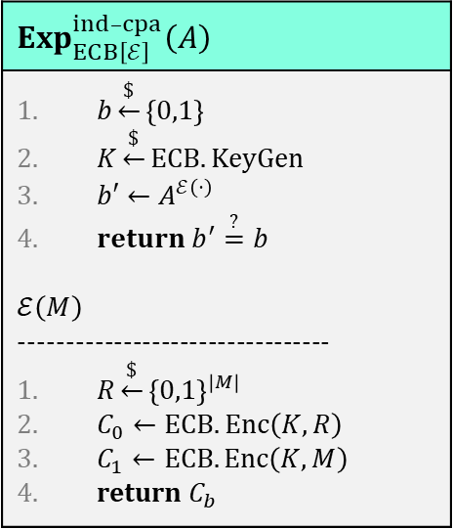

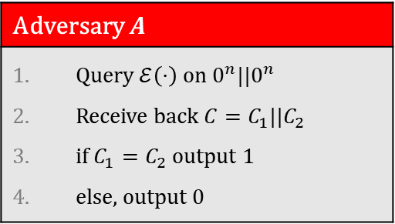



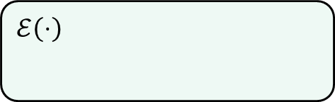

Example: IND-CPA insecurity of ECB mode
$$Exp_{ECB\left[ℰ\right]}^{ind­­–cpa}\left(A\right)$$
$b\underset{←}{\$}\left\{0,1\right\}$ $K\underset{←}{\$}ECB.KeyGen$ $b′←A^{ℰ\left(⋅\right)}$ $return b^{′}\overset{?}{=}b$ $$ℰ\left(M\right)$$ --------------------------------- $R\underset{←}{\$}{\left\{0,1\right\}}^{\left|M\right|}$ $C_{0}←ECB.Enc\left(K, R\right)$ $C_{1}←ECB.Enc\left(K, M\right)$ return $C_{b}$
Adversary $A$
Query $ℰ\left(⋅\right)$ on $0^{n}||0^{n}$ Receive back ${C=C}_{1}||C_{2}$ if $C_{1}=C_{2}$ output $1$ else, output $0$
$${ 0}^{n}$$
$0^{n}$
$$ℰ\left(⋅\right)$$
$${ ℰ}_{K}$$
$${ ℰ}_{K}$$
$$C_{1}$$
$$C_{2}$$

Slide 11





Example: IND-CPA insecurity of ECB mode
$$Exp_{ECB\left[ℰ\right]}^{ind­­–cpa}\left(A\right)$$
$b\underset{←}{\$}\left\{0,1\right\}$ $K\underset{←}{\$}ECB.KeyGen$ $b′←A^{ℰ\left(⋅\right)}$ $return b^{′}\overset{?}{=}b$ $$ℰ\left(M\right)$$ --------------------------------- $R\underset{←}{\$}{\left\{0,1\right\}}^{\left|M\right|}$ $C_{0}←ECB.Enc\left(K, R\right)$ $C_{1}←ECB.Enc\left(K, M\right)$ return $C_{b}$
Adversary $A$
Query $ℰ\left(⋅\right)$ on $0^{n}||0^{n}$ Receive back ${C=C}_{1}||C_{2}$ if $C_{1}=C_{2}$ output $1$ else, output $0$
$${ 0}^{n}$$
$0^{n}$
$$ℰ\left(⋅\right)$$
$${ ℰ}_{K}$$
$${ ℰ}_{K}$$
$$C_{1}$$
$$C_{2}$$
$$\operatorname{Pr}\left[{Exp}_{ECB[ℰ]}^{ind–cpa}\left(A\right)⇒true\right]$$
$$= \operatorname{Pr}\left[b^{′}=b\right]$$
$= \operatorname{Pr}\left[b^{′}=0 ∣ b=0\right]⋅1/2 +\operatorname{Pr}\left[b^{′}=1 ∣ b=1\right]⋅1/2$
$= \left(\operatorname{Pr}\left[C_{1}≠C_{2} ∣ b=0\right]+\operatorname{Pr}\left[C_{1}=C_{2} ∣ b=1\right]\right)⋅1/ 2$
$= \left(\operatorname{Pr}\left[C_{1}≠C_{2} ∣ b=0\right]+ 1 \right)⋅1/ 2$
$= \left(1−Pr\left[C_{1}=C_{2} ∣ b=0\right]+ 1 \right)⋅1/ 2$
$$= 1 −\frac{1}{2}⋅Pr\left[C_{1}=C_{2} ∣ b=0\right]$$
$$= 1 −\frac{1}{2}⋅\frac{1}{2^{n}}$$
$$= 1 −\frac{1}{2^{n+1}}$$

Slide 12



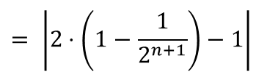
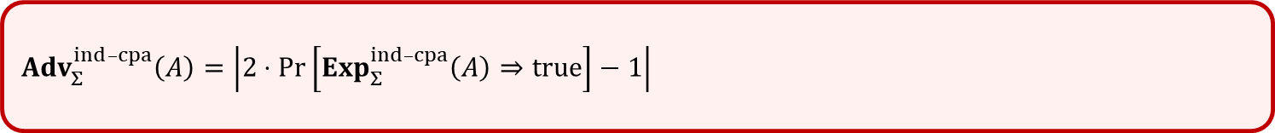
Example: IND-CPA insecurity of ECB mode
$$Exp_{ECB\left[ℰ\right]}^{ind­­–cpa}\left(A\right)$$
$b\underset{←}{\$}\left\{0,1\right\}$ $K\underset{←}{\$}ECB.KeyGen$ $b′←A^{ℰ\left(⋅\right)}$ $return b^{′}\overset{?}{=}b$ $$ℰ\left(M\right)$$ --------------------------------- $R\underset{←}{\$}{\left\{0,1\right\}}^{\left|M\right|}$ $C_{0}←ECB.Enc\left(K, R\right)$ $C_{1}←ECB.Enc\left(K, M\right)$ return $C_{b}$
Adversary $A$
Query $ℰ\left(⋅\right)$ on $0^{n}||0^{n}$ Receive back ${C=C}_{1}||C_{2}$ if $C_{1}=C_{2}$ output $1$ else, output $0$
$${ 0}^{n}$$
$0^{n}$
$$ℰ\left(⋅\right)$$
$${ ℰ}_{K}$$
$${ ℰ}_{K}$$
$$C_{1}$$
$$C_{2}$$
$$\operatorname{Pr}\left[{Exp}_{ECB[ℰ]}^{ind–cpa}\left(A\right)⇒true\right]$$
$$= 1 −\frac{1}{2^{n+1}}$$
$${Adv}_{Σ}^{ind­–cpa}\left(A\right)=\left|2⋅Pr\left[Exp_{Σ}^{ind–cpa}\left(A\right)⇒true\right]−1\right|$$
$$= \left|2⋅\left(1−\frac{1}{2^{n+1}}\right)−1\right|$$
$$= 1−\frac{1}{2^{n}}$$
$$≈ 1$$

Slide 13
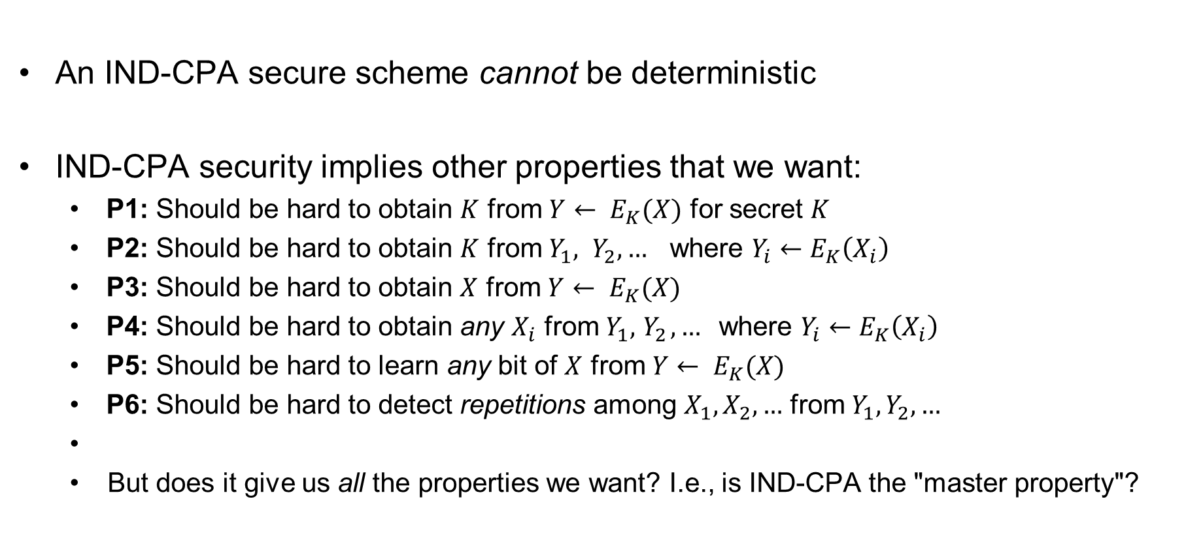
Consequences of the definition
An IND-CPA secure scheme cannot be deterministic
IND-CPA security implies other properties that we want:
  P1: Should be hard to obtain $K$ from ${Y← E}_{K}(X)$ for secret $K$
  P2: Should be hard to obtain $K$ from $Y_{1}, Y_{2}, …$ where $Y_{i}←E_{K}\left(X_{i}\right)$
  P3: Should be hard to obtain $X$ from ${Y← E}_{K}(X)$
  P4: Should be hard to obtain any $X_{i}$ from $Y_{1}, { Y}_{2}, …$where $Y_{i}←E_{K}\left(X_{i}\right)$
  P5: Should be hard to learn any bit of $X$ from ${Y← E}_{K}(X)$
  P6: Should be hard to detect repetitions among $X_{1}, X_{2},…$ from $Y_{1}, Y_{2}, …$
  But does it give us all the properties we want? I.e., is IND-CPA the "master property"?

Slide 14
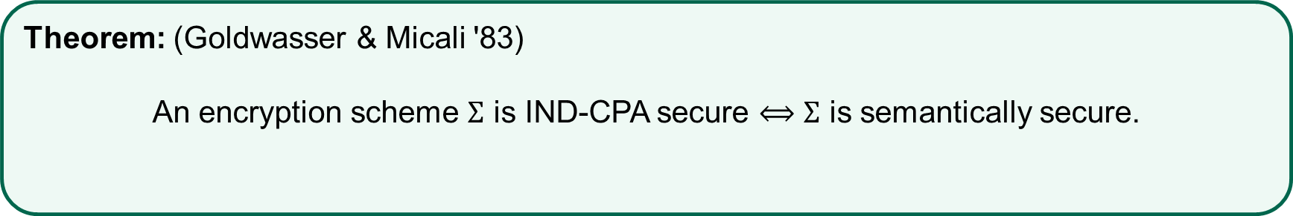
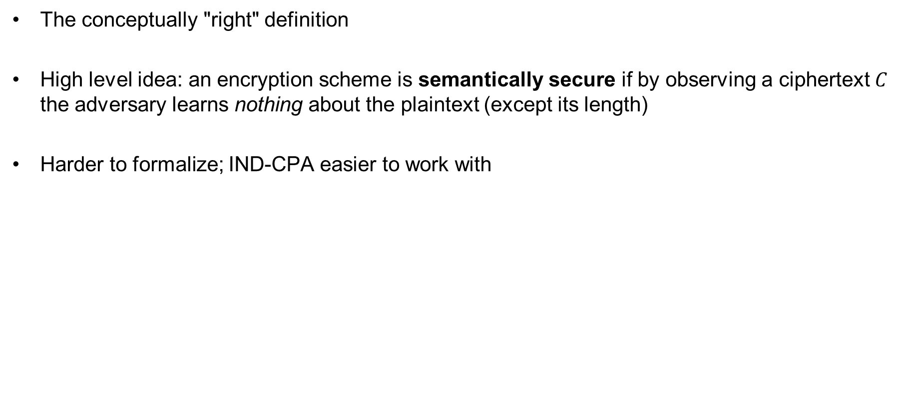
Semantic security
The conceptually "right" definition
High level idea: an encryption scheme is semantically secure if by observing a ciphertext $C$ the adversary learns nothing about the plaintext (except its length)
Harder to formalize; IND-CPA easier to work with
Theorem: (Goldwasser & Micali '83)
An encryption scheme $Σ$ is IND-CPA secure $⟺$ $Σ$ is semantically secure.

Slide 15
Length-leaking attacks
Google maps
  World regions have unique "fingerprints" based on length of data (based on map tiles)
Variable-bitrate encoding
  Can e.g., fingerprint movies streamed over Netflix
To combat length-leaking attacks: message padding
  Can be expensive
  Supported in TLS, but seldom used
  Used by TOR

Slide 16


Constructing symmetric
encryption schemes

Slide 17


How to achieve non-deterministic encryption?
Randomized encryption
  Coins flipped internally by the algorithm
Nonce-based encryption
  Encryption scheme itself is deterministic
  Non-determinism injected from the outside
Plaintext
Ciphertext
$$M$$
$$M′$$

Slide 18






CTR$ mode
pick randomly
ctr
ctr+1
ctr+2
ctr+3
$${ ℰ}_{K}$$
$${ ℰ}_{K}$$
$${ ℰ}_{K}$$
keystream
$$M$$
=
$$C_{0}$$
$$C$$

Slide 19
CTR$ mode
pick randomly
ctr
ctr+1
ctr+2
ctr+3
$${ ℰ}_{K}$$
$${ ℰ}_{K}$$
$${ ℰ}_{K}$$
keystream
$$M$$
=
$$C_{0}$$
$$C$$

Slide 20





CTR properties
Fully parallelizable
Inverse direction of $ℰ_{K}$ not needed
  Can use a PRF instead of a PRP
Key stream can be generated in advance
No padding needed for messages not a multiple of block length
What about security?
pick randomly
ctr
ctr+1
ctr+2
ctr+3
$${ ℰ}_{K}$$
$${ ℰ}_{K}$$
$${ ℰ}_{K}$$
keystream
$$M$$
=
$$C_{0}$$
$$C$$

Slide 21
Modern approach to cryptography
Trying to make cryptography more a science than an art
Focus on formal definitions of security (and insecurity)
Clearly stated assumptions
Analysis supported by mathematical proofs

Slide 22
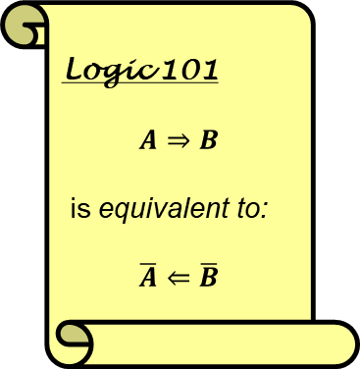
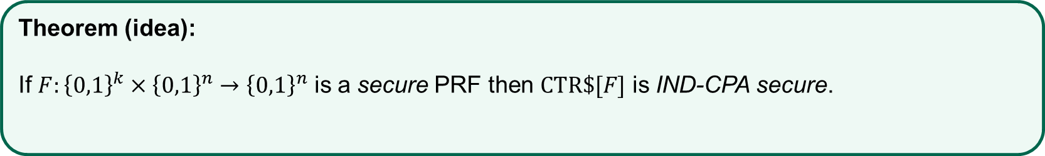

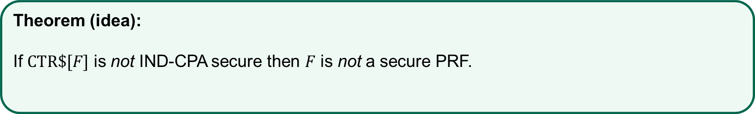
Security of CTR$
Logic 101
$$A⇒B$$
is equivalent to:
$$\overline{A}⇐\overline{B}$$
Theorem (idea):
If $F:{\left\{0,1\right\}}^{k}×{\left\{0,1\right\}}^{n}→{\left\{0,1\right\}}^{n}$ is a secure PRF then $CTR\$[F]$ is IND-CPA secure.
$$⟺$$
equivalent!
Theorem (idea):
If $CTR\$[F]$ is not IND-CPA secure then $F$ is not a secure PRF.

Slide 23

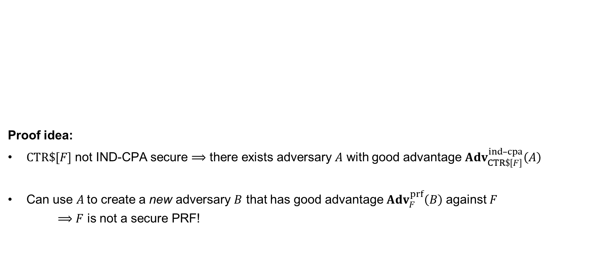
Security of CTR$
Proof idea:
$CTR\$[F]$ not IND-CPA secure $⟹$ there exists adversary $A$ with good advantage ${Adv}_{CTR\$\left[F\right]}^{ind­–cpa}\left(A\right)$
Can use $A$to create a new adversary $B$ that has good advantage ${Adv}_{F}^{prf}\left(B\right)$ against $F$
$⟹$ $F$ is not a secure PRF!
Theorem (idea):
If $CTR\$[F]$ is not IND-CPA secure then $F$ is not a secure PRF.

Slide 24
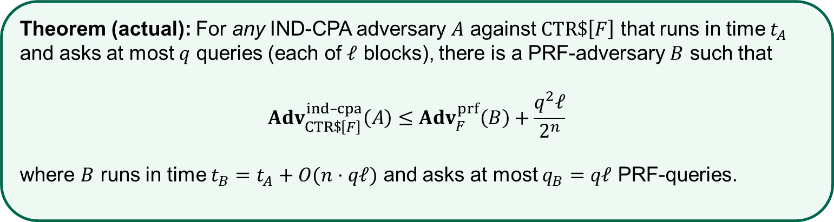
Security of CTR$
Theorem (actual): For any IND-CPA adversary $A$ against $CTR\$\left[F\right]$ that runs in time $t_{A}$ and asks at most $q$ queries (each of $ℓ$ blocks), there is a PRF-adversary $B$ such that
$${Adv}_{CTR\$\left[F\right]}^{ind­–cpa}\left(A\right)≤{Adv}_{F}^{prf}\left(B\right)+\frac{q^{2}ℓ}{2^{n}}$$
where $B$ runs in time $t_{B}=t_{A}+O(n⋅qℓ)$ and asks at most $q_{B}=qℓ$ PRF-queries.

Slide 25
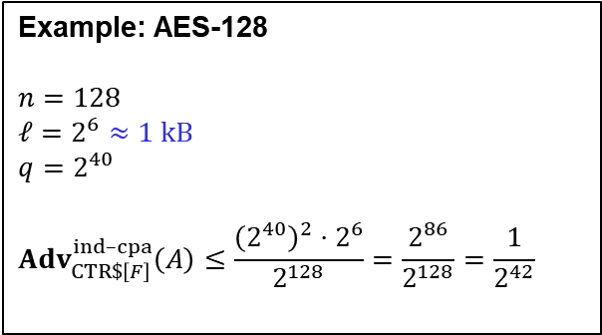

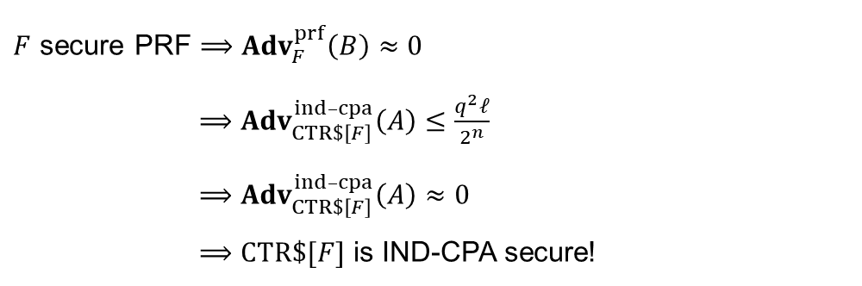

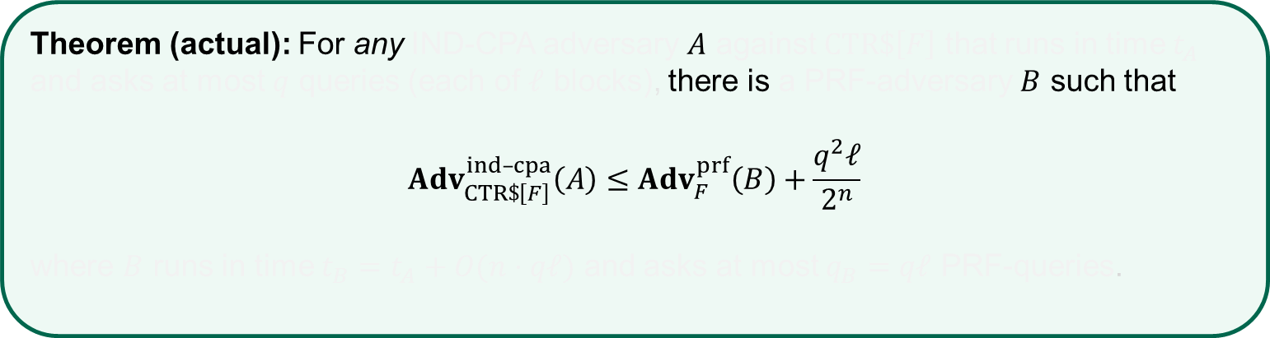
Security of CTR$
Theorem (actual): For any IND-CPA adversary $A$ against $CTR\$\left[F\right]$ that runs in time $t_{A}$ and asks at most $q$ queries (each of $ℓ$ blocks), there is a PRF-adversary $B$ such that
$${Adv}_{CTR\$\left[F\right]}^{ind­–cpa}\left(A\right)≤{Adv}_{F}^{prf}\left(B\right)+\frac{q^{2}ℓ}{2^{n}}$$
where $B$ runs in time $t_{B}=t_{A}+O(n⋅qℓ)$ and asks at most $q_{B}=qℓ$ PRF-queries.
$F$ secure PRF $⟹$ ${Adv}_{F}^{prf}\left(B\right)≈0$
$⟹$ ${Adv}_{CTR\$\left[F\right]}^{ind­–cpa}\left(A\right)≤\frac{q^{2}ℓ}{2^{n}}$
$⟹$ ${Adv}_{CTR\$\left[F\right]}^{ind­–cpa}\left(A\right)≈0$
$⟹CTR\$[F]$ is IND-CPA secure!
Example: AES-128
$$n=128$$
$ℓ=2^{6}≈1 kB$
$$q=2^{40}$$
$${Adv}_{CTR\$\left[F\right]}^{ind­–cpa}\left(A\right)≤\frac{{\left(2^{40}\right)}^{2}⋅2^{6}}{2^{128}}=\frac{2^{86}}{2^{128}}=\frac{1}{2^{42}}$$
$$≈70 TB$$
$$\left(qℓ≪2^{n/2}\right)$$

Slide 26


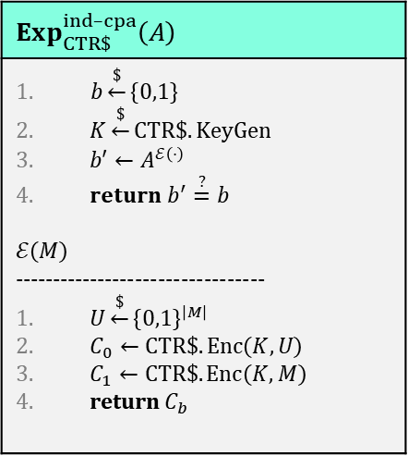
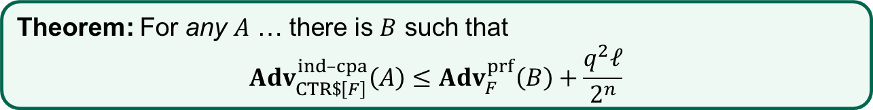

Security of CTR$ – proof idea
Theorem: For any $A$ … there is $B$ such that
$${Adv}_{CTR\$\left[F\right]}^{ind­–cpa}\left(A\right)≤{Adv}_{F}^{prf}\left(B\right)+\frac{q^{2}ℓ}{2^{n}}$$
$$Exp_{CTR\$}^{ind­­–cpa}\left(A\right)$$
$b\underset{←}{\$}\left\{0,1\right\}$ $K\underset{←}{\$}CTR\$.KeyGen$ $b′←A^{ℰ\left(⋅\right)}$ $return b^{′}\overset{?}{=}b$ $$ℰ\left(M\right)$$ --------------------------------- $U\underset{←}{\$}{\left\{0,1\right\}}^{\left|M\right|}$ $C_{0}←CTR\$.Enc\left(K, U\right)$ $C_{1}←CTR\$.Enc\left(K, M\right)$ return $C_{b}$
$$M$$
$$M[1]$$ | $$M[2]$$ | $$M[3]$$ | $$⋯$$ | $$M[ℓ]$$
$$F_{K}(R+1)$$ | $$F_{K}(R+2)$$ | $$F_{K}(R+3)$$ | $$⋯$$ | $$F_{K}(R+ℓ)$$
$$=$$
$$C[1]$$ | $$C[2]$$ | $$C[3]$$ | $$⋯$$ | $$C\left[ℓ\right]$$
$$C$$

Slide 27


Security of CTR$ – proof idea
Theorem: For any $A$ … there is $B$ such that
$${Adv}_{CTR\$\left[F\right]}^{ind­–cpa}\left(A\right)≤{Adv}_{F}^{prf}\left(B\right)+\frac{q^{2}ℓ}{2^{n}}$$
$$Exp_{CTR\$}^{ind­­–cpa}\left(A\right)$$
$b\underset{←}{\$}\left\{0,1\right\}$ $K\underset{←}{\$}CTR\$.KeyGen$ $b′←A^{ℰ\left(⋅\right)}$ $return b^{′}\overset{?}{=}b$ $$ℰ\left(M\right)$$ --------------------------------- $U\underset{←}{\$}{\left\{0,1\right\}}^{\left|M\right|}$ $C_{0}←CTR\$.Enc\left(K, U\right)$ $C_{1}←CTR\$.Enc\left(K, M\right)$ return $C_{b}$
$$M$$
$$M[1]$$ | $$M[2]$$ | $$M[3]$$ | $$⋯$$ | $$M[ℓ]$$
$$ρ(R+1)$$ | $$ρ(R+2)$$ | $$ρ(R+3)$$ | $$⋯$$ | $$ρ(R+ℓ)$$
$$=$$
$$C[1]$$ | $$C[2]$$ | $$C[3]$$ | $$⋯$$ | $$C\left[ℓ\right]$$
$$C$$
$$ρ\underset{←}{\$}Func[n,n]$$
$≈ F_{K}$ by PRF-security

Slide 28
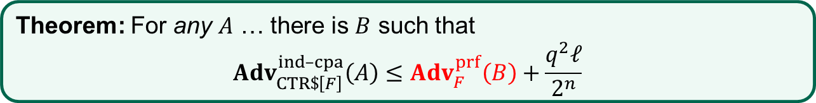
Security of CTR$ – proof idea
Theorem: For any $A$ … there is $B$ such that
$${Adv}_{CTR\$\left[F\right]}^{ind­–cpa}\left(A\right)≤{Adv}_{F}^{prf}\left(B\right)+\frac{q^{2}ℓ}{2^{n}}$$
$$Exp_{CTR\$}^{ind­­–cpa}\left(A\right)$$
$b\underset{←}{\$}\left\{0,1\right\}$ $K\underset{←}{\$}CTR\$.KeyGen$ $b′←A^{ℰ\left(⋅\right)}$ $return b^{′}\overset{?}{=}b$ $$ℰ\left(M\right)$$ --------------------------------- $U\underset{←}{\$}{\left\{0,1\right\}}^{\left|M\right|}$ $C_{0}←CTR\$.Enc\left(K, U\right)$ $C_{1}←CTR\$.Enc\left(K, M\right)$ return $C_{b}$
$$M$$
$$M[1]$$ | $$M[2]$$ | $$M[3]$$ | $$⋯$$ | $$M[ℓ]$$
$$ρ(R+1)$$ | $$ρ(R+2)$$ | $$ρ(R+3)$$ | $$⋯$$ | $$ρ(R+ℓ)$$
$$=$$
$$C[1]$$ | $$C[2]$$ | $$C[3]$$ | $$⋯$$ | $$C\left[ℓ\right]$$
$$C$$
$$ρ\underset{←}{\$}Func[n,n]$$
$≈ F_{K}$ by PRF-security

Slide 29

Security of CTR$ – proof idea
Theorem: For any $A$ … there is $B$ such that
$${Adv}_{CTR\$\left[F\right]}^{ind­–cpa}\left(A\right)≤{Adv}_{F}^{prf}\left(B\right)+\frac{q^{2}ℓ}{2^{n}}$$
$$Exp_{CTR\$}^{ind­­–cpa}\left(A\right)$$
$b\underset{←}{\$}\left\{0,1\right\}$ $K\underset{←}{\$}CTR\$.KeyGen$ $b′←A^{ℰ\left(⋅\right)}$ $return b^{′}\overset{?}{=}b$ $$ℰ\left(M\right)$$ --------------------------------- $U\underset{←}{\$}{\left\{0,1\right\}}^{\left|M\right|}$ $C_{0}←CTR\$.Enc\left(K, U\right)$ $C_{1}←CTR\$.Enc\left(K, M\right)$ return $C_{b}$
$$M$$
$$M[1]$$ | $$M[2]$$ | $$M[3]$$ | $$⋯$$ | $$M[ℓ]$$
$$ρ(R+1)$$ | $$ρ(R+2)$$ | $$ρ(R+3)$$ | $$⋯$$ | $$ρ(R+ℓ)$$
$$=$$
$$C[1]$$ | $$C[2]$$ | $$C[3]$$ | $$⋯$$ | $$C\left[ℓ\right]$$
$$C$$
$$ρ\underset{←}{\$}Func[n,n]$$
$$OTP$$
$≈ F_{K}$ by PRF-security

Slide 30
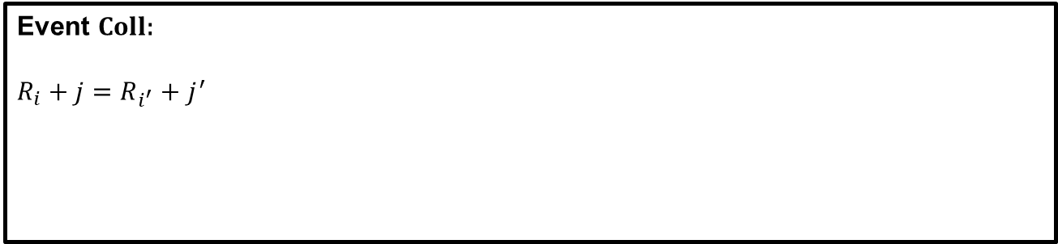



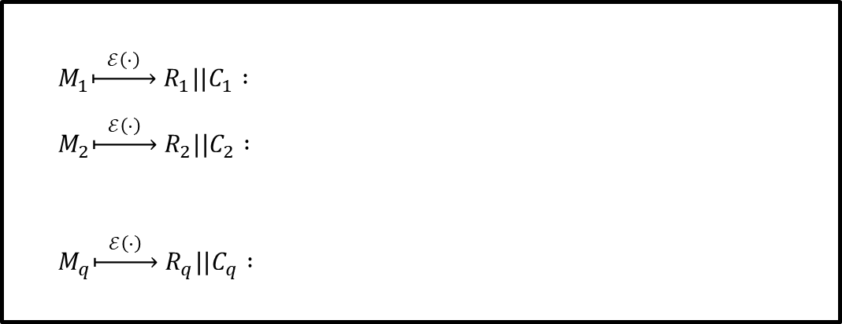

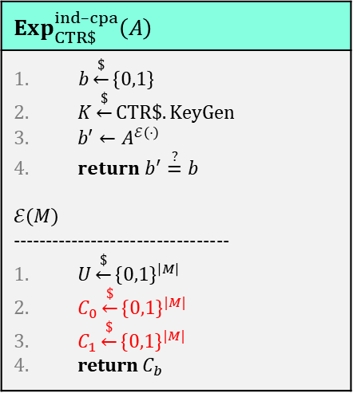


Security of CTR$ – proof idea
Theorem: For any $A$ … there is $B$ such that
$${Adv}_{CTR\$\left[F\right]}^{ind­–cpa}\left(A\right)≤{Adv}_{F}^{prf}\left(B\right)+\frac{q^{2}ℓ}{2^{n}}$$
$$Exp_{CTR\$}^{ind­­–cpa}\left(A\right)$$
$b\underset{←}{\$}\left\{0,1\right\}$ $K\underset{←}{\$}CTR\$.KeyGen$ $b′←A^{ℰ\left(⋅\right)}$ $return b^{′}\overset{?}{=}b$ $$ℰ\left(M\right)$$ --------------------------------- $U\underset{←}{\$}{\left\{0,1\right\}}^{\left|M\right|}$ $C_{0}\underset{←}{\$}{\left\{0,1\right\}}^{|M|}$ $C_{1}\underset{←}{\$}{\left\{0,1\right\}}^{|M|}$ return $C_{b}$
$M_{1}\underset{↦}{ ℰ\left(⋅\right) } R_{1}||C_{1} :$
$M_{2}\underset{↦}{ ℰ\left(⋅\right) } R_{2}||C_{2} :$
$M_{q}\underset{↦}{ ℰ\left(⋅\right) } R_{q}||C_{q} :$
$\begin{matrix}R_{1} & R_{1}+1 & R_{1}+2\end{matrix} \begin{matrix}⋯ & R_{1}+ℓ\end{matrix}$
$\begin{matrix}R_{2} & R_{2}+1 & R_{2}+2\end{matrix} \begin{matrix}⋯ & R_{2}+ℓ\end{matrix}$
$$M$$
$$⋮$$
$$⋮$$
$$M[1]$$ | $$M[2]$$ | $$M[3]$$ | $$⋯$$ | $$M[ℓ]$$
$\begin{matrix}R_{q} & R_{q}+1 & R_{q}+2\end{matrix} \begin{matrix}⋯ & R_{q}+ℓ\end{matrix}$
$$ρ(R+1)$$ | $$ρ(R+2)$$ | $$ρ(R+3)$$ | $$⋯$$ | $$ρ(R+ℓ)$$
$$=$$
Event $Coll$:
$R_{i}+j=R_{i^{′}}+j^{′}$
$$C[1]$$ | $$C[2]$$ | $$C[3]$$ | $$⋯$$ | $$C\left[ℓ\right]$$
$$⟹ρ\left(R_{i}+j\right)=ρ\left(R_{i^{′}}+j^{′}\right)=P$$
$$⟹C_{i}\left[j\right]⊕C_{i}\left[j^{′}\right]=\left(P⊕M_{i}\left[j\right]\right)⊕\left(P⊕M_{i^{′}}\left[j^{′}\right]\right)=M_{i}\left[j\right]⊕M_{i^{′}}\left[j^{′}\right]$$
$$C$$
$$ρ\underset{←}{\$}Func[n,n]$$
$$OTP$$
$≈ F_{K}$ by PRF-security

Slide 31





Security of CTR$ – proof idea
$0$ $1$ $…$
$$2^{n}−1$$
$$R_{j}, R_{j}+1,…$$
$$R_{i}, R_{i}+1,…$$
$$R_{k}, R_{k}+1,…$$

Slide 32

Security of CTR$ – proof idea
$0$ $1$ $…$
$$Coll_{j}$$
$$2^{n}−1$$
$$R_{j}, R_{j}+1,…$$
$$R_{i}, R_{i}+1,…$$
$$R_{k}, R_{k}+1,…$$

Slide 33





Security of CTR$ – proof idea
$0$ $1$ $…$
$$ℓ$$
$$2^{n}−1$$
$$R_{2}, R_{2}+1,…$$
$$R_{1}, R_{1}+1,…$$
$$Pr\left[Coll\right]=Pr\left[Coll_{1}∨Coll_{2}∨⋯∨Coll_{q}\right]$$
$$≤Pr\left[Coll_{1}\right]+Pr\left[Coll_{2}\right]+…+Pr\left[Coll_{q}\right]$$
$$≤ 0$$
$$+ \frac{2ℓ}{2^{n}}$$

Slide 34




Security of CTR$ – proof idea
$0$ $1$ $…$
$$ℓ$$
$$ℓ$$
$$2^{n}−1$$
$$R_{3}, R_{3}+1,…$$
$$R_{3}, R_{3}+1,…$$
$$R_{1}, R_{1}+1,…$$
$$R_{2}, R_{2}+1,…$$
$$Pr\left[Coll\right]=Pr\left[Coll_{1}∨Coll_{2}∨⋯∨Coll_{q}\right]$$
$$≤Pr\left[Coll_{1}\right]+Pr\left[Coll_{2}\right]+…+Pr\left[Coll_{q}\right]$$
$$≤ 0$$
$$+ \frac{2ℓ}{2^{n}}$$
$$+ \frac{2⋅2ℓ}{2^{n}}$$

Slide 35





Security of CTR$ – proof idea
$0$ $1$ $…$
$$ℓ$$
$$ℓ$$
$$ℓ$$
$$2^{n}−1$$
$$R_{1}, R_{1}+1,…$$
$$R_{3}, R_{3}+1,…$$
$$R_{4}, R_{4}+1,…$$
$$R_{2}, R_{2}+1,…$$
$$R_{4}, R_{4}+1,…$$
$$R_{4}, R_{4}+1,…$$
$$Pr\left[Coll\right]=Pr\left[Coll_{1}∨Coll_{2}∨⋯∨Coll_{q}\right]$$
$$≤Pr\left[Coll_{1}\right]+Pr\left[Coll_{2}\right]+…+Pr\left[Coll_{q}\right]$$
$$≤ 0$$
$$+ \frac{2ℓ}{2^{n}}$$
$$+ \frac{2⋅2ℓ}{2^{n}}$$
$$+ \frac{3⋅2ℓ}{2^{n}}$$

Slide 36




Security of CTR$ – proof idea
$0$ $1$ $…$
$$ℓ$$
$$ℓ$$
$$ℓ$$
$$ℓ$$
$$2^{n}−1$$
$$R_{1}, R_{1}+1,…$$
$$R_{3}, R_{3}+1,…$$
$$R_{4}, R_{4}+1,…$$
$$R_{2}, R_{2}+1,…$$
$$Pr\left[Coll\right]=Pr\left[Coll_{1}∨Coll_{2}∨⋯∨Coll_{q}\right]$$
$$≤Pr\left[Coll_{1}\right]+Pr\left[Coll_{2}\right]+…+Pr\left[Coll_{q}\right]$$
$$≤ 0$$
$$+ \frac{2ℓ}{2^{n}}$$
$$+ \frac{2⋅2ℓ}{2^{n}}$$
$$+ \frac{3⋅2ℓ}{2^{n}}$$
$$+ ⋯ + \frac{(q−1)⋅2ℓ}{2^{n}}$$
$$= \frac{2ℓ}{2^{n}}⋅\left(1+2+3+⋯+\left(q−1\right)\right)$$
$$≤\frac{q^{2}ℓ}{2^{n}}$$
$$\frac{q(q−1)}{2}$$

Slide 37
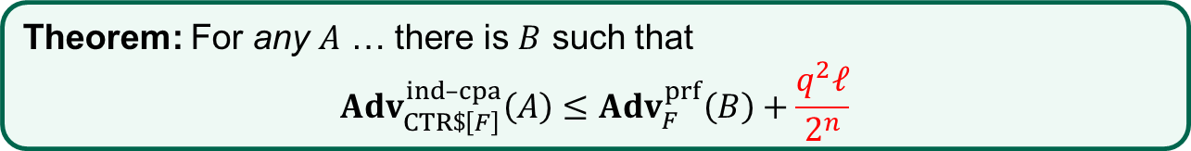
Security of CTR$ – proof idea
Theorem: For any $A$ … there is $B$ such that
$${Adv}_{CTR\$\left[F\right]}^{ind­–cpa}\left(A\right)≤{Adv}_{F}^{prf}\left(B\right)+\frac{q^{2}ℓ}{2^{n}}$$
$$Exp_{CTR\$}^{ind­­–cpa}\left(A\right)$$
$b\underset{←}{\$}\left\{0,1\right\}$ $K\underset{←}{\$}CTR\$.KeyGen$ $b′←A^{ℰ\left(⋅\right)}$ $return b^{′}\overset{?}{=}b$ $$ℰ\left(M\right)$$ --------------------------------- $U\underset{←}{\$}{\left\{0,1\right\}}^{\left|M\right|}$ $C_{0}\underset{←}{\$}{\left\{0,1\right\}}^{|M|}$ $C_{1}\underset{←}{\$}{\left\{0,1\right\}}^{|M|}$ return $C_{b}$
$$M$$
$$M[1]$$ | $$M[2]$$ | $$M[3]$$ | $$⋯$$ | $$M[ℓ]$$
$$ρ(R+1)$$ | $$ρ(R+2)$$ | $$ρ(R+3)$$ | $$⋯$$ | $$ρ(R+ℓ)$$
$$=$$
$$C[1]$$ | $$C[2]$$ | $$C[3]$$ | $$⋯$$ | $$C\left[ℓ\right]$$
$$C$$
$$ρ\underset{←}{\$}Func[n,n]$$
$≈ F_{K}$ by PRF-security

Slide 38



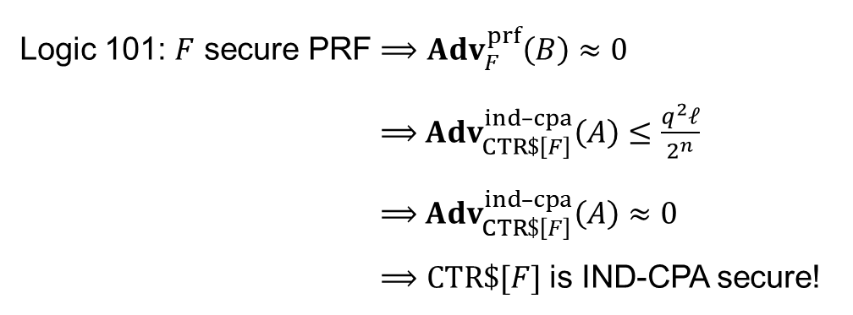
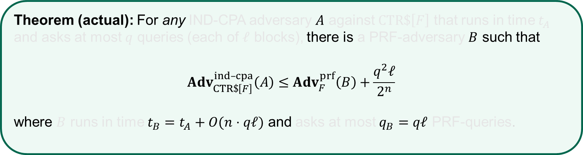
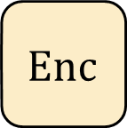

Nonce-based encryption
$$Enc :𝒦×ℳ→𝒞$$
$$\$$$
$$M$$
$$Enc$$
$$C$$
$$Enc\left(K,M\right)={Enc}_{K}\left(M\right)$$
$$K$$
Randomized
Nonce
$$Enc :𝒦×𝒩×ℳ→𝒞$$
$$N$$
$$Enc$$
$$Enc\left(K, N, M\right)=Enc_{K}\left(N, M\right)={Enc}_{K}^{N}\left(M\right)$$
$$M$$
$$C$$
$$K$$
Nonce-based
How to create the nonce?
Randomly (also called IV-based)
Counter
Combination
Deterministic

Slide 39



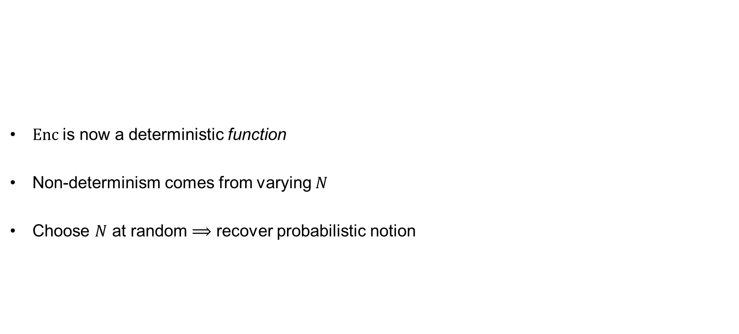


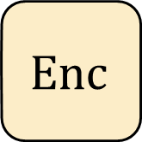


Nonce-based encryption – new syntax
$Enc$is now a deterministic function
Non-determinism comes from varying $N$
Choose $N$ at random $⟹$ recover probabilistic notion
Nonce-based
$$Enc :𝒦×𝒩×ℳ→𝒞$$
$$N$$
$$Enc$$
$$Enc\left(K, N, M\right)={Enc}_{K}\left(N, M\right)={Enc}_{K}^{N}\left(M\right)$$
$$M$$
$$C$$
$$K$$
$$\$$$
$$Enc$$
$$M$$
$$C$$
$$K$$
Randomized

Slide 40
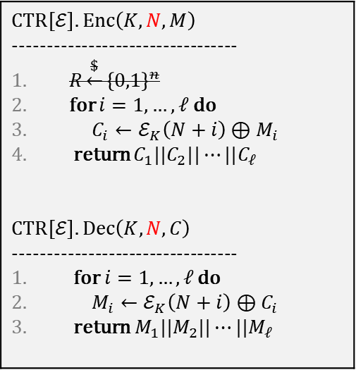
Nonce-based CTR
Nonce value must be updated and stored by sender
  Stateful encryption
  Receiver doesn't need to store state
Alternatively: pick nonce at random
  Gives CTR$
Common in practice:
  pick some parts of N at random and let the rest be a counter (always starting at 0)
  e.g., 96 bits random and 32 bits counter for 128-bits N
$$CTR\left[ℰ\right].Enc\left(K,N,M\right)$$ --------------------------------- $R\underset{←}{\$}{\left\{0,1\right\}}^{n}$ for $i=1, …, ℓ$ do $C_{i}←ℰ_{K}\left(N+i\right)⊕M_{i}$ return $C_{1}||C_{2}||⋯||C_{ℓ}$ $$CTR\left[ℰ\right].Dec\left(K, N, C\right)$$ --------------------------------- for $i=1, …, ℓ$ do $M_{i}←ℰ_{K}\left(N+i\right)⊕C_{i}$ return $M_{1}||M_{2}||⋯||M_{ℓ}$

Slide 41
CTR$ vs. (nonce-based) CTR
$$CTR\$\left[ℰ\right].Enc\left(K,M\right)$$ --------------------------------- $ctr\underset{←}{\$}{\left\{0,1\right\}}^{n}$ $C_{0}←ctr$ for $i=1, …, ℓ$ do $C_{i}←ℰ_{K}\left(ctr+i\right)⊕M_{i}$ return $C_{0}||C_{1}||⋯||C_{ℓ}$
$$CTR\left[ℰ\right].Enc\left(K,N,M\right)$$ --------------------------------- $ctr←N\underset{←}{\$}$ $C_{0}←ctr$ for $i=1, …, ℓ$ do $C_{i}←ℰ_{K}\left(ctr+i\right)⊕M_{i}$ return $C_{0}||C_{1}||⋯||C_{ℓ}$
vs.

Slide 42


Nonce-based CTR – IND-CPA security
Theorem (CTR): For any IND-CPA adversary $A$ against $CTR\left[F\right]$ that runs in time $t_{A}$
and asks at most $q$ queries (each of $ℓ$ blocks), there is a PRF-adversary $B$ such that
$${Adv}_{CTR\left[F\right]}^{ind­–cpa}\left(A\right)≤{Adv}_{F}^{prf}\left(B\right)$$
where $B$ runs in time $t_{B}=t_{A}+O(n⋅qℓ)$ and asks at most $q_{B}=qℓ$ PRF-queries.
vs.
Theorem (CTR$): For any IND-CPA adversary $A$ against $CTR\$\left[F\right]$ that runs in time $t_{A}$ and asks at most $q$ queries (each of $ℓ$ blocks), there is a PRF-adversary $B$ such that
$${Adv}_{CTR\$\left[F\right]}^{ind­–cpa}\left(A\right)≤{Adv}_{F}^{prf}\left(B\right)+\frac{q^{2}ℓ}{2^{n}}$$
where $B$ runs in time $t_{B}=t_{A}+O(n⋅qℓ)$ and asks at most $q_{B}=qℓ$ PRF-queries.

Slide 43














CBC$ – Cipher Block Chaining mode
pick randomly
$$IV$$
$$M_{1}$$
$$M_{2}$$
$$M_{3}$$
$$M_{4}$$
$${ ℰ}_{K}$$
$${ ℰ}_{K}$$
$${ ℰ}_{K}$$
$${ ℰ}_{K}$$
$$C_{0}$$
$$C_{1}$$
$$C_{2}$$
$$C_{3}$$
$$C_{4}$$

Slide 44
























CBC$ – Cipher Block Chaining mode
pick randomly
$$IV$$
$$M_{1}$$
$$M_{2}$$
$$M_{3}$$
$$M_{4}$$
$$M_{1}$$
$$M_{2}$$
$$M_{3}$$
$$M_{4}$$
$${ ℰ}_{K}$$
$${ ℰ}_{K}$$
$$ℰ_{K}$$
$$ℰ_{K}$$
$${ ℰ}_{K}^{−1}$$
$${ ℰ}_{K}^{−1}$$
$${ ℰ}_{K}^{−1}$$
$${ ℰ}_{K}^{−1}$$
$$C_{0}$$
$$C_{1}$$
$$C_{2}$$
$$C_{3}$$
$$C_{4}$$
$$C_{0}$$
$$C_{1}$$
$$C_{2}$$
$$C_{3}$$
$$C_{4}$$

Slide 45













CBC
Theorem: IND-CPA secure for random IV
(assuming $ℰ$ is a good block cipher)
Not IND-CPA secure for nonce-based IV
  (exercise: show this)
Not parallelizable; cannot precompute values
Inverse of block cipher $ℰ$ needed for decryption
Padding needed for messages not a multiple of block length
…historically one of the most used modes-of-operation
pick randomly
$$IV$$
$$M_{1}$$
$$M_{2}$$
$$M_{3}$$
$$M_{4}$$
$${ ℰ}_{K}$$
$${ ℰ}_{K}$$
$${ ℰ}_{K}$$
$${ ℰ}_{K}$$
$$C_{0}$$
$$C_{1}$$
$$C_{2}$$
$$C_{3}$$
$$C_{4}$$

Slide 46


IND-CPA – Indistinguishability against chosen-plaintext attacks
World 1
Input $M$: return $Σ.Enc\left(K, M\right)$
World 0
Input $M$: return $Σ.Enc\left(K, \$\right)$
I’m in World $b′$

Slide 47

IND-CCA – Indistinguishability against chosen-ciphertext attacks
World 1
Input $M$: return $Σ.Enc\left(K, M\right)$ Input $C$: return $Σ.Dec\left(K,C\right)$
World 0
Input $M$: return $Σ.Enc\left(K, \$\right)$ Input $C$: return $Σ.Dec\left(K,C\right)$
I’m in World $b′$
Restriction: not allowed to query $Dec\left(K,C\right)$ after an $Enc\left(K,M\right)$ call returned $C$

Slide 48
IND-CCA
None of the schemes we have looked at today are IND-CCA secure
  Attacks are easy to demonstrate (exercise)
New techniques are needed
Next week: message authentication codes

