Slide 1
Lecture 2 – Block ciphers, PRFs/PRPs,
DES, AES
TEK4500
01.09.2021
Håkon Jacobsen
hakon.jacobsen@its.uio.no

Slide 2

Ideal solution: secure channels
Internet
But how to build?
Alice
Bob
M
Adversary
Security goals:
Data privacy: adversary should not be able to read message M ✓
Data integrity: adversary should not be able to modify message M ✓
Data authenticity: message M really originated from Alice ✓

Slide 3
Basic goals of cryptography
 | Message privacy | Message integrity / authentication
Symmetric keys | Symmetric encryption | Message authentication codes (MAC)
Asymmetric keys | Asymmetric encryption (a.k.a. public-key encryption) | Digital signatures

Slide 4

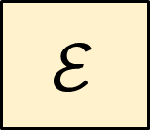



Encryption schemes
Plaintext
$$ℳ$$
$$\$$$
$$ℰ$$
$$𝒦$$
Key
Ciphertext
$$𝒞$$

Slide 5



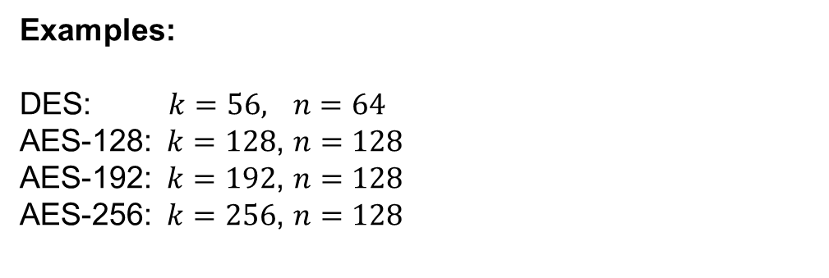


Block ciphers
Plaintext
$${\left\{0,1\right\}}^{n}$$
$$128$$
$$ℰ$$
$${\left\{0,1\right\}}^{k}$$
Key
$$128$$
Ciphertext
Examples:
DES: $k=56,$ $n=64$
AES-128: $k=128$, $n=128$
AES-192: $k=192$, $n=128$
AES-256: $k=256$, $n=128$
$${\left\{0,1\right\}}^{n}$$

Slide 6







Block cipher applications (1)
Encryption of messages of 128 bits (block length)
However: we usually want to encrypt messages of arbitrary length!
  Splitting the message into multiple 128 bit blocks (like above) is not secure!
  Need to use them in a proper mode-of-operation (covered later in the course)
Correct viewpoint: block ciphers are not encryption schemes!
  Block ciphers are primitives used to construct other things
$$K$$
$$K$$
$$Y_{1}, { Y}_{2},…, { Y}_{t}$$
$$Y_{i}←E_{K}(M_{i})$$
$$M_{i}←E_{K}^{−1}(Y_{i})$$

Slide 7
Block cipher applications (2)
The “work horse” of crypto
Can be used to build:
  Encryption of arbitrary length messages (including stream ciphers)
  Message authentication codes
  Authenticated encryption
  Hash functions
  (Cryptographically secure) pseudorandom generators
  Key derivation functions

Slide 8
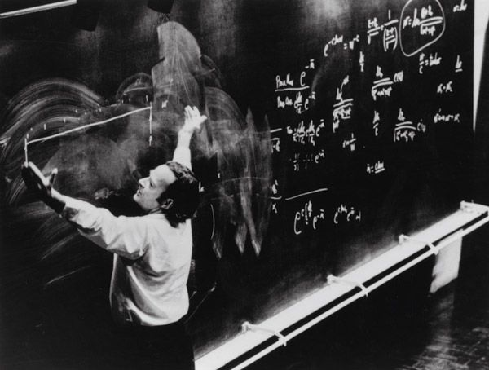
Defining block ciphers

Slide 9
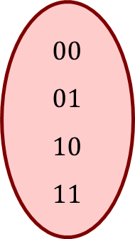
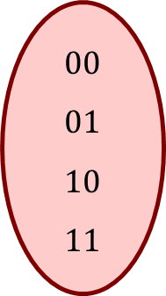


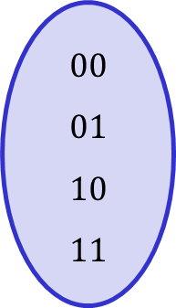
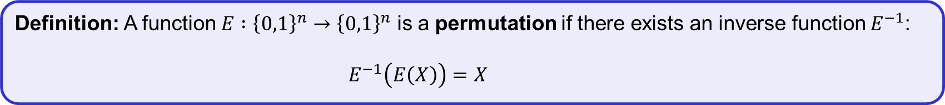
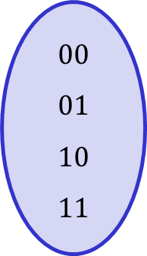
Permutations
Definition: A function $E :{\left\{0,1\right\}}^{n}→{\left\{0,1\right\}}^{n}$ is a permutation if there exists an inverse function $E^{−1}$:
$E^{−1}\left(E\left(X\right)\right)=X$
$$E$$
$$F$$
$$00 \\ 01 \\ 10 \\ 11$$
$$00 \\ 01 \\ 10 \\ 11$$
$$00 \\ 01 \\ 10 \\ 11$$
$$00 \\ 01 \\ 10 \\ 11$$
Permutation
Not a permutation

Slide 10

Permutations
Definition: A function $E :{\left\{0,1\right\}}^{n}→{\left\{0,1\right\}}^{n}$ is a permutation if there exists an inverse function $E^{−1}$:
$E^{−1}\left(E\left(X\right)\right)=X$
$$E^{−1}$$
$$F$$
$$00 \\ 01 \\ 10 \\ 11$$
$$00 \\ 01 \\ 10 \\ 11$$
$$00 \\ 01 \\ 10 \\ 11$$
$$00 \\ 01 \\ 10 \\ 11$$
Permutation
Not a permutation

Slide 11
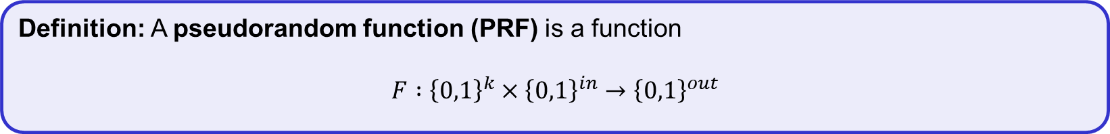
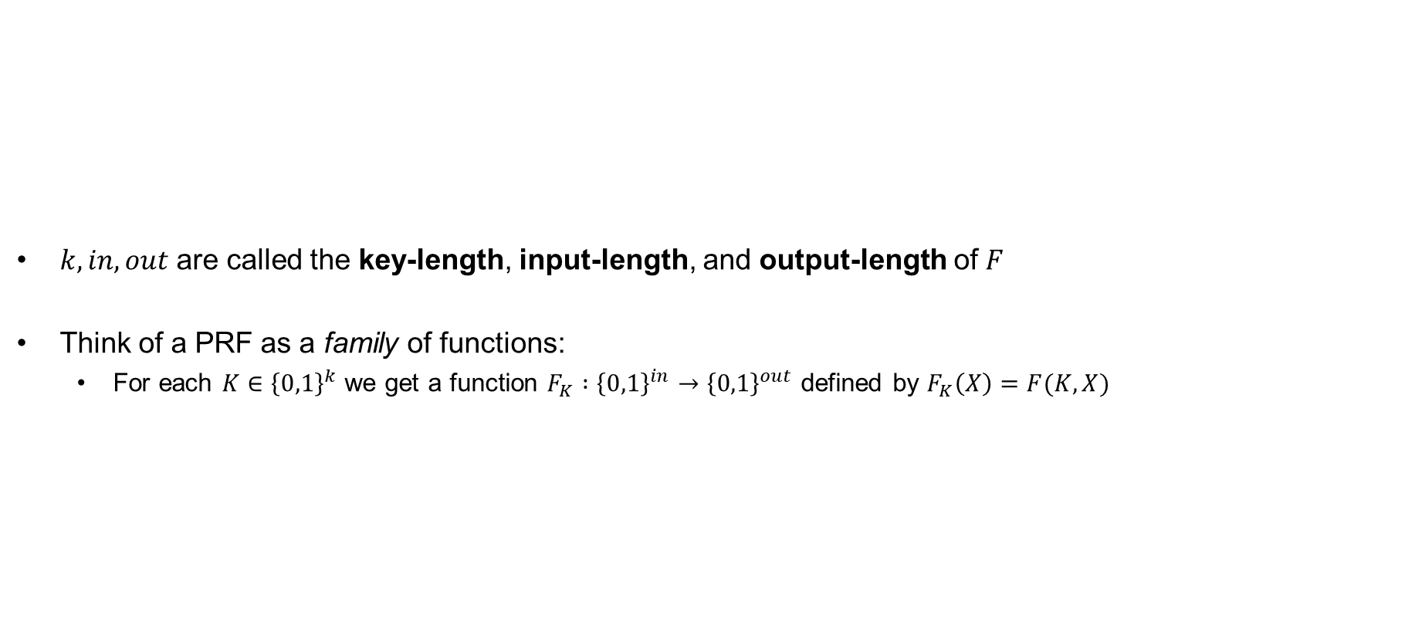
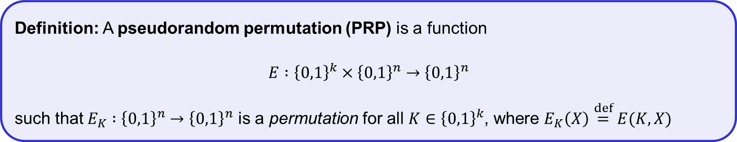
Pseudorandom functions (PRFs) and permutations (PRP)
$k, in, out$ are called the key-length, input-length, and output-length of $F$
Think of a PRF as a family of functions:
  For each $K∈{\left\{0,1\right\}}^{k}$ we get a function $F_{K} :{\left\{0,1\right\}}^{in}→{\left\{0,1\right\}}^{out}$ defined by $F_{K}\left(X\right)=F(K, X)$
Definition: A pseudorandom function (PRF) is a function
$$F :{\left\{0,1\right\}}^{k}×{\left\{0,1\right\}}^{in}→{\left\{0,1\right\}}^{out}$$
PRP = block cipher
note: all PRPs are PRFs
(but not all PRFs are PRPs!)
Definition: A pseudorandom permutation (PRP) is a function
$$E :{\left\{0,1\right\}}^{k}×{\left\{0,1\right\}}^{n}→{\left\{0,1\right\}}^{n}$$
such that $E_{K} :{\left\{0,1\right\}}^{n}→{\left\{0,1\right\}}^{n}$ is a permutation for all $K∈{\left\{0,1\right\}}^{k}$, where $E_{K}\left(X\right)\overset{def}{=}E(K, X)$

Slide 12
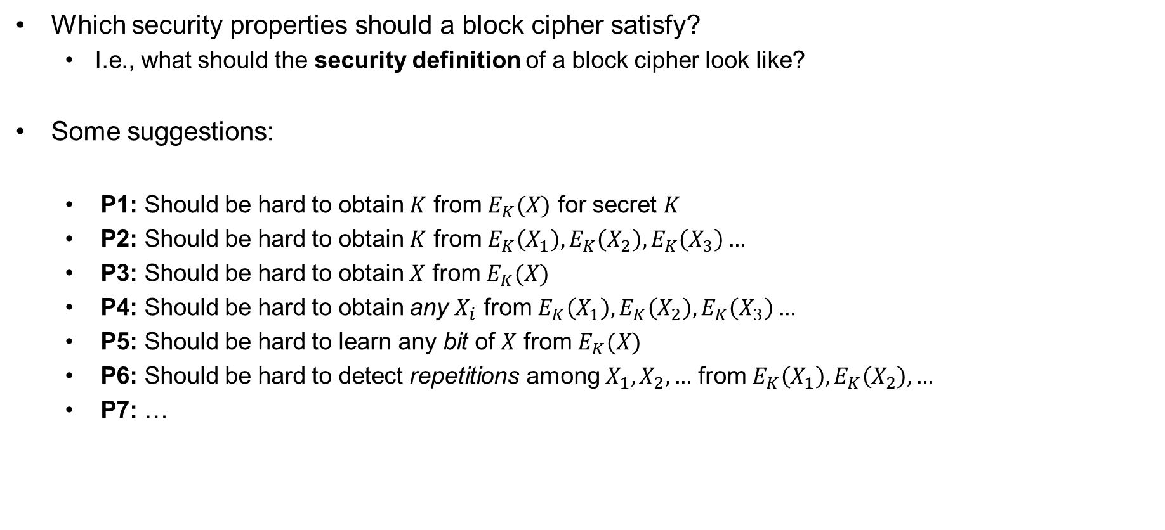
Block cipher security
Which security properties should a block cipher satisfy?
  I.e., what should the security definition of a block cipher look like?
Some suggestions:
  P1: Should be hard to obtain $K$ from $E_{K}(X)$ for secret $K$
  P2: Should be hard to obtain $K$ from $E_{K}\left(X_{1}\right),E_{K}\left(X_{2}\right),E_{K}\left(X_{3}\right)…$
  P3: Should be hard to obtain $X$ from $E_{K}(X)$
  P4: Should be hard to obtain any $X_{i}$ from $E_{K}\left(X_{1}\right),E_{K}\left(X_{2}\right),E_{K}\left(X_{3}\right)…$
  P5: Should be hard to learn any bit of $X$ from $E_{K}(X)$
  P6: Should be hard to detect repetitions among $X_{1},X_{2},…$ from $E_{K}\left(X_{1}\right),E_{K}\left(X_{2}\right), …$
  P7: …
Not good enough!
  Impossible!

Slide 13

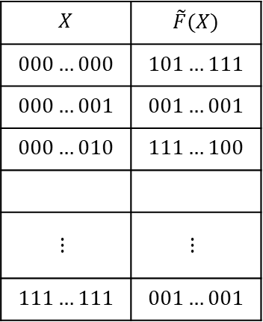


Random functions
$$\tilde{F }:{\left\{0,1\right\}}^{in}→{\left\{0,1\right\}}^{out}$$
$$X$$ | $$\tilde{F}(X)$$
$$000…000$$ | $$101…111$$
$$000…001$$ | $$001…001$$
$$000…010$$ | $$111…100$$
$$⋮$$ | $$⋮$$
$$111…111$$ | $$001…001$$
$$2^{in}$$
$$out$$

Slide 14
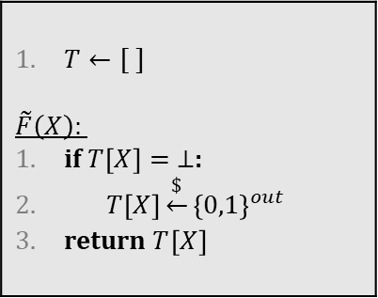
Random functions
$$\tilde{F }:{\left\{0,1\right\}}^{in}→{\left\{0,1\right\}}^{out}$$
$$X$$ | $$\tilde{F}(X)$$
$$000…000$$ | $$101…111$$
$$000…001$$ | $$001…001$$
$$000…010$$ | $$111…100$$
$$⋮$$ | $$⋮$$
$$111…111$$ | $$001…001$$
$T←[ ]$ $$\tilde{F}\left(X\right):$$ if $T\left[X\right]= ⊥$: $T\left[X\right]\underset{←}{\$}{\left\{0,1\right\}}^{out}$ return $T{\left[X\right]}^{}$

Slide 15


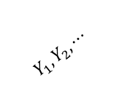
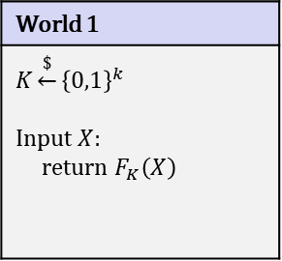
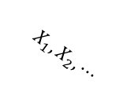

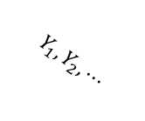

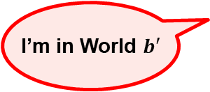
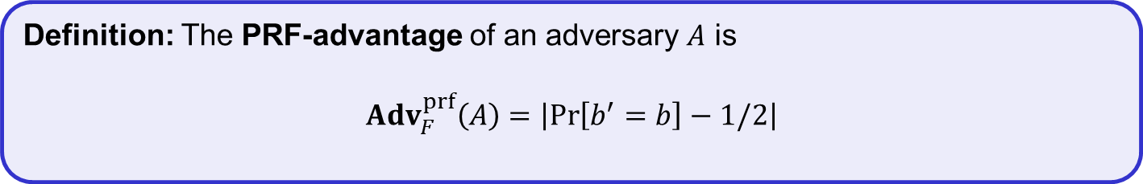
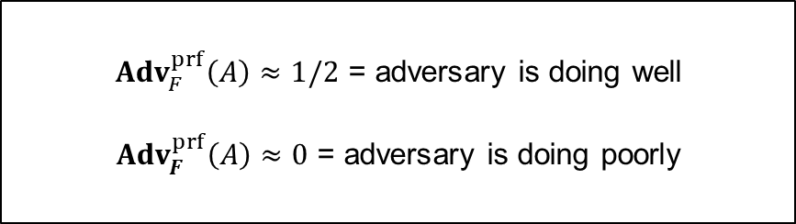

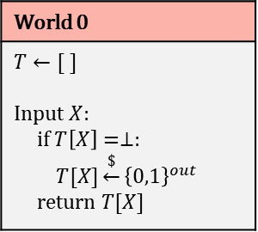
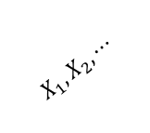
PRF – security; formal definition
World 1
$$K\underset{←}{\$}{\left\{0,1\right\}}^{k}$$ Input $X$: return $F_{K}\left(X\right)$
$b$
World 0
$$T←[ ]$$ Input $X$: if $T\left[X\right]=⊥:$ $T[X]\underset{←}{\$}{\left\{0,1\right\}}^{out}$ return $T[X]$
$$b=1$$
$$b=0$$
$$X_{1}, X_{2}, ⋯$$
$$X_{1}, X_{2}, ⋯$$
${Adv}_{F}^{prf}\left(A\right)≈1/2$ = adversary is doing well
${Adv}_{F}^{prf}\left(A\right)≈0$ = adversary is doing poorly
$$Y_{1}, Y_{2}, ⋯$$
$$Y_{1}, Y_{2}, ⋯$$
I’m in World $b′$
Definition: The PRF-advantage of an adversary $A$ is
$${Adv}_{F}^{prf}\left(A\right)=\left|\operatorname{Pr}\left[b^{′}=b\right]−1/2\right|$$

Slide 16
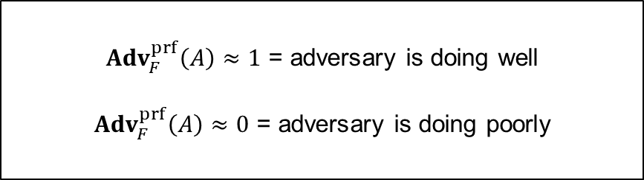
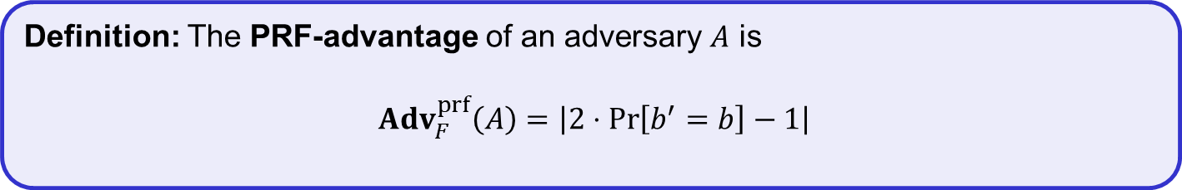
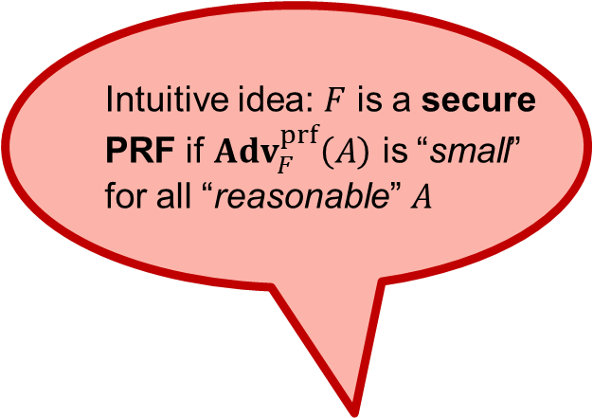
PRF – security; formal definition
World 1
$$K\underset{←}{\$}{\left\{0,1\right\}}^{k}$$ Input $X$: return $F_{K}\left(X\right)$
$b$
World 0
$$T←[ ]$$ Input $X$: if $T\left[X\right]=⊥:$ $T[X]\underset{←}{\$}{\left\{0,1\right\}}^{out}$ return $T[X]$
$$b=1$$
$$b=0$$
Intuitive idea: $F$ is a secure
PRF if ${Adv}_{F}^{prf}\left(A\right)$ is “small”
for all “reasonable” $A$
${Adv}_{F}^{prf}\left(A\right)≈1$ = adversary is doing well
${Adv}_{F}^{prf}\left(A\right)≈0$ = adversary is doing poorly
I’m in World $b′$
Definition: The PRF-advantage of an adversary $A$ is
$${Adv}_{F}^{prf}\left(A\right)=\left|2⋅Pr\left[b^{′}=b\right]−1\right|$$

Slide 17
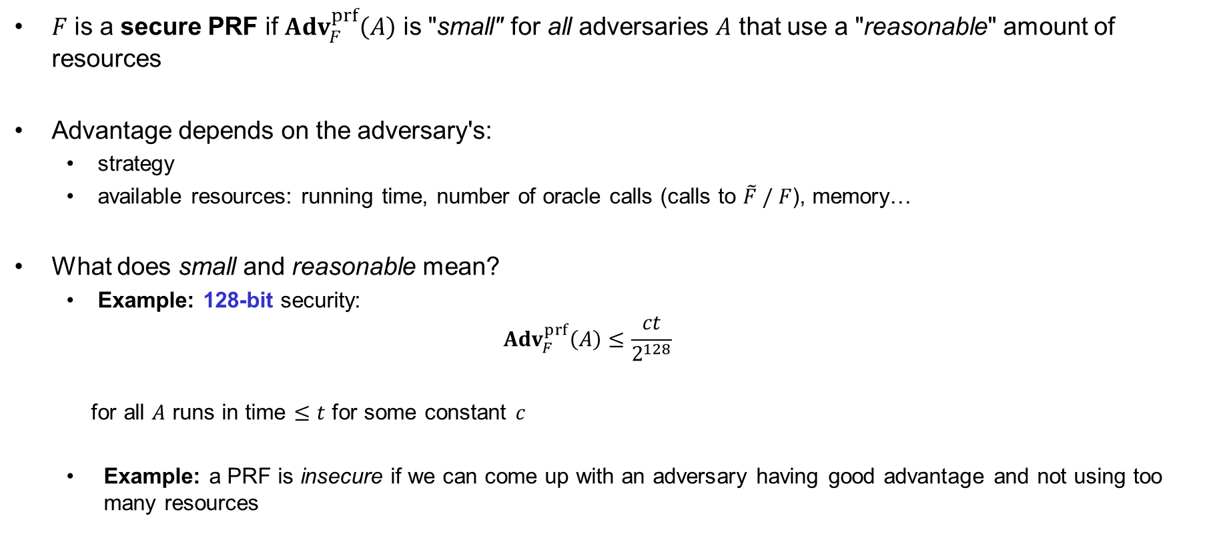
Understanding "advantage"
$F$ is a secure PRF if ${Adv}_{F}^{prf}\left(A\right)$ is "small" for all adversaries $A$ that use a "reasonable" amount of resources
Advantage depends on the adversary's:
  strategy
  available resources: running time, number of oracle calls (calls to $\tilde{F} / F$), memory…
What does small and reasonable mean?
  Example: 128-bit security:
  ${Adv}_{F}^{prf}\left(A\right)≤\frac{ct}{2^{128}}$
  for all $A$ runs in time $≤t$ for some constant $c$
  Example: a PRF is insecure if we can come up with an adversary having good advantage and not using too many resources

Slide 18


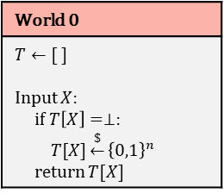

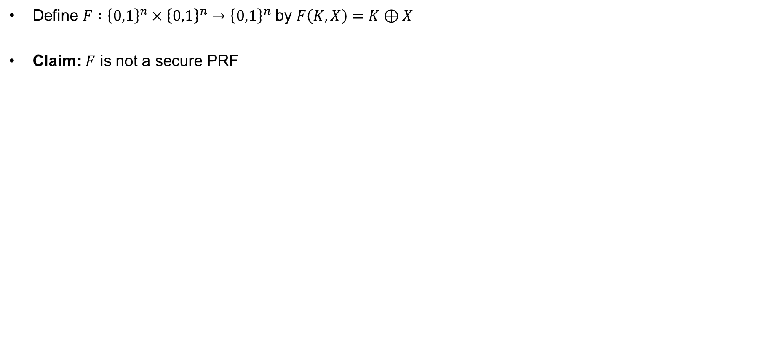
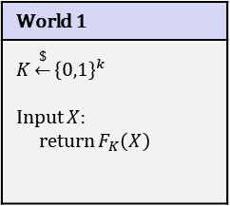
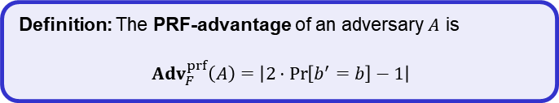




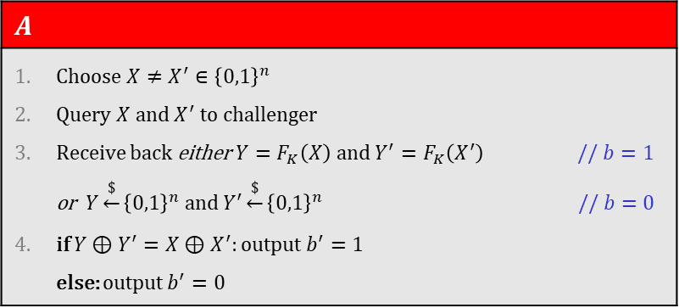
Example
Define $F :{\left\{0,1\right\}}^{n}×{\left\{0,1\right\}}^{n}→{\left\{0,1\right\}}^{n}$ by $F\left(K, X\right)=K⊕X$
Claim: $F$ is not a secure PRF
World 1
$$K\underset{←}{\$}{\left\{0,1\right\}}^{k}$$ Input $X$: return $F_{K}\left(X\right)$
World 0
$$T←[ ]$$ Input $X$: if $T\left[X\right]=⊥:$ $T[X]\underset{←}{\$}{\left\{0,1\right\}}^{n}$ return $T[X]$
$b$
$$b=1$$
$$b=0$$
$$A$$
Choose $X≠X^{′}∈{\left\{0,1\right\}}^{n}$ Query $X$ and $X^{′}$ to challenger Receive back either $Y=F_{K}\left(X\right)$ and $Y^{′}=F_{K}\left(X^{′}\right)$ // $b=1$ or $Y\underset{←}{\$}{\left\{0,1\right\}}^{n} \text{and} Y^{′}\underset{←}{\$}{\left\{0,1\right\}}^{n}$ // $b=0$ if $Y⊕Y^{′}=X⊕X^{′}$: output $b^{′}=1$ else: output $b^{′}=0$
I’m in World $b′$
Definition: The PRF-advantage of an adversary $A$ is
$${Adv}_{F}^{prf}\left(A\right)=\left|2⋅Pr\left[b^{′}=b\right]−1\right|$$
$$= \operatorname{Pr}\left[b^{′}=1 ∣ b=1\right]⋅\operatorname{Pr}\left[ b=1\right]+\operatorname{Pr}\left[b^{′}=0 ∣ b=0\right]⋅\operatorname{Pr}\left[ b=0\right]$$
$$\operatorname{Pr}\left[b^{′}=b\right]$$
$$= \operatorname{Pr}\left[b^{′}=1 ∣ b=1\right]⋅1/2 +\operatorname{Pr}\left[b^{′}=0 ∣ b=0\right]⋅1/ 2$$
$$= Pr\left[Y⊕Y^{′}=X⊕X^{′}∣b=1\right]{⋅1/2} +\operatorname{Pr}\left[b^{′}=0 ∣ b=0\right]⋅1/ 2$$
$$= 1⋅1/2 +\operatorname{Pr}\left[b^{′}=0 ∣ b=0\right]⋅1/ 2$$

Slide 19
Example
Define $F :{\left\{0,1\right\}}^{n}×{\left\{0,1\right\}}^{n}→{\left\{0,1\right\}}^{n}$ by $F\left(K, X\right)=K⊕X$
Claim: $F$ is not a secure PRF
World 1
$$K\underset{←}{\$}{\left\{0,1\right\}}^{k}$$ Input $X$: return $F_{K}\left(X\right)$
World 0
$$T←[ ]$$ Input $X$: if $T\left[X\right]=⊥:$ $T[X]\underset{←}{\$}{\left\{0,1\right\}}^{n}$ return $T[X]$
$b$
$$b=1$$
$$b=0$$
$$A$$
Choose $X≠X^{′}∈{\left\{0,1\right\}}^{n}$ Query $X$ and $X^{′}$ to challenger Receive back either $Y=F_{K}\left(X\right)$ and $Y^{′}=F_{K}\left(X^{′}\right)$ // $b=1$ or $Y\underset{←}{\$}{\left\{0,1\right\}}^{n} \text{and} Y^{′}\underset{←}{\$}{\left\{0,1\right\}}^{n}$ // $b=0$ if $Y⊕Y^{′}=X⊕X^{′}$: output $b^{′}=1$ else: output $b^{′}=0$
I’m in World $b′$
Definition: The PRF-advantage of an adversary $A$ is
$${Adv}_{F}^{prf}\left(A\right)=\left|2⋅Pr\left[b^{′}=b\right]−1\right|$$
$$= \operatorname{Pr}\left[b^{′}=1 ∣ b=1\right]⋅\operatorname{Pr}\left[ b=1\right]+\operatorname{Pr}\left[b^{′}=0 ∣ b=0\right]⋅\operatorname{Pr}\left[ b=0\right]$$
$$\operatorname{Pr}\left[b^{′}=b\right]$$
$$= \operatorname{Pr}\left[b^{′}=1 ∣ b=1\right]⋅1/2 +\operatorname{Pr}\left[b^{′}=0 ∣ b=0\right]⋅1/ 2$$
$$= Pr\left[Y⊕Y^{′}=X⊕X^{′}∣b=1\right]{⋅1/2} +\operatorname{Pr}\left[b^{′}=0 ∣ b=0\right]⋅1/ 2$$
$$= 1⋅1/2 +(1 − \operatorname{Pr}\left[b^{′}=1 ∣ b=0\right])⋅1/ 2$$

Slide 20
Example
Define $F :{\left\{0,1\right\}}^{n}×{\left\{0,1\right\}}^{n}→{\left\{0,1\right\}}^{n}$ by $F\left(K, X\right)=K⊕X$
Claim: $F$ is not a secure PRF
World 1
$$K\underset{←}{\$}{\left\{0,1\right\}}^{k}$$ Input $X$: return $F_{K}\left(X\right)$
World 0
$$T←[ ]$$ Input $X$: if $T\left[X\right]=⊥:$ $T[X]\underset{←}{\$}{\left\{0,1\right\}}^{n}$ return $T[X]$
$b$
$$b=1$$
$$b=0$$
$$A$$
Choose $X≠X^{′}∈{\left\{0,1\right\}}^{n}$ Query $X$ and $X^{′}$ to challenger Receive back either $Y=F_{K}\left(X\right)$ and $Y^{′}=F_{K}\left(X^{′}\right)$ // $b=1$ or $Y\underset{←}{\$}{\left\{0,1\right\}}^{n} \text{and} Y^{′}\underset{←}{\$}{\left\{0,1\right\}}^{n}$ // $b=0$ if $Y⊕Y^{′}=X⊕X^{′}$: output $b^{′}=1$ else: output $b^{′}=0$
I’m in World $b′$
Definition: The PRF-advantage of an adversary $A$ is
$${Adv}_{F}^{prf}\left(A\right)=\left|2⋅Pr\left[b^{′}=b\right]−1\right|$$
$$= \operatorname{Pr}\left[b^{′}=1 ∣ b=1\right]⋅\operatorname{Pr}\left[ b=1\right]+\operatorname{Pr}\left[b^{′}=0 ∣ b=0\right]⋅\operatorname{Pr}\left[ b=0\right]$$
$$\operatorname{Pr}\left[b^{′}=b\right]$$
$$= \operatorname{Pr}\left[b^{′}=1 ∣ b=1\right]⋅1/2 +\operatorname{Pr}\left[b^{′}=0 ∣ b=0\right]⋅1/ 2$$
$$= Pr\left[Y⊕Y^{′}=X⊕X^{′}∣b=1\right]{⋅1/2} +\operatorname{Pr}\left[b^{′}=0 ∣ b=0\right]⋅1/ 2$$
$$= 1⋅1/2 +(1 − \operatorname{Pr}\left[Y⊕Y^{′}=X⊕X^{′} ∣ b=0\right])⋅1/ 2$$

Slide 21
Example
Define $F :{\left\{0,1\right\}}^{n}×{\left\{0,1\right\}}^{n}→{\left\{0,1\right\}}^{n}$ by $F\left(K, X\right)=K⊕X$
Claim: $F$ is not a secure PRF
World 1
$$K\underset{←}{\$}{\left\{0,1\right\}}^{k}$$ Input $X$: return $F_{K}\left(X\right)$
World 0
$$T←[ ]$$ Input $X$: if $T\left[X\right]=⊥:$ $T[X]\underset{←}{\$}{\left\{0,1\right\}}^{n}$ return $T[X]$
$b$
$$b=1$$
$$b=0$$
$$A$$
Choose $X≠X^{′}∈{\left\{0,1\right\}}^{n}$ Query $X$ and $X^{′}$ to challenger Receive back either $Y=F_{K}\left(X\right)$ and $Y^{′}=F_{K}\left(X^{′}\right)$ // $b=1$ or $Y\underset{←}{\$}{\left\{0,1\right\}}^{n} \text{and} Y^{′}\underset{←}{\$}{\left\{0,1\right\}}^{n}$ // $b=0$ if $Y⊕Y^{′}=X⊕X^{′}$: output $b^{′}=1$ else: output $b^{′}=0$
I’m in World $b′$
Definition: The PRF-advantage of an adversary $A$ is
$${Adv}_{F}^{prf}\left(A\right)=\left|2⋅Pr\left[b^{′}=b\right]−1\right|$$
$$= \operatorname{Pr}\left[b^{′}=1 ∣ b=1\right]⋅\operatorname{Pr}\left[ b=1\right]+\operatorname{Pr}\left[b^{′}=0 ∣ b=0\right]⋅\operatorname{Pr}\left[ b=0\right]$$
$$\operatorname{Pr}\left[b^{′}=b\right]$$
$$= \operatorname{Pr}\left[b^{′}=1 ∣ b=1\right]⋅1/2 +\operatorname{Pr}\left[b^{′}=0 ∣ b=0\right]⋅1/ 2$$
$$= Pr\left[Y⊕Y^{′}=X⊕X^{′}∣b=1\right]{⋅1/2} +\operatorname{Pr}\left[b^{′}=0 ∣ b=0\right]⋅1/ 2$$
$$= 1⋅1/2 +(1 − \operatorname{Pr}\left[Y=X⊕X^{′}⊕Y^{′} ∣ b=0\right])⋅1/ 2$$

Slide 22
Example
Define $F :{\left\{0,1\right\}}^{n}×{\left\{0,1\right\}}^{n}→{\left\{0,1\right\}}^{n}$ by $F\left(K, X\right)=K⊕X$
Claim: $F$ is not a secure PRF
World 1
$$K\underset{←}{\$}{\left\{0,1\right\}}^{k}$$ Input $X$: return $F_{K}\left(X\right)$
World 0
$$T←[ ]$$ Input $X$: if $T\left[X\right]=⊥:$ $T[X]\underset{←}{\$}{\left\{0,1\right\}}^{n}$ return $T[X]$
$b$
$$b=1$$
$$b=0$$
$$A$$
Choose $X≠X^{′}∈{\left\{0,1\right\}}^{n}$ Query $X$ and $X^{′}$ to challenger Receive back either $Y=F_{K}\left(X\right)$ and $Y^{′}=F_{K}\left(X^{′}\right)$ // $b=1$ or $Y\underset{←}{\$}{\left\{0,1\right\}}^{n} \text{and} Y^{′}\underset{←}{\$}{\left\{0,1\right\}}^{n}$ // $b=0$ if $Y⊕Y^{′}=X⊕X^{′}$: output $b^{′}=1$ else: output $b^{′}=0$
I’m in World $b′$
Definition: The PRF-advantage of an adversary $A$ is
$${Adv}_{F}^{prf}\left(A\right)=\left|2⋅Pr\left[b^{′}=b\right]−1\right|$$
$$= \operatorname{Pr}\left[b^{′}=1 ∣ b=1\right]⋅\operatorname{Pr}\left[ b=1\right]+\operatorname{Pr}\left[b^{′}=0 ∣ b=0\right]⋅\operatorname{Pr}\left[ b=0\right]$$
$$\operatorname{Pr}\left[b^{′}=b\right]$$
$$= \operatorname{Pr}\left[b^{′}=1 ∣ b=1\right]⋅1/2 +\operatorname{Pr}\left[b^{′}=0 ∣ b=0\right]⋅1/ 2$$
$$= Pr\left[Y⊕Y^{′}=X⊕X^{′}∣b=1\right]{⋅1/2} +\operatorname{Pr}\left[b^{′}=0 ∣ b=0\right]⋅1/ 2$$
$$= 1⋅1/2 +(1 − \operatorname{Pr}\left[Y=Z ∣ b=0\right])⋅1/ 2$$

Slide 23
Example
Define $F :{\left\{0,1\right\}}^{n}×{\left\{0,1\right\}}^{n}→{\left\{0,1\right\}}^{n}$ by $F\left(K, X\right)=K⊕X$
Claim: $F$ is not a secure PRF
World 1
$$K\underset{←}{\$}{\left\{0,1\right\}}^{k}$$ Input $X$: return $F_{K}\left(X\right)$
World 0
$$T←[ ]$$ Input $X$: if $T\left[X\right]=⊥:$ $T[X]\underset{←}{\$}{\left\{0,1\right\}}^{n}$ return $T[X]$
$b$
$$b=1$$
$$b=0$$
$$A$$
Choose $X≠X^{′}∈{\left\{0,1\right\}}^{n}$ Query $X$ and $X^{′}$ to challenger Receive back either $Y=F_{K}\left(X\right)$ and $Y^{′}=F_{K}\left(X^{′}\right)$ // $b=1$ or $Y\underset{←}{\$}{\left\{0,1\right\}}^{n} \text{and} Y^{′}\underset{←}{\$}{\left\{0,1\right\}}^{n}$ // $b=0$ if $Y⊕Y^{′}=X⊕X^{′}$: output $b^{′}=1$ else: output $b^{′}=0$
I’m in World $b′$
Definition: The PRF-advantage of an adversary $A$ is
$${Adv}_{F}^{prf}\left(A\right)=\left|2⋅Pr\left[b^{′}=b\right]−1\right|$$
$$= \operatorname{Pr}\left[b^{′}=1 ∣ b=1\right]⋅\operatorname{Pr}\left[ b=1\right]+\operatorname{Pr}\left[b^{′}=0 ∣ b=0\right]⋅\operatorname{Pr}\left[ b=0\right]$$
$$\operatorname{Pr}\left[b^{′}=b\right]$$
$$= \operatorname{Pr}\left[b^{′}=1 ∣ b=1\right]⋅1/2 +\operatorname{Pr}\left[b^{′}=0 ∣ b=0\right]⋅1/ 2$$
$$= Pr\left[Y⊕Y^{′}=X⊕X^{′}∣b=1\right]{⋅1/2} +\operatorname{Pr}\left[b^{′}=0 ∣ b=0\right]⋅1/ 2$$
$= 1⋅1/2 +\left(1 −2^{−n}\right)⋅1/ 2$

Slide 24
Example
Define $F :{\left\{0,1\right\}}^{n}×{\left\{0,1\right\}}^{n}→{\left\{0,1\right\}}^{n}$ by $F\left(K, X\right)=K⊕X$
Claim: $F$ is not a secure PRF
World 1
$$K\underset{←}{\$}{\left\{0,1\right\}}^{k}$$ Input $X$: return $F_{K}\left(X\right)$
World 0
$$T←[ ]$$ Input $X$: if $T\left[X\right]=⊥:$ $T[X]\underset{←}{\$}{\left\{0,1\right\}}^{n}$ return $T[X]$
$b$
$$b=1$$
$$b=0$$
$$A$$
Choose $X≠X^{′}∈{\left\{0,1\right\}}^{n}$ Query $X$ and $X^{′}$ to challenger Receive back either $Y=F_{K}\left(X\right)$ and $Y^{′}=F_{K}\left(X^{′}\right)$ // $b=1$ or $Y\underset{←}{\$}{\left\{0,1\right\}}^{n} \text{and} Y^{′}\underset{←}{\$}{\left\{0,1\right\}}^{n}$ // $b=0$ if $Y⊕Y^{′}=X⊕X^{′}$: output $b^{′}=1$ else: output $b^{′}=0$
I’m in World $b′$
Definition: The PRF-advantage of an adversary $A$ is
$${Adv}_{F}^{prf}\left(A\right)=\left|2⋅Pr\left[b^{′}=b\right]−1\right|$$
$$= \operatorname{Pr}\left[b^{′}=1 ∣ b=1\right]⋅\operatorname{Pr}\left[ b=1\right]+\operatorname{Pr}\left[b^{′}=0 ∣ b=0\right]⋅\operatorname{Pr}\left[ b=0\right]$$
$$\operatorname{Pr}\left[b^{′}=b\right]$$
$$= \operatorname{Pr}\left[b^{′}=1 ∣ b=1\right]⋅1/2 +\operatorname{Pr}\left[b^{′}=0 ∣ b=0\right]⋅1/ 2$$
$$= Pr\left[Y⊕Y^{′}=X⊕X^{′}∣b=1\right]{⋅1/2} +\operatorname{Pr}\left[b^{′}=0 ∣ b=0\right]⋅1/ 2$$
$$= 1 −2^{−n}⋅1/ 2$$

Slide 25



Example
Define $F :{\left\{0,1\right\}}^{n}×{\left\{0,1\right\}}^{n}→{\left\{0,1\right\}}^{n}$ by $F\left(K, X\right)=K⊕X$
Claim: $F$ is not a secure PRF
World 1
$$K\underset{←}{\$}{\left\{0,1\right\}}^{k}$$ Input $X$: return $F_{K}\left(X\right)$
World 0
$$T←[ ]$$ Input $X$: if $T\left[X\right]=⊥:$ $T[X]\underset{←}{\$}{\left\{0,1\right\}}^{n}$ return $T[X]$
$b$
$$b=1$$
$$b=0$$
$$A$$
Choose $X≠X^{′}∈{\left\{0,1\right\}}^{n}$ Query $X$ and $X^{′}$ to challenger Receive back either $Y=F_{K}\left(X\right)$ and $Y^{′}=F_{K}\left(X^{′}\right)$ // $b=1$ or $Y\underset{←}{\$}{\left\{0,1\right\}}^{n} \text{and} Y^{′}\underset{←}{\$}{\left\{0,1\right\}}^{n}$ // $b=0$ if $Y⊕Y^{′}=X⊕X^{′}$: output $b^{′}=1$ else: output $b^{′}=0$
I’m in World $b′$
Definition: The PRF-advantage of an adversary $A$ is
$${Adv}_{F}^{prf}\left(A\right)=\left|2⋅Pr\left[b^{′}=b\right]−1\right|$$
$$\operatorname{Pr}\left[b^{′}=b\right]$$
$$= 1−2^{−n}⋅1/2$$
$${Adv}_{F}^{prf}\left(A\right)=\left|2⋅Pr\left[{Exp}_{F}^{prf}\left(A\right)⇒true\right]−1\right|$$
$$=\left|2⋅(1−2^{−n}⋅1/2)−1\right|=1−2^{−n}$$
$$≈ 1$$

Slide 26

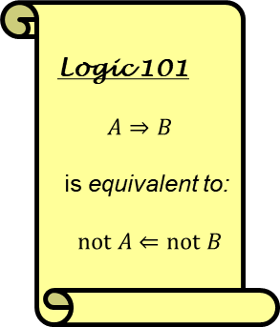
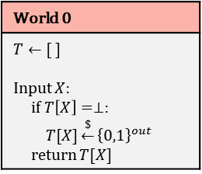

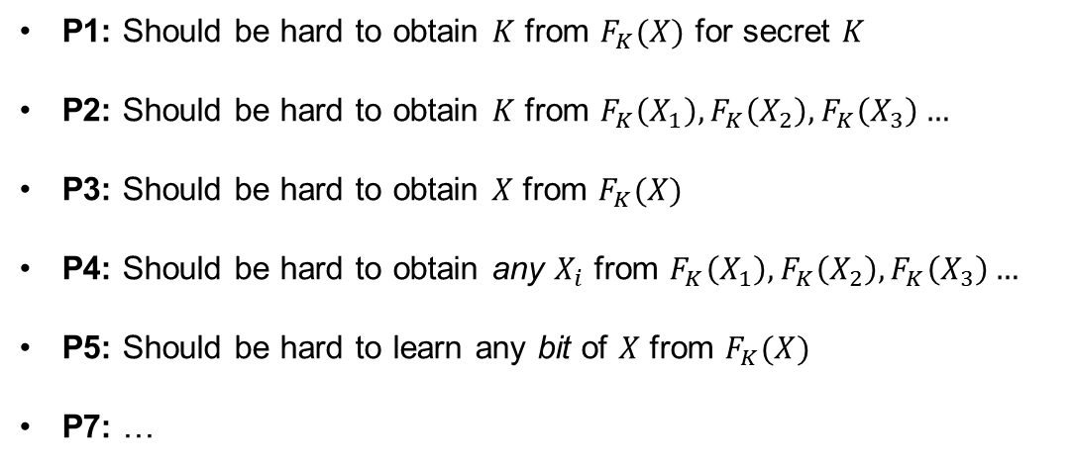

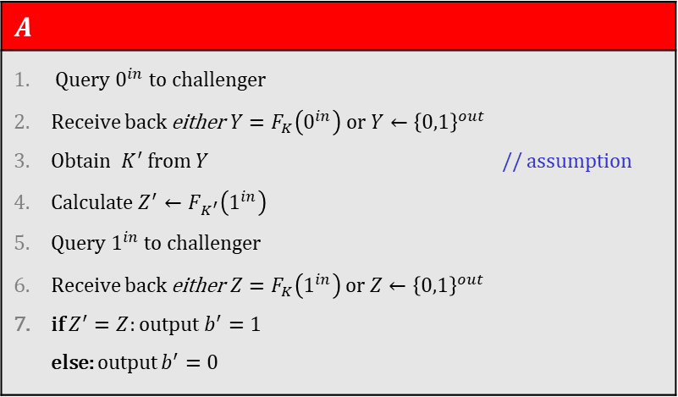

Why is this definition good?
World 1
$$K\underset{←}{\$}{\left\{0,1\right\}}^{k}$$ Input $X$: return $F_{K}\left(X\right)$
World 0
$$T←[ ]$$ Input $X$: if $T\left[X\right]=⊥:$ $T[X]\underset{←}{\$}{\left\{0,1\right\}}^{out}$ return $T[X]$
$b$
  P1: Should be hard to obtain $K$ from $F_{K}(X)$ for secret $K$
  P2: Should be hard to obtain $K$ from $F_{K}\left(X_{1}\right),F_{K}\left(X_{2}\right),F_{K}\left(X_{3}\right)…$
  P3: Should be hard to obtain $X$ from $F_{K}(X)$
  P4: Should be hard to obtain any $X_{i}$ from $F_{K}\left(X_{1}\right),F_{K}\left(X_{2}\right),F_{K}\left(X_{3}\right)…$
  P5: Should be hard to learn any bit of $X$ from $F_{K}(X)$
  P7: …
$$A$$
Query $0^{in}$ to challenger Receive back either $Y=F_{K}\left(0^{in}\right)$ or $Y←{\left\{0,1\right\}}^{out}$ Obtain $K^{′}$ from $Y$ // assumption Calculate $Z^{′}←F_{K^{′}}\left(1^{in}\right)$ Query $1^{in}$ to challenger Receive back either $Z=F_{K}\left(1^{in}\right)$ or $Z←{\left\{0,1\right\}}^{out}$ if $Z^{′}=Z$: output $b^{′}=1$ else: output $b^{′}=0$
$$b=1$$
$$b=0$$
Logic 101
$$A⇒B$$
is equivalent to:
$not A⇐not B$
I’m in World $b′$
Definition: The PRF-advantage of an adversary $A$ is
$${Adv}_{F}^{prf}\left(A\right)=\left|2⋅Pr\left[b^{′}=b\right]−1\right|$$
$F$ is PRF secure $⟹$ $F$ has properties P1 – P5, P7, …
$$\operatorname{Pr}\left[b^{′}=1 ∣ b=1\right]=$$
$$1$$
$F$ is not PRF secure $⟸$ $F$ does not have properties P1 – P5, P7, …
$$1−\frac{1}{2^{out}}$$
$$\operatorname{Pr}\left[b^{′}=0 ∣ b=0\right]=$$

Slide 27


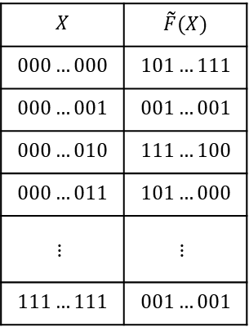
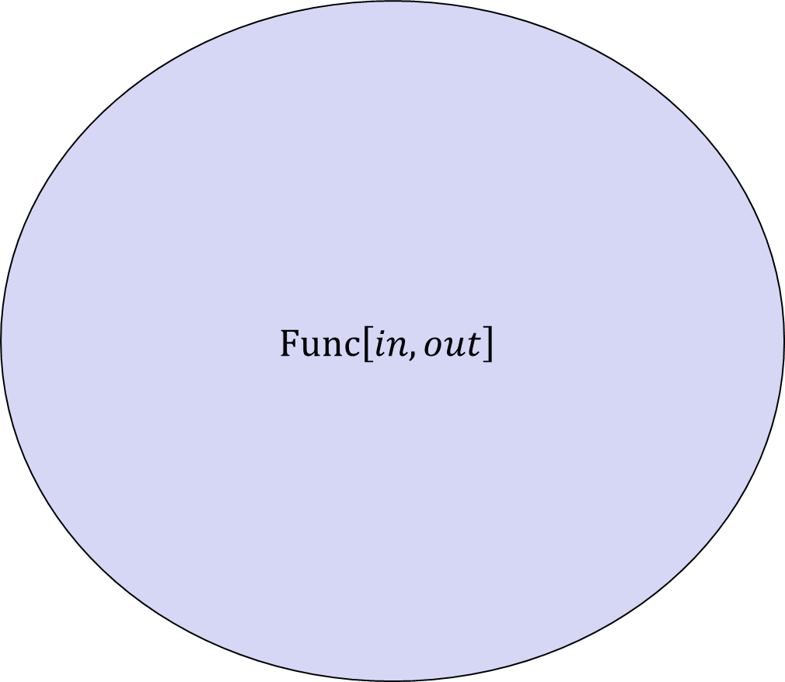




PRF – security; equivalent view
$$\left|Func\left[in,out\right]\right|=$$
$$Func\left[in, out\right]$$
$$X$$ | $$\tilde{F}(X)$$
$$000…000$$ | $$101…111$$
$$000…001$$ | $$001…001$$
$$000…010$$ | $$111…100$$
$$000…011$$ | $$101…000$$
$$⋮$$ | $$⋮$$
$$111…111$$ | $$001…001$$
$$G\left(X\right)=\overline{X}$$
$$F\left(X\right)=X$$
$$2^{in}$$
$$V\left(X\right)=X⊕17$$
$$\tilde{F}$$
$$out$$
$$H\left(X\right)=00…0$$

Slide 28







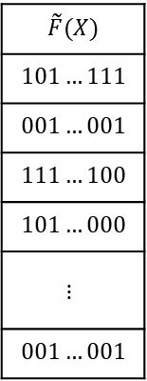


PRF – security; equivalent view
$$Func\left[in, out\right]$$
$$\left|Func\left[in,out\right]\right|=$$
# bitstrings of length $2^{in}⋅out$
$$=2^{\left(2^{in}⋅out\right)}$$
$$\tilde{F}(X)$$
$$101…111$$
$$001…001$$
$$111…100$$
$$101…000$$
$$⋮$$
$$001…001$$
$$G\left(X\right)=\overline{X}$$
Example:
$$\left|Func\left[3,2\right]\right|=$$
$$2^{2^{3}⋅2}$$
$$F\left(X\right)=X$$
$$2^{in}$$
$$V\left(X\right)=X⊕17$$
$$=2^{16}$$
$$=65536$$
$$\tilde{F}$$
$$out$$
$$H\left(X\right)=00…0$$
- Bits needed to specify one
function: $2^{in}⋅out$
- Each bitstring of length $2^{in}⋅out$
represents a distinct function

Slide 29





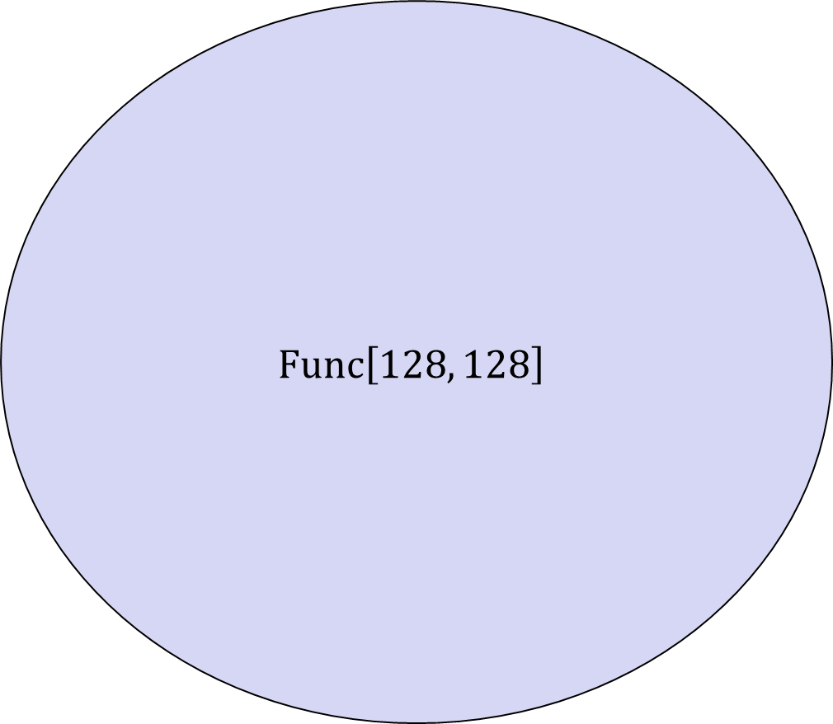




PRF – security; equivalent view
$$Func\left[128, 128\right]$$
$$\left|Func\left[in,out\right]\right|=$$
# bitstrings of length $2^{in}⋅out$
$$=2^{\left(2^{in}⋅out\right)}$$
$$\tilde{F}(X)$$
$$101…111$$
$$001…001$$
$$111…100$$
$$101…000$$
$$⋮$$
$$001…001$$
$$G\left(X\right)=\overline{X}$$
Example:
$$\left|Func\left[3,2\right]\right|=$$
$$2^{2^{3}⋅2}$$
$$F\left(X\right)=X$$
$$2^{in}$$
$$V\left(X\right)=X⊕17$$
$$=2^{16}$$
$$=65536$$
$$\tilde{F}$$
$$out$$
$$H\left(X\right)=00…0$$
$$AES$$
$$2^{2^{128}⋅128}$$
- Bits needed to specify one
function: $2^{in}⋅out$
$$\left|Func\left[128,128\right]\right|=$$
$${AES}_{00…}\left(X\right)$$
$${AES}_{101…}\left(X\right)$$
- Each bitstring of length $2^{in}⋅out$
represents a distinct function
$$\left|AES\right|=$$
$$2^{128}$$
$${AES}_{11…}\left(X\right)$$

Slide 30

PRF – security; equivalent view
$$Func\left[128, 128\right]$$
$$\left|Func\left[in,out\right]\right|=$$
# bitstrings of length $2^{in}⋅out$
$$=2^{\left(2^{in}⋅out\right)}$$
$$\tilde{F}(X)$$
$$101…111$$
$$001…001$$
$$111…100$$
$$101…000$$
$$⋮$$
$$001…001$$
$$G\left(X\right)=\overline{X}$$
Example:
$$\left|Func\left[3,2\right]\right|=$$
$$2^{2^{3}⋅2}$$
$$F\left(X\right)=X$$
$$2^{in}$$
$$V\left(X\right)=X⊕17$$
$$=2^{16}$$
$$=65536$$
$$\tilde{F}$$
$$out$$
$$H\left(X\right)=00…0$$
$$2^{2^{128}⋅128}$$
- Bits needed to specify one
function: $2^{in}⋅out$
$$\left|Func\left[128,128\right]\right|=$$
- Each bitstring of length $2^{in}⋅out$
represents a distinct function
$$\left|AES\right|=$$
$$2^{128}$$
$$AES$$

Slide 31

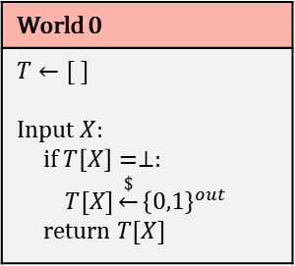
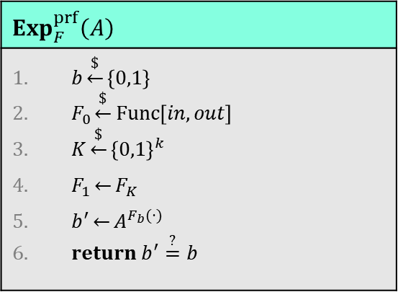
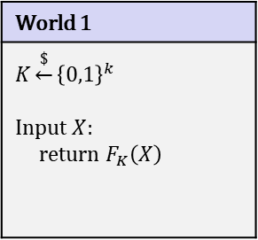
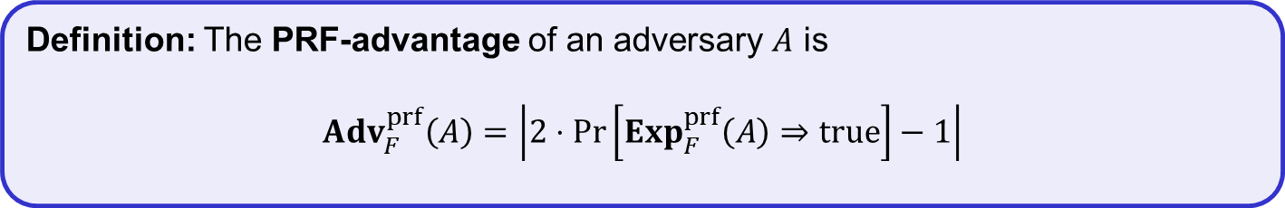



PRF – security; formal definition
equivalent
$$Exp_{F}^{prf}\left(A\right)$$
$b\underset{←}{\$}\left\{0,1\right\}$ $F_{0}\underset{←}{\$}Func\left[in, out\right]$ $K\underset{←}{\$}{\left\{0,1\right\}}^{k}$ $F_{1}\underset{←}{}F_{K}$ $b^{′}\underset{←}{}A^{F_{b}(⋅)}$ $return b^{′}\overset{?}{=}b$
World 1
$$K\underset{←}{\$}{\left\{0,1\right\}}^{k}$$ Input $X$: return $F_{K}\left(X\right)$
World 0
$$T←[ ]$$ Input $X$: if $T\left[X\right]=⊥:$ $T[X]\underset{←}{\$}{\left\{0,1\right\}}^{out}$ return $T[X]$
$b$
$$A=$$
I’m in World $b′$
Definition: The PRF-advantage of an adversary $A$ is
$${Adv}_{F}^{prf}\left(A\right)=\left|2⋅Pr\left[b^{′}=b\right]−1\right|$$
Definition: The PRF-advantage of an adversary $A$ is
$${Adv}_{F}^{prf}\left(A\right)=\left|2⋅Pr\left[Exp_{F}^{prf}\left(A\right)⇒true\right]−1\right|$$

Slide 32


Block ciphers – security
$$\left|Func\left[128,128\right]\right|=$$
$$2^{2^{128}⋅128}$$
$$Func\left[128, 128\right]$$
$$G\left(X\right)=\overline{X}$$
$$F\left(X\right)=X$$
$$V\left(X\right)=X⊕17$$
$$H\left(X\right)=00…0$$
$$\left|AES\right|=$$
$$2^{128}$$
$$AES$$

Slide 33
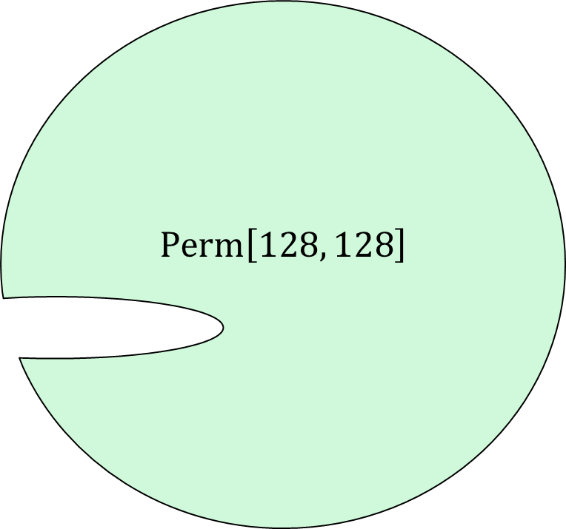


Block ciphers – security
$$\left|Func\left[128,128\right]\right|=$$
$$2^{2^{128}⋅128}$$
$$Func\left[128, 128\right]$$
$$\left|Perm\left[128,128\right]\right|=$$
$$2^{128}!$$
$$Perm\left[128, 128\right]$$
$$G\left(X\right)=\overline{X}$$
$$F\left(X\right)=X$$
$$V\left(X\right)=X⊕17$$
$$H\left(X\right)=00…0$$
$$\left|AES\right|=$$
$$2^{128}$$
$$AES$$

Slide 34


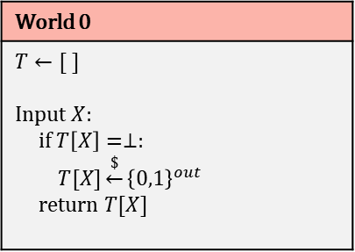

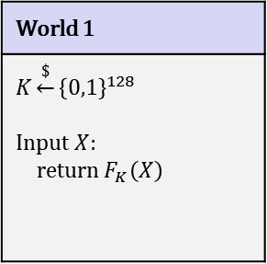

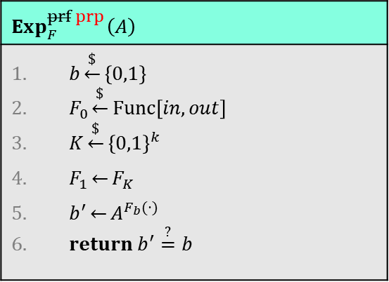
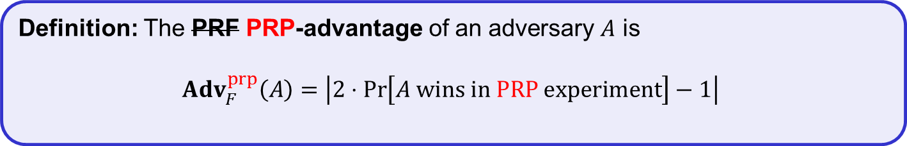

PRF PRP – security; formal definition
World 1
$$K\underset{←}{\$}{\left\{0,1\right\}}^{128}$$ Input $X$: return $F_{K}\left(X\right)$
$b$
World 0
$$T←[ ]$$ Input $X$: if $T\left[X\right]=⊥:$ $T[X]\underset{←}{\$}{\left\{0,1\right\}}^{out}$ return $T[X]$
$$Exp_{F}^{prf prp}\left(A\right)$$
$b\underset{←}{\$}\left\{0,1\right\}$ $F_{0}\underset{←}{\$}Func\left[in, out\right]$ $K\underset{←}{\$}{\left\{0,1\right\}}^{k}$ $F_{1}\underset{←}{}F_{K}$ $b^{′}\underset{←}{}A^{F_{b}(⋅)}$ $return b^{′}\overset{?}{=}b$
$$A=$$
$$Perm\left[128,128\right]$$
$$\backslash T.values$$
I’m in World $b′$
Definition: The PRF PRP-advantage of an adversary $A$ is
$${Adv}_{F}^{prp}\left(A\right)=\left|2⋅Pr\left[A wins in PRP­­­ experiment\right]−1\right|$$

Slide 35
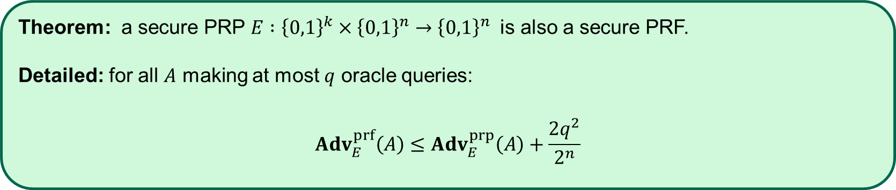
PRP security $⟹$ PRF security
Theorem: a secure PRP $E :{\left\{0,1\right\}}^{k}×{\left\{0,1\right\}}^{n}→{\left\{0,1\right\}}^{n}$ is also a secure PRF.
Detailed: for all $A$ making at most $q$ oracle queries:
$${Adv}_{E}^{prf}\left(A\right)≤{Adv}_{E}^{prp}\left(A\right)+\frac{{2q}^{2}}{2^{n}}$$

Slide 36


Constructing block ciphers

Slide 37
PRF – security; formal definition
$$Exp_{F}^{prf}\left(A\right)$$
$b\underset{←}{\$}\left\{0,1\right\}$ $F_{0}\underset{←}{\$}Func\left[in, out\right]$ $K\underset{←}{\$}{\left\{0,1\right\}}^{k}$ $F_{1}\underset{←}{}F_{K}$ $b^{′}\underset{←}{}A^{F_{b}(⋅)}$ $return b^{′}\overset{?}{=}b$
World 1
$$K\underset{←}{\$}{\left\{0,1\right\}}^{k}$$ Input $X$: return $F_{K}\left(X\right)$
World 0
$$T←[ ]$$ Input $X$: if $T\left[X\right]=⊥:$ $T[X]\underset{←}{\$}{\left\{0,1\right\}}^{out}$ return $T[X]$
$b$
$$A=$$
I’m in World $b′$
Definition: The PRF-advantage of an adversary $A$ is
$${Adv}_{F}^{prf}\left(A\right)=\left|2⋅Pr\left[b^{′}=b\right]−1\right|$$
Definition: The PRF-advantage of an adversary $A$ is
$${Adv}_{F}^{prf}\left(A\right)=\left|2⋅Pr\left[Exp_{F}^{prf}\left(A\right)⇒true\right]−1\right|$$

Slide 38
PRF PRP – security; formal definition
World 1
$$K\underset{←}{\$}{\left\{0,1\right\}}^{128}$$ Input $X$: return $F_{K}\left(X\right)$
$b$
World 0
$$T←[ ]$$ Input $X$: if $T\left[X\right]=⊥:$ $T[X]\underset{←}{\$}{\left\{0,1\right\}}^{out}$ return $T[X]$
$$Exp_{F}^{prf prp}\left(A\right)$$
$b\underset{←}{\$}\left\{0,1\right\}$ $F_{0}\underset{←}{\$}Func\left[in, out\right]$ $K\underset{←}{\$}{\left\{0,1\right\}}^{k}$ $F_{1}\underset{←}{}F_{K}$ $b^{′}\underset{←}{}A^{F_{b}(⋅)}$ $return b^{′}\overset{?}{=}b$
$$A=$$
$$Perm\left[128,128\right]$$
$$\backslash T.values$$
I’m in World $b′$
Definition: The PRF PRP-advantage of an adversary $A$ is
$${Adv}_{F}^{prp}\left(A\right)=\left|2⋅Pr\left[A wins in PRP­­­ experiment\right]−1\right|$$

Slide 39
Principles for designing block ciphers
Claude Shannon, “Communication Theory of Secrecy Systems”(1949):
  Diffusion: plaintext spread over large parts of the ciphertext
  Confusion: a complex relation between plaintext, key and ciphertext

Slide 40

















Block ciphers
$$K$$
$$ℰ$$
$$M$$
Key expansion
$$C$$
$n$ bits
$$K_{1}$$
$$K_{2}$$
$$K_{3}$$
$$K_{R}$$
$n$ bits
$$Rnd$$
$$Rnd$$
$$Rnd$$
$$Rnd$$
$$⋯$$
$Rnd(K_{i}, M)$ is called a round function
DES $R=16$
AES-128/192/256 $R=10/12/14$

Slide 41









PRPs from PRFs – the Feistel construction
$$L_{0}$$
$$R_{0}$$
Let $F :{{\left\{0,1\right\}}^{k}×\left\{0,1\right\}}^{n/2}→{\left\{0,1\right\}}^{n/2}$ be a PRF
  not a permutation!
Function $E\left(K,X\right)={Feistel}_{F}^{\left(4\right)}(K, X)$ is a PRP
  Called a Feistel network/construction
  $E :{\left\{0,1\right\}}^{4k}×{\left\{0,1\right\}}^{n}→{\left\{0,1\right\}}^{n}$
More or less DES:
$DES≈{Feistel}_{F}^{\left(16\right)} :{\left\{0,1\right\}}^{56}×{\left\{0,1\right\}}^{64}→{\left\{0,1\right\}}^{64}$
(56-bit key is expanded to 16 48-bit roundkeys)
$${ F}_{K_{1}}$$
$${ F}_{K_{2}}$$
$${ F}_{K_{3}}$$
$${ F}_{K_{4}}$$
$$L_{4}$$
$$R_{4}$$

Slide 42






Feistel network security – theory
$$L_{0}$$
$$R_{0}$$
Theorem: (Luby & Rackoff '86)
$F :{{\left\{0,1\right\}}^{k}×\left\{0,1\right\}}^{n/2}→{\left\{0,1\right\}}^{n/2}$ is a secure PRF
$⟹$ 3-round Feistel $E :{\left\{0,1\right\}}^{3k}×{\left\{0,1\right\}}^{n}→{\left\{0,1\right\}}^{n}$ is a secure PRP
$${ F}_{K_{1}}$$
$${ F}_{K_{2}}$$
$${ F}_{K_{3}}$$
$$L_{4}$$
$$R_{4}$$

Slide 43

Data Encryption Standard (DES)
1972 – NIST calls for a block cipher standard
1974 – Horst Feistel at IBM designs Lucifer
  Key-length: 128 bits; block-length: 128 bits
Lucifer evolves into DES
  Input from the NSA
  Key-length: 56 bits; block-length: 64 bits
  #Rounds: 16
1976 – Lucifer (now DES) is standardized
Widely implemented
1997 – Broken by exhaustive search
2001 – Replaced by AES

Slide 44
Block ciphers
$$K$$
$$ℰ$$
$$M$$
Key expansion
$$C$$
$n$ bits
$$K_{1}$$
$$K_{2}$$
$$K_{3}$$
$$K_{R}$$
$n$ bits
$$Rnd$$
$$Rnd$$
$$Rnd$$
$$Rnd$$
$$⋯$$

Slide 45












DES
$$L_{0}$$
$$R_{0}$$
$$K$$
$$ℰ$$
$${ F}_{K_{1}}$$
$$M$$
Key expansion
$$C$$
$64$ bits
$64$ bits
$${ F}_{K_{2}}$$
$$IP$$
$$IP^{−1}$$
$$⋮$$
$${ F}_{K_{16}}$$
$$F:{\left\{0,1\right\}}^{48}×{\left\{0,1\right\}}^{32}→{\left\{0,1\right\}}^{32}$$
$$L_{16}$$
$$R_{16}$$

Slide 46












DES round function
$$L_{0}$$
$$R_{0}$$
$$F(K_{i}, X)$$
$${ F}_{K_{1}}$$
$${ F}_{K_{2}}$$
$$⋮$$
S-box: function ${\left\{0,1\right\}}^{6}→{\left\{0,1\right\}}^{4}$
Implemented as a look-up table
$${ F}_{K_{16}}$$
$$L_{16}$$
$$R_{16}$$

Slide 47

DES properties
Easy to implement in hardware
Not as efficient in software
Many design decisions still unclear
  Design criteria classified for many years
  Controversy around NSA influence
  Initial S-boxes were changed
  Switching to 56-bit keys (from 128 bits) probably to allow NSA to decrypt
Not secure since key space and block length too small $⟹$ replacement needed

Slide 48
Advanced Encryption Standard

Slide 49






AES-128
128
$$K$$
128
128
128
128
128
$$K_{0}$$
$$K_{1}$$
$$K_{2}$$
$$K_{9}$$
$$K_{10}$$
input
SubBytes
ShiftRow
MixColumn
SubBytes
ShiftRow
MixColumn
SubBytes
ShiftRow
output
$$⊕$$
$$⊕$$
$$⊕$$
$$⋯$$
$$⊕$$
$$⊕$$
10 rounds

Slide 50



AES round function
SubBytes
ShiftRow
MixColumn

Slide 51



AES round function - SubBytes
SubBytes
ShiftRow
MixColumn
$a_{2,2}=$ 8A
$b_{2,2}=$ 7E

Slide 52
AES round function - ShiftRows
SubBytes
ShiftRow
MixColumn

Slide 53




AES round function - MixColumns
$$a_{1}$$
$$b_{1}$$
$$Ma_{1}=b_{1}$$
$$\left(\begin{matrix}\begin{matrix}02 & 03 \\ 01 & 02\end{matrix} & \begin{matrix}01 & 01 \\ 03 & 01\end{matrix} \\ \begin{matrix}01 & 01 \\ 03 & 01\end{matrix} & \begin{matrix}02 & 03 \\ 01 & 02\end{matrix}\end{matrix}\right)\left(\begin{matrix}a_{0,1} \\ a_{1,1} \\ \begin{matrix}a_{2,1} \\ a_{3,1}\end{matrix}\end{matrix}\right)=\left(\begin{matrix}b_{0,1} \\ b_{1,1} \\ \begin{matrix}b_{2,1} \\ b_{3,1}\end{matrix}\end{matrix}\right)$$
SubBytes
ShiftRow
MixColumn
$$1⋅a_{0,1}+2⋅a_{1,1}+3⋅a_{2,1}+1⋅a_{3,1}=b_{1,1}$$
$$a_{0,1}⊕{2⋇a}_{1,1}⊕3⋇a_{2,1}⊕a_{3,1}=b_{1,1}$$

Slide 54

AES-128
128
$$K$$
128
128
128
128
128
$$K_{0}$$
$$K_{1}$$
$$K_{2}$$
$$K_{9}$$
$$K_{10}$$
input
SubBytes
ShiftRow
MixColumn
SubBytes
ShiftRow
MixColumn
SubBytes
ShiftRow
output
$$⊕$$
$$⊕$$
$$⊕$$
$$⋯$$
$$⊕$$
$$⊕$$
10 rounds

Slide 55





AES round
$$a_{0,0}$$ | $$a_{0,1}$$ | $$a_{0,2}$$ | $$a_{0,3}$$
$$a_{1,0}$$ | $$a_{1,1}$$ | $$a_{1,2}$$ | $$a_{1,3}$$
$$a_{2,0}$$ | $$a_{2,1}$$ | $$a_{2,2}$$ | $$a_{2,3}$$
$$a_{3,0}$$ | $$a_{3,1}$$ | $$a_{3,2}$$ | $$a_{3,3}$$
SubBytes | $$b_{i,j}=S[a_{i,j}]$$
ShiftRows | $$\left[\begin{matrix}c_{0,j} \\ c_{1,j} \\ \begin{matrix}c_{2,j} \\ c_{3,j}\end{matrix}\end{matrix}\right]=\left[\begin{matrix}b_{0,j} \\ b_{1,j−1} \\ \begin{matrix}b_{2,j−2} \\ b_{3,j−3}\end{matrix}\end{matrix}\right]$$
MixColumns | $$\left[\begin{matrix}d_{0,j} \\ d_{1,j} \\ \begin{matrix}d_{2,j} \\ d_{3,j}\end{matrix}\end{matrix}\right]=\left[\begin{matrix}\begin{matrix}02 & 03 \\ 01 & 02\end{matrix} & \begin{matrix}01 & 01 \\ 03 & 01\end{matrix} \\ \begin{matrix}01 & 01 \\ 03 & 01\end{matrix} & \begin{matrix}02 & 03 \\ 01 & 02\end{matrix}\end{matrix}\right]\left[\begin{matrix}c_{0,j} \\ c_{1,j} \\ \begin{matrix}c_{2,j} \\ c_{3,j}\end{matrix}\end{matrix}\right]$$
AddRoundKey | $$\left[\begin{matrix}e_{0,j} \\ e_{1,j} \\ \begin{matrix}e_{2,j} \\ e_{3,j}\end{matrix}\end{matrix}\right]=\left[\begin{matrix}d_{0,j} \\ d_{1,j} \\ \begin{matrix}d_{2,j} \\ d_{3,j}\end{matrix}\end{matrix}\right]⊕\left[\begin{matrix}k_{0,j} \\ k_{1,j} \\ \begin{matrix}k_{2,j} \\ k_{3,j}\end{matrix}\end{matrix}\right]$$
$$\left[\begin{matrix}e_{0,j} \\ e_{1,j} \\ \begin{matrix}e_{2,j} \\ e_{3,j}\end{matrix}\end{matrix}\right]=\left[\begin{matrix}\begin{matrix}02 & 03 \\ 01 & 02\end{matrix} & \begin{matrix}01 & 01 \\ 03 & 01\end{matrix} \\ \begin{matrix}01 & 01 \\ 03 & 01\end{matrix} & \begin{matrix}02 & 03 \\ 01 & 02\end{matrix}\end{matrix}\right]\left[\begin{aligned}S[a_{0,j}] \\ S[a_{1,j−1}] \\ S[a_{2,j−2}] \\ S[a_{3,j−3}]\end{aligned}\right]⊕\left[\begin{matrix}k_{0,j} \\ k_{1,j} \\ \begin{matrix}k_{2,j} \\ k_{3,j}\end{matrix}\end{matrix}\right]$$
$$=\left(\left[\begin{aligned}02 \\ 01 \\ 01 \\ 03\end{aligned}\right]∙S[a_{0,j}]\right)⊕\left(\left[\begin{aligned}03 \\ 02 \\ 01 \\ 01\end{aligned}\right]∙S\left[a_{1,j−1}\right]\right)$$
$$⊕\left(\left[\begin{aligned}01 \\ 03 \\ 02 \\ 01\end{aligned}\right]∙S[a_{2,j−2}]\right)⊕\left(\left[\begin{aligned}01 \\ 01 \\ 03 \\ 02\end{aligned}\right]∙S[a_{3,j−3}]\right)⊕\left[\begin{matrix}k_{0,j} \\ k_{1,j} \\ \begin{matrix}k_{2,j} \\ k_{3,j}\end{matrix}\end{matrix}\right]$$
$$T_{0}\left[x\right]=\left(\left[\begin{aligned}02 \\ 01 \\ 01 \\ 03\end{aligned}\right]∙S\left[x\right]\right)$$ | $$T_{1}\left[x\right]=\left(\left[\begin{aligned}03 \\ 02 \\ 01 \\ 01\end{aligned}\right]∙S\left[x\right]\right)$$ | $$T_{2}\left[x\right]=\left(\left[\begin{aligned}01 \\ 03 \\ 02 \\ 01\end{aligned}\right]∙S\left[x\right]\right)$$ | $$T_{3}\left[x\right]=\left(\left[\begin{aligned}01 \\ 01 \\ 03 \\ 02\end{aligned}\right]∙S\left[x\right]\right)$$

Slide 56

AES round
$$a_{0,0}$$ | $$a_{0,1}$$ | $$a_{0,2}$$ | $$a_{0,3}$$
$$a_{1,0}$$ | $$a_{1,1}$$ | $$a_{1,2}$$ | $$a_{1,3}$$
$$a_{2,0}$$ | $$a_{2,1}$$ | $$a_{2,2}$$ | $$a_{2,3}$$
$$a_{3,0}$$ | $$a_{3,1}$$ | $$a_{3,2}$$ | $$a_{3,3}$$
SubBytes | $$b_{i,j}=S[a_{i,j}]$$
ShiftRows | $$\left[\begin{matrix}c_{0,j} \\ c_{1,j} \\ \begin{matrix}c_{2,j} \\ c_{3,j}\end{matrix}\end{matrix}\right]=\left[\begin{matrix}b_{0,j} \\ b_{1,j−1} \\ \begin{matrix}b_{2,j−2} \\ b_{3,j−3}\end{matrix}\end{matrix}\right]$$
MixColumns | $$\left[\begin{matrix}d_{0,j} \\ d_{1,j} \\ \begin{matrix}d_{2,j} \\ d_{3,j}\end{matrix}\end{matrix}\right]=\left[\begin{matrix}\begin{matrix}02 & 03 \\ 01 & 02\end{matrix} & \begin{matrix}01 & 01 \\ 03 & 01\end{matrix} \\ \begin{matrix}01 & 01 \\ 03 & 01\end{matrix} & \begin{matrix}02 & 03 \\ 01 & 02\end{matrix}\end{matrix}\right]\left[\begin{matrix}c_{0,j} \\ c_{1,j} \\ \begin{matrix}c_{2,j} \\ c_{3,j}\end{matrix}\end{matrix}\right]$$
AddRoundKey | $$\left[\begin{matrix}e_{0,j} \\ e_{1,j} \\ \begin{matrix}e_{2,j} \\ e_{3,j}\end{matrix}\end{matrix}\right]=\left[\begin{matrix}d_{0,j} \\ d_{1,j} \\ \begin{matrix}d_{2,j} \\ d_{3,j}\end{matrix}\end{matrix}\right]⊕\left[\begin{matrix}k_{0,j} \\ k_{1,j} \\ \begin{matrix}k_{2,j} \\ k_{3,j}\end{matrix}\end{matrix}\right]$$
$$\left[\begin{matrix}e_{0,j} \\ e_{1,j} \\ \begin{matrix}e_{2,j} \\ e_{3,j}\end{matrix}\end{matrix}\right]=T_{0}\left[a_{0,j}\right]⊕T_{1}\left[a_{1,j−1}\right]⊕T_{2}\left[a_{2,j−2}\right]⊕T_{3}\left[a_{3,j−3}\right]⊕\left[\begin{matrix}k_{0,j} \\ k_{1,j} \\ \begin{matrix}k_{2,j} \\ k_{3,j}\end{matrix}\end{matrix}\right]$$
$$T_{0}\left[x\right]=\left(\left[\begin{aligned}02 \\ 01 \\ 01 \\ 03\end{aligned}\right]∙S\left[x\right]\right)$$ | $$T_{1}\left[x\right]=\left(\left[\begin{aligned}03 \\ 02 \\ 01 \\ 01\end{aligned}\right]∙S\left[x\right]\right)$$ | $$T_{2}\left[x\right]=\left(\left[\begin{aligned}01 \\ 03 \\ 02 \\ 01\end{aligned}\right]∙S\left[x\right]\right)$$ | $$T_{3}\left[x\right]=\left(\left[\begin{aligned}01 \\ 01 \\ 03 \\ 02\end{aligned}\right]∙S\left[x\right]\right)$$

Slide 57
AES performance
AES is reasonably efficient in software
  T-table implementation very fast
  (but not secure!)
  Hard to implement fast and constant-time
Intel introduced dedicated AES instructions into their CPUs (AES-NI):
  aesenc, aesenclast: do one round of AES in one cycle
  aeskeygenassist: do AES key expansion
  aesdec, aesdeclast: do one round of AES decryption in one cycle
  aesimc: do AES inverser MixColumns
  Now standard in all modern CPUs
 | Throughput (my laptop)
AES-128 (in software) | 0.27 GB/s
AES-128 (w/AES-NI) | 3.45 GB/s

Slide 58


Attacking block ciphers

Slide 59
Attacks on block ciphers
Brute force attacks: search through every possible key in key space
  Generic: works for all block ciphers
  Not practical for large key spaces
Advanced attacks: try to exploit the concrete details of the block cipher
  Differential cryptanalysis ('90, but known by the designers of DES + NSA since mid '70 )
  Linear cryptanalysis ('92)
  AES designed to resist both
Implementation attacks: vulnerabilities due to implementation characteristics
  Power draw
  Timing
  Cache misses

Slide 60
Summary
Block ciphers are very important primitives (building blocks) – but they are not encryption schemes!
Correct abstraction: block ciphers = PRPs
Right security notion for PRFs/PRPs:
indistinguishability from random function/permutation
Concrete block cipher designs: DES and AES

