Slide 1
Lecture 1 – Introduction to cryptography
TEK4500
25.08.2021
Håkon Jacobsen
hakon.jacobsen@its.uio.no

Slide 2


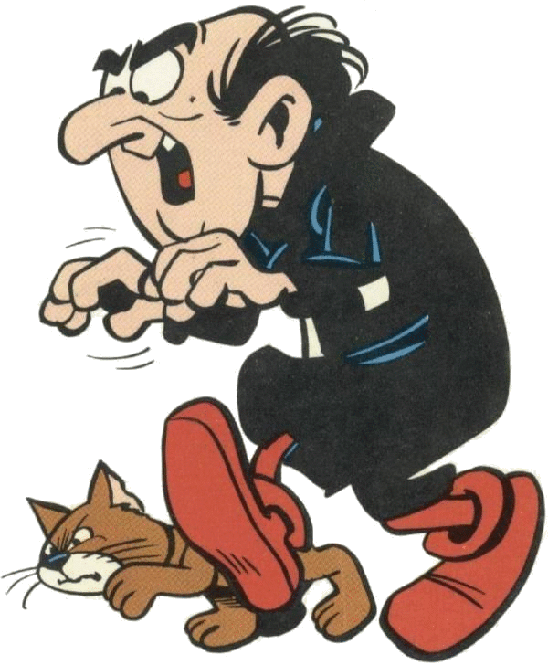
What is cryptography?
Internet
Alice
Bob
M
Adversary

Slide 3






What is cryptography?
Internet
Alice
Bob
M
Adversary

Slide 4
What is cryptography?
Internet
Alice
Bob
M
Adversary
Security goals:
Data privacy: adversary should not be able to read message M

Slide 5
What is cryptography?
Internet
Alice
Bob
M
M'
Adversary
Security goals:
Data privacy: adversary should not be able to read message M
Data integrity: adversary should not be able to modify message M
Data authenticity: message M really originated from Alice

Slide 6
Ideal solution: secure channels
Internet
But how to build?
Alice
Bob
M
Course done!
Adversary
Security goals:
Data privacy: adversary should not be able to read message M ✓
Data integrity: adversary should not be able to modify message M ✓
Data authenticity: message M really originated from Alice ✓

Slide 7


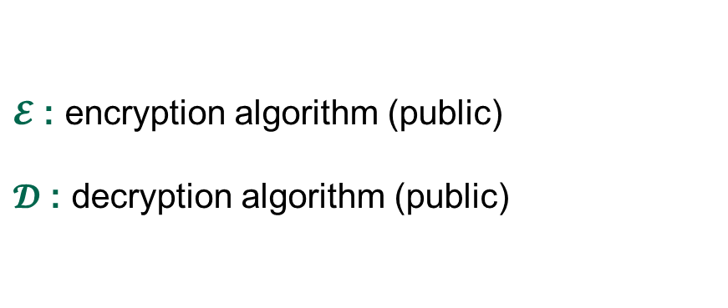
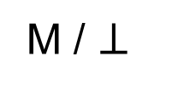
Creating secure channels: encryption schemes
Internet
Alice
Bob
K
K
$$ℰ$$
C
$$𝒟$$
M
M / $⊥$
Adversary
$𝓔$ : encryption algorithm (public)
$𝓓$ : decryption algorithm (public)
K : encryption / decryption key (secret)

Slide 8
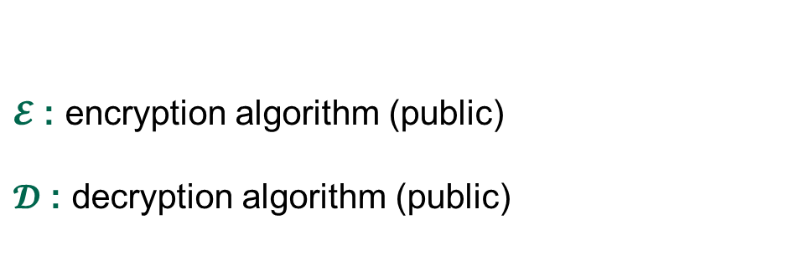
Creating secure channels: encryption schemes
Internet
Alice
Bob
K_{e}
K_{d}
$$ℰ$$
C
$$𝒟$$
M
M / $⊥$
Adversary
$𝓔$ : encryption algorithm (public)
$𝓓$ : decryption algorithm (public)
K : encryption / decryption key (secret)

Slide 9
Creating secure channels: encryption schemes
Internet
Alice
Bob
K_{e}
K_{d}
$$ℰ$$
C
$$𝒟$$
M
M / $⊥$
Adversary
$𝓔$ : encryption algorithm (public)
$𝓓$ : decryption algorithm (public)
K_{e} : encryption key (public)
K_{d} : decryption key (secret)

Slide 10
Basic goals of cryptography
 | Message privacy | Message integrity / authentication
Symmetric keys | Symmetric encryption | Message authentication codes (MAC)
Asymmetric keys | Asymmetric encryption (a.k.a. public-key encryption) | Digital signatures

Slide 11
Basic goals of cryptography
 | Message privacy | Message integrity / authentication
Symmetric keys | Symmetric encryption | Message authentication codes (MAC)
Asymmetric keys | Asymmetric encryption (a.k.a. public-key encryption) | Digital signatures

Slide 12
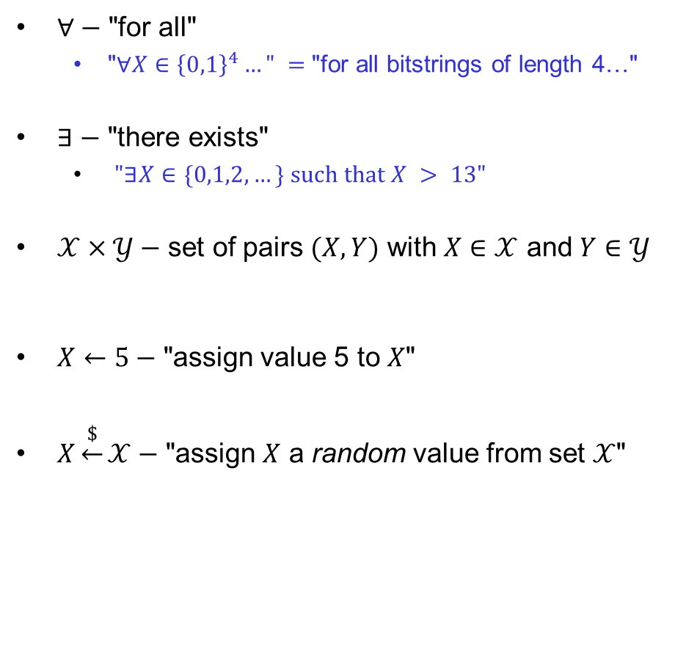
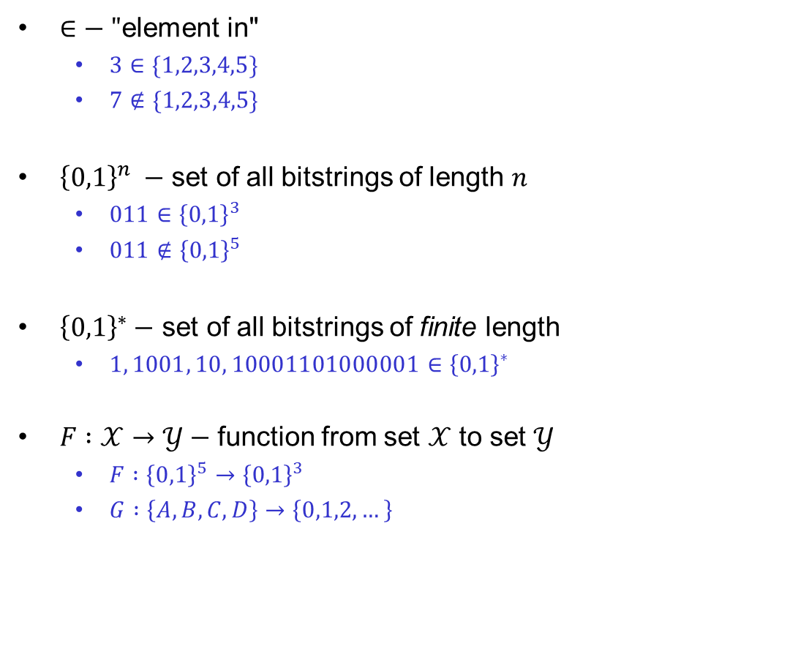
Some notation
$∈−$ "element in"
  $3∈\{1,2,3,4,5\}$
  $7∉\{1,2,3,4,5\}$
${\left\{0,1\right\}}^{n} −$ set of all bitstrings of length $n$
  $011∈{\left\{0,1\right\}}^{3}$
  $011∉{\left\{0,1\right\}}^{5}$
${\left\{0,1\right\}}^{∗}−$ set of all bitstrings of finite length
  $1, 1001, 10, 10001101000001∈{\left\{0,1\right\}}^{∗}$
$F :𝒳→𝒴−$ function from set $𝒳$ to set $𝒴$
  $F :{\left\{0,1\right\}}^{5}→{\left\{0,1\right\}}^{3}$
  $G :\left\{A,B,C,D\right\}→\left\{0,1,2,…\right\}$
$∀−$ "for all"
  "$∀X∈{\left\{0,1\right\}}^{4}…" =$"for all bitstrings of length 4…"
$∃−$ "there exists"
  $"∃X∈\{0,1,2, …\} such that X > 13"$
$𝒳×𝒴−$ set of pairs $(X,Y)$ with $X∈𝒳$ and $Y∈𝒴$
$X←5−$ "assign value 5 to $X$"
$X\underset{←}{\$}𝒳−$ "assign $X$ a random value from set $𝒳$"
…independent, and uniformly distributed…

Slide 13

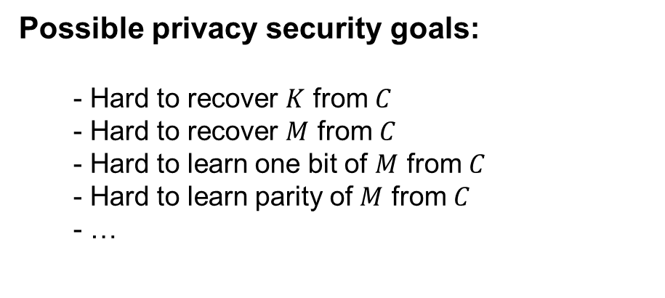
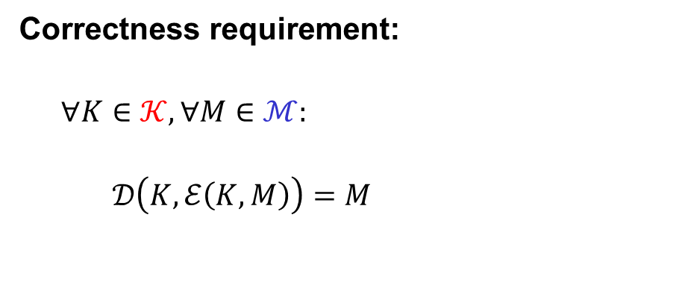




Symmetric encryption – syntax
$$Π=\left(ℰ, 𝒟\right)$$
Examples:
$$ℰ :𝒦×ℳ→𝒞$$
$$𝒦={\left\{0,1\right\}}^{128} ℳ={\left\{0,1\right\}}^{∗} 𝒞={\left\{0,1\right\}}^{∗}$$
$$ℰ\left(K, M\right)=ℰ_{K}\left(M\right)=C$$
$$𝒦={\left\{0,1\right\}}^{128} ℳ=\left\{A,B,…, Z\right\} 𝒞=\left\{A,B,…, Z\right\}$$
$$𝒟:𝒦×𝒞→ℳ$$
$$𝒦={\left\{0,1\right\}}^{128} ℳ=\left\{YES, NO\right\} 𝒞= {\left\{0,1\right\}}^{∗}$$
$$𝒟\left(K, C\right)=𝒟_{K}\left(C\right)=M$$
$$𝒦=\left\{1,…,p\right\} ℳ=\left\{A,B,…,Z\right\} 𝒞={\left\{0,1\right\}}^{∗}$$
Correctness requirement:
$$∀K∈𝒦, ∀M∈ℳ:$$
  $$𝒟\left(K, ℰ\left(K, M\right)\right)=M$$
Possible privacy security goals:
  Hard to recover $K$ from $C$
  Hard to recover $M$ from $C$
  Hard to learn one bit of $M$ from $C$
  Hard to learn parity of $M$ from $C$
  …

Slide 14
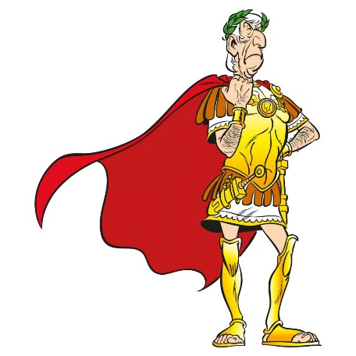
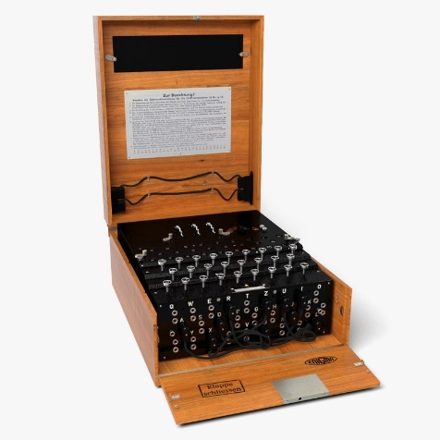
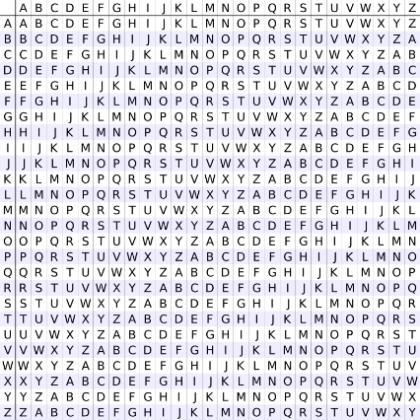
Historical encryption algorithms

Slide 15
Ceasar cipher
a b c d e f g h i j k l m n o p q r s t u v w x y z
a b c d e f g h i j k l m n o p q r s t u v w x y z
…
a
in the far distance a helicopter skimmed down between the roofs, hovered for an instant like a bluebottle, and darted away again with a curving flight. It was the police patrol, snooping into people's windows
lq wkh idu glvwdqfh d kholfrswhu vnlpphg grzq ehwzhhq wkh urriv, kryhuhg iru dq lqvwdqw olnh d eoxherwwoh, dqg gduwhg dzdb djdlq zlwk d fxuylqj ioljkw. Lw zdv wkh srolfh sdwuro, vqrrslqj lqwr shrsoh'v zlqgrzv

Slide 16
Ceasar cipher (ROT-13)
a b c d e f g h i j k l m n o p q r s t u v w x y z
a b c d e f g h i j k l m n o p q r s t u v w x y z
in the far distance a helicopter skimmed down between the roofs, hovered for an instant like a bluebottle, and darted away again with a curving flight. It was the police patrol, snooping into people's windows
va gur sne qvfgnapr n uryvpbcgre fxvzzrq qbja orgjrra gur ebbsf, ubirerq sbe na vafgnag yvxr n oyhrobggyr,
naq qnegrq njnl ntnva jvgu n pheivat syvtug. Vg jnf
gur cbyvpr cngeby, fabbcvat vagb crbcyr'f jvaqbjf

Slide 17
















Modular arithmetic
$$−4$$
$$−3$$
$$−2$$
$$−1$$
$$0$$
$$1$$
$$2$$
$$3$$
$$4$$
$$5$$
$$6$$
$$7$$
$$8$$
$$9$$
$$10$$
$$11$$

Slide 18




















Modular arithmetic
$$14$$
$$13$$
$$5$$
$$4$$
$$12$$
$$15$$
$$3$$
$$6$$
$$16$$
$$7$$
$$2$$
$$11$$
$$20$$
$$8$$
$$17$$
$$1$$
$$10$$
$$19$$
$$−4$$
$$−3$$
$$−2$$
$$−1$$
$$0$$
$$9$$
$$18$$

Slide 19
Modular arithmetic
$$14$$
$$13$$
$$5$$
$$4$$
$$12$$
$$15$$
$$3$$
$$6$$
$$16$$
$$7$$
$$2$$
$$11$$
$$20$$
$$8$$
$$17$$
$$1$$
$$10$$
$$19$$
$$−4$$
$$−3$$
$$−2$$
$$−1$$
$$0$$
$$9$$
$$18$$

Slide 20





Modular arithmetic
$$14$$
$$13$$
$$5$$
$$4$$
$$−4$$
$$12$$
$$15$$
$$3$$
$$6$$
$$−3$$
$$7$$
$$−2$$
$$2$$
$$16$$
$$11$$
$$20$$
$$−1$$
$$8$$
$$17$$
$$1$$
$$10$$
$$19$$
$$0$$
$$9$$
$$18$$

Slide 21












Modular arithmetic
$$14$$
$$13$$
$$5$$
$$4$$
$$1+3=4$$
$$−4$$
$$12$$
$$15$$
$$3$$
$$5+8=13$$
$$≡4 mod⁡9$$
$$6$$
$$−3$$
$$5⋅4=20≡2 mod⁡9$$
$$\operatorname{mod}{9}$$
$$2−5=−3≡6 mod⁡9$$
$$7$$
$$−2$$
$$2$$
$$16$$
$$11$$
$$20$$
$$2^{10}=1024≡7 mod⁡9$$
$$−1$$
$$8$$
$$17$$
$$1$$
$$10$$
$$158$$
$$=153+r$$
$$≡r\operatorname{mod}{9≡5 mod⁡9}$$
$$19$$
$$0$$
$$9$$
$$r<9$$
$$18$$
$$9→18→27→36→…→153→162$$

Slide 22

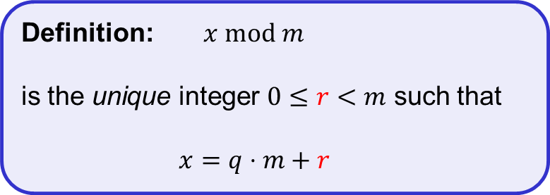
Modular arithmetic
$$14$$
$$13$$
$$5$$
$$4$$
$$1+3=4$$
$$−4$$
$$12$$
$$15$$
$$3$$
$$5+8=13$$
$$≡4 mod⁡9$$
$$6$$
$$−3$$
$$5⋅4=20≡2 mod⁡9$$
$$\operatorname{mod}{9}$$
$$2−5=−3≡6 mod⁡9$$
$$7$$
$$−2$$
$$2$$
$$16$$
$$11$$
$$20$$
$$2^{10}=1024≡7 mod⁡9$$
$$−1$$
$$8$$
Definition: $x mod m$
is the unique integer $0≤r<m$ such that
$x=q⋅m+r$
$$17$$
$$1$$
$$10$$
$$158$$
$$=153+r$$
$$≡r\operatorname{mod}{9≡5 mod⁡9}$$
$$19$$
$$0$$
$$9$$
$$r<9$$
$$18$$
$$9→18→27→36→…→153→162$$
More details: https://en.wikibooks.org/wiki/High_School_Mathematics_Extensions/Primes/Modular_Arithmetic

Slide 23

Ceasar cipher
a ↔ 0
b ↔ 1
c ↔ 2
d ↔ 3
e ↔ 4
⁞
z ↔ 25
$$C←M+3 (\operatorname{mod}{26})$$

Slide 24







ROT-13
a ↔ 0
b ↔ 1
c ↔ 2
d ↔ 3
e ↔ 4
⁞
z ↔ 25
$$C←M+13 (\operatorname{mod}{26})$$
$$M←C−13 (\operatorname{mod}{26})$$
$$𝒦=\{ \}$$
$$ℰ :𝒦×ℳ→𝒞$$
$$ℳ=\{0,1,2,…, 25\}$$
$$𝒟 :𝒦×𝒞→ℳ$$
$$𝒞=\{0,1,2,…, 25\}$$

Slide 25



ROT-K
a ↔ 0
b ↔ 1
c ↔ 2
d ↔ 3
e ↔ 4
⁞
z ↔ 25
$$C←M+K (\operatorname{mod}{26})$$
$$M←C−K (\operatorname{mod}{26})$$
$$𝒦=\{0,1,2, …,25\}$$
$$ℰ :𝒦×ℳ→𝒞$$
$$ℳ=\{0,1,2,…, 25\}$$
$$𝒟 :𝒦×𝒞→ℳ$$
$$𝒞=\{0,1,2,…, 25\}$$

Slide 26
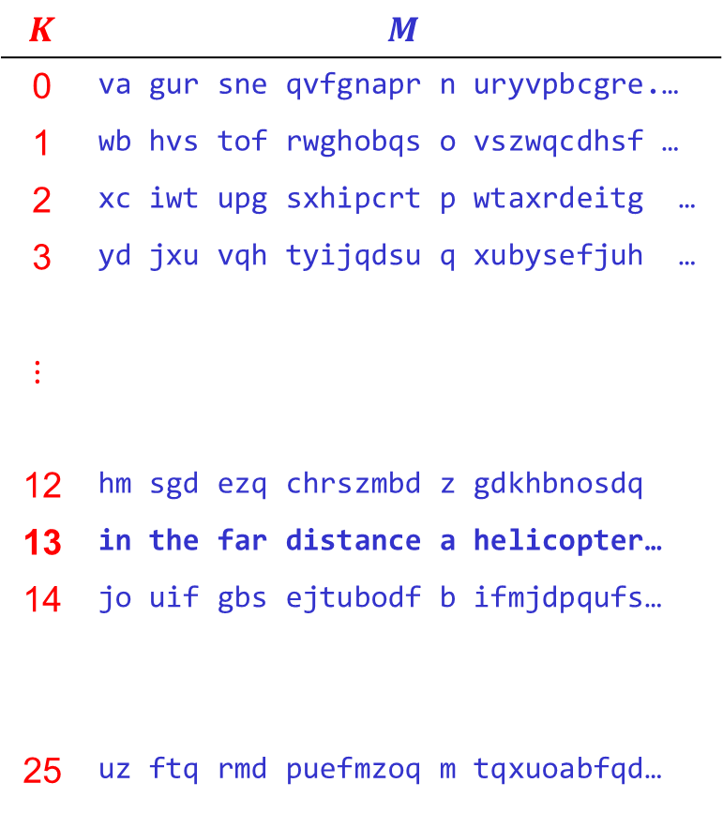


Attacking ROT-K
$$K$$ | $$M$$
0 | va gur sne qvfgnapr n uryvpbcgre.…
1 | wb hvs tof rwghobqs o vszwqcdhsf …
2 | xc iwt upg sxhipcrt p wtaxrdeitg …
3 | yd jxu vqh tyijqdsu q xubysefjuh …
$$⋮$$
12 | hm sgd ezq chrszmbd z gdkhbnosdq
13 | in the far distance a helicopter…
14 | jo uif gbs ejtubodf b ifmjdpqufs…
25 | uz ftq rmd puefmzoq m tqxuoabfqd…
$$\left|𝒦\right|=26$$
$C$ = va gur sne qvfgnapr n uryvpbcgre…
Conclusion: key space must be large enough!

Slide 27

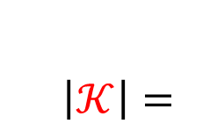

Substitution cipher
$\left|𝒦\right|=$
$$26!$$
$$≈{10}^{26}≈2^{88}$$
a b c d e f g h i j k l m n o p q r s t u v w x y z
↕ ↕ ↕ ↕ … ↕
s x d y w q f m j k o i l g z b e n t u c p a r v h
in the far distance a helicopter skimmed down between the roofs, hovered for an instant like a bluebottle, and darted away again with a curving flight. It was the police patrol, snooping into people's windows
jg umw qsn yjtusgdw s mwijdzbuwn tojllwy yzag xwuawwg umw nzzqt, mzpwnwy qzn sg jgtusgu ijow s xicwxzuuiw, sgy ysnuwy sasv sfsjg
ajum s dcnpjgf qijfmu. ju ast umw bzijdw bsunzi, tgzzbjgf jguz bwzbiw't ajgyzat

Slide 28

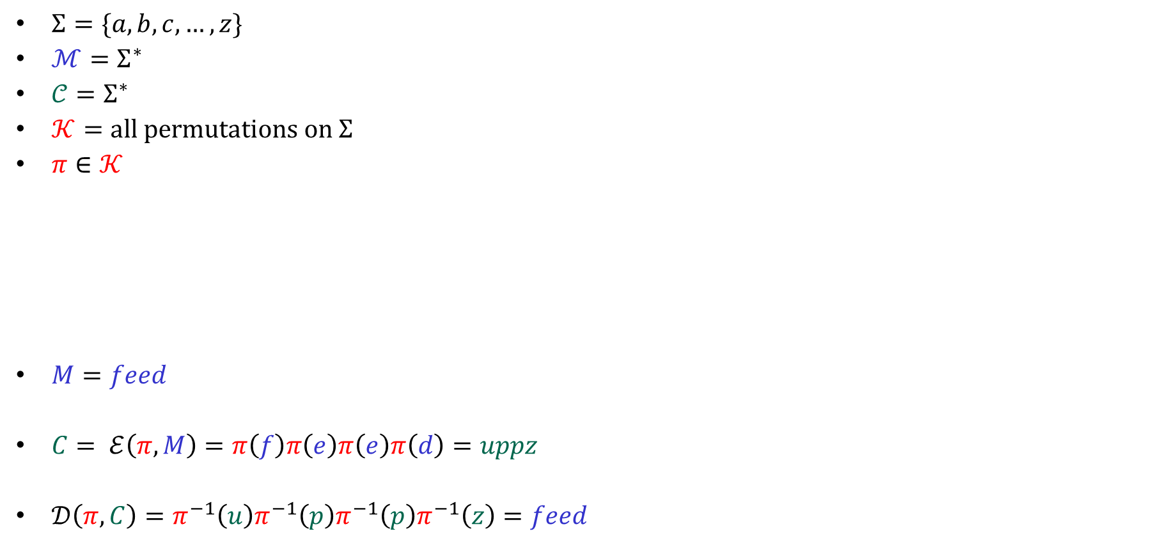

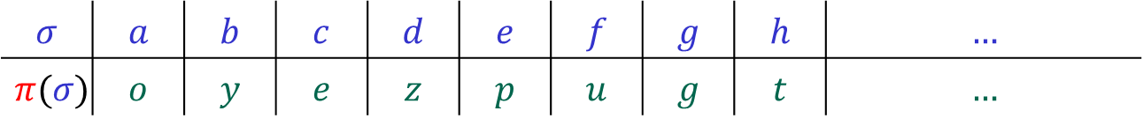

Substitution cipher – formal syntax
$Σ=\{a,b,c,…, z\}$
$ℳ=Σ^{∗}$
$𝒞=Σ^{∗}$
$𝒦=all permutations on Σ$
$π∈𝒦$
$M=feed$
$C= ℰ\left(π, M\right)=π\left(f\right)π\left(e\right)π\left(e\right)π\left(d\right)=uppz$
$𝒟\left(π, C\right)=π^{−1}\left(u\right)π^{−1}\left(p\right)π^{−1}\left(p\right)π^{−1}\left(z\right)=feed$
$$ℰ :𝒦×ℳ→𝒞$$
$$𝒟 :𝒦×𝒞→ℳ$$
$$= \{π :Σ→Σ ∣π a permutation\}$$
$$σ$$ | $$a$$ | $$b$$ | $$c$$ | $$d$$ | $$e$$ | $$f$$ | $$g$$ | $$h$$ | $$…$$
$$π(σ)$$ | $$o$$ | $$y$$ | $$e$$ | $$z$$ | $$p$$ | $$u$$ | $$g$$ | $$t$$ | $$…$$

Slide 29
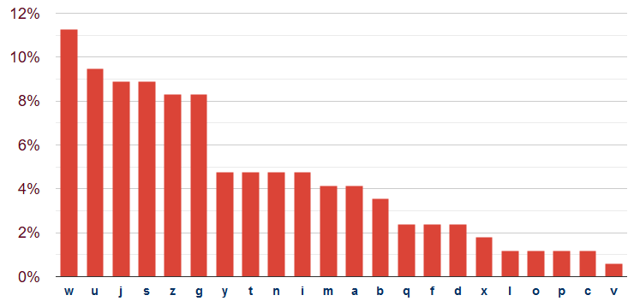
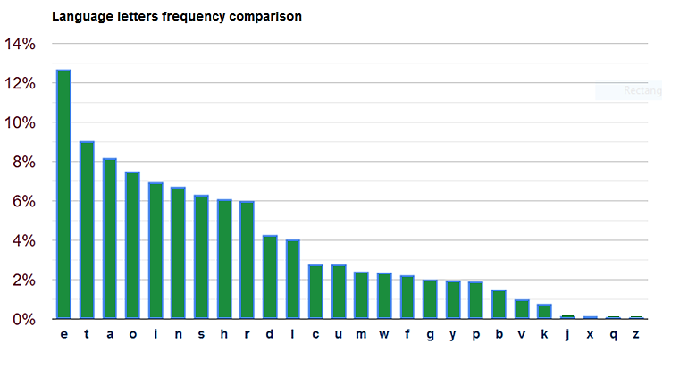


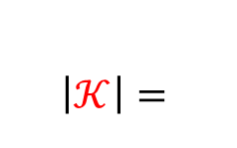
Attacking the substitution cipher
$\left|𝒦\right|=$
jg umw qsn yjtusgdw s mwijdzbuwn tojllwy yzag xwuawwg umw nzzqt, mzpwnwy qzn sg jgtusgu ijow s xicwxzuuiw, sgy ysnuwy sasv sfsjg ajum s dcnpjgf qijfmu. ju ast umw bzijdw bsunzi, tgzzbjgf jguz bwzbiw't ajgyzat
$$26!$$
$$≈{10}^{26}≈2^{88}$$
English letter frequency

Slide 30
Attacking the substitution cipher
$\left|𝒦\right|=$
jg ume qsn yjtusgde s meijdzbuen tojlley yzag xeuaeeg ume nzzqt, mzpeney qzn sg jgtusgu ijoe s xicexzuuie, sgy ysnuey sasv sfsjg ajum s dcnpjgf qijfmu. ju ast ume bzijde bsunzi, tgzzbjgf jguz bezbie't ajgyzat
$$26!$$
$$≈{10}^{26}≈2^{88}$$
English letter frequency
✓
✓

Slide 31
Attacking the substitution cipher
$\left|𝒦\right|=$
jg tme qsn yjttsgde s meijdzbten tojlley yzag xetaeeg tme nzzqt, mzpeney qzn sg jgttsgt ijoe s xicexzttie, sgy ysntey sasv sfsjg ajtm s dcnpjgf qijfmt. jt ast tme bzijde bstnzi, tgzzbjgf jgtz bezbie't ajgyzat
$$26!$$
$$≈{10}^{26}≈2^{88}$$
English letter frequency
✓
✓
✓
✓

Slide 32
Attacking the substitution cipher
$\left|𝒦\right|=$
jg tme qan yjttagde a meijdzbten tojlley yzag xetaeeg tme nzzqt, mzpeney qzn ag jgttagt ijoe a xicexzttie, agy yantey aaav afajg ajtm a dcnpjgf qijfmt. jt aat tme bzijde batnzi, tgzzbjgf jgtz bezbie't ajgyzat
$$26!$$
$$≈{10}^{26}≈2^{88}$$
English letter frequency
✓
✓
✓
✓
✓
✓

Slide 33
Attacking the substitution cipher
$\left|𝒦\right|=$
ig tme qan yittagde a meiidzbten toilley yzag xetaeeg tme nzzqt, mzpeney qzn ag igttagt iioe a xicexzttie, agy yantey aaav afaig aitm a dcnpigf qiifmt. it aat tme bziide batnzi, tgzzbigf igtz bezbie't aigyzat
$$26!$$
$$≈{10}^{26}≈2^{88}$$
English letter frequency
✓
✓
✓
✓
✓
✓
✓
✓

Slide 34
Attacking the substitution cipher
$\left|𝒦\right|=$
ig tme qan yittagde a meiidobten toilley yoag xetaeeg tme nooqt, mopeney qon ag igttagt iioe a xicexottie, agy yantey aaav afaig aitm a dcnpigf qiifmt. it aat tme boiide batnoi, tgoobigf igto beobie't aigyoat
$$26!$$
$$≈{10}^{26}≈2^{88}$$
English letter frequency
✓
✓
✓
✓
✓
✓
✓
✓
✓
✓

Slide 35
Attacking the substitution cipher
$\left|𝒦\right|=$
in tme qan yittande a meiidobten toilley yoan xetaeen tme nooqt, mopeney qon an inttant iioe a xicexottie, any yantey aaav afain aitm a dcnpinf qiifmt. it aat tme boiide batnoi, tnoobinf into beobie't ainyoat
$$26!$$
$$≈{10}^{26}≈2^{88}$$
English letter frequency
✓
✓
✓
✓
✓
✓
✓
✓
✓
✓
✓
✓

Slide 36
Attacking the substitution cipher
$\left|𝒦\right|=$
in tme qan yistande a meiidobten soilley yoan xetaeen tme nooqs, mopeney qon an instant iioe a xicexottie, any yantey aaav afain aitm a dcnpinf qiifmt. it aas tme boiide batnoi, tnoobinf into beobie's ainyoas
$$26!$$
$$≈{10}^{26}≈2^{88}$$
English letter frequency
✓
✓
✓
✓
✓
✓
✓
✓
✓
✓
✓
✓
✓
✓

Slide 37
Attacking the substitution cipher
$\left|𝒦\right|=$
in the qan distande a heiidobter soilled down xetween the rooqs, hopered qor an instant iioe a xicexottie, and danted awav afain with a dcrpinf qiifht. it was tme boiide batroi, tnoobinf into beobie's windows
$$26!$$
$$≈{10}^{26}≈2^{88}$$
English letter frequency
✓
✓
✓
✓
✓
✓
✓
✓
✓
✓
✓
✓
✓
✓
✓
✓
✓
✓
✓
✓
✓
✓
Notes:
https://planetcalc.com/8047/

Slide 38
Conclusions
Key space must be large enough
Ciphertext should not reveal letter frequency of the message
Is this enough?

Slide 39
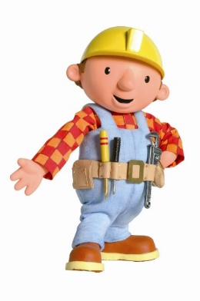


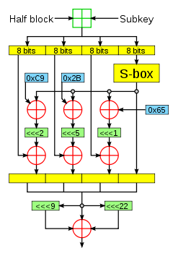

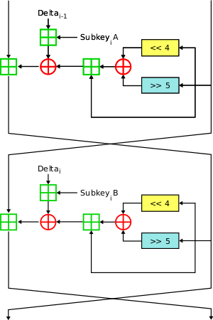
Historical approach to crypto development
build → break → fix → break → fix → break → fix ...
secure?

Slide 40
Modern approach
Trying to make cryptography more a science than an art
Focus on formal definitions of security (and insecurity)
Clearly stated assumptions
Analysis supported by mathematical proofs
... but old fashioned cryptanalysis continues to be very important!

Slide 41
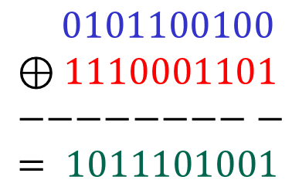







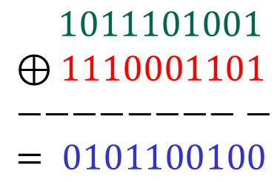






The one-time-pad (OTP)
$𝒦 ={\left\{0,1\right\}}^{n}$
Is OTP secure?
$ℳ={\left\{0,1\right\}}^{n}$
$𝒞 ={\left\{0,1\right\}}^{n}$
$$ℰ :𝒦×ℳ→𝒞$$
$$𝒟 :𝒦×𝒞→ℳ$$
$$ℰ\left(K, M\right)=K⊕M$$
$$𝒟\left(K, C\right)=K⊕C$$
$$0101100100$$
$$⊕1110001101 \\ −−−−−−−−− \\ = 1011101001$$
$$M$$
$$1011101001$$
$$⊕1110001101 \\ −−−−−−−−− \\ = 0101100100$$
$$C$$
$$K$$
$$K$$
$$C$$
$$M$$

Slide 42
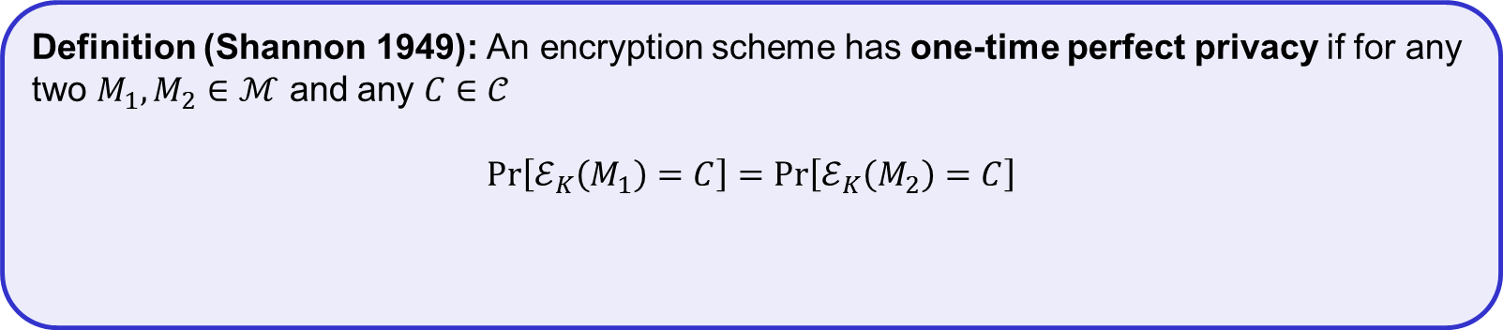
The one-time-pad (OTP)
$𝒦 ={\left\{0,1\right\}}^{n}$
Is OTP secure?
$ℳ={\left\{0,1\right\}}^{n}$
$𝒞 ={\left\{0,1\right\}}^{n}$
$$ℰ :𝒦×ℳ→𝒞$$
$$𝒟 :𝒦×𝒞→ℳ$$
$$ℰ\left(K, M\right)=K⊕M$$
$$𝒟\left(K, C\right)=K⊕C$$
Theorem: The OTP encryption scheme has one-time perfect privacy
Definition (Shannon 1949): An encryption scheme has one-time perfect privacy if for any two $M_{1}, M_{2}∈ℳ$ and any $C∈𝒞$
$$Pr\left[ℰ_{K}\left(M_{1}\right)=C\right]=Pr\left[ℰ_{K}\left(M_{2}\right)=C\right]$$
probability taken over the random choice $K\underset{←}{\$}𝒦$ and the random coins used by $ℰ$ (if any)

Slide 43
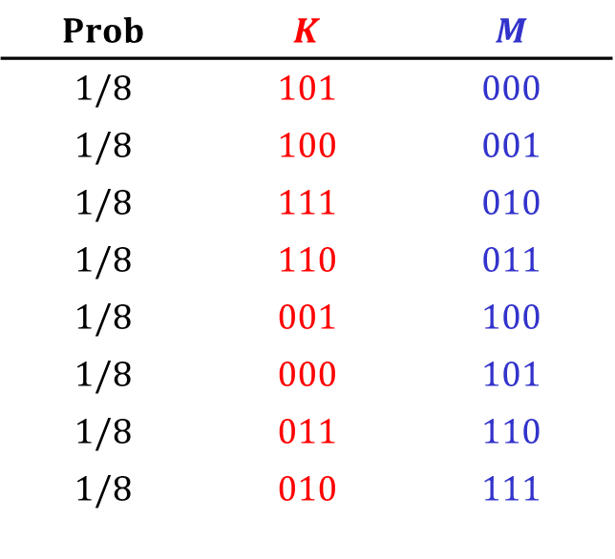
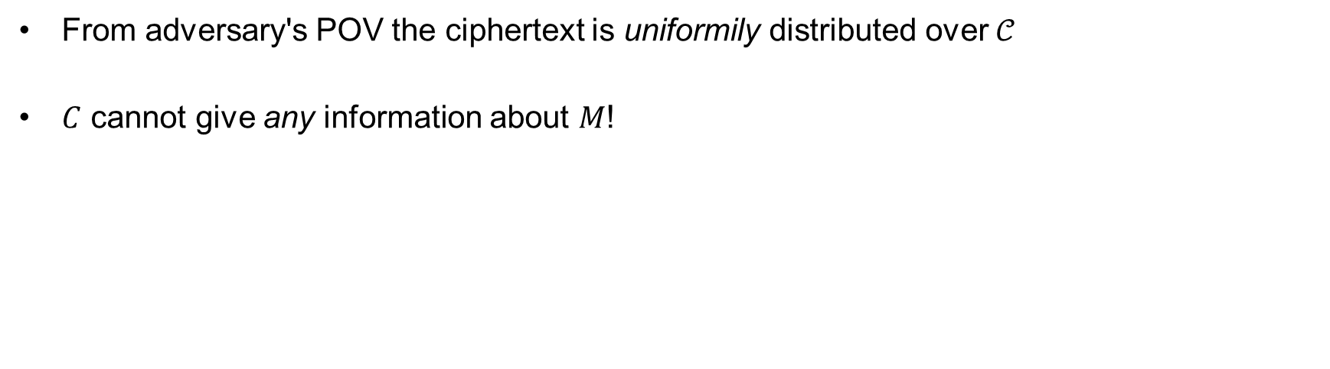

(One-time) perfect secrecy
From adversary's POV the ciphertext is uniformily distributed over $𝒞$
$C$ cannot give any information about $M$!
$$C=101$$
$$Prob$$ | $$K$$ | $$M$$
$$1/8$$ | $$101$$ | $$000$$
$$1/8$$ | $$100$$ | $$001$$
$$1/8$$ | $$111$$ | $$010$$
$$1/8$$ | $$110$$ | $$011$$
$$1/8$$ | $$001$$ | $$100$$
$$1/8$$ | $$000$$ | $$101$$
$$1/8$$ | $$011$$ | $$110$$
$$1/8$$ | $$010$$ | $$111$$

Slide 44
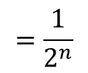

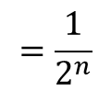
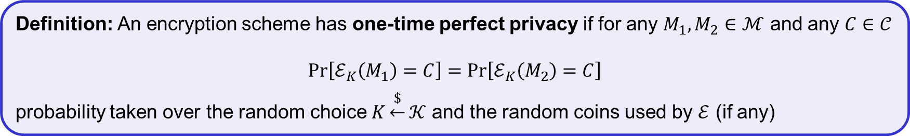






Proof of OTP one-time perfect privacy
Theorem: The OTP encryption scheme has one-time perfect privacy
Definition: An encryption scheme has one-time perfect privacy if for any $M_{1}, M_{2}∈ℳ$ and any $C∈𝒞$
$$Pr\left[ℰ_{K}\left(M_{1}\right)=C\right]=Pr\left[ℰ_{K}\left(M_{2}\right)=C\right]$$
probability taken over the random choice $K\underset{←}{\$}𝒦$ and the random coins used by $ℰ$ (if any)
Proof:
fix $M_{1}, M_{2}, C∈{\left\{0,1\right\}}^{n}$
Need to show: $\operatorname{Pr}\left[K⊕M_{1}=C\right]=\operatorname{Pr}\left[K⊕M_{2}=C\right]$
$$=Pr\left[K=M_{1}⊕C\right]$$
$$=Pr\left[K=Z_{1}\right]$$
$$=\frac{1}{2^{n}}$$
$$\operatorname{Pr}\left[K⊕M_{1}=C\right]$$
$$=Pr\left[K=M_{2}⊕C\right]$$
$$=Pr\left[K=Z_{2}\right]$$
$$=\frac{1}{2^{n}}$$
$$\operatorname{Pr}\left[K⊕M_{2}=C\right]$$
QED

Slide 45
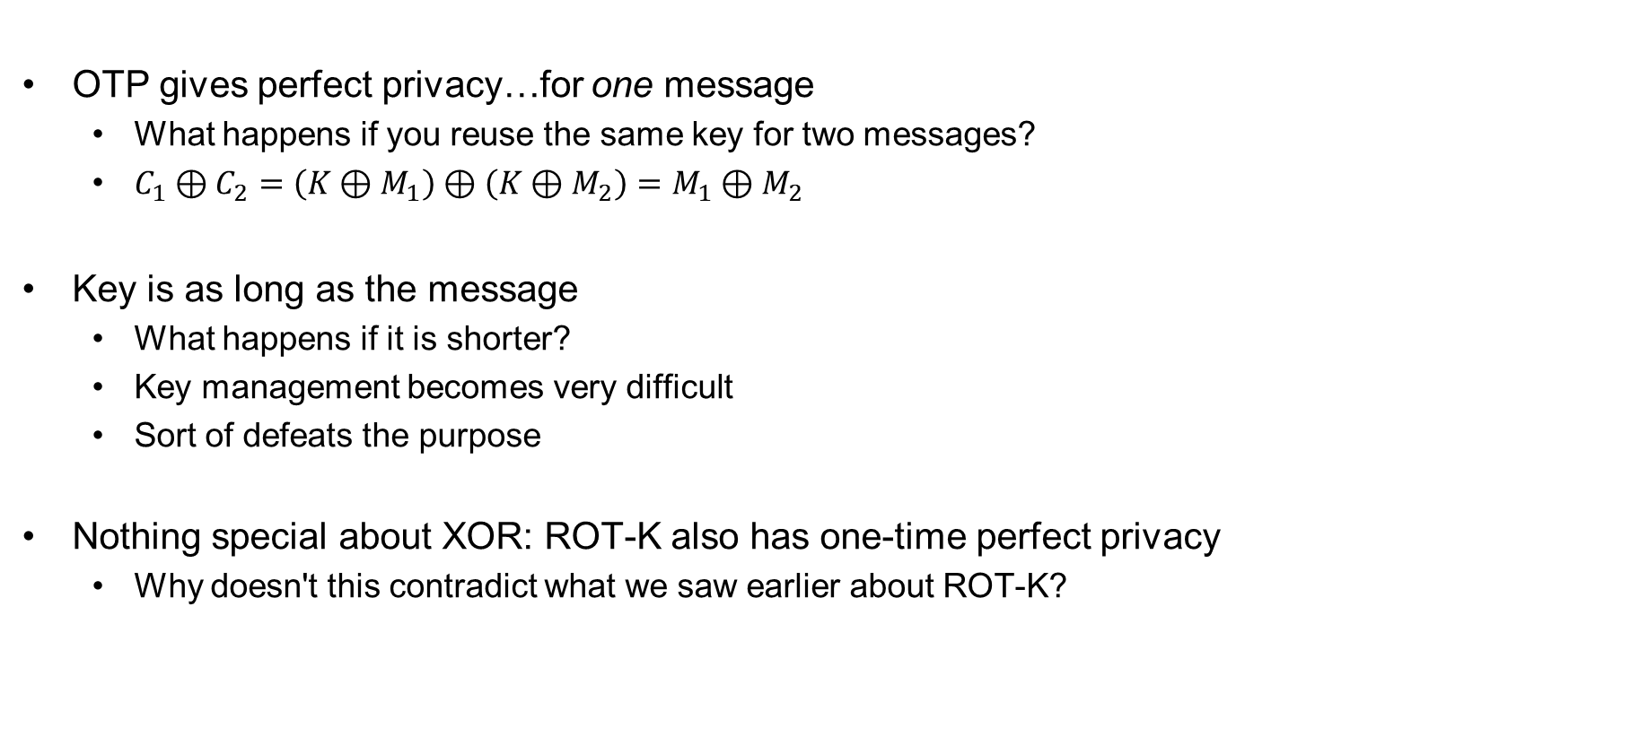
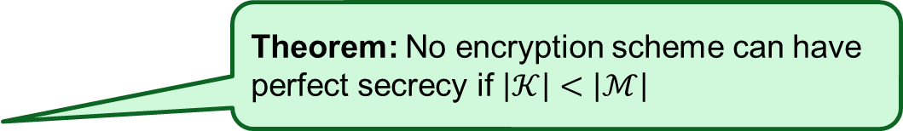
One-time pad – perfect?
OTP gives perfect privacy…for one message
  What happens if you reuse the same key for two messages?
  $C_{1}⊕C_{2}=\left(K⊕M_{1}\right)⊕\left(K⊕M_{2}\right)=M_{1}⊕M_{2}$
Key is as long as the message
  What happens if it is shorter?
  Key management becomes very difficult
  Sort of defeats the purpose
Nothing special about XOR: ROT-K also has one-time perfect privacy
  Why doesn't this contradict what we saw earlier about ROT-K?
Theorem: No encryption scheme can have perfect secrecy if $\left|𝒦\right|<\left|ℳ\right|$

Slide 46
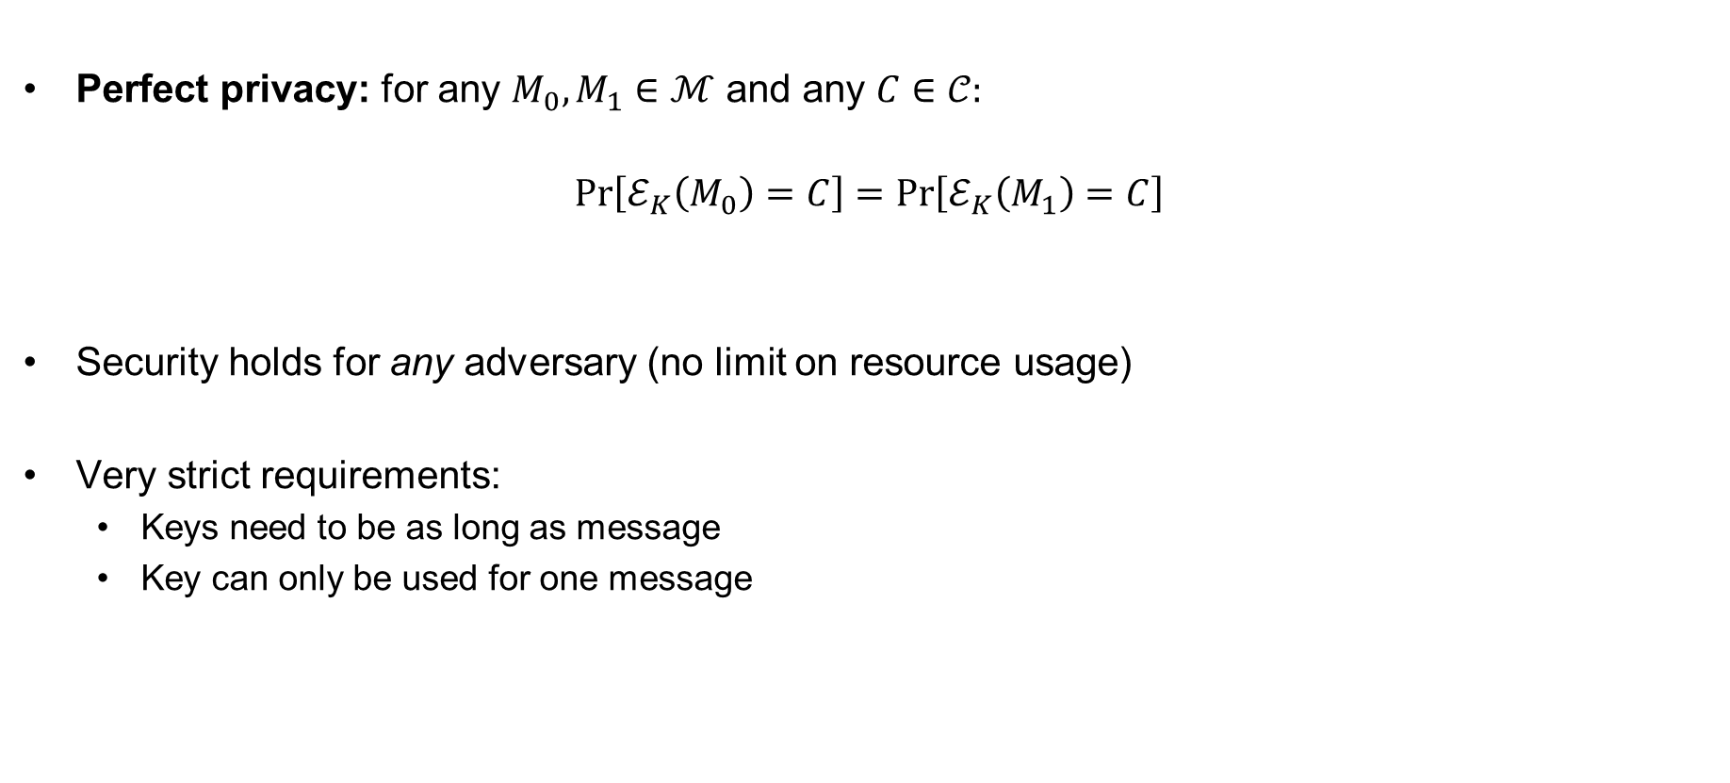
Wanted: security definition for symmetric encryption
Perfect privacy: for any $M_{0},M_{1}∈ℳ$ and any $C∈𝒞:$
$$Pr\left[ℰ_{K}\left(M_{0}\right)=C\right]=Pr\left[ℰ_{K}\left(M_{1}\right)=C\right]$$
Security holds for any adversary (no limit on resource usage)
Very strict requirements:
  Keys need to be as long as message
  Key can only be used for one message

Slide 47
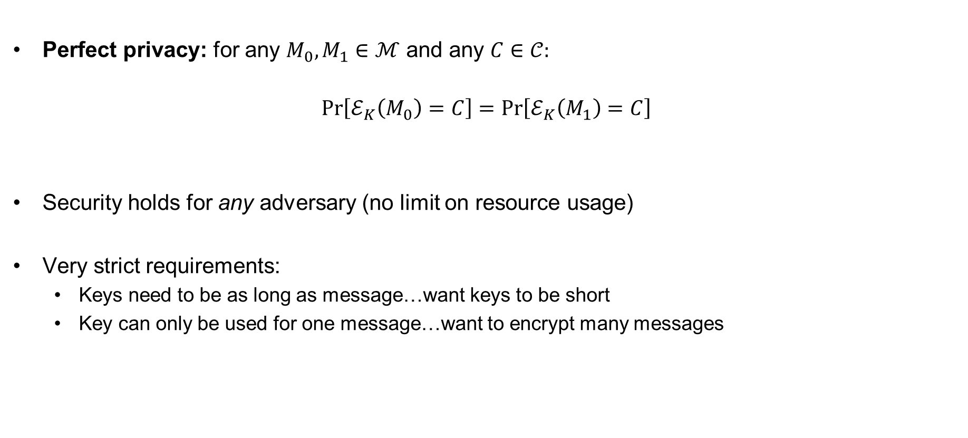
Wanted: security definition for symmetric encryption
Perfect privacy: for any $M_{0},M_{1}∈ℳ$ and any $C∈𝒞:$
$$Pr\left[ℰ_{K}\left(M_{0}\right)=C\right]=Pr\left[ℰ_{K}\left(M_{1}\right)=C\right]$$
Security holds for any adversary (no limit on resource usage)
Very strict requirements:
  Keys need to be as long as message…want keys to be short
  Key can only be used for one message…want to encrypt many messages

Slide 48

Modern cryptography – idea
Perfect privacy: for any $M_{0},M_{1}∈ℳ$ and any $C∈𝒞:$
$$Pr\left[ℰ_{K}\left(M_{0}\right)=C\right]=Pr\left[ℰ_{K}\left(M_{1}\right)=C\right]$$
Security holds for any adversary (no limit on resource usage)
Very strict requirements:
  Keys need to be as long as message…want keys to be short
  Key can only be used for one message…want to encrypt many messages
Computational
$$≈$$
resource bounded
✓
✓

Slide 49
Outline of course
 | Message privacy | Message integrity / authentication
Symmetric keys | Symmetric encryption | Message authentication codes (MAC)
Asymmetric keys | Asymmetric encryption (a.k.a. public-key encryption) | Digital signatures

Slide 50
Outline of course
 | Message privacy | Message integrity / authentication
Symmetric keys | Symmetric encryption | Message authentication codes (MAC)
Asymmetric keys | Asymmetric encryption (a.k.a. public-key encryption) | Digital signatures
Part I

Slide 51
Outline of course
 | Message privacy | Message integrity / authentication
Symmetric keys | Symmetric encryption | Message authentication codes (MAC)
Asymmetric keys | Asymmetric encryption (a.k.a. public-key encryption) | Digital signatures
Part II

Slide 52

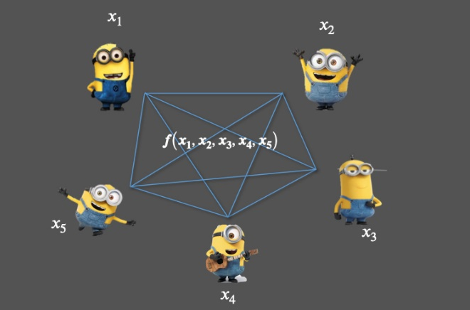
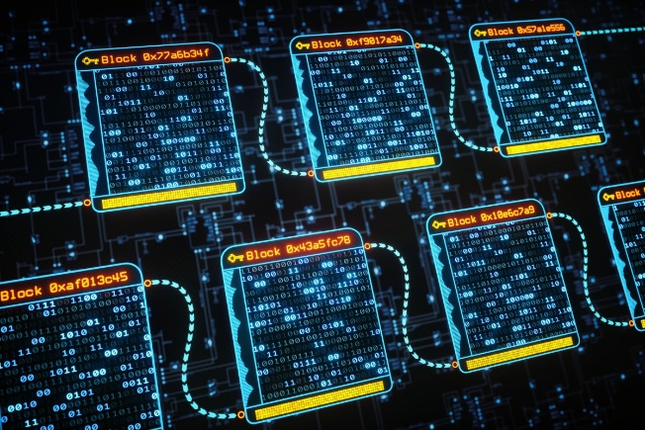
Much more to cryptography
Zero-knowledge proofs
Fully-homomorphic encryption
Multi-party computation
Blockchain
Password?
I know it
Welcome!
$$Enc\left(K, M_{1}+M_{2}\right)=Enc\left(K,M_{1}\right)+Enc\left(K, M_{2}\right)$$

Slide 53
The security pyramid
IN 5280 – Security by design
IN 5540 – Privacy by design
IN 5290 – Ethical hacking
User
Secure
systems
TEK 5510 – Security in operating systems and software
Communication
protocols
TEK 5520 – Cyber security of industrial systems
TEK 4500 – Introduction to cryptography
TEK 5550 – Advanced topics in cryptograpy
Cryptographic mechanisms

Slide 54
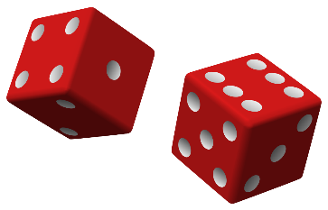
Discrete probability
the bare minimum
More detail: https://en.wikibooks.org/wiki/High_School_Mathematics_Extensions/Discrete_Probability

Slide 55
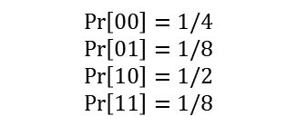
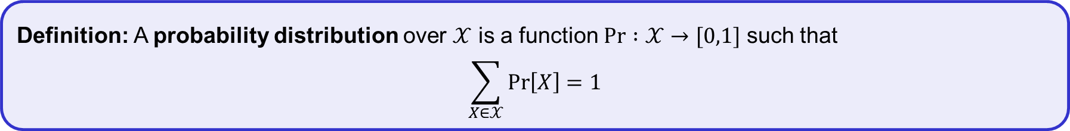
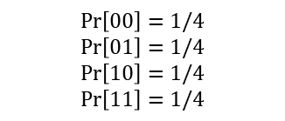

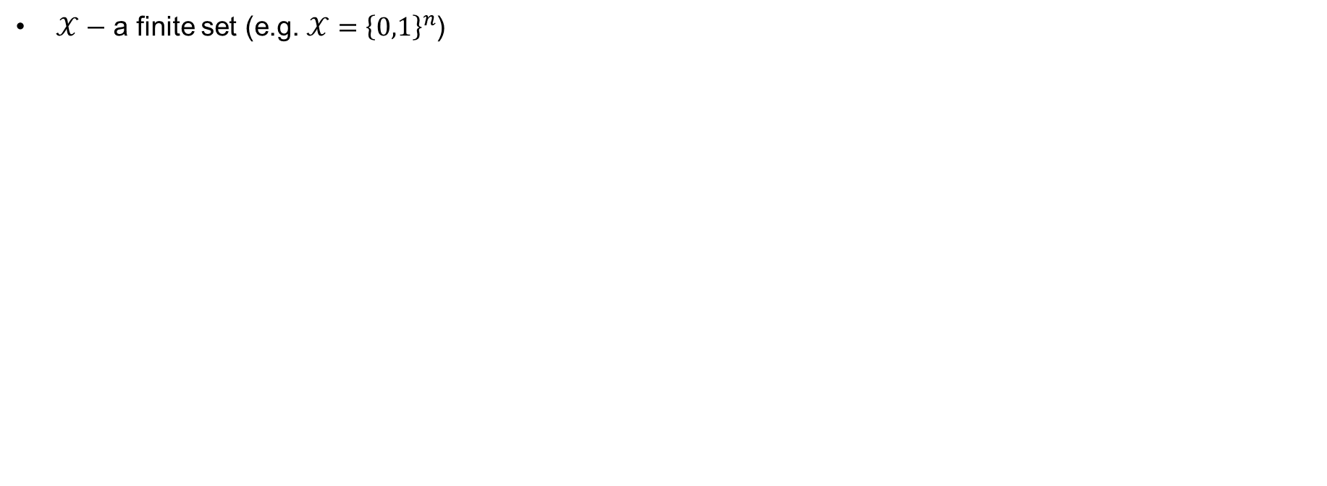


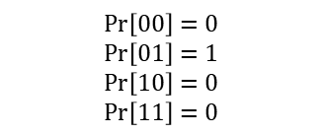
Discrete probability
$𝒳−$ a finite set (e.g. $𝒳={\left\{0,1\right\}}^{n}$)
Definition: A probability distribution over $𝒳$ is a function $\operatorname{Pr}{ :𝒳→[0,1]}$ such that
$$\sum_{X∈𝒳}{\operatorname{Pr}\left[X\right]=1}$$
$$𝒳={\left\{0,1\right\}}^{2}= \left\{00, 01, 10, 11\right\}$$
$$\operatorname{Pr}\left[X\right]$$
$$\operatorname{Pr}\left[X\right]$$
$$\operatorname{Pr}\left[00\right]=1/4$$
$$\operatorname{Pr}\left[01\right]=1/4$$
$$\operatorname{Pr}\left[10\right]=1/4$$
$$\operatorname{Pr}\left[11\right]=1/4$$
$$\operatorname{Pr}\left[00\right]=1/4$$
$$\operatorname{Pr}\left[01\right]=1/8$$
$$\operatorname{Pr}\left[10\right]=1/2$$
$$\operatorname{Pr}\left[11\right]=1/8$$
$$\operatorname{Pr}\left[00\right]=0$$
$$\operatorname{Pr}\left[01\right]=1$$
$$\operatorname{Pr}\left[10\right]=0$$
$$\operatorname{Pr}\left[11\right]=0$$
Uniform distribution
Point distribution

Slide 56
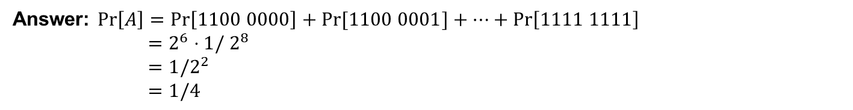
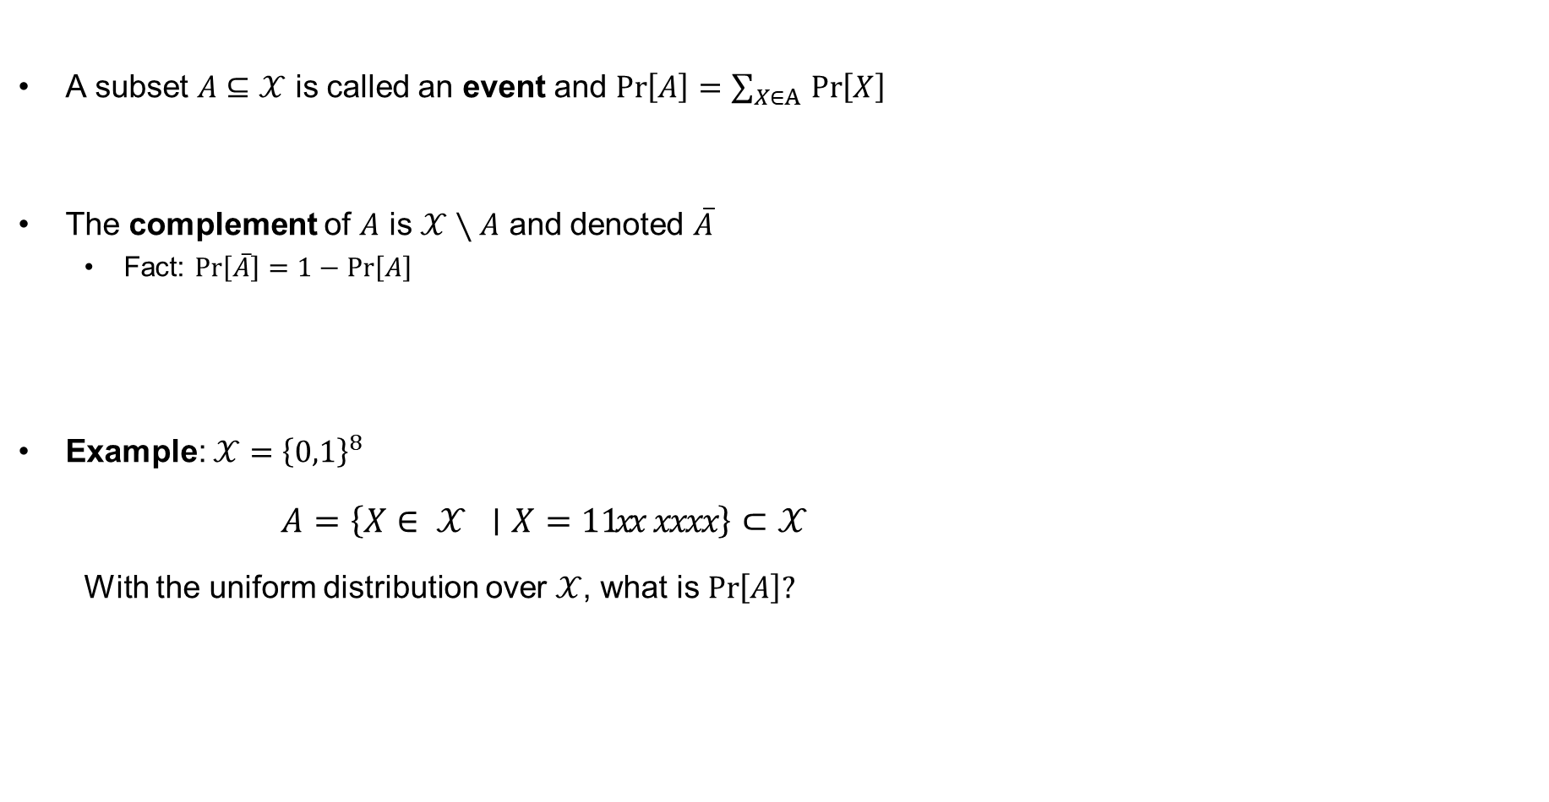

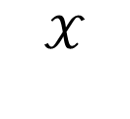
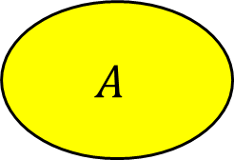
Discrete probability
A subset $A⊆𝒳$ is called an event and $\operatorname{Pr}\left[A\right]=\sum_{X∈A }{\operatorname{Pr}\left[X\right] }$
The complement of $A$ is $𝒳∖A$ and denoted $\overline{A}$
  Fact: $\operatorname{Pr}\left[\overline{A}\right]=1−\operatorname{Pr}\left[A\right]$
Example: $𝒳={\left\{0,1\right\}}^{8}$
  $A=\left\{X∈ 𝒳 ∣X=1 1xx xxxx\right\}⊂𝒳$
  With the uniform distribution over $𝒳$, what is $\operatorname{Pr}\left[A\right]?$
$$𝒳$$
$$A$$
$$\overline{A}$$
Answer: $\operatorname{Pr}\left[A\right]=\operatorname{Pr}\left[1100 0000\right]+Pr⁡[1100 0001]+…+\operatorname{Pr}\left[1111 1111\right]$
$=2^{6}⋅1/ 2^{8}$
$=1/2^{2}$
$=1/4$

Slide 57
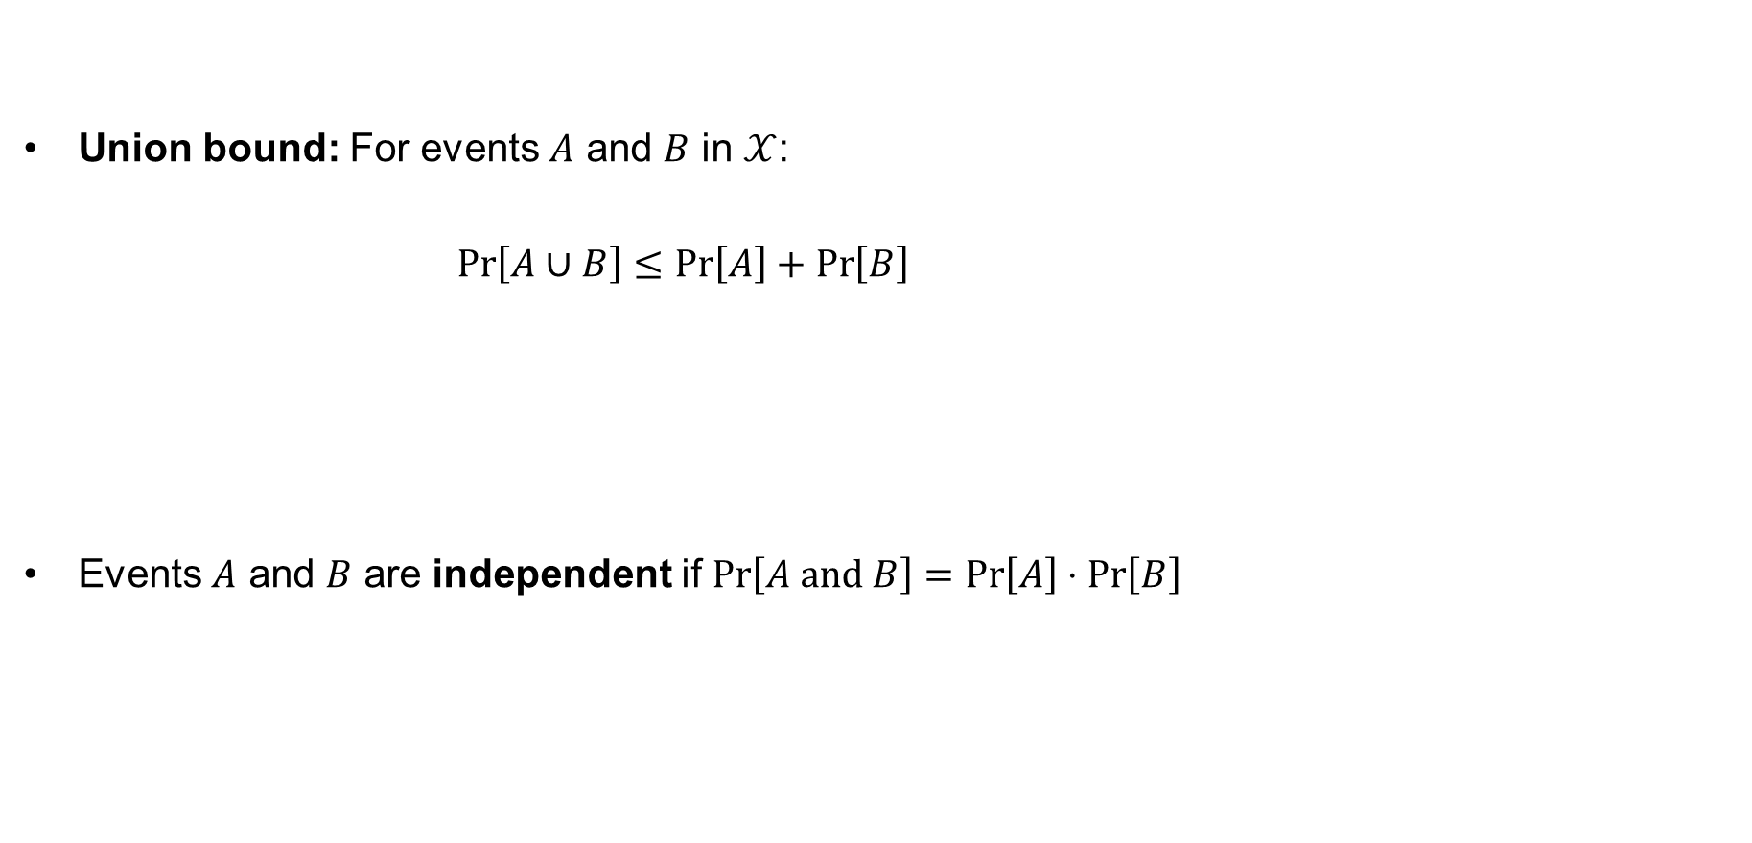
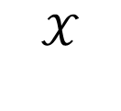
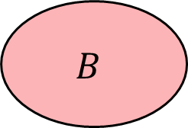

Union bound and independence
Union bound: For events $A$ and $B$ in $𝒳$:
$\operatorname{Pr}\left[A∪B\right]≤\operatorname{Pr}\left[A\right]+\operatorname{Pr}\left[B\right]$
Events $A$ and $B$ are independent if $\operatorname{Pr}\left[A and B\right]=\operatorname{Pr}\left[A\right]⋅\operatorname{Pr}\left[B\right]$
$$𝒳$$
$$A$$
$$B$$

Slide 58
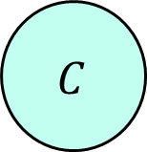












Law of total probability
Conditional probability
Total probability:
  $\operatorname{Pr}\left[A\right]=\operatorname{Pr}\left[A∣E_{1}\right]⋅\operatorname{Pr}\left[E_{1}\right]$
  $+\operatorname{Pr}\left[A∣E_{2}\right]⋅\operatorname{Pr}\left[E_{2}\right]$
  $⋮$
  $+Pr\left[A∣E_{n}\right]⋅\operatorname{Pr}\left[E_{n}\right]$
$$B$$
$$𝒳$$
$$\operatorname{Pr}\left[A∣B\right]>$$
$$\operatorname{Pr}\left[A\right]$$
$$C$$
$$\operatorname{Pr}\left[A∣C\right]=0$$
$$A$$
$$E_{1}$$
$$E_{3}$$
$$A$$
$$E_{2}$$
$$E_{n}$$

Slide 59







Randomized algorithms
Deterministic algorithm:
$y←A(x)$
Randomized algorithm:
$y←A(x;r)$ where $r\underset{←}{\$}{\left\{0,1\right\}}^{n}$
$y\underset{←}{\$}A(x)$
Inputs
Outputs
$$x$$
$$A(x)$$
$$x$$
$$A(x)$$
$$x′$$
$$A(x)$$

Slide 60
Next week
Block ciphers
Pseudorandom functions and pseuorandom permutations
DES, AES

