Slide 1
Lecture 8 – Group theory,
Diffie-Hellman key exchange
TEK4500
13.10.2020
Håkon Jacobsen
hakon.jacobsen@its.uio.no

Slide 2

Ideal solution: secure channels
How to build?
Internet
Alice
Bob
M
Adversary
Security goals:
Data privacy: adversary should not be able to read message M ✓
Data integrity: adversary should not be able to modify message M ✓
Data authenticity: message M really originated from Alice ✓

Slide 3



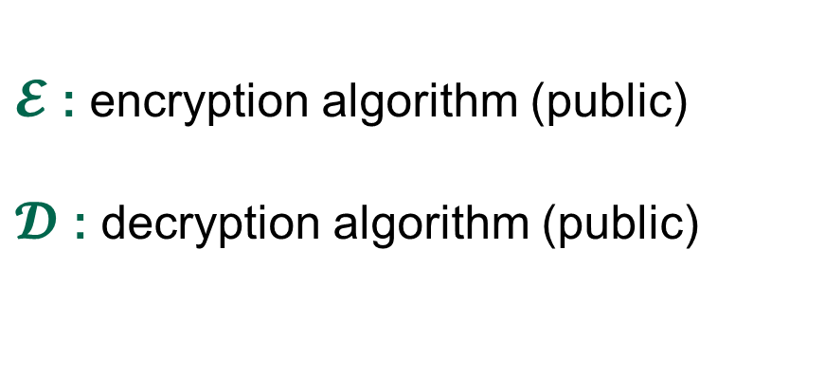
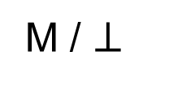
Creating secure channels: encryption schemes
Internet
Alice
Bob
K
K
$$ℰ$$
C
$$𝒟$$
M
M / $⊥$
Adversary
$𝓔$ : encryption algorithm (public)
$𝓓$ : decryption algorithm (public)
/ decryption
K : encryption key (secret)

Slide 4





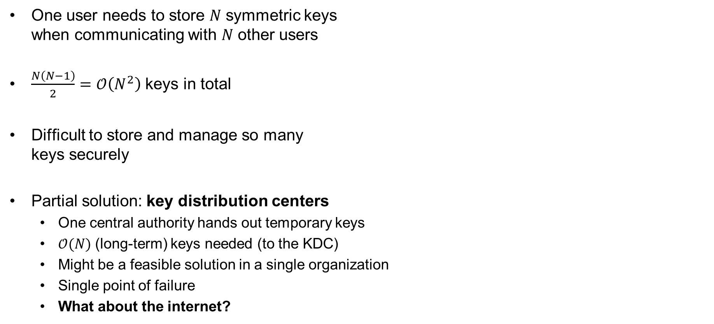
Symmetric key distribution problem
One user needs to store $N$ symmetric keys
when communicating with $N$ other users
$\frac{N\left(N−1\right)}{2}=𝒪\left(N^{2}\right)$ keys in total
Difficult to store and manage so many
keys securely
Partial solution: key distribution centers
  One central authority hands out temporary keys
  $𝒪(N)$ (long-term) keys needed (to the KDC)
  Might be a feasible solution in a single organization
  Single point of failure
  What about the internet?

Slide 5

The public-key revolution

Slide 6
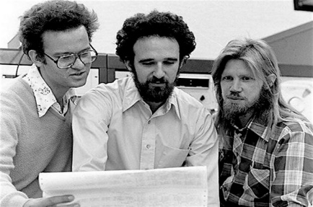
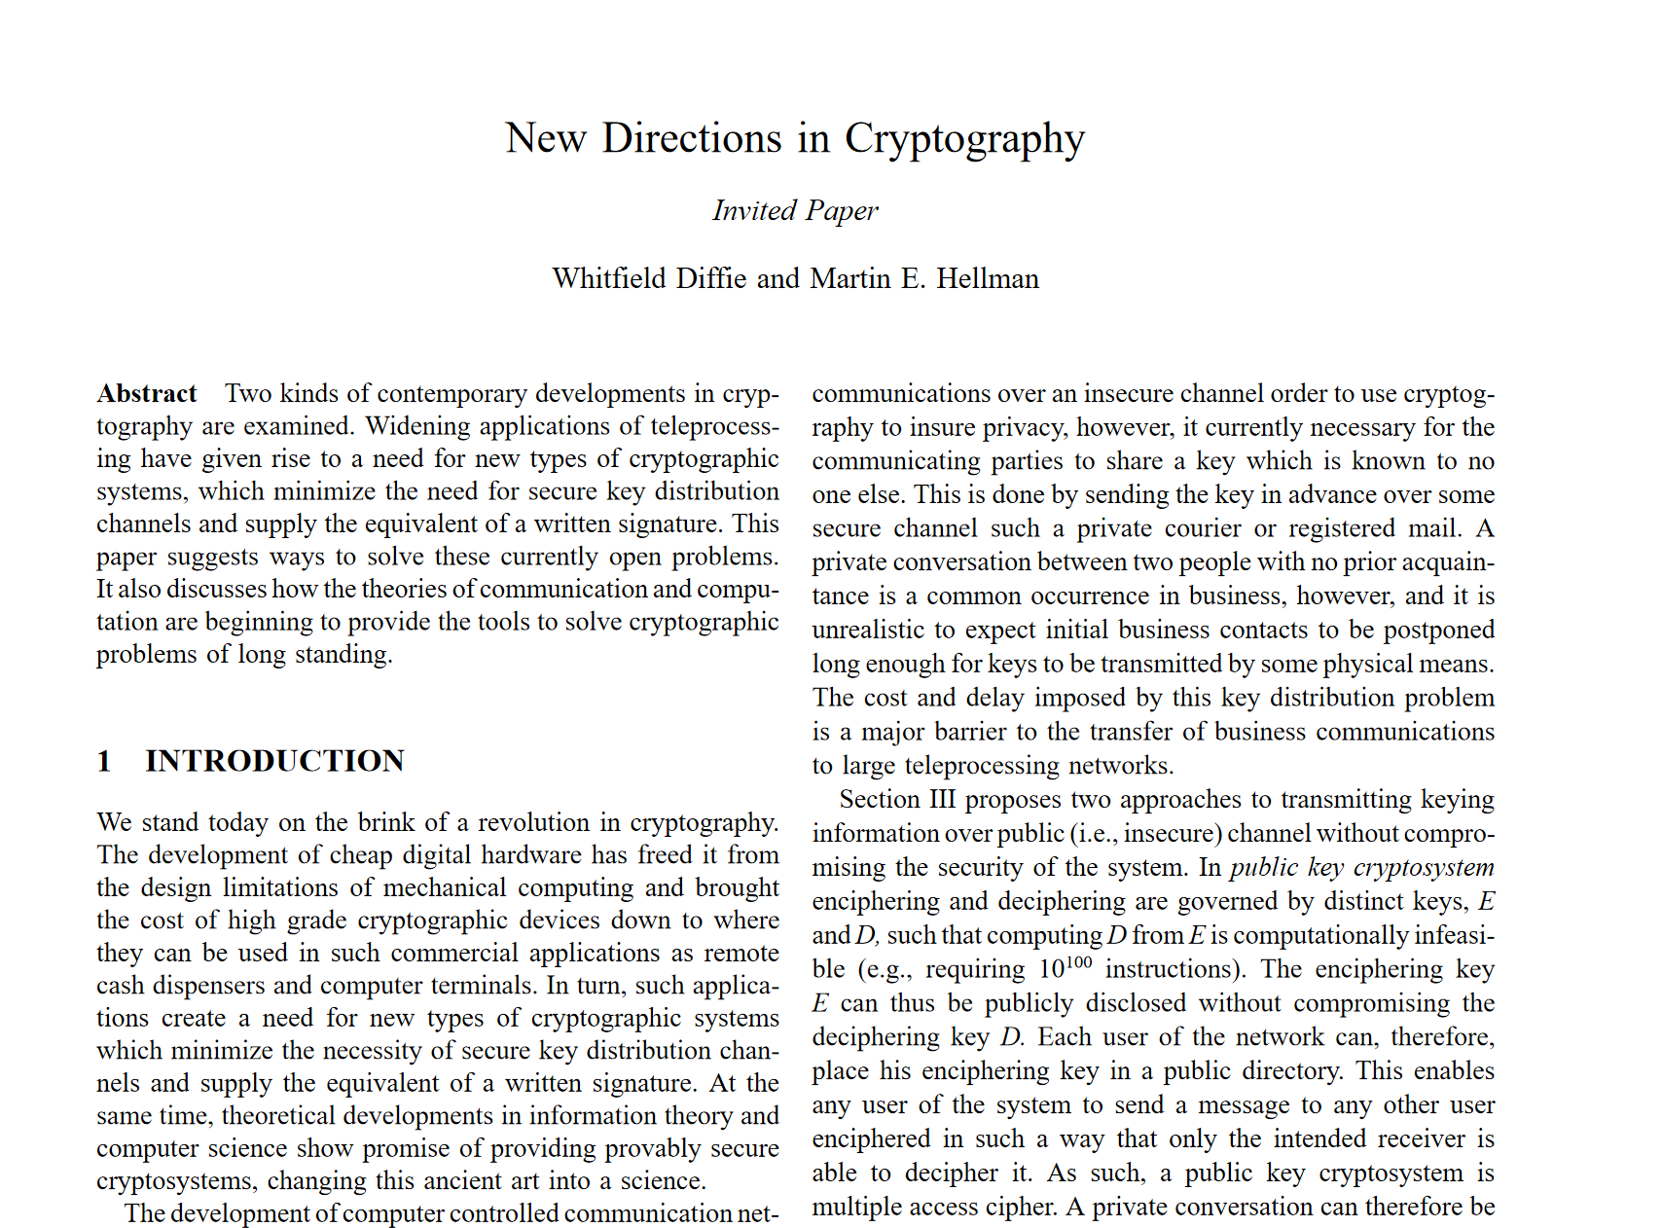
Diffie-Hellman key exchange
Discovered in the 1970's
Allows two parties to establish a shared secret
without ever having met
Diffie & Hellman paper also introduced:
  Public-key encryption
  Digital signatures
Ralph Merkle
Whitfield Diffie
Martin Hellman

Slide 7
Basic goals of cryptography
 | Message privacy | Message integrity / authentication
Symmetric keys | Symmetric encryption | Message authentication codes (MAC)
Asymmetric keys | Asymmetric encryption (a.k.a. public-key encryption) | Digital signatures
(Key exchange)

Slide 8















Diffie-Hellman key exchange – idea

Slide 9


Diffie-Hellman key exchange – idea
$$K$$
$$K$$

Slide 10
Diffie-Hellman key exchange + authenticated encryption
AES-GCM
$$K$$
$$K$$

Slide 11


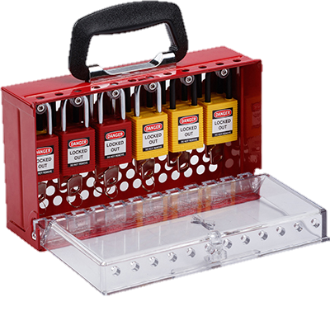

Public-key encryption

Slide 12
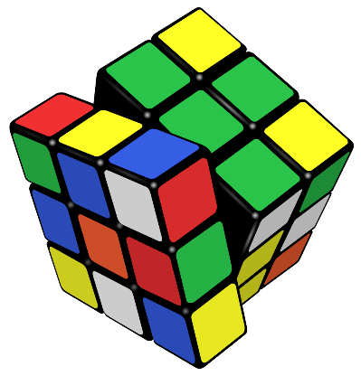
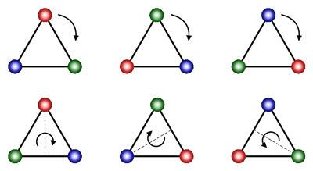




$$Z_{10}$$
$$Z_{5}$$
$$Z_{2}$$
$$0$$
Constructing asymmetric cryptography: group theory + number theory

Slide 13
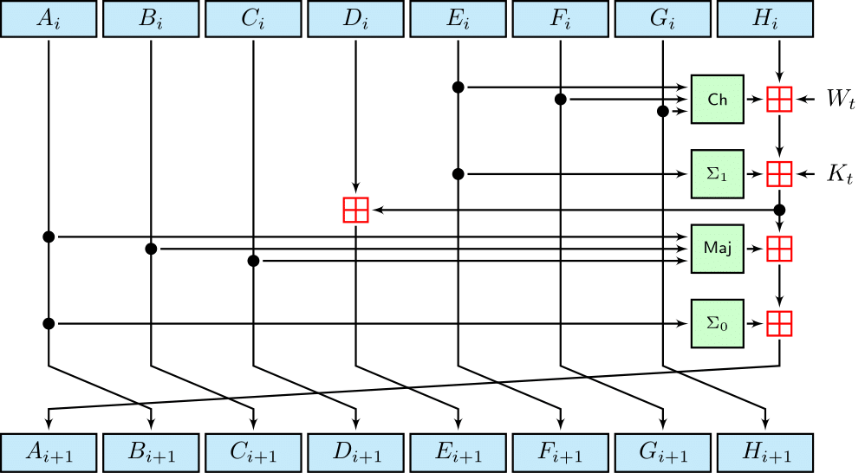
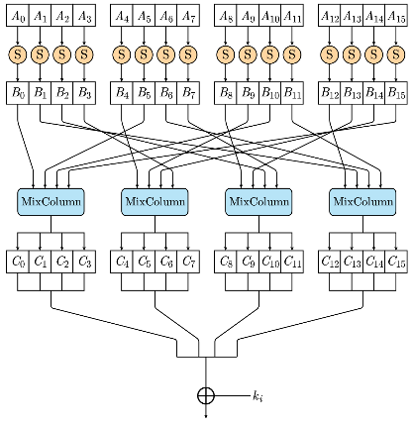
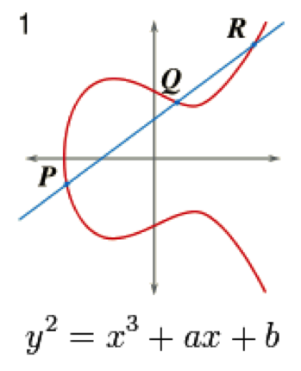
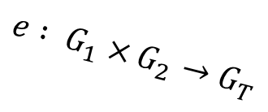

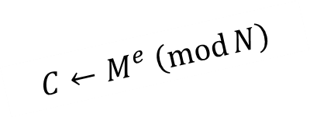
A different kind of primitives
Symmetric crypto boils down to the security of a few primitives
  Block ciphers, PRFs, hash functions
  Good candidates: AES-256, SHA2-256
  Why are these considered secure?
    Answer: lots and lots of cryptanalysis
  However, they are artificial and man-made
Want asymmetric crypto to be based on a few well-studied primitives too
  Candidates now come from a different place:
    hard mathematical problems
  Good candidates: discrete logarithm problem, factoring
  Much more algebraic structure
$$Z_{n}^{∗}≃Z_{p_{1}}^{∗}×Z_{p_{2}}^{∗}×⋯×Z_{p_{t}}^{∗}$$
$$C←M^{e} \left(\operatorname{mod}{N}\right)$$
$$e : G_{1}×G_{2}→G_{T}$$

Slide 14









Preliminaries
(integers)
$$Z=\left\{…, −2, −1, 0, 1, 2, 3, …\right\}$$
(reals)
$R=$ the real numbers
$R^{∗}=R∖\{0\}$
(integers “mod $n$”)
$$Z_{n}=\left\{0, 1, 2, …, n−1\right\}$$
(integers “mod $p$”)
$$Z_{p}=\left\{0, 1, 2, …, p−1\right\}$$
$$Z_{p}^{∗}=Z_{p}∖\left\{0\right\}$$
Examples:
$$Z_{11}=\left\{0, 1, 2, 3, 4, 5, 6, 7, 8, 9, 10\right\}$$
$$Z_{11}^{∗}=\left\{1, 2, 3, 4, 5, 6, 7, 8, 9, 10\right\}$$

Slide 15
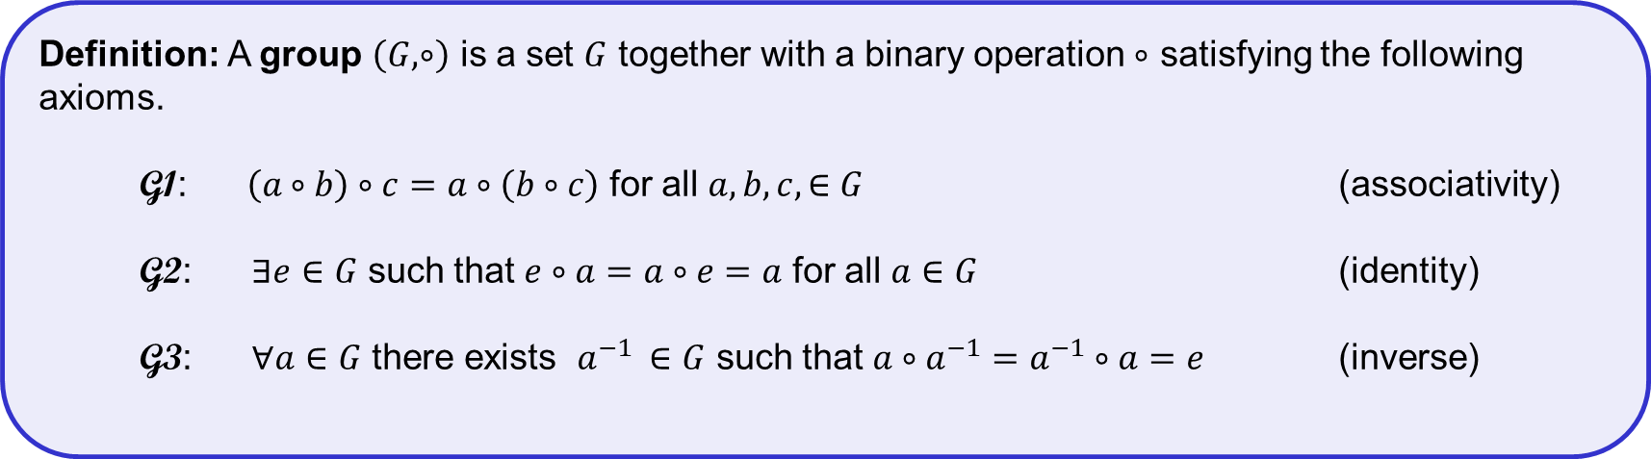
Group – definition
Definition: A group $\left(G, ∘\right)$ is a set $G$ together with a binary operation $∘$ satisfying the following axioms.
G1: $\left(a∘b\right)∘c=a∘\left(b∘c\right)$ for all $a,b,c,∈G$ (associativity)
G2: $∃e∈G$ such that $e∘a=a∘e=a$ for all $a∈G$ (identity)
G3: $∀a∈G$ there exists $a^{−1 }∈G$ such that $a∘a^{−1}=a^{−1}∘a=e$ (inverse)
A group is abelian/commutative if: $a∘b=b∘a$ for all $a,b∈G$
The order of a group is the number of elements in $G$, denoted $\left|G\right|$

Slide 16
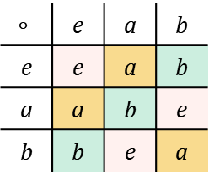





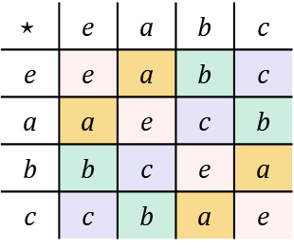
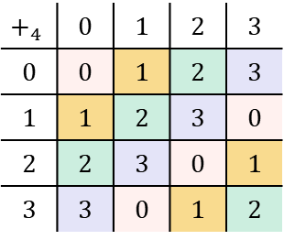



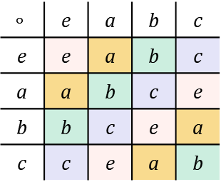















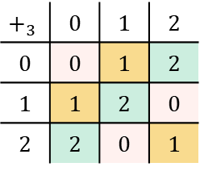

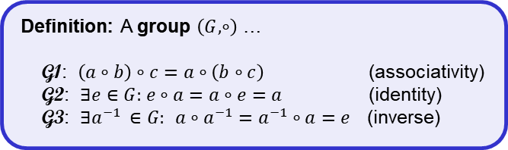


Groups – examples
Definition: A group $\left(G, ∘\right)$ …
G1: $\left(a∘b\right)∘c=a∘\left(b∘c\right)$ (associativity)
G2: $∃e∈G:$ $e∘a=a∘e=a$ (identity)
G3: $∃a^{−1 }∈G:$ $a∘a^{−1}=a^{−1}∘a=e$ (inverse)
Groups
Not groups
$$\left(Z,+\right)$$
$$e=0$$
$${"3}^{−1}"=−3$$
$$\left(Z, ⋅\right)$$
$$2^{−1}= ?$$
$$\left(Z,−\right)$$
$$\left(1−2\right)−3≠1−(2−3)$$
$$\left(R,+\right)$$
$$e=0$$
$${"\left(9/7\right)}^{−1"}=−9/7$$
$$\left(R^{∗},⋅\right)$$
$$e=1$$
$${\left(9/7\right)}^{−1}=7/9$$
$$\left(R, ⋅\right)$$
$$0⋅x=1?$$
$$\left(Z_{n},+_{n}\right)$$
$$e=0$$
$${"3}^{−1}"=x: 3+x≡0 mod⁡n$$
$$\left(Z_{n},{ ⋅}_{n}\right)$$
$$2x=1 \left(\operatorname{mod}{4}\right)?$$
$$\left(Z_{p}^{∗},{ ⋅}_{p}\right)$$
$$e=1$$
$$\left(Z_{p},{ ⋅}_{p}\right)$$
$${"3}^{−1}"=x: 3⋅x≡1 mod⁡p$$
$$\left(G, ∘ \right)$$
$$\left(Z_{4},+_{4}\right)$$
$$\left(G, ⋆ \right)$$
$$\left(G, ∘ \right)$$
$$\left(Z_{3},+_{3}\right)$$
$$∘$$ | e | a | b | c
e | e | a | b | c
a | a | b | c | e
b | b | c | e | a
c | c | e | a | b
$$+_{4}$$ | 0 | 1 | 2 | 3
0 | 0 | 1 | 2 | 3
1 | 1 | 2 | 3 | 0
2 | 2 | 3 | 0 | 1
3 | 3 | 0 | 1 | 2
$$⋆$$ | e | a | b | c
e | e | a | b | c
a | a | e | c | b
b | b | c | e | a
c | c | b | a | e
$$∘$$ | e | a | b
e | e | a | b
a | a | b | e
b | b | e | a
$$+_{3}$$ | 0 | 1 | 2
0 | 0 | 1 | 2
1 | 1 | 2 | 0
2 | 2 | 0 | 1

Slide 17













Group arithmetic
$15$
$$g^{0}\overset{def}{=}e$$
$$\left(Z,+\right):$$
$${"3}^{15}"=3+3+3+⋯+3=15⋅3$$
$n$
$$g^{n}\overset{def}{=}g∘g∘⋯∘g$$
$$g^{−n}\overset{def}{=}{\left(g^{−1}\right)}^{n}$$
$n$
$m$
Fact:
$$g^{n}g^{m}$$
$$=g∘⋯∘g∘g∘⋯∘g$$
$$=g^{n+m}$$
$n+m$
Fact:
$${\left(g^{n}\right)}^{m}=g^{nm}={\left(g^{m}\right)}^{n}$$

Slide 18
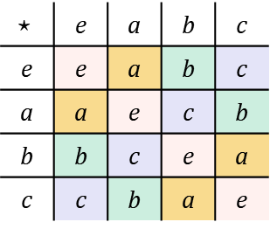


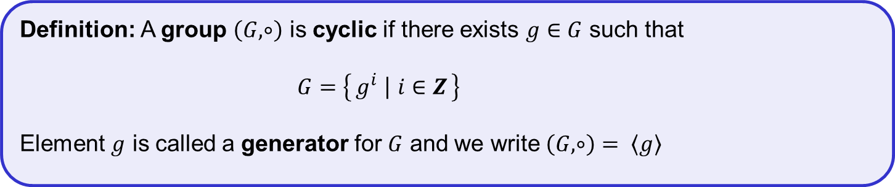

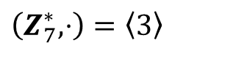






Cyclic groups
Definition: A group $\left(G, ∘\right)$ is cyclic if there exists $g∈G$ such that
$G=\left\{g^{i} ∣ i∈Z\right\}$
Element $g$ is called a generator for $G$ and we write $\left(G, ∘\right)= \left\langle g\right\rangle$
$$=\left\{…,g^{−2},g^{−1},g^{0},g^{1},g^{2},g^{3},…\right\}$$
Examples:
Not cyclic groups:
$$\left(Z, +\right)=〈1〉$$
$$\left(R, +\right)$$
$$\left(R^{∗}, ⋅\right)$$
$$\left(Z_{n}, +_{n}\right)=〈1〉$$
$$\left(G, ⋆ \right)$$
$\left(Z_{p}^{∗}, ⋅\right)=\left\langle a\right\rangle$
$$⋆$$ | e | a | b | c
e | e | a | b | c
a | a | e | c | b
b | b | c | e | a
c | c | b | a | e
$\left(Z_{7}^{∗}, ⋅\right)=\left\langle 3\right\rangle$
$$=\left\{3^{0},3^{1},3^{2},3^{3},3^{4},3^{5}\right\}=\left\{1, 3, 2, 6, 4, 5\right\}$$
$$=\left\langle 5\right\rangle$$
$$=\left\{5^{0},5^{1},5^{2},5^{3},5^{4},5^{5}\right\}=\left\{1, 5, 4, 6, 2, 3\right\}$$
$$≠\left\langle 2\right\rangle$$
$$=\left\{2^{0},2^{1},2^{2},2^{3},2^{4},2^{5}\right\}=\left\{1, 2, 4, 1, 2, 4\right\}=\left\{1, 2, 4\right\}$$

Slide 19







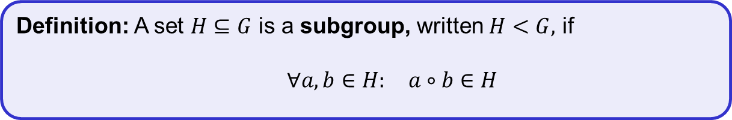










Subgroups
Definition: A set $H⊆G$ is a subgroup, written $H<G,$ if
$∀a,b∈H:$ $a∘b∈H$
$$G$$
$$H$$
$$x^{−1}$$
$$x∘y$$
Fact: a subgroup $H$ is a group
$$y$$
$$x$$
$$e$$
positive real numbers
Examples:
$\left\{e\right\}<G$ (for all groups)
$$R_{+}<\left(R^{∗}, ⋅\right)$$
$G<G$ (for all groups)
$$\left\{1,−1\right\}<\left(R^{∗}, ⋅\right)$$
$\left\langle 5\right\rangle =\left\{0, 5, 10,…,35\right\}$
$$2Z=\left\{…,−2, 0, 2, 4, 6,…\right\}<\left(Z,+\right)$$
$$\left\langle 20\right\rangle <\left\langle 10\right\rangle <\left\langle 5\right\rangle <\left(Z_{40}, +\right)$$
$\left\langle 10\right\rangle =\left\{0, 10, 20, 30\right\}$
$$3Z=\left\{…,−3, 0, 3, 6, 9,…\right\}<\left(Z,+\right)$$
$\left\langle 20\right\rangle =\left\{0, 20\right\}$

Slide 20












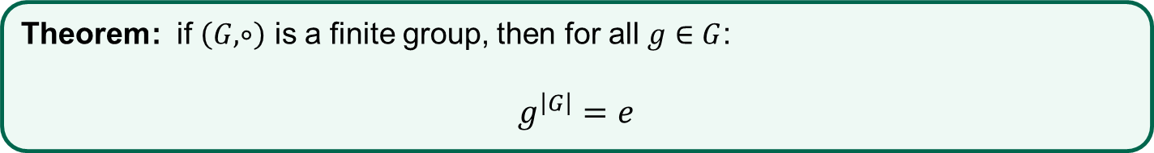




Cyclic groups
Theorem: if $\left(G,∘\right)$ is a finite group, then for all $g∈G$:
$$g^{\left|G\right|}=e$$
Proof (finite cyclic groups):
$$G$$
$$\left|G\right|=\left|\left\langle g\right\rangle \right|=n$$
$$e$$
$$g^{1}$$
$$g^{2}$$
$$g^{3}$$
$$⋯$$
$$g^{n−1}$$
$$g^{n}$$
$$g^{n+1}$$
$$g^{n+2}$$
$$⋯$$
$$g^{n}=g^{3}$$
$${⟹ g}^{n−3}=e$$
${⟹ g}^{j}=e$ $j<n$
contradiction!
Corollary I: $g^{i}=g^{i\operatorname{mod}{n}}=g^{i\operatorname{mod}\left|G\right|}$
Corollary II (Lagrange's theorem): if $H<G$ then the order of $H$ divides the order of $G$ (i.e $\left|H\right| | \left|G\right|$)

Slide 21


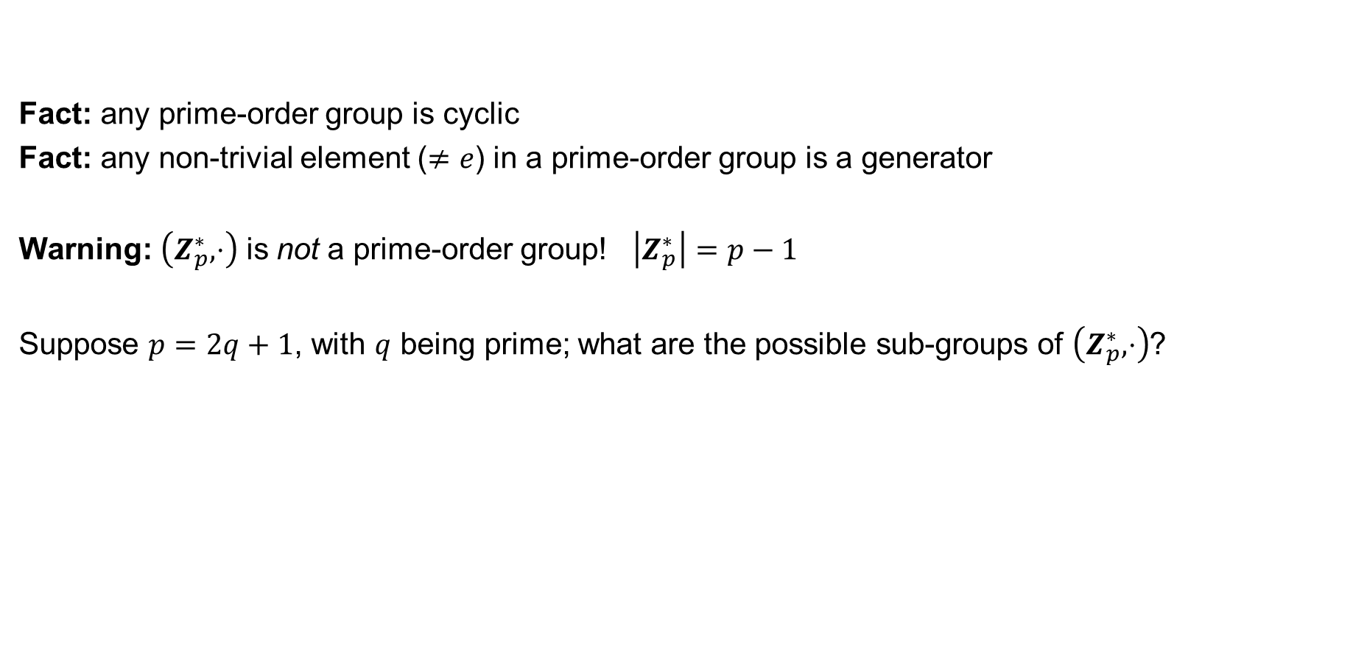




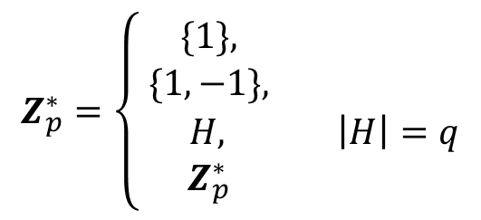

Groups of prime order
Fact: any prime-order group is cyclic
Fact: any non-trivial element ($≠e$) in a prime-order group is a generator
Warning: $\left(Z_{p}^{∗},⋅\right)$ is not a prime-order group! $\left|Z_{p}^{∗}\right|=p−1$
Suppose $p=2q+1$, with $q$ being prime; what are the possible sub-groups of $\left(Z_{p}^{∗},⋅\right)$?
Corollary II (Lagrange's theorem): if $H<G$ then the order of $H$ divides the order of $G$
$$\left|Z_{p}^{∗}\right|=p−1=2q$$
Example:
$$Z_{11}^{∗}$$
$$=\left\{1, 2, 3, 4, 5, 6, 7, 8, 9, 10\right\}$$
$$\left\{1\right\}<Z_{11}^{∗}$$
$$Z_{p}^{∗}=\left\{\begin{aligned}\{1\}, \\ \{1,−1\}, \\ \begin{matrix}H, & \left|H\right|=q\end{matrix} \\ Z_{p}^{∗} \end{aligned}\right.$$
$$11=2⋅5+1$$
$$\left\{1,−1\right\}=\{1,10\}<Z_{11}^{∗}$$
$$H=\left\langle 3\right\rangle =\left\langle 4\right\rangle =\left\langle 5\right\rangle =\left\langle 9\right\rangle =\{1, 3, 4, 5, 9\}<Z_{11}^{∗}$$
$$Z_{11}^{∗}<Z_{11}^{∗}$$

Slide 22
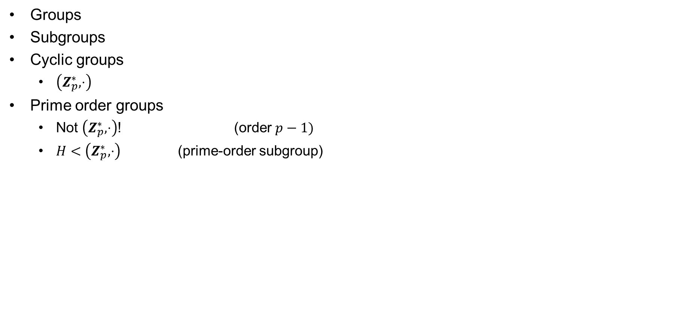
Before the break
Groups
Subgroups
Cyclic groups
  $\left(Z_{p}^{∗},⋅\right)$
Prime order groups
  Not $\left(Z_{p}^{∗},⋅\right)$! (order $p−1)$
  $H<\left(Z_{p}^{∗},⋅\right)$ (prime-order subgroup)

Slide 23












Diffie-Hellman
public
$$G=〈g〉$$
$$A=g^{a}$$
$$a\underset{←}{\$}\left\{1, …, \left|G\right|\right\}$$
$$B=g^{b}$$
$$b\underset{←}{\$}\left\{1, …, \left|G\right|\right\}$$
$$Z←B^{a}$$
$$={(g^{b})}^{a} =g^{ab}$$
$$Z′←A^{b}$$
$${=\left(g^{a}\right)}^{b}=g^{ab}$$
Claim: $Z=Z′$

Slide 24











Diffie-Hellman – example
$$Z_{1019}^{∗}=〈2〉$$
$$570$$
$$493\underset{←}{\$}\left\{1, …, 1018\right\}$$
$$72$$
$$901\underset{←}{\$}\left\{1, …, 1018\right\}$$
$$570←2^{493} mod⁡1019$$
$$72←2^{901} mod 1019$$
$Z←{72}^{493}\operatorname{mod}{1019}$
$$≡531$$
$$Z^{′}←{570}^{901}\operatorname{mod}{1019}$$
$$≡531$$

Slide 25

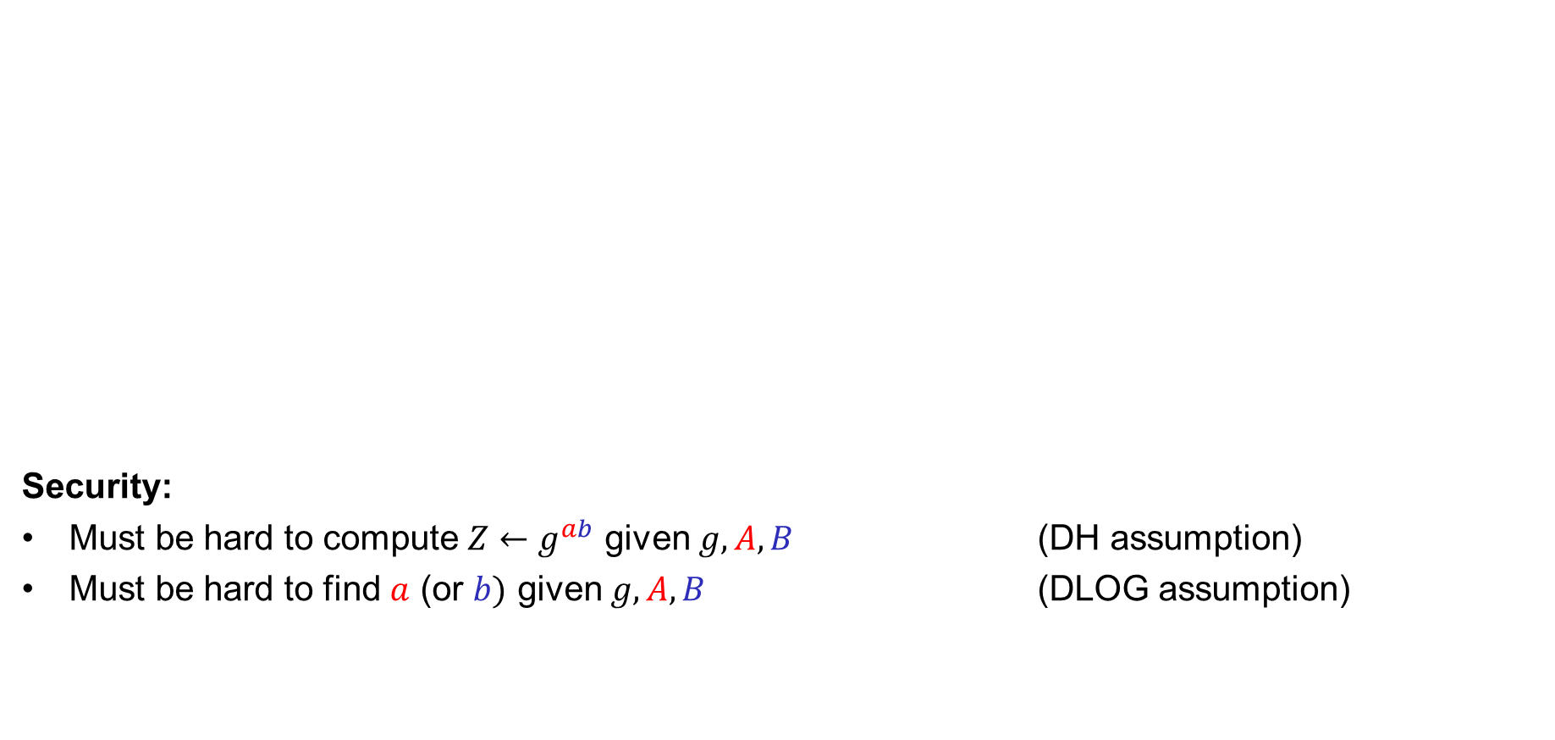


Diffie-Hellman
public
Security:
Must be hard to compute $Z←g^{ab}$ given $g, A, B$ (DH assumption)
Must be hard to find $a$ (or $b)$ given $g, A, B$ (DLOG assumption)
$$G=〈g〉$$
$$A=g^{a}$$
$$a\underset{←}{\$}\left\{1, …, \left|G\right|\right\}$$
$$B=g^{b}$$
$$b\underset{←}{\$}\left\{1, …, \left|G\right|\right\}$$
$$Z←B^{a}$$
$$={(g^{b})}^{a} =g^{ab}$$
$$Z′←A^{b}$$
$${=\left(g^{a}\right)}^{b}=g^{ab}$$
Doesn't work: $A∘B$
$$=g^{a}∘g^{b}=g^{a+b}≠g^{ab}$$

Slide 26
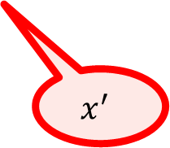


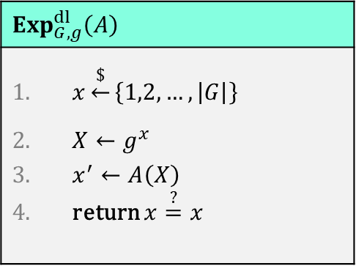

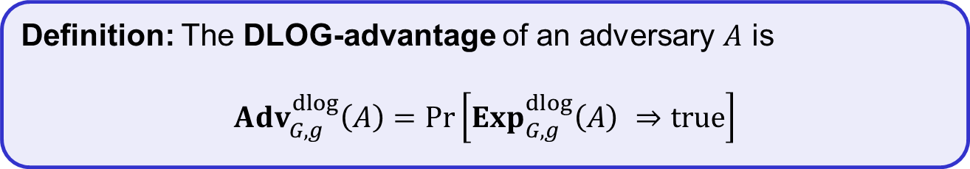



Discrete logarithm (DLOG) problem
Public: $G=\left\langle g\right\rangle$
Challenger
$$Exp_{G,g}^{dl}\left(A\right)$$
$x\underset{←}{\$}\left\{1,2,…,\left|G\right|\right\}$ $X←g^{x}$ $x^{′}←A\left(X\right)$ return $x\overset{?}{=}x$
$$x\underset{←}{\$}\left\{1,2,…,\left|G\right|\right\}$$
$$X$$
$$X←g^{x}$$
$$x^{′}$$
Adversary wins if $x^{′}=x$
In other words: $x^{′}={DLog}_{g}\left(X\right)$
Definition: The DLOG-advantage of an adversary $A$ is
$${Adv}_{G,g}^{dlog}\left(A\right)=\operatorname{Pr}\left[Exp_{G,g}^{dlog}\left(A\right) ⇒true\right]$$

Slide 27


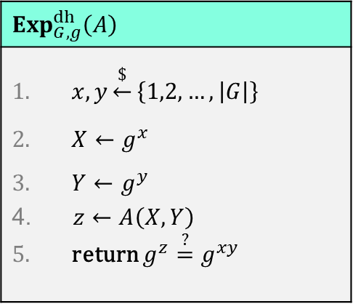


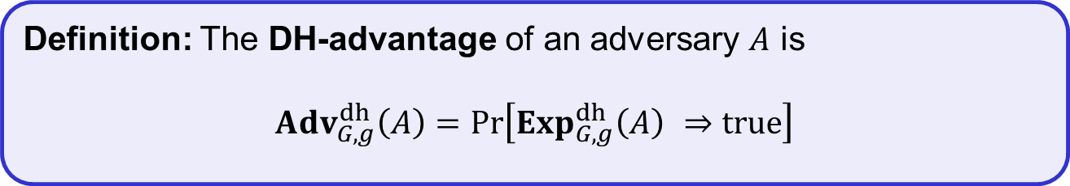

Diffie-Hellman problem
Public: $G=\left\langle g\right\rangle$
Challenger
$$Exp_{G,g}^{dh}\left(A\right)$$
$x,y\underset{←}{\$}\left\{1,2,…,\left|G\right|\right\}$ $X←g^{x}$ $Y←g^{y}$ $z←A\left(X,Y\right)$ return $g^{z}\overset{?}{=}g^{xy}$
$$x,y\underset{←}{\$}\left\{1,2,…,\left|G\right|\right\}$$
$$X,Y$$
$$X←g^{x}$$
$$Y←g^{y}$$
$$z$$
Adversary wins if $g^{z}=g^{xy}$
Definition: The DH-advantage of an adversary $A$ is
$${Adv}_{G,g}^{dh}\left(A\right)=\operatorname{Pr}\left[Exp_{G,g}^{dh}\left(A\right) ⇒true\right]$$

Slide 28
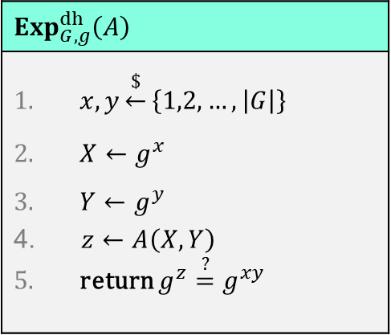
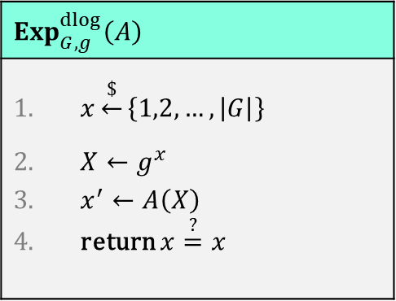


DLOG vs. DH
$$Exp_{G,g}^{dlog}\left(A\right)$$
$x\underset{←}{\$}\left\{1,2,…,\left|G\right|\right\}$ $X←g^{x}$ $x^{′}←A\left(X\right)$ return $x\overset{?}{=}x$
$$Exp_{G,g}^{dh}\left(A\right)$$
$x,y\underset{←}{\$}\left\{1,2,…,\left|G\right|\right\}$ $X←g^{x}$ $Y←g^{y}$ $z←A\left(X,Y\right)$ return $g^{z}\overset{?}{=}g^{xy}$
DLOG security $⟸$ DH security
DLOG security $\overset{?}{⟹}$ DH security

Slide 29
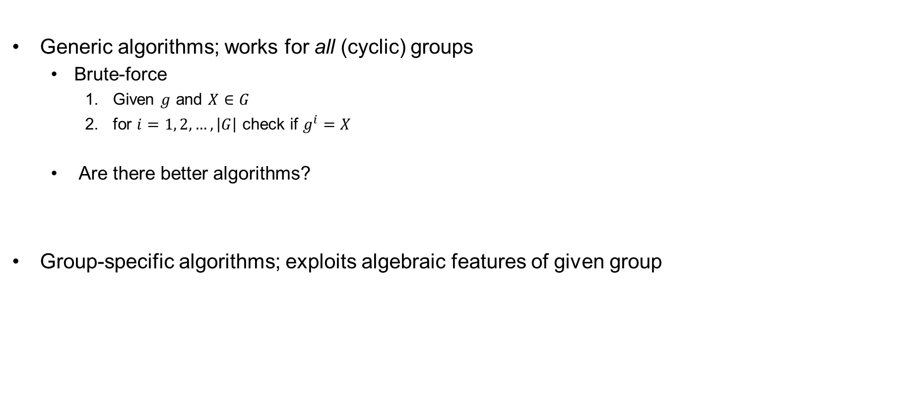
Algorithms for solving DLOG
Generic algorithms; works for all (cyclic) groups
  Brute-force
    Given $g$ and $X∈G$
    for $i=1, 2, …, \left|G\right|$ check if $g^{i}=X$
  Are there better algorithms?
Group-specific algorithms; exploits algebraic features of given group
running time: $𝒪\left(\left|G\right|\right)≈𝒪\left(2^{n}\right)$, given $\left|G\right|≈2^{n}$

Slide 30

















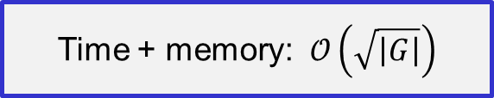














Solving DLOG: the baby-step giant-step algorithm
Given:
$$X←g^{x}$$
$$Y←g^{n}$$
$$n←\left\lceil \sqrt{\left|G\right|}\right\rceil$$
Find: $x$
$$𝒪\left(\sqrt{\left|G\right|}⋅\log{\sqrt{\left|G\right|}}\right)$$
$$≈𝒪\left(\sqrt{\left|G\right|}\right)$$
$$X_{0}←Xg^{−0}$$
$$Y^{0}$$
Find “collision”:
$$X_{i}=Y^{j}$$
$$X_{1}←Xg^{−1}$$
$$Y^{1}$$
$$Xg^{−i} ={ g}^{nj}$$
$$X_{2}←Xg^{−2}$$
$${⋅g}^{i}$$
$${⋅g}^{i}$$
$$Y^{2}$$
$$X_{3}←Xg^{−3}$$
$$X=g^{nj+i}$$
$$Y^{3}$$
$$𝒪\left(\sqrt{\left|G\right|}\right)$$
$$𝒪\left(\sqrt{\left|G\right|}\right)$$
$$⋮$$
$$DLog\left(X\right) =DLog\left(g^{nj+i}\right)$$
$$⋮$$
$$X_{i}←Xg^{−i}$$
$$Y^{j}$$
$$x =nj+i$$
$$⋮$$
$$⋮$$
$$X_{n}←Xg^{−n}$$
Time + memory: $𝒪\left(\sqrt{\left|G\right|}\right)$
$$Y^{n}$$

Slide 31
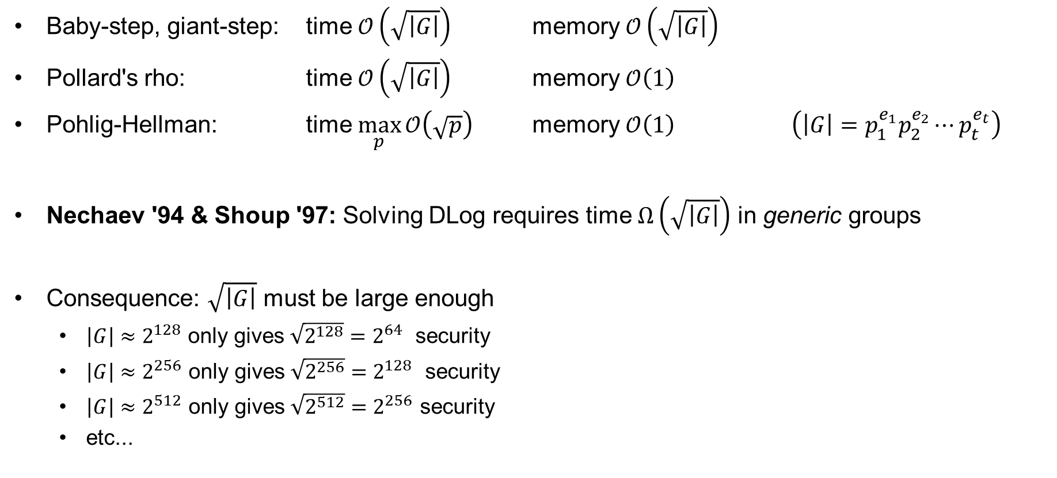
Generic algorithms for solving DLOG
Baby-step, giant-step: time $𝒪\left(\sqrt{\left|G\right|}\right)$ memory $𝒪\left(\sqrt{\left|G\right|}\right)$
Pollard's rho: time $𝒪\left(\sqrt{\left|G\right|}\right)$ memory $𝒪\left(1\right)$
Pohlig-Hellman: time $\max_{p}{𝒪\left(\sqrt{p}\right)}$ memory $𝒪\left(1\right)$ $\left(\left|G\right|=p_{1}^{e_{1}}p_{2}^{e_{2}}⋯p_{t}^{e_{t}}\right)$
Nechaev '94 & Shoup '97: Solving DLog requires time $Ω\left(\sqrt{\left|G\right|}\right)$ in generic groups
Consequence: $\sqrt{\left|G\right|}$ must be large enough
  $\left|G\right|≈2^{128}$ only gives $\sqrt{2^{128}}=2^{64}$ security
  $\left|G\right|≈2^{256}$ only gives $\sqrt{2^{256}}=2^{128}$ security
  $\left|G\right|≈2^{512}$ only gives $\sqrt{2^{512}}=2^{256}$ security
  etc...

Slide 32
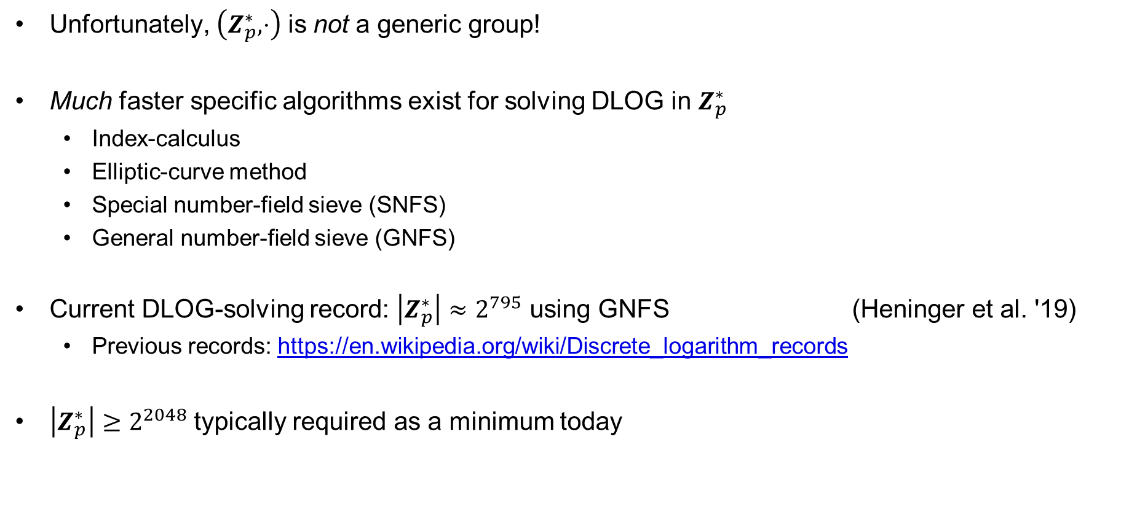
Non-generic algorithms for DLOG
Unfortunately, $\left(Z_{p}^{∗}, ⋅\right)$ is not a generic group!
Much faster specific algorithms exist for solving DLOG in $Z_{p}^{∗}$
  Index-calculus
  Elliptic-curve method
  Special number-field sieve (SNFS)
  General number-field sieve (GNFS)
Current DLOG-solving record: $\left|Z_{p}^{∗}\right|≈2^{795}$ using GNFS (Heninger et al. '19)
  Previous records: https://en.wikipedia.org/wiki/Discrete_logarithm_records
$\left|Z_{p}^{∗}\right|≥2^{2048}$ typically required as a minimum today
exceptionally complicated algorithms, requiring very advanced mathematics!

Slide 33

Better alternatives to $Z_{p}^{∗}$?

Slide 34
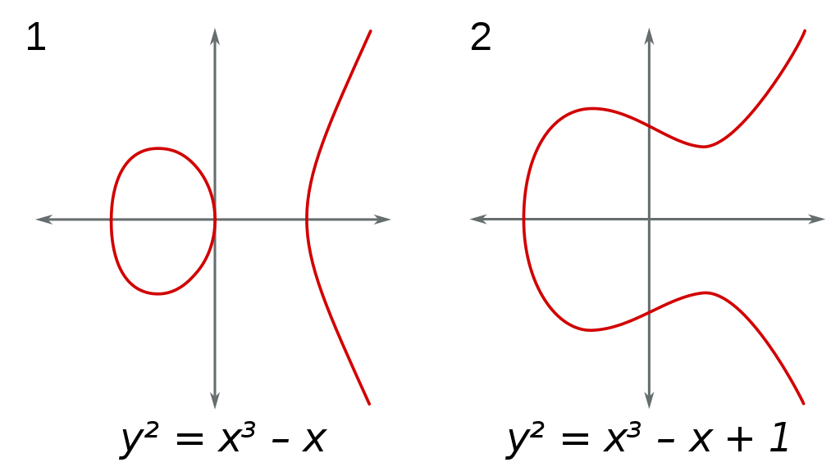


Elliptic curves
$$y^{2}=x^{3}+ax+b$$
$$a,b,x,y∈R$$

Slide 35



Elliptic curves
$$y^{2}=x^{3}+ax+b$$
$$Q$$
$$a,b,x,y∈R$$
$$P$$
$$P+Q$$

Slide 36



Elliptic curves
$$y^{2}=x^{3}+ax+b$$
$$P+Q$$
$$a,b,x,y∈R$$
$$Q$$
$$P$$

Slide 37



Elliptic curves
$$y^{2}=x^{3}+ax+b$$
$$P$$
$$a,b,x,y∈R$$
$$Q$$
$$P+Q$$

Slide 38



Elliptic curves
$$Q$$
$$y^{2}=x^{3}+ax+b$$
$$P$$
$$a,b,x,y∈R$$
$$P+Q$$

Slide 39



Elliptic curves
$$P$$
$$y^{2}=x^{3}+ax+b$$
$$P+Q$$
$$Q$$
$$a,b,x,y∈R$$

Slide 40



Elliptic curves
$$Q$$
$$y^{2}=x^{3}+ax+b$$
$$a,b,x,y∈R$$
$$P+Q=𝒪$$
Identity element
$$P$$

Slide 41


Elliptic curves
$$y^{2}=x^{3}+ax+b$$
$$a,b,x,y∈R$$
$$P$$
$$P+P$$

Slide 42


Elliptic curves
$$y^{2}=x^{3}+a^{′}x+b^{′}$$
$$a^{′},b^{′},x,y∈R$$

Slide 43
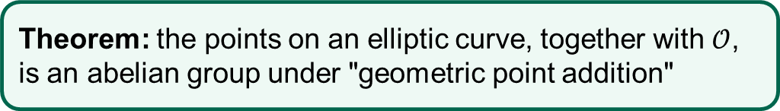
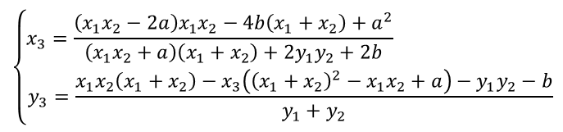
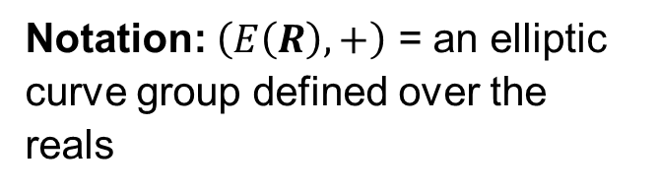

Elliptic curves
Theorem: the points on an elliptic curve, together with $𝒪$, is an abelian group under "geometric point addition"
$$y^{2}=x^{3}+ax+b$$
$$Q$$
$$a,b,x,y∈R$$
$$P$$
$$P+Q=\left(x_{1},y_{1}\right)+\left(x_{2},y_{2}\right)=\left(x_{3},y_{3}\right)$$
$$\left\{\begin{matrix}x_{3}=\frac{\left(x_{1}x_{2}−2a\right)x_{1}x_{2}−4b\left(x_{1}+x_{2}\right)+a^{2}}{\left(x_{1}x_{2}+a\right)\left(x_{1}+x_{2}\right)+2y_{1}y_{2}+2b} \\ y_{3}=\frac{x_{1}x_{2}\left(x_{1}+x_{2}\right)−x_{3}\left({\left(x_{1}+x_{2}\right)}^{2}−x_{1}x_{2}+a\right)−y_{1}y_{2}−b}{y_{1}+y_{2}}\end{matrix}\right.$$
Notation: $\left(E\left(R\right),+\right)$ = an elliptic curve group defined over the reals
$$P+Q$$

Slide 44

Elliptic curves
$$y^{2}=x^{3}+ax+b$$
$$Q$$
$$a,b,x,y∈Z_{p}$$
$$P$$
$$P+Q=\left(x_{1},y_{1}\right)+\left(x_{2},y_{2}\right)=\left(x_{3},y_{3}\right)$$
$$\left\{\begin{matrix}x_{3}=\frac{\left(x_{1}x_{2}−2a\right)x_{1}x_{2}−4b\left(x_{1}+x_{2}\right)+a^{2}}{\left(x_{1}x_{2}+a\right)\left(x_{1}+x_{2}\right)+2y_{1}y_{2}+2b} \\ y_{3}=\frac{x_{1}x_{2}\left(x_{1}+x_{2}\right)−x_{3}\left({\left(x_{1}+x_{2}\right)}^{2}−x_{1}x_{2}+a\right)−y_{1}y_{2}−b}{y_{1}+y_{2}}\end{matrix}\right.$$
$$P+Q$$
Still valid!

Slide 45
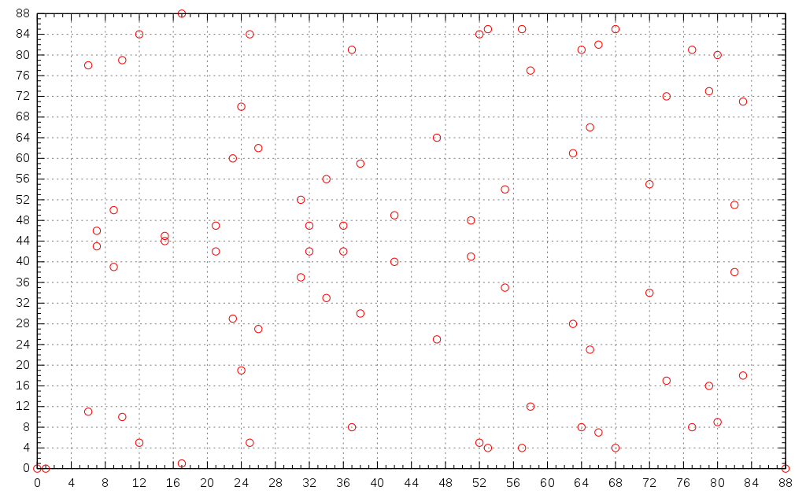


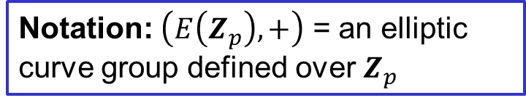
Elliptic curves
Theorem: the points on an elliptic curve, together with $𝒪$, is an abelian group under "geometric point addition"
Notation: $\left(E\left(Z_{p}\right),+\right)$ = an elliptic curve group defined over $Z_{p}$
$$\left(E\left(Z_{88}\right),+\right)$$
$$y^{2}=x^{3}+ax+b$$
$${∈Z}_{88}$$
$$a,b,x,y∈Z_{p}$$
$$P+Q=\left(x_{1},y_{1}\right)+\left(x_{2},y_{2}\right)=\left(x_{3},y_{3}\right)$$
$$\left\{\begin{matrix}x_{3}=\frac{\left(x_{1}x_{2}−2a\right)x_{1}x_{2}−4b\left(x_{1}+x_{2}\right)+a^{2}}{\left(x_{1}x_{2}+a\right)\left(x_{1}+x_{2}\right)+2y_{1}y_{2}+2b} \\ y_{3}=\frac{x_{1}x_{2}\left(x_{1}+x_{2}\right)−x_{3}\left({\left(x_{1}+x_{2}\right)}^{2}−x_{1}x_{2}+a\right)−y_{1}y_{2}−b}{y_{1}+y_{2}}\end{matrix}\right.$$

Slide 46
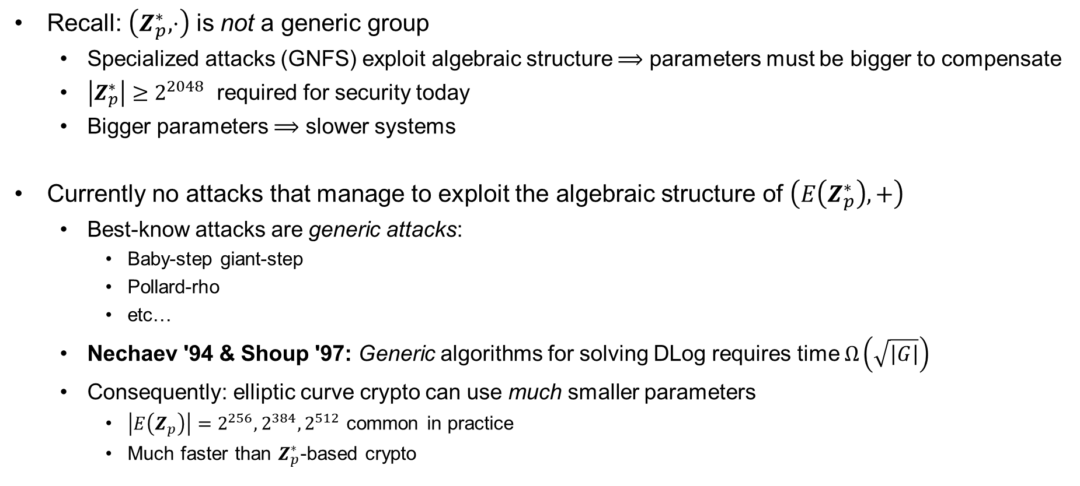
$E\left(Z_{p}\right)$ – properties
Recall: $\left(Z_{p}^{∗},⋅\right)$ is not a generic group
  Specialized attacks (GNFS) exploit algebraic structure $⟹$ parameters must be bigger to compensate
  $\left|Z_{p}^{∗}\right|≥2^{2048}$ required for security today
  Bigger parameters $⟹$ slower systems
Currently no attacks that manage to exploit the algebraic structure of $\left(E\left(Z_{p}^{∗}\right),+\right)$
  Best-know attacks are generic attacks:
    Baby-step giant-step
    Pollard-rho
    etc…
  Nechaev '94 & Shoup '97: Generic algorithms for solving DLog requires time $Ω\left(\sqrt{\left|G\right|}\right)$
  Consequently: elliptic curve crypto can use much smaller parameters
    $\left|E\left(Z_{p}\right)\right|=2^{256}, 2^{384}, 2^{512}$ common in practice
    Much faster than $Z_{p}^{∗}$-based crypto

Slide 47
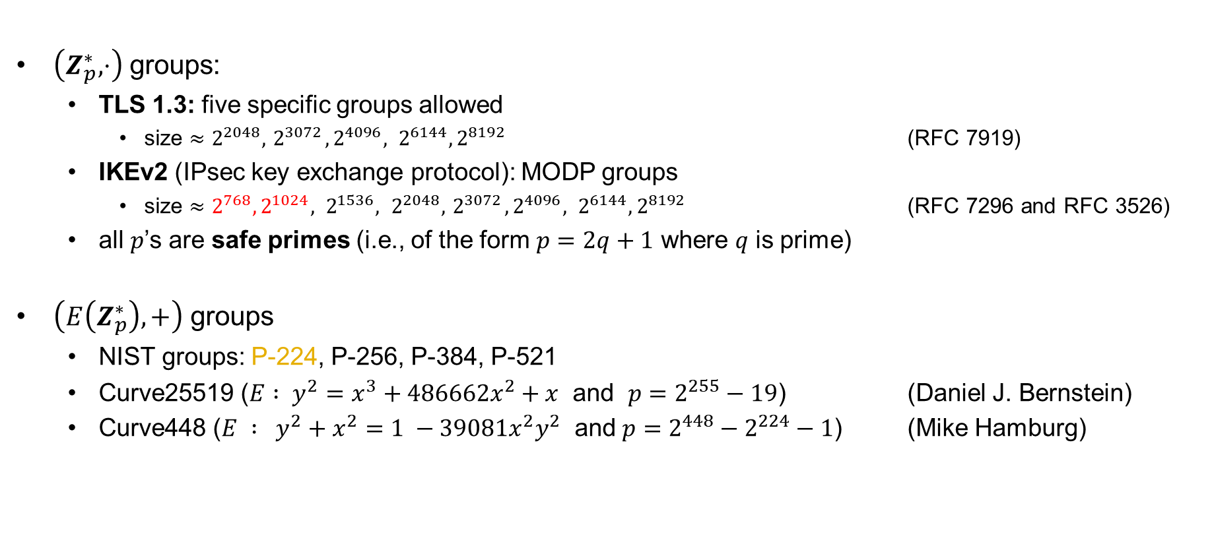
Cryptographic groups in practice
$\left(Z_{p}^{∗},⋅\right)$ groups:
  TLS 1.3: five specific groups allowed
    size $≈2^{2048}, { 2}^{3072}, 2^{4096}, 2^{6144}, 2^{8192}$ (RFC 7919)
  IKEv2 (IPsec key exchange protocol): MODP groups
    size $≈{2^{768}, 2^{1024}, 2}^{1536}, 2^{2048}, { 2}^{3072}, 2^{4096}, 2^{6144}, 2^{8192}$ (RFC 7296 and RFC 3526)
  all $p$’s are safe primes (i.e., of the form $p=2q+1$ where $q$ is prime)
$\left(E\left(Z_{p}^{∗}\right),+\right)$ groups
  NIST groups: P-224, P-256, P-384, P-521
  Curve25519 ($E : y^{2}=x^{3}+486662x^{2}+x$ and $p=2^{255}−19$) (Daniel J. Bernstein)
  Curve448 ($E : y^{2}+x^{2}=1 −39081x^{2}y^{2}$ and $p=2^{448}−2^{224}−1$) (Mike Hamburg)

Slide 48




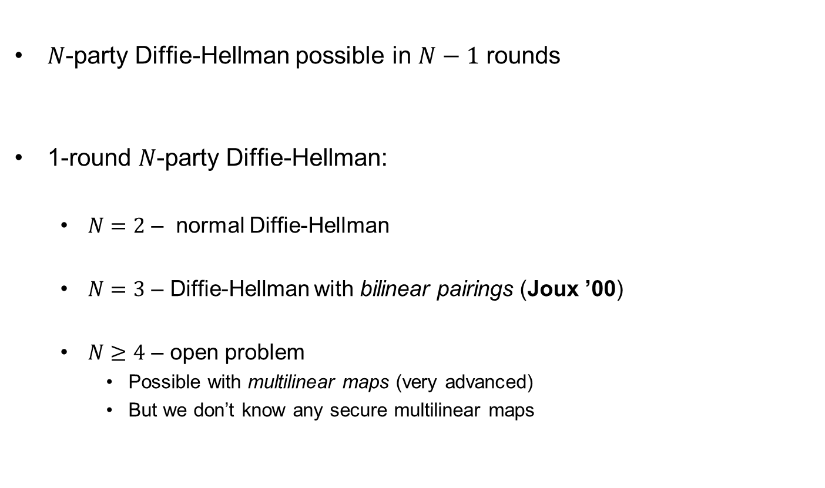
















$N$-party Diffie-Hellman
$N$-party Diffie-Hellman possible in $N−1$ rounds
1-round $N$-party Diffie-Hellman:
  $N=2$ – normal Diffie-Hellman
  $N=3$ – Diffie-Hellman with bilinear pairings (Joux ’00)
  $N≥4$ – open problem
    Possible with multilinear maps (very advanced)
    But we don’t know any secure multilinear maps
$$g^{a}$$
$$g^{a}$$
$$g^{b}$$
$$g^{b}$$
$$g^{ab}$$
$$g^{ab}$$
$$g^{abc}$$
$$g^{ab}$$
$$g^{ac}$$
$$g^{a}$$
$$g^{ab}$$
$$g^{b}$$
Round 1
Round 2
$$g^{abc}$$
$$g^{ac}$$
$$g^{abc}$$
$$g^{bc}$$
$$g^{bc}$$
$$g^{c}$$

Slide 49
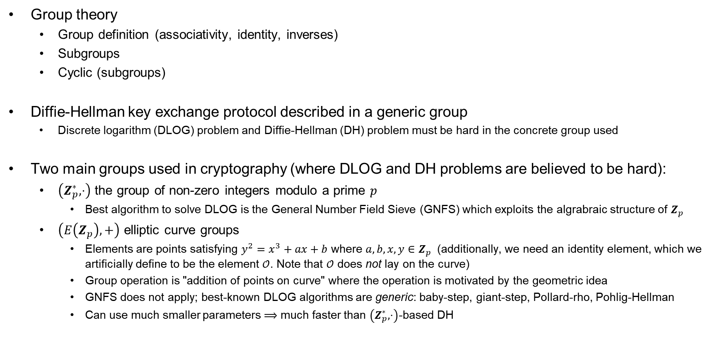
Summary
Group theory
  Group definition (associativity, identity, inverses)
  Subgroups
  Cyclic (subgroups)
Diffie-Hellman key exchange protocol described in a generic group
  Discrete logarithm (DLOG) problem and Diffie-Hellman (DH) problem must be hard in the concrete group used
Two main groups used in cryptography (where DLOG and DH problems are believed to be hard):
  $\left(Z_{p}^{∗},⋅\right)$ the group of non-zero integers modulo a prime $p$
    Best algorithm to solve DLOG is the General Number Field Sieve (GNFS) which exploits the algrabraic structure of $Z_{p}$
  $\left(E\left(Z_{p}\right),+\right)$ elliptic curve groups
    Elements are points satisfying $y^{2}=x^{3}+ax+b$ where $a,b,x,y∈Z_{p}$ (additionally, we need an identity element, which we artificially define to be the element $𝒪$. Note that $𝒪$ does not lay on the curve)
    Group operation is "addition of points on curve" where the operation is motivated by the geometric idea
    GNFS does not apply; best-known DLOG algorithms are generic: baby-step, giant-step, Pollard-rho, Pohlig-Hellman
    Can use much smaller parameters $⟹$ much faster than $\left(Z_{p}^{∗},⋅\right)$-based DH

