Slide 1
Digital Technologies, Refugees and Internal Displacement
Silvia Masiero
silvima@ifi.uio.no
IN5370 – ICT and Global Inequalities
11.09.2024

Slide 2
Overview
Refugees and internal displacement in ICT4D research
Digital technology for refugees: the theoretical link
Problematising the link: care, policing and «compassionate repression»

Slide 3
After this lecture, you can…
Outline the main discourses of ICT4D research concerned with issues of refugees and internal displacement, relating them to the global development agenda and the Global Refugee Compact
Describe the theoretical link between digital technologies and assistance to refugees and displaced persons, putting it in relation with the tenets of the «technology for refugees» orthodoxy
Problematise the same theoretical link, noting the tension between logics of care and policing and discussing the adverse implications of technologies for refugee population management.

Slide 4
Digital Technologies, Refugees and Internal Displacement

Slide 5
Digital Technologies, Refugees and Internal Displacement
UNHCR (2022): 89.3 million people worldwide were forcibly displaced at the end of 2021 as a result of persecution, conflict, violence, human rights violations or events seriously disturbing public order.
The 2030 Agenda for Sustainable Development contains a pledge that no one would be left behind, and includes specific reference to refugees and other displaced people.
SDG indicator on refugees: “The number of refugees by country of origin as a proportion of the national population of that country of origin”, meaning the percentage of a country’s population which is displaced abroad.

Slide 6
Global Compact for Refugees
“A framework for more predictable and equitable responsibility-sharing, recognizing that a sustainable solution to refugee situations cannot be achieved without international cooperation.” (UNHCR, 2018)
Four objectives:
  Ease the pressures on host countries;
  Enhance refugee self-reliance;
  Expand access to third-country solutions;
  Support conditions in countries of origin for return in safety and dignity.

Slide 7
Refugees and Displacement in ICT4D research
A relatively recent research endeavour!
Three main discourses in the Information Systems literature:
  The migrant as a subject of social inclusion
  The migrant as an object of surveillance
  The migrant as an information seeker
All three discourses are found in the ICT4D literature, so far with a predominance for the social inclusion discourse.

Slide 8
Refugees and Displacement in ICT4D research
Discouse 1: Migrant as Subject of Social Inclusion
Focus on ICTs as a route to social inclusion, variously but positively participating in resettlement of forced migrants.
ICT is viewed as a means for refugees and displaced persons to become part of the social setting of the host country or region.
ICT supports the maintenance of links with the place of origin, and at the same time it supports integration within the host country and its local infrastructures (Diaz Andrade & Doolin, 2016).
Use of ICTs as means to economic empowerment: ICT-led entrepreneurship; formation of refugee communities (Brown et al., 2021)
Links with the information seeking discourse: information platforms designed for refugees in host countries (Schreieck et al. 2017).

Slide 9
Refugees and Displacement in ICT4D research
Discourse 2: Migrant as Object of Surveillance
Focus: profilability of forced migrants through the same technologies that should support their social inclusion (Newell et al., 2016)
Risks: putting the migrant at the centre of a surveillance apparatus that may result in capture, deportation and even death
Examples: studies of risk run by forced migrants through exposure to digital systems; interoperability of asylum seeker databases with databases of European police forces (Pelizza, 2020)
Core tenet: inclusion in digital systems results in greater profiling and policing, generating forms of adverse digital incorporation that increase the position of risk that vulnerable migrants are already in.

Slide 10
Refugees and Displacement in ICT4D research
Discourse 3: Migrant as Information Seeker
Focus: shift of the migrant from a passive position (object of surveillance and profiling) to the active position of information seeker for their own needs in the host country
Forced migrant at the center of complex information needs, connected to the establishment of a social network and to the pursuit of economic independence in the host country
Platform focus: Schreieck et al. (2017) on a platform developed for the needs of refugees in Germany – platform properties enable refugees to seek and find the needed information
Role of mobile connectivity: highly diffused across migrants; enables many of the key interactions that characterise migrants’ daily lives.

Slide 11
«Technology for Refugees»: The Theoretical Link

Slide 12
«Technology for Refugees»: The Theoretical Link
So far, the social inclusion discourse is predominant in the Information Systems (IS) literature on technology and refugees.
This discourse is grounded on the ability of digital technology to include refugees in information infrastructures that are relevant to their needs.
A theoretical link is at the basis of the “technology for refugees” orthodoxy!

Slide 13
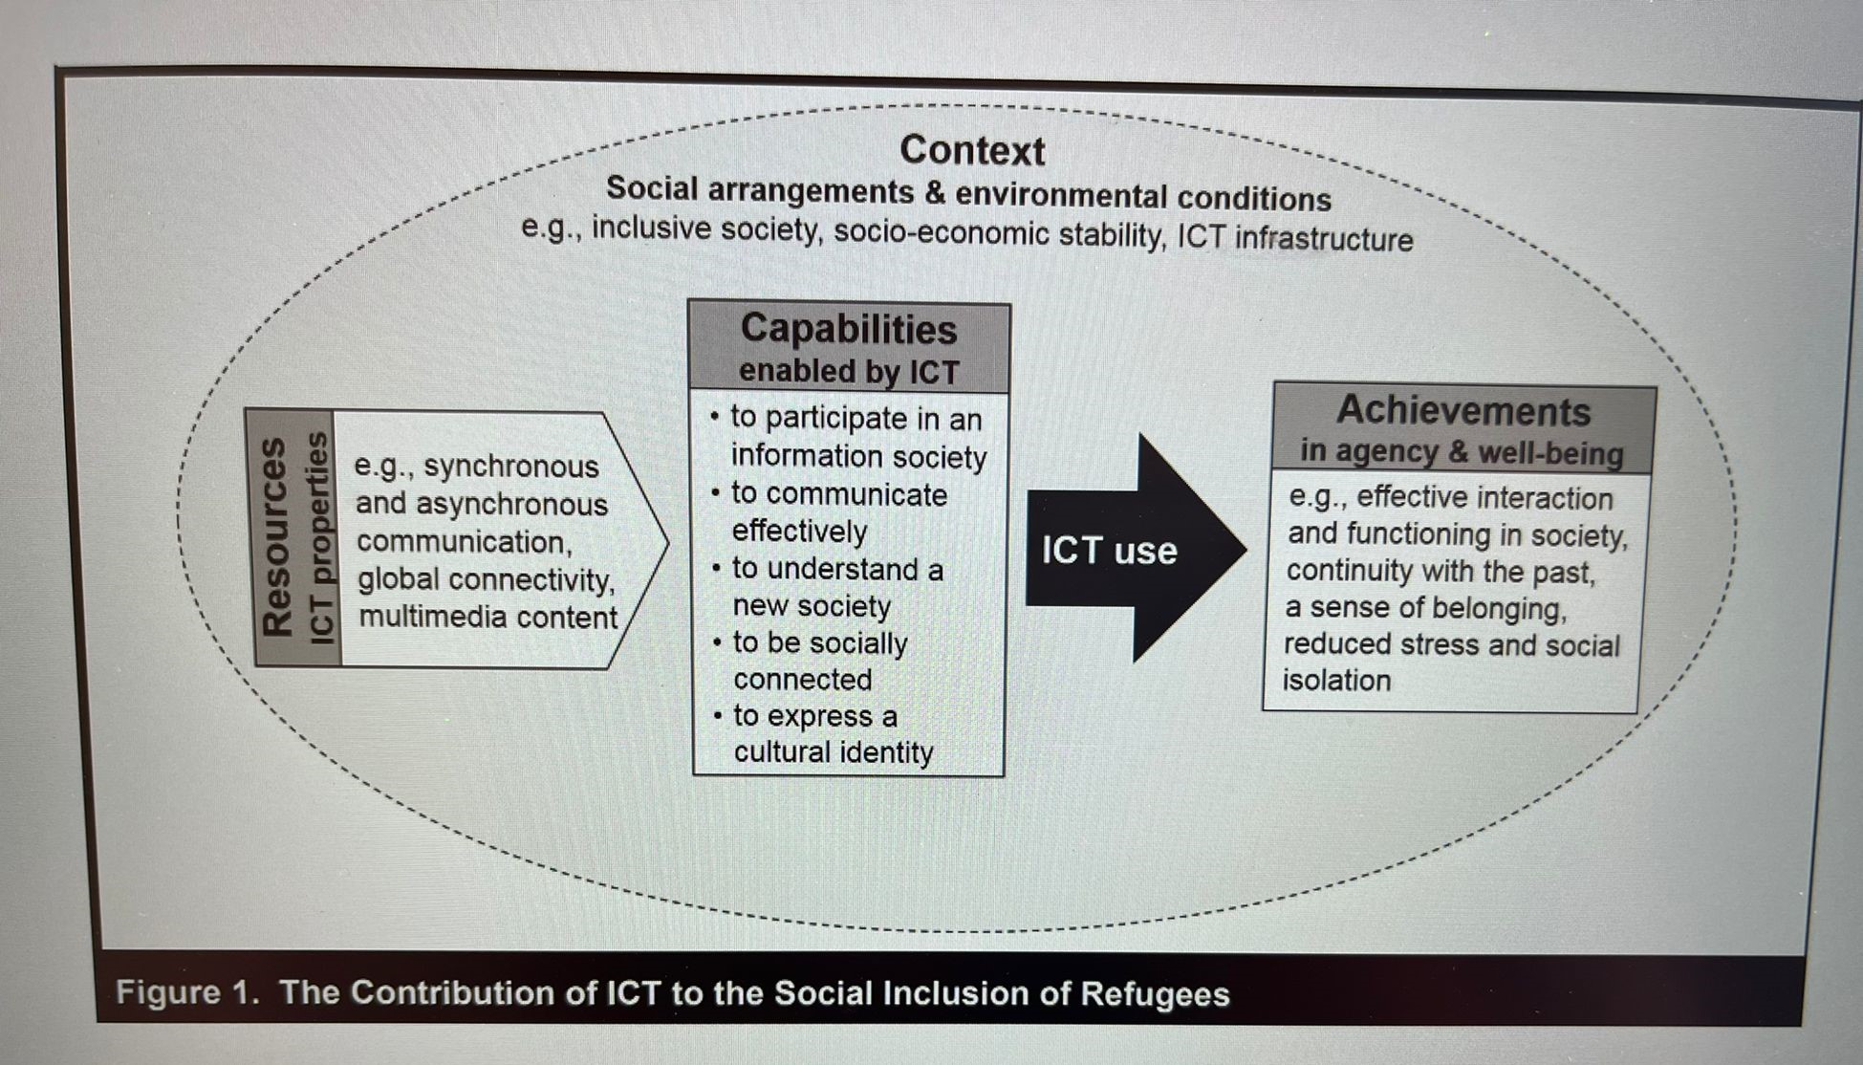
Technology & Refugees: The Theoretical Link
Technology & refugees: a capabilities approach perspective (Diaz Andrade & Doolin, 2016)

Slide 14
«Technology for Refugees»: The Theoretical Link
Diaz-Andrade & Doolin (2016): a capabilities approach perspective on the use of digital technologies by newly resettled refugees
ICTs as a resource from which a set of five valuable capabilities is derived: to participate in an information society, to communicate effectively, to understand a new society, to be socially connected, and to express a cultural identity
In realising these capabilities through ICT use, refugees exercise their own agency and enhance their well-being, in ways that assist them to function effectively in a new society and regain control on their lives
A theoretical link centred on the agency of refugees, rather than conceptualising them just as objects of ICT-based inclusion initiatives.

Slide 15
But…
The theoretical link is highly problematised, especially by works within the discourse on the migrant as an object of surveillance.
Iazzolino (2021): infrastructures of compassionate repression. The same infrastructures (i.e. biometric recognition databases) that should enact a logic of care, identifying refugees to provide them services, are used to profile them, sharing data with police authorities and enhancing risk.
A broader debate on digital identity in humanitarian aid: a technology “between surveillance and recognition” (Weitzberg et al. 2021)

Slide 16
Infrastructures of compassionate repression
Iazzolino (2021): case study of a Biometric Identity Management System (BIMS) for the distribution of food aid in Kakuma refugee camp, Kenya
Refugee household heads urged to register their fingerprints to receive food rations at the distribution points in the camp. Request met with a counter-request from refugees: to accompany biometric registrations with increases in food rations, as registrations are perceived as dangerous and harmful.
Background: deeply ingrained surveillant attitude of Kenya’s government especially towards refugees of Somali ethnic origin, culminating into policies of confinement and deportation and increasing the risk from profiling.

Slide 17
Between aid and surveillance
Weitzberg et al. (2021): the debate on datafication and technology use in the aid sector is characterised by a tension between aid and surveillance.
Aid organisations often see digital identification technologies as tools of recognition and inclusion rather than oppressive forms of monitoring, tracking and top-down control.
In contrast, Privacy International’s “Aiding Surveillance” report details how digital aid programmes involve the surveillance of individuals, groups, and entire populations. The collection and use of personal information in these initiatives is “without precedent, and subject to few legal safeguards”.

Slide 18
So…
Three main discourses – centred respectively on social inclusion, surveillance and information seeking – inform the ICT4D literature on ICTs, refugees and internal displacement.
The social inclusion discourse, articulated by Diaz Andrade and Doolin (2016) through the capabilities approach, is being challenged by approaches that highlight the coexistence of “care” and “surveillance” in the same systems of digital registration and authentication of refugees.
An idea of “infrastructures of compassionate repression” underpins the discussion, showing the embeddedness of surveillance in the very same technologies designed for social protection.

Slide 19
Thank you!
silvima@ifi.uio.no

Slide 20
Readings
Core Reading
Diaz Andrade, A., & Doolin, B. (2016). Information and communication technology and the social inclusion of refugees. Mis Quarterly, 40(2), 405-416.
Iazzolino, G. (2021). Infrastructure of compassionate repression: making sense of biometrics in Kakuma refugee camp. Information Technology for Development, 27(1), 111-128.
Supplementary Reading
Newell, B. C., Gomez, R., & Guajardo, V. E. (2016). Information seeking, technology use, and vulnerability among migrants at the United States–Mexico border. The Information Society, 32(3), 176-191.
Janmyr, M., & Mourad, L. (2018). Modes of ordering: labelling, classification and categorization in Lebanon’s refugee response. Journal of Refugee Studies, 31(4), 544-565.

