Slide 1
Responsible AI in Information Systems
Miria Grisot – Digital Innovation Group
miriag@ifi.uio.no

Slide 2
agenda
Pensum
Faraj, S., Pachidi, S., & Sayegh, K. (2018). Working and organizing in the age of the learning algorithm. Information and Organization, 28(1), 62-70.
Ågerfalk, P. J. (2020). Artificial intelligence as digital agency. European Journal of Information Systems, 29(1), 1–8.
Zuboff, S. (2015). Big other: surveillance capitalism and the prospects of an information civilization. Journal of Information Technology, 30(1), 75-89.
Perspectives on AI
What AI is and is not
Accountability
Transparency
Explicability
AI4users project

Slide 3
How AI is understood
AI=technology
Powerful techniques to identify patterns in very large amount of data
machine learning techniques and deep learning
Currently is mostly pattern matching (stochastic, non-deterministic)
AI=field of science
Old, not new
Trying to understand human intelligence by building artificial models
Modelling intelligence as means to understand intelligence
AI=next step in digitalization
Is everything AI?
IoT, robotics, cyber-stuff…
difficult to understand its impacts and implications
AI=magical entity transforming the world
Almost magical entity
AI will rule everything, we loose control
Superficial, ‘mass-media’
Science fiction

Slide 4
What is AI?
https://www.ambitiouskitchen.com/grandmas-buttermilk-waffles/
Not just algorithms
  all computer systems use algorithms
  we use algorithms (ex. recipe for baking waffles)
Not just machine learning
  approaches and models
Not just data
  what we feed algorithms with
input
output
https://healthyrecipesblogs.com/gluten-free-waffles/

Slide 5
What is AI?
We cannot only consider the technical solution/technology itself: we need to consider the sociotechnical system around it – which is made of:
people who have built it
people who feed it with data
people who use it (how, when, what etc)
people who decides how the system should be used and for what
people who are directly or indirectly affected by what the system does
more people….
https://www.dreamstime.com/seamless-pattern-lots-diverse-people-image119265486
the study of AI – not as technological objects – but as a class of actors with particular behavioral patterns and ecology
needs an empirical approach (vs theoretical)
needs to consider the socio/organizational/institutional (…) environments/contexts in which AI operate.
Rahwan, I., Cebrian, M., Obradovich, N., Bongard, J., Bonnefon, J. F., Breazeal, C., ... & Jennings, N. R. (2019). Machine behaviour. Nature, 568(7753), 477-486.

Slide 6
AI is not intelligence
Important to realize that AI is not intelligence
The AI solutions that are around at present can do well the following things:
identify patterns in data – in images, text, video
extrapolate those patterns to new data
take actions based on those patterns
Ex of AI solution for medical image analysis.
What AI solutions do NOT understand: the meaning of the pattern:
can identify cancer cells but cannot explain you what it is
it is based on identifying patterns of pixels in the picture not on the meaning of the images in the picture
AI solutions cannot do (yet?)
common sense reasoning – understand context, and understand meaning
learning from few examples
learning general concepts
combine learning and reasoning

Slide 7
Accountability of Algorithms
When we (or an organization or the public services) are using AI solutions who is responsible and accountable for its results (outputs) and implications?
Algorithms are ubiquitous – within organizations and toward costumers in general – algorithms determining or influencing decisions about:
• getting hired or promoted
• offered a loan or housing
• advertising
• etc
What happens when there are mistakes?
What happens when mistakes are due to bias in the data feeds?
What happens when mistakes cannot be explained?
When mistakes are not detected?
Algorithms are not neutral
if algorithms preclude individuals from taking responsibility within a decision (because of their complexity, their opacity) – then who is responsible?
Martin, K. (2019). Ethical implications and accountability of algorithms. Journal of Business Ethics, 160(4), 835-850.

Slide 8
Accountability and transparency
The norm is ‘full opacity’
Q: would transparency contribute to restoring accountability for such systems?
Full opacity
Full transparency
What are the risks of full transparency?
  Loss of privacy
  Disclosure of algorithms can lead to ‘gaming the system’
  Loss of competitive advantage
  Limited ‘answerability’ anyway
Rather than transparent – algorithmic decisions should become ‘understandable’
Interpreted ex-post
Interpretable ex-ante
From transparency to interpretability of AI.
De Laat, P. B. (2018). Algorithmic decision-making based on machine learning from Big Data: Can transparency restore accountability?. Philosophy & technology, 31(4), 525-541.

Slide 9
The black-box problem
Complexity and opacity – what are the causes?
Increasing complexity of AI agents
Imperfections in data
Source code+model structures+data for training the system are often proprietary
Even if available they are often insufficient to predict with precision
Difficult to estimate the effects of algorithms on inidviduals and society
Algorithmic bias
input
output

Slide 10
Project AI4users
Explicability of AI solution for users
How to design AI intelligibility and accountability tools for non-experts facilitating meaningful human control?
citizens,
case handlers at the operational level,
middle managers and policy makers.
Three key stakeholder groups targeted:
The project will design, prototype and assess tools for enabling users without technical background to understand, appropriately trust, and effectively manage AI solutions.

Slide 11
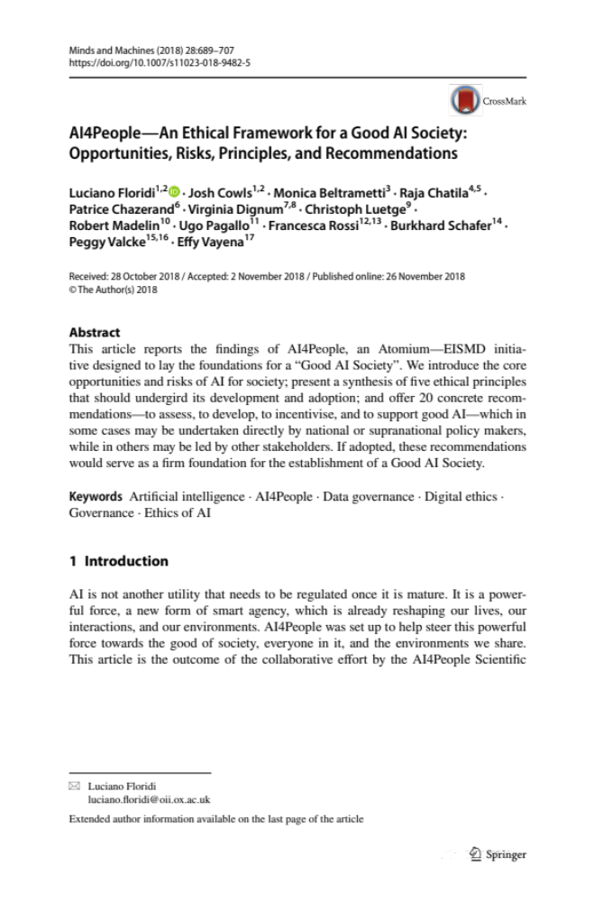
Good AI society
principles that should undergird the adoption of AI:
AI should be designed and developed in ways that:
decrease inequality and
further social empowerment,
with respect for human autonomy, and increase benefits that are shared by all, equitably.
It is especially important that AI be explicable, as explicability is a critical tool to build public trust in, and understanding of, the technology.
This requires a multistakeholder approach, which is the most effective way to ensure that AI will serve the needs of society, by enabling developers, users and rule-makers to be on board and collabo- rating from the outset.

Slide 12
Pensum
Faraj, S., Pachidi, S., & Sayegh, K. (2018). Working and organizing in the age of the learning algorithm. Information and Organization, 28(1), 62-70.
Ågerfalk, P. J. (2020). Artificial intelligence as digital agency. European Journal of Information Systems, 29(1), 1–8.
Zuboff, S. (2015). Big other: surveillance capitalism and the prospects of an information civilization. Journal of Information Technology, 30(1), 75-89.
AI in organizations
AI is performative – transform expertise, reshapes work and occupational boundaries and creates new forms of coordination and control.
AI in and historical IS perspective – why should IS be concerned with AI now?
Surveillance capitalism – a view on how AI is transforming society and capitalism
New form of power based on data

