Slide 1
Thinking Parallel
IN5050:
Programming heterogeneous multi-core processors
19/1 - 2021

Slide 2
Parallel algorithms
Have been developed for decades
Algorithm examples ?

Slide 3
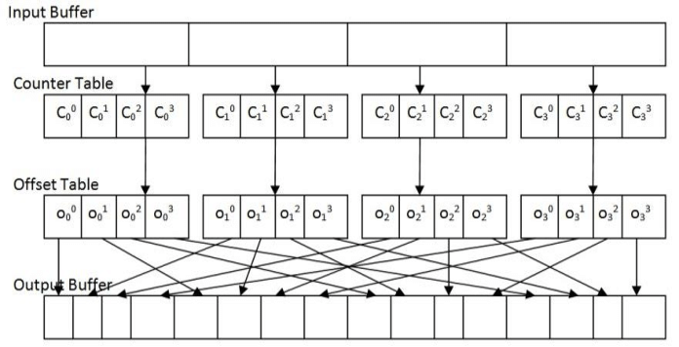
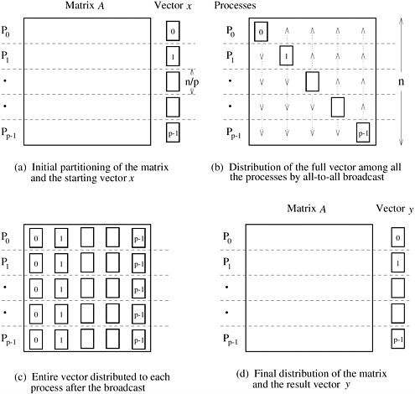
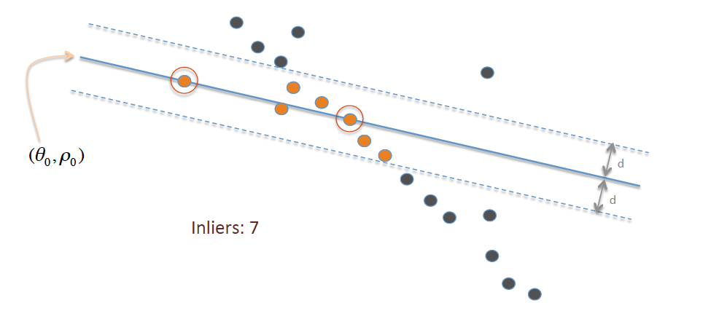
Parallel algorithms
Have been developed for decades
  Parallel search
  Parallel sort
  Prime numbers
  Dense matrix-vector multiplication
  Sparse matrix-vector multiplication
  Convex hull
  Parallel RANSAC (random sample consensus)
  …
radix sort
rowwise 1D dMVM
line fitting

Slide 4

Parallel algorithms
Have been developed for decades
  Parallel search
  Parallel sort
  Prime numbers
  Dense matrix-vector multiplication
  Sparse matrix-vector multiplication
  Convex hull
  Parallel RANSAC (random sample consensus)
  …
$$O(f\left(n\right)⟹O\left(f(n,p\right))$$
Data assignment
memory latency
randomness

Slide 5
Designing and Building Parallel Programs
Ian Foster’s framework proposal: http://www.mcs.anl.gov/~itf/dbpp/
  be able to design simple parallel algorithms in a methodical fashion
  be able to partition computations, using both domain and functional decomposition techniques
  be able to use agglomeration as a means of reducing communication and implementation costs
  be familiar with a range of load-balancing strategies
  develop intuition as to what constitutes a good parallel algorithm
  recognize design flaws that compromise efficiency or scalability
  know how to recognize and implement both local and global, static and dynamic, structured and unstructured, and synchronous and asynchronous communication structures

Slide 6
Designing and Building Parallel Programs
Ian Foster’s framework proposal
Be creative …
…… but take a methodical approach
Methodical Design: PCAM
Partitioning
Communication
Agglomeration
Mapping

Slide 7
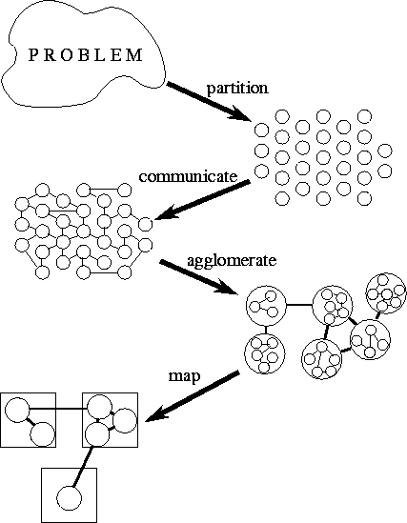
Methodical Design
Most programming problems have several parallel solutions
The best solution may differ from the best existing sequential one
Outcome
  Create, migrate and destroy tasks dynamically
  use load-balancing techniques to control mapping
Or
  a SIMD program with one task per processor
  however, agglomeration and mapping are one phase for SIMD
Partitioning
Communication
Agglomeration
Mapping
PCAM looks sequential
it isn’t
explore alternatives right away
avoid backtracking and complete redesign

Slide 8
Partitioning
Expose algorithmic opportunities for parallel execution
Which algorithmic opportunities?
Provide the greatest flexibility
  Later stages may invalidate opportunities
  Typical reasons for invalidation:
    Communication
    Target architecture
    Software engineering

Slide 9
Partitioning
Expose algorithmic opportunities for parallel execution
define a large number of small tasks
achieve a fine-grained decomposition
Provide the greatest flexibility
  Later stages may invalidate opportunities
  Typical reasons for invalidation:
    Communication
    Target architecture
    Software engineering
Revisit partitioning in agglomeration

Slide 10
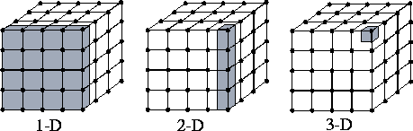
Partitioning
Partition strategies
  Domain (or data) decomposition
    divides computation and data into small pieces
    focus first on the data
    partition it
    finally, associate computation with data

Slide 11
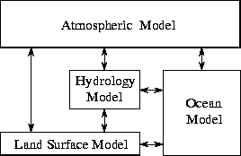
Partitioning
Partition strategies
  Functional decomposition
    first decompose the computation
    then deal with the data
Modularity
Pipelining
(incl. parallel pipelines)
Processing graphs
Recursion

Slide 12
Partitioning
Partition strategies
  Domain decomposition
    divides computation and data into small pieces
    focus first on the data
    partition it
    finally, associate computation with data
  Functional decomposition
    first decompose the computation
    then deal with the data
  Complementary techniques
    you can try both
    even for parts of the same problem

Slide 13
Partitioning
Define disjoint sets of computation and data
  don’t replicate computation
  don’t replicate data
  revisit in communication

Slide 14
Partitioning Design Checklist
  Does your partition define at least an order of magnitude more tasks than there are processors in your target computer?
    If not, you have little flexibility in subsequent design stages
  Does your partition avoid redundant computation and storage requirements?
    If not, the resulting algorithm may not be scalable to deal with large problems
  Are tasks of comparable size?
    If not, it may be hard to allocate each processor equal amounts of work
  Does the number of tasks scale with problem size?
    Ideally, an increase in problem size should increase the number of tasks rather than the size of individual tasks
    If this is not the case, your parallel algorithm may not be able to solve larger problems when more processors are available
  Have you identified several alternative partitions?
    You can maximize flexibility in subsequent design stages by considering alternatives now
    Remember to investigate both domain and functional decompositions
We may have to conclude that we haven’t managed to find useful partition

Slide 15
Communication
Define the communication between partitions
Kinds of communication?
Notes:
Do not forget memory read / write !
Lock or not!

Slide 16
Communication
Define the communication between partitions
Tasks can rarely execute independently
Flow between tasks is specified in the communication phase
Define a channel structure
  consisting of producers and consumers
  not necessarily implemented in software – could be memory reads and writes
  avoid introducing unnecessary channels and communication
  optimize performance by distributing communication operations over many tasks
  organize communication operations in a way that permits concurrent execution

Slide 17
Communication
Communication requirements for functional decomposition are often easy
  correspond to the data flow between tasks
In domain decomposition problems, communication requirements can be difficult
  first partitioning data structures into disjoint subsets
  associating operations with each datum
  some operations that require data from several tasks usually remain
  communication is then required
  organizing this communication in an efficient manner can be challenging
  even simple decompositions can have complex communication structures

Slide 18
Communication Design Checklist
  do all tasks perform about the same number of communication operations?
    unbalanced communication requirements suggest a non-scalable construct
    if a frequently accessed data structure is encapsulated in a single task, consider distributing or replicating this data structure
  does each task communicate only with a small number of neighbors?
    if each task must communicate with many other tasks, evaluate the possibility of formulating this global communication in terms of a local communication structure
  are communication operations able to proceed concurrently?
    if not, your algorithm is likely to be inefficient and non-scalable
    try to use divide-and-conquer
  is the computation associated with different tasks able to proceed concurrently?
    if not, your algorithm is likely to be inefficient and non-scalable
    consider whether you can reorder communication and computation operations
We may have to back to the specification

Slide 19
Agglomeration
Consider the usefulness of combining
(agglomerating) tasks
Partitioning and communication provide abstract output
Their outputs are not specialized for any computers
Problems with result of C stage?

Slide 20
Agglomeration
Consider the usefulness of combining
(agglomerating) tasks
Partitioning and communication provide abstract output
Their outputs are not specialized for any computers
may be highly inefficient
  e.g. creates many more tasks than there are processors
  too small tasks
  too many tasks
  too much communication
  too much scheduling overhead
  …
Problems with direct use?

Slide 21
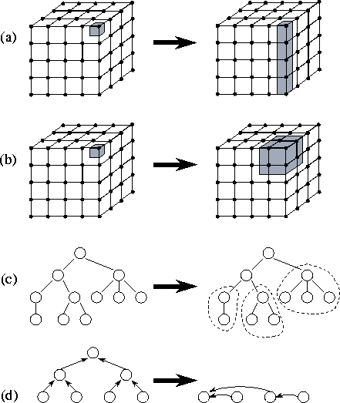
Agglomeration
Consider the usefulness of combining
(agglomerating) tasks
Agglomeration moves from abstract to concrete
revisit partitioning and communication
consider whether it is useful to combine (agglomerate) tasks …
… and change mode of communication
determine whether it is worthwhile to replicate data and/or computation
number of tasks should still be greater than number of processors
Notes:
CACHES
COMMUNICATION COSTS

Slide 22
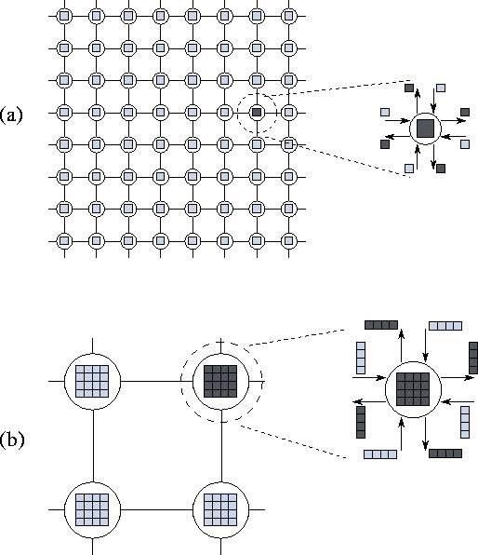
Agglomeration
Increasing Granularity
  surface to volume effects
  replicating computation
  avoiding communication
Preserving Flexibility
  agglomerating can lead to design decisions
  limit an algorithm's scalability unnecessarily
Notes:
DEFINE #DATA IN UNIT
NOT ENTIRE DIMENSIONS -> bad scaling with problem size

Slide 23
Agglomeration Design Checklist
Has agglomeration reduced communication costs by increasing locality?
If not, examine your algorithm to determine whether this could be achieved using an alternative agglomeration strategy
If agglomeration has replicated computation, have you verified that the benefits of this replication outweigh its costs, for a range of problem sizes and processor counts?
If agglomeration replicates data, have you verified that this does not compromise the scalability of your algorithm by restricting the range of problem sizes or processor counts that it can address?
Has agglomeration yielded tasks with similar computation and communication costs?
The larger the tasks created by agglomeration, the more important it is that they have similar costs
If we have created just one task per processor, then these tasks should have nearly identical costs
Does the number of tasks still scale with problem size?
If not, then your algorithm is no longer able to solve larger problems on larger parallel computers
If agglomeration eliminated opportunities for concurrent execution, have you verified that there is sufficient concurrency for current and future target computers?
An algorithm with insufficient concurrency may still be the most efficient, if other algorithms have excessive communication costs; performance models can be used to quantify these tradeoffs
Can the number of tasks be reduced still further, without introducing load imbalances, increasing software engineering costs, or reducing scalability
Other things being equal, algorithms that create fewer larger-grained tasks are often simpler and more efficient than those that create many fine-grained tasks
If you are parallelizing an existing sequential program, have you considered the cost of the modifications required to the sequential code?
If these costs are high, consider alternative agglomeration strategies that increase opportunities for code reuse
If the resulting algorithms are less efficient, use performance modeling techniques to estimate cost tradeoffs

Slide 24
Mapping
Mapping
Specify where each task executes
Specify where data is located
Architecture’s influence on mapping?

Slide 25
Mapping
Mapping
Specify where each task executes
Specify where data is located
Specify where each task executes
  this does not apply:
    on uniprocessors
    on shared-memory computers with automatic task scheduling
Sensible general-purpose mapping mechanisms (independent of the algorithms) for scalable parallel computers do not exist
Mapping remains a difficult
  mapping problem is known to be NP-complete

Slide 26
Mapping
Mapping
Specify where each task executes
Specify where data is located
Mapping requires a goal
Foster’s goal
  Minimize total execution time
Other goals
  Achieve a good trade-off between energy/price and execution time
  Achieve real-time speeds
  Maximize battery lifetime
  …

Slide 27
Mapping
Mapping
Specify where each task executes
Specify where data is located
Mapping strategies
  increase concurrency: place tasks that can execute concurrently on different processors
  increase locality: place tasks that communicate frequently on the same processor
These strategies conflict
Resource limitations may restrict tasks per processor
Design trade-offs exists

Slide 28
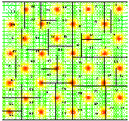
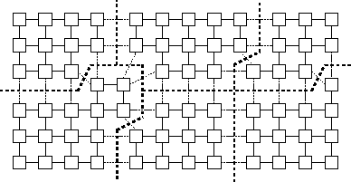
Mapping options
Load Balancing
  recursive bisection methods
  probabilistic methods
  cyclic mappings
  local algorithms
Task-Scheduling
Algorithms
  manager/worker
  hierarchical manager/worker
  decentralized schemes
  (work stealing)

Slide 29
Mapping Design Checklist
  If considering a SIMD/SPMD design for a complex problem, have you also considered an algorithm based on dynamic task creation and deletion?
  The latter approach can yield a simpler algorithm
  Performance can be problematic
  If considering a design based on dynamic task creation and deletion, have you also considered a SIMD/SPMD algorithm?
  A SIMD/SPMD algorithm provides greater control over the scheduling of communication and computation but can be more complex.
  If using a centralized load-balancing scheme, have you verified that the manager will not become a bottleneck?
  You may be able to reduce communication costs in these schemes by passing pointers to tasks, rather than the tasks themselves, to the manager.
  If using a dynamic load-balancing scheme, have you evaluated the relative costs of different strategies?
  Be sure to include the implementation costs in your analysis.
  Probabilistic or cyclic mapping schemes are simple and should always be considered, because they can avoid the need for repeated load-balancing operations.
  If using probabilistic or cyclic methods, do you have a large enough number of tasks to ensure reasonable load balance?
  Typically, at least ten times as many tasks as processors are required.

