Slide 1
(M-)JPEG
Parts of the code explained…
IN5050:
Programming heterogeneous multi-core processors

Slide 2
Why ?
Hmmmm… IN5050 is about programming heterogeneous multi-core processors.
Why video coding?
We want to look at parallelism that is required for everyday tasks…
According to Cisco in 2016, Internet video will in 2017 globally …
have a compound annual growth rate of 30%
reach 62.7 Exabytes per month with 69% of Internet traffic
have 2 trillion minutes (5 million years) of video content crossing the Internet each month. That's 914,100 minutes of video every second streamed or downloaded …
Many of the video codec applications are time-critical
A codec can become memory-bound, CPU-bound, IO-bound
opportunities for both data and execution parallelism AND real-world relevant
(Today, we define a video as a sequence of still images – (M)JPEG)

Slide 3
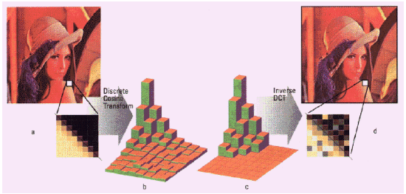
Data Compression
The human eye
  is good at seeing small differences in brightness over a large area
  not so good at distinguishing the exact strength of a high frequency brightness variation
  ➔ can reduce the amount of information in the high frequency components

Slide 4
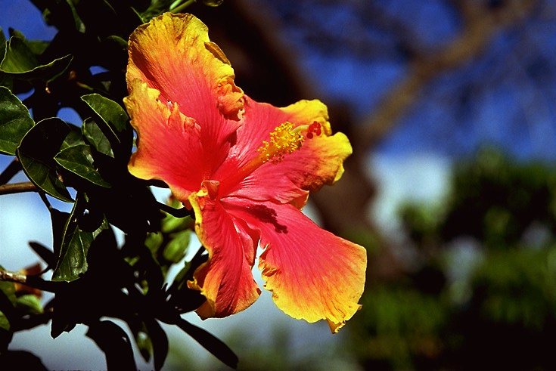

Data Compression
Alternative description of data requiring less storage and bandwidth
Uncompressed: 1 Mbyte
Compressed (JPEG): 50 Kbyte (20:1)
... while, for example, a 20 Megapixel camera creates 6016 x 4000 images,
in 8-bit RGB that makes more than 72 uncompressed Mbytes per image

Slide 5
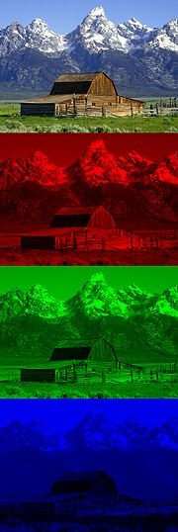

Channels & color conversion (RGB and YCbCr/YUV)
RGB
YCbCr
Y image is essentially a greyscale copy of the main image
the white snow is represented as a middle value in both Cr and Cb
the brown barn is represented by weak Cb and strong Cr
the green grass is represented by weak Cb and weak Cr
the blue sky is represented by strong Cb and weak Cr
Y
G
Cb
B
Cr
Notes:
Originally, YUV was for analog signals and YCbCr was used for digital encoding of color information suited for video and still-image compression. Today, the term YUV is commonly used in the computer industry to describe file-formats that are encoded using YCbCr.
invented when engineers wanted color television in a black-and-white infrastructure -- UV representation of chrominance was chosen over straight R and B signals because U and V are color difference signals. This meant that in a black and white scene the U and V signals would be zero and only the Y' signal would need to be transmitted.

Slide 6
(Chroma) Downsampling
Downsampling (first compression step)
  humans can see considerably more fine detail in the brightness,
  i.e., can reduce the spatial resolution of the Cb and Cr components
  4:4:4
  (no downsampling)
  4:2:2
  (reduce by factor of 2 in
  horizontal direction)
  4:2:0
  (reduce by factor of 2 in
  horizontal and vertical
  directions)
YCbCr
Y
Cb
Cr

Slide 7
1 - Split each picture in 8x8 blocks
Each sub-picture is divided into 8x8 blocks, number depends on resolution

Slide 8

2 - Discrete cosine transform (DCT)
Each 8×8 block is converted to a frequency-domain representation, using a normalized, two-dimensional DCT

Slide 9
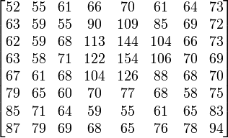
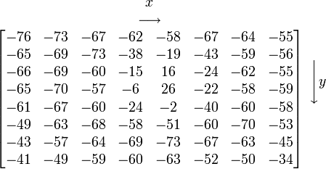
2 - Discrete cosine transform (DCT)
Each 8×8 block is converted to a frequency-domain representation, using a normalized, two-dimensional DCT
  each pixel is represented by a [0, 255]-value
  each pixel is transformed to a [-128, 127]-value
- 128
Notes:
Note: color block and number matrix is not corresponding - just a number example.

Slide 10


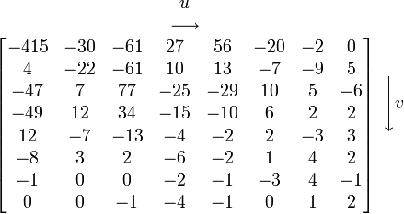
2 - Discrete cosine transform (DCT)
Each 8×8 block is converted to a frequency-domain representation, using a normalized, two-dimensional DCT
  two-dimensional DCT:
    G_{u,v} is the DCT at coordinates (u,v)
    u is the horizontal spatial frequency [0,8>
    v is the vertical spatial frequency [0,8>
    g_{x,y} is the pixel value at coordinates (x,y)
    α is a normalizing function:
Note the rather large value of the top-left corner (DC coefficient). The remaining 63 are AC coefficients. The advantage of the DCT is its tendency to aggregate most of the signal in one corner of the result, as may be seen above.
Compression possible: the following quantization step accentuates this effect while simultaneously reducing the overall size of the DCT coefficients

Slide 11
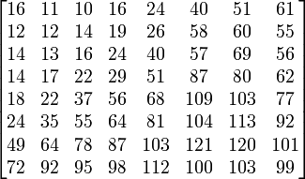
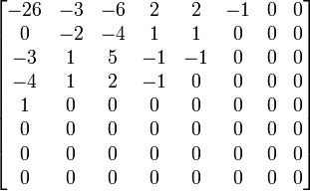
3 - Quantization
The human eye
  is good at seeing small differences in brightness over a large area
  not so good at distinguishing the exact strength of a high frequency brightness variation
  can reduce the amount of information in the high frequency components
  simply dividing each component in the frequency domain by a known constant for that component, and then rounding to the nearest integer:
  where Q_{j,k} is a quantization matrix, e.g., for JPEG
G_{0,0} = -415
= -25.9375000000 ≈ -26
Q_{0,0} = 16

Slide 12
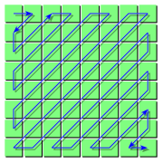
4 - Lossless compression
The resulting data for all 8×8 blocks is further compressed with a loss-less algorithm:
  organizing numbers in a zigzag pattern:
  -26, -3, 0, -3, -2, -6, 2, -4, 1, -4, 1, 1, 5, 1, 2, -1, 1, -1, 2,
  0, 0, 0, 0, 0, -1, -1, 0 , 0, 0, 0, 0, 0, 0, 0, 0, … , 0, 0
  Compress using for example run-length or Huffman coding

Slide 13
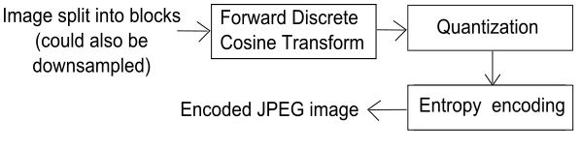
JPEG Encoder Overview
Prepare
(RGB2YUV)
F_{n}
(current)
DCT
Quant
Entropy coding
Encoding:

Slide 14

DCT / Quantization
// Make 8x8 block of the entire picture
for(y = 0; y < height; y += 8)
{
for(x = 0; x < width; x += 8)
{
…
//Loop through all elements of the block
for(u = 0; u < 8; ++u)
{
for(v = 0; v < 8; ++v)
{
for(j = 0; j < jj; ++j) // Inner DCT
for(i = 0; i < ii; ++i)
{ // Inner sum of DCT
float coeff = in_data[(y+j)*width+(x+i)] - 128.0f;
dct += coeff * (float) (cos(…) * cos(…));
}
float a1 = !u ? ISQRT2 : 1.0f; float a2 = !v ? ISQRT2 : 1.0f;
/* Scale according to normalizing function */
dct *= a1*a2/4.0f;
/* Quantization */
out_data[…] = (int16_t)(floor(0.5f + dct / (float)(quanti […])));
}
}
}
}
g_{x,y} = pixel(x,y) - 128;

Slide 15
DCT / Quantization
// Make 8x8 block of the entire picture
for(y = 0; y < height; y += 8)
{
for(x = 0; x < width; x += 8)
{
…
//Loop through all elements of the block
for(u = 0; u < 8; ++u)
{
for(v = 0; v < 8; ++v)
{
for(j = 0; j < jj; ++j) // Inner DCT
for(i = 0; i < ii; ++i)
{ // Inner sum of DCT
float coeff = in_data[(y+j)*width+(x+i)] - 128.0f;
dct += coeff * (float) (cos(…) * cos(…));
}
float a1 = !u ? ISQRT2 : 1.0f; float a2 = !v ? ISQRT2 : 1.0f;
/* Scale according to normalizing function */
dct *= a1*a2/4.0f;
/* Quantization */
out_data[…] = (int16_t)(floor(0.5f + dct / (float)(quanti […])));
}
}
}
}
g_{x,y} = pixel(x,y) - 128;

Slide 16
Zigzag
static uint8_t zigzag_U[64] =
{
0,
1, 0,
0, 1, 2,
3, 2, 1, 0,
0, 1, 2, 3, 4,
5, 4, 3, 2, 1, 0,
0, 1, 2, 3, 4, 5, 6,
7, 6, 5, 4, 3, 2, 1, 0,
1, 2, 3, 4, 5, 6, 7,
7, 6, 5, 4, 3, 2,
3, 4, 5, 6, 7,
7, 6, 5, 4,
5, 6, 7,
7, 6,
7,
};
static uint8_t zigzag_V[64] =
{
0,
0, 1,
2, 1, 0,
0, 1, 2, 3,
4, 3, 2, 1, 0,
0, 1, 2, 3, 4, 5,
6, 5, 4, 3, 2, 1, 0,
0, 1, 2, 3, 4, 5, 6, 7,
7, 6, 5, 4, 3, 2, 1,
2, 3, 4, 5, 6, 7,
7, 6, 5, 4, 3,
4, 5, 6, 7,
7, 6, 5,
6, 7,
7,
};
voffset
uoffset
width = (padded) width of image
u
v
…
for (zigzag = 0; zigzag < 64; zigzag++)
{
uint8_t u = zigzag_U[zigzag];
uint8_t v = zigzag_V[zigzag];
block[zigzag] = in_data[(voffset+v)*width+(uoffset+u)];
}
…

Slide 17



(M-)JPEG
SSE / AVX examples

Slide 18
Optimizing DCT
v-ph-dct
// Make 8x8 block of the entire picture
for(y = 0; y < height; y += 8)
{
for(x = 0; x < width; x += 8)
{
…
//Loop through all elements of the block
for(u = 0; u < 8; ++u)
{
for(v = 0; v < 8; ++v)
{
for(j = 0; j < jj; ++j) // Inner DCT
for(i = 0; i < ii; ++i)
{ // Inner sum of DCT
float coeff = in_data[(y+j)*width+(x+i)] - 128.0f;
dct += coeff * (float) (cos(…) * cos(…));
}
float a1 = !u ? ISQRT2 : 1.0f; float a2 = !v ? ISQRT2 : 1.0f;
/* Scale according to normalizing function */
dct *= a1*a2/4.0f;
/* Quantization */
}
}
}
}

Slide 19
DCT – Approach 1 – normalization table
v-ph-dct
// Make 8x8 block of the entire picture
for(y = 0; y < height; y += 8)
{
for(x = 0; x < width; x += 8)
{
…
//Loop through all elements of the block
for(u = 0; u < 8; ++u)
{
for(v = 0; v < 8; ++v)
{
for(j = 0; j < jj; ++j) // Inner DCT
for(i = 0; i < ii; ++i)
{ // Inner sum of DCT
float coeff = in_data[(y+j)*width+(x+i)] - 128.0f;
dct += coeff * (float) (cos(…) * cos(…));
}
float a1 = !u ? ISQRT2 : 1.0f; float a2 = !v ? ISQRT2 : 1.0f;
/* Scale according to normalizing function */
dct *= a1*a2/4.0f;
/* Quantization */
}
}
}
}
 | √1/8 | √2/8 | √2/8 | √2/8 | √2/8 | √2/8 | √2/8 | √2/8
√1/8 | ISQRT2 * ISQRT2 / 4 | 1 * ISQRT2 / 4 | 1 * ISQRT2 / 4 | 1 * ISQRT2 / 4 | 1 * ISQRT2 / 4 | 1 * ISQRT2 / 4 | 1 * ISQRT2 / 4 | 1 * ISQRT2 / 4
√2/8 | ISQRT2 * 1 / 4 | 1 * 1 / 4 | 1 * 1 / 4 | 1 * 1 / 4 | 1 * 1 / 4 | 1 * 1 / 4 | 1 * 1 / 4 | 1 * 1 / 4
√2/8 | ISQRT2 * 1 / 4 | 1 * 1 / 4 | 1 * 1 / 4 | 1 * 1 / 4 | 1 * 1 / 4 | 1 * 1 / 4 | 1 * 1 / 4 | 1 * 1 / 4
√2/8 | ISQRT2 * 1 / 4 | 1 * 1 / 4 | 1 * 1 / 4 | 1 * 1 / 4 | 1 * 1 / 4 | 1 * 1 / 4 | 1 * 1 / 4 | 1 * 1 / 4
√2/8 | ISQRT2 * 1 / 4 | 1 * 1 / 4 | 1 * 1 / 4 | 1 * 1 / 4 | 1 * 1 / 4 | 1 * 1 / 4 | 1 * 1 / 4 | 1 * 1 / 4
√2/8 | ISQRT2 * 1 / 4 | 1 * 1 / 4 | 1 * 1 / 4 | 1 * 1 / 4 | 1 * 1 / 4 | 1 * 1 / 4 | 1 * 1 / 4 | 1 * 1 / 4
√2/8 | ISQRT2 * 1 / 4 | 1 * 1 / 4 | 1 * 1 / 4 | 1 * 1 / 4 | 1 * 1 / 4 | 1 * 1 / 4 | 1 * 1 / 4 | 1 * 1 / 4
√2/8 | ISQRT2 * 1 / 4 | 1 * 1 / 4 | 1 * 1 / 4 | 1 * 1 / 4 | 1 * 1 / 4 | 1 * 1 / 4 | 1 * 1 / 4 | 1 * 1 / 4
/* Scale according to normalizing function */
dct *= dct_norm_table[u][v];

Slide 20
DCT – Approach 2 – cosine table
v-ph-dct
// Make 8x8 block of the entire picture
for(y = 0; y < height; y += 8)
{
for(x = 0; x < width; x += 8)
{
…
//Loop through all elements of the block
for(u = 0; u < 8; ++u)
{
for(v = 0; v < 8; ++v)
{
for(j = 0; j < jj; ++j) // Inner DCT
for(i = 0; i < ii; ++i)
{ // Inner sum of DCT
float coeff = in_data[(y+j)*width+(x+i)] - 128.0f;
dct += coeff * (float) (cos(…) * cos(…));
}
/* Scale according to normalizing function */
dct *= dct_norm_table[u][v];
/* Quantization */
}
}
}
}
 | 0 | 1 | 2 | 3 | 4 | 5 | 6 | 7
0 | C(0, 0) | C(0, 1) | C(0, 2) | C(0, 3) | C(0, 4) | C(0, 5) | C(0, 6) | C(0, 6)
1 | C(1, 0) | C(1, 1) | C(1, 2) | C(1, 3) | C(1, 4) | C(1, 5) | C(1, 6) | C(1, 7)
2 | C(2, 0) | C(2, 1) | C(2, 2) | … | … | … | … | …
3 | C(3, 0) | C(3, 1) | … | C(3, 3) | … | … | … | …
4 | C(4, 0) | C(4, 1) | … | … | C(4, 4) | … | … | …
5 | C(5, 0) | C(5, 1) | … | … | … | C(5, 5) | … | …
6 | C(6, 0) | C(6, 1) | … | … | … | … | C(6, 6) | …
7 | C(7, 0) | C(7, 1) | … | … | … | … | … | C(7, 7)
dct += coeff * costable[i][u] * costable[j][v];
C(x,u) = cos((2*x+1)*u*PI/16.0f);

Slide 21

DCT – Approach 3 – SSE entire row
v-ph-dct
// Make 8x8 block of the entire picture
for(y = 0; y < height; y += 8)
{
for(x = 0; x < width; x += 8)
{
…
//Loop through all elements of the block
for(u = 0; u < 8; ++u)
{
for(v = 0; v < 8; ++v)
{
for(j = 0; j < jj; ++j) // Inner DCT
for(i = 0; i < ii; ++i)
{ // Inner sum of DCT
float coeff = in_data[(y+j)*width+(x+i)] - 128.0f;
dct += coeff * costable[i][u] * costable[j][v];
}
/* Scale according to normalizing function */
dct *= dct_norm_table[u][v];
/* Quantization */
}
}
}
}
-128, *cos, *cos
-128, *cos, *cos
dct += a0+a1+a2+a3+b0+b1+b2+b3
dct += a0+a1+a2+a3+b0+b1+b2+b3
dct += a0+a1+a2+a3+b0+b1+b2+b3
dct += a0+a1+a2+a3+b0+b1+b2+b3
dct += a0+a1+a2+a3+b0+b1+b2+b3
dct += a0+a1+a2+a3+b0+b1+b2+b3
dct += a0+a1+a2+a3+b0+b1+b2+b3
dct += a0+a1+a2+a3+b0+b1+b2+b3

Slide 22
DCT – Approach 4 – AVX entire row
v-ph-dct-avx
// Make 8x8 block of the entire picture
for(y = 0; y < height; y += 8)
{
for(x = 0; x < width; x += 8)
{
…
//Loop through all elements of the block
for(u = 0; u < 8; ++u)
{
for(v = 0; v < 8; ++v)
{
for(j = 0; j < jj; ++j) // Inner DCT
for(i = 0; i < ii; ++i)
{ // Inner sum of DCT
float coeff = in_data[(y+j)*width+(x+i)] - 128.0f;
dct += coeff * costable[i][u] * costable[j][v];
}
/* Scale according to normalizing function */
dct *= dct_norm_table[u][v];
/* Quantization */
}
}
}
}
dct += a0+a1+a2+a3+b0+b1+b2+b3
dct += a0+a1+a2+a3+a4+a5+a6+a7
…
…
…
…
…
…
…

Slide 23
DCT – Approach 5 – AVX entire row, add
v-ph-dct2-avx
// Make 8x8 block of the entire picture
for(y = 0; y < height; y += 8)
{
for(x = 0; x < width; x += 8)
{
…
//Loop through all elements of the block
for(u = 0; u < 8; ++u)
{
for(v = 0; v < 8; ++v)
{
for(j = 0; j < jj; ++j) // Inner DCT
for(i = 0; i < ii; ++i)
{ // Inner sum of DCT
float coeff = in_data[(y+j)*width+(x+i)] - 128.0f;
dct += coeff * costable[i][u] * costable[j][v];
}
/* Scale according to normalizing function */
dct *= dct_norm_table[u][v];
/* Quantization */
}
}
}
}
dct_vec += [a0,a1,a2,a3,a4,a5,a6,a7]
dct += a0+a1+a2+a3+a4+a5+a6+a7
dct_vec += [a0,a1,a2,a3,a4,a5,a6,a7]
dct += a0+a1+a2+a3+a4+a5+a6+a7
dct += a0+a1+a2+a3+a4+a5+a6+a7
dct_vec += [a0,a1,a2,a3,a4,a5,a6,a7]
dct += a0+a1+a2+a3+a4+a5+a6+a7
dct_vec += [a0,a1,a2,a3,a4,a5,a6,a7]
dct += a0+a1+a2+a3+a4+a5+a6+a7
dct_vec += [a0,a1,a2,a3,a4,a5,a6,a7]
dct += a0+a1+a2+a3+a4+a5+a6+a7
dct_vec += [a0,a1,a2,a3,a4,a5,a6,a7]
dct += a0+a1+a2+a3+a4+a5+a6+a7
dct_vec += [a0,a1,a2,a3,a4,a5,a6,a7]
dct += a0+a1+a2+a3+a4+a5+a6+a7
dct_vec += [a0,a1,a2,a3,a4,a5,a6,a7]
dct += dct_vec[0]+dct_vec[1]+…+dct_vec[7]

Slide 24


