Slide 1

Case Study
- a descriptive research methodology
INF5000/9000
Feb 7 2024 Guri Verne,
Design group

Slide 2
WHAT IS A CS?
A case is an example of something
A choice of what to study
    A case is a speciﬁc, unique, bound system
    (Stake 2005)
Case studies focus on activities, functionings and local meaning within speciﬁc case(s) (Stake 2005)
The study of complex phenomena in their context, in particular when the boundaries between the phenomenon and the context are not clear (Baxter & Jack 2008)
A case study is a situated and detailed inquiry for learning – not proving (Flyvbjerg 2011)
«Fallstudie» in Swedish

Slide 3
From a case we can
understand something
get a rich description of something
learn that something is not the case
learn from a rarely occuring situation
suggest a theory or framework for something
get a basis for action or design
…..

Slide 4
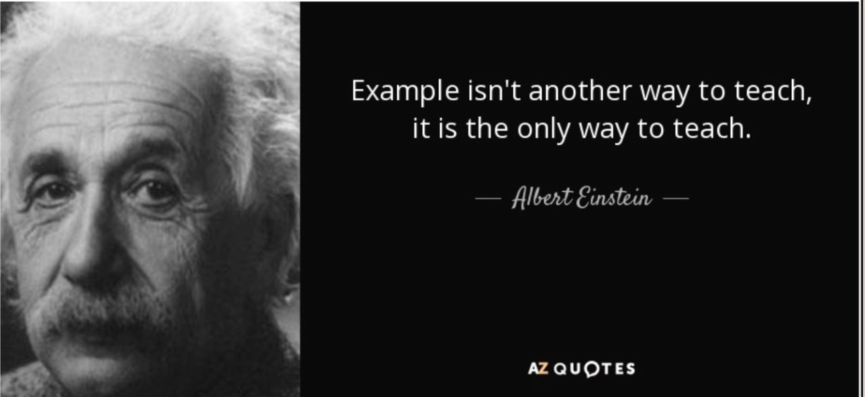

Slide 5
A case is an example of something
Talk to your neighbour:
Do you have experience with illustrating examples? What can you learn from it?

Slide 6
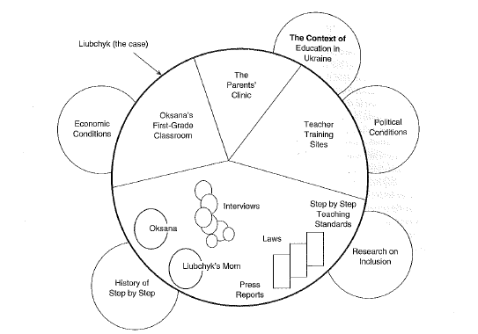
A case in its context
  (Stake 2005)

Slide 7
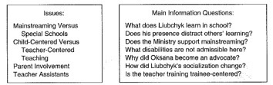
A case in its context
  (Stake 2005)

Slide 8
PARADIGM
Interpretive
Critical, or
Positivist
Origin: Social sciences

Slide 9
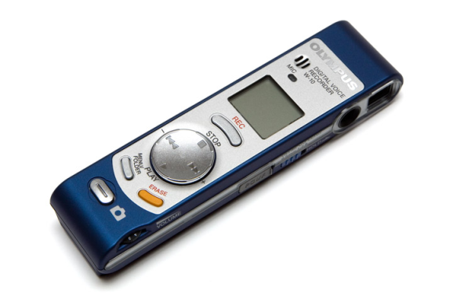


METHODS
Interview
Documents
Observation
Coding (GT)
Interpretation (GT)
  (Stake 2005)

Slide 10




TYPES OF CASE STUDIES
Intrinsic – the case itself
Instrumental – to learn about something else
Collective case study – to learn from many cases
(Stake 2005)

Slide 11
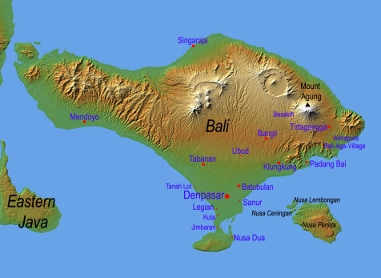
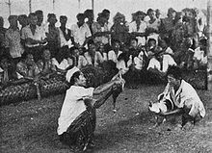
CASE STUDY EXAMPLES 1
Deep Play: Notes on The Balinese cockfight (Geertz 1972)
  Getting access
  “Much of Bali surfaces in a cock ring”
  For further readings on Geertz and ‘thick description’ see e.g. Atkinson & Delamont (2005)
  The case =
  unit of analysis
  (Baxter & Jack 2008)

Slide 12
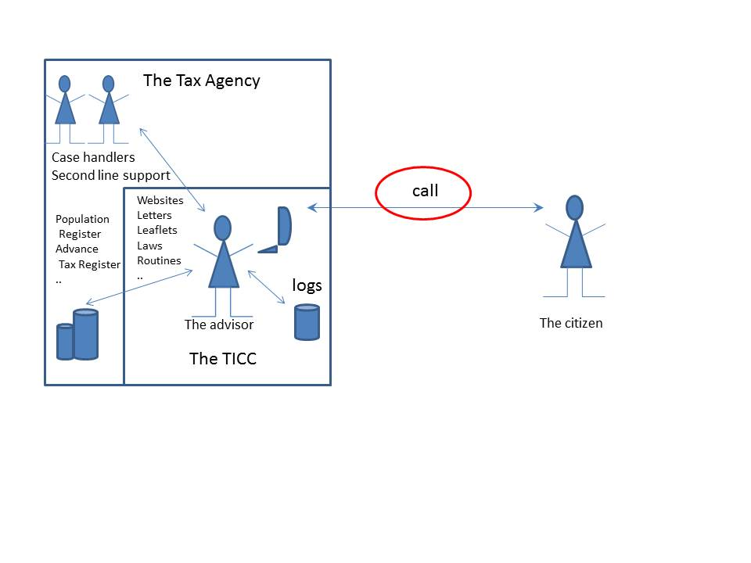
CASE STUDY EXAMPLES 2
”The winners are those who have used the old paper form”
On citizens and automated public services (Verne 2015)
- an instrumental case study within a critical research
paradigm (Stake 2005; Myers Living version).
The Tax Administration
Studying the calls from citizens to learn about how automation functioned.
SOL

Slide 13
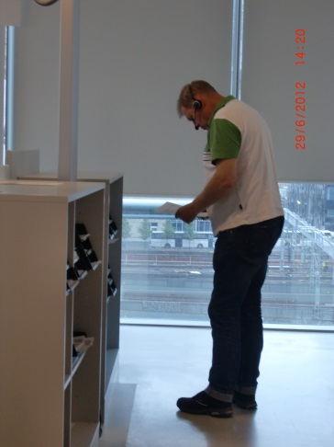
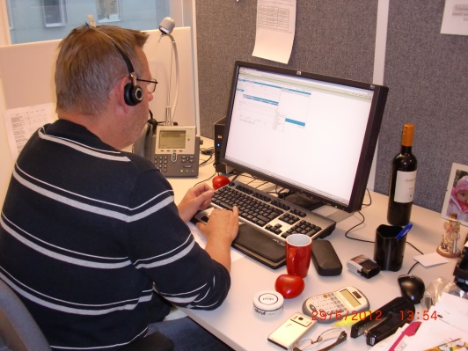
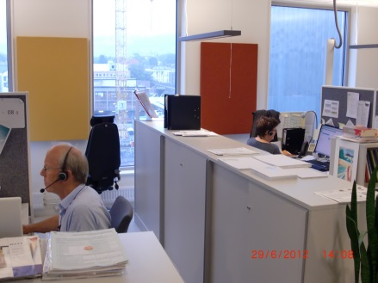
Description of the case
Chapter 4. The sociomaterial assemblage of doing taxes
4.1 SOL - The advisor’s workplace
4.2 IT in the Tax Administration
4.3 The call advisor
4.4 The advisor in action
4.5 The callers
4.6 The call

Slide 14
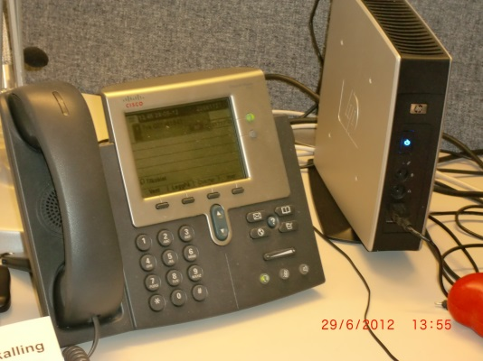
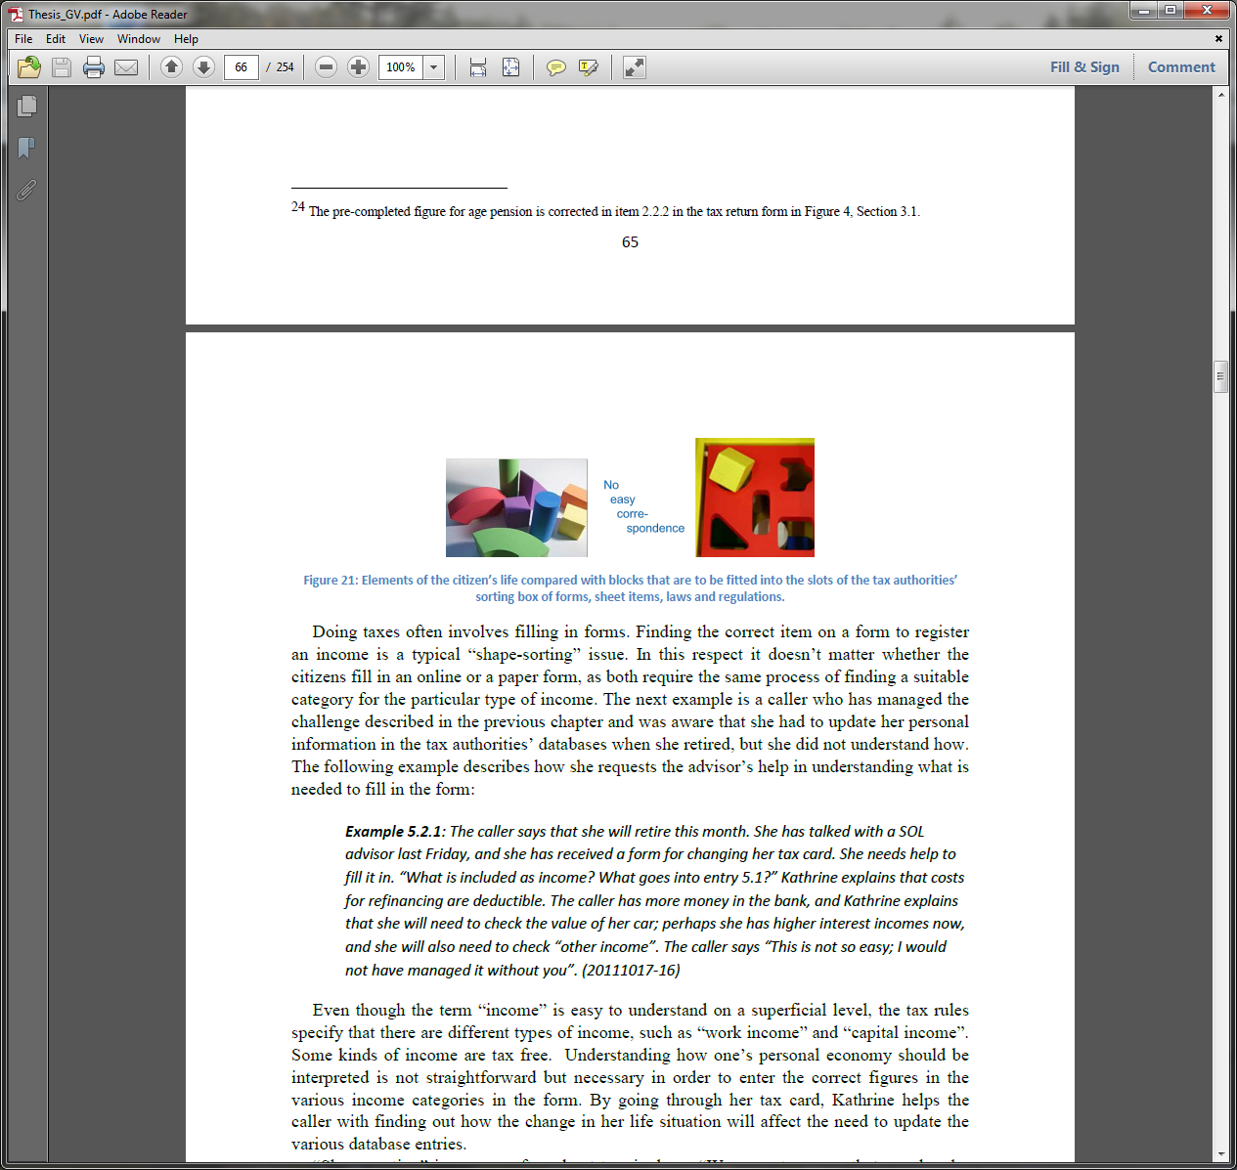
Description of the case
Chapter 4. The sociomaterial assemblage of doing taxes
4.1 SOL - The advisor’s workplace
4.2 IT in the Tax Administration
4.3 The call advisor
4.4 The advisor in action
4.5 The callers
4.6 The call
Chapter 5. Into the telephone calls

Slide 15
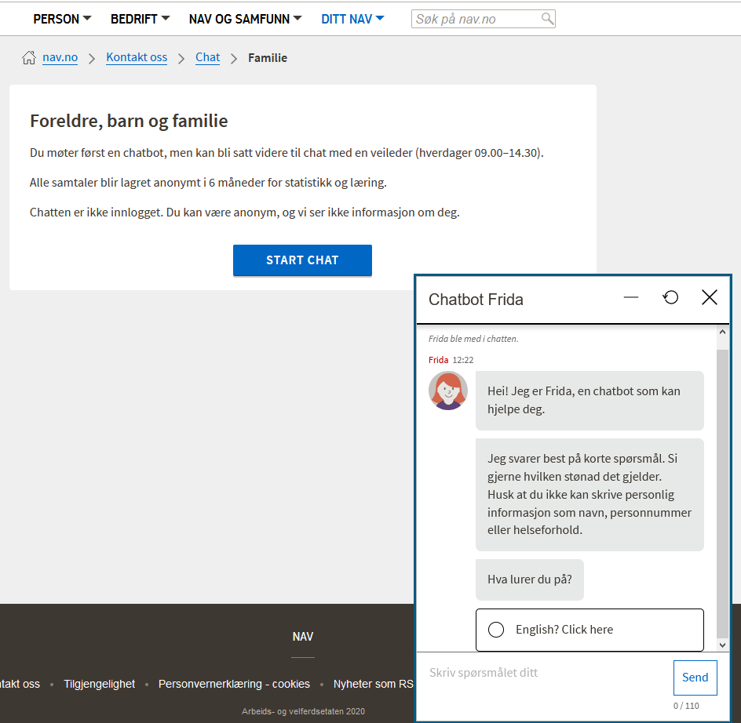

Case 3 Chatbot in NAV
Methods:
Text analysis
Interviews
Observations
Used theory and technical knowledge for the analysis
Linett Simonsen (2019) «Når brukerdialogen automatiseres – hva blir vanskelig? En kvalitativ studie av sekvensen av handlinger mellom menneske og maskin», Master thesis, IfI, UiO

Slide 16
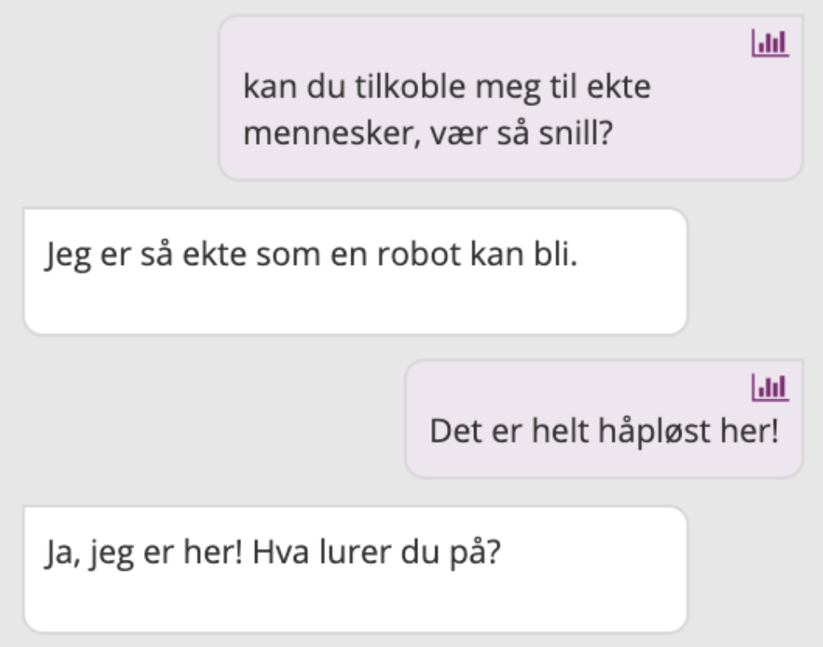
From the chatbot log
Linett categorized the problems from the chat examples:
Language issues
Weak chatbot understanding
Weak NAV/domain understanding
She suggested improvements of different kinds:
Preparing the users’ expectations to the chatbot
Adding synonyms
Less antropomorphism
Less text

Slide 17

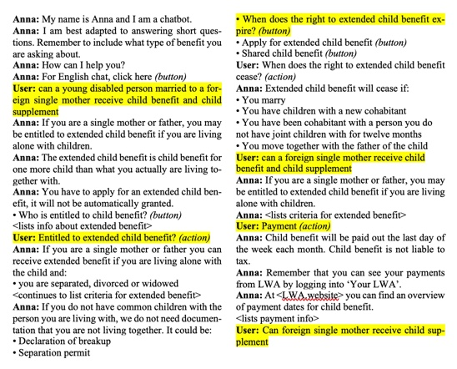
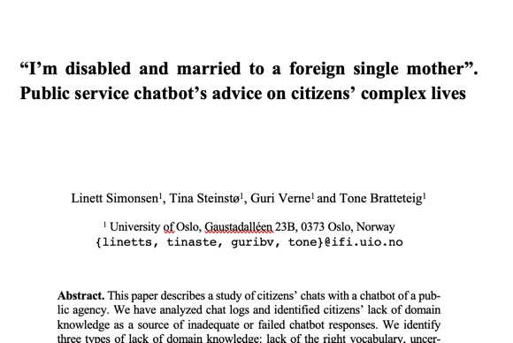
Married to a single mother
The chatbot does not respond to the mismatch between “married” and “single mother”.
Simonsen L., Steinstø T., Verne G., Bratteteig T. (2020)
“I’m Disabled and Married to a Foreign Single Mother”.
Public Service Chatbot’s Advice on Citizens’ Complex Lives.
In: Hofmann S. et al. (eds) Electronic Participation. ePart 2020.
Lecture Notes in Computer Science, vol 12220.
Springer, Cham.

Slide 18
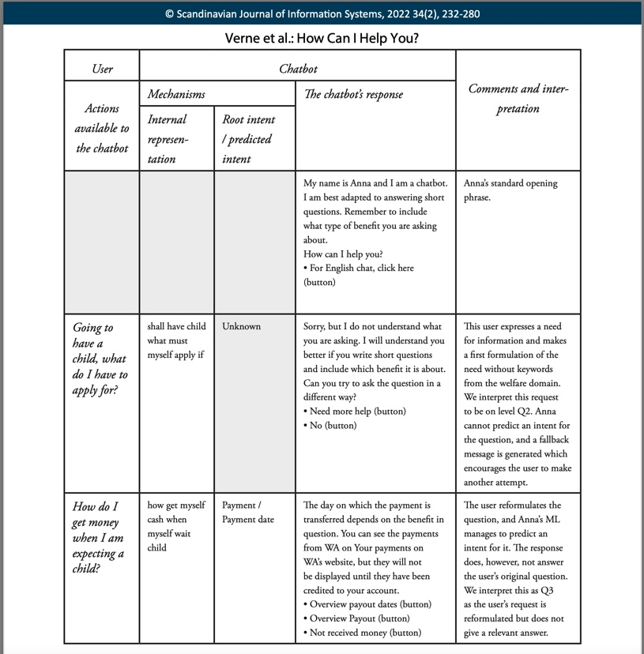
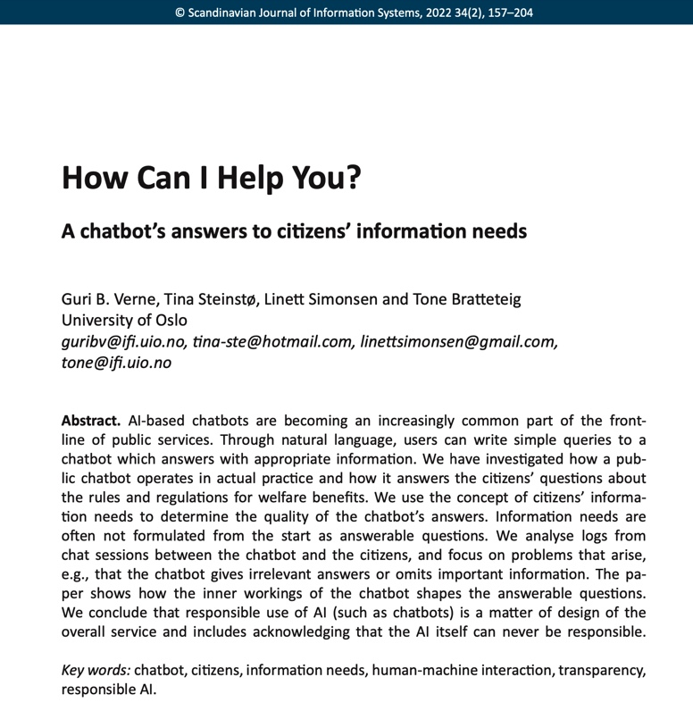
The chatbot does not give a satisfactory answer after two attempts from the user.

Slide 19
Talk in groups
Do you have experience from a case study?
Do you have experience with a thick description?
How can you make a thick description in your master project?

Slide 20
CASE STUDY RESEARCH
Figure out what is important about the case within its own world: its own issues, contexts, and interpretations, its “thick description”¹
Focus on the case and its activities and functioning + its contexts (social, cultural, economic, legal, political, historical)
What is going on? – What can be learned from the case?
Be reﬂective: think about what you encounter. Dig into meanings, relate them to contexts and experiences. Revise.
Seeking the particular more than the ordinary
    You need both!
(Stake 2005)
1) Cliﬀord Geertz is one of the founding fathers of this notion by which is meant that ethnographic accounts should include contexts to fully capture and lay bare a case.

Slide 21
CASE STUDY RESEARCH
When probing the particular and common (but mostly the uncommon) of a case, take into account and gather material on:
The nature of the case, particularly its activity and functioning
Its historical background
Its physical setting
Other contexts, such as social, economic, political, legal and aesthetic
Other cases through which this case is recognized, and
Those informants through whom the case can be known
(Stake 2005:447)

Slide 22
SELECTING A CASE
It is ok to be pragmatic
Learn from atypical cases
Gives opportunity to learn
Accessible cases
Possibility to stay long
Strategic choice of case
(Stake 2005, Flyvbjerg 2011)

Slide 23
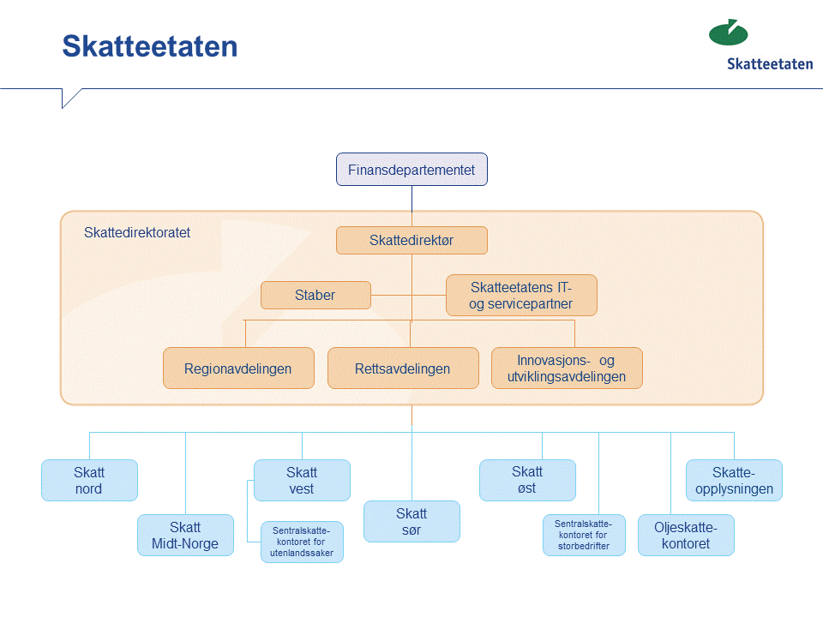
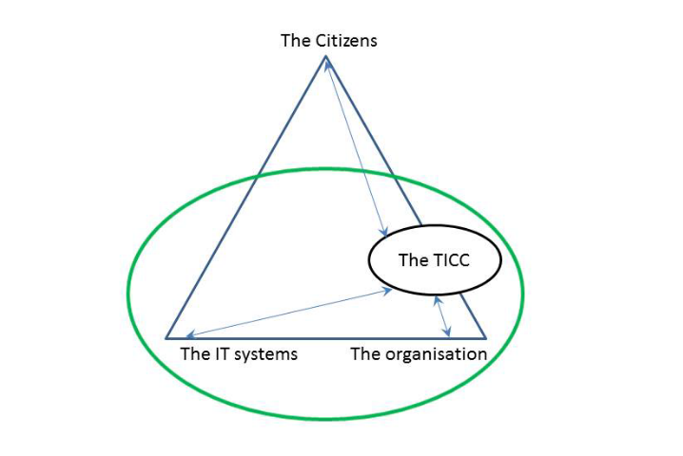
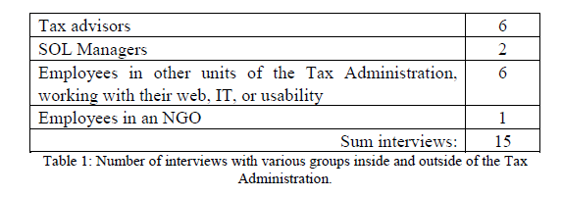
DESCRIBING THE CASE 1
Report the collection of field data
  The research sites
  The reason for this choice
  The number of people interviewed
  Their positions
  Other data sources
  Over what period
How the iterative process between field data and theory took place and evolved
(Walsham 2002)

Slide 24
DESCRIBING THE CASE 2
Converge data from multiple sources
Chronological report, a story or address issues (Baxter and Jack 2008)
Good narratives express complexities of real life
Details, not general conceptualizations (Flyvbjerg 2011)
  “Present a coherent point of view with grace, wit and felicity” (Van Maanen 1989, p 32)

Slide 25
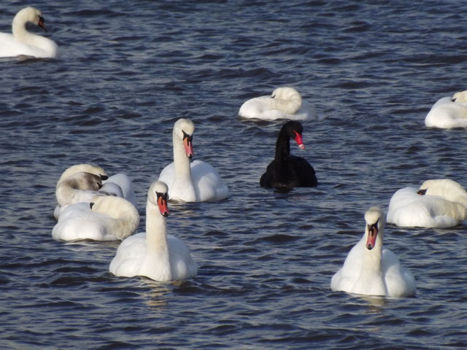
ISSUES TO CONSIDER
Bounding the case, conceptualizing the object of study
Selecting phenomena, themes, issues (i.e. the research questions to emphasize)
Seeking patterns of data to develop issues
  Data collection and analysis occur concurrently
Triangulating for clarification and diversity
Selecting alternative interpretations to pursue
Developing assertions about the case
(Stake 2005)
Generalizations – the black swan
What is this case a case of?
(Flyvbjerg 2011, p. 12)

Slide 26
Literature not listed on syllabus
Simonsen L., Steinstø T., Verne G., Bratteteig T. (2020)
“I’m Disabled and Married to a Foreign Single Mother”.
Public Service Chatbot’s Advice on Citizens’ Complex Lives.
In: Hofmann S. et al. (eds) Electronic Participation. ePart 2020.
Lecture Notes in Computer Science, vol 12220.
Springer, Cham.
Verne, Guri B.; Steinstø, Tina; Simonsen, Linett; and Bratteteig,
Tone (2022) "How Can I Help You? A chatbot’s answers to
citizens’ information needs," Scandinavian Journal of
Information Systems: Vol. 34: Iss. 2, Article 7.

