Slide 1
Engaged qualitative research: Methodologies
Silvia Masiero
silvima@ifi.uio.no
IN4340 – Engaged Qualitative Research Methods
02.09.2024

Slide 2
Overview
What is qualitative research?
Qualitative research methodologies: an overview
Using qualitative methodologies in digital health research

Slide 3
After this lecture, you can…
Define qualitative research and understand its main characteristics, as well as the differences with quantitative research
Describe the four main approaches to qualitative research in digital health – case studies, action research, ethnography, grounded theory – and discuss their advantages and disadvantages in determinate field situations
Discuss how different qualitative research methodologies are applied to digital health research, according to research questions and field circumstances.

Slide 4
From last week…
We have encountered epistemology, which we have defined as our assumptions about knowledge and how it can be obtained
We have introduced the three epistemological paradigms of positivist, interpretivist and critical research, with their core assumptions and their implications for how research is conducted
On top of this, we have noted that our epistemological position influences the theoretical perspective and, importantly, the methodologies and methods adopted in our research!

Slide 5
What is qualitative research?

Slide 6
What is qualitative research?
A key distinction:
Quantitative research is the process of collecting and analysing numerical data. It can be used to find patterns and averages, make predictions, test causal relationships, and generalize results to wider populations.
Qualitative research involves the use of qualitative data, such as interviews, documents, and participant observation data, to understand and explain social phenomena.

Slide 7
What is qualitative research?
…a data-based distinction!
The distinction between quantitative and qualitative research is in terms of the type of data used to conduct the research.
This puts the distinction at the level of methodology, meaning: “the plan of action, process or design lying behind the choice and use of particular methods” (Crotty, 1998).

Slide 8
Doing qualitative research
Qualitative research is defined by the nature of the data collected, rather than the underlying epistemology or the theories adopted in the study.
As such, it encompasses a wide range of methodologies, which researchers from different disciplines may apply in different ways.
In the field of digital health (Nielsen & Sahay, 2022), four methodologies are predominant for the conduct of research: ethnography; case studies; action research and grounded theory.

Slide 9
Ethnography
“One of the most in-depth research methods possible” (Myers, 1997)
Ethnographers immerse themselves in the lives of the people they study, seeking to place the phenomena studied in their social and cultural context.
Normally requires a significant amount of time in the field, assuming the perspective of the studied subjects.

Slide 10
Ethnography
Critical ethnography (Myers, 1997):
The goal of ethnographic research is to improve our understanding of human thought and action through interpretation of human actions in context.
For an ethnographer, the context is what defines the situation and makes it what it is. This explains the long time spent appraising it.
Anthropological approaches to ethnography, unlike more involved methodologies (e.g. action research), do not prescribe the direct involvement of the researcher with the research object. While taking the participants’ perspective, the researcher does not actively seek to influence it.

Slide 11
For example...
Lin et al. (2015): Extending ICT4D studies: The Value of Critical Research
An Information & Communication Technology for Development (ICT4D) project in a school in Taiwan, based on computers for school teaching
The mainstream narrative: a successful project, highlighted by mainstream media and the School principal as a landmark tech-for-development success
Critical ethnography uncovers a different reality: parents and teachers reveal frustration with the ICT4D project, which while creating an appealing image to the media, is stifling learning and disempowering class teachers.
The ethnographer does not take action, but her enquiry uncovers an oppressive, alienating reality lived every day by the study participants.

Slide 12
Case studies
“The most common qualitative method used in information systems” (Orlikowski & Baroudi, 1991)
Defined as an inquiry that:
  Investigates a contemporary phenomenon within its real-life context, especially when
  The boundaries between phenomenon and context are not clearly evident.
Case studies can be positivist, interpretive or critical, depending on the assumptions made on the nature of knowledge (epistemology).

Slide 13
Case studies
Interpretive case studies (Walsham, 2006):
Spectrum of involvement: the researcher can be more or less involved with the field, ranging from being a detached observer to an active participant.
In the in-depth case study, largely used in IS research, the research involves frequent visits to the field site over an extended period of time.
Entering organisations, the researcher faces complex and intertwined conceptual structures, which they need to understand from within.
The in-depth case study offers a window on the lived experience of phenomena, which is crucial to how research participants form their own meaning of things.

Slide 14

For example…
Digital Transformation under a pandemic: A case study of Covid-19 contact tracing in Norway
https://www.duo.uio.no/handle/10852/83189

Slide 15
Action Research
“Action research aims to contribute both to the practical concerns of people in an immediate problematic situation and to the goals of social science by joint collaboration within a mutually acceptable ethical framework” (Rapoport, 1970, in Myers, 1997: 6)
Action research: operates the concomitant processes of taking action on a certain object, and doing research on it.
Two core assumptions of action research:
  Social settings cannot be reduced for study,
  Action brings understanding.

Slide 16
Action Research
Numerous works from the HISP Centre illustrating the value of action research in the IS context!
Some examples:
Braa, Monteiro & Sahay (2004) – presents action research interventions as one element in a larger network of action to ensure sustainability of the intervention
Braa & Sahay (2012) – discuss participatory design, noting its consequences on design, development, implementation and scaling of a digital platform (DHIS2) across the health systems of various countries

Slide 17
Action Research
…a very suited method for engaged research!
Remember Mathiassen’s (2017) definition of engaged research as a participatory form of research for studying complex real-world problems from the perspectives of key stakeholders.
Action research brings the researcher in close contact with stakeholders, and immerses them in action on the complex real-world problem at the centre of the research.

Slide 18
Grounded theory
“A research method that seeks to develop theory that is grounded in data systematically gathered and analysed” (Myers, 1997)
Widely seen in the Information Systems community as the one method that best accommodates a positivist epistemology
Strong reliance on coding – developing codes from qualitative data and using them to arrive at theoretical categories (Strauss & Corbin, 1998)

Slide 19
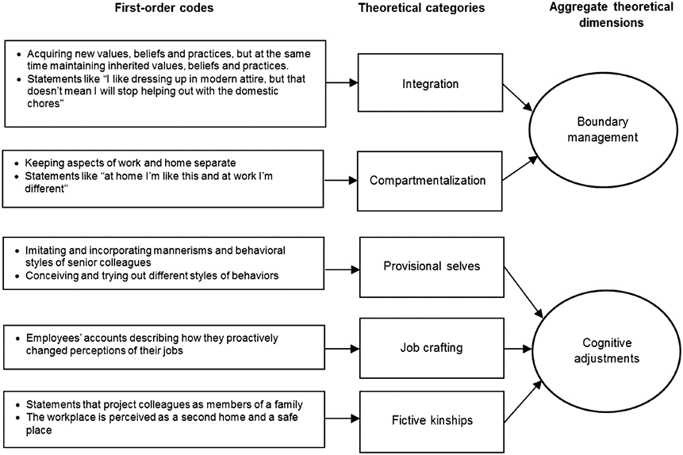
For example…
Sociocultural transitions and developmental impacts in the digital economy of impact sourcing

Slide 20
So…
Ethnography, ase studies, action research, and grounded theory are methodologies that appear frequently in information systems research.
While not exhaustive, this taxonomy gives us a strong starting point to begin reviewing the specificities, techniques and challenges of each methodology in relation to digital health!

Slide 21
Using qualitative methods in digital health research
An example…
Digital Transformation under a pandemic: A case study of COVID-19 contact tracing in Norway. Gundersen et al. (2020)
Early 2020: municipalities in Norway did their best to cope with pandemic, doing contact tracing using excel spreadsheets or pen and paper
Case study of digital contact tracing with the DHIS2 platform: collaborative efforts made to address this challenging situation by the University of Oslo (UiO), the Norwegian Association of Local and Regional Authorities (KS), the Norwegian Institute of Public Health (NIPH) and several municipalities.
Case study method as a window on the world of health managers, contact tracers and health staff that had to do with the DHIS2 system.

Slide 22
Using qualitative methods in digital health research
Here we have…
An in-depth case study conducted under time pressure: emergency situation; need for a fast, prompt and responsive organisation of a large shared research effort
A research strategy centred on direct participation in the lifeworlds of contact tracers, their approach to the DHIS2 platform, and the meaning they constructed around the experience of doing digital contact tracing.

Slide 23
To recap…
In this lecture we have introduced qualitative research as research that uses qualitative data to understand and explain social phenomena.
We have introduced four methodologies – ethnography; case studies; action research and grounded theory – that are common in digital health research. Each methodology has its own specificities, advantages and disadvantages in relation to particular contexts and research question.
This will equip us to understand different research methods, meaning the techniques and procedures used to collect and analyse data!

Slide 24
Thank you!
silvima@ifi.uio.no

Slide 25
Readings
Core Reading
Myers, M. D. (1997). Qualitative Research in Information Systems. MISQ Discovery, 1-18.
Orlikowski, W. J., & Baroudi, J. J. (1991). Studying information technology in organizations: Research approaches and assumptions. Information Systems Research, 2(1), 1-28.
Supplementary Reading
Myers, M. D., & Avison, D. (Eds.). (2002). Qualitative Research in Information Systems: A Reader. London: Sage. Chapter 4.
Crotty, M. (1998). The foundations of social research: Meaning and perspective in the research process. Thousand Oaks: Sage. Chapter 1.

