Slide 1
Writing your own thesis proposal – part 1
Silvia Masiero
silvima@ifi.uio.no
IN4340 – Engaged Qualitative Research Methods
08.11.2023

Slide 2
Overview
Writing a MSc Thesis!
Structuring your MSc Thesis Essay
Thesis structure: one way to build it

Slide 3
Writing a MSc thesis!

Slide 4
The MSc thesis at UiO
60 credits for long thesis, 30 for short thesis
An independent piece of research, building on MSc knowledge to investigate one or more research questions, approach them through data collection and analysis, and make a theoretical contribution to a field of research.
The main focus of your second year!

Slide 5
The MSc Thesis Essay
1 June: short essay (ca. 10 pages) discussing the core problem of your MSc thesis research, intended research questions, the methodology you plan to use to respond them, and the contribution which you expect your research to make.
While this is an early-stage document, a clear structure for it will give you a sense of direction for your thesis, and help you identify areas that still need work.
The research design diagram by Mathiassen (2017) offers a useful way to structure your essay!

Slide 6
Structuring your thesis essay

Slide 7
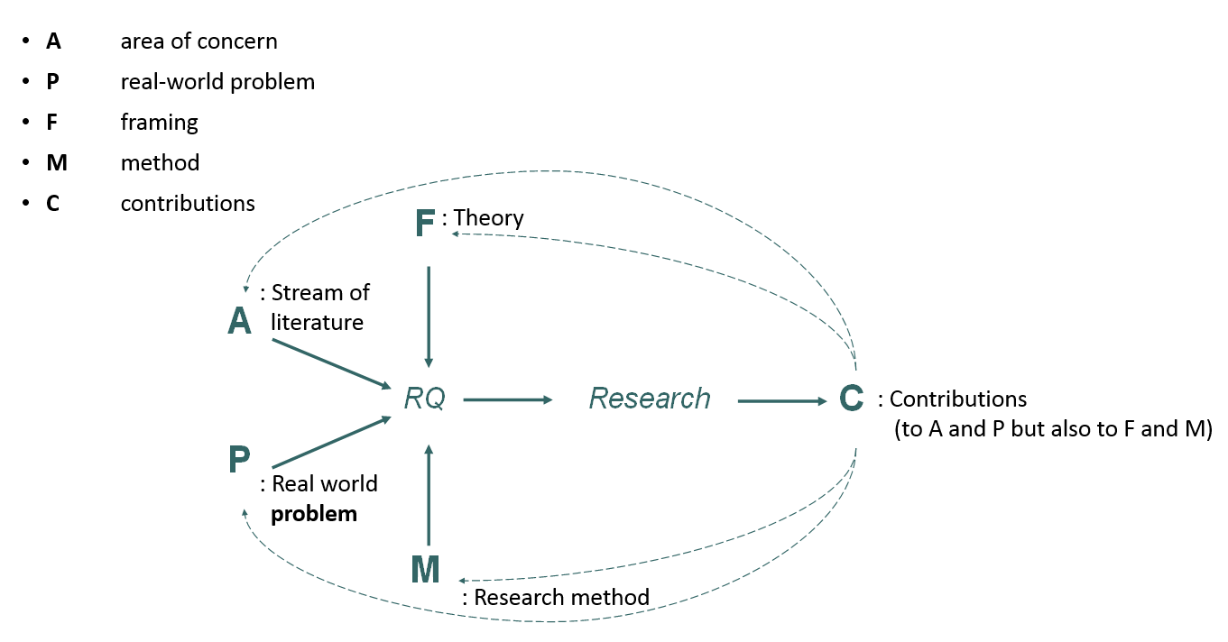
Research Design (Mathiassen, 2017)

Slide 8
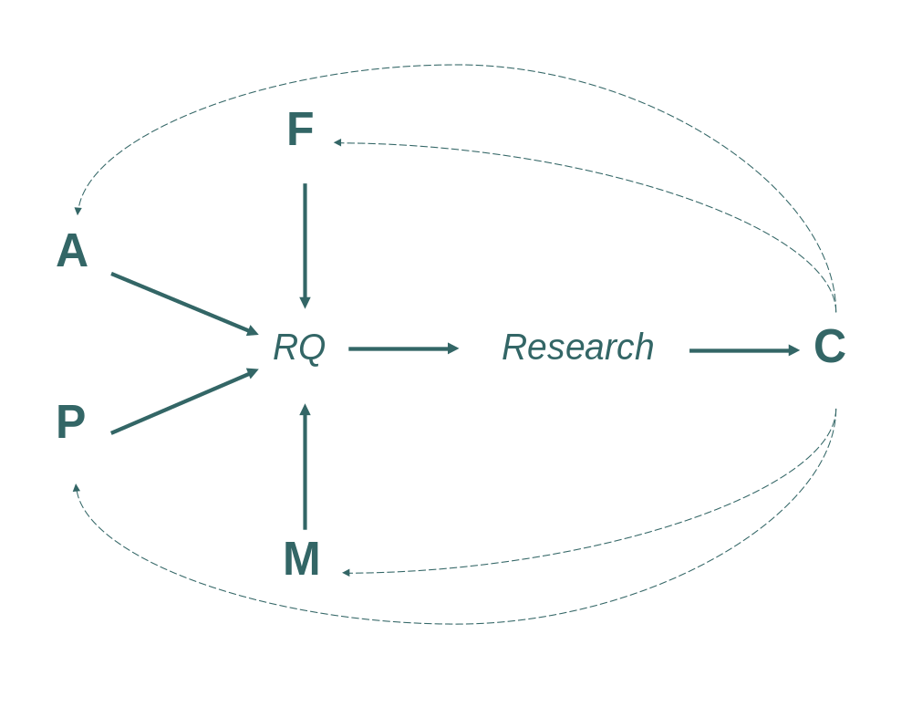
An example (Amuha, 2021)
Education Management Information Systems (EMIS) data management process and decision making at district level
Institutional theory,
institutional logics
Contributions (mainly) to EMIS literature (A) and IS literature
Contribution to P; computerized, decentralized data management. Readily available data to guide decision making
How can decentralization of EMIS using a digital platform support data management and decision making at district level?
Largely manual data management process, no readily available data at districts to guide decision making
Interpretive qualitative case study:
participant observation, informal interviews and conversation, and reviews of documentation

Slide 9
Thesis structure!

Slide 10
Thesis structure
1 Introduction
This is where the work is showcased. The introduction offers a synthesis of the thesis, why it is important, and the contribution.
2 Literature Review
This section shows “what has been written” on the topic. It identifies the literature you are contributing to, and the gap you are filling.
3 Theoretical Framework
This section contains the theoretical assumptions that frame your work. You use these assumptions to structure your research question and contribution.
4 Methodology
In this section you state how you answered the research question, i.e. the methodology. A methodology needs to be harmonised to the question asked, so to frame the response to it.

Slide 11
Thesis structure
5 Empirical Data
  Description – of the empirics you have studied, and its context
  Findings – the main results of your research, in response to the question
6 Discussion
In this section, you position the work within existing literature. Here you go back to section 2, the literature review, and state where your contribution is.
7 Conclusion
A brief summary of the work, and some pointers for further research.

Slide 12
Introduction
An introduction offers a synoptic perspective on the thesis. It identifies the core problem of the work, the literature to which it contributes, as well as its research questions, methodology, findings and contributions.
After having read the introduction, the reader should have a very firm sense of what you have researched, the essence and novelty of your findings, and the contribution you made to your literature of choice.
For this reason, a clear introduction is an essential ingredient for a solid thesis!

Slide 13
Literature Review
This section identifies the domain of literature that your thesis contributes to. Having reviewed the main debates on the topic, it leads to your research questions by illuminating one, or more, debates that still remain open.
The same research problem – e.g.: healthcare staff’ perception of a new app; challenges in the adoption of a new disease tracking protocol; use of health MIS in a developing country… - can be made to contribute to different literatures!
As you approach your review of the literature, you will need to identify the area of literature (Mathiassen’s A) you wish to contribute to.

Slide 14
Theoretical Framework
Theoretical perspective: the philosophical stance informing the methodology and providing context for the process and grounding its logic and criteria (Crotty, 1998)
In a MSc thesis, a theoretical framework provides an illuminating lens that supports you in structuring your research questions, devising a methodology to address them, and interpreting your results
In the case of grounded theory approaches, rather than a pre-fixed framework, the researcher discovers theory directly from the data.

Slide 15
Methodology
Methodology: the plan of action, process or design lying behind the choice and use of particular methods (Crotty, 1998)
A methodology section describes the route you have taken to answer your research question, and is harmonised with the epistemological assumptions made at the origin of the research.
Your methodology comprises of the set of methods that you will have used to collect the data and, in a second stage, to analyse them in response to the research question.

Slide 16
Empirical Data
A section normally divided in two parts: a descriptive one, making sense of the empirical domain of your research, and an analytical one, in which the question is answered.
Contextual richness is highly desirable: the reader wishes to learn about the context of your research, and how that has informed your findings!
In the analytical question, you will apply your theoretical framework to analyse the findings from your research. If using grounded theory, this is where your coding structure will be positioned.

Slide 17
Discussion
Arguably the most important part of the thesis!
In the discussion, your findings are placed within the literature which you have reviewed earlier in the thesis. As a result, the discussion is where your findings are made to contribute to your literature of choice.
The importance of the discussion stems from the fact that this is where your independent work, conducted across two years, is put in conversation with the existing literature.

Slide 18
Conclusion
Normally a short section, clear and concise
The conclusion restates the research problem that you faced, the methodology with which you faced it, and the contribution you have made through the original findings of your research.
It is also an opportunity to state pointers for further research, which your MSc research study has opened for the future.

Slide 19
So…
Although there is no fixed structure for a MSc thesis, today we reviewed one that can support you through developing a clear architecture for your study, making its independent contribution emerge clearly from the data.
Next week we will review techniques of data collection and analysis that will help you arrive at your findings in a solid way!

Slide 20
Thank you!
silvima@ifi.uio.no

Slide 21
Readings
Core Reading
Mathiassen, L. (2017). Designing engaged scholarship: From real-world problems to research publications. Engaged Management Review, 1(1), 2.
Supplementary Reading
Van de Ven, A. H. (2007). Engaged scholarship: A guide for organizational and social research. London: Oxford University Press.

