Slide 1
Decisions and if-statements
DIGHEL4360
Lars Tveito,
Institutt for Informatikk, UiO

Slide 2
Previous week – recap
Variables
  Used for storing data
  Declaration and assignment
Input
  Prompt the user to input values
  Datatype is always string
a = 5
b = ‘Hei’
c = 3.14
name = input(’Your name please: ‘)

Slide 3
Decisions

Slide 4
Candy
>0,5 kg
Between 0,2 and 0,5 kg
<0,2 kg
Stomach ache
Happy
Unsatisfied

Slide 5
> 7
< 7
= 7
Basic
Acidic
Neutral
pH

Slide 6
T < 0
0 ≤ T≤ 20
T > 20
Winter jacket
Sunscreen
Check temperature
Light jacket

Slide 7
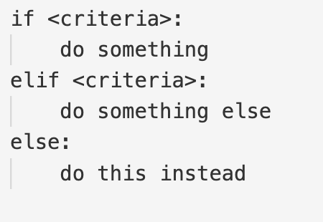
If-statements in programming
Used to execute blocks of code if some criteria is satisfied
If – elif – else
  First true ends the sequence!

Slide 8
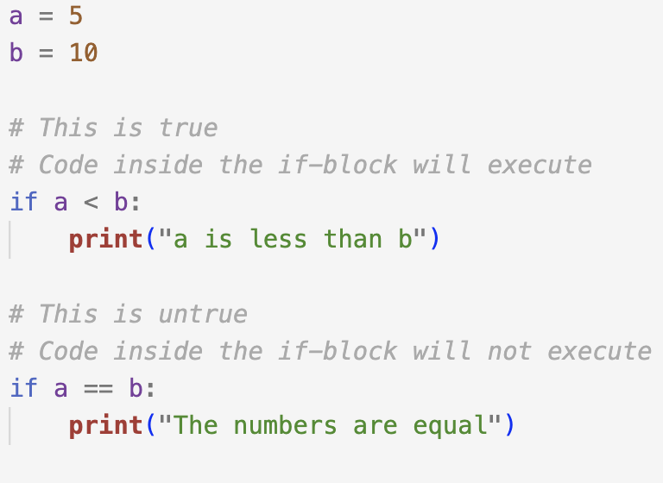
Relational operators
a == b
  a is equal to b
a != b
  a is not equal to b
a > b
  a is greater than b
a < b
  a is less than b
a >= b
  a is greater than or equal to b
a <= b
  a is less than or equal to b

Slide 9
Exercises 1
Task 1
Write a program containing two variables. If the values you choose are the same, the program should print a message saying «the numbers are equal». Otherwise, the program should print «the numbers are not equal».
Change your program such that the value of the variables is instead determined by input given by the user.
Task 2
Write a program that prompts the user to input a username and a password. If the username is «lars» and the password is «donald duck», the program should print «access granted». In all other cases the program should print «access denied».

Slide 10
Loops

Slide 11
What are loops?
Used for code repetition
There are two kinds of loops in Python
  The while loop
  The for loop
  We will have a look at these shortly...
Often used in conjunction with lists

Slide 12
The while loop
A state loop
  As long as <condition> is satisfied, continue doing something
Has a wide variety of use cases
  Counting
  Waiting for correct input
Warning: when used for counting, remember to
increment your counting variable!
a = 1
while a < 5:
print(a)
a = a + 1
Output:
1
2
3
4

Slide 13
The for loop
«Counting loop»
  For each element in... do something
  In our case used with numbers in a range
  ...but often used in conjunction with lists
The range function
  Specify an interval through which you wish to iterate
  Takes one, two or three arguments
  Includes the starting parameter,
  does not include the ending parameter!
for i in range(0, 5):
print(i)
Output:
0
1
2
3
4

Slide 14
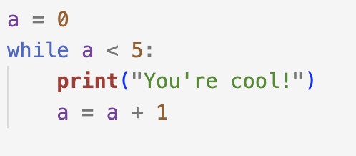
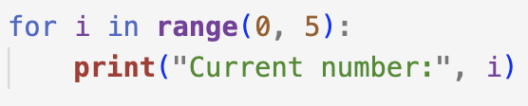
Two kinds of loops
Loops = code repetition
 | While | For
Kind | «State loop» | «Counting loop»
Generally | while <condition>: <do this> | for <variable> in range(start, end, step): <do this>
Example

Slide 15
Exercises 2
Task 1
Write a program that prints every whole number from 10 up to and including 20
Using a while loop
Using a for loop
Task 2
Write a program that prints every odd number between 0 and 100
Using the step parameter of the for loop
Using an if-statement inside a while loop
(hint: a % 2 gives the remainder of a divided by 2)

Slide 16
Challenge – revisiting our pneumothorax patient
A patient has undergone a pleurectomy and lung resection. Post op. the patient is given a Marcain blockade going at 6 ml/hr.
Write a program that prints the total amount of Marcain administered (in ml) for each hour up to and including 10 hours.

