Slide 1

Circle U. – ny søknad
Januar 2023

Slide 2




Videreføring av alliansen
Our vision:
By 2030, Circle U. is a research-intensive and interdisciplinary alliance deploying, through a joint innovative, adaptive and fully operational ecosystem, outstanding interdisciplinary education, research and innovation as a guiding light for progress towards more sustainable, democratic and healthier societies.
Our mission:
Empowering our students and staff to mobilize knowledge for impact in order to make the world a better place.
University of Oslo
Aarhus University
Kings college,
London
Humboldt Universität zu Berlin
UCLovain
Universite de Paris
University of Vienna
University of Pisa
University of Beograd

Slide 3
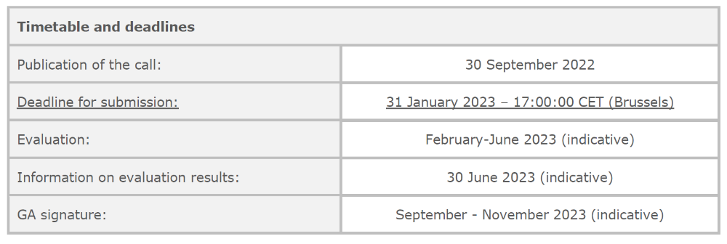
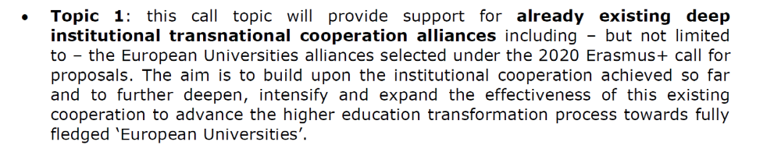
Call

Slide 4

Task-force for ny søknad
Bjørn Stensaker (leder TF)
Eivind Engebretsen (editor /leder skriveteamet)
Kevin Guillaume (GS)
Esther Sulimovic (Paris)
Katy Burgess / Viktoria Menczel
(Wien)
Veronica Moretti (Pisa)
Shefali Shah (King’s)
Tony Sandset (Oslo)
Ingemar Pongratz (konsulent)

Slide 5
KH1
Global health
KH2
Demo-cracy
KH3
Climate
KH4
To be defined
Open Campus
(joint master programmes, joint PhD courses, digital courses, open lectures, innovation activities, collaborative spaces)
Teaching Innovation Lab
InCUbator
Early Career Researcher Community of Practice
Front window
Back office
Multilingualism, Interculturality and Language Lab

Slide 6
WP1: MANAGEMENT AND COORDINATION
WP2. INCREASE MOBILITY AND INTERNATIONAL EXPOSURE FOR ALL
WP6.. CREATING A FULLY FUNCTIONAL INTER-UNIVERSITY CAMPUS
WP3. INTERDISCIPLINARY AND INNOVATIVE TEACHING AND LEARNING OPPORTUNITIES
WP7. COMMUNICATION AND DISSEINATION
WP4. STRENGTHENING COLLABORATION AND BUILDING CAPACITY IN RESEARCH
WP5. STRENGTHENING OUR SOCIETAL ENGAGEMENT

Slide 7
Utdanningsaktiviteter organisert i Open Campus
1. Three joint programmes on Master’s or PhD level across and beyond the Knowledge Hubs
2. A new set of Bachelor modules on sustainability across and beyond the Knowledge Hubs
3. Short-term and blended flagship learning formats such as:
  Circle U. Summer/Winter schools – scaling up the existing summer schools with more participants and possible summer/winter schools organized both by the Circle U. Knowledge Hubs and outside the KH topic areas.
  Circle U. Conversations – blended and physical open “lectures” or seminars to larger audiences, in which academics and researchers engage with (non-academic) partners on a specific topic linked to our priority themes
  Circle U. Open Courses – offering online courses or modules to Circle U. students and other learners that will lead to a certificate of participation, completion, credits (similar to small MOOCs)
  Circle U. Challenge-based learning – multiplying and scaling up collaborative learning opportunities with more participants in diversified formats (hackathons, games, bootcamps, etc.) that will lead to a certificate of participation, completion, credits
  Circle U. language and intercultural skills modules – offering online and blended modules to Circle U. students and other learners to reinforce their language and intercultural competences

Slide 8


