Slide 1
UiO -UV
Differ data insights (1 aug-16 aug)

Slide 2
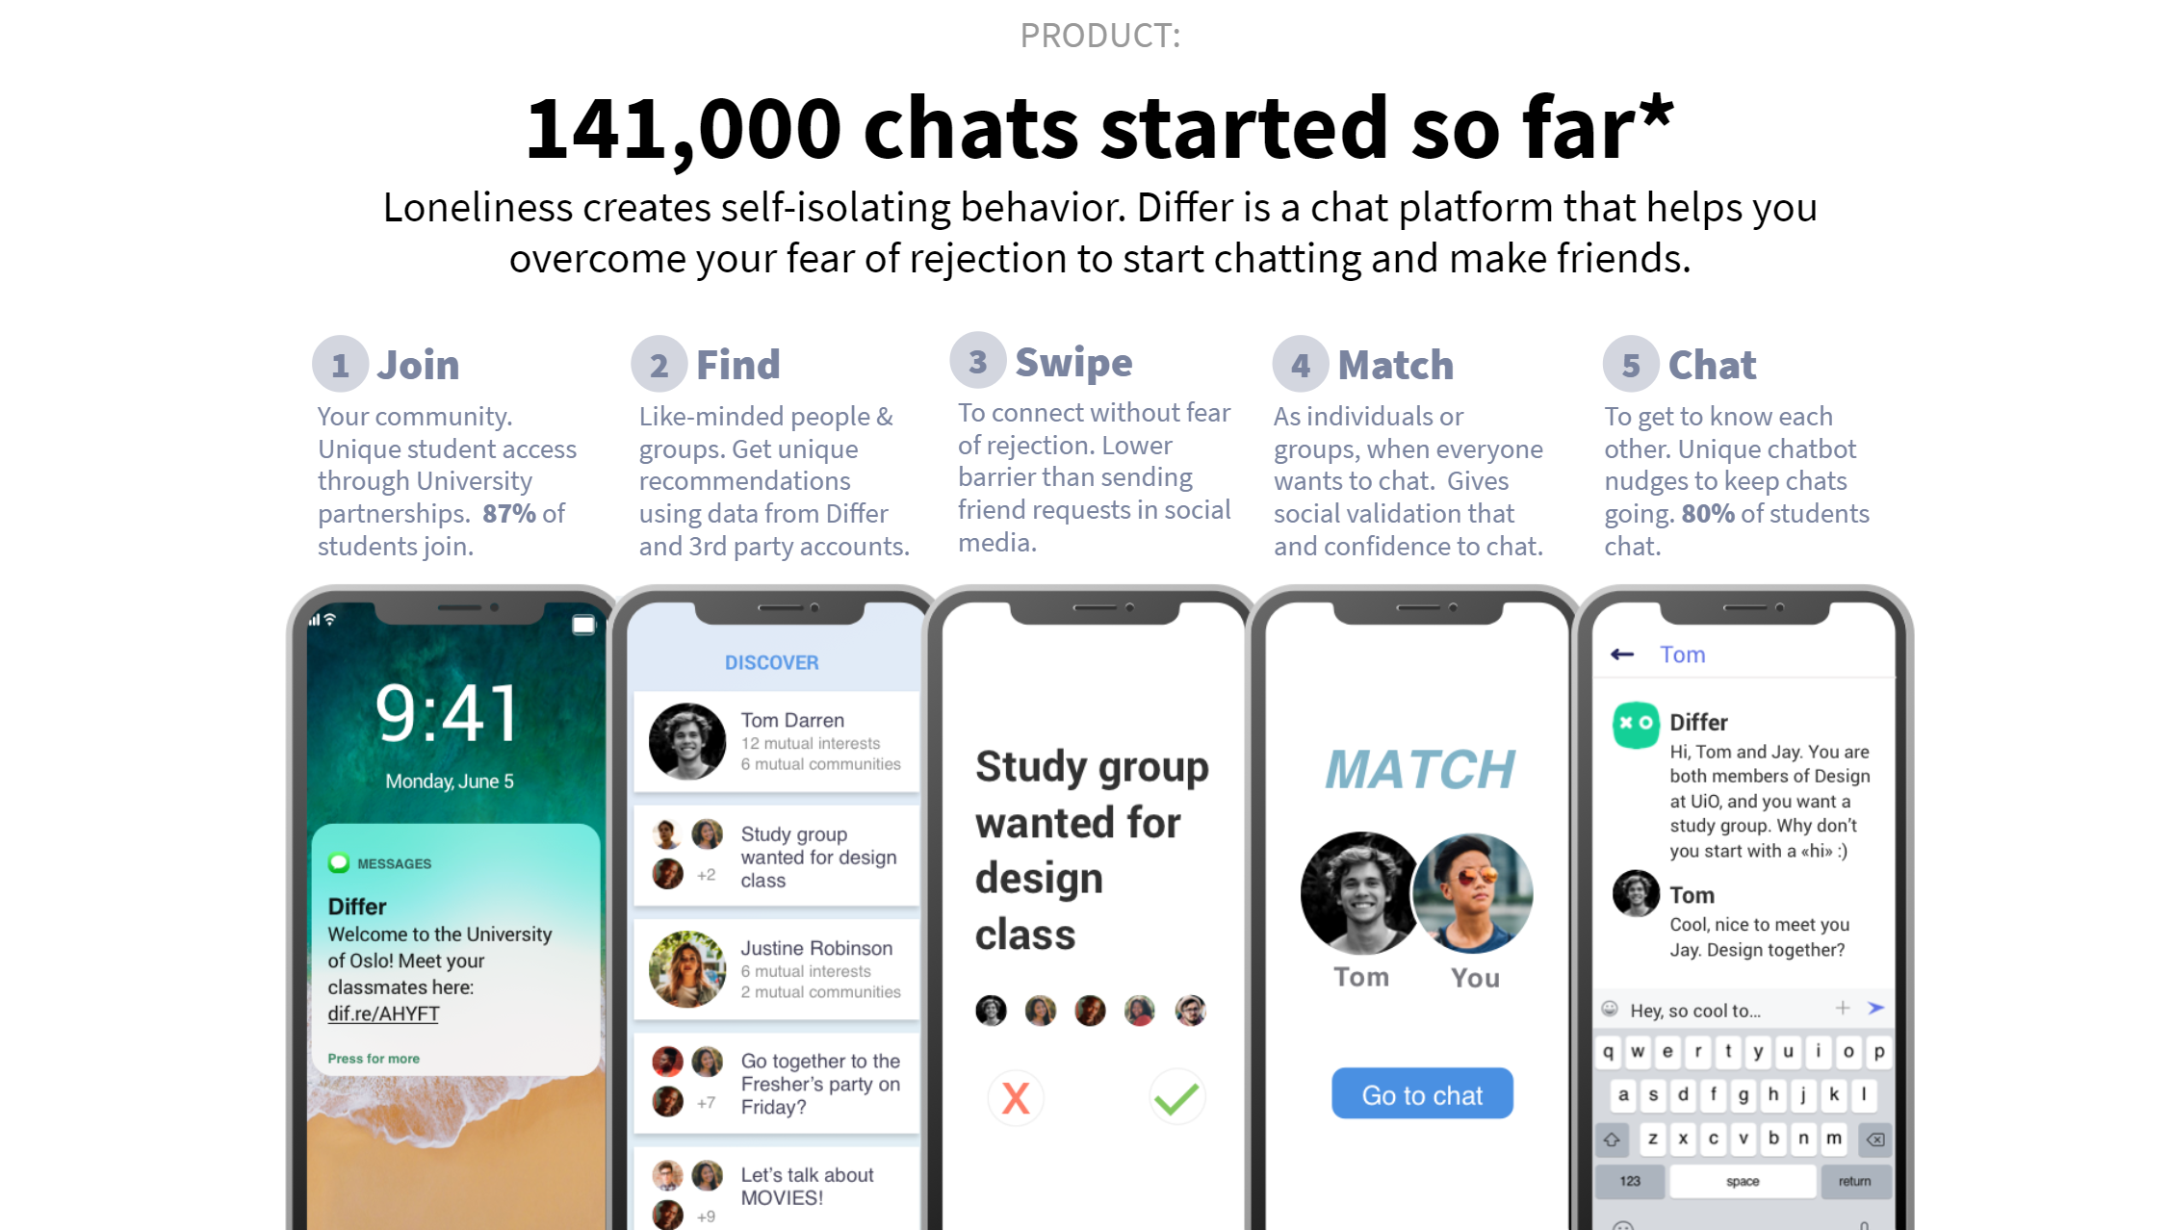

Slide 3
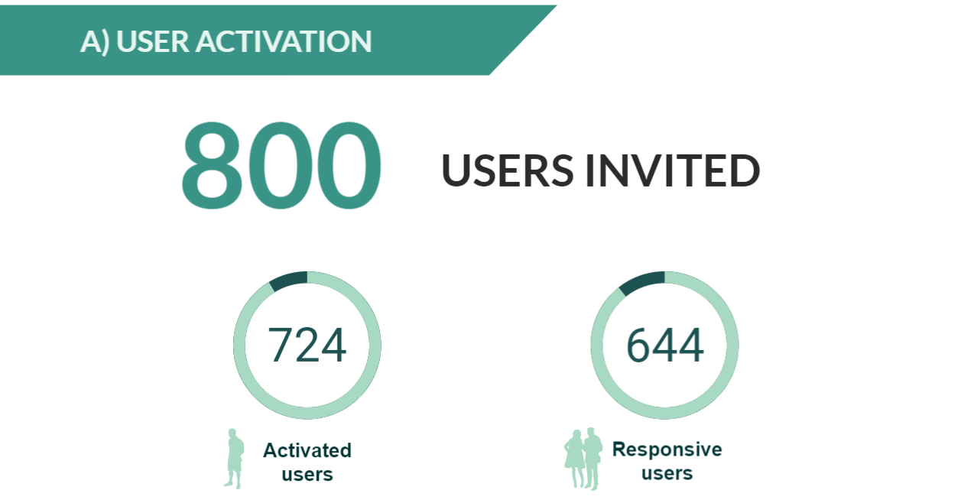
91%
89%

Slide 4
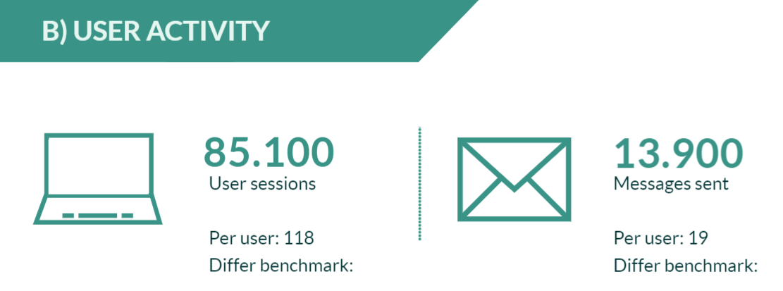

Slide 5

Peer connections
UiO - UV 2019:
50%
Benchmark 2018: 15%

Slide 6
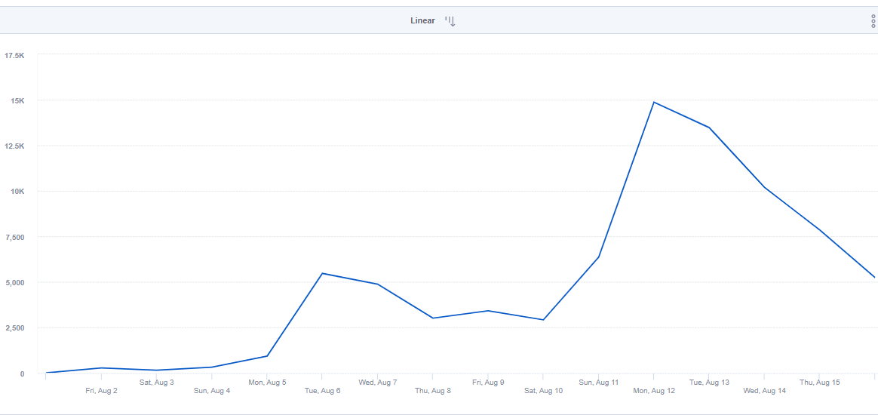
Total new sessions

Slide 7
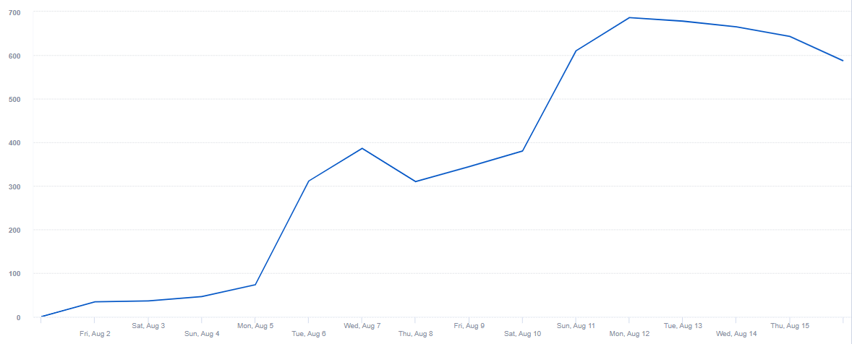
Unique users starting a new session

Slide 8
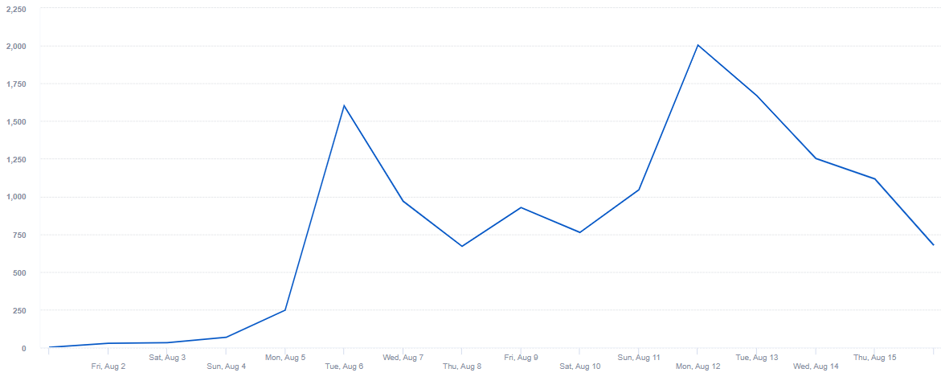
Total mesages sent

Slide 9
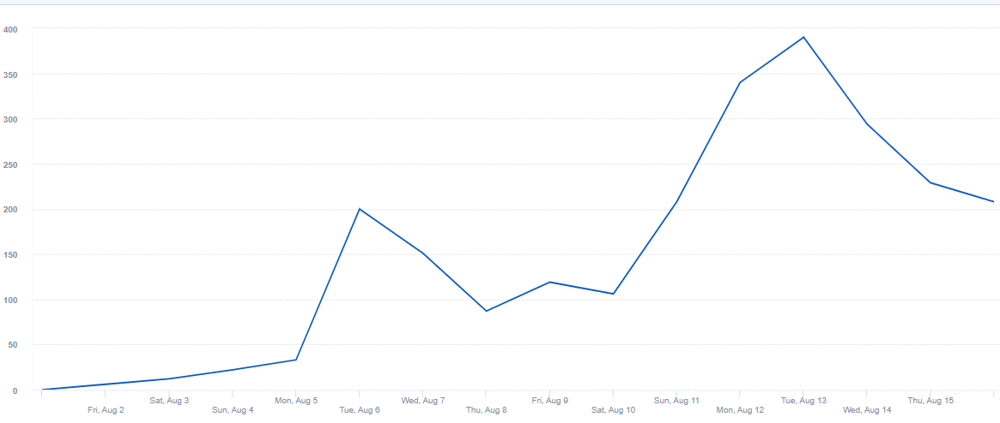
Unique users sending a message

Slide 10
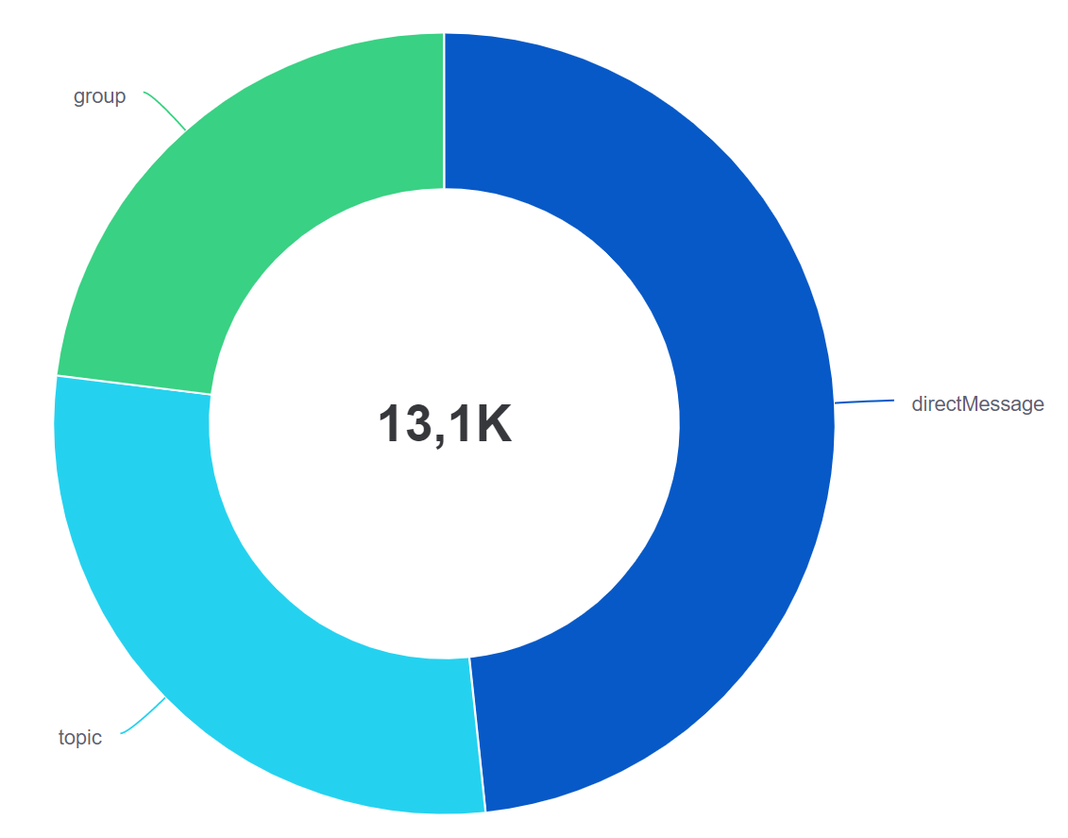
Type of messages

Slide 11
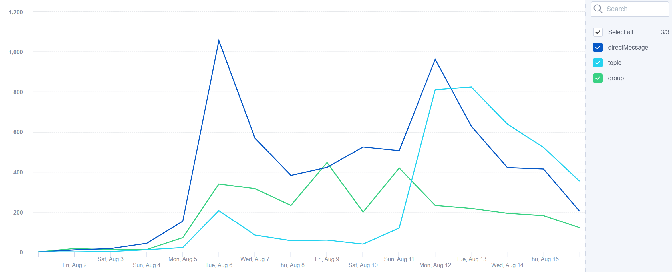
Type of messages over time

Slide 12
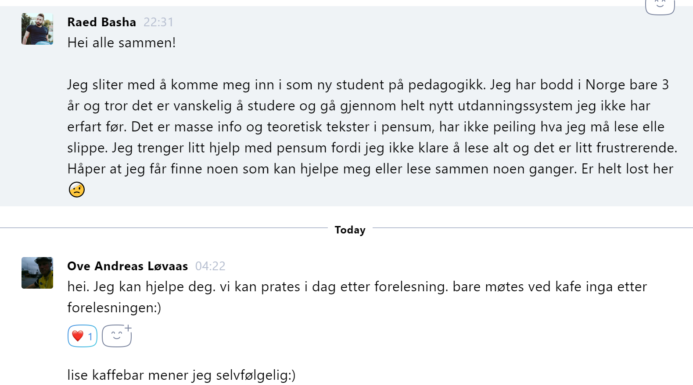

Slide 13
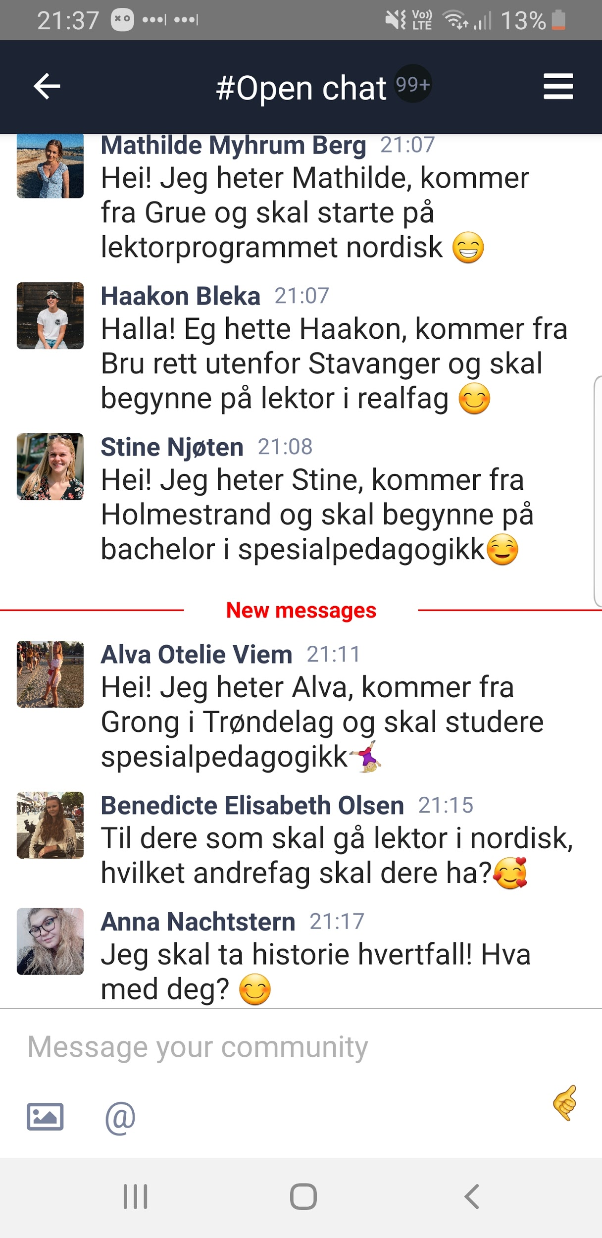

Slide 14
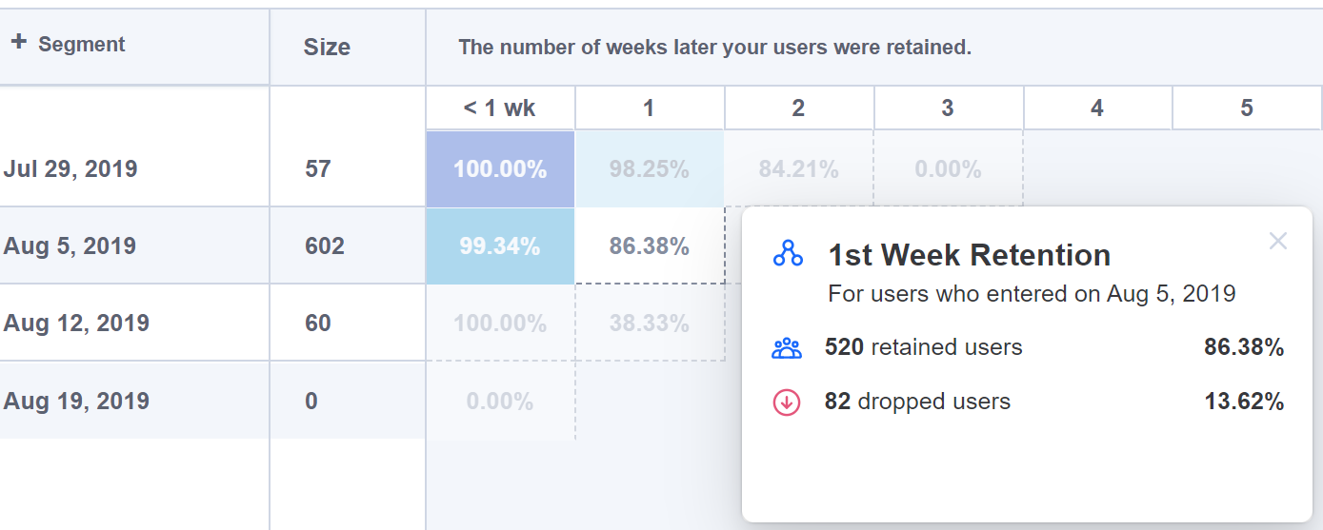
Student retention

