Slide 1
Career Development Programme
TourDeRITMO, Dec. 5–6, 2023
10.00–10.05: Welcome
10.05-10.25: Justin London on Time Management and Career Planning
10.25–11.00: Confessions and Tips from RITMO Staff
11.00–11.15: Coffe Break
11.15–11.20: Instructions to tasks
11.20–11.40: Individual work. Use the tools at p. 2–5 to think about your career development –
your near and future goals and your strategies to achive these goals.
11.40–12.00: Discuss these with a collage.
12.00–12.15: Prepare the time management task at p. 6.
12.15–13.00: Presentation of the time management task in a plenary session.

Slide 2
SWOT analysis
 | POSITIVE FACTORS | NEGATIVE FACTORS
INTERNAL FACTORS | Strengths: | Weaknesses:
EXTERNAL FACTORS | Opportunities: | Threats:

Slide 3
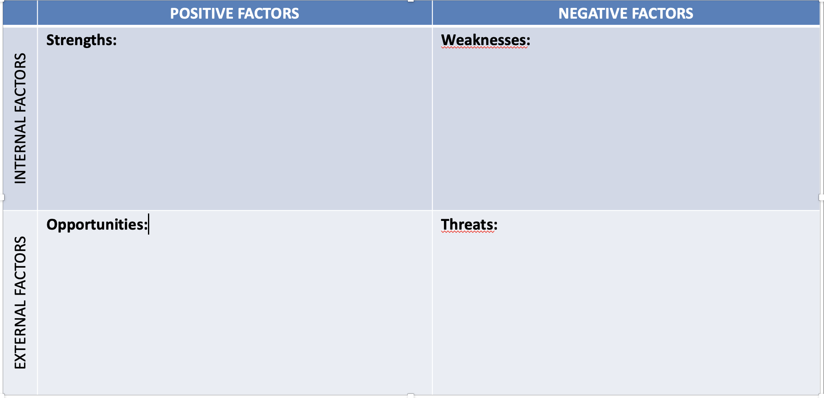
Vision and Goals
Vision
The situation in 2–3 years
Development and goals we should work on in the strategy period:
______________________________________
______________________________________
______________________________________
______________________________________
Status today
SWOT

Slide 4
Vision and Goals
Vision
The situation in 5–10 years
Development and goals we should work on in the strategy period:
______________________________________
______________________________________
______________________________________
______________________________________
Status today
SWOT

Slide 5
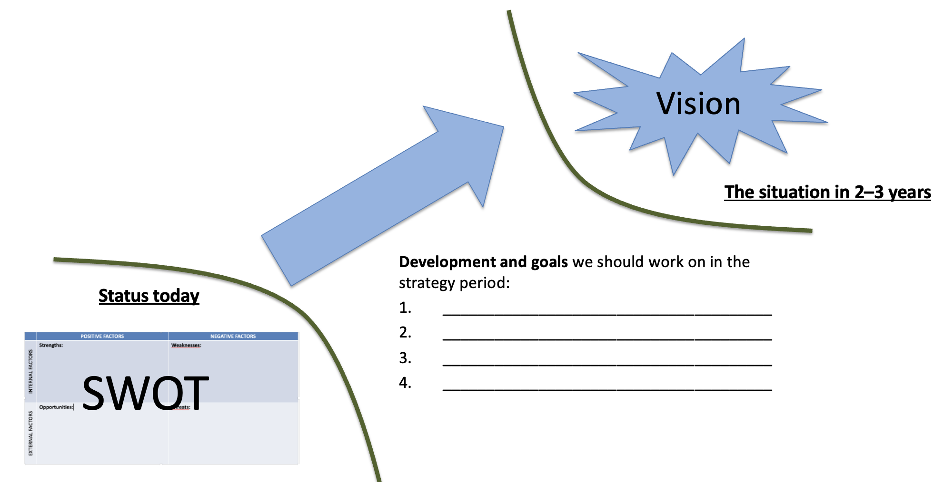
Strategies to Achieve the Goals
Internal and external strategies to achieve your goals:
______________________________________
______________________________________
______________________________________
______________________________________
______________________________________
______________________________________

Slide 6
Time Management
Consider and prepare answers to the following two questions (to be presented in planary):
1: What have you succeeded with when it comes to time management (any tips to share with others)?
2: What do you want to implement or improve when it comes to time management?

