Slide 1
Project Plan Template
(Help text appears in cursive on slides and in the notes field)

Slide 2
Project Plan: Introduction
The Project Plan is a living document based on the Project Description. It will provide the basis for the best possible dialogue between the Project Manager and the Steering Committee while ensuring traceability for the decisions and directions taken during the project. The Project Plan can also be used as a source of information and basis for dialog with other relevant actors and Stakeholders.
Elements of the Project Plan Template are: 1) information about the project, 2) status reporting, 3) discussion and options, 4) decision points, and 5) the way forward. All five aspects must be discussed in meetings with the Steering Committee.
To enhance its relevance and increase engagement in dialog with the Steering Committee, the Project Plan is configured as a PowerPoint template. Help text appears in cursive on the slides and in the notes field.
The Project Manager updates the document for each meeting with the Steering Committee. Afterward, the Project Manager saves the document in .pdf format together with a summary of meeting minutes and sends these documents to the Steering Committee.
The Project Manager defines which slides are appropriate for which meetings, contexts, and phases, and adapts presentations accordingly. The scope of information and the number of slides in the Project Plan will depend on the context in which it is used.
If a project goes through multiple implementation phases—update the Project Description for re-approval by the Steering Committee before continuing the project or beginning a new implementation phase.
Also, update the Project Description if the Steering Committee requests major changes in objectives, scope, roles, or resources.
Notes:
Think of the Project Description and the latest version of the Project Plan as the contract between the Steering Committee and the Project Manager.

Slide 3
Project Plan Contents
Page | Agenda | Topic
5 | Background and Rationale | Project About the Project
6 | Desired Outcomes and Benefits
7 | Scope and Deliveries
8 | Organization and Responsibilities
9-10 | Project Plan and Progress | Status
11 | Resource Use
12 | Status and Challenges
13 | Cost/Benefit Analysis
14 | Concrete Questions the Steering Committee must consider | Discussion and Options
15 | Recommendations Related to Implementation, Completion, etc. | Decision Points
16 | Meeting Evaluation, Setting the Next Meeting, Discuss the Next Important Steps | Summary and the Way Forward
Notes:
Page numbers and contents must be updated for the version of the Project Plan being presented.

Slide 4
Background and Rationale
Taken from the Project Description. A short, bullet-pointed version can also be used.

Slide 5
Desired Outcomes and Benefits
Level | Description | Success Criteria
Organizational Objectives (for UiO)
Desired Outcomes (practical benefits)
Project Objectives
Notes:
Taken from the Project Description. If there is a lot of text, split up the table and distribute the Levels over several slides rather than presenting one slide with microscopic, unreadable text. ☺
Organizational Objectives: To which of UiO's strategic goals does this project contribute? Why are we doing this?
Desired Outcomes: Long-term benefits. Note that these can be both "hard"/quantifiable and "soft"/ qualitative.
Project Objectives: the objectives for the project itself; measured in, e.g., time, cost, and quality, etc.
Success Criteria: what is required to achieve this goal/objective?

Slide 6
Deliveries and Scope
Key Deliveries:
Scope:
Notes:
Taken from the Project Description.

Slide 7
Organization and Responsibilities
Steering Committee:
NN (Project Owner), NN, NN,
Project Group: NN (Project Manager), NN, NN, NN, NN
Referance Group: NN, NN, NN, NN
End-user Group X: NN, NN, NN
End-user Group Y: NN, NN, NN
Notes:
Taken from the Project Description. Ideally in graphic and/or text: name the Project Owner and the Steering Committee responsible for project authorization. Describe the size and composition of the Project Group. Describe other relevant groups/roles and their associated responsibilities.

Slide 8
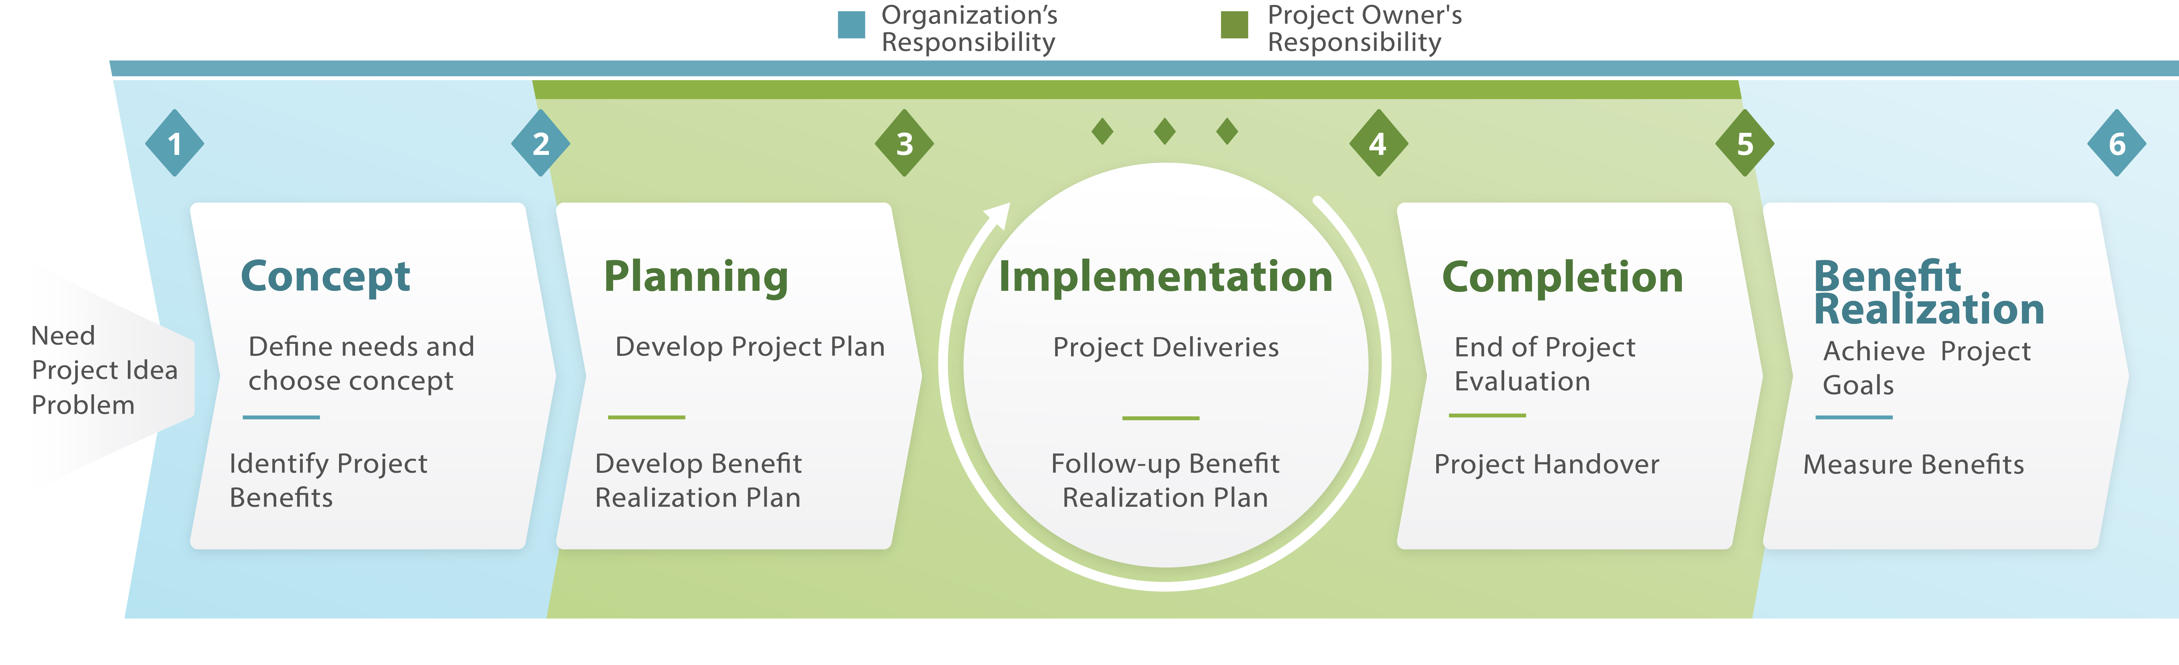
Project Plan in Phases
Idea, Need, Goal Structure
Mandate for the Concept Phase and Project Description
Rolls and Responsibilities,Stakeholders
AUTHORIZATION
Project Plan
Planned Milestones and Activities + Risk Analysis
Benefit Realization Plan
INVOLVEMENT
(one or more phases)
Project Plan
Reporting on progress, strategic choices, unforeseen events
INVOLVEMENT
Post-project Report
Evaluation, Lessons
ACCEPTANCE
Initiate Benefit- Realization Plan
Implementation Support within the organization
Maintenance
Evaluation
IMPLEMENTATION
AUTHORIZATION/COMMITMENT. Continuous evaluation of the project.
Notes:
Use this slide to illustrate/remind the participants about the project model that UiO uses, which phase the project is currently in and, thus, the most important focus, activities, documents, and decisions at this moment.

Slide 9
General Timeline
Sept. 2017
Oct.
Nov.
Dec.
2018
2019
Delivery X
Delivery Y
Delivery Z
Notes:
Summarize the Project Timeline in the Project Description and the project’s defined deliveries. There are many variations on this type of illustration. Whether you make it in PowerPoint or import a chart from Excel or another software tool such as MS Project is up to the Project Manager and Steering Committee.

Slide 10
Resource Use
Summarized resource requirements (people and hours/percentage of work hours dedicated to the project) from the Project Description.
During the Implementation Phase (with reference to the Estimated Resource Requirements in the Project Description, Resource Agreements, and Resource Planning): how is resource use in relation to project progress?

Slide 11
Status and Challenges
Describe what has happened in the project since your last meeting. With reference to deliveries and planned activities:
What has been delivered/produced?
What are you particularly happy with?
Are there deviations from your plan?
Have any risks changed or have any new risks been identified?
Have there been any unforeseen occurrences or challenges you would like to make the Steering Committee aware of?
Is there any other relevant information to report?

Slide 12
Cost/Benefit Analysis
In the Start-up Phase: take this information from the Project Description (considerations associated with expected benefits and costs related to the project). Evaluate the proposed alternate solutions to maximize benefits, conditions necessary for benefit realization, and the most important risk factors in the project.
During Implementation: has anything occurred that necessitate a re-evaluation of the cost/benefit analysis?

Slide 13
Discussion and Options
Present the project-specific issues that you need the Steering Committee to consider to put the project in the best position going forward.
If the issues are closely related to topics presented in previous slides, you can choose to facilitate the discussion when the slide comes up in your presentation or inform the committee that the topic will be raised as a point here.

Slide 14
Decision Points
What decisions do you need the Steering Committee to make? This will depend on where you are in the Project. Decisions can be connected to formal Decision Points e.g., DP3—recommendations on decisions related to Implementation, DP4—decisions related to closing the project and delivery to the organization, and so on, or to other factors that are relevant to project progress.

Slide 15

Summary of the Next Steps
Summarize the meeting and create a common understanding of the next steps in the project. Make sure that the options and decisions are correctly recorded.
It may also be helpful to conduct a simple evaluation of the meeting, in the interest of improving the presentation for the next meeting.
Meeting Evaluation

Slide 16


Thank participants for the meeting and end on a positive note and, if possible, with an appropriate picture—Does the project have its own motto or can you find an image that illustrates the goal or current phase of the Project? The picture below is only an example. ☺

